Slide 1
Neutrino Target Remote Exchange
Design considerations and developments
Eric Harvey-Fishenden High Power Targets Group STFC RAL
In conjunction with FNAL Target Systems and KEK Neutrino Beam Group
Notes:
The abstract pattern can be removed or repositioned if required. Be careful to ‘Send to Back’ so that it does not obscure any important information.

Slide 2
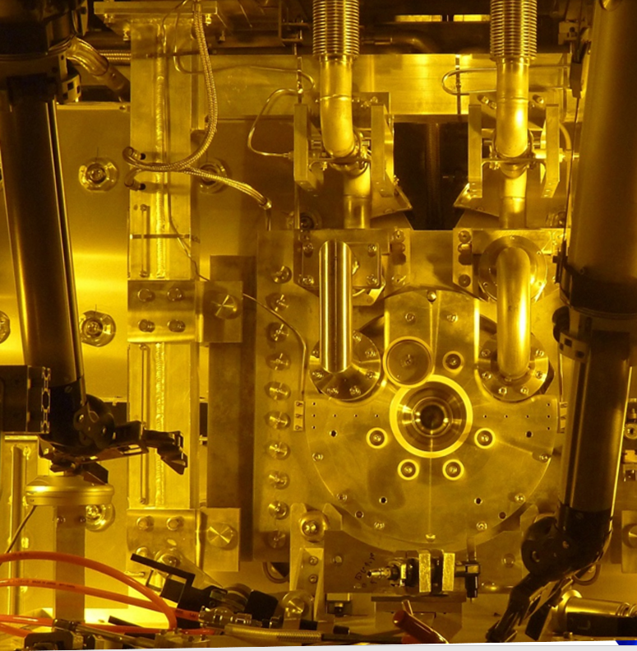
Agenda
1 Overview
Neutrino beamline overview, fundamental challenges and design drivers of remotely exchanging neutrino targets
2 Current Experience
The T2K target exchange system and experience to date
3 Current Design and Development
The LBNF target exchange system and prototypic development at RAL
4 Future Design and Development
Potential future work in developing target exchange technology for both LBNF and T2K
2
Notes:
To replace photo with one of your own. 1) Send the geometric shape overlay to the back – Right-Click > Send to Back > Send to Back. 2) Replace image – use the guides provided to correctly position it. 3) Send your image to the back so that the geometric overlay re-appears over the image. Remember to delete the image credit if using your own image.

Slide 3
1. Overview
3
Notes:
The abstract pattern can be removed or repositioned if required. Be careful to ‘Send to Back’ so that it does not obscure any important information.

Slide 4
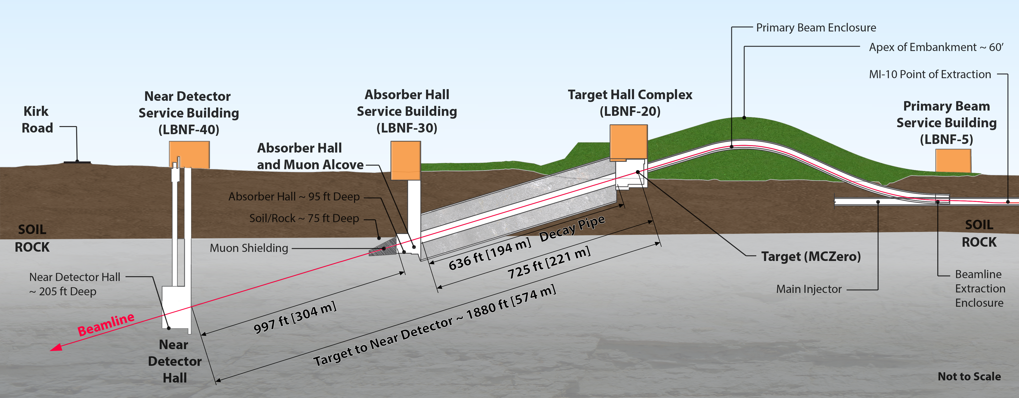
1.1 Neutrino Beamline Overview (LBNF) (LBNF)
Image © STFC John Dawson
4
Notes:
PLEASE DELETE/REPLACE PHOTO CREDIT IF CHANGING THE IMAGE.

Slide 5
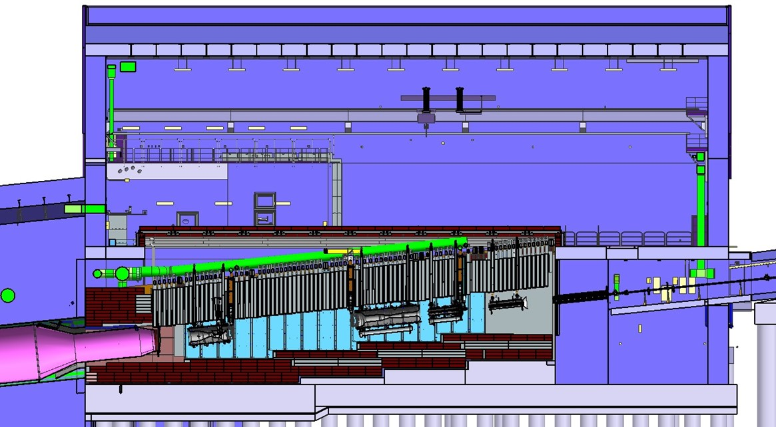
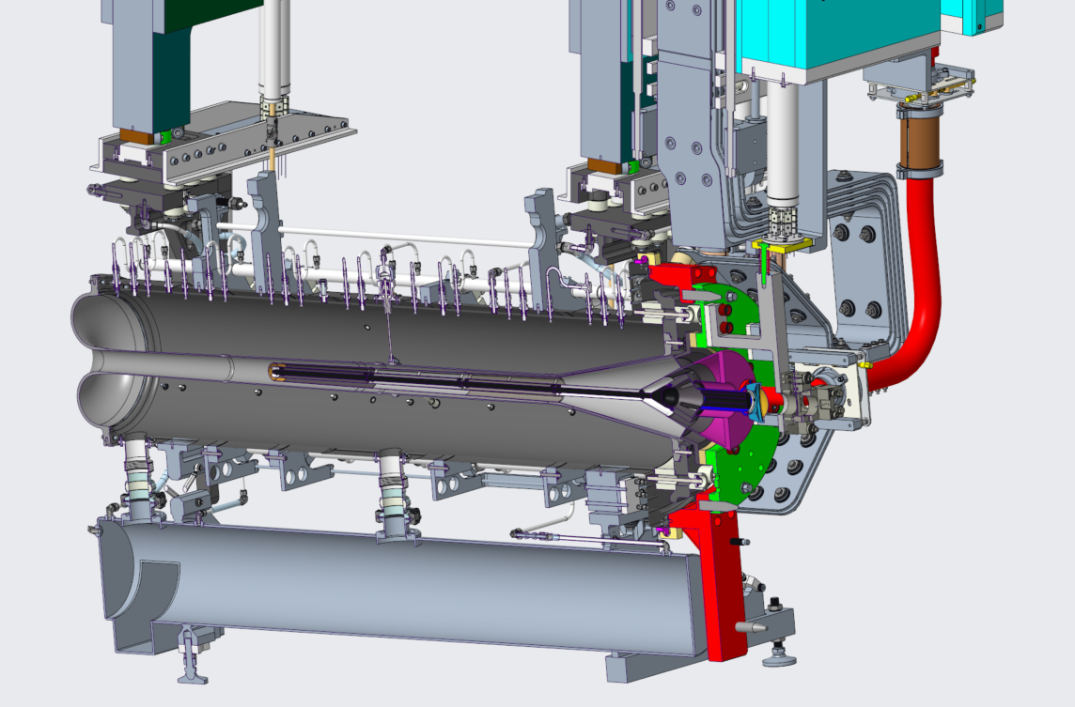
1.2 Neutrino Beamline Overview (LBNF)
Image © STFC John Dawson
5
Notes:
PLEASE DELETE/REPLACE PHOTO CREDIT IF CHANGING THE IMAGE.

Slide 6
1.3 Remote Handling Cell - LBNF
Shield
wall
Work cell shielding
Telemanipulator pair
Remote personnel
Work cell door
Targets
Target container
Pb glass windows (x2)
Target exchange system (TXS)
Lift tables
6

Slide 7
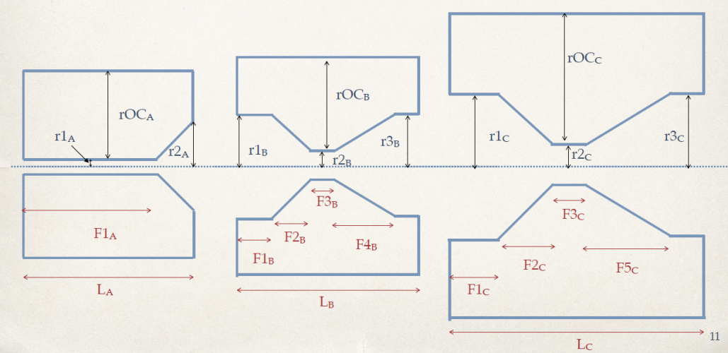
1.2 Why Do We Need To Exchange Targets?
Horn & target configuration is highly optimised
This tends towards a long, low mass, cantilevered target
Achieving a long target pushes fundamental limits (deflection, natural frequency, manufacturing etc.)
Targets have an inherent fragility – we must be prepared for them to fail
Horns are complex, costly and take a long time to manufacture and assemble
Target cost ≈1/10th horn cost, and spares can be produced more readily
Hence the need for an independently exchangeable target
LBNF/DUNE Beamline Optimisation (Laura Fields)
Image © STFC John Dawson
7
Notes:
PLEASE DELETE/REPLACE PHOTO CREDIT IF CHANGING THE IMAGE.

Slide 8
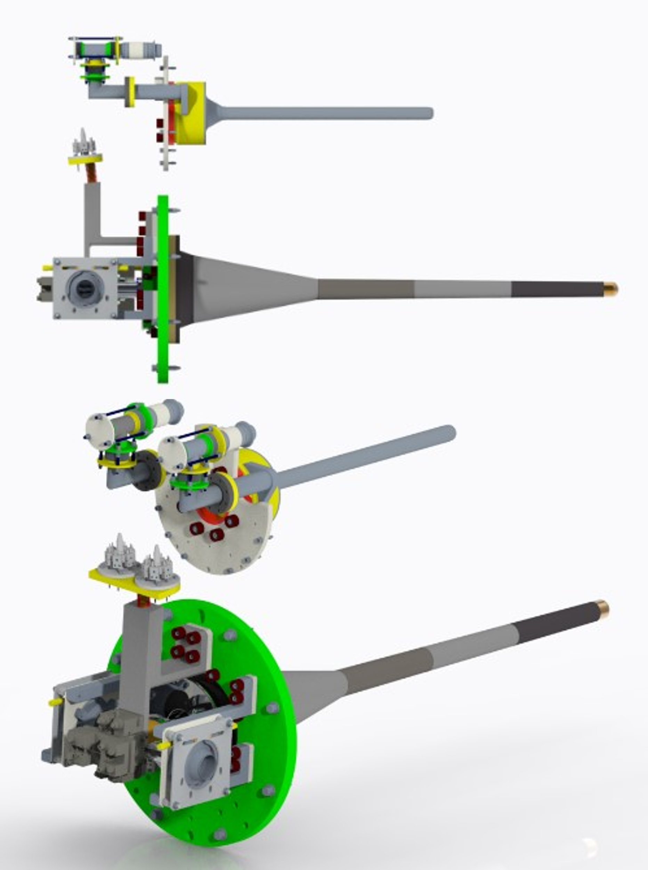
1.3 Remote Handling Challenges
T2K Target (0.9m)
Highly optimised design with:
Tight positional tolerance of target location
Maximum length of target graphite
Minimum material in target containment
Target fully housed inside electromagnetic horn bore
Have to remotely install a long, fragile component, to a tightly controlled location within a close fitting electromagnet
Biggest risk is lack of force feedback & potential for damage to costly, long lead time assemblies
LBNF Target (1.5m)
8
Notes:
To replace photo with one of your own. 1) Send the geometric shape overlay to the back – Right-Click > Send to Back > Send to Back. 2) Replace image – use the guides provided to correctly position it. 3) Send your image to the back so that the geometric overlay re-appears over the image. Remember to delete the image credit if using your own image.

Slide 9
2. Current Experience – T2K
9
Notes:
The abstract pattern can be removed or repositioned if required. Be careful to ‘Send to Back’ so that it does not obscure any important information.

Slide 10
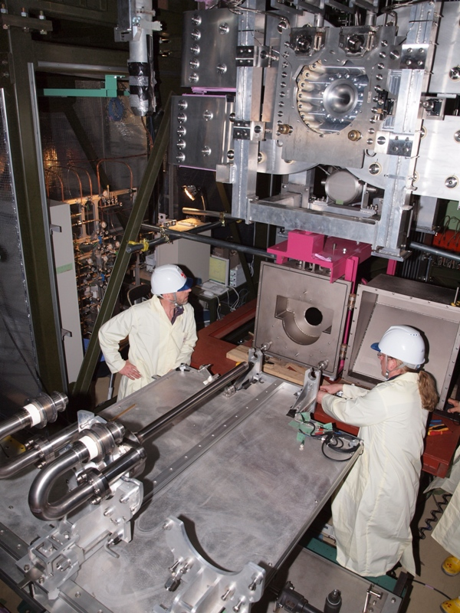
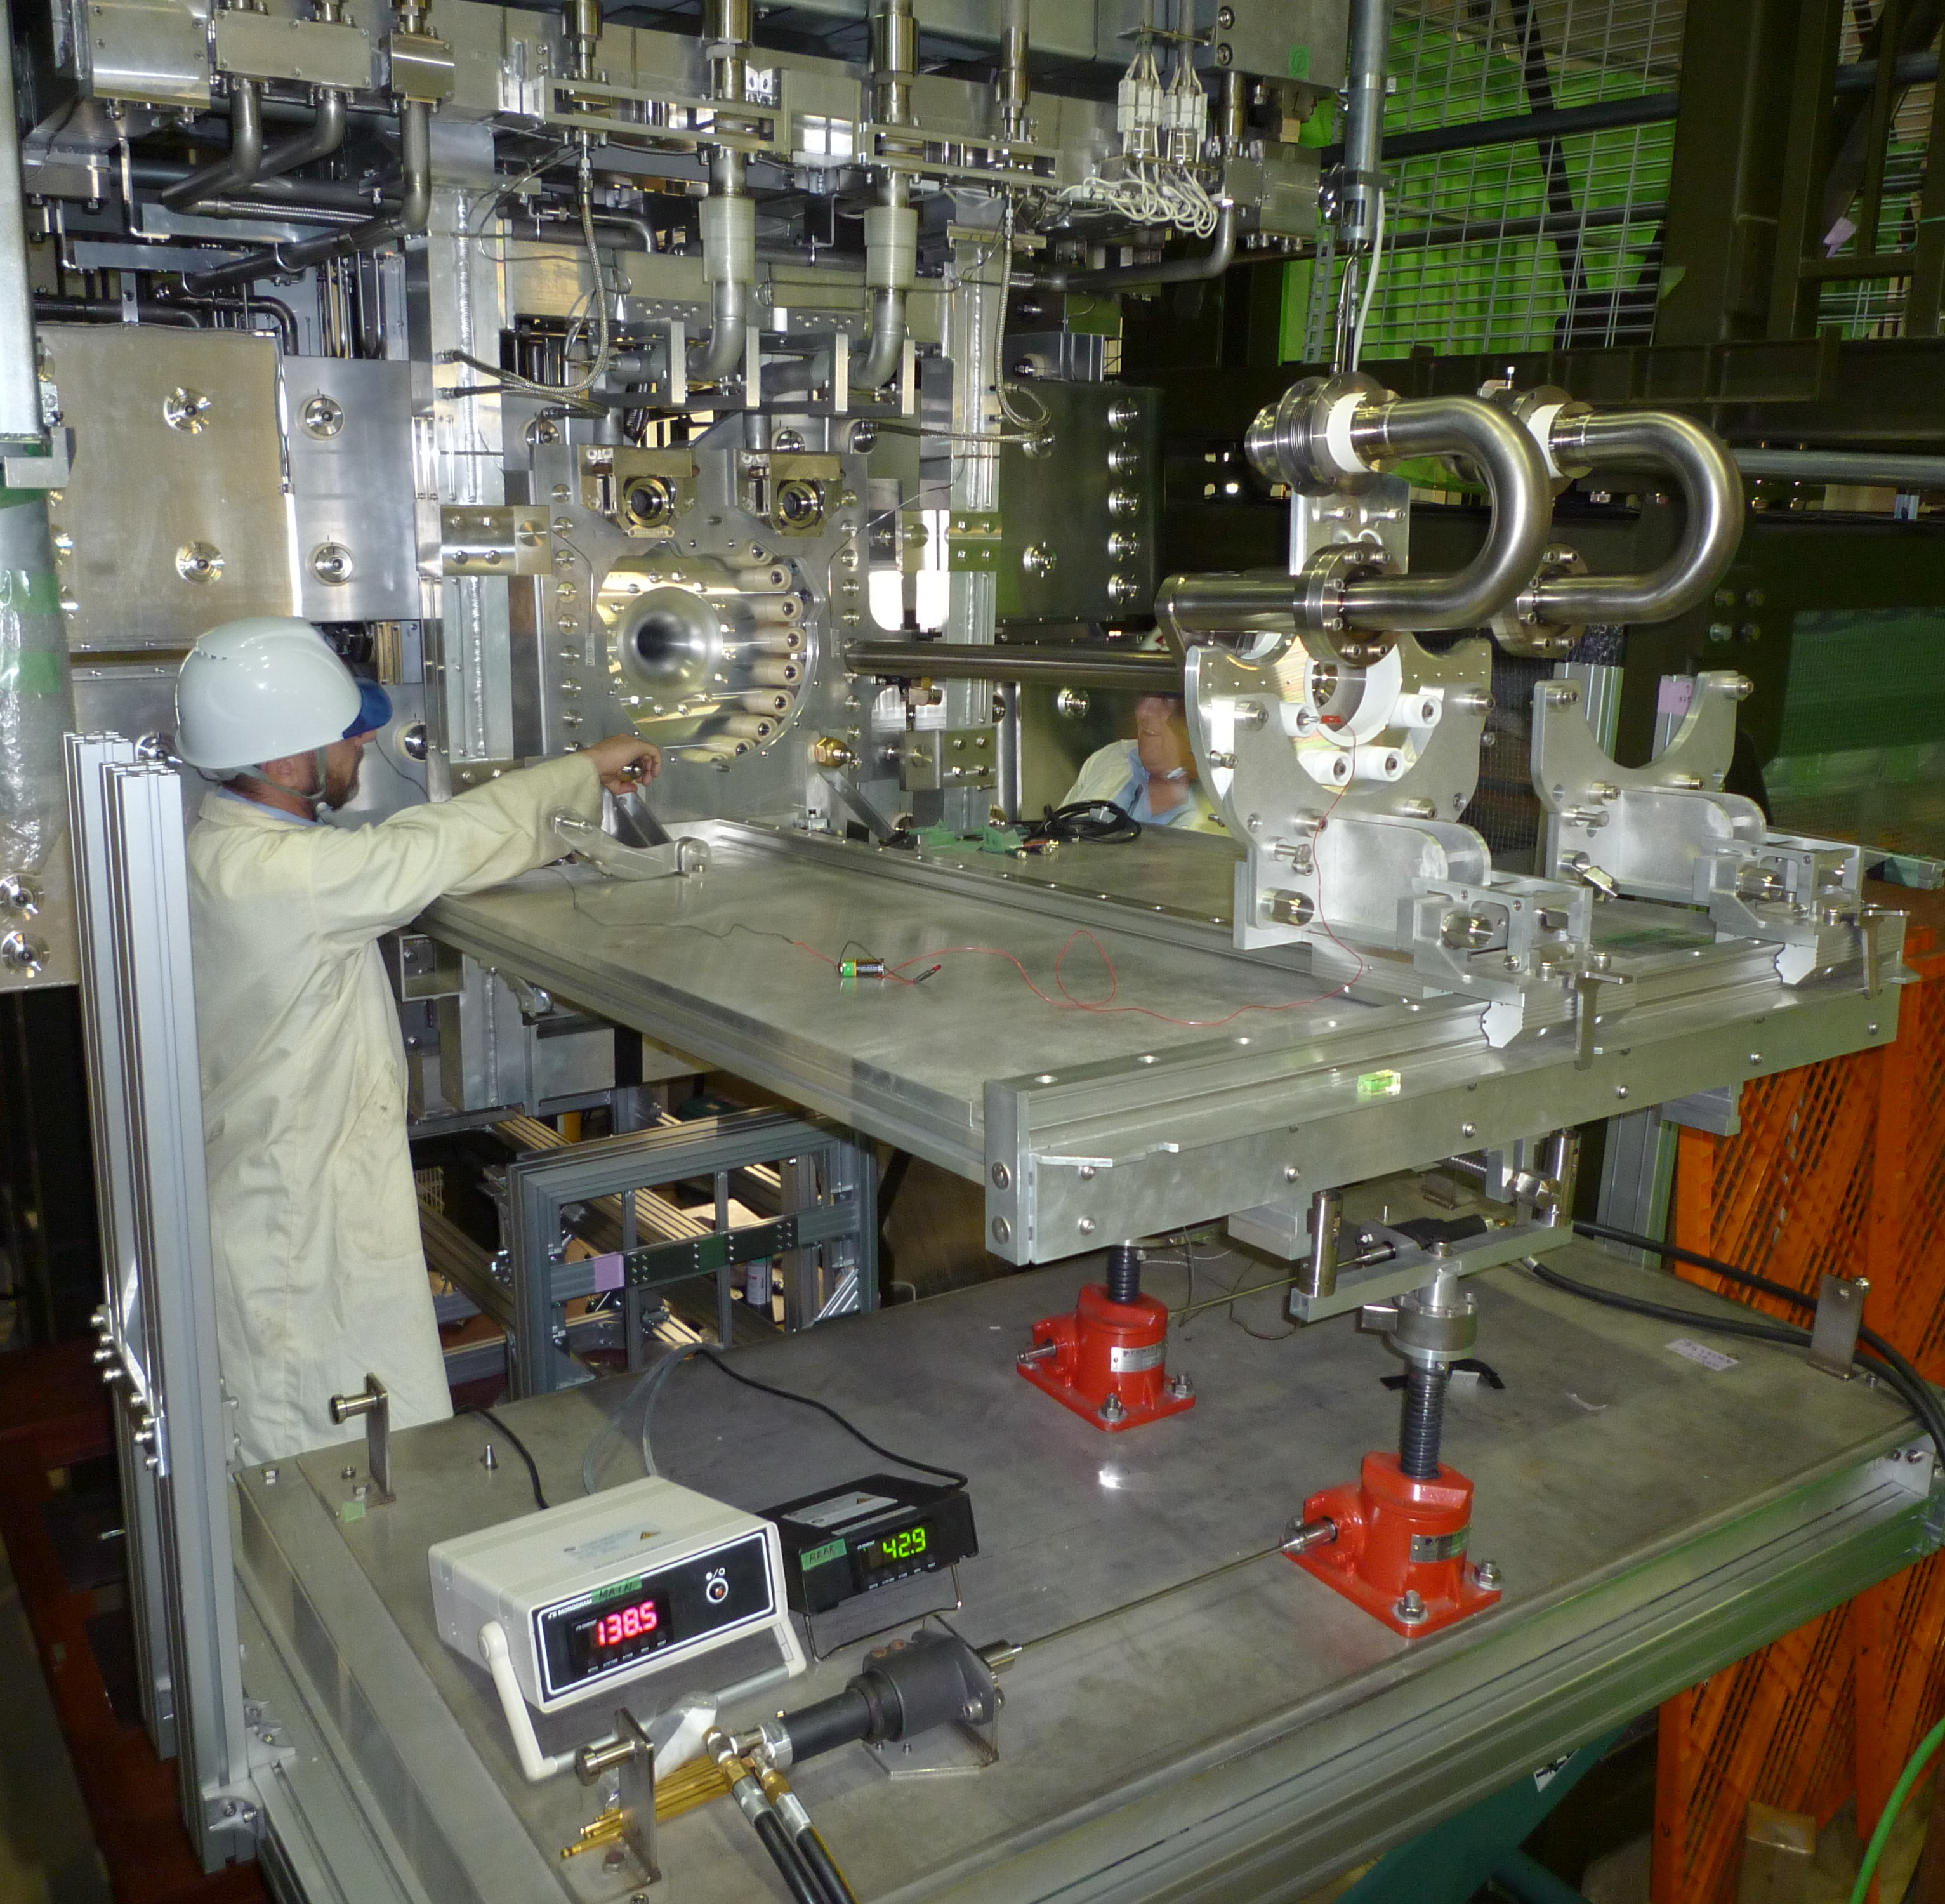
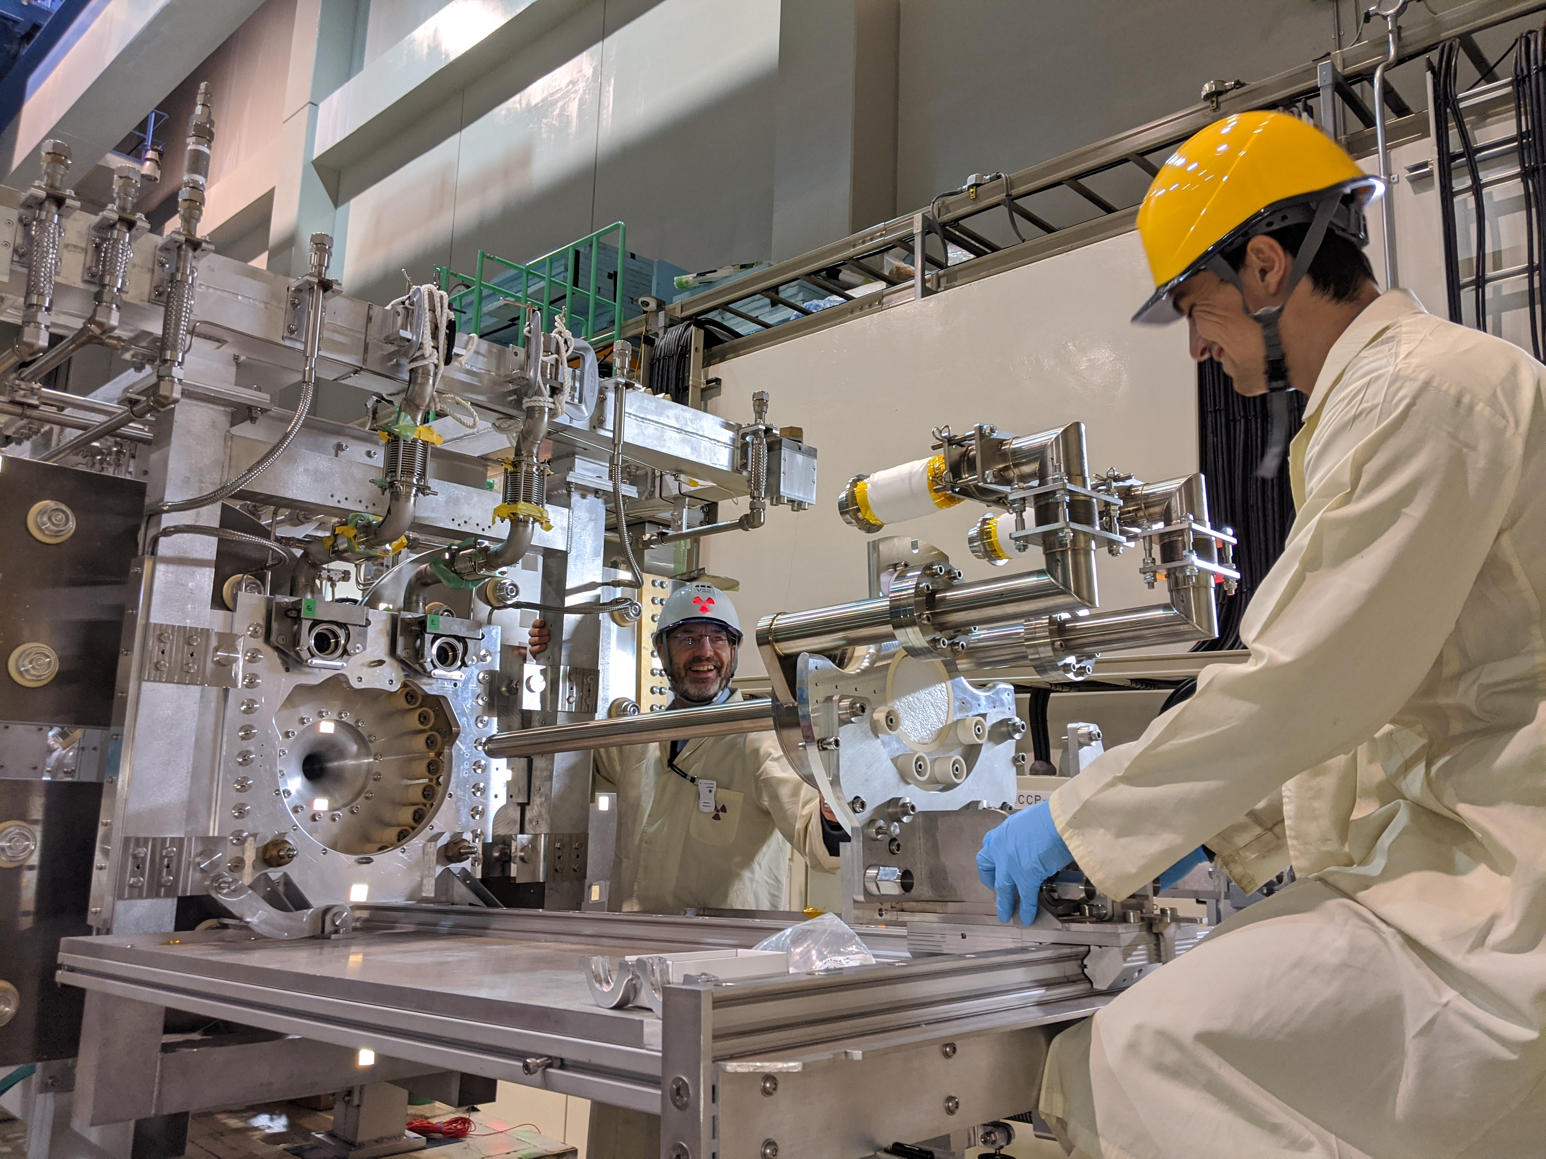
2.1 Current Experience – T2K
T2K Target Exchange System
Consists of adjustable, compliant stage that mechanically aligns to the target support system
Used for most target handling (remote & hands-on)
It has been through several iterations/upgrades since first use
10
Notes:
PLEASE DELETE/REPLACE PHOTO CREDIT IF CHANGING THE IMAGE.

Slide 11
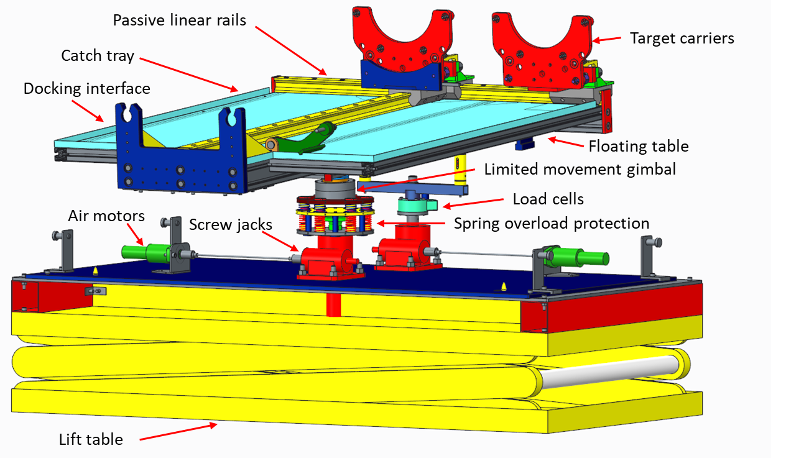
2.2 T2K Target Exchanger Overview
11
Notes:
PLEASE DELETE/REPLACE PHOTO CREDIT IF CHANGING THE IMAGE.

Slide 12
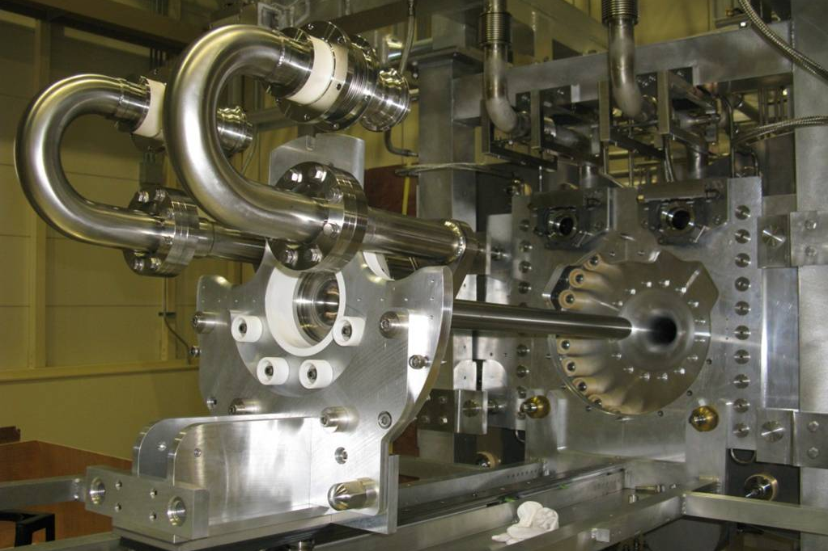
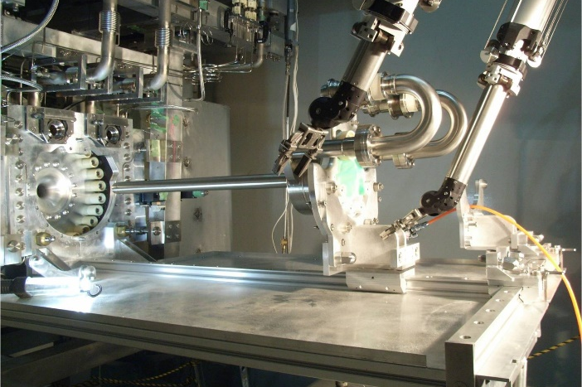
2.3 T2K Remote Handling in RMA
There have been no target (window/graphite) failures in T2K operation to date
Targets have been retired from service at the same time as their respective horns
The exchange tooling has been used successfully with assistance from TRIUMF to replace a target helium cooling pipe, following a ceramic break failure in 2015
Video: https://www.youtube.com/watch?v=VWGXz5QHFH4 (Tada-san, KEK)
12
Notes:
PLEASE DELETE/REPLACE PHOTO CREDIT IF CHANGING THE IMAGE.

Slide 13
2.4 Lessons Learnt
Successful exchange tooling is a balance between compliance and instability
Early testing and refinement iterations are highly beneficial
Some degree of compliance is required between exchange rail and target
Positional accuracy of target on exchange system ~1mm
Clearance on target alignment pins ~10µm
Loadcell readouts are absolutely critical to avoid damaging target, horn or exchange tooling
Extra diagnostics would be highly desirable
13
Notes:
PLEASE DELETE/REPLACE PHOTO CREDIT IF CHANGING THE IMAGE.

Slide 14
3. Current Design and Development - LBNF
14
Notes:
The abstract pattern can be removed or repositioned if required. Be careful to ‘Send to Back’ so that it does not obscure any important information.

Slide 15
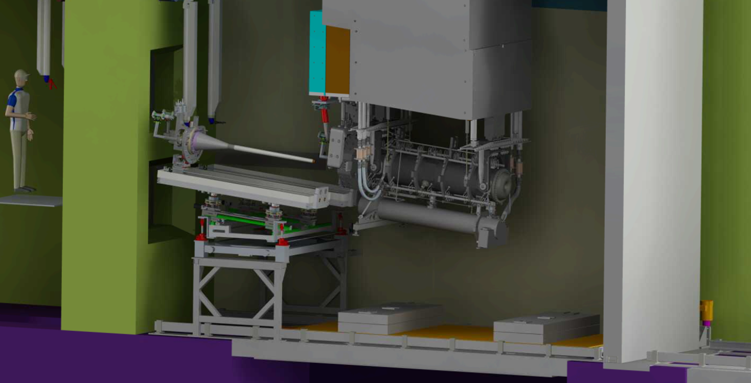
3.1 LBNF Target Exchange System (TXS)
15
Notes:
PLEASE DELETE/REPLACE PHOTO CREDIT IF CHANGING THE IMAGE.

Slide 16
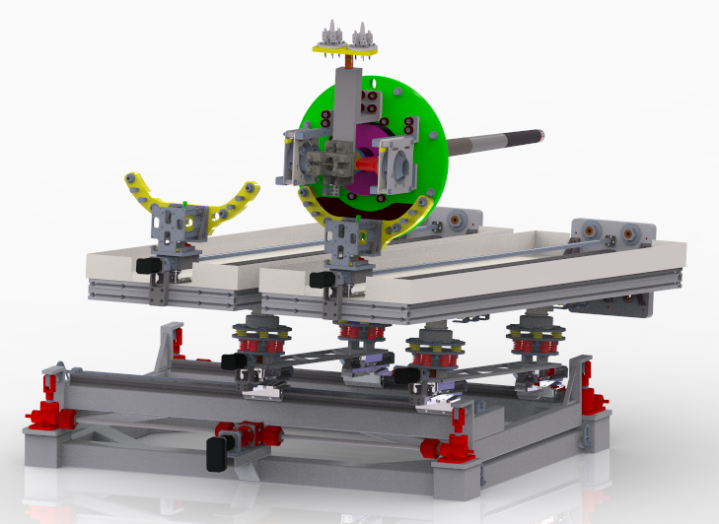
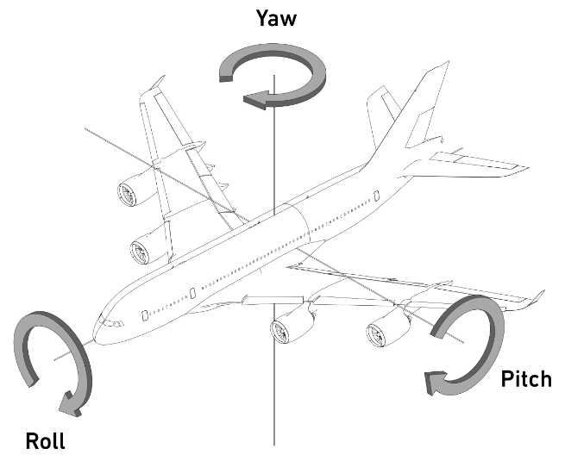
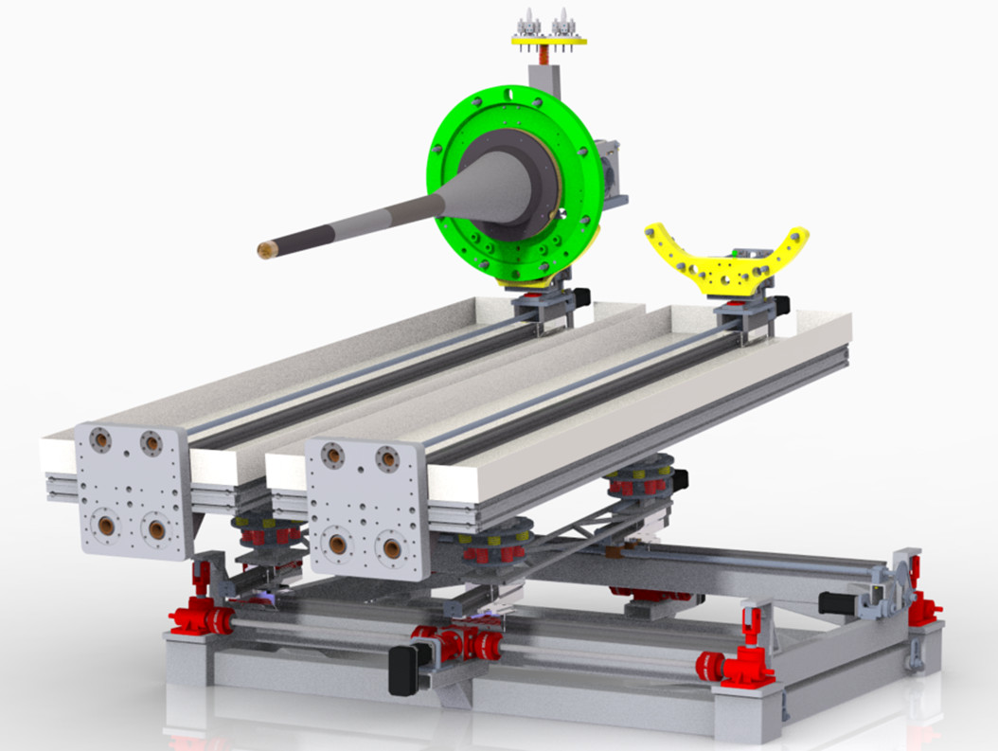
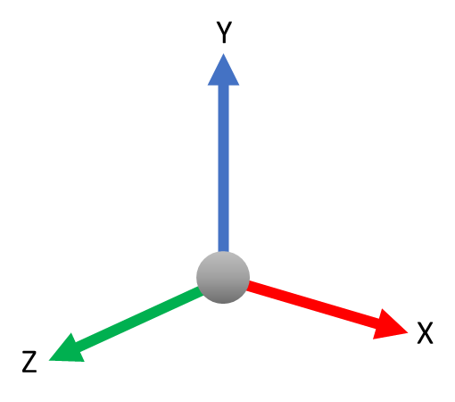
3.2 LBNF Target Exchange System (TXS)
Target
Target carrier (x2)
Target compliance mechanism (x2)
Target table (x2)
Docking interface (x2)
Target slide (x2)
Screw jack (x4)
Spring support (x4)
Gimbal (x4)
X-Stage
Electric motor
(x7)
Z-stage (x2)
TXS Base
16
Notes:
PLEASE DELETE/REPLACE PHOTO CREDIT IF CHANGING THE IMAGE.

Slide 17
3.3 Feature Prototyping
“Target Compliance Mechanism”
17
Notes:
PLEASE DELETE/REPLACE PHOTO CREDIT IF CHANGING THE IMAGE.

Slide 18
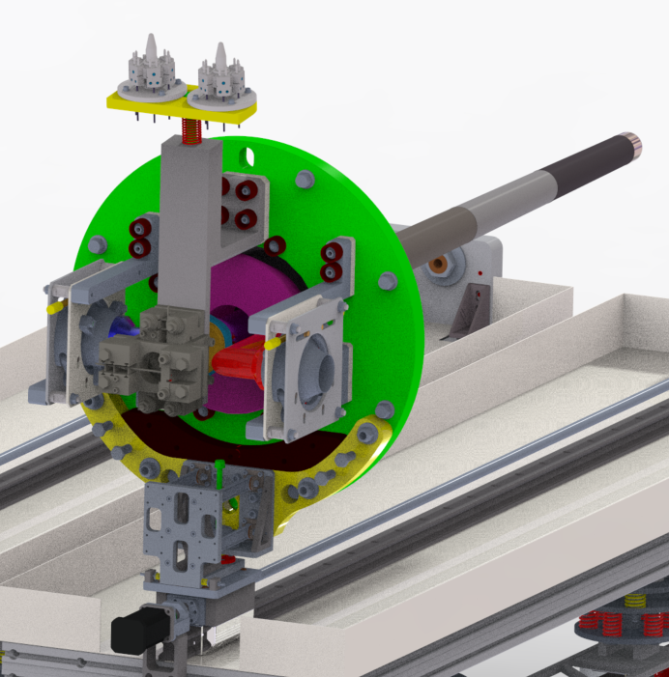
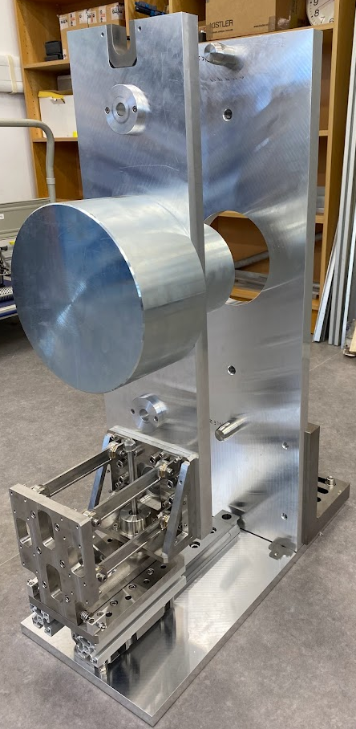
3.4 Target Compliance Mechanism
4 Bar link driven vertical (Y) compliance (preloaded compression spring)
Horizontal compliance from deflection of slim links (X compliance)
Rotational stage to allow "yaw" compliance, "roll" compliance from flexible links
Stiffest DOF in “pitch” to counteract target cantilever
Allows target to “find” alignment pins with some misalignment
Stays in the same position with/without target mass
Dummy target mass
Compliance mechanism
Insertion rail
Target support mock-up with alignment pins
18
Notes:
PLEASE DELETE/REPLACE PHOTO CREDIT IF CHANGING THE IMAGE.

Slide 19
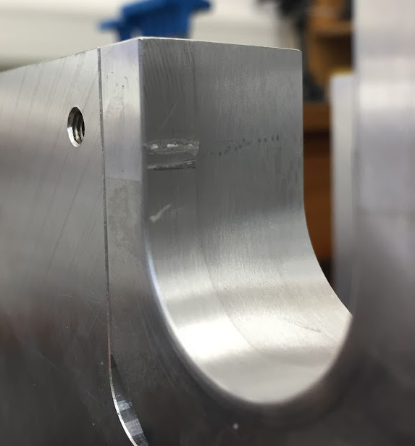
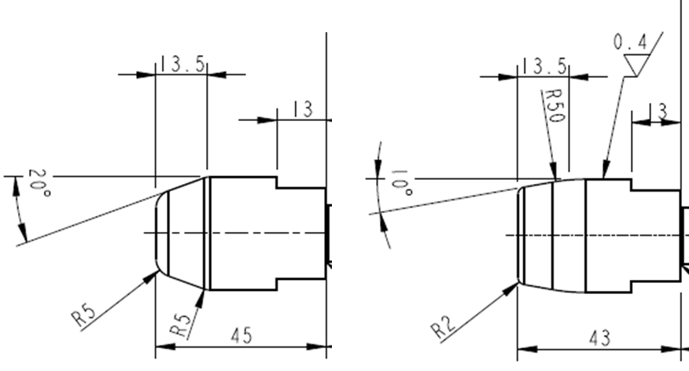
3.5 Troubleshooting
Issue | Description | Solution
Vendor error | Non conforming parts | Sent back for rework
Fit | Very tight fit (for remote installation) initially specified with possibility of size-for-size | Relaxed fit (max clearance 50µm and no size-for-size possibility)
Shape | Alignment pin geometry wasn’t ideal – could jam under slight angular misalignment | Increased blend radius on tapers Reduced taper angle Decrease engagement length to reduce over constraint
Materials | Galling – metal pickup between SS316 alignment pin and Al5083 alignment features under relatively low contact pressure | Hard anodized aluminium inserts for alignment features Smoother surface finish on SS pins
19
Notes:
PLEASE DELETE/REPLACE PHOTO CREDIT IF CHANGING THE IMAGE.

Slide 20
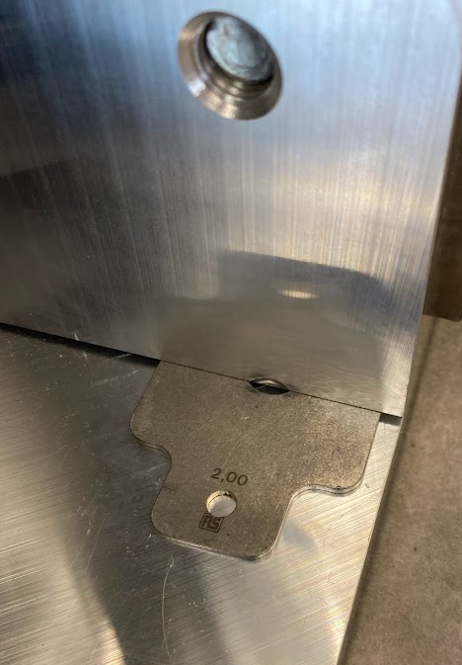
3.6 Testing
Offsets:
Removed/added shims to achieve:
±2mm in X and Y
Angular tilt from removing 2mm in shims from one side (~6mm offset at alignment slot)
Results:
“Target” finds and mates with alignment pins in all cases
No significant increase in force required to actuate carriage
Notes:
Z-axis rotational stiffness is low – this is not a stability issue providing target COG is over rail
Considering hard stops to prevent excessive movement and some small design changes to increase stiffness
Y
X
20
Notes:
PLEASE DELETE/REPLACE PHOTO CREDIT IF CHANGING THE IMAGE.

Slide 21
4. Future Design and Development - LBNF
21
Notes:
The abstract pattern can be removed or repositioned if required. Be careful to ‘Send to Back’ so that it does not obscure any important information.

Slide 22
4.1 Future Prototyping
Docking diagnostics testing
22
Notes:
PLEASE DELETE/REPLACE PHOTO CREDIT IF CHANGING THE IMAGE.

Slide 23
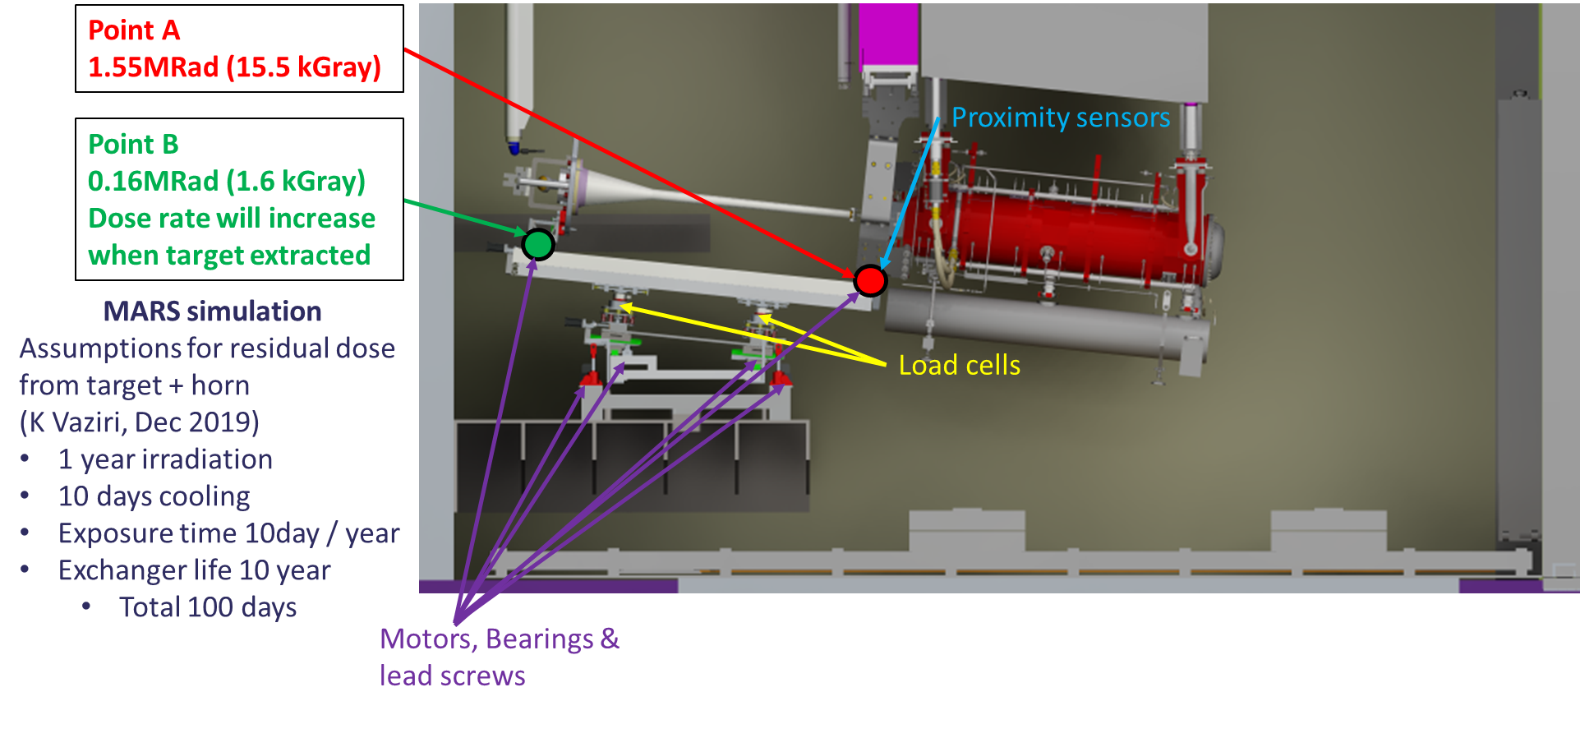
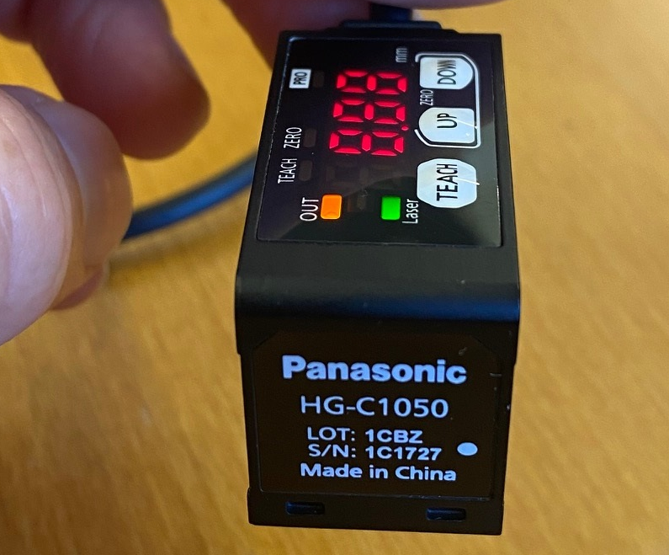
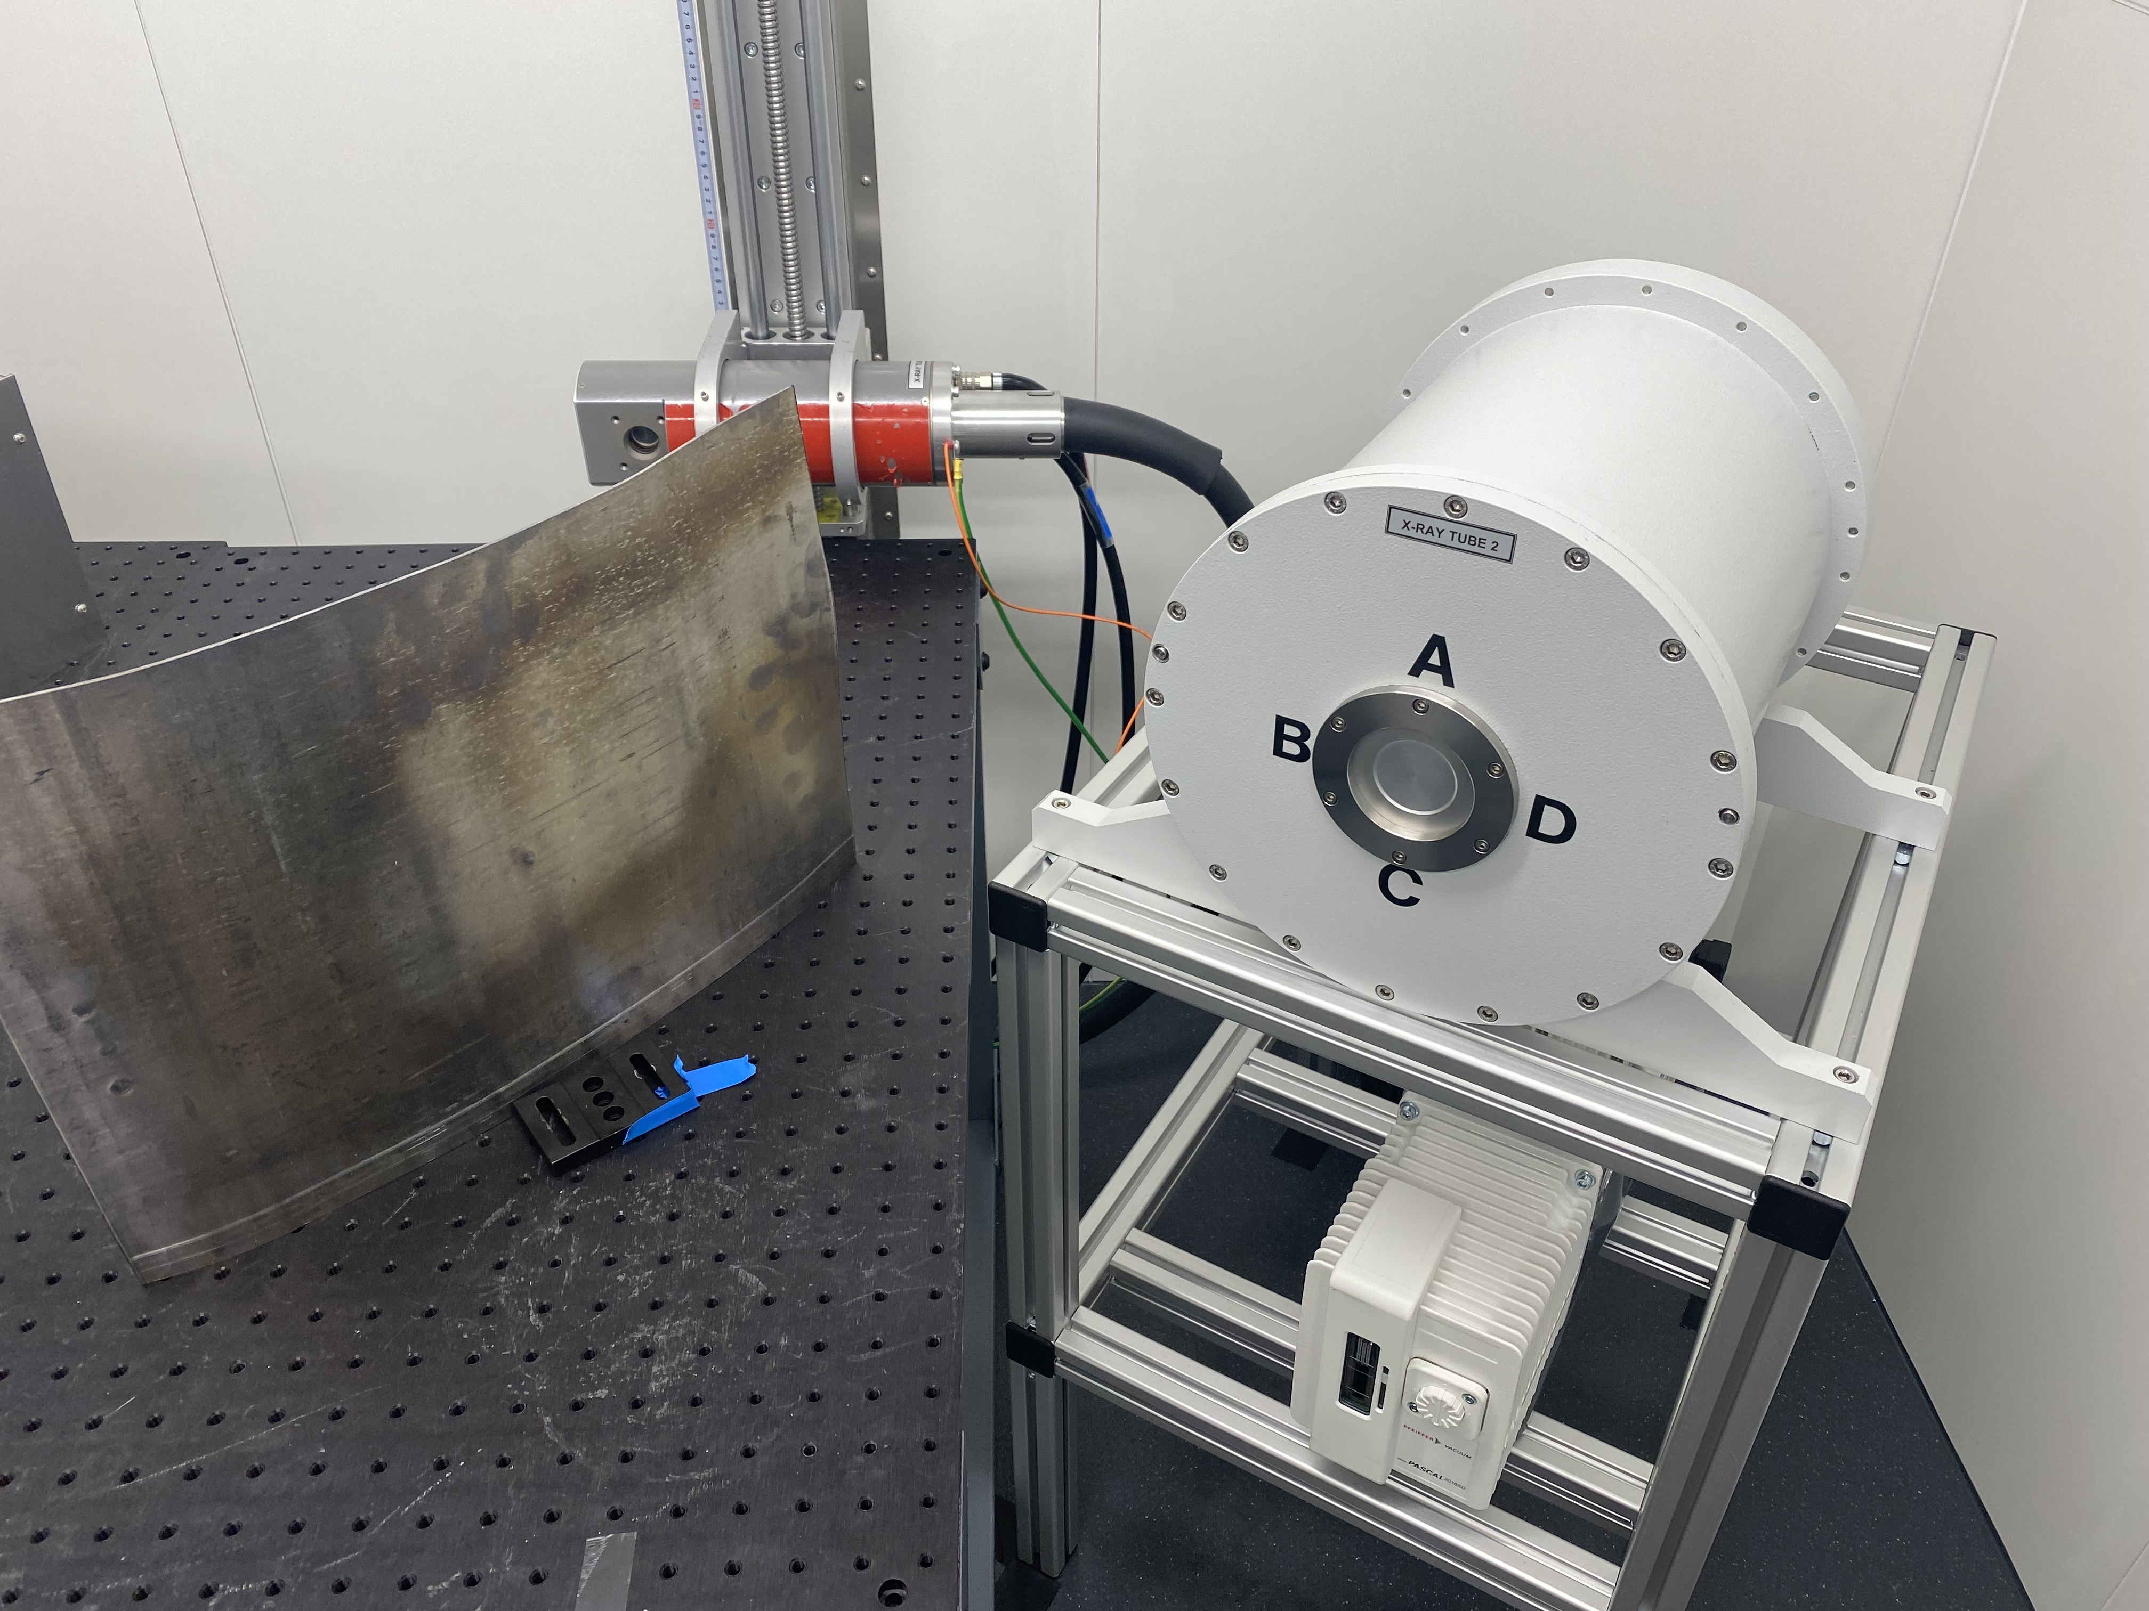
4.2 Diagnostics Studies
Docking alignment is dictated by face-to-face contact of TXS and target supports
Confirmation of this is highly desirable alongside load-cell readouts to confirm tooling is correctly aligned before commencing exchange procedures
Used horn/target are extremely radioactive – prompt dose from X-rays/gammas will be very high at docking interface
Planning irradiation tests on proximity sensors using RAL detector division X-ray bay
Cheap and replaceable?
Radiation hard?
23
Notes:
PLEASE DELETE/REPLACE PHOTO CREDIT IF CHANGING THE IMAGE.

Slide 24
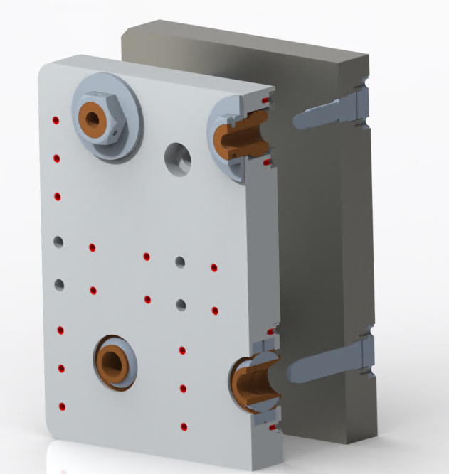
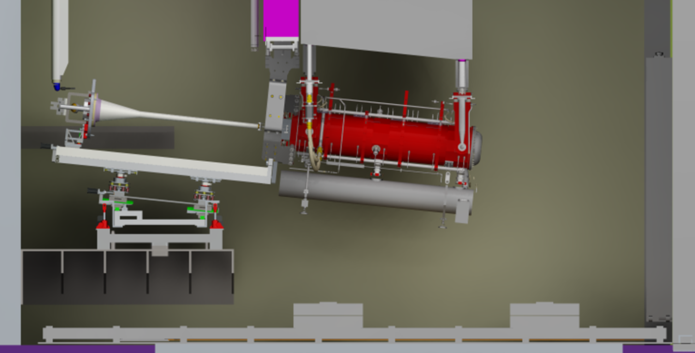
4.3 Future Prototyping
Prototype of docking interface
Alignment pins set X/Y position
Captive (floating) nuts to pull plates face to face to fix position and set alignment for TXS
This is a key interface which will need to be assembled remotely many times, so prototyping this to iron out any issues early is crucial
24
Notes:
PLEASE DELETE/REPLACE PHOTO CREDIT IF CHANGING THE IMAGE.

Slide 25
25
Notes:
The abstract pattern can be removed or repositioned if required. Be careful to ‘Send to Back’ so that it does not obscure any important information.

Slide 26
Science and Technology Facilities Council
@STFC_matters
Science and Technology Facilities Council
26
Notes:
The abstract pattern can be removed or repositioned if required. Be careful to ‘Send to Back’ so that it does not obscure any important information.

