Slide 1
Fermilab Remote Handling
Patrick Hurh
Vladimir Sidorov
Sept 21, 2022
NBI Workshop 2022

Slide 2
Remote Handling for LBNF Neutrino Beamline Based Upon NuMI Experience
LBNF Target Complex Remote Handling
Services
3 Horns (A/B/C)
Target, mounted in Horn A
Baffle (protection collimator)
Decay Pipe Upstream Window*
Primary Remote Handling Equipment
60 ton remotely controlled crane
Shielded Work Cell w/ Manipulators and Ops Center
Large, Shielded Morgue Pit
Distributed Vision System
Hatch Covers, Shield Doors, Air Seals
Rail System
Casks/Containers
NuMI Target Hall Remote Handling
Services
2 Horns (1/2)
Target/Baffle
Primary Remote Handling Equipment
30 ton remotely controlled crane
Shielded Work Cell
Small, Shielded Morgue Pit
Distributed Vision System
Hatch Covers, Shield Door
Rail System
Casks/Containers
(*See Q. Peterson Talk)

Slide 3
LBNF and NuMI Share Similar Facility/Beamline Layout
Baffle
Target/Horn-A
Horn-B
Horn-C
Decay pipe
Work Cell

Slide 4
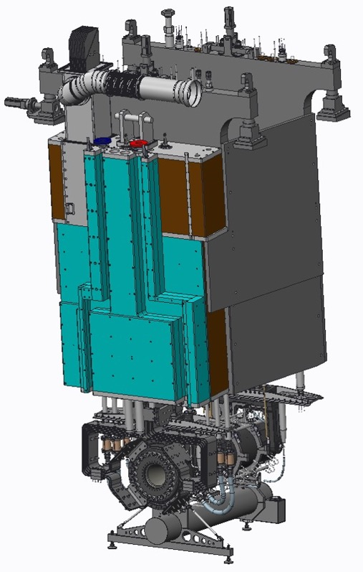
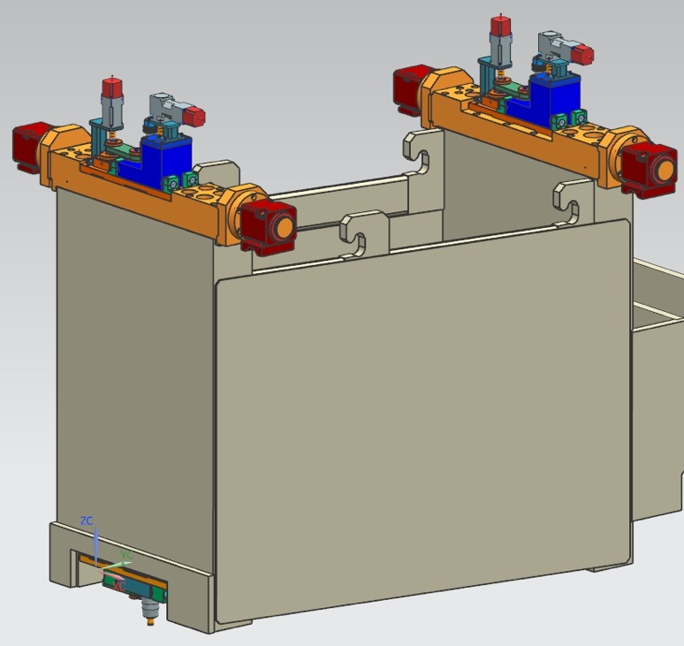
Both NuMI and LBNF Utilize Modules to Support Components
LBNF Horn A on Module
NuMI Horn 1 Module
(Mike Campbell, C. Crowley, FNAL)

Slide 5
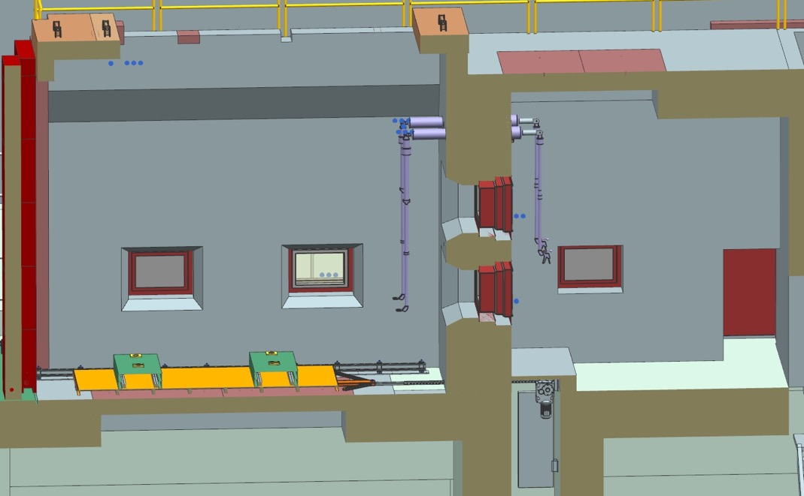
LBNF Will Have More Capable Workcell Than NuMI
LBNF Workcell
NuMI Workcell
(Vladimir Sidorov, FNAL)
Work Cell
Door
Operation Center
Tele-manipulator
Pb-Glass window
Chain drive
mechanism
No Manipulators
No Operations Center
Kalideiscope Pb Glass Windows
Transfer cart
with lifting tables
Shielding plate
Guide rails

Slide 6
NuMI Workcell Kaleidoscope Pb Windows

Slide 7
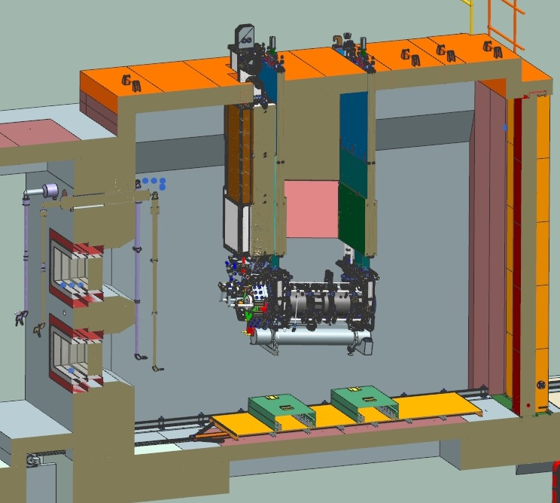
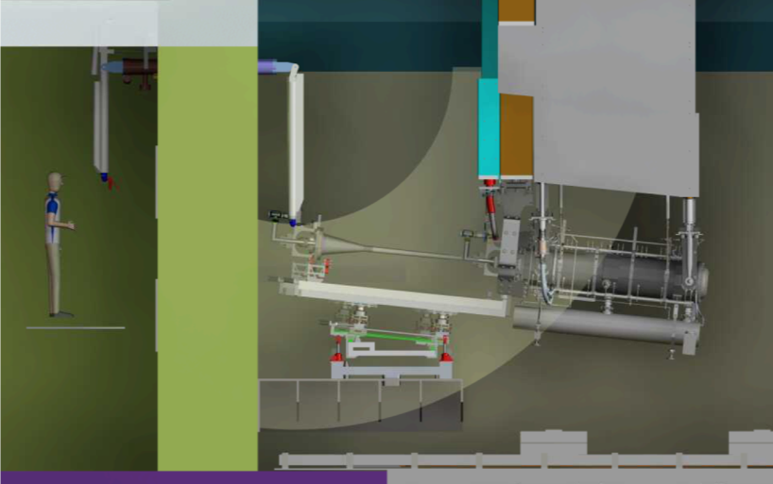
Horn A with Target in LBNF-20 Work Cell*
Manipulators required for Target Exchange
Manipulators will be useful for other operations
Accommodation of different components/modules complicates viewing
(*See E. Harvey-Fishenden Talk)
(Vladimir Sidorov, FNAL)

Slide 8
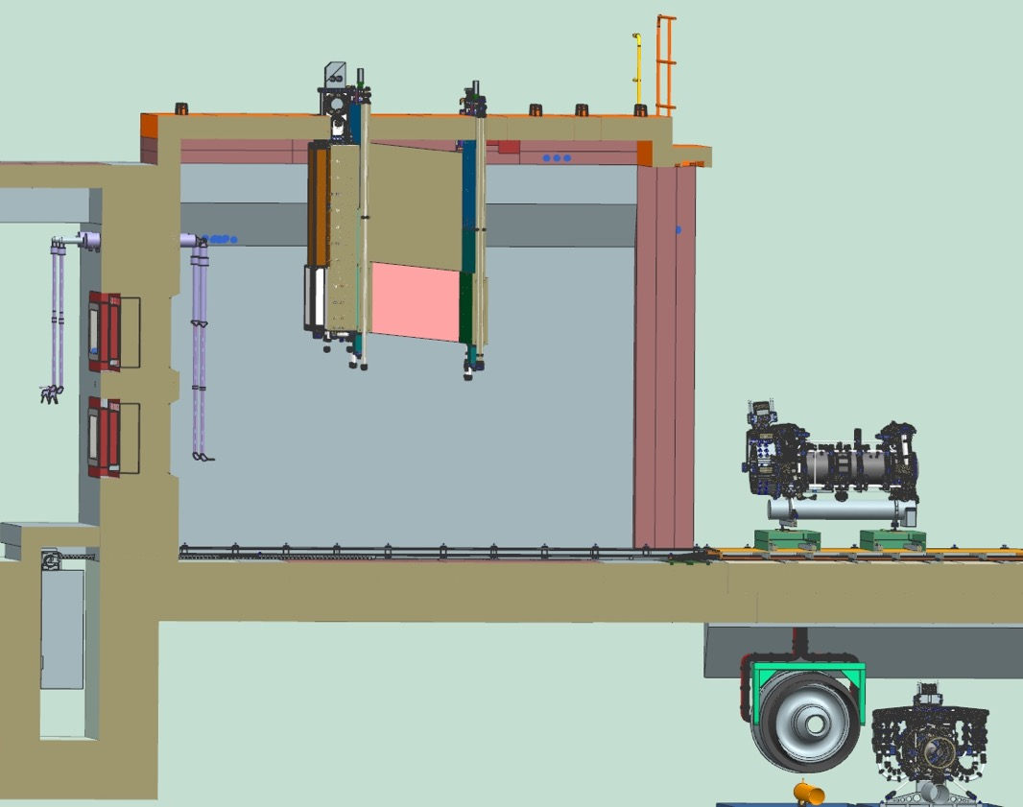
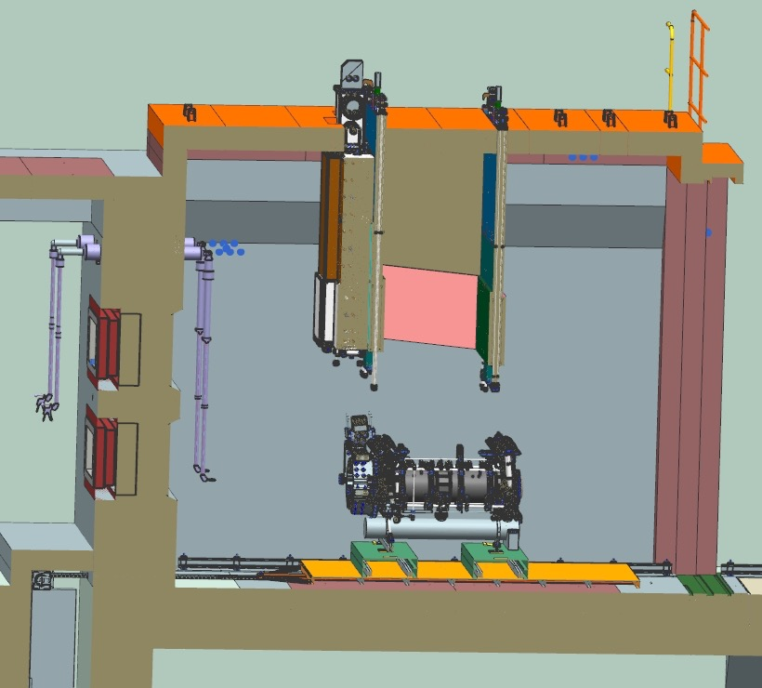
Horn A Disconnected from Module
Module
Horn A
Serapid Rigid Chain type: CH60PS2000
Stroke 10meters ( 397in)
Push-pull force 2,810 lbf
Speed 7 fpm
(Vladimir Sidorov, FNAL)

Slide 9
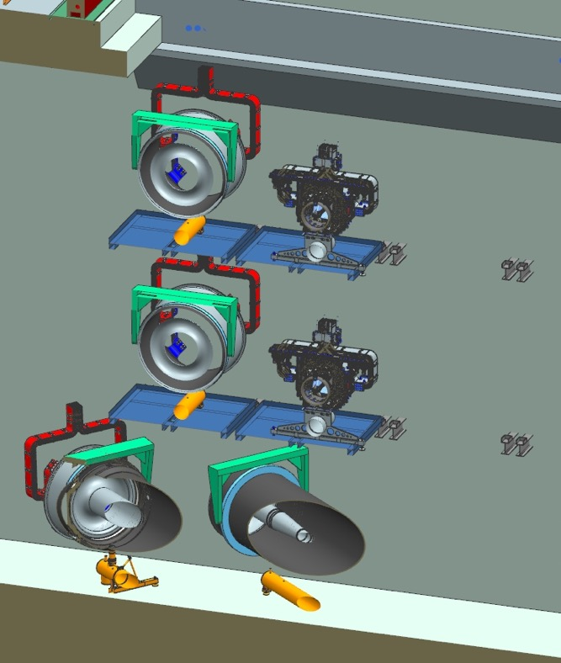
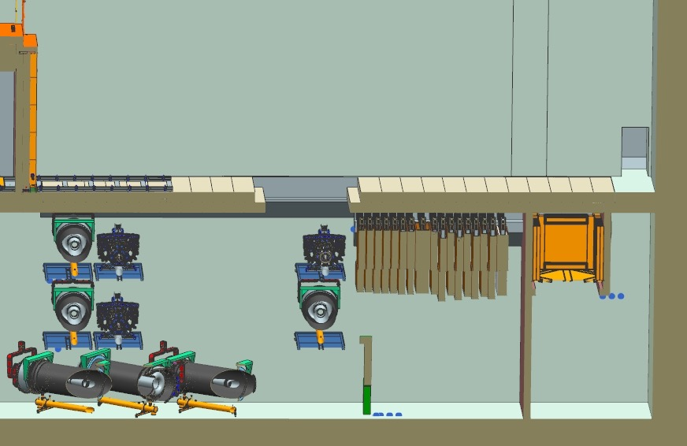
LBNF Target Hall Morgue Area for Storage of Spent Components
Horn A
T-Blocks
Morgue
Horn C
T-Blocks Pit
Horn B
(Vladimir Sidorov, FNAL)

Slide 10
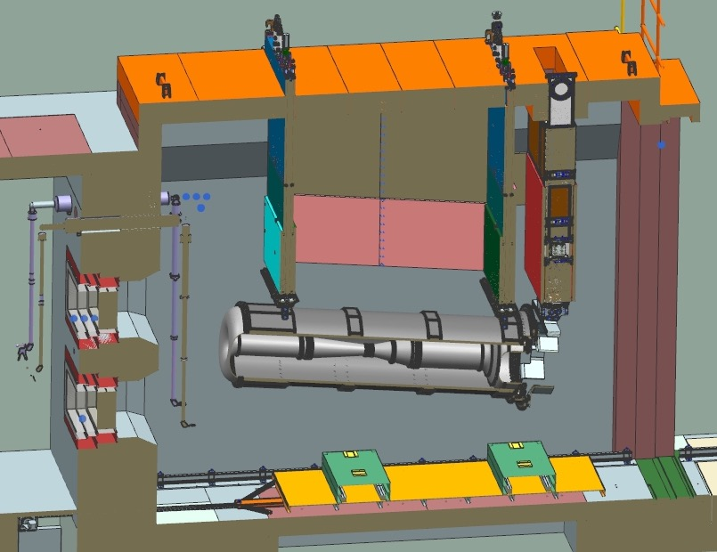
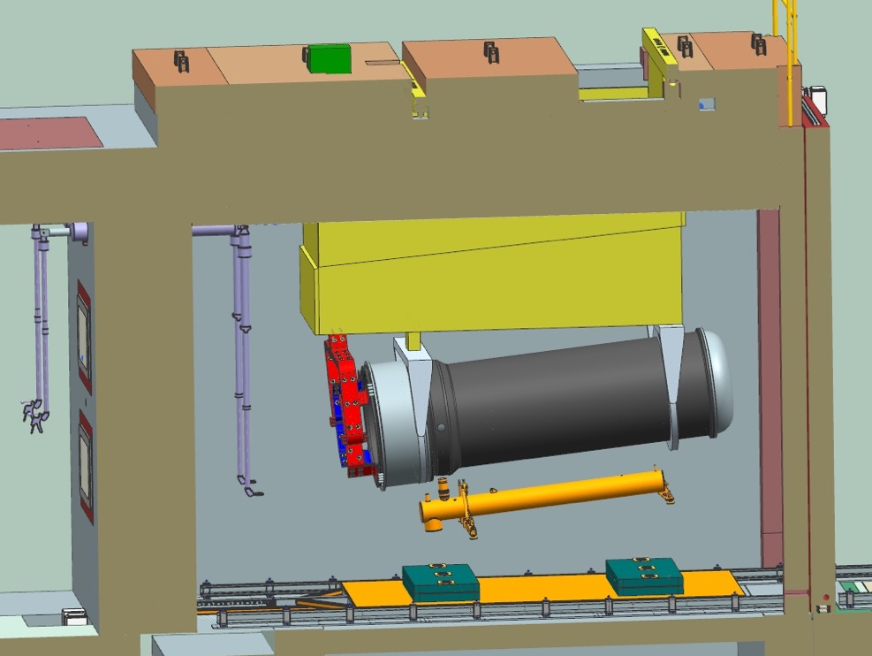
LBNF Horn B and Horn C in the Workcell
These horn/module models as shown here are over 1 year out of date
(Vladimir Sidorov, FNAL)

Slide 11
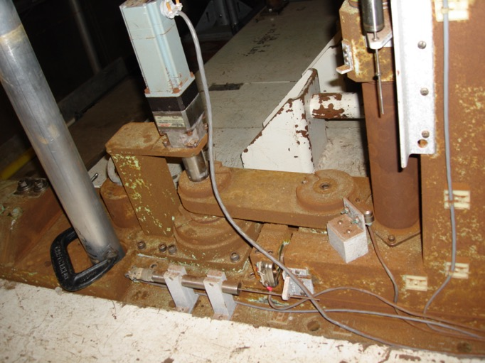
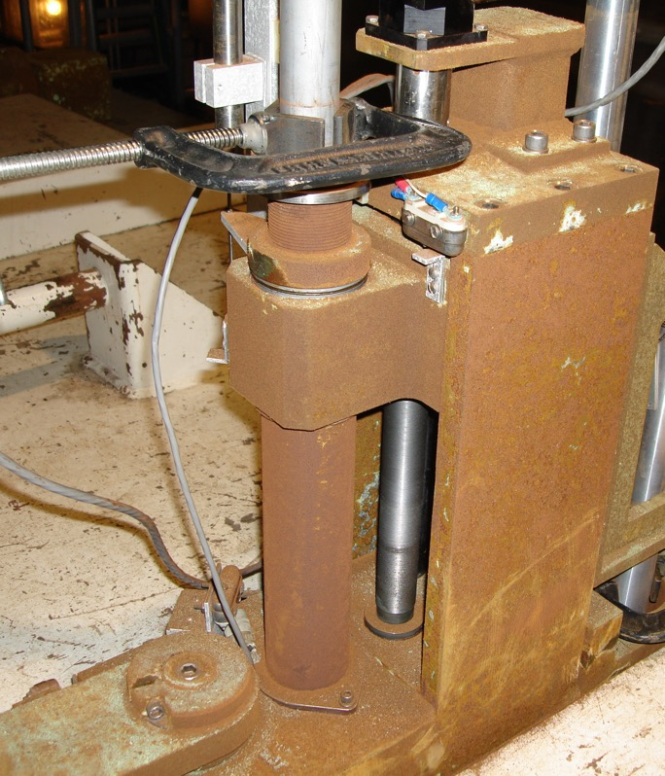
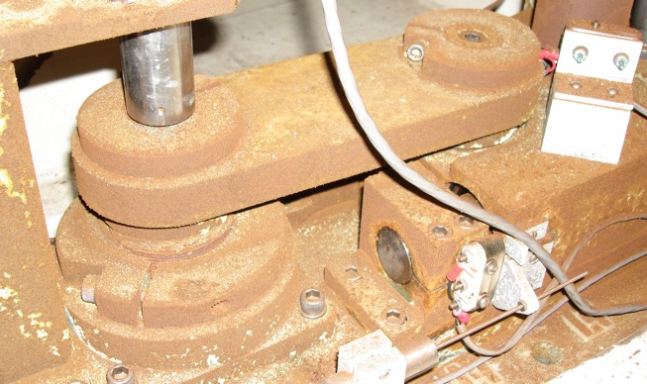
NuMI – 1 MW Horn 1 and Target Module Refurbishment (part of 1 MW NuMI AIP)
Main
shaft
Transverse
shaft
Lifter drive shaft
Link
(Vladimir Sidorov, FNAL)

Slide 12
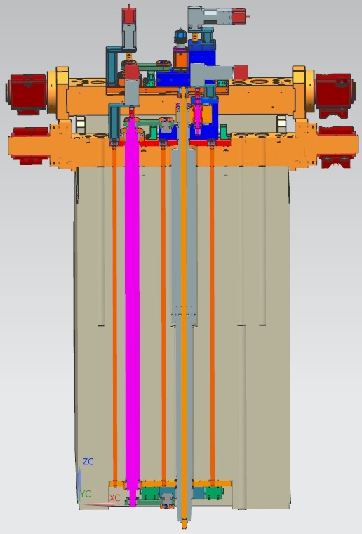
Support Modules provide shielded feedthroughs for positioners & utilities
Upper drive
mechanism
Transverse
shaft
Main shaft w/ drawscrew
Lower drive
mechanism
Module

Slide 13
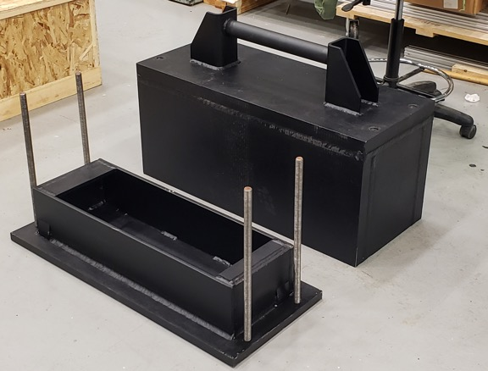
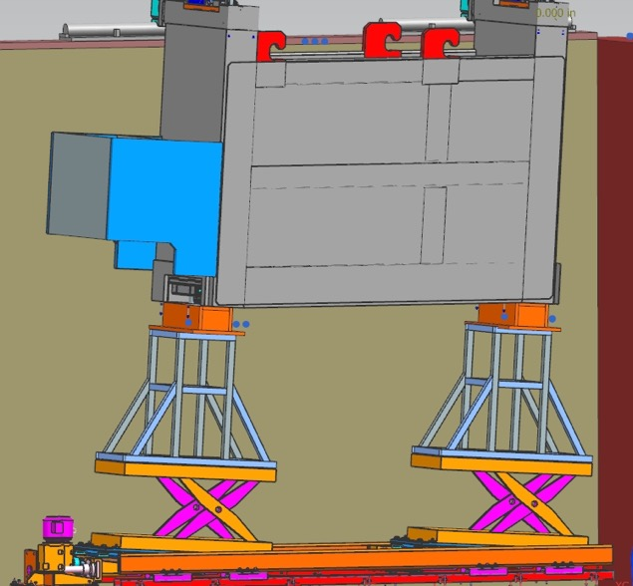
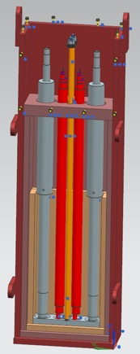
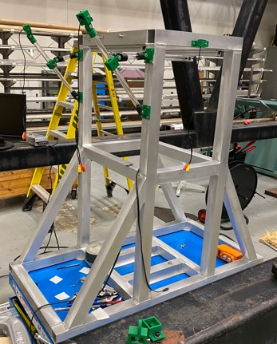
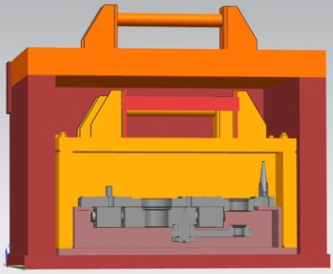
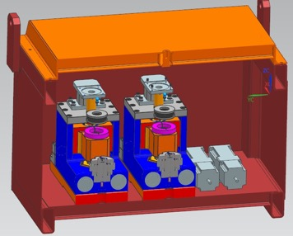
Horn 1 and Target Module Upgrades Executed Successfully
(Vladimir Sidorov, FNAL)
Module
Lower transfer drive
Casks

Slide 14
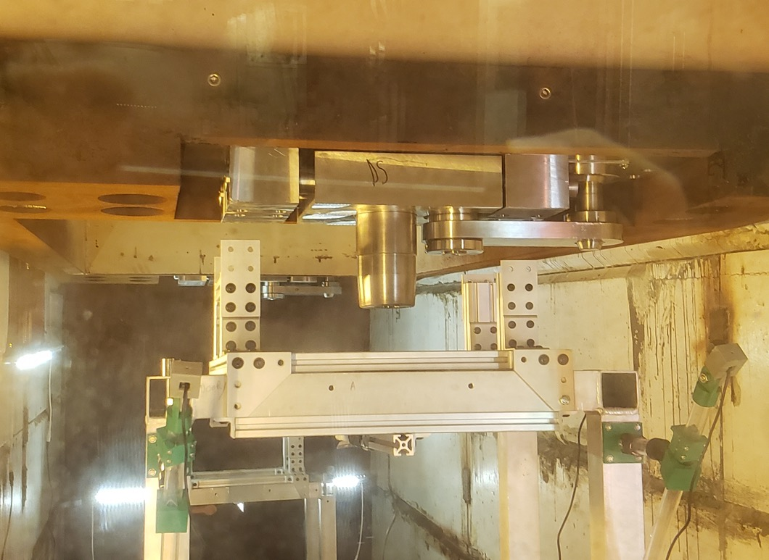
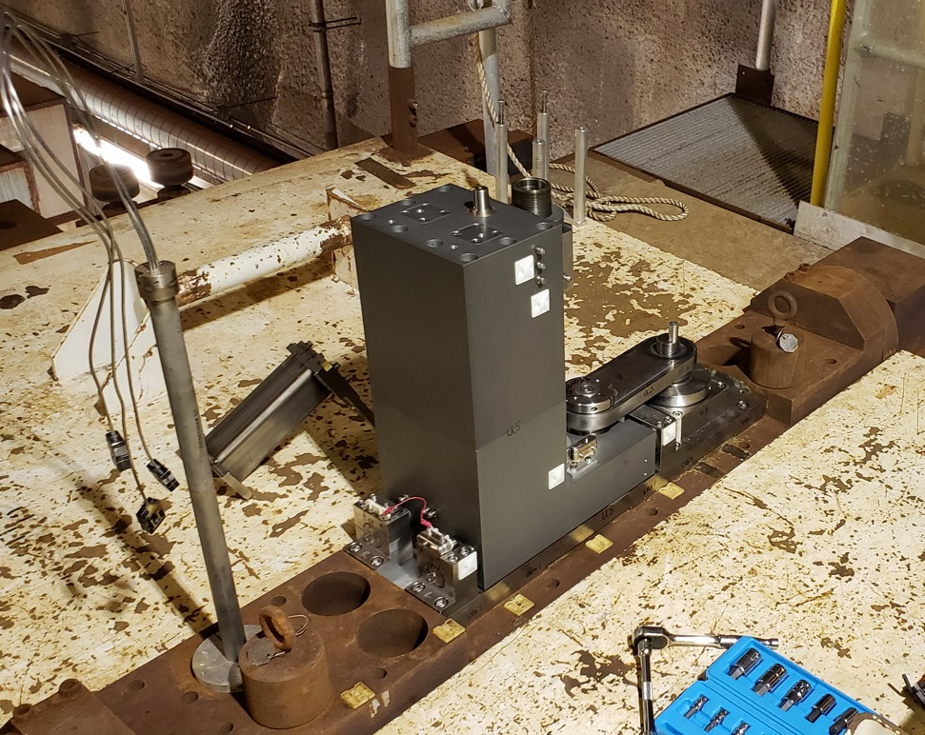
Horn 1 Module Shiny New Parts!
(Vladimir Sidorov, Keith Anderson; FNAL)

Slide 15
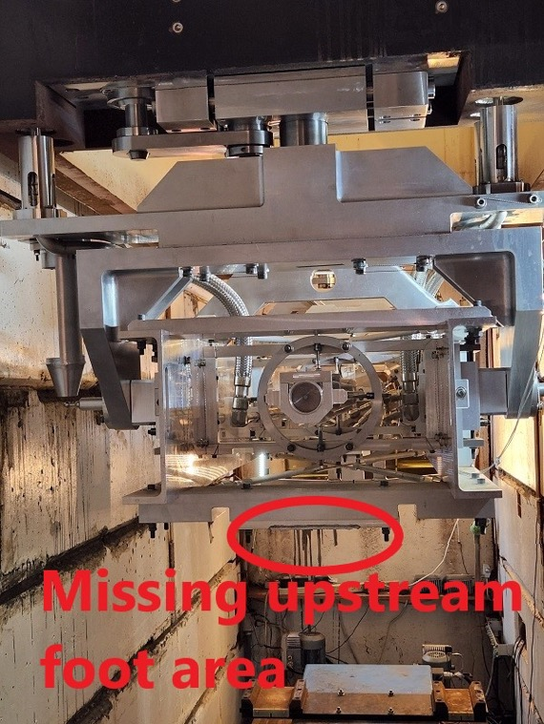
3 weeks ago: Remote Handling Incident Damaging NuMI Target TA-05
During a remote crane move of the Target on it’s module (similar to that in video above), the leveling feet on the target carrier hit an improperly configured concrete shielding block.

Slide 16
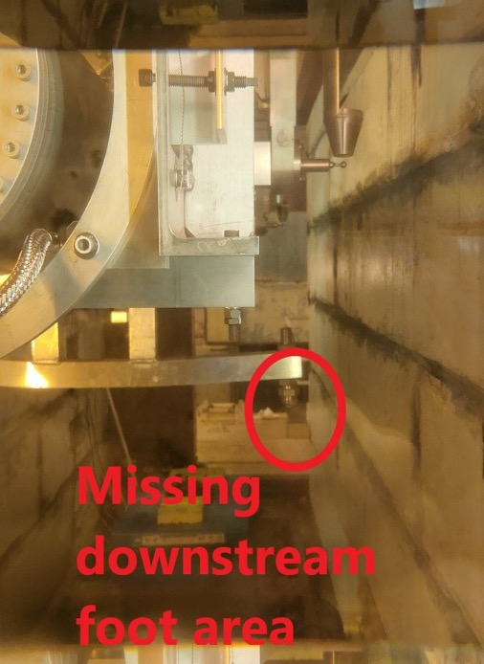
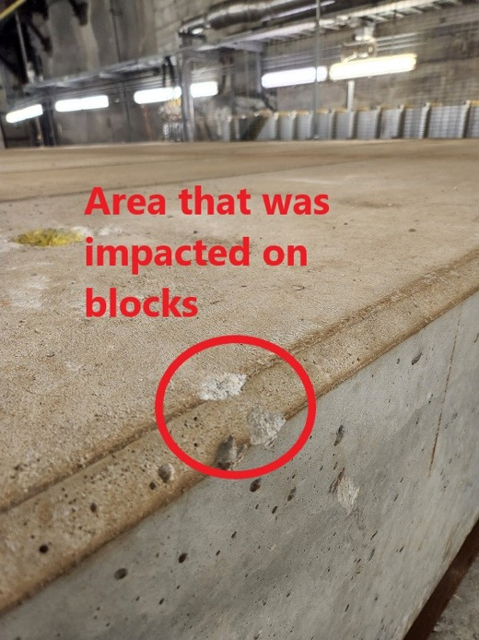
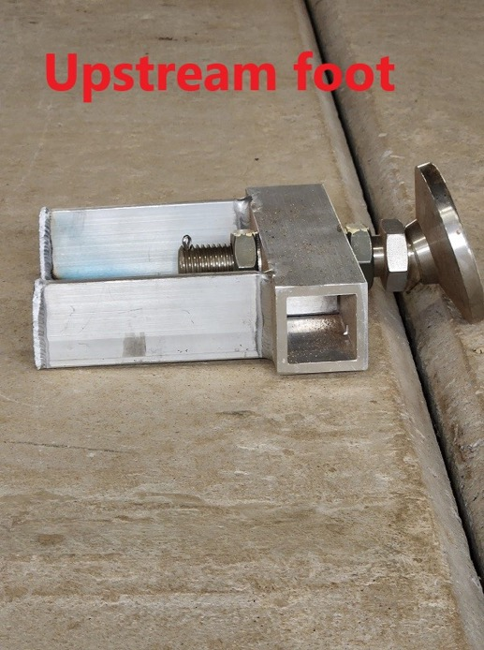
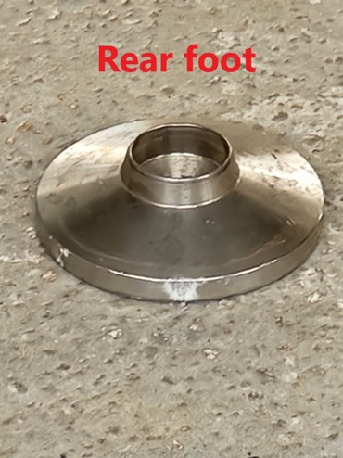
3 weeks ago: Remote Handling Incident Damaging NuMI Target TA-05
Lesson learned: Follow procedures and perform required pre-job “walk-down” (inspection)
Do not let confidence turn into complacence

Slide 17
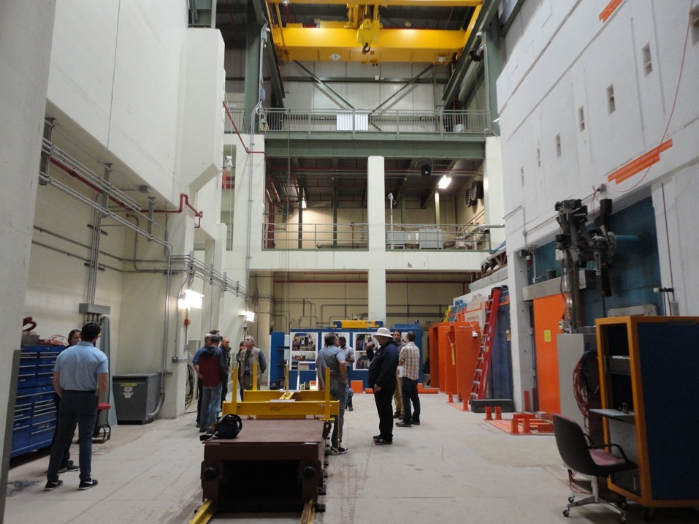
Other Existing Systems that LBNF will copy and/or utilize
Re-configurable vision system with multiple PTZ and dome cameras
C-0 Hot Cell and Storage Area
(Keith Anderson; FNAL)
(Vladimir Sidorov, Cory Crowley; FNAL)

Slide 18
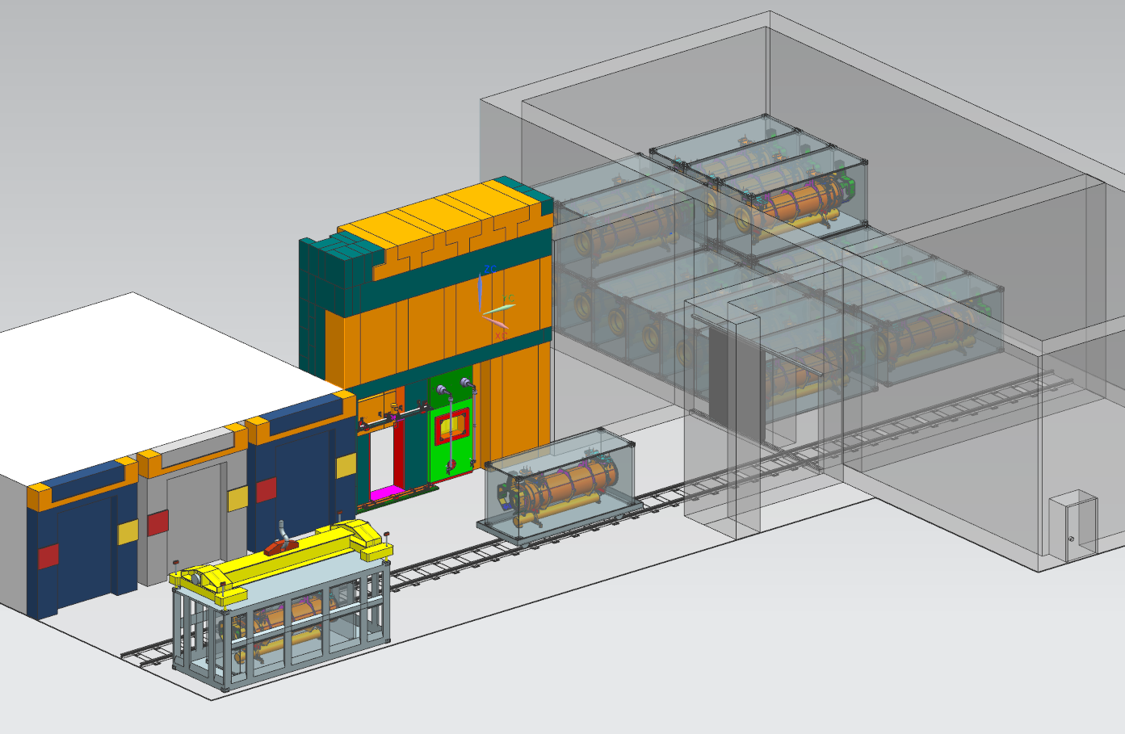
C-0 Radioactive Handling & Storage Facility Layout
Long-Term Storage
Large Volume Hot Cell
Cold Side (Crane Storage)
Morgue Storage Bays
(Vladimir Sidorov, Cory Crowley, Mike Campbell; FNAL)

Slide 19
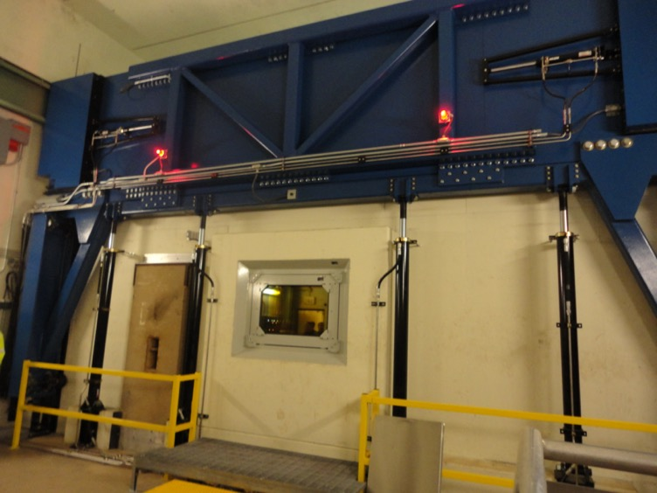
Radioactive Component Long-term Storage
(Cory Crowley, Mike Campbell, Vladimir Sidorov; FNAL)

Slide 20
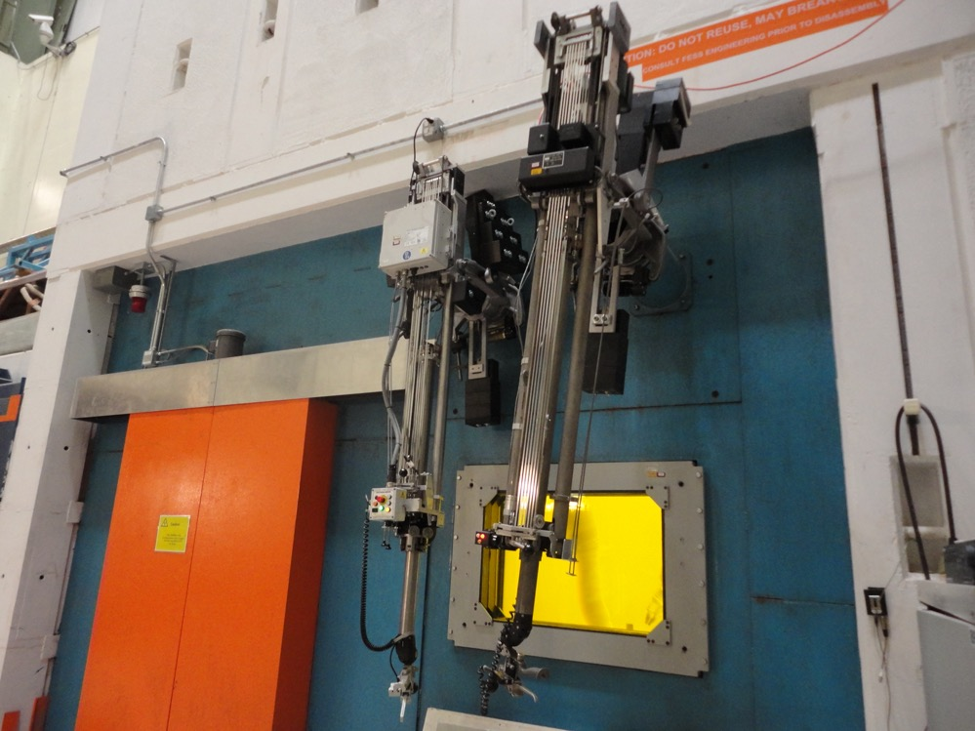
C-0 Large volume Hot Cell (10 ton internal bridge crane and jig crane)
(Vladimir Sidorov,; FNAL)

Slide 21
Back-up and Additional Information Slides Follow

Slide 22
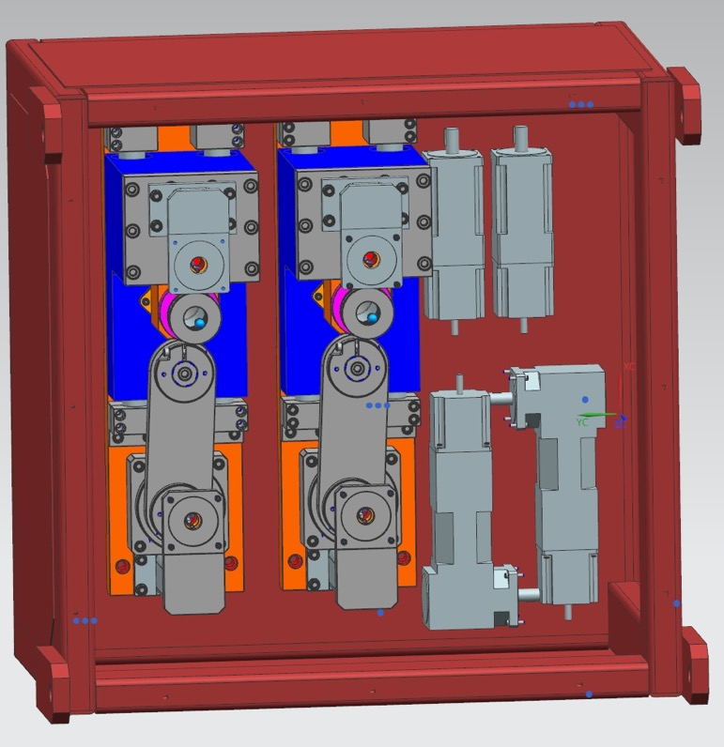
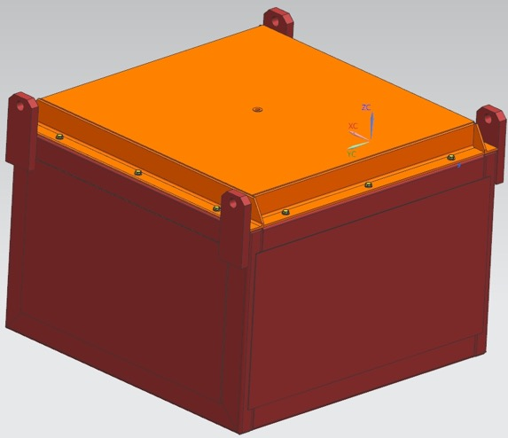
Upper drive mechanisms storage box
(Vladimir Sidorov,; FNAL)

Slide 23
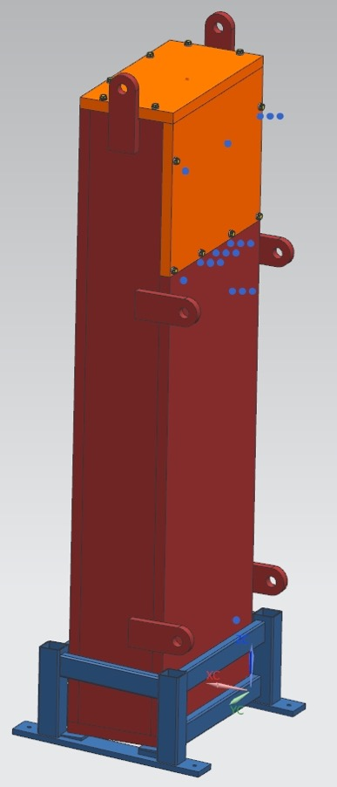
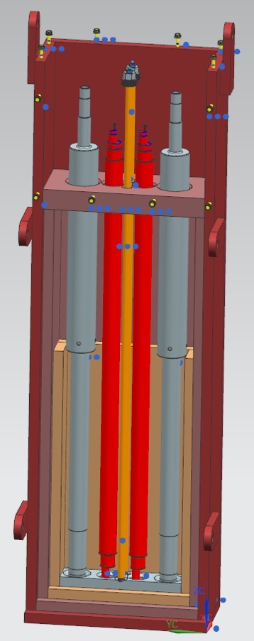
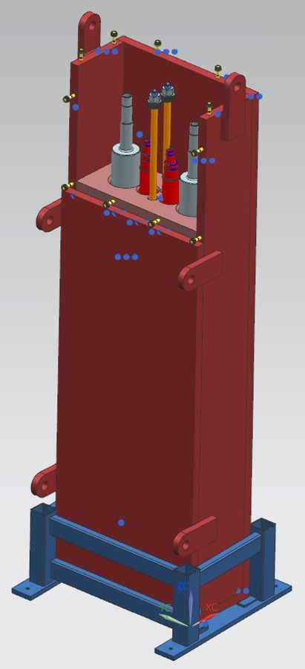
Transverse drives shafts storage
Cover
Cask
Shafts
Support
frame
(Vladimir Sidorov,; FNAL)

Slide 24
Lower drive mechanism cask
Top cover
Lower Cask
(Vladimir Sidorov,; FNAL)

Slide 25
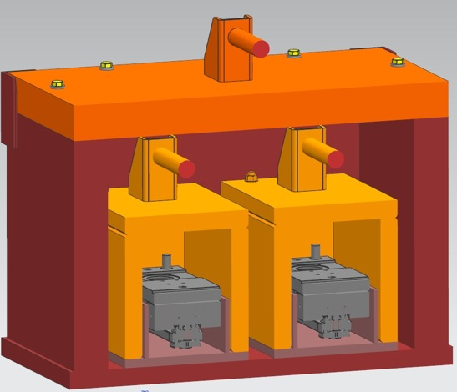
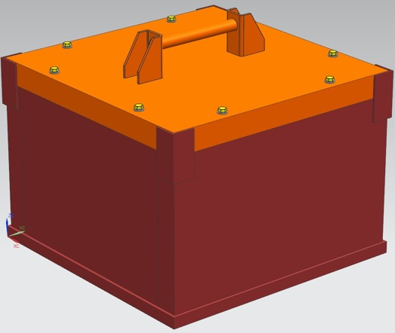
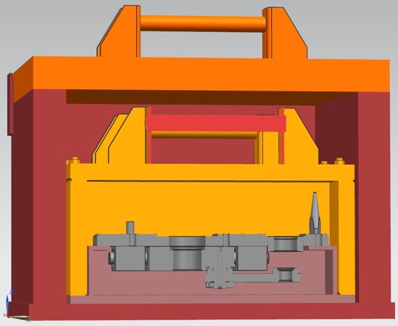
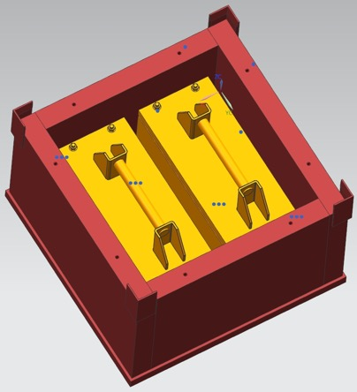
Lower Drive Mechanisms Casks
Main cask
Small cask
Lower drive
mechanism
(Vladimir Sidorov,; FNAL)

Slide 26
Left Section View of LBNF-20 Target Complex – Target Hall
Work
Cell
Target
Hall
Decay
Region
Primary Beam Enclosure
Target
Bunker
Mechanical
Shaft

Slide 27
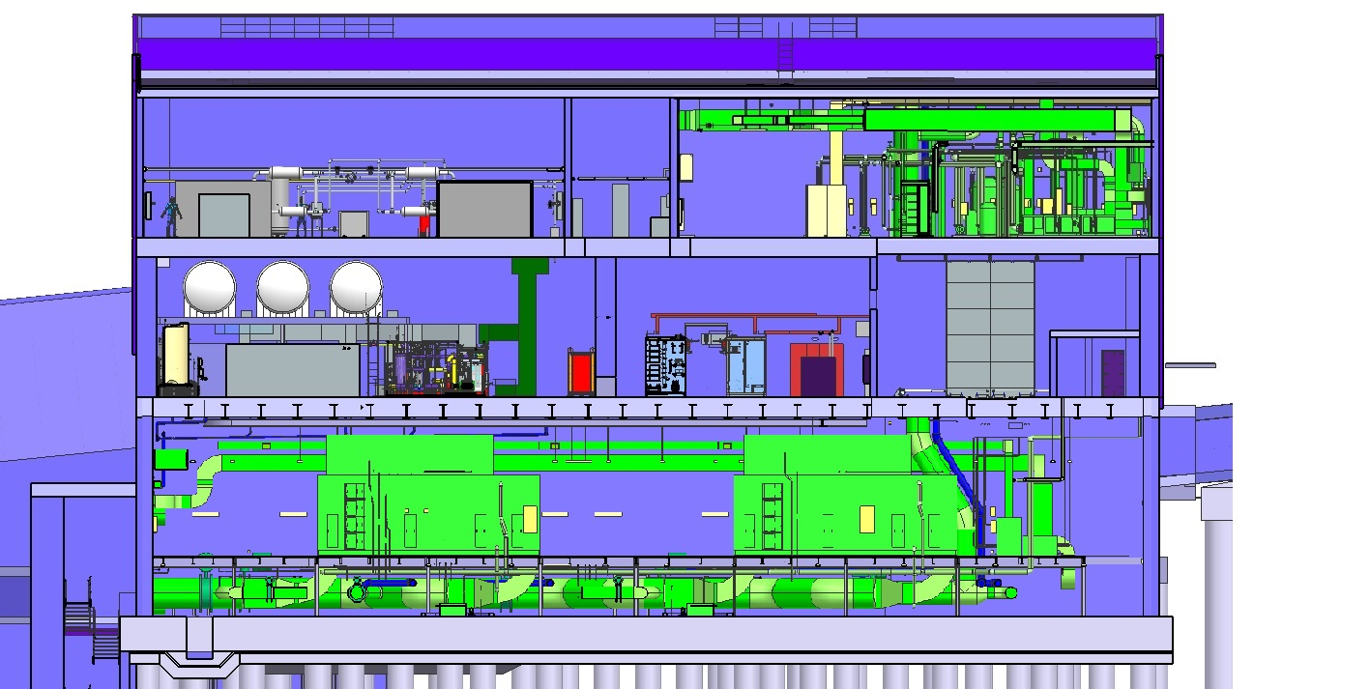
Left Section View of LBNF-20 Target Complex – Support Rooms
Control
Room
Mechanical/
Electrical Room
Helium
Room
RAW
Room
Power Supply
Room
Nitrogen/Air
Handling Room

Slide 28
Left Section View of LBNF-20 Target Complex – High Bay
High Bay
Mezzanine
High Bay
Truck Bay

Slide 29
Left Section View of LBNF-20 Target Hall Complex’s Target Bunker
Removable
Steel Shielding
Work
Cell
Sealed Hatch Covers
Decay Region Upstream Window
Steel
Shielding
Cooling
Panels
Horn A with Target
Primary Beam Window
Assembly
Horn C
Horn B
Baffle

Slide 30
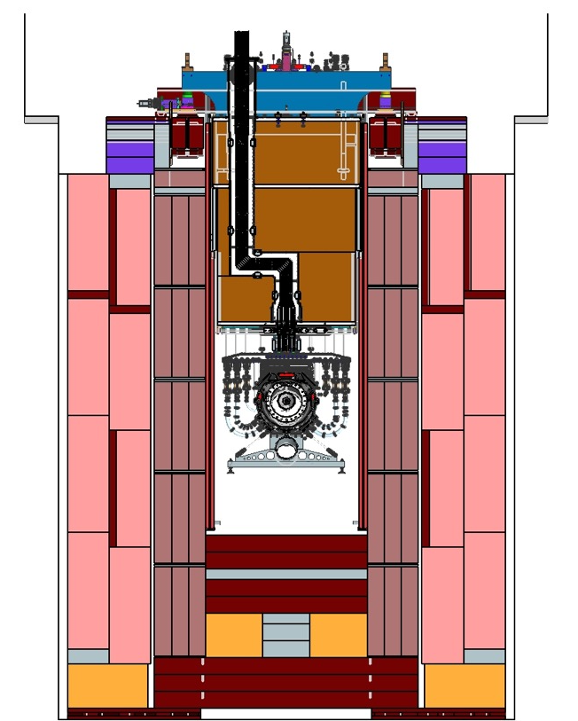
Cross Section View of Target and Horn A
Horn A
Module
With Stripline
Stainless Steel Liner
Steel Shielding
Target
Horn A
Horn A
Water Tank and Legs
Nitrogen Flow
Passages
Cooling
Panels

Slide 31
Left Section View of LBNF-30 Absorber Complex
Surface
Hatch
Absorber
Service
Building
Absorber
Hall
Muon
Monitors
with
Shielding
Muon
Steel
Shielding
Neutrino Beam
From Target Complex
Neutrino Beam
to SURF, SD
Hadron
Absorber
Decay Region
Nitrogen
Cooling
Decay Region
Helium Vessel

Slide 32
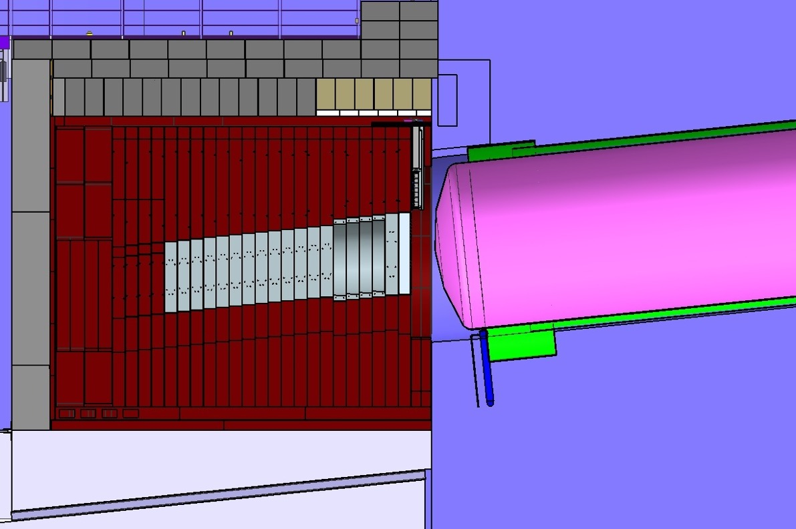
Left Section View of LBNF-30 Absorber Complex (Continued)
Removable
Concrete
Shielding
HADES
Monitor
Decay Region
Helium Vessel
Non- Removable Concrete Shielding
Neutrino Beam
From Target Complex
Helium Vessel Torispherical Head
Steel
Shielding
Decay Region
Nitrogen ‘Turn Around’ Box
Aluminum
Cores

Slide 33
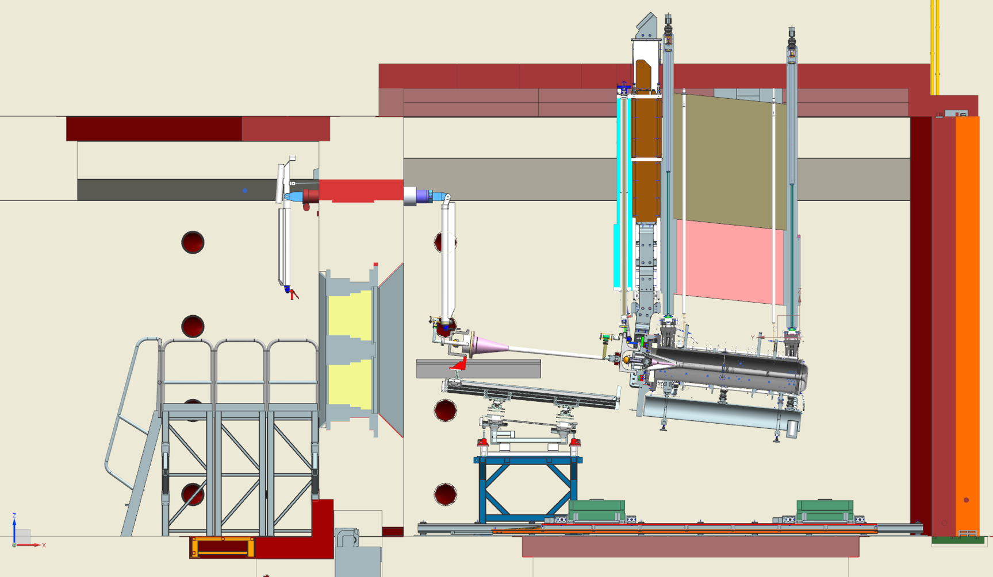
Horn A module in the Work Cell
Hatch length is increased
8.2825”
210.4mm
48”
13.5”
343mm
97.4”
2474mm
90-3/8”
194.16”
4932mm
145”
3683mm
96.76”
2458mm
32.8”
270-3/16”

