Slide 1
NuMI Beam Monitoring Simulation and Data Analysis
Yiding Yu
Don Athula Wickremasinghe
Pavel Snopok
Eduardo Ossorio
Jennifer Thomas
Katsuya Yonehara
Sudeshna Ganguly
Thomas Carroll
NBI2022 Abingdon, UK
Sep 20, 2022

Slide 2
Outline
Overview of NuMI beamline Monitoring system
Machine Learning based on measurement data
Summary
Introduction to muon monitor simulation
Beam parameter effect on pixels at MMs
Compare the simulation with data

Slide 3
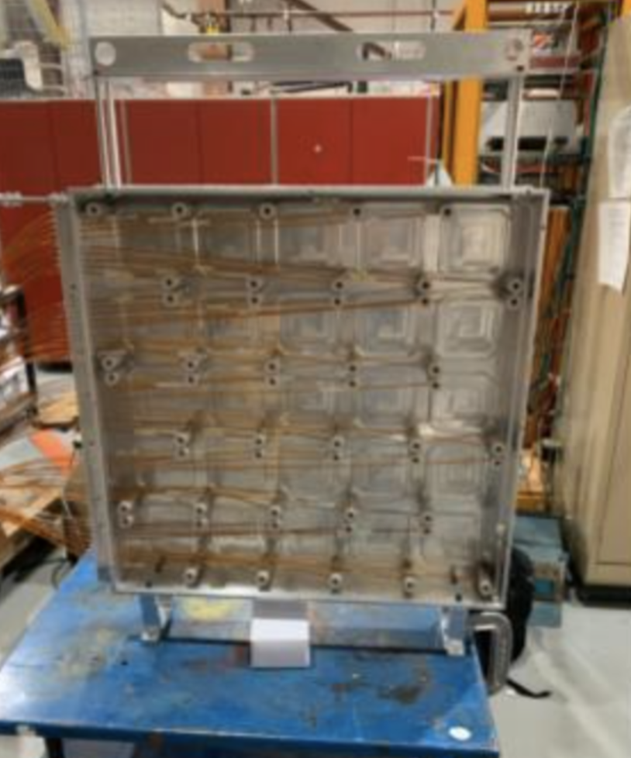
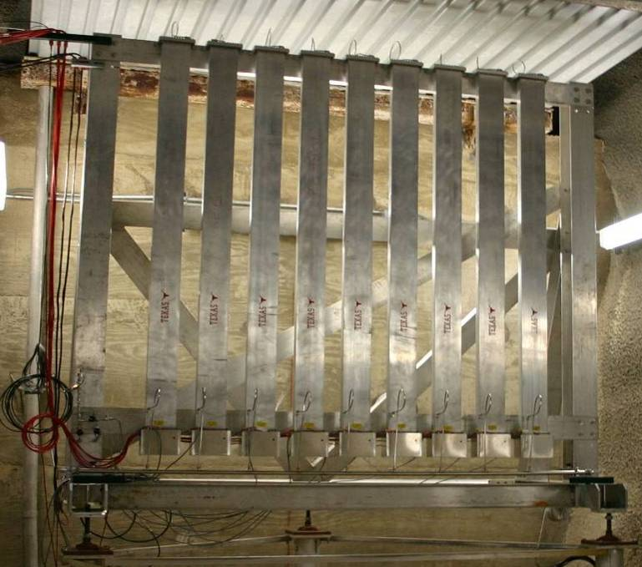
Overview of NuMI beamline Monitoring system
Motivation:
With MINOS detector shut down in 2019, the muon monitors now provide essential information to monitor the beam and target
The goal of this study is to maintain the quality of the monitor signals and to establish correlations with the neutrino beam profile
Thermocouple detector
(3+3 Be wires)
Hadron monitor
( 5x5 pixels)
Muon monitor
(2x2 m2, 9x9 pixels)

Slide 4
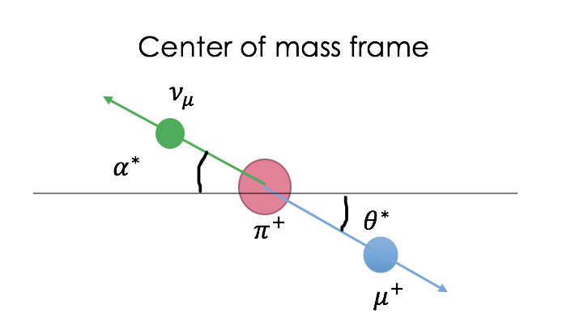
Introduction to muon monitor simulation
G4NuMI is the main tool that we use to run simulations for NuMI beam and muon monitors. It is based on Geant4
The procedure of muon monitor simulation:
1. Generate neutrinos by running G4NuMI 2. Convert neutrinos back to their parent particles 3. Generate muons based on those parent particles 4. Feed those muons into a separate G4NuMI simulation to generate muons at the muon monitors
$$π$$
Separate
G4NuMI
G4NuMI
$$μ$$
$$v_{μ}$$

Slide 5
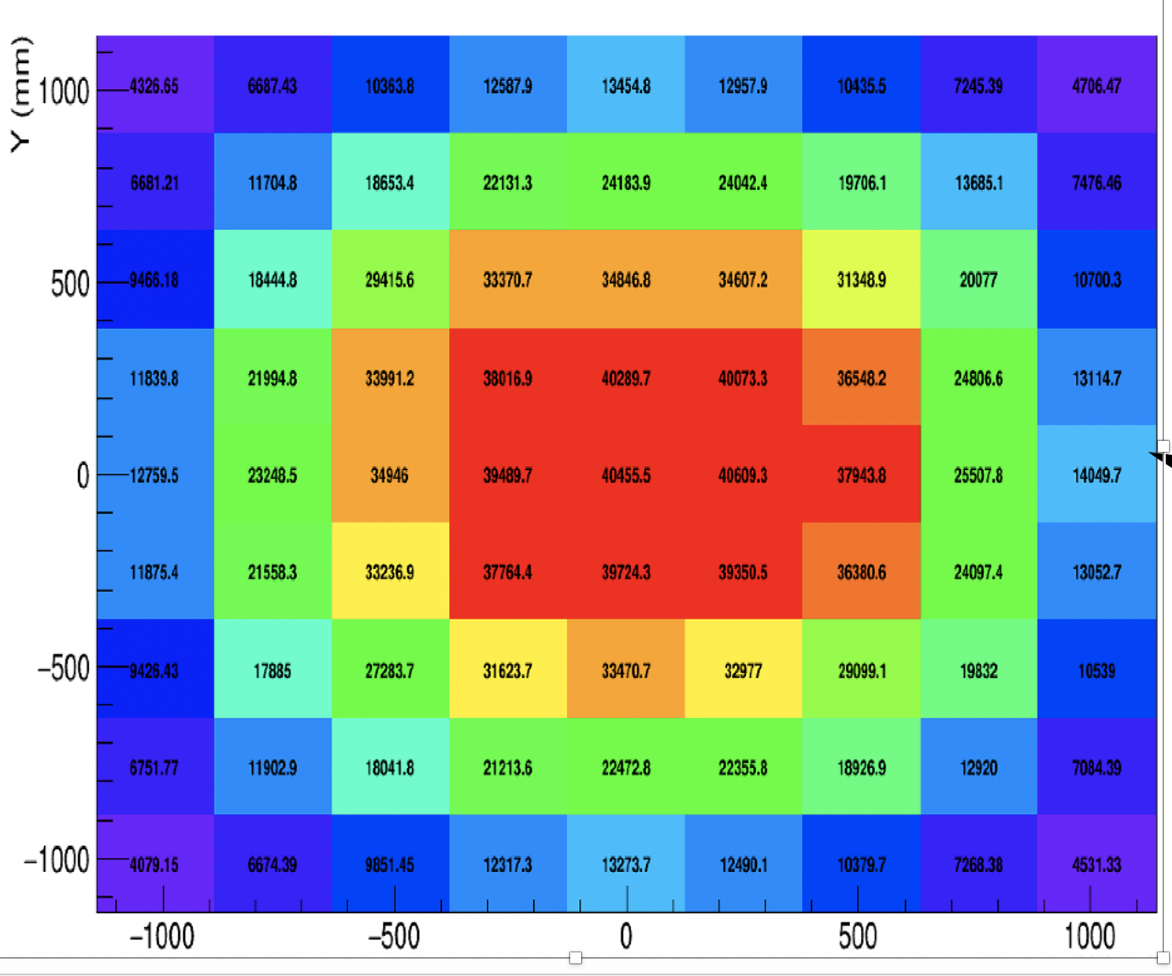
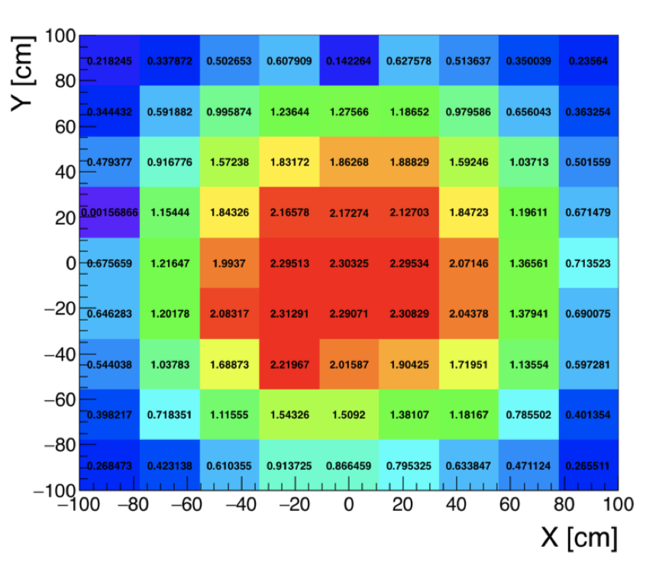
A general result muon monitor simulation
2D histogram of simulation
2D histogram of data
The numbers in pixels are the voltage signal
The number on each pixel is the number of events

Slide 6
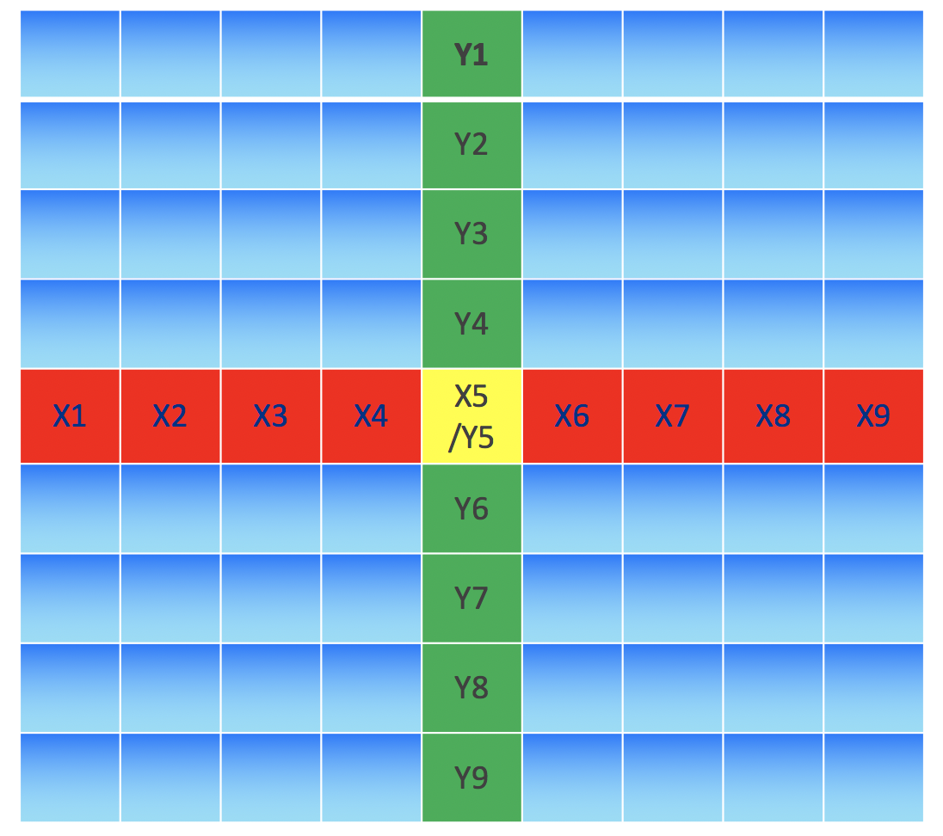
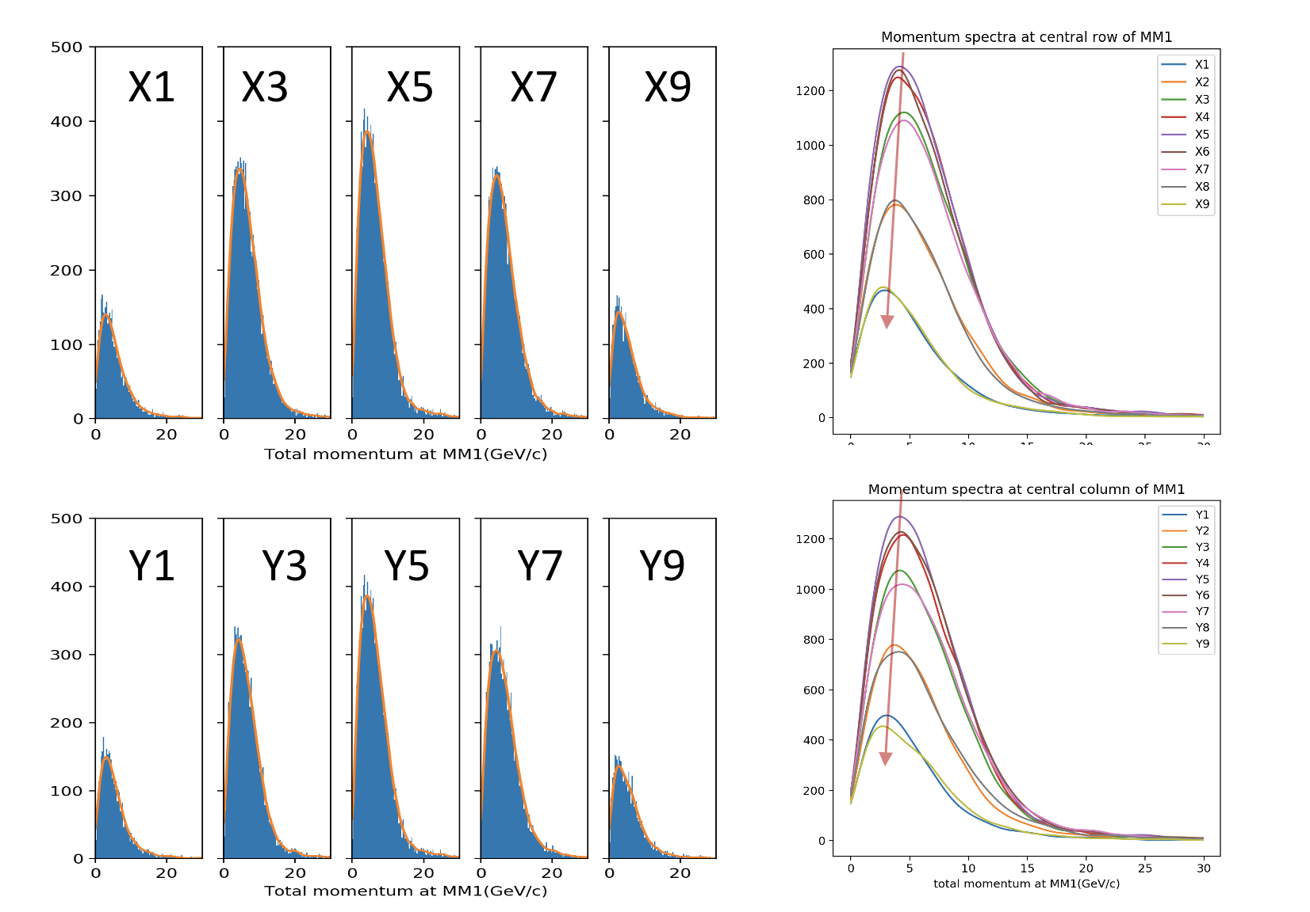
Muon monitor simulation( pixels information)
MM11
Different pixels have different muon spectra The peaks of the spectra move to low momentum from center to edge of MM1

Slide 7
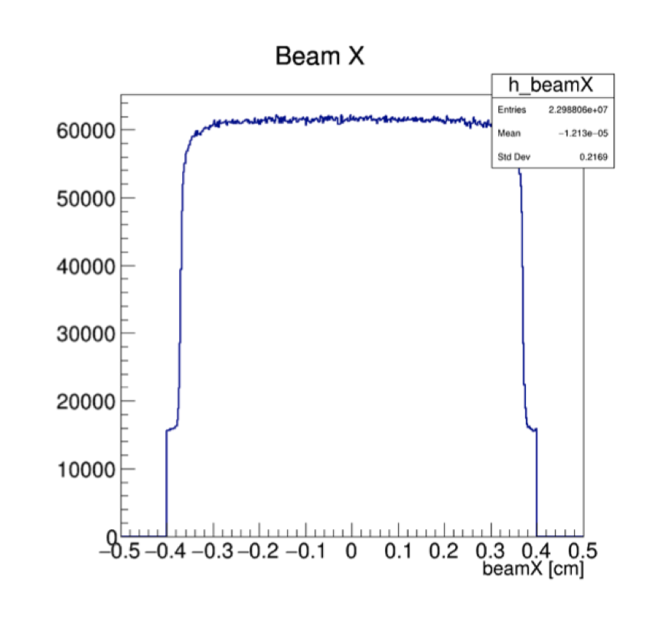
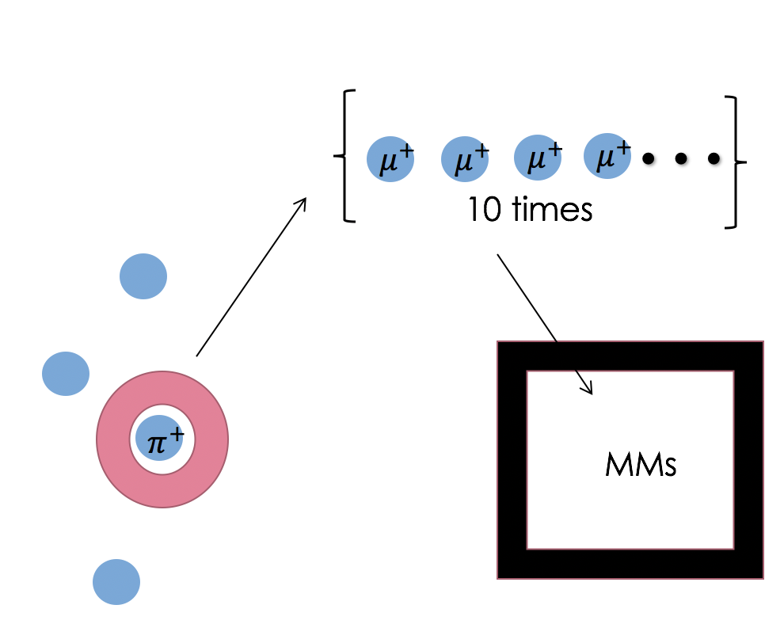
Uniform beam simulation + multiple decay
Uniform beam simulation*
Start by simulating a uniformly distributed proton beam hitting the target
Then apply Gaussian weights to the protons based on position when analyzing to simulate different beam positions
Useful for neutrino flux and muon monitor studies
Multiple decay
Make the pions decay to multiple muons
Then simulate those muons through the absorbers and muon monitors
*by Athula Wickremasinghe (nova-doc-49610, nova-doc-51702)

Slide 8
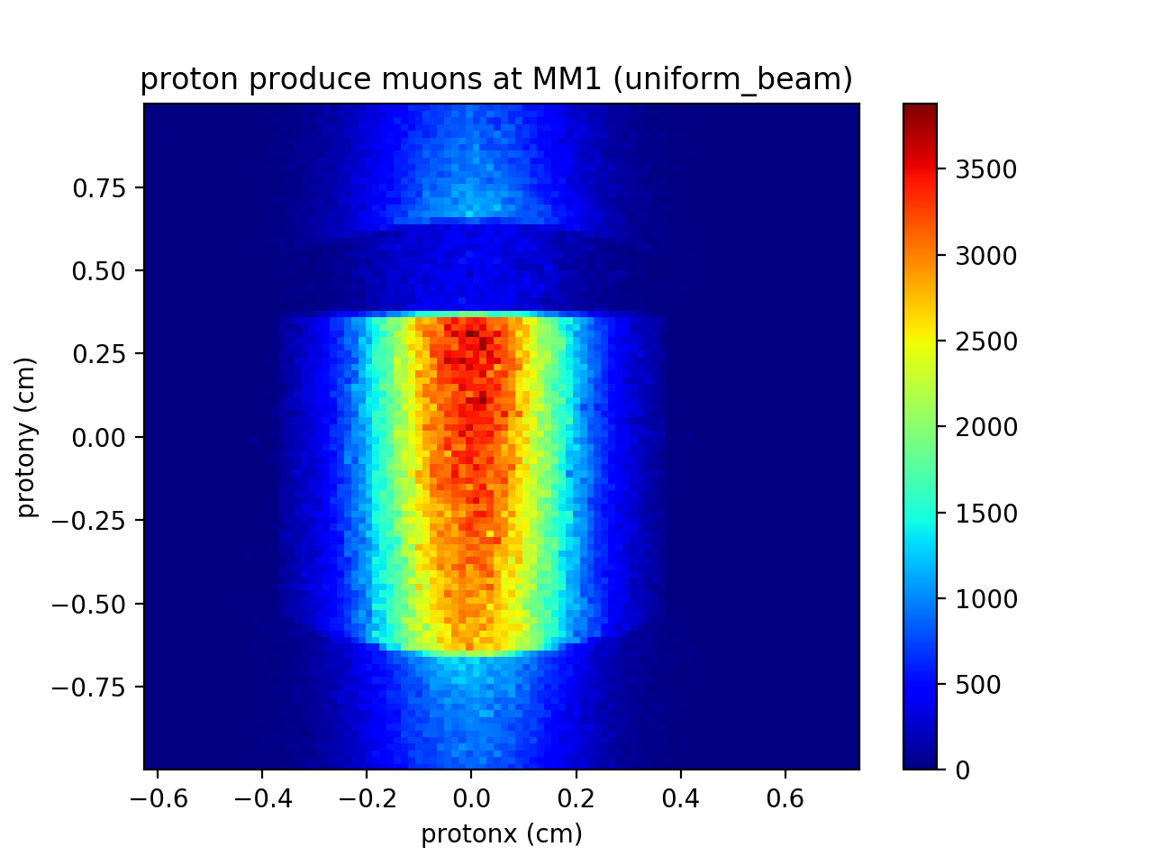
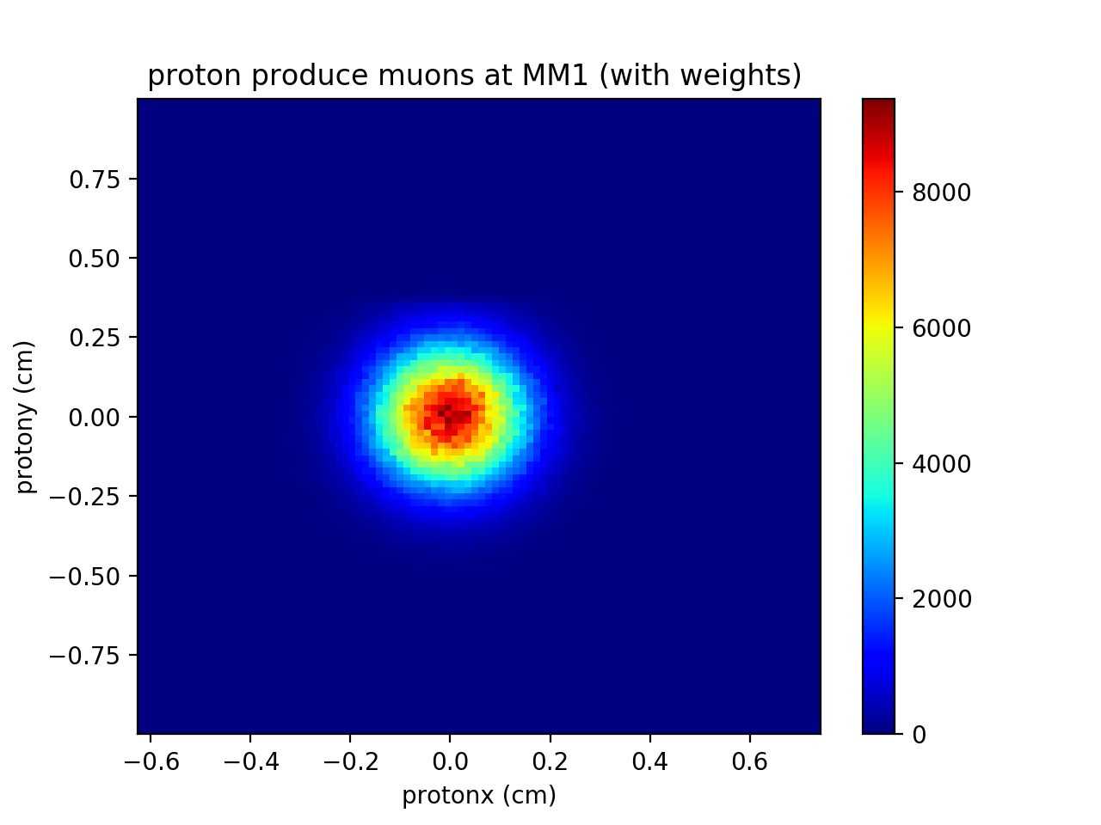
Uniform beam simulation
Gaussian weights

Slide 9
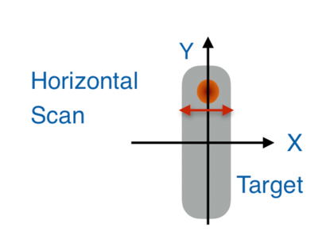
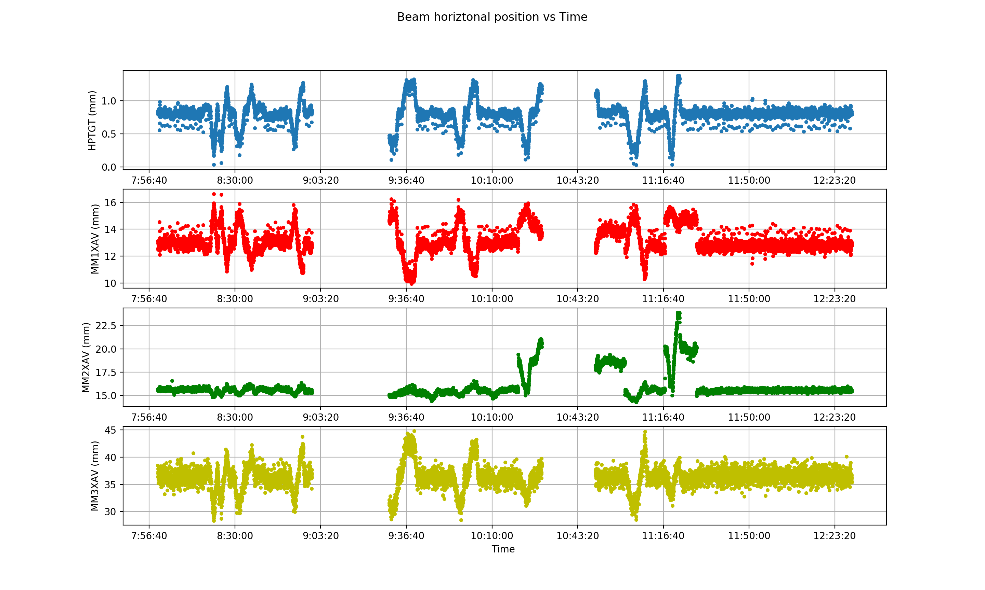
Muon monitor data analysis(Target beam scan data)
Details are in Athula’s talk: Machine learning applications to maintain the NuMI neutrino beam quality
Proton_x
To understand the behavior of the N beam and be able to predict the effect of the changes in the key beam parameters, multiple beams scans are carried out
Beam parameters are changed:
the beam position on target
the beam spot size
the focusing horn currents
MM1_x
MM2_x
MM3_x

Slide 10
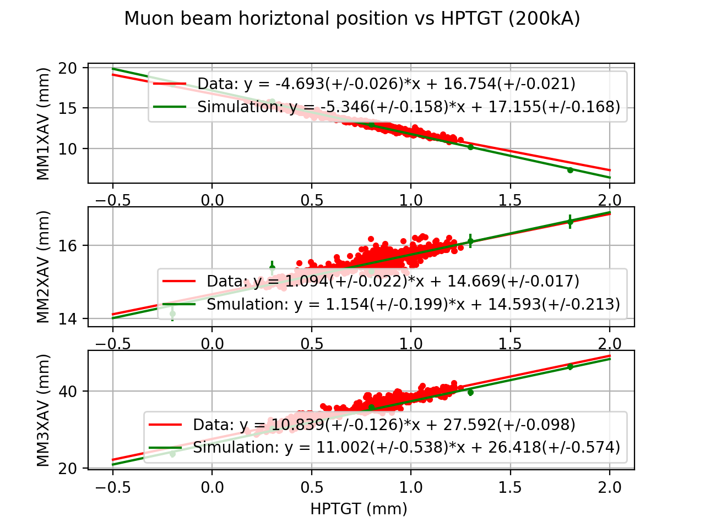
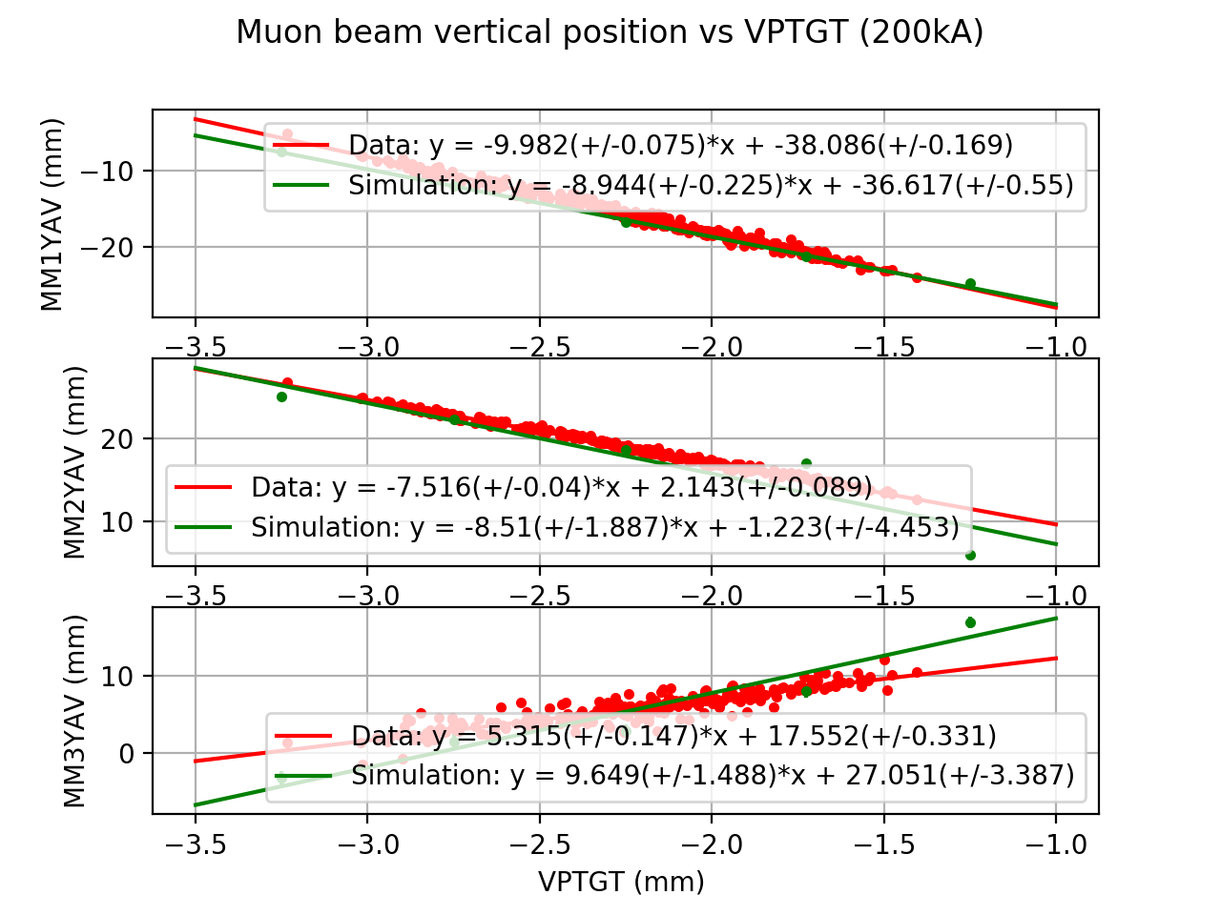
Muon beam centroid vs proton beam position at MMs (validating the simulation)
We can see three muon monitors are responding differently to the proton beam variations from the different slopes
Simulation results are consistent with data

Slide 11
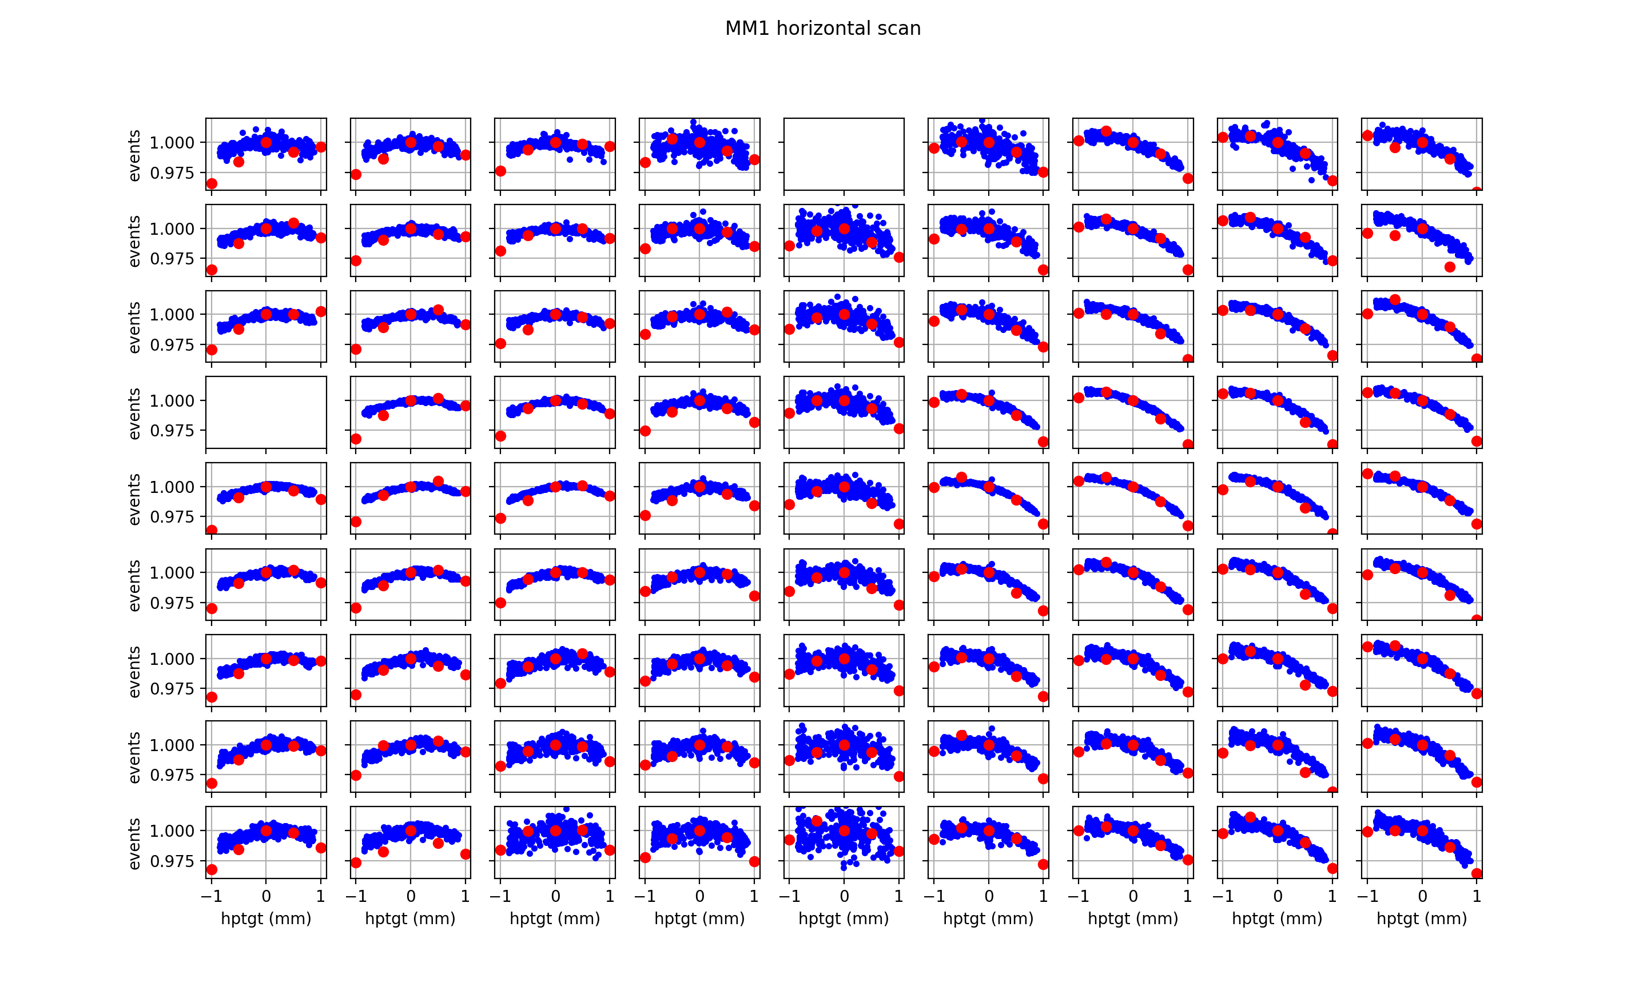
DATA VS SIM
Muon monitor pixel study (validating the simulation)
The simulation shows similar trends with some quantitative differences with data in some key pixels.
Blue: data of latest beam scan
Red: simulation
The events of data and simulation are normalized by the value of signal/events of 0 mm.

Slide 12
Beam parameter effect on pixels at MMs
The study about the effect of some parameters at pixels of MMs
Horn tilt: −3 mrad, −2 mrad, −1 mrad, +1 mrad, +2 mrad, +3 mrad
Target offset: −1 mm, −0.5 mm, −0.1 mm, +0.1 mm, +0.5 mm, +1 mm
Each simulation has 50 MPoT and each pion and kaon multiple-decays to 20 muons
Horn current: 200 kA
Could the muon monitors detect the effects of beam parameters?

Slide 13
Horn1 tilt

Slide 14
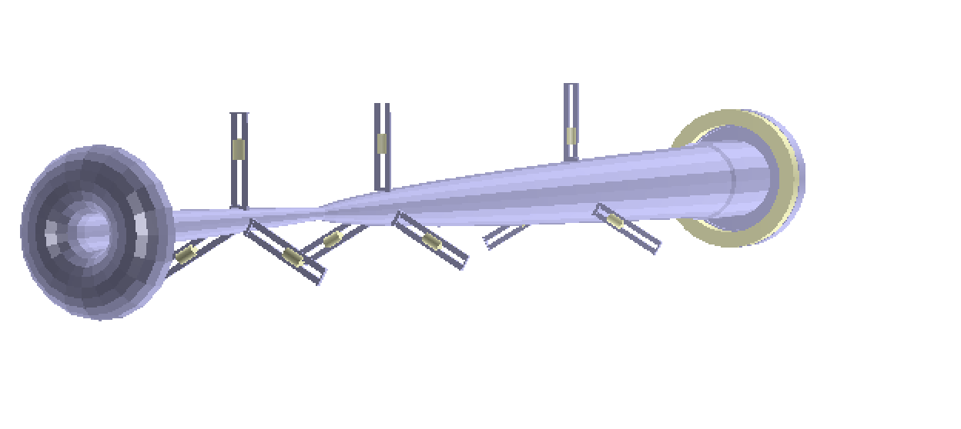
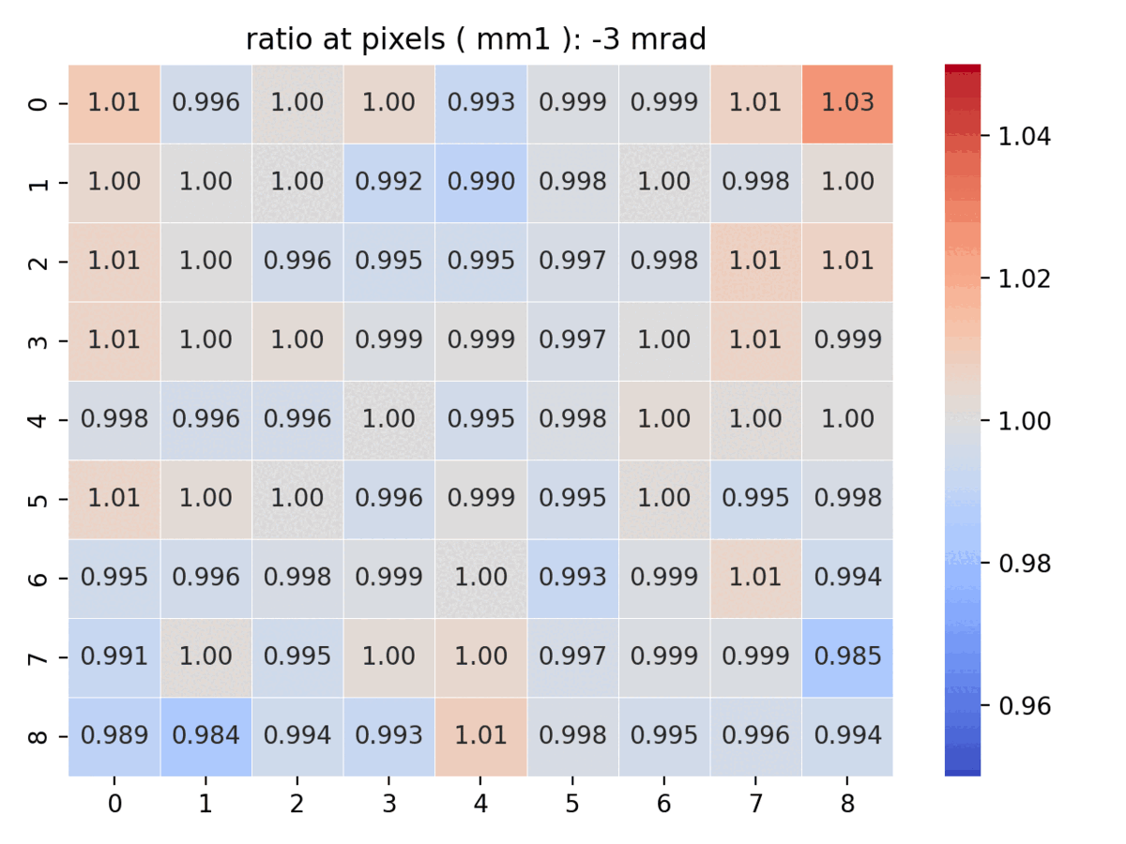
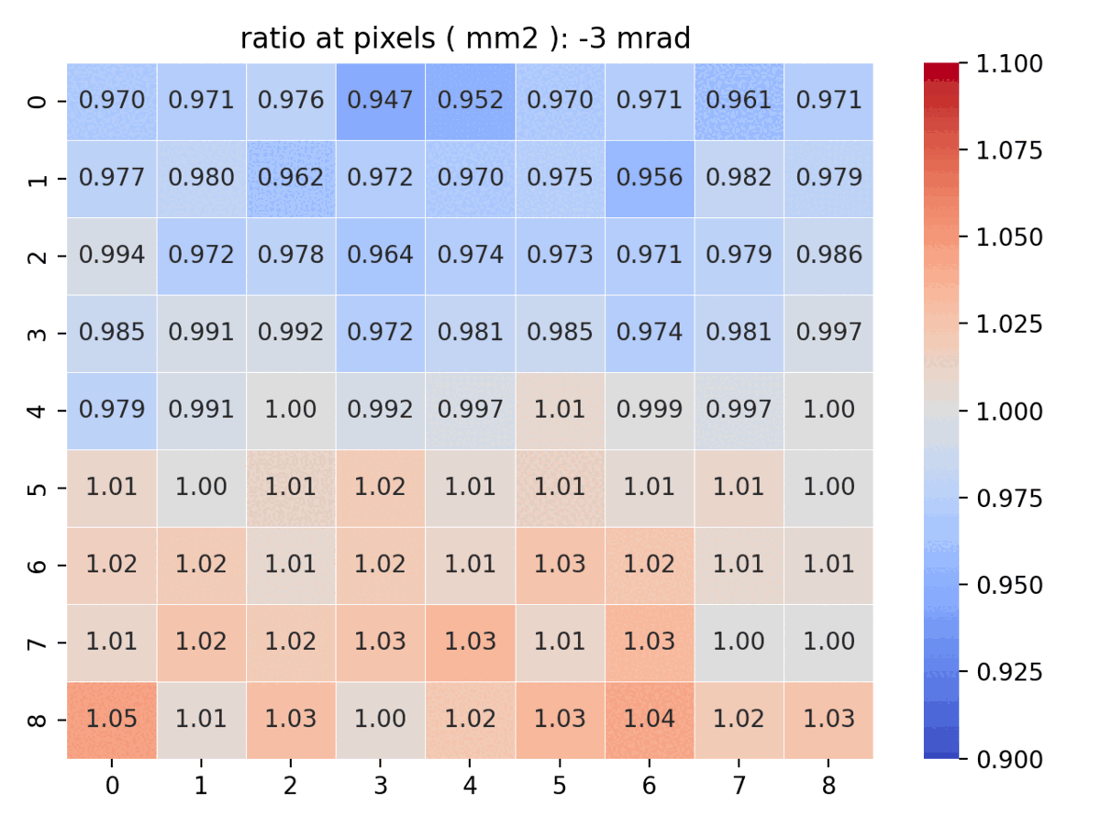
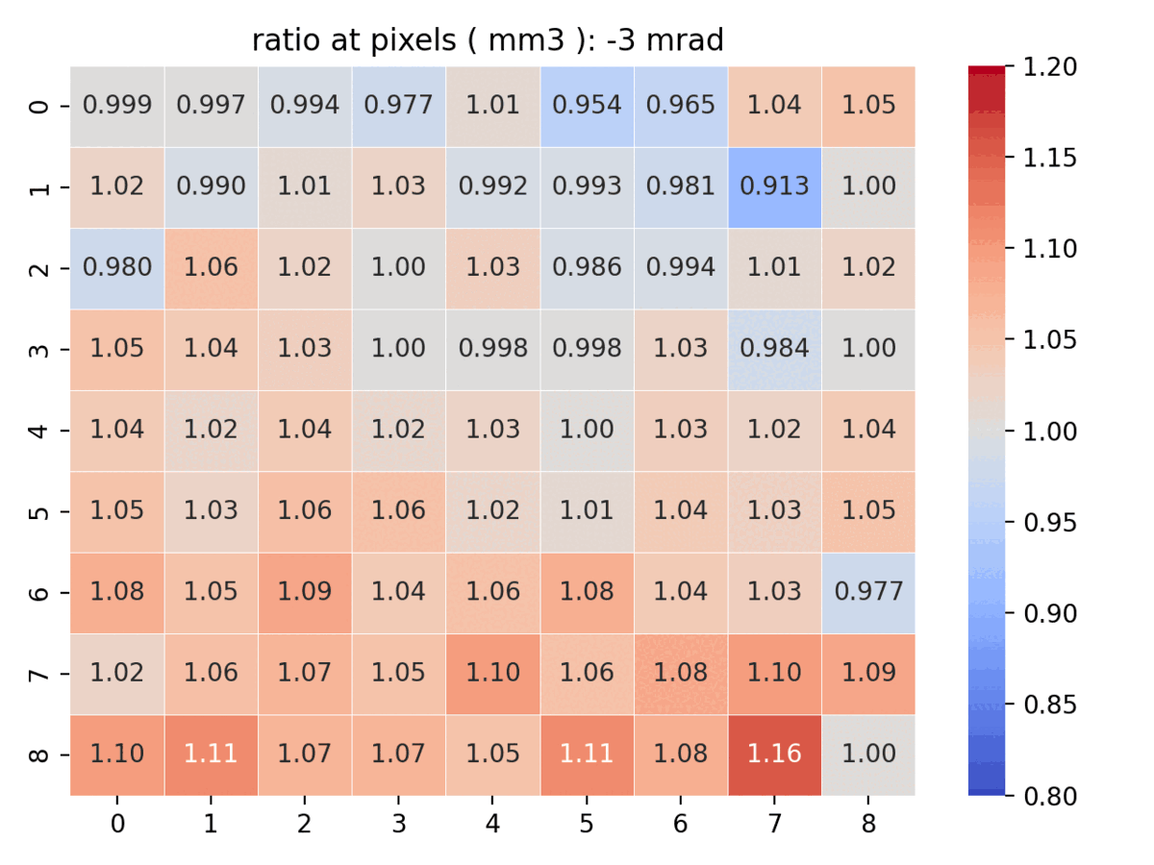
Horn1 tilt angle (x axis) effect
y
x
MM2 and MM3 are more sensitive to the Horn1 tilt angle change
z
MM1: average error : 0.3%
MM2: average error : 1.0%
MM3: average error : 2.5%

Slide 15
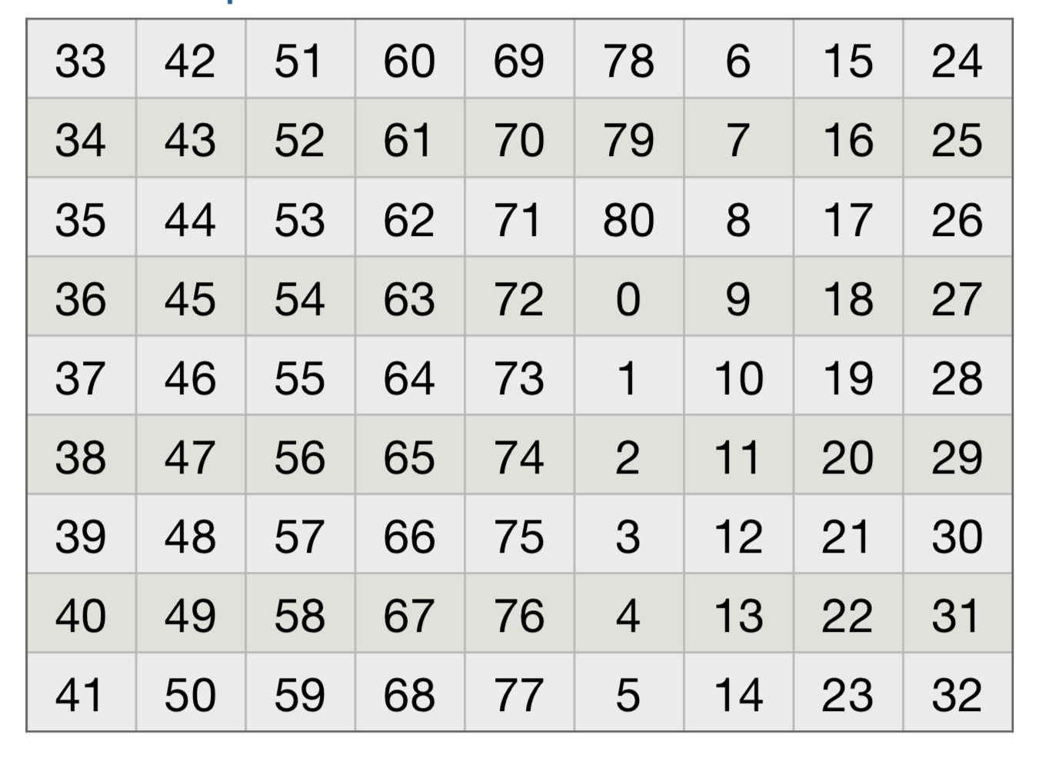
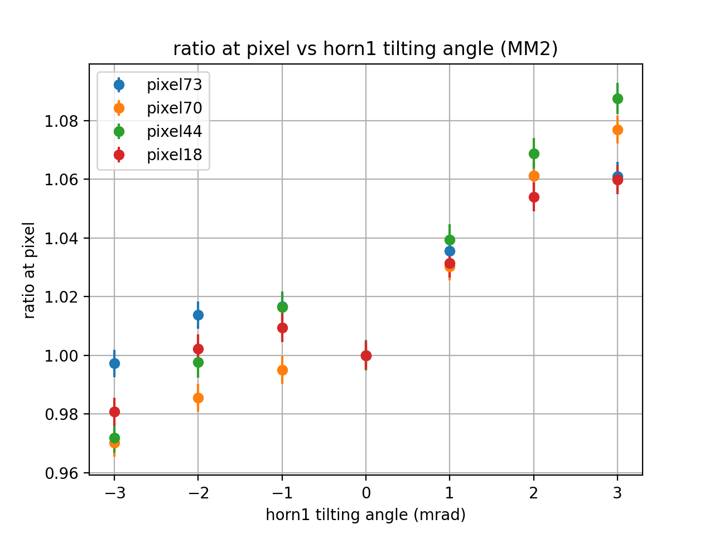
Horn1 tilt angle(x axis) effect
x
y
z
Top pixel are more sensitive to the change

Slide 16
Target offset in vertical direction

Slide 17
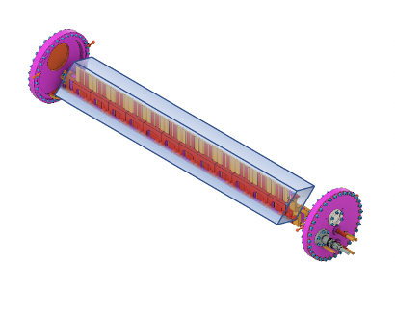
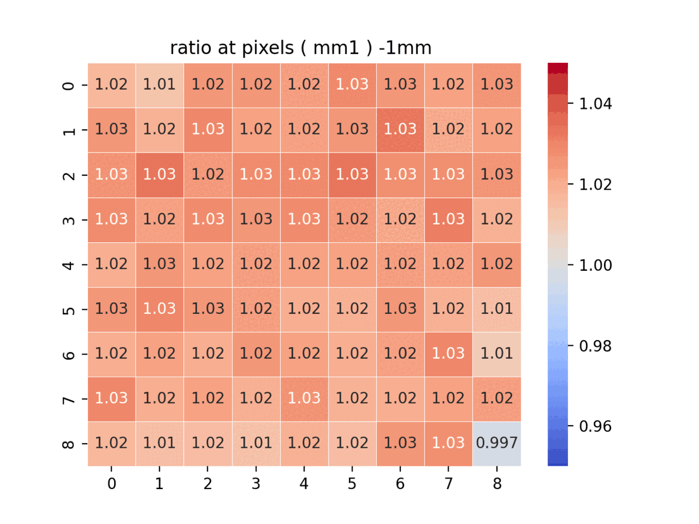
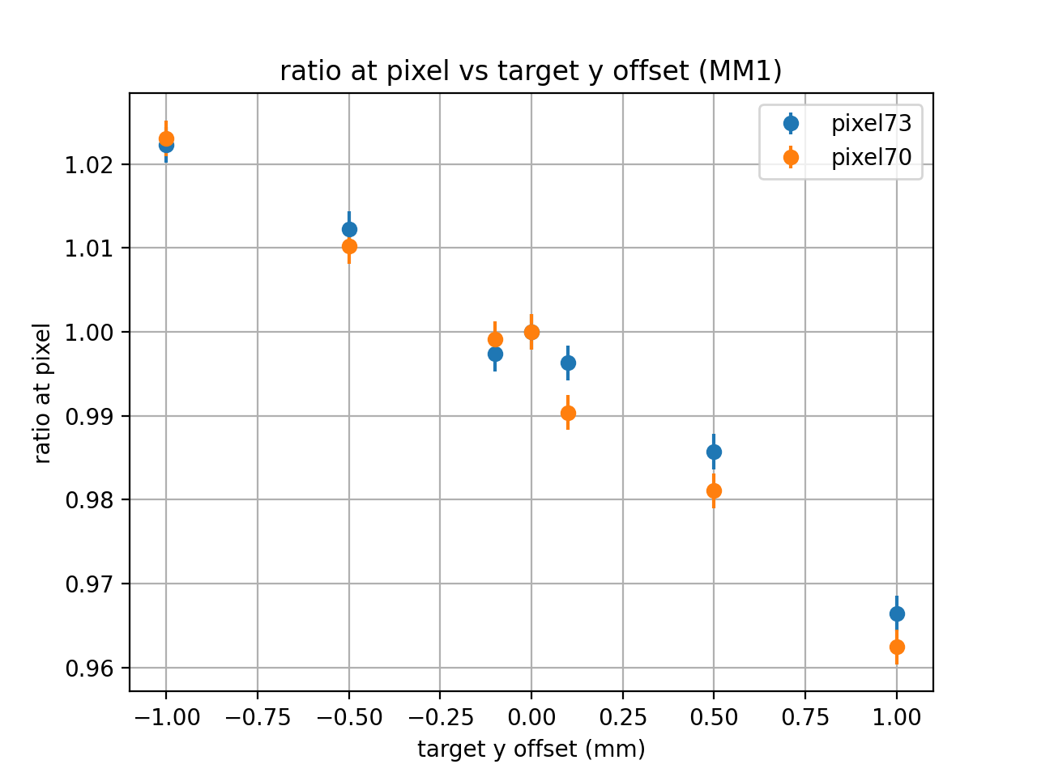
Target offset effect (vertical direction)
Y

Slide 18
Beam parameter | change | MM1 | MM2 | MM3
Horn1 tilt angle Y | $±$ 3 mrad | ❌ | ⭕️ | ⭕️
Horn1 tilt angle Y | $±$ 2 mrad | ❌ | ⭕️ | ⭕️
Horn1 tilt angle Y | $±$ 1 mrad | ❌ | ⭕️ | ❌
Target offset Y | $±$ 1 mm | ⭕️ | ⭕️ | ⭕️
Target offset Y | $±$ 0.5 mm | ⭕️ | ⭕️ | ⭕️
Target offset Y | $±$ 0.1 mm | ⭕️ | ❌ | ❌
Target density | - 1% | ❌ | ❌ | ❌
Horn1 position Y | $±$ 1 mm | ❌ | ⭕️ | ⭕️
Horn current | $±$ 1 kA | ⭕️ | ⭕️ | ⭕️
Magnetic field in decay pipe | No and twice | ⭕️ | ⭕️ | ❌
⭕️: difference is over 3 sigma at some pixels
❌: difference is within 3 sigma

Slide 19
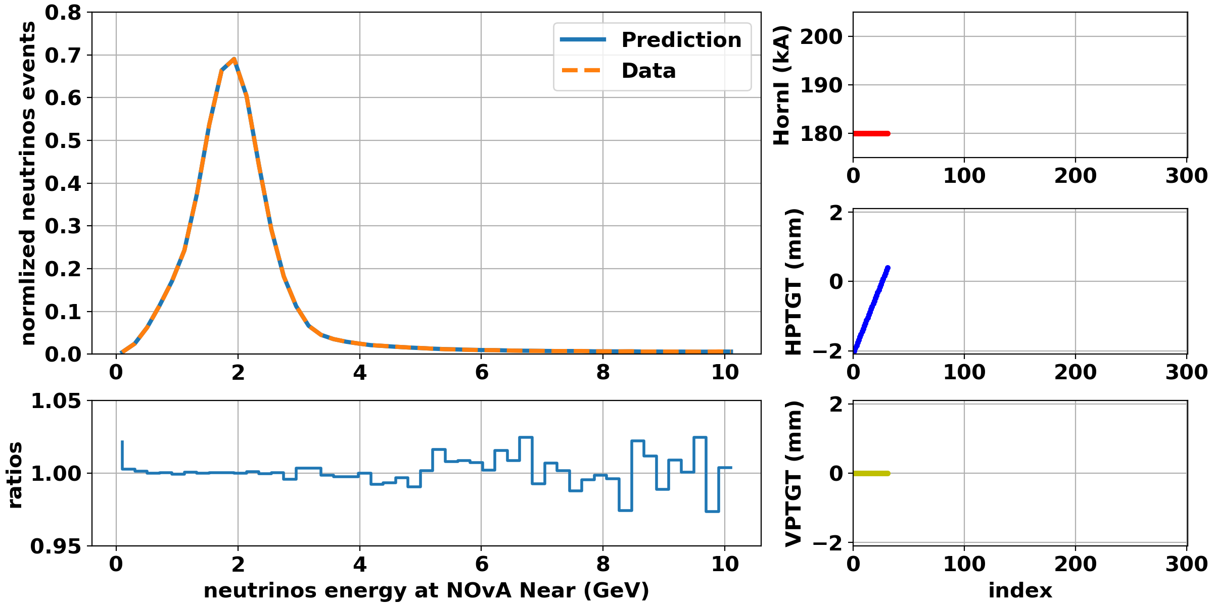
Machine Learning based on simulation
Output:
Beam paraameters
neutrinos flux at NOvA Near
Input:
muon events at 81 pixels of MM1, MM2 and MM3
Model
linear regression
Or neural network
The muon events need to divided with a fixed number: such as 2000
Data samples: 6000 points form the uniform beam simulation.
Independent test samples: 300 points form an independent simulation.

Slide 20
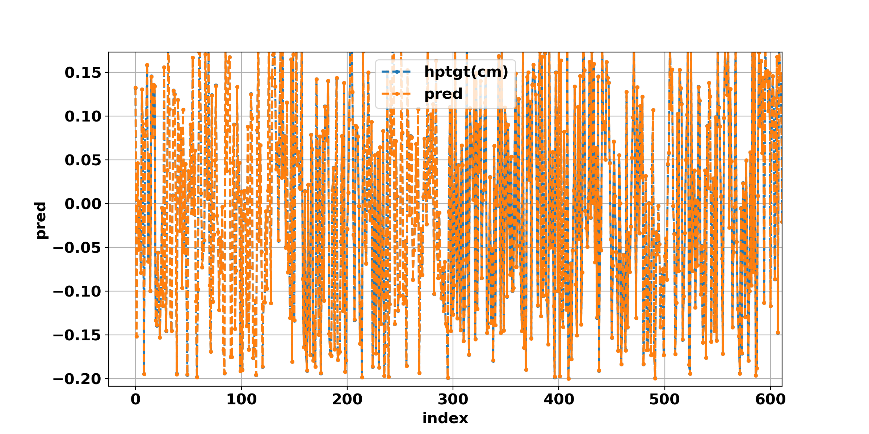
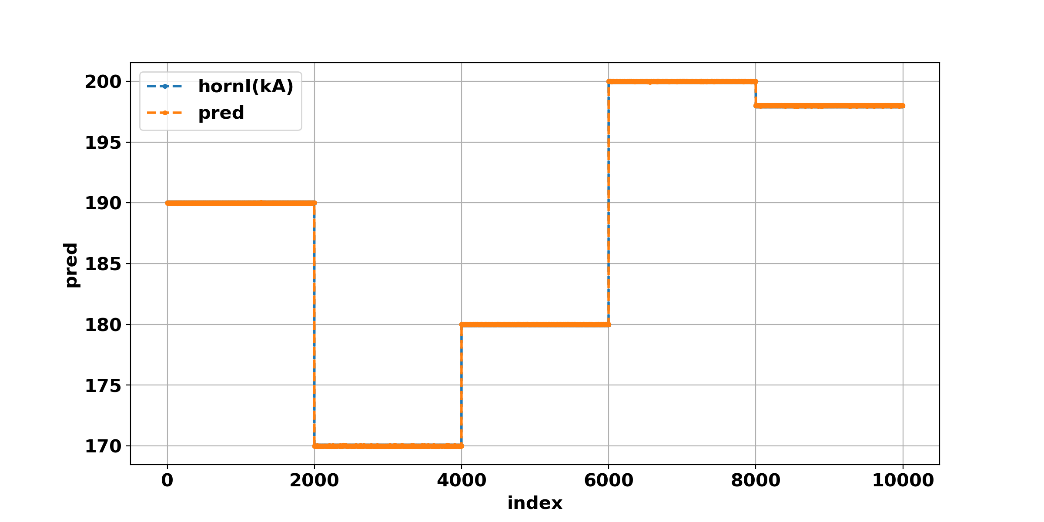
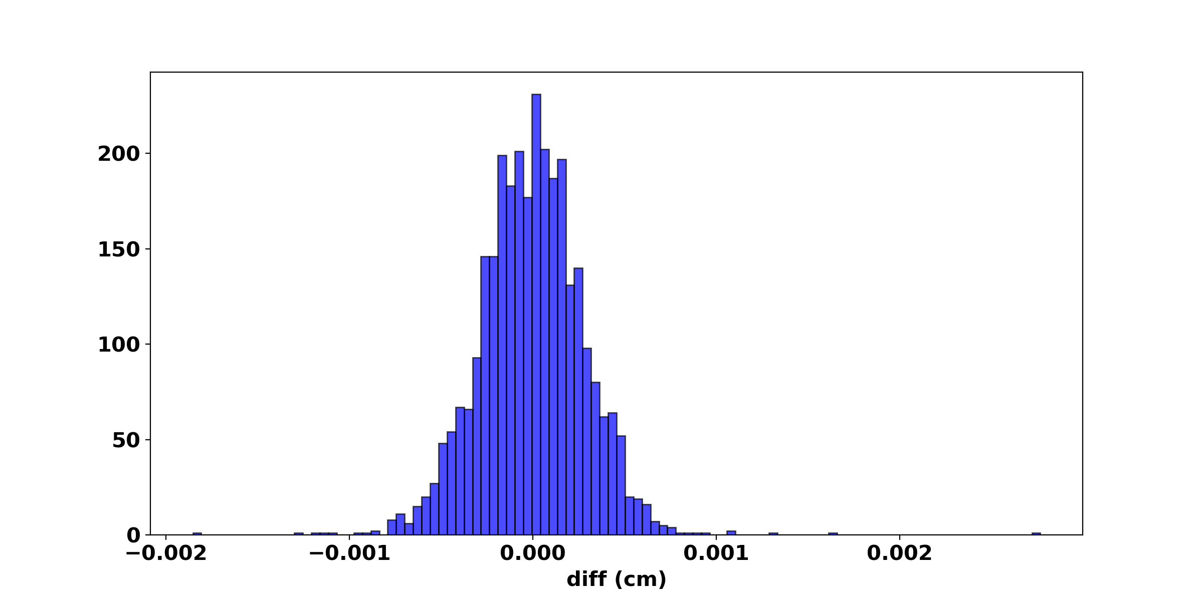
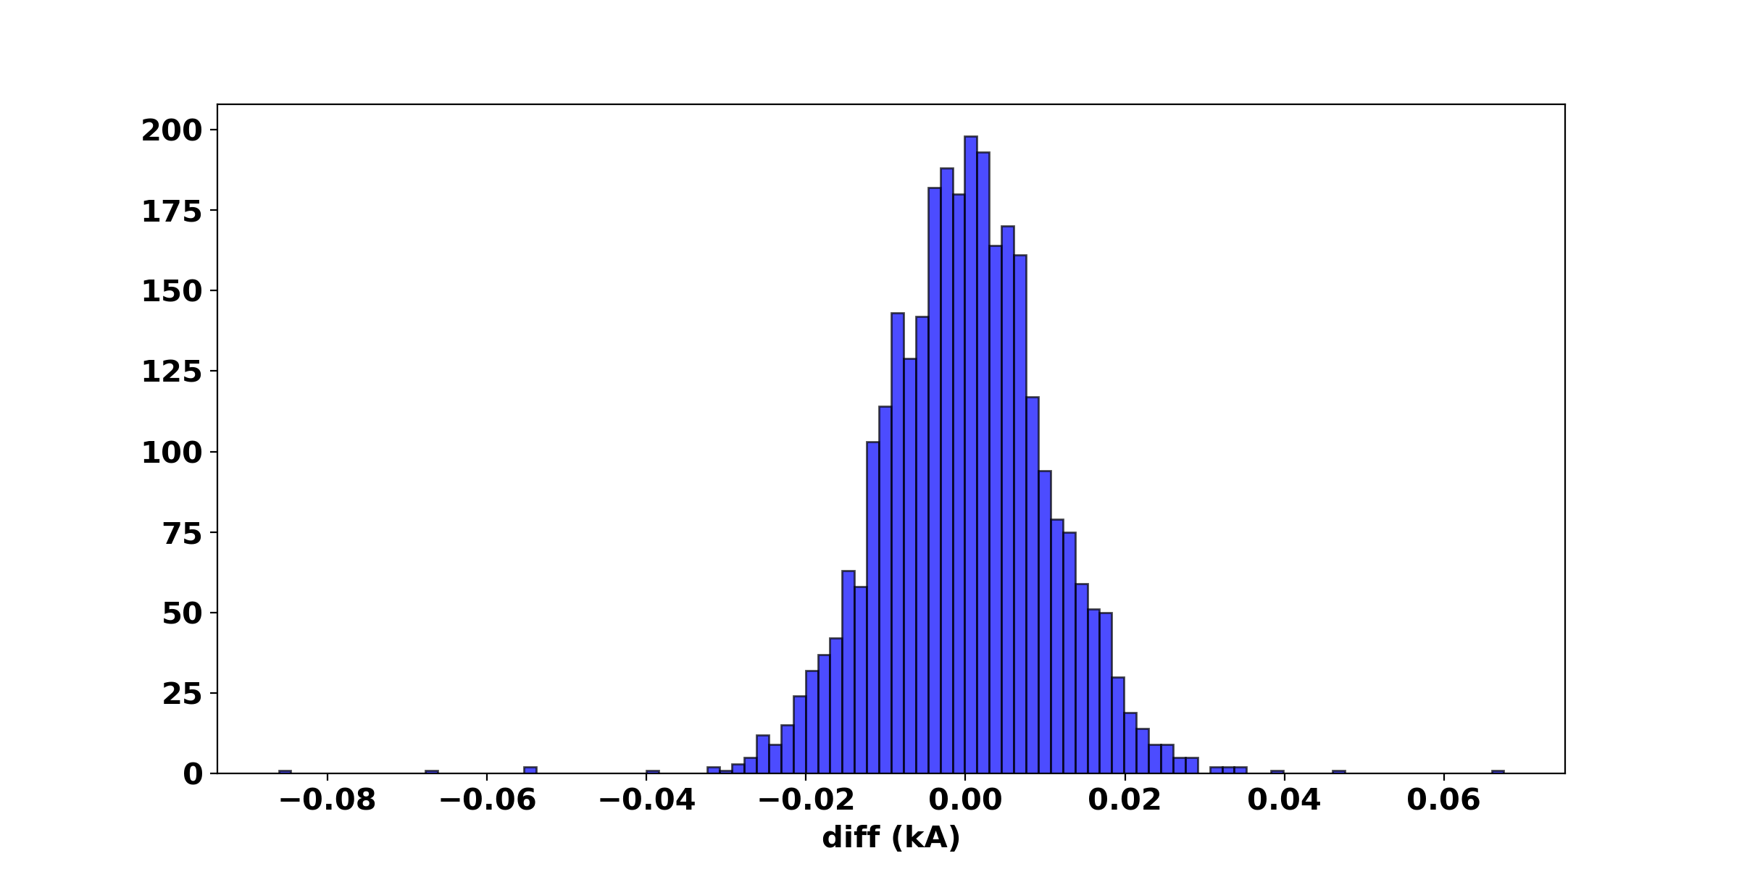
Machine Learning based on simulation
rms of the error is 0.0003 cm
rms of the error is 0.01 kA

Slide 21
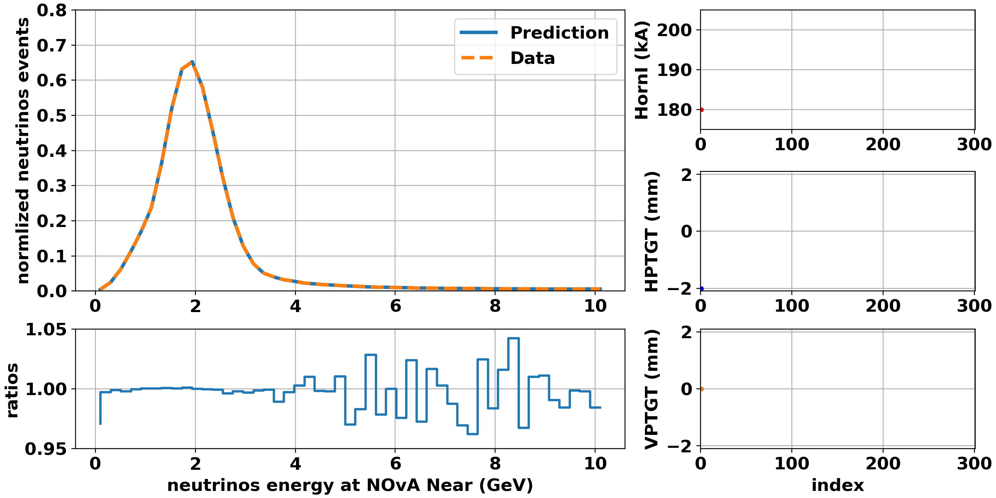

Slide 22
Summary
We combined the uniform beam simulation and multiple decay simulation to increase the efficiency of the simulation => able to produce very high stat samples
Muon monitor pixel study was improved, we can use the information of pixels of MMs to find the effect of varying the beam parameters => systematic study underway
We built a Machine Learning tool to predict / reconstruct upstream beam parameters and horn current by using muon monitor data => extending its capabilities now
Now we are generating the samples for ML using the new simulation and test the ML

Slide 23
Back up

Slide 24
Target density change

Slide 25
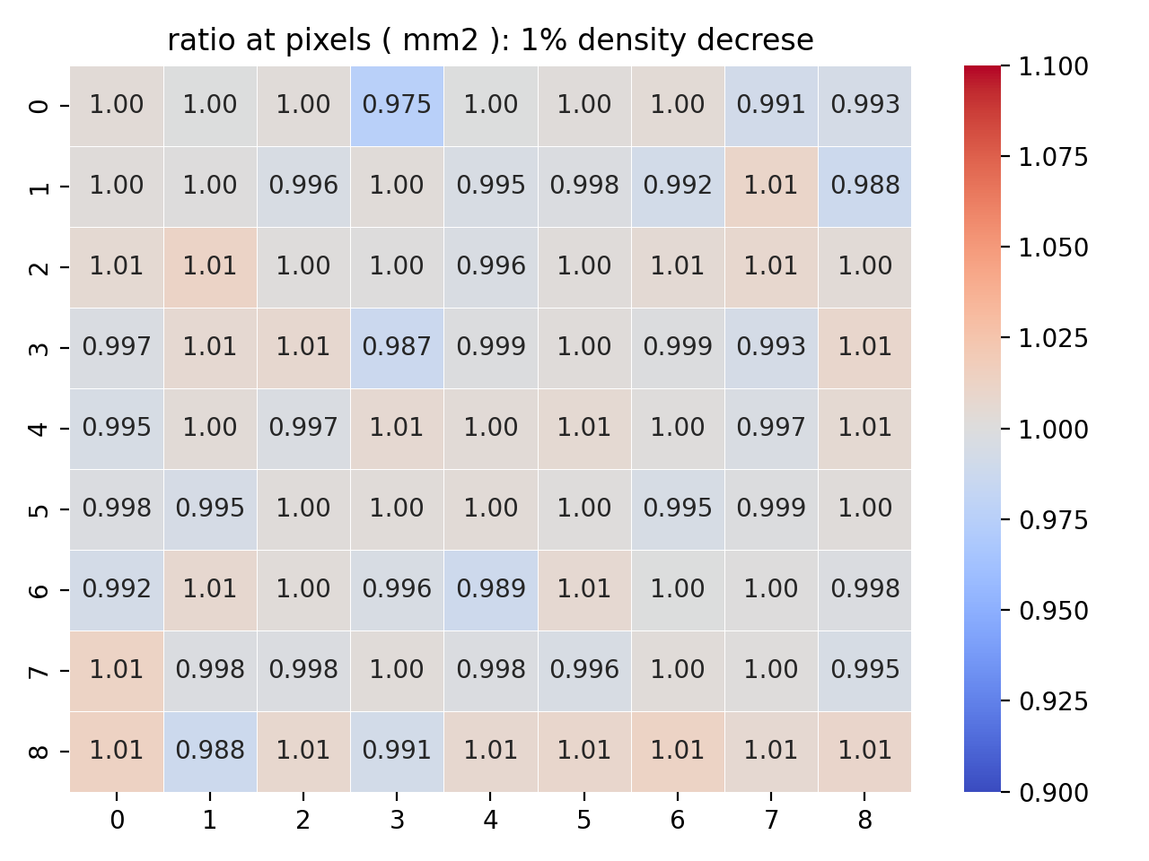
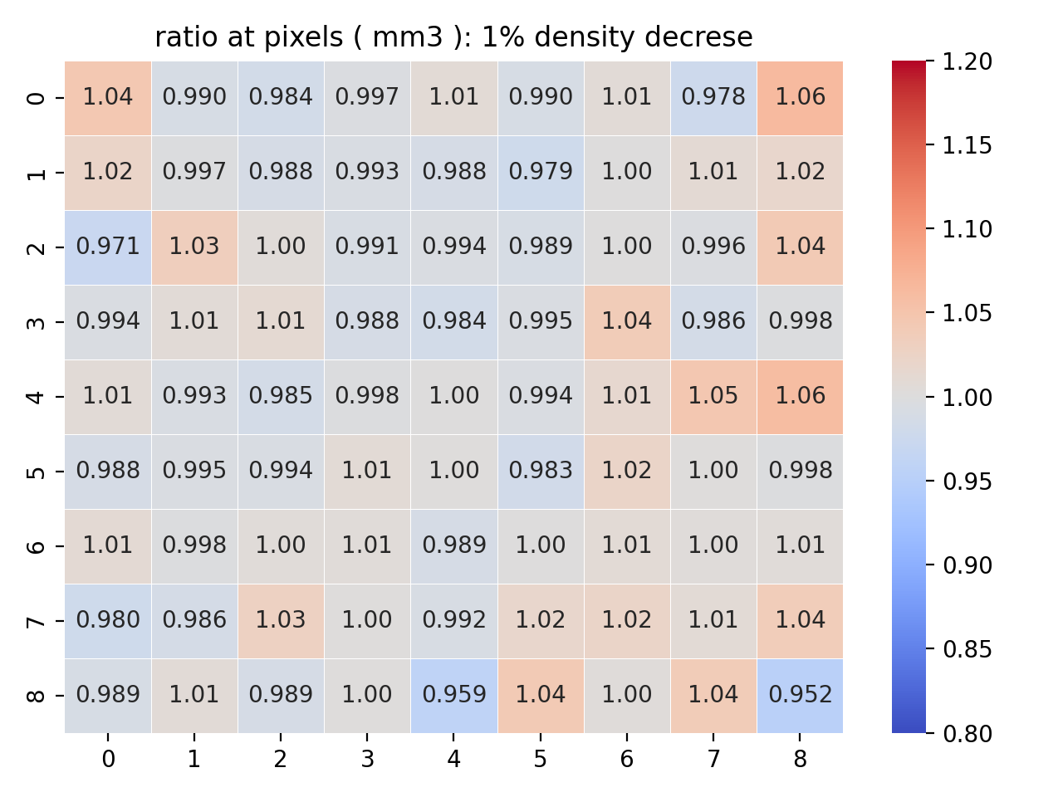
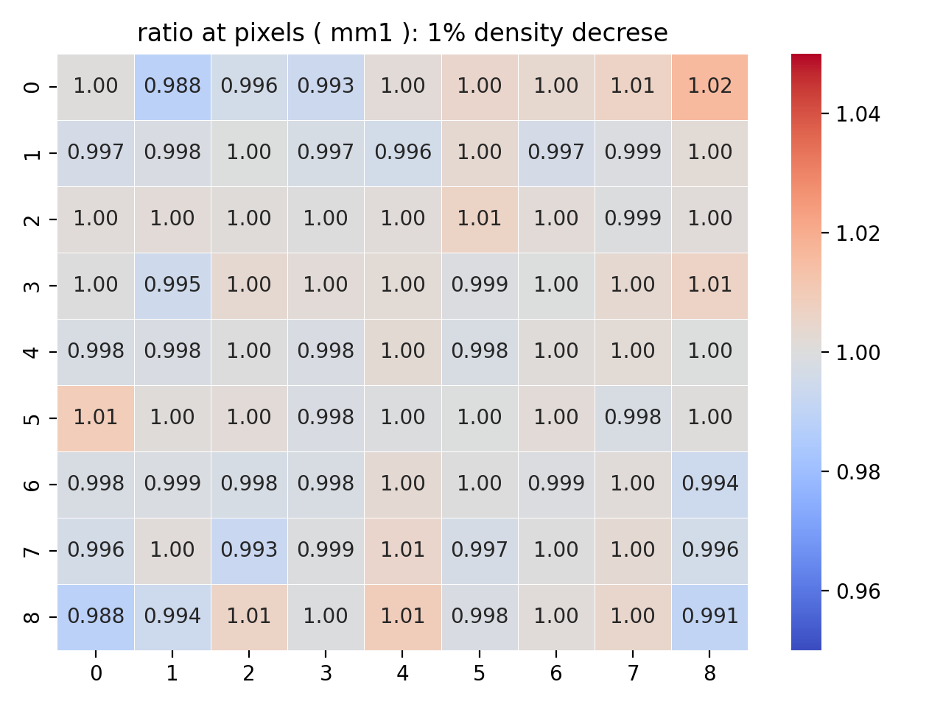
Target density change effect (1.78 => 1.76 g/cm³)
1% density decrease does not have much effect on the simulation results
MM1: average error 0.3%
MM2: average error 1.0%
MM3: average error 2.5%

Slide 26
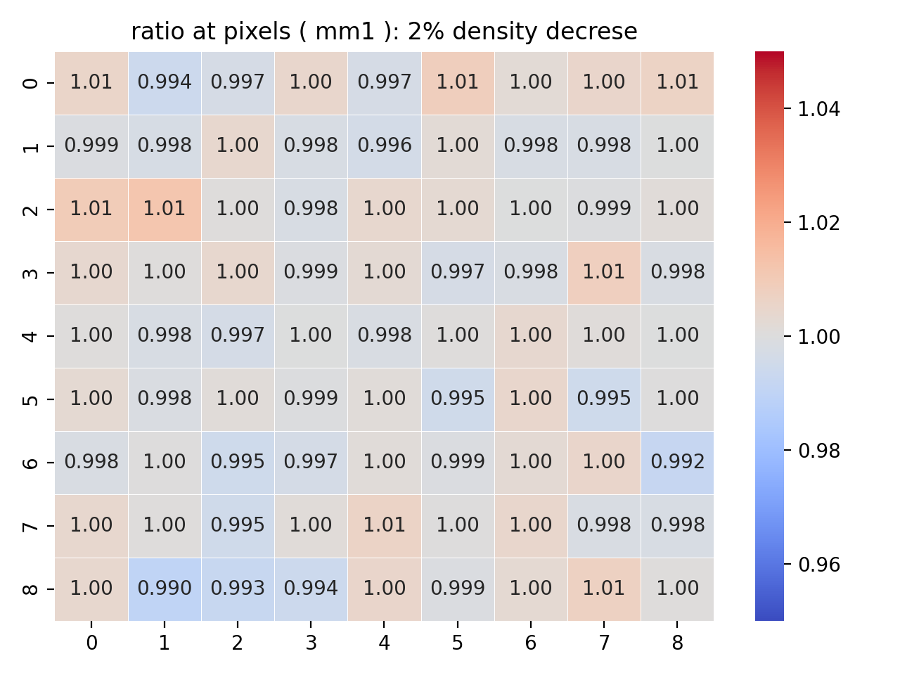
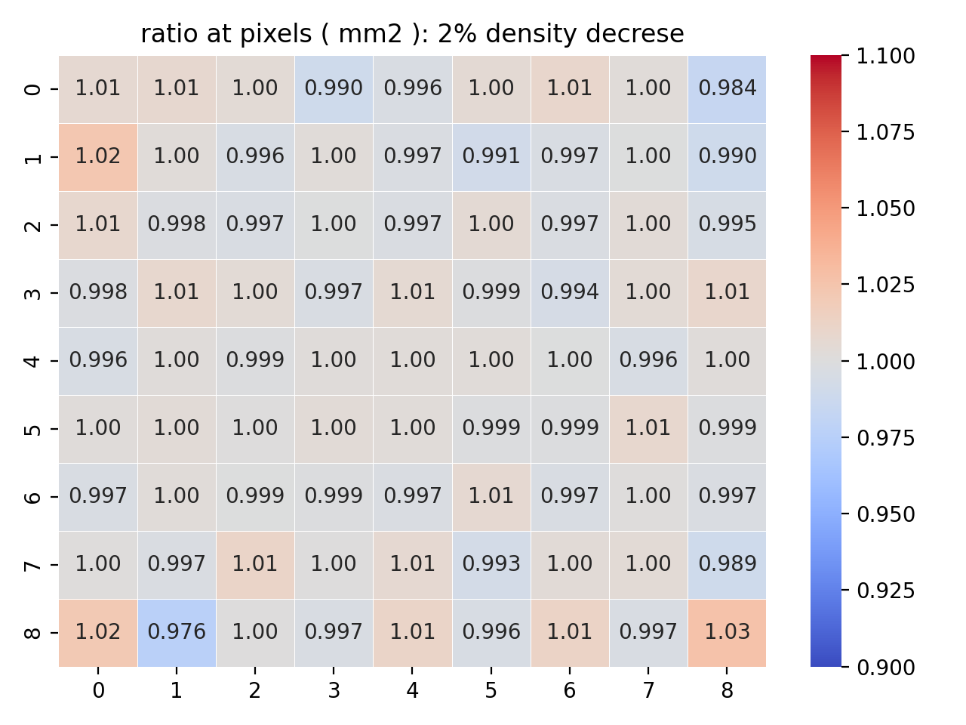
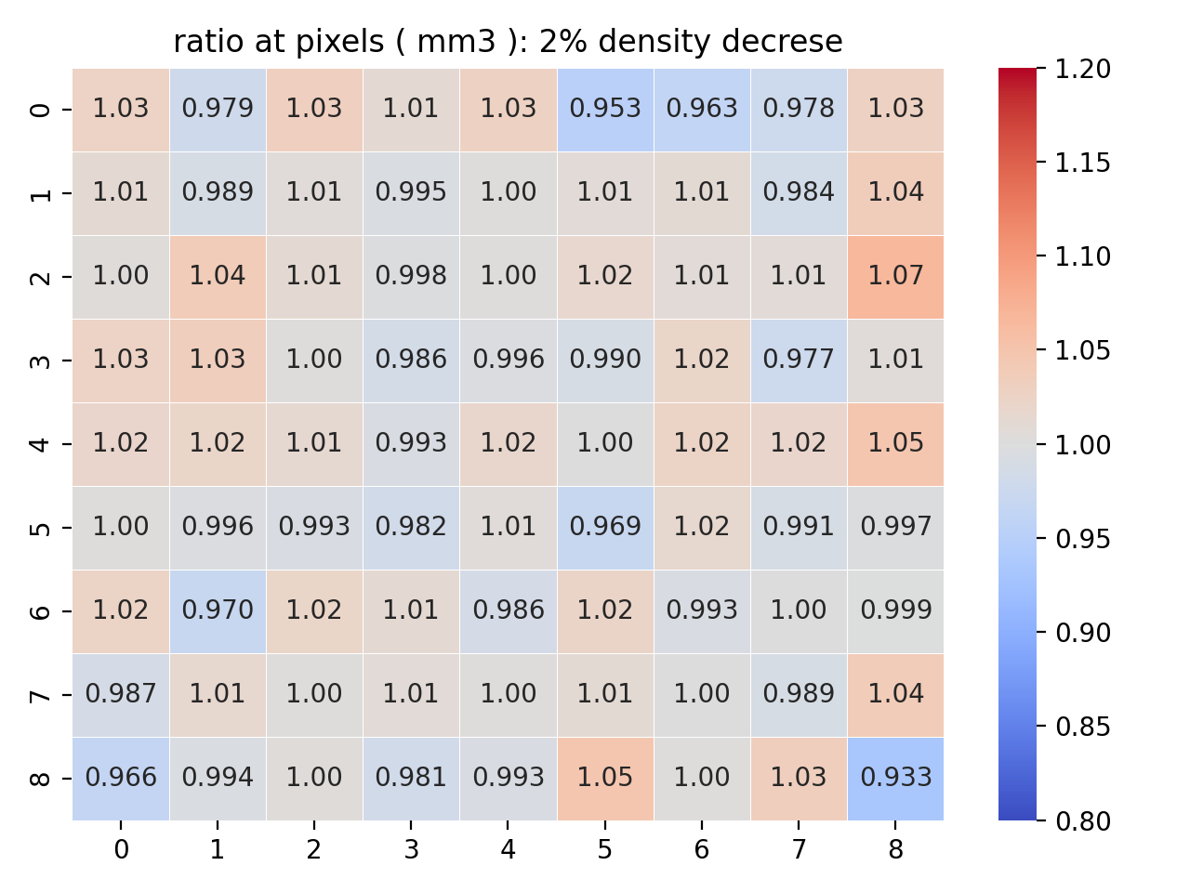
Target density change effect(1.78 => 1.744 g/cm³)
2% density decrease: we start seeing some difference at MM1
MM1: average error 0.3%
MM2: average error 1.0%
MM3: average error 2.5%

Slide 27
Horn current change

Slide 28
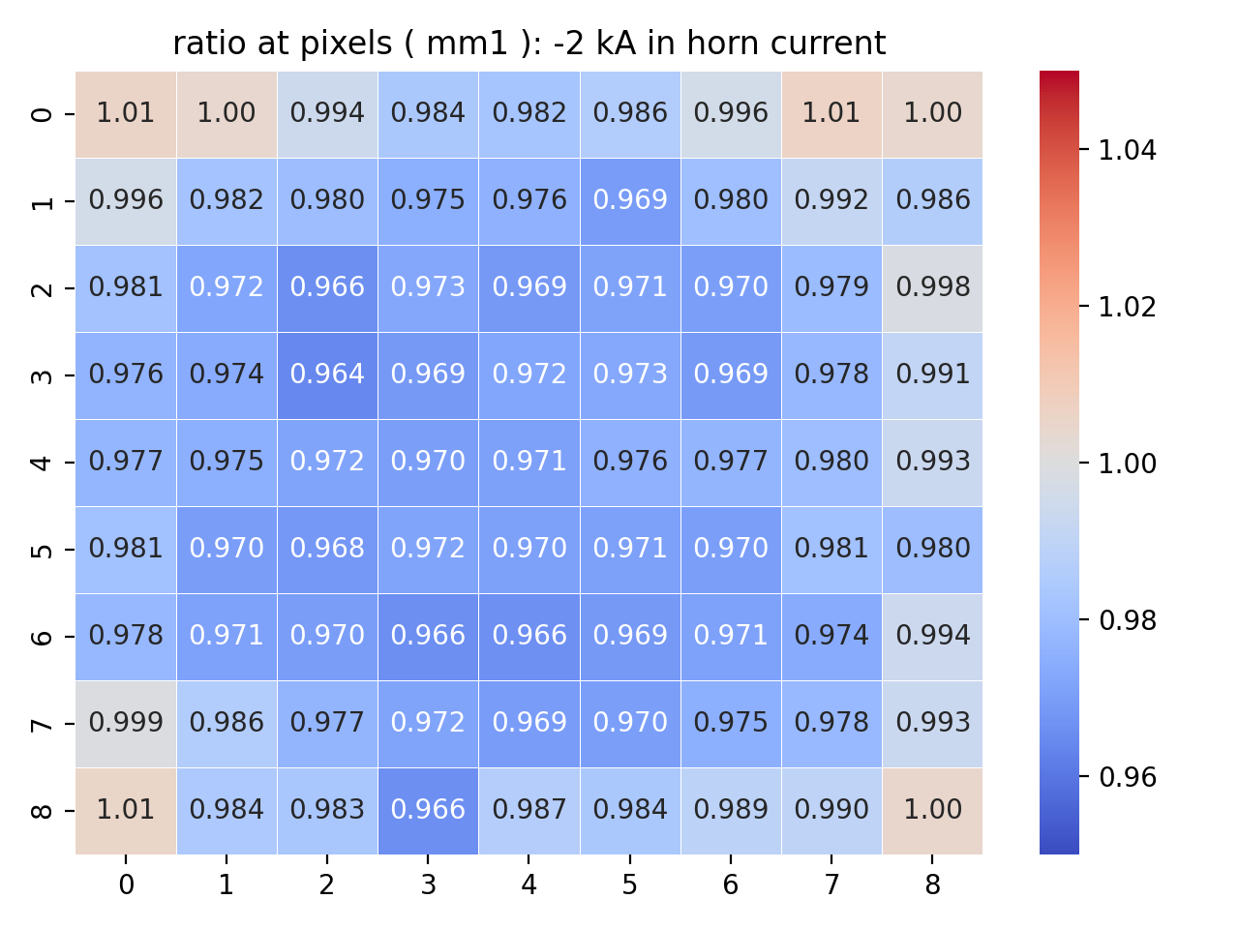
Horn current effect (198 kA)
Past studies indicate that the moun monitors can catch the change in horn current 1~2 kA.
(The # of events reduces by 3% in some pixels of MM1)
Now with the new simulation technique, we can look at the effect of a much smaller change in horn current

Slide 29
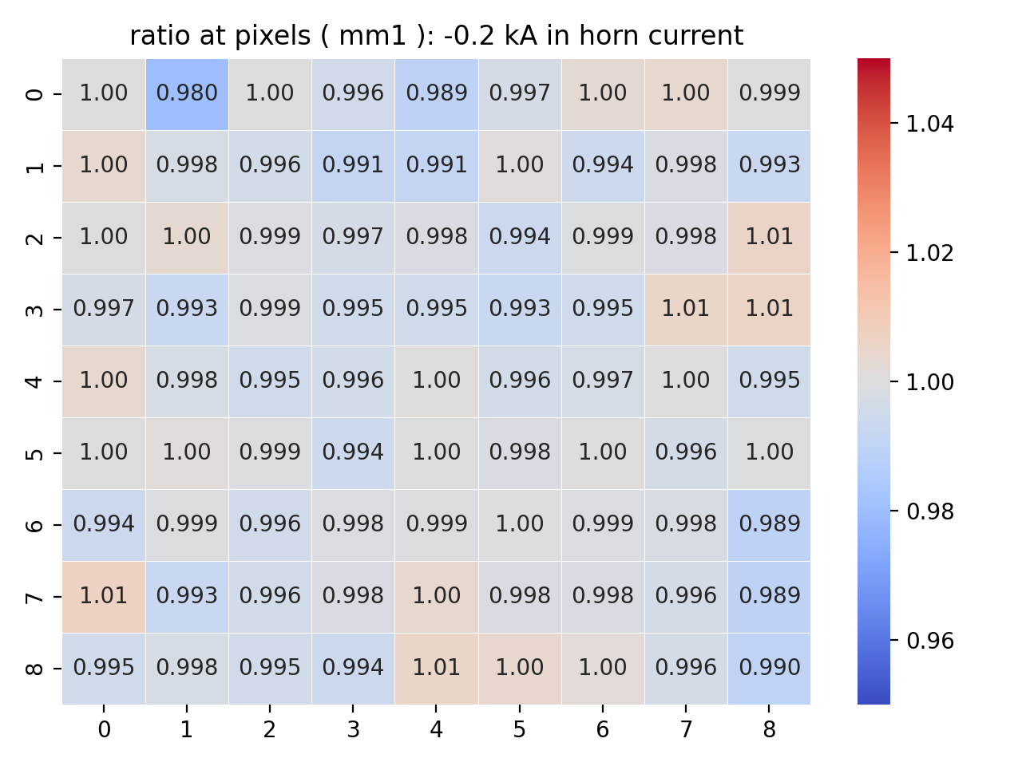
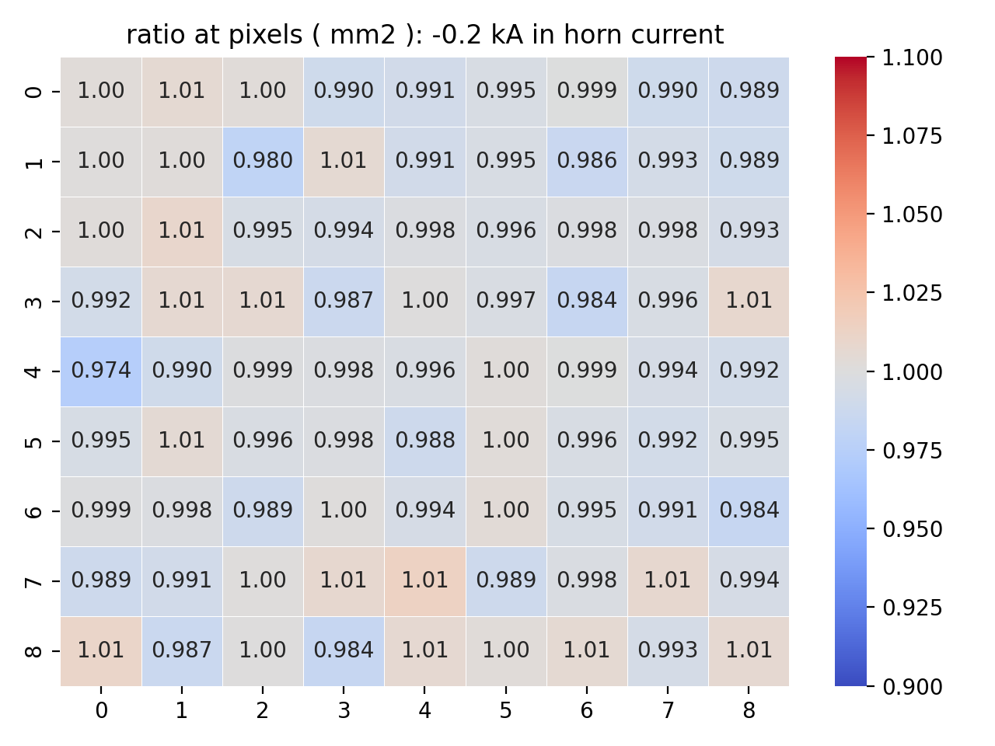
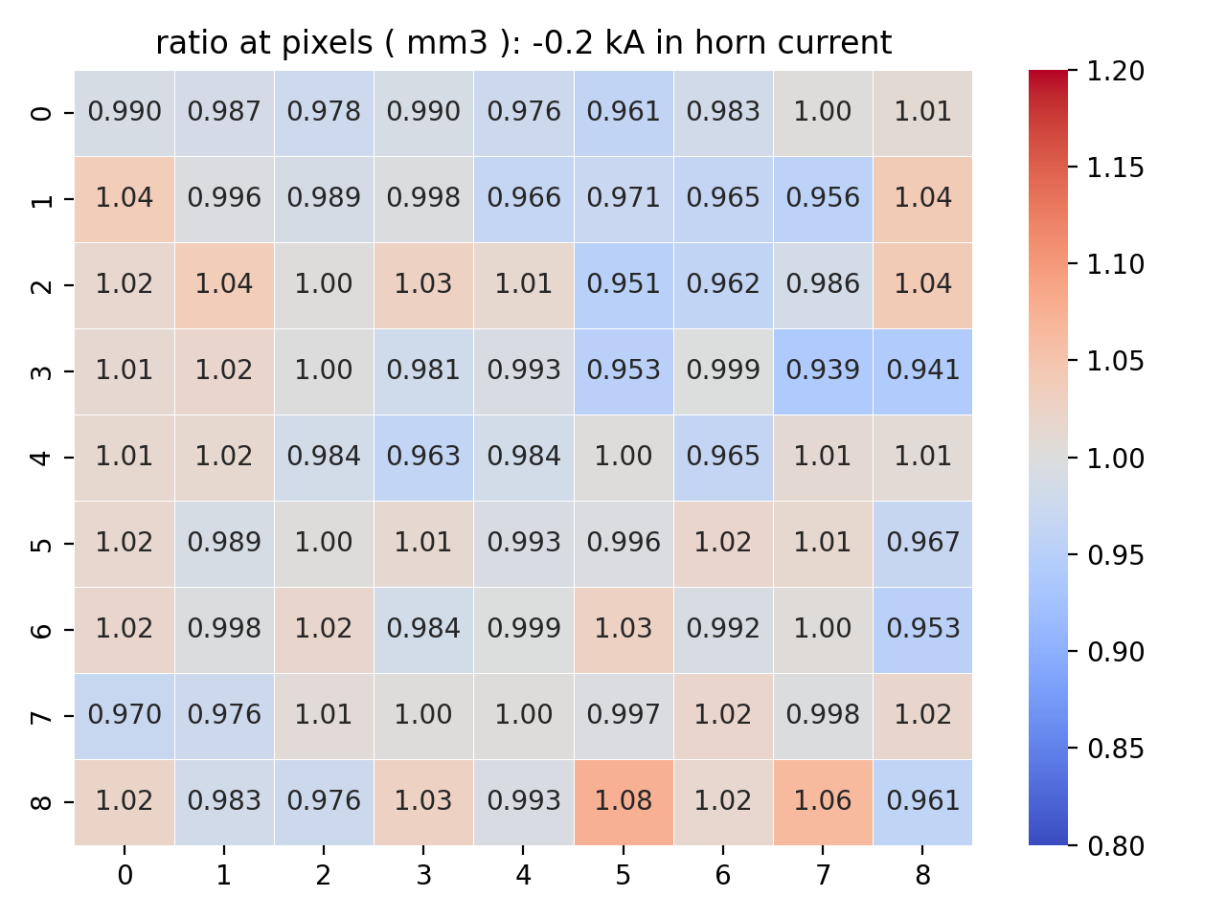
Horn current effect (199.8 kA)
MM1: average error 0.3%
MM2: average error 1.0%
MM3: average error 2.5%
The difference at some pixels of MM1 is about 1 sigma (0.3%)

Slide 30
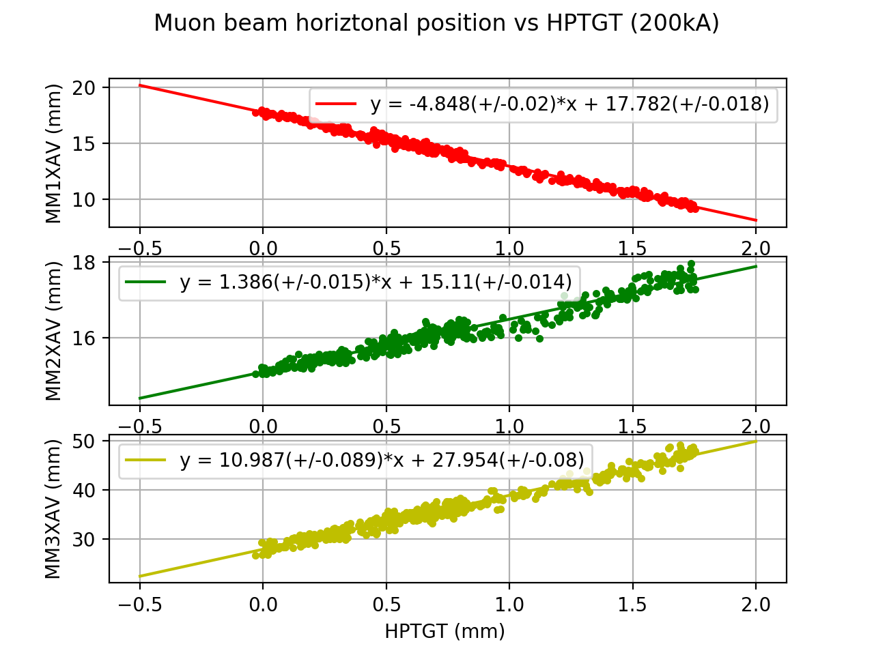
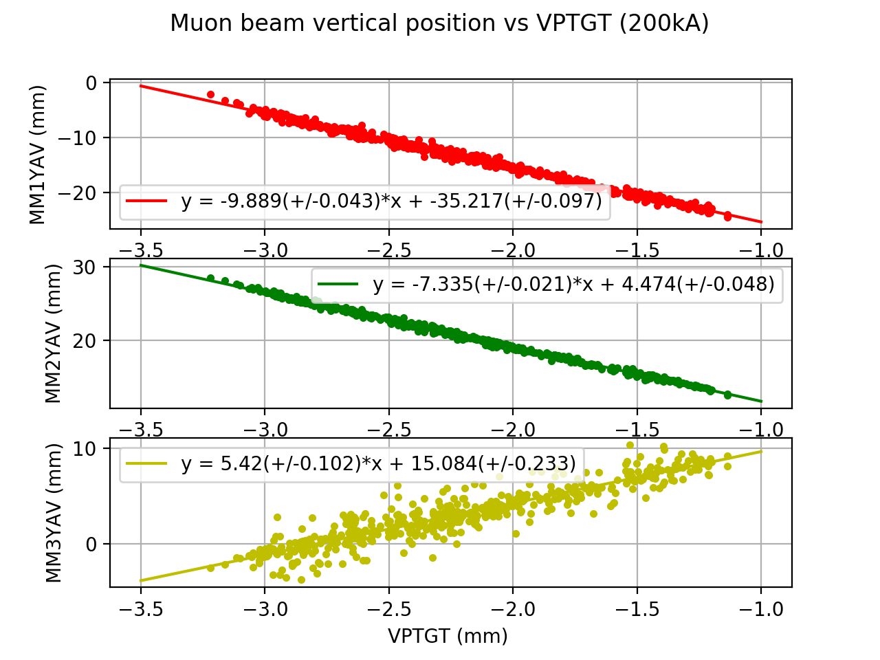
Muon monitor data analysis(Slopes at muon monitors)
Target scans show how each muon monitor responds to beam position variations in horizontal and vertical directions
The observed beam centroid on muon monitors shows a linear response. Different slopes show the focus effect for different energy range of muons

Slide 31
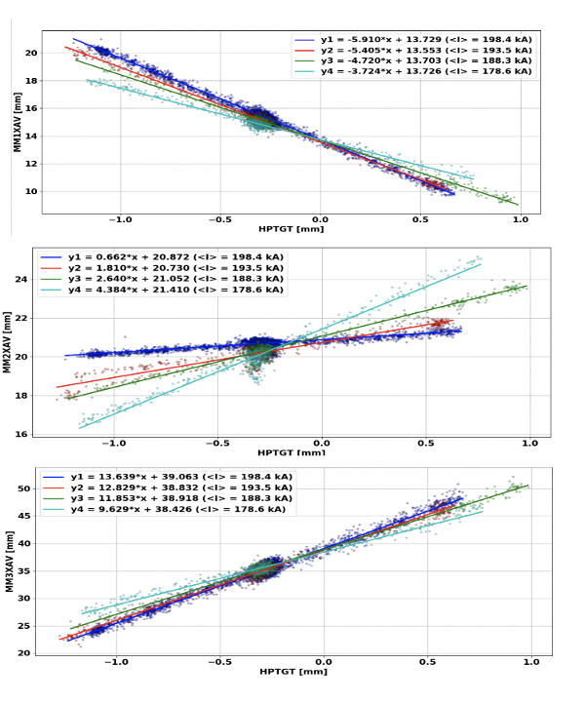
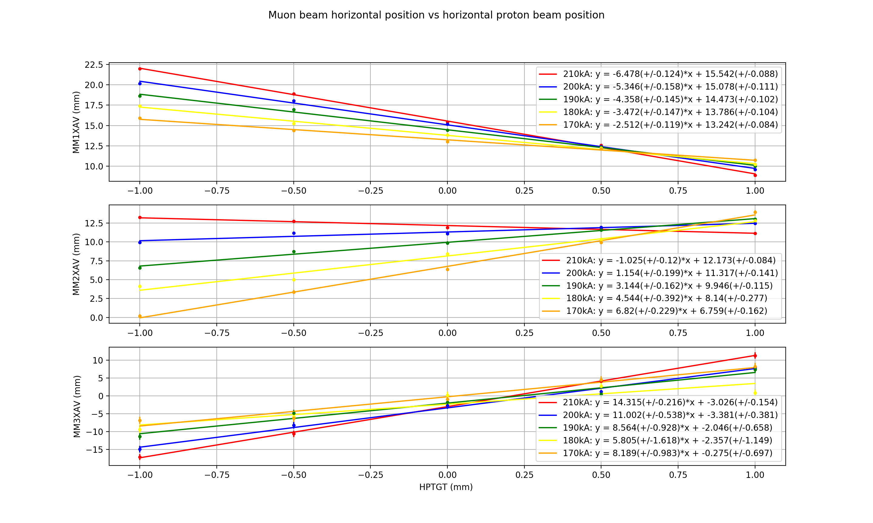
Slopes for different horn current (validating the simulation)
Data
simulation
We carry out several horn current scans for horn current change step is 10 kA
The slopes of fitted lines change for currents at all three muon monitors
Simulation results are consistent with data

Slide 32
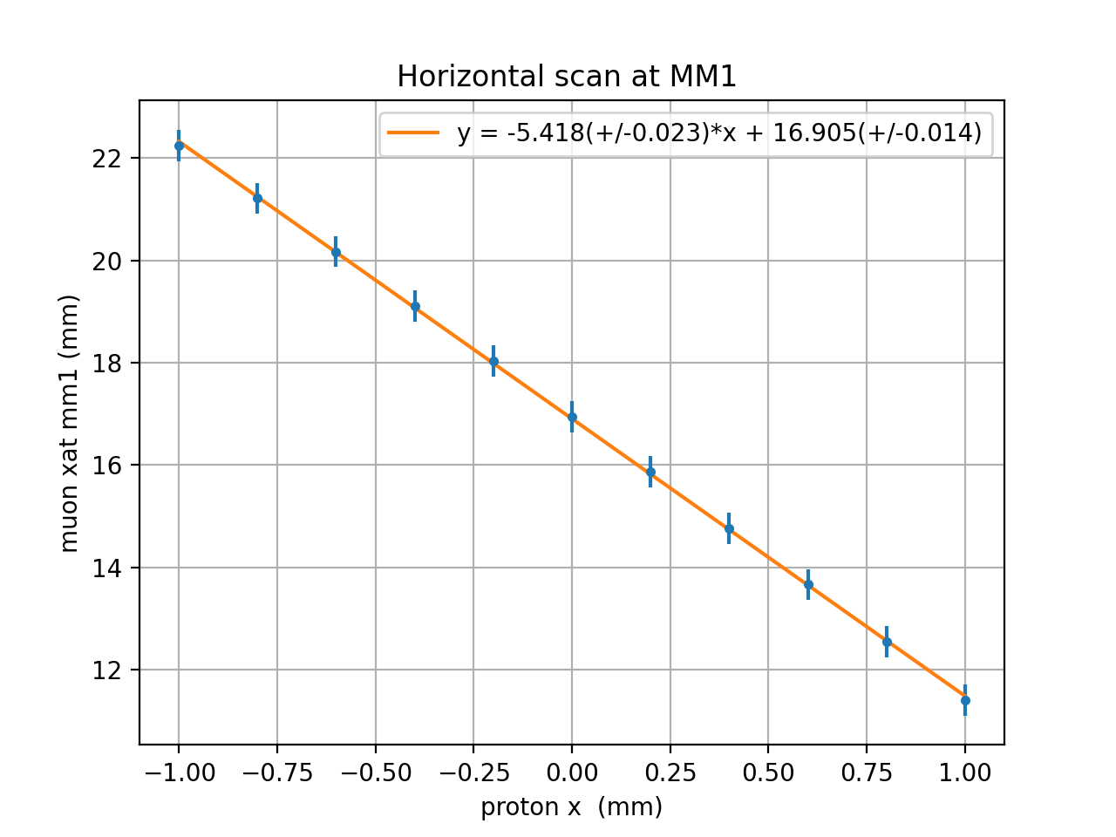
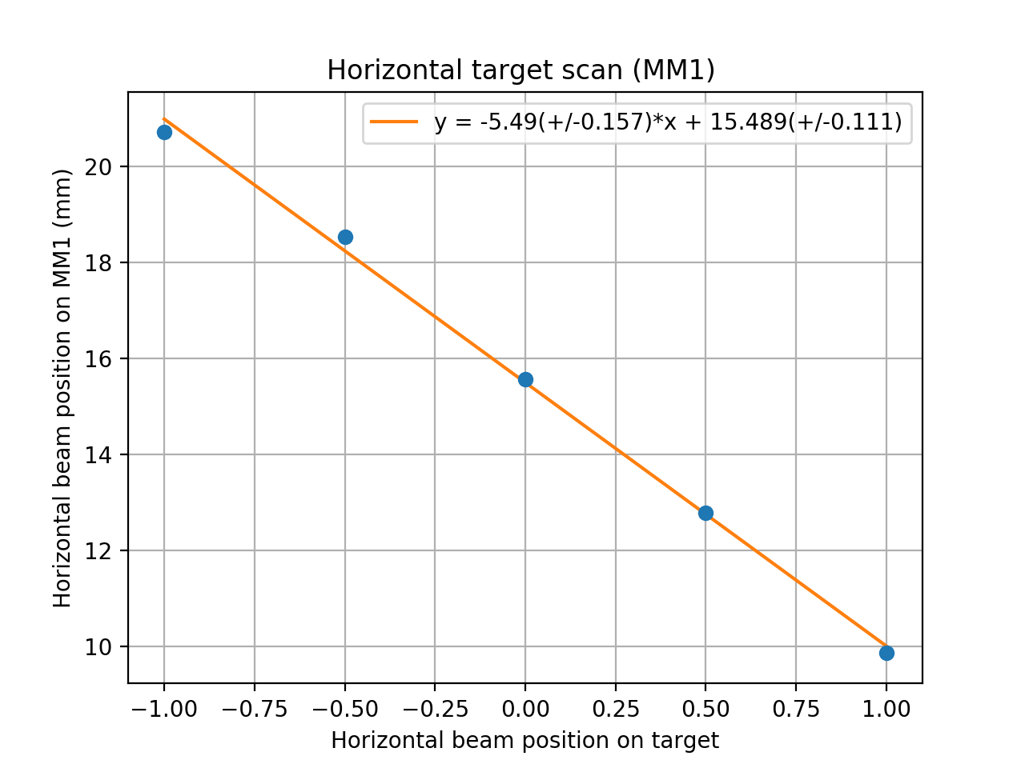
Slope at MM1X (with virtual detectors)
nominal
uniform

Slide 33
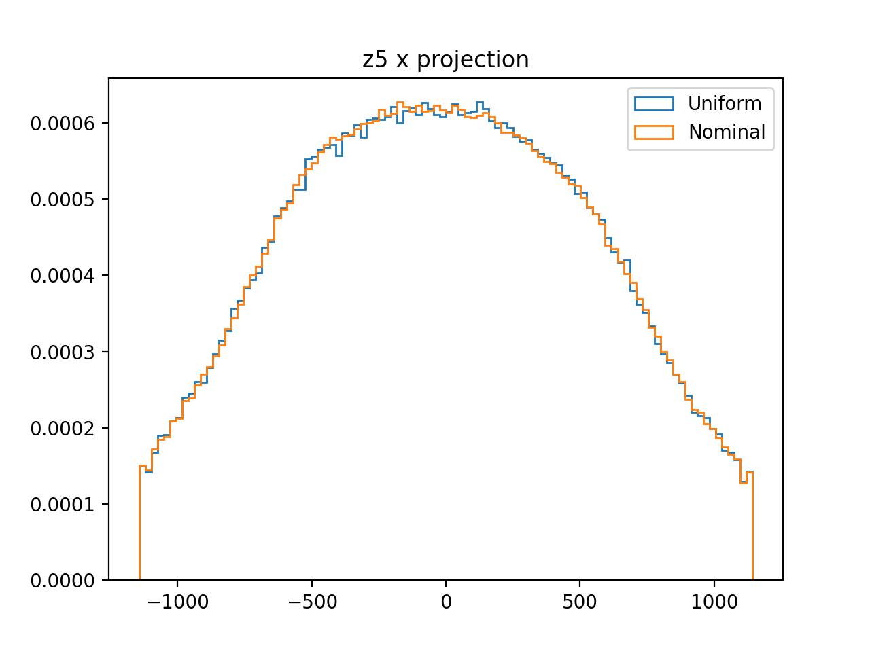
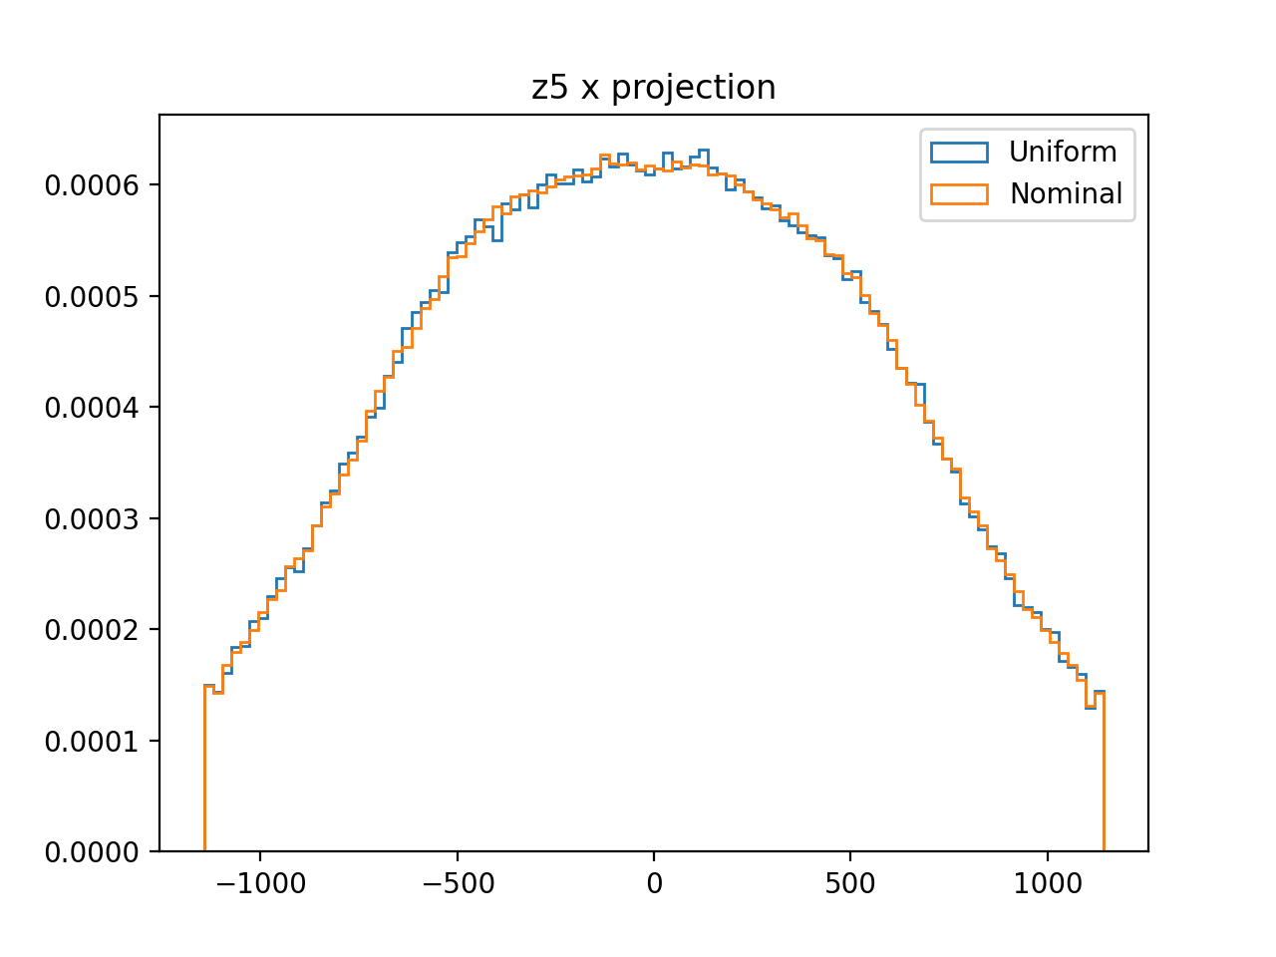
Muon distribution at virtual detectors (z5)
Protonx:0mm
Protonx:1mm

Slide 34
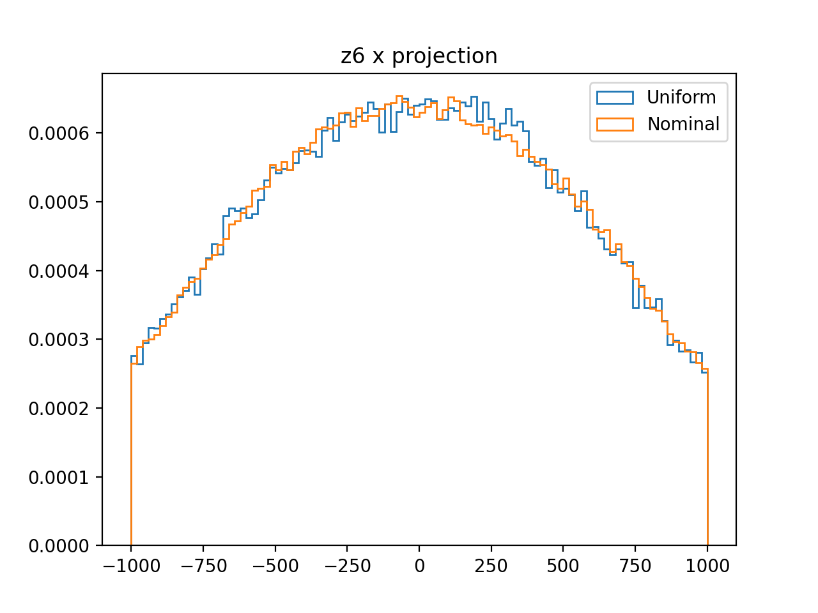
Muon distribution at virtual detectors (z6)
Protonx:0mm
Protonx:1mm

Slide 35
Muon distribution at virtual detectors (z7)
Protonx:0mm
Protonx:1mm

Slide 36
Muon production momentum

Slide 37
Muon momentum at MM1 and MM2

Slide 41
Magnetic field in decay pipe
Magnetic field in decay pipe: Bx = 0.1 Gauss, By = −0.3 Gauss, Bz = −0.07 Gauss

Slide 42
MM events change for no magnetic field in decay pipe
The MM1 is most sensitive to the change of madnetic fields in decay pipe(low enerfy muons)
Nominal: Magnetic field in decay pipe: Bx = 0.1 Gauss, By = −0.3 Gauss, Bz = −0.07 Gauss

Slide 43
MM events change for twice magnetic field in decay pipe
The pattern change at MM1 is opposite to no field
Nominal: Magnetic field in decay pipe: Bx = 0.1 Gauss, By = −0.3 Gauss, Bz = −0.07 Gauss
Twice the field in x and y: Bx = 0.2 Gauss, By = −0.6 Gauss, Bz = −0.07 Gauss

Slide 44
Bx= 0.1 gaus By= -0.3 gaus
Data / nominal
No field
2 *field

Slide 45
Data sample from the simulation
#Id | hornI(kA) | hptgt(cm) | vptgt(cm) | spot_size(cm) | pixel1 | pixel2
1.0 | 200.0 | -0.0134 | -0.0756 | 0.0809 | 18178 | 28009
2.0 | 200.0 | 0.0695 | -0.0719 | 0.0797 | 17000 | 27049
3.0 | 200.0 | -0.0165 | 0.107 | 0.0615 | 20081 | 28869
4.0 | 200.0 | 0.173 | 0.131 | 0.193 | 17231 | 26905
5.0 | 200.0 | -0.140 | 0.0725 | 0.0534 | 20040 | 31803
6.0 | 200.0 | -0.0517 | 0.0404 | 0.156 | 19227 | 30047
Content: # of events at 81 pixels
(mm1,mm2,mm3)
Horn current
proton x
proton y
spot size
100 points took 133 s
Each point correspond to a spill in the measurement data

Slide 46
Predicting beam variables with Machine Learning
Athula Wickremasinghe
Building a Machine Learning tool to predict / reconstruct upstream beam parameters and horn current by using muon monitor data
Muon monitors are giving an external measurement to understand the quality of the beam delivery
In this approach, we are trying to untangle the correlations of muon monitor signal measurements to the beam and horn current behaviors

