Slide 1

Beam Instrumentation On Fixed Target Experiments at CERN
S.Burger / T. Lefevre – CERN
NBI2022 12th International Workshop Neutrino Beams Instrumentation

Slide 2
Outline
Fixed Target Facilities at CERN
Performance and Limitation of Beam Instrumentation
Examples of R&D activities
Conclusions

Slide 3
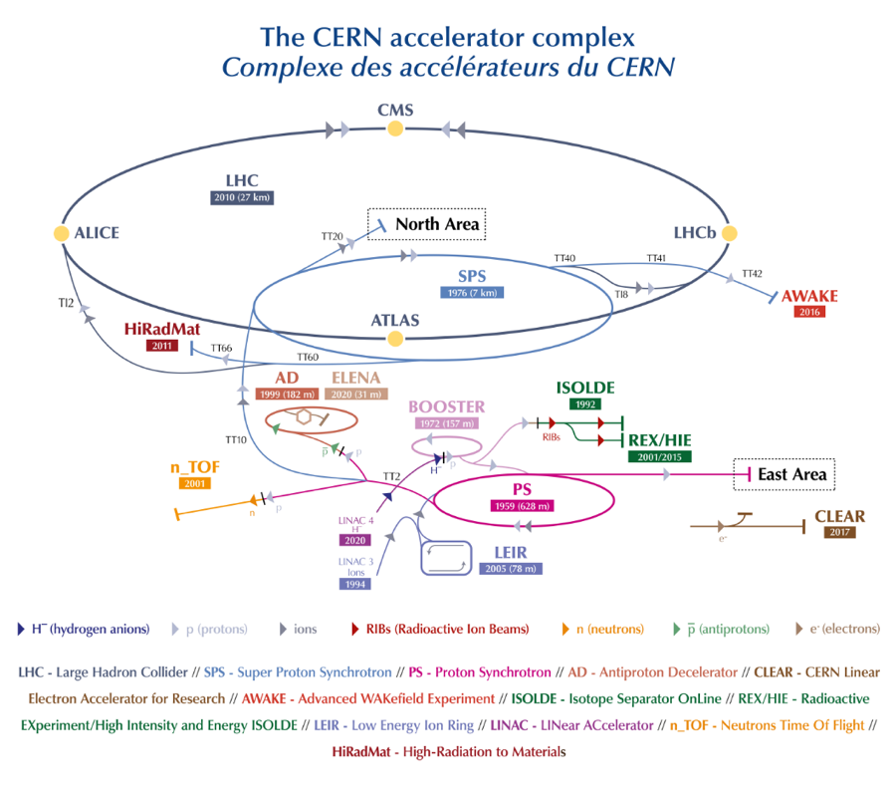
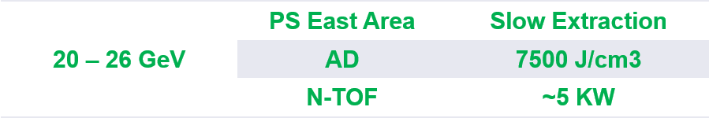

Fixed-Targets at CERN
Fixed Target Facilities
CNGS – 500kW 2006-2012
Beam energy | Target Facility | Power / Energy

Slide 4
Fixed-Targets (Beam Dumps) at CERN
Beam Dumps
LHC-560MJ
SPS-300kW
2 main constraints for Beam Instrumentation design
Material issue → Power to handle with intercepting devices
Radiation level

Slide 5
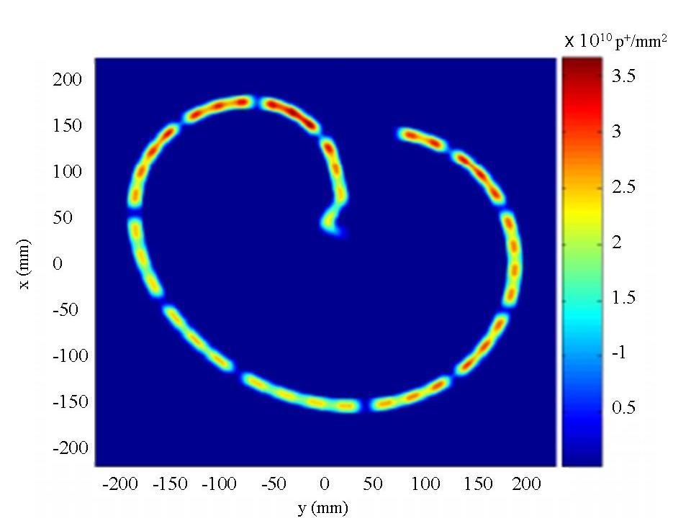
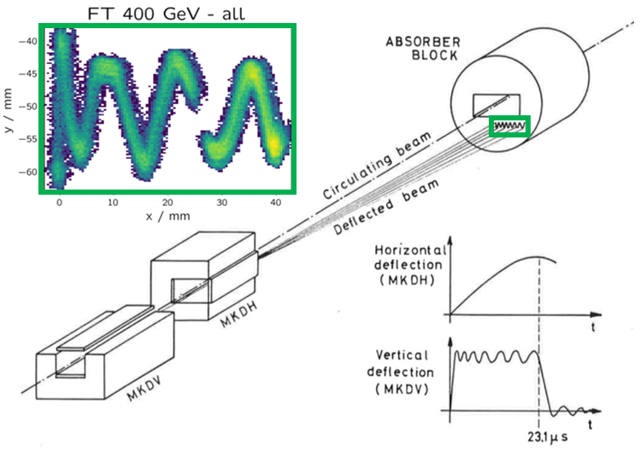
Performance and Limitations of Beam Instrumentation
LHC and SPS dumps – beam dilution observation systems
Using a set of H-V kickers to dilute the beam power on the dump surface
LHC beam footprint
SPS beam footprint
Beam sizes
6mm@450GeV
1.2mm@7TeV

Slide 6
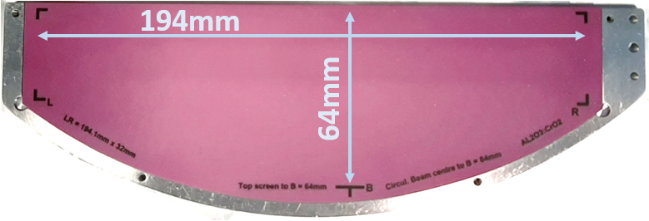
Performance and Limitations of Beam Instrumentation
SPS Dump: Observation Screen
Screen underneath circulating beam
DUMP
Circulating beam
Dumped beam
17m long optical line
Set of high-quality mirrors
F600mm focal length camera lens
Al₂O₃:CrO₂
1mm thick
Standard digital Camera inside Shielding
S. Burger et al, ‘New CERN SPS Beam Dump Imaging System’, IBIC 2021

Slide 7
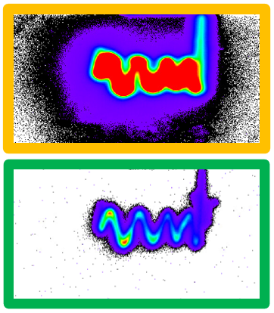
Performance and Limitations of Beam Instrumentation
SPS Dump: Camera Settings
The acquisition system is based on the decay time of the Chromox screen which can be quite long i.e. > few 100ms; saturation level depending on beam intensity, size and dilution strength
Multiple images (@35Hz) are stored as soon as a trigger event - from the extraction kicker system - is received.
The on-line SW performs the selection of the first non-saturated image.
S. Burger et al, ‘New CERN SPS Beam Dump Imaging System’, IBIC 2021

Slide 8
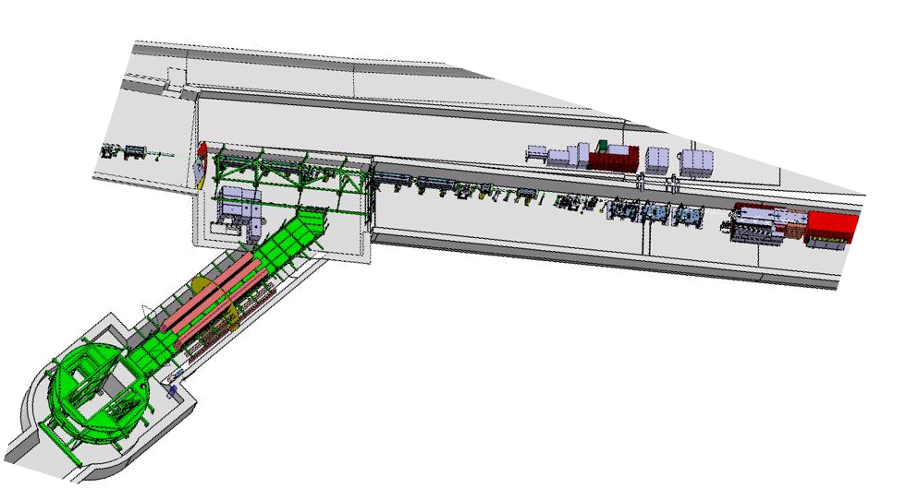
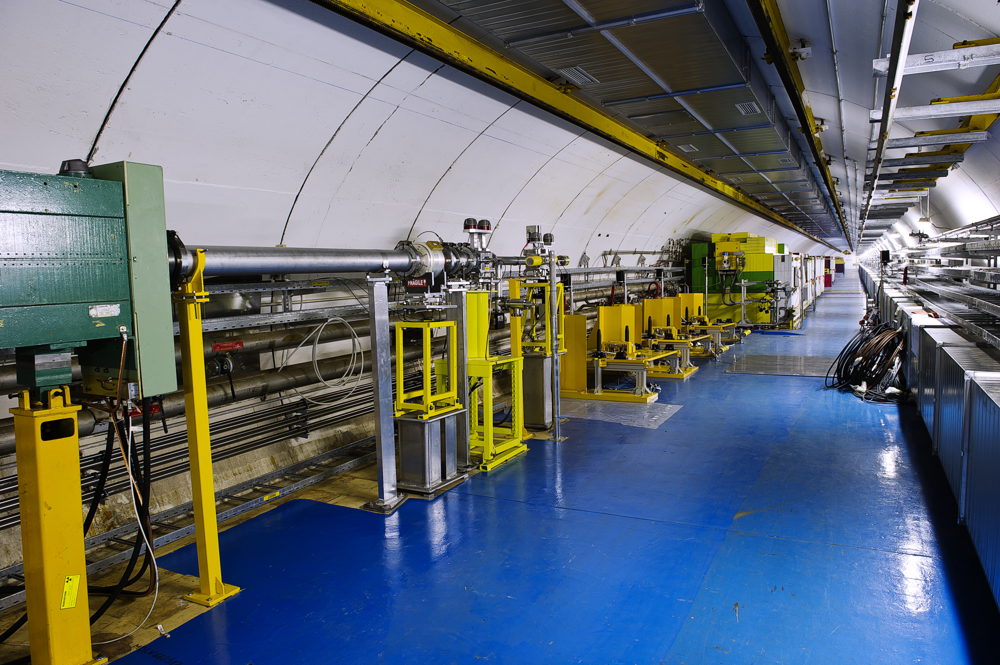
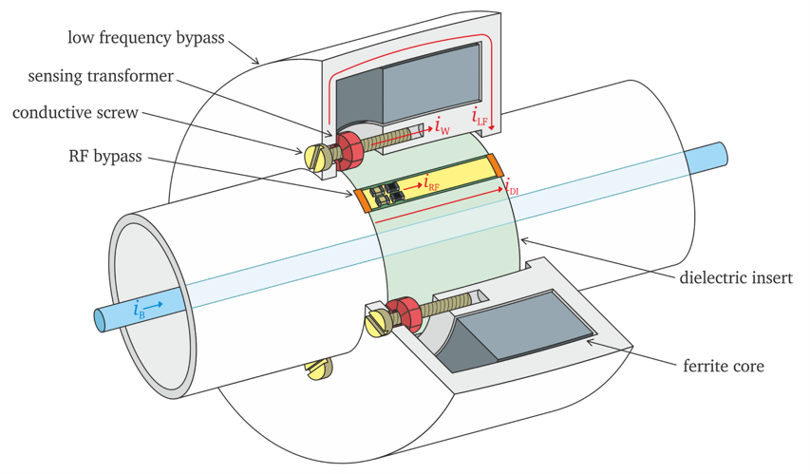
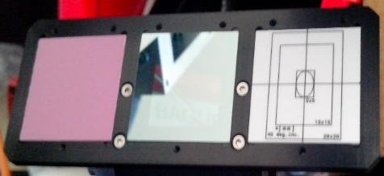
Performance and Limitations of Beam Instrumentation
4x Beam position monitors, 1x Beam current transformer and 4x Screens

Slide 9
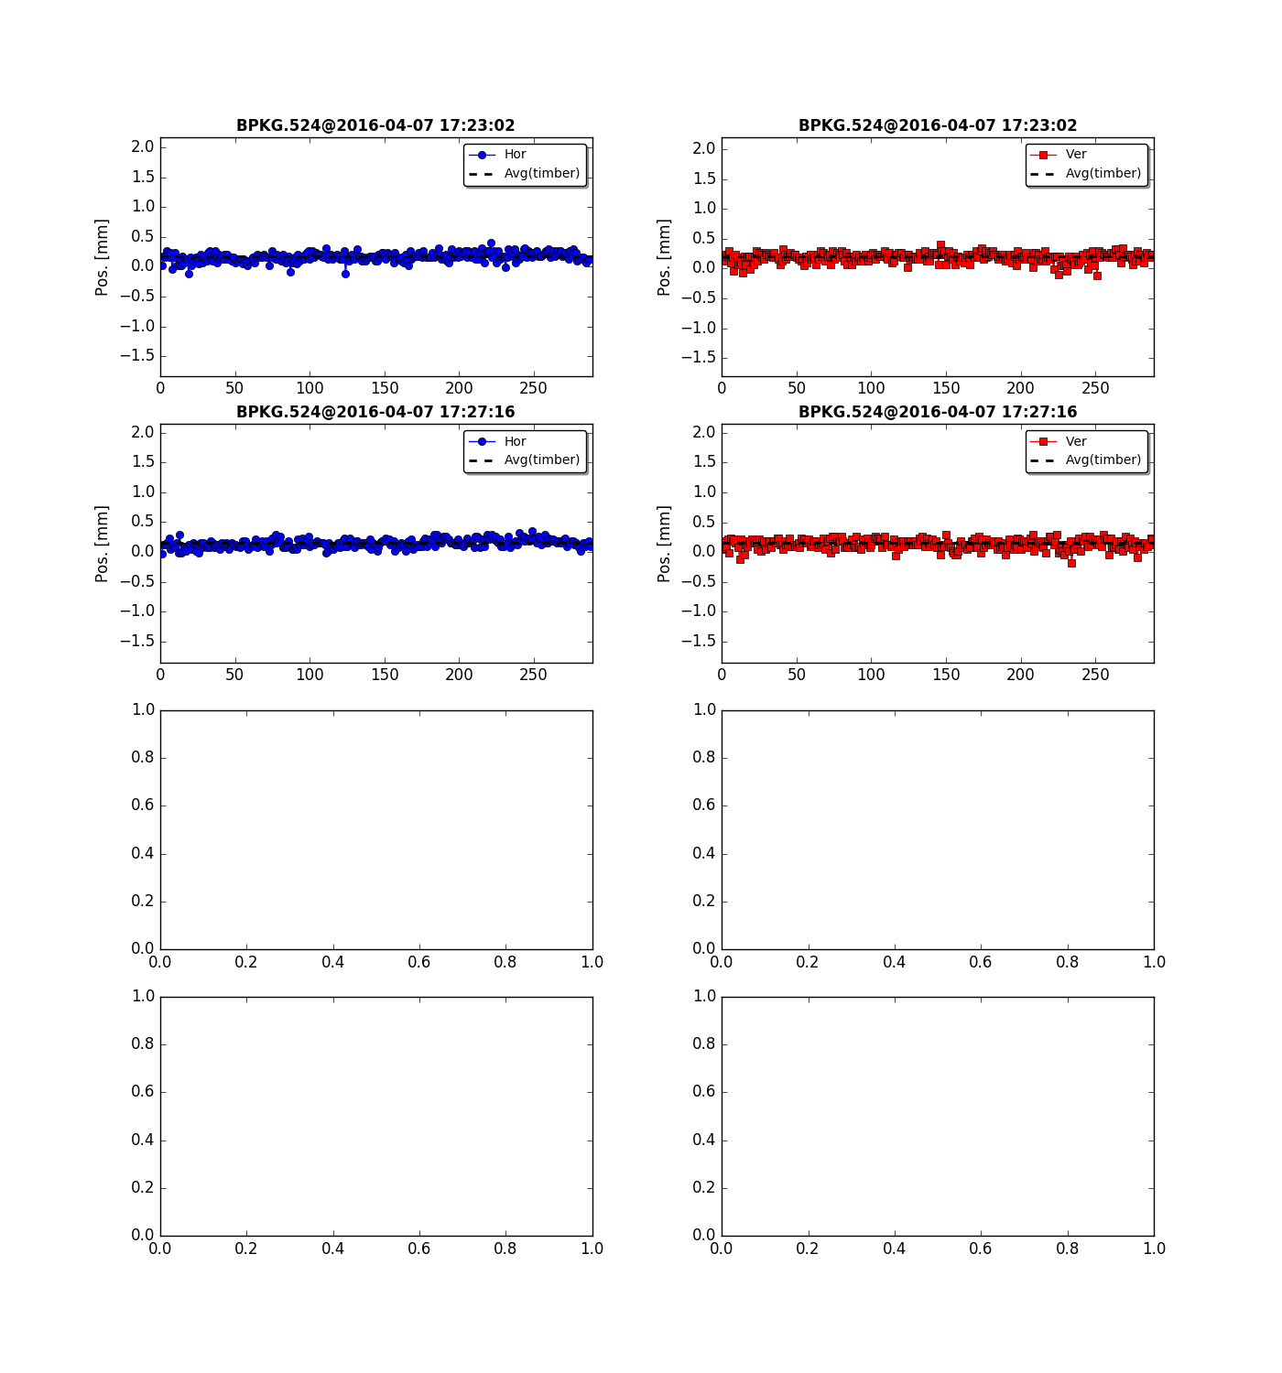
Performance and Limitations of Beam Instrumentation
Noise / Perturbation on Electro-magnetic monitors
Beam position monitor - No target – BPM524 in front of the experimental stations
T. Lefevre, unpublished

Slide 10
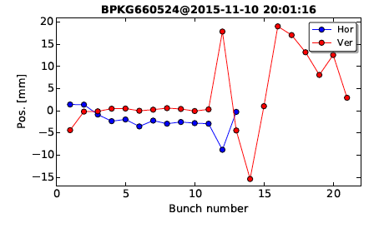
Performance and Limitations of Beam Instrumentation
Noise / Perturbation on Electro-magnetic monitors
Beam position monitors - With target
First Observed in fall 2015 when testing high-Z targets affecting all BPMs
    Backscattered particles affecting the electronic
    Relocation of the electronic in a radiation safe zone in 2016
But still some perturbations observed on the beam position signal resulting in large fluctuations in the BPM readings (±mm)
T. Lefevre, unpublished

Slide 11
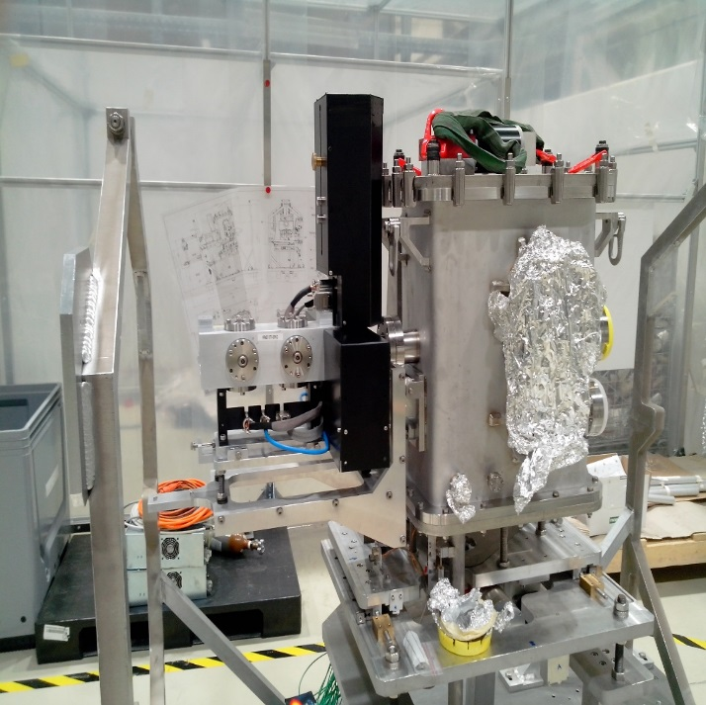
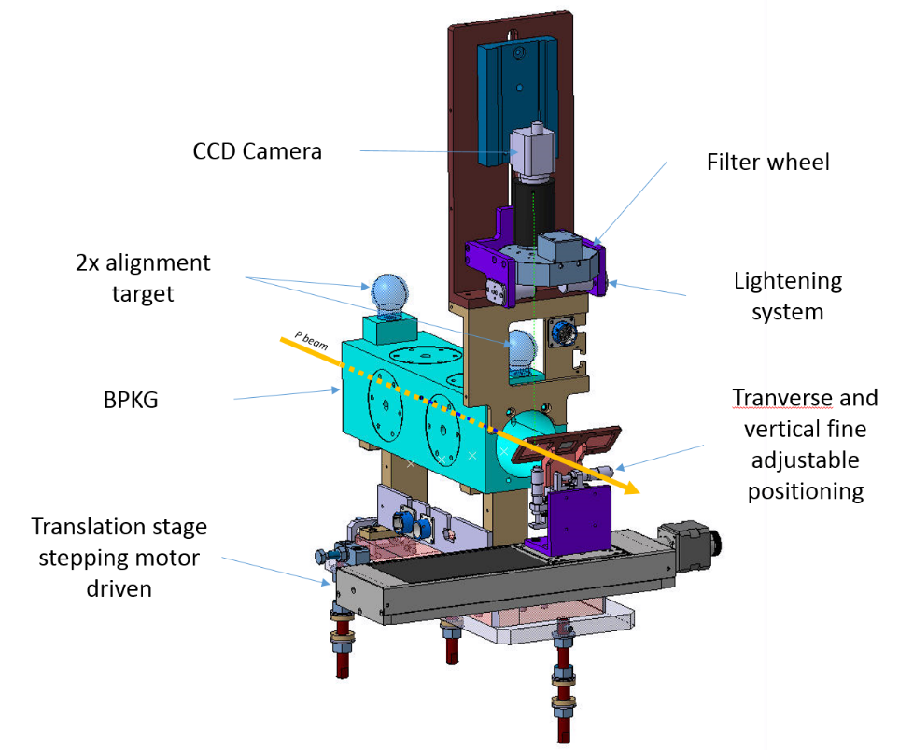
Performance and Limitations of Beam Instrumentation
Request for Target instrumentation
  Measuring beam position as close as possible from the target/experiment
  → BPM using a screen for offset calibration
  Finally, screen based instrument design capable to withstand all beam intensities (288 x 1.2 10¹¹ p⁺) and sizes (< 0.25x0.25 mm)

Slide 12
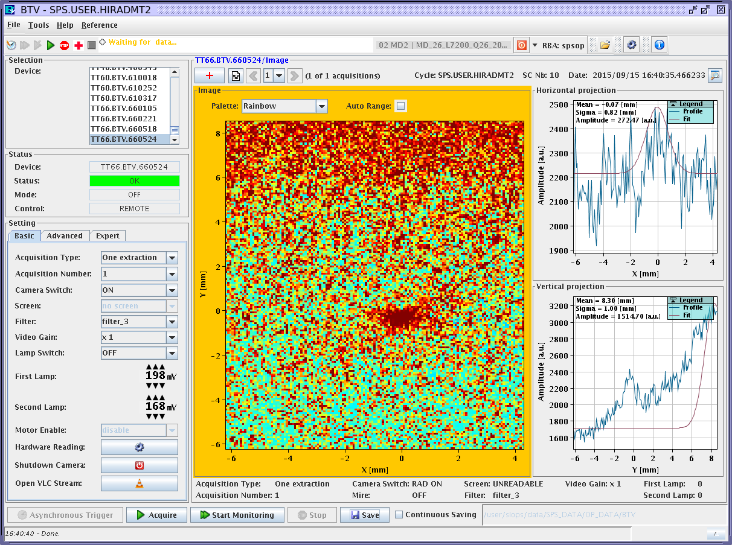
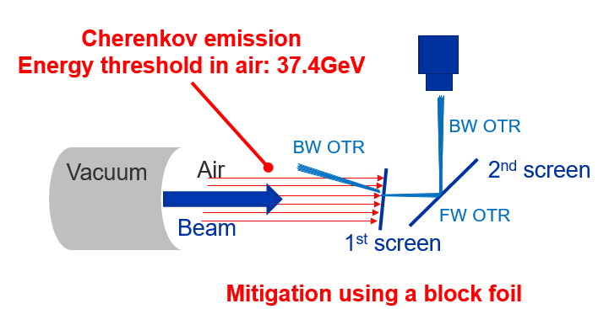
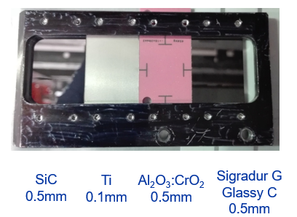
Performance and Limitations of Beam Instrumentation
Main points to solve for relying on screen instrument for HiRadMat
Backscattered particles disturbing the measurement (instantaneous process)
  → Move camera outside of the area
Target IN
Originally in air → parasitical lights (Cherenkov, luminescence, etc…) that distorts the measurement → Blocking foil + put the screen in vacuum
Screen material for high intenstity / small beam size
  Glassy C HTW Germany (sigradur.com)
SiC
0.5mm
Ti
0.1mm
Al₂O₃:CrO₂ 0.5mm
Sigradur G Glassy C
0.5mm

Slide 13
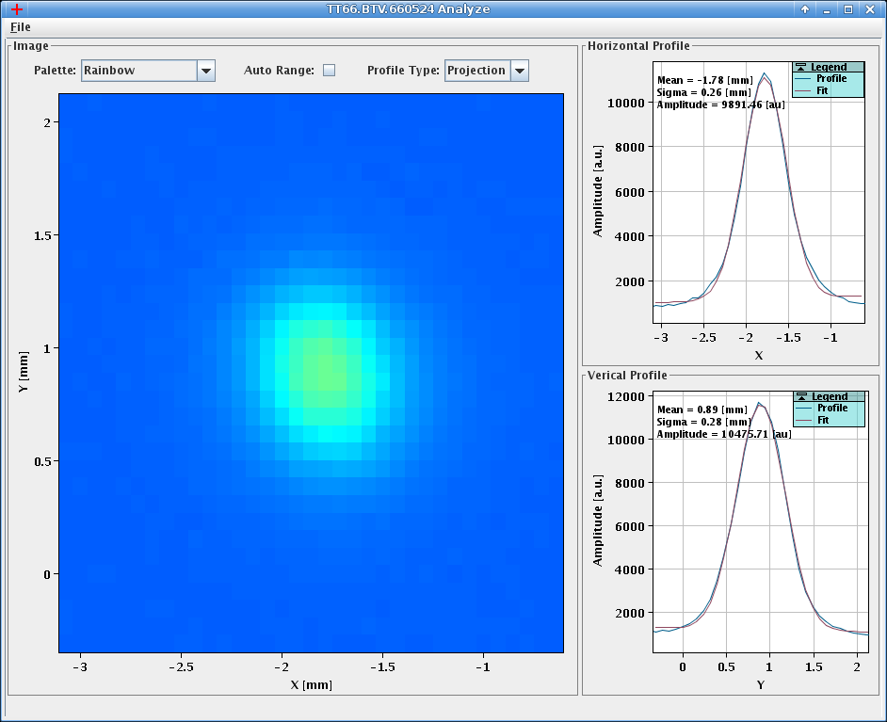
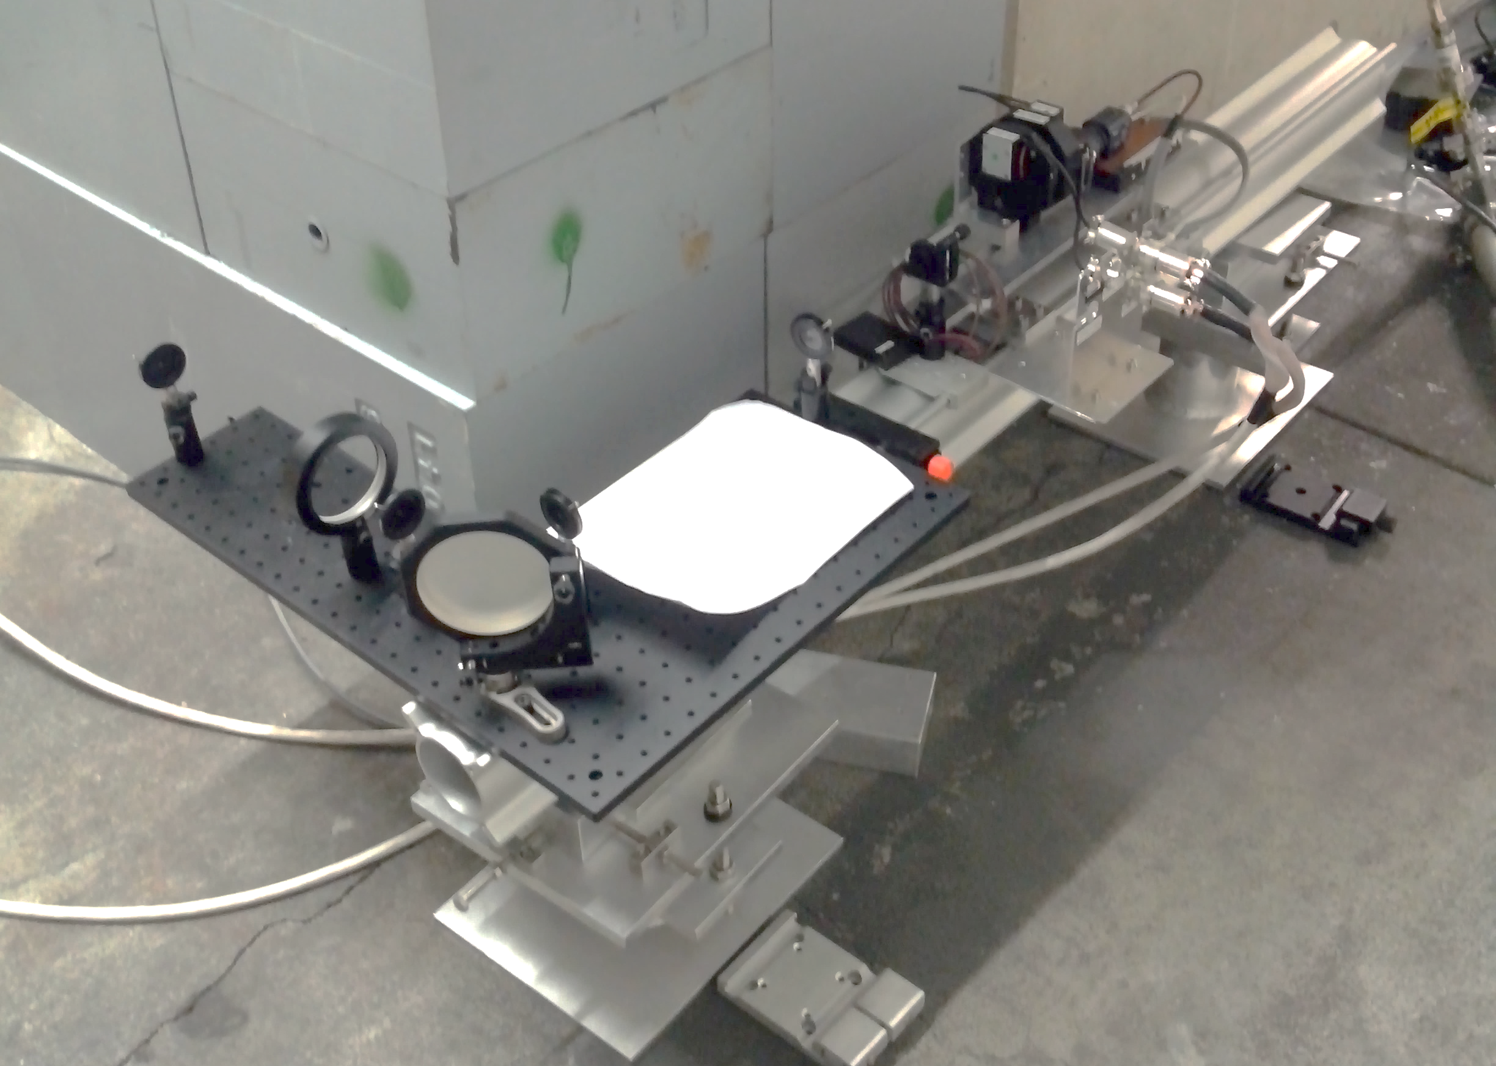
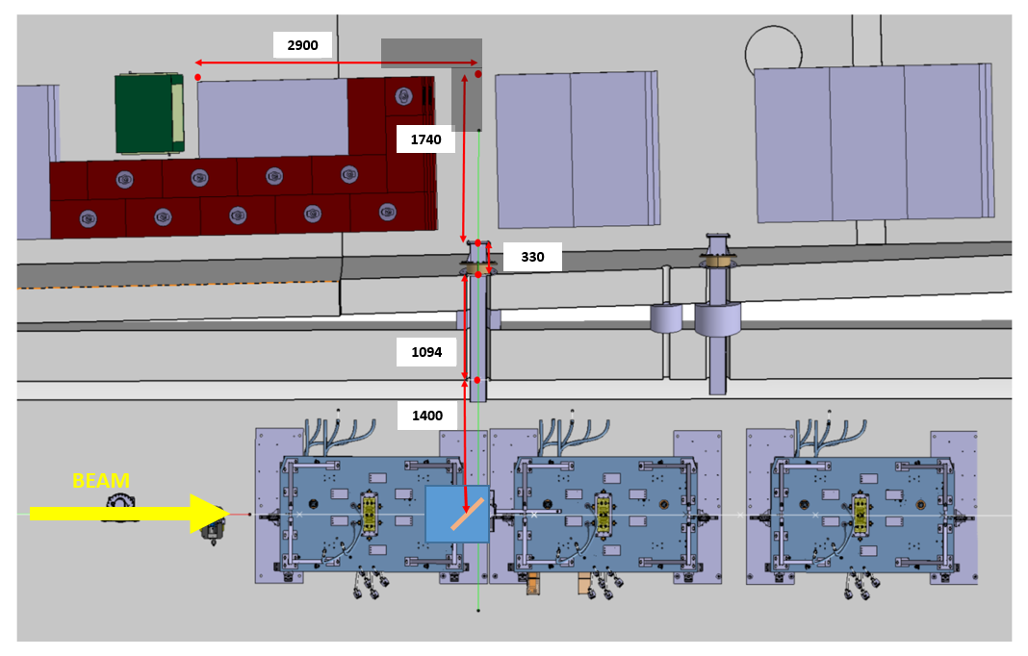
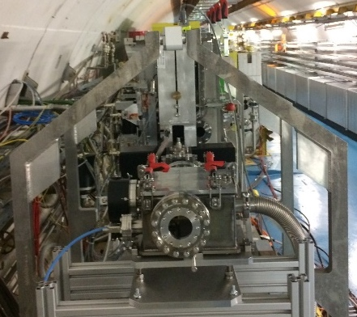
Performance and Limitations of Beam Instrumentation
Relying on Screen for Target instrumentation
>5m optical line to install the camera in a radiation-friendly location
Photons
288 bunches at 1.2e11ppb
σ_{H} = 0.26mm
σ_{V} = 0.28mm
Photons
Upgrade of the optical line may improve the accuracy
of the measurement by reducing the spherical aberrations
Thermal resistant OTR screen in primary vacuum
BEAM

Slide 14
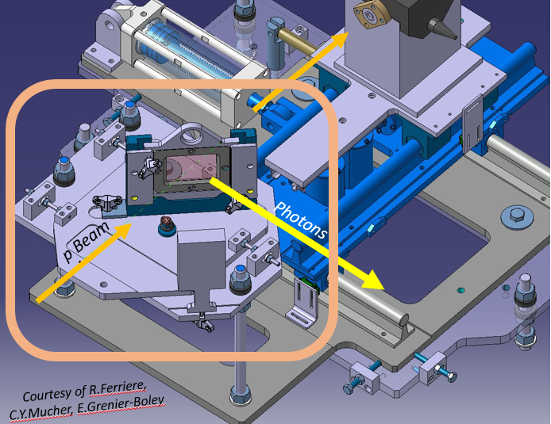
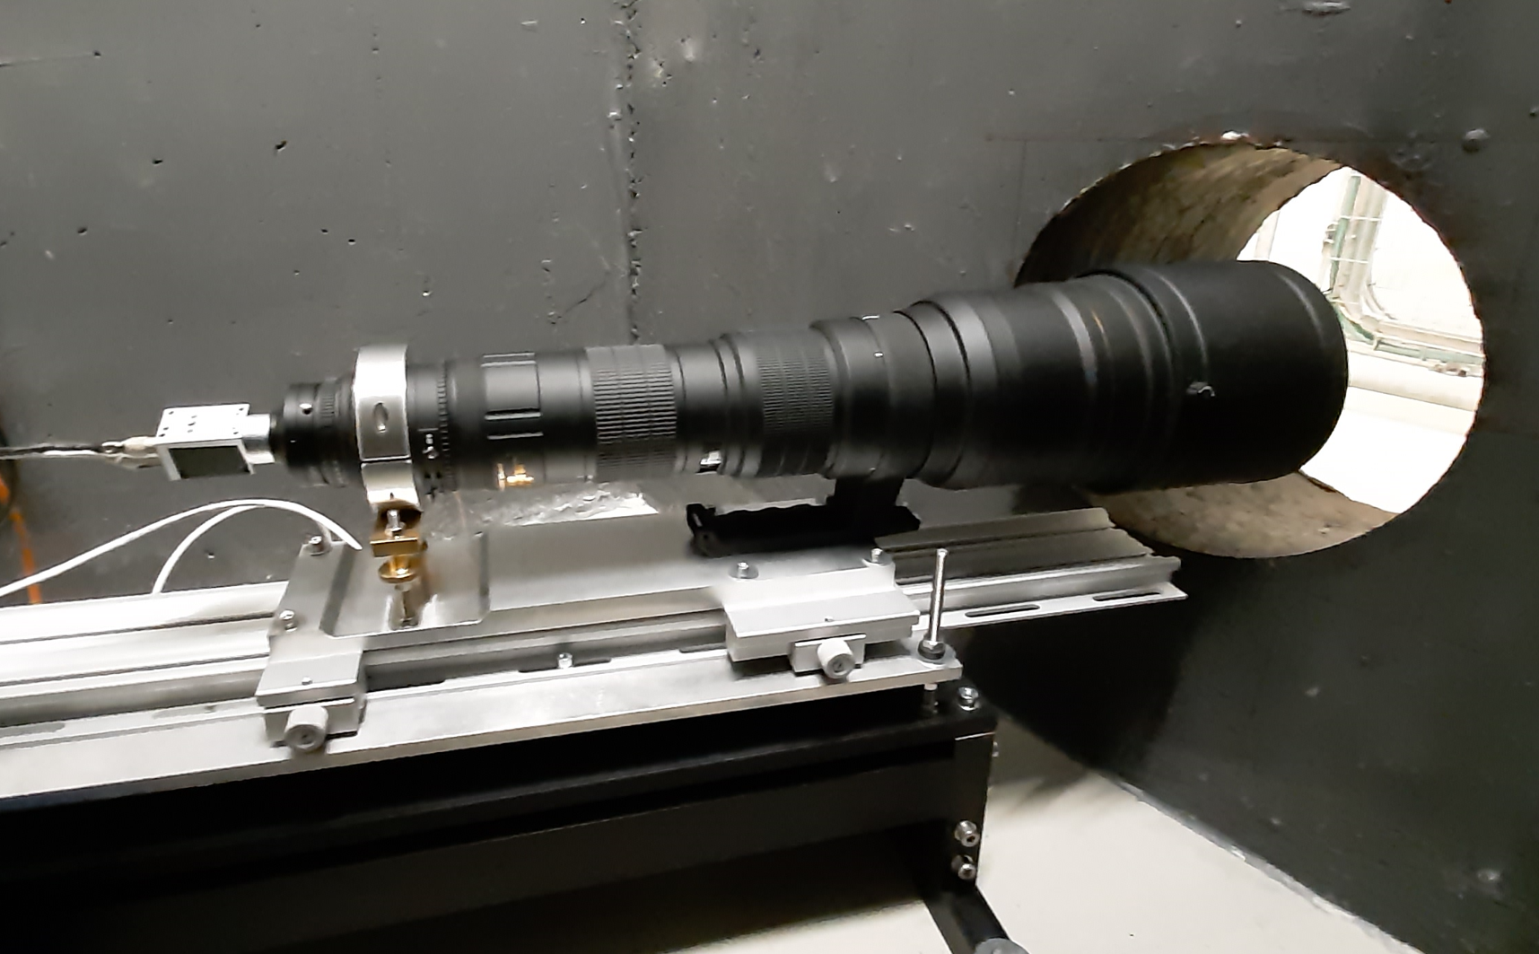
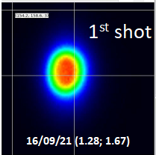
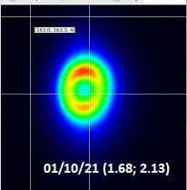
Performance and Limitations of beam instrumentation
AD target instrumentation renovated in 2020
20m long optical line
Digital camera installed in safe area
F800mm
Al2O3:CrO2 screen degrading in air (oxydation?)
Chromox

Slide 15
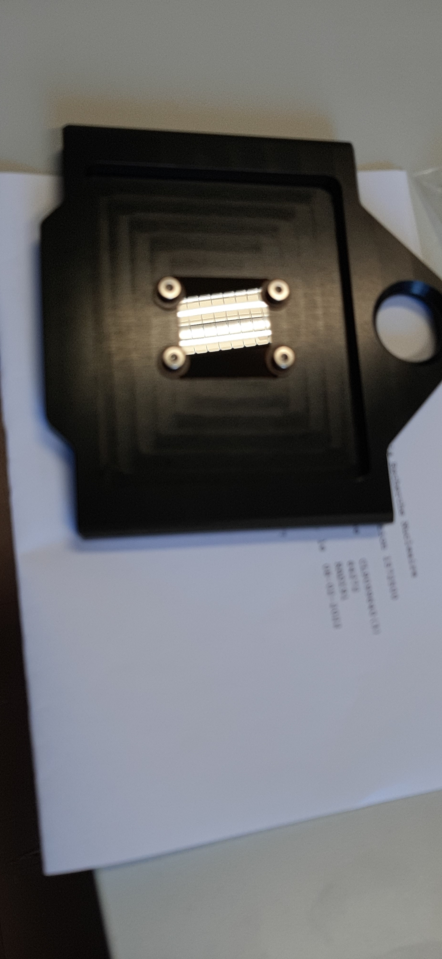
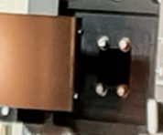
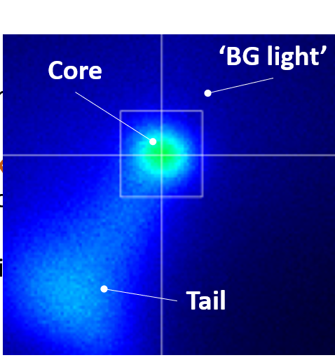
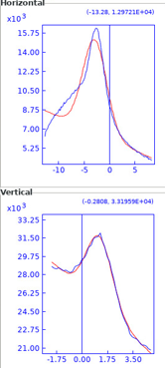
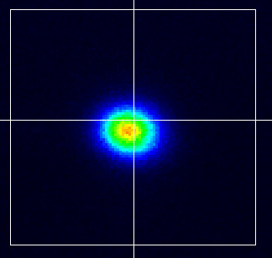
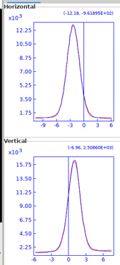
Performance and Limitations of beam instrumentation
Screen upgrade
OTR Glassy C screen
OTR Glassy C screen + blocking foil
We got signal thanks to:
Good initial alignment
& large OTR emission angle
Beam
Image seems totally cleaned-up !!
Need to verify the impact of the Forward OTR from the blocking foil
But lot of background light + unexpected tail

Slide 16
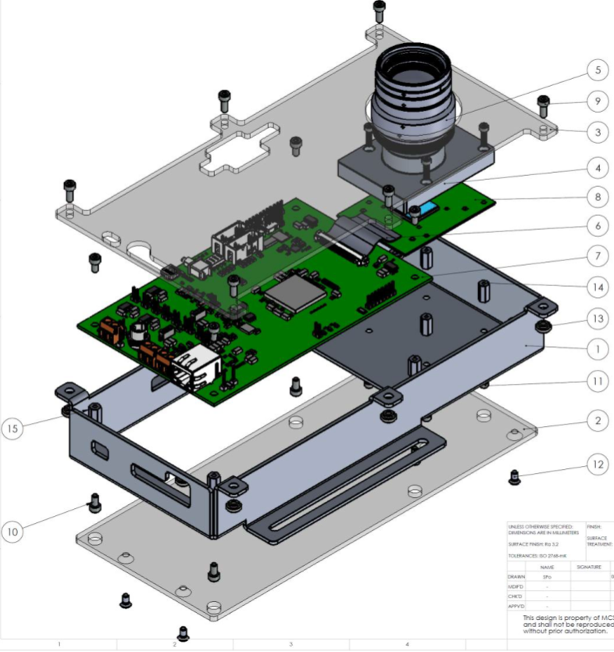
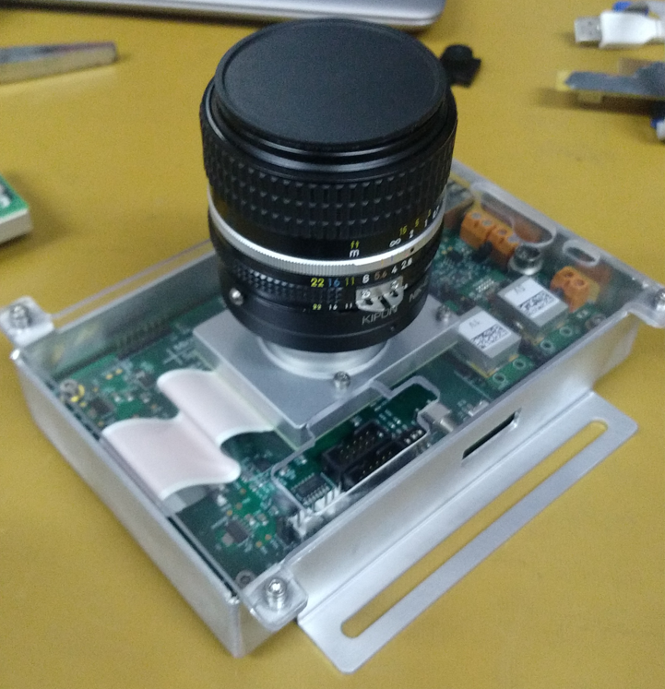
R&D on Rad-tolerant Camera
Collaboration with MicroCameras & Space Exploration
Design initiated to develop a rad-tolerant camera
Full prototype ready in 2021
Using of the shelf qualified electronics components
www.microcameras.ch

Slide 17
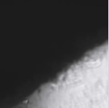
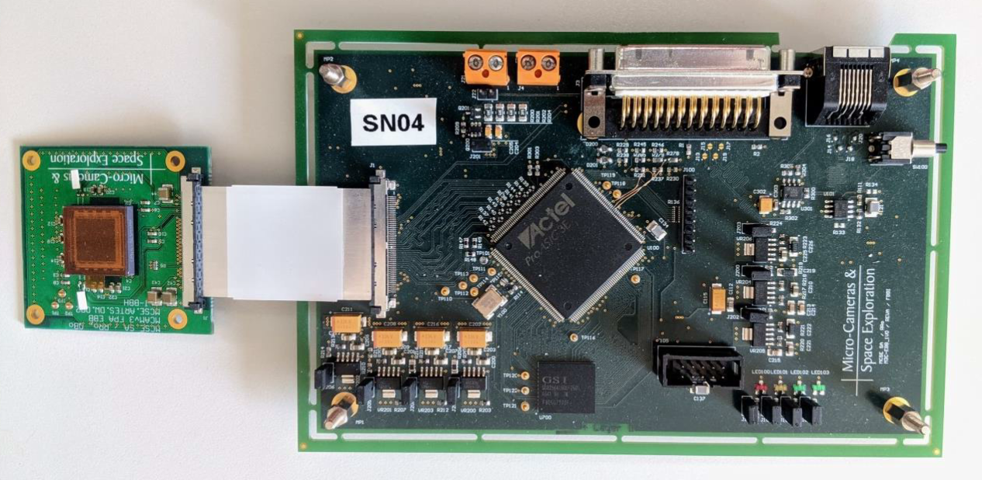
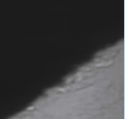
MC BeamCam Irradiation Test Preliminary Results
3 campains of irradiation test done the last years
1x mixed field CERN CHARM facility in 2018
2x Co60 sources (Spain & CERN) in 2020 and 2021
  Reached TID of 36 Krad
CERN CHARM facility in 2022 (next week)
  Latest version of the electronics
  Aim of validating the SE immunity
REF
36krad

Slide 18
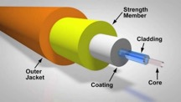



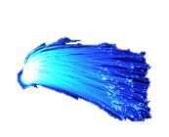


R&D on Optical lines using Machine Learning
An image will not be preserved at the exit of one fiber
Can it be recovered ?
Beam
Fibre output
Applying ML algorithms to beam imaging technology
ARTIFICIAL INTELLIGENCE-ASSISTED BEAM DISTRIBUTION
IMAGING USING A SINGLE MULTIMODE FIBER AT CERN. G.TRAD (CERN) IPAC2022, Bangkok, Thailand
Courtesy of G. Trad

Slide 19
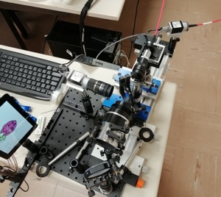
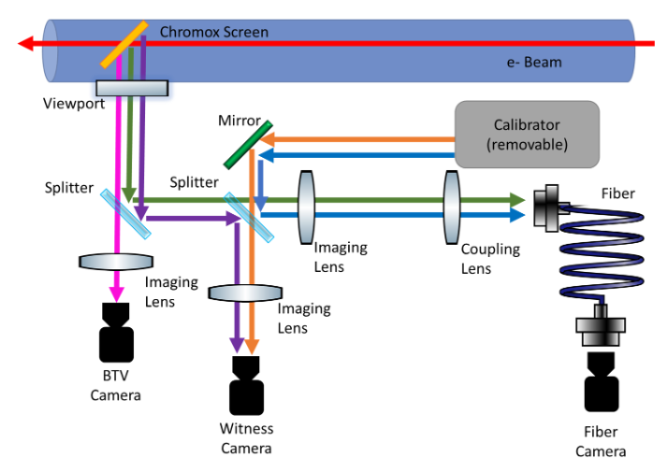
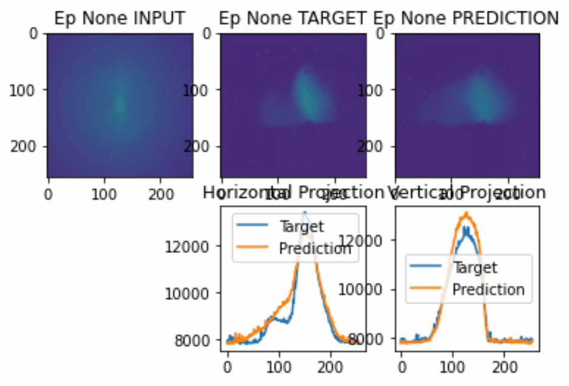
R&D on Optical lines using Machine Learning
Simulations showed ML can work with few % accuracy
Lab. studies carried out using large core multimode optical fibre
Beam tests carried out at CLEAR@CERN
Typical beam image reconstruction for a model trained on real data
Fiber OUTPUT
Beam Image
Predicted Image
Encouraging first results with some improvements foreseen on training algorithms and experimental set-up
Courtesy of G. Trad

Slide 20
Conclusions
Beam instrumentation for High Power Targets is very challenging
  need to cope with high radiation level
  need robust material for intercepting devices
At CERN, it is mainly based on optical methods (OTR imaging systems / Optical lines)
New projects under studies at CERN in the framework of the Physics Beyond Collider program (e.g. ShiP, Hiradmat 2) will require improved performances
R&D on radiation-tolerant camera and optical systems using ML on-going
R&D on screen using low density materials (Carbon Nano Tubes, Graphene, BNNT, etc…)

Slide 21
Thanks for your attention
A big thanks to all colleagues at CERN and elsewhere

Slide 23
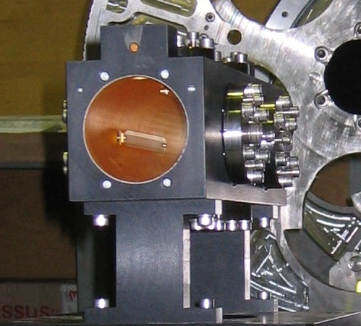
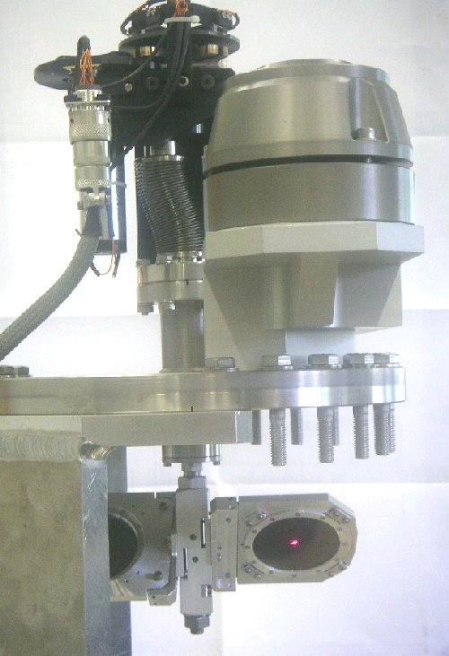

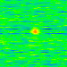
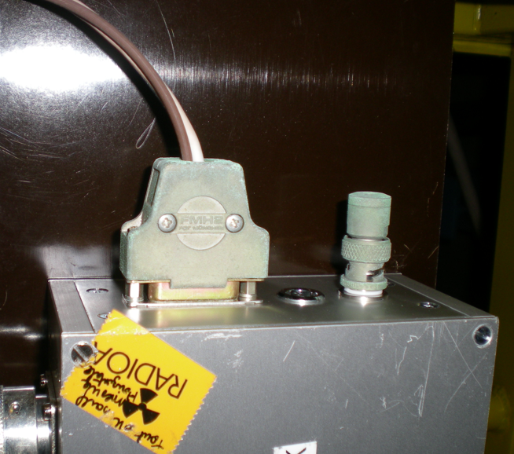
Performance and Limitations of beam instrumentation (1)
Experience from CNGS target beam instrumentation
  Stripline BPM
  Beam imaging systems using
    OTR screen (Optical Transition Radiation) : Carbon and Titanium material
    Rad-tolerant CMOS sensor : SYRA Camera (10Mrad)
BTV images
10¹² protons 10¹³ protons
Some radiation effects on Camera at high intensities on the monitor installed close the target
Picture of stripline BPM in air in CNGS
Picture of the BTV in CNGS during mechanical calibration
In-air BPM and BTV worked well during beam commissioning
Finally not used much during normal operation due to background leading to some unreliable readings
Courtesy of R. Jones, T. Bogey, S. Burger and E. Bravin

Slide 24
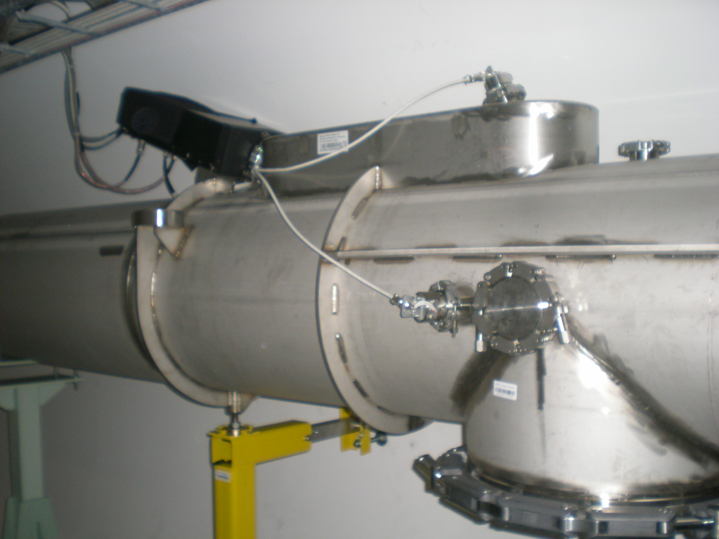
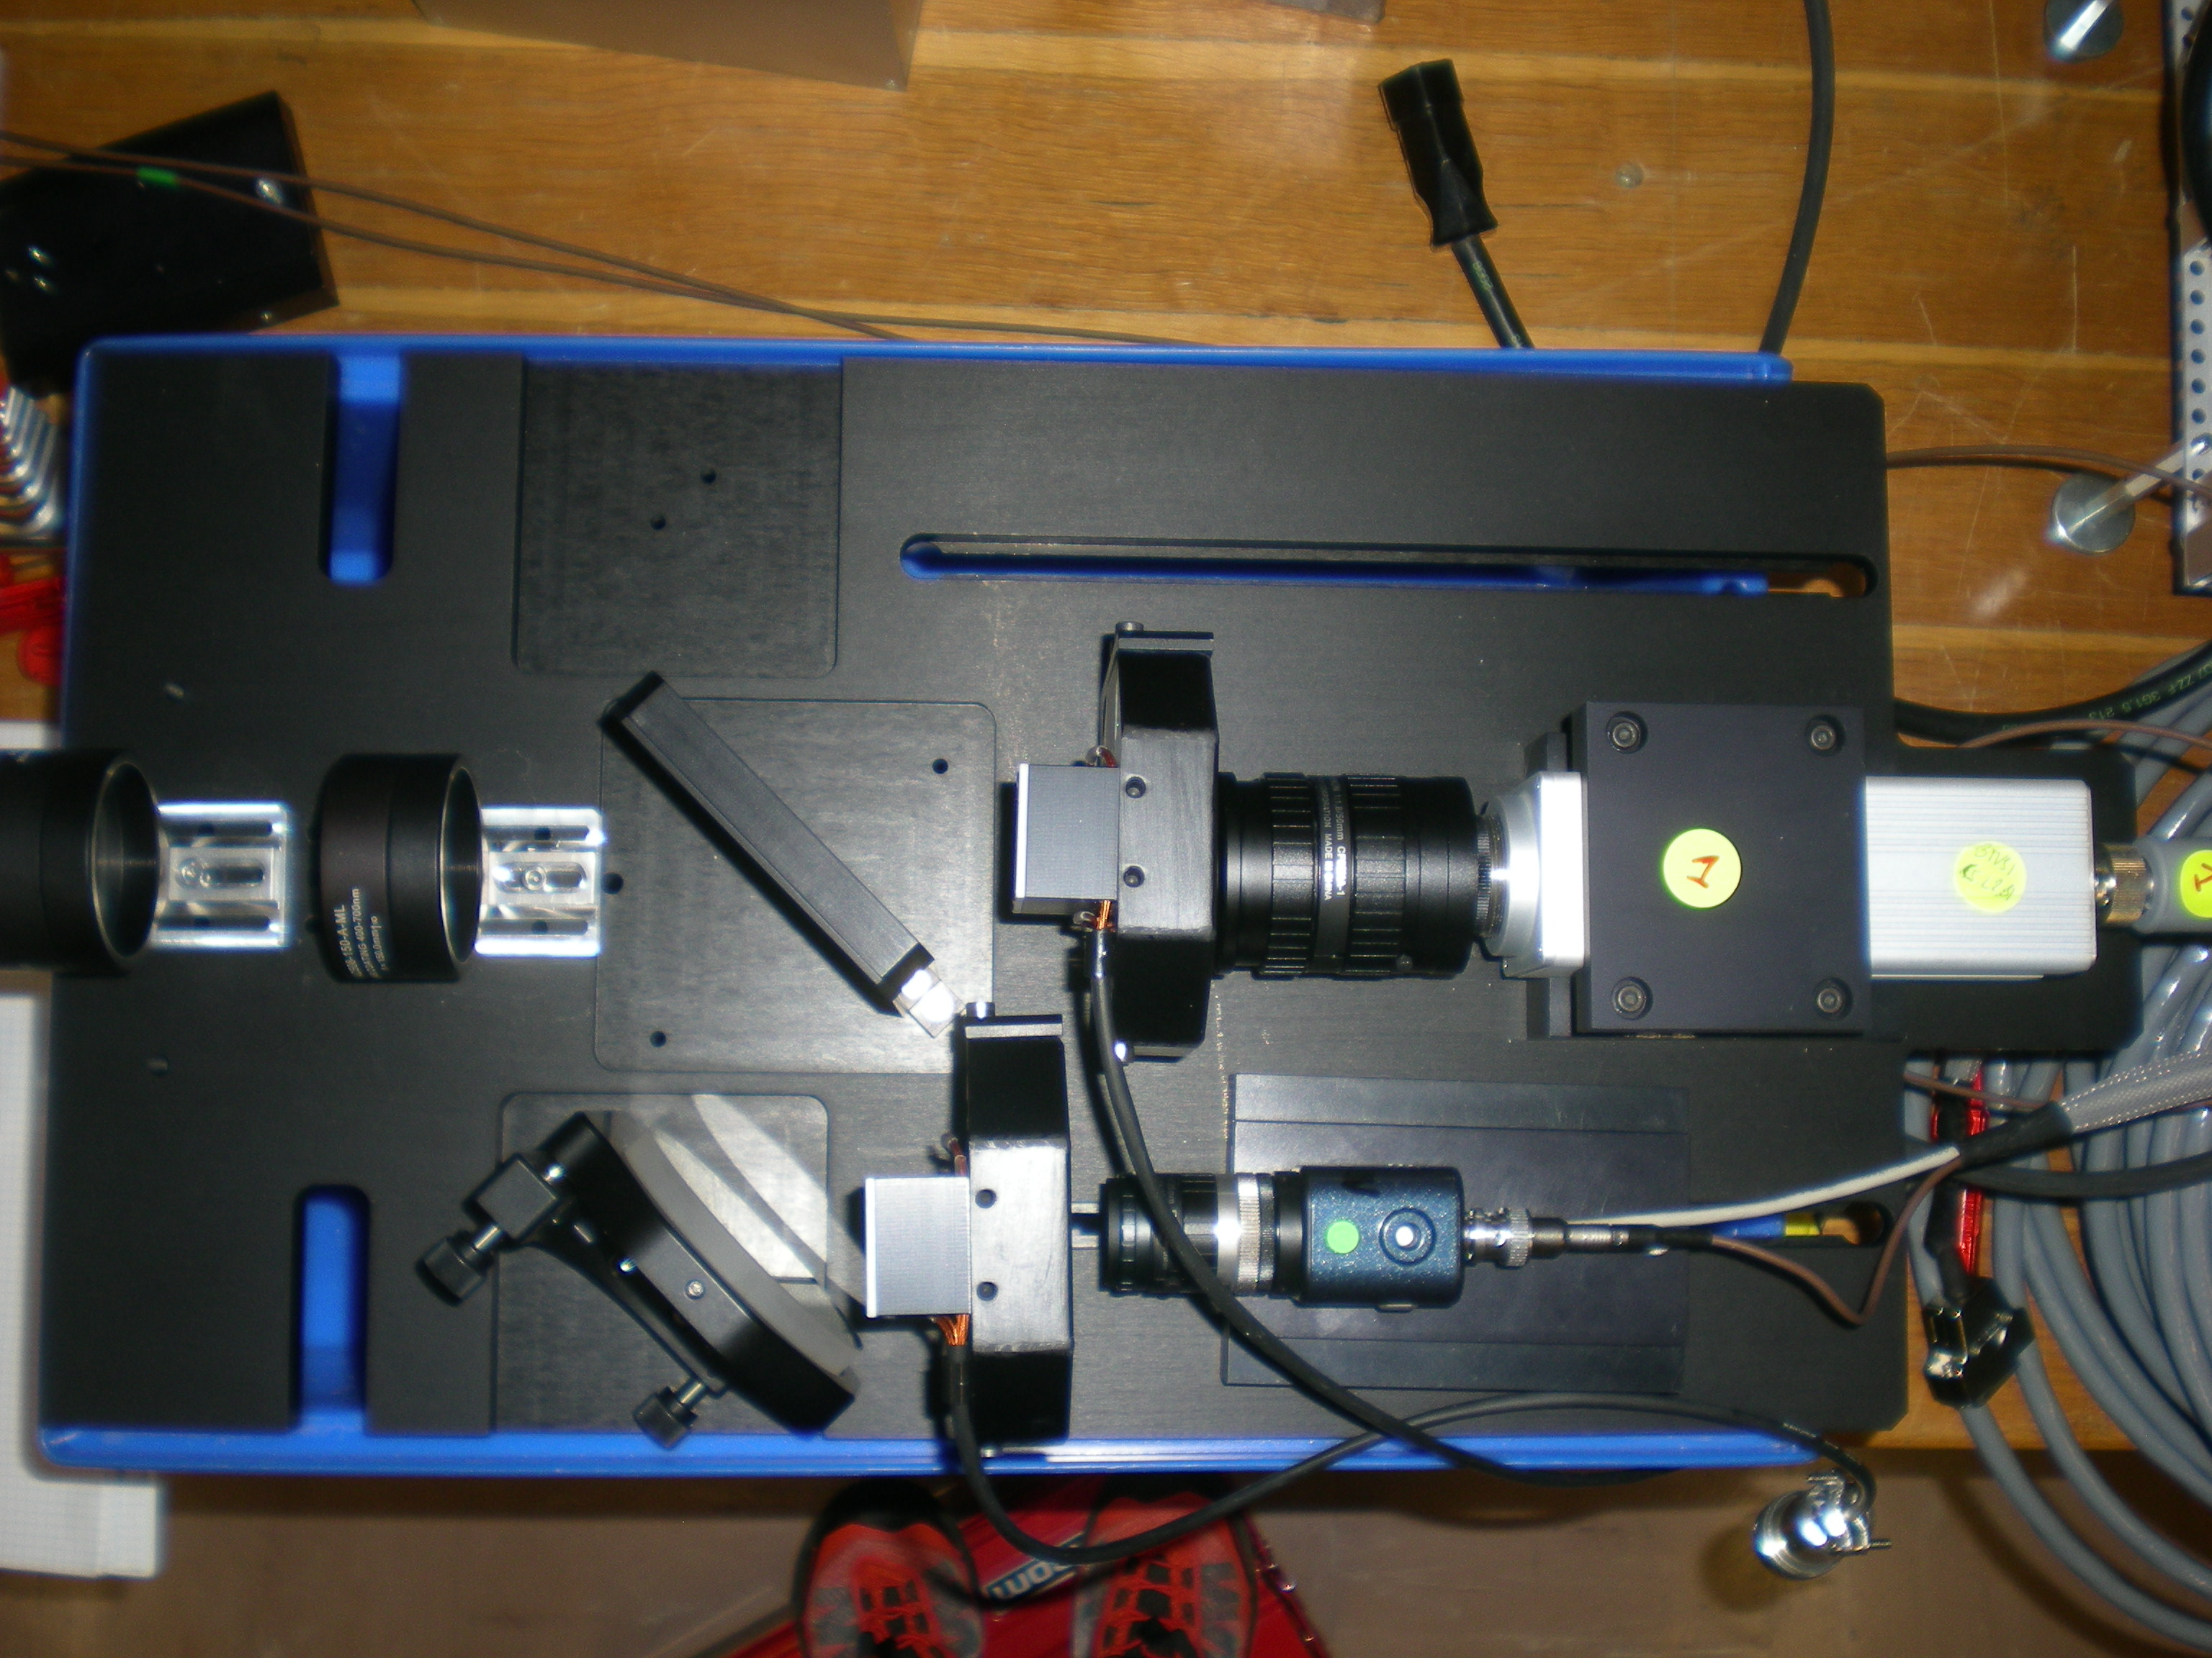
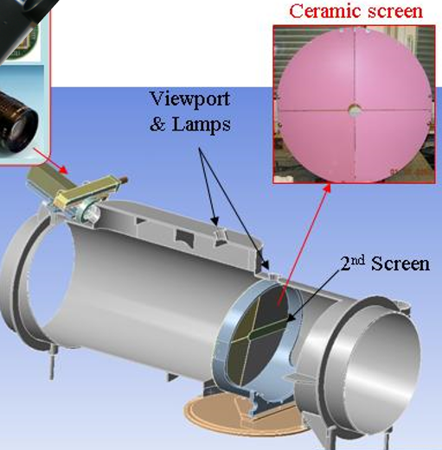
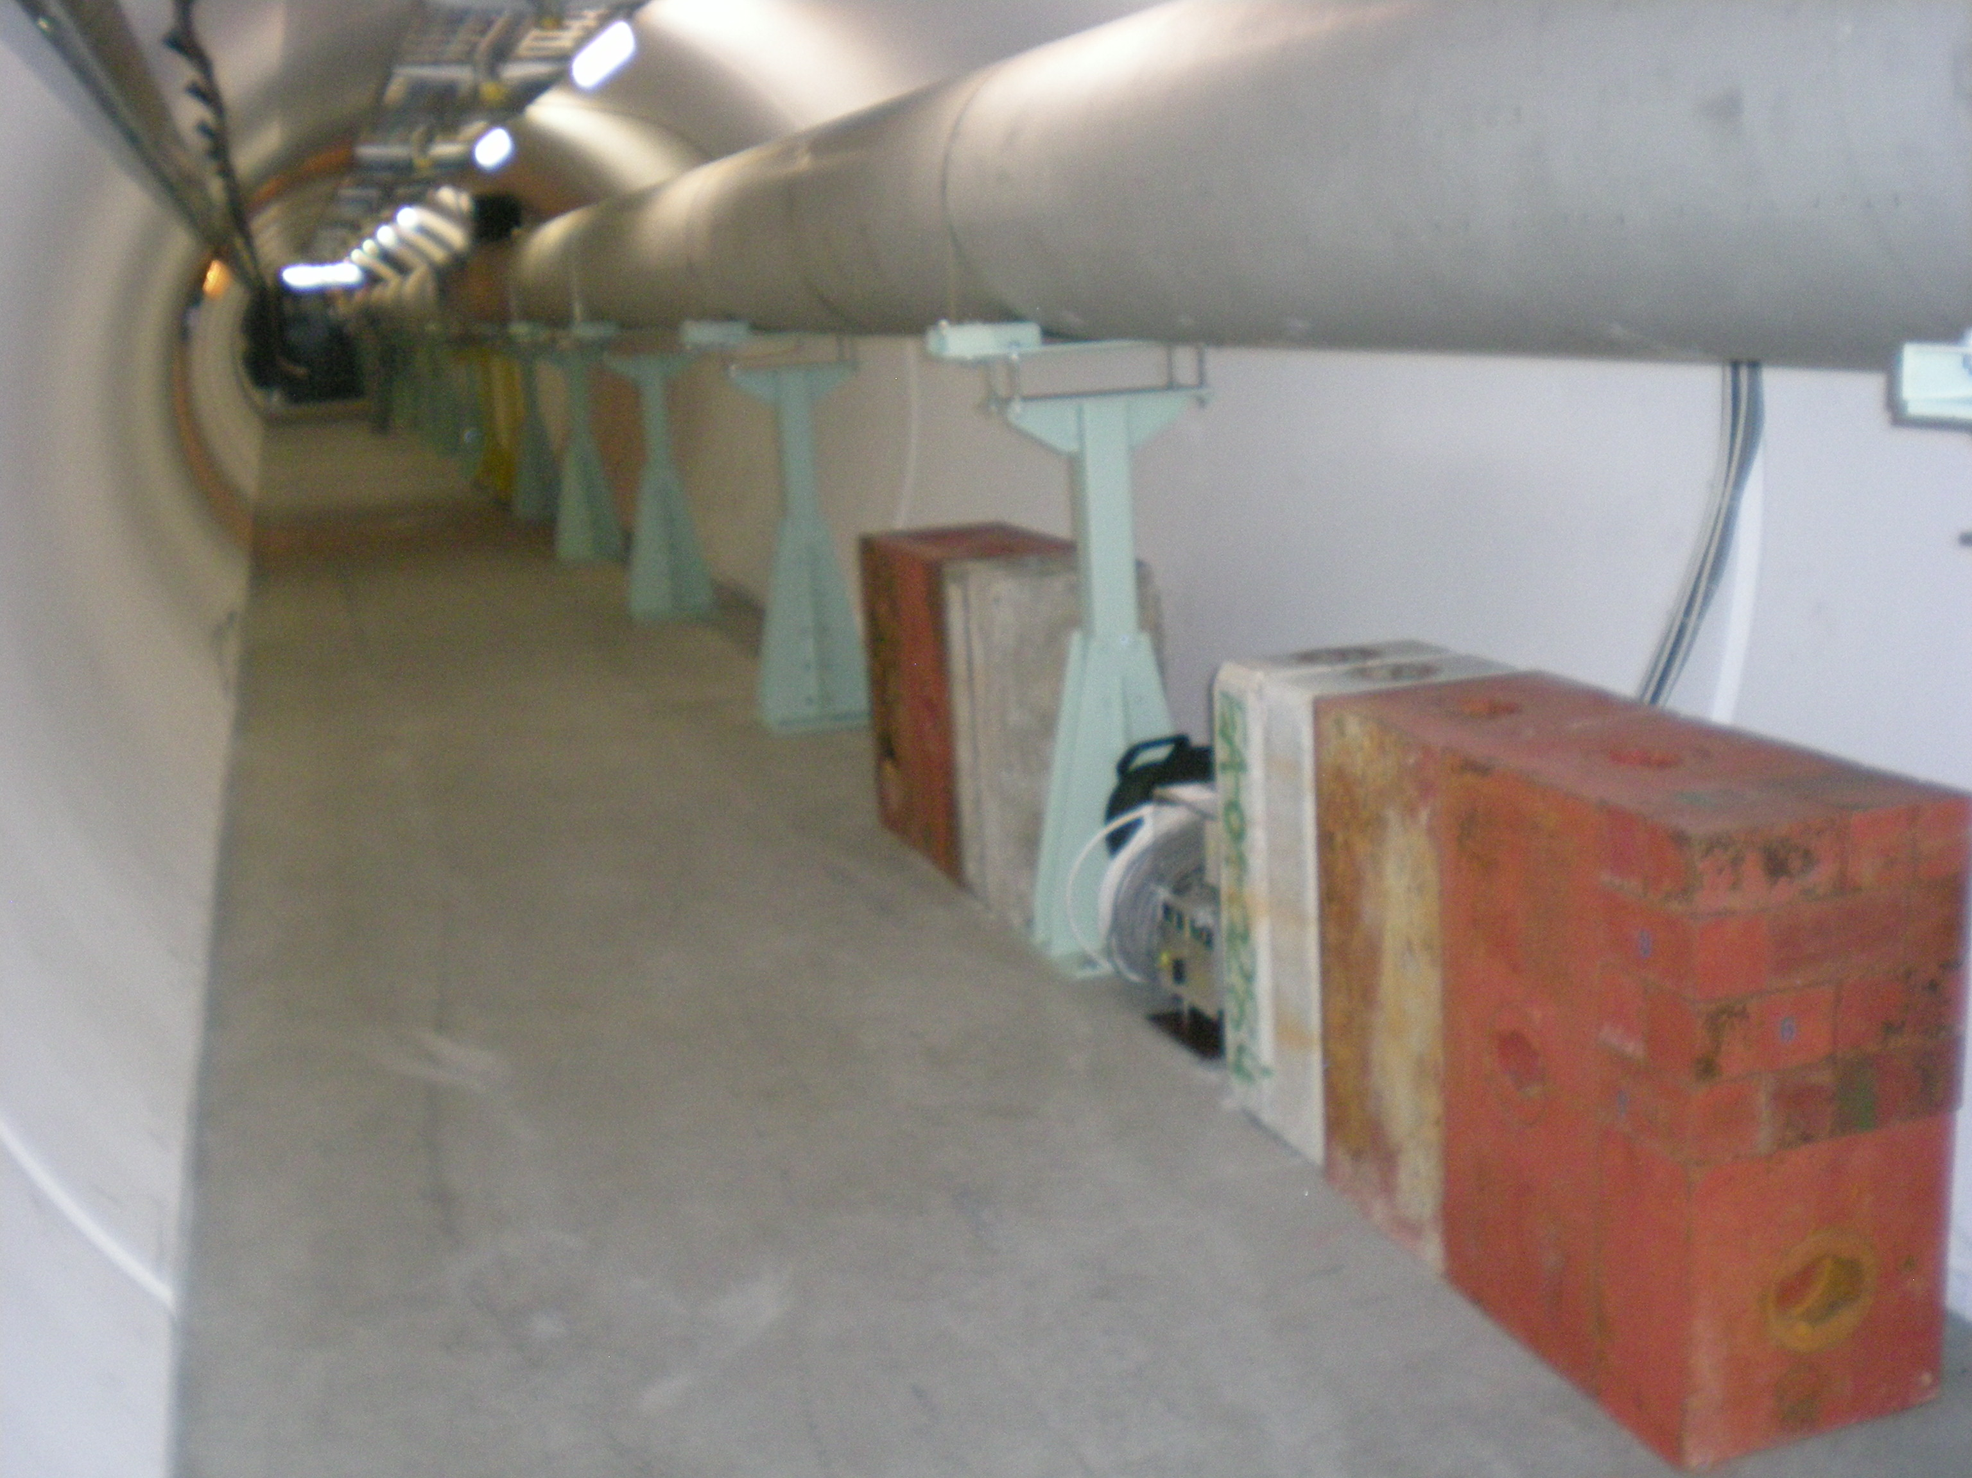
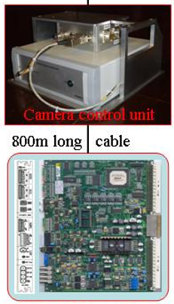
Performance and Limitations of beam instrumentation (3)
LHC Dump Observation Screen
60cm ∅ screen installed at the end of a 900m long line ~ 30m upstream of the dump
Electronics located another 20m upstream the cameras in the tunnel behind an dedicated shielding made of iron
Cam1
Al₂O₃:CrO₂
3mm thick
4 quadrants
Beam Splitter
Electronics behind iron shielding
Cam2
30m
Shielding
Work very reliably since 2009 !
900m
→ DAQ
T. Lefevre et al, ‘A large scintillating screen for LHC dump line’, DIPAC 2007

Slide 25



Performance and Limitations of Beam Instrumentation
Noise / Perturbation on Electro-magnetic monitors
BCT
No target 1.72g/cm³ 5.39g/cm³
Perturbations increasing with higher density targets
→ BCT were moved upstream in the line
T. Levens, unpublished

Slide 26



Performance and Limitations of beam instrumentation
Relying on Screen for Target instrumentation
OTR screens without Target downstream
OTR screen alone
Filter OD 3.7
OTR screen + Al foil in front
Filter OD 3
SiC
0.5mm
Ti
0.1mm
Al₂O₃:CrO₂ 0.5mm
Sigradur G Glassy C
0.5mm
Strange and unexpected beam shape
5x less light, but ‘normal’ shape

Slide 27
Performance and Limitations of beam instrumentation
Relying on Screen for Target instrumentation
Cherenkov emission
Energy threshold in air: 37.4GeV
OTR Light
SiC
0.5mm
Ti
0.1mm
Al₂O₃:CrO₂ 0.5mm
Sigradur G Glassy C
0.5mm
Vacuum
Air
Beam
OTR screen
S. Burger et al, ‘Scintillation and OTR Screen Characterization with a 440 GeV/c Proton Beam in Air at the CERN HiRadMat Facility’, IBIC 2016

Slide 28
Performance and Limitations of beam instrumentation
Relying on Screen for Target instrumentation
Cherenkov emission
Energy threshold in air: 37.4GeV
Sigradur G Glassy C
0.5mm
BW OTR
SiC
0.5mm
Ti
0.1mm
Al₂O₃:CrO₂ 0.5mm
BW OTR
Vacuum
Air
2nd screen
Beam
FW OTR
1st screen
Mitigation using a block foil
R. Keiffer et al, ‘Experimental Observation of “Shadowing” in Optical Transition Radiation’’, PRL 120, 094802, 2018

Slide 29


Performance and Limitations of beam instrumentation
AD target instrumentation renovated in 2020
Before
After
Screen
Target
Horn
Courtesy of S. Burger

Slide 30


R&D on Optical lines using Fibre Bundle
Motivation :
“Transport an image far away from the target to a location with low radiation level”
IPAC 19-24 May 2019 – Melbourne, Australia
https://doi.org/10.18429/JACoW-IPAC2019-WEPGW078
Joint ARIES-ADA Workshop on 'Scintillation Screens and Optical Technology for Transverse Profile Measurements
31 March – 3 April 2019 Krakow, Poland
https://indico.cern.ch/event/765975/contributions/3250516/
R2E annual meeting – 2018 11 December
https://indico.cern.ch/event/760345/timetable/
Courtesy of D.Celeste & Co

Slide 31



R&D on Optical lines using Fibre Bundle
Tested rad-hard ‘FIGR-10 from Fujikura (10k fibres)
  Light transmission down by a factor 35
  Contrast down by a factor 3
  50% light reduction after 694kGy irradiation using ⁶⁰Co source at CEA
Beam tests on PS extraction showed some crosstalk between fibres
Standard optics/camera system
Fiber bundle system
→ Project currently stopped
Courtesy of D.Celeste & Co

Slide 32





New fast wire scanners in PSB, PS and SPS rings
‘Lower density material’ for more robust wire – Study on Carbon NanoTubes wires
Wire
100 µm
Strips
~ 0,5 µm
CNT
From graphene to Carbon Nano-Tubes
~ 20 nm
CNTW multi-scale
Test of CNT wires at Hiradmat@CERN in 2021

Slide 33


Fixed-target / Beam dumps beam parameters at CERN
Particle type | Protons / ions
Beam energy | 440 GeV/c
Beam intensity | 5 10⁹ to 3.5 10¹³
Pulse length | 7.95us
Pulse period | 20s
Energy per pulse on Target | 2.4MJ
Beam size on Target (RMS) | 0.5 to 2mm
TT61
TNC
72 bunches
72 bunches
72 bunches
72 bunches
Potential to double the beam intensity using LIU beams in the future

