Slide 1
LBNF Horns and Challenges
Meredith Lee
Accelerator Division/Target Systems Department
9/20/2022

Slide 2
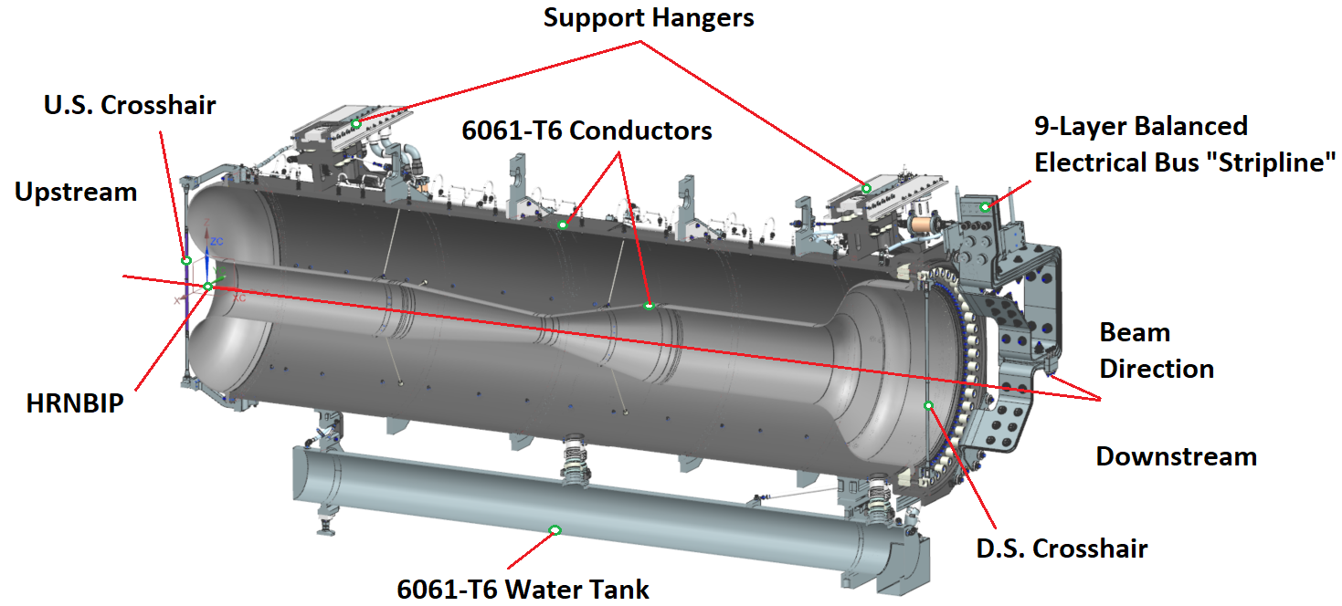
Agenda
Overview of LBNF Horns
Challenges
Welding Horns B & C Inner Conductors
Horns B & C Forgings
Horns B & C Coatings
Assembly in Flipping Fixture
Summary
Horn B system overview

Slide 3
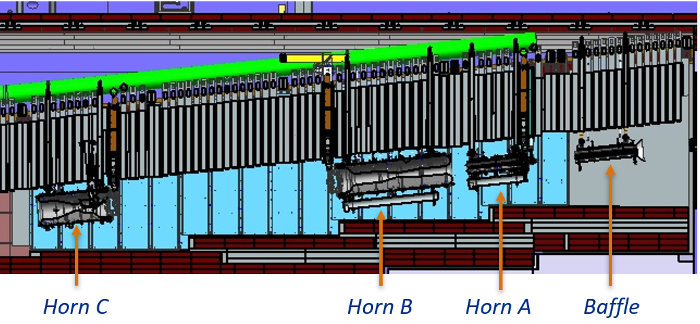
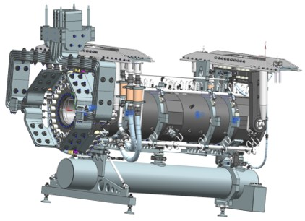
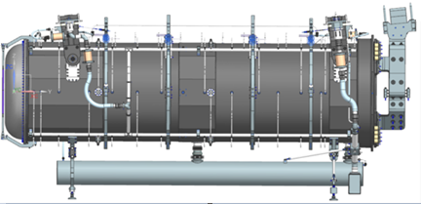
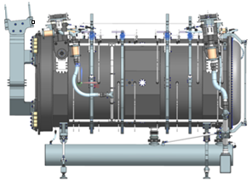
Overview of LBNF Horns
Three horn focusing system
Horn A followed by Horn B and Horn C
Pulsed at 300 kA
Designed for 1.2 MW and upgradeable to 2.4 MW
Horn B is largest horn to be built at Fermilab
15 ft. long and 40 in. diameter
Horn C has same diameter as Horn B
Horn A
Horn B
Horn C

Slide 4
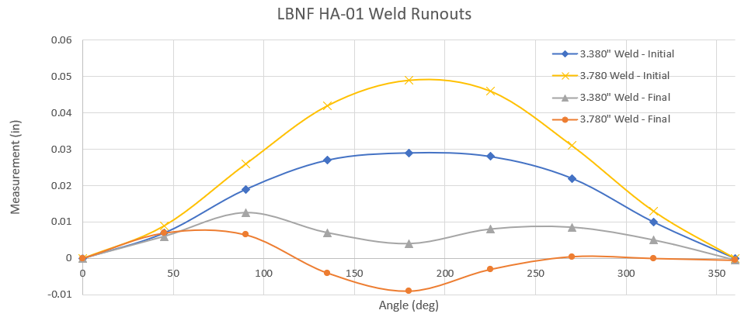
Overview of LBNF Horns
Prototype Horn A currently in fabrication
Outer conductor machined and surveyed
To be hardcoat anodized soon
Inner conductor successfully welded in February
X-Rayed to NAS 1514 Class 1 on both welds
Straightened to within 0.020” TIR requirement
All supporting parts ordered and received
Horns B & C in final design stages
Prototype Horn A Outer Conductor

Slide 5
Challenges
NuMI and BNB horn experience invaluable for LBNF
Several anticipated fabrication and assembly challenges
Differences in design from NuMI
Large size creates fabrication and assembly challenges
Many vendors cannot accommodate
Space/storage constraints
New assembly procedures with no NuMI/BnB precedent

Slide 6
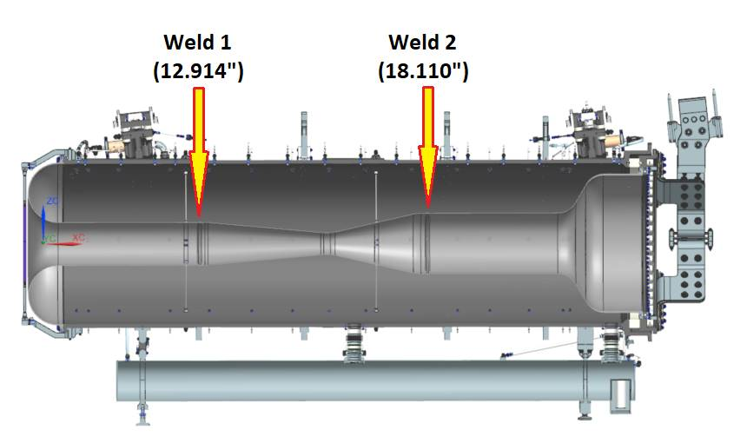
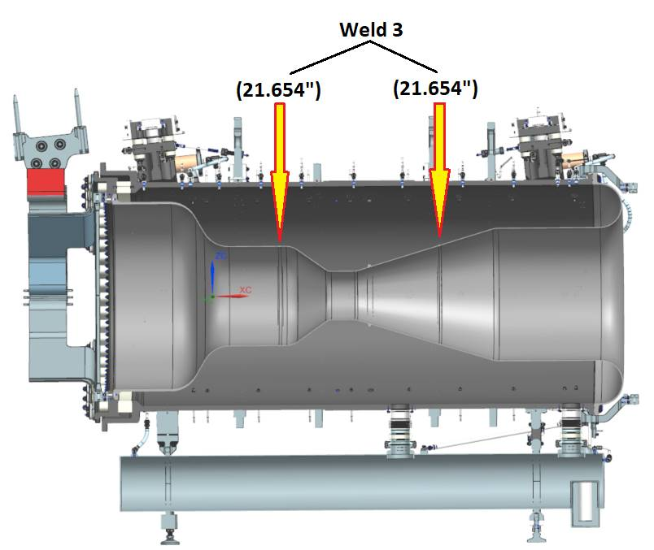
Challenges – Welding Horns B and C Inner Conductors
Horn B and C inner conductors have comparatively large diameter welds
Horn A: 3.380”, 3.780” diameters
Largest NuMI Horn 2 weld: 21.343”
Horn B Weld Diameters and Locations
Horn C Weld Diameters and Locations

Slide 7
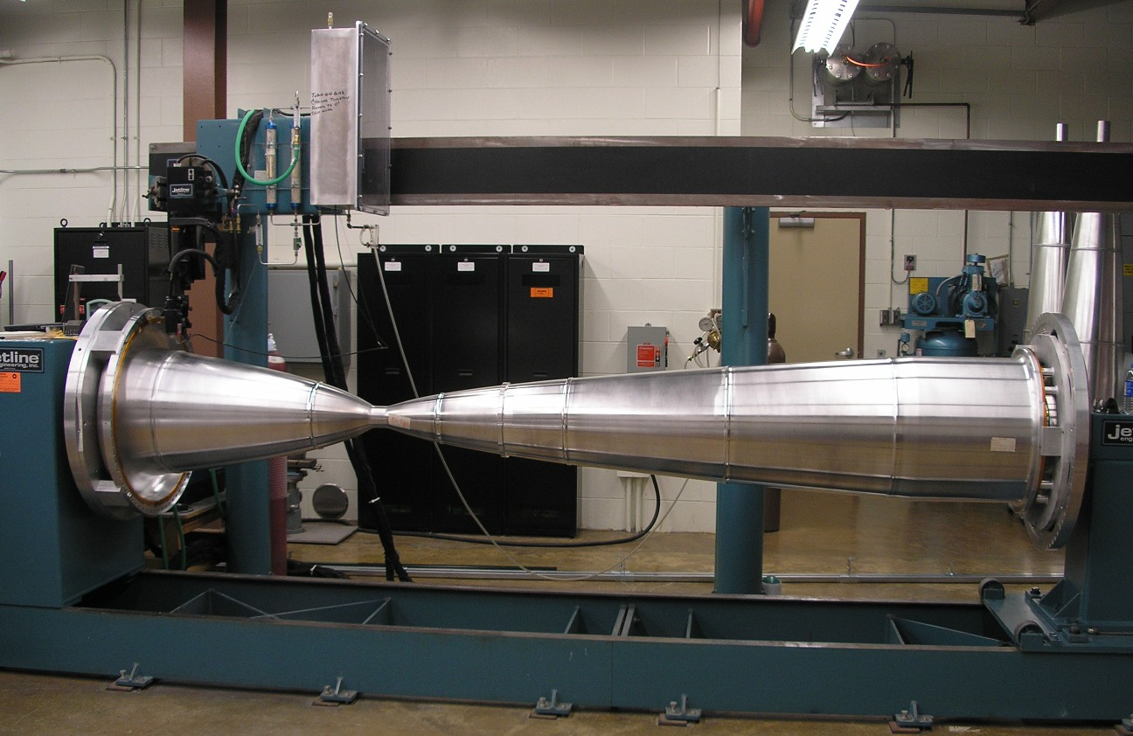
Challenges – Welding Horns B and C Inner Conductors
CNC TIG welding machine
Program weld routines for precise control of welding parameters
Current, arc voltage, wire feed rate, etc.
Order of operations for each horn weld:
1. Welding over previous sample weld/multi-ring to test routine
2. Weld sample part
3. Modify routine and weld new sample
4. Iterate between steps 2 and 3
100% penetration weld
Acceptable crown on weld surface
NuMI Horn 2 inner conductor on welding machine

Slide 8
Challenges – Welding Horns B and C Inner Conductors
Four sample welds planned for each horn diameter
Typically do up to 6 sample welds for NuMI and LBNF Horn A
Tack welds needed for larger welds (> 8” diameter)
Ensure parts do not open up during welding
Tack welds should have small crown and not produce underbead
Can only test effectiveness on samples
Weld sample reusable parts approach

Slide 9
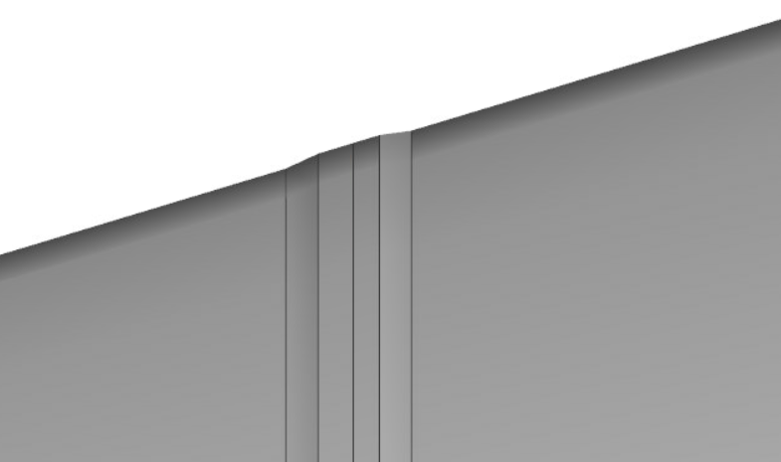
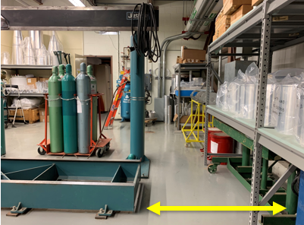
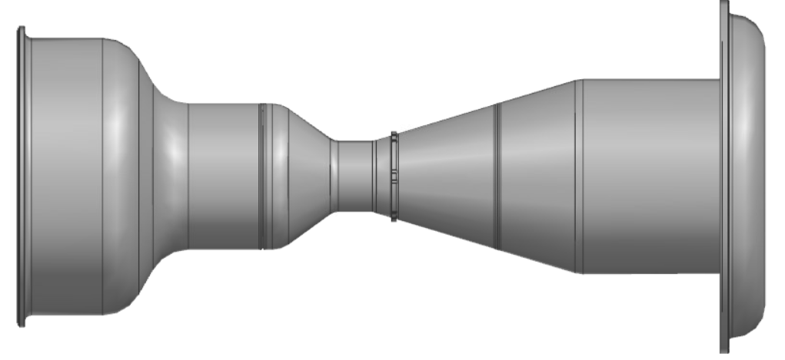
Challenges – Welding Horns B and C Inner Conductors
Typical torch orientation
Welding second Horn C weld at an angle
Only experience doing this for BNB horn
Need to extend welding machine rails to accommodate Horn B length
Torch rotated 16.8$°$
Welding machine planned rail extension
Horn C inner conductor

Slide 10
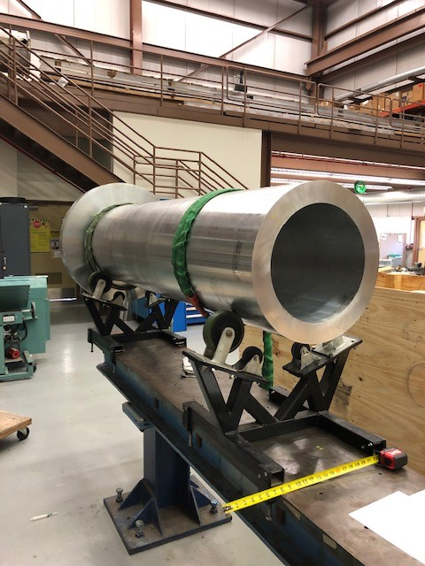
Challenges – Horns B and C Forgings
Horn B and C forgings are large and numerous
Total of 24 horn and weld sample forgings
Expensive and long lead time
Estimated cost: $750k for horn forgings
Lead time based on Horn A experience: 5 months (only 3 forgings)
Only one vendor qualified for this job
Excellent work for NuMI, BNB, and prototype Horn A
Procuring all at once requires significant accommodation from vendor
Machining vendor options also limited
Horn A outer conductor forging
Notes:
12 weld sample forgings, 12 horn forgings

Slide 11
Challenges – Horns B and C Coatings
Anodizing and nickel plating Horns B and C conductors
Large tank size needed
Nickel plating: 16 ft length, < 58” width
Anodizing: 16 ft x 5 ft x 5 ft
FNAL planning to build and supply tank to vendor
Fixture designs will need to be more contained within volume of horn than fixtures for previous horns
Minimize tank size
Horn B nickel plating fixture concept

Slide 12
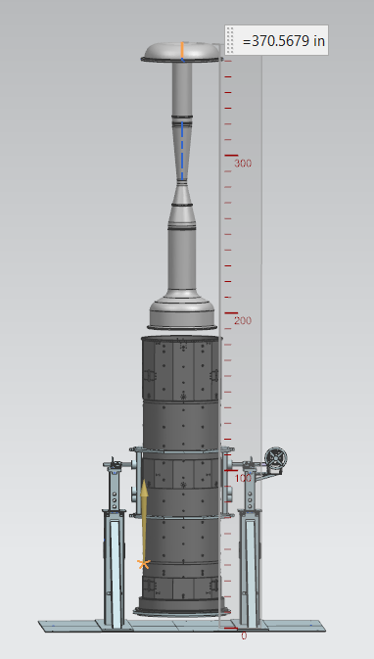
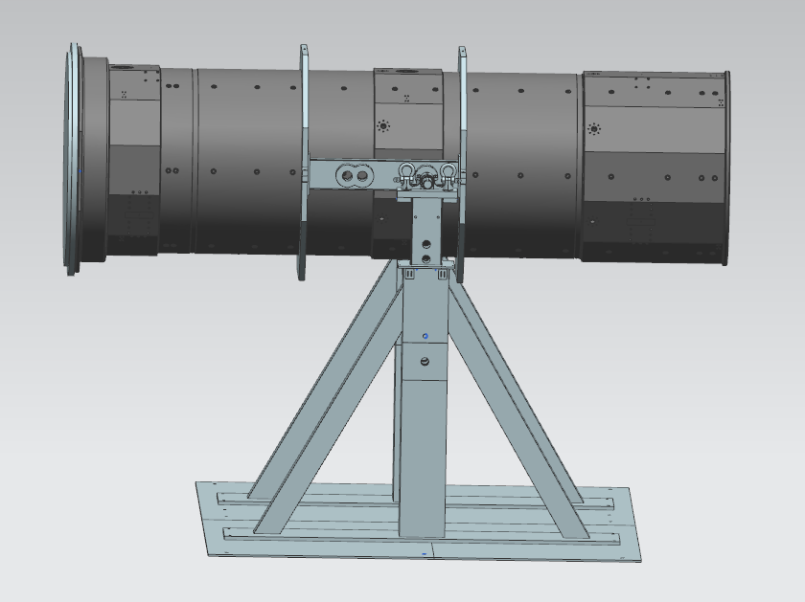
Challenges – Assembly in Flipping Fixture
Flipping fixture rotates horn outer conductor for inner and outer conductor mating
Flipping fixture and Horn B use up nearly all available hook height
32 ft minimum required
~35 ft hook height
6” clearance between conductors
30.9 ft
Initial orientation of Horn B OC in fixture
Inner conductor lowered into outer conductor

Slide 13
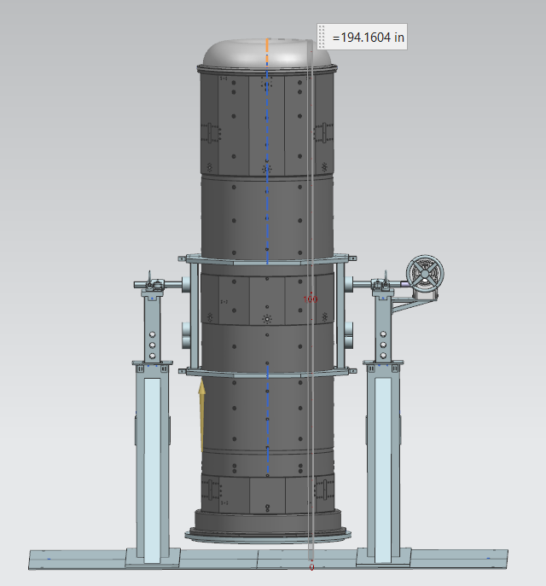
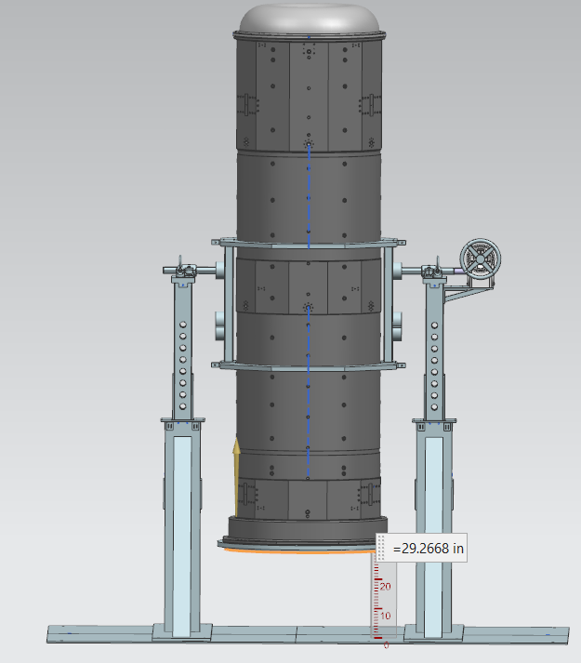
Challenge – Assembly in Flipping Fixture
Must raise stands’ inner telescoping beams midway through assembly
Allows for rotation of conductors back to horizontal
Raise both beams equally without binding
Install connecting plate and ceramic ring
16.2 ft
2.4 ft
Raising stand height for ceramic ring and connecting plate installation

Slide 14
Summary
Fabricating Horns B & C pose the most challenges
Dependent on one vendor for forgings
Little margin for error for weld routine creation for inner conductor
Nickel plating and anodizing fixtures required to take up minimum volume
Assembly in flipping fixture requires challenging stand adjustment with conductors installed

Slide 15
Backup

Slide 16
Horn C Weld

