Slide 1
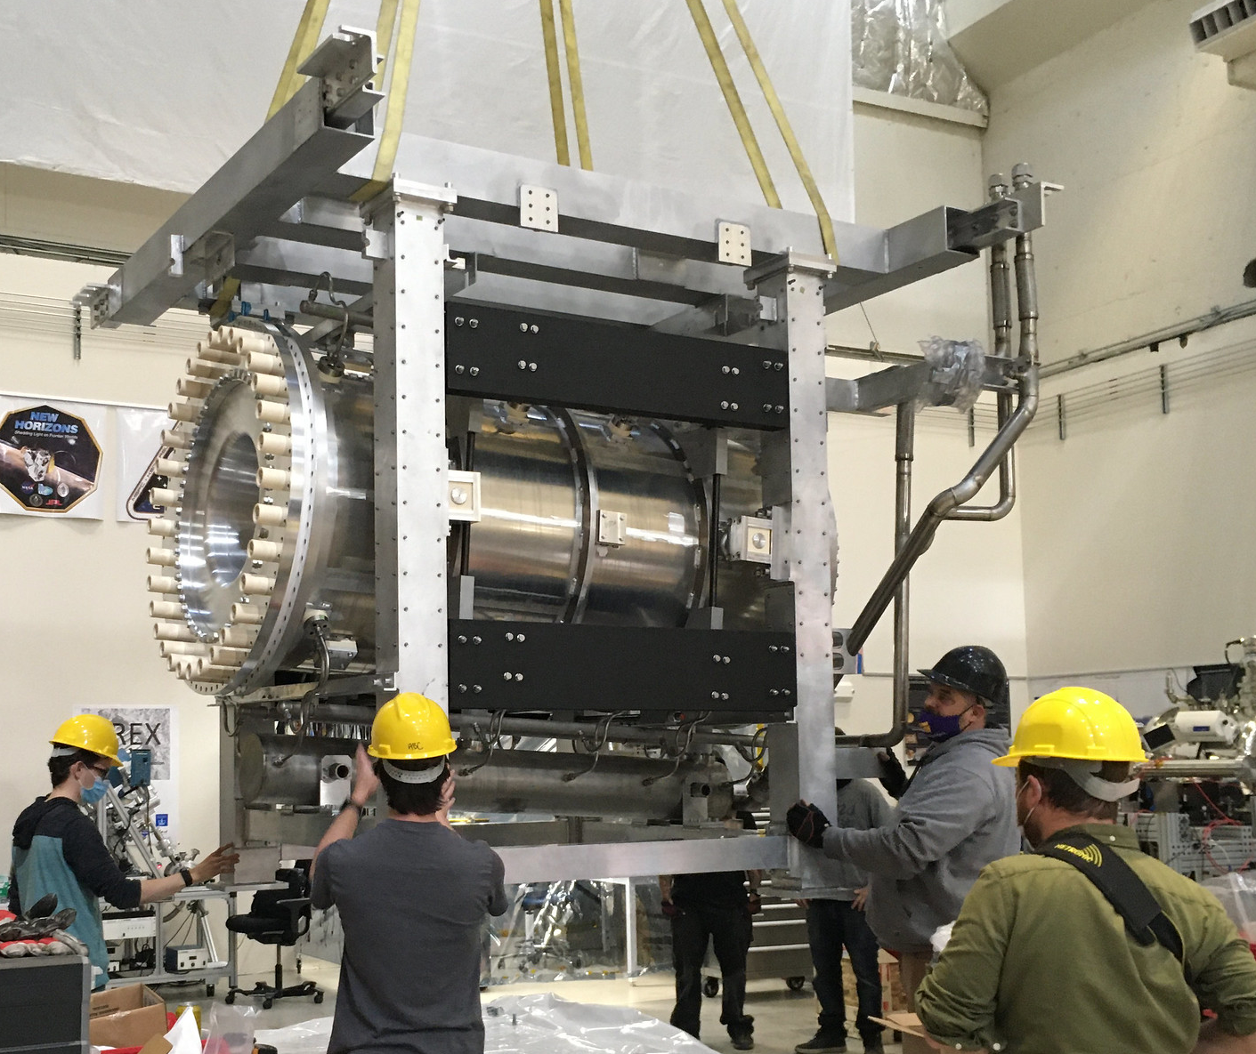
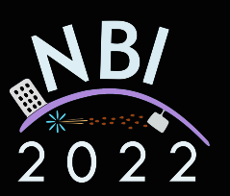
Horn Construction at CU Boulder
Michael Reh
for

Slide 2
Content
T2K horns
Updates to design
Recent construction

Slide 3
T2K Horns
T2K uses 3 aluminum focusing horns
Beam target sits inside first horn
Two more horns downstream help to direct the beam towards the near and far detectors
Suspended in a helium chamber, cooled by water from spray nozzles mounted on outer conductor
Target
Water sprayed from outer conductor onto inner conductor
Beam
Helium chamber
Horn 1
Horn 2
Horn 3
Notes:
3 horns, get sequentially larger
First horn houses beam target
Cooling: Beam would melt the horn if no cooling. Minor heating leads to thermal expansion which can hurt horn alignment

Slide 4
T2K Horn History
Generation | Horn 1 | Horn 2 | Horn 3
1 | Japan (2009-2013) | CU (2009-2013) | Japan (2009-2013)
2 | Japan (2014-2022) | CU (2014-2022) | Japan (2014-present)
3 | CU (2023-?) | CU (2023-?) | -
4 | CU (Spare) | - | -
Starting production soon!
Most recent production at CU
Notes:
Horns are replaced as a precaution
No T2K has failed thus far
Recent replacements will help with the beamline upgrade challenges

Slide 5
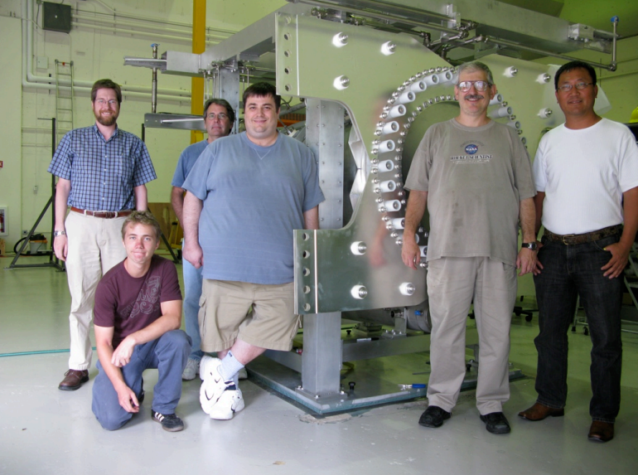
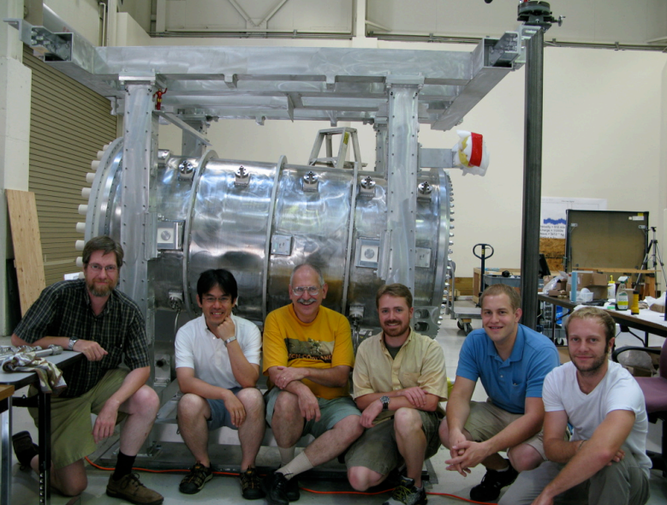
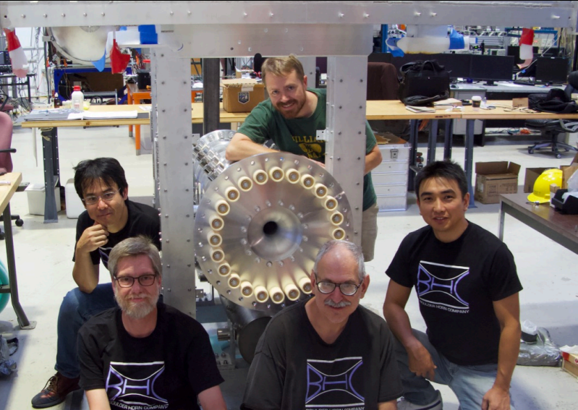
Past CU Horn Production Teams
2007-2008, Horn 2
2012-2013, First Replacement Horn 2
2014-2019, Second Replacement Horn 1

Slide 6
What’s New with Horn 2?

Slide 7
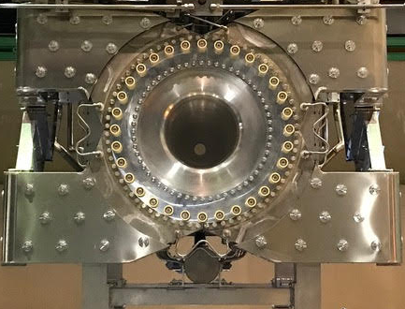
Design Updates to Horn 2
Motivation:
Upgrading beam power (500 kW -> 1.3 MW)
Upgrading horn current (250 kA -> 320 kA)
Other ease of production upgrades
Notes:
More current should increase beam flux 10%
More power also increases beam flux (more protons coming in)

Slide 8
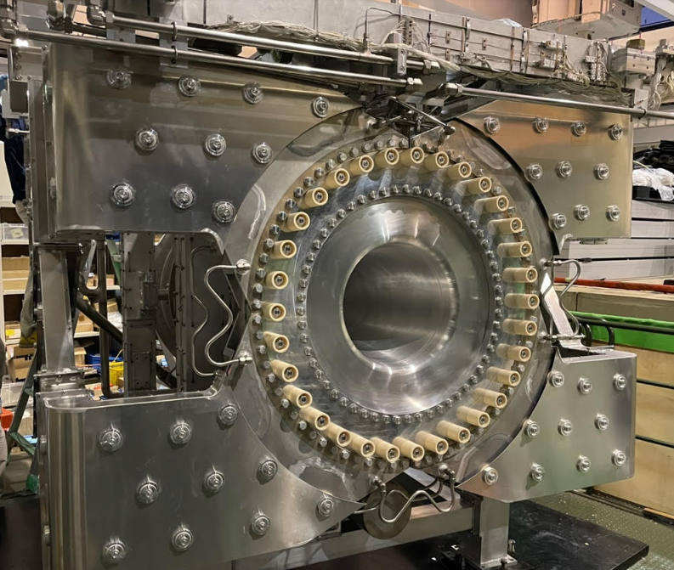
Design Updates to Horn 2
Upstream cooling lines to handle higher power beam & higher current (made in Japan)
Cooling lines embedded in the upstream flange and strip lines
Water lines electrically isolated using ceramic buffers
Strip Line Cooling
Flange Cooling

Slide 9
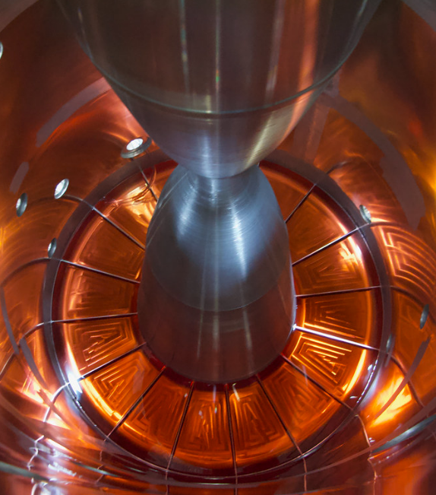
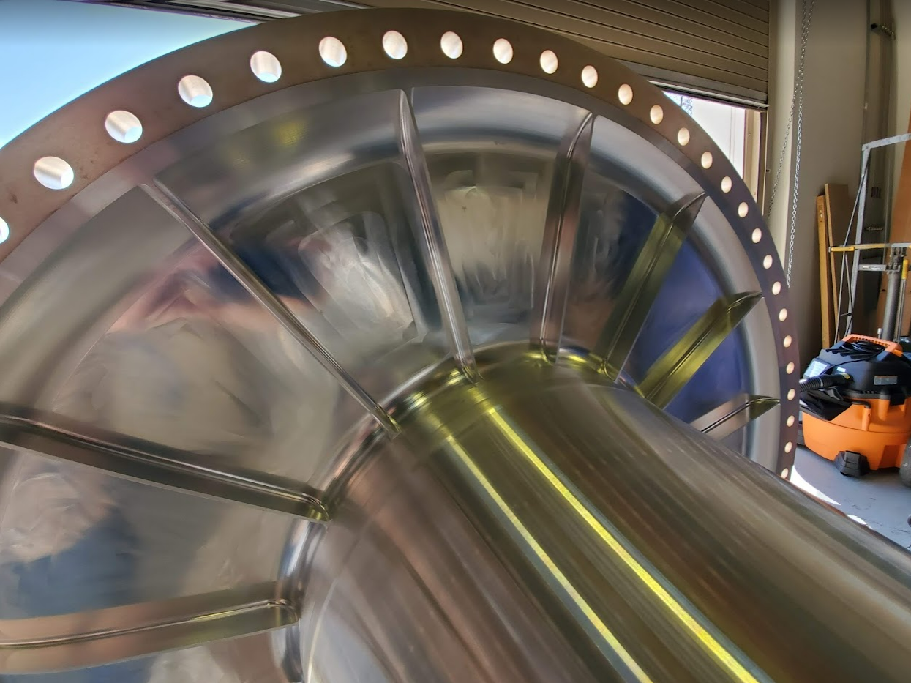
Design Updates to Horn 2
Added ribs to the inner conductor to improve resistance to magnetic and thermal warping
The previous horn 2 had a large tympanic vibration -> ribs will help reduce fatigue

Slide 10
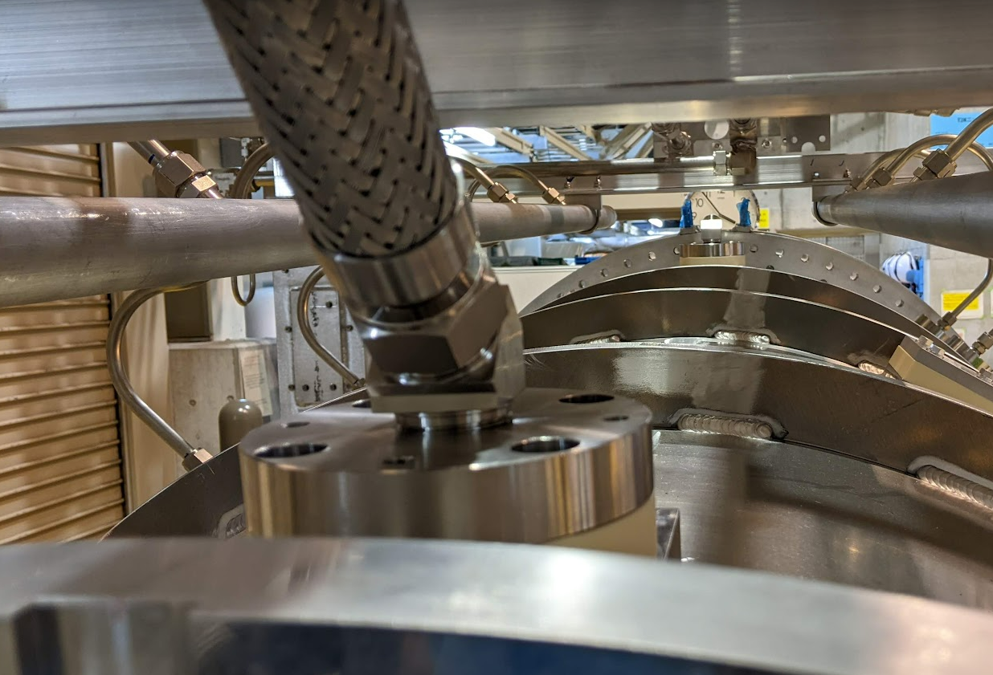
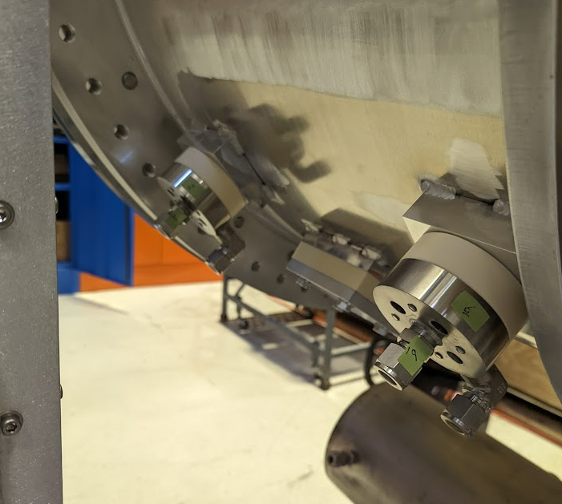
Design Updates to Horn 2
Replaced steel and aluminum bolts with titanium in several places (cooling nozzles, helium ports, threaded rods holding inner/outer conductors together)
Previously, would torque with steel screws to crush seals, then replace 1:1 with aluminum screws
Now, use titanium screws from the start
Notes:
Ti has higher Z (more impacted by beam), but also stronger and so less failure prone than Al

Slide 11
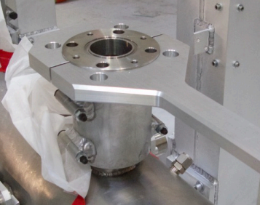
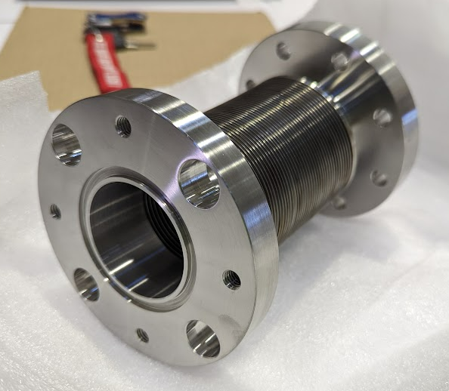
Design Updates to Horn 2
Changed the design of drain bellows
Previously welded directly to the drain tank
Now can be more easily moved as needed; easier to crush seals
Flange bolt size increased for stronger seal
Previously welded to the drain tank
No longer pre-welded; easier to install due to being unconstrained
Notes:
Previously had to crush seals on top of the drain tank
Now have more flexibility for assembly

Slide 12
T2K Horn 2 Construction at CU (2021-2022)

Slide 13
Challenging Times
Slow part procurement & production due to worldwide supply chain issues (COVID)
Had to change vendors for several parts
Over-reliance on local machining due to difficulty working with external vendors

Slide 14
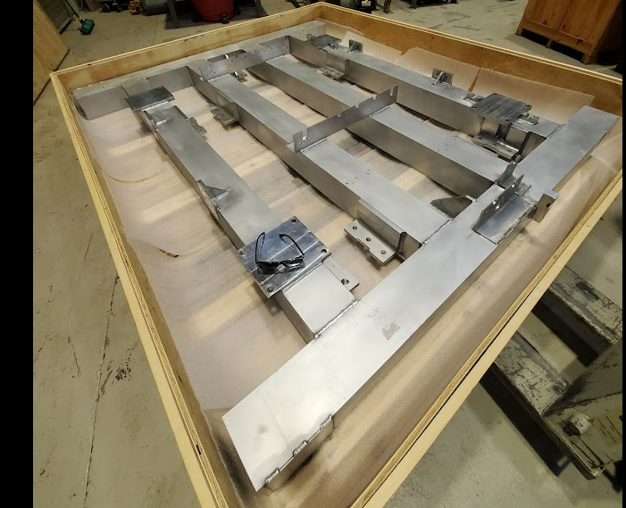
Delivery of Major Pieces (2021)
Received major pieces in early 2021
Top frame from GETT Industries (February 2021)
Notes:
Left in its crate since it goes on late in production

Slide 15
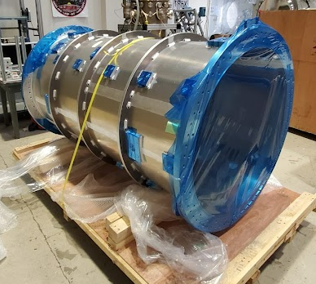
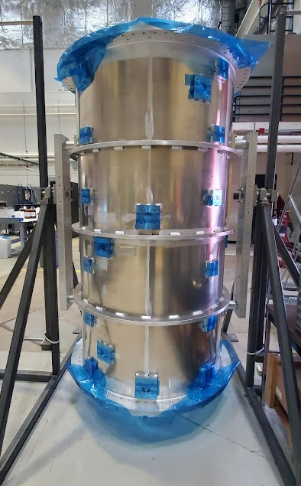
Delivery of Major Pieces (2021)
Received major pieces in early 2021
Top frame from GETT Industries (February 2021)
Outer conductor from Japan (February 2021)
Rotating Fixture
Notes:
Mounted in rotating fixture for later

Slide 16
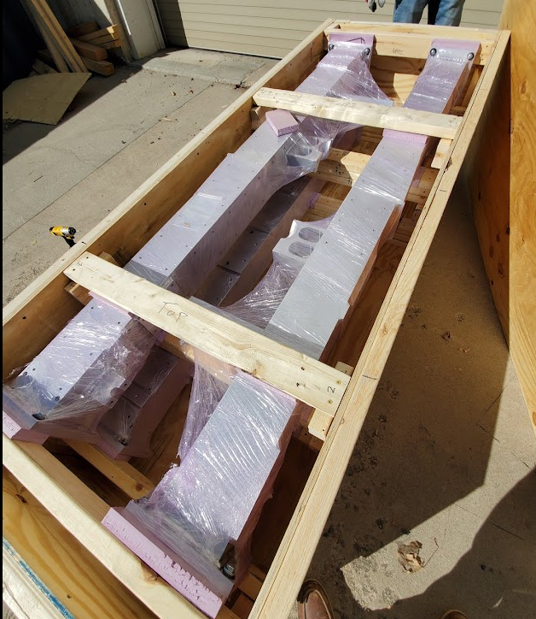
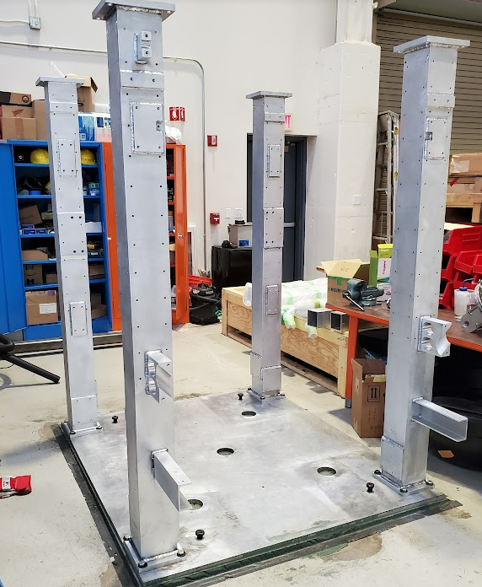
Delivery of Major Pieces (2021)
Received major pieces in early 2021
Top frame from GETT Industries (February 2021)
Outer conductor from Japan (February 2021)
Frame columns from Boston University shop (March 2021)
Grout-leveled plate
Notes:
BU shop did a great job, think we will be working with them more in the future

Slide 17
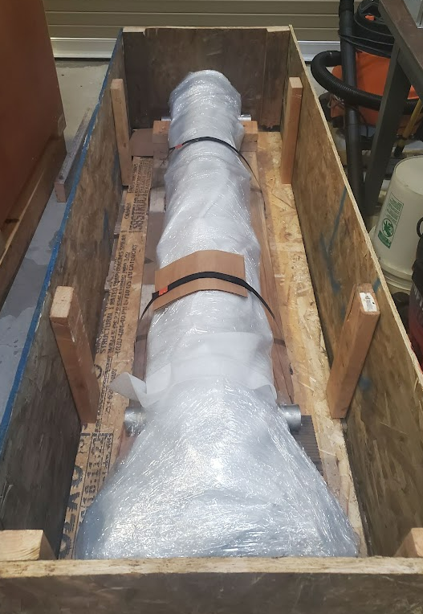
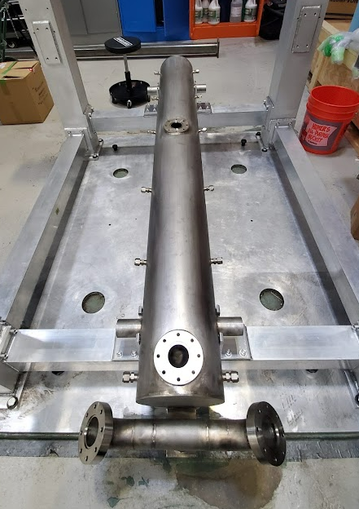
Delivery of Major Pieces (2021)
Received major pieces in early 2021
Top frame from GETT Industries (February 2021)
Outer conductor from Japan (February 2021)
Frame columns from Boston University shop (March 2021)
Drain tank from Bright Light Welding (April 2021)
Notes:
Installed among the frame columns

Slide 18
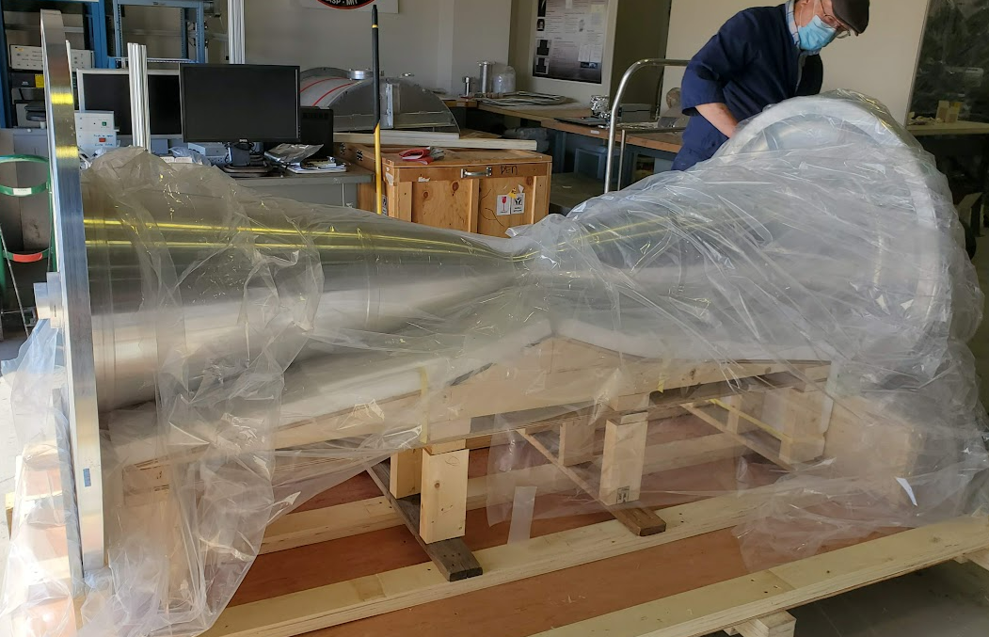
Delivery of Major Pieces (2021)
Received major pieces in early 2021
Top frame from GETT Industries (February 2021)
Outer conductor from Japan (February 2021)
Frame columns from Boston University shop (March 2021)
Drain tank from Bright Light Welding (April 2021)
Inner conductor from Japan (April 2021)

Slide 19
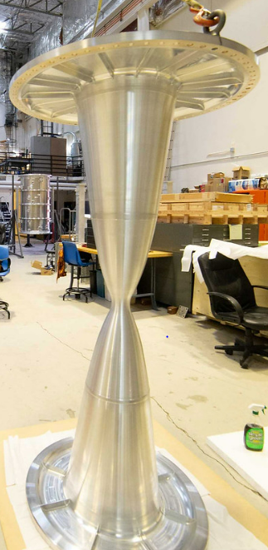
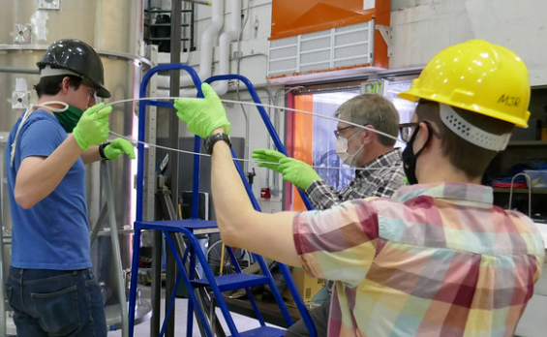
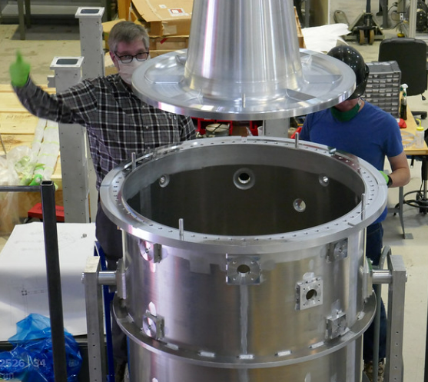
Installing the Inner Conductor
Lifted inner conductor using eye bolts (no extra support required)
A soft aluminum seal gets crushed between conductor flanges
Notes:
Larry did a deflection test to show that no extra support was needed for I.C. (would not buckle)
Soft aluminum seal flows under pressure, filling in gaps between flanges

Slide 20
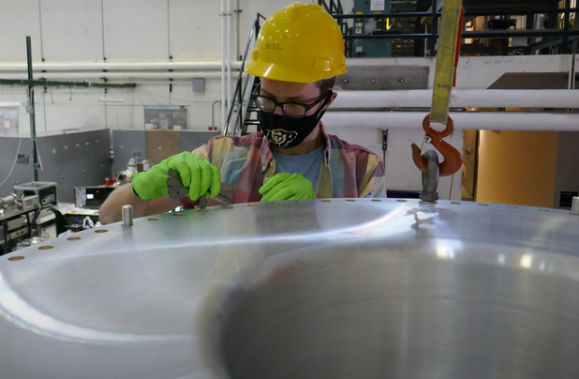
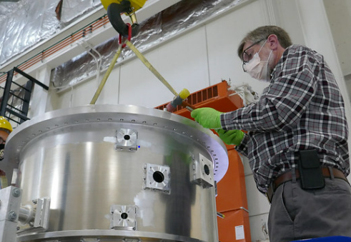
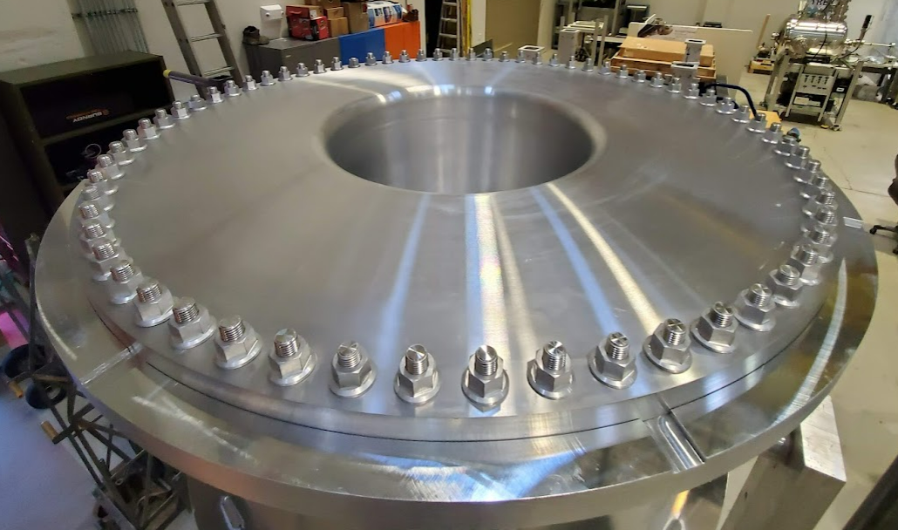
Installing the Inner Conductor
Centered inner conductor to within 0.2 mm!
Feeler gauge
Tighten in “star” pattern (uniformly crush seal)
Notes:
Feeler gauge all around to ensure centering
Tightened nuts in a star pattern to uniformly crush the seal
Spiralock nuts do a great job of holding, but were a huge pain to order

Slide 21
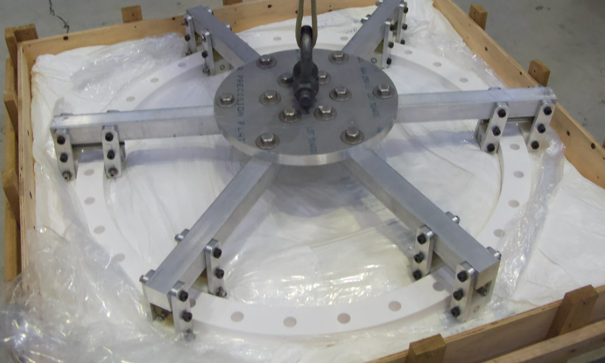
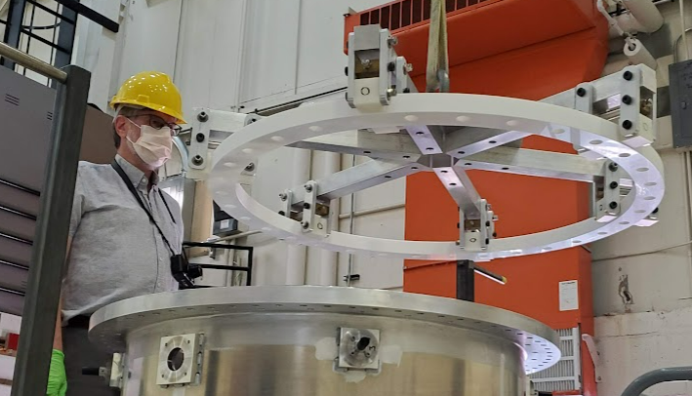
Upstream Ceramic
Conductors isolated by ceramic ring on upstream end
“Spider” lifting fixture
Teflon contacts grip the ceramic ring
Ceramic Ring
Notes:
Ceramic requires special “spider” lifting fixture -> too fragile to sustain its own weight

Slide 22
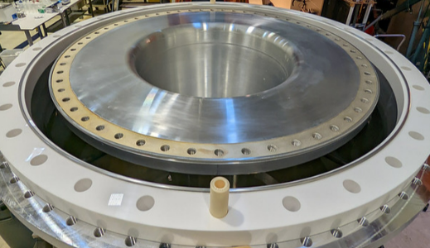
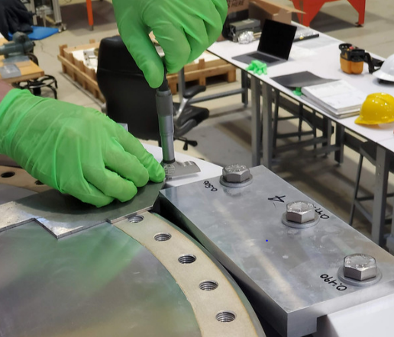
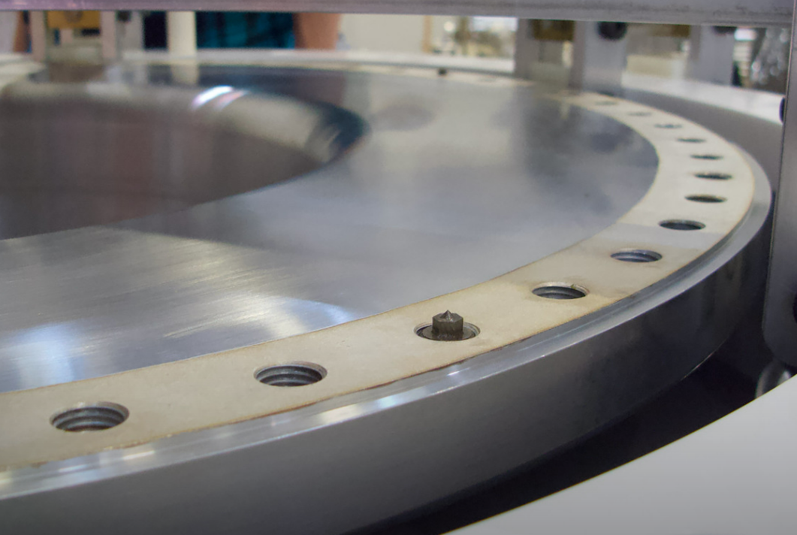
Upstream Flange
Must transfer depth measurements to flange to get a good fit
Depth gauge locates ceramic ring and conductor
Transfer punches locate the clocking on the flange
Notes:
Flange must be machined to match depth of I.C. and ceramic all the way around
Don’t know the exact depths and clocking until the test-fit
Machining was outsourced (can’t remember where)

Slide 23
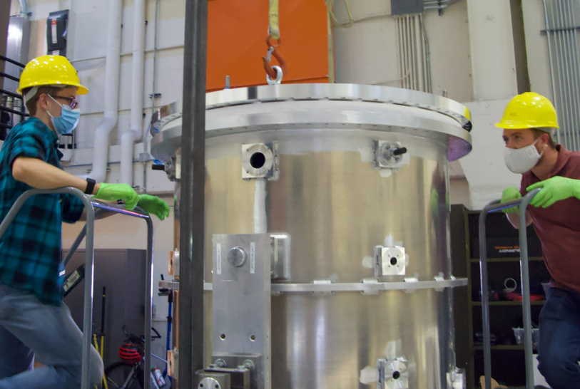
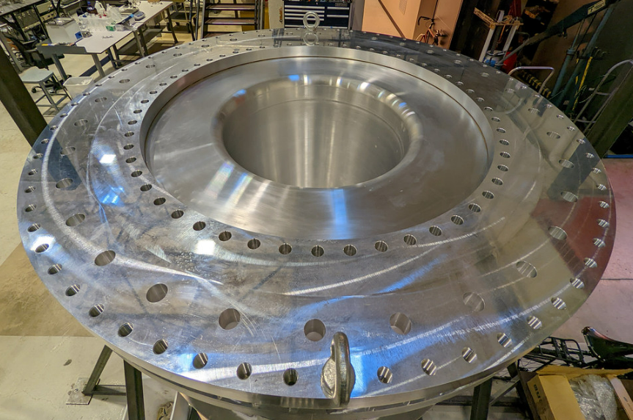
Installing Upstream Flange
Sent the flange for machining, then installed it on upstream end
Notes:
Flange had to be redone because the first job didn’t go so well

Slide 24
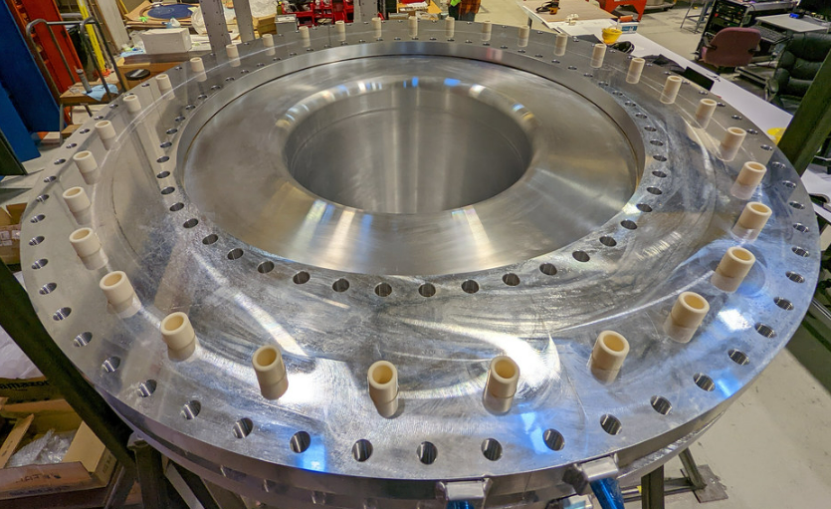
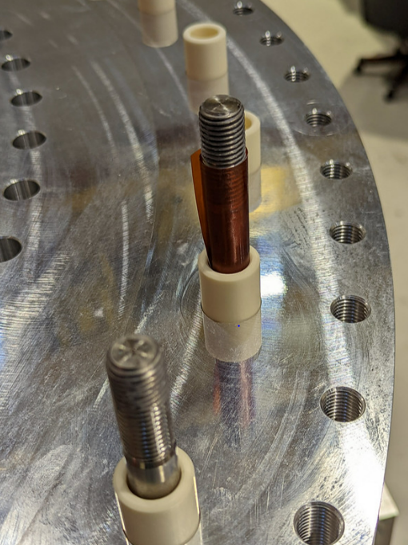
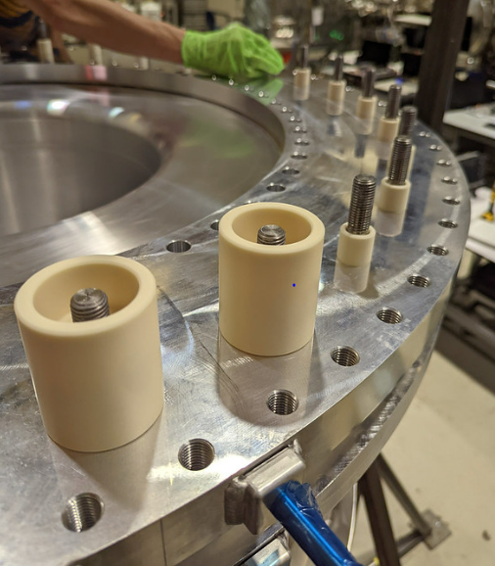
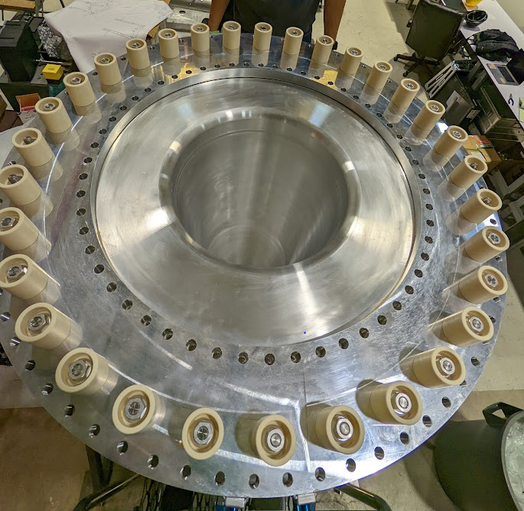
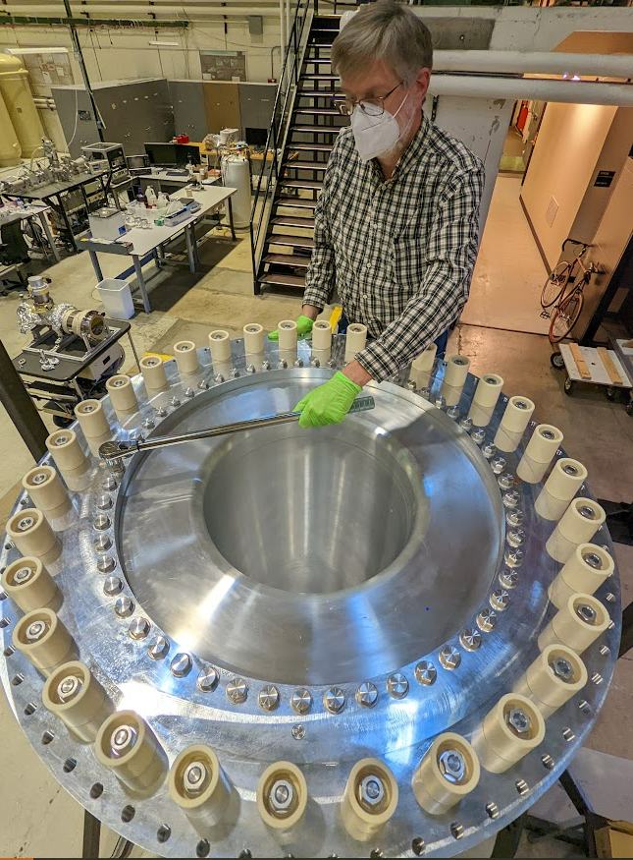
Installing Upstream Flange
Ceramic tubes isolate threaded rods from flange
Spiralock nuts hold flange to the outer conductor
Tightened w/ star pattern to uniformly crush seals!
Notes:
Kapton on threaded rods to prevent rods from scratching ceramic
Flange in electric contact with I.C.; isolated from O.C.

Slide 25
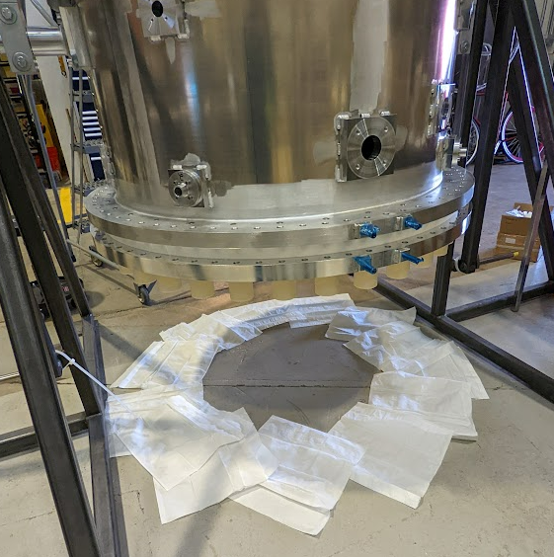
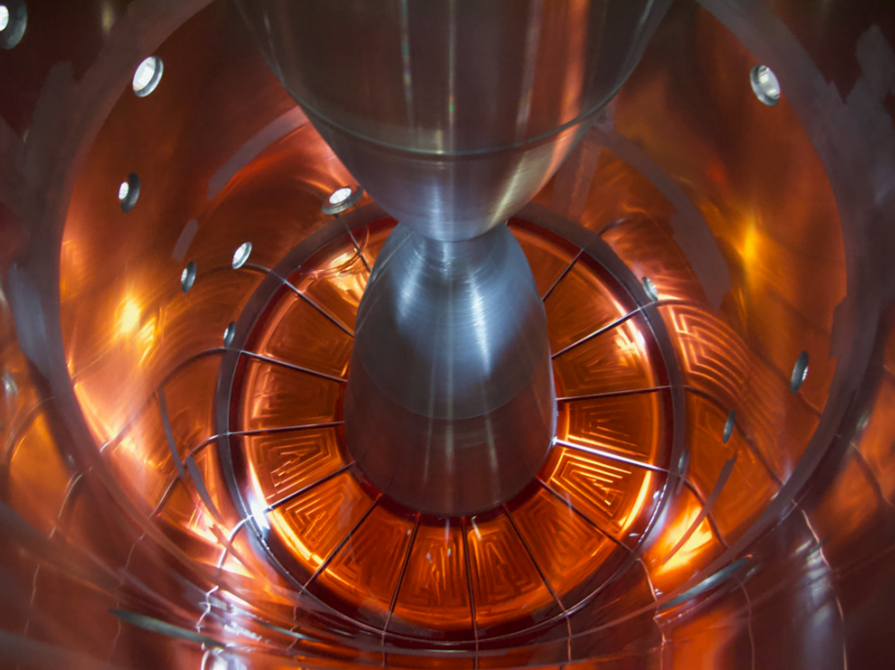
Leak Testing
Check the performance of the seal
Red food coloring + kimwipes make leaks easy to identify
Tests performed for both upstream and downstream ends
No leaks after 24 hrs!
Notes:
Both upstream and downstream seals were tested in this way
Used a siphon to get liquid in and out

Slide 26
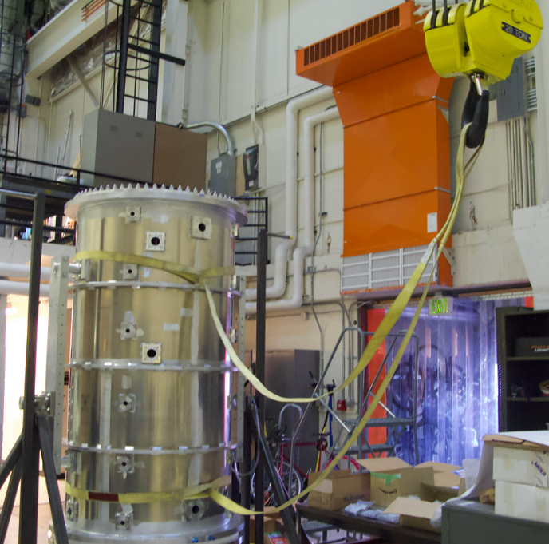
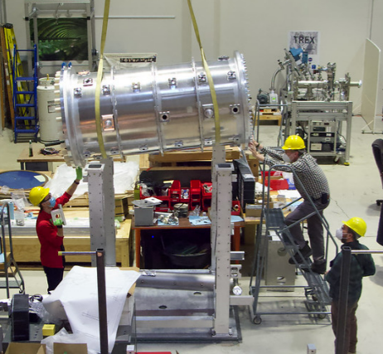
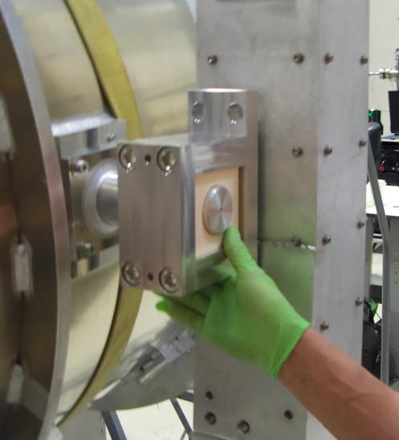
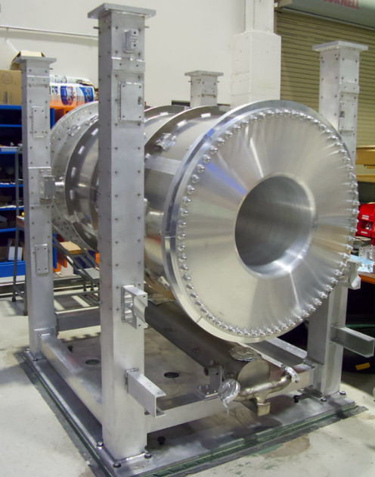
Moving Conductors into Frame
Horn connected to columns with ceramic isolation blocks

Slide 27
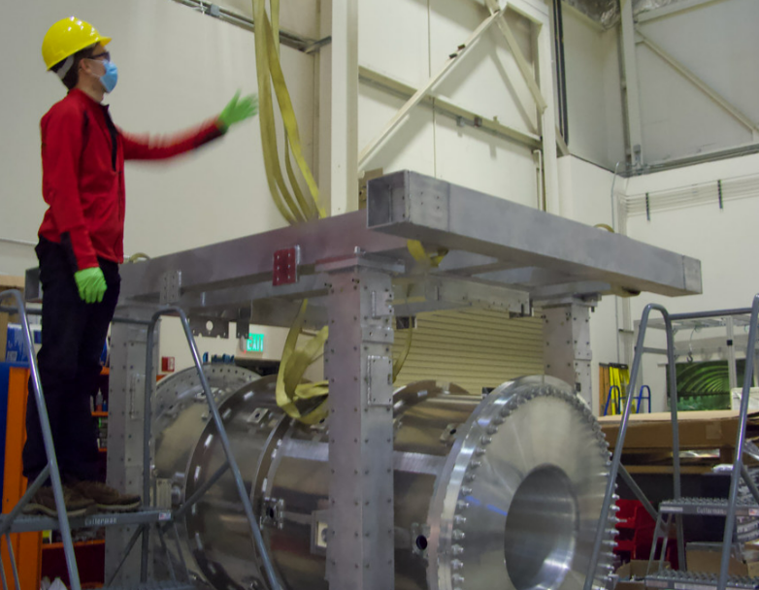
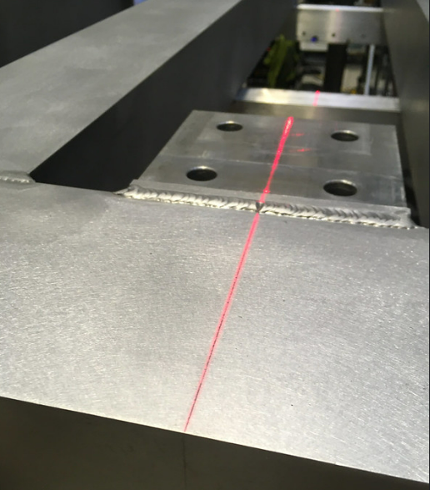
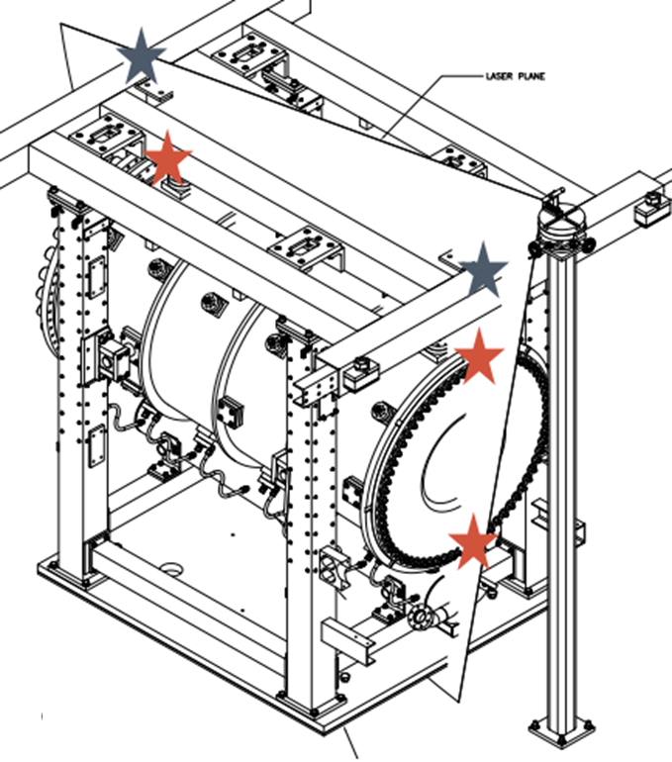
Installing the Top Frame
Moved the top frame onto the columns
Use a laser to align top frame to outer conductor
Aligned frame to within the guide laser’s precision (1 mm)

Slide 28
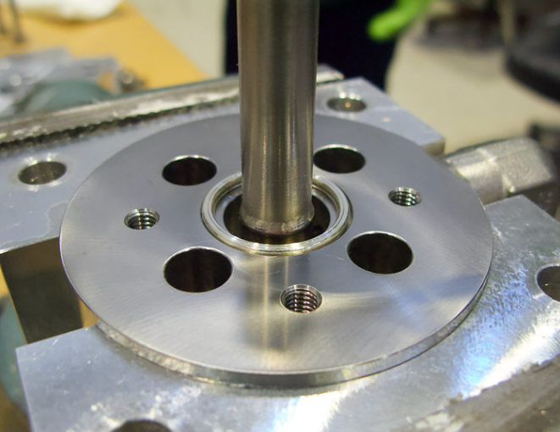
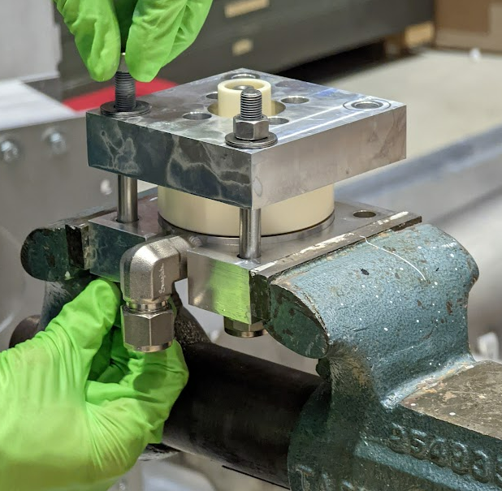
Seal Crushing
Use helicoflex seals between ceramics and stainless steel parts
Quite tough to crush
Need to ensure good ceramic-steel interface
Use a custom jig to do the crushing
Helicoflex between SS and ceramic
Get extra crushing power from external plates
Notes:
Helicoflex seals are tough to crush, so need extra power from external jig
24 spray nozzles, made in this way

Slide 29
Seal Crushing
Similar process for other seal crushing
Drain bellows seal crushing:
Hold ceramic + steel flange
Custom Clamp
Crush using external plate
Notes:
Uses another unique clamp to hold pieces in place, but the main steps are the same.

Slide 30
Seal Crushing Problems
Light gap re-opens after removing crushing plates (gap between ceramic and steel)
Tried tightening bolts past torque specs
Added grease under bolt heads to reduce torque loss to friction
Tried newer seals
Bellows clamp leaves metal marks on the ceramic
Will have to modify the clamp in the future so it only contacts the steel flange
Notes:
Most of the helicoflex seals used here were leftovers from previous horns
Have to hope that the light gap does not translate to water leaks
Bellows flange is thinner than it used to be, so the normal clamp is now too big

Slide 31
Plumbing
Attached water cooling nozzles using titanium bolts
Cleaned and installed water manifolds
Bent tubes connect nozzles to supply manifolds and drain tank
Tube shape allows for some flexibility, but the fits are still very tight
Notes:
Had to manually bend one of the tubes to make it fit
Auxiliary drains prevent corrosion of SS nozzles
(lesson from MiniBoone horns)

Slide 32
Pressure Test
Pressurized to +14 psi with compressed air
Fell to 10 psi in 20 hours
Main source of leaks was temporary Viton seals on helium ports
Spot-checked all joints with snoop and tightened any visible leaks
Tighten the leaky joints
Notes:
At this point, the horn is not complete; several temporary seals in place
Viton seals were the main source of leaks
Being replaced later anyways, so no big deal
Tightened up any Swagelok connections that might be leaky

Slide 33
Shipping
Shipping fixture helps to reduce horn motion in transit
Protects the ceramic blocks that hold the conductors
Braces fix conductor ribs to frame
Held together by long threaded rods
Brackets too big to lift by hand
Connect upstream and downstream ribs; tight fit
Notes:
Shipping fixture is a pain to install due to constraints
Helps support conductors and take stress off ceramic blocks

Slide 34
Shipping
Same crating company used for all horns built at CU
Craters & Freighters
Protecting the flange ceramics
3 meter cube!

Slide 35
Shipping
Military vehicle on our shipping truck
?!?
Horn in crate
Notes:
Surprise guest riding on our delivery truck
Military vehicle followed by huge black tarp box -> very suspicious on highway

Slide 36
Shipping
Tight fit trying to extract horn crate from the CU lab
Notes:
Driven from CU to LAX, flown in a 747 to Japan
Military vehicle followed by huge black tarp box -> very suspicious on highway

Slide 37
Work in Japan
Stephen Coleman and I travelled to J-PARC to work with Tetsuro Sekiguchi-san on the remainder of the horn
Installed plumbing for frame cooling, flange cooling, and helium

Slide 38
Work in Japan
Problems with parts
Some changes in plumbing design didn’t make it to production drawings
Flex hoses for water draining had to be reinforced on the fly after seeing previous hoses break
Flex hoses for water return were destroyed during removal of the old horn.
Reinforced for the future.
Notes:
Some parts the wrong size, wrong fits due to not having all of our production drawings ready
E.g. ordering of water return lines was changed
Some modifications had to be made on the fly, e.g. the reinforcement of flex hoses

Slide 39
Work in Japan
Last bit of plumbing, and strip lines were installed by Sekiguchi-san, completing the horn
Successfully installed in the helium vessel as of September 1!

Slide 40
Upcoming Production
New T2K spare horn 1 production to begin soon
CU is committed to building the next Horn 1 for T2K, and more horns in the future!
Notes:
Want to get top frame & columns this FY, rest of production next FY

Slide 41
Thank you!
T. Sekiguchi
M. Reh
S. Coleman
K. Allison
B. Rumberger
A. Cudd
L. Bartoszek
E. Zimmerman

Slide 42
Backup
Notes:
Want to get top frame & columns this FY, rest of production next FY

Slide 43
T2K Horns
Design produces a toroidal field that can focus or de-focus either positive or negative charges to give a neutrino or anti-neutrino beam depending on horn current direction
Pulses every 2.48 s @ 250 kA for ~2.1 T field
Cross section cartoon of horn 2
Notes:
Current direction drives particle selection

Slide 44
Cleaning Parts
Simple Green and isopropyl alcohol go a long way
Inner conductor
Outer conductor
Soft aluminum seals
Have to edge off waterjet burrs with stone
Notes:
Had to edge water jet burrs off the aluminum seals using sharpening stones

Slide 45
Rotating the Conductors
To ensure the inner conductor does not bend while rotating the fixture, installed steel braces to hold it in place

Slide 46
Leveling Columns
Uneven frames make horn alignment uncertain
Largest difference between column levels = 3/128” (acceptable)
Notes:
Leveling is a testament to the quality from the BU shop

Slide 47
Frame Cooling
U-shaped water lines go into each column to reduce thermal expansion
Held into place with dozens of aluminum blocks
Had to hand-tap all ~100 of them ☹
Special tool for locating blocks
Holding Blocks
U-channel

Slide 48
Installing the Inner Conductor
Drilling and tapping holes for the lifting eye bolts

Slide 49
Installing the Top Frame
Re-mounted laser because previous floor threads were unusable
Guide laser could not easily reach all score marks
Had to custom-mount the laser
Laser had to be mounted with duct tape for it to line up correctly
Drilling new holes for laser mount

Slide 50
Plumbing
Water drain pipes had some trouble with clamping
Clamp holes
Bracket too wide!
Had to pivot to U-bolts
Bracket holes

Slide 51
Seal Crushing
Steel spray nozzle
Custom vise clamp
1. Place nozzle in clamp
Notes:
24 spray nozzles to make

Slide 52
Seal Crushing
Seal to be crushed
1. Place nozzle in clamp
2. Add helicoflex seal

Slide 53
Seal Crushing
1. Place nozzle in clamp
2. Add aluminum seal
3. Cover seal with ceramic piece

Slide 54
Seal Crushing
Finger loose during crushing!
1. Place nozzle in clamp
2. Add aluminum seal
3. Cover seal with ceramic piece
4. Prepare bolts

Slide 55
Seal Crushing
Bring bolts up to torque after seal is crushed
Crush until no light gap here
1. Place nozzle in clamp
2. Add aluminum seal
3. Cover seal with ceramic piece
4. Prepare bolts
5. Add top crushing plate & crush seal by tightening nuts
Notes:
Crush seal by tightening bolts sequentially (want seal to crush uniformly).
Tighten until no light can be seen coming between ceramic and aluminum.
Once seal is crushed, tighten bolts up to spec.
Pre-crushing the seal reduces the likelihood of failure from bolt pressure points

Slide 56
Nozzle Problems
Welding nozzles from the outside results in warping
If the flange surface does not lie flat, it may break the ceramic during seal crushing

Slide 57
Plumbing
Attached steel bellows to drain tank (had to get these redone due to bolt holes being misaligned)
Misalignment
Fixed!

