Slide 1
Fermilab Horns Operational Experience
Meredith Lee
Accelerator Division/Target Systems Department
9/20/2022

Slide 2
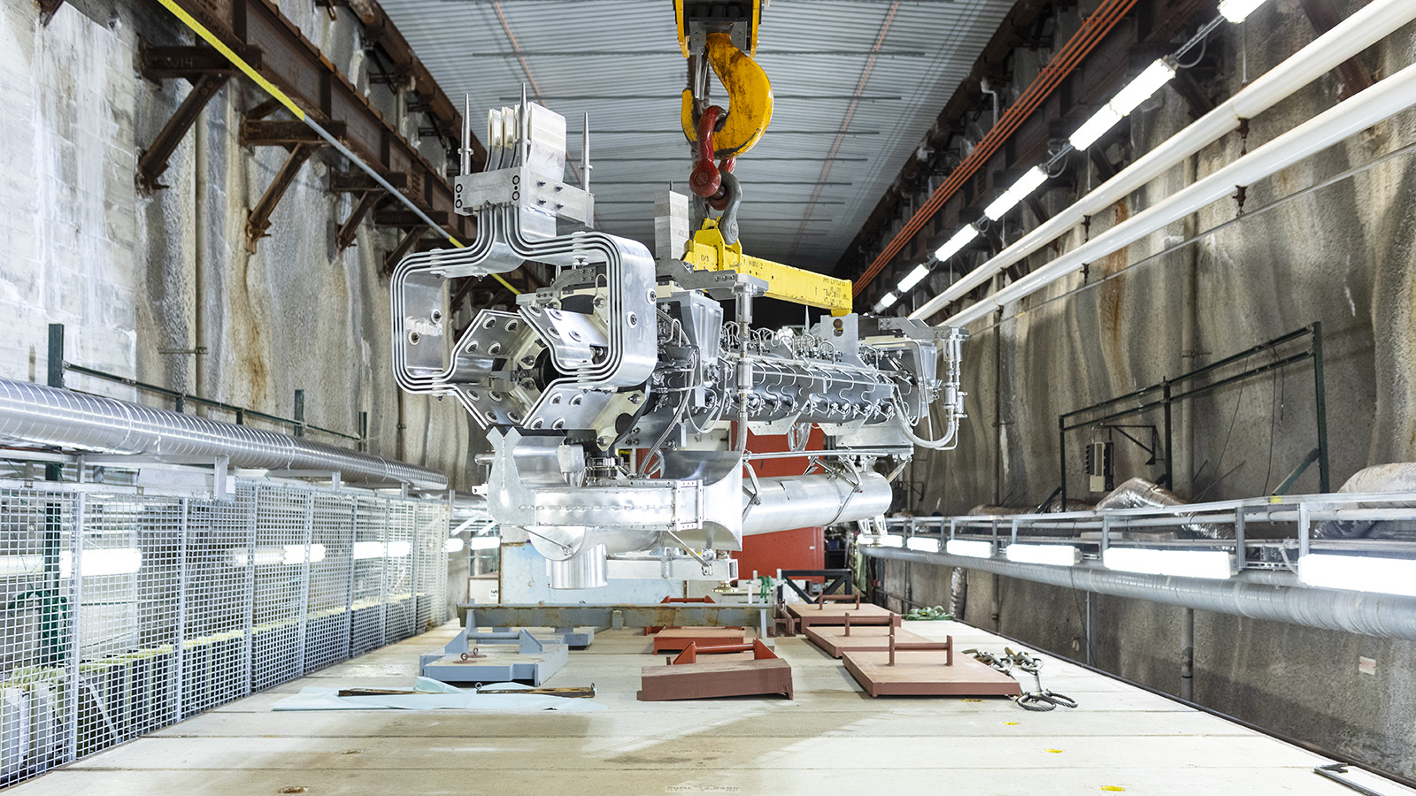
Agenda
Overview
PH2-02 – Leaking Water
SLB-08 – Ground Fault
PH1-04 – Stripline Failure
PH2-01 – Stripline Failure
PH1-03 – Hanger Water Leak
PH1-01 – Broken Suction Line
Summary
1 MW Horn PH1-05 being installed in 2020 shutdown

Slide 3
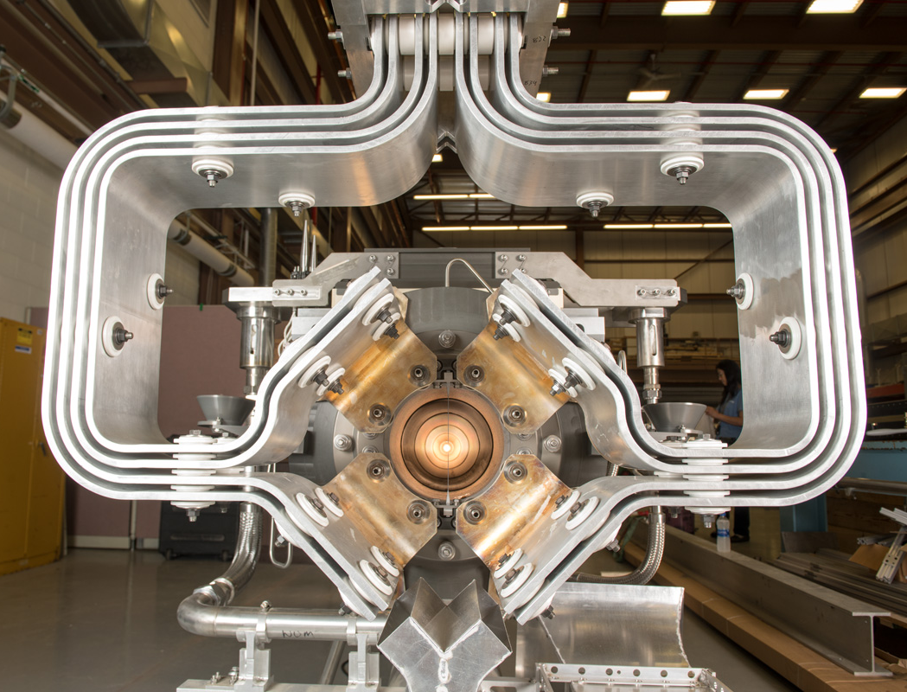
Overview
Running NuMI horns since 2005
Initially designed for 400 kW
Upgraded for 700 kW, then 1 MW operation
Designed for 100 M pulse lifetime
Annual shutdowns is key for horn and target-related maintenance to prolong operations
Replace horns or supporting systems if necessary
1 MW upgrade in 2020
1 MW Horn PH1-05
Horn | Lifetime Pulses
PH1-01 | 24,200,000
PH1-02 | 45,900,000
PH1-03 | 26,960,000
PH1-04 | 52,390,424
PH2-01 | 28,100,000
PH2-02 | 125,250,424
Lifetimes of horns no longer in operation

Slide 4
Overview – History
Several significant horn events during 17 years of NuMI running that have required horn replacement
Some root causes of horn failures have been practicalities of operation
Hard to predict
Not necessarily due to ineffective design, assembly, testing, or install
Same failure has not happened twice
Thorough troubleshooting and resolution of problems

Slide 5
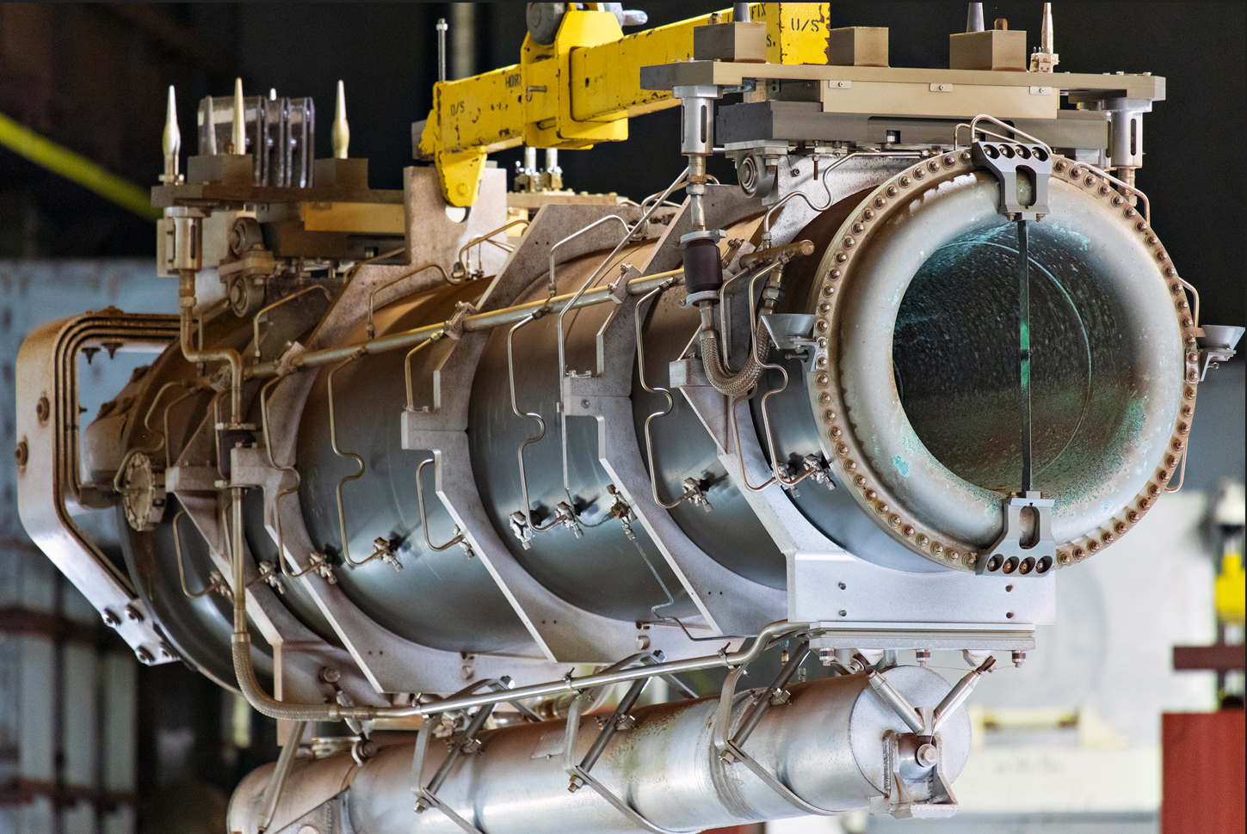
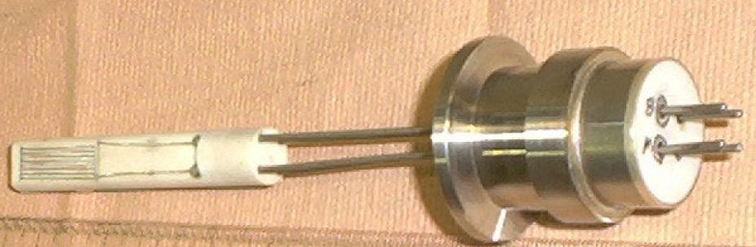
PH2-02 – Leaking Water
PH2-02 leaking water from beam left Bdot
Device used to measure magnetic field
At neck of the horn
Removed during 2020 summer shutdown
Leaking water for ~1 year
4-5 gallons per day
PH2-02 during removal from target hall
Horn 2 Bdot location
Bdot

Slide 6
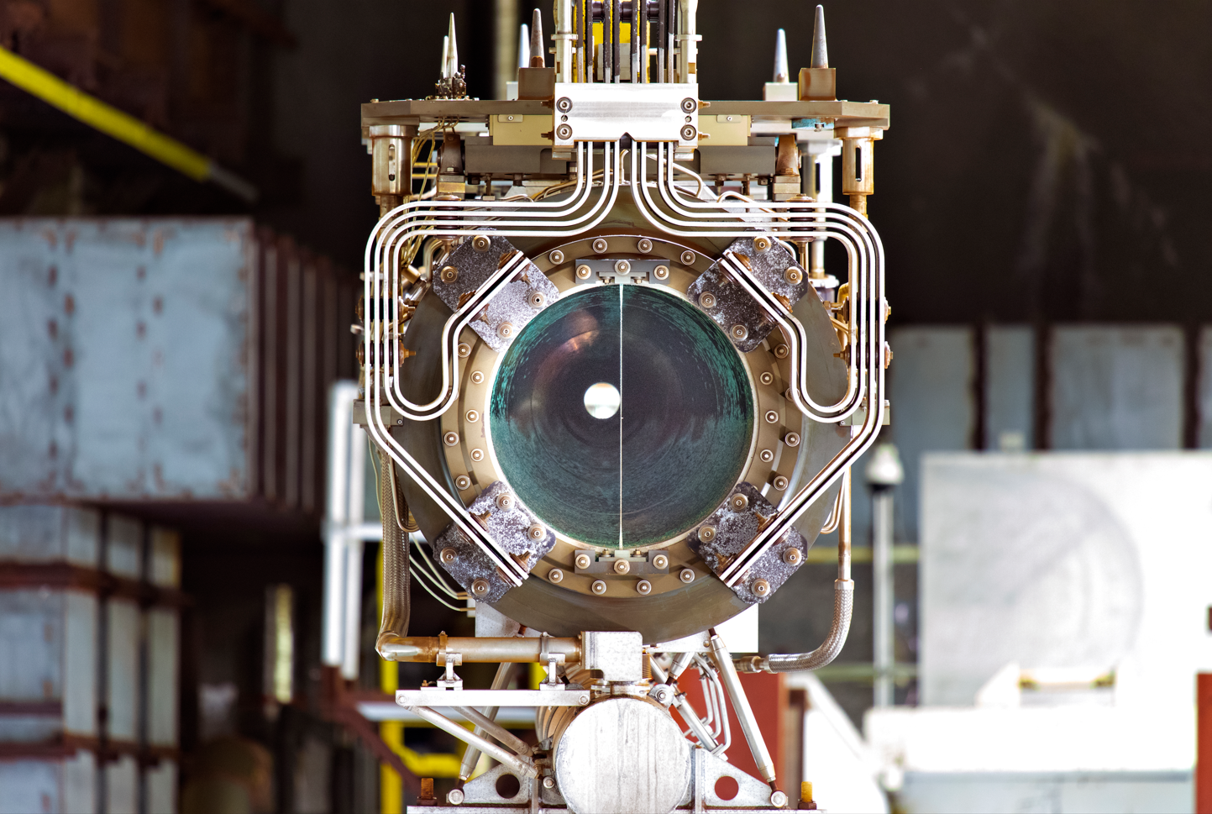
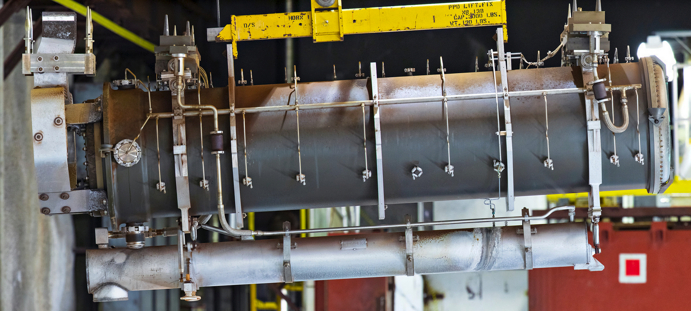
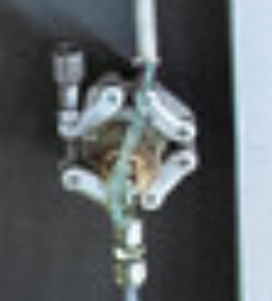
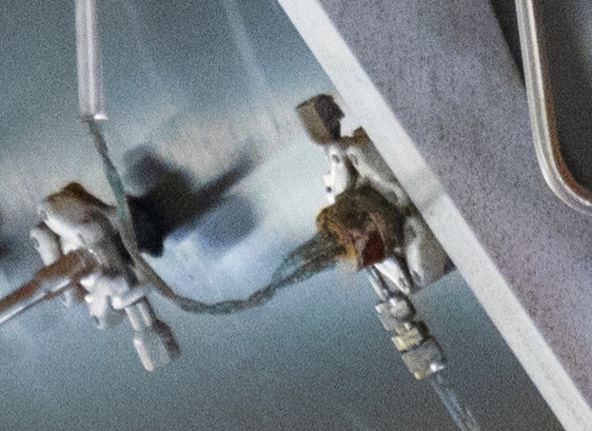
PH2-02 – Leaking Water
Water leak evidenced by corrosion near Bdot
Twelve year lifetime
125,250,424 pulses
Have not used Bdots on subsequent horns
Capped off flange prior to install
PH2-02 during removal from target hall
Corrosion visible at Bdot
PH2-02 during removal from target hall

Slide 7
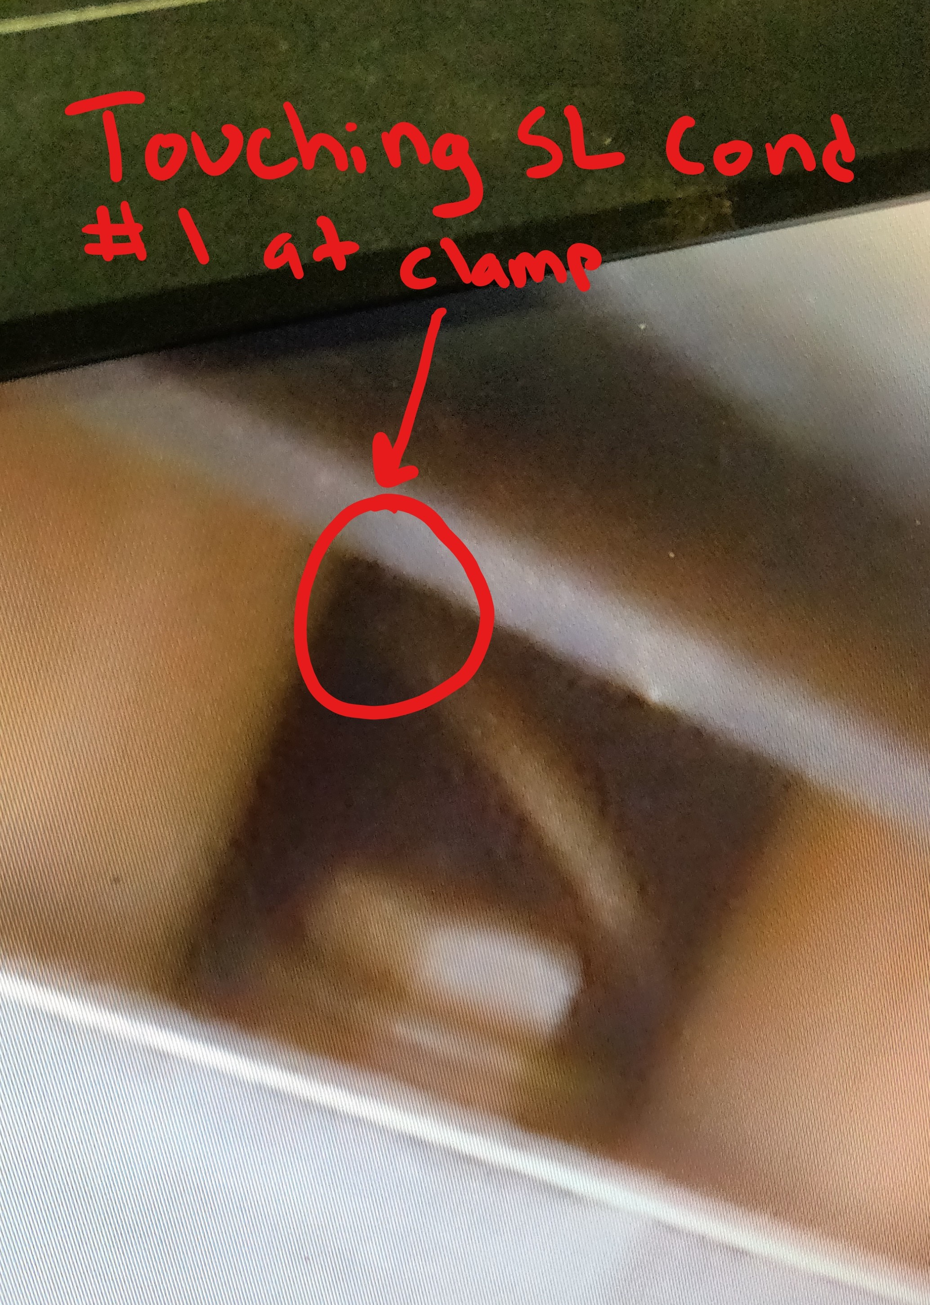
SLB-08 – Ground Fault
Stripline blocks connect power supply stripline to horn stripline
Interior aluminum stripline shielded via thick steel panels
Replaced both NuMI horns and accompanying stripline blocks in 2020 shutdown
1 MW upgrade
Ground fault in the horn system discovered shortly after
Traced to loose washer in the stripline block SLB-08
Shorting current from one of the outermost stripline layers
NuMI stripline block
2020
Borescope image of loose washer

Slide 8
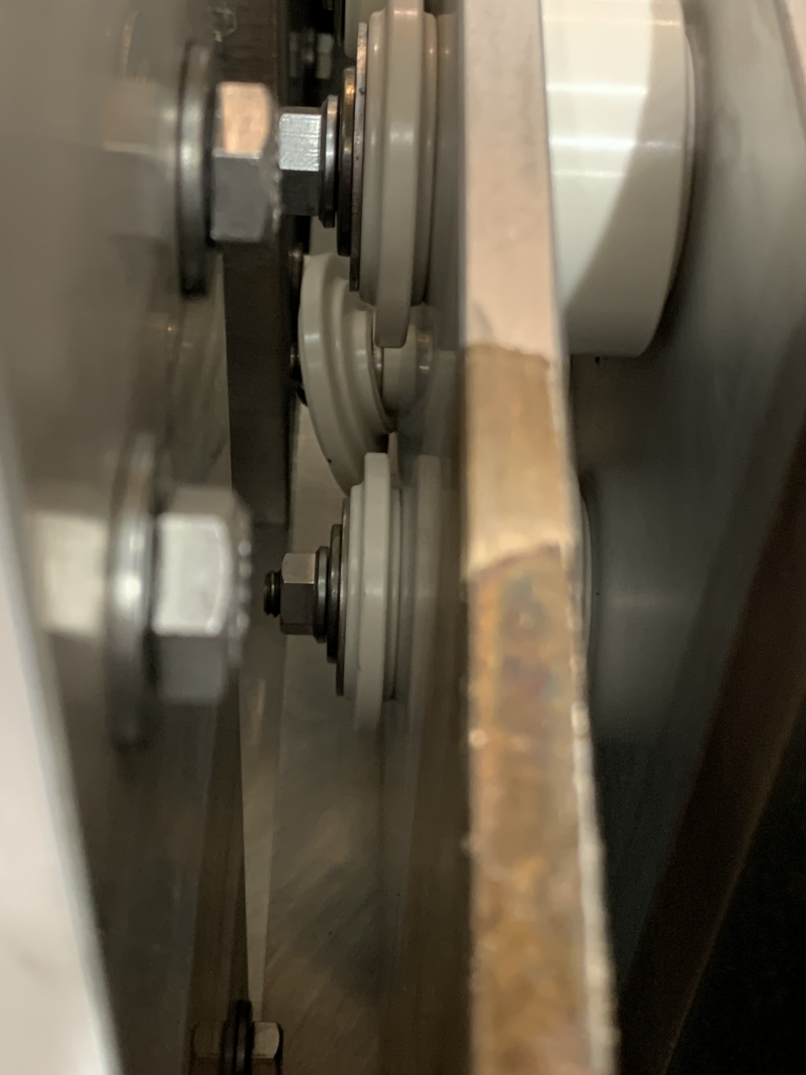
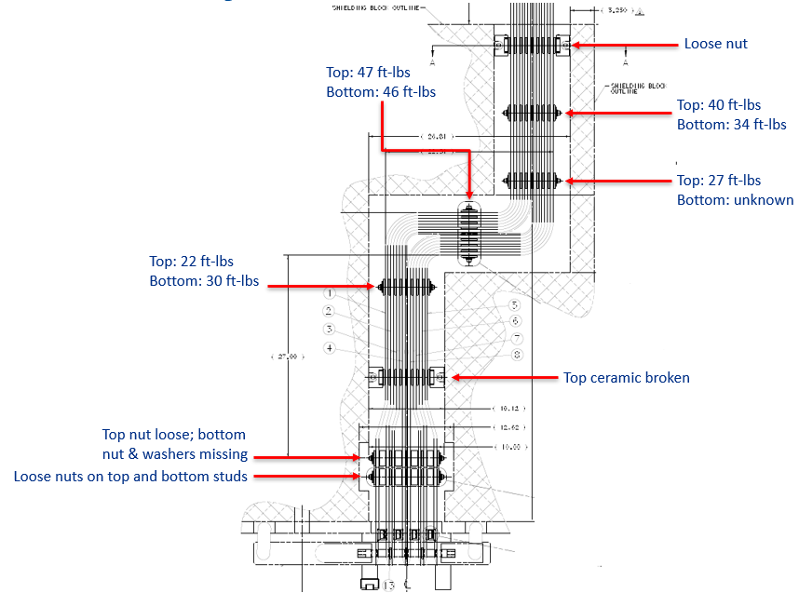
SLB-08 – Ground Fault
Disassembled and removed stripline block covers
One stud found with missing and loose hardware on one end
Other notable anomalies
Recorded breakaway torque for all nuts on rest of stripline
Several lower than 40 ft-lbs torque spec
Root cause: stripline bolts not torqued to 40 ft-lbs torque spec
Missing nut and washer; loose ceramic
2020
Breakaway torque results

Slide 9
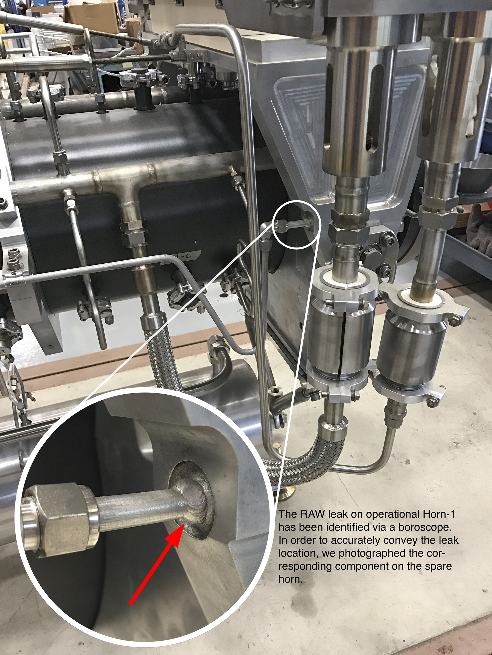
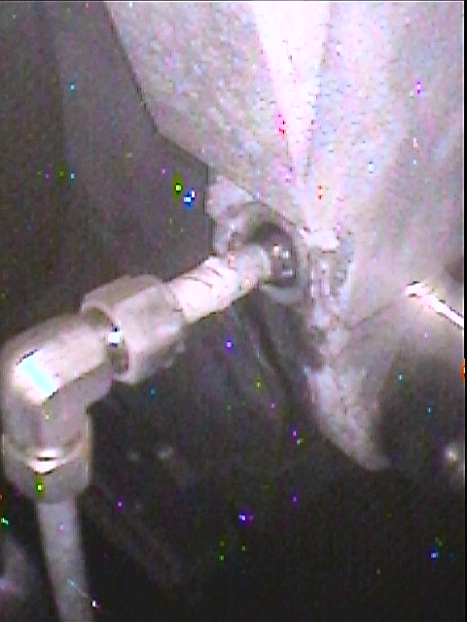
PH1-03 – Hanger Water Leak
Cooling circuit to cool hanger
Minimize thermal expansion
Minimize movement of horn
Leaking 20 gallons of water per day
Attributed to weld porosity
Performed weld spot repair
Ran until 2020 until it was replaced with PH1-05 for 1 MW upgrade
Location of leak on spare horn
2018
Location of leak on PH1-03

Slide 10
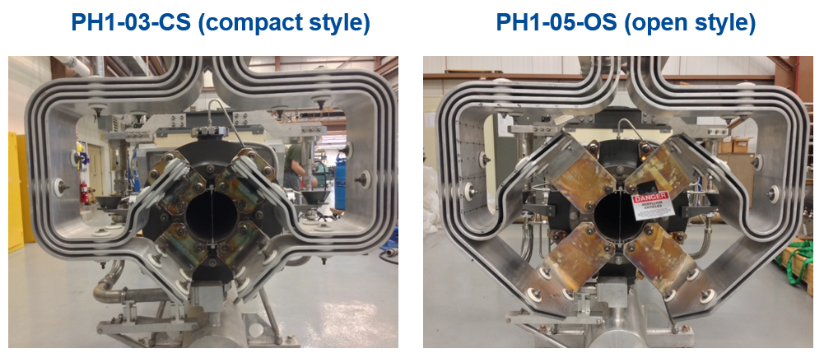
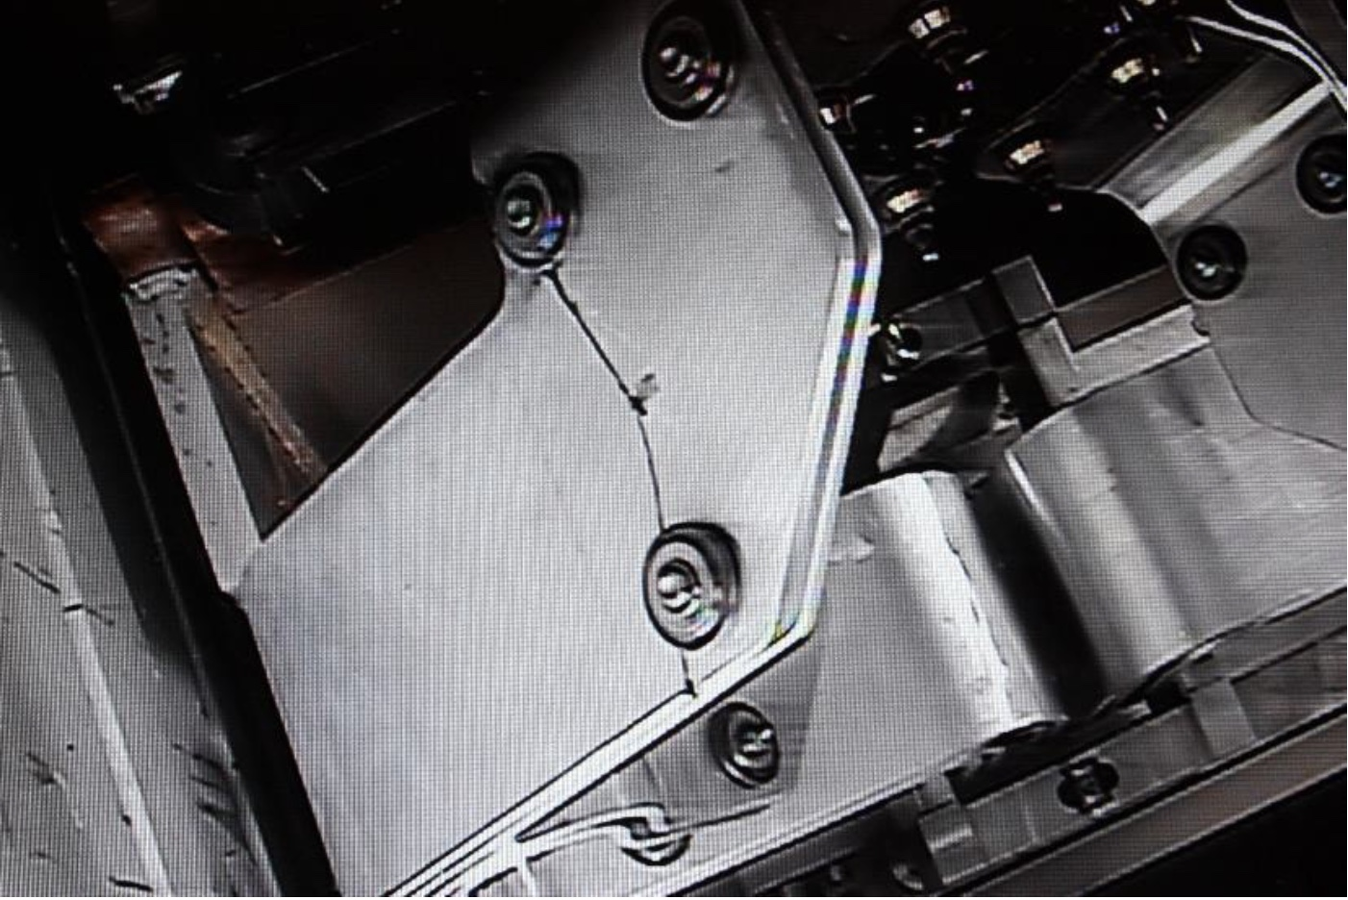
PH1-04 – Stripline Failure
PH1-04 had new open style stripline
Improved cooling of stripline flags
Ran fine at 400 kW
First stripline to operate at 700 kW
Horn current imbalance identified after 2 years of operation
Borescope image showed crack in stripline
27M pulses before failure
NuMI Horn 1 compact (original) and open stripline
2015
Crack in PH1-04 stripline

Slide 11
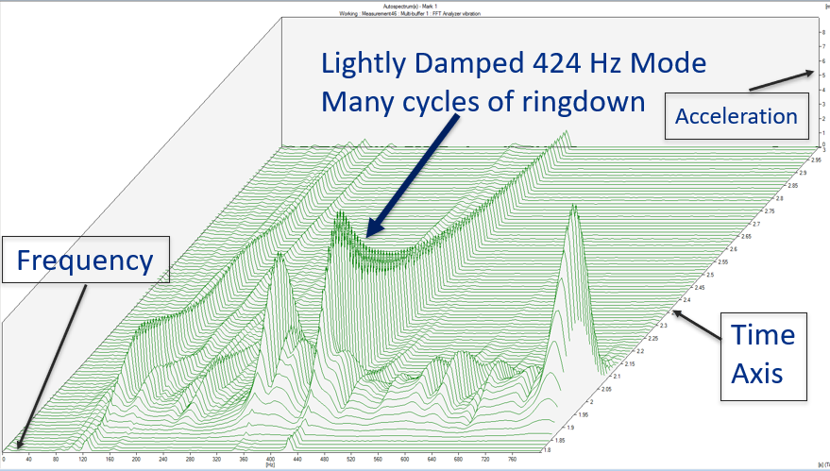
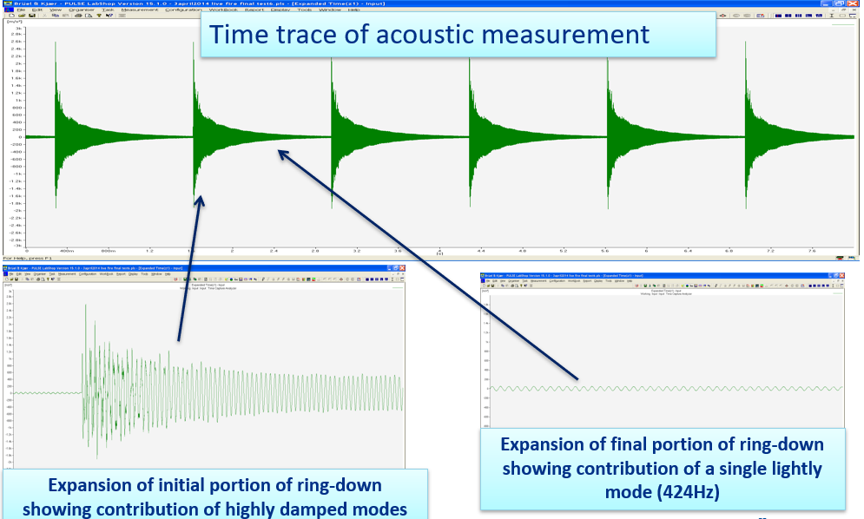
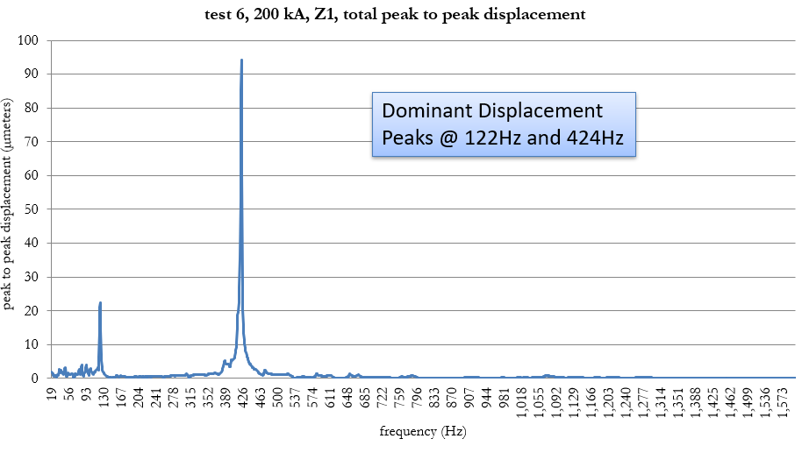
PH1-04 – Stripline Failure
Vibration tests showed lightly damped modes on lower stripline flag
Large displacements
Additional cycles from ringdown contributed to high cycle fatigue
Stress concentration from bolts in region contributed to fracture
Waterfall plot for comparison of mode damping
2015

Slide 12
PH2-01 – Stripline Failure
Hydrogen embrittlement of high strength steel washer
Stripline fractured due to lack of clamping force
Solution: use lower strength SS washers
2008
Notes:
Higher tensile strength correlated with greater susceptibility to hydrogen embrittlement

Slide 13
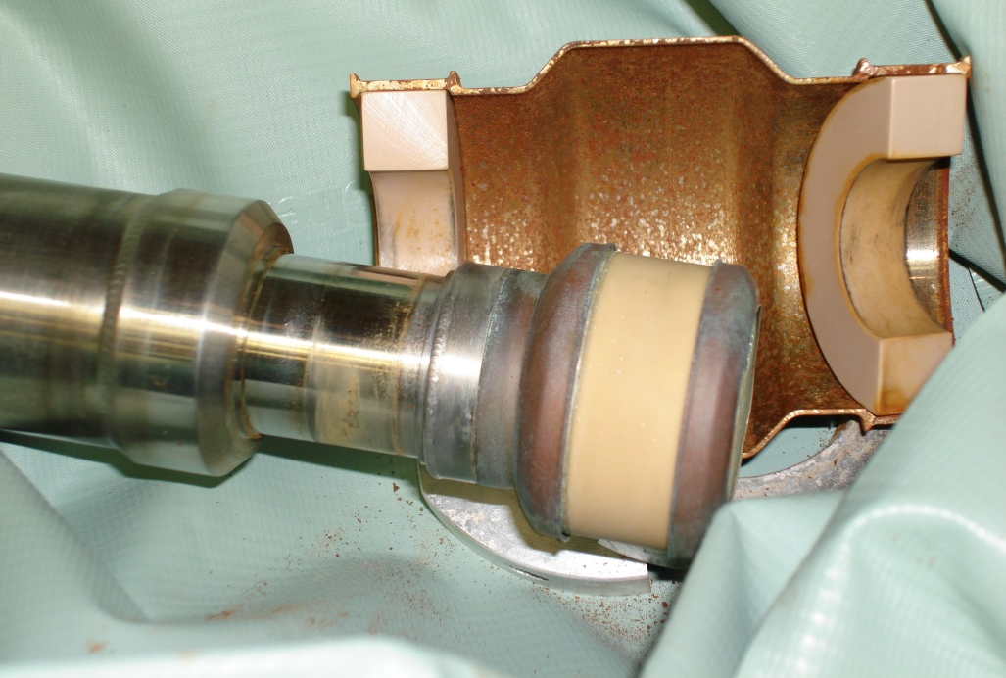
PH1-01 – Broken Suction Line
Suction lines were Kovar to ceramic brazed assemblies
Suction line broke at electrical insulator
Solution:
Used thicker layer of steel at transition to insulator
Shrink fit assembly
Example of suction line failure
Shrink fitting currently used assembly
2008

Slide 14
Summary
NuMI horns have been running for 17 years
All horns have achieved at least 2 year lifetime
Several failures due to practicalities of target hall environment
All failures and lessons learned are invaluable for LBNF
Large influence on design, assembly, and fabrication

Slide 15
Acknowledgements
Jim Hylen
Kris Anderson
Katsuya Yonehara
Marty Murphy

