Slide 1




Target and horn
pulsed effects and vibration issues
Peter Loveridge
STFC Rutherford Appleton Laboratory
NBI Workshop, September 2022

Slide 2
Motivation
Question:
“Could the LBNF target lifetime be impacted by dynamic loading coming from the horn?”
In this talk I will discuss ongoing efforts to quantify / mitigate this issue through design, simulation and measurements

Slide 3
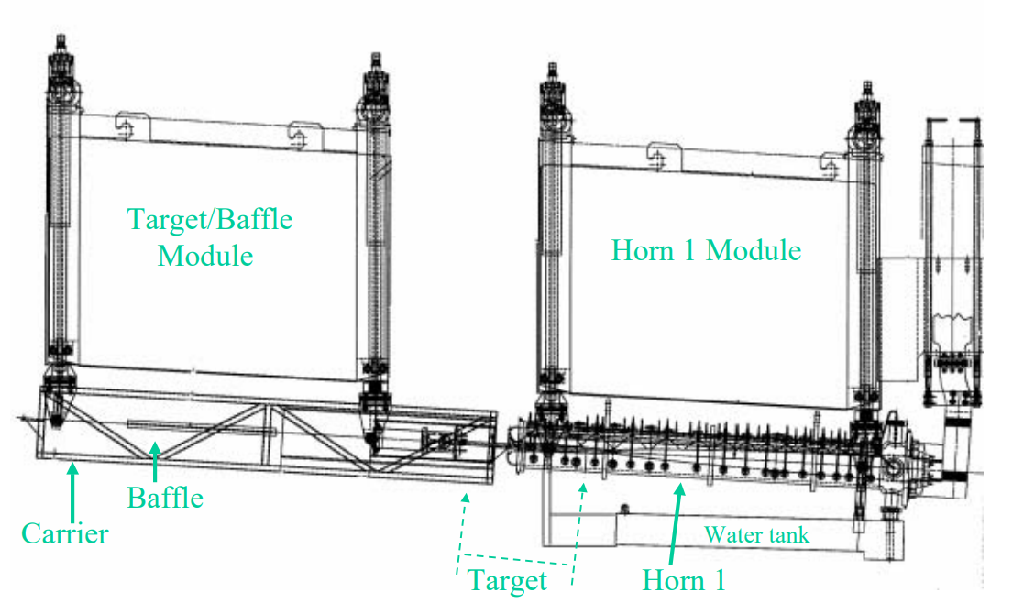
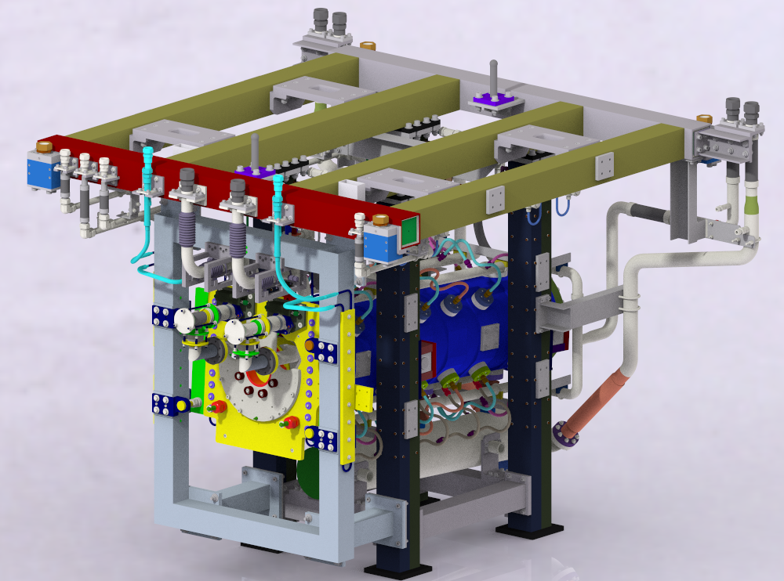
Target / Horn
Mechanical Coupling
NuMI
LBNF
Target and horn supported from separate modules
T2K
Close mechanical coupling between LBNF target and horn is a departure from NuMI & T2K operating experience
Target and horn attached to common support frame

Slide 4
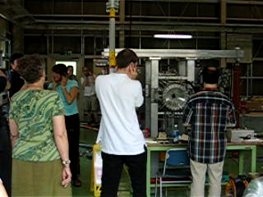


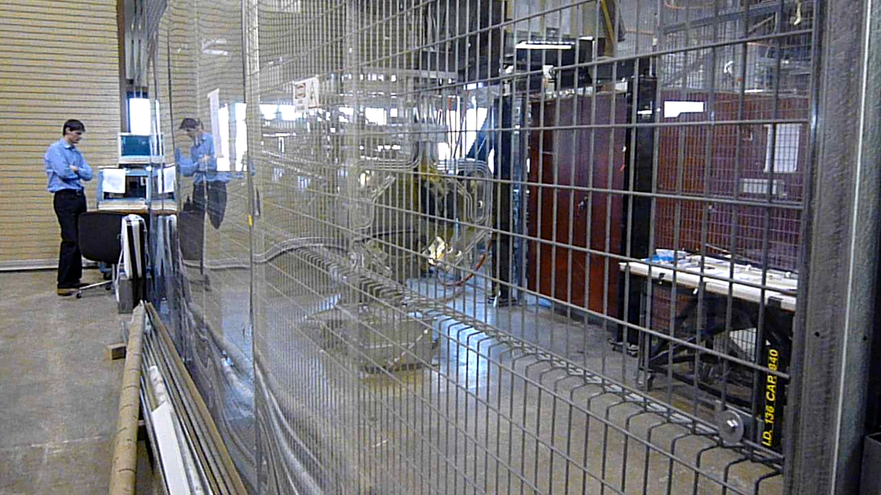
So What’s the Problem..?
T2K horn test firing
NuMI horn test firing
Horn “rings like a bell” …
… potential for dynamic excitation of nearby structures

Slide 5
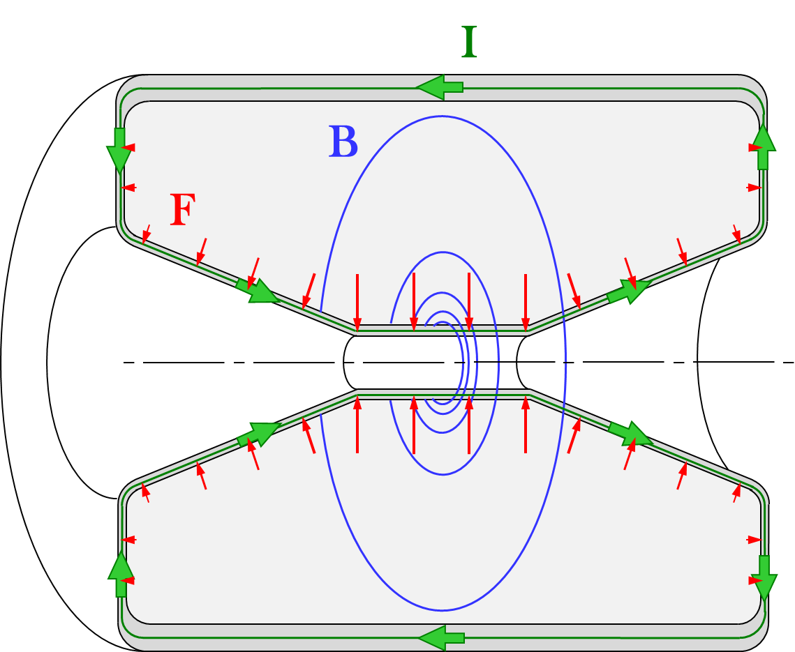
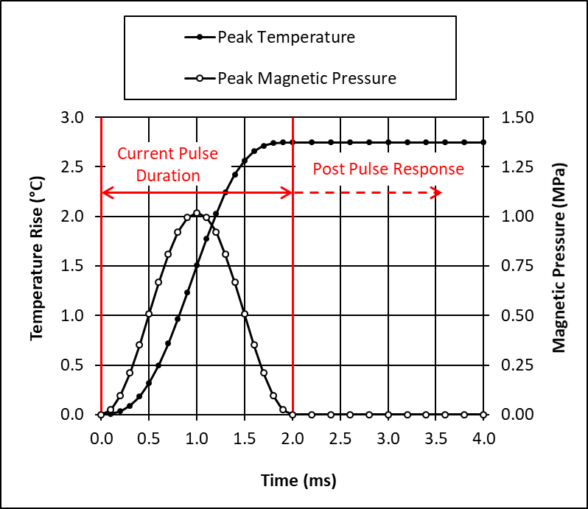
LBNF Project Outlook
Combined horn + target pulse test planned in ~2-3 yrs time
In the mean time: focus on simulation efforts to inform target mounting design and potential mitigation measures
  Need FE models of horn and target
  Need to capture how they are coupled together
  Horn pulsing is relatively complex simulation challenge! (see right)

Slide 6
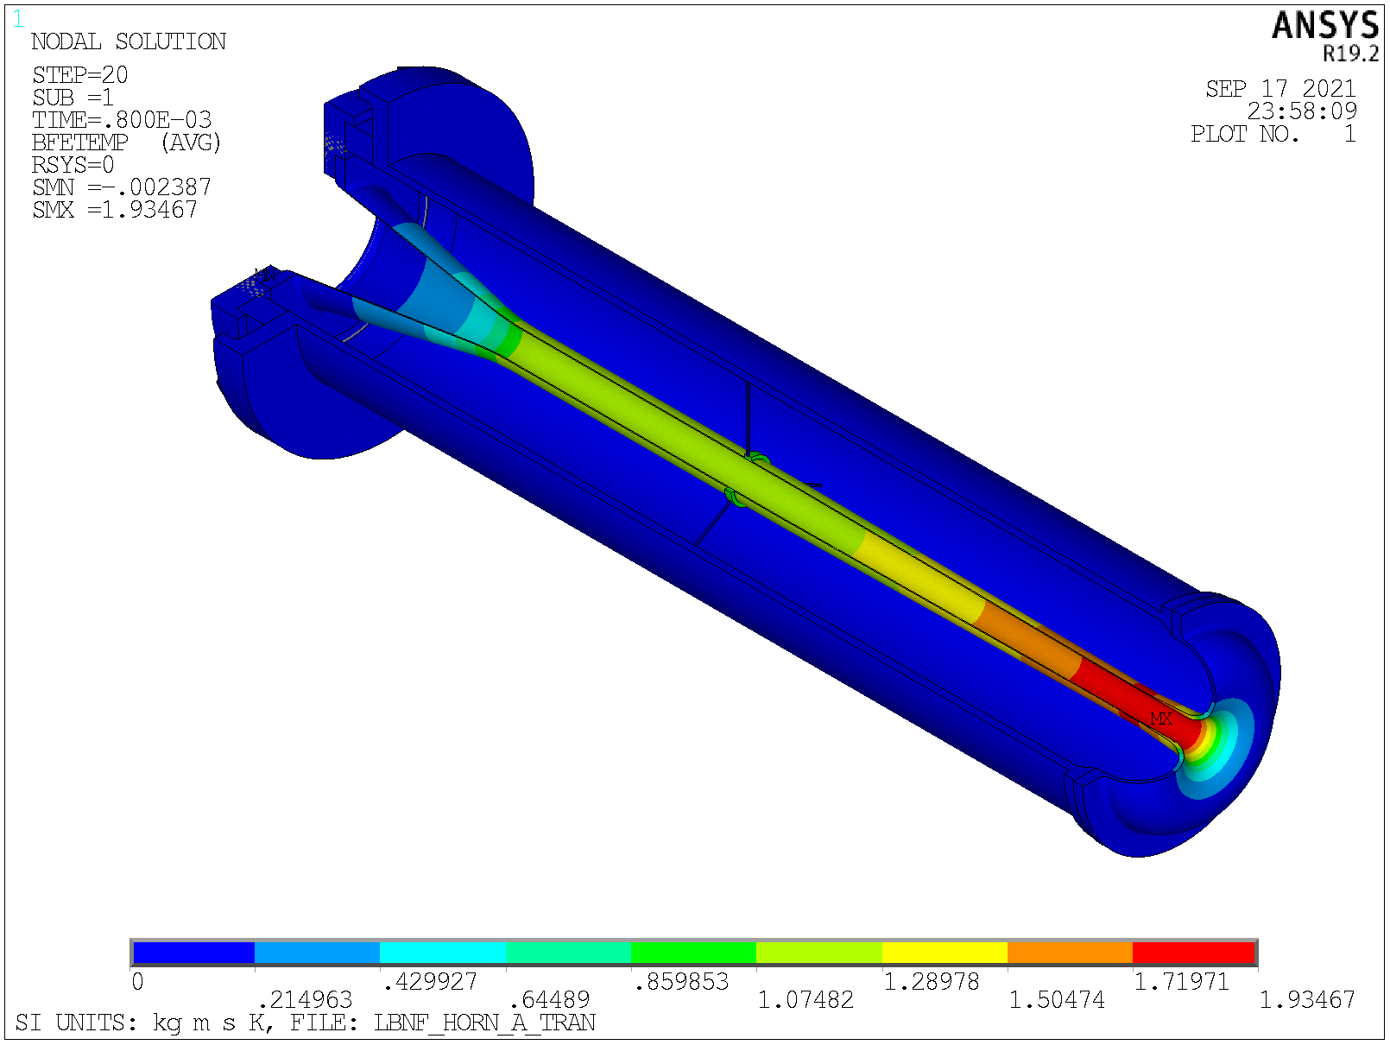
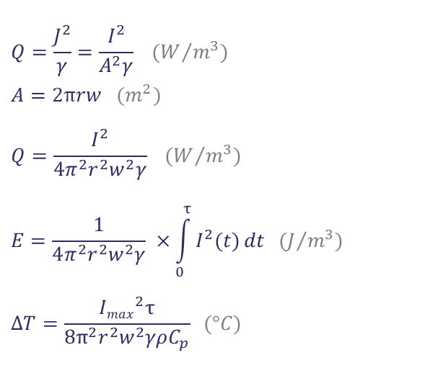
Horn Vibration Modelling Trick #1: Joule Heating
Inner conductor as a thin-walled tube:
Half sine-wave shaped current pulse:
I_{max}
= 300kA
r
No need to model electric current flow…
w
0
0
τ=0.8ms
$$Q=\frac{J^{2}}{γ}=\frac{I^{2}}{A^{2}γ} (W/{m^{3}})$$
$$A=2πrw (m^{2})$$
$$Q=\frac{I^{2}}{4π^{2}r^{2}w^{2}γ} {(W}/{m^{3})}$$
$$E=\frac{1}{4π^{2}r^{2}w^{2}γ} ×\int_{0}^{τ}{I^{2}(t)}dt (J/{m^{3}})$$
$$ΔT=\frac{{Imax}^{2}τ}{8π^{2}r^{2}w^{2}γρC_{p}} (°C)$$
Ohm’s Law
… directly apply
temperature rise as a function
of position in mechanical simulation
Volumetric heating
0°C
1.9°C
Temperature rise in conductor simply varies as a function of $\frac{1}{r^{2}}$

Slide 7
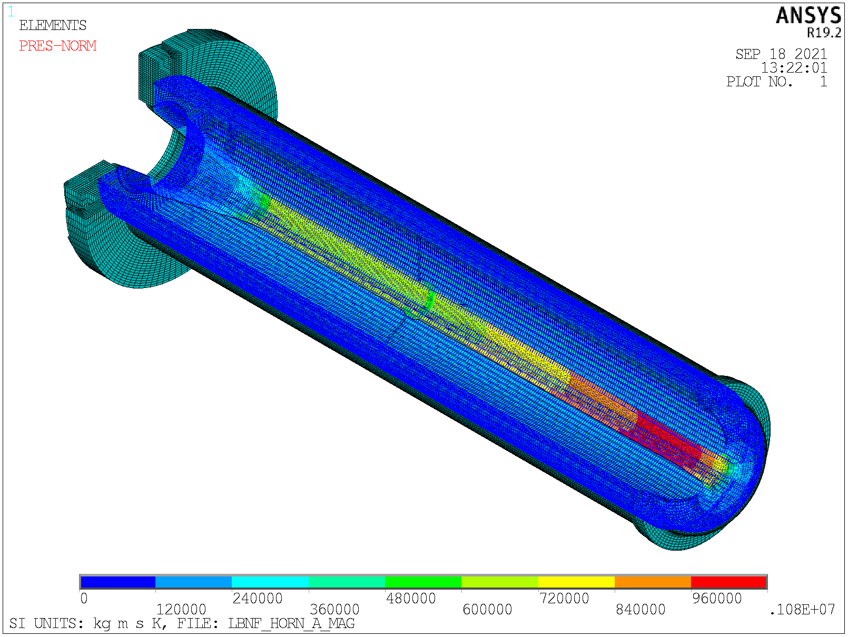
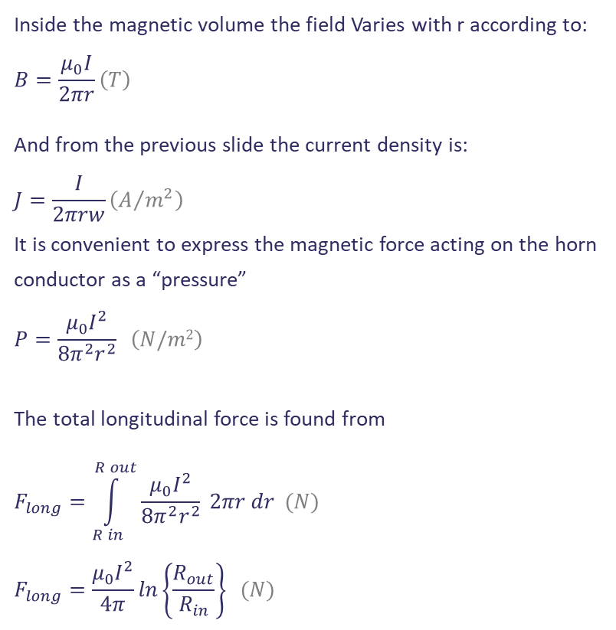
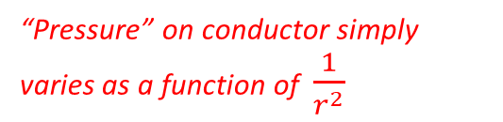
Horn Vibration Modelling Trick #2: Magnetic Forces
Inside the magnetic volume the field Varies with r according to:
$$B=\frac{μ_{0}I}{2πr}\left(T\right)$$
And from the previous slide the current density is:
$$J=\frac{I}{2πrw}\left(A/{m^{2}}\right)$$
It is convenient to express the magnetic force acting on the horn conductor as a “pressure”
$$P=\frac{μ_{0}I^{2}}{8π^{2}r^{2}} \left(N/m2\right)$$
The total longitudinal force is found from
$$F_{long}=\int_{R in}^{R out}{\frac{μ_{0}I^{2}}{8π^{2}r^{2}} 2πr dr (N)}$$
$$F_{long}=\frac{μ_{0}I^{2}}{4π}\ln\left\{\frac{R_{out}}{R_{in}}\right\} (N)$$
Field near a current-carrying wire
No need to model magnetic field…
“Pressure” on conductor simply varies as a function of $\frac{1}{r^{2}}$
… directly apply
pressure load as a function
of position in mechanical simulation
0 MPa
1 MPa
More than 1 tonne longitudinal repelling force between two ends while current flows

Slide 8
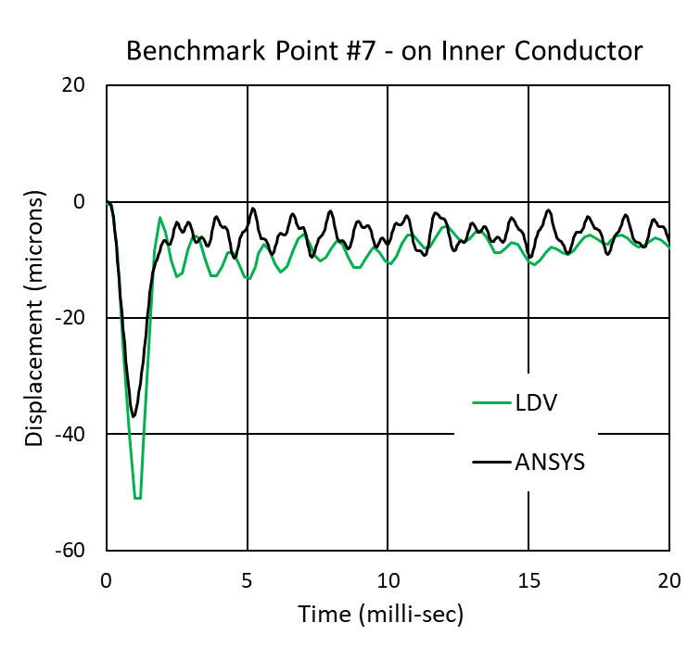
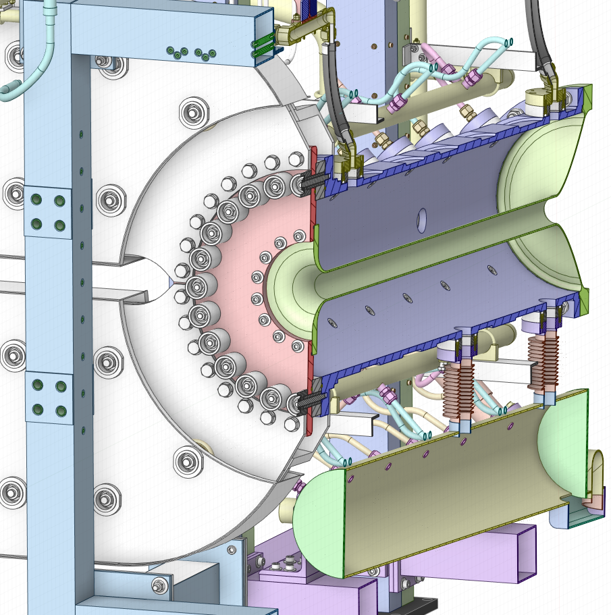
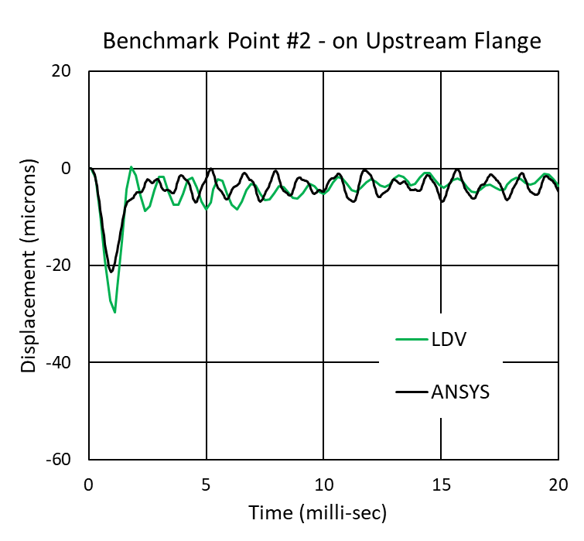
Does the Model Work..? Yes!
Point #7
Point #2
Max vibration amplitude at various locations
– T. Sekiguchi, KEK

Slide 9
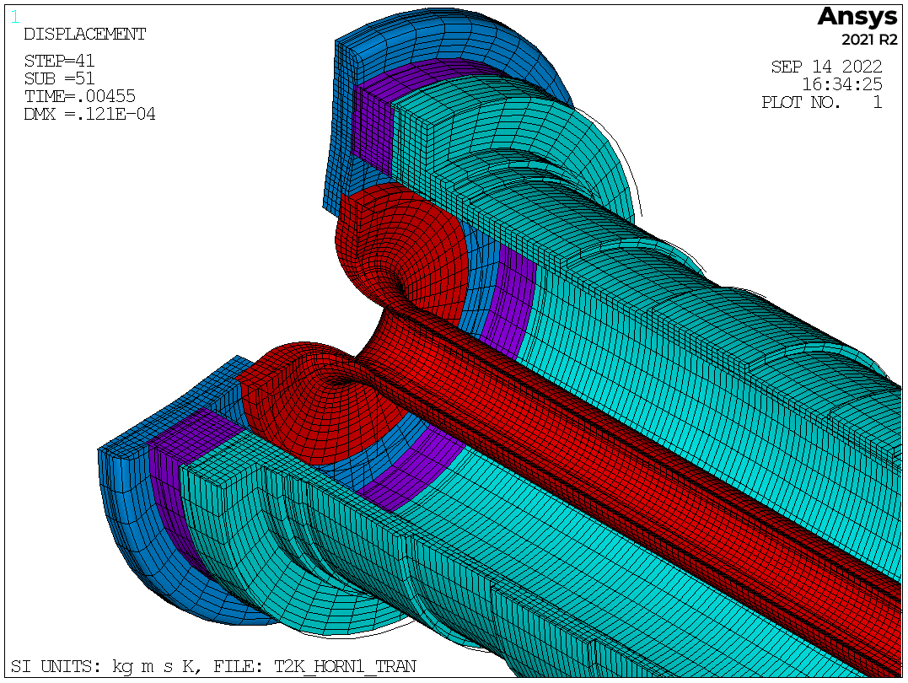
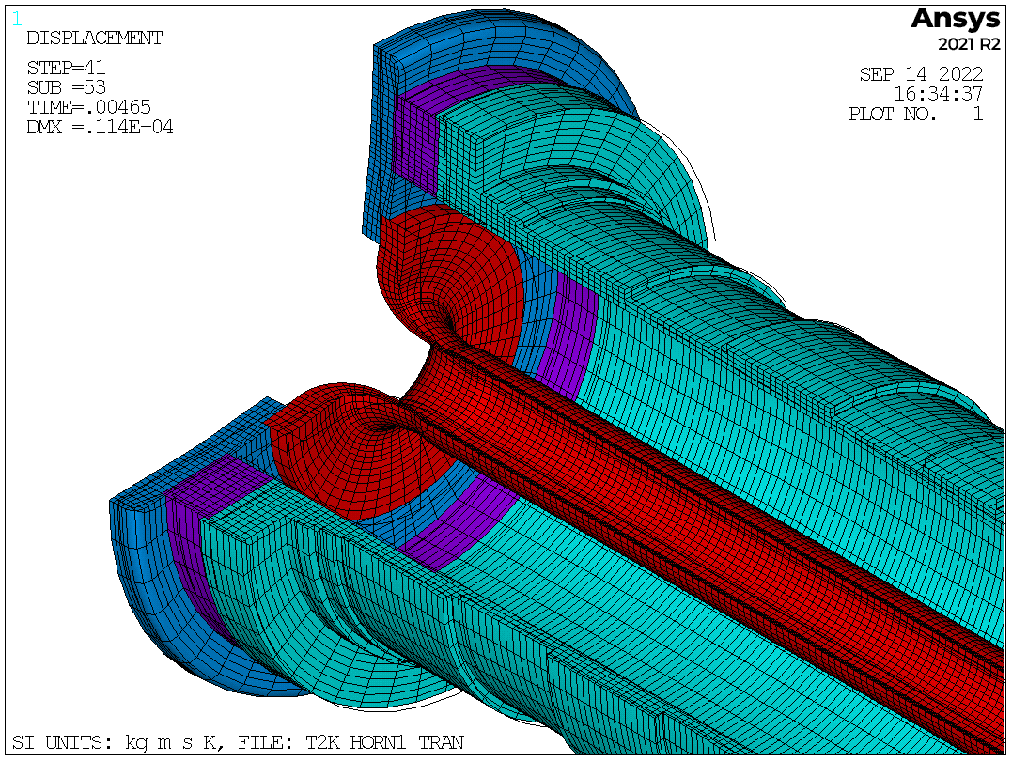

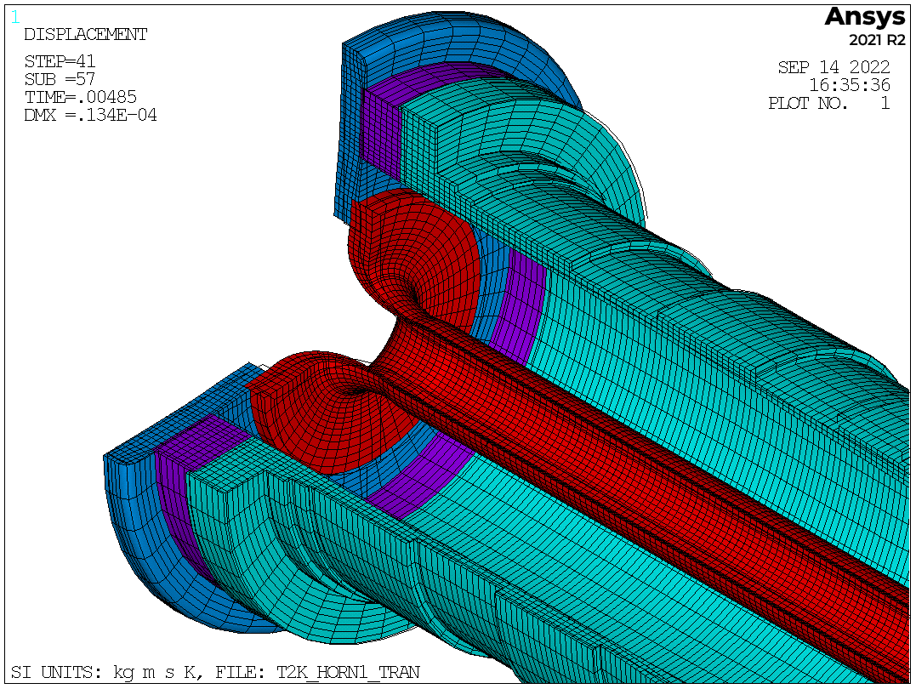






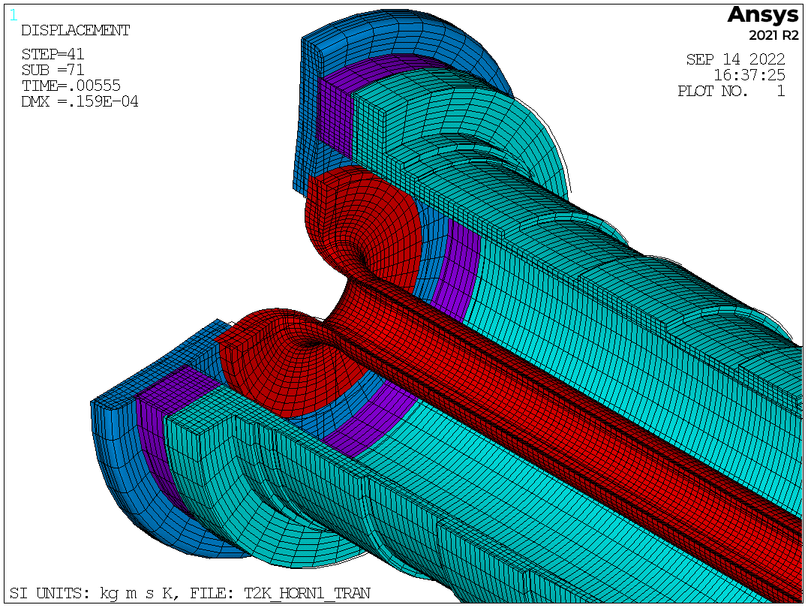
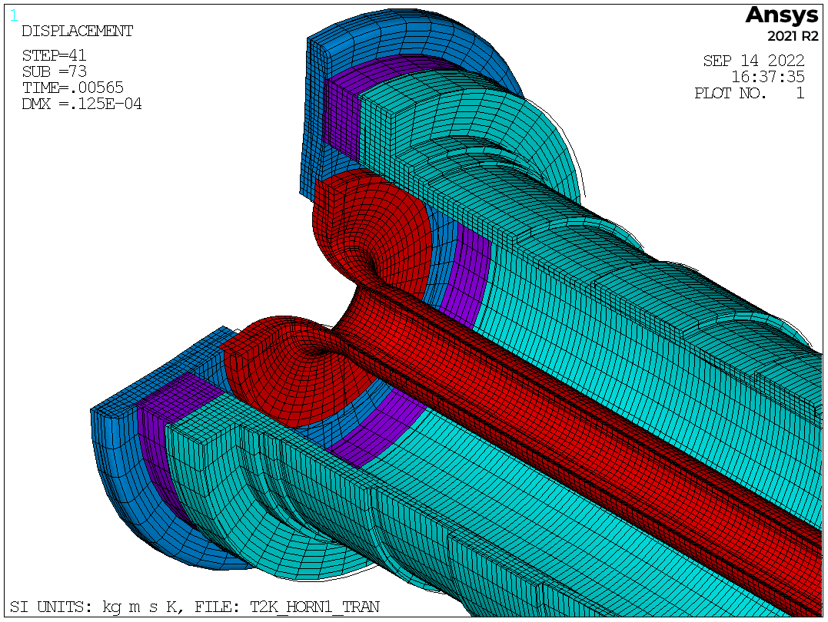






















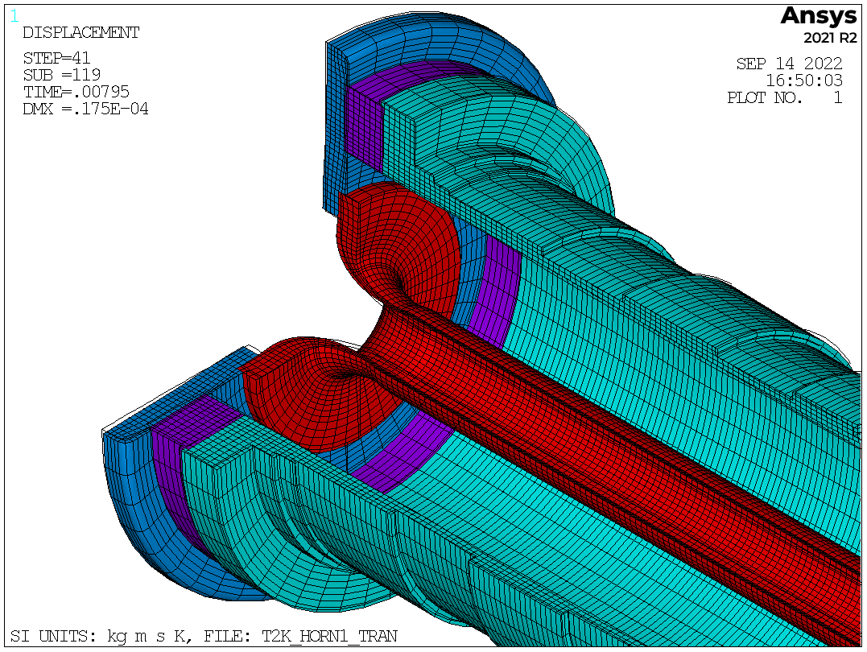

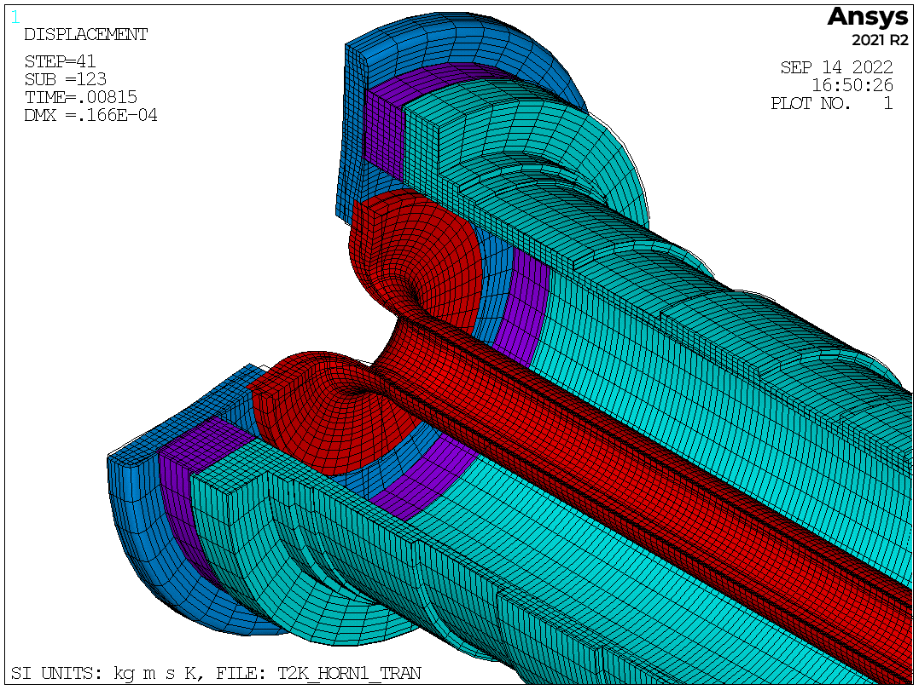



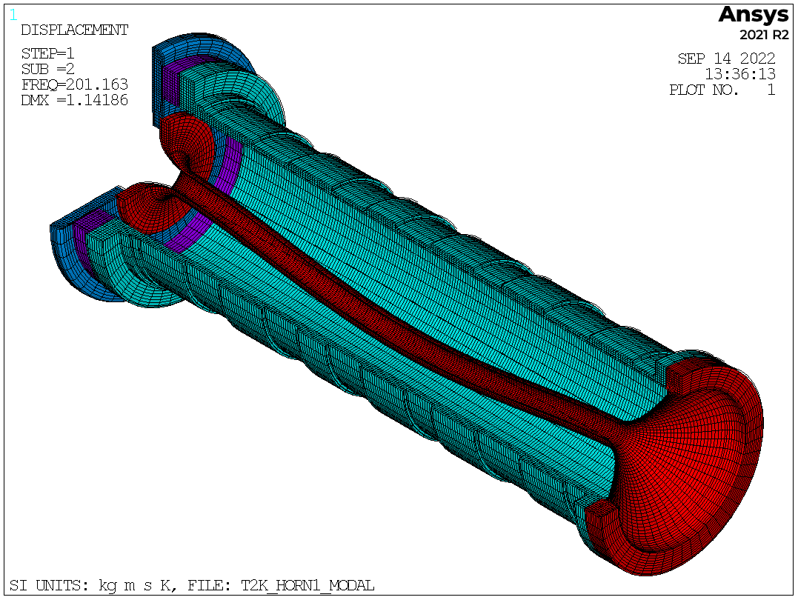



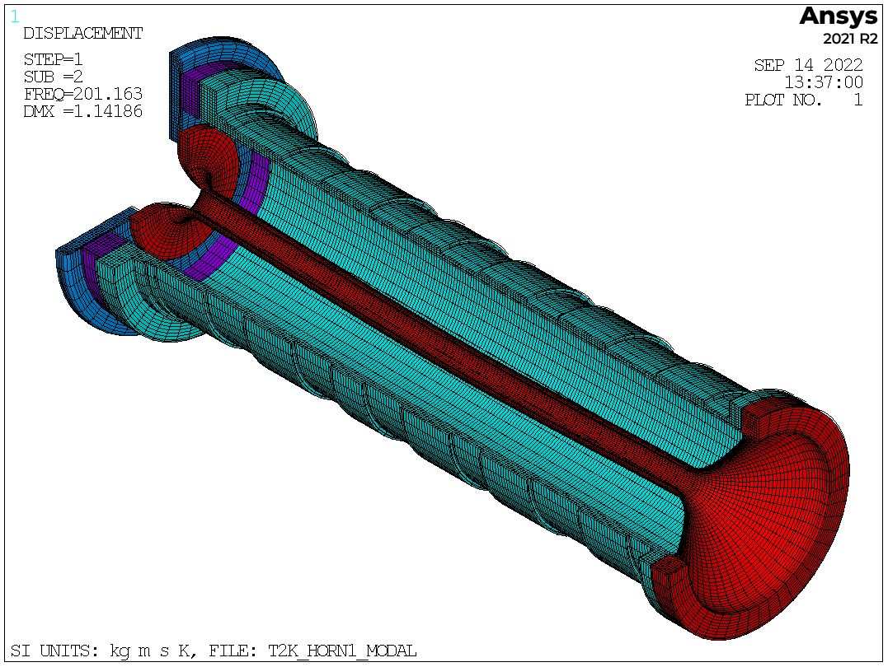


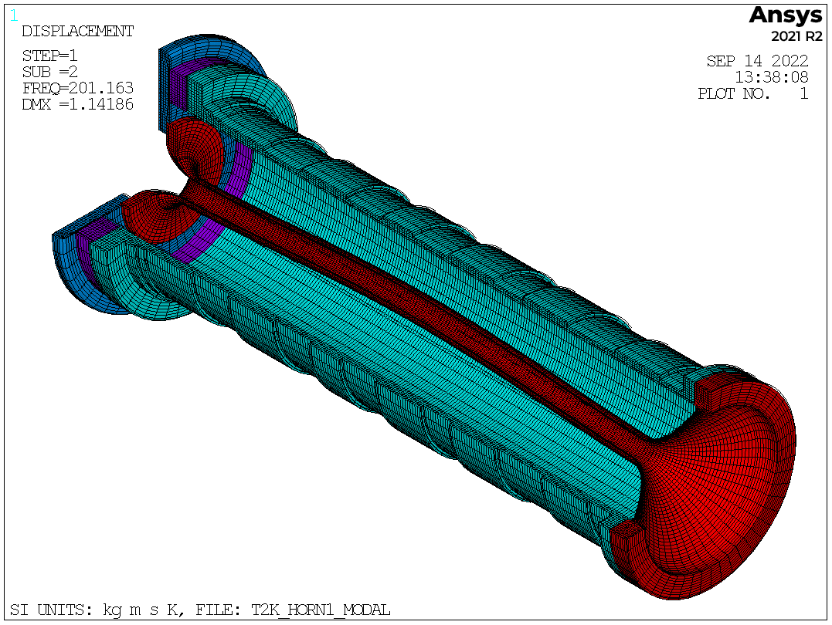

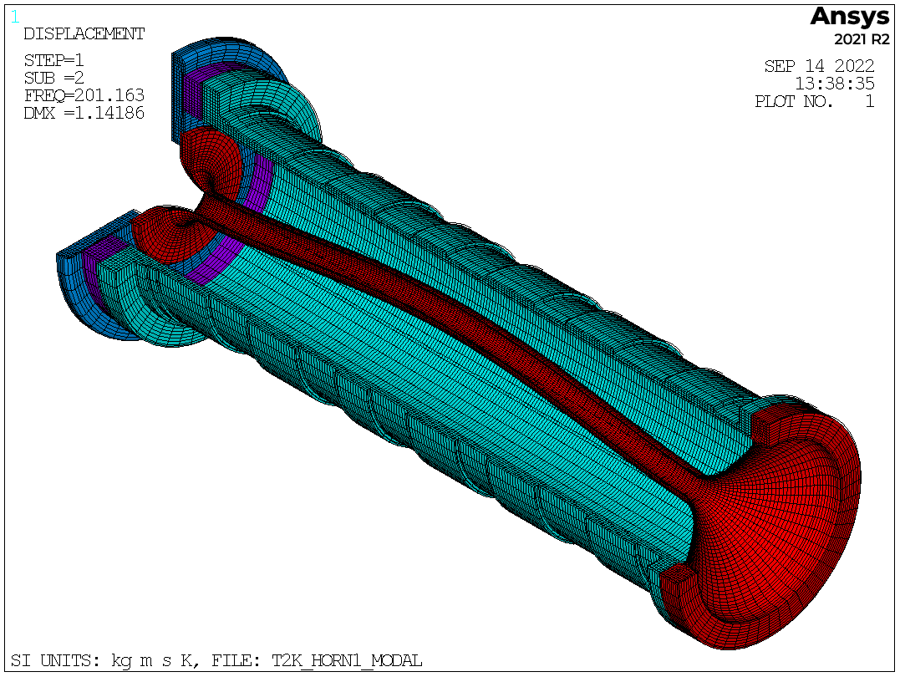
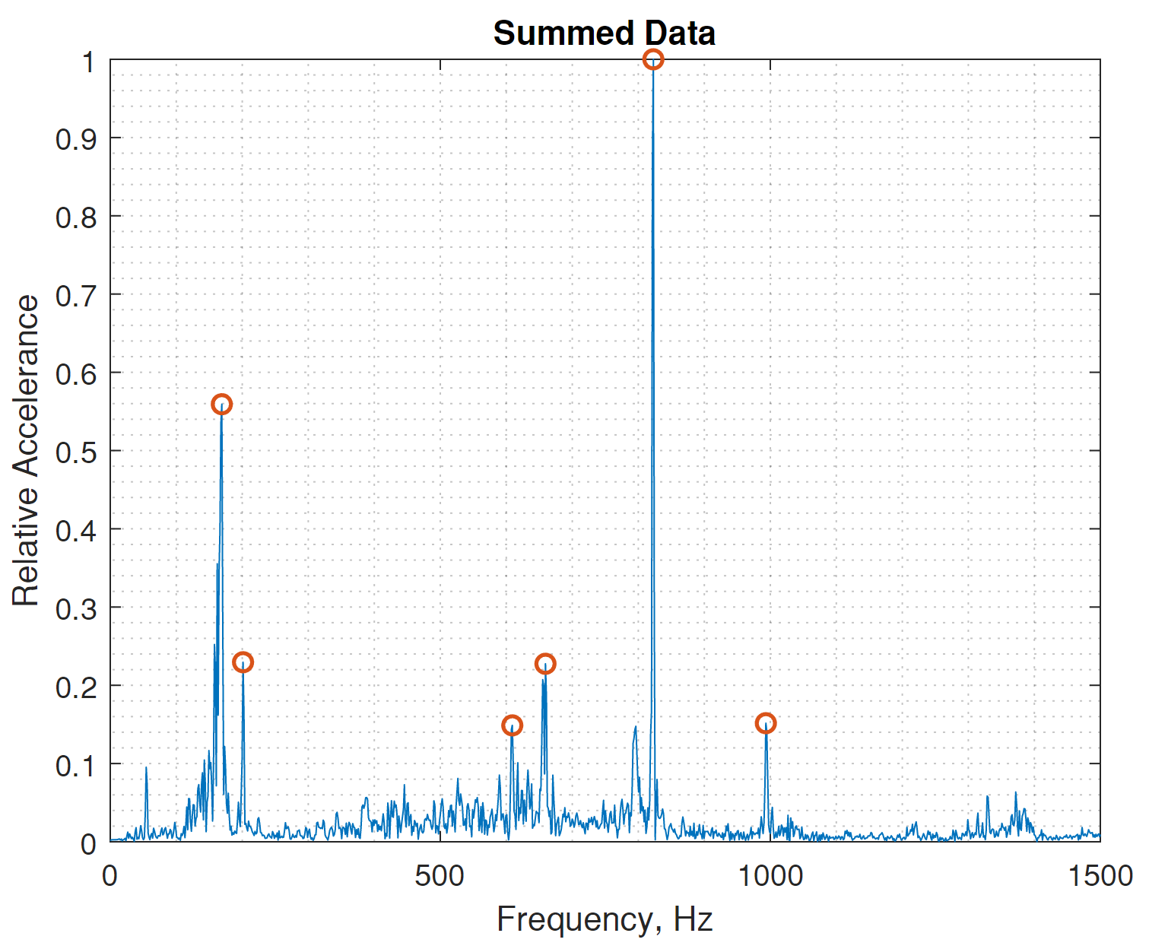
LDV Interpretation:
Modes
200Hz
Inner Conductor “Violin Mode”
800Hz
Longitudinal Mode
Signal differentiated to give acceleration
FFT carried out on acceleration- this gives more pronounced peaks as there is a low frequency decay in the displacement
Ben Suitters, RAL

Slide 10
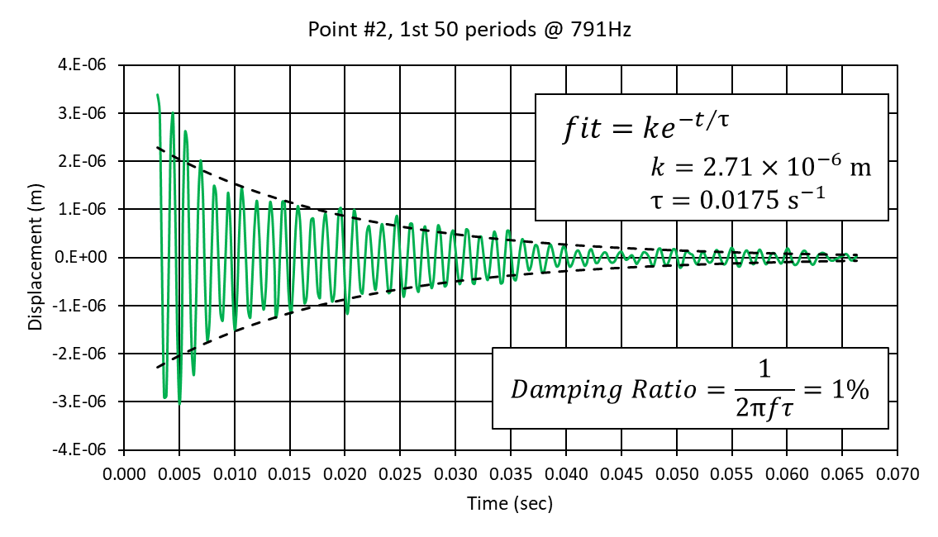
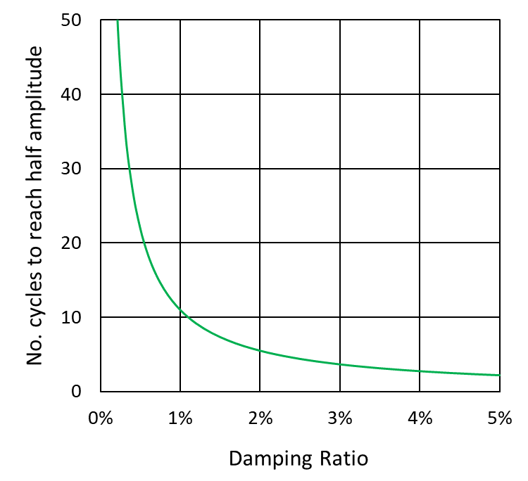
LDV Interpretation: Damping
Can estimate “damping ratio” (% of critical damping) from the initial ~800Hz response component in the LDV data
Expect inherently low levels of damping
  Metal structure, Bolted joints
Damping ratio is important dynamic characteristic:
  i.e. how many stress/strain cycles per pulse?

Slide 11
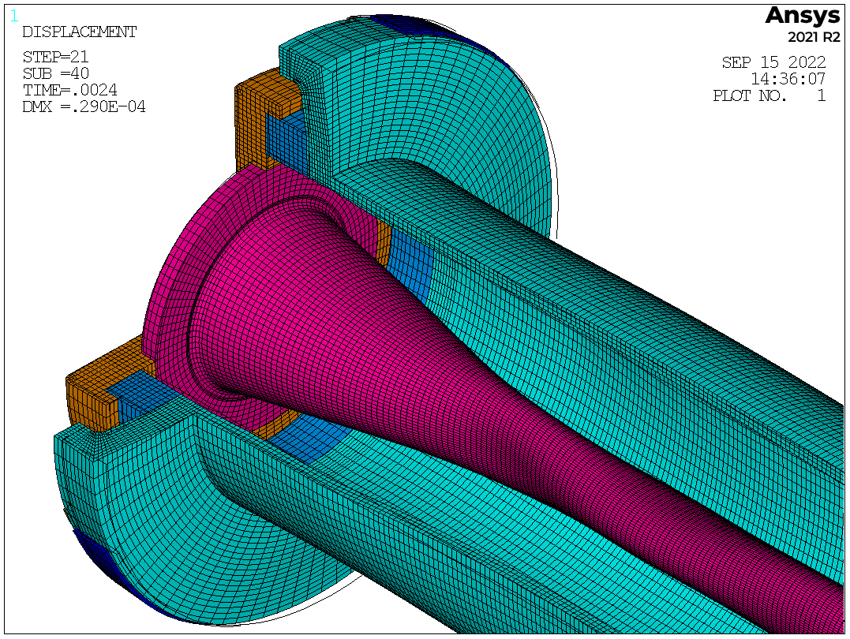
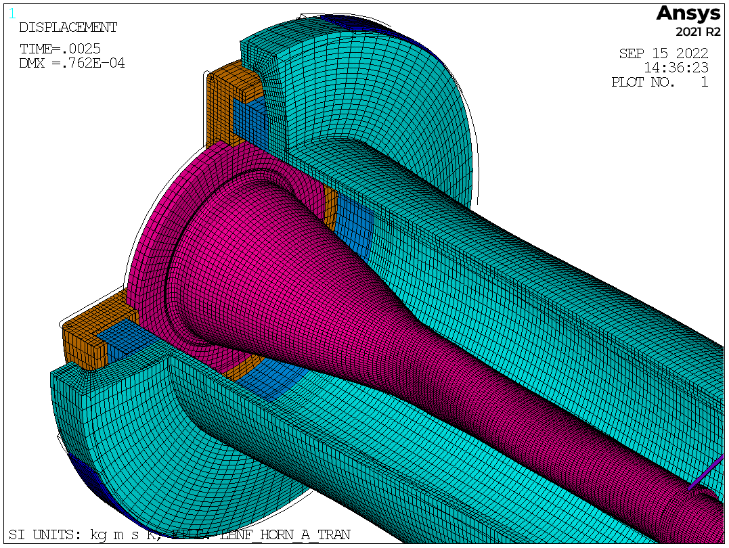
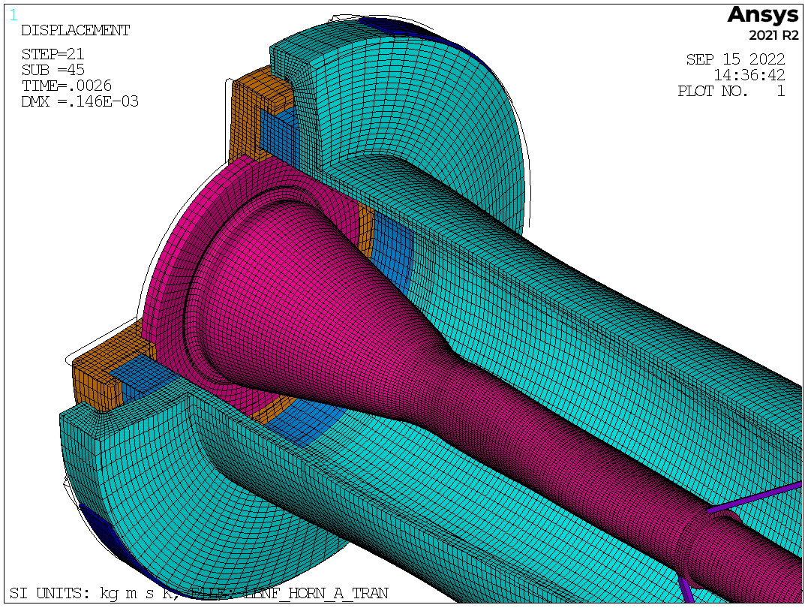
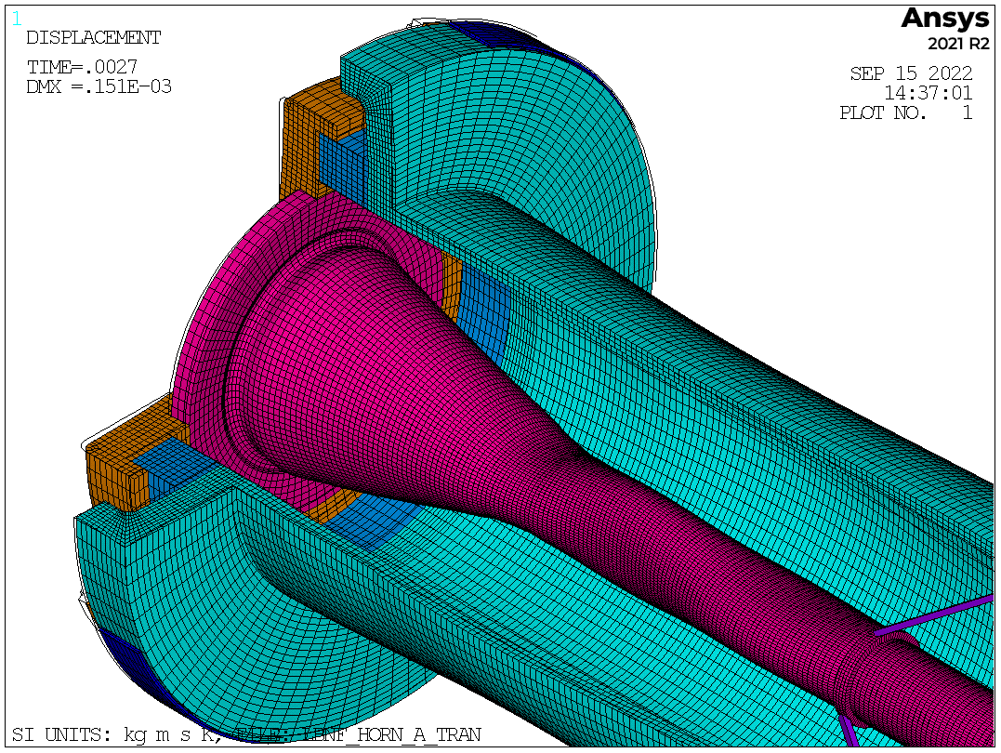
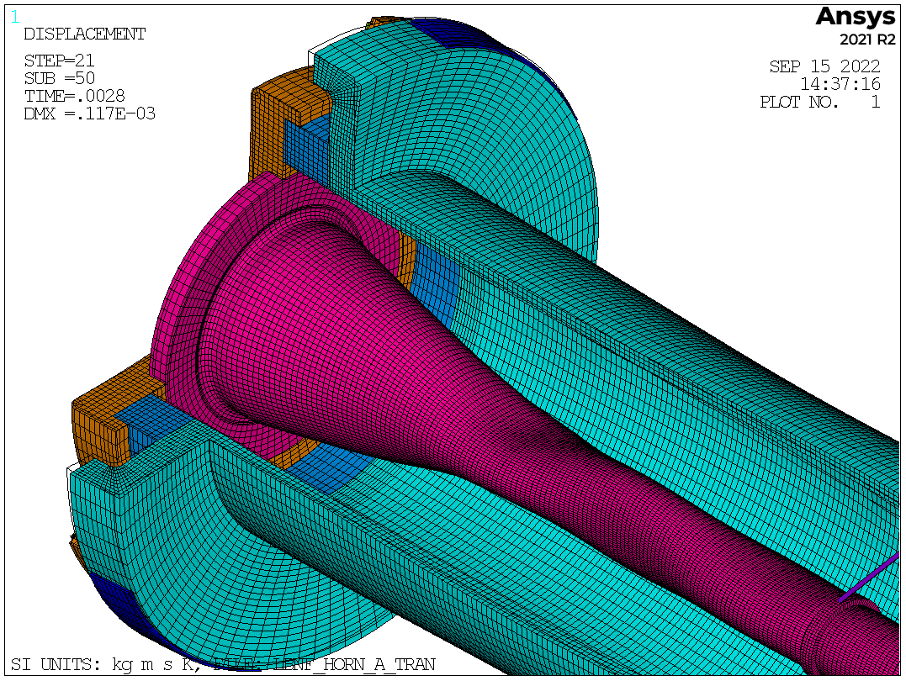
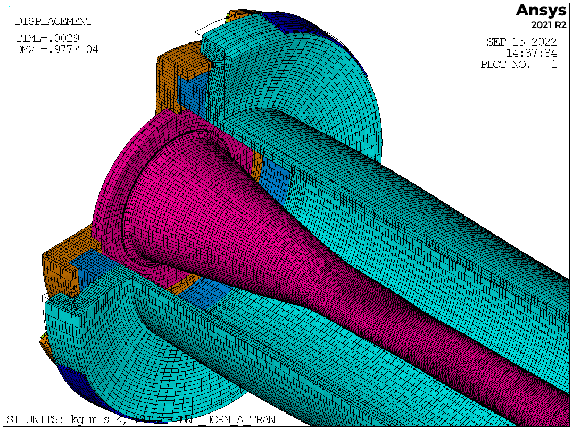

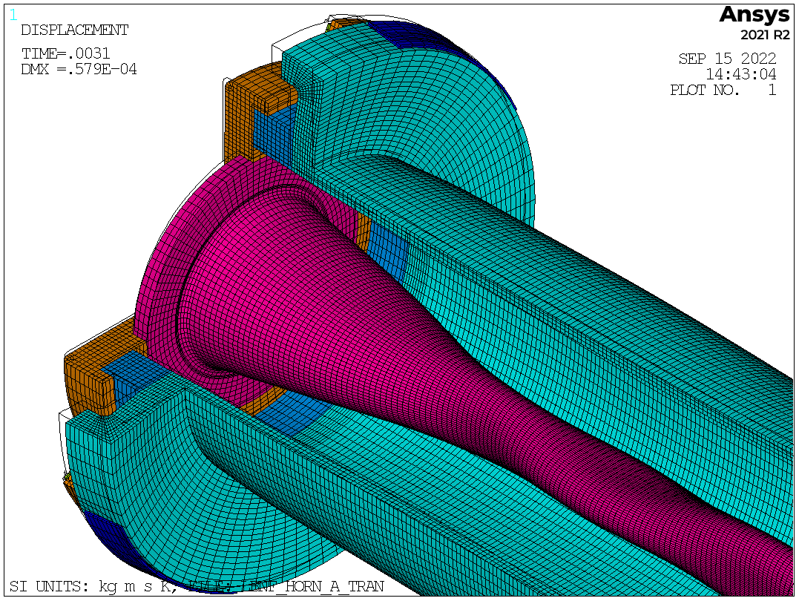
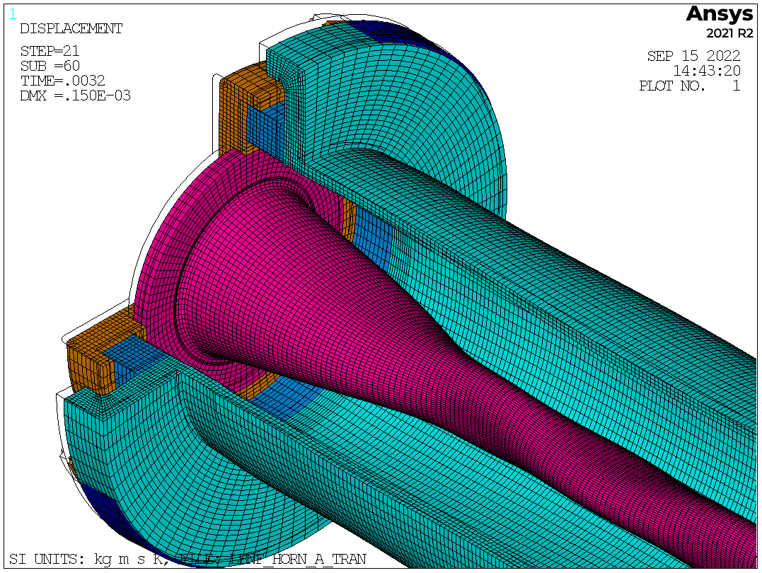
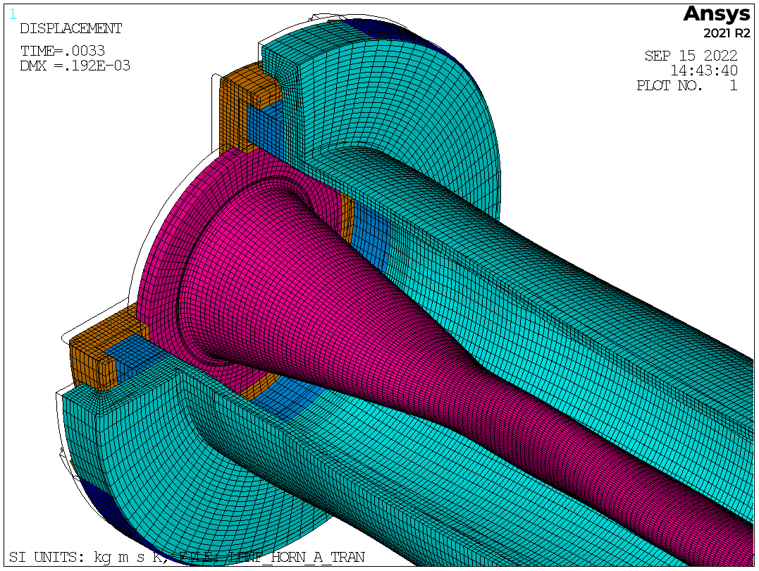
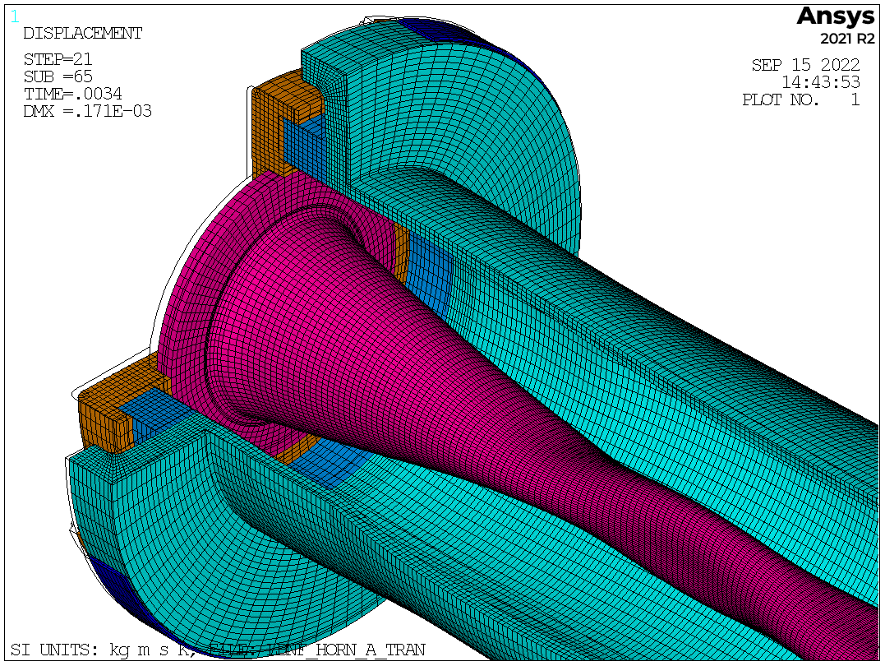
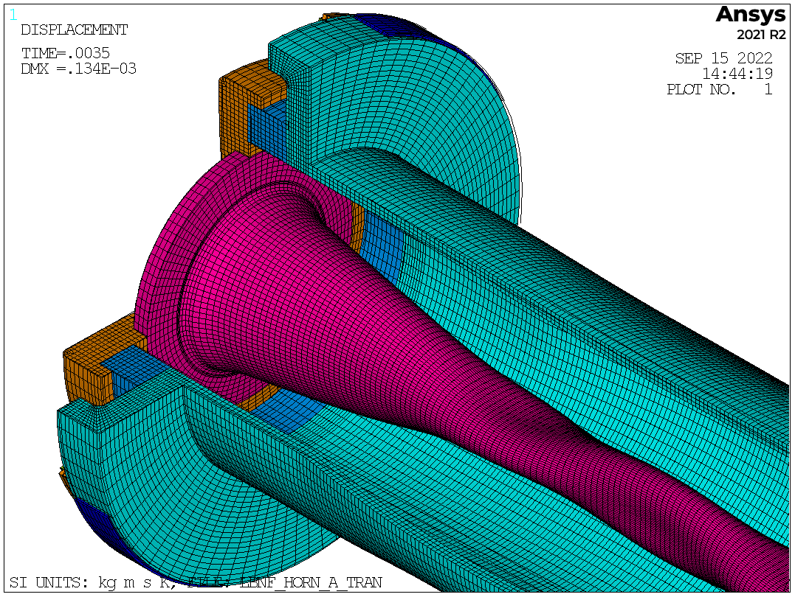
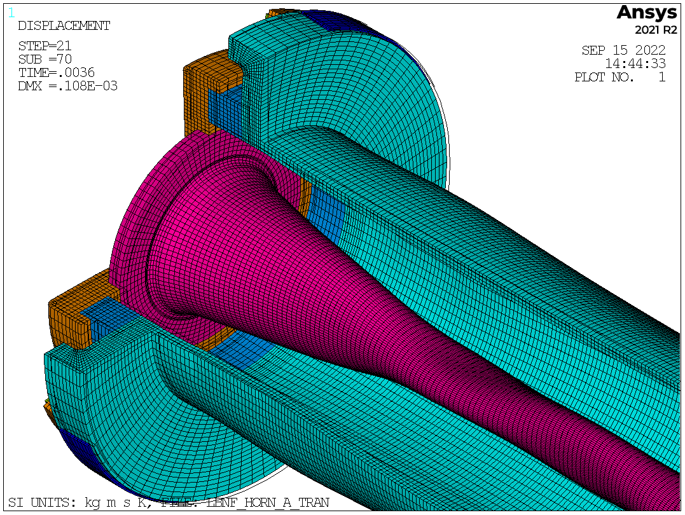
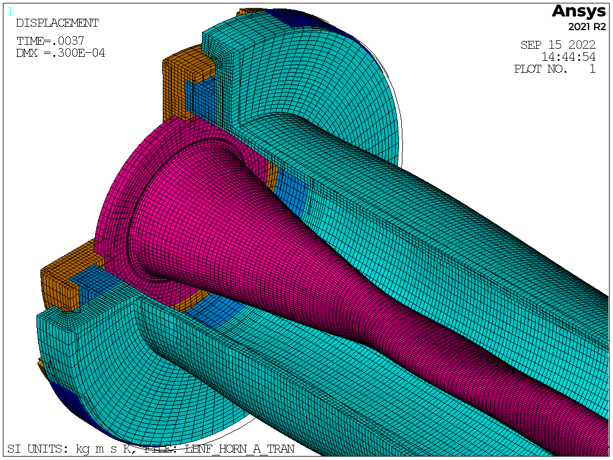
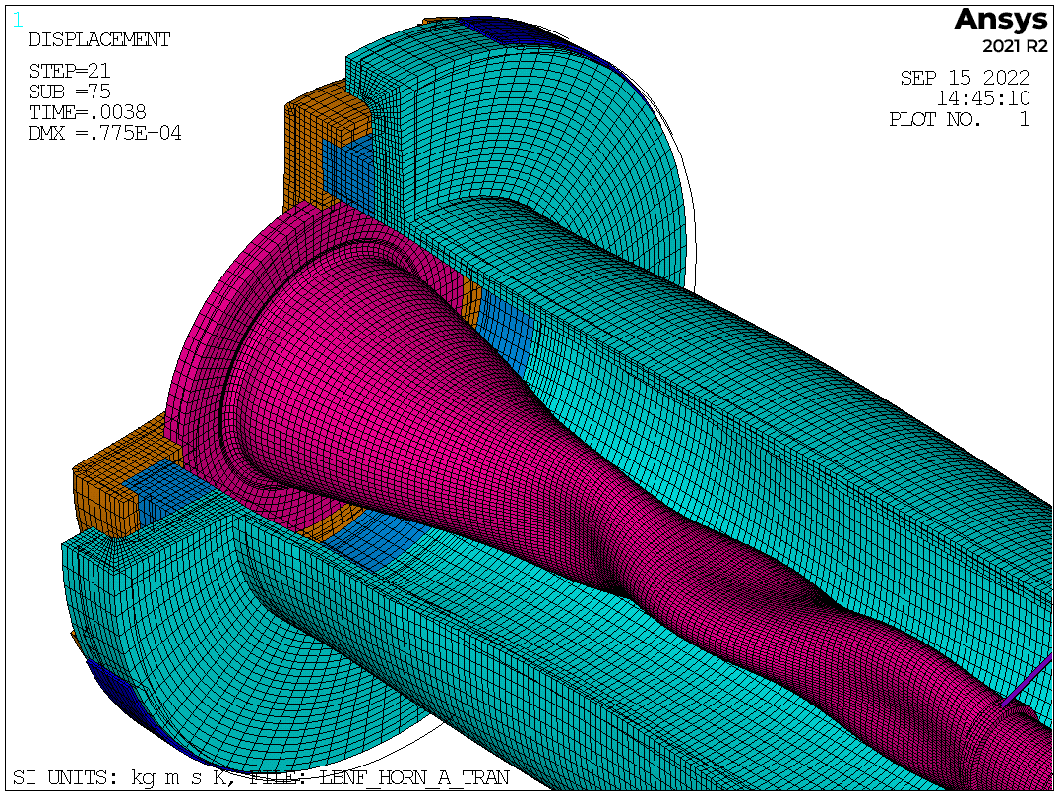
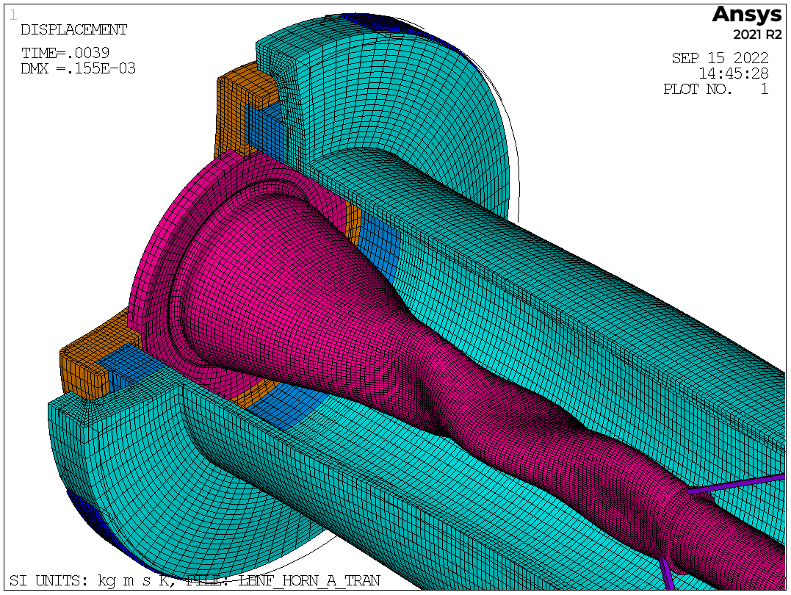
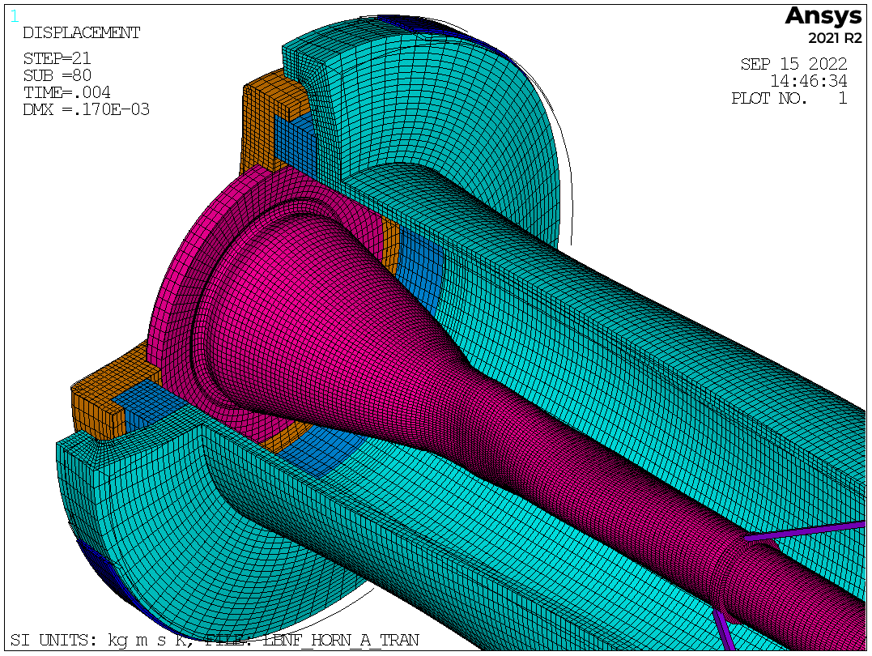

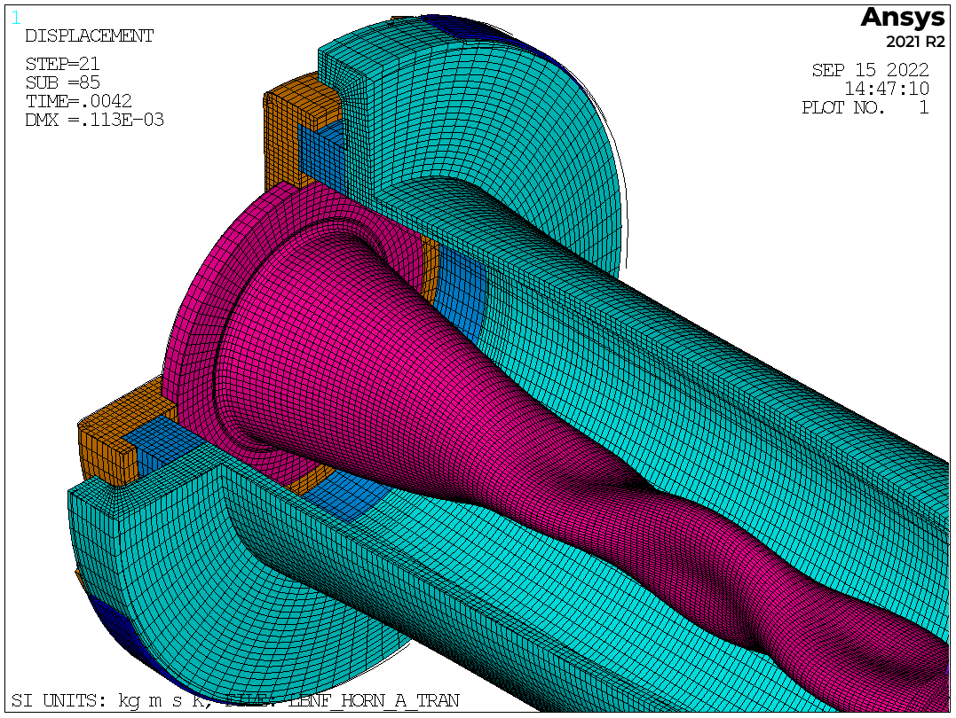


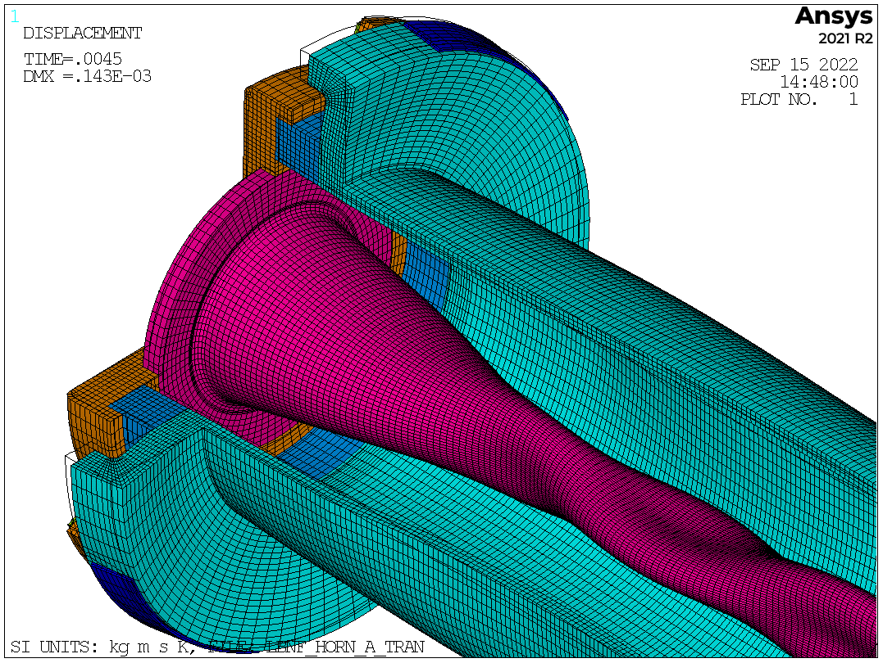
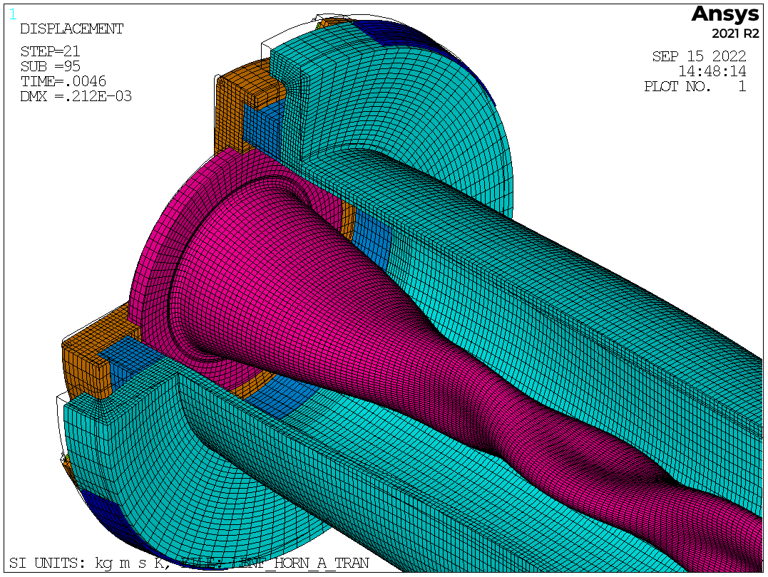


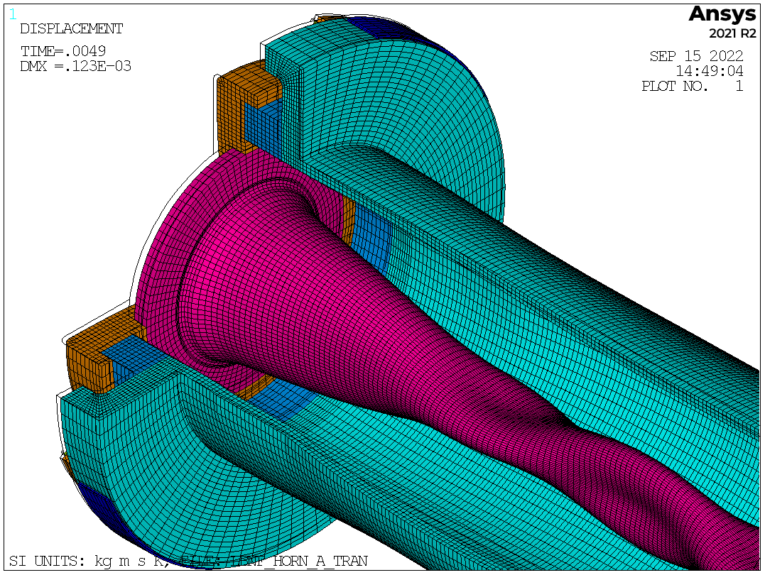
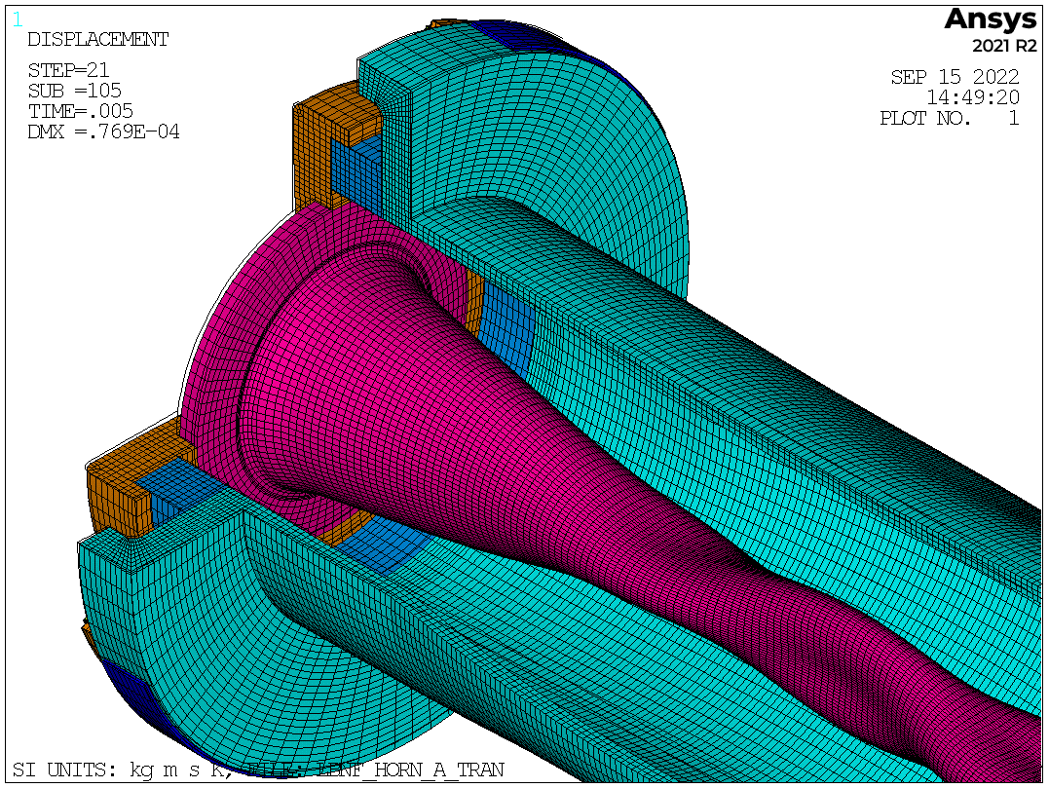
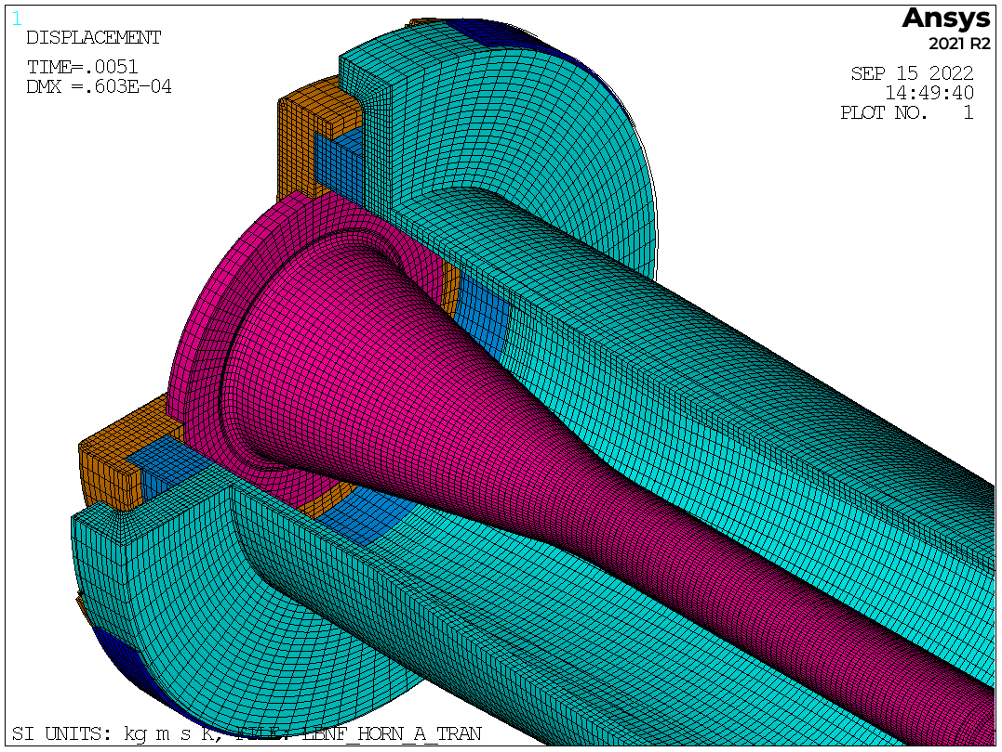



















LBNF Target Vibration?
Axial vibrations observed at target mounting flange
Response as a function of stripline mass
LBNF Horn-A FE model (Loveridge)
  Simulated horn response to electric current pulse
  Observed axial vibration mode at target mounting flange
LBNF Target FE model (Wilcox)
  Input frequency/amplitude at mounting positions
  Observed potentially large deflection/stress response in target
  How to mitigate this?
Axial vibrations transmitted
from horn to target mount
(Peak applied acceleration ≈20g)

Slide 12





Different Mounting Variants Investigated
Used “Sine-Sweep” method to investigate various mounting design variants
Predicts target response to constant amplitude sinusoid across a range of frequencies
Potential driving frequency range
(yellow zone)
Stress Criterion
Baseline Geometry
(Aluminium Plate)
Steel Plate
(Stiffer)
2 thin plates
(Axially Compliant)
Dan Wilcox, RAL

Slide 13


Present Modelling Effort:
“Full Transient”
Gauge point is on target titanium flow-divider
(location of peak stress)
Combined target + horn model
Full transient
Two-way dynamic coupling
Driving frequency (axial deformation at the horn flange) is ~640Hz
Similar response frequency in target, but direction is lateral
On the limits of what we can solve with available computational fire-power!

Slide 14


Future Thoughts and Plans
Project schedule enables us to construct and then install a prototype target in the prototype horn for pulse testing, prior to construction of the first operating target
If issues identified during pulse test then strategy is to modify the (green) support plate i.e. do not need to re-design target
Double-plate concept appears promising at this stage. May be “tuneable” – plate spacing, thickness, etc.
Tuneable Target Mounting Plate
Forcing Function
Cantilever target
2x 6mm thick plates, with 58mm spacing between
Gravity
Sag

Slide 15




