Slide 1



T2K target experience and upgrades for HyperK (1.3MW)
NBI 2022
Mike Fitton, Chris Densham
& Eric Harvey-Fishenden
20th September 2022
RAL High Power Targets Group
Notes:
The abstract pattern can be removed or repositioned if required. Be careful to ‘Send to Back’ so that it does not obscure any important information.

Slide 2
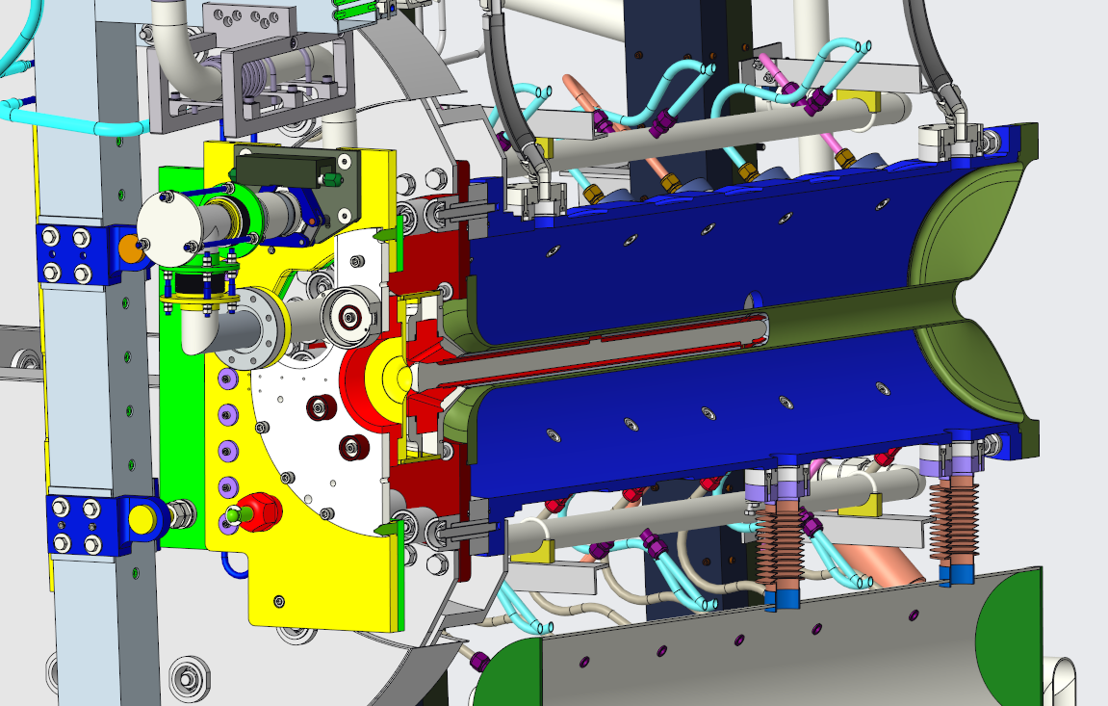
T2K target experience to date
Helium cooled graphite rod, enclosed in grade 5 titanium container
Original design beam power: 750 kW
Beam power so far: ~510 kW (2.6 x10¹⁴ppp @ 2.48Hz)
Approximately 3% beam power deposited in target as heat
1st target & horn replaced after 4 years, 6.5e20 p.o.t.
2nd target currently being replaced after 3.1e21 p.o.t.
No target failure experienced to date.
Only failure was of helium outlet pipe in 2016
  This was remotely replaced
HK upgrade
Current upgrades to accelerator will result in a rapid increase in rep rate and beam power.
  1.3MW beam anticipated around 2026.
  (3.2x10¹⁴ppp @ 1.16Hz)

Slide 3
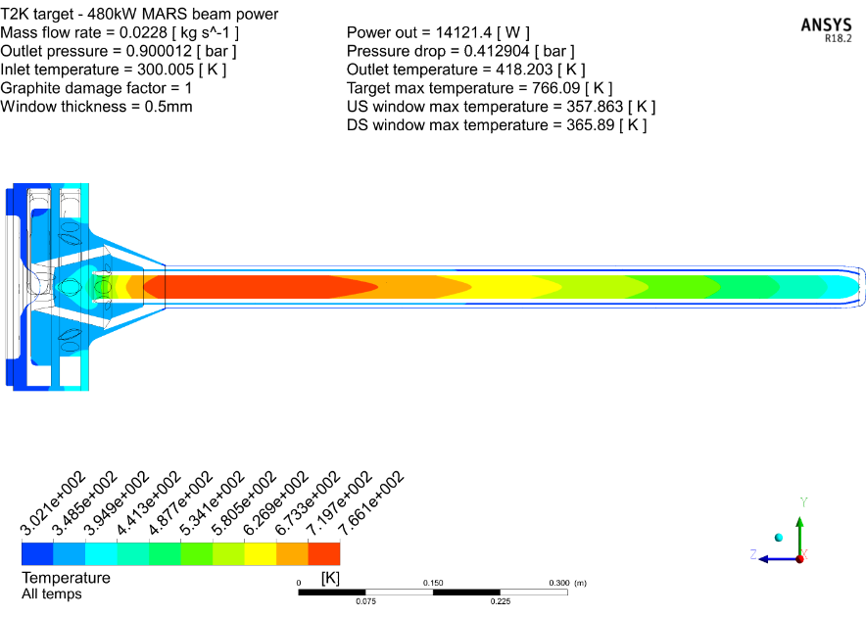

Target heat load - Comparison of operational T2K data (Beam power deposited) with MonteCarlo codes
The best measure of heat load on the T2K target is the helium outlet temperature which is measured reasonably close to the target. Along with the measured flow rate this enables us to calculate the power deposited by the beam. Original MonteCarlo simulations have been updated with FLUKA in 2019
480kW operational data, temp. rise of He = 73.4°C @ 22.9g/s → 8716W
480kW MARS (2006), temp. rise of He = 145.2°C @ 22.9g/s → 14,121W (x1.6)
480kW FLUKA (2019), temp. rise of He = 89.0°C @ 22.9g/s → 10,636W (x1.2)
This is good news as flow rate & pressure for 1.3MW could be reduced
NOTE: We are aware that older versions of MARS can predict significantly more heat load than FLUKA and newer versions of MARS.
Helium ΔT is large -> Errors should be small
Other heat losses estimated to be small
MARS (2006)
FLUKA (2019)

Slide 4
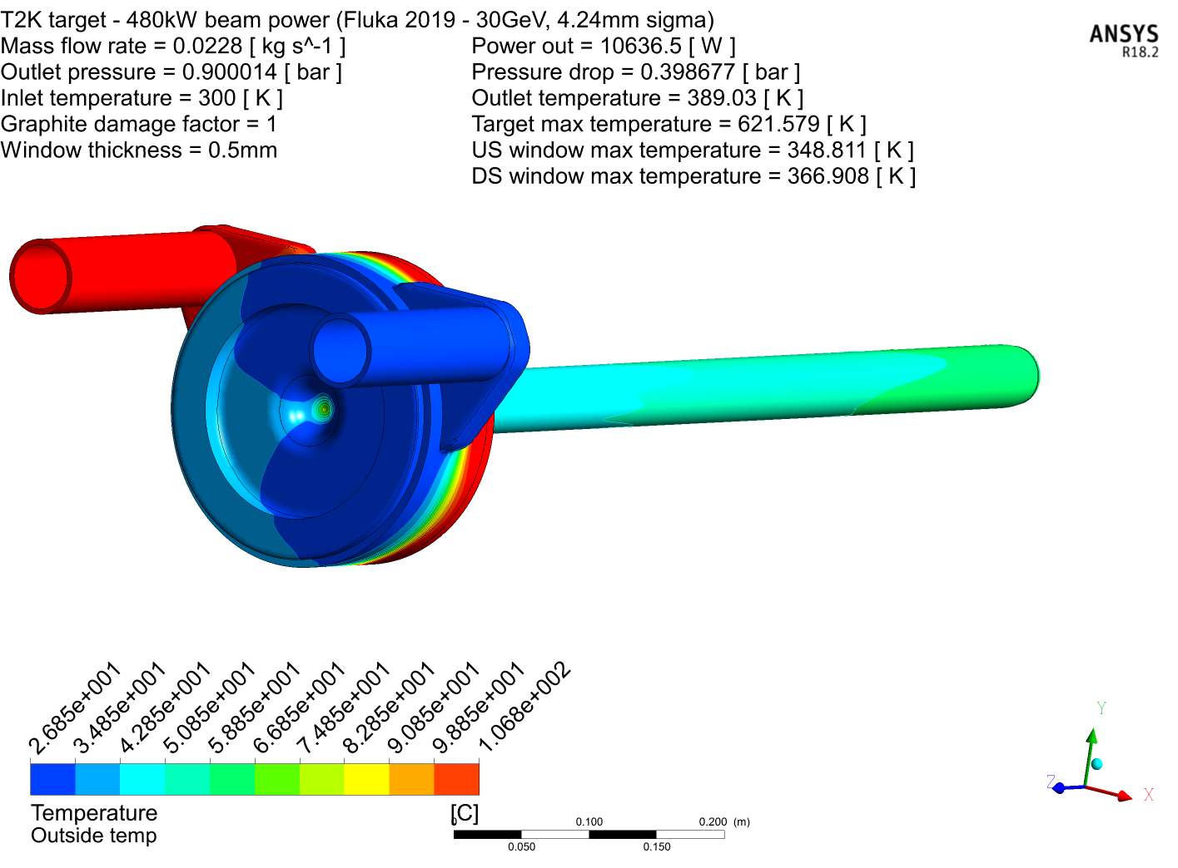
Possible sources of heat loss (error) in temperature measurement
Convection heat loss from outlet pipe
Heat loss from 50.8mm pipe between target outlet and thermocouple (approx. 1m).
HTC ~ 10W/m².K
Ambient helium temperature = 40°C
Helium pipe @ target outlet temp = 100°C
Pipe surface area/meter = 0.159m²
Power loss = 10 x 0.159m² x (100-40) = 63.6W/meter (negligible)
2. Conduction from target supports
Front face of target is cool (34°C) as helium passes it first.
Target support plates are water cooled, approx. 30°C
Target is mounted via Alumina ceramics (low conductivity and
thermal interfaces add resistance)
No significant heat transfer
3. Convective losses from titanium tube
Surface temperature is similar to ambient (40-50C)
dT and surface area small -> negligible
Target surface temperature @ 480kW

Slide 5
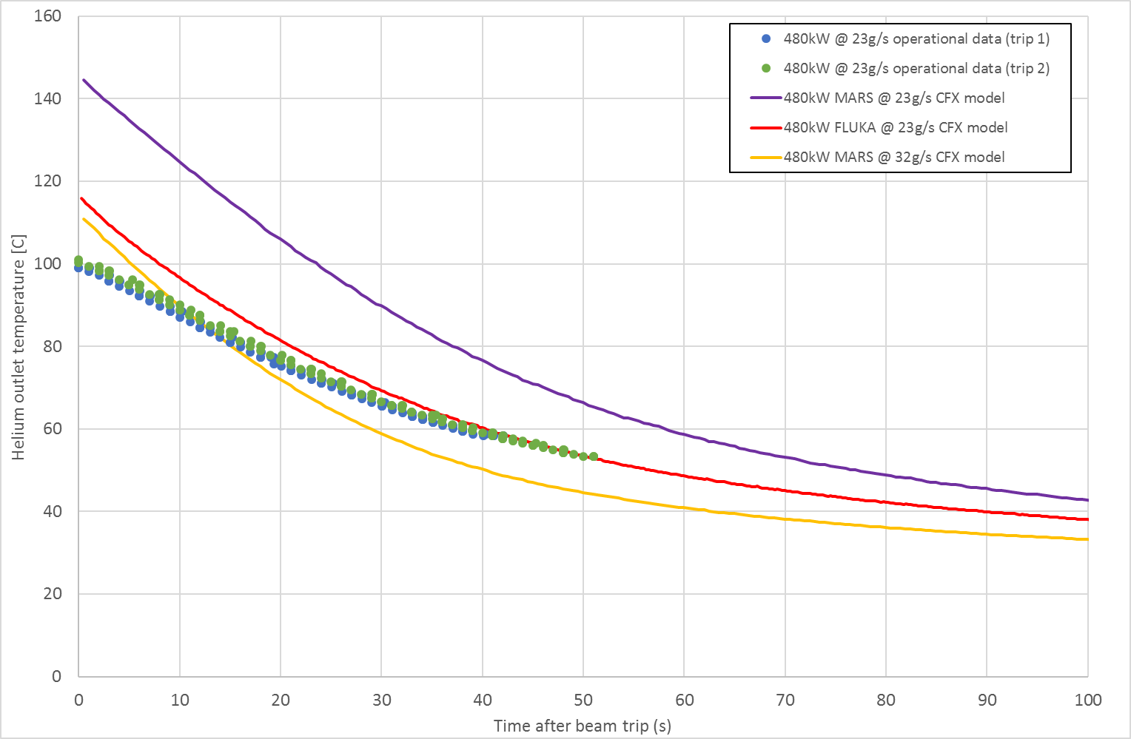
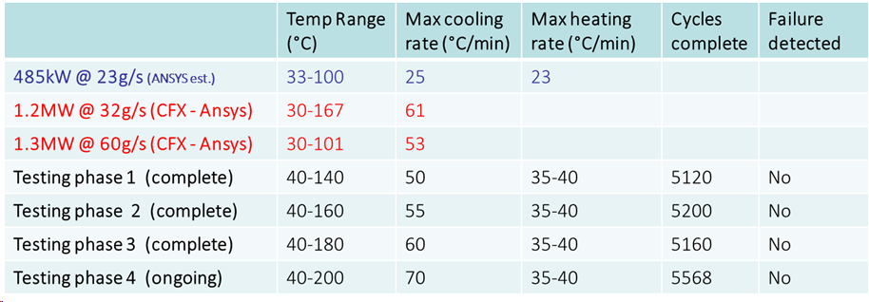
Estimation of helium outlet temperature vs. time (beam trip condition)
These simulations also highlighted the rapid cooling that would be experienced by the helium outlet pipe.
Operational data from 29/04/2018
Beam power = 480kW
Helium flow rate = 22.9g/s
Ansys transient simulation with FLUKA heat deposition is closest match to the operational data
At 1.3MW the rate of helium cooling will double.
Potential issues for thermal shock on the ceramic isolator
We decided that test programme was required to evaluate the isolators thermal fatigue resistance
480kW @ (32g/s) excludes the possibility that flow rate is higher than expected as cooling rate is too high

Slide 6
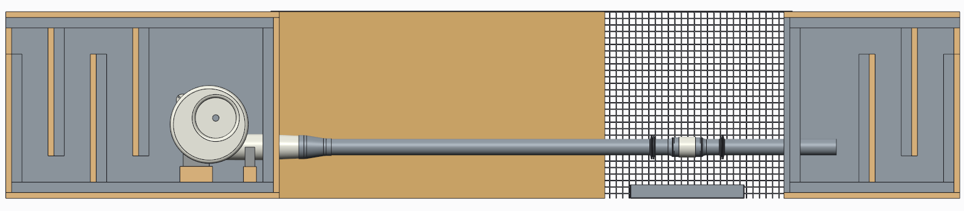
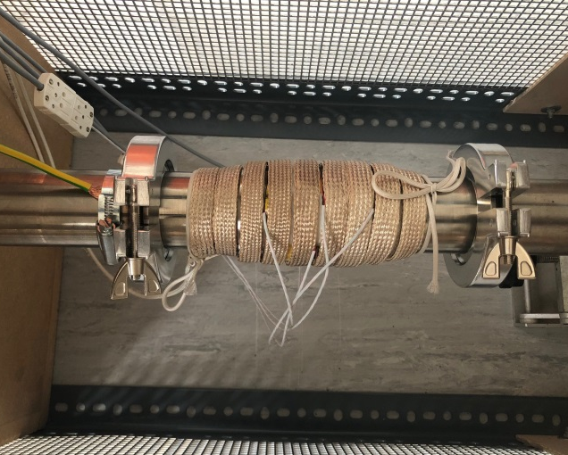
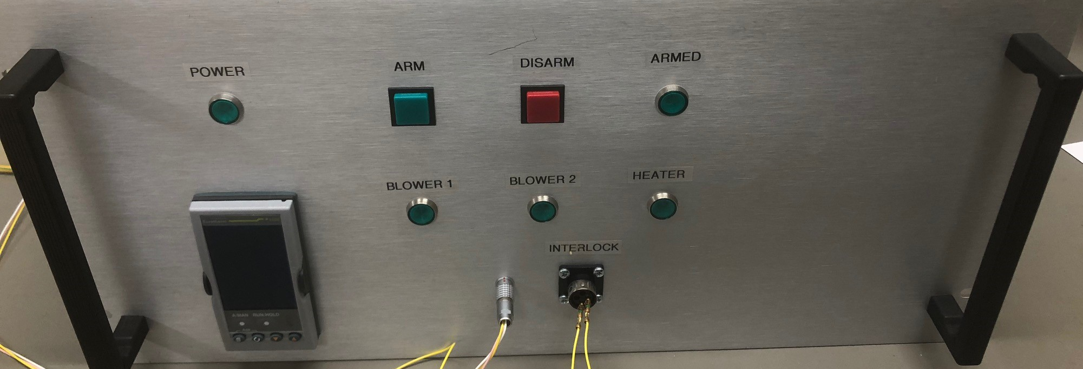
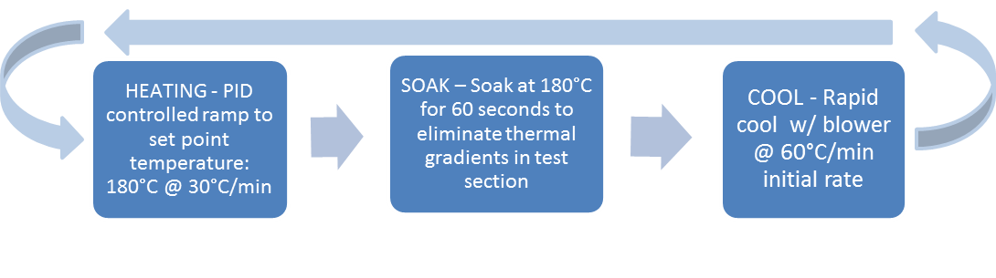
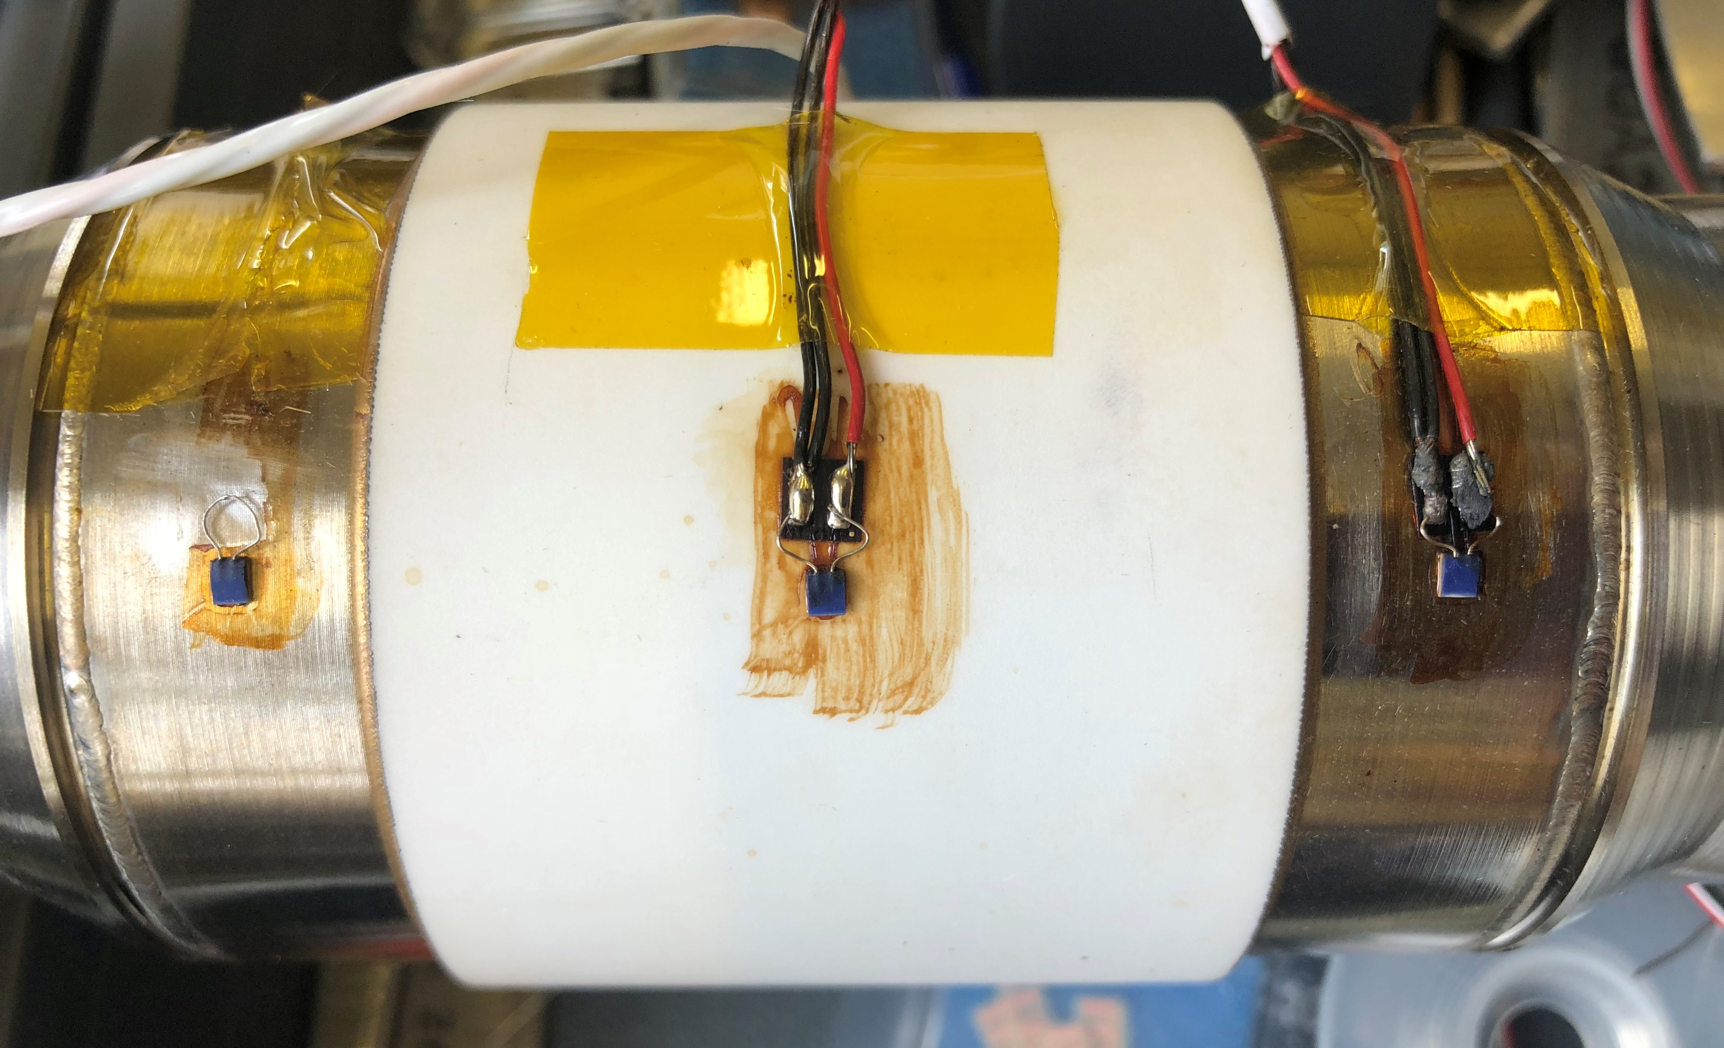
Thermal fatigue testing of ceramic isolators - RAL Ceramic isolator test rig
Test section heated by 600W heater tape
Cooled by internal forced convection with air
Heating/cooling PID controlled
Max test temperatures ~200°C
(limited by instrumentation)
70°/min cooling rate achieved at ceramic outer surface
Blower (600m^3/hr)
Ceramic test section
Acoustic baffles (inlet and exhaust) for 24hr running
PID control system
Isolator with tape heater
PT100’s bonded to isolator
Temperature of cooling air fixed at room temperature.
Cooling rates can be controlled by changing the dT -> Max temp of ceramic isolator
Notes:
PLEASE DELETE/REPLACE PHOTO CREDIT IF CHANGING THE IMAGE.

Slide 7
Helium isolator R&D – results
Testing of original ceramic joint (diffusion bonded) and proposed (brazed) has been completed
Brazed ceramic isolator is still ok after 4th phase of testing (19,548 cycles) 4years @ cooling rate more severe than 1.3MW
    1 year of operation is estimated to be about 5000 beam trips
 | Temp Range (°C) | Max cooling rate* (°C/min) | Max heating rate (°C/min) | Cycles complete | Failure detected**
485kW @ 23g/s (Operational data + ansys) | 33-100 | 25 | 23
1.2MW @ 32g/s (CFX - Ansys) | 30-167 | 61
1.3MW @ 60g/s (CFX - Ansys) | 30-101 | 53
Testing phase 1 (complete) | 40-140 | 50 | 35-40 | 5120 | No
Testing phase 2 (complete) | 40-160 | 55 | 35-40 | 5200 | No
Testing phase 3 (complete) | 40-180 | 60 | 35-40 | 5160 | No
Testing phase 4 (complete) | 40-200 | 70 | 35-40 | 19,548 | No
← Beam data
← Extrapolation of beam data
Brazed isolator
Testing has given good confidence that the brazed isolator can withstand the thermal cycling from beam trips & looks good for higher power operation
Diffusion bonded ceramic failed between 450-770 cycles (leak tested at ~1E-5mbar l/s) and would not pump down on the leak detector after 1090 cycles at 40-140°C
Brazed isolator is preferred technology for thermal fatigue resistance
* Measured or calculated at ceramic surface (e.g. position of PT100)
** Failure detected by helium leak test

Slide 8
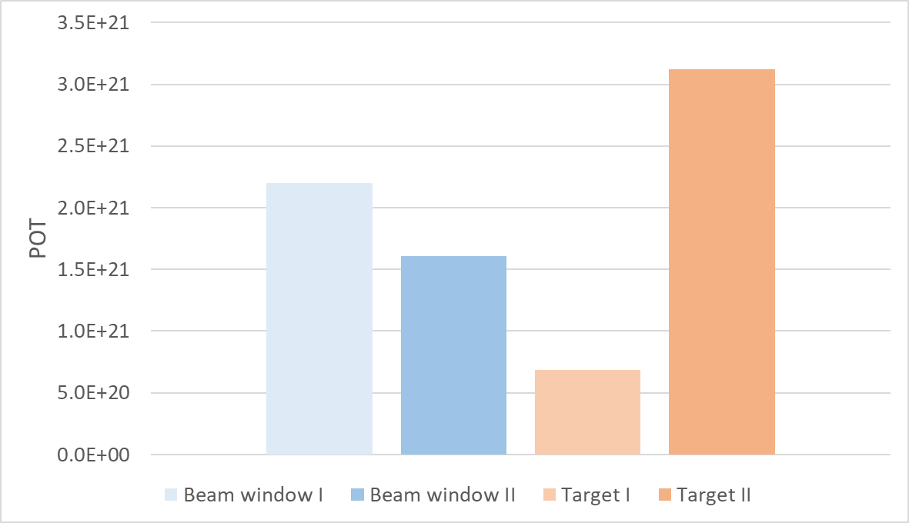
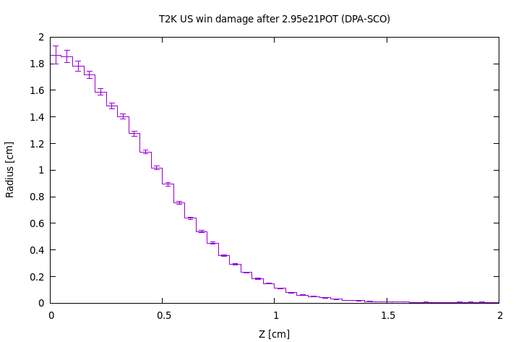
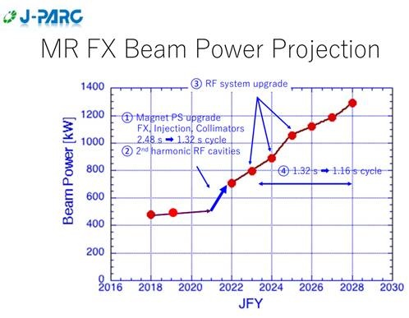
T2K Experience of target and beam window lifetime (POT and DPA)
How long will a Ti-6Al-4V target/window last?
    No titanium failures observed to date
    No indications of graphite failure
T2K Target II has highest POT ~3 x 10²¹ POT →1.9DPA-SCO (ARC) in Ti-6-4
DPA higher than BLIP samples! → 0.95DPA-NRT
3.1x10²¹
1.6x10²¹
Currently being replace No failure
FLUKA estimate current target window @ 1.9DPA
Damage threshold = 40eV
Replaced before failure
Replaced before failure
In service
In HK era we can expect around 3 x 10²¹ POT/yr
Ideally a target & beam window will not need to be replaced more than 1 time per year. More data needed!

Slide 9
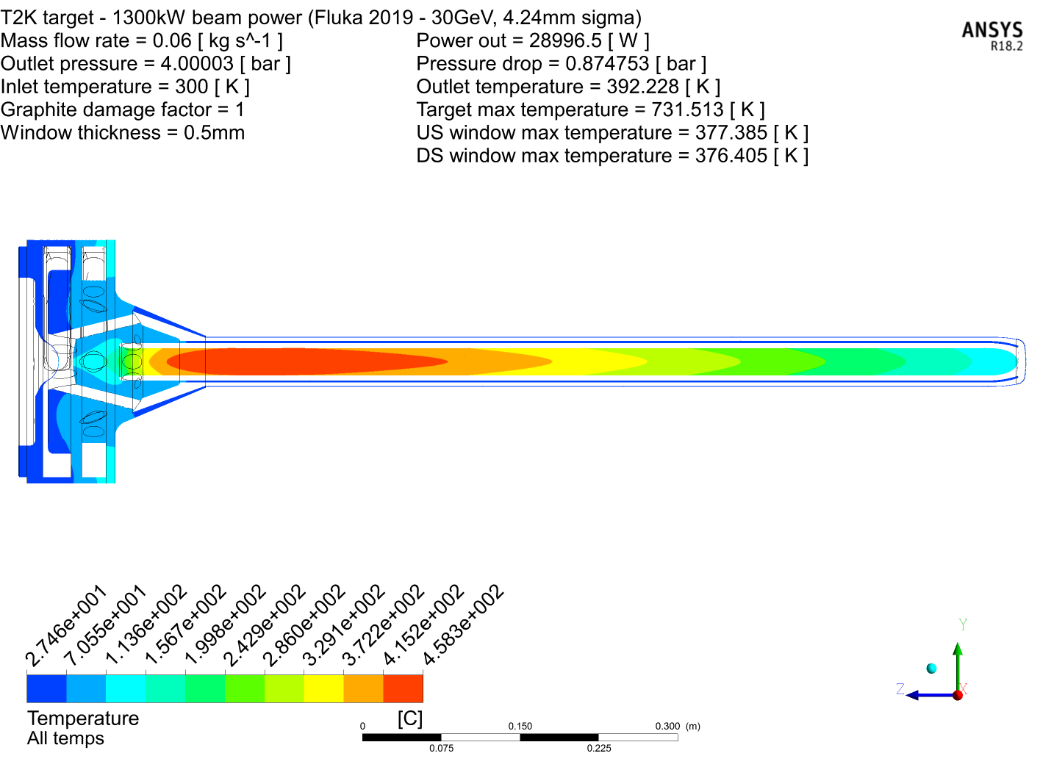
T2K -> HyperK - Target requirements for upgrade to 1.3MW
Current operational experience up to ~500kW (0.5MW)
Beam power 0.75→1.3MW will increase the integrated heat load on the target (x 1.7 times)
Need more cooling but can’t just increase flowrate
  Pressure drop -> @ 60g/s would be 2bar!
  Helium velocity -> @ 60g/s approaching Mach 1!
Solution - Increase operating pressure:
  Increases Helium density
  Allows higher mass flow rate without big increase in pressure drop or velocities
  Compressor will be smaller, lower power and less heating
60g/s @ 4.9bar (4barG outlet) – 1.3MW beam power (Heat load from FLUKA 2019)
458 °C
104 °C
103 °C
Target components must be:
Re-designed/optimised for operation at 5 bar (Working pressure), and tested at 7.5 bar
With outlet pressure @4 barG the pressure drop of the system is comparable to the 750kW design (32g/s @1.6bar/0.9barG outlet) = 0.73bar

Slide 10
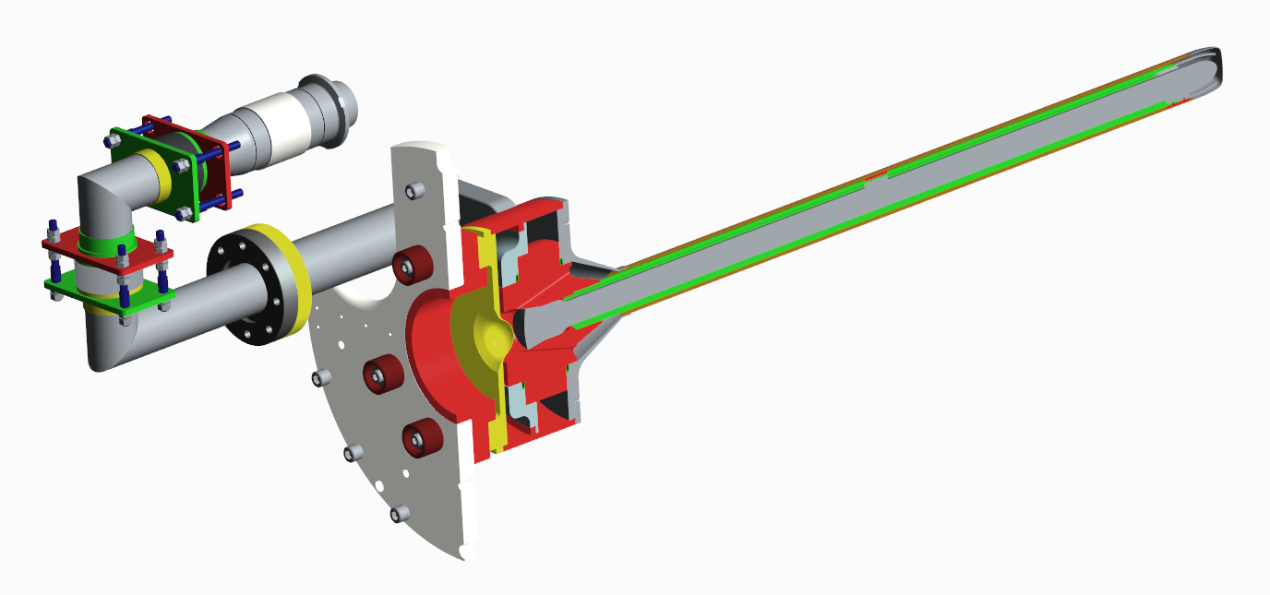
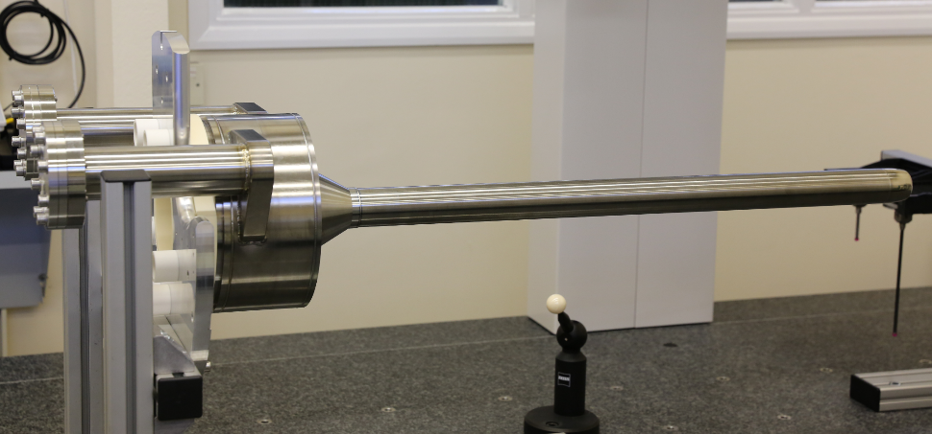
Required Target upgrades for operation at higher pressure
Redesign target pipes for 5 bar operation. Increase pressure rating and remove thrust force
Full penetration EB weld at downstream target window
Thrust force 1.4kN @ 5bar (per pipe)
Need to remove to prevent target deflections form 2.8kN force
Re-optimise downstream target window to reduce pressure stress & maintain good cooling
+ Enhanced QA testing and traceability
Re-optimise upstream target window to reduce pressure stress & maintain good cooling

Slide 11
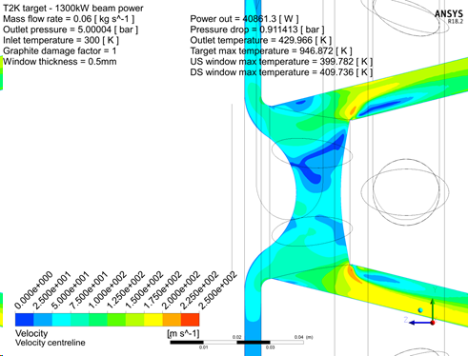
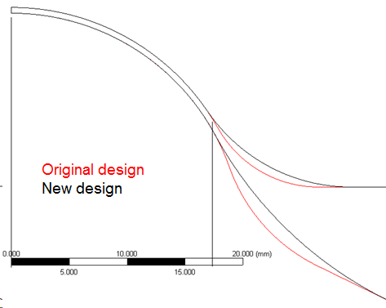
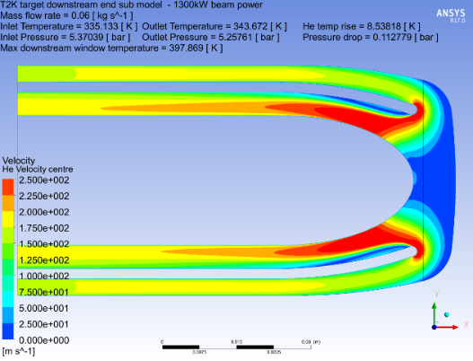
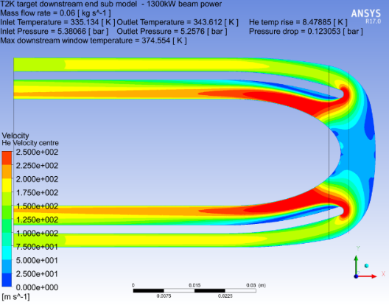
Target Windows Optimisations for high pressure
Downstream Window:
Curvature of window and blend radius increased
Pressure stress reduced by a factor of 3
Small increase in cooling effectiveness
  (6% temperature reduction)
Small increase in pressure drop (0.01bar)
Upstream Window:
Plate thickness increased (7 → 10mm)
Window profile maintained the same up to R18mm – for off-centre beams
Blend radii increased
Stress reduced from 74MPa →38MPa
CFD shows modifications have little effect on flow/cooling
750kW design
1.3MW design
Modifications analysed in both FEA and CFD.
Need to check stresses + the effects on cooling and pressure drop

Slide 12
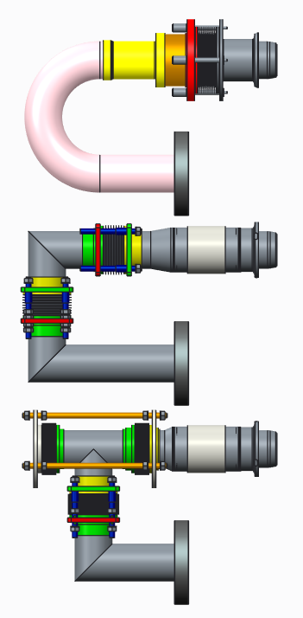
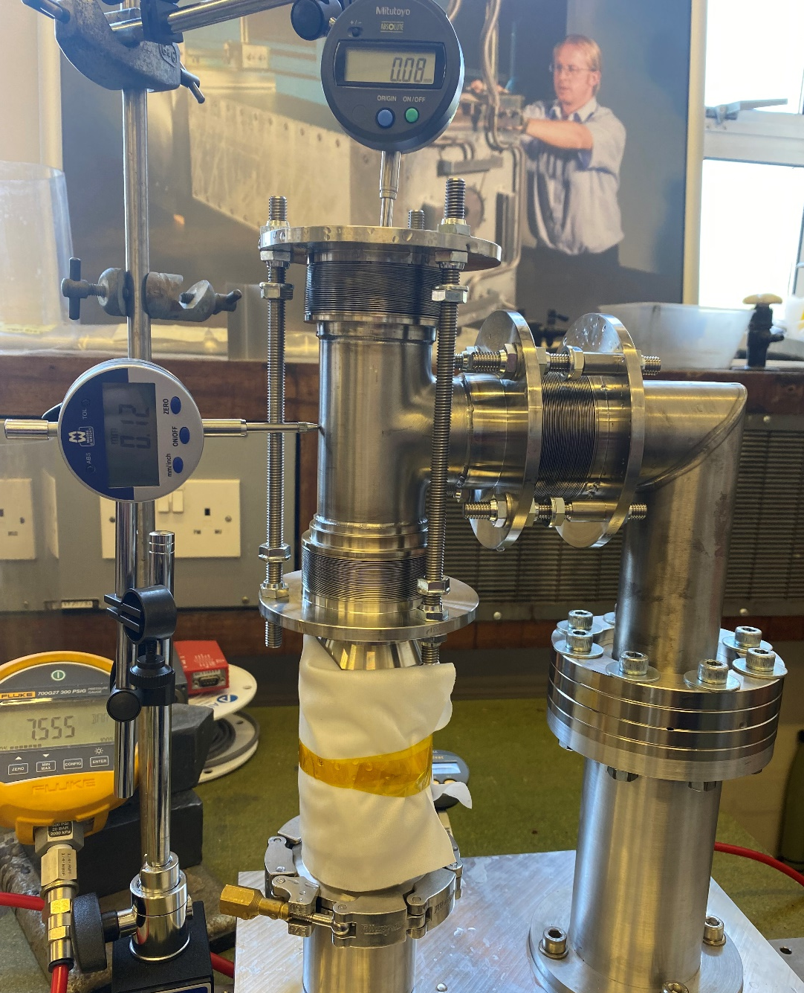
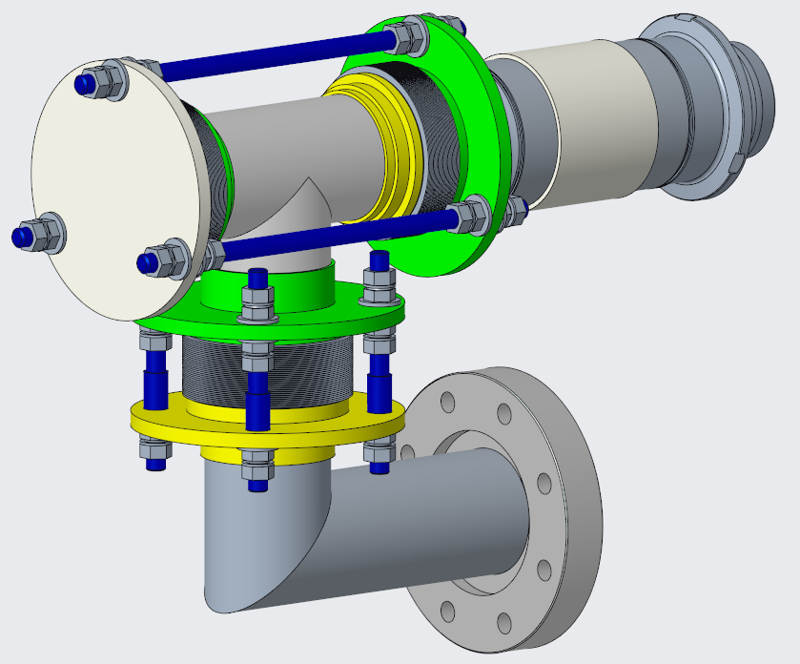
Target pipe development
Target Pipe Evolution
Leak tested with total leak rate <1E-12mbar l/s
Pressure tested to 7.5bar with acceptable deflections
0.08mm
Pressure balanced pipe design:
All bellows rated for 5 bar WP and 8 bar test
Balancing bellows cancels out thrust force
0.12mm
Time→
1.5x Working pressure
7.5 bar
Active bellows
Balancing bellows
Adjustment bellows
2.8kg
Tri-axis load cell under remote connector measures force during pressure test.
1.4kN Thrust force almost eliminated!
Electrically isolated helium pipes are challenging to design and manufacture

Slide 13
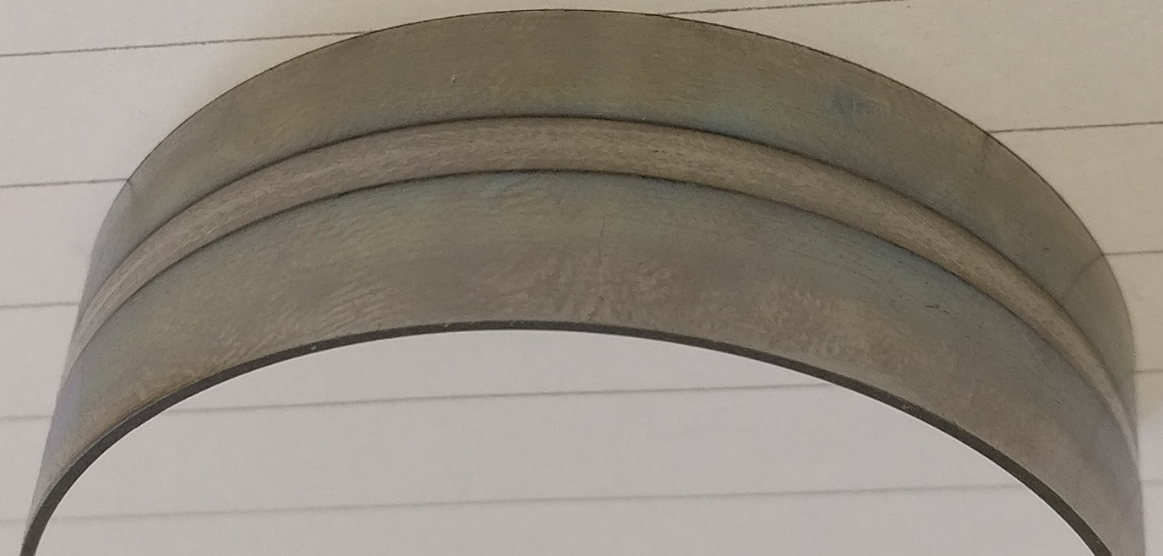
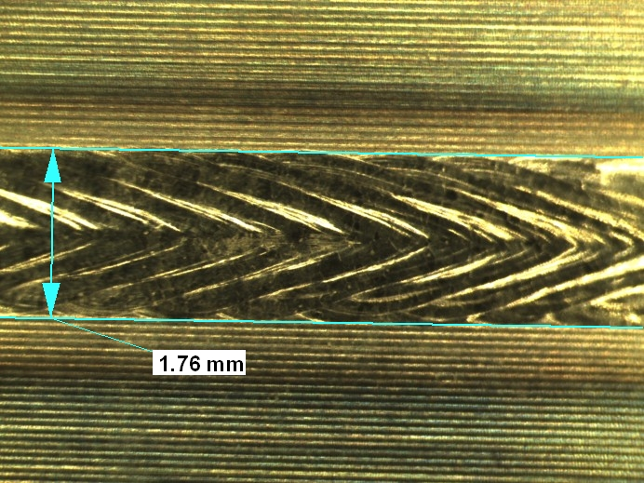
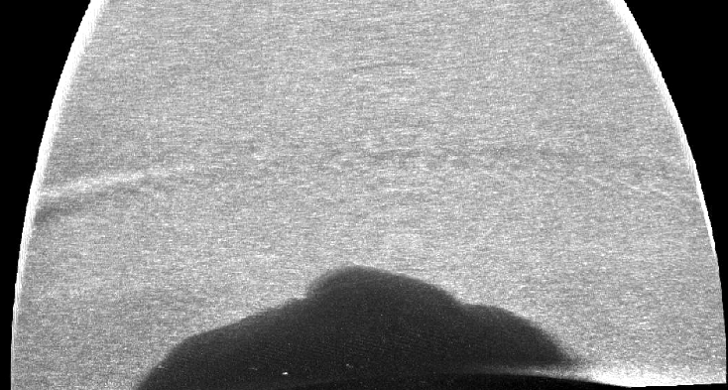
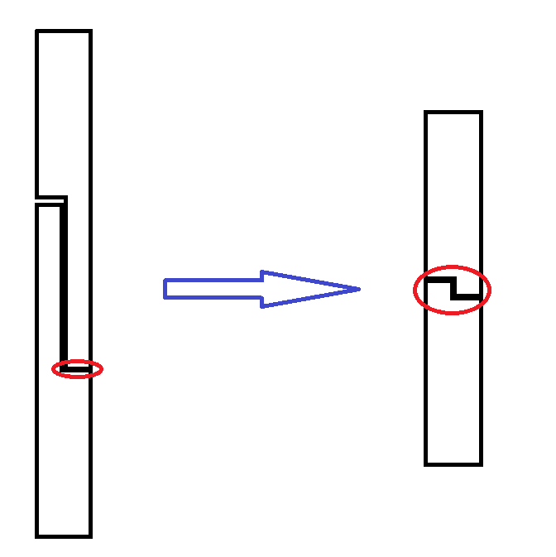
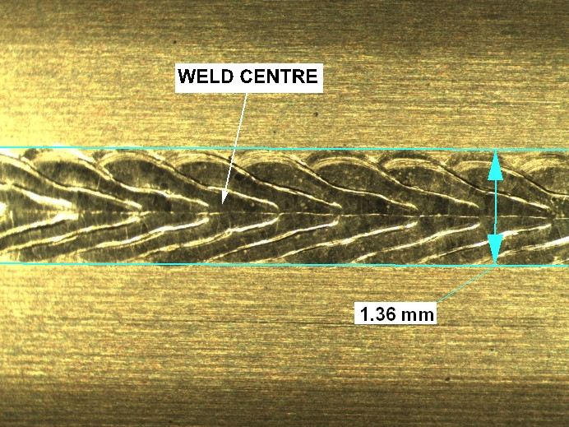
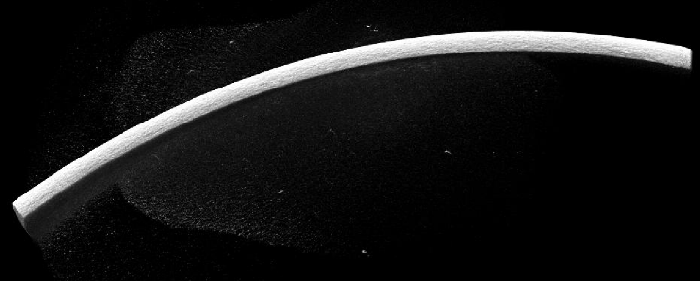
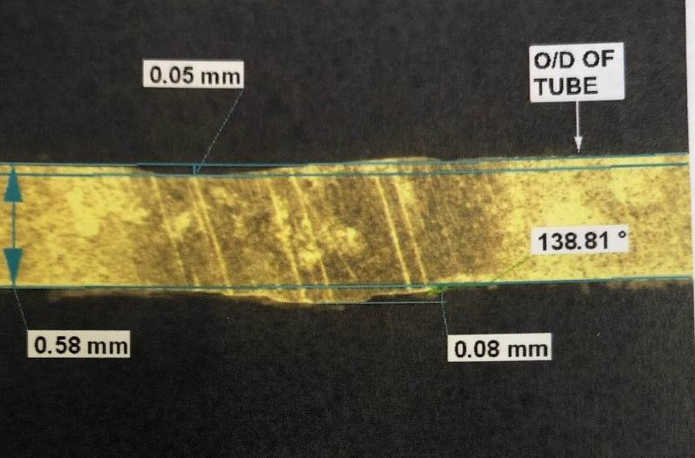
Downstream Window full penetration EB Weld Development
T2K design had just 0.25mm penetration – for higher pressure operation we require a full penetration weld.
New joint designed and developed with EB welding company. Weld location features are consumed in the weld – Fit needs to be good to prevent voids or lack fill
EB welding development
Top bead
Micro-CT scan
T2K target design
Proposed HyperK
design
Re-slice through weld
Under bead
0.25mm penetration weld
Full penetration EB weld (joint prep is consumed)
Location step now only 0.5mm deep and 0.25mm wide.
Difficult to manufacture + measure
Visual inspection, cut section, dye pen & CT scan all look good
– no visible pores or defects.
0.5mm
Cross Section
New design a success ☺

Slide 14
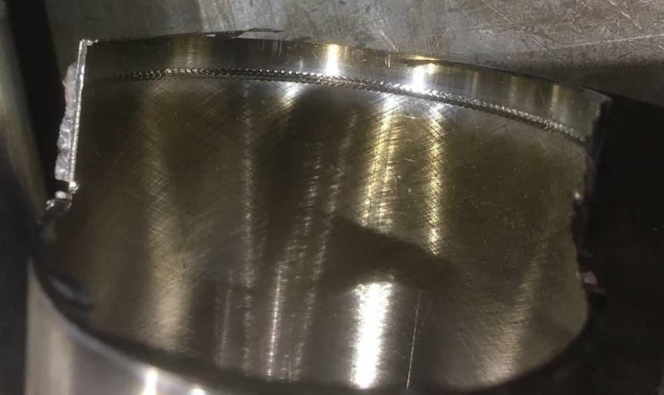
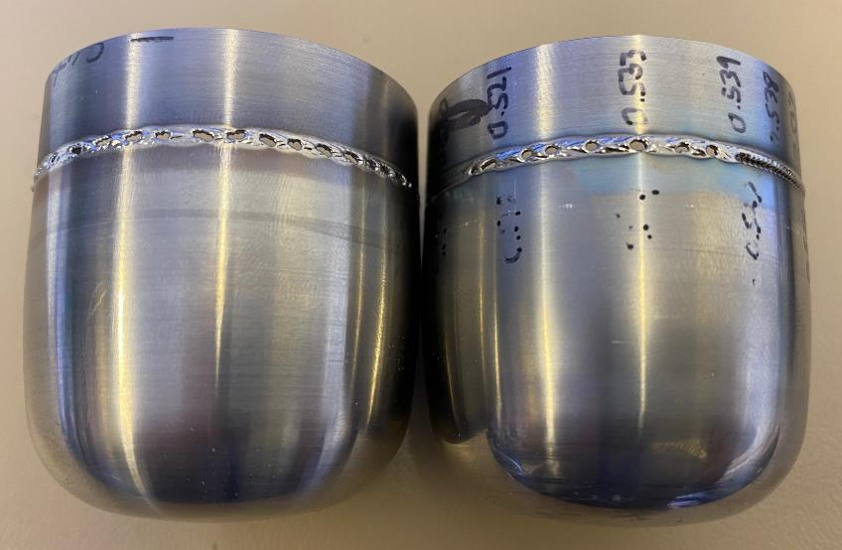
1.3MW prototype target production – DS window EB weld (1st attempt)
Before welding production parts we completed a repeat control batch – All OK
Then we completed the weld on a prototype tube and downstream window first – Results were not as expected.
Initially we thought this was due to difference in the wall thickness between the control batch samples and actual components.
Tolerance on parts allows a 10% variation in wall thickness
After manufacture and welding of another set of control batch samples, we had another failure of real target parts!
Control batch – weld ok
Production parts – weld failure x 2
Not so successful ☹

Slide 15
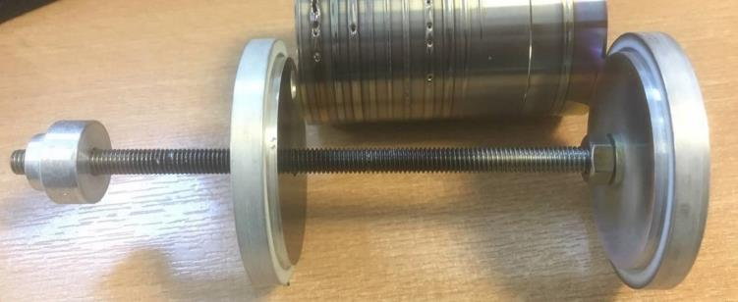
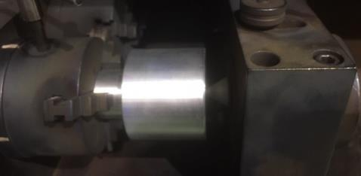
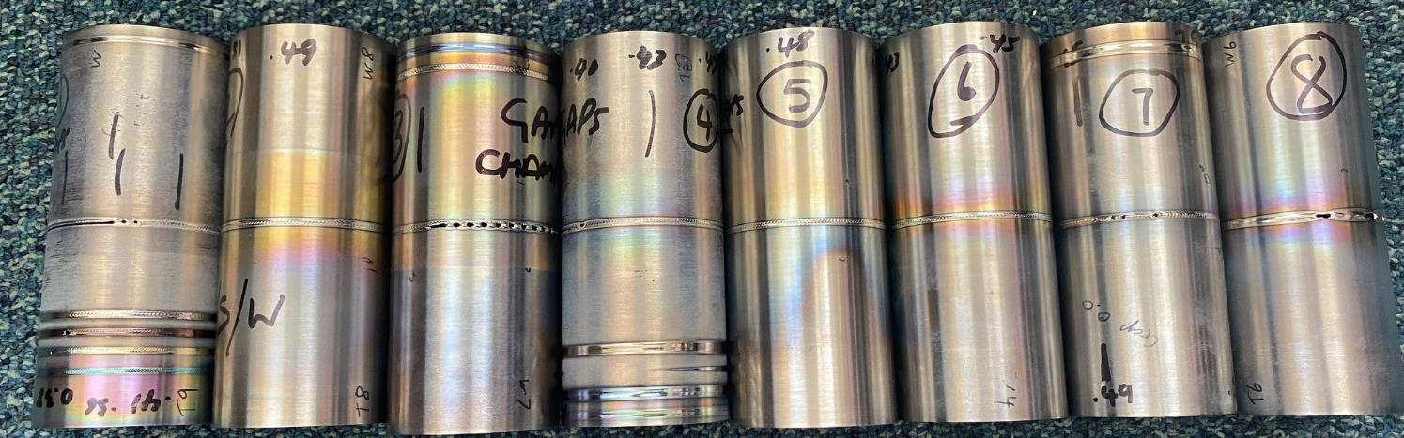
1.3MW prototype target production
2nd theory was joints opening up during welding. We found that the EB company was not constraining real parts in same way!
To overcome this we tried to develop
Tack -> Stitch -> Full pass technique.
Still not able to achieve a consistent weld.
Only 2 out of 8 parts successful.
Insufficient confidence to commit more production parts.
We decided that this join design was no longer suitable.
Weld development
Real target tooling
Chuck + Centre + tooling

Slide 16
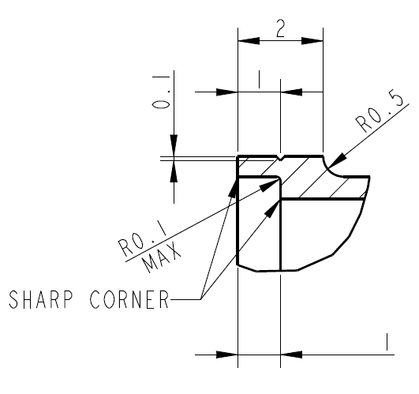
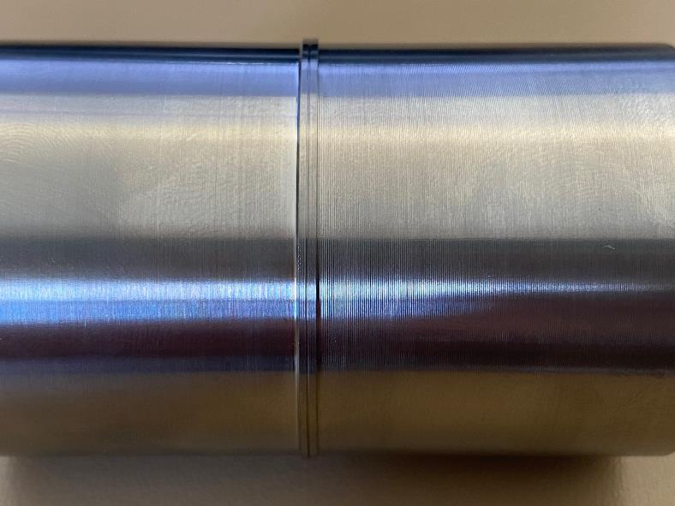
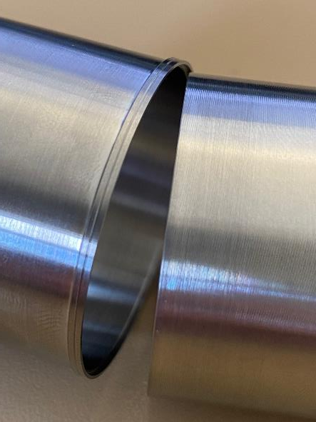
1.3MW prototype target production – Downstream window EB weld redesign
We came up with new design that has external socket that locally thickens the joint and provides filler material.
Due to the increased wall thickness, this weld prep also proved much easier to manufacture than the previous design and removed difficult (0.25mm thick) feature from the end of titanium tube.
EB
Part has scribe line to aim the EB weld

Slide 17
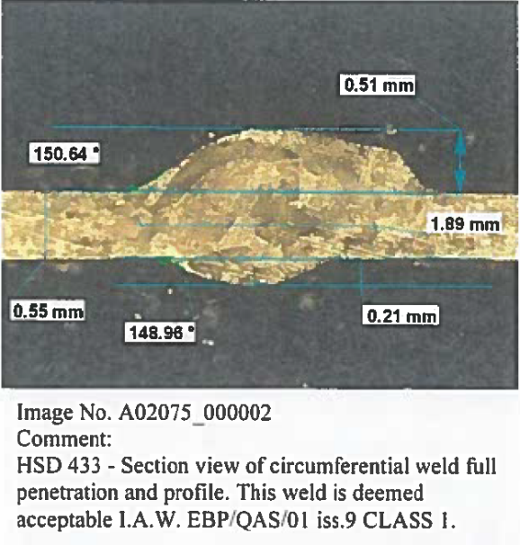
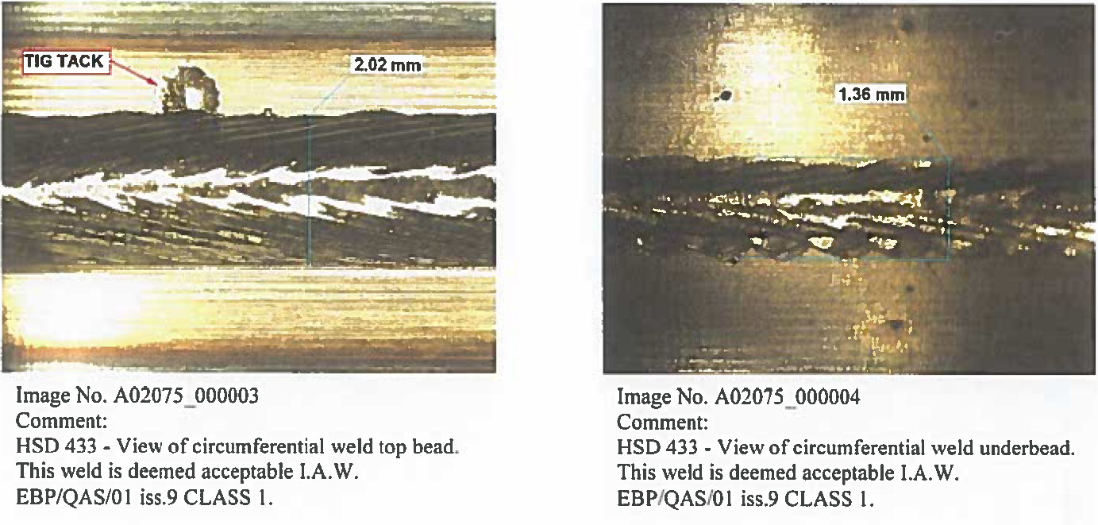
1.3MW prototype target production – Downstream window EB weld redesign development
Company reported no problems welding these samples and no burn thoughts during development
Under-bead is more significant and protrudes 0.2mm as shown below.
Full penetration, no loss in material thickness, no concavity -> Acceptable for high pressure (5bar) operation
Cross section
Top bead
Under bead
External filler
Underbead
This new EB weld design was adopted for the 1.3MW prototype target.

Slide 18
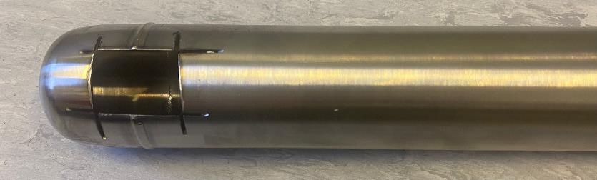
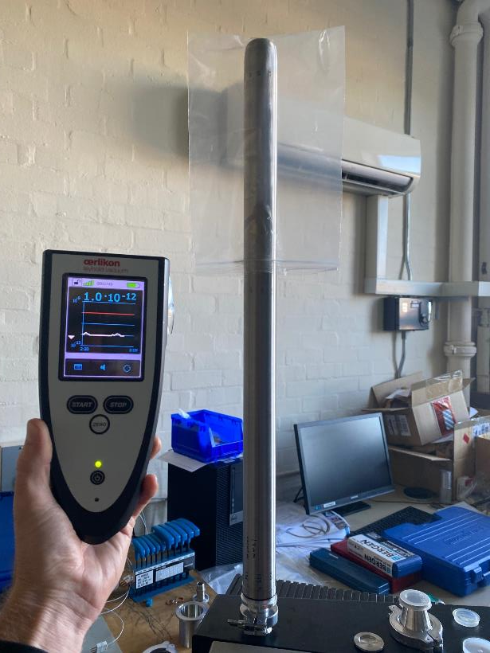
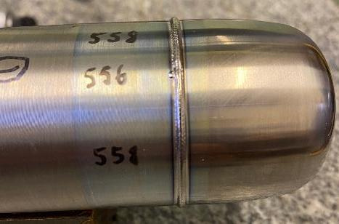
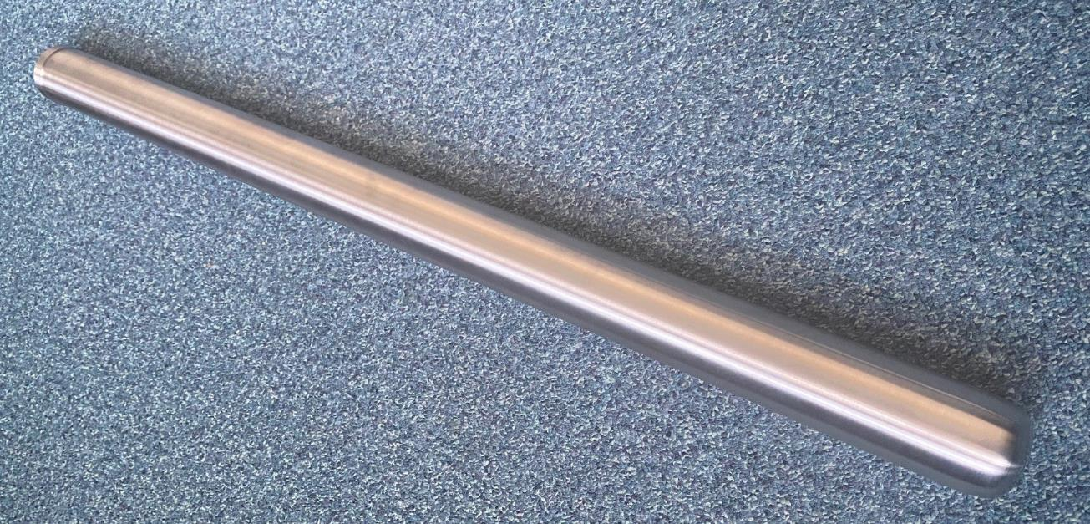
1.3MW prototype target production – Welding of final target tube to DS window
Bag filled with Helium
Before welding the final tube we completed another batch control test on a scrap (slightly short) tube. Weld was deemed acceptable so we proceeded with the real target
As welded final tube
Final tube after removal of excess filler.
Removed due to small clearance between target and horn
After welding and machining off the excess weld filler the assembly passed a helium leak test > 1 x 10⁻¹²mbar.l/s.
No leak after 30mins

Slide 19
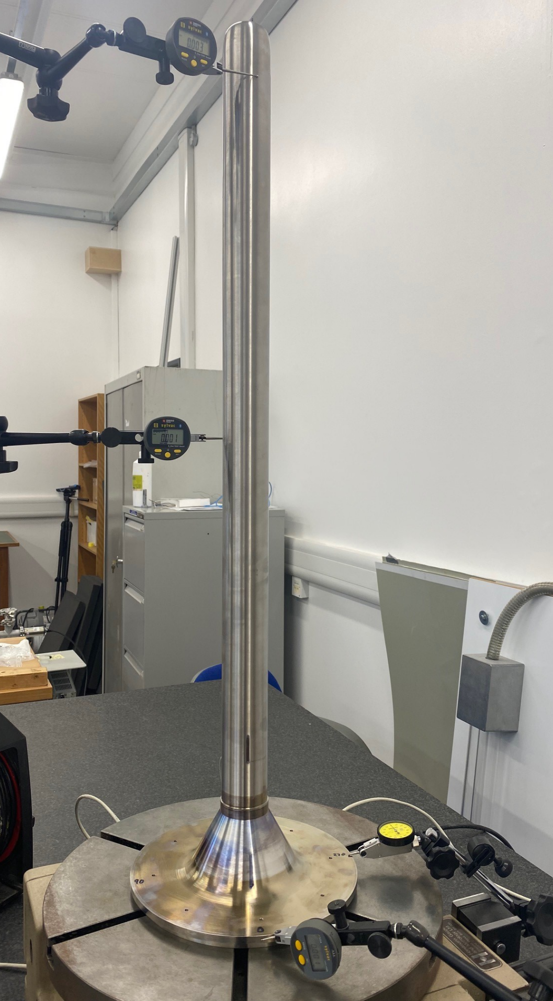
1.3MW prototype target production – Target tube straightness
Runout checks are made before and after welding the tube assembly to the target head.
This weld is critical to the straightness of the target assembly.
Measurement of total runout captures tube straightness, roundness and concentricity.
After welding
Max total runout = 0.518mm
Straightness is approx. 0.259mm
At this stage the assembly can be rotated so that the end of the target points up. This will compensate for the gravity deflection and reduce shimming requirements later.
Runout
Before welding = 0.313mm
After welding = 0.518mm
Runout
Before welding = 0.159mm
After welding = 0.379mm
Base level = 0.006mm
Base runout = 0.004mm

Slide 20
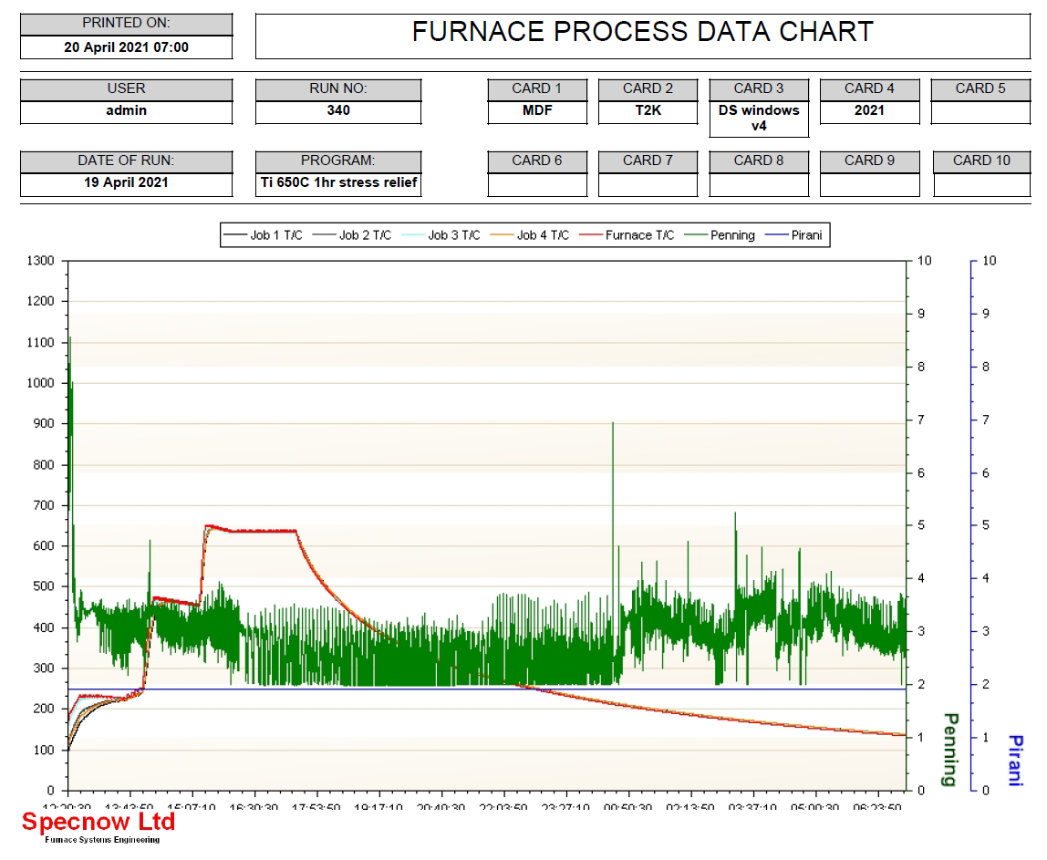
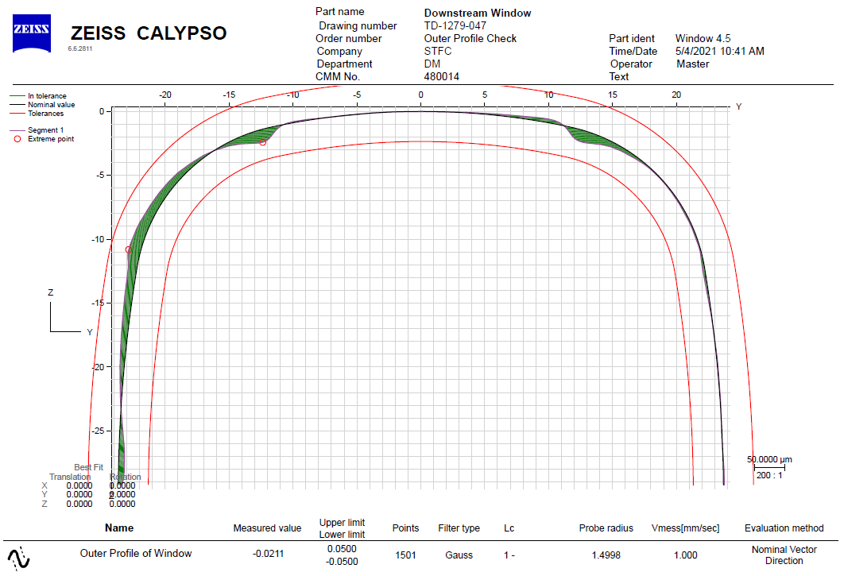
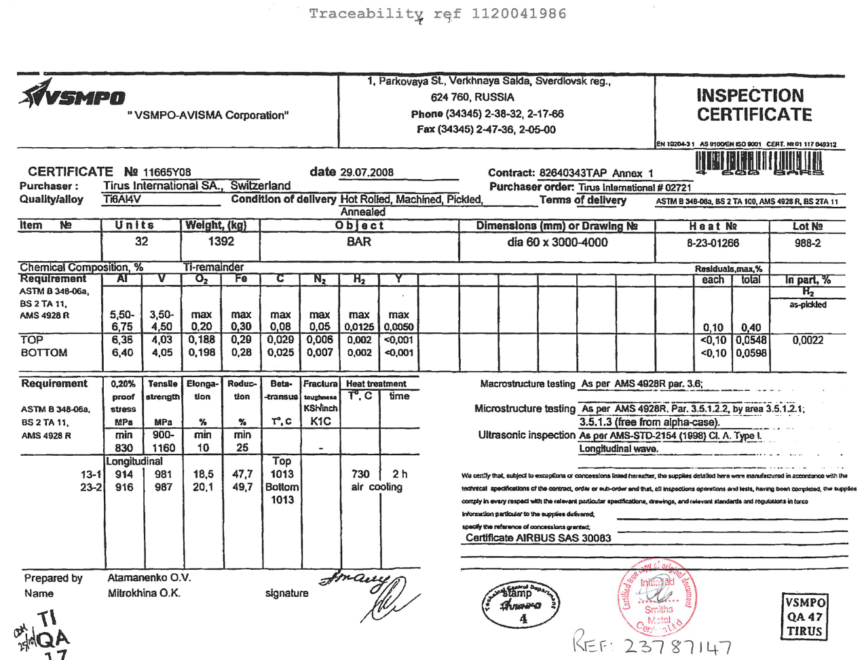
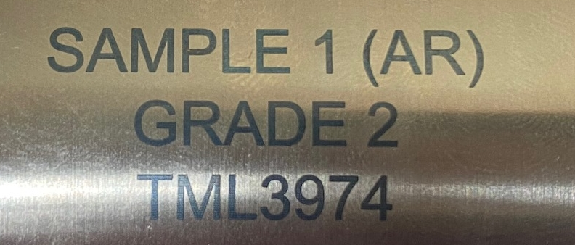
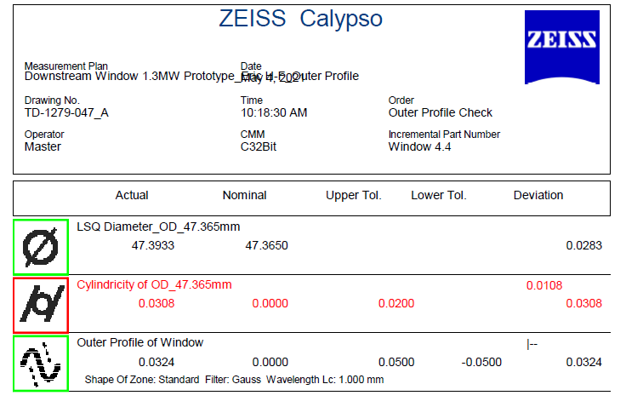
Target QA – Traceability
A Hyperlinked spreadsheet format has been generated, linking all Q/A data and ensuring traceability for a given target build.
Components used in final build are recorded in sub assemblies + test result (e.g leak & pressure tests)
Heat treatments
Part marking of components for traceability
Metrology data reports
Material CERTs
Material traceability and history increasingly important for radiation damage studies as beam power increases

Slide 21



Target QA – CT Scanning (μ-VIS at the University of Southampton)
Full CT scan of target @ 27micron, 32bit resolution -> ~1TB file!
Thin section of target scanned at 170kV @ 180uA

Slide 22


Target QA – CT Scanning (μ-VIS at the University of Southampton)
Full scan consists of 19 concatenated volumes
Each volume consist of 3200 radiographs during 360° rotation
Radiographs reconstructed into CT data
Titanium container
Graphite flow guide
Target rod
EB weld of downstream window to titanium tube (0.5mm wall)
This area is of significant interest for weld and pressure vessel QA
Dark shadow is caused by local thickening (underbead)
Radiographs show no significant indications (voids or inclusions) ☺

Slide 23




Target QA – CT Scanning (μ-VIS at the University of Southampton)
HOWEVER! Re-constructed CT scan shows far more detail and contrast than Radiographs of the same weld!
From the CT scan we can find ~8 voids. All are isolated and the biggest is 0.25x the wall thickness.
Under ASME BPVC Section VIII (Pressure Vessels, Division 2), Part 7 (Testing and Examination) this just acceptable.
CT scanning is not a ASME requirement
CT can be “resliced” to determine exact position of defect. In this case it is aligned with the local reinforcement (underbead)

Slide 24



Target QA – CT Scanning (μ-VIS at the University of Southampton)
Other areas of interest
Target / tube spacers
Reslice
Live Demo of CT scan can be seen during the RAL tour
Gap measured from CT = 63um
Fasteners and cross flow holes in graphite

Slide 25


Further upgrades – Removal of pipe TIG welds –> New compact bolted design
Current design has two risky hand TIG welds as final stage of assembly – if these go wrong, we have to scrap whole target and start again!
Welding pipes to ears has tricky access
Welding CF flanges has risk of damaging knife edge
We are investigating a design change to remove these risky welds – do this by adding a bolted flange joint to the target “ears”
New Design:
Moves bolted joint from the CF flange on the pipes to the target “head”
Removes a weld from the target assembly
Target helium pipes bolt straight to the target “ears”
Replaces a CF flange joint with a more suitable Helicoflex joint
Helicoflex seals are approve and rated for internal pressure unlike CF
More difficult to replace only target pipes

Slide 26


Further upgrades – New compact bolted design prototyping and testing
Rotatable flange to allow pipe alignment
Ti-6Al-4V
316L SS
New design has been prototyped with correct materials and tested with helicoflex seal.
Total Helium leak rate 1x10-12mbar.l/s
Next step is to thermally cycle the joint in our rig (30-180°C) and repeat leak testing

Slide 27

Questions?

