Slide 1




Designing a Novel Low-Energy Beamline for NA61/SHINE
Carlo A. Mussolini
University of Oxford,
CERN (BE-EA)
Supervisors:
P. Burrows
John Adams Institute
N. Charitonidis
CERN (BE-EA)

Slide 2
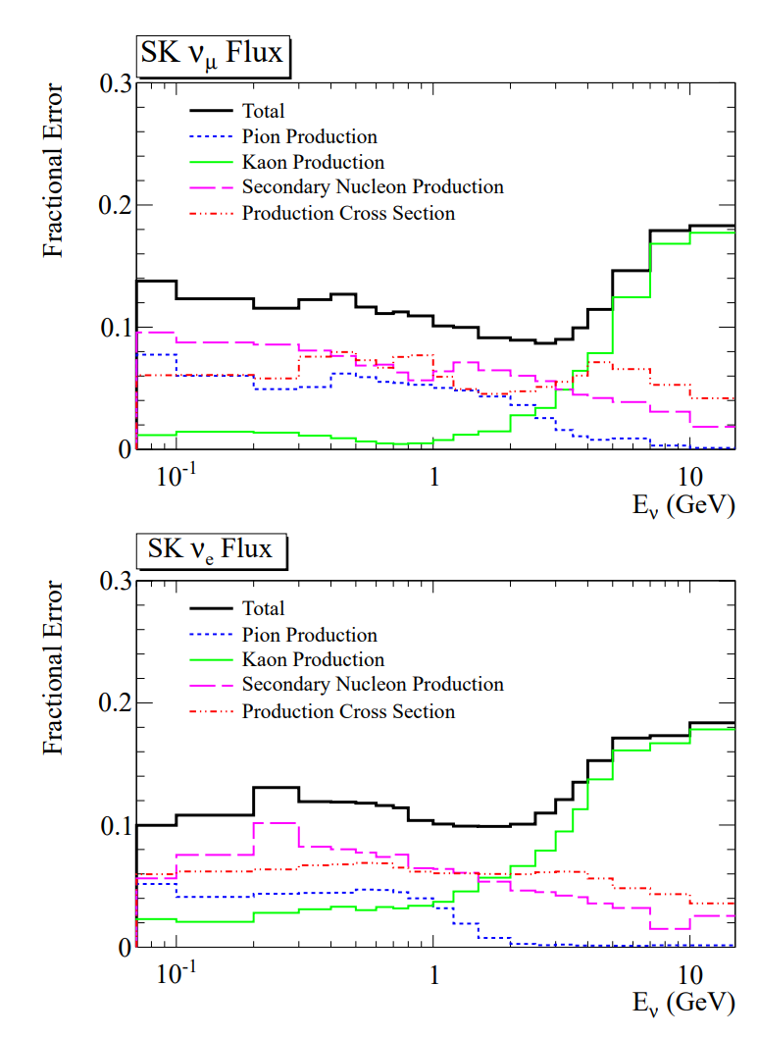
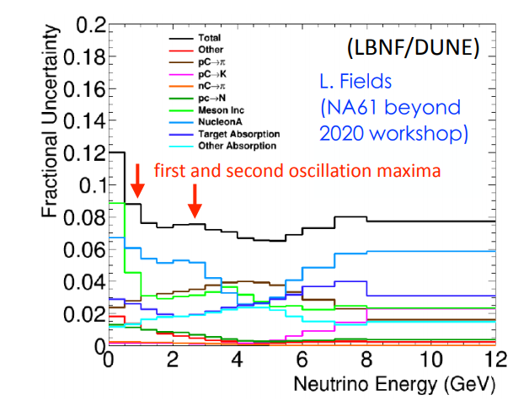
Need for a Low-Energy Beamline
As there is a lack of particle production data in the 1 – 13 GeV/c momentum range, results obtained by NA61/SHINE using this beamline could prove to be of great use in reducing the systematic uncertainties of many experiments such as [1]:
T2K
DUNE
Hyper-K
JSNS2
COHERENT
[1] “NA61/SHINE at Low Energy” workshop, December 2020
Plot on left from: L. Fields, Overview and hadron production for LBNF/DUNE, “NA61 beyond 2020” workshop, July 2017
Plots on right from: T2K Collaboration, K. Abe et al., "T2K neutrino flux prediction", in "Phys. Rev. D", vol. 87, p. 012001 (2013)

Slide 3
Need for a Low-Energy Beamline
CERN’s North Area beam facilities offer a unique place for test-beams and fixed target experiments, however low-energy particles are extremely challenging:
SHINE’s H2 beamline is designed for momenta greater than 300 GeV/c
Limitations on the magnets, the power supplies, and the acceptance
Length is a limiting factor as beamline is too long for low energy particles and many of the pions and kaons decay before they reach the experiments (H2 length to NA61 is 600 m)
For these reasons, a new design has been studied, tailor-made for lower energy particles

Slide 4
The new secondary beamline proposal
Acceptance Quadrupoles
Final Focusing Quadrupoles
Target Collimator & BPD Instrumentation Space NA61/SHINE Experiment
Here we can see how the beamline will fit in the North Area

Slide 5
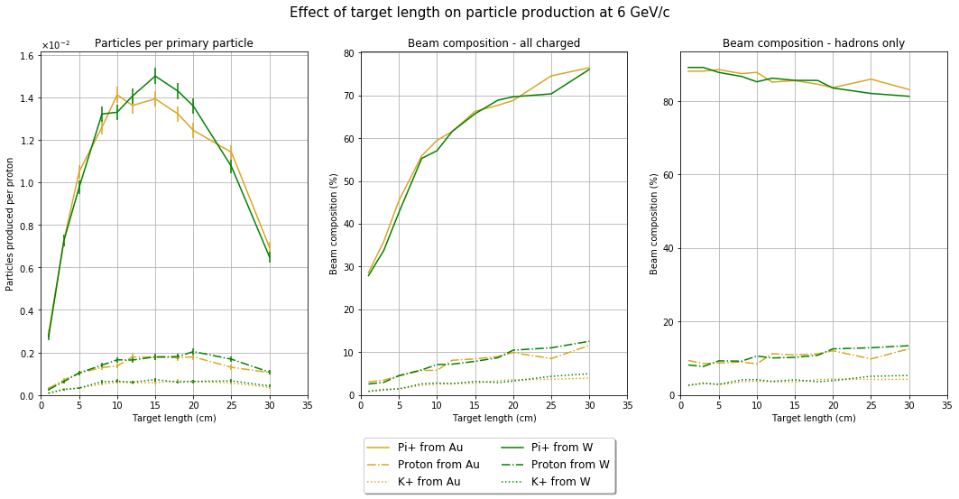
Optimisation: target studies
Simulated many different targets geometries and materials, both high and low-Z
Found that there was a trade-off between rate and beam purity
There is no target which is optimal for the whole energy range for each particle

Slide 6
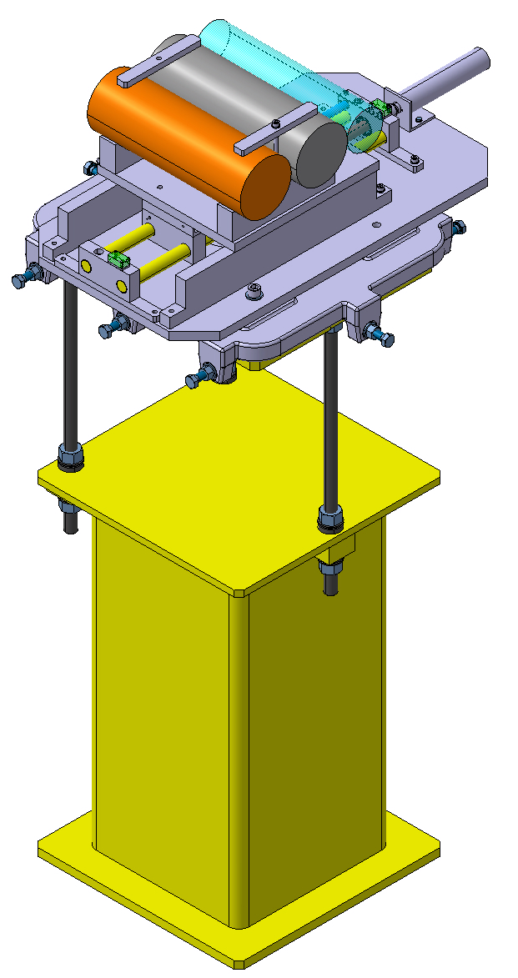
Optimisation: target studies
A multi target station is envisaged for the new beam line
Our study of the targets has found three possible targets for the production of secondary hadrons. These were:
For high yields : 20 cm W target with a 400 GeV primary
For balanced : 30 cm W target with a 400 GeV primary
For high hadron compositions : 15 cm W target with a 70 GeV primary
They all provided different types of beams, focusing on different properties. The implementation would be trivial, remote exchange of target very easy
Beam

Slide 7
Beamline optimisation
The beamline must:
Have a large acceptance, for a sufficient rate
Be short, to minimise particle decays
Have a good momentum resolution
Have a small spot size at the NA61 target
Not be too contaminated by backgrounds
A full parameter scan
Our approach to design this beamline has been to scan the parameter space and generate millions of beamline configurations, their acceptance and spot size at the end of the line.
Using this information it is then possible to select the beamline that best matches the experiment’s requirements, as every solution should be there
Beamline parameter scan for the back end
(Order 100 M configurations)
Beamline parameter scan for the acceptance quadrupoles
(Order 100 M configurations)
Select beamlines based on acceptance and beamspot on NA61 target
(Order 100s configurations)
Select beamlines based on acceptance and momentum resolution
(Order 100 configurations)
Run tracking code using output of target studies to select the best beamline
Run tracking code using output of target studies to select the best front end

Slide 8
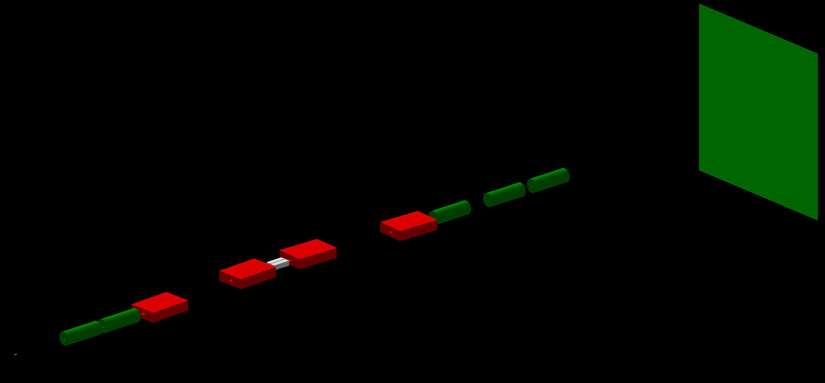
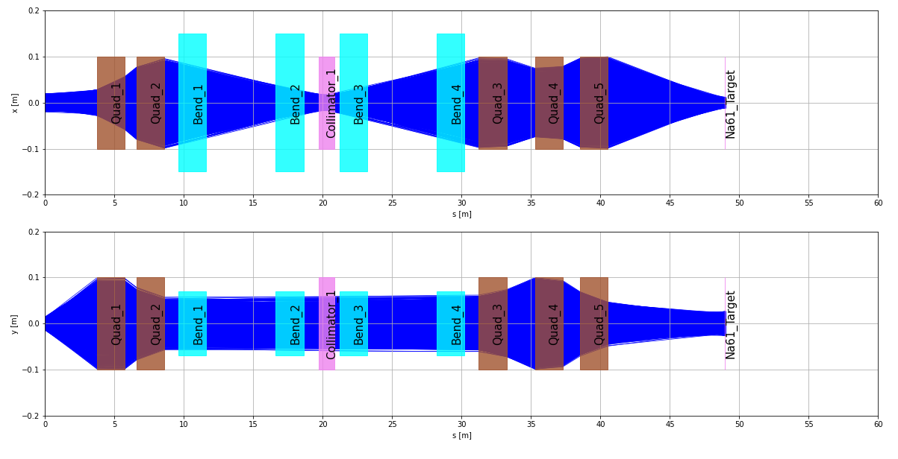
Optimisation: the beamline optics
The optics have been designed with a wholly new optimisation scheme, custom made to meet the demands of NA61/SHINE
Focused on optimising the:
Acceptance of the beamline
Momentum resolution
Small beamspot at the end of the line

Slide 9
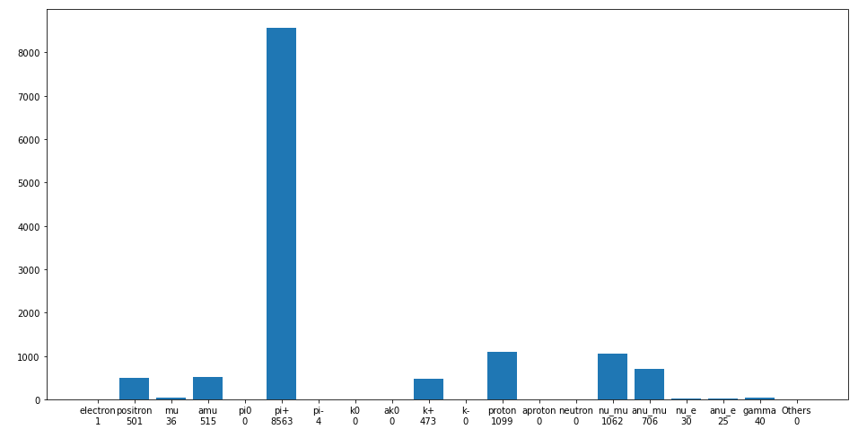
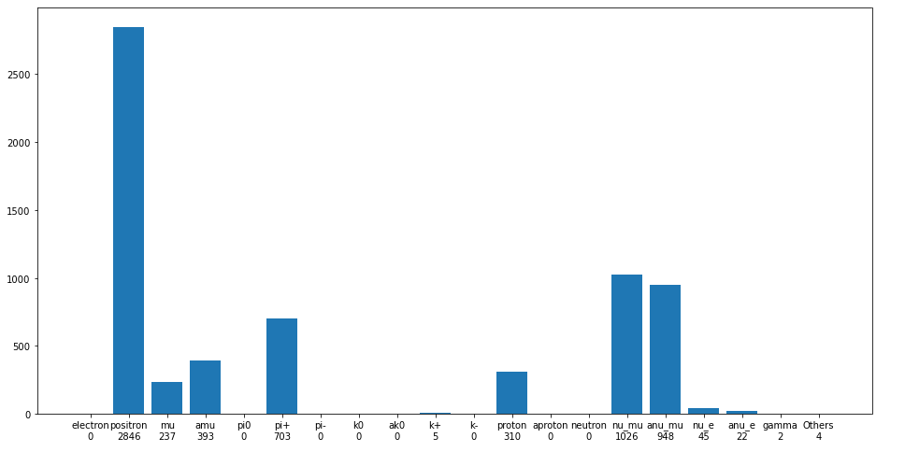
Particle rates
These rates are for 1E6 400 GeV/c primary protons extracted from the SPS. We can expect around 3000 such spills per day
The top plot shows the particle rates at 13 GeV/c, bottom is at 2 GeV/c
Overall, we can expect around 2.5E7 pions per day at 13 GeV/c and 2.1E6 at 2 GeV/c
A normal run is expected to be a few weeks per year

Slide 10
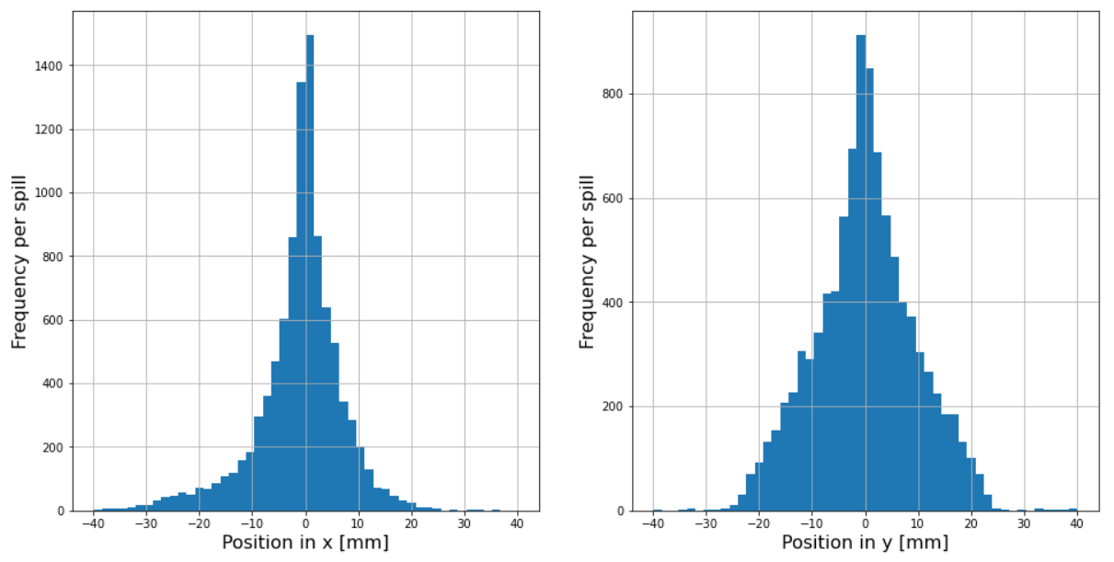
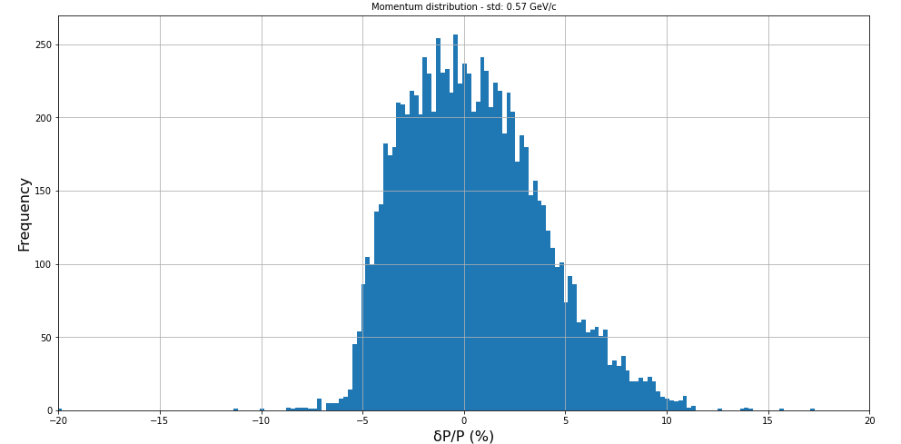
Spotsize and momentum resolution
It is important to keep the size of the beam at the NA61/SHINE target as small as possible to maximise the number of interactions and have a good momentum resolution
The beamline can achieve at 13 GeV/c
Std – x = 9.7 mm
Std – y = 12.1 mm
4% momentum resolution – can go down to 1% (1 sigma)
Similar results can be obtained at other energies

Slide 11
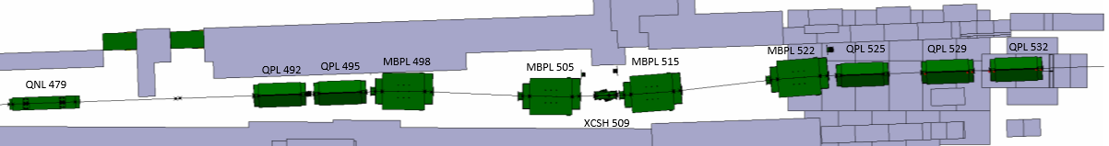
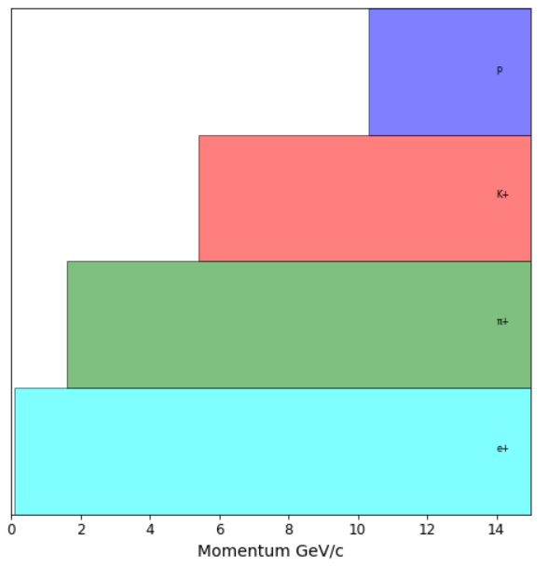
Instrumentation proposal
Above 5 GeV/c:
Use 3 XCET (starting at 15 bar CO2) to identify electrons, pions and kaons
With scintillator for total number of particles, all species can be identified
XCET
ToF

Slide 12
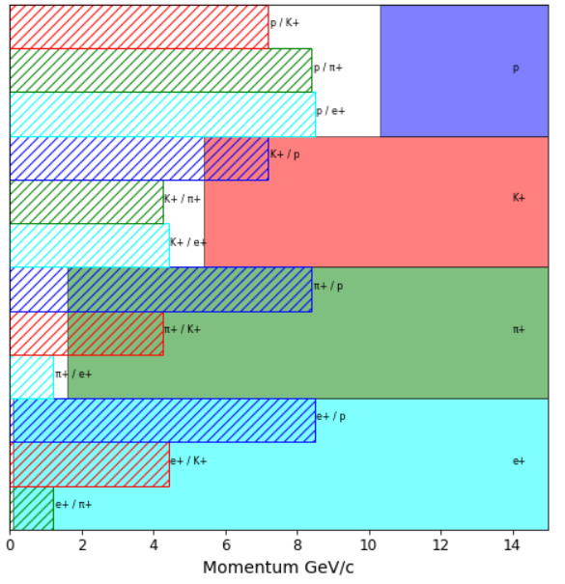
Instrumentation proposal
Above 5 GeV/c:
Use 3 XCET (starting at 15 bar CO2) to identify electrons, pions and kaons
With scintillator for total number of particles, all species can be identified
Below 5 GeV/c:
Use ToF (40 meters apart) to identify the protons
Use XCET 1 to identify electrons (7 bar He)
After 3 GeV/c use XCET 2 (at 7 bar CO2) to identify pions. At lower energies ToF will suffice starting
XCET
ToF

Slide 13
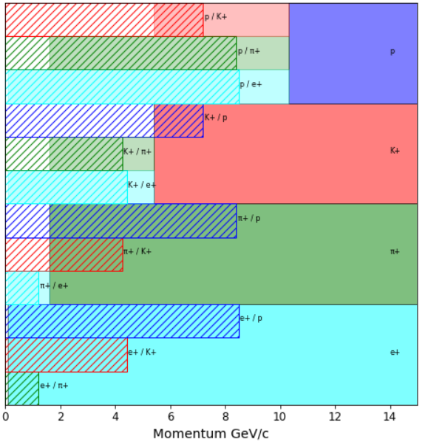
Instrumentation proposal
Above 5 GeV/c:
Use 3 XCET (starting at 15 bar CO2) to identify electrons, pions and kaons
With scintillator for total number of particles, all species can be identified
Below 5 GeV/c:
Use ToF (40 meters apart) to identify the protons
Use XCET 1 to identify electrons (7 bar He)
After 3 GeV/c use XCET 2 (at 7 bar CO2) to identify pions. At lower energies ToF will suffice starting
XCET
ToF

Slide 14

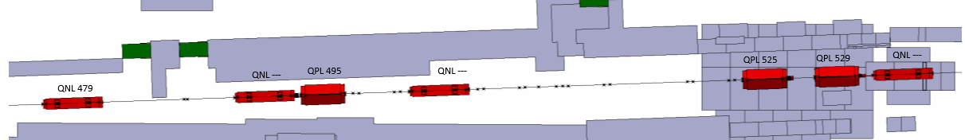

Installation in the North Area
To minimise the switch time between the low-energy and the standard H2 beamline a system using rails is currently being envisioned
Some modifications to the shielding are envisioned but the North Area’s flexibility allows this to happen easily
Rail system

Slide 15
Where does the project stand
Started working on this beamline in 2020 and since then we have
Completed the design of the beamline
Finalising the selection on the instrumentation
Have brought this to CERN’s SPSC in October 2021 and addressed the follow up in June 2022
Aiming for this beamline to be installed in YETS 2023
Are now preparing the Engineering Change Request for this beamline, the final step before changes are implemented in the experimental areas
“The SPSC recognizes the scientific value of the improvements that the low energy beam line could bring to the knowledge of the neutrino cross sections and recommends that the corresponding technical feasibility be studied in detail.”

Slide 16
Conclusion
A new low-energy beamline has been proposed and is in an advanced stage of development:
Optimisation of targets and beamline optics completed
Meeting all requirements set out by NA61/SHINE
Studied the implementation of the beamline with the technicians and developed a system to implement the beamline
Minimising the impact on the existing experiments
Developed a scheme for the instrumentation to enable particle-by-particle identification
Have the support of the SPSC and will move to attempt to build the beamline in 2023

Slide 17
Thank you for your attention
Any questions?

Slide 18
Additional slides

Slide 19
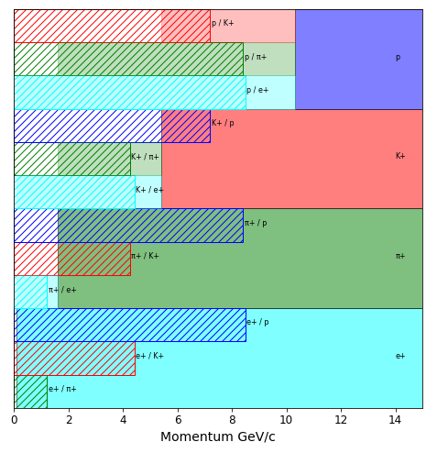
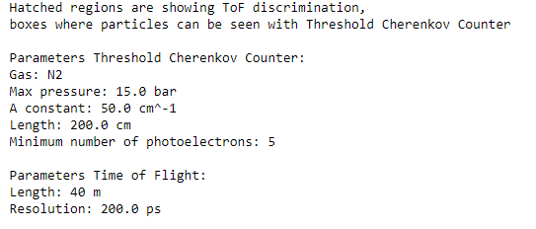
General information on instrumentation

Slide 20
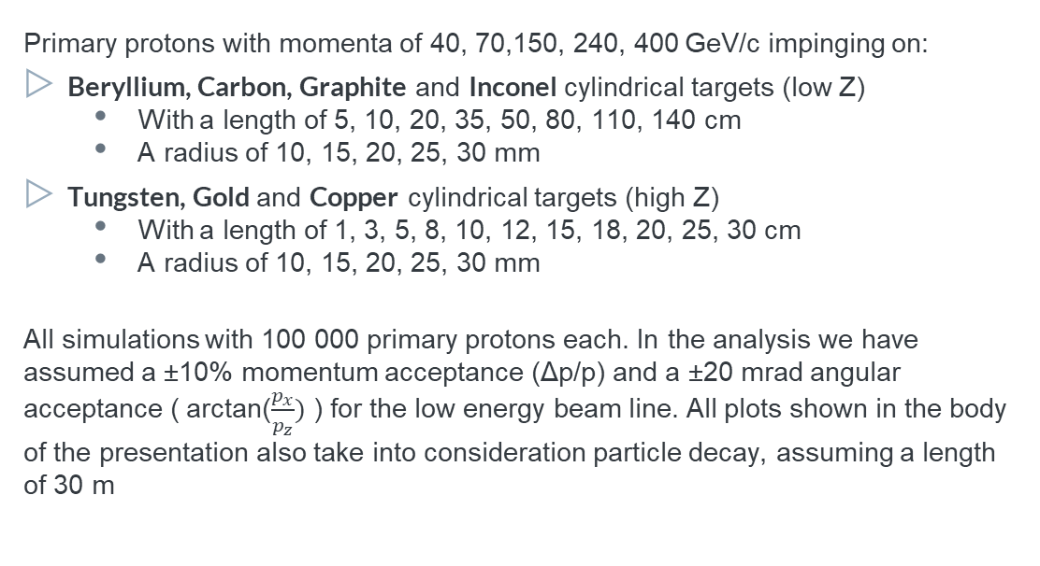
Library of targets and Analysis
Primary protons with momenta of 40, 70,150, 240, 400 GeV/c impinging on:
Beryllium, Carbon, Graphite and Inconel cylindrical targets (low Z)
  With a length of 5, 10, 20, 35, 50, 80, 110, 140 cm
  A radius of 10, 15, 20, 25, 30 mm
Tungsten, Gold and Copper cylindrical targets (high Z)
  With a length of 1, 3, 5, 8, 10, 12, 15, 18, 20, 25, 30 cm
  A radius of 10, 15, 20, 25, 30 mm
All simulations with 100 000 primary protons each. In the analysis we have assumed a ±10% momentum acceptance (Δp/p) and a ±20 mrad angular acceptance ( arctan($\frac{p_{x}}{p_{z}})$ ) for the low energy beam line. All plots shown in the body of the presentation also take into consideration particle decay, assuming a length of 30 m

Slide 21
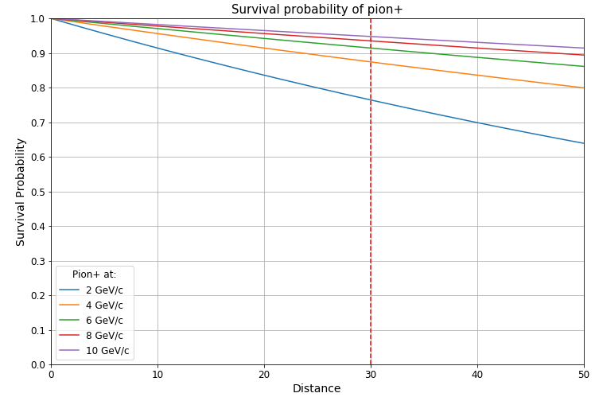
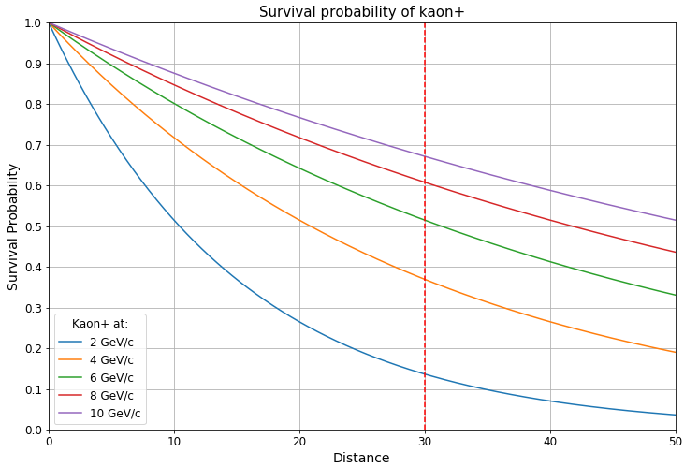
Expected survival in beamline
With a 30 meter beamline we expect a survival of above 75% for pions at all energies
For Kaons, we expect a survival of 13.6% @ 2 GeV/c, 36.9% @ 4 GeV/c, 51.4% @ 6 GeV/c

Slide 22
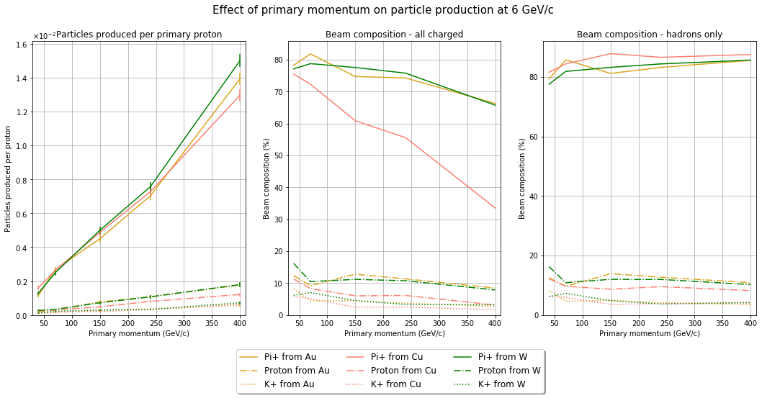
Effects of primary momentum (High Z)
Primary momentum
Considering a realistic beam on 15 cm long targets
Trade off between high particle yields and beam composition
Electron suppression may be necessary

Slide 23
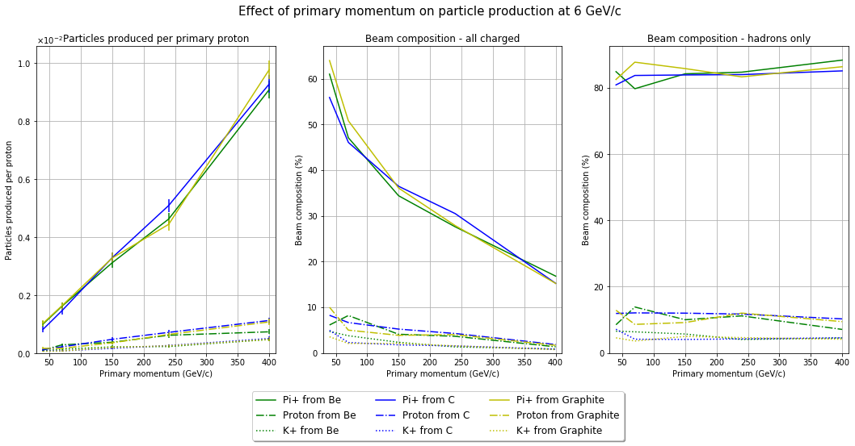
Effects of primary momentum (Low Z)
Primary momentum
Considering a realistic beam on 80 cm long targets
Trade off between high particle yields and beam composition
Electron suppression may be necessary

Slide 24
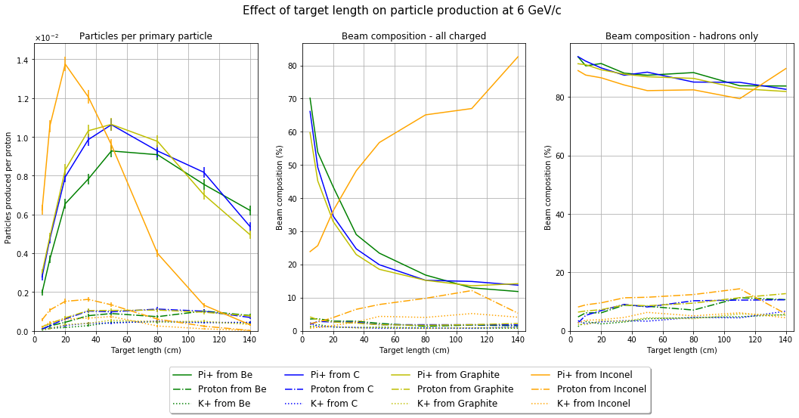
Effects of length (Low Z)
Target Length
Considering a realistic beam at 400 GeV/c
Trade off between high particle yields and beam composition
Electron suppression may be necessary

