Slide 1
T2K target -- Physics design and optimization --
T. Nakadaira
High Energy Accelerator Research Organization (KEK) IPNS / J-PARC
for
T2K collaboration
J-PARC neutrino facility

Slide 2
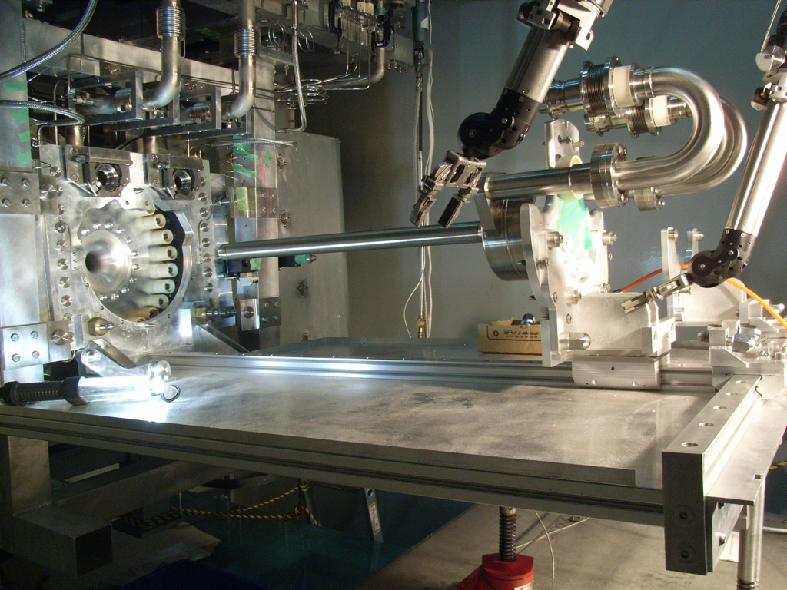
Contents
Design of current T2K target
Conceptual ideas for future upgrade of target improvement for CP violation search.

Slide 3
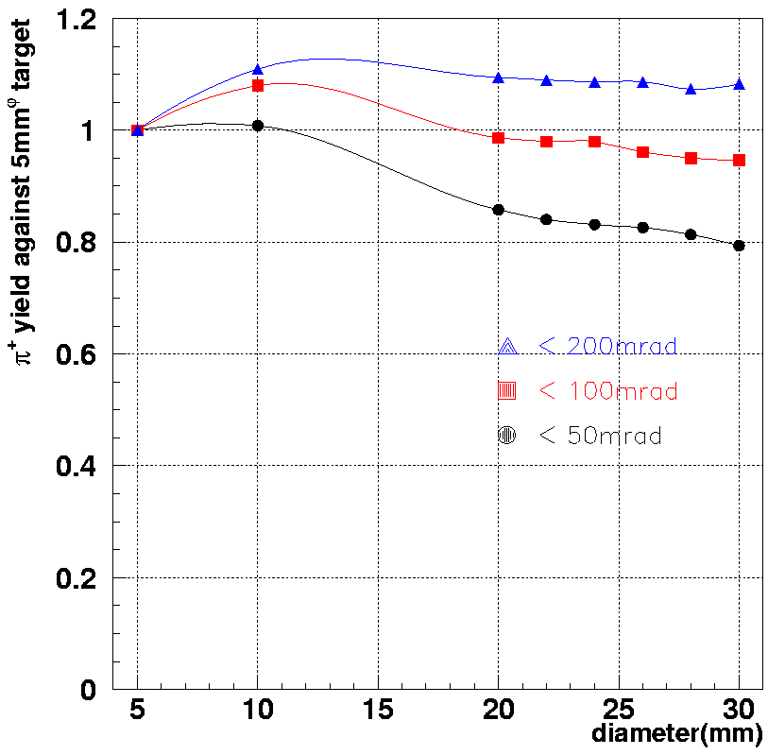
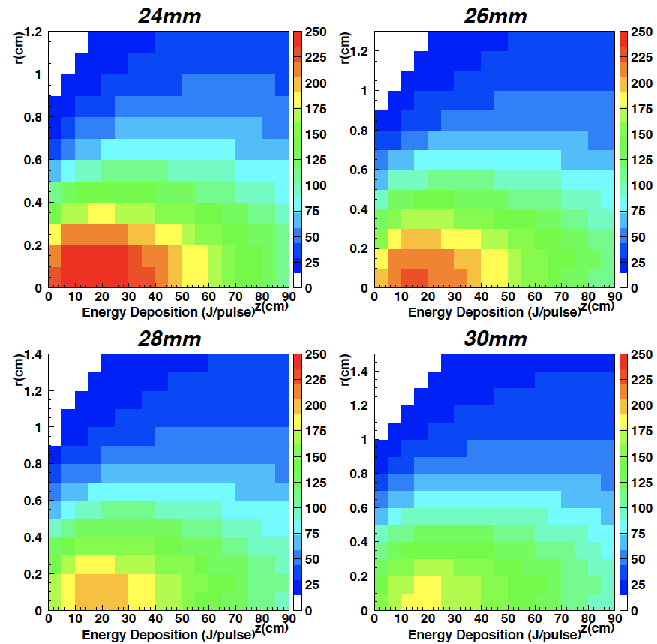
T2K target size
T2K target was designed in around 2003 to maximize the muon neutrino flux.
Solid target in horn system for high intensity beam → Graphite
Length : L~900mm (~ 2 interaction length)
Target diameter is determined to balancing forward pion production and energy deposit concentration.
Using simulation (GCALOR, MARS) assuming target diameter = 2.5×σ_{beam}
Forward pion for Gaussian beam
Energy deposit @ target (MARS)
Balance

Slide 4
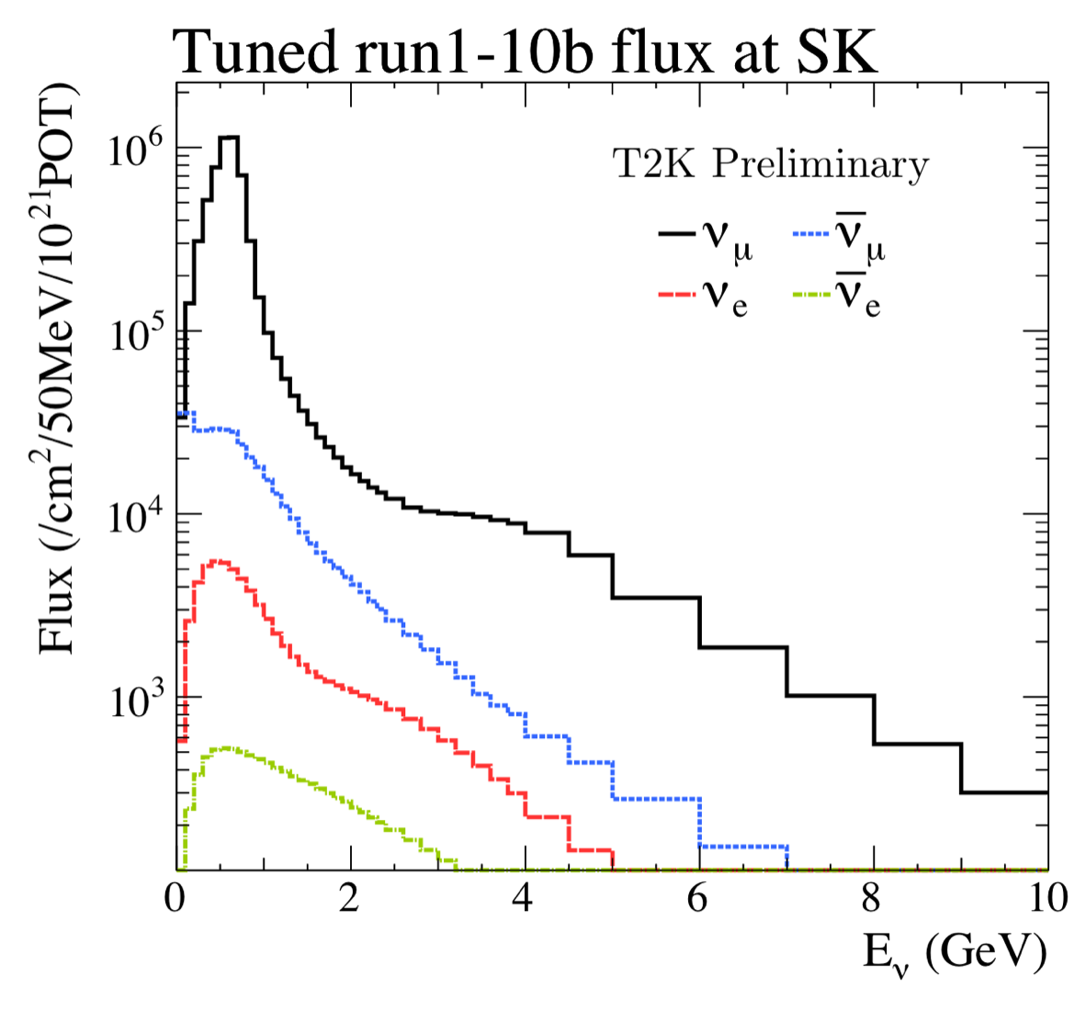
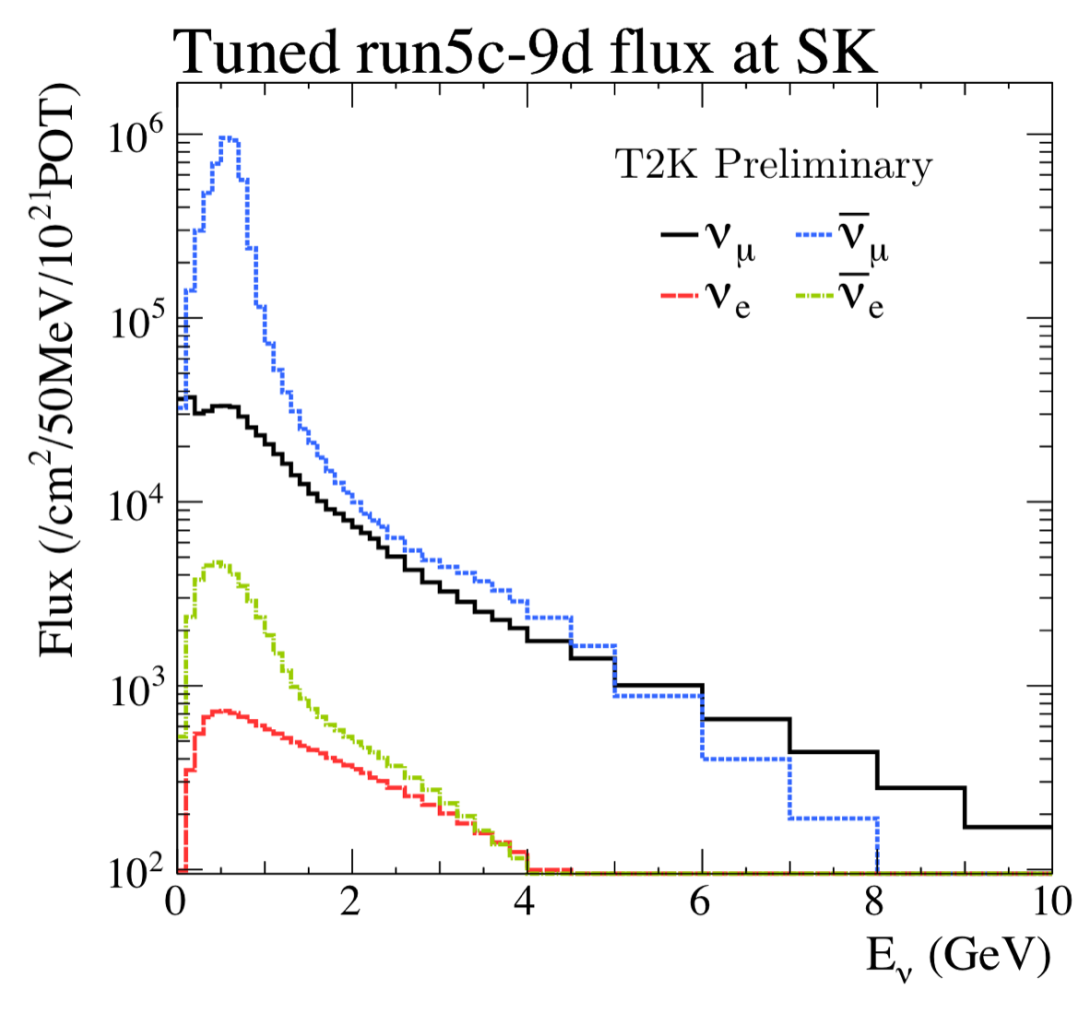
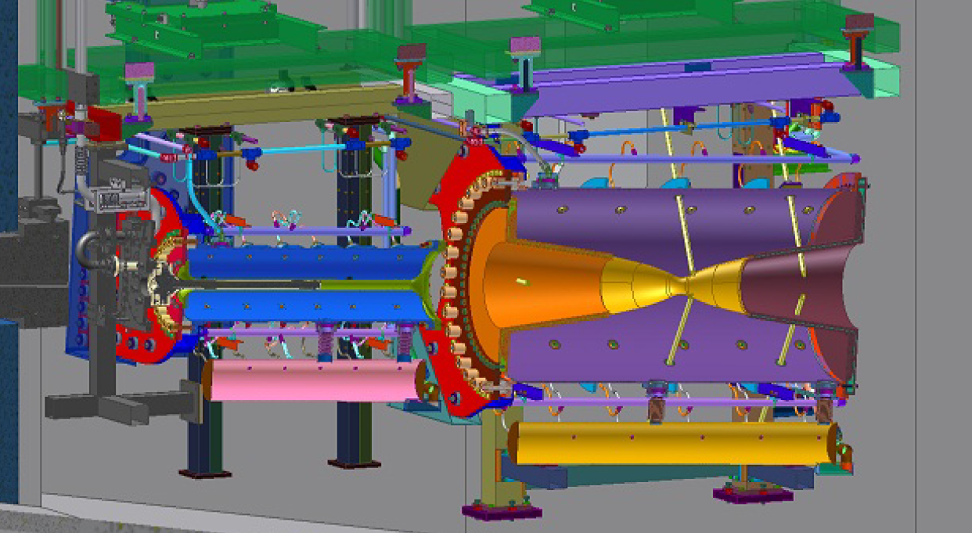
Possible optimization in future
From 2014, T2K starts CP violation search. → Reducing “wrong-sign” component is also important. “wrong-sign” : ν̅ in ν-beam and ν in ν̅-beam cause the “fake” CP-Violating effect.
Majority of wrong sign components are produced by forward π⁻ in ν-beam and forward π⁺ for ν̅-beam. ← Not defocused by horns.
Neutrino beam
anti-Neutrino beam

Slide 5
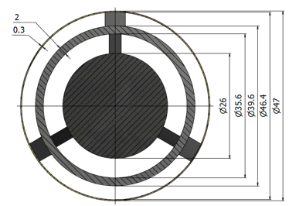
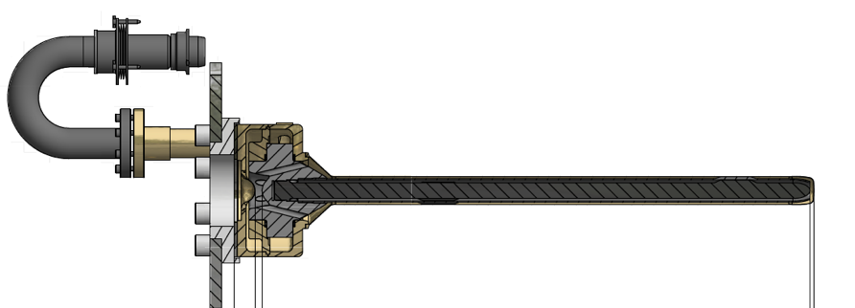
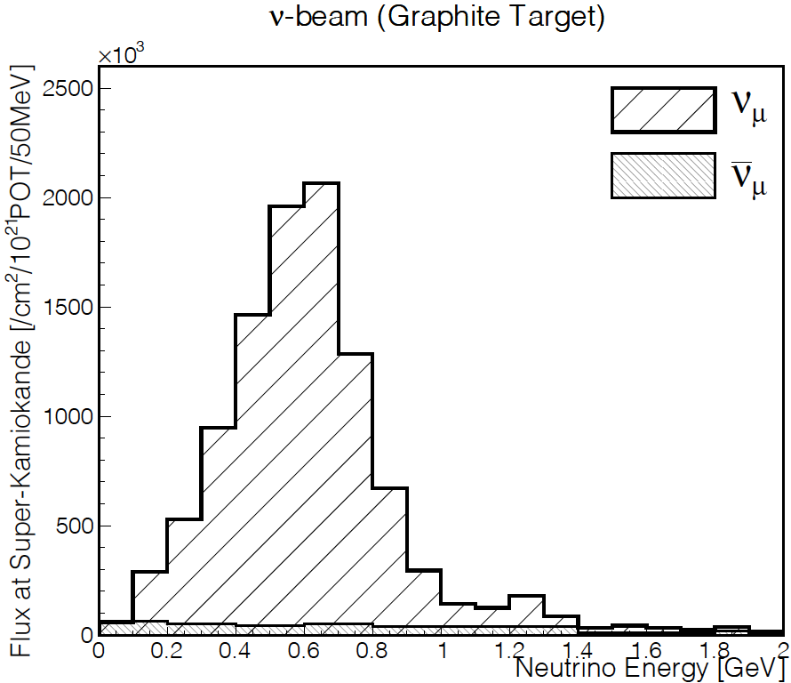
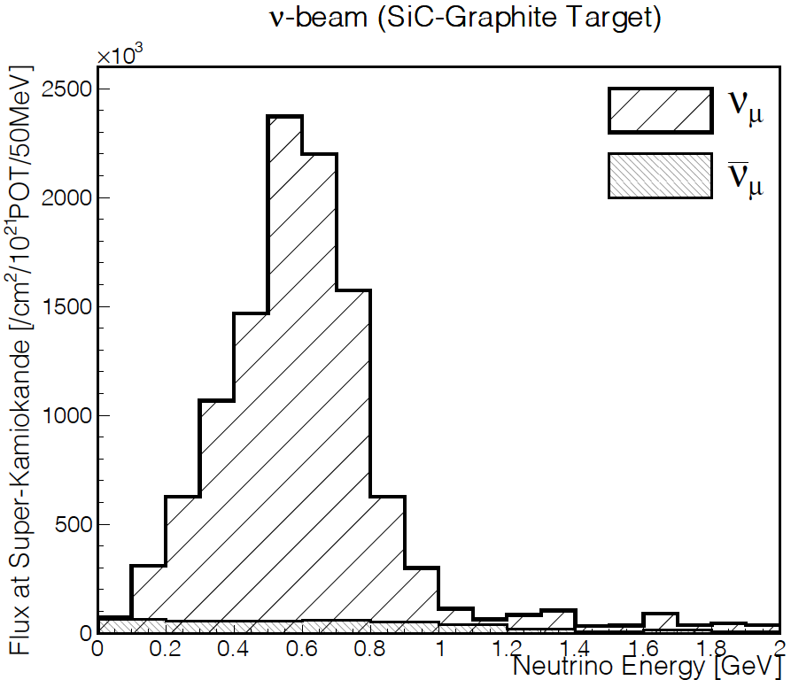
Idea of target optimization (1)
Hybrid target
Embed high-density material to reduce the pion outside horn-1 acceptance.
Possible material: ceramics with high thermal shock resistance. : SiC (3.2 g/cm³), SiAlON(3.2 g/cm³) → By placing ceramic part inside the graphite sheath, it would not scatter even if the ceramic were to break.
high-density material in graphite
ν-beam
MC
MC
ν-beam

Slide 6
Idea of target optimization (1)
Hybrid target
Embed high-density material to reduce the pion outside horn-1 acceptance.
Possible material: ceramics with high thermal shock resistance. : SiC (3.2 g/cm³), SiAlON(3.2 g/cm³) → By placing ceramic part inside the graphite sheath, it would not scatter even if the ceramic were to break.
high-density material in graphite
ν̅-beam
MC
MC
ν̅-beam

Slide 7
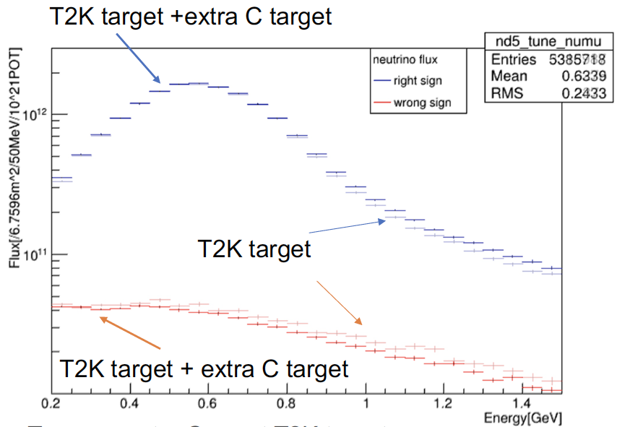
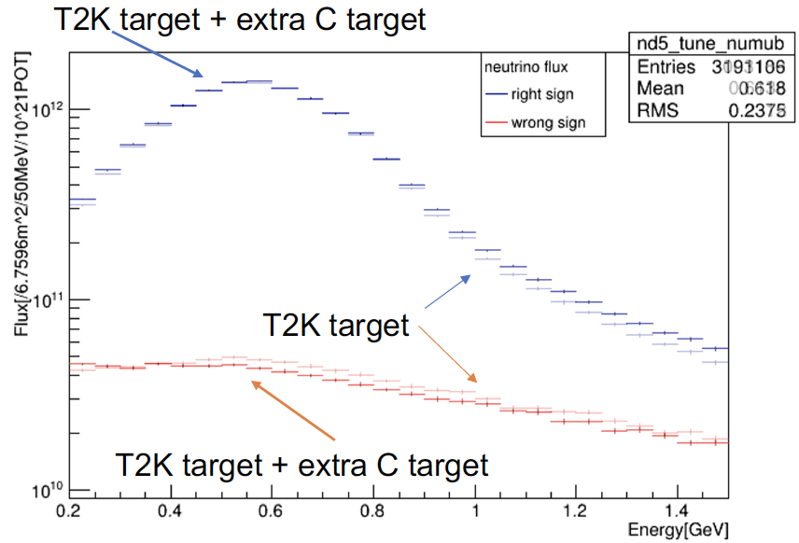
Idea of target optimization (2)
“Second target” in horn1 : (L. H. Lam, J. Nugent, P. Soler Univ. of Glasgow)
Current horn setting in T2K
Changed horn setting
90 cm graphite
90 cm graphite + 75 cm 2nd target
ν-beam MC
ν̅-beam MC

Slide 8
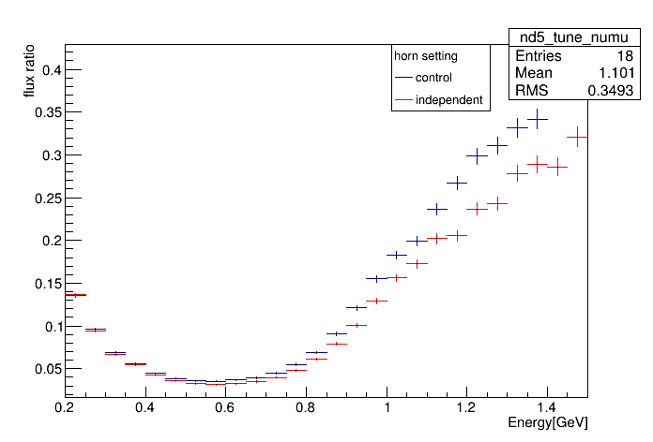
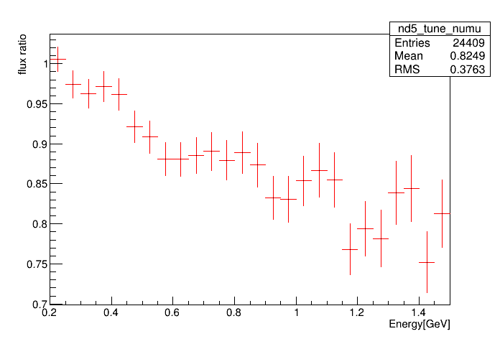
Idea of target optimization (2)
“Second target” in horn1 : (L. H. Lam, J. Nugent, P. Soler Univ. of Glasgow)
Current horn setting in T2K
Changed horn setting
90 cm graphite
90 cm graphite + 75 cm 2nd target
Comparison wrong-sign
Ratio of wrong-sign ratios
ν̅-beam MC
1.0
ν̅-beam MC
T2K target
T2K target + extra C target
T2K+C target / T2K target

Slide 9
Idea of target optimization (2)
“Second target” in horn1 : (L. H. Lam, J. Nugent, P. Soler Univ. of Glasgow)
Current horn setting in T2K
Changed horn setting
90 cm graphite + 75 cm 2nd target + extra plate for support
90 cm graphite
Comparison wrong-sign
Ratio of wrong-sign ratios
ν̅-beam MC
1.0
ν̅-beam MC
T2K target
T2K target + extra C target
T2K+C target / T2K target

Slide 10
Summary
Current T2K target is optimized to maximize the muon neutrino flux for 1st observation of ν_{e} appearance.
Csonsidering the balance between the forward pion production and energy deposit concentration.
For LBL neutrino experiment aiming CP violation search, Reducing “wrong-sign” component is also important.
Ideas of target configuration change for future upgrade is considered, although it is still very conceptual.

