Slide 1
Neutrino Beam Instrumentation 2021 2022
Cosener’s House, Abingdon, UK
19th - 21st September 2022
RaDIATE meeting
Rutherford Appleton Laboratory
Harwell Campus
22nd - 23rd September 2022
Chris Densham
STFC Rutherford Appleton Laboratory
Notes:
Panel: Neil Geddes, Liz Fellman and Joanne Brown (all attending via Zoom).
Comms support: Alan Bird and Karen Summers via Zoom.
Technical support: Ewan Brown providing technical support in person at ROE, Laura Bennett on Zoom.

Slide 2
Thank-you for your understanding that today is the funeral of Her Majesty Queen Elizabeth II
The Queen was UK Head of State for 70 years and provided continuity and stability over the administrations of 15 UK Prime Ministers
​​​​​​​Throughout her reign, The Queen has been a stalwart supporter of science and innovation in the UK, from visiting Harwell in 1957 and ROE in 1965, to officially opening the Diamond Light Synchrotron in 2007.
UKRI/STFC National Laboratories are following a formal mourning protocol as a mark of respect.
We have been granted permission to honour our commitment to host this workshop with some modifications to the timetable on this national holiday
Notes:
Colleagues required to attend work for operational reasons over the bank holiday period should agree a suitable alternative date in lieu with their line manager.
Employees who already have annual leave booked on Monday 19 September should adjust their leave booking in order to use use the bank holiday time.
We are aware the Bank Holiday coincides with an existing bank holiday for our Edinburgh sites. Employees who are affected by this have received a separate communications with further information.

Slide 3
Why is NBI2022 being hosted in the UK?
Strong UK participation in LBNF/DUNE and T2K/HyperK
Both leading international neutrino experiments currently under construction

Slide 4
Solidarity with Ukraine

Slide 5
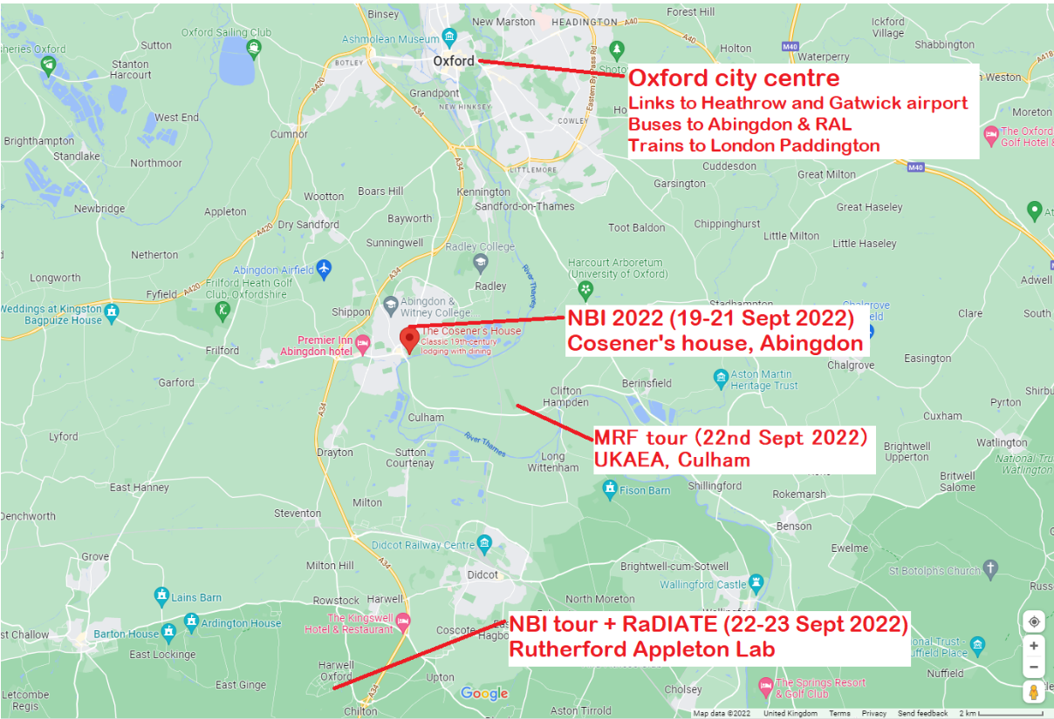

Slide 6
Thursday - Friday: Tours and RaDIATE meetings
Transport has been arranged for Thursday for those who have requested a tour at either Rutherford Appleton Laboratory or Culham Laboratory
Further details in workshop booklet
Transport has also been arranged for all those registered for the RaDIATE meetings at RAL on Thursday afternoon and Friday
Pick-up and drop-off will be from Cosener’s House and is arranged for visitors only (ie not for RAL or Culham staff)
Detailed times etc will be shared on Wednesday afternoon
For any special requests please contact
cat.lewin-williams@stfc.ac.uk

Slide 7
Schedule update for today
The meeting will pause at 11 am for the funeral of Her Majesty Queen Elizabeth II
Lunch will be served 12:30 – 13:30
The meeting is currently scheduled to recommence at 15:00 and conclude at 19:00
‘Welcome’ drinks reception has been re-scheduled for Tuesday
Please make your own arrangements for dinner this evening
NB Cosener’s House is available for dinner bookings
Pubs/restaurants in Abingdon may also be available

Slide 8
Wi-Fi Access
(Recommended) Use GovWiFi: Send a text message with "Go" as the message to 07537 417 417 These credentials can be used at any STFC site and many other locations around the country.
Use STFC's Coupon system: Register at the following address https://visitorwifi.stfc.ac.uk
Ask for approval by cat.lewin-williams@stfc.ac.uk

Slide 9
Questions?
Speakers
Please allow 5 minutes of your allotted presentation time for questions

Slide 10
Notes:
Colleagues required to attend work for operational reasons over the bank holiday period should agree a suitable alternative date in lieu with their line manager.
Employees who already have annual leave booked on Monday 19 September should adjust their leave booking in order to use use the bank holiday time.
We are aware the Bank Holiday coincides with an existing bank holiday for our Edinburgh sites. Employees who are affected by this have received a separate communications with further information.

