Slide 1
LBNF Overview
Keith Gollwitzer
Fermilab
NBI 2022
19 September 2022

Slide 2
Outline
DUNE & LBNF
Beamline part of LBNF
Primary/Proton Beamline
Target Station Complex
Decay Volume
Absorber Complex
Schedule
Summary
Further Details in other Workshop Presentations

Slide 3
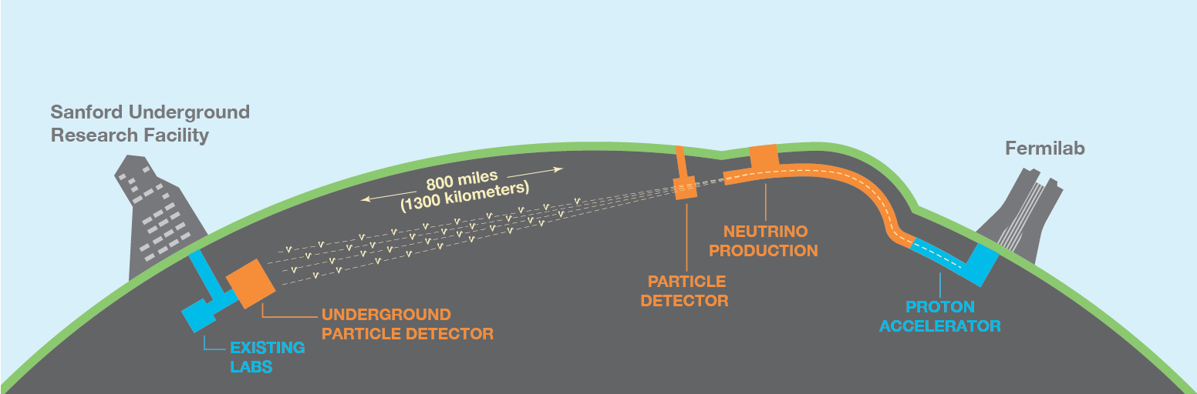
Overview
The Deep Underground Neutrino Experiment will be a world-leading experiment for neutrino science, potentially transforming our understanding of why the universe exists as it does.
The Long-Baseline Neutrino Facility is the infrastructure necessary to send a powerful beam of neutrinos 800 miles through the earth and measure them deep underground at South Dakota’s Sanford Underground Research Facility.
LBNF includes the civil structures (orange in above cartoon); support items for the detectors; and beamline (focus of this talk)

Slide 4
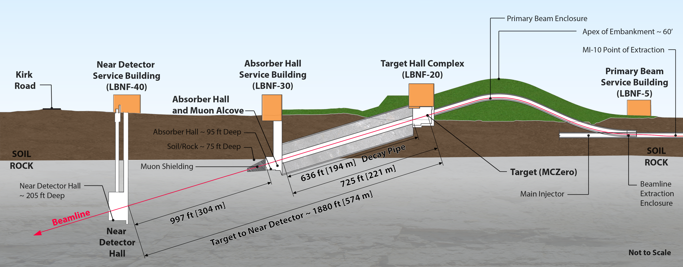
LBNF at Fermilab Site
Above: Cartoon of facility layout (not to scale)
Right: Facility layout overlaid on aerial photograph

Slide 5
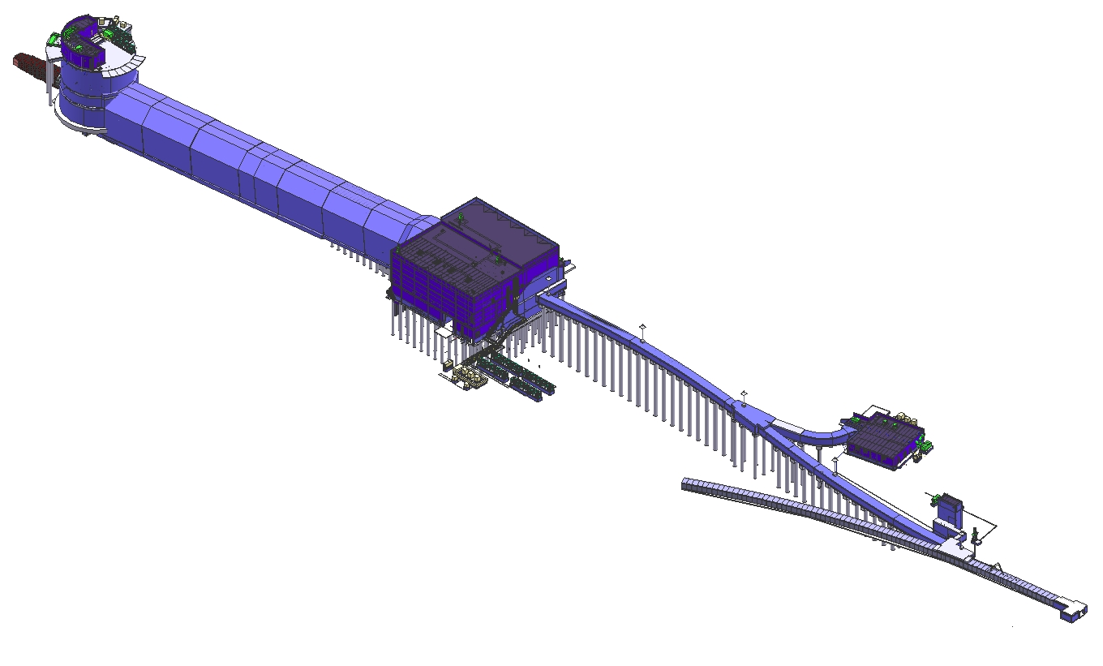
LBNF Beamline
Neutrino Beam
to SURF, SD
Absorber Complex
(LBNF-30)
Target
Complex
(LBNF-20)
Primary
Beamline
Enclosure
Decay Region
Primary Beam Service Building
(LBNF-5)
Major
Vehicle
Access
Fermilab
Main Injector
Tunnel
Extraction
Enclosure
Proton Beam
From MI-10

Slide 6
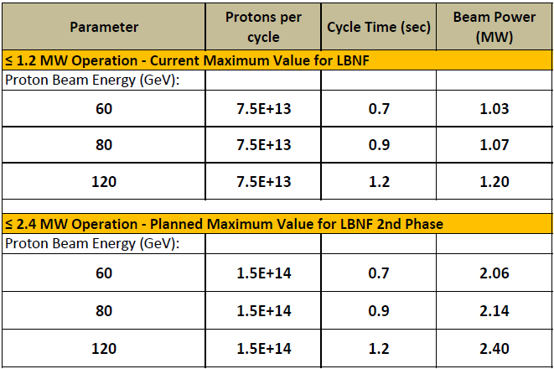
Beamline
Possible different proton beam energy
Fast extraction from Main Injector
  Pulse length: 10 μs
Beam Size at Target
  Tunable: 1-4 mm
  Planned size for 1.2 MW: ~2.7mm
Replaceable items/components are being designed for 1.2 MW
Permanent items are being designed for 2.4 MW

Slide 7
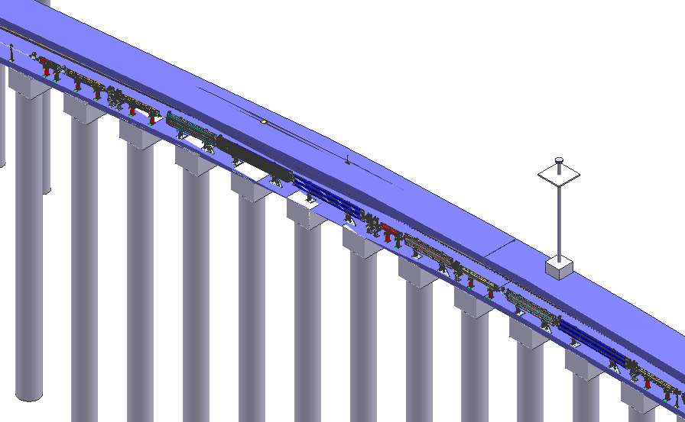
Proton Beam Enclosure
Proton Beam
to Target
Corrector Magnets
Quadrupole
Magnets
Survey
Riser
Proton Beam from
Extraction Enclosure

Slide 8
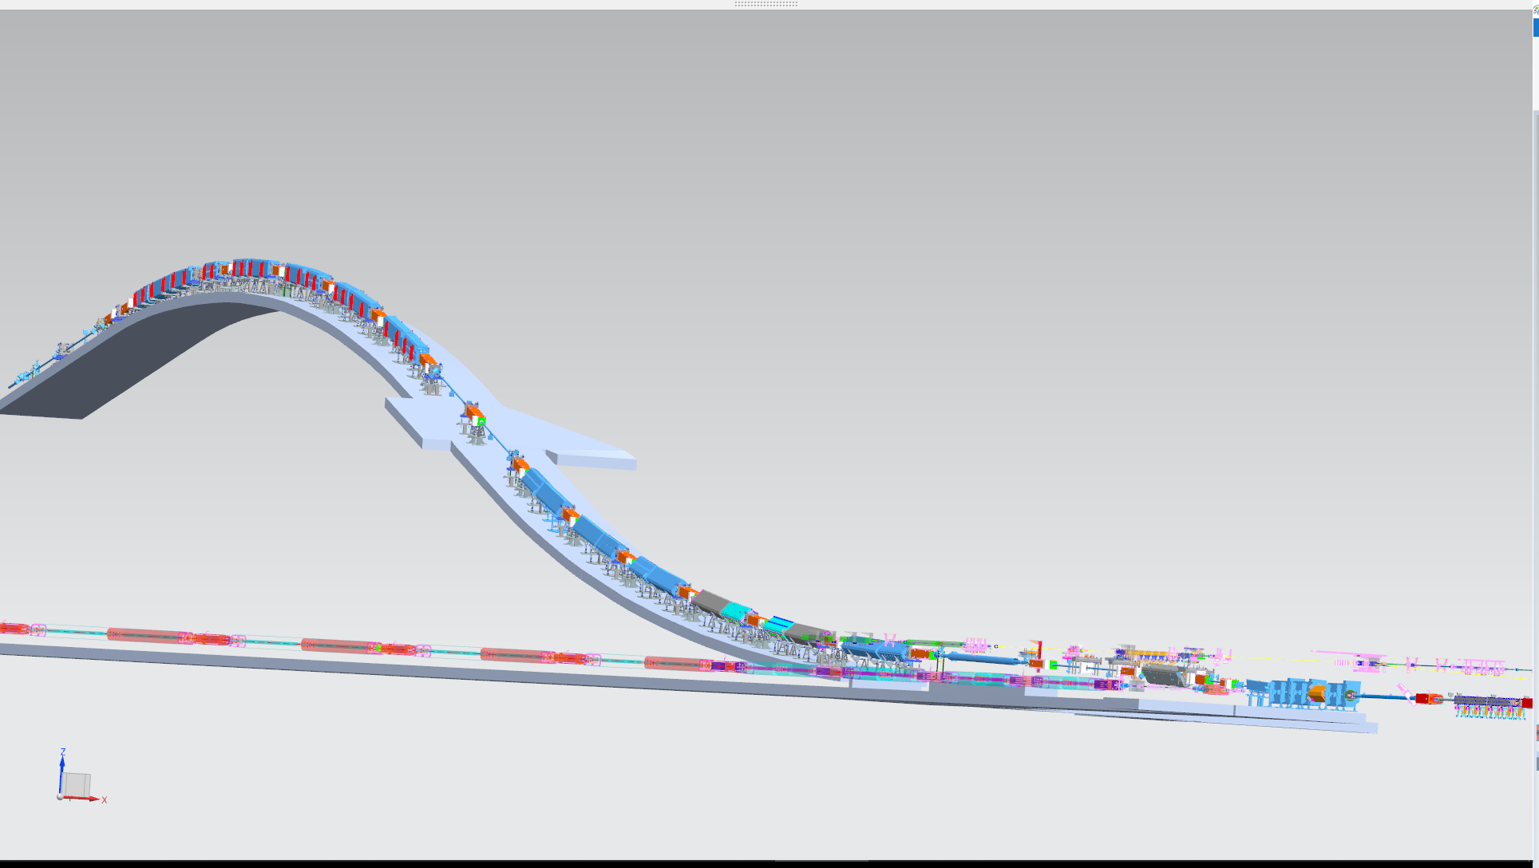
Primary Beam Delivery
Magnet Installation Tunnel Junction
Magnets
25 dipoles
21 quads
23 correctors
8-degree slope, 14% grade max
MI Wall Penetration
DS End: Primary Beam Window
Lambertsons
US Start: MI Kickers at Q100
Main Injector

Slide 9


Magnets
Type | Common Name | Source | Nominal Strength at 120 GeV | #
Dipoles
RKE | Kicker | new | 0.058 T | 6
ILA | MI Lambertson | NUMI | 0.532 / 1.000 T | 3
ICA | MI C Magnet | NUMI | 1.003 T | 1
IDAL | Dipole 6 m (“MI”) | new – BARC | 1.003 - 1.604 T | 13
IDDL | Dipole 4 m (“MI”) | new – BARC | 1.003 - 1.604 T | 12
Quadrupoles
QQD | 120 quadrupole (“3Q120”) | new – BARC | 9.189 - 16.546 T/m | 17
QQE | 60” quadrupole (“3Q60”) | new – BARC | 11.135 - 17.082 T/m | 4
Correctors
IDS | LBNF trim dipoles (“IDH”) | new - IHEP | Up to 0.365 T | 23
Proton beamline design is based upon the successful NuMI proton design.
Magnet designs are based upon successful Fermilab magnet designs
Kicker prototype work is in progress
In Kind Contributions
BARC of India providing main dipoles and quadrupoles
IHEP of China has provided correctors

Slide 10
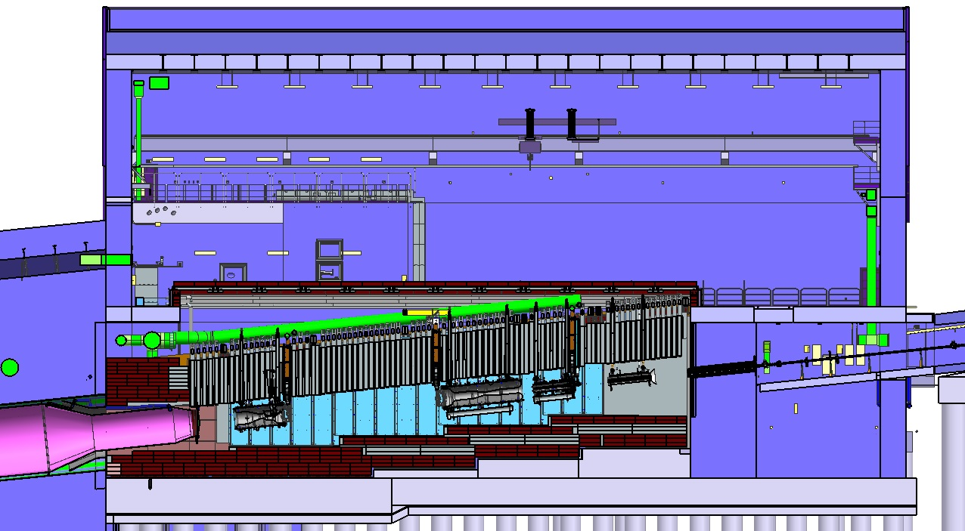
Target Hall – Beamline Components
Baffle
Primary Beam
Secondaries Beam
Horn C
Horn B
Horn A with Target

Slide 11
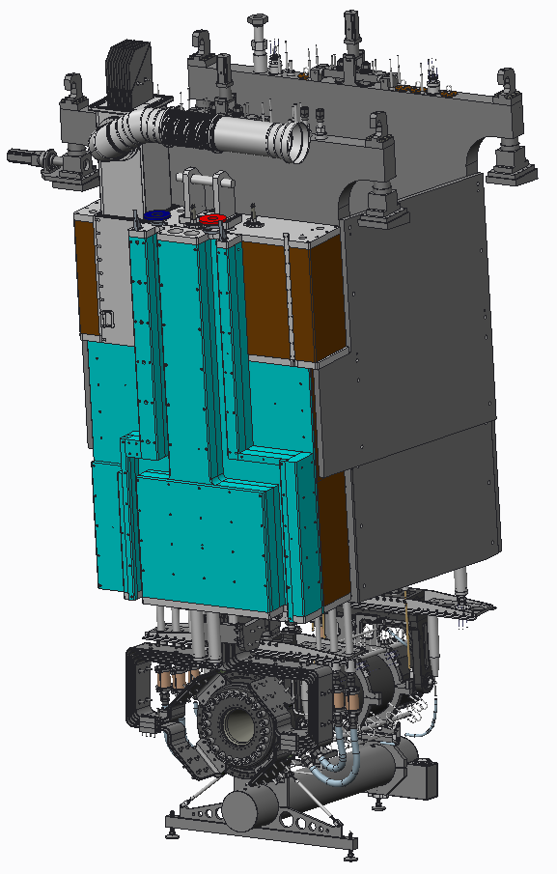

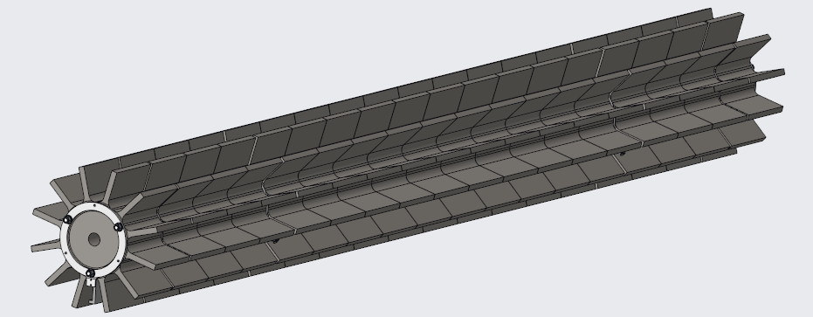
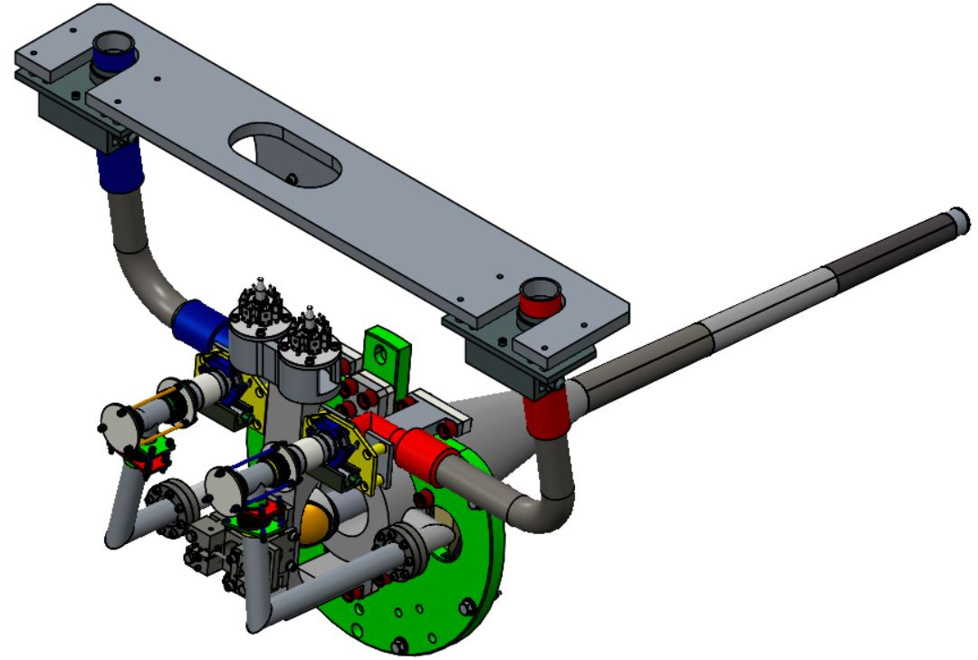
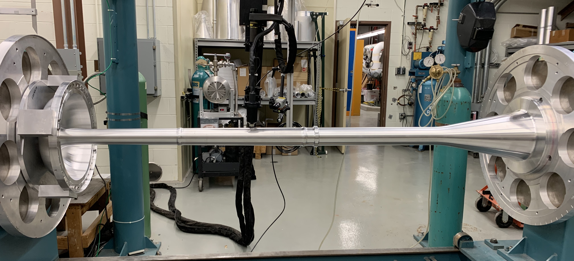
Target Station Beamline Components
M. Lee 1330 Tue.
UKRI in-kind contributions
  Baffle
  Target
Three Horn System
  Target will be installed in Horn A
J. Back 1710 Mon.
Horn Power Supply
  300,000 Amp half sine wave pulse (~1 ms)
  Same pulse for all repetition rates
D. Wilcox 1135 Tue.
P Loveridge 1155 Tue.

Slide 12
Target Hall – Shielding
Battlement
Hatch Cover Shielding
Custom Shielding
T-Blocks
Bulk Shielding
Bulk Shielding

Slide 13
Radiation Safety
D. Reitzer 1155 Wed.
Shielding
  Prompt Dose
  Protection of workers performing maintenance
  Protection of environment
Understanding of activation
  Components
  Shielding
  Air and Cooling gas
  Water
Control of radioactive gas releases to the atmosphere
  Radioactive Air Path to allow decay of most isotopes
  Tank system associated with water systems head space
Control of tritium in the form of tritiated water and water vapor
  Radioactive Water systems
  Dehumidifiers
  Limit tritium leaving shielding during maintenance periods

Slide 14
Target Hall – Cooling & Remote Handling
Work Cell
Nitrogen Gas Cooling
Hatch Covers
Water Cooling Panels

Slide 15
Removal of Heat
By Radioactive Water (RAW) Systems
  Target/Baffle RAW
    Cold side of heat exchanger for He gas
  Each horn has a RAW
  Target Shield Pile first layer of shielding includes water panels
    Sandwich between steel slabs
  Absorber Core
Two Intermediate Water Systems
  Provide buffer between RAW systems and outside chilled water/environment
  He gas system components
By Gas Systems
  Helium System
    Target and its support
  Nitrogen Systems
    Target Shield Pile
      Including components within the shield pile
      Requires hatch cover system
    Structure of the Decay Volume
  Air System
    Absorber Shield Pile

Slide 16
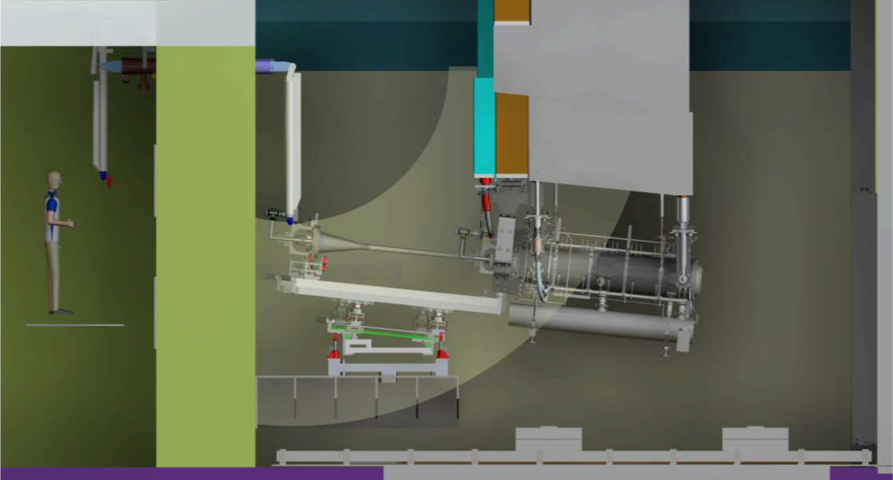
Remote Handling and Work Cell
Connection of components to support structures based upon NuMI
  Including support services: water and instrumentation
UKRI providing Target Exchange System and Telemanipulators for work cell to be used for removal/installation of target from/into Horn A
Removal/installation of hatch cover system and support structures based upon NuMI experience
P Hurh 0920 Wed.
E Harvey-Fishenden 0940 Wed.

Slide 17
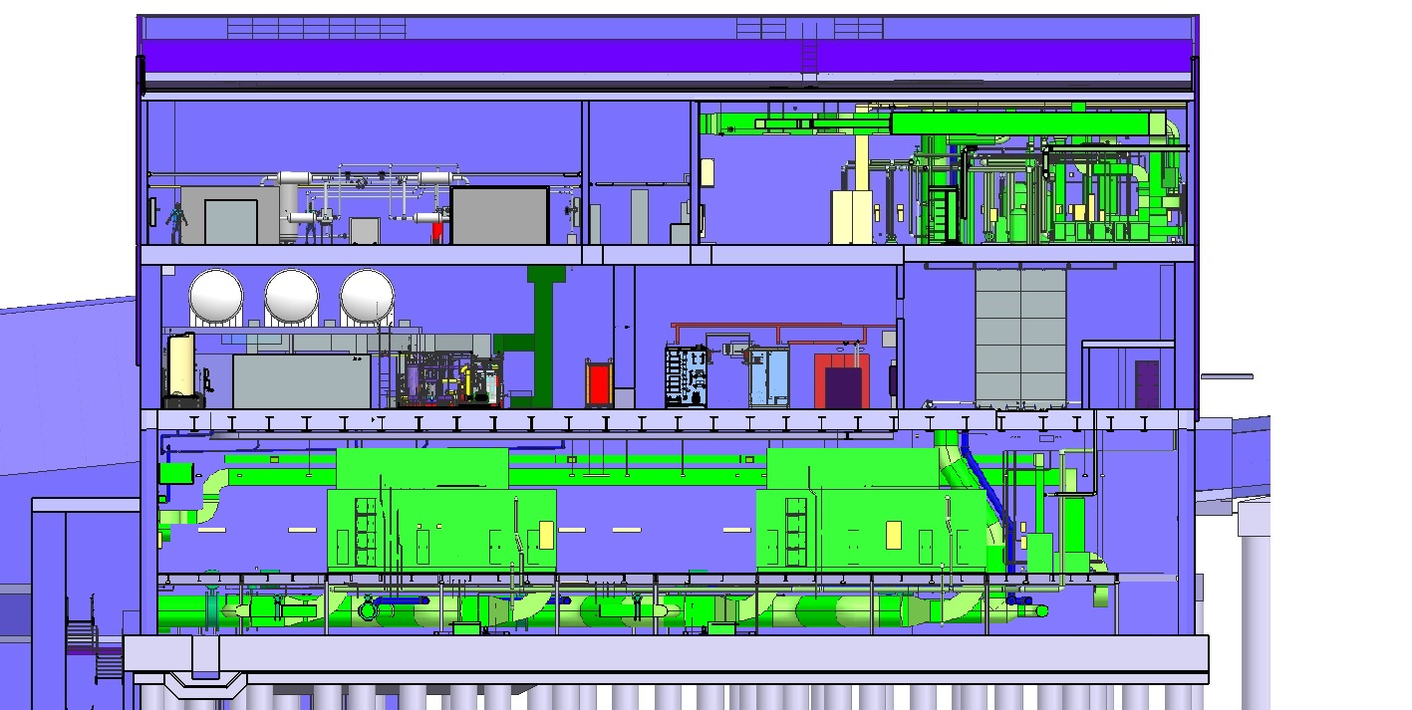
Support Rooms (Target Complex)
Target Helium Gas Cooling System (UKRI/LBNF)
Power Supply
RAW Systems
Target Hall Shield Door
Shielded Doors (not shown): -- Rooms containing RAW Systems & Nitrogen Systems
-- Work Cell Doors
Nitrogen Gas Cooling

Slide 18
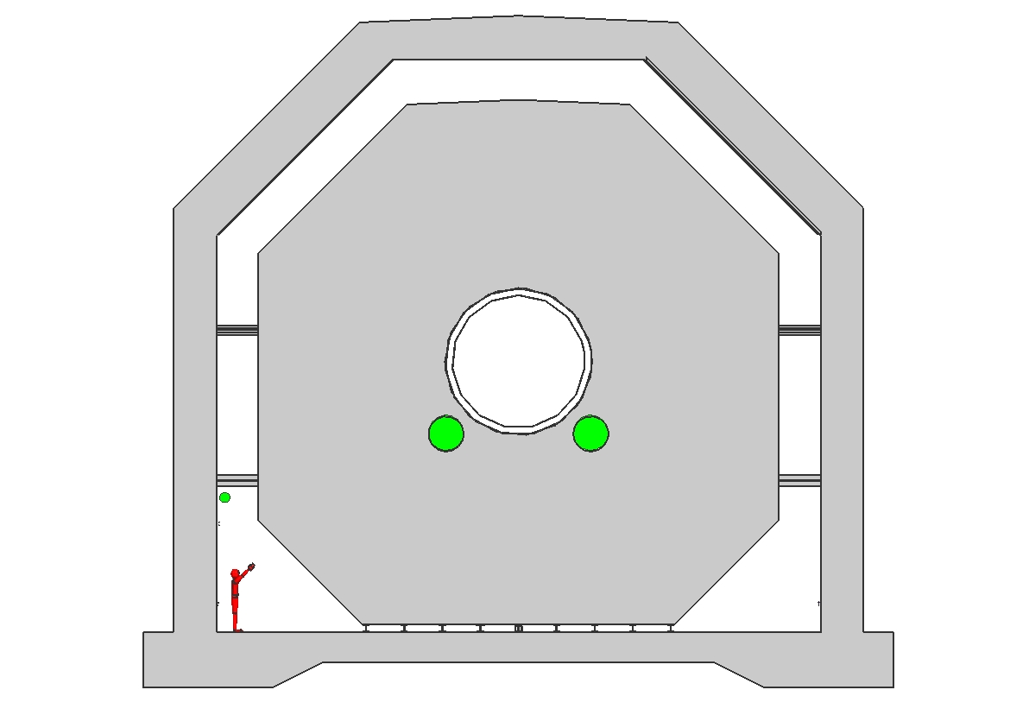
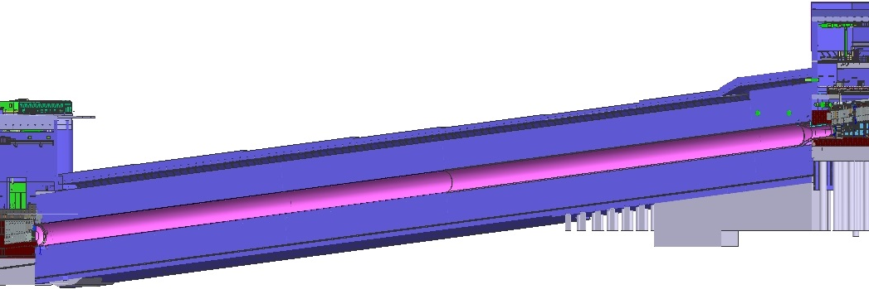
Decay Volume
Decay Volume length: 204 m
Decay Volume Diameter: 4 m
>5.4 m of concrete shielding contains all prompt radiation
Concrete shield is on rails to allow thermal expansion
Steel vessel containing helium cooled by nitrogen gas system
Decay Region Structure keeps any water seepage from contact with concrete shielding
Decay Region
Structure
Concrete
Shielding
Helium Vessel
Decay Air
Piping
Nitrogen Cooling Annulus
6 Foot “Fermi-Man”
For Reference of Scale
Nitrogen Return

Slide 19
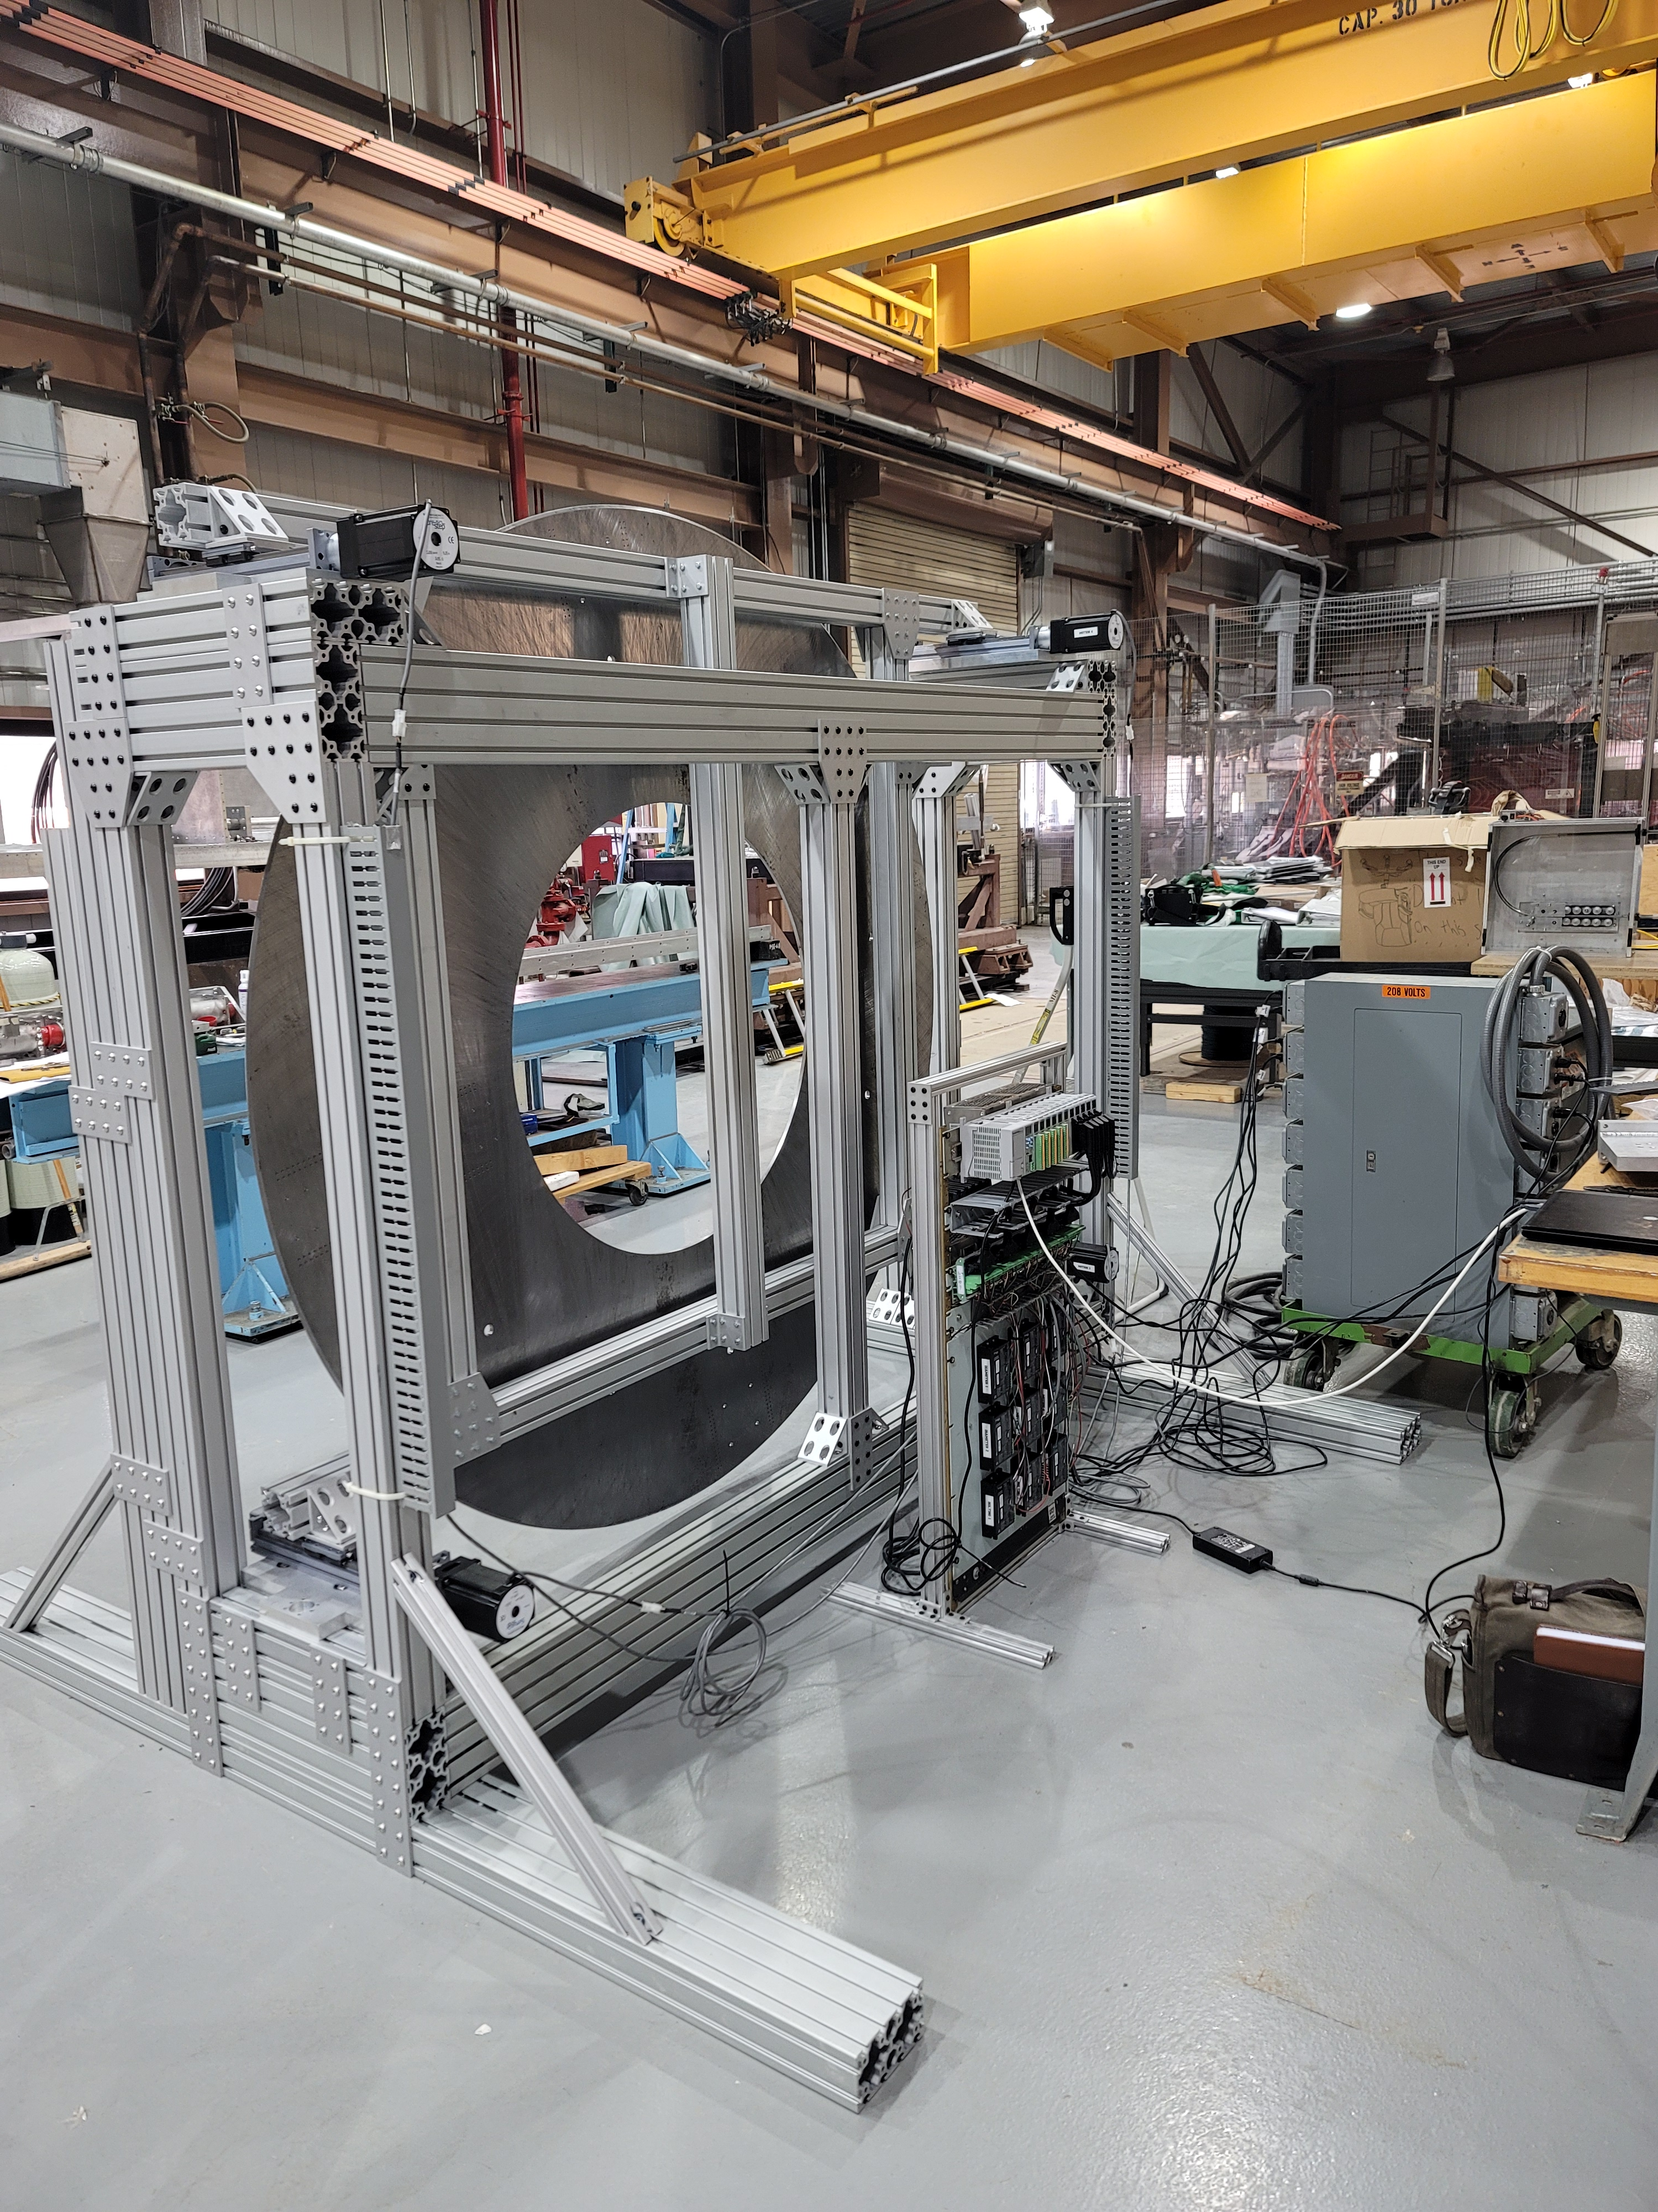
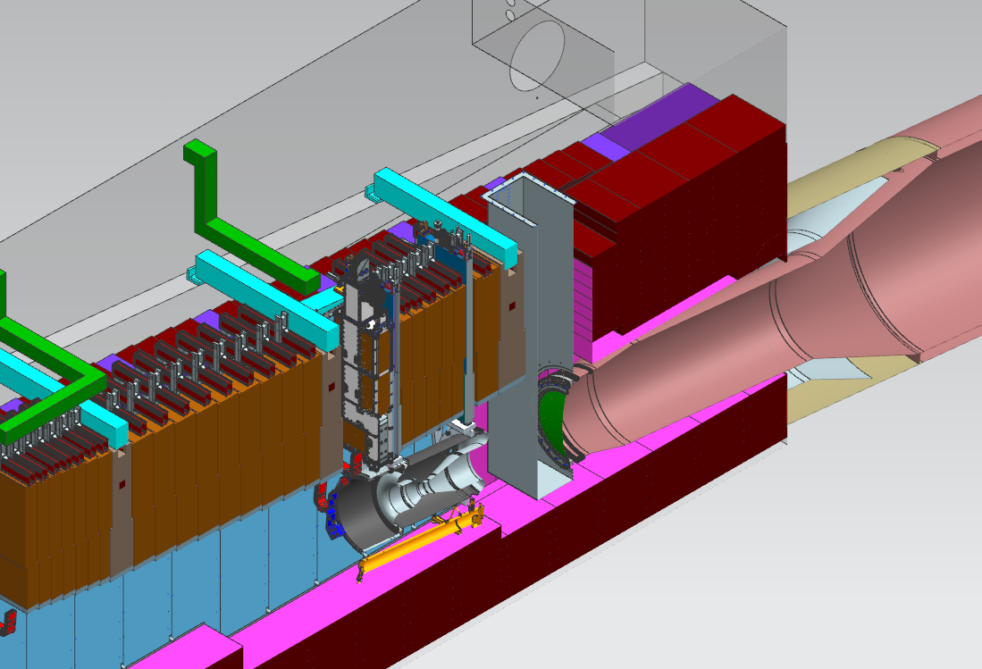
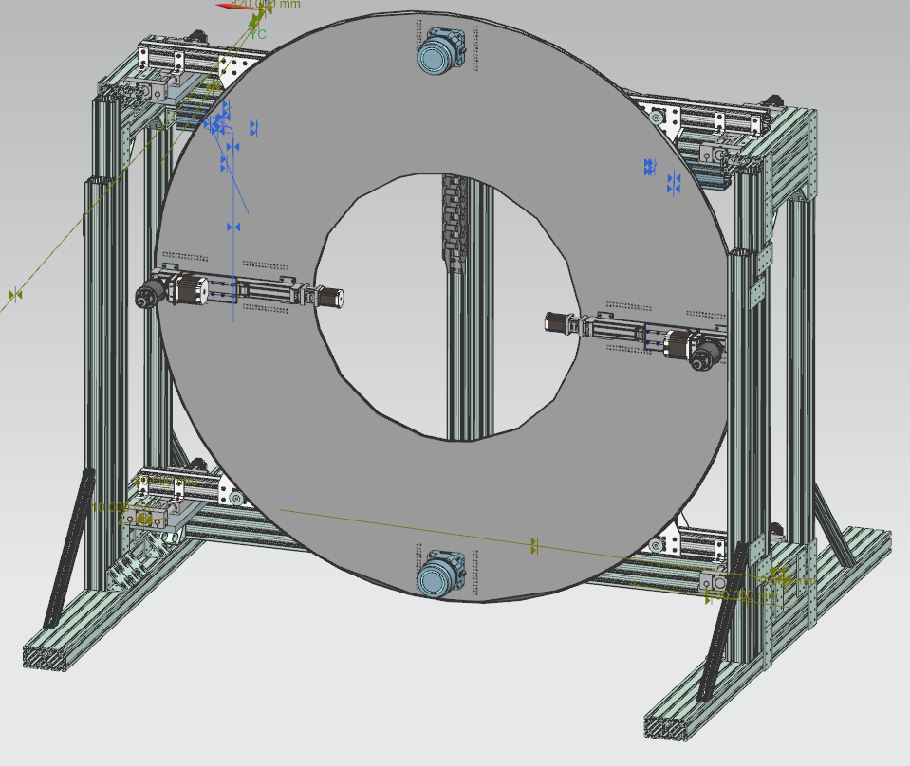
Window between Target Shield Pile and Decay Volume
Separate gas volumes
  Cooling nitrogen on Target Shield Pile side
  Low Density Helium in Decay Volume
Q. Peterson 1330 Wed.
T Block Shielding
USDP Window
Chute

Slide 20
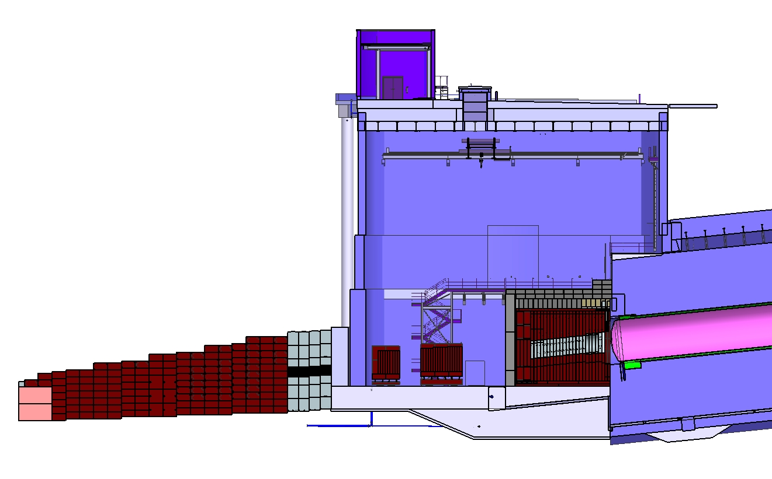
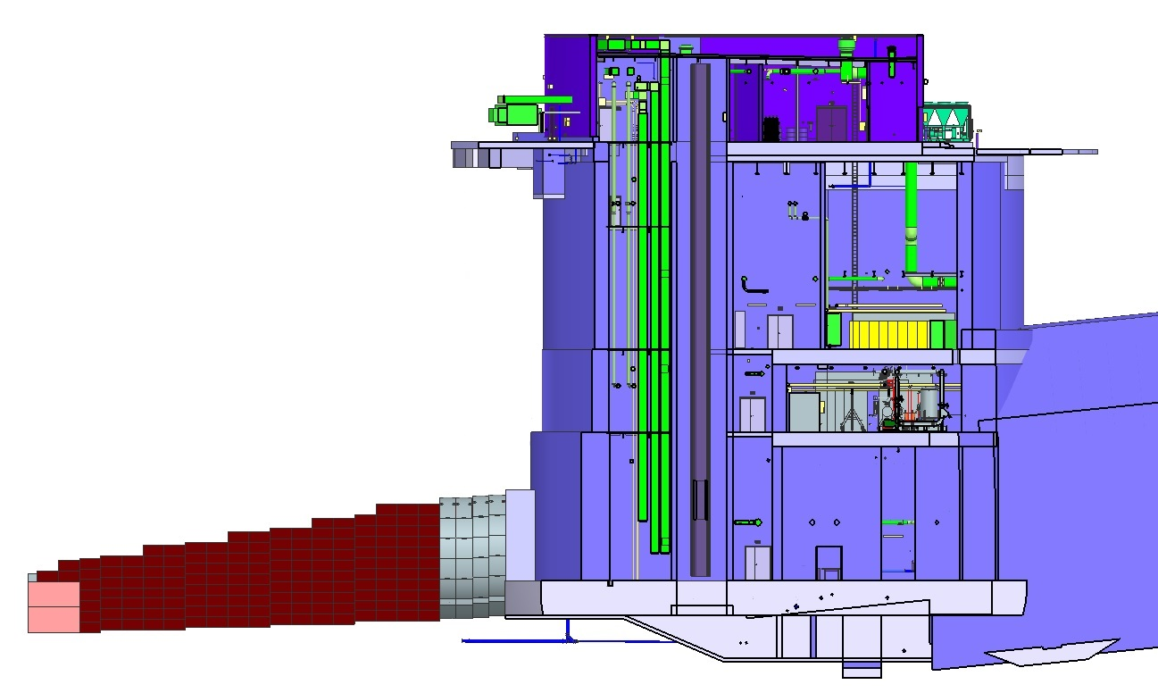
Absorber Complex
Morgue and absorber - Remote Handling
RAW System
HaDeS
Shielded Doors (not shown): -- Entries into Absorber Hall
-- Entry into RAW room

Slide 21
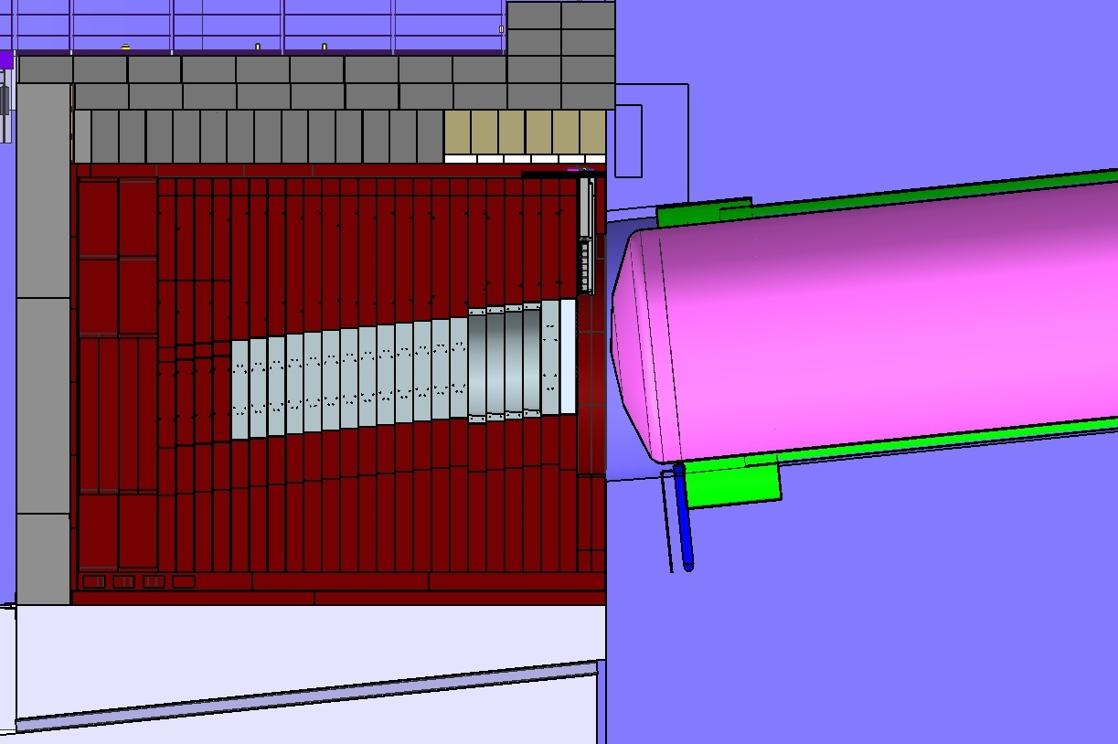
Hadron Absorber
V. Sidorov 1350 Wed..
Removable
Concrete
Shielding
HADES
Monitor
Decay Region
Helium Vessel
Non- Removable Concrete Shielding
Neutrino Beam
From Target Complex
Steel
Shielding
Decay Region
Nitrogen ‘Turn Around’ Box
Aluminum
Cores

Slide 22
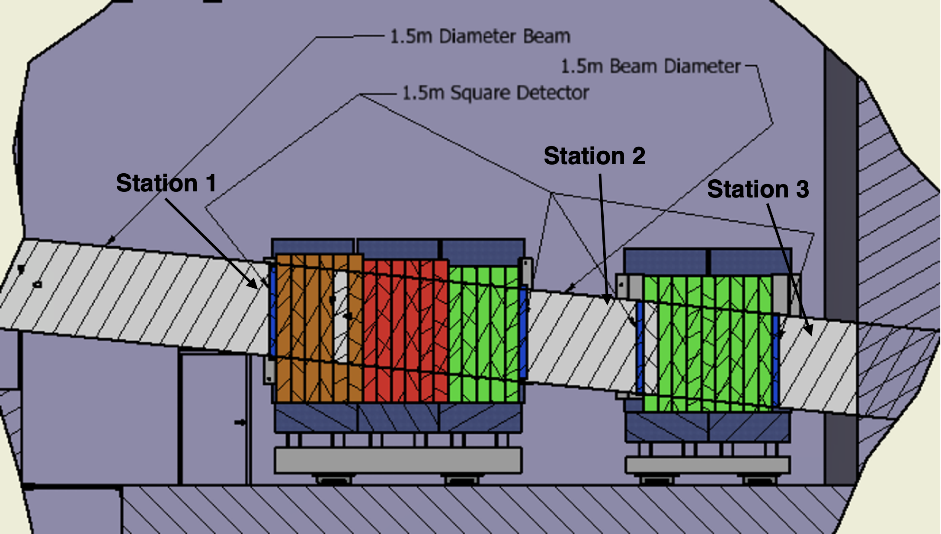
Instrumentation
Beam Base Alignment
  Proton Beam BPMs
  Cross Hairs and Loss Monitors
  Hadron Detector
Beam Monitoring
  Proton Beam BPMs & SEMs
  Hydrostatic Level System
  Muon Monitor System
  Absorber thermometry
Z. Pavlovic 0940 Tue.
Z. Pavlovic 1625 Tue.

Slide 23
Schedule
Beamline is funding limited
LBNF/DUNE has prioritized the far site
Most beamline design work will be completed in 2023/24
Funding LBNF construction at Fermilab starts in 2026
Rady for first beam expect in 2031

Slide 24
Summary
LBNF Beamline has done some evolution since NBI 2019
There will be several presentations later in NBI 2022 where details will be discussed.
Please ask me questions if the other presentations do not cover your area of interest

