Slide 1

Neutrinos @LHC
NBI2022 workshop
19th September 2022
J. Boyd, F. Cerutti, M. S. Gilarte, R. Jacobsson, A. de Roeck and M. Calviani (CERN), G. De Lellis, A. Di Crescenzo (Uni Napoli, INFN)
for CERN FLUKA team, SND@LHC and FASERν

Slide 2
Motivation
LHC is unique in offering GeV to few TeV laboratory neutrinos, aimed at probing νN interactions in an explored domain
Ideas for neutrino physics at LHC dates back several years
  K. Winter (1990), A. De Rújula (1993), F. Vannucci (1993), etc.
  More recently with the CMS-XSEN proposal (S. Buontempo, 2018)
Recent interest led to the approval of two advanced experiments (FASERν & SND) that will open the physics for collider neutrinos

Slide 3
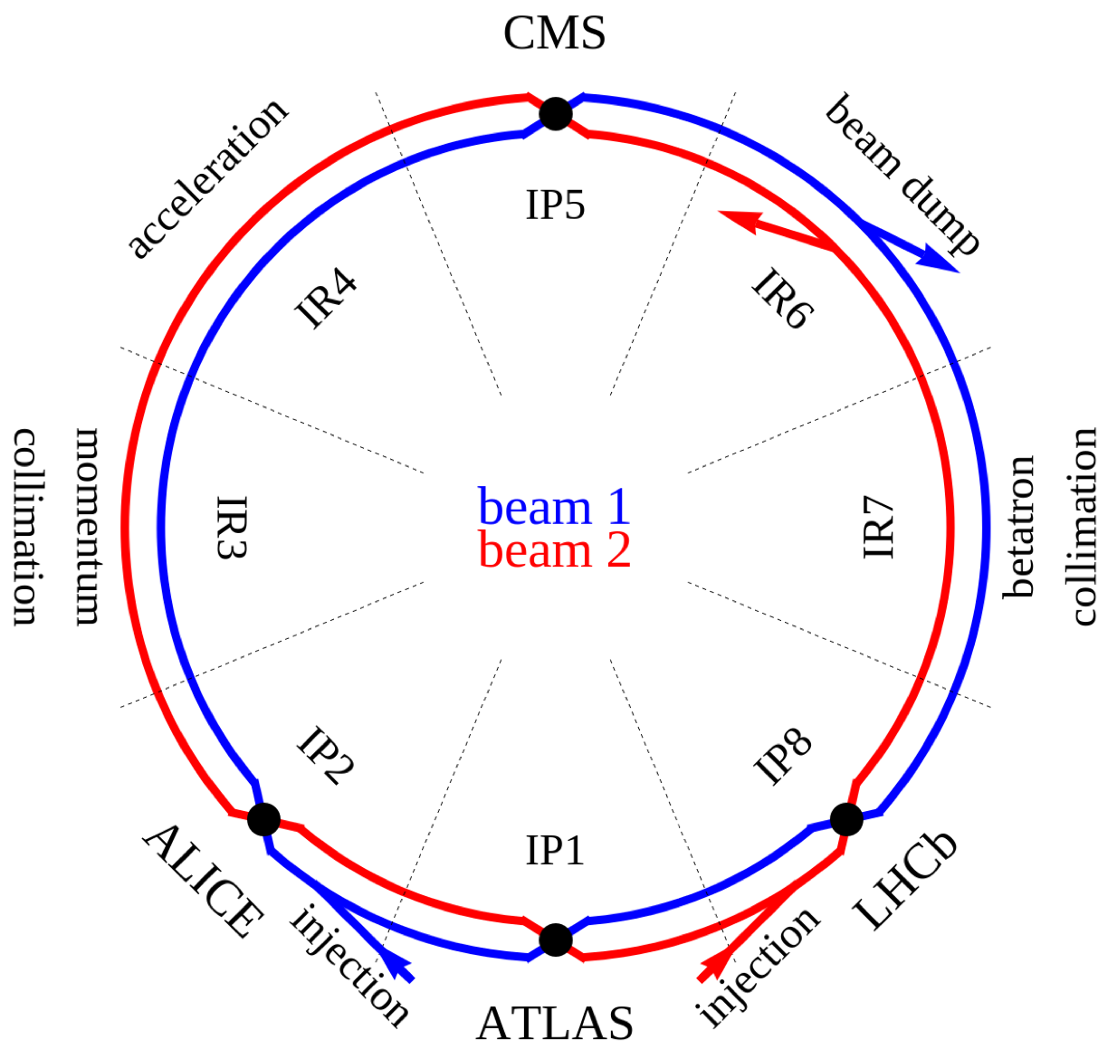
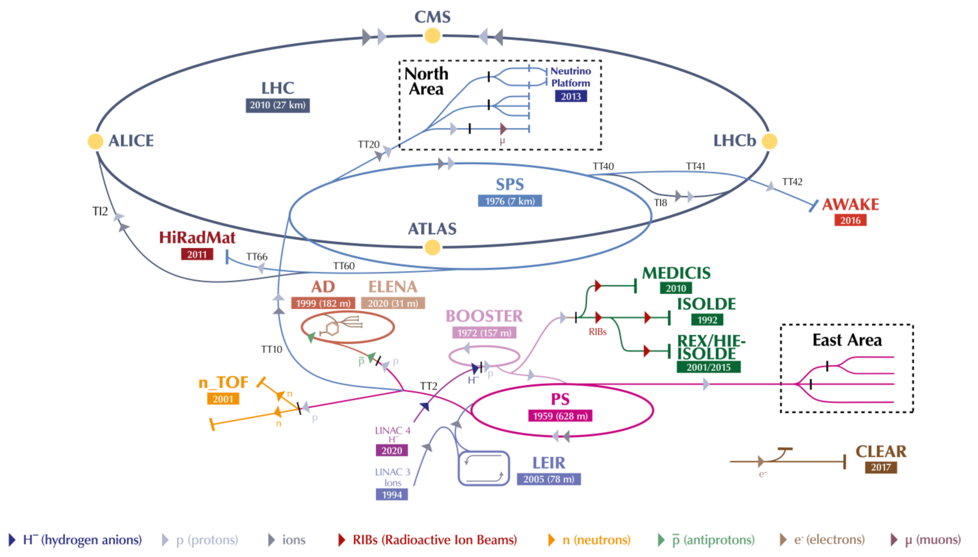
CERN’s accelerator complex

Slide 4

What is the source of neutrinos at LHC?
Neutrinos produced in the forward direction at the LHC originate from the decay of hadrons, mainly pions, kaons, and D mesons
Proton-proton inelastic reaction
80 mb (incl. diffractive) at √s = 13 TeV

Slide 5

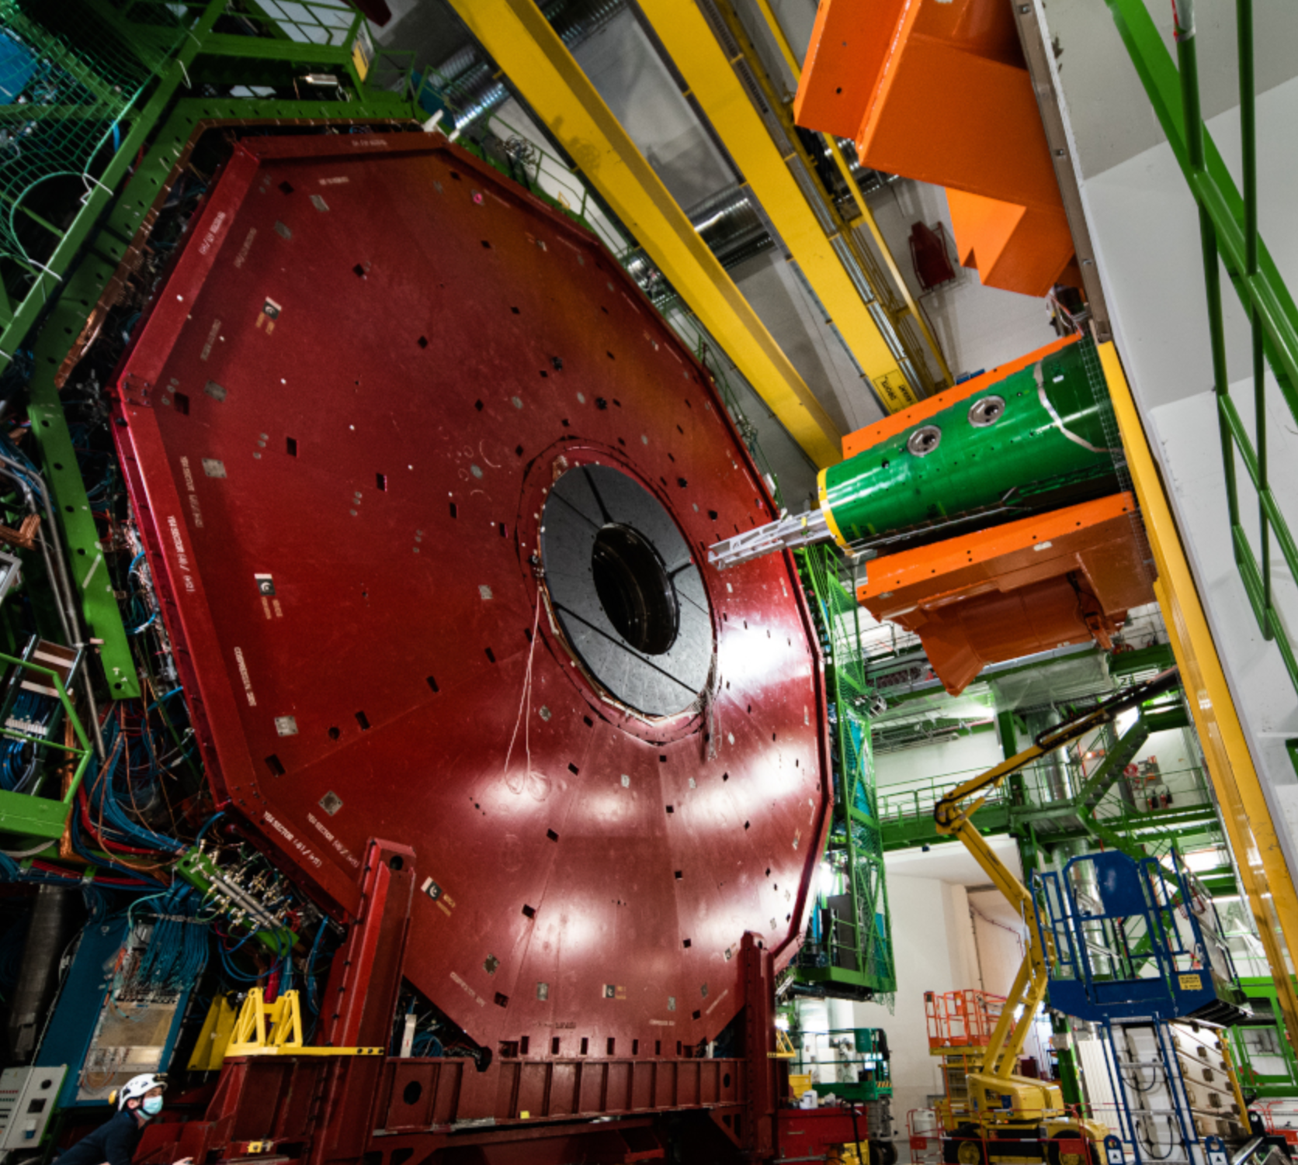
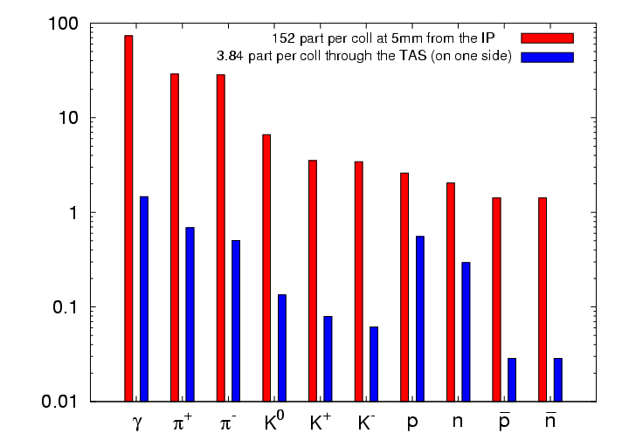
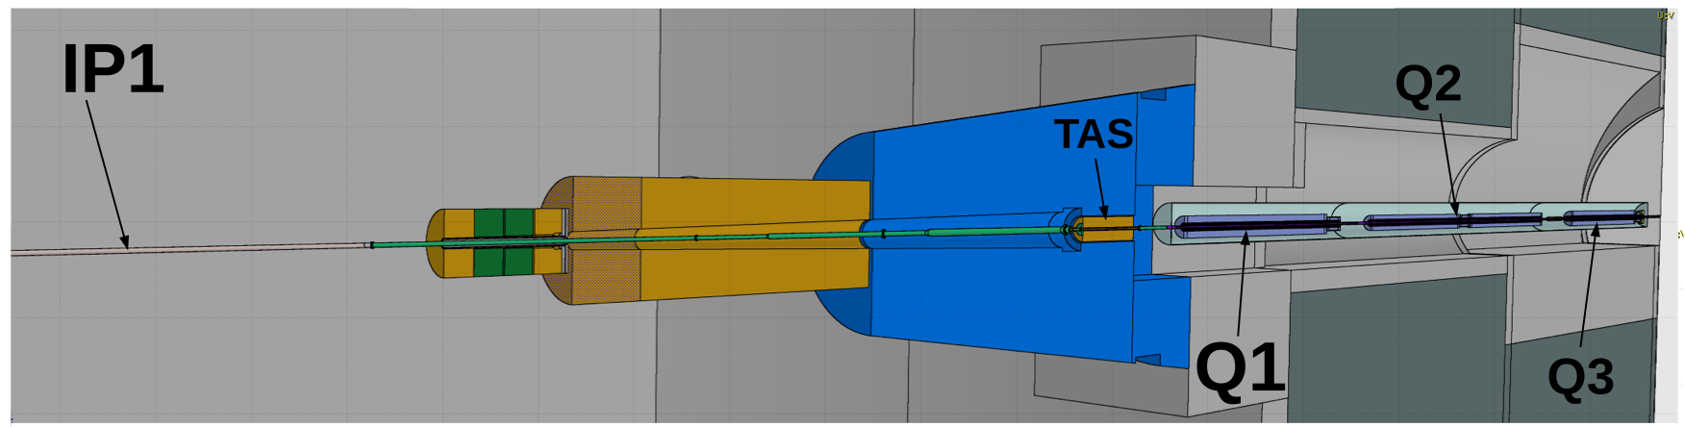
FLUKA uses DPMJET III (v10) as event generator
TAS is a copper absorber to protect inner triplets and dipoles from debris generated at IP
ATLAS interaction point and collision point

Slide 6
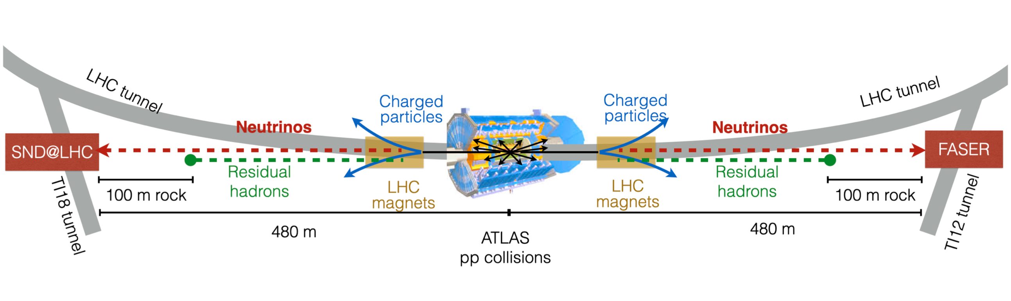
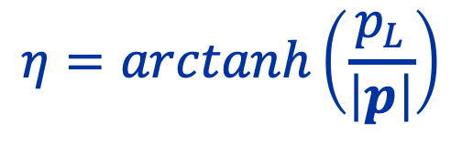
Current neutrino physics at LHC experiments
Generally referred as “forward physics” , referring to regions of the detector(s) which are close to the beam axis, at high pseudorapidity η
$$η=arctanh\left(\frac{p_{L}}{\left|p\right|}\right)$$

Slide 7
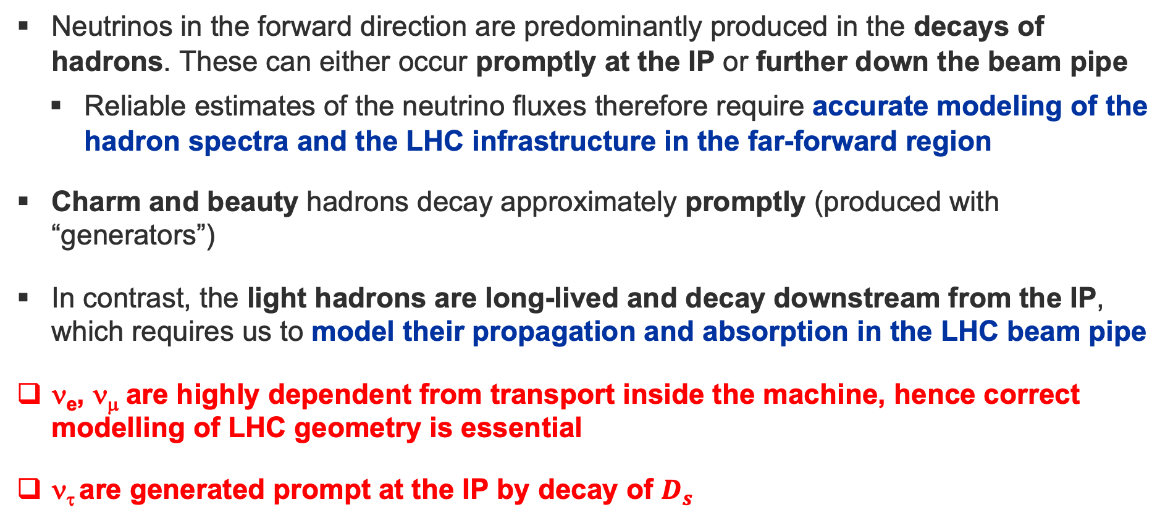
General considerations on produced neutrinos
Neutrinos in the forward direction are predominantly produced in the decays of hadrons. These can either occur promptly at the IP or further down the beam pipe
  Reliable estimates of the neutrino fluxes therefore require accurate modeling of the hadron spectra and the LHC infrastructure in the far-forward region
Charm and beauty hadrons decay approximately promptly (produced with “generators”)
In contrast, the light hadrons are long-lived and decay downstream from the IP, which requires us to model their propagation and absorption in the LHC beam pipe
ν_{e}, ν_{μ} are highly dependent from transport inside the machine, hence correct modelling of LHC geometry is essential
ν_{τ} are generated prompt at the IP by decay of $D_{s}$

Slide 8
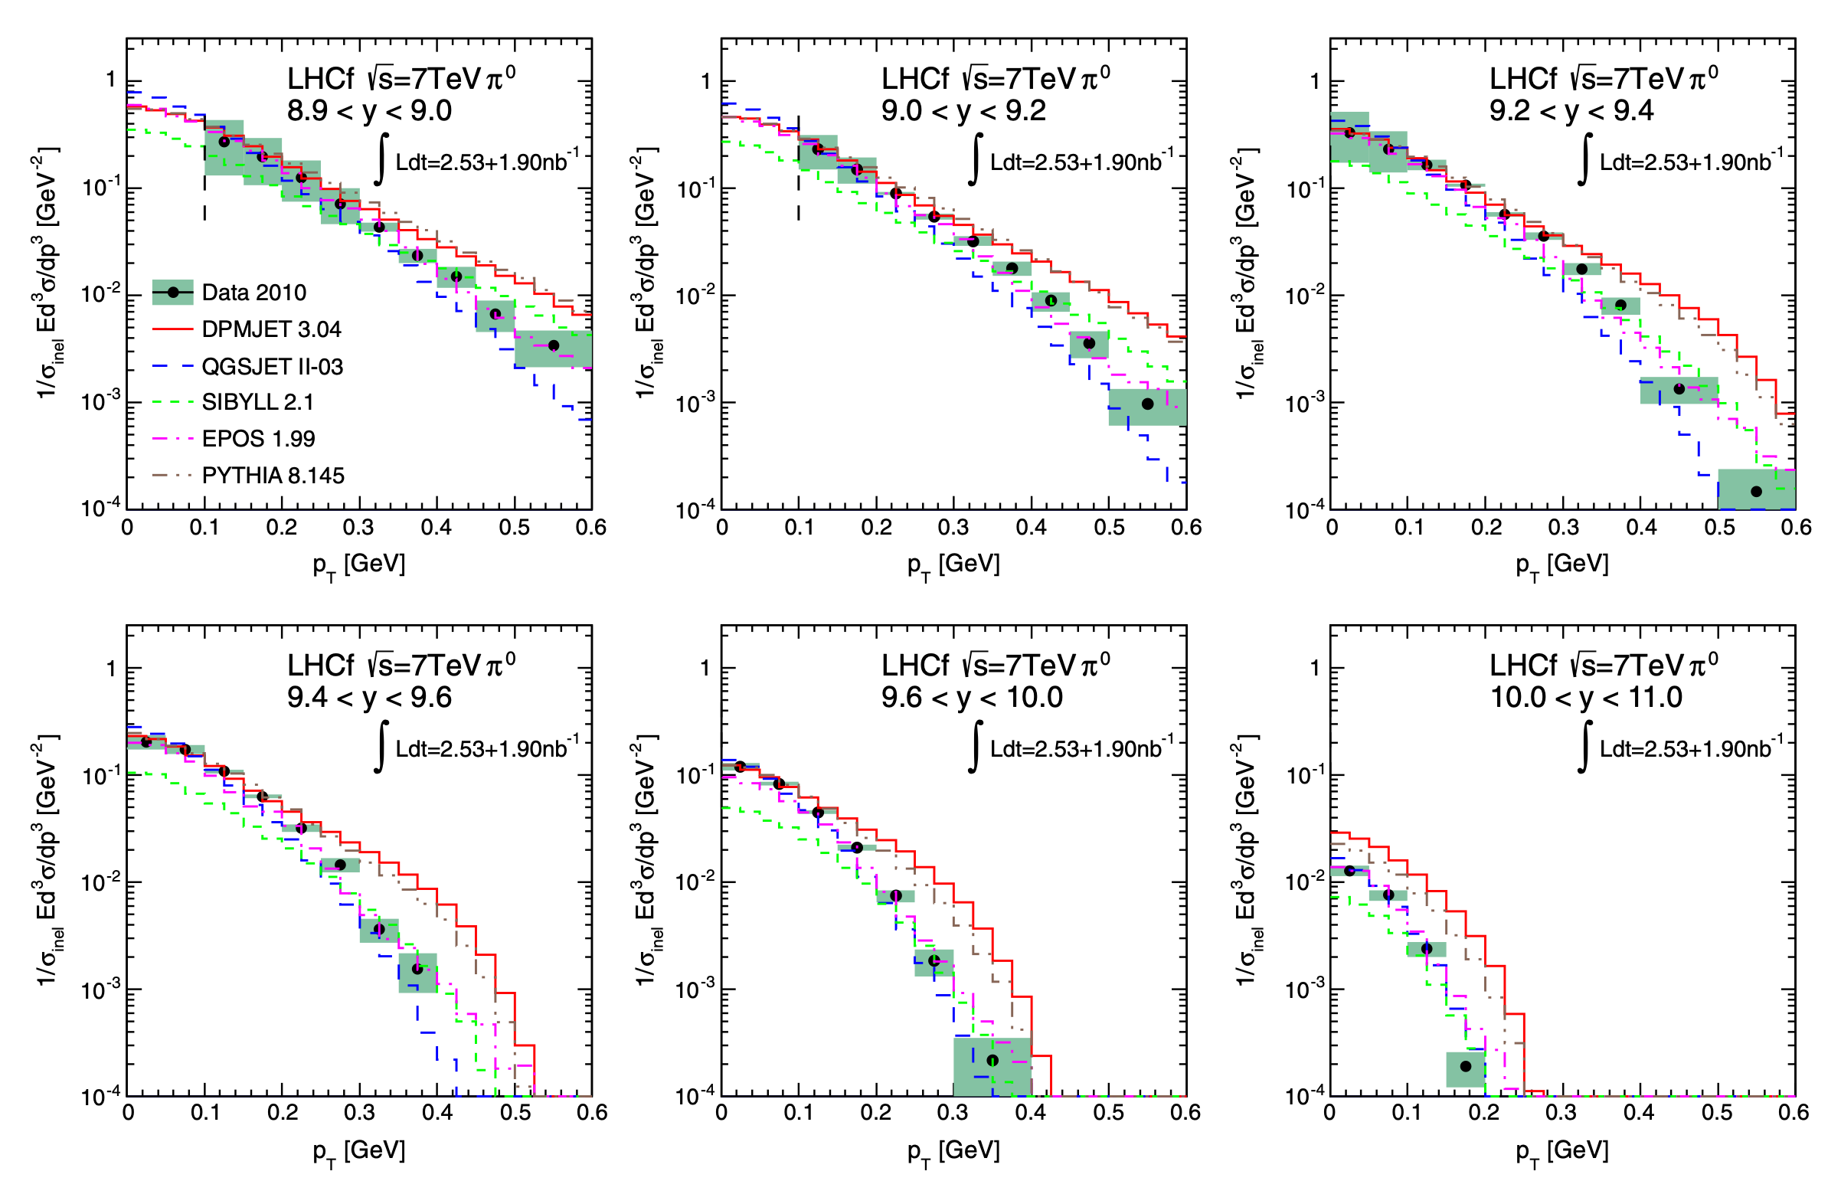
DPMJET validation with data from LHCf
Phys. Rev. D 86 092001

Slide 9
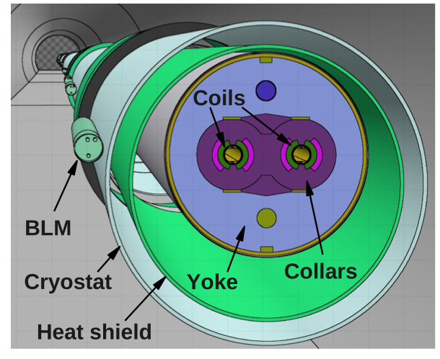
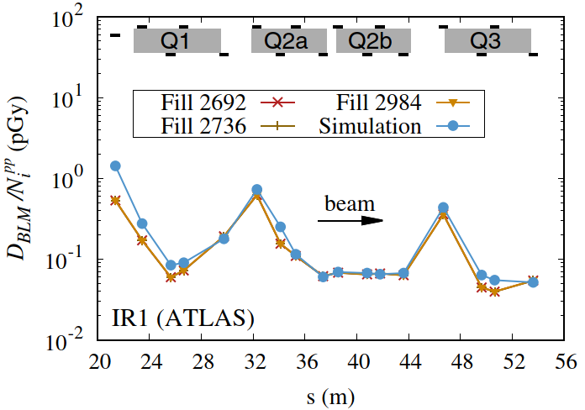
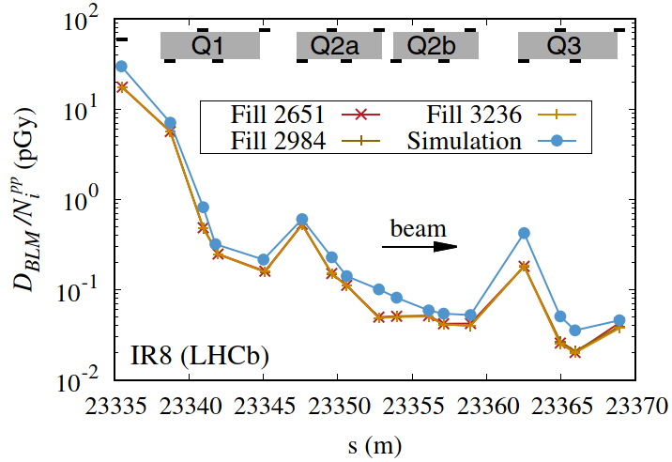
Validation of FLUKA modelling with BLMs
Phys. Rev. Accel. Beams 22 071003
Demonstrated excellent predictive power of particle shower simulations for quantifying beam induced energy depositions in the LHC (as well as applications for targetry, BIDs design, radiation protection & others)
Regularly employed for LHC operation as well as for HL-LHC machine design

Slide 10
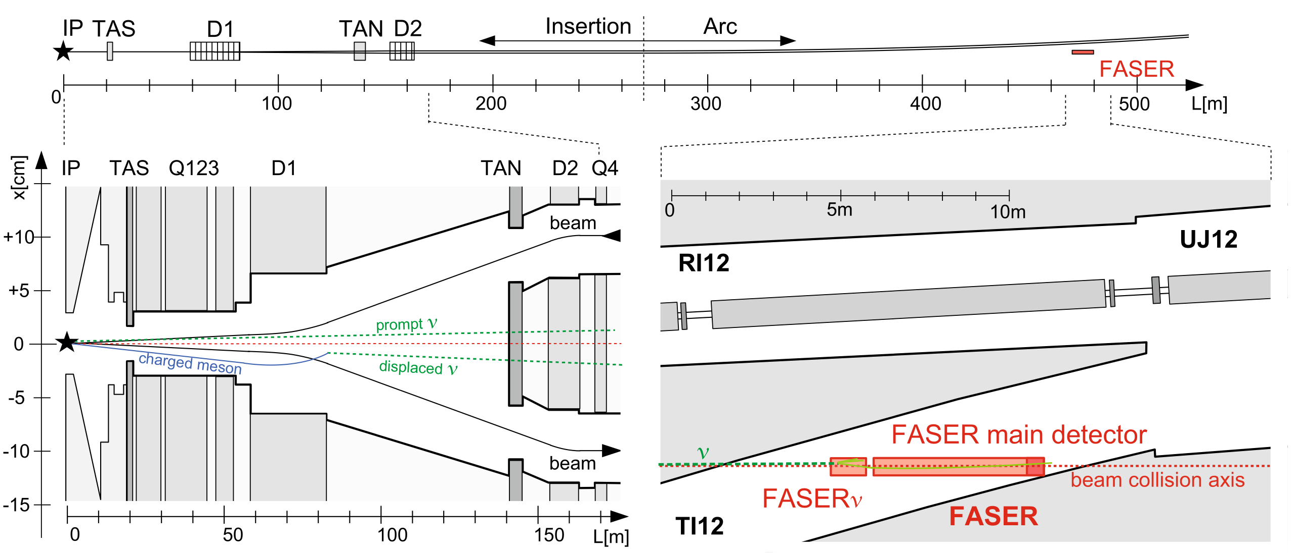
Eur. Phys. J. C (2020) 80:61
Notes:
Schematic view of the far-forward region downstream of ATLAS. Upper panel: FASER is located 480 m downstream of ATLAS along the beam collision axis (dotted line) after the main LHC tunnel curves away. Lower left panel: High-energy particles produced at the IP in the far-forward direction. Charged particles (solid lines) are deflected by LHC quadrupole (Q) and dipole (D) magnets. Neutral hadrons are absorbed by either the TAS front quadrupole absorber or by the TAN neutral particle absorber. Neutrinos (dashed lines) are produced either promptly or displaced and pass through the LHC infrastructure without interacting. Note the extreme difference in horizontal and vertical scales. Lower right panel: Neutrinos may then travel ∼ 480 m further downstream into tunnel TI12 and interact in FASERν, which is located at the front of the FASER main detector.

Slide 11
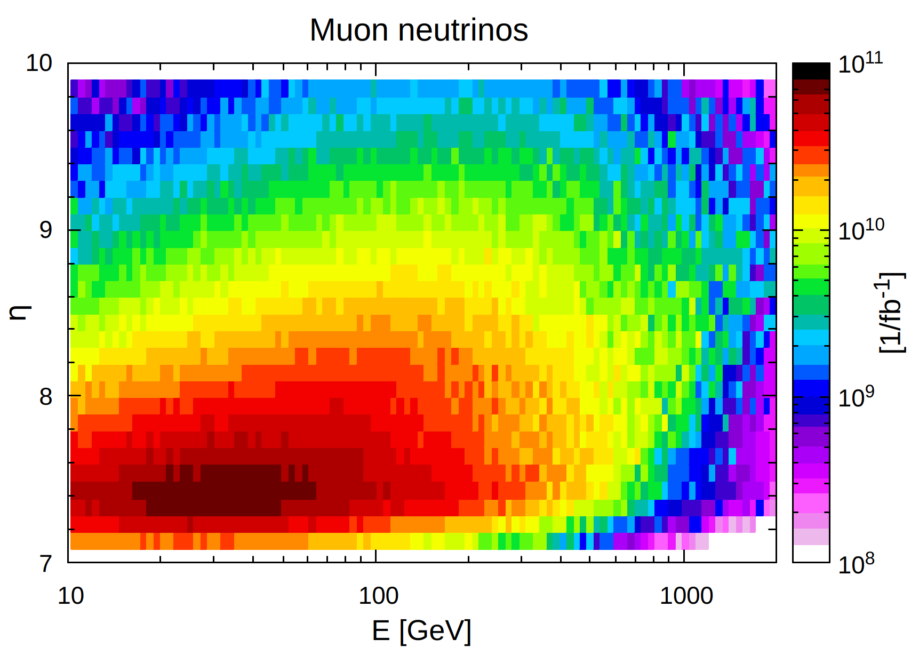
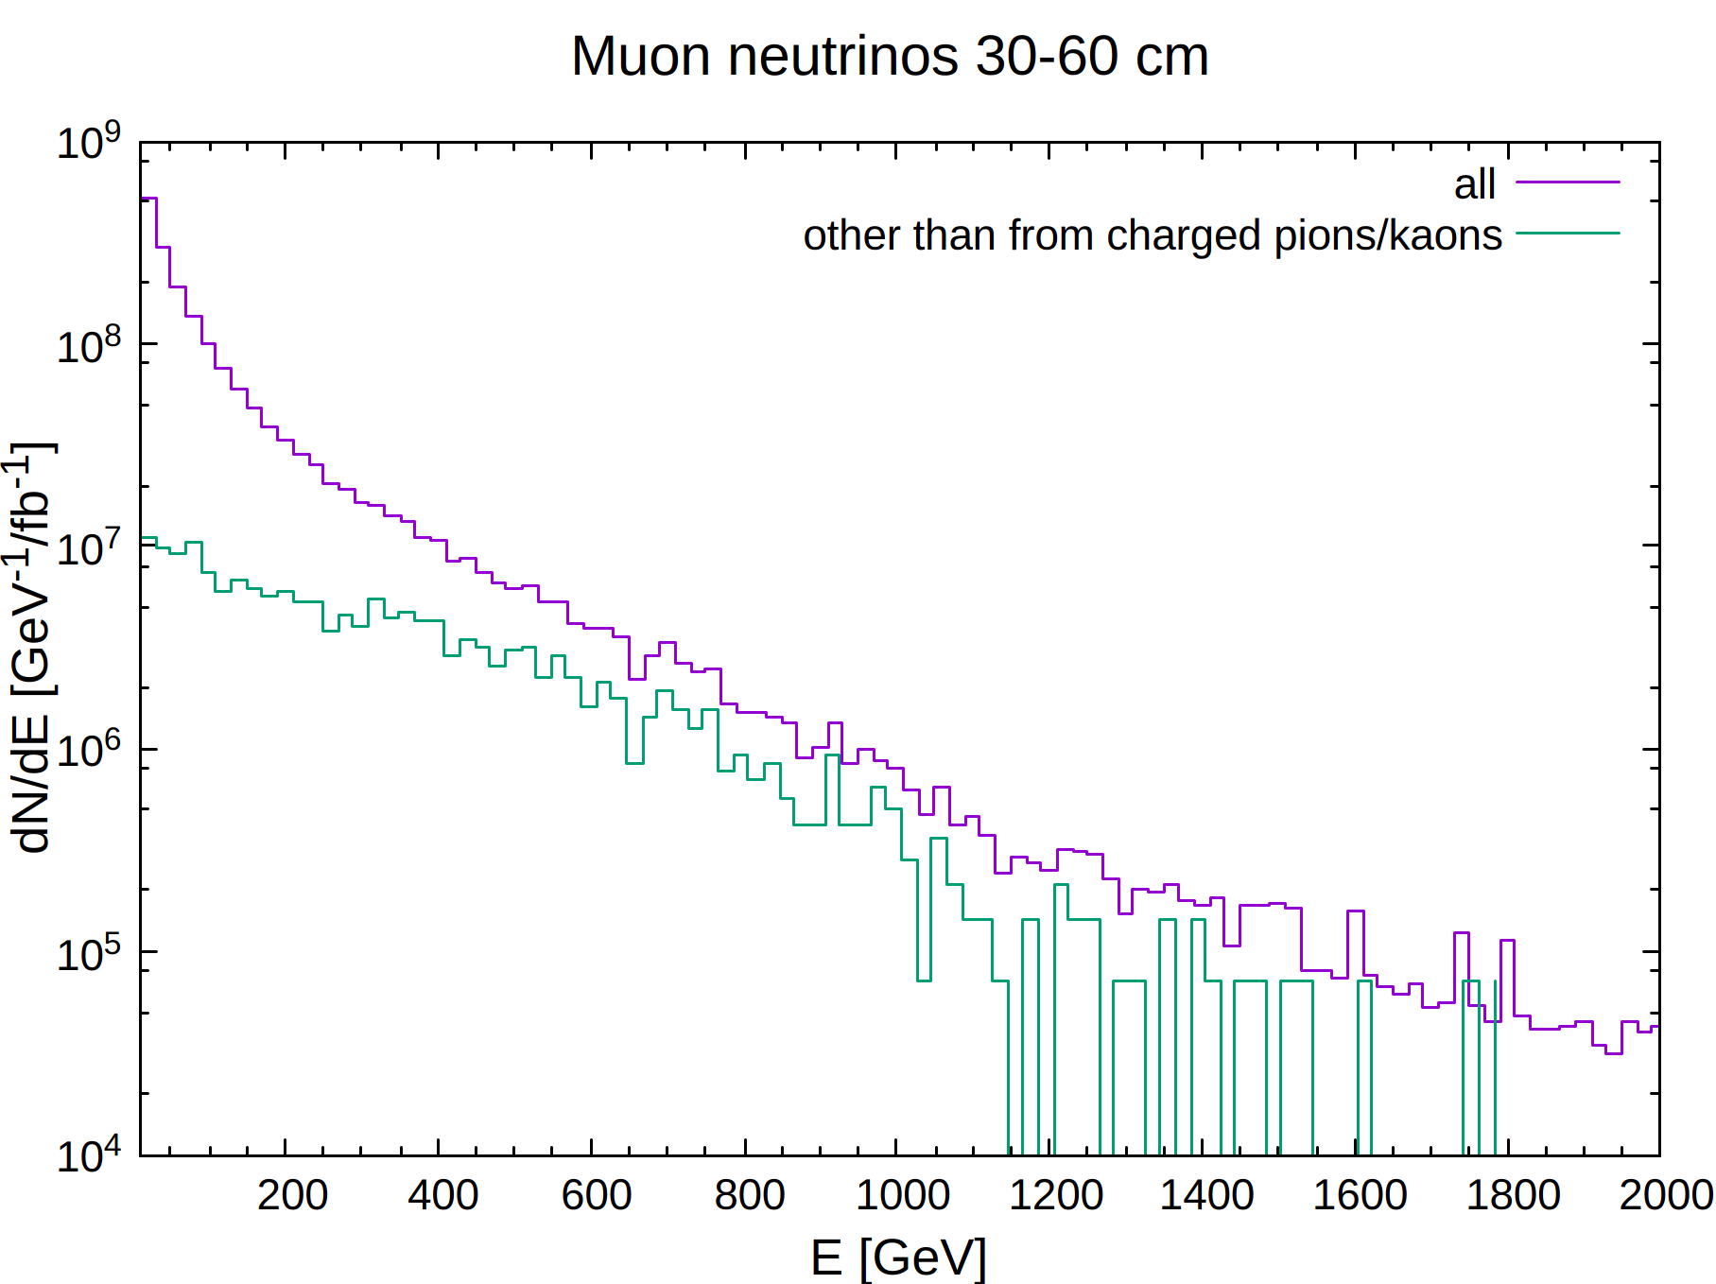
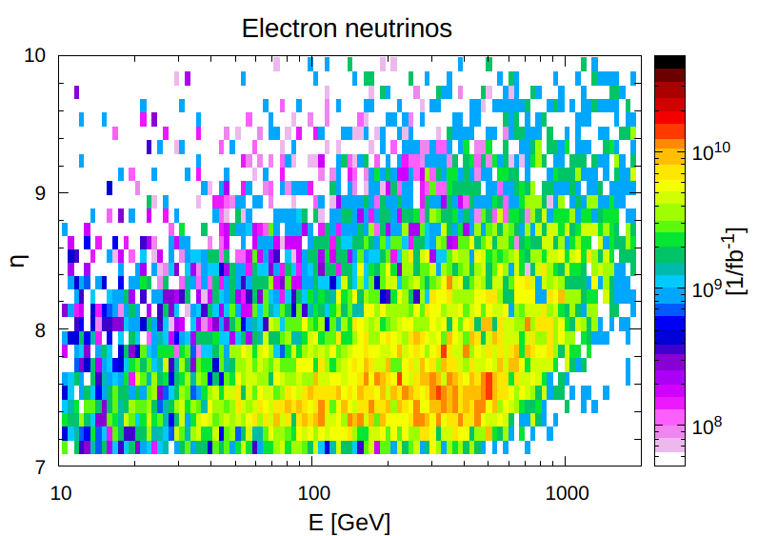
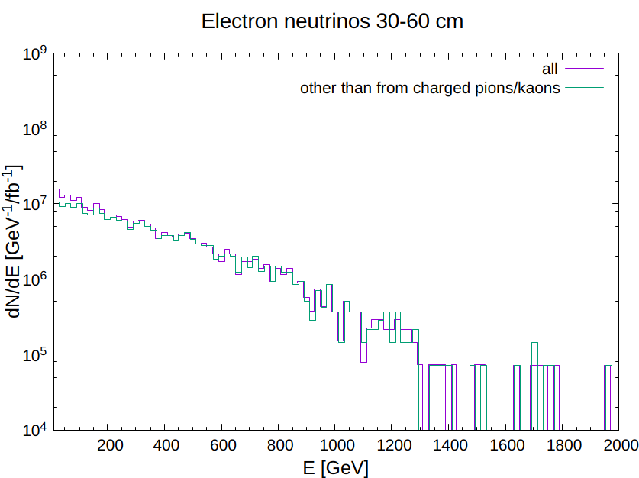
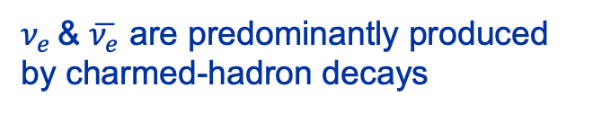
Neutrinos @484 m
(roughly @SND)
FASERν
SND
$ν_{e }$& $\overline{ν_{e}}$ are predominantly produced by charmed-hadron decays

Slide 12
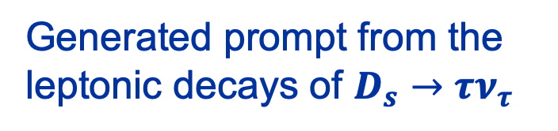
Neutrinos @484 m
Generated prompt from the leptonic decays of $D_{s}→τν_{τ}$

Slide 13
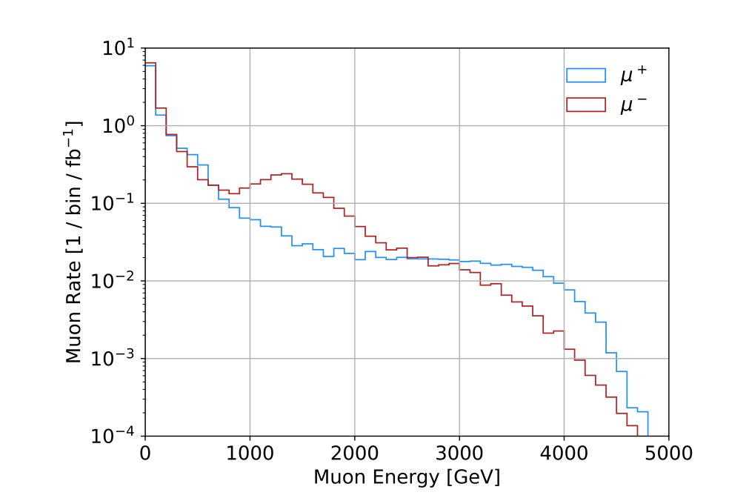
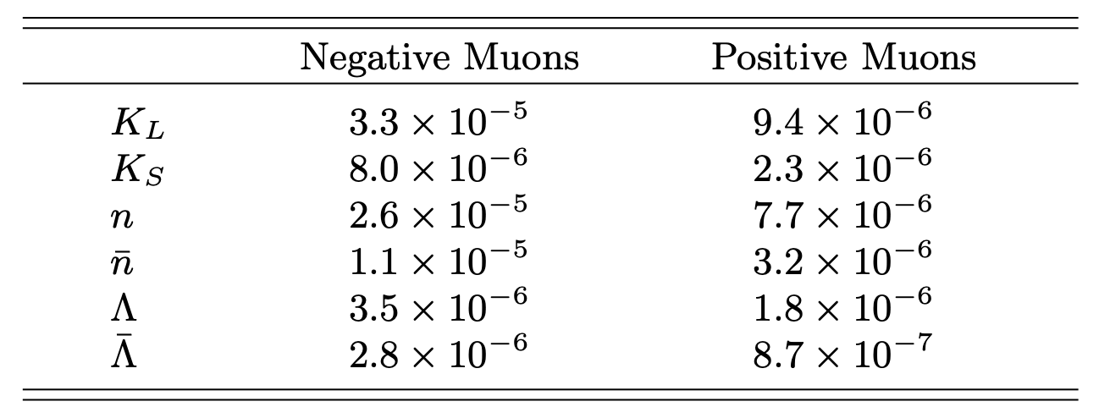
Muons @409 m experimental background
The dominant source of background to neutrino interactions is inelastic interactions of neutral hadrons produced in muon photonuclear interactions upstream of the detector
Inside the rock with 75 m still to travel through (30 GeV loss for MIPs), with neutron production
8 10¹³ pp collisions correspond to 1 fb⁻¹
CERN-EP-2021-087
The production rates of neutral hadrons per incident muon with an energy threshold of 10 GeV

Slide 14
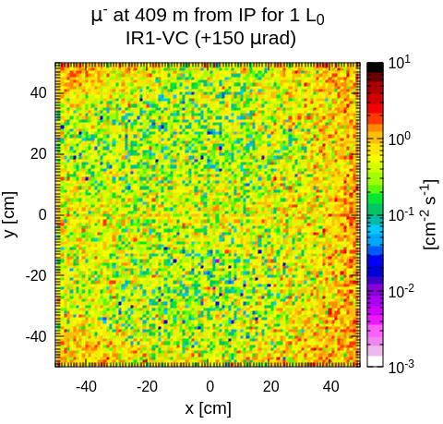
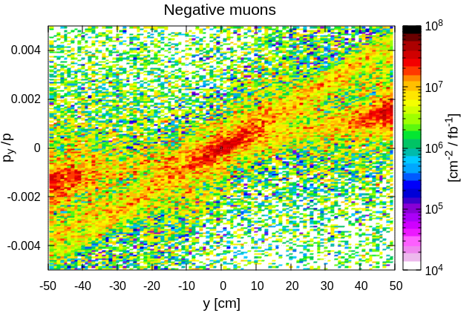
Negative muons (μ⁻) @409 m

Slide 15
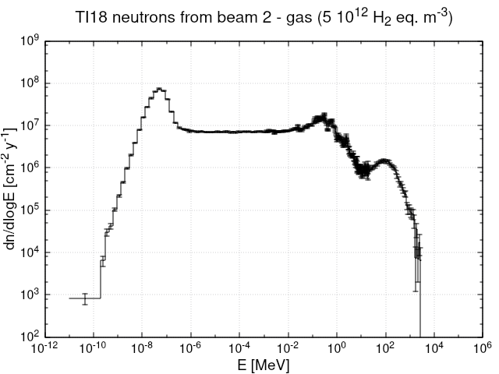
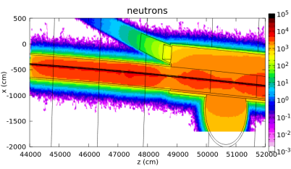
Radiation environment in TI18
Source of radiation is Beam2 interaction with residual gas (5*10¹² H₂ eq m⁻³)
2018 thermal neutrons measurements indicated good agreement with simulations
2.8 10⁸ neutrons cm⁻² y⁻¹
45% >1 eV
4% >1 MeV
1.3% >20 MeV

Slide 16
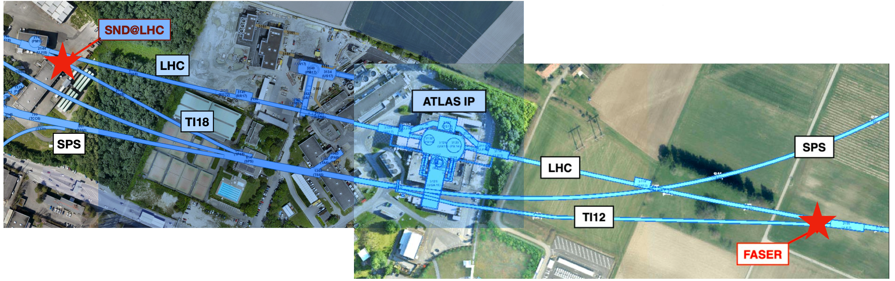
Two recently approved CERN experiments
SND@LHC and FASERν as complementary experiments
SND off axis
7.2<η<8.4
FASERν on axis (LOS)
η>8.8

Slide 17
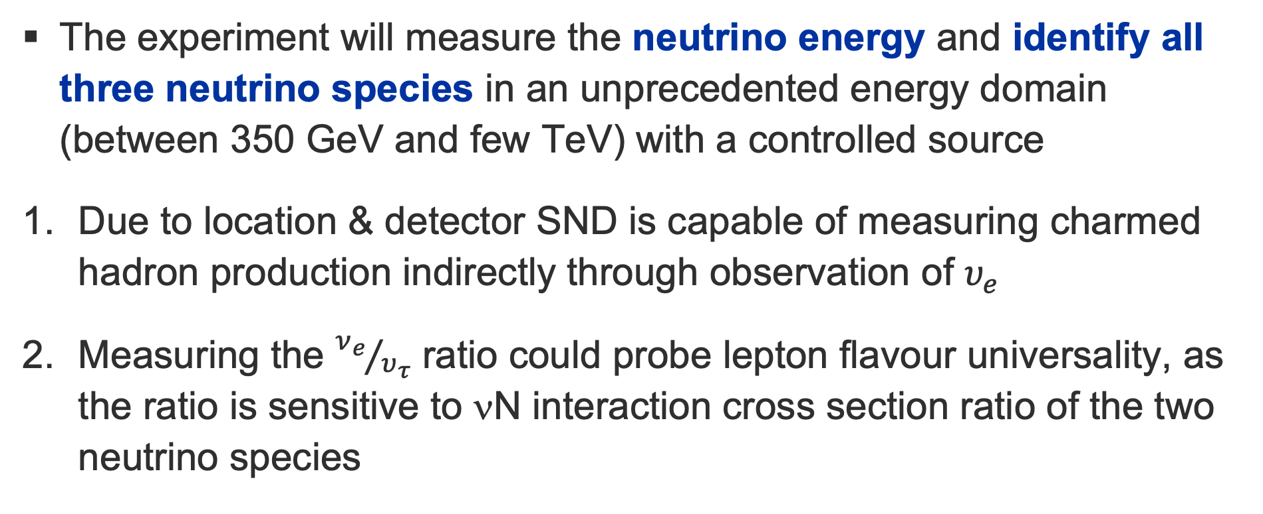
SND@LHC
Physics motivation
The experiment will measure the neutrino energy and identify all three neutrino species in an unprecedented energy domain (between 350 GeV and few TeV) with a controlled source
Due to location & detector SND is capable of measuring charmed hadron production indirectly through observation of $υ_{e}$
Measuring the ${ν_{e}}/{υ_{τ}}$ ratio could probe lepton flavour universality, as the ratio is sensitive to νN interaction cross section ratio of the two neutrino species
CERN-LHCC-2021-003 / LHCC-P-016

Slide 18
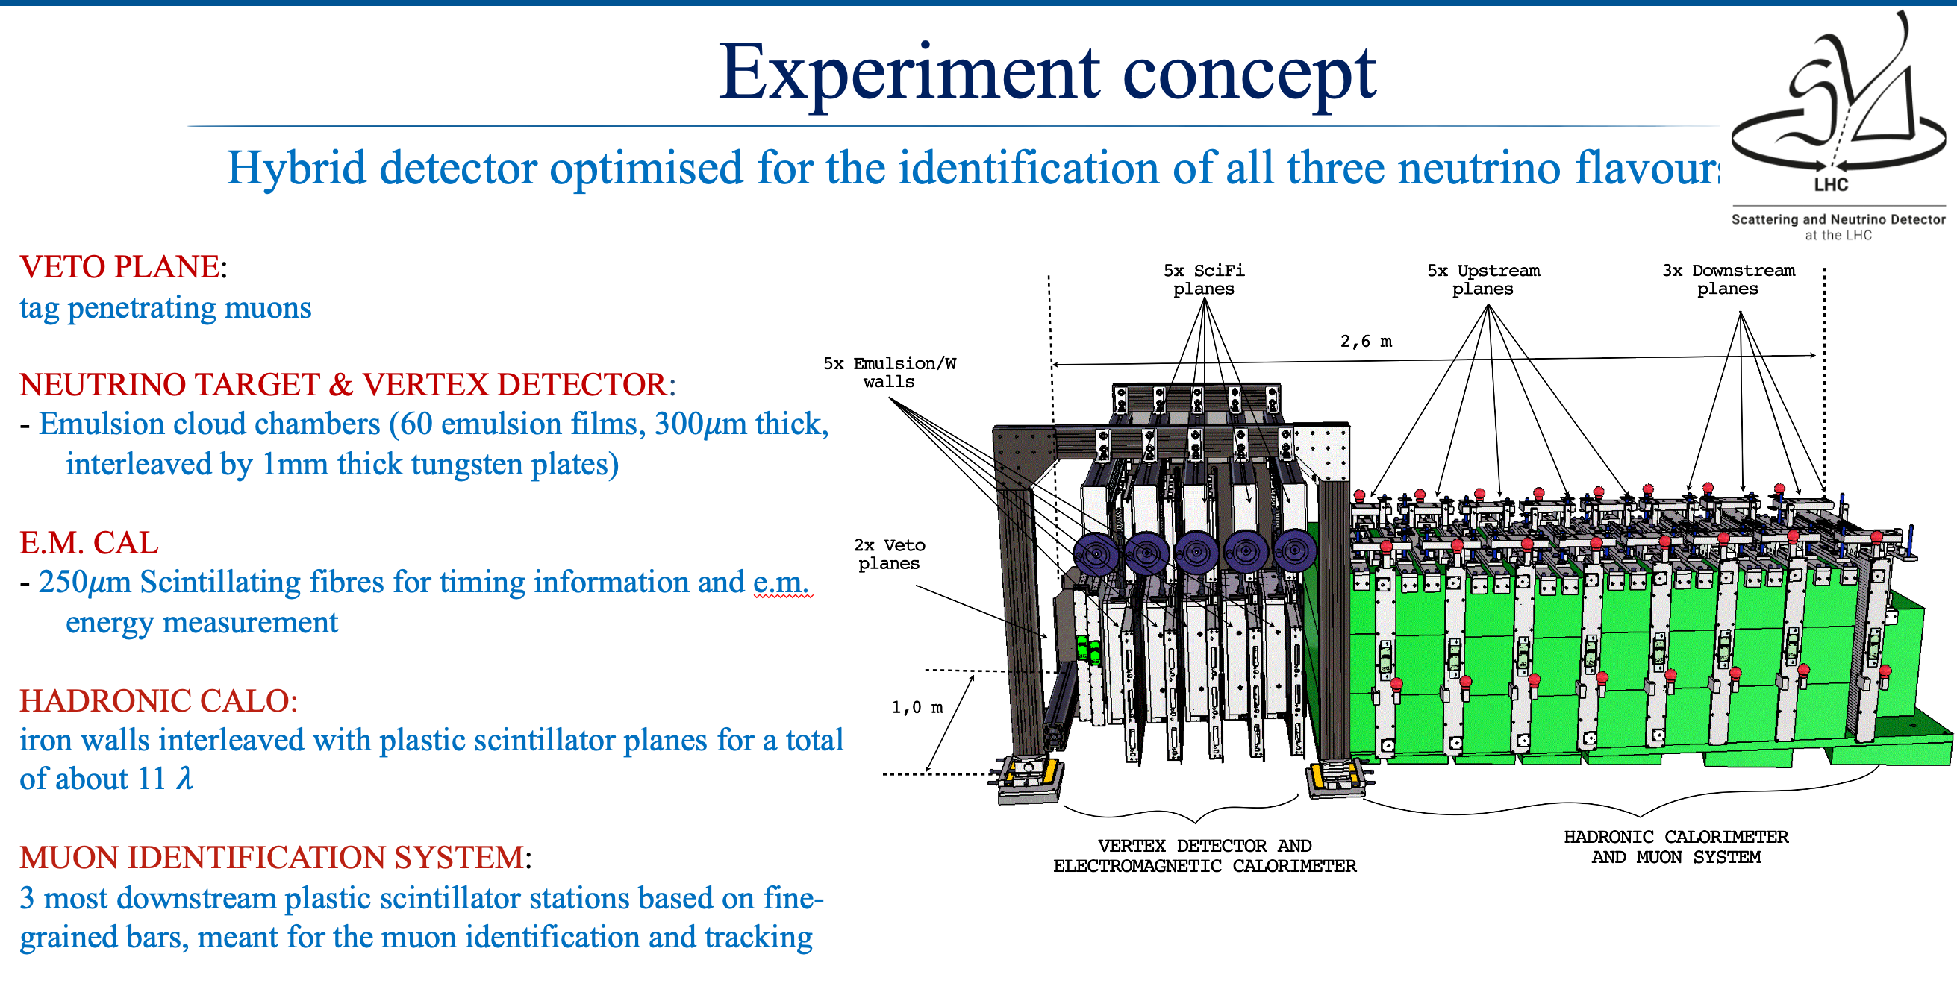

Slide 19
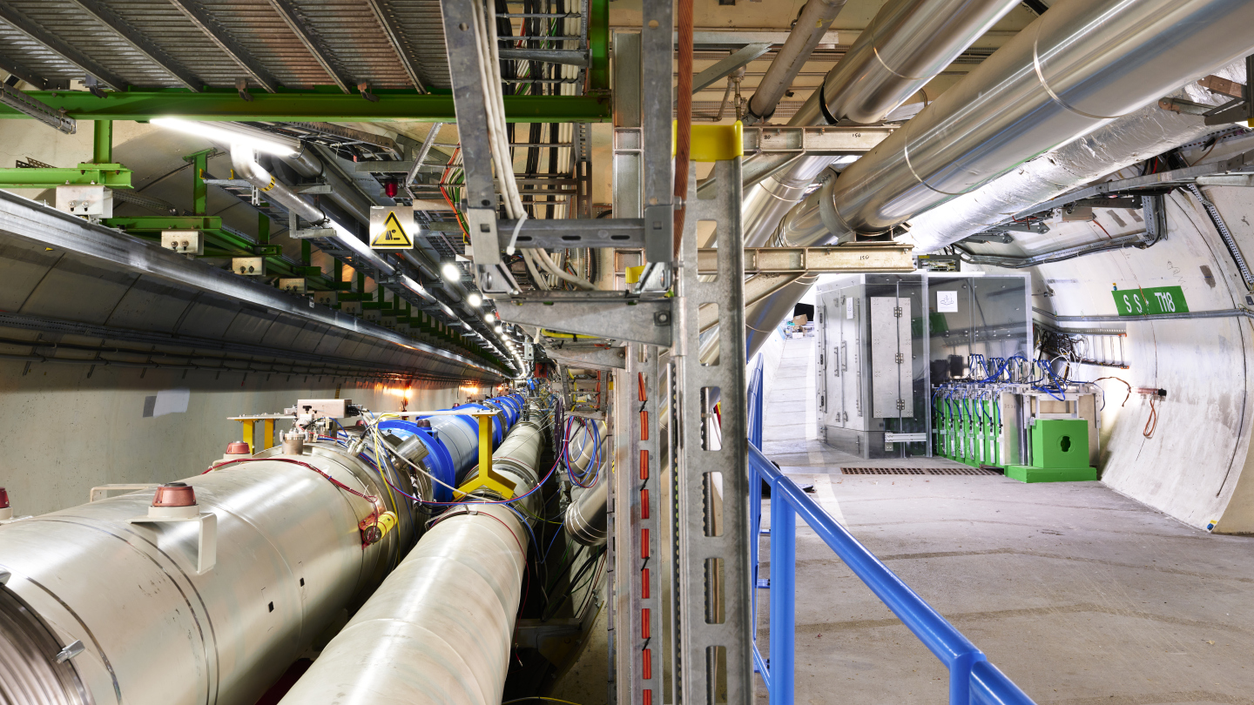

Slide 20
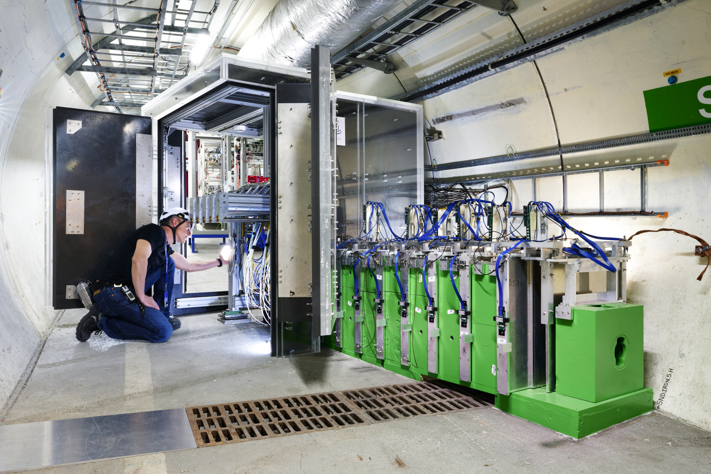

Slide 21
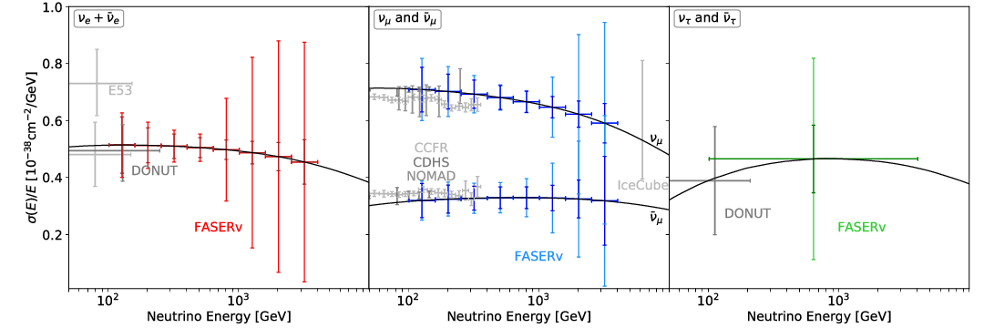
FASERν
Main physics goals
Addition to the Forward Search Experiment (FASER) approved in March 2019 to search for light and weakly interacting long-lived particles at solid angles beyond the reach of conventional collider detectors
Measurement of interaction cross-section of all neutrino flavours
Constraints on non-standard neutrino interactions
Improve measurements of proton parton-density functions in certain phase space
Projected sensitivity to neutrino cross section measurements
arXiv: 2207.11427, arXiv: 2001.03073, arXiv: 1908.02310

Slide 22
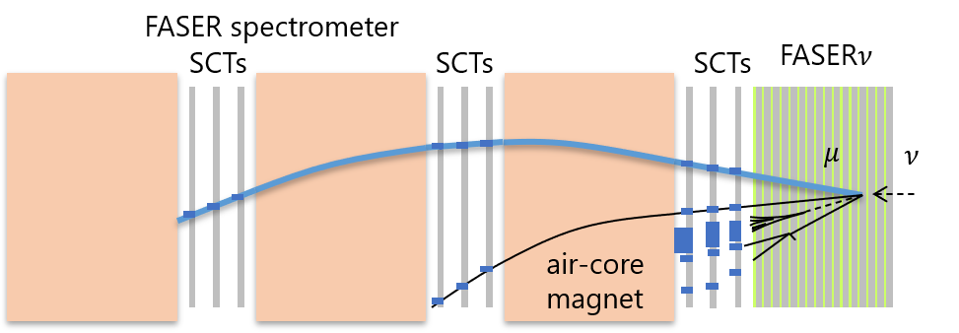
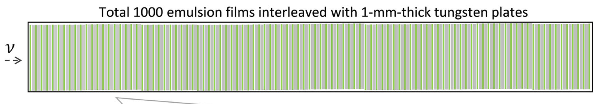
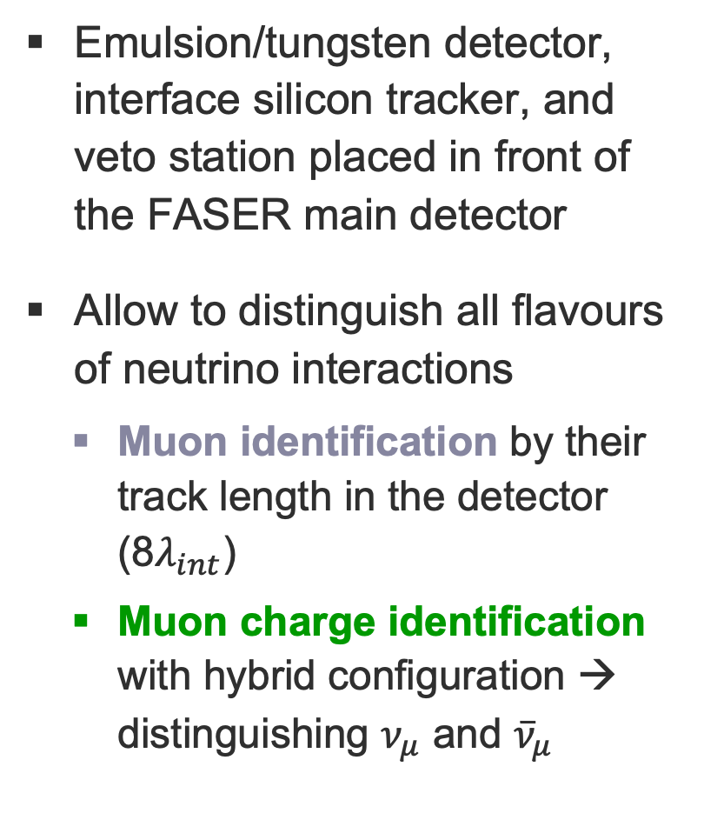
Emulsion/tungsten detector, interface silicon tracker, and veto station placed in front of the FASER main detector
Allow to distinguish all flavours of neutrino interactions
    Muon identification by their track length in the detector (8$λ_{int}$)
    Muon charge identification with hybrid configuration → distinguishing $ν_{μ}$ and ${\overline{ν}}_{μ}$
arXiv: 2207.11427, arXiv: 2001.03073, arXiv: 1908.02310

Slide 23
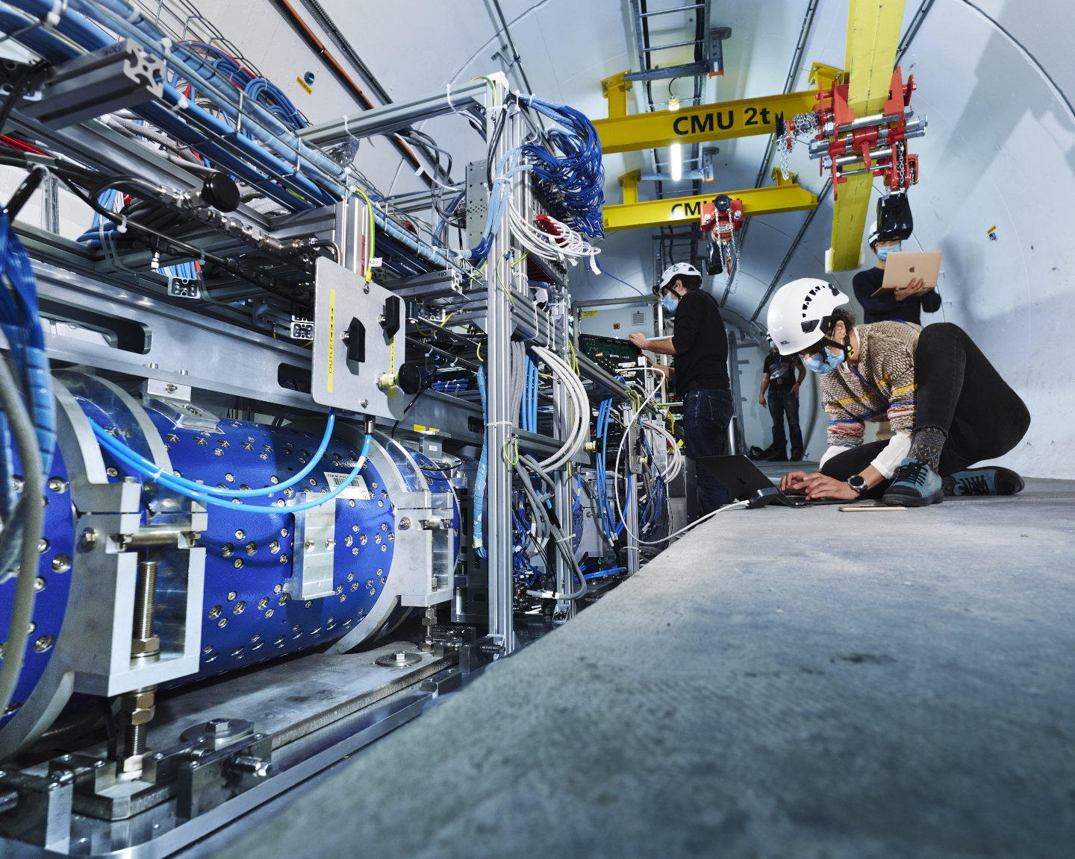
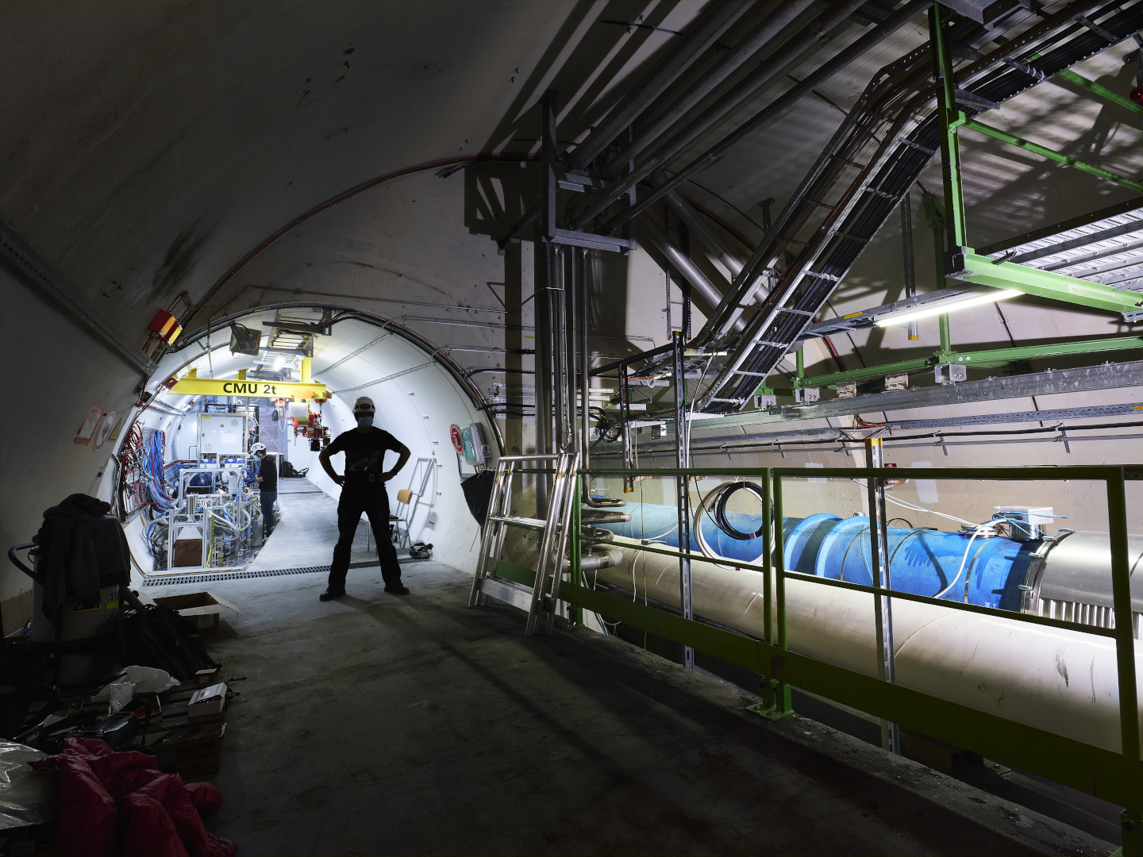
arXiv: 2207.11427, arXiv: 2001.03073, arXiv: 1908.02310

Slide 24
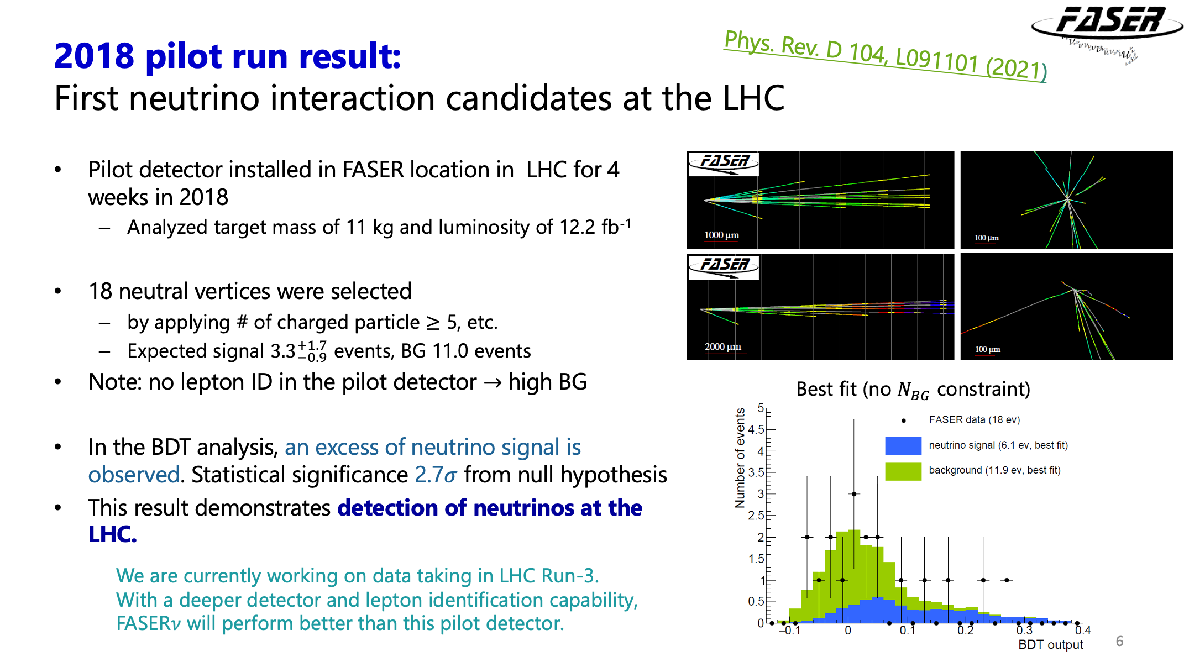
Phys. Rev. D 104 L091101

Slide 25
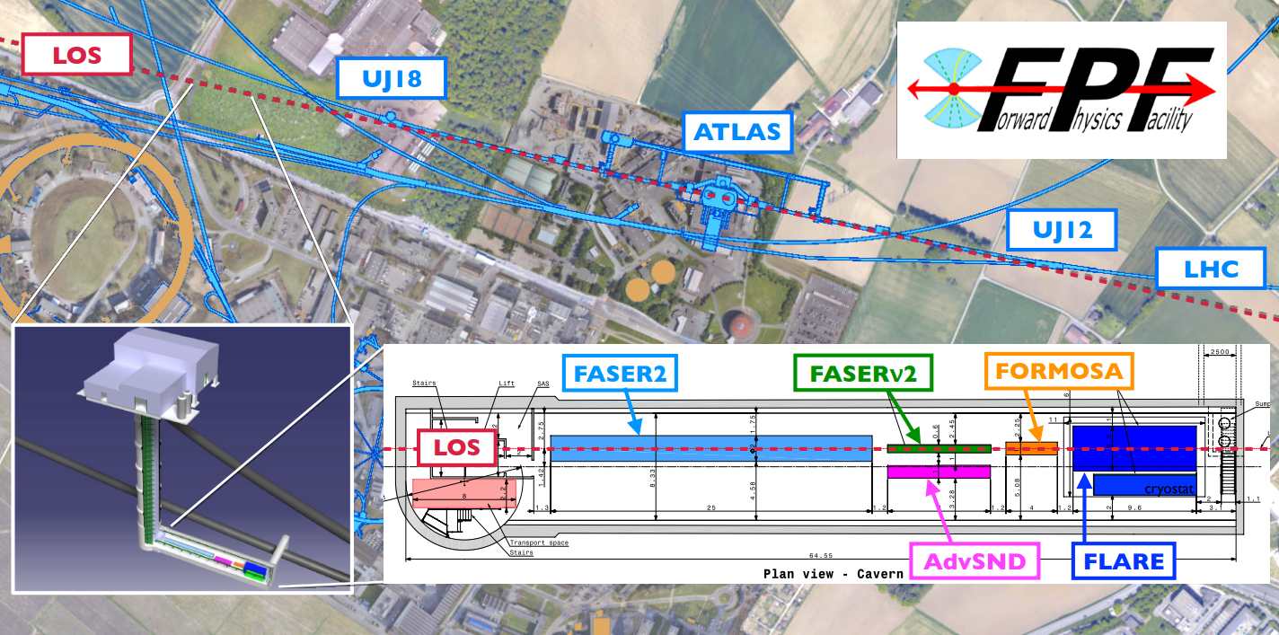
Forward Physics Facility
The Forward Physics Facility (FPF) for the HL-LHC is a proposed facility that could house a suite of experiments to enhance the LHC’s physics potential for BSM physics searches, neutrino physics and QCD
  The background μ rate may be reduced with a sweeper magnet
  O(10) ton neutrino experiments at the FPF would be able to collect O(10⁵) ν_{e}, O(10⁶) ν_{μ} and O(10³) ν_{τ} interactions
  More details in the FPF White paper: arxiv:2203.05090 and : PBC FPF

Slide 26
Conclusions
New era of collider neutrinos started!
FASERn and SND are the first neutrino experiments operating at a collider
  Beam at new kinematical regime, including 3 flavours
  Detectors with flavour sensitivity
  Exploring different pseudo-rapidity regimes, on & off-axis
Data taking of both experiments starting in 2022 for full exploitation during Run3 (2022-2025)
Future projects (FPF) at the HL-LHC are under discussion

