Slide 1
Recent Fermilab Neutrino beam operations
(Booster Neutrino Beam and Neutrinos at the Main Injector)
Katsuya Yonehara
NBI 2022, Abingdon, UK
September 19, 2022

Slide 2
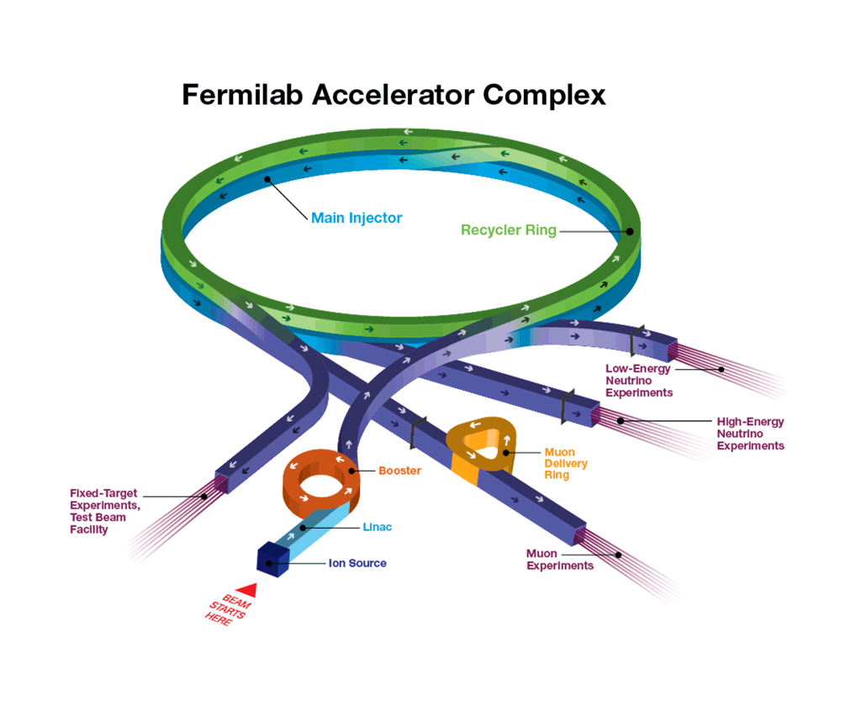
Fermilab Accelerator Complex and Neutrino lines
Tevatron (collider program) shut down in 2011
Proton-Improvement-Plan (PIP) has begun since 2011 to reprogram 8 GeV proton beam system for Muon campus (g-2 & Mu2e) and Booster Neutrino Beamline (BNB), and 120 GeV/c proton beam system for NuMI and Fermilab Test Beam Facility
Refurbish Linac and Booster for 15 Hz beam operation
Reoptimize Recycler ring and Main Injector
Accelerator Improvement Plan (AIP) issued since 2018 and ended 2022
Present available proton beam power 30 kW for BNB & 900 kW for NOvA

Slide 3
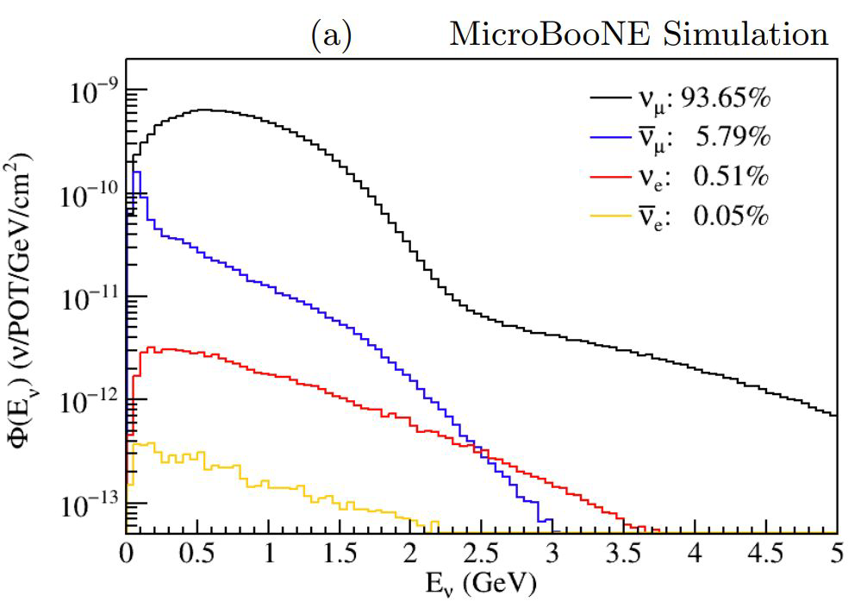
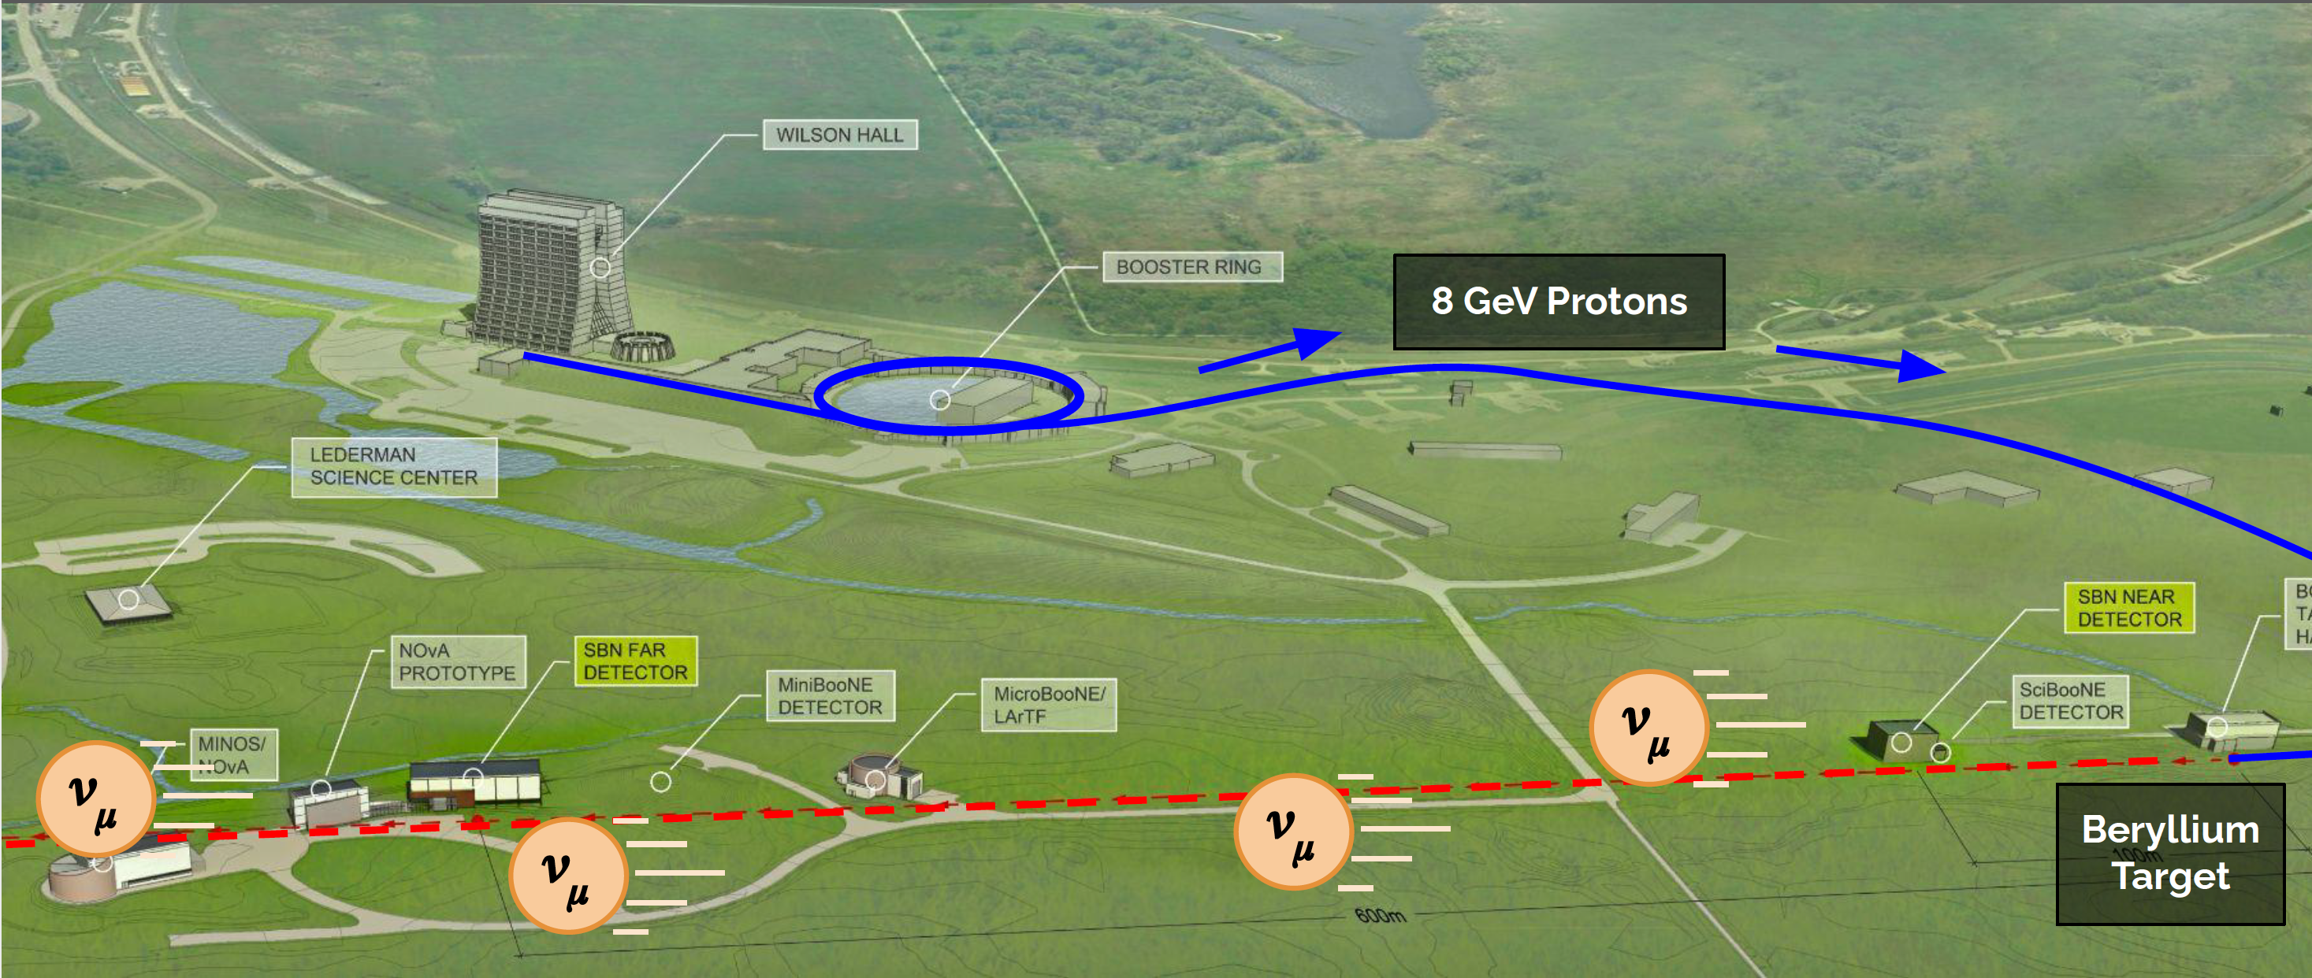
Booster Neutrino Beam (Utilize 8 GeV protons)
Up to ~30 kW of beam (5e12 ppp)
Anticipate to complete run in FY27
  Future running TBD
M.Ross-Lonergan
Phys.Rev.D 105 (2022)
11, 112005

Slide 4
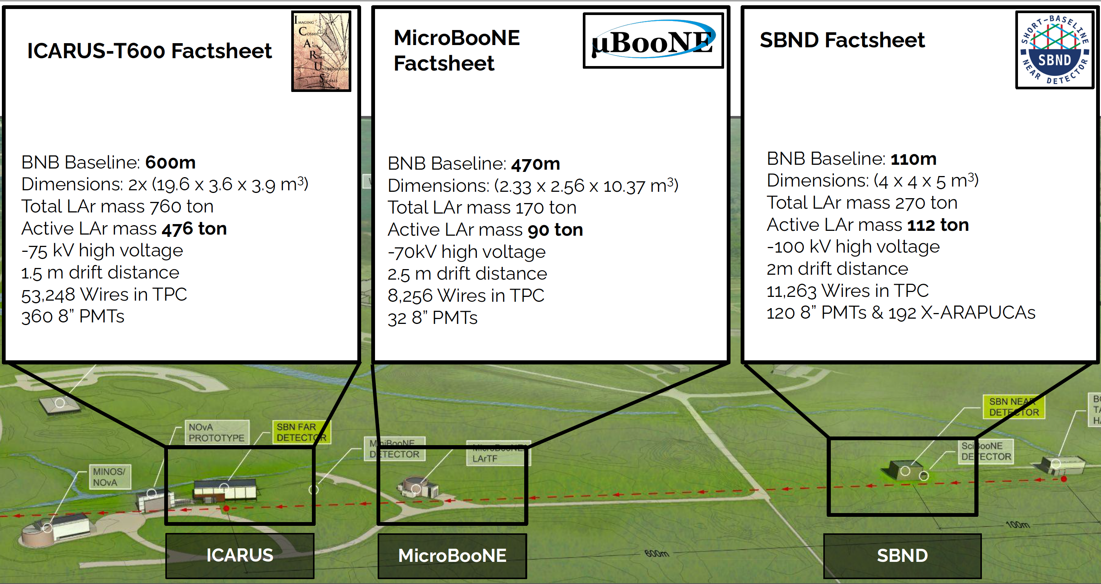
LArTPC detectors in BNB
M.Ross-Lonergan
Physics data with full CRT
begun June 2022
Collected data from 2015 to 2020
Largest sample of ν in LAr
Start from late 2023
SBND-PRISM similar as DUNE ND

Slide 5
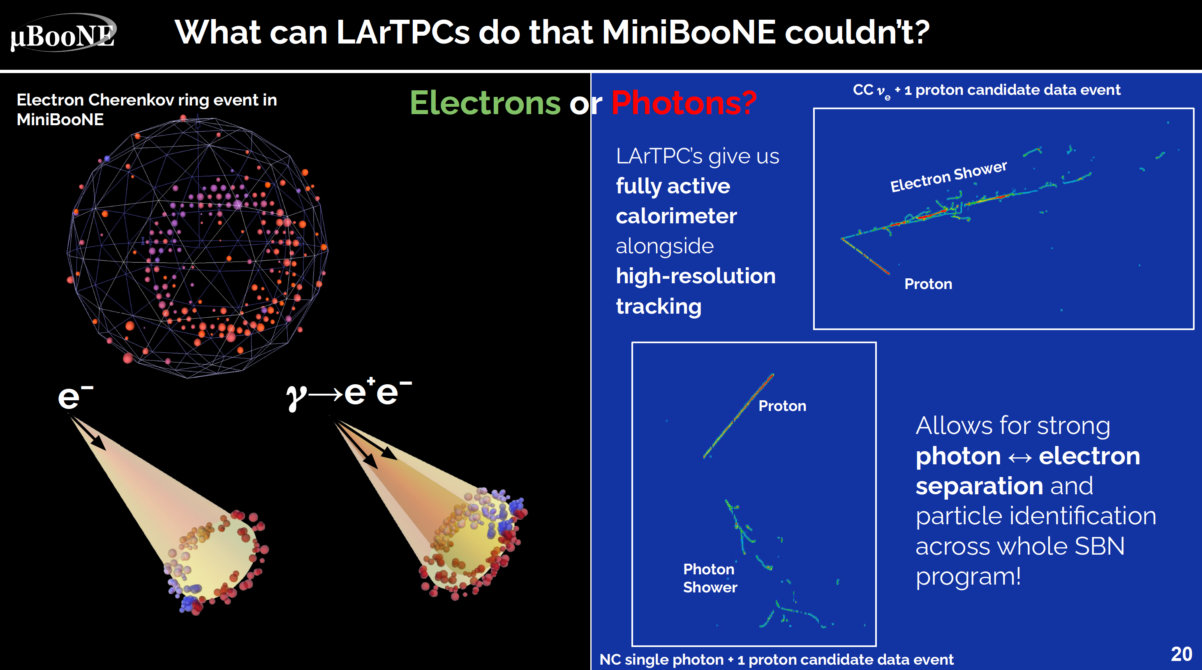
M.Ross-Lonergan
Low-energy excess researches and other exotic BSM physics
Improving our understanding ν-Ar interactions
LArTPC hardware and software R&D

Slide 6
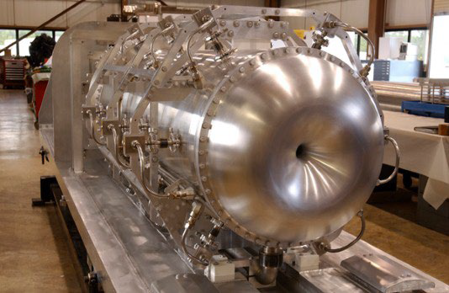
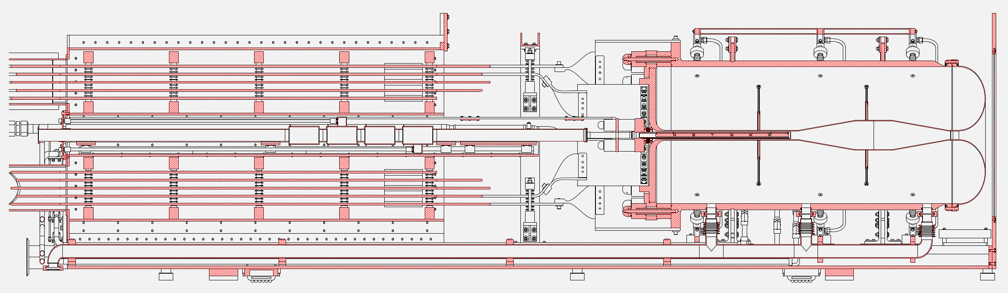
BNB target system
8 GeV proton beam
Two target/horn assemblies have been replaced (water)
  2nd horn lasted ten years and > 400M pulses Design lifetime was about one year and 100M pulses
  Requires to redesign and replace adjustor platform and horn extraction mechanism (corrosion)
3rd horn installed 2015 –still operating
4th horn complete and tested, undergoing minor upgrades
5th horn fabrication in progress

Slide 7
BNB Upgrades
T. Kobilarcik
Complete
  Horn Charging Supply has been upgraded to charge at 20 Hz, in anticipation of PIP-II era.
  Average repetition rate will remain at 5 Hz. Limit is joule heating in stripline.
  Protons limits (per pulse, hourly, yearly) have not been revised. This would require a detailed study of the target.
In progress
  “New” target multiwire
    1st wire worked well, 2nd and 3rd gens did not work well, thus it is back to the original design
  Remote disconnect for target BPM cables
    New design includes a “carrier pipe” for coax connecting BPM to front-plate of horn box. Allows for replacement of entire coax assembly.

Slide 8
NuMI Neutrino Beam to NOvA (utilize 120 GeV/c p)
NuMI (Neutrinos at the Main Injector) provides a high-quality neutrino beam to the NOvA (NuMI Off-axis ν_{e} Appearance) Near/Far Detectors (ND/FD)
Mission is creating high statistic and low systematic accelerator neutrino events in NOvA ND/FD
Anticipate to operate until FY27
K. ENGMAN/SCIENCE 345, 6204
J. Wolcott, FNAL JETP Seminar Sept. 18, 2020

Slide 9
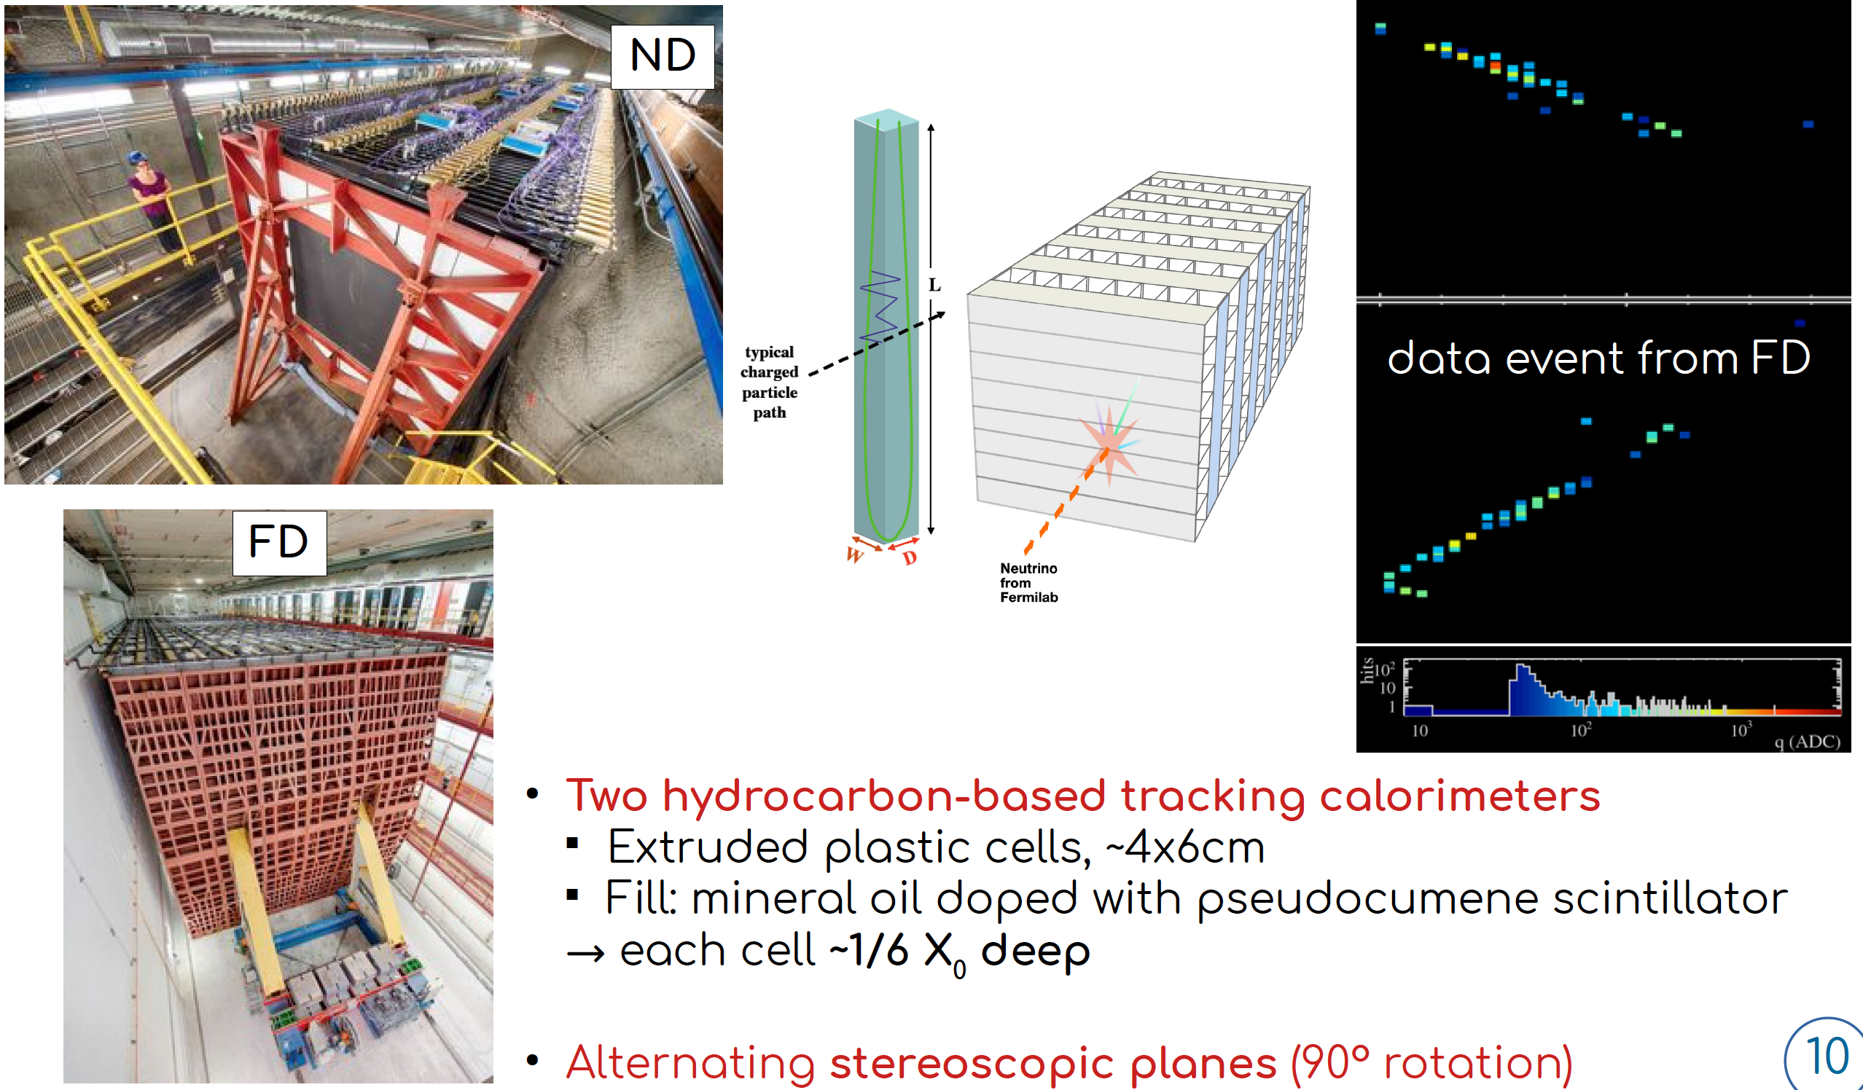
NOvA Neutrino Detectors
J. Wolcott
Same type of detectors used at ND and FD to mitigate systematics for oscillation measurements
ND also contributes to study the two ν_{μ} CC X-section measurement

Slide 10
NuMI Accelerator Improvement Plan
Present NuMI beam record 895 kW in July 2022
Absorber
NuMI beam parameter
Present target goal
Target
Main injector
Layout of NuMI target system

Slide 11
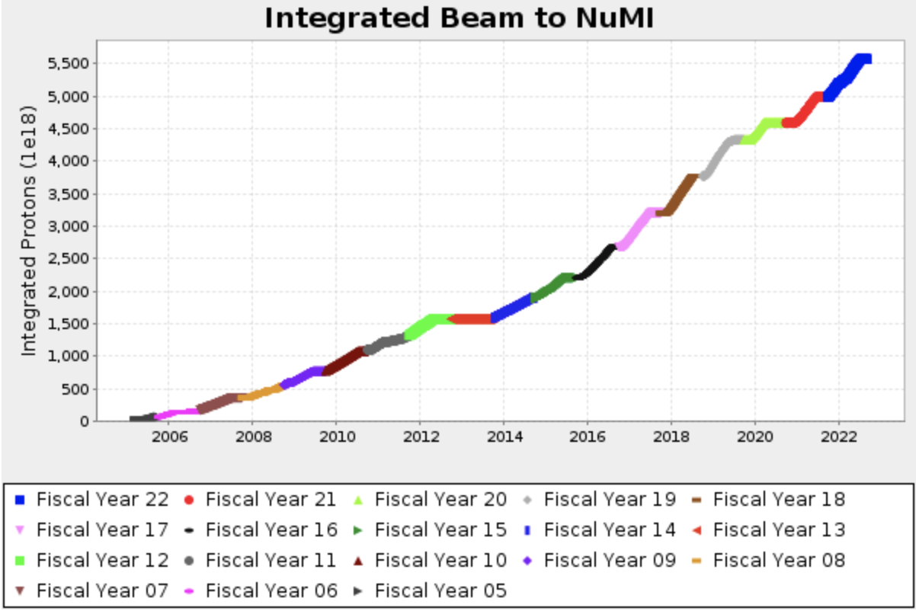
Integrated POT
700 kW
400 kW
900+ kW

Slide 12
After 2013 Upgrade
MET03
(POT 0.56E21)
700 kW TARGET
900+ kW TARGET
MET01
(POT 1.01E21)
“COVID 19”
MET02
(POT 1.18E21)
MET05
(POT 1.23E21)

Slide 13
Inventory of NuMI target system
MET-05: Total POT 1.23e21 for 3-years operation, no issue
MET-06: Installed in the 2022 summer shutdown
MET-07: Fabrication in progress
PH1-03: Total POT 2.36e21 for 5-years operation, replaced in 2020 to upgrade 1-MW capable horn
PH1-04: spare, 700 kW capable
PH1-05: 1-MW horn using now, Total POT 1e21 for 2-years operation
PH1-06: spare
PH2-02: Total POT > 5e21 for 12-years operation, replaced in 2020 due to water leak
PH2-04: use now, total POT 1e21 for 2-years operation
PH2-03: spare

Slide 14
1-MW horn
Peak horn current 200 kA, 2.3 ms (half sin wave)
Convectional air flow on a stripline for 1-MW through air-diverter
Air flow
Beam
Air diverter
Downstream end

Slide 15
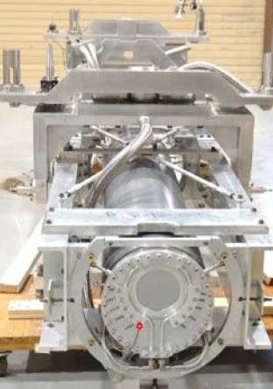
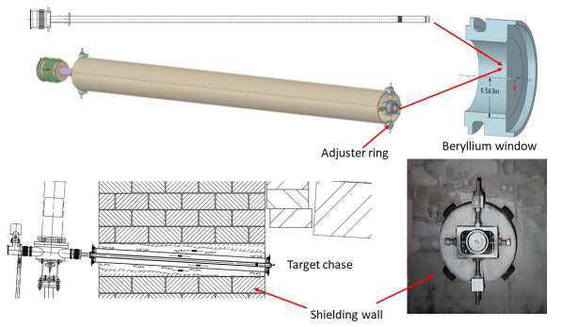
Tune NuMI beam optics
NuMI target
Study 900+ kW beam lattice in the NuMI beam transport line
  Enlarge RMS beam spot size at the NuMI target from 1.2 to 1.4 mm to mitigate thermal impact on the system including target fin, pretarget Beryllium window, and DS Beryllium window
Beam position
DS Be window
Pretarget window

Slide 16
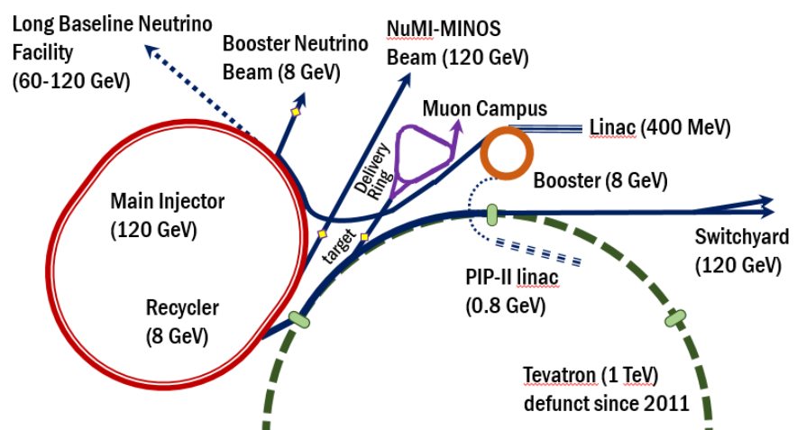
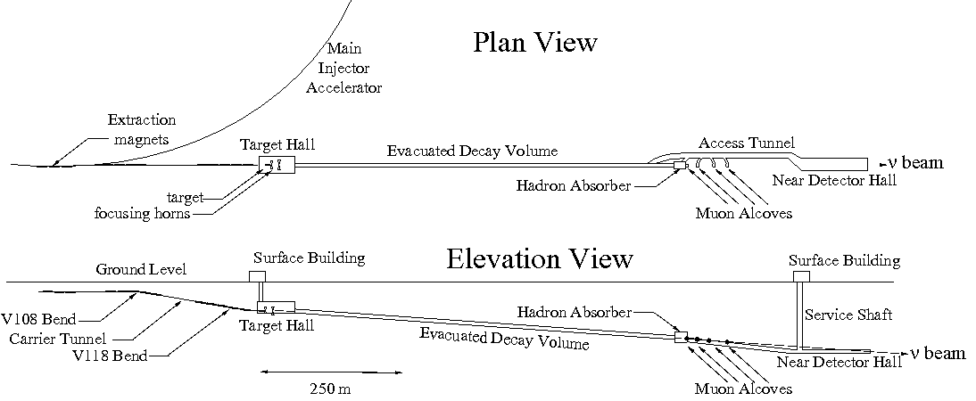
NuMI beam transport line (from MI to Target)
Deliver 120 GeV/c protons from MI every 1.2 second by fast extraction
Each beam spill contains 6 batches in 10 μsec
Maximum average beam power 896 kW (5.6e13 protons/spill)
Total length of the transport line is 360 m
  17 dipole magnets
  21 quadrupole magnets
  19 steering magnets
Beam directs downward by 58 mrad at the target

Slide 17
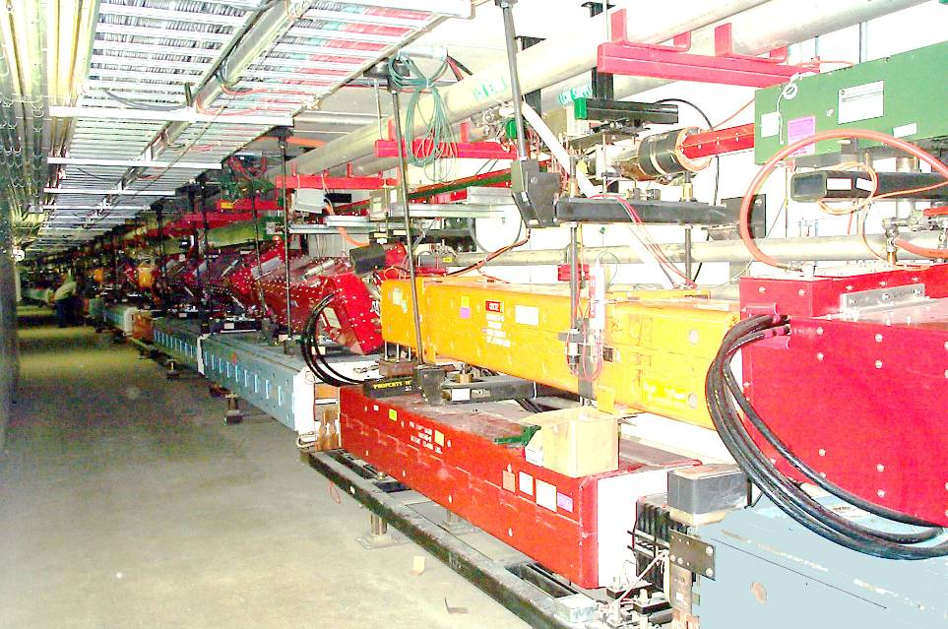
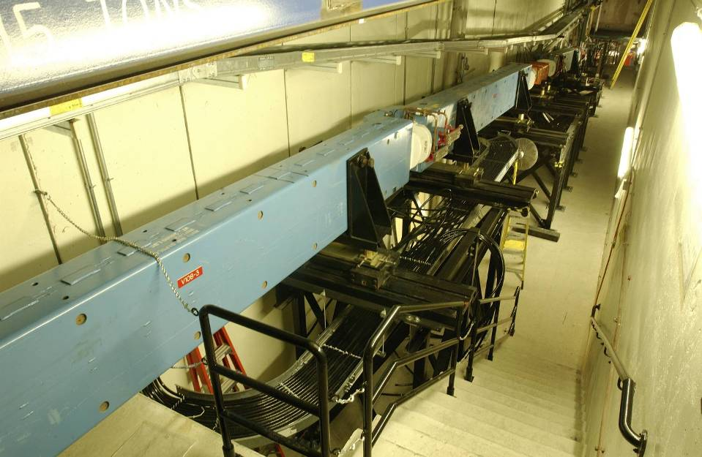
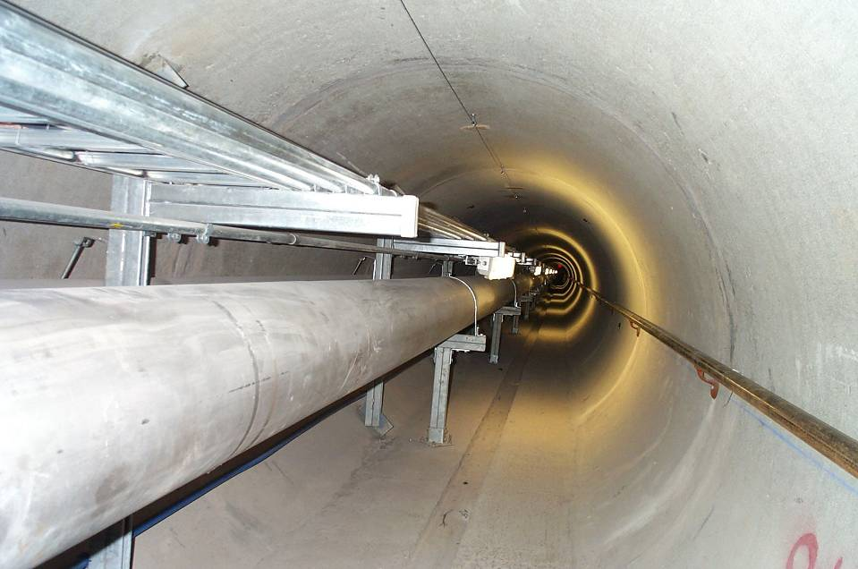
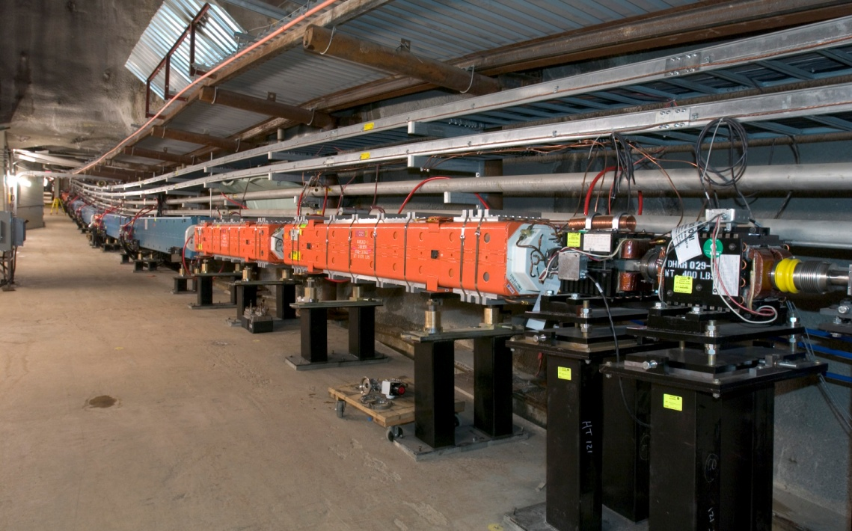
NuMI beam transport line
RR
proton
NuMI
proton
Bending downward by 156 mrad
MI
Extraction
Carrier tunnel
Bending beam to the correct vertical angle 58 mrad
proton
proton

Slide 18
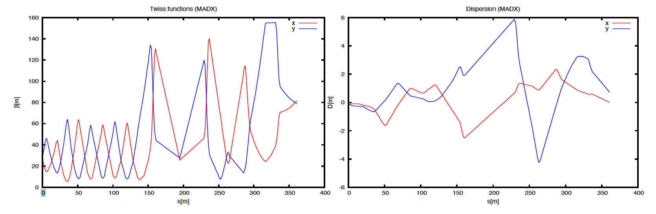
Beam lattice
Matching
Collins insert
FODO
Final focusing
Matching: Match the beam into the straight line
FODO+Insert: Prepare beam for the final focusing
Final Focusing: Low dispersion and beta at the target

Slide 19
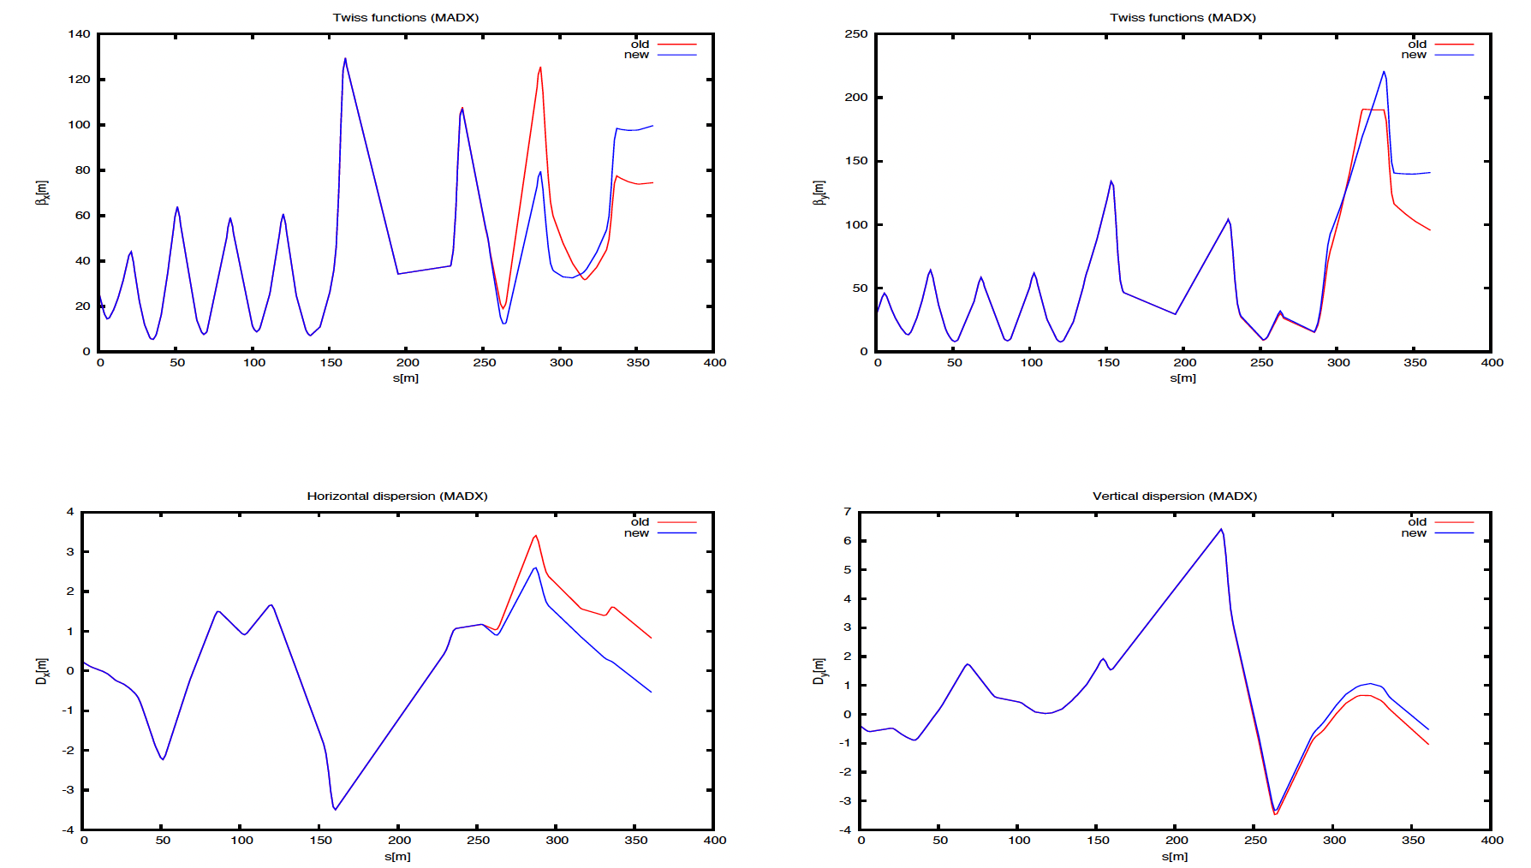
Proposed optics (Simulation)
Quad current list (unit Amp)
Horizontal β, Disp.
Vertical β, Disp.
Red: Present
Blue: Option2
QF: Quadrupole Focusing in horizontal plane
QD: Quadrupole Defocusing in horizontal plane
Number: Location (bigger is closer to the NuMI target)
Option 1 is lower current strength but dispersion at the target is non-zero
Option 2 is higher current but dispersion at the target is close to zero

Slide 20
Observed Horizontal Beam spot size at PM121 and PMTGT
beam
PM121
PMTGT
PM121 (z=20 m)
PMTGT (z=10 m)
TGT (z=0 m)
Horizontal beam spot size (mm)
option 2
option 1
present
Measurement shows that the beam spot size is enlarged with both options

Slide 21
Observed Vertical Beam spot size at PM121 and PMTGT
PM121
PMTGT
Vertical beam spot size (mm)
option 2
option 1
present
Measurement shows that the beam spot size is enlarged with both options
Beam diverging larger with option 1 than option 2
option 2 is more preferrable than option 1

Slide 22
Strategic plan for NuMI beam commisioning
When do we apply the new optics?
  Prefer to use the present optics for the target scan since the resolution of target scan is better by using smaller spot size beam
  Prefer to use option 2 at the beginning of HEP beam operation
    Need to make sure that Quads and PSs are stable at high current operation
Target system is ready for 900+ kW operation in FY23!
  I heard that the MI group is ready for the 900+ kW beam operation, too
    Beam intensity will exceed 5.6e13 (until 6.2e13 (1-MW))

Slide 23
Future beam power upgrade plan
PIP-II SRF Linac + 20 Hz Booster for 1.2 MW (2025? -)
PIP-II SRF Linac + New accelerator system (SRF Linac or Fast ramp RCS) for 2.4+ MW (203X -)
Booster
PIP-II SRF linac
PIP-III RCS
PIP-III SRF linac

Slide 24
Fast Ramping RCS at Fermilab
Integrable optics has a potential to compensate a space charge: The concept has been tested at Fermilab Accelerator Science and Technology (FAST)
If success, we will have a solution to accelerate a 5-MW scale beam in PIP-III RCS
Integrable optics magnet in FAST
Demonstrate prototype fast
ramp HTS at Fermilab (12 T/s)
IOTA/FAST https://fast.fnal.gov/?p=papers
H. Piekarz, NIMA 162490 2019

Slide 25
Summary
Fermilab has successfully operated BNB and NuMI beams for neutrino programs
BNB and NuMI beam elements have been upgraded continuously
Highest NuMI beam power record 895 kW
Future prospect for higher beam power operation
  Optimize NuMI beam optics
  Understand radiation damage on beam element
  Apply AI for beam permit and target anomaly detection
  Study new muon monitor to extract further neutrino information
In this talk
RaDIATE
Yiding on Tue

