Slide 1
T2K / J-PARC status
T. Nakadaira
High Energy Accelerator Research Organization (KEK)
IPNS / J-PARC
for
T2K collaboration
J-PARC neutrino facility

Slide 2
Contents
Overview of J-PARC and J-PARC neutrino facility
J-PARC Accelerator status
Operation status of J-PARC neutrino facility
Recent T2K physics results & Prospects
Future Project: Hyper-Kamiokande

Slide 3
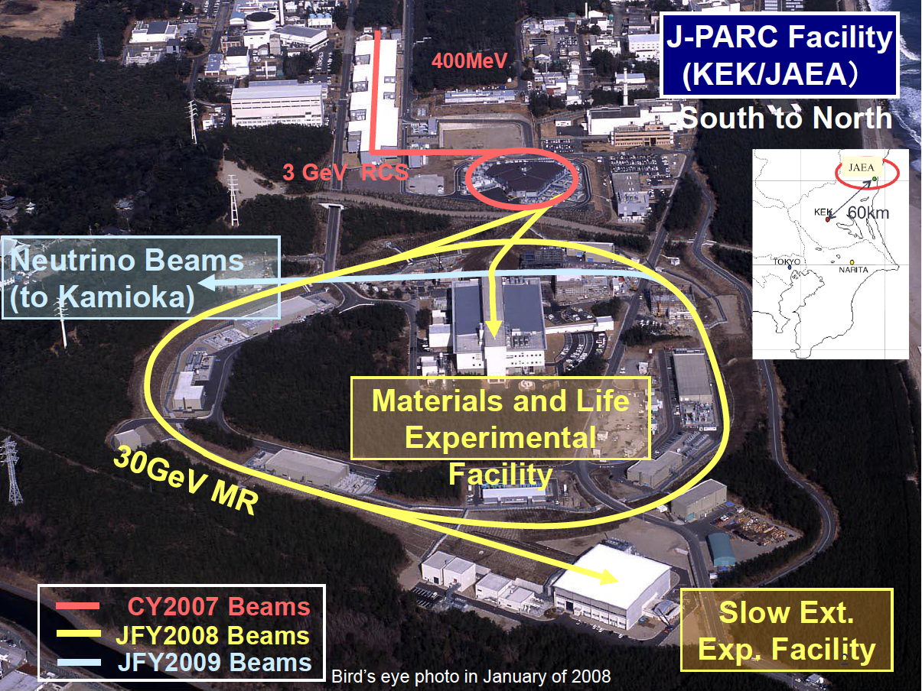
J-PARC: Japan Proton Accelerator Research Complex
3 accelerators and 3 experimental facility

Slide 4
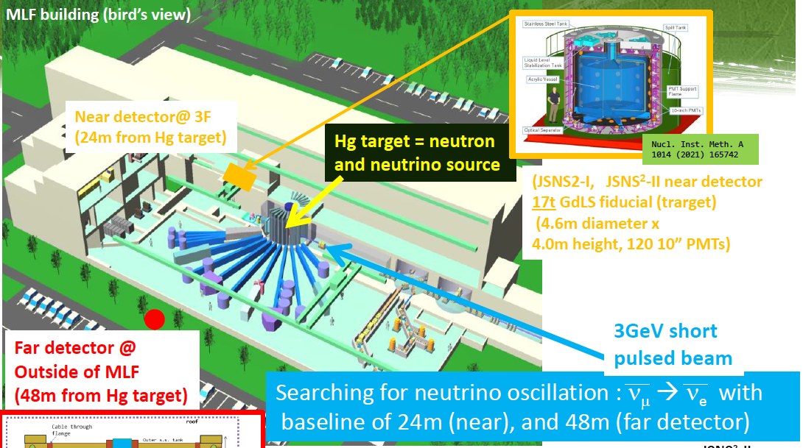
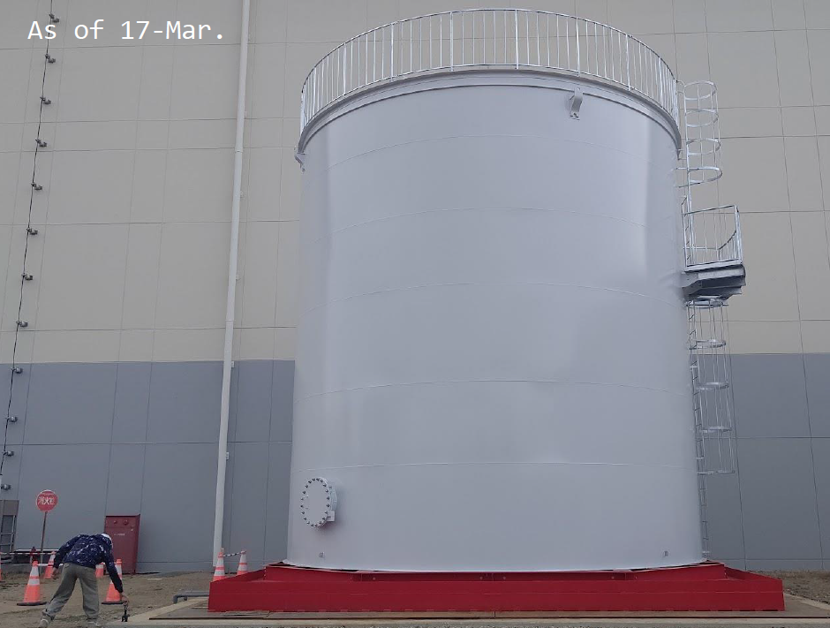
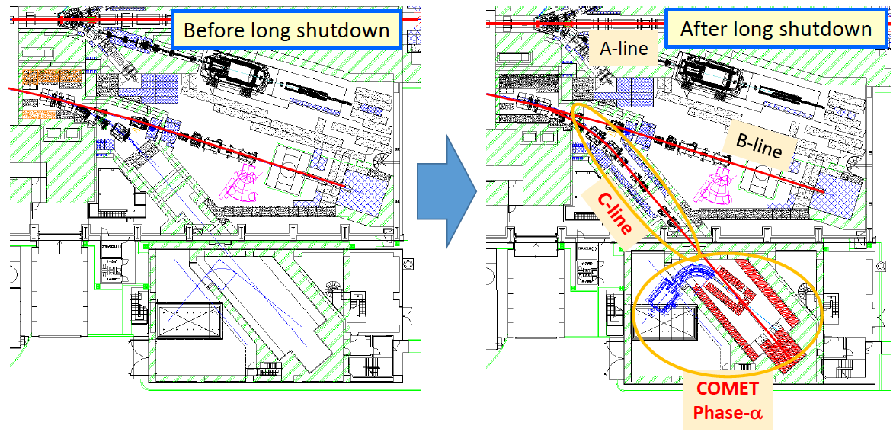
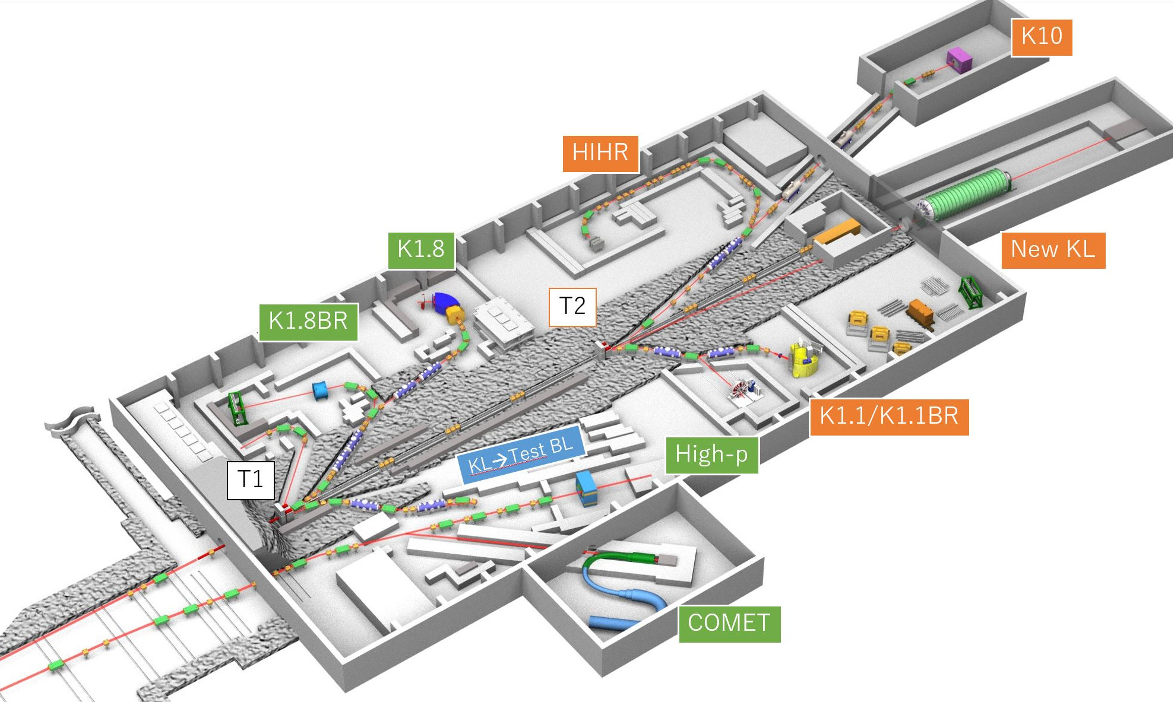
Experimental Facilities @ J-PARC
MLF: Material & Life science
JSNS²(E56: Short-baseline neutrino experiment) is running.
JSNS²-II (E82: w/ 2nd detector) is under preparation. T. Maruyama @ 34th J-PARC PAC
Hadron experimental Facilities
COMET (E21) experiment is about to start!
Hadron hall extension : high-prioritized project in KEK-PIP 2022.

Slide 5
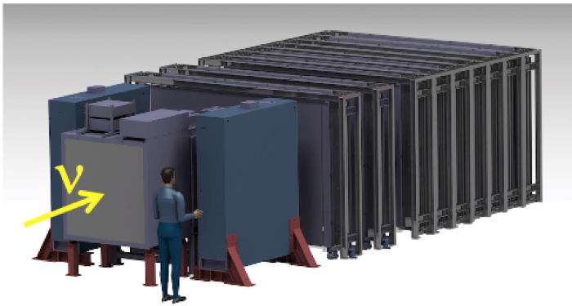
J-PARC neutrino experimental facility
High intensity neutrino beam by MR-FX 30GeV protons for Long base-line neutrino experiments: T2K (E11/E65) and Hyper-K.
Operation start @ 2009: Original design
750 [kW]: 3.3×10¹⁴ [p/pulse], Repetition 2.1[s] → Upgraded goal: 1.3 [MW] 3.3×10¹⁴ [p/pulse], Rep. 1.16[s]
T2K near detectors
NINJA (E71): Running
SUBMET (P83:)
Neutrino Near-detector hall
E69/T2K WAGASCI
E71 Emulsion
MR

Slide 6
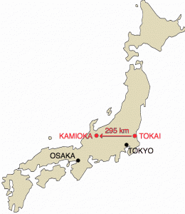
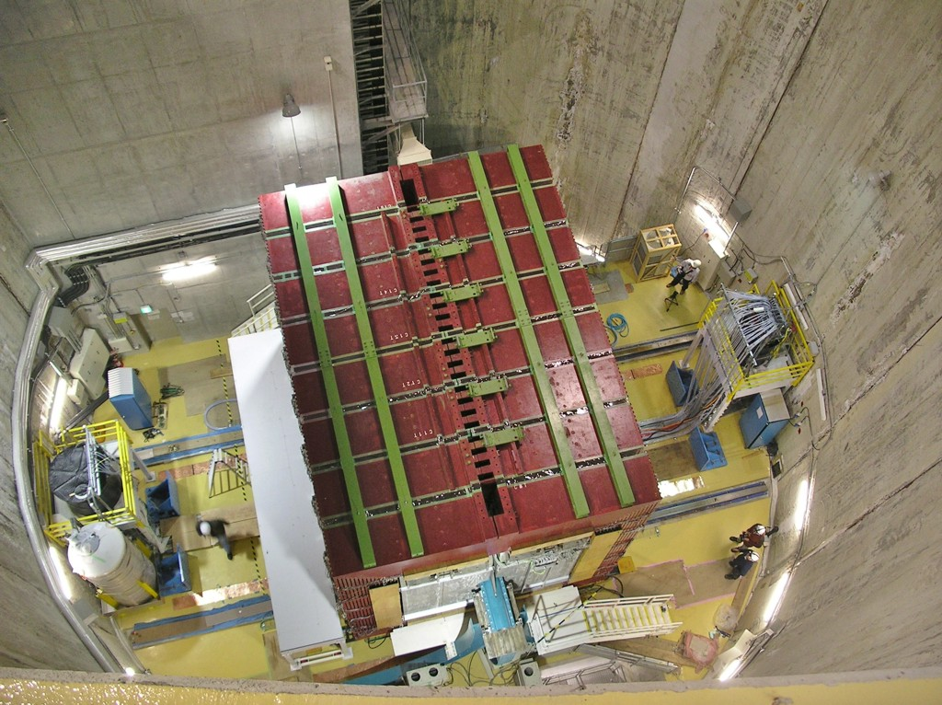
T2K: LBL neutrino oscillation experiment
Physics goals
Search for the new neutrino oscillation: ν_{μ}→ν_{e} (~2013)
Search for CP violation in lepton sector (2014~)
~528 members, 70 Institutes, 14 countries

Slide 7
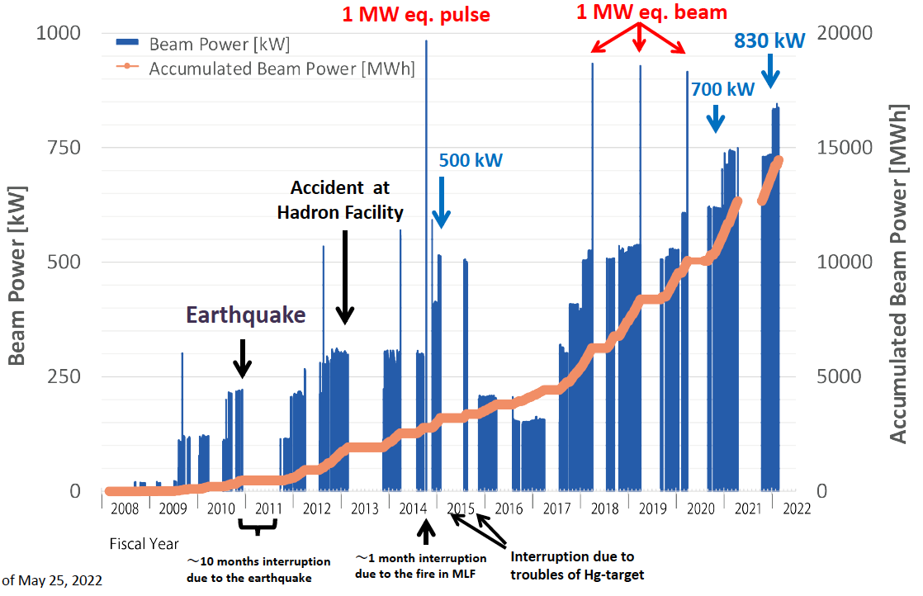
J-PARC Accelerator status: LINAC+RCS
RCS beam power to MLF (Design: 1MW) → 830kW stable beam has been achieved!

Slide 8
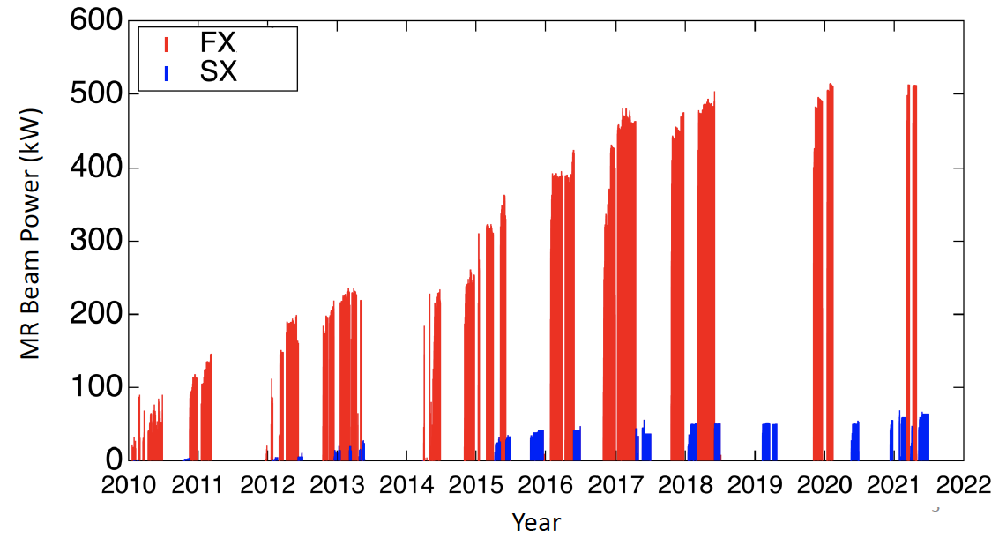
J-PARC Accelerator: MR beam power
~510kW for NU/FX user
2.6×10¹⁴ proton/pulse w/ 2.48s repetition .
~65kW for HD/SX user
Extraction efficiency of 99.5%

Slide 9
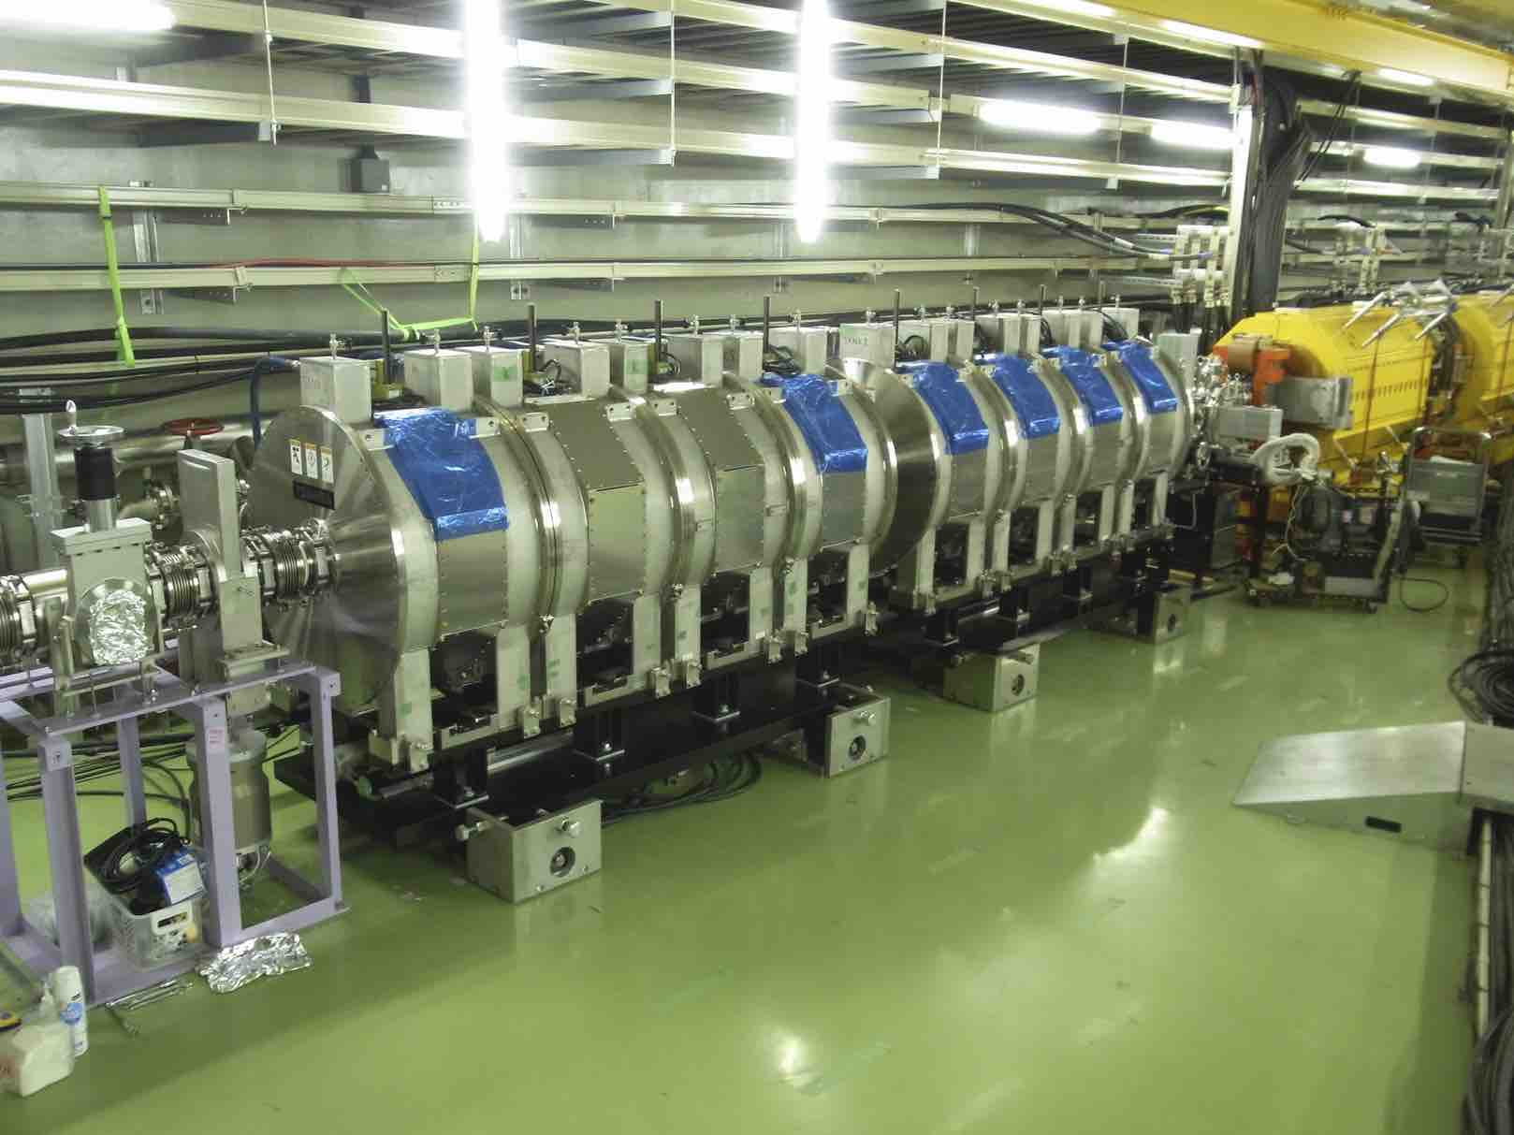
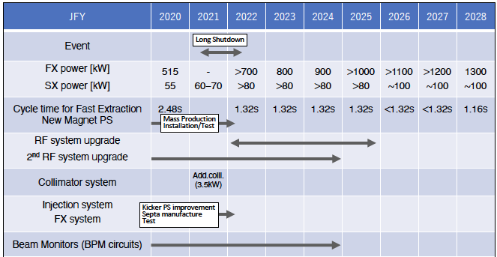
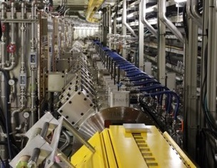
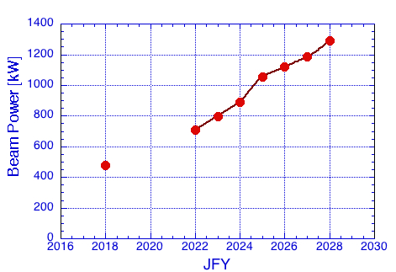
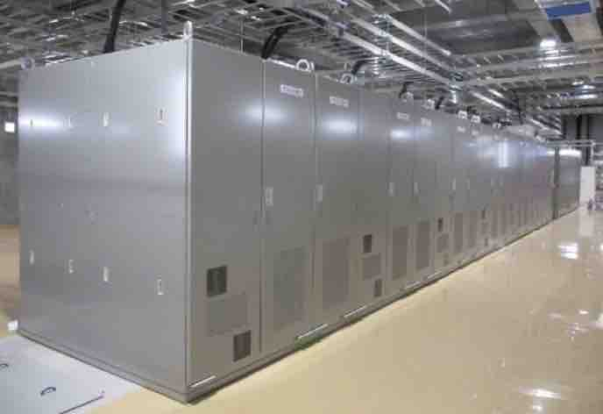
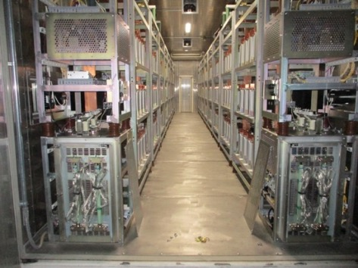
J-PARC MR Mid-term plan
RF system
① Magnet PS upgrade
2.48 →1.32 s cycle
④ 1.32 →1.16 s cycle
③ RF system upgrade
② 2nd harmonic RF cavities
2022 June: Beam circulation (3GeV-DC)
2022 Nov.: 30GeV acceleration commissioning.
New power supply
Capacitor bank

Slide 10
J-PARC MR-FX Beam structure
Operation rate of beam-line equipment should be increased.
Horn, Beam-monitor DAQ, Beam interlock, etc
Target protons/pulse is same as J-PARC original design. → Requirement for a single spill is not changed.
Thermal shock tolerance of target, beam window, etc
Beam heat load, Radiation, Radio-activation will be increased w.r.t beam power or POT.
Cooling capability, radiation shields, radioactive waste treatment, etc
Bunch width 20~40 ns (FW)
Bunch interval 581ns (RF=1.72MHz)
8 bunches / pulse
pulse width ~4.5μs
3.1×10¹³ [p/bunch] = 150 [kJ/bunch] (now) → 4.1×10¹³ [p/bunch]
= 200 [kJ/bunch] (upgrade)
2.5×10¹⁴ [p/pulse] = 1.2 [MJ/pulse] (now)
→ 3.3×10¹⁴ [p/pulse]
= 1.6 [MJ/pulse] (upgrade)
2.48s → 1.16s

Slide 11
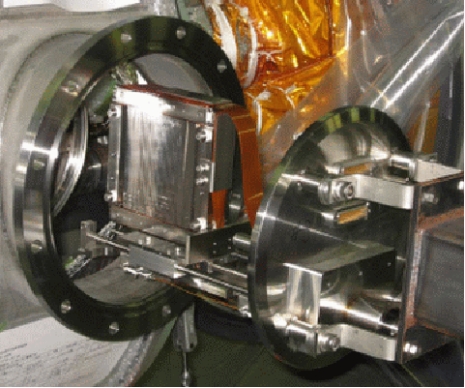
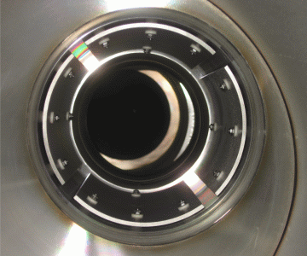
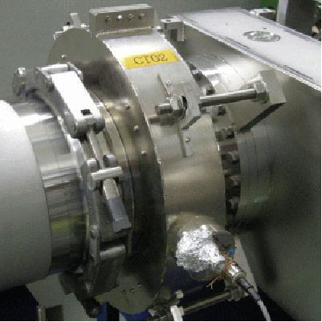
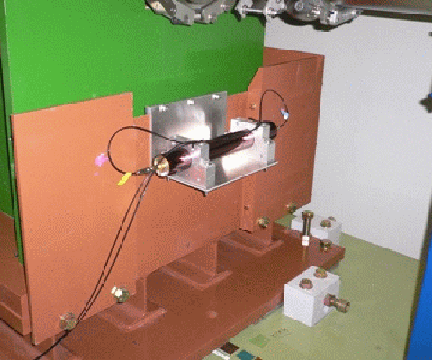
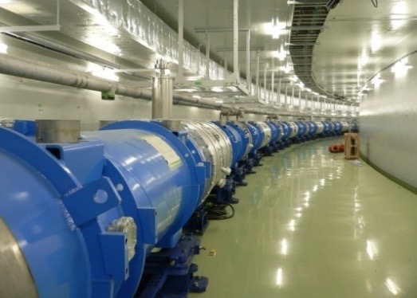
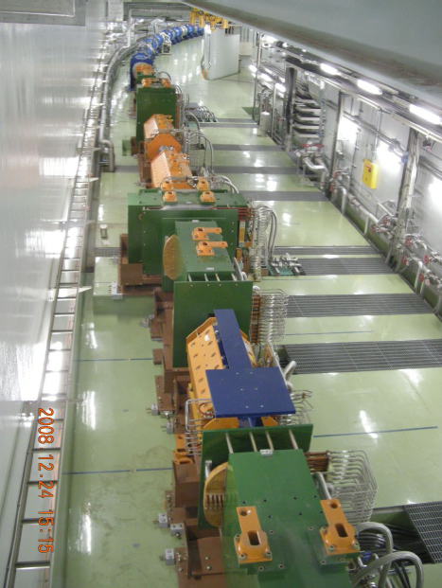
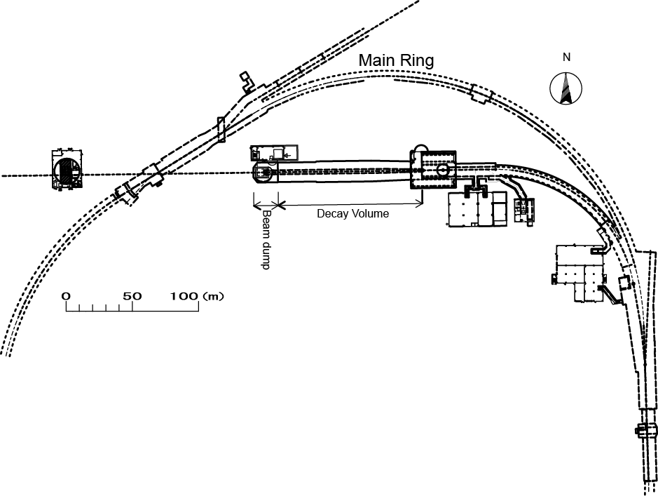
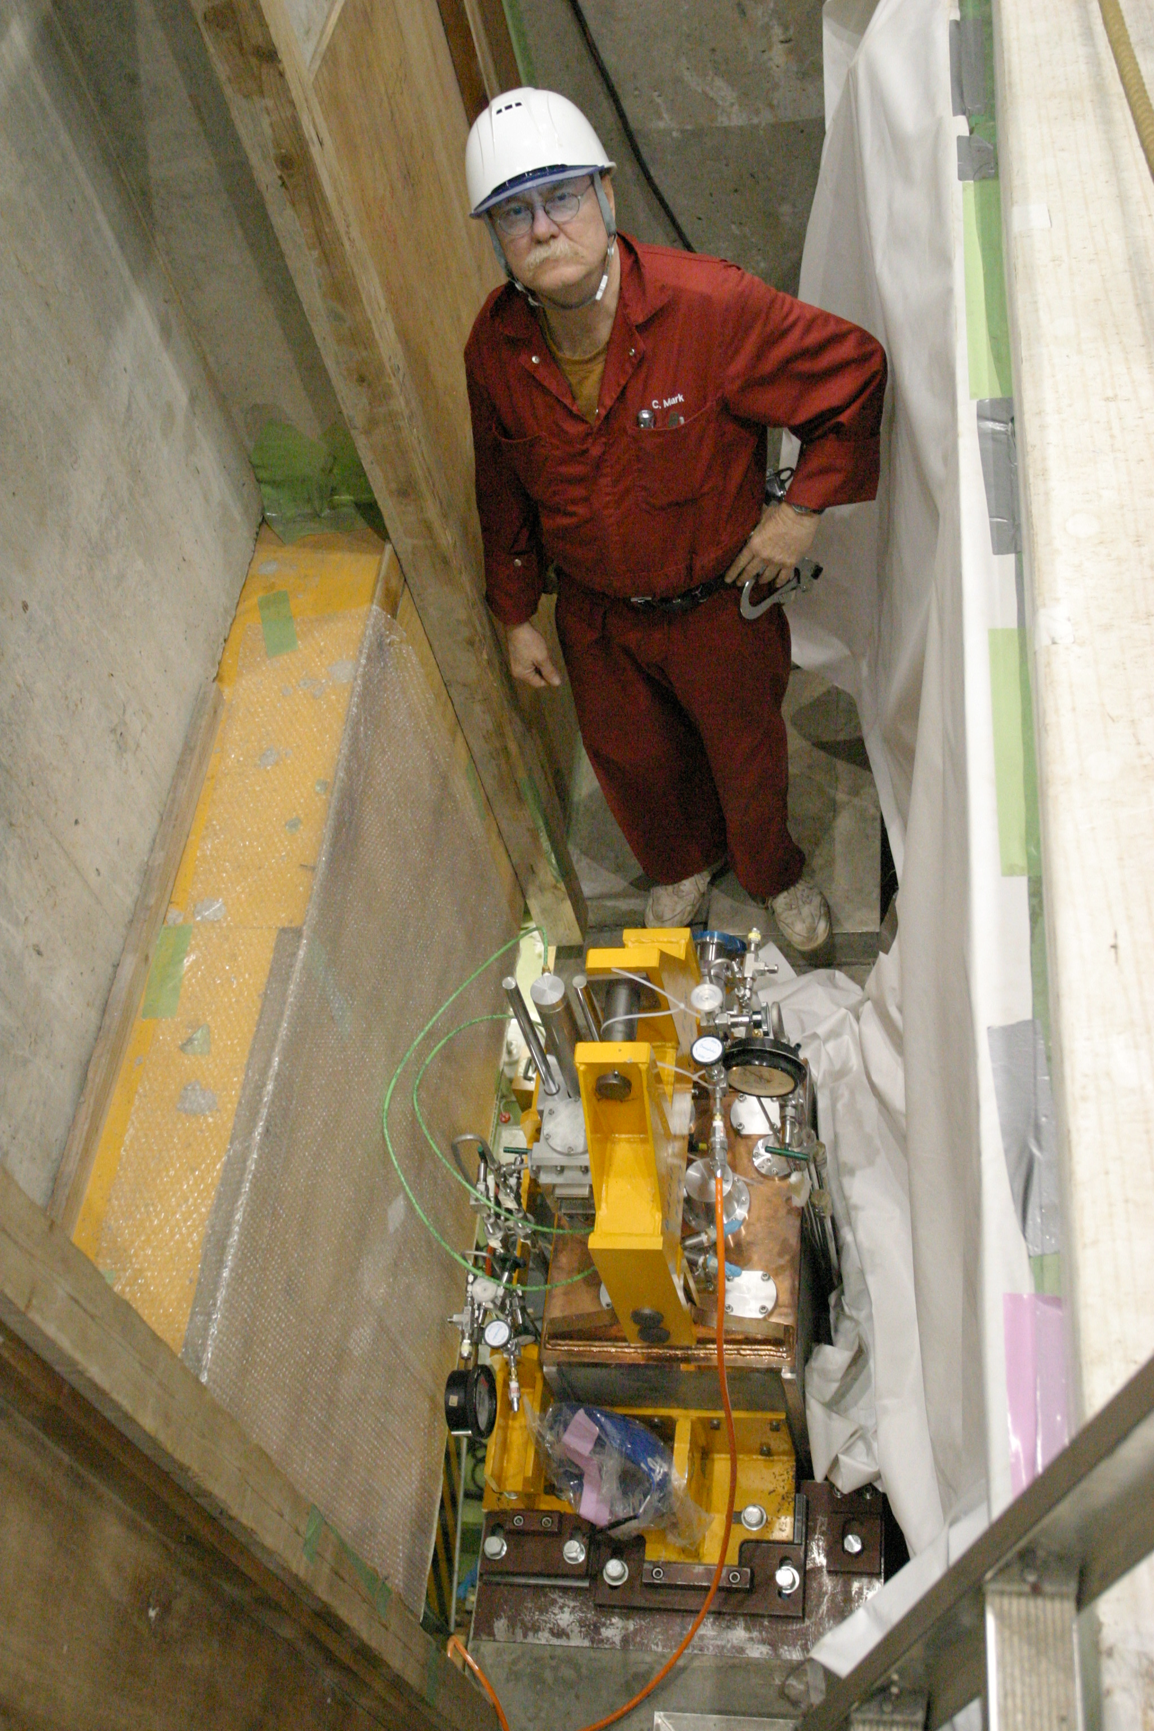
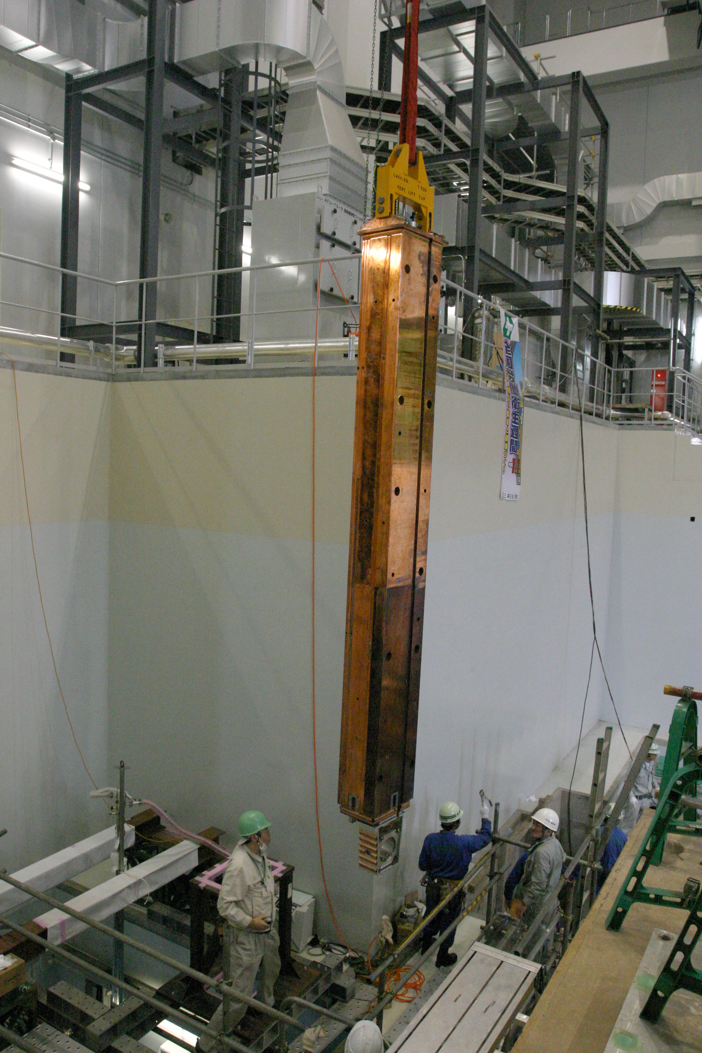
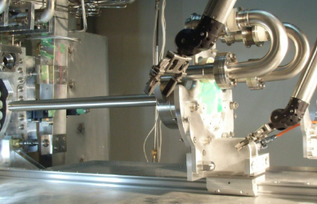
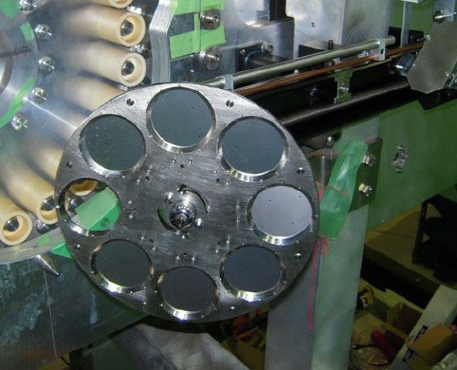
J-PARC ν beam line :Primary-line
Beam monitors are install along the proton beam transport
Primary proton
transport line
Profile (19)
Position (21)
Intensity (5)
Beam loss (50)
Super-conducting combined-function magnets
Target
Normal-conducting
magnets
×
Beam
Target :graphite rod
φ26mm,L=900mm
Optical Transition Radiation (OTR) Profile monitor
Vacuum chamber and structure
for most downstream beam monitors

Slide 12
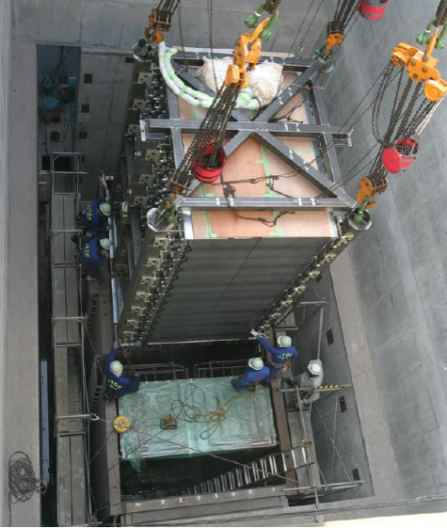
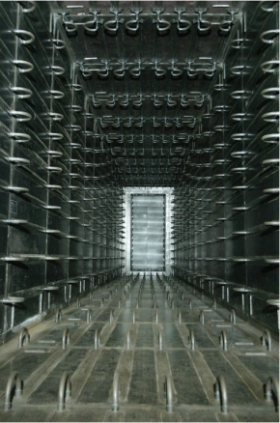
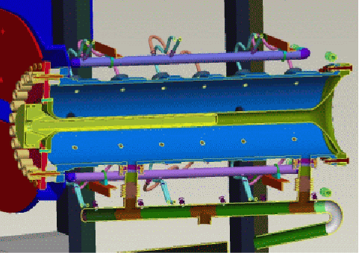
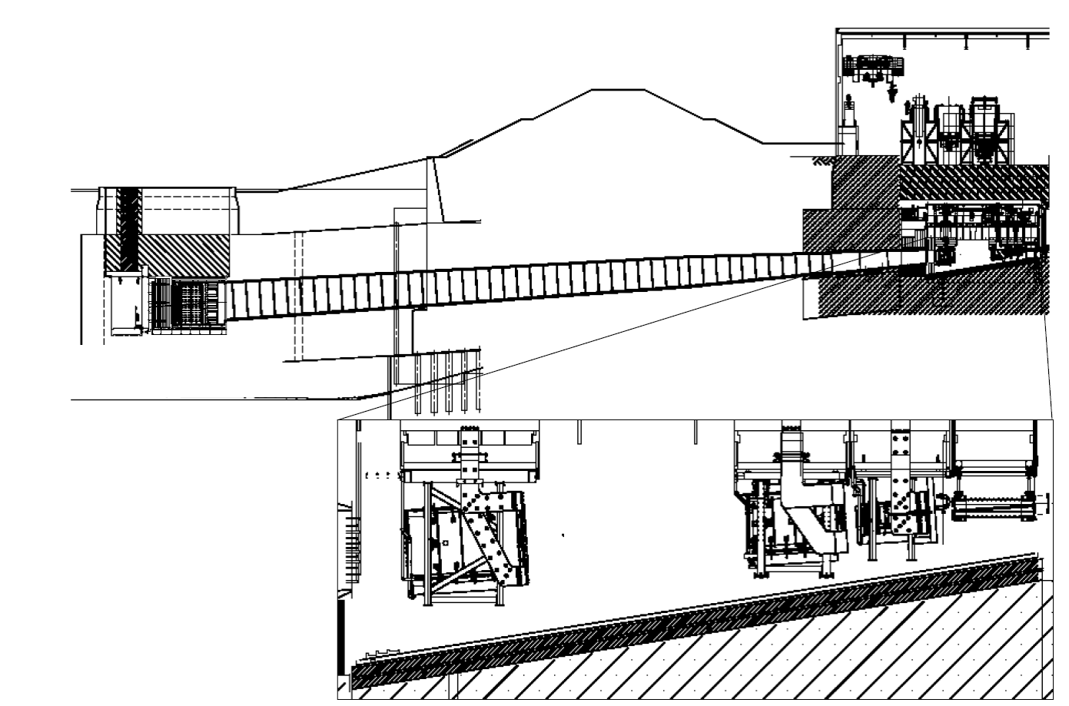
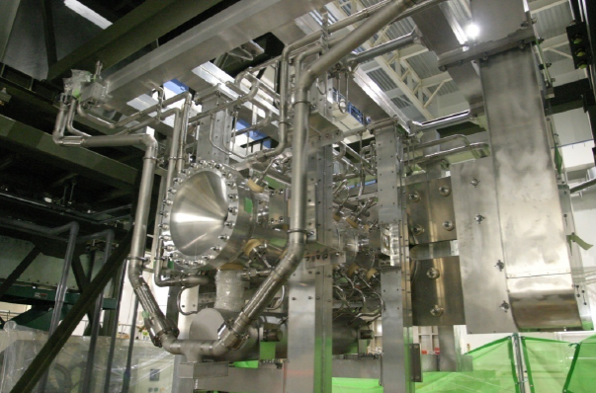
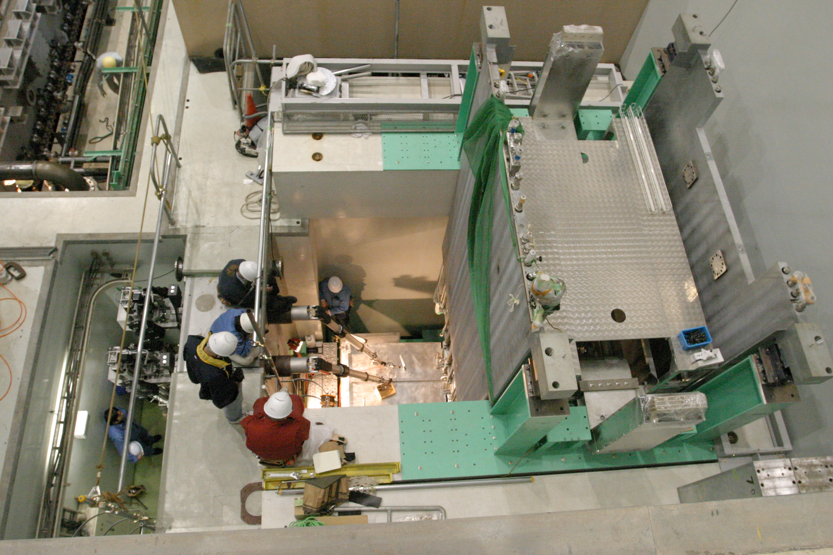
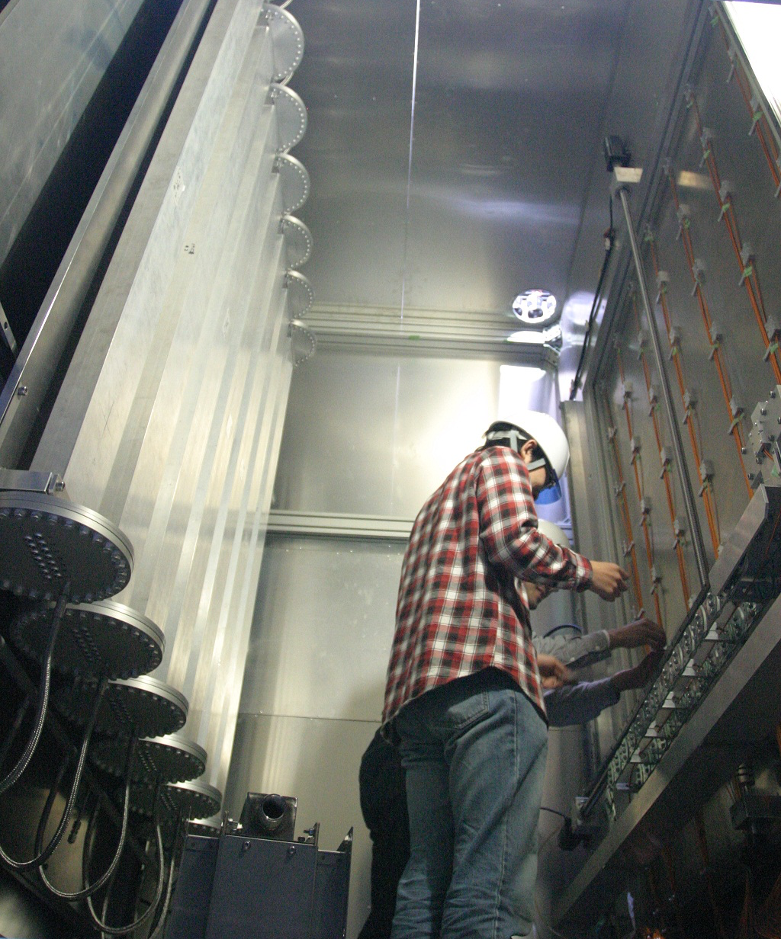
J-PARC ν beam line: secondary line
Near Detector
Target
m⁺
p⁺
n_{m}
Beam dump
109m
Decay volume (He gas filled)
Target installed in 1st horn.
p⁺
m⁺
n_{m}
Target/Horn Remote Maintenance area.
Muon monitor
p⁺
´
p
Pions are focused by 3 electromagnetic Horns.

Slide 13
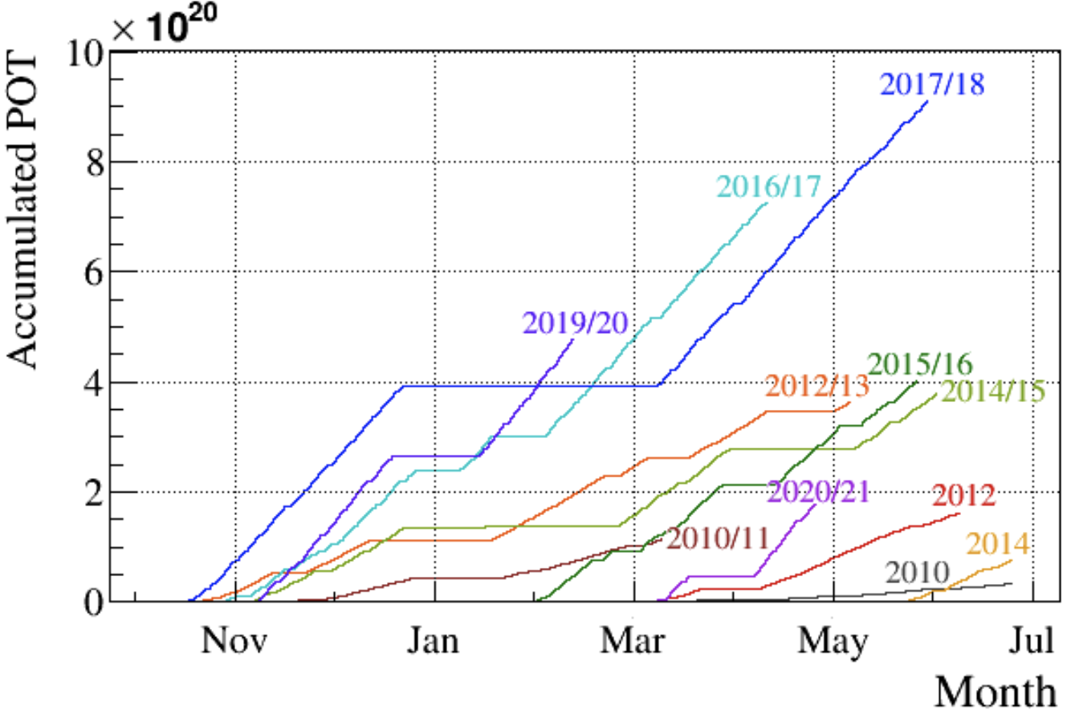
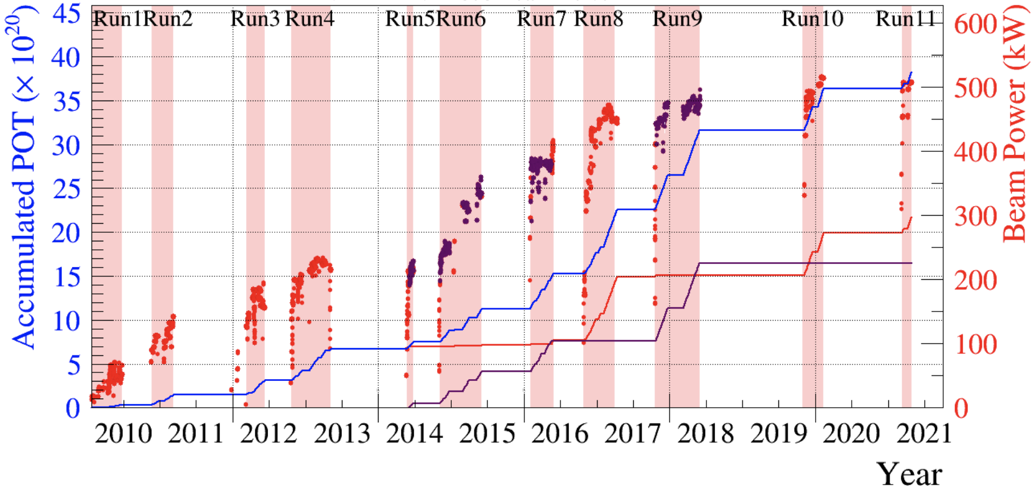
Operation history
>510kW stable neutrino beam is achieved.
Total: 3.82×10²¹ POT

Slide 14
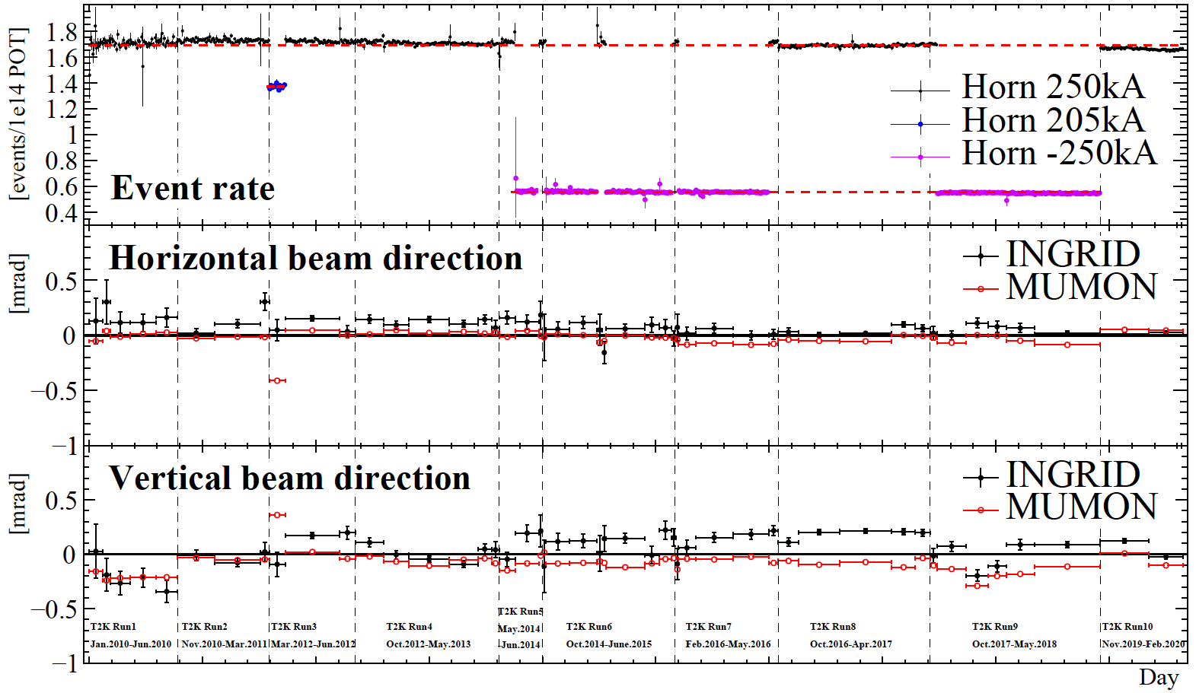
Neutrino beam stability
We have successfully tuned neutrino beam direction within << 1mrad.

Slide 15
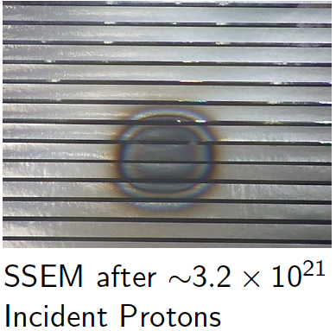
Operation & maintenance history
J-PARC ν-beam-line equipment has survived up to 2~3×10²¹ POT!
J-PARC MR Long shutdown
T2K
(~2026)
Additional
>6×10²¹ POT
expected
2023~
MR
cycle
3.5s 3.2s
2.56s
2.48s
1.36s→ 1.16s
Target-1
Target-2
Target-3
OTR-1
OTR-2
OTR-3
~6.7×10²⁰ POT
~3.2×10²¹ POT
Horn ver.1
Horn ver.2
H1,H2 ver3
H3 ver2
~2.3×10²¹ POT
Beam window-1
BW-2
1.6×10²¹ POT
SSEM 19 foil
Horn
current
250kA by 2 power supplies
320kA by 3 PSs

Slide 16
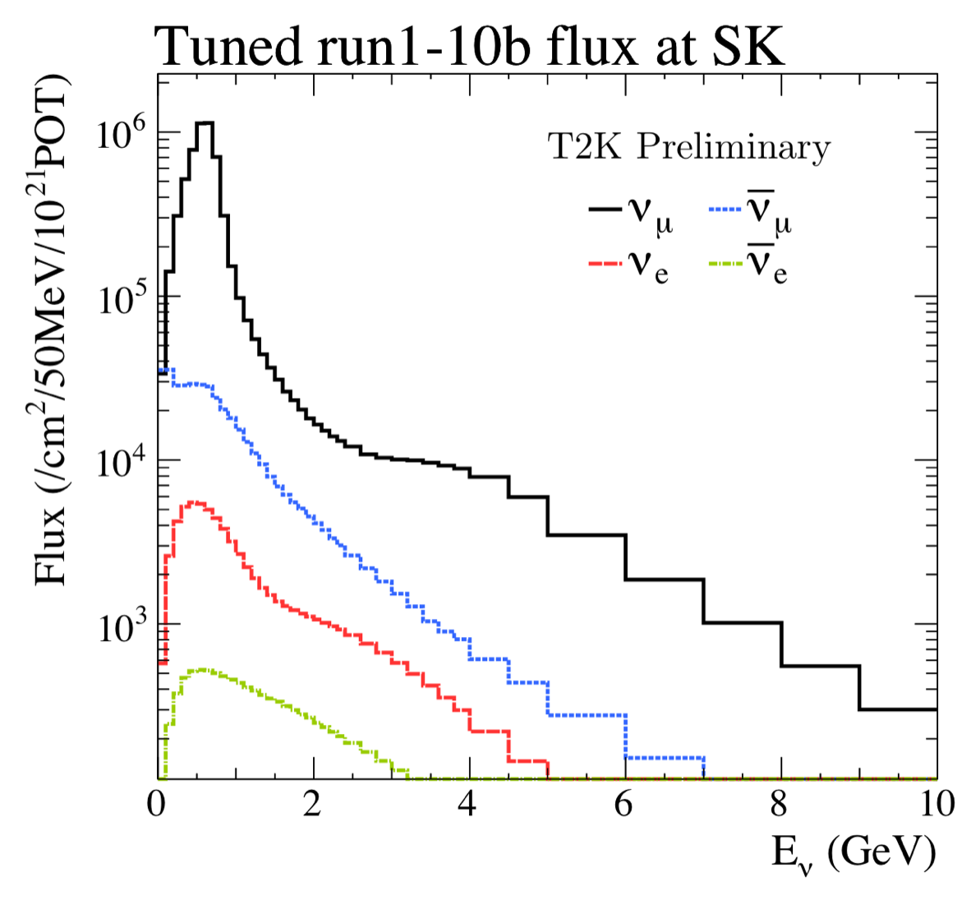
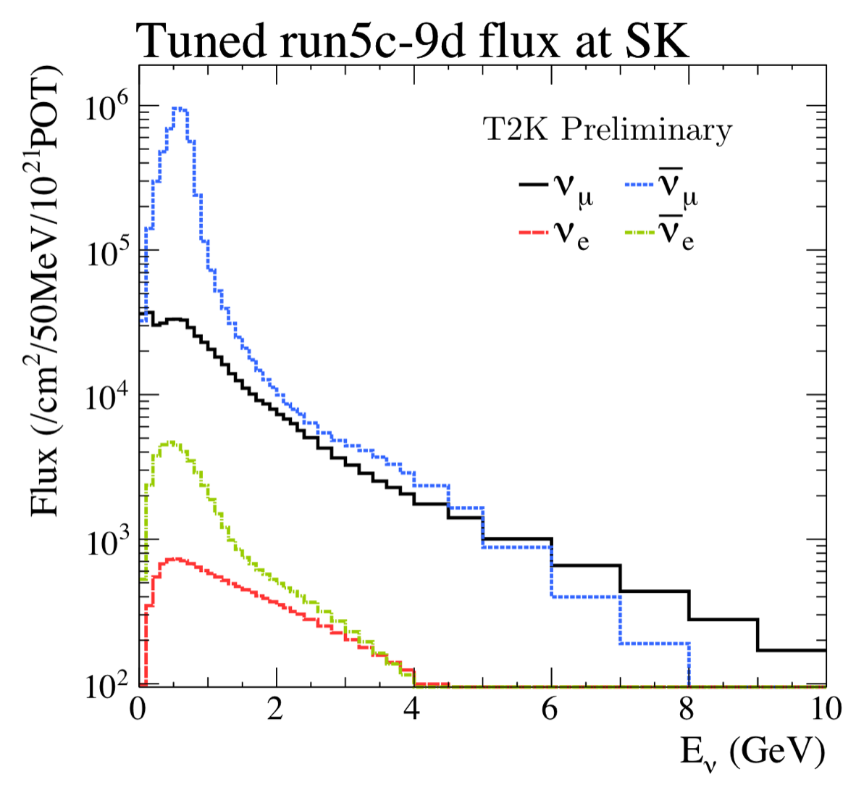
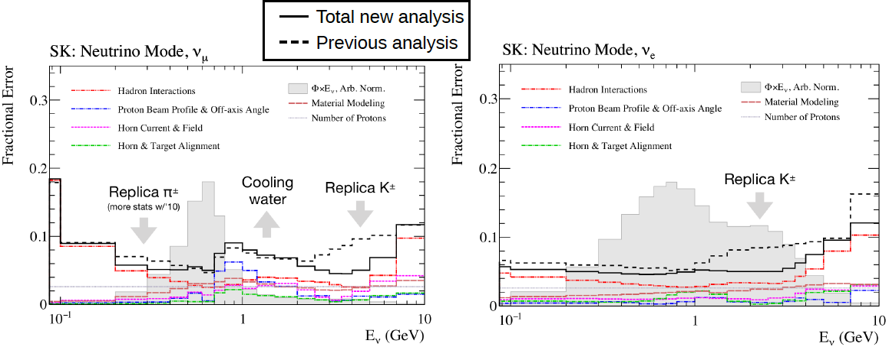
Neutrino flux
Flux is estimated using dedicated hadron production measurement: CERN NA61/SHINE.
Neutrino beam
anti-Neutrino beam
Flux uncertainty is improved using NA61/SHINE replica-target data in 2010. But, more conservative treatment due to material modeling is necessary.
New NA61/SHINE T2K replica-target run in 2022 summer. → Further high-statistics data has been obtained.

Slide 17
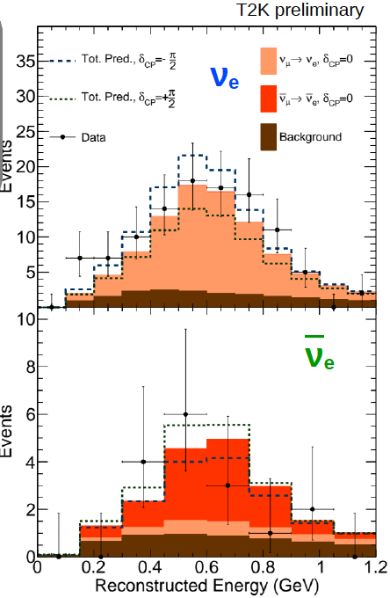
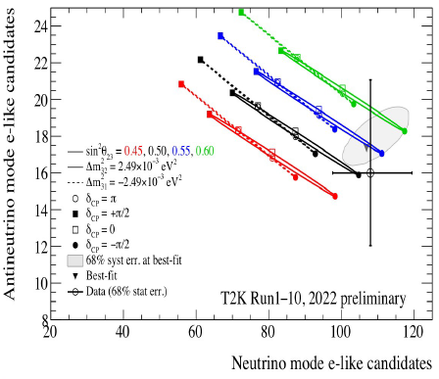
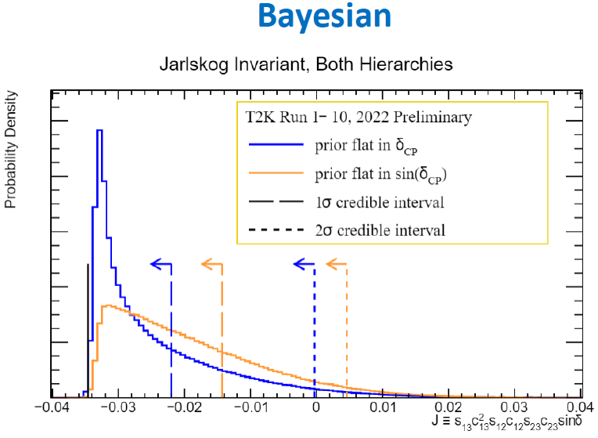
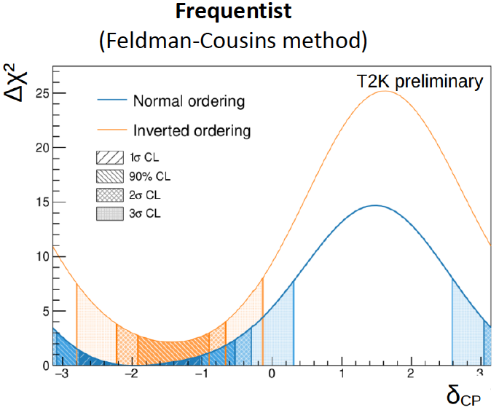
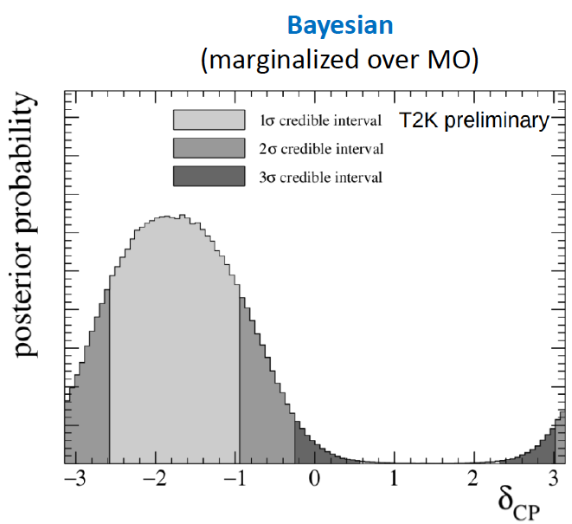
Recent results from T2K
New results by improved analysis using 2010-2020 data.
Improved neutrino flux, using ND280 event samples with new categories, increasing new SK event samples, …
Hint for Lepton CPV w/ 90% CL.

Slide 18
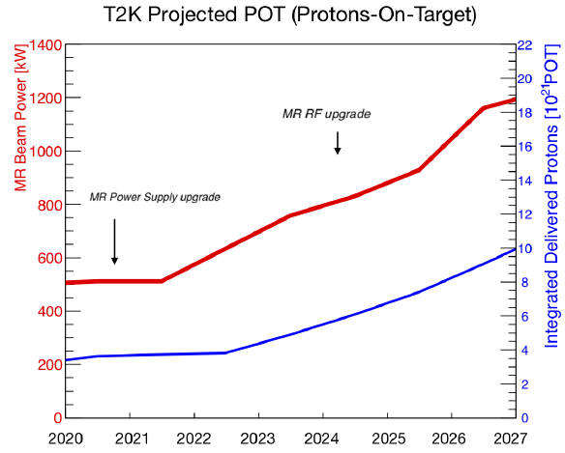
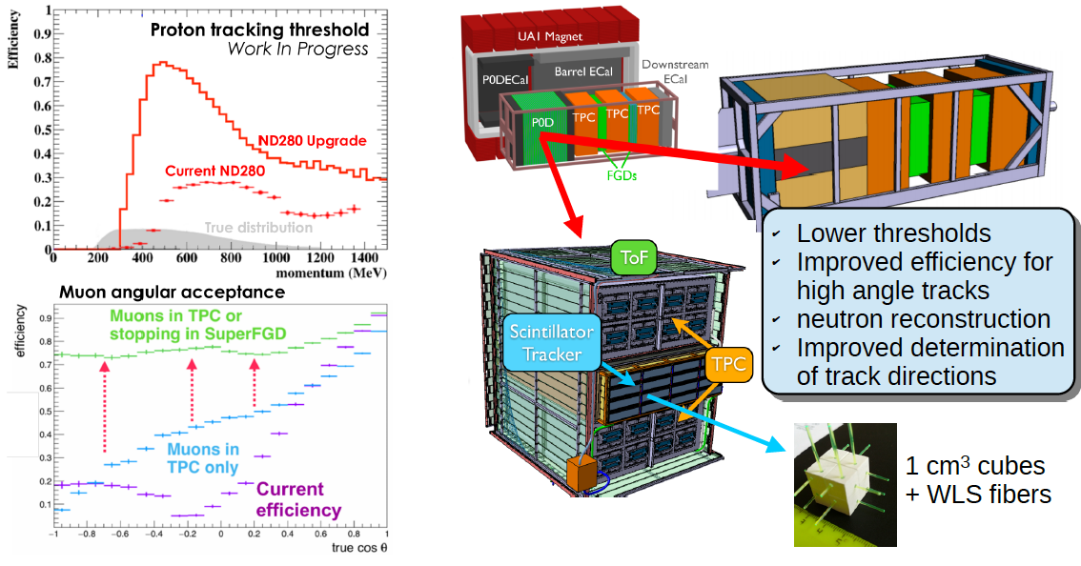
T2K prospects
Aiming CPV search with >3σ sensitivity for largest CPV
Accumulating Total ~1×10²² POT (3 times statistics) + Horn current 250kA → 320kA (~10% increase ν flux/proton)
Upgrading ND280 with new Detectors: SuperFGD and HA-TPC.

Slide 19
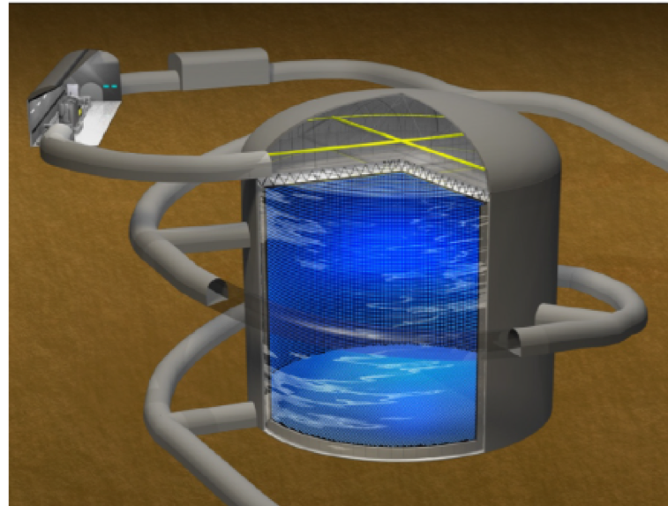
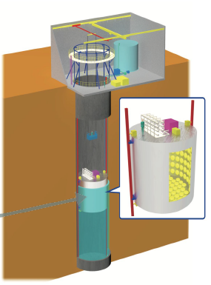
Future Project: Hyper-Kamiokande
Main physics goal : Discovery of CP violation in lepton sector with >5σ significance by accumulating ~2000 νμ→νe events and ~2000 events in ~10 years.
Construction started in 2020. Exp. start in 2027.
Hyper-Kamiokande
New near-detector
Beam power upgrade
750kW → 1.3MW
400 MeV LINAC
260kt
Cf: SK=50kt
Intensity upgrade of J-PARC neutrino beam is essential.

Slide 20
Summary
J-PARC is multi-purpose facility using MW-class high-intensity proton accelerator. → Many neutrino-related experiments are running. → Accelerator performance is now approaching to original design after 13 years operation.
Upgrade of J-PARC MR and Neutrino beam facility is on-going. → J-PARC MR operation has beam resumed after ~1 year long shutdown from 2021 July.
Recent T2K results shows exciting hints for lepton CPV. → Resumed T2K running from 2023 and future Hyper-K from 2027 is very promising.

