Slide 1



PhD studentship on LHCb
Beauty mesons as a probe of New Physics
Stefania Ricciardi, STFC, RAL
Franz Muheim, University of Edinburgh
February 2021

Slide 2
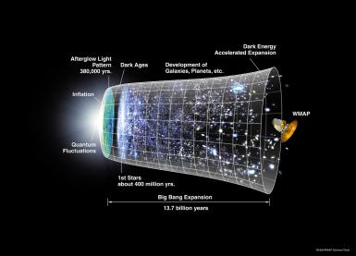
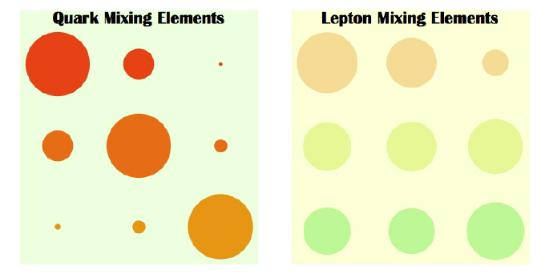
The need for New Physics
The Standard Model of Particle Physics works very well up to energy scale of a few hundred GeV
However there are compelling reasons to state its incompleteness. To mention just a few examples:
Cosmology
New sources of CPV required by baryogenesis.
Missing Dark matter candidate
Standard Model flavour puzzle:
why 3 generations quarks and leptons?
what is the origin of the hierarchy observed in the fermion masses and quark mixing parameters
(and why so different from lepton mixing anarchy?)

Slide 3
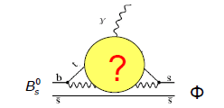
Indirect New Physics search at LHCb
Discovery potential far beyond the energy frontier via studies of forbidden or SM suppressed processes, e.g. loop processes where new virtual particles may contribute
Complementary to direct searches at ATLAS and CMS, where new particles may be directly produced and observed
New particles can be virtually produced ⇒ sensitivity limited by precision, not by collision energy. Sensitivity to new particles up to ~100 TeV can be reached at LHCb
[A. Buras et al. JHEP1411(2014)121]

Slide 4
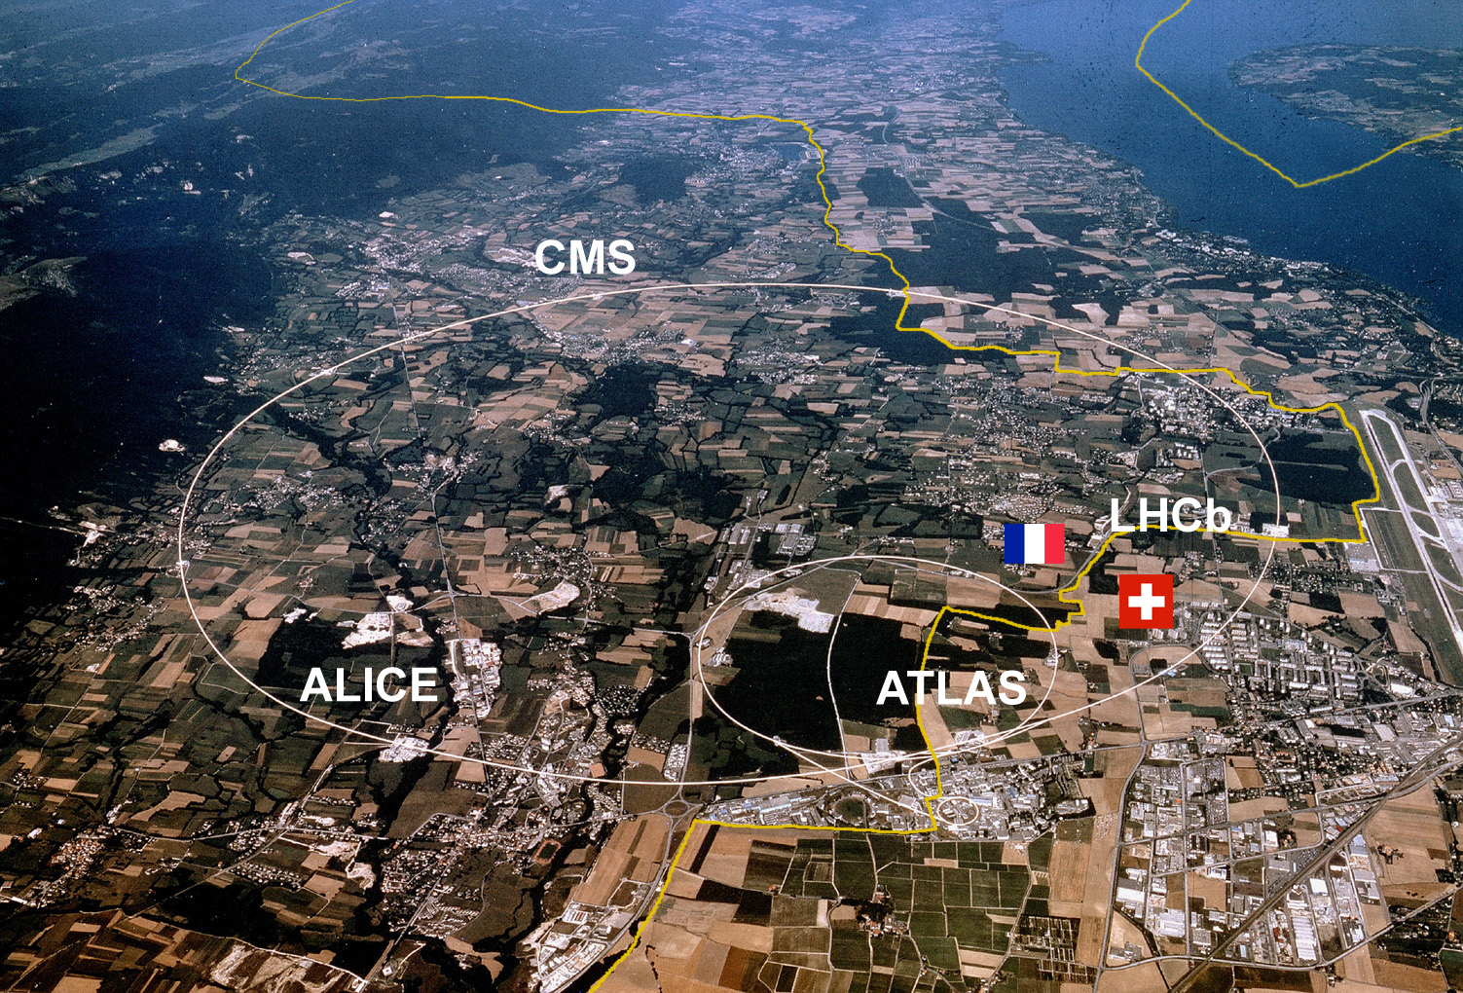
LHC at CERN
ALICE

Slide 5
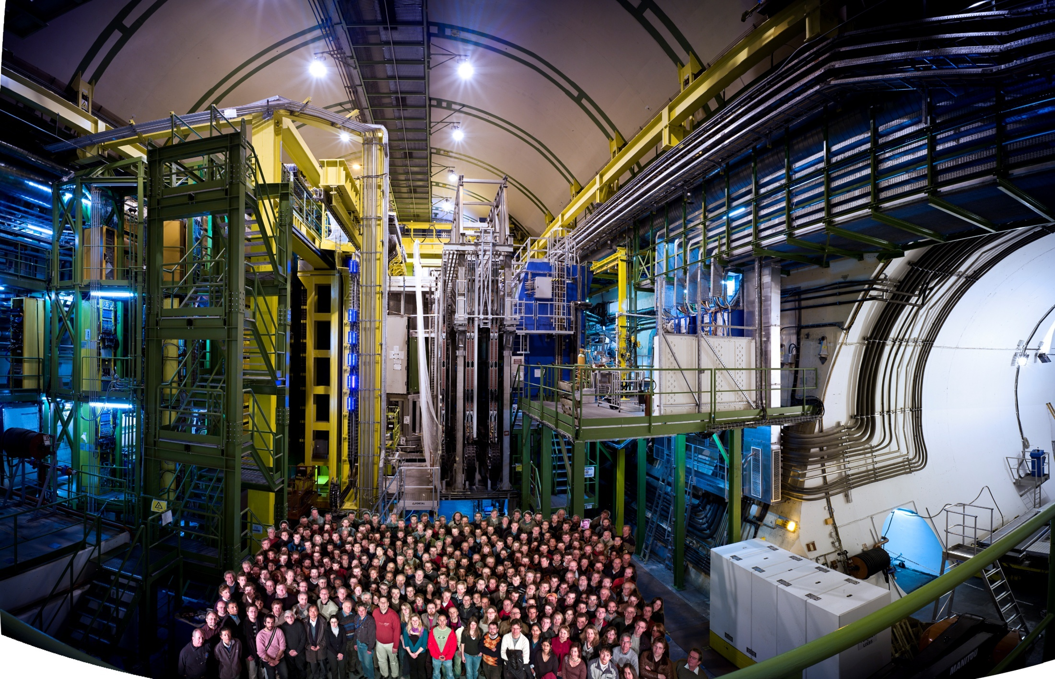

LHCb Collaboration
~1000 authors and >40 nationalities
87 institutes from 18 countries
Edinburgh group:
P. Clarke, F. Muheim, M.Needham, M. Williams, R. Currie, S. Eisenhardt, S. Gambetta, F.Oliva +
PhD students: K.Gizdov, S.Mitchell, R.O’Neil, S.Petrucci, G. Robertson
+ MPhys and Msc students and dedicated engineers
RAL group: S. Easo, R. Nandakumar, A.Papanestis, S. Ricciardi, F. Wilson +
PhD students: Z. Aliouche, D. Foulds-Holt + Msc students
RAL TD

Slide 6
LHCb : a forward single-arm spectrometer
At the LHC: $\frac{m_{b}}{\sqrt{s}}\sim {10}^{−3}.$ Highly boosted b-hadrons are produced => forward spectrometer
Optimised for b physics
The “b” in LHCb name stands for “beauty”
Excellent vertexing, tracking
and particle identification
(RICH system, unique at LHC)
p
p
Interaction point
b-hadrons have emerged as an optimal laboratory to look for NP in rare decays and study CP violation

Slide 7
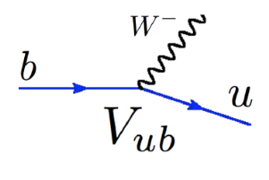

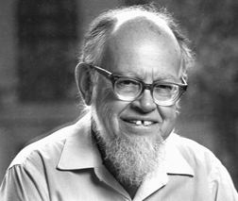

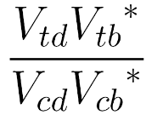
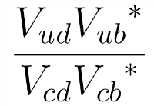


CPV and CKM: a reminder
V
ud
V
us
V
ub
V
=
V
V
V
CKM
cd
cs
cb
V_{CKM}=
V
V
V
td
ts
tb
Wolfenstein parameterisation
V_{ud}V_{ub}* + V_{cd}V_{cb}* + V_{td}V_{tb}* = 0
α
CP
γ
β
Unitarity Triangle apex can be overconstrained by doing several independent measurements

Slide 8
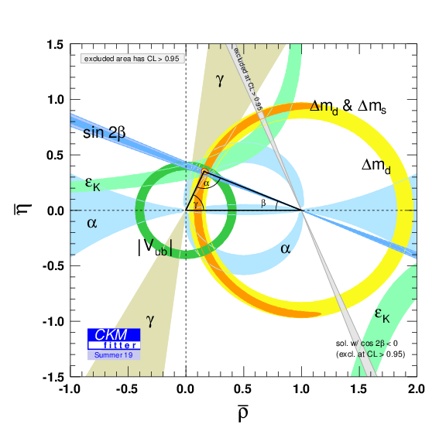
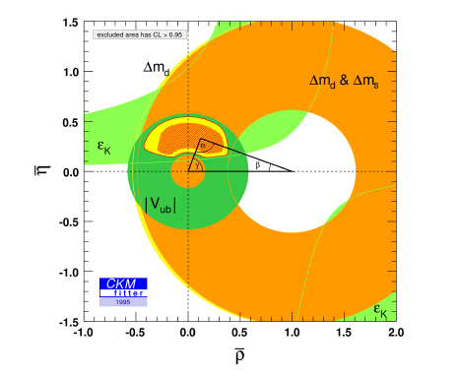
Long history
Testing the consistency of the Unitarity Triangle is one of the main goals of flavour physics!
1995
25 years of work
Each coloured band defines the allowed region for the apex of the UT according to a specific measurement
All bands overlap, huge success for the SM! Still room for NP, but more precision required

Slide 9
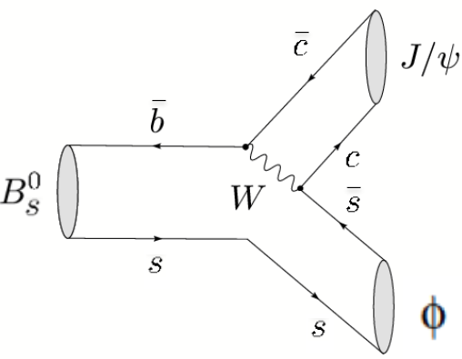
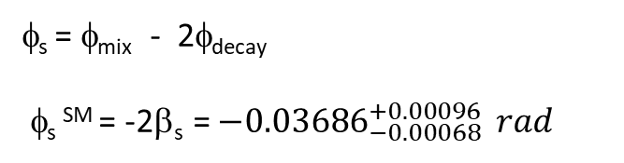
The CP-violating phase φ_{s}
It can be studied with Bs decays proceeding via b→$c\overline{c}s$ transition
CPV in decay
w/wo mixing
φ_{s} = φ_{mix} - 2φ_{decay}
φ_{s} SM = -2β_{s} = ${−0.03686}_{−0.00068}^{+0.00096 } rad$
Time-dependent CP asymmetry
Very well known in the Standard Model
Very small in the SM
Very sensitive probe of New Physics

Slide 10
Flavour tagging: a crucial analysis ingredient
Flavour tagging determines whether a b or a bbar was produced
Statistical process: the tag is not always right
Not all B candidates in an analysis can be tagged
New Total Event tagger: an opportunity for this PhD thesis
Two kinds of tagger:
Opposite side (OS) taggers: kaon, lepton, charm, vertex charge
Same Side (SS) taggers: pion, kaon, proton

Slide 11
Upgrades timeline
PhD studentship
L = 2 x10³³ cm⁻² s⁻¹
L = 2 x10³⁴ cm⁻² s⁻¹
Upgrade I in construction – full software trigger
  will allow to run at 5 x pre-upgrade instant luminosity
  aim to collect 50 fb⁻¹ by LS4
  detector consolidation and enhancement foreseen in LS3 (start of HL-LHC)
Upgrade II -
  Major detector upgrade in LS4 (2030) – R&D starting now
  Aim to run at 10 x Upgrade I luminosity and collect 300 fb⁻¹
    Challenging conditions for flavour physics
    (number of visible interactions/bunch crossing ~50)
  Improved sub-detectors time-resolution

Slide 12
RICH System and upgrades
Schematic and photos of the dismantled RCH system
Upgraded detectors same structure, but different optics and different photodetectors:
Upgrade I: MAPMT Upgrade II: SiPM (baseline choice)

Slide 13
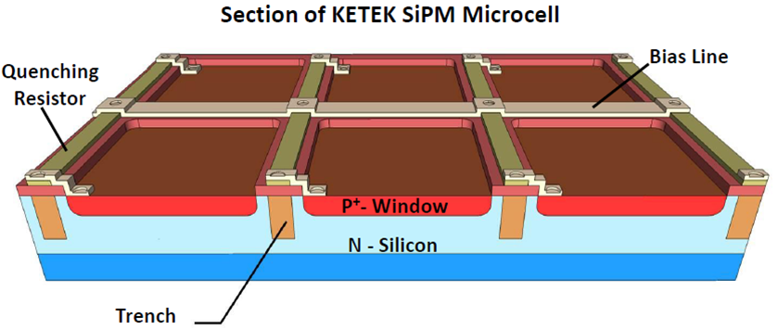
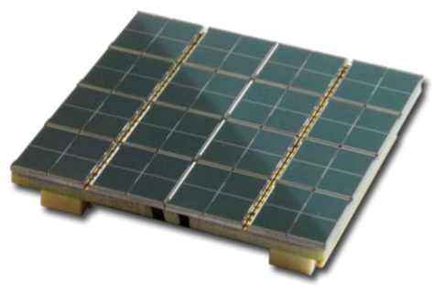
SiPM
A SiPM is a matrix of APD (avalanche photodiodes) operating in Geiger mode. Each cell fires independently, so the output is proportional to the number of fired cells.
Desirable features:
High gain (~10⁶)
Good granularity (1mm²)
Good timing capabilities (<=200ps)
Large Quantum Efficiency in the green
Excellent single photon separation
Low bias voltage (~50V)
Cheap and easy to produce
Insensitive to magnetic fields
A few drawbacks:
High dark count rate
( ->operate at low temperature -40°C)
Sensitive to radiation damage
Characterization of SiPM is an important part of this PhD thesis

Slide 14
Courtesy :Sajan Easo

Slide 15
Opportunities for the student
Software:
use a large fraction of the Run 3 dataset to significantly improve the measurement of one of the most sensitive observables to New Physics
Develop data analysis tools
Gain expertise in C++ and Python software development and Machine Learning techniques
Become an expert in data-intensive science
Communication:
presentations, writing, public engagement
Travel:
Several opportunities, including a placement at CERN
(extra funding to cover the costs with living abroad)
Hardware:
Characterise photon detectors, such as SiPMs
Gain experience in cutting-edge technology;
Collaborate with people from all over the world: soft skills!
Highly-sought set of skills for a career in particle physics, but also transferable to work in other fields

Slide 16
Example of projects and timeline
Year 1: in Edinburgh – PhD lectures;
  Develop flavour tagging using Run 2 data
  Validation of early Run 3 data
Year 2: at CERN
  Perform a time-dependent data-analysis using Run 3 data
  Contribute to the design, installation and operation of RICH prototypes in the CERN test beam facilities
  Contribute to the LHCb data-taking as RICH expert on call
Year 3: at RAL
  Evaluate the performance of novel photon detectors such as silicon photomultipliers
  Complete the data-analysis

Slide 17
Conclusion
This project offers a combination of crucial detector development activities, and an analysis programme which could lead to several high impact publications
Would you like to join us?
Please sign up for a chat with Franz and me tomorrow

Slide 18
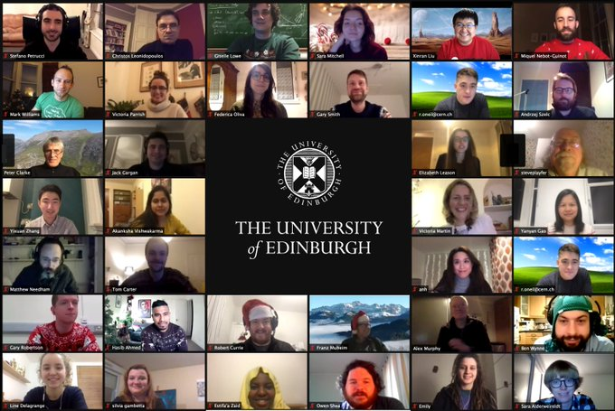
Backup

Slide 19
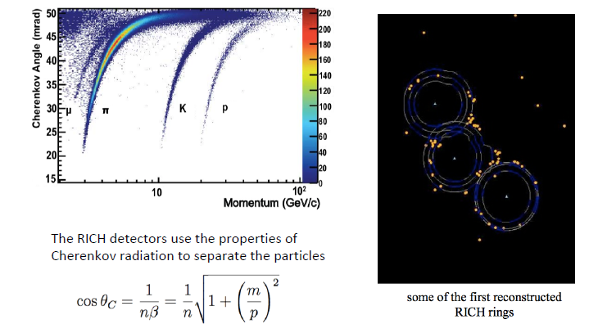
RICH system
Hadron PID in 2-100 GeV range, using Ring Imaging Cherenkov (RICH) detector is a unique feature of LHCb and it is used for most of the physics results of LHCb

Slide 20
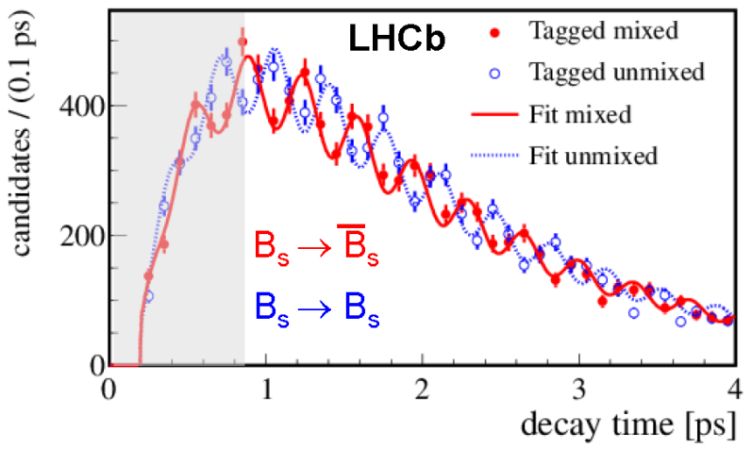
Measuring φ_{s}
Requirements:
Knowledge of the CP eigenvalue of the final state η_{f}
Fast Bs oscillation → excellent time resolution
Model decay-time and angular efficiencies
Knowledge of the B flavour at production →flavour tagging

Slide 21
Current measurement of φ_{s}
φ_{s} = -41 ± 25 mrad
Well compatible with SM at the present level of precision
Precision mostly driven by LHCb, Atlas, CMS
Starting to approach the sensitivity to observe a non-zero SM value
Tensions between the various measurements of Γ_{s} and ΔΓ_{s} call for a clarification of the experimental picture
arXiv 2001.07115

