Slide 1
ATLAS activities and studentship
Stewart Martin-Haugh, Mark Owen

Slide 2
LHC
LHC first started serious data taking in 2011
Run 1, ran at up to 75% nominal luminosity, culminated in discovery of Higgs boson
LHC Run 2 finished at end of 2018
Reached 2 times nominal luminosity, delivered over 5 times data of Run 1
Now in Long Shutdown 2 for upgrade for Run 3 (2022-2024)
Machine consolidation, Phase-I upgrades to ATLAS
Further Long Shutdown 3 starting in 2024 for upgrade to HL-LHC
Phase-II upgrades to ATLAS for 5 to 7 times nominal luminosity

Slide 3
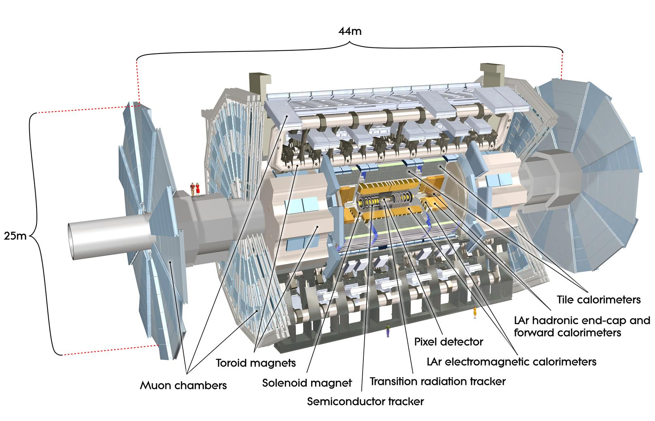
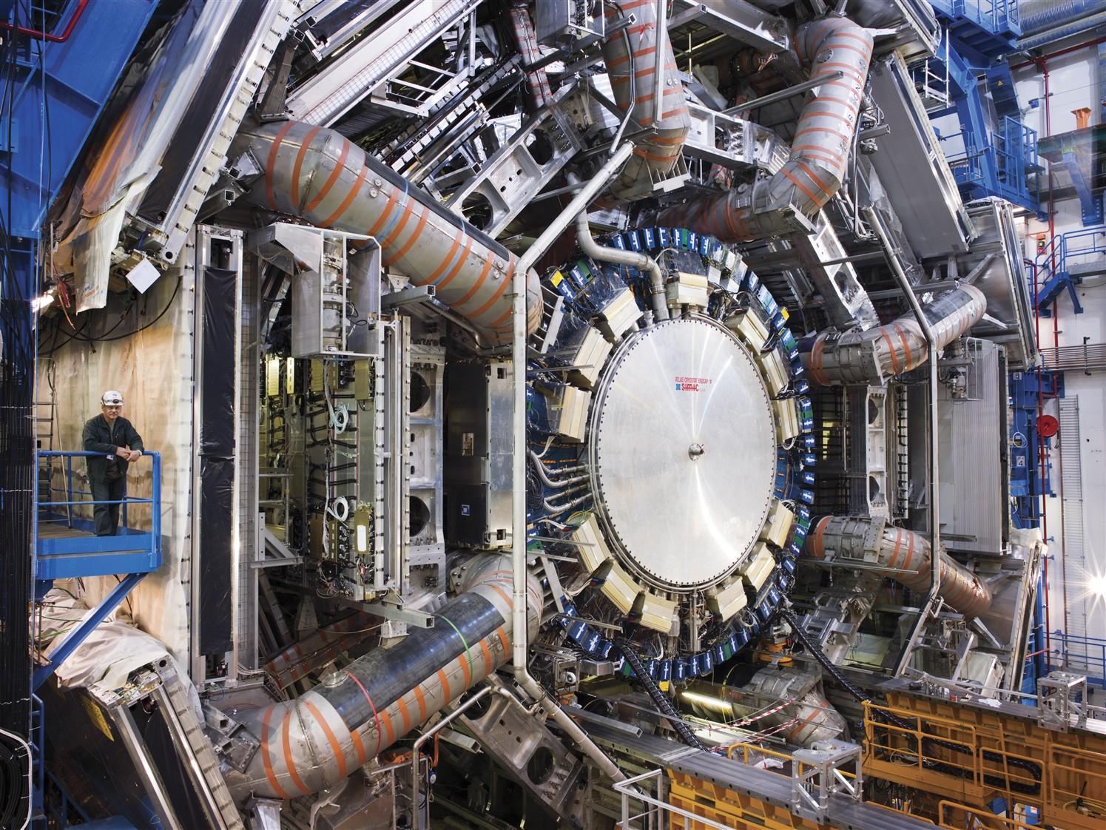
ATLAS
One of two general purpose detectors at the Large Hadron Collider
Different subsystems in layers around collision point to record trajectory, momentum and energy of particles

Slide 4
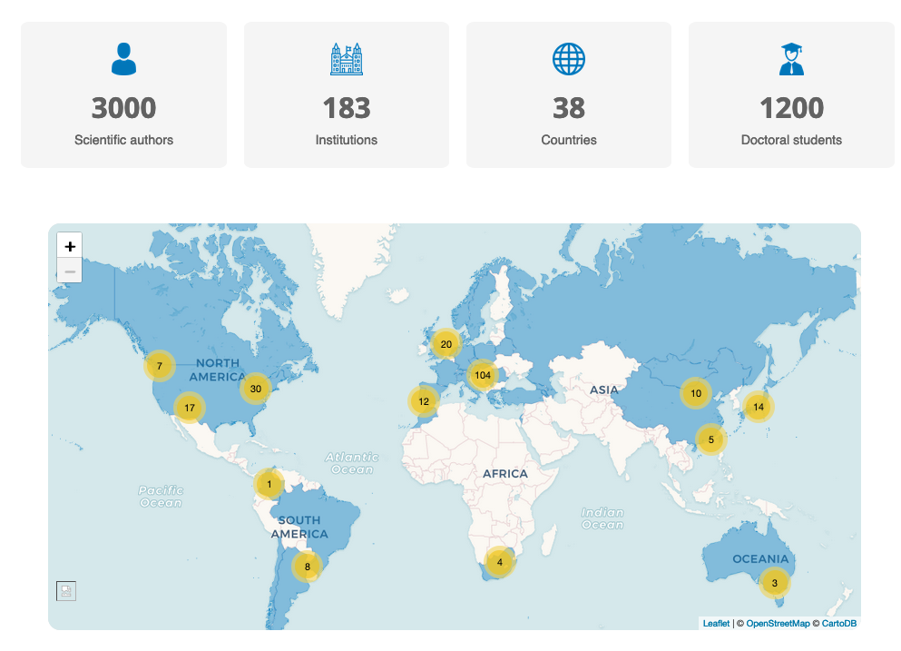
ATLAS Collaboration
Worldwide effort
Beyond the scientific authorship, significant engineering effort: ~1000 people

Slide 5
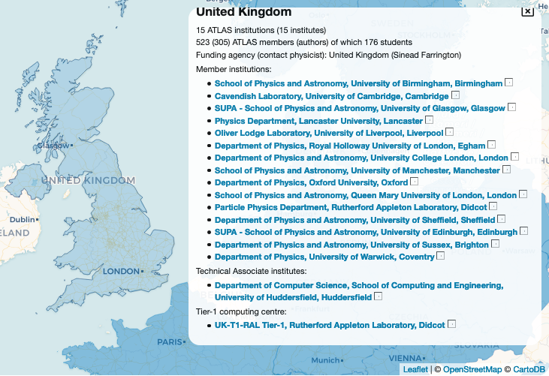
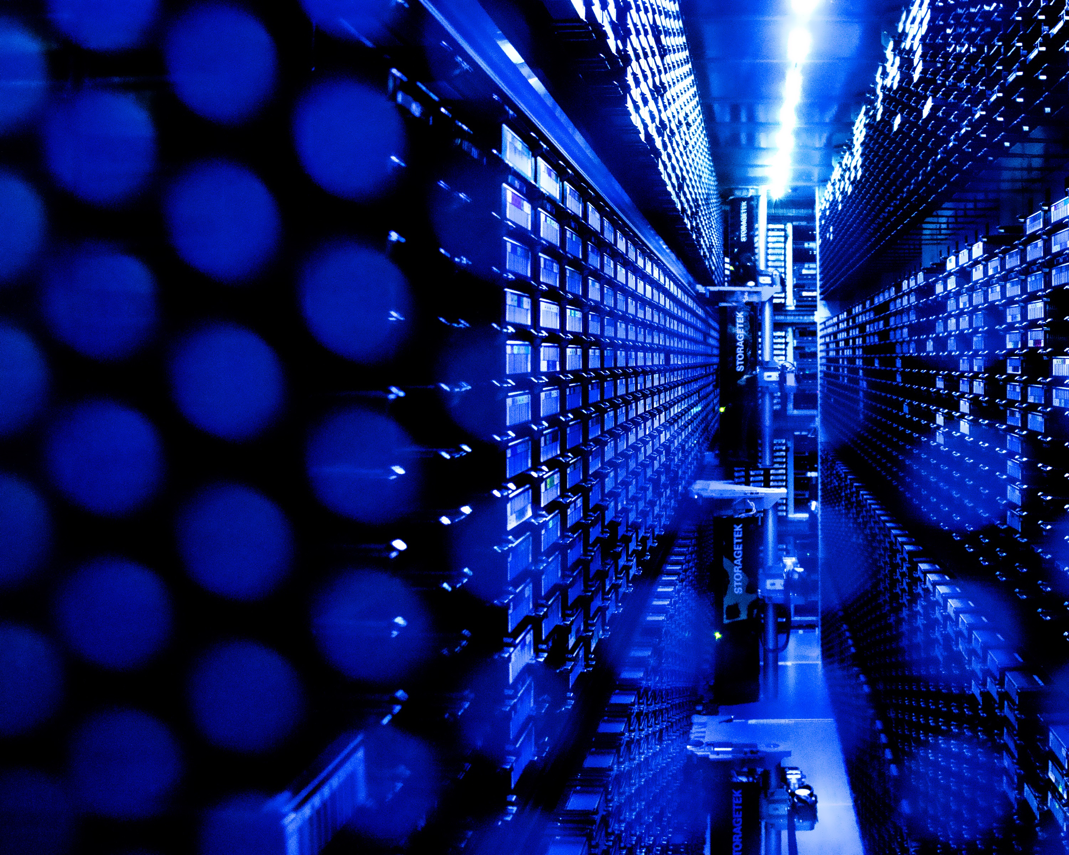
ATLAS UK
14 universities + RAL PPD
We have good links with all ATLAS UK universities
RAL also hosts the UK Tier-1 computing centre
Dedicated internet link to CERN
Complete copy of LHC raw data

Slide 6
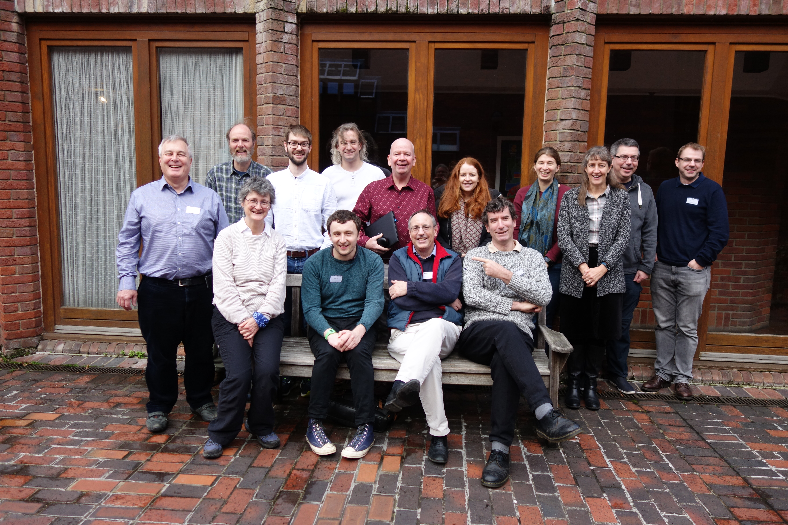
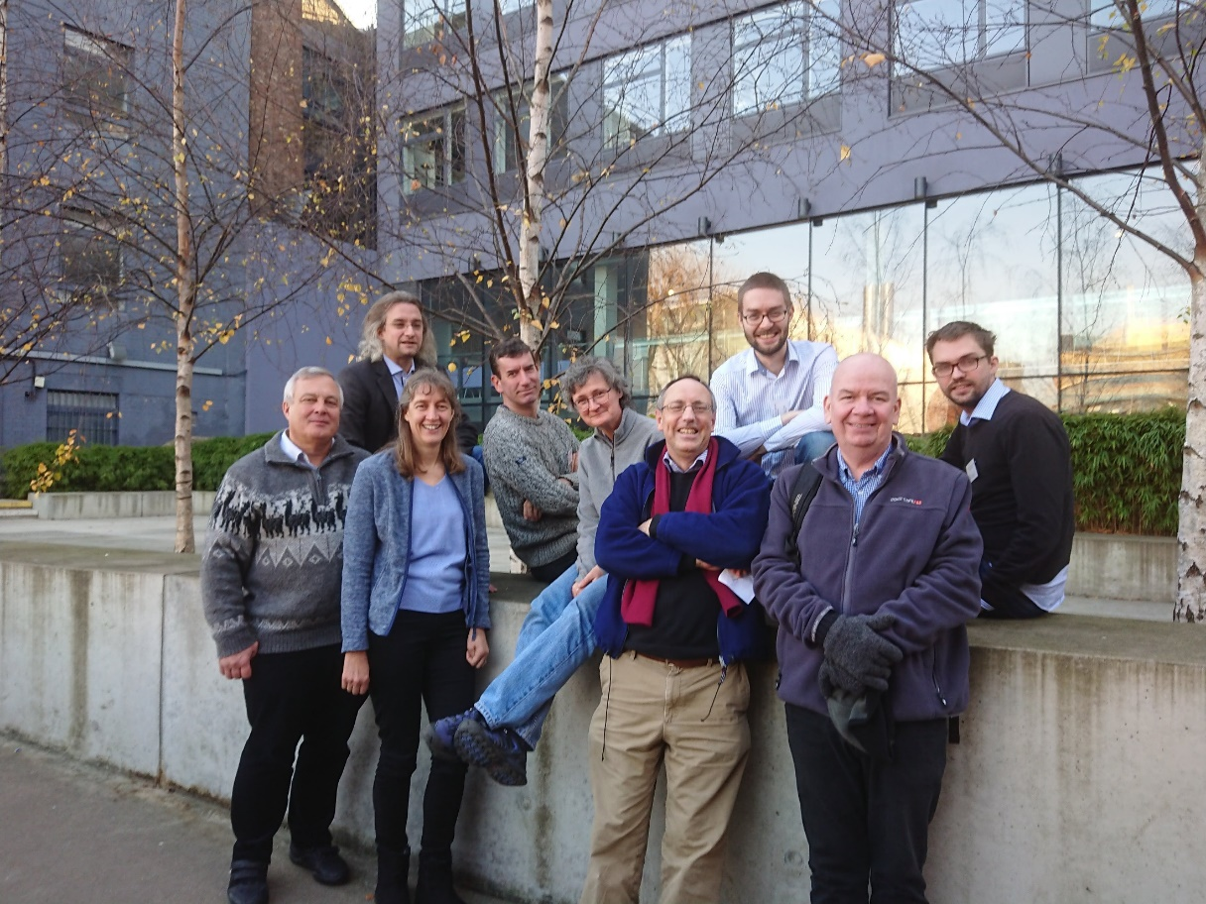
RAL ATLAS group
22 staff (physicists, engineers)
2 PhD students (Warwick, Birmingham) (soon to be 3!)
Photos not comprehensive

Slide 7
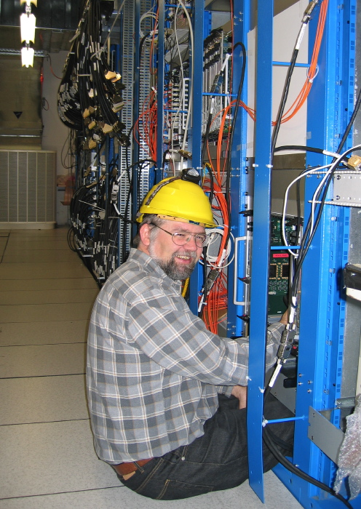
RAL activities
Built and operated SemiConductor Tracker and trigger systems in Run 1 and 2
Phase-I upgrades: installation before Run 3 (2022)
Level-1 Calorimeter Trigger and High Level Trigger
Phase-II upgrades: installation before Run 4 (2026)
Level-0 Global Trigger, Event Filter and new Inner Tracker (ITk)
Diverse physics involvement: Higgs, searches for new heavy bosons, B-physics

Slide 8
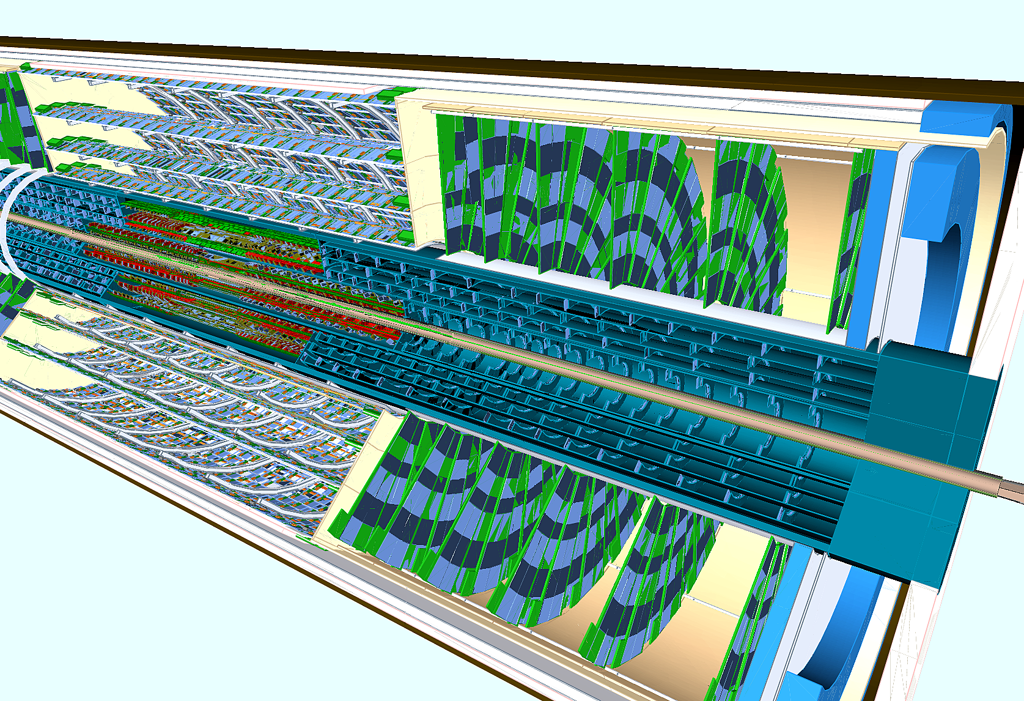
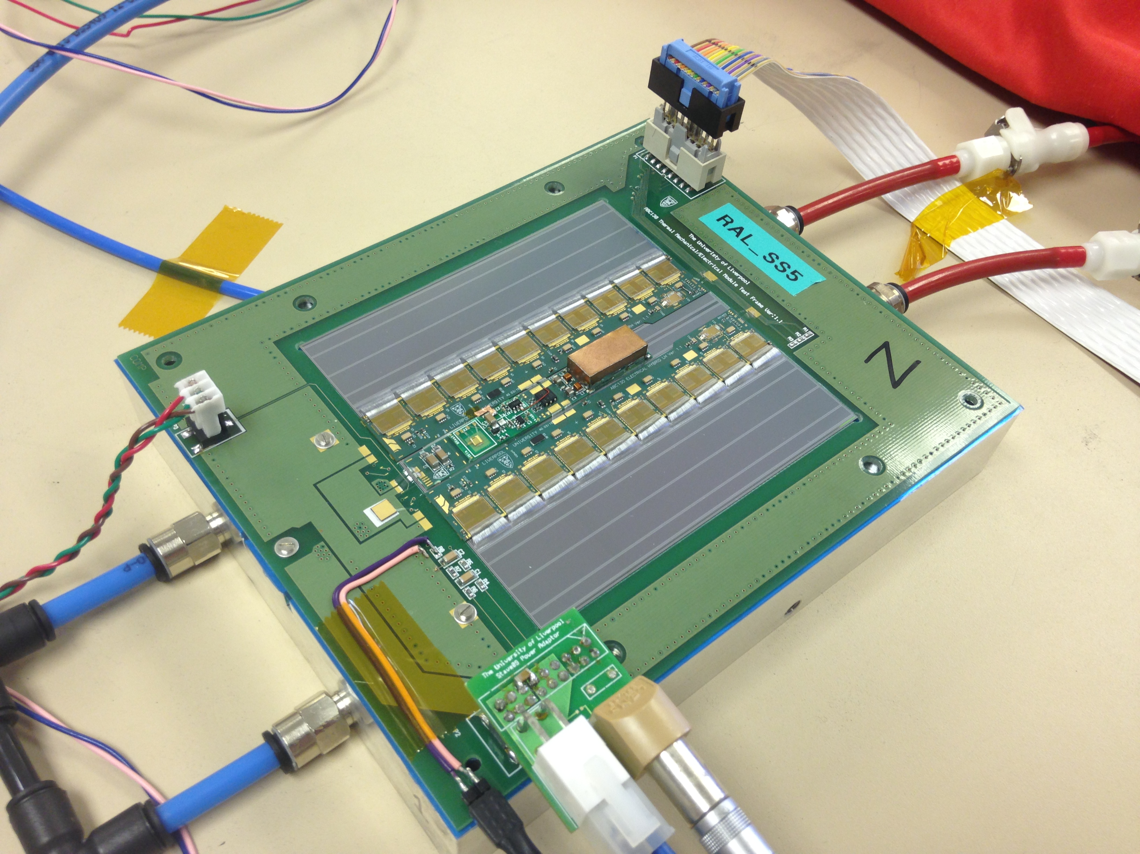
ITk
Original Inner Detector reaches its end of life in 2024
Will be replaced with new all-silicon detector
RAL group working on barrel strips and endcap pixels
Design, data acquisition, assembly and eventually operation

Slide 9
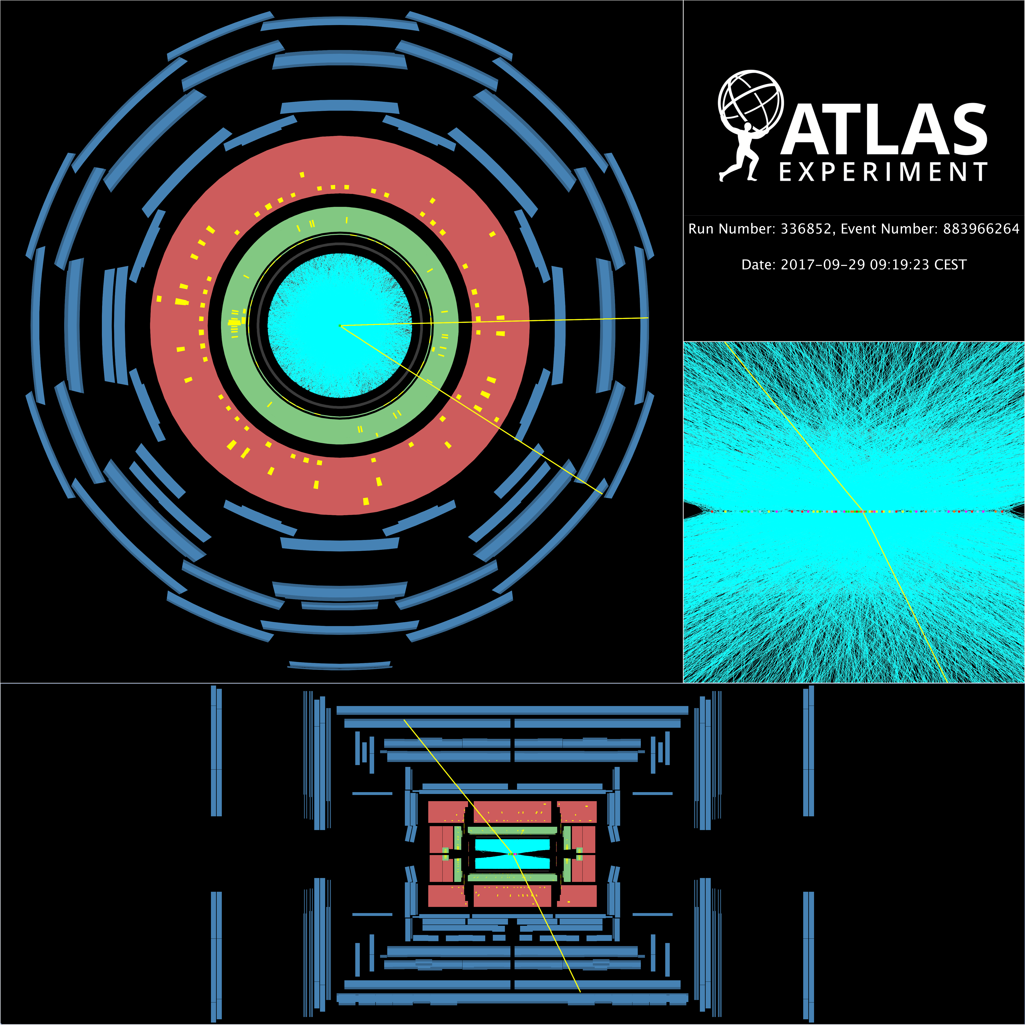
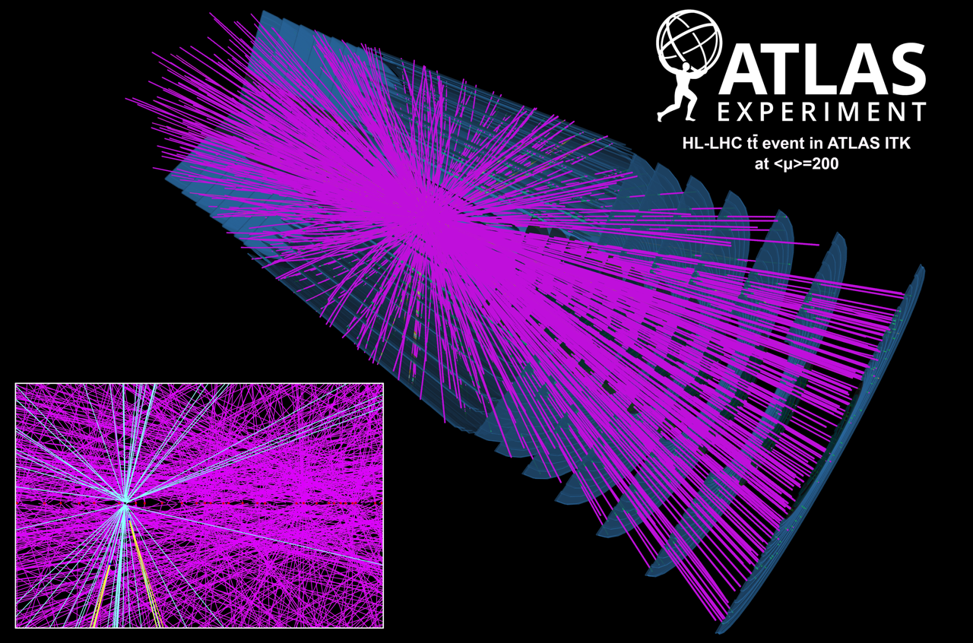
Triggering at the LHC
LHC collides bunched beams of protons 40 million times per second
Every time the bunches cross, multiple protons collide
Real example from 2016 with 85 collisions
at end of Run 2 LHC delivering ~1 billion proton-proton collisions per second
In Run 4, expect an average of 200 collisions each time bunches cross
up to 10 billion collisions per second
Interesting collisions at much much lower rate
1 Higgs boson per 10 billion collisions, some processes only a few collisions per year
We want just the interesting collisions
Sitting in a sea of ‘pileup’ collisions

Slide 10
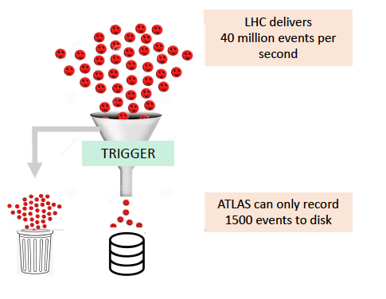
ATLAS Trigger
If we stored all the data that ATLAS generates from collisions, we would use every hard drive in the world within weeks
Store only the interesting collisions (1500/s)
Still record the equivalent of full Netflix catalogue every year
Use dedicated hardware (Level 1 Trigger) and 60,000 CPUs (High Level Trigger)

Slide 11
ATLAS High Level Trigger
During LS2 rewrote entire trigger code (nearly 1M lines of C++ and Python) to enable multi-threading and improve the selection algorithms
RAL interests:
Tracking – using machine learning techniques to find tracks quickly and efficiently
Core trigger software – flow of events/algorithms, control room tools, analysis tools, etc.
Validation of trigger software – are we finding the events we want efficiently? Resource usage – memory and CPU time?
Beyond CPUs: GPUs and FPGAs for Run 4

Slide 12
The Glasgow Group
Group of 10 academics & ~16 research staff + technicians, engineers & PhD students
Active in many of the world-leading particle physics activities:
ATLAS, LHCb & NA62 on the LHC
Grid computing (Tier 2 centre here in the building)
Neutrinos (T2K & MICE)
Linear collider
Detector development
On ATLAS: Higgs, top, SM measurements & BSM searches. Involved in the trigger, computing, simulation & upgrade (tracker & trigger)

Slide 13
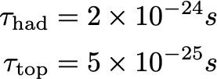
Why the top quark?
In the SM it’s the only quark:
With a natural mass:
Top quark interacts strongly with the Higgs sector - special role in EWSB?
Decays before hadronizing:
Copious production rate at the LHC allows for precise tests of QCD involving multiple scales (pT(top), m(top), m(b))

Slide 14
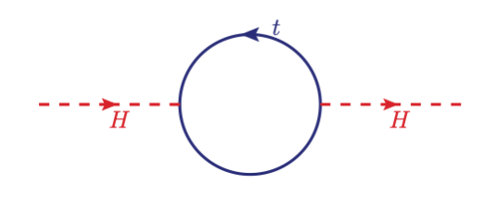
Why the top quark?
Corrections to Higgs mass depend on the top quark Yukawa:
Assume new physics enters at some high scale:
In effective theory approach:
For less than 90% cancellation:
Top quark is perhaps the most likely place we will see new physics.

Slide 15
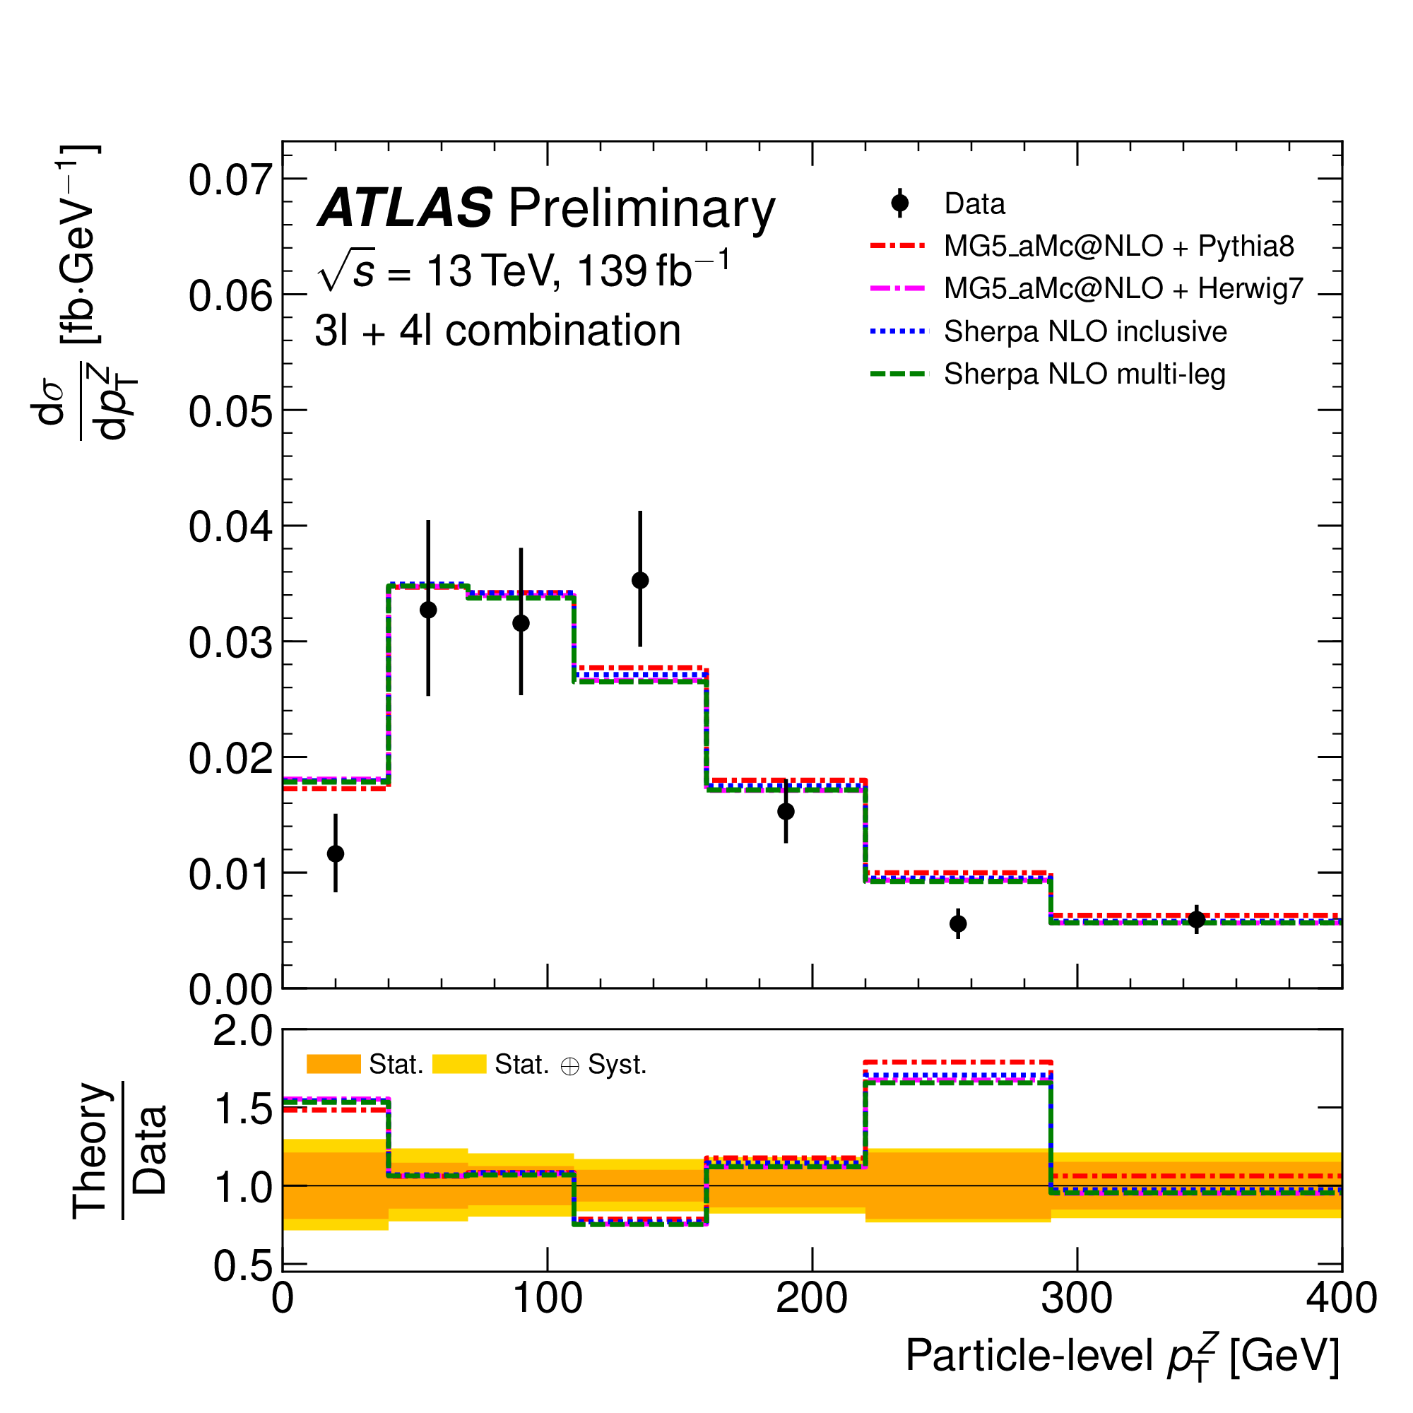
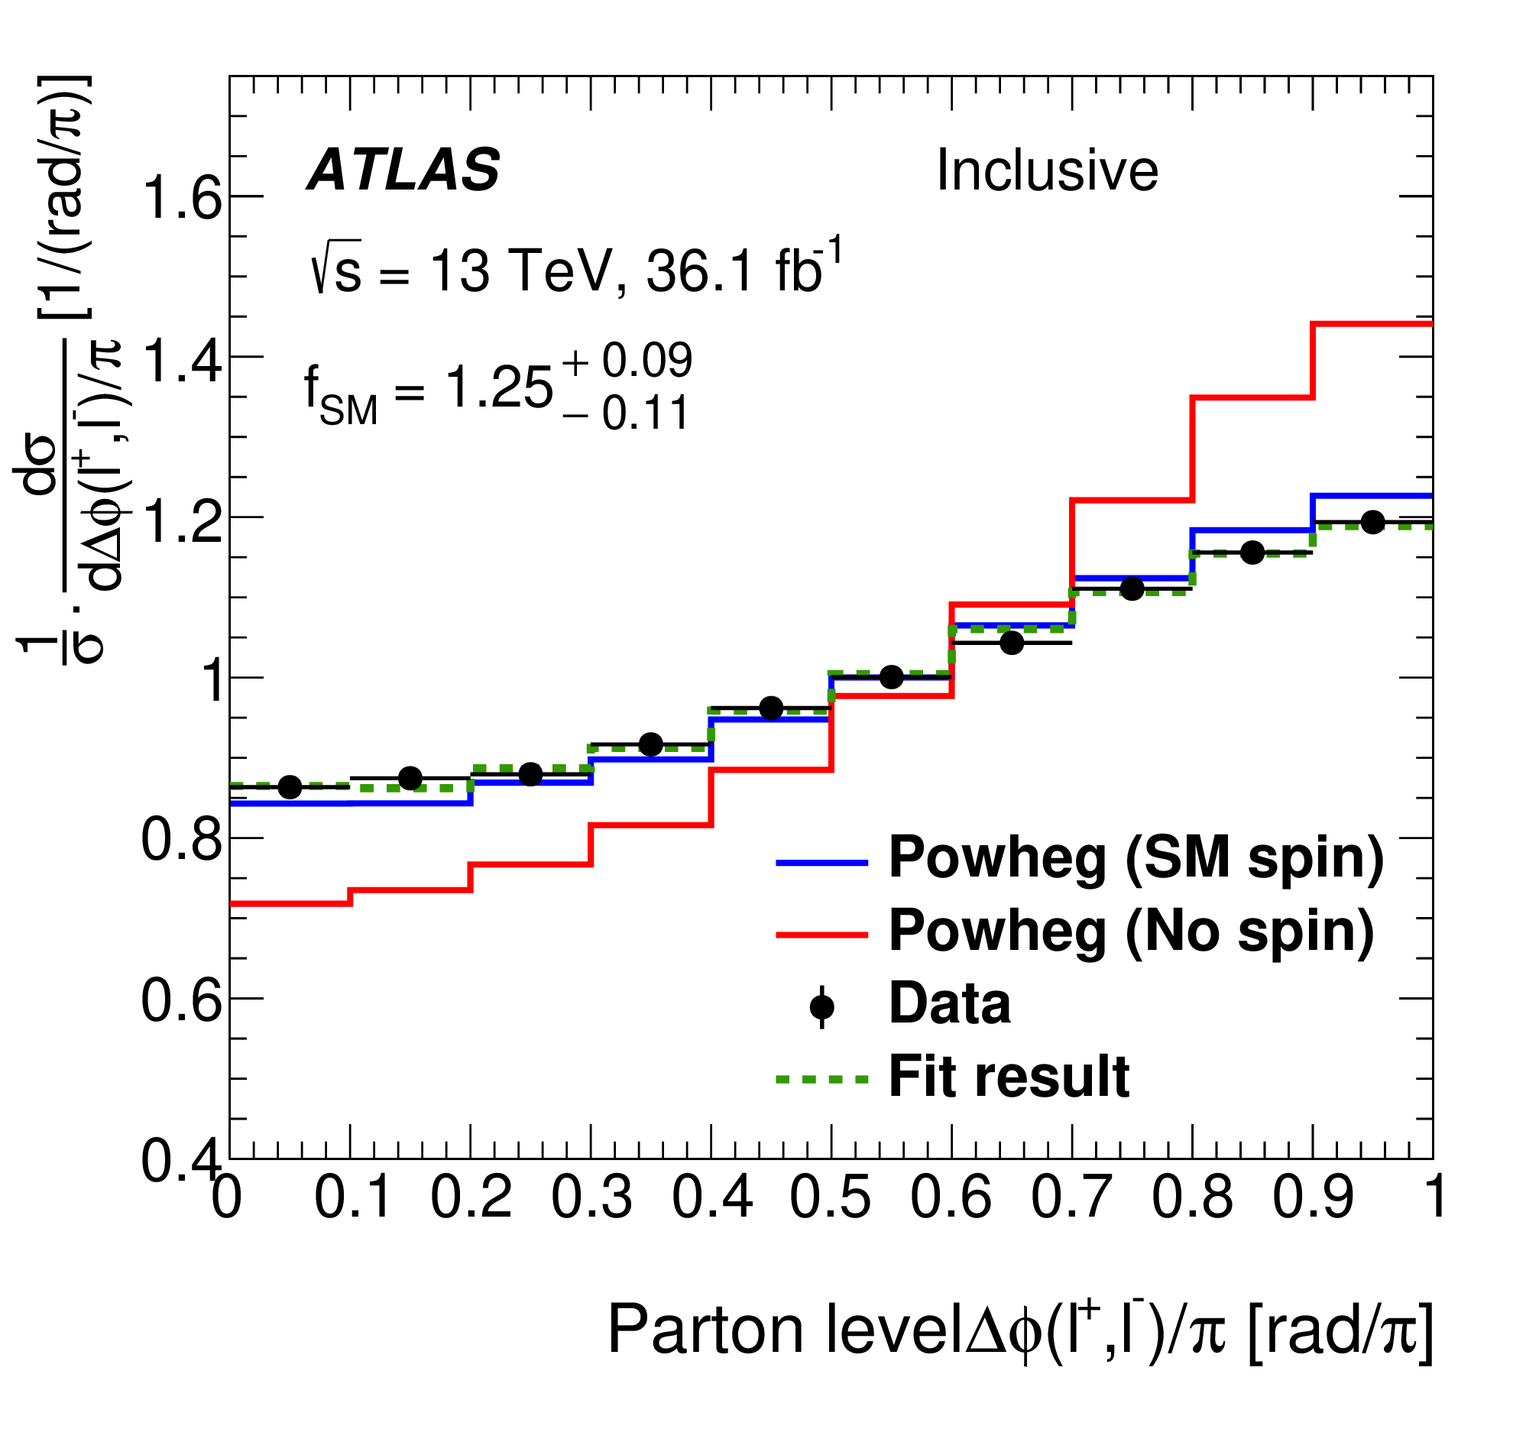
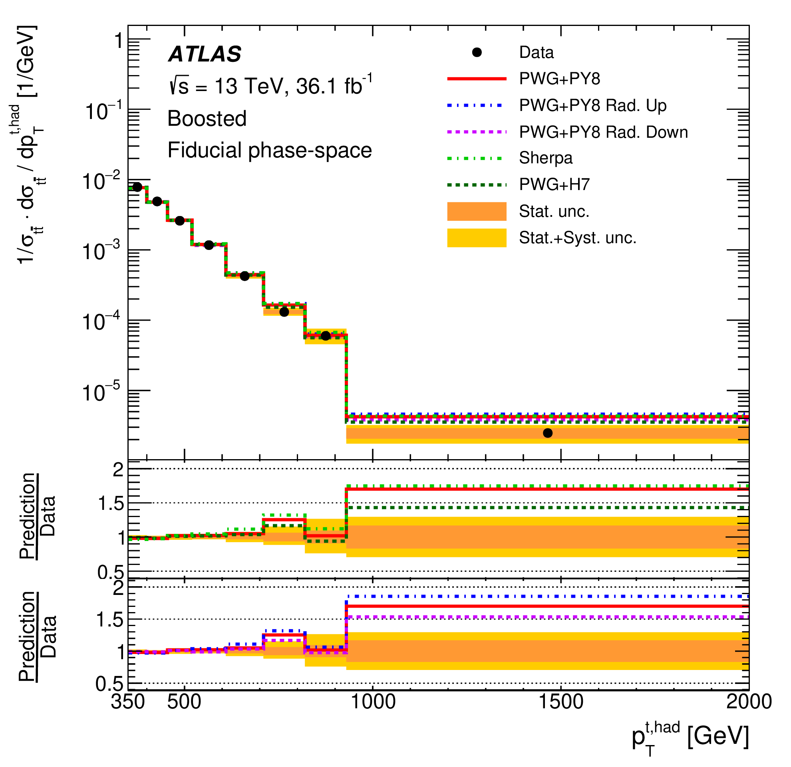
Top physics at Glasgow
Nice group of people (3 academics + 2 post-docs + 4 PhD students) on a range of top physics:
Measuring tops with pT > 1 TeV
Measuring rare tt+Z production
Spin correlation in top-quark pairs
Keep precise PhD analysis project flexible at this point - also allows to see how LHC schedule develops

Slide 16
Studentship outline
Start at Glasgow(~6 months)
Academic and computing courses
Start work on HLT – gain familiarity with project
Some time at RAL, then 12 - 18 months at CERN
Hands-on experience commissioning/operating HLT system during Run 3
control room shifts, expert on-call support
Join physics analysis group, foundation for physics analysis component of thesis
Return to RAL
Finish physics analysis, write thesis

