Slide 1

Laser-hybrid Accelerator for Radiobiological Applications (LhARA)
Centre for the Clinical Application of Particles
Mission: to develop the technologies, systems, techniques and capabilities necessary to deliver a paradigm shift in the clinical exploitation of particles
Aim: to deliver a step change in the delivery of therapy by 2050
LhARA
Science – Explore radiobiology in new regimes
Technology – Prove the techniques required to deliver the 2050 step change
https://ccap.hep.ph.ic.ac.uk/trac

Slide 3
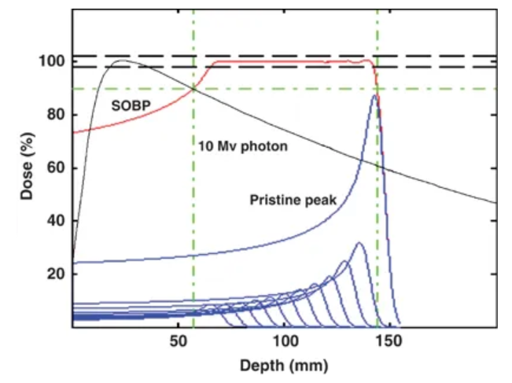
X-ray, proton and ion therapy
Most radiotherapy uses X-ray photons
Protons/ions have advantages over photons due to energy loss mechanisms for photons and ions in material.
Get exponential dose depth profile for photons, “Bragg peak” for ions.
Clinical treatments use a Spread Out Bragg Peak (SOBP) to conform dose over the length of the tumour.
Carbon ions have a better dose profile in front of the tumour than protons, though fragmentation creates a distal tail.
Levin et al. “Proton beam therapy” British Journal of Cancer volume 93, pages 849–854 (2005).

Slide 4
Example of proton vs. photon therapy
Volumetric Modulated Arc Therapy (VMAT) therapy delivers X-ray dose conformal to tumour by modulating beam while rotating around patient.
Beam collimated to tumour shape
Here for prostate cancer patient:
Minimises dose to surrounding tissues.
Compare with dose distribution from four-beam intensity modulated treatment plan using protons:
Allows reduced dose to critical tissues, here, bowel and spine.
Treatment planning for protons: range uncertainties have large effect

Slide 5
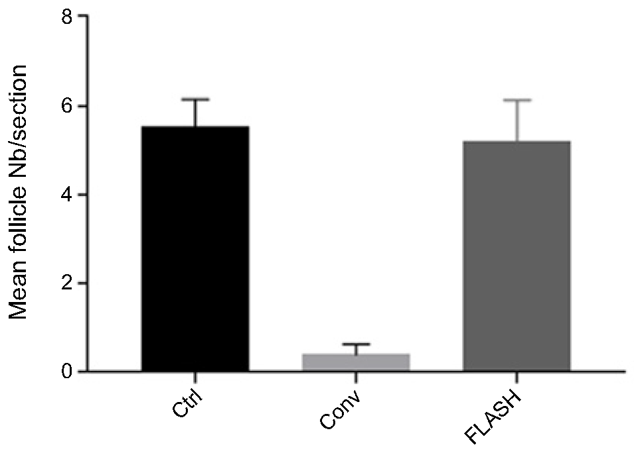
Radiobiology challenges
Relative Biological Effectiveness (RBE)
Biological effects of a given dose of radiation depend on the type of radiation (and other factors).
RBE is ratio of effectiveness cf. photons.
Systematic studies needed to improve understanding of underlying radiation damage mechanisms.
FLASH Radiotherapy
Conventional treatment, dose rate typically a few Gy/min, flash treatments, dose rates above 100 Gy/s.
Efficacy higher for a given dose.
Evidence that normal tissue sparing is also improved
36 weeks post-radiotherapy, quantification of hair follicles per tissue section:
Unirradiated, Conventional-RT, and FLASH-RT
Almost total recovery with FLASH
Microbeam Radiotherapy
Multiple beamlets on sub-mm pitch
Irradiated areas separated by unirradiated tissue
Recovery of healthy tissue accelerated
“The Advantage of FLASH Radiotherapy Confirmed in Mini-pig and Cat-cancer Patients.” Vozenin et al. Clin. Cancer Res. 2019 Jan 1;25(1):35-42.

Slide 6
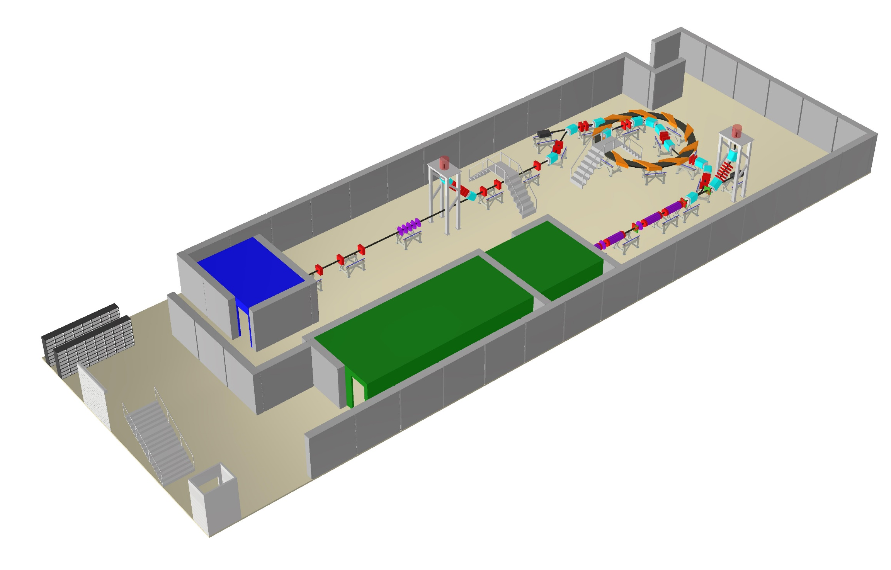

Laser-hybrid Accelerator for Radiobiological Applications (LhARA)
Radiobiology research facility
Initial acceleration laser driven
Large flux of protons/ions in very short bunches
Allows large instantaneous doses
High energy in vitro end station
In vivo end station
Low energy in vitro end station
Laser target
Laser
Implementation in two stages.
  In vitro studies, 15 MeV protons.
  In vivo studies, 127 MeV protons, in vitro studies with 33 MeV/u carbon 6+ ions.

Slide 7
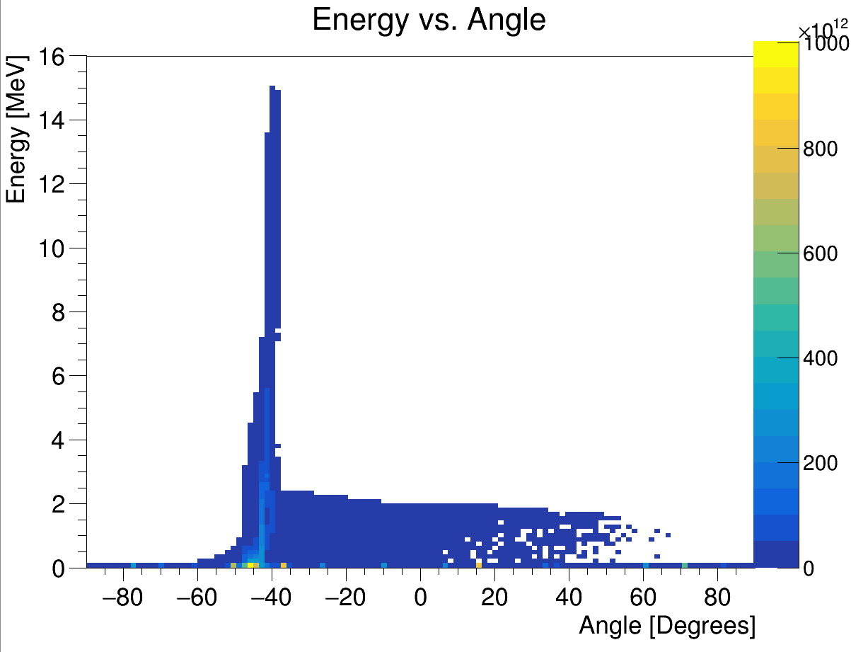
Laser proton source and acceleration
Produces large flux of ions in pulse of ~ 30 fs duration.
Kinetic energy up to 15 MeV.
Target normal sheath acceleration mechanism.
Protons from (hydrocarbon) contamination on foil surface.
Energy vs angle with respect to laser beam direction
Laser driven ion beam simulation using EPOCH. Latest simulations using SMILEI-2D

Slide 8
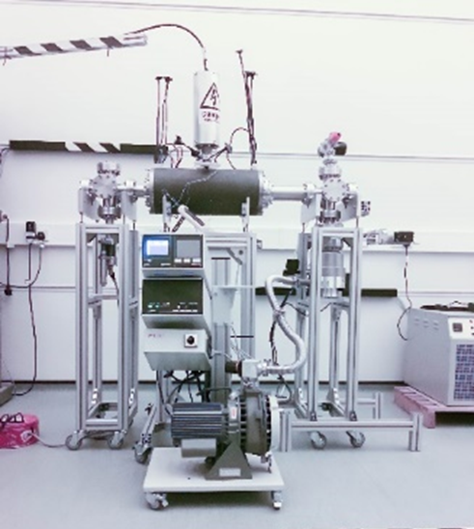
Capture and focussing of beam from source
Initial beam has small size, large divergence, large energy spread.
Capture and focusing difficult.
Here, propose to use Gabor lenses.
Focusing by space charge of electron cloud.
Electrons confined electrostatically (axial) and magnetically (radial)
R_{A} ~ 20 mm, R_{C} ~ 10 mm, L ~ 0.5 m.
V_{A} ~ 600 kV, B_{Z} ~ 0.3 T.
Prototype Gabor lens constructed at Imperial College
Initial measurements with prototype using 1 MeV proton beam at Surrey Ion Beam Centre.
Next steps: Vacuum tests, Tests with radioactive source, Tests with the laser driven ion beam. Update Design.

Slide 9
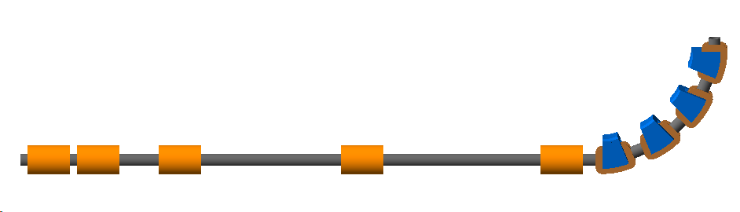

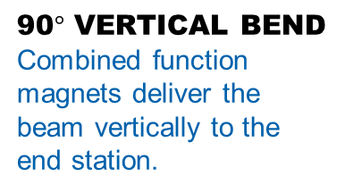
LhARA stage 1 (For irradiation of cell samples)
END STATION
Where the cells are irradiated. The beam is delivered vertically from below the cell culture plate.
LASER TARGET
Laser used to generate intense beams of different types of ions, e.g. protons and carbon ions.
beam
ENERGY SELECTION
A Gabor lens and a collimator are used to select particle energy.
y
z
2.55 m
45$°$
laser
11.58 m
CAPTURE SECTION
Gabor lenses used for compact focussing to capture the large divergence and energy spread of the laser-driven ion beam.
MATCHING
Further Gabor lenses are used to adjust the beam size and divergence in the end station.
90$°$ VERTICAL BEND
Combined function magnets deliver the beam vertically to the end station.
Simulated using BDSIM (based on GEANT4). Gabor lenses represented by solenoids, full EM simulation needed.

Slide 10
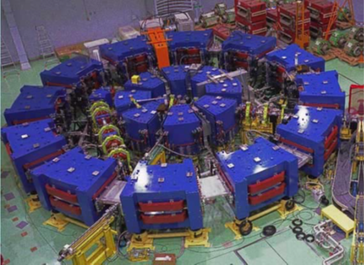
LhARA Stage 2 FFA
Stage 2 Goal – irradiate animal models.
Need post-acceleration to increase energy of the beam driven by the laser.
Current solution is based on a fixed field alternating gradient accelerator (FFA).
FFAs are accelerators in which magnetic fields do not vary in time but are a strong function of radius.
FFAs proposed for: muon accelerators, accelerator driven sub-critical reactors, medical applications.
Upgrade of ISIS neutron source at STFC/RAL proposed to use FFA.
Advantages over conventional medical cyclotrons.
  Variable energy operation without energy degraders.
  Operation with different ions.
  Multiple extraction ports.
Number of sectors 10
k 5.19
R_{min} 2.92 m
R_{max} 3.49 m
B_{max} 1.4 T
Max p injection E 15 MeV
Max p extraction E 127 MeV
RF freq 2.89…6.48 MHz
Bunch intensity 10⁸ protons
FFA for ADSR, Kyoto University (KURNS)
LhARA FFA design parameters

Slide 11

Instrumentation for LhARA
Instrumentation possibilities:
Laser interaction region
Low energy and transfer beamlines
Sciwire and for low energy beamline
FFA needs some custom solutions, synergies with KURNS and ISIS Upgrade
SmartPhantom under development for high energy beamline
SciWire:
Scintillating fibre detector for low-energy ion beams.
  Energy measurement.
  Intensity profile.
Plane made of fibres arranged in two layers perpendicular to each other.
Detector consists of multiple planes.
Scintillation light from all planes is read out from one side for each orientation.
Currently early stage prototypes exist
Fast feedback and controls:
Monte Carlo simulation of the LhARA beam line in firmware
Development of an automated system for tuning the beam
What did we hit anyway ?
Secondary gamma measurements
Secondary PET measurements
Ion / proton acoustic tomography
250$μ$m
5cm
5cm

Slide 12
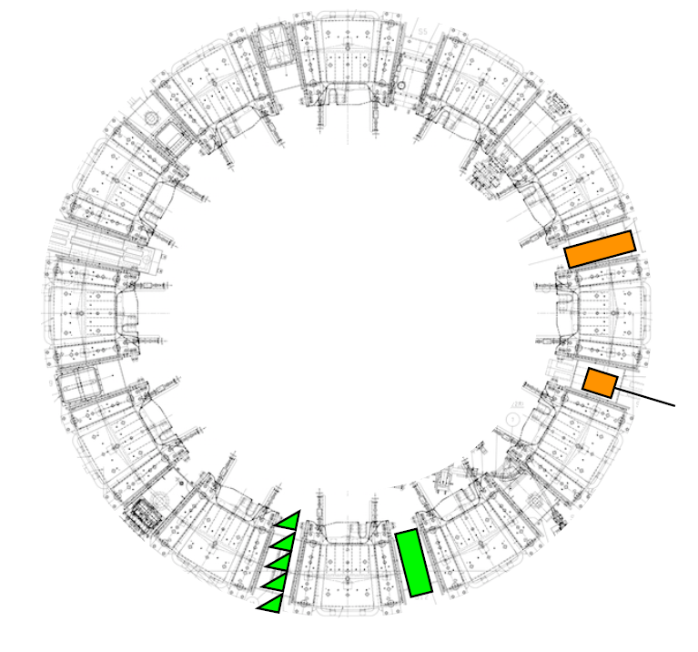
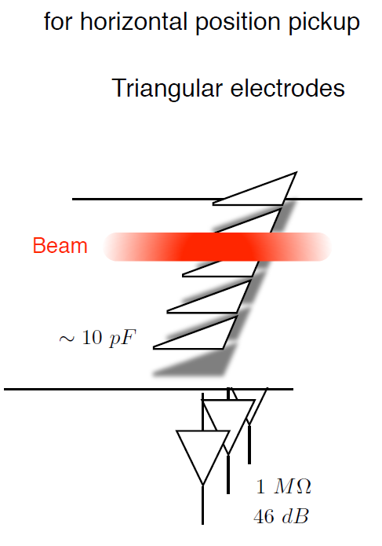
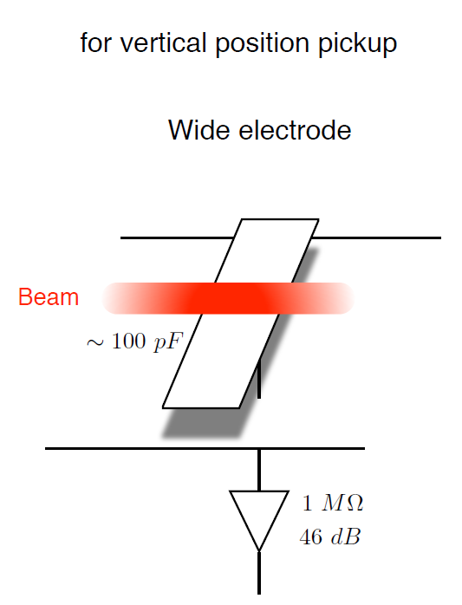
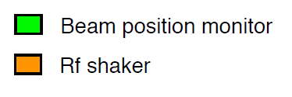
FFA Instrumentation
KURNS FFA main ring
Would be useful to understand beam pickup response in more detail, e.g. using CST Particle Studio
CERN, Kyoto willing to collaborate
LhARA:
Beam position measured at injection and extraction septa
Position measurement at least every second cell
KURNS = Institute for Integrated Radiation and Nuclear Science, Kyoto University

Slide 13
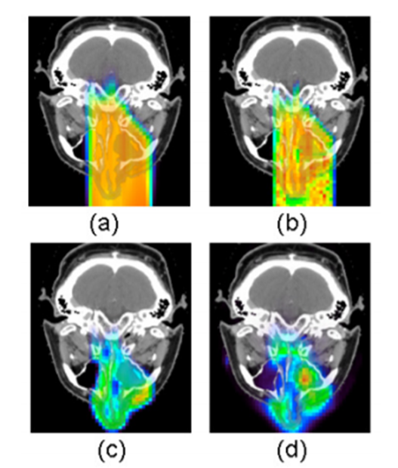
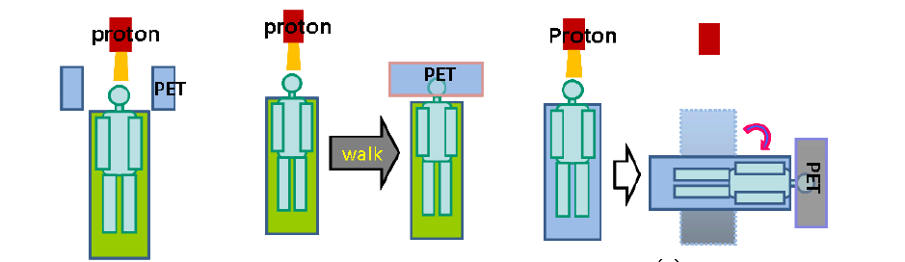
How to characterise the Bragg peak in a patient ?
Secondary gammas
  Inelastic interactions of protons => prompt gammas
  Prompt gammas used to reconstruct Bragg peak position
  Photon energy 4-10 MeV makes detectors challenging
Positron Emission Tomography (PET)
  Target nuclei fragmentation (protons) or projectile fragmentation (ions)
  Leaves a footprint of radioactive nuclei, some of which can be measured using a PET scanner
Proton- or ion- acoustic imaging
  Next slide !
Treatment plan
MC from treatment plan
PET signal from MC
Measured PET signal

Slide 14
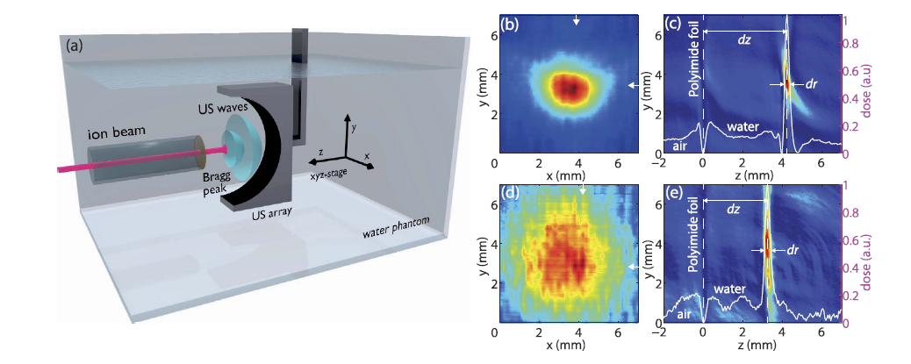
Ionoacoustic Tomography
200ns pulsed beam incident on water phantom (tandem VdG Munich)
Localised temperature jump => expansion => acoustic wave
64-element ultrasound transducer array used to reconstruct Bragg peak in 3D
Complementary with hospital ultrasound scanners => anatomy
Also complementary with optoacoustic imaging
Intention is to use in vivo in certain cancers
Ion interaction simulated in GEANT4
Acoustic simulation using k-Wave (Matlab Toolbox)
Diffraction limit 0.2-0.3mm
Kellnberger, S. et al. Ionoacoustic tomography of the proton Bragg peak in combination
with ultrasound and optoacoustic imaging. Sci. Rep. 6, 29305; doi: 10.1038/srep29305 (2016).

Slide 15






LhARA encompasses a huge range of technological innovations in the support of a new understanding of radiobiology.
It is a young collaboration with roles becoming more clearly defined; a LhARA student would have numerous opportunities for involvement and a choice of areas to suit their own interests.
Not to mention the opportunities for travel and collaboration….
Geneva
Kyoto
Vienna
Pavia
Heidelberg
Paris

Slide 16
Spare Slides

Slide 17
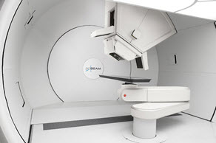
Ion therapy challenges – accelerator
Cyclotrons deliver beams at final, single energy.
Degraders used to decrease beam energy, cause scattering, produce radiation.
Low energy injection of cyclotrons limits beam current due to space charge.
Cyclotrons one ion species.
Synchrotrons can accelerate multiple ion species but larger and more costly.
Gantries, significant cost of the accelerator facility.
MedAustron p and C synchrotron:
Varian proton gantry:
17

Slide 18
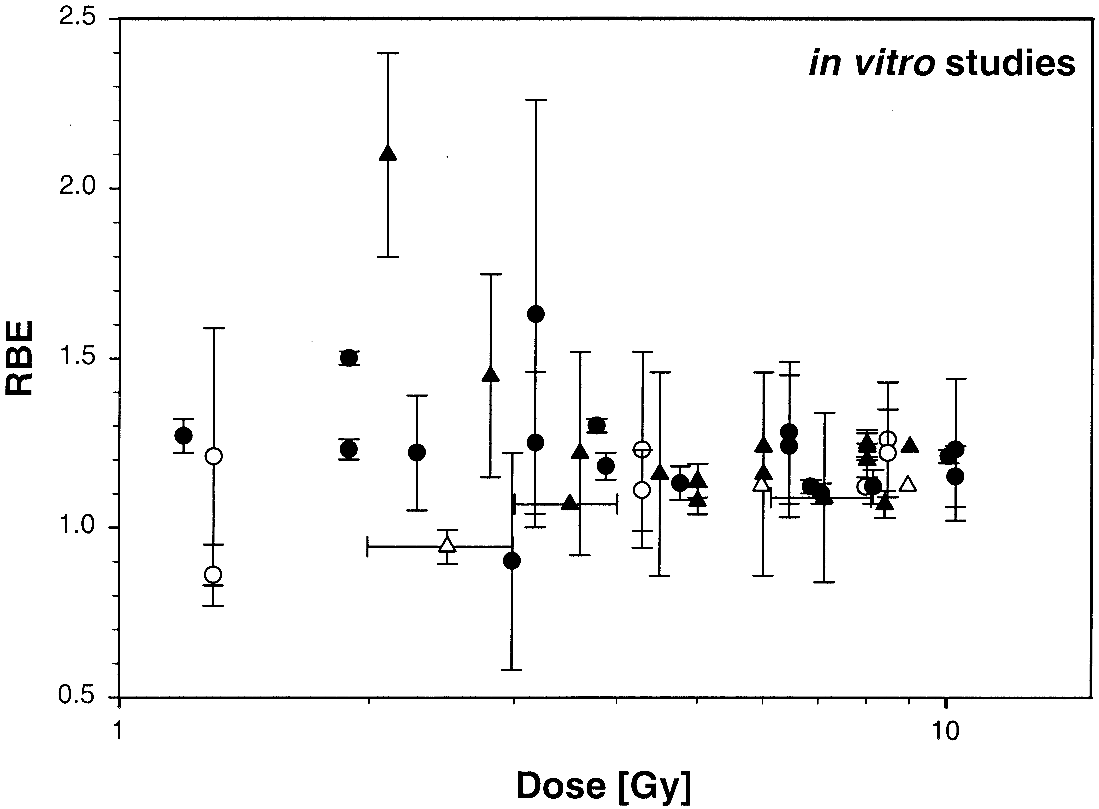
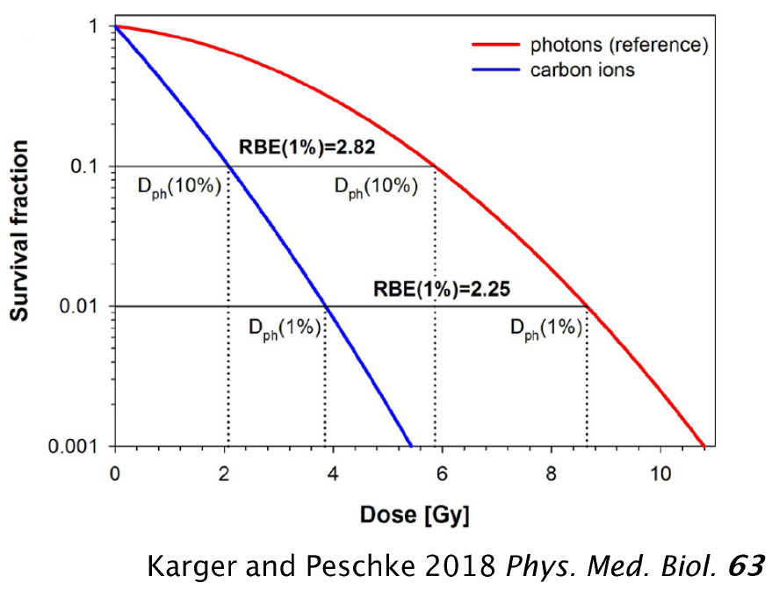
Radiobiology challenges
Biological effects of a given dose of radiation depend on the type of radiation (and other factors).
Radiobiological effectiveness (RBE) is ratio of effectiveness cf. photons.
Typically, constant RBE = 1.1 used for planning proton therapy.
For carbon ions, RBE typically above about 2.25.
Systematic studies needed to improve data and understanding of underlying radiation damage mechanisms.
Important for planning of proton and ion treatments.
Experimental proton RBE values relative to ⁶⁰Co.
Paganetti H et al. 2002 Relative biological effectiveness (RBE) values for proton beam therapy Int. J. Radiat. Oncol. Biol. Phys. 53 407–21

Slide 20
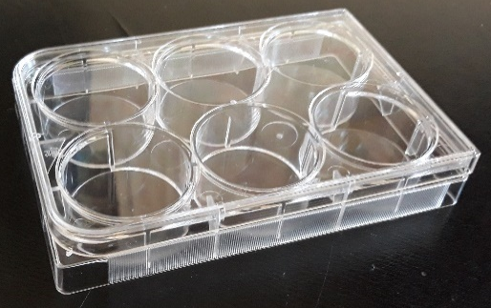
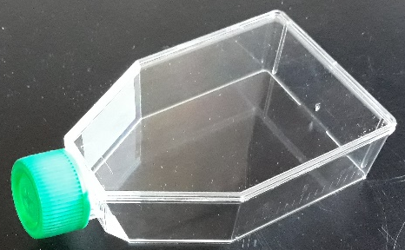
Stage 1 end station
10 mm
Material budget determines required beam energy.
  More material increases cost of laser.
  Consider cell sample containers.
Energy deposition and dose calculation very important for the design of the end station.
  Want the Bragg peak in the cell layer.
  Ensure efficient delivery of dose to the cells (i.e. minimize the time needed to irradiate a sample).
  Dose verification.
  Simulations => 15 MeV is sufficient
15 mm cell nutrient
solution.
0.03 mm cell layer.
1.15 mm sample
container base.
5mm air gap.
0.25 mm scintillating fibre layer.
0.075 mm vacuum window.
beam

Slide 21
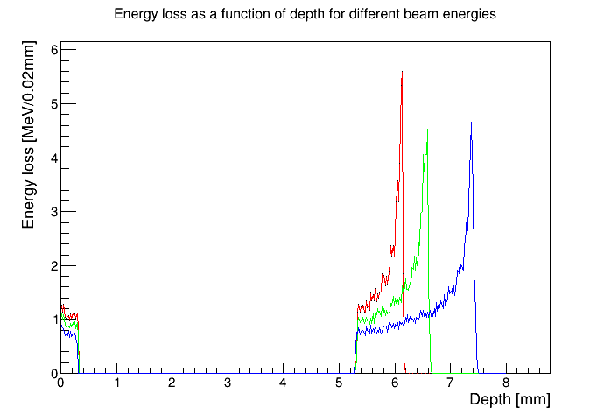
Stage 1 (In Vitro) End Station
Beam energy chosen to ensure Bragg peak can be scanned through cell layer.
Detailed simulation of delivery of beam to sample.
Energy loss as function of depth
10 MeV
12 MeV
15 MeV
beam
0.075 mm window
0.25 mm scint. fibre layer
5 mm air gap
1.15 mm base
0.03 mm cells
15 mm cell nutrients

Slide 22
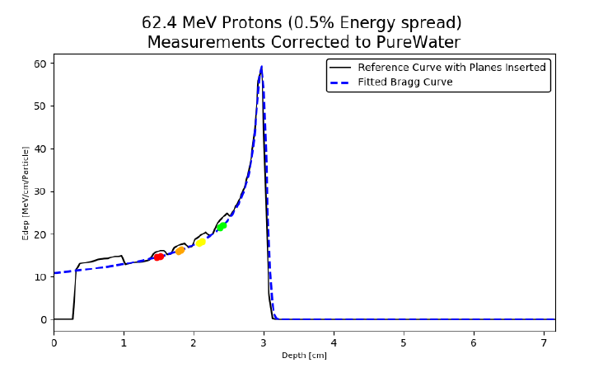
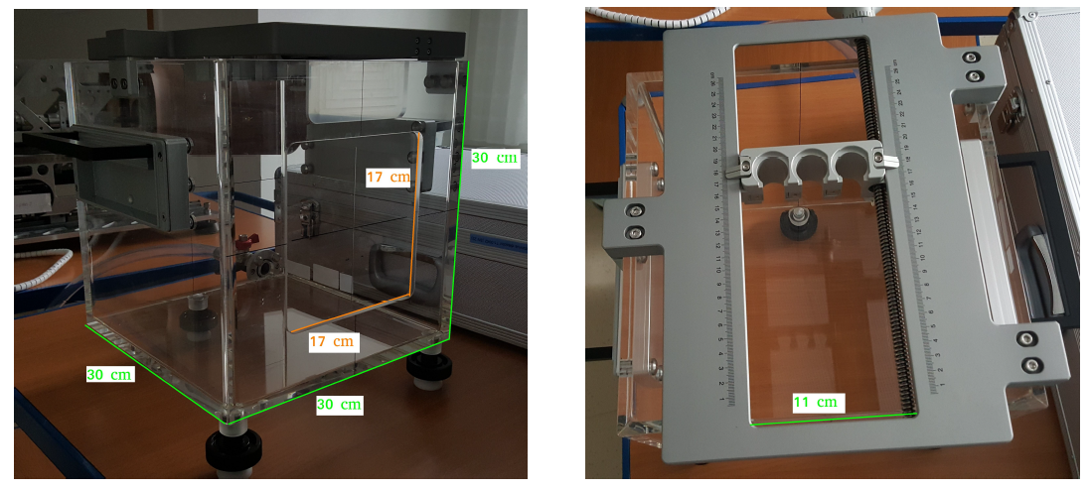
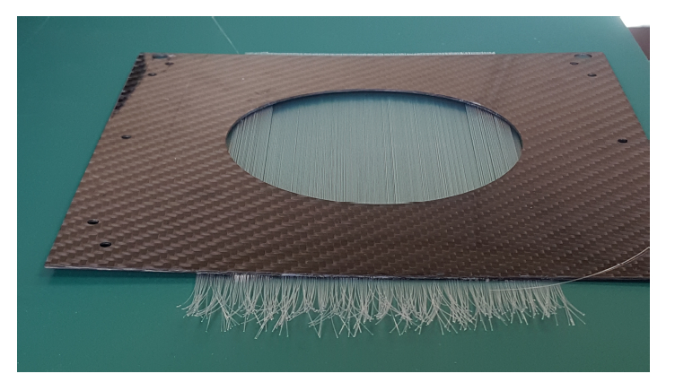
SmartPhantom – water phantom for Stage 2
H.T.Lau
SmartPhantom is being simulated in GEANT4
Simulations will be used to develop analysis scripts, to fit the data and find the position of the Bragg peak, beam profile, LET and dose delivered in real time.
Derive these parameters from measurements taken shot by shot, not purely from Monte Carlo simulations.
Collaboration with the Technical University of Vienna
Decide on readout (CMOS camera, PIN diode….. ?) test planes with sources
Test first prototypes of the SmartPhantom at MedAustron (Austrian national facility for research into proton and carbon-ion radiotherapy)

Slide 23
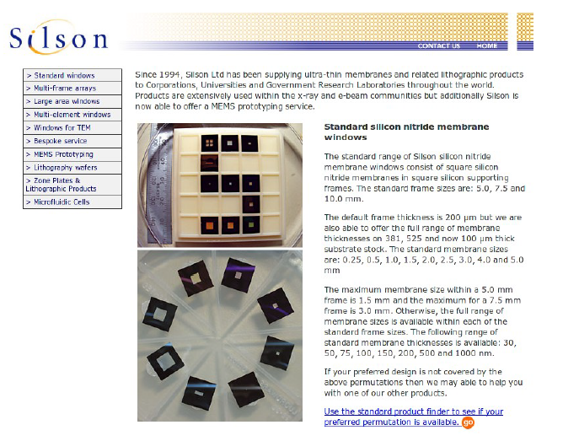
Thin ceramic monitors – beam profile for Stage 1
AlN or SiN membrane 50-150 micron
Chemically etched and metal electrodes deposited
Beam induces currents on the electrodes
Needs some work to define diameter, thickness, mechanics, electrode geometry, readout
Available from industry (Silson, Ametek/HSFoils)
Thanks to Alex Howard

Slide 24
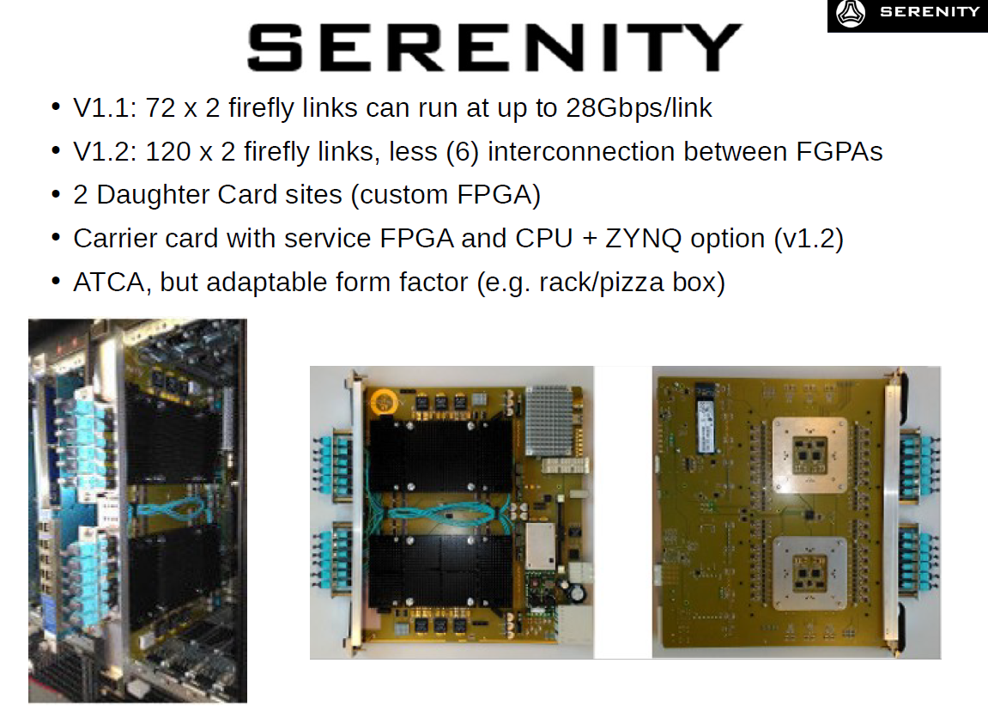
DAQ – Use of FPGAs for fast feedback and control
Serenity – prototype versatile FPGA board developed for CMS DAQ
Alex Howard

Slide 25
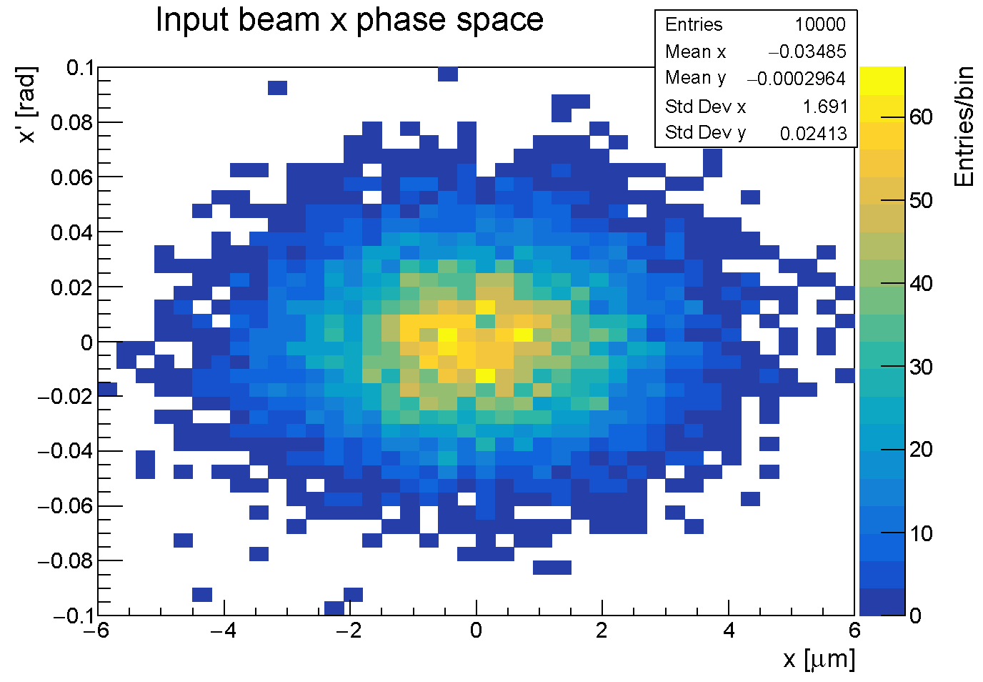
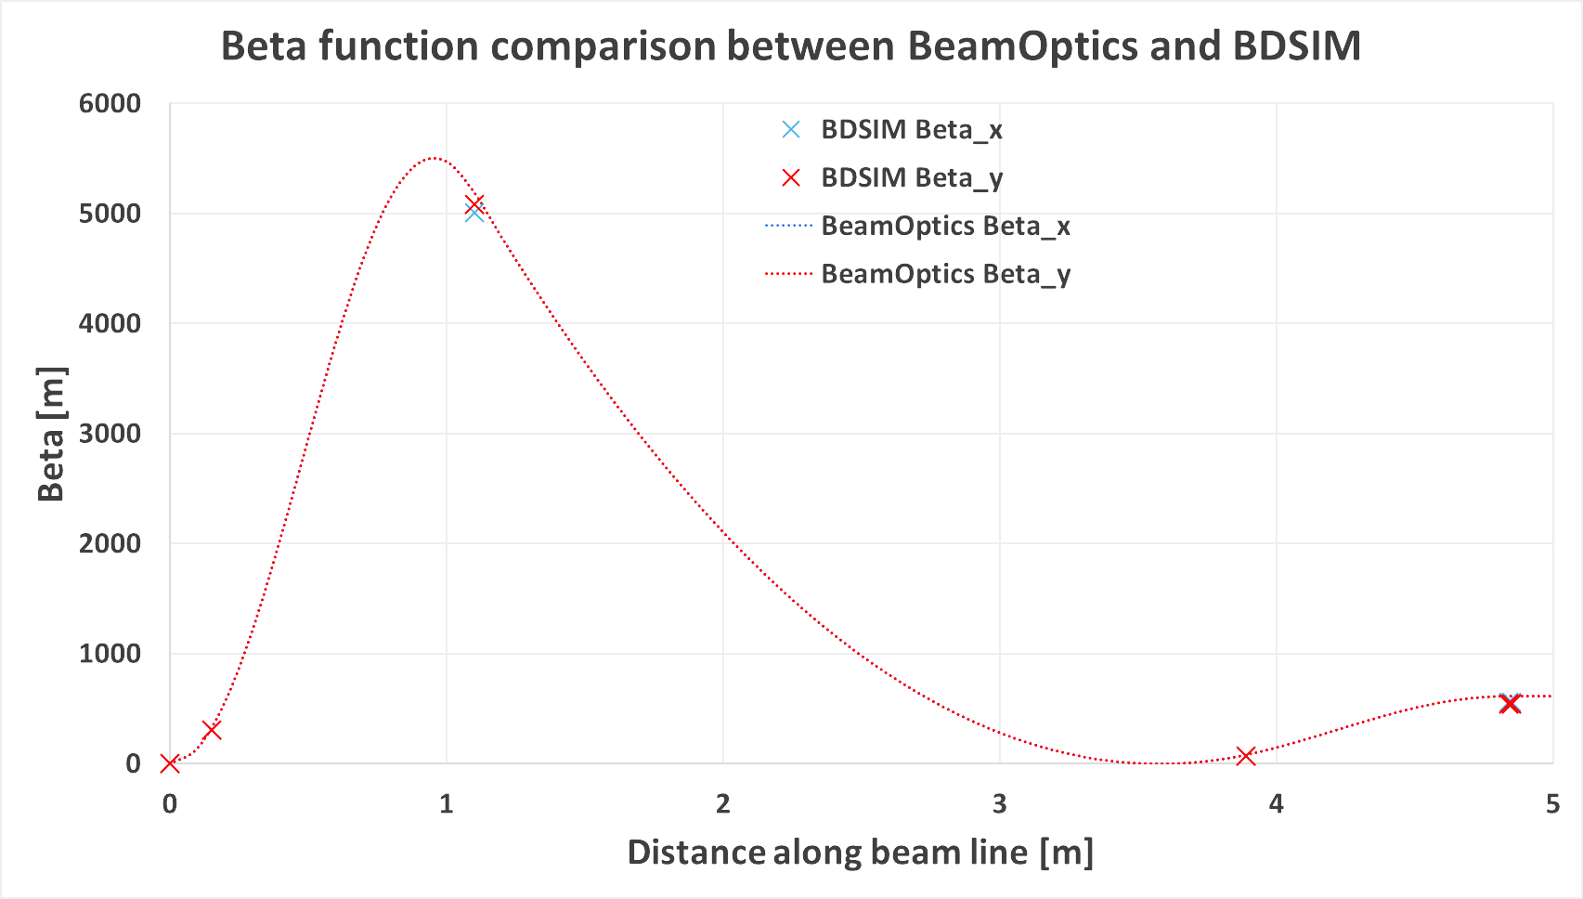
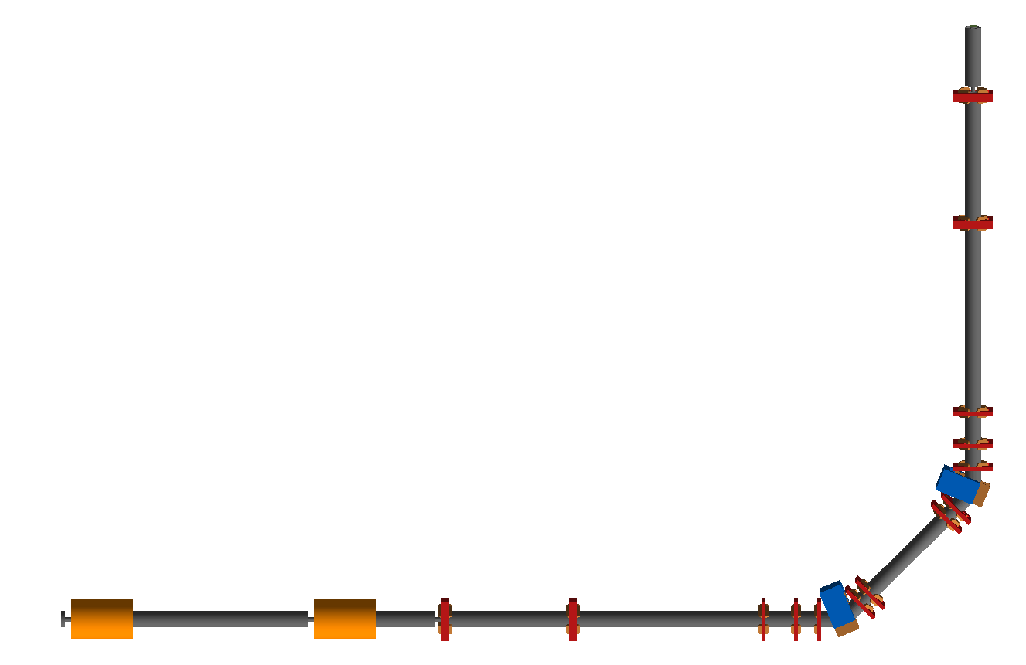
Beam transport
Simulate beam transport from source through to target station using BDSIM (Beam Delivery Simulation), based on Geant4.
  Model beam line elements.
  Track through 3D EM fields.
  Simulate material interactions.
  Extract beam optics parameters and energy deposition.
While design evolving, Gabor lenses modelled as equivalent focal length solenoidal magnets.
Shift to EM simulation of lenses at later stage.
Initial beam
generated by
BDSIM.
Tracked
through
LhARA:

Slide 26
Fixed field alternating gradient accelerators
FFAGs are accelerators in which magnetic fields do not vary in time but are a strong function of radius.
Orbit changes with momentum are relatively small.
Radius of orbit given by
Scaling FFAG, orbit shape independent of momentum.
Non-scaling FFAG, shape of orbit is function of momentum.
Scaling FFAG, k ~3.
Non-scaling FFAG, k can be as large as 80.
F
High energy
D
D
Low energy
Beam dynamics (and orbits) more complex than in cyclotron.
High energy
D
F
D
Low energy
26

Slide 27
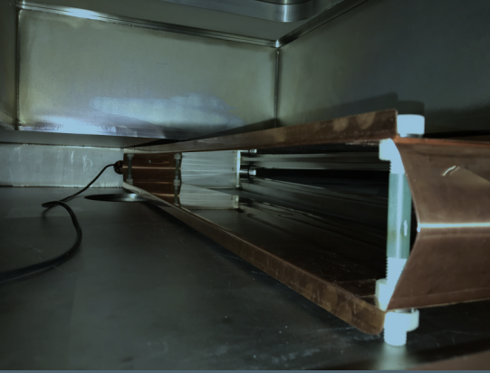
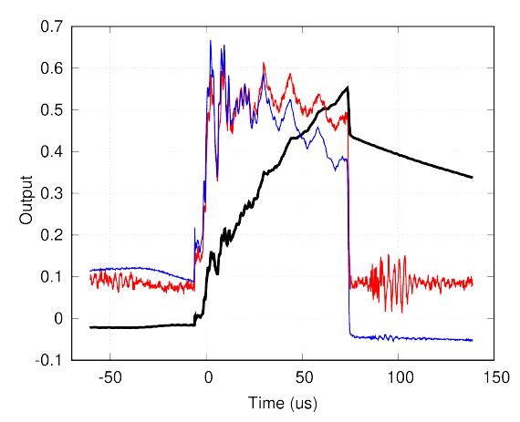
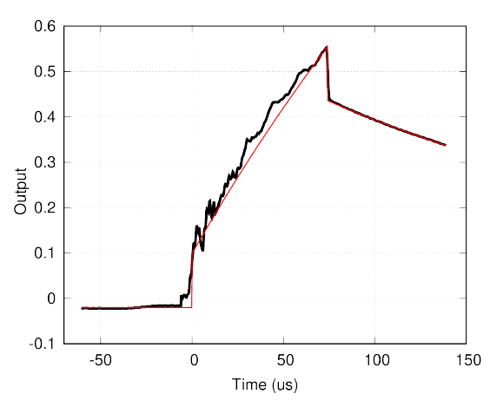

Full aperture bunch monitor (FAB) at KURNS
Comparison:
FAB
Foil (destructive)
Current transformer
Full-aperture bunch monitor (FAB)
Response to rectangular input: Data / Fit
Normalised FAB output used to identify beam losses

Slide 28
Pre-CDR Research Plan
Low energy beam Conventional diagnostics
Beam position – capacitive button pickups
Beam current - BCT
Beam current and energy - multi-layer Faraday cups (destructive)
Emittance - slit-grid/slit scanners or pepper-pot emittance monitors
Low energy beam diagnostics
SciWire - online beam profile measurement
Thin ceramic monitors - online beam profile measurement
Fast feedback and controls
Initial R&D for the fast feedback system will focus on Stage 1
Depends on details of the low energy beam instrumentation
Development of an automated system for tuning the beam
Monte Carlo simulation of the LhARA beam line in firmware
Later extend to include Stage 2
High energy beam diagnostics
Develop beam position measurement for the FFA
Investigate conventional diagnostics for beam current, position and profile measurement in the transfer lines
Bunch length is important in the transfer line to the in vivo end station
Emittance measurements by conventional instruments
Use COTS solutions wherever possible
Online dosimetry and dose profile
Development of SciWire - dose profile at low energy end station
Development of thin ceramic monitors - dose profile at low energy end station
Development of SmartPhantom - online dose measurements in the high energy end stations
Absolute dosimetry at ultra-high dose rates
Characterisation of nonlinear response of film detectors at high dose rates
Investigate use of films for calibrating the online dose monitors Add calorimetry

Slide 29
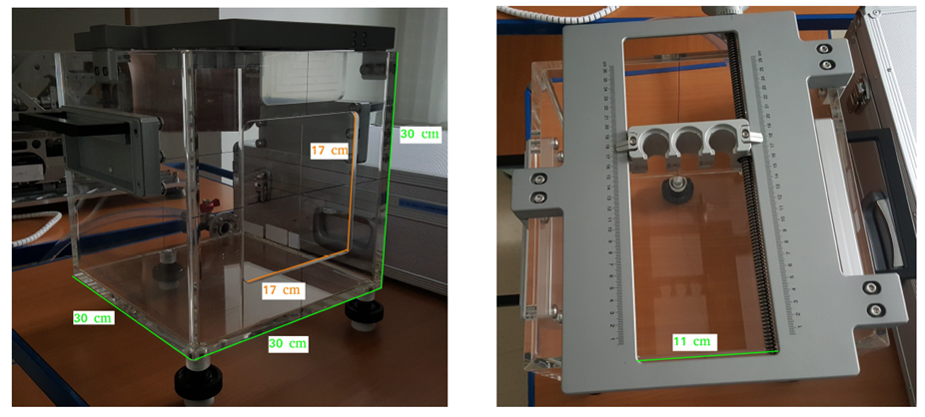
End station beam measurement possibilities
SciWire:
Scintillating fibre detector for low-energy ion beams.
  Energy measurement.
  Intensity profile.
Plane made of fibres arranged in two layers perpendicular to each other.
Detector consists of multiple planes.
Scintillation light from all planes is read out from one side for each orientation.
Currently early stage prototypes exist
SmartPhantom:
250$μ$m
SmartPhantom is being simulated in GEANT4
Simulations will be used to develop analysis scripts, to fit the data and find the position of the Bragg peak, beam profile, LET and dose delivered in real time.
Derive these parameters from measurements taken shot by shot, not purely from Monte Carlo simulations.
Collaboration with the Technical University of Vienna and MedAustron
5cm
5cm

Slide 30
What simulation packages ?
  Laser on target – EPOCH particle-in-cell laser-plasma simulations (Tony Arber, Warwick), SMILEI-2D
  Capture and beamline BDSIM (based on GEANT4)
  Gabor lens full EM simulation – comes later…. COMSOL Multiphysics (e.g.)
  Beam pickups etc. CST Particle Studio
  Interaction of beam with matter GEANT4
  PET/SPECT instrumentation GEANT4 or GATE
  Acoustic simulations k-Wave (Matlab Toolbox)

