Slide 1
Quantum Technologies for Fundamental Physics: The AION project
RAL Cold Strontium Laboratory: Atom Interferometry
Kai Bongs, Pawel Majewski and Tristan Valenzuela

Slide 2
Atom Interferometry
What it is? How it works?
Ingredients
The Strontium lab at RAL

Slide 3
Atom Interferometry
What it is? How it works?
Interferences with Light
Mach-Zehnder Interferometer
ΔΦ
I
ΔΦ

Slide 4
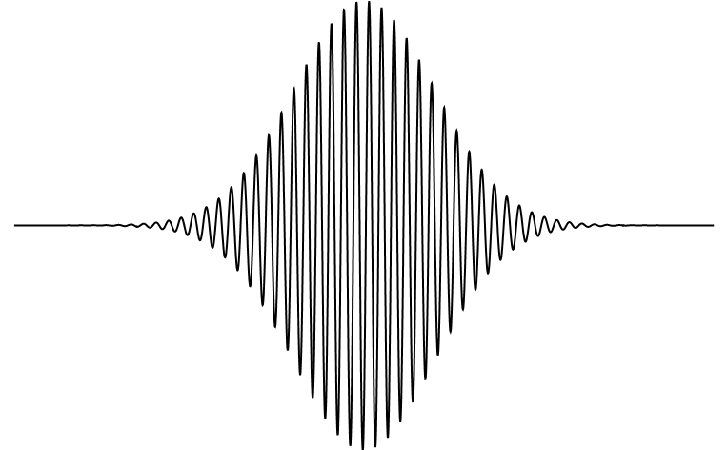
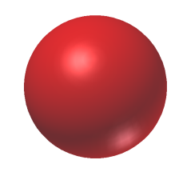
Atom Interferometry
What it is? How it works?
Wave-Particle Duality
de Broglie, Ann. Phys. 3, 32 (1925)
λ= h/p = h/mv de Broglie wavelength
Electron diffraction by Davisson and Germer,
Phys. Rev. 30, 705 (1927)
eg. ⁸⁸Sr m= 1.4×10⁻²⁵kg
T=10μK
λ∼60nm

Slide 5
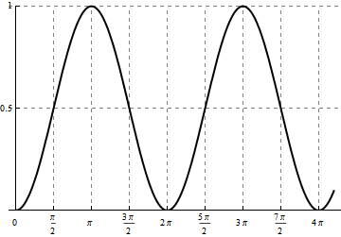
Atom Interferometry
What it is? How it works?
Two level atom
|e⟩
Rabbi Oscillation
|g⟩
Population in |e⟩ ∼ cos²(Ω_{r}t)
Rabi frequency →${ Ω}_{r}=\sqrt{{Ω_{eg}}^{2}+δ^{2}}$
Population in |e⟩
$$Ω_{eg}=\frac{\left\langle e | \vec{d}∙\vec{E_{0}} | g\right\rangle }{ℏ}$$
δ = ω_{L}- ω_{eg} $$ωeg=Eeg⁄ℏ$$
Pulse length $/Ωr$

Slide 6
Atom Interferometry
What it is? How it works?
$$π/2$$
$$π$$
$$π/2$$
space
$$\vec{p}$$
$$\vec{p}+ℏ\vec{k}$$
Δφ=kgT²
$$\vec{p}+ℏ\vec{k}$$
$$\vec{p}$$
$$\vec{p}$$
Beam Splitter
Mirror
Beam Splitter
Pumping
Detection
0
T
2T
time

Slide 7
Atom Interferometry
What it is? How it works?
Benefits of Atoms vs Light Interferometers
Shorter wavelength $→$ more sensitivity for GW
Complementary frequency detection window for GW
Stronger gravitational coupling $→$ sensitivity to DM

Slide 8
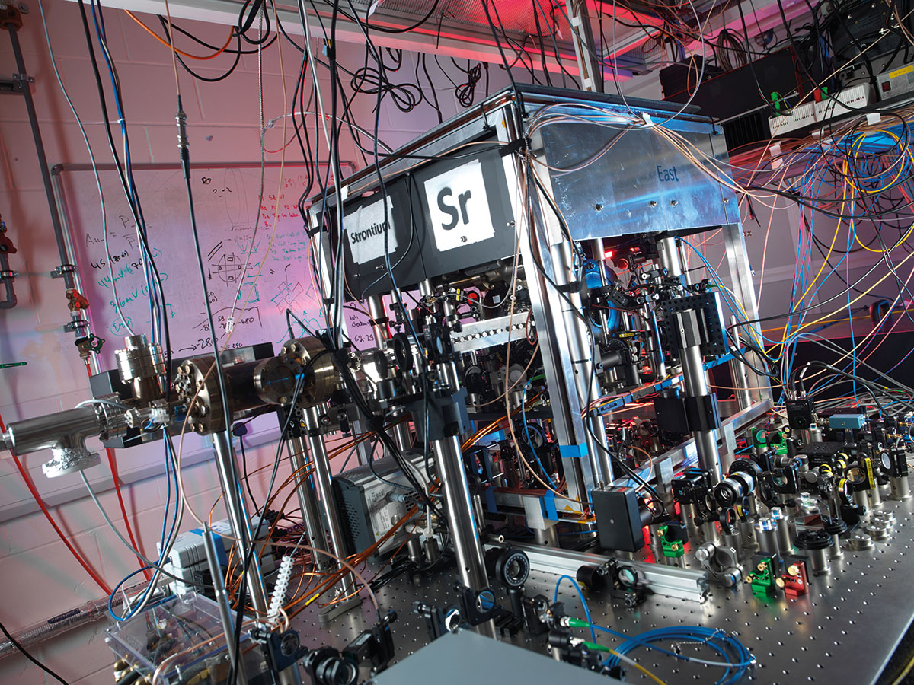
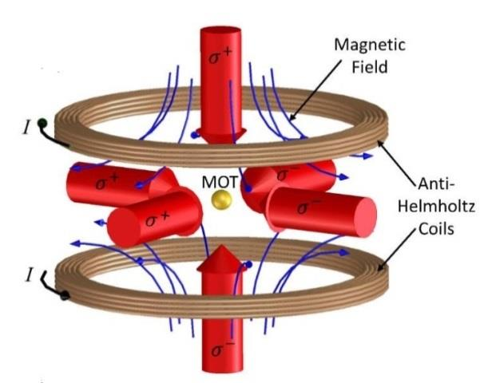
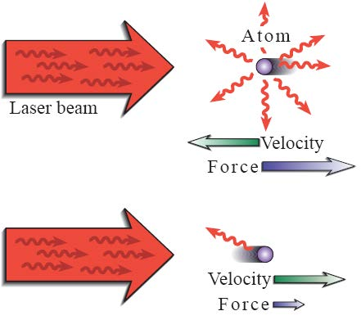
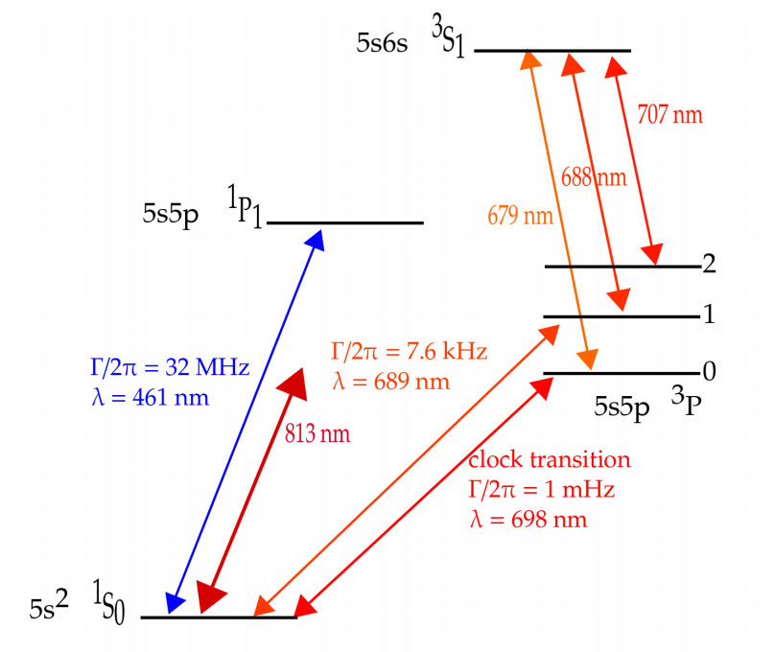
Atom Interferometry
What it is? How it works?
Ingredients
Cold Atoms
NPL Lab

Slide 9
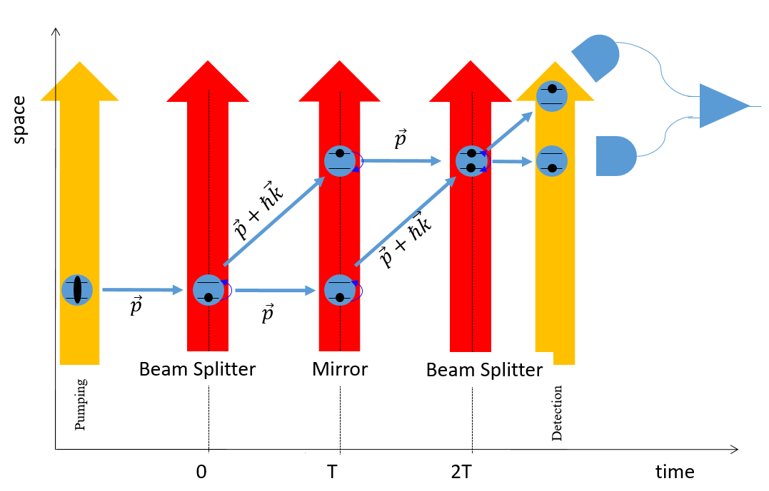
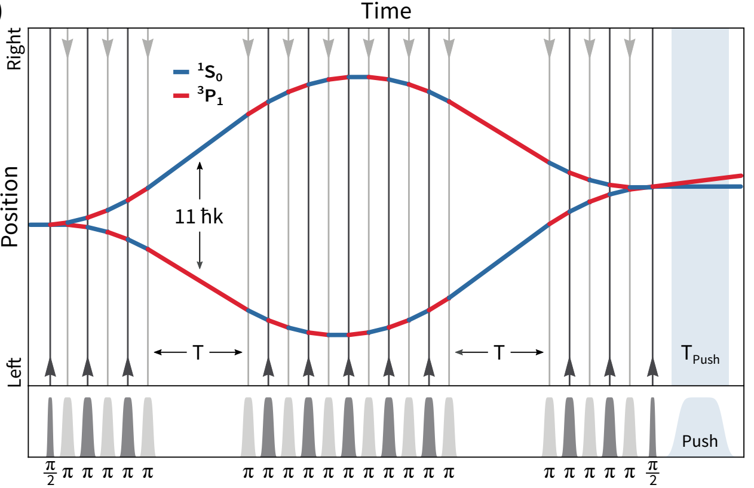
Atom Interferometry
What it is? How it works?
Ingredients
The Strontium lab at RAL in collaboration with U of Birmingham
$$Δφ=k g T^{2}$$
$$ℏk$$
Goal: $1000 ℏk$
J Rudolph et. al, Phys. Rev. Lett. 124, 083604

Slide 10
Join us and use
Quantum 2.0 to
Do Gravitational Waves astronomy
Detect Dark Matter
Build the on of the most accurate clocks
Get your instruments into Space

Slide 11
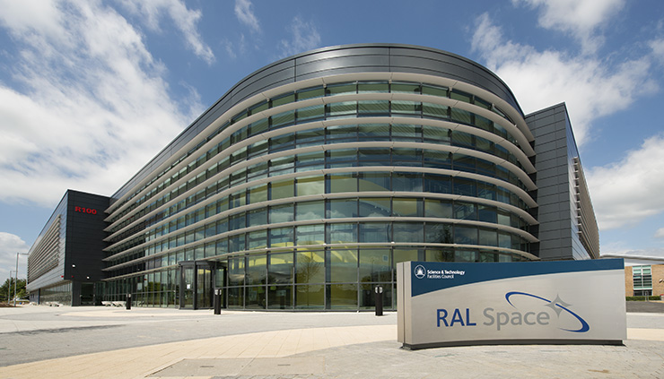
Thank you!
Tristan Valenzuela
Tristan.Valenzuela@stfc.ac.uk
Head of Quantum Sensors Group RAL Space, Harwell, UK
http://www.ralspace.ac.uk

