Slide 1
DRTS meeting - Security coordination, trust and policy Cybersecurity for Science Research in EU Europe (Trusted CI Virtual Institute, 25 June 2019) 1 Dec 2020
David Kelsey, RAL PPD
STFC, UK Research and Innovation

Slide 2
Security Coordination – DavidK & STFC roles - HISTORY
Various roles in Security, Trust and Identity since year 2000
In UK GridPP, WLCG and EU-funded projects (EU DataGrid, EGEE, EGI-Inspire, EGI-Engage, AARC/AARC2, EOSC-hub. EGI-ACE, EOSC Future)
2000: DaveK EU CA Coordination Group -> X.509 EUGridPMA (2004) & TAGPMA & IGTF (2005)
AndrewS ran the first UK CA. Jens joined soon after
2001: EU DataGrid WP7 Security Group started – Linda worked on Security Requirements (D7.5)
2003: Security policies for GridPP (UK) & Worldwide Large Hadron Collider Computing Grid (WLCG) - IanN
2004: EGEE starts. WLCG/EGEE/OSG Joint Security Policy Group (JSPG)
2005: EGEE OSCT/CSIRT and Software Vulnerability Group (SVG) - IanN & Linda
2010: EGI Foundation created – EGI CSIRT, SVG and SPG
2011: FIM4R.org (Research Community Federated IdM requirements) – founding partner
2013: Security for Collaborating Infrastructures (SCI) - version 1 published
2015: WISE & SCI version 2 (published 2017)
2018: EOSC-hub starts and then -
Threat Intelligence - WLCG SOC Working Group - DavidC
UK IRIS – Policy/Trust Asset development and Operational Security – DavidC
2020: Join GEANT GN4-3 WP5 Enabling Collaboration (EnCo) policy group
2021: EGI-ACE and EOSC-Future start

Slide 3
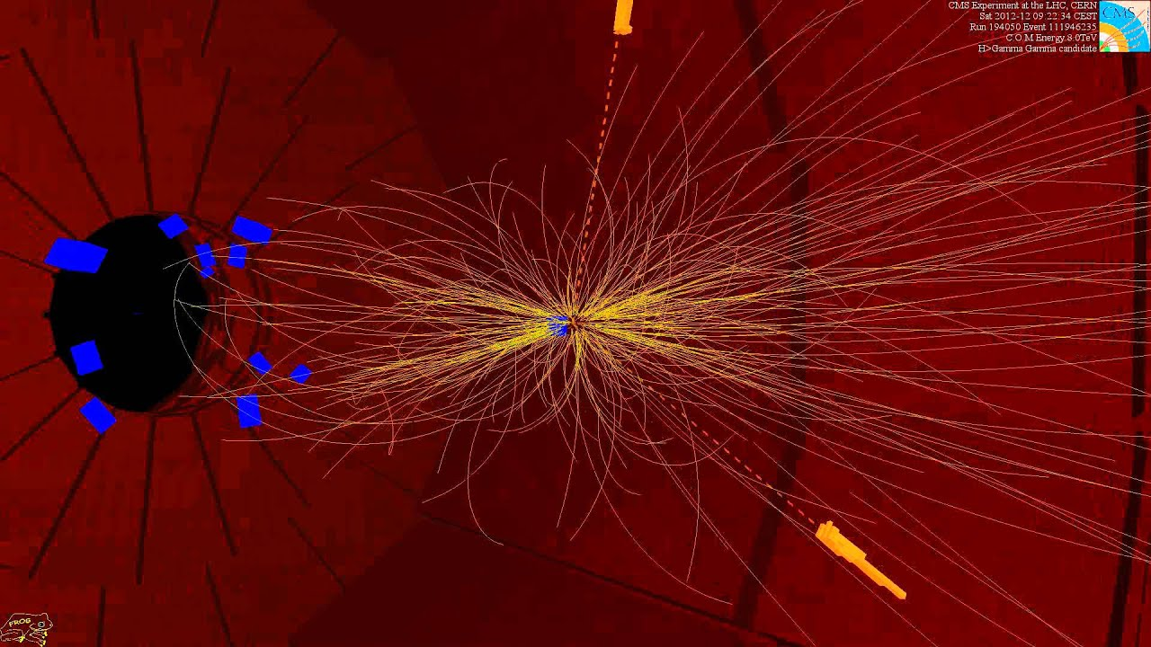
WLCG: Evolving Distributed Computing for the LHC
Ian Bird
CERN
EGI Conference
Amsterdam, 6th May 2019

Slide 4
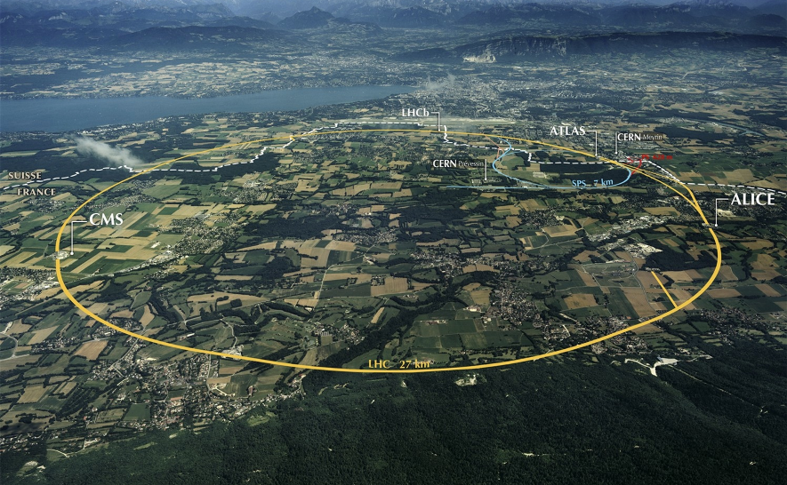
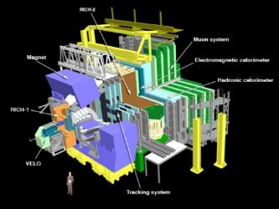
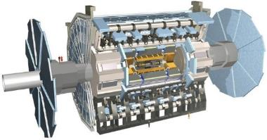
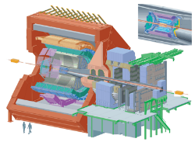
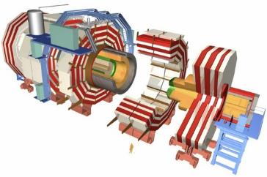
The Large Hadron Collider (LHC)
>1 GB/s
~700 MB/s
A new frontier in Energy & Data volumes:
LHC experiments generate 50 PB/year in Run 2
~10 GB/s
>1 GB/s
Notes:
Largest scientific apparatus ever build
27km around
2 general purpose detectors: Huge microscopes – to explore the very small – using a long lever arm
2 specialized detectors

Slide 5
Some lessons and comments
A federated infrastructure is of tremendous value and importance
This is the *key* feature that identifies our collaborative distributed infrastructure
Even though the X.509 model was difficult to use and manage
Security coordination; policies, incident response, vulnerability & threat intelligence is of huge value
The network is a fundamental resource and opportunity, not a problem to be solved
Redundancy and distribution of services as originally foreseen was unnecessary, complex, and expensive
Today service model is much simplified and streamlined
Today’s operational structure is very simple – coordination at a high level, no need for the heavyweight operations centres
Integrated global ticketing system was essential
Ubiquitous use of “pilot” jobs rather than resource brokering – far more efficient for using available resources
In future the potential specialization of resources may affect this
Distributed data management and storage is expensive – hardware and operations
Data pre-placement is not an optimal strategy (it is a complex problem)
Hardware and cost evolution is becoming a serious concern –
“Moore’s law” as we assumed it is broken
Future of storage technology is a concern – tape and disk
The future computational resources are very heterogenous

Slide 6
LCG Policy
Incident
Response
picture from Ian Neilson
Certification
Authorities
Audit
Requirements
Usage
Rules
Security & Availability
Policy
GOC
Guides
User Registration & VO Management
Application Development
& Network Admin Guide
http://cern.ch/proj-lcg-security/documents.html

Slide 7
EGI CSIRT Activities (2010 onwards)
Prevention of security incidents
Risk assessment & mitigation
Security Monitoring
Vulnerability Handling
Incident Response
Support Infrastructure, community & service security teams
Digital forensics
Mitigation
Security Drills & communication challenges
Training and dissemination
Security Policy Group

Slide 8
More details published in https://www.egi.eu/wp-content/uploads/2017/07/EGI-CSIRT-report-July-2017.pdf

Slide 9
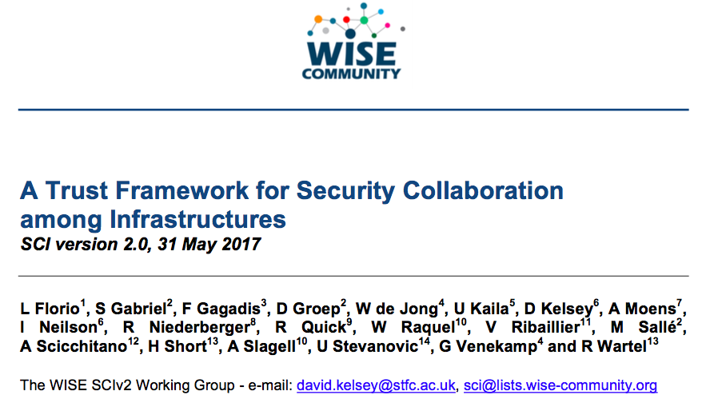
SCI Version 2 – published 31 May 2017
https://wise-community.org/sci/

Slide 10
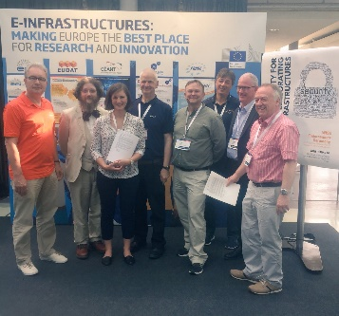
Endorsement of SCI Version 2 at TNC17 (Linz)
1st June 2017
Infrastructures endorse the governing principles and approach of SCI, as produced by WISE, as a medium of building trust between infrastructures, to facilitate the exchange of security information in the event of a cross-infrastructure incident, and the collaboration of e-Infrastructures to support the process. These Infrastructures welcome the development of an information security community for the Infrastructures, and underline that the present activities by the research and e-Infrastructures should be continued and reinforced
Endorsements have been received from the following infrastructures; EGI, EUDAT, GEANT, GridPP, MYREN, PRACE, SURF, WLCG, XSEDE, HBP
https://www.geant.org/News_and_Events/Pages/supporting-security-for-collaborating-infrastructures.aspx

Slide 11
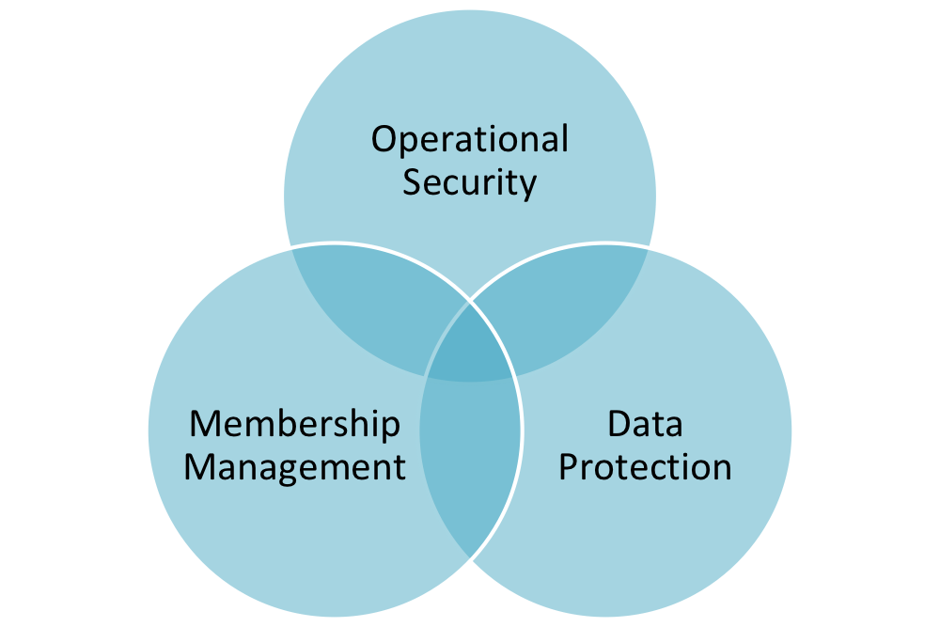
AARC Policy Development Kit
SCI paper (A Trust Framework for Security Collaboration among Infrastructures)
SNCTFI (Scalable Negotiator for a Community Trust Framework in Federated Infrastructures)
Top level policy
Operational Security
Membership management
Data protection
Consider current best practices (EGI, CERN, ELIXIR, TrustedCI, etc.)
Policies started from EGI versions
And then modified
Some other policies (Infrastructure-related) will need to be handled by WISE/EOSC-hub

Slide 12
FIM4R version 2
David Kelsey (STFC UK Research and Innovation) at UK AAAI meeting 24-25 July 2018
With thanks to the FIM4R Authors and Contributors for their collaboration on the whitepaper and the following slides.
** Not all contributors’ logos represented

Slide 13
“Every researcher is entitled to focus on their work and not be impeded by needless obstacles nor required to understand anything about the FIM infrastructure enabling their access to research services.” FIM4R version 2

Slide 14
FIM4R

