Slide 1
Introduction
Roger Jones

Slide 2
Zoom Etiquette
Please set your microphone to mute as default.
Use the ‘raise hand’ and chat functions during the breakout sessions to make comments/contributions/ask questions.
Try to make your comments as concise as possible – we are large in number and short on time! ☺
There is limited capacity to answer questions in the plenary sessions owing to the number of people in the meeting, so please use the chat function to ask questions and we will endeavour to pick these up in real time or answer them after the meeting.

Slide 3
PPAP membership
In 2020 STFC introduced a new panel application process, that is more transparent and consistent with the principles of equality, diversity and inclusion.
Good applications were received for the PPAP, but numbers were still small.
The community are encouraged to apply to future rounds.
We thank the outgoing PPAP members: Joanne Cole, Pawel Majewski, and Matthew Malek
We welcome three new PPAP members: Adrian Bevan, Monica D’Onofrio, and Ruben Saakyan; new addition, Kim Palladino
Reminder: Matthew Needham will be the new chair of the PPAP from the Spring
Roger Jones will continue to support the panel to produce to its new roadmap

Slide 4
Reminder of Roadmap Process
PPAP has been asked to provide a new Particle Physics roadmap in response to the ESPPU.
Establish UK position following the ESPPU to input into other exercises going on in Europe through ECFA and LDG, and worldwide.
PPAP Roadmap timeline:
28 September – community meeting
Slides from that meeting for summary of ESPPU update addition slides here
November –current experiment update meeting
This is the current meeting, 20th November
December/January initial drafting, consult with Nuclear and Astroparticle panels etc
New Year – community meeting to discuss the draft roadmap
Date now set, 19th February
April 2021 – roadmap published
Presentation of near final at STFC Town Meeting

Slide 5
Nature of process
PPAP roadmapping is not Dragon’s Den!
Attempt to establish the location and weight of UK ambition and interest.
Likely form of roadmap
There will not be a single ranked list
But some degree of prioritisation for UK
Not necessarily financial, could also be potential for cross council working, strong international partnerships, strong technology development etc.
Almost certainly we will produce several scenarios
Many factors are external to the UK
Important for the UK to engage in international exercises
Common themes and common developments are likely to be lower risk and higher reward
Important to recognise synergies and the steps needed to prepare for future experiments (i.e. R&D)

Slide 6
PPAP Scope
PPAP looks at the (particle) physics goals and roadmap.
Technology matters, but as an emergent need form those goals, not an end in itself
PPAP ~= PPTAP!
PPTAP is a new committee, established by programmes to inform the European roadmapping
PPAP and the community should communicate technology needs to PPTAP
By chance we have one cross member
More permanently, the TAB sits parallel to Science Board in STFC
Looks in a cross-STFC way at technologies

Slide 7
Written inputs
Written inputs can help the panel, but are not required.
Solicited in Community meeting on 16th September, encouraged early submission (soft target 18th October)
Subsequent much later target of 27th November, announced in regular HiPhy on 4th November
No pro-forma
We will now give brief topical summaries of the state of play ~ by Monday
No suggestion we favour earlier submissions! This is for information only
Later submissions will be noted

Slide 8
European
Strategy key
points and current UK programme

Slide 9
European Particle Physics Strategy 2020
The European Strategy has seven sections:
Major developments from the 2013 Strategy
General considerations for the 2020 update
High-priority future initiatives
Other essential scientific activities for particle physics
Synergies with neighbouring fields
Organisational issues
Environmental and societal impact
Overall, the UK programme aligns reasonably well with the European Strategy, but there is more we can do.
It will be important for the future UK programme to be focussed and to identify priorities.
Notes:
There may be some repetition of the recommendations with the other speakers, but I think that’s ok

Slide 10
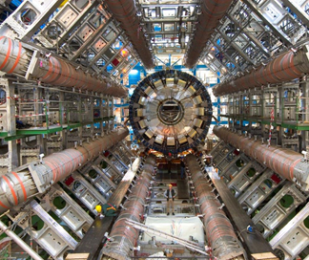
Major developments from the 2013 Strategy
Full exploitation of LHC physics potential and successful completion of the high-luminosity upgrade of accelerators and experiments are high priorities.
Phase 2 upgrades for ATLAS and CMS are underway
Phase 1 upgrade for LHCb is near completion
R&D for LHCb future upgrades is to be reviewed in 2020
HL-LHC-UK-2 is underway
SwiftHEP initiative will help software readiness
European support for the long-baseline neutrino projects in Japan and US is a high priority.
DUNE construction project underway
Hyper-K preconstruction is ongoing and a proposal for construction will be reviewed in 2020-21

Slide 11
General considerations for the 2020 update
The implementation of the European strategy should ensure Europe’s continued scientific and technological leadership, strengthen the ecosystem of research centres in Europe, and be in collaboration with global partners and neighbouring fields.
UK researchers regularly hold leadership positions in experiments – current spokespersons for DUNE, LHCb and NA62.
We should look for ways to make the most of UK national laboratory facilities through collaboration within the UK, and with European partners, CERN, and beyond.
The UK community is encouraged to actively engage in the implementation of the strategy, working with ECFA, the European Lab Directors’ Group and the other relevant committees.

Slide 12
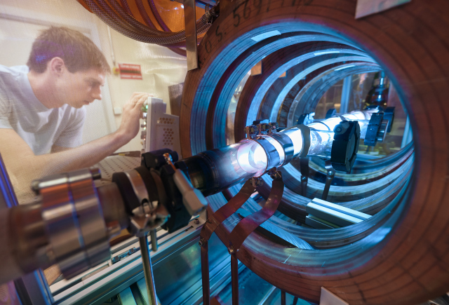
High-priority future initiatives
The strategy calls for increased R&D for accelerator technologies: high-field superconducting magnets, high-gradient accelerating structures, plasma wakefield, muon colliders, etc. and investigating the technical and financial feasibility of a future hadron and e⁺e⁻ collider at CERN.
The International Linear Collider (ILC) in Japan is highlighted in the strategy, with a timely realisation being consistent with that strategy.
Its potential was noted in the STFC infrastructure prioritisation process (PPAP flagged this as true for all HE e⁺e⁻ options).
We need to strengthen our engagement with early stage R&D for future accelerators and detectors – but we have to prioritise.
AWAKE helicon plasma cell R&D lab

Slide 13
Other essential scientific activities for particle physics
The strategy emphasises the importance of supporting a diverse range of experiments in Europe and beyond, having a strong theory programme, and coherence across R&D activities.
The UK has maintained a broad programme in particle physics, particle astrophysics and accelerators, through consolidated grant funding and project funding.
The concerns raised in the Programme Evaluations around future programme diversity have been noted by the Balance of Programme 2.
STFC supports a diverse theory programme and the Institute of Particle Physics Phenomenology, and the number of PDRAs was increased in CG 2019.
We can do more to address the future computing challenge for the HL-LHC and beyond.
We can do more to engage with industry, recognising that this is important and seeking out opportunities that support engagement and knowledge transfer.

Slide 14
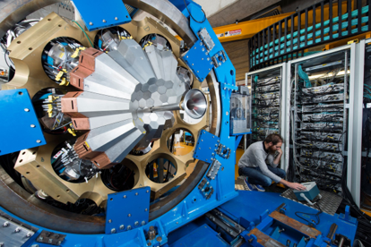
Synergies with neighbouring fields
The strategy notes the importance of synergies between particle physics with particle astrophysics and nuclear physics.
The importance of supporting PA and NP is recognised in Balance of Programme 2, including concerns around levels of funding.
The Electron-Ion Collider (EIC) was seen as a high priority in the STFC infrastructure prioritisation process.

Slide 15
Organisational issues
Key points
An ambitious next-generation collider project will require global collaboration and a long-term commitment to construction and operations by all parties. CERN should initiate discussions with potential major partners as part of the feasibility study for such a project being hosted at CERN.
The strategy stresses the importance of working in partnership.
The particle physics community and the European Commission have a strong record of collaboration and this should be further strengthened.
European science policy is quickly moving towards Open Science, which promotes and accelerates the sharing of scientific knowledge with the community at large.
The particle physics community should work with the relevant authorities to help shape the emerging consensus on Open Science to be adopted for publicly funded research.

Slide 16
Environmental and societal impact
Key points
The energy efficiency of present and future accelerators, and of computing facilities, is and should remain an area requiring constant attention.
Travel represents an environmental challenge, due to the international nature of the field.
Education and training are crucial for the needs of the field and of society at large. Ensure support for early career researchers and to recognise individuals developing and maintaining experiments, computing and software.
Ensure the principles of equality, diversity and inclusion are at the heart of all activities.
Promote knowledge transfer and engage with industry.
Public engagement, education and communication in particle physics should continue to be recognised as important components of the scientific activity and receive adequate support.

