Slide 1
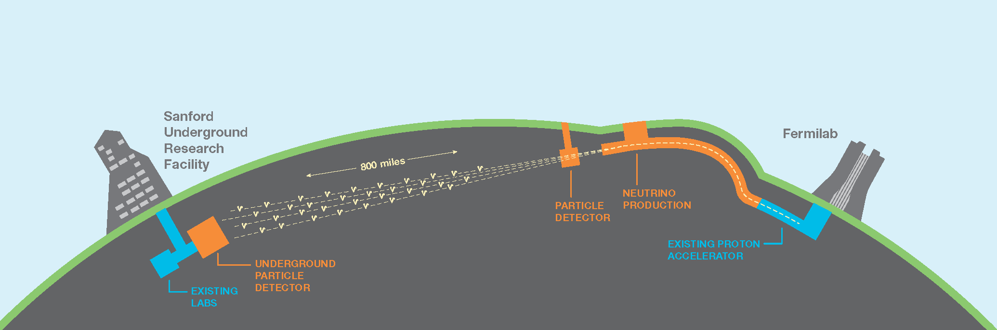
“North American” Accelerator Neutrino Programme
Stefan Söldner-Rembold
PPAP
19 November 2020

Slide 2
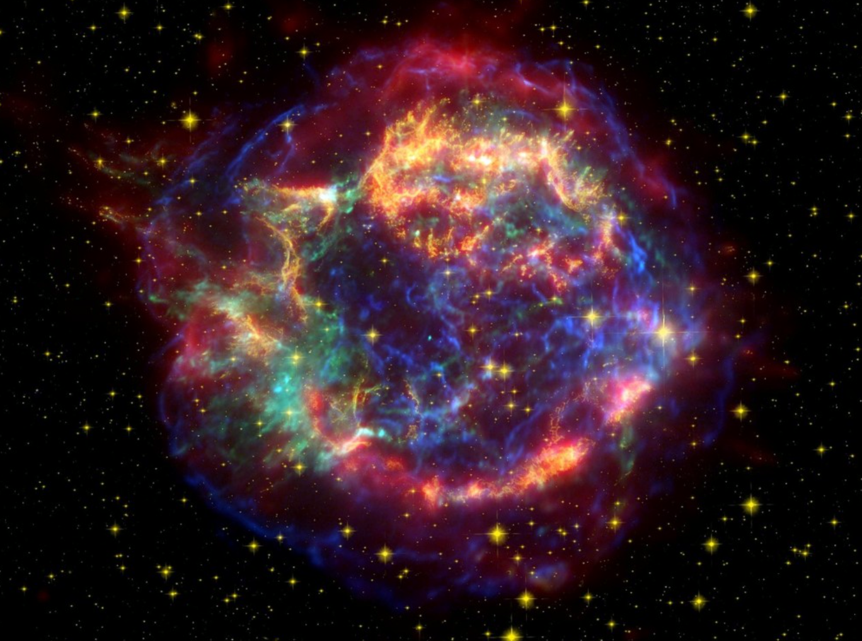
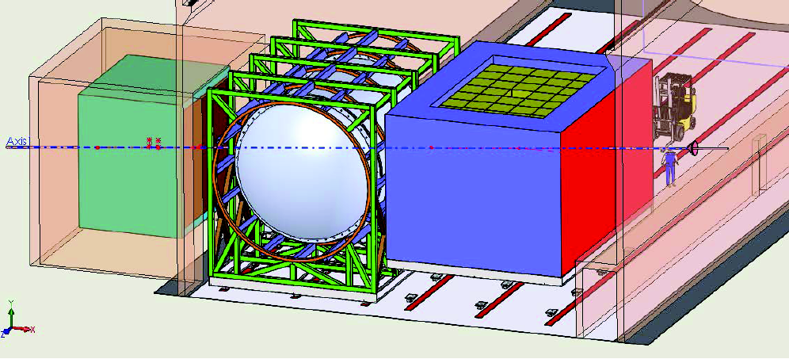
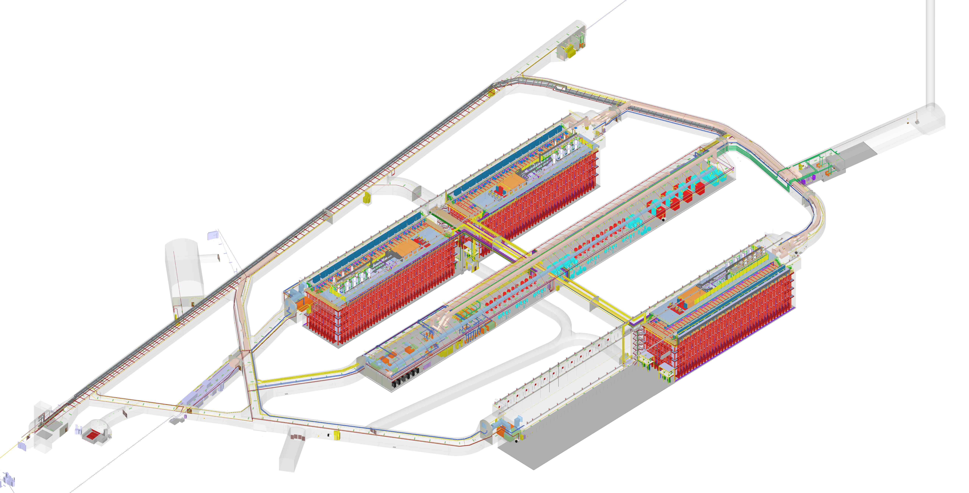
Three pillars of DUNE
May 2018
  A high-power (1.2-2.4 MW), wide-band neutrino beam.
  A ≈ 70 kt liquid-argon underground Far Detector in South Dakota.
  A capable Near Detector located close to the neutrino source.

Slide 3
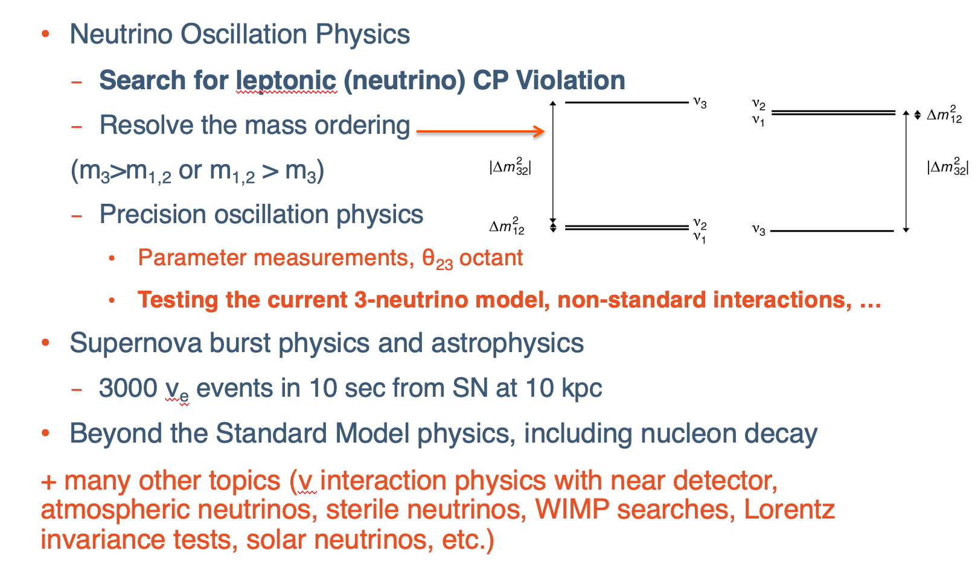
DUNE Science Programme

Slide 4
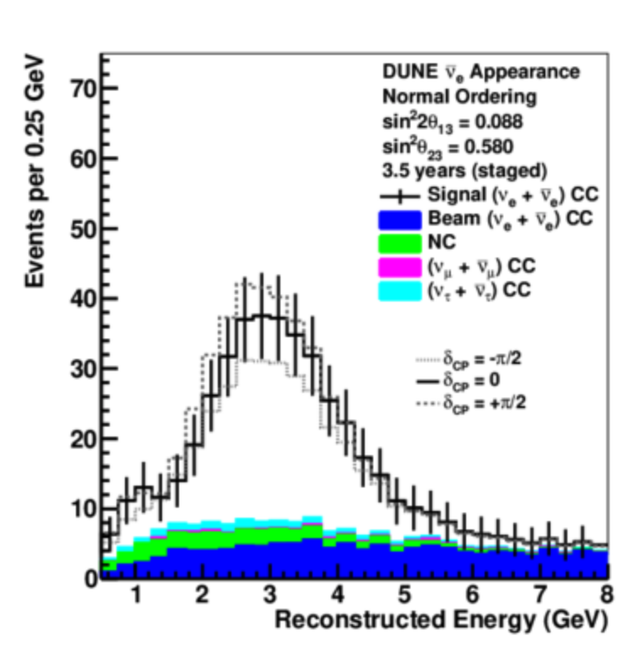
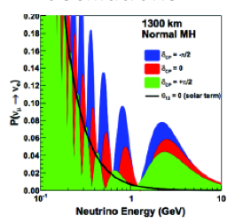
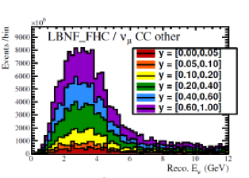
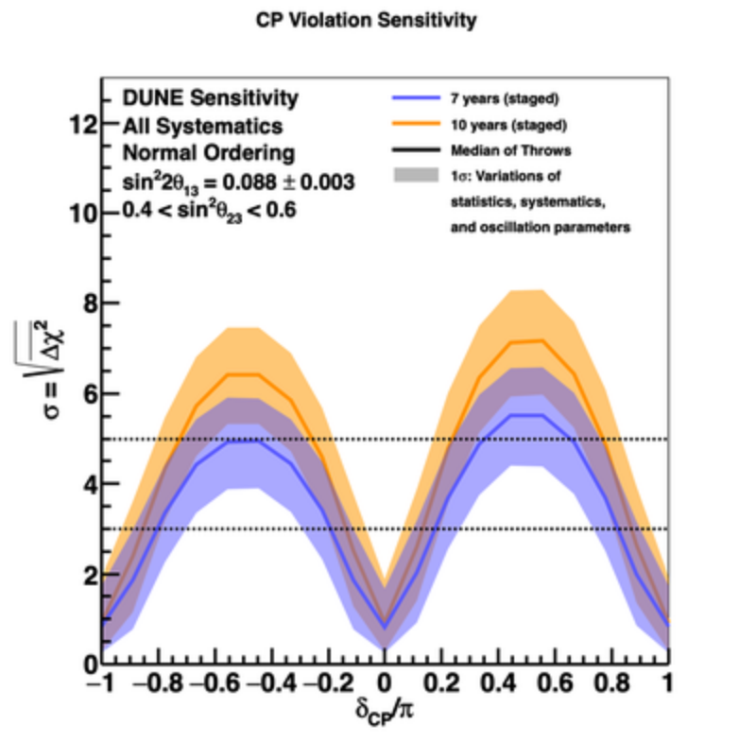
How is the science done?
May 2018
1300 km
FD
ND
The measurement is performed by comparing the measured energy spectra in the Near and Far Detectors (𝜒² test).
The Far Detector is dominated by statistics – need large volume and intense beam.
The Near Detector controls systematics – this drives ND requirements.

Slide 5
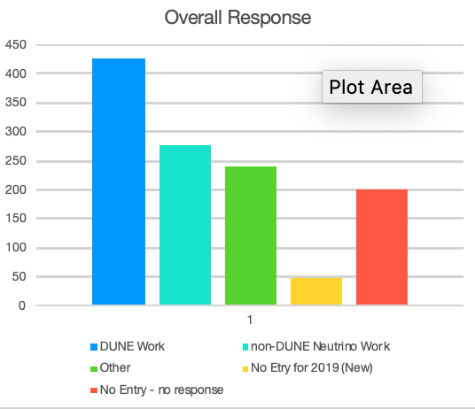
DUNE – a global Collaboration
1214 collaborators from
202 institutions in 32 countries (incl. CERN)
Daresbury, Durham, Imperial College, Lancaster, QMUL, RHUL, RAL, UCL, Birmingham, Bristol, Cambridge, Edinburgh, Liverpool, Manchester, Oxford, Sheffield, Sussex, Warwick
18 institutions
169 UK collaborators
About 420 FTEs on DUNE reported in database for 2019
50:50 US – non-US

Slide 6
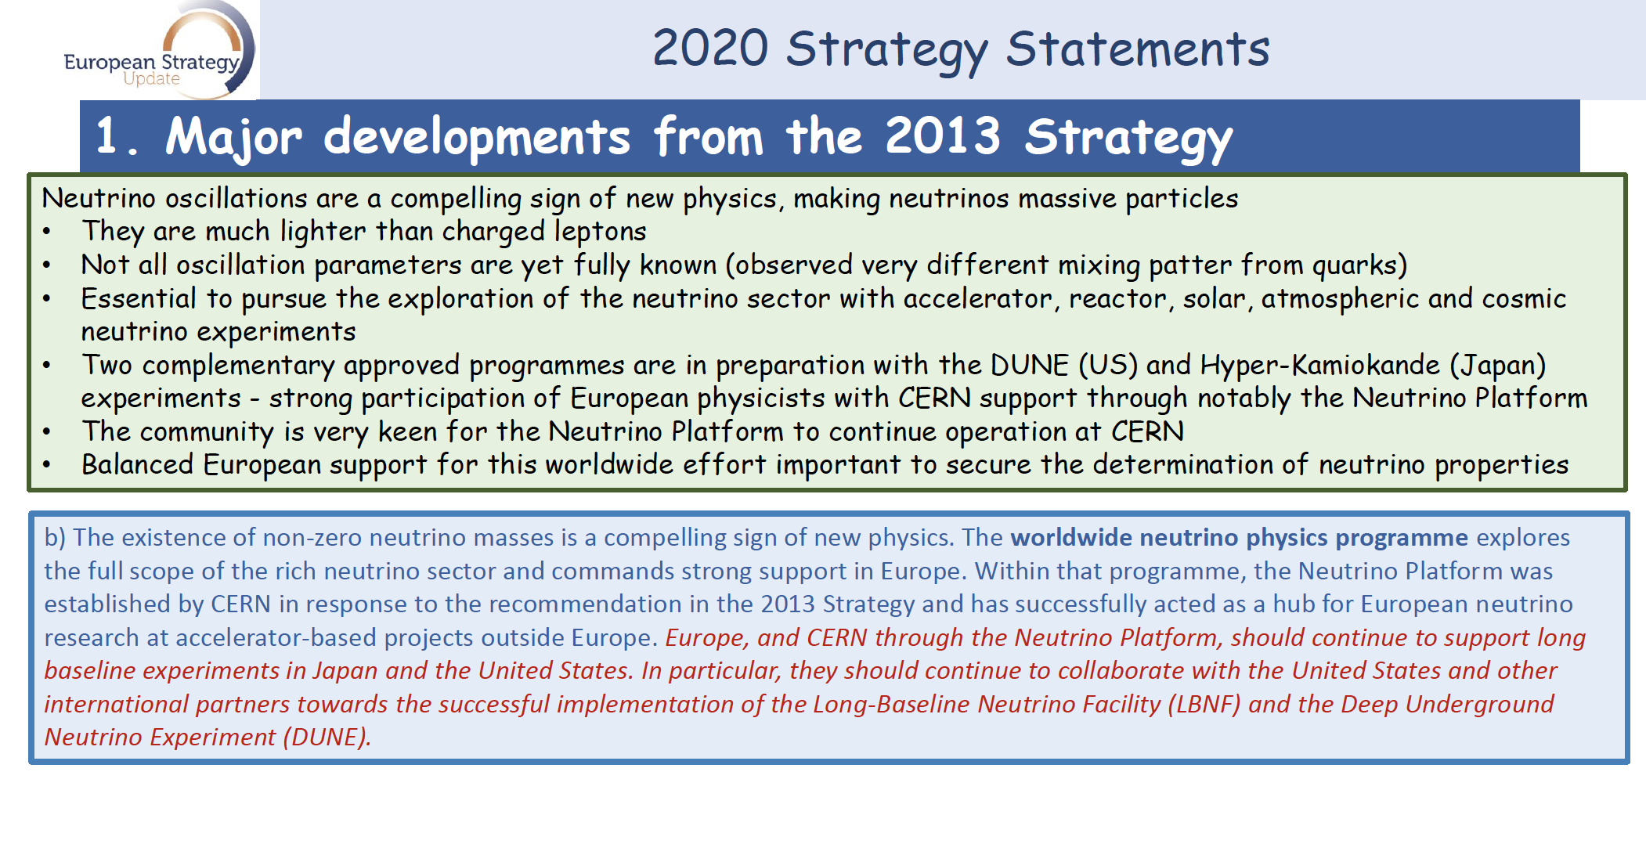
European Strategy Update
Strong support for DUNE!

Slide 7
FD Technical Design Report
Strong UK contributions
TDR volumes I, III, and IV now published in JINST
Vol I:
https://iopscience.iop.org/article/10.1088/1748-0221/15/08/T08008
Vol III:
https://iopscience.iop.org/article/10.1088/1748-0221/15/08/T08009
Vol IV:
https://iopscience.iop.org/article/10.1088/1748-0221/15/08/T08010
Physics volume published as three separate papers in EPJC, plus PRD on CVN reconstruction
ProtoDUNE-SP provided crucial design validation.

Slide 8

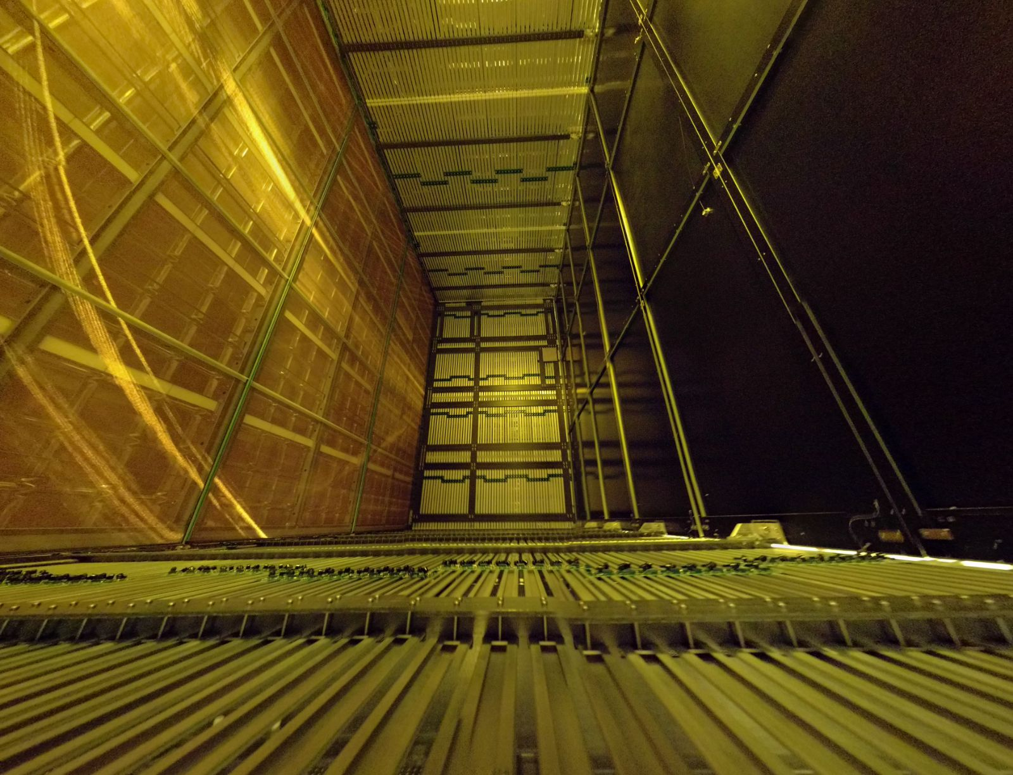




Published in JINST

Slide 9
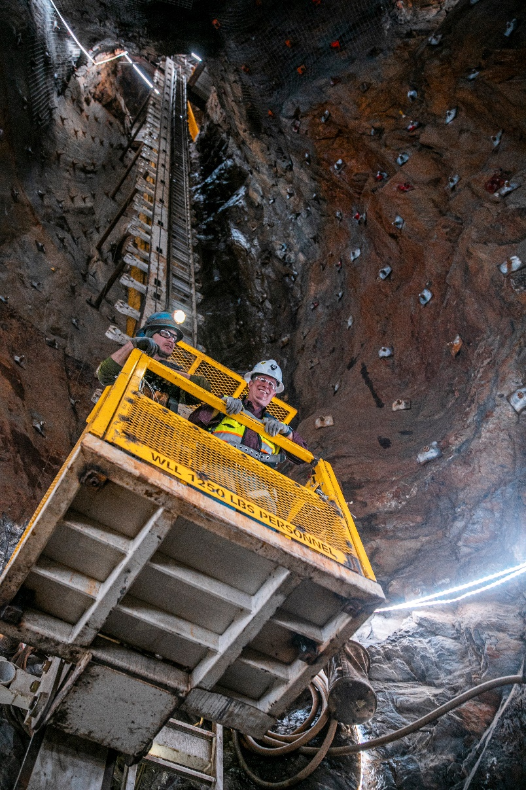
DUNE Far Detector in TDR
Four separate 17 kt (about 10 kt fiducial) LAr TPCs
4 identically sized cryostats: 2 single phase (SP) + 1 dual phase (DP) +1 “opportunity”
Strategy evolving – US baselining of two detectors
SP
SP-APA
DP
SP
145 m

Slide 10
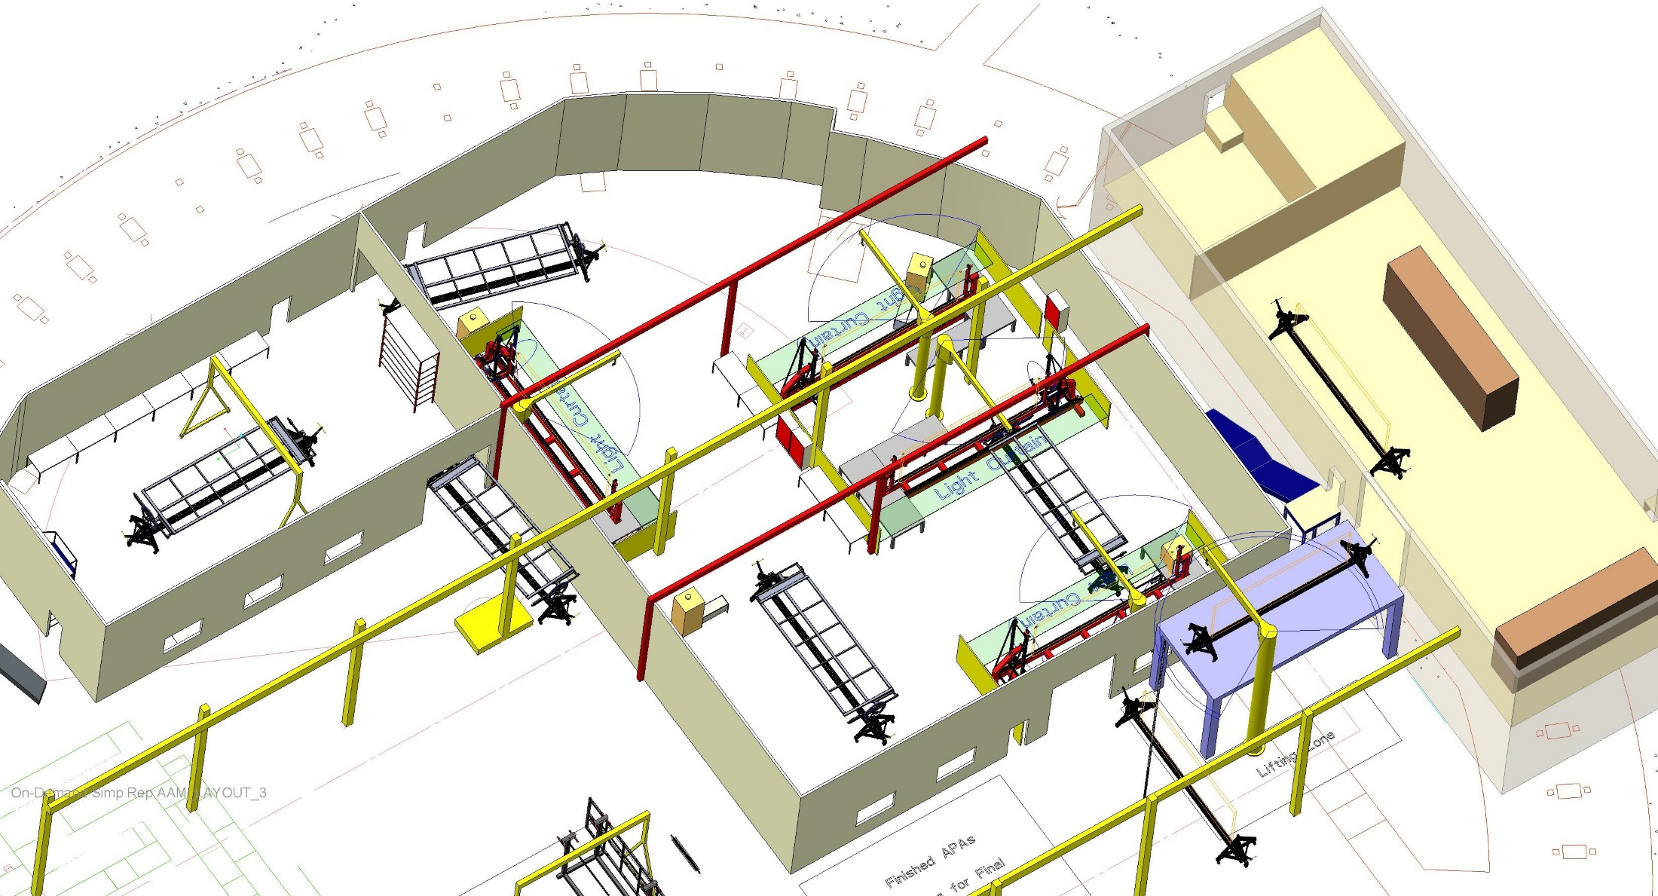
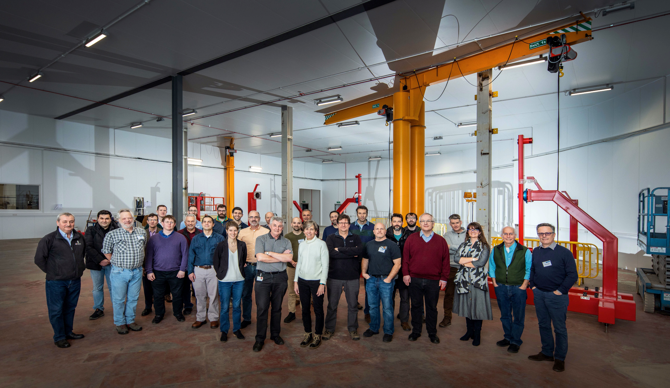
APA factories
Daresbury (UK): purpose built factory inside repurposed accelerator hall
4 winding machines, 10 process carts; 5 new dedicated swing arm pillar cranes
1,085 m² including pre- and post- processing areas, safety systems
UK factory ready to go – starting to build APAs for ProtoDUNE-II

Slide 11
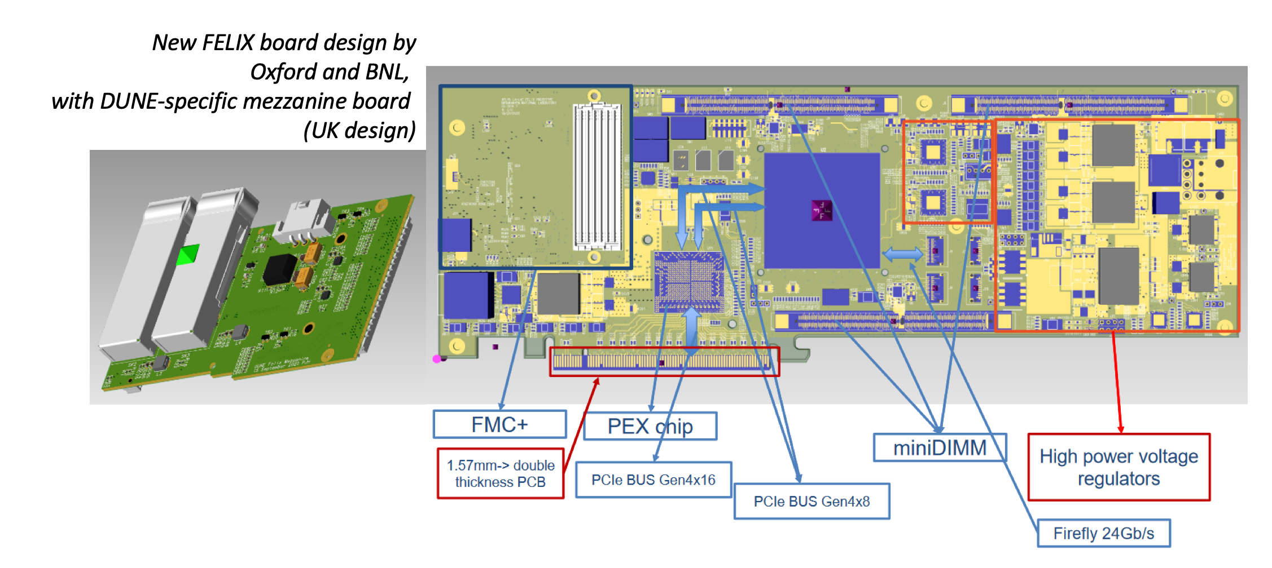
UK leading in Far Detector UK
Simon Peeters, Giles Barr

Slide 12
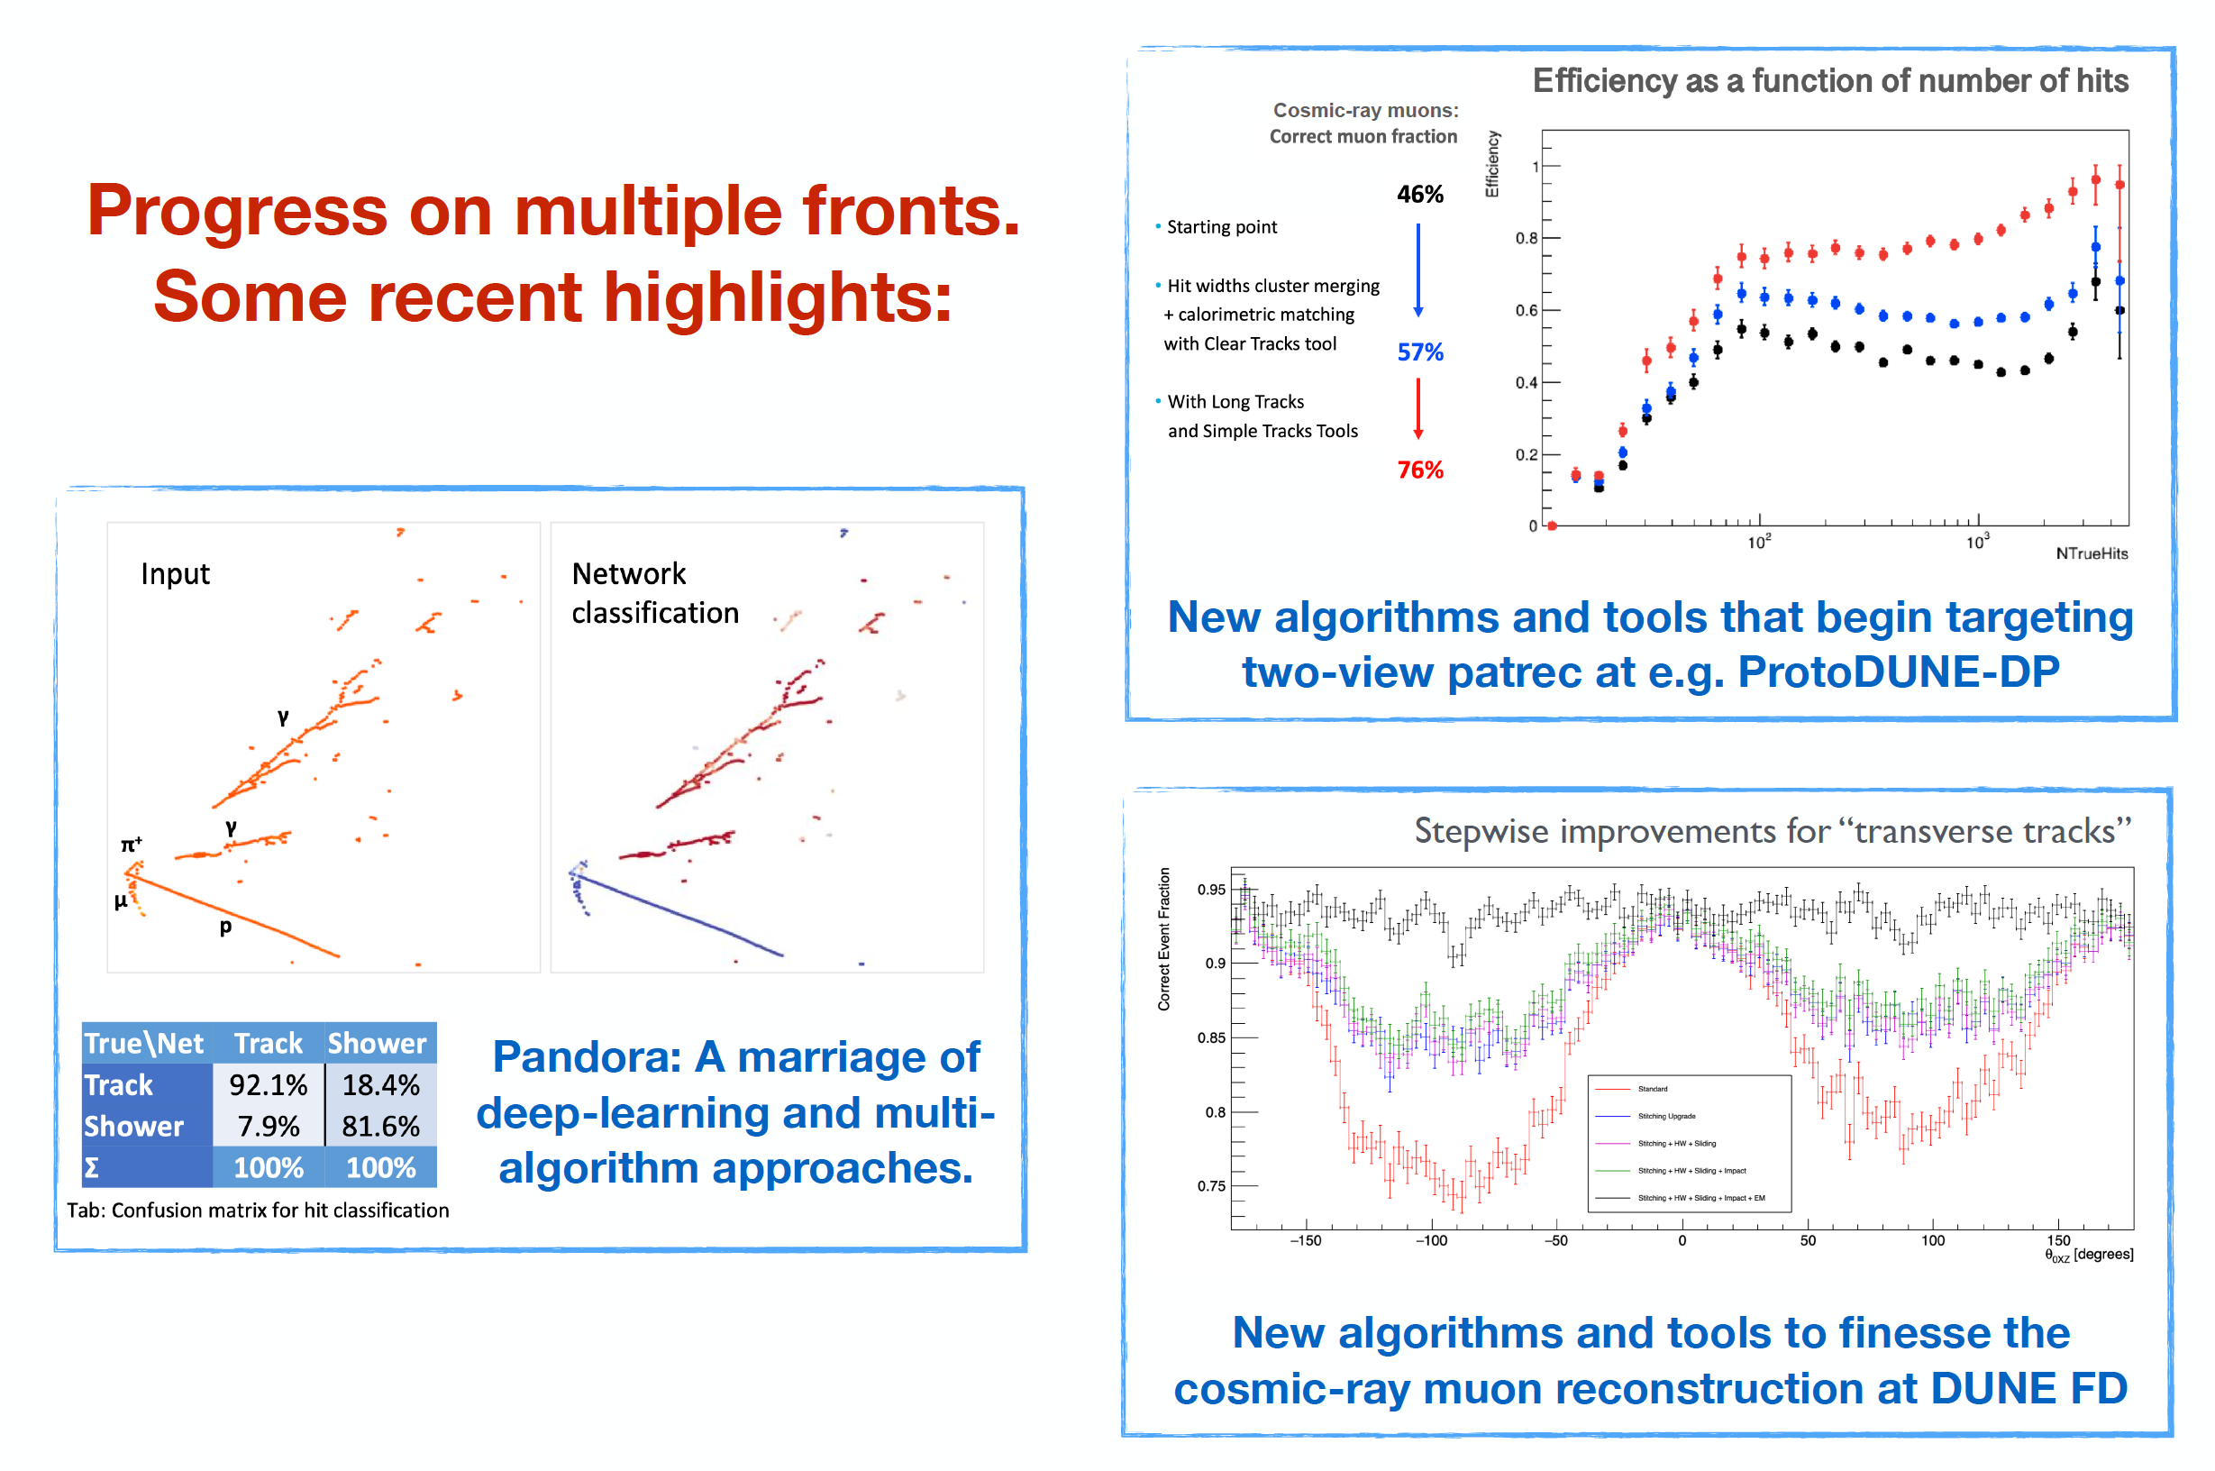
Pandora Pattern Recognition
John Marshall, A. Blake

Slide 13
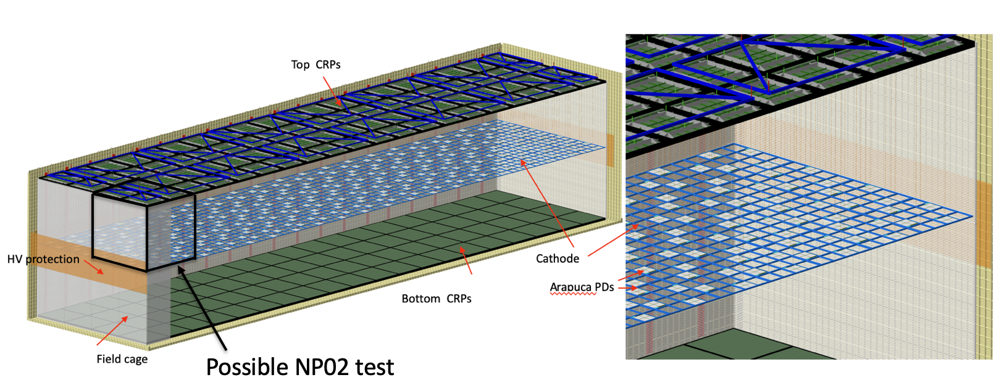
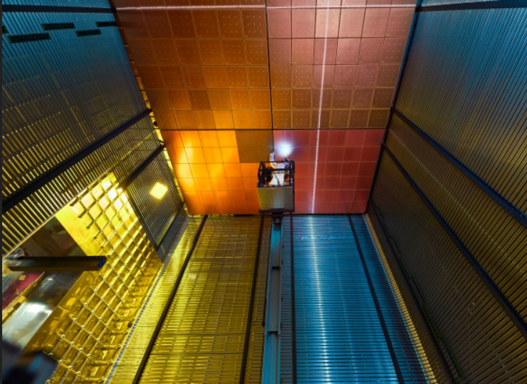
Possible Vertical Drift Module
Development based on DP with potential advantages, but also challenges
Full prototype on time scale 2023/24.

Slide 14
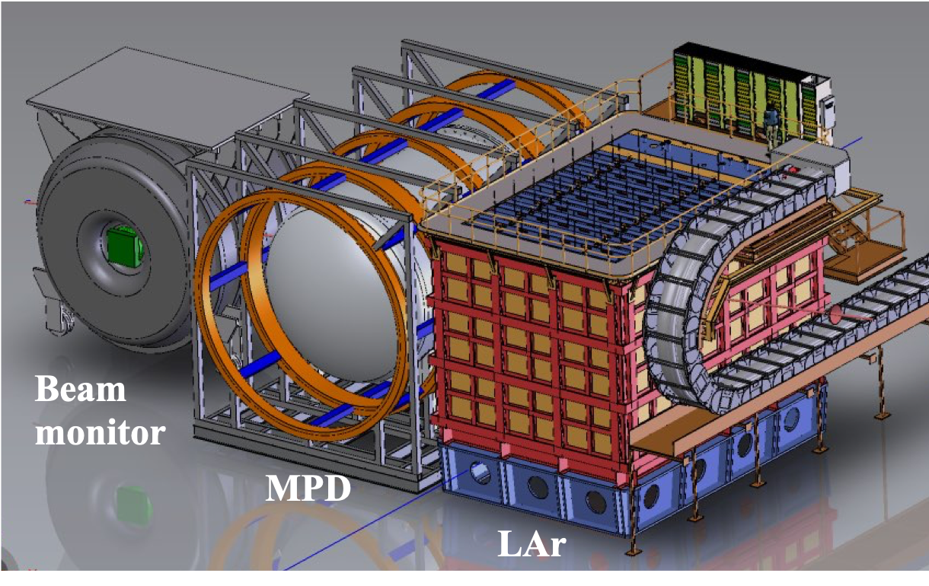
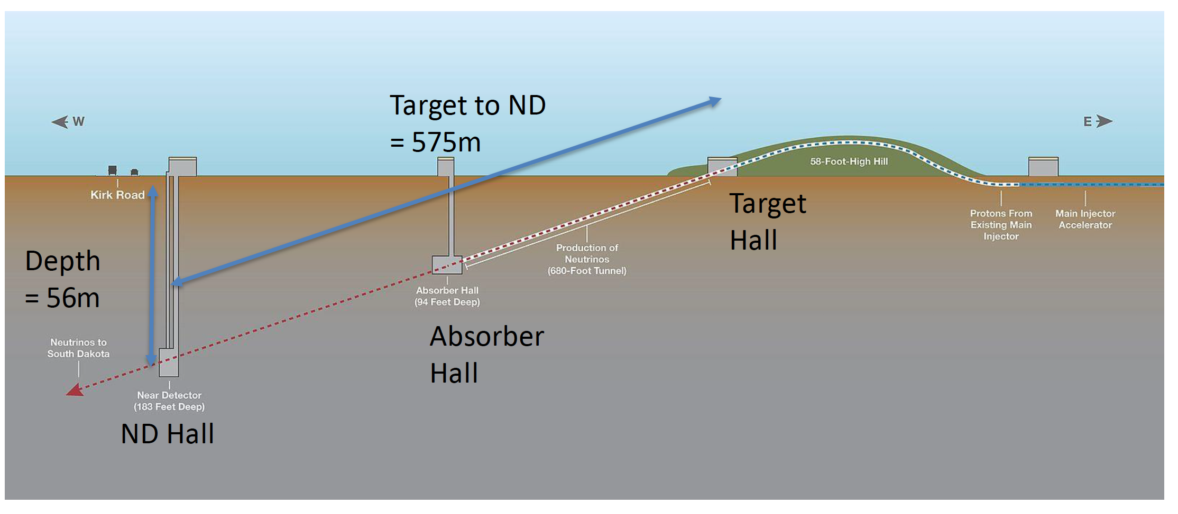
Near Detector Concept
UK leads Task Force on ND-DAQ (A. Kaboth) and Design Group (A. Weber)

Slide 15
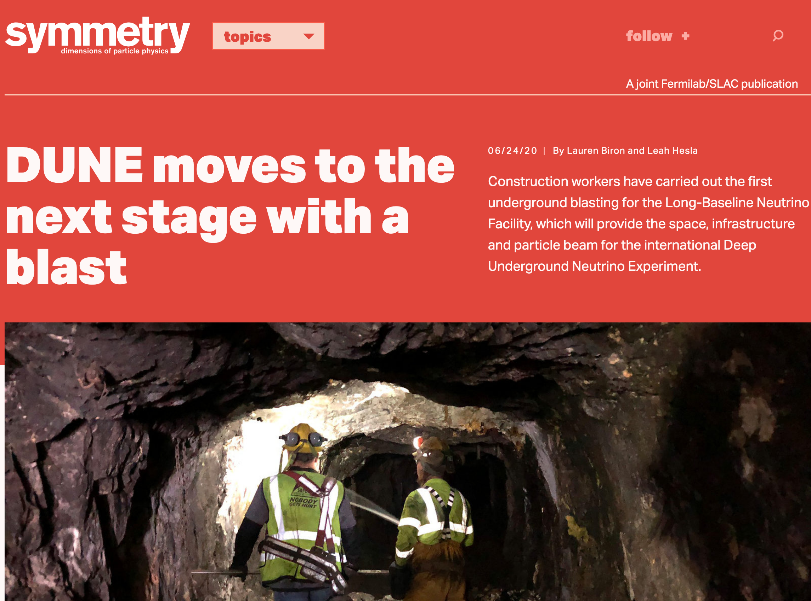
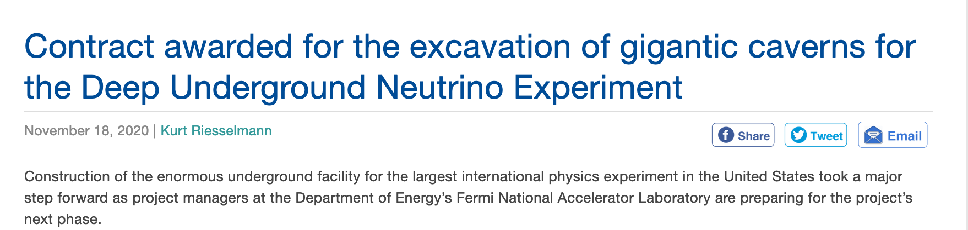

Slide 16
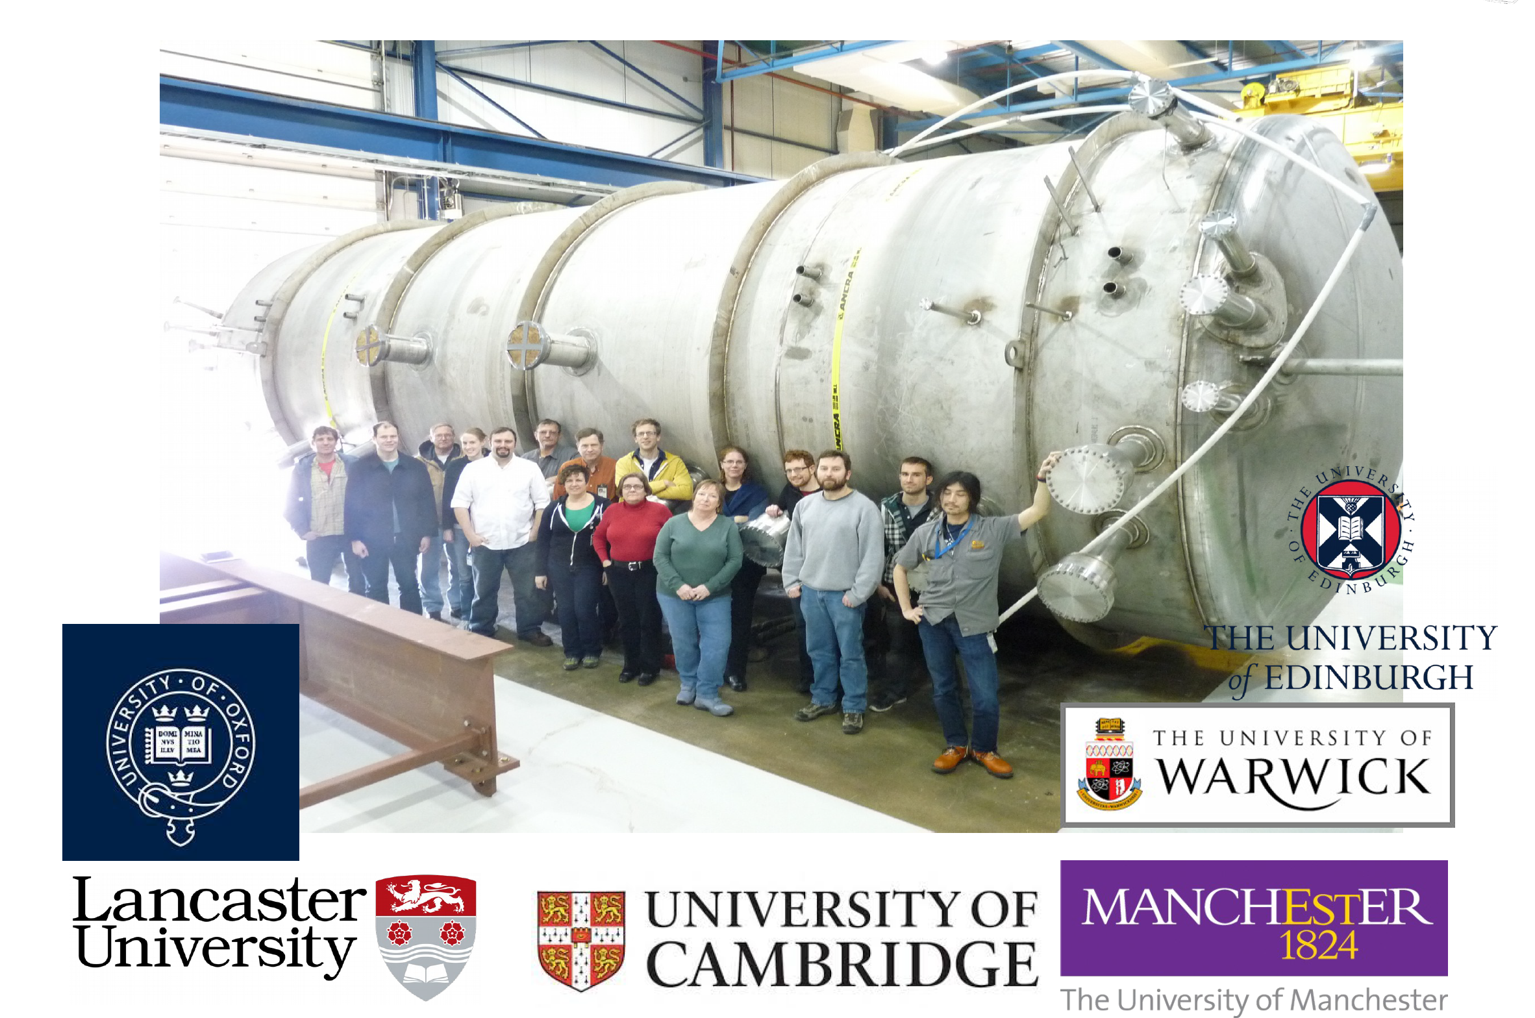
MicroBooNE at FNAL
A. Szelc

Slide 17
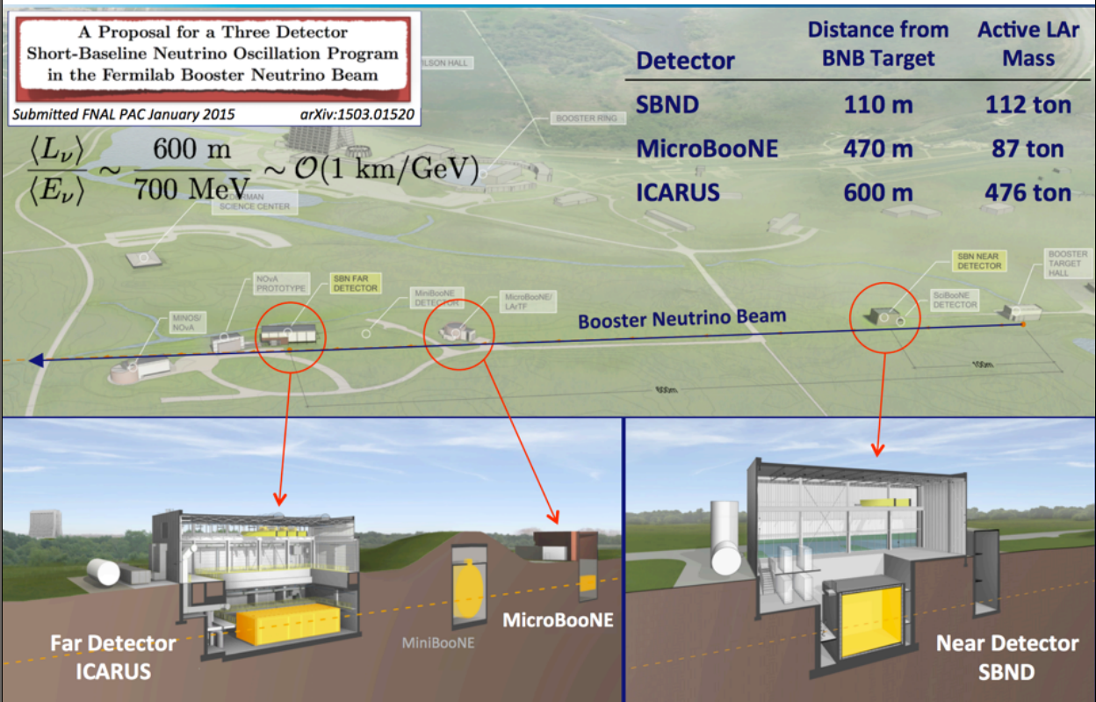
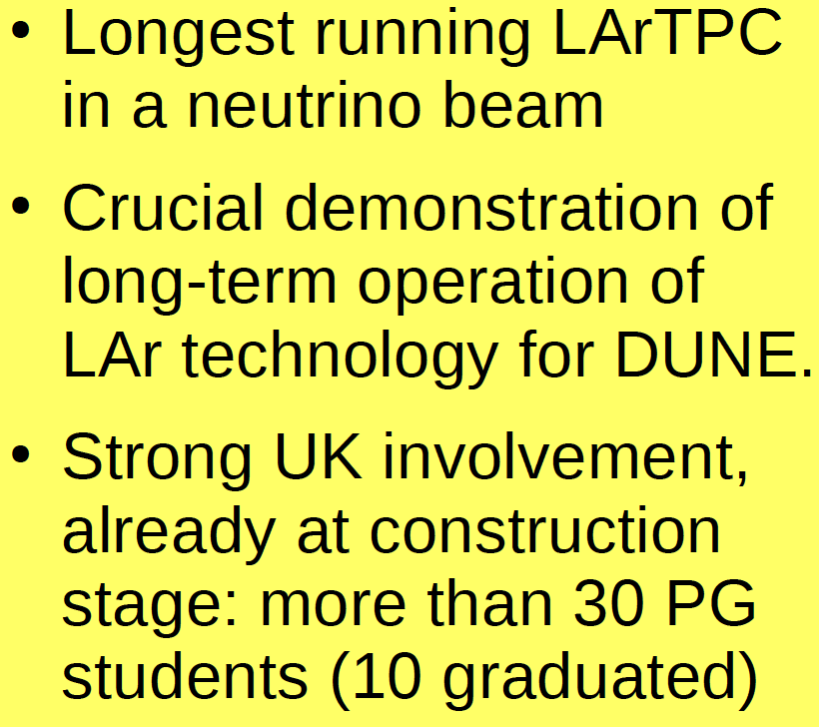
MicroBooNE: first SBN detector

Slide 18
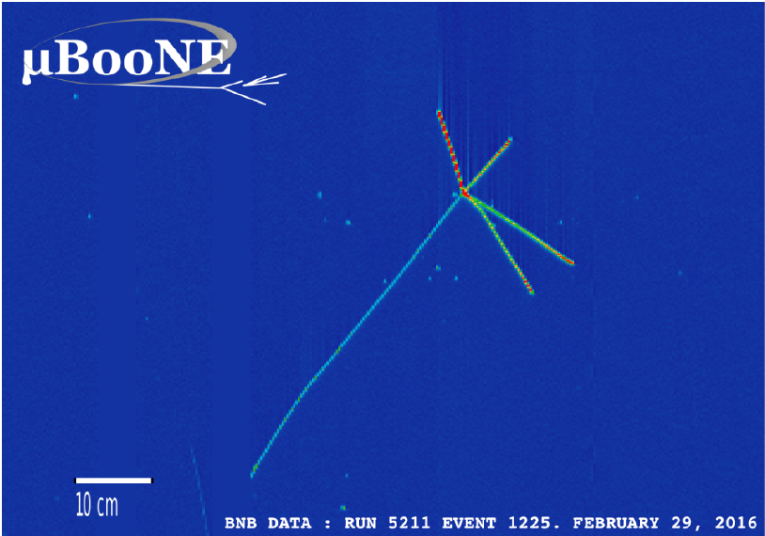
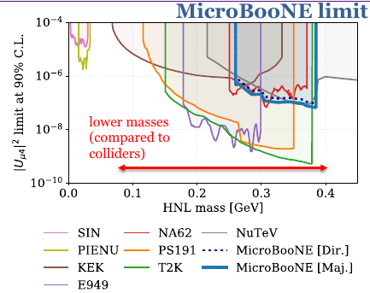
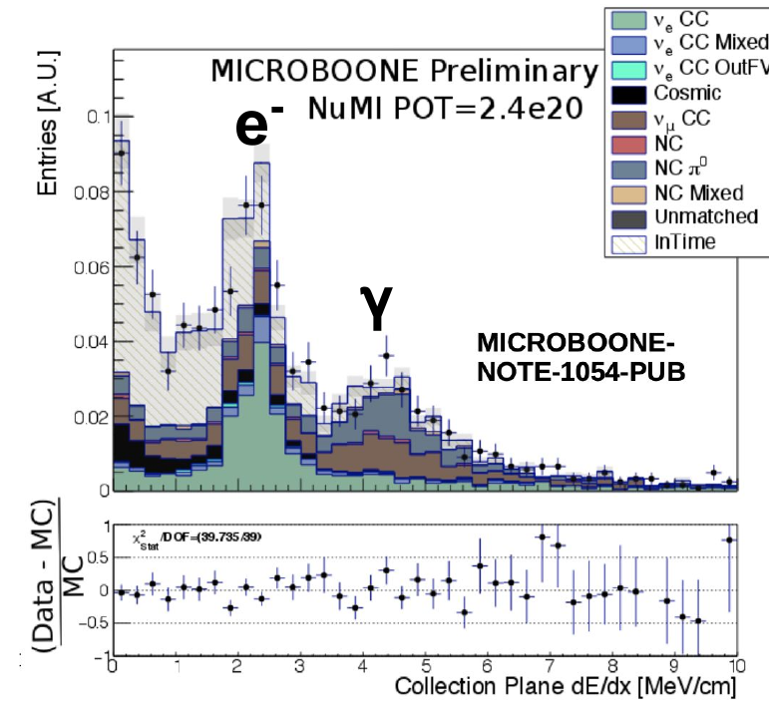
MicroBooNE Physics
Selected UK-led results:
  ν_{μ} CC Inclusive
  Phys.Rev.Lett. 123 (2019) 13, 131801
  ν_{μ} CC N-protons/0 pions
  ArXiV:2010.02390 [hep-ex]
  Search for Heavy Neutral Leptons
  Phys.Rev.D 101 (2020) 5, 052001
Coming Soon:
  CC ν_{e} from NUMI beam
  Search for Higgs-portal scalars.
  Search for MiniBooNE LEE.
Crucial cross section measurements and
development of BSM analyses
for DUNE

Slide 19
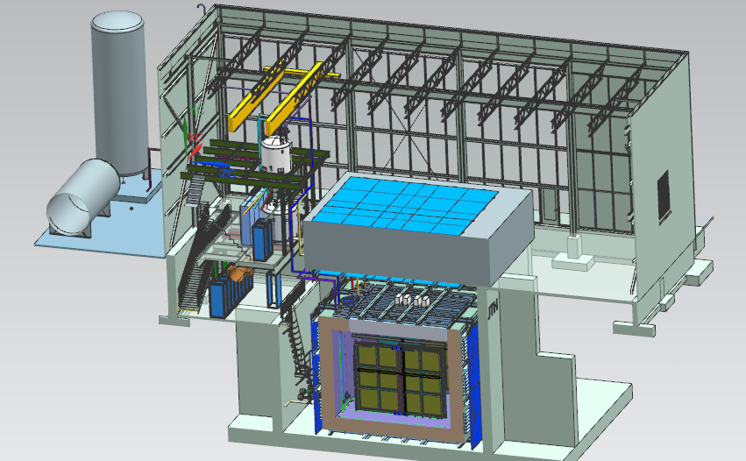
SBND at FNAL
20 ton crane
Top CRT and Overburden
Cryogenic Dewars
Proximity Cryogenics
Readout racks
TPC
Cryostat
Side CRT

Slide 20
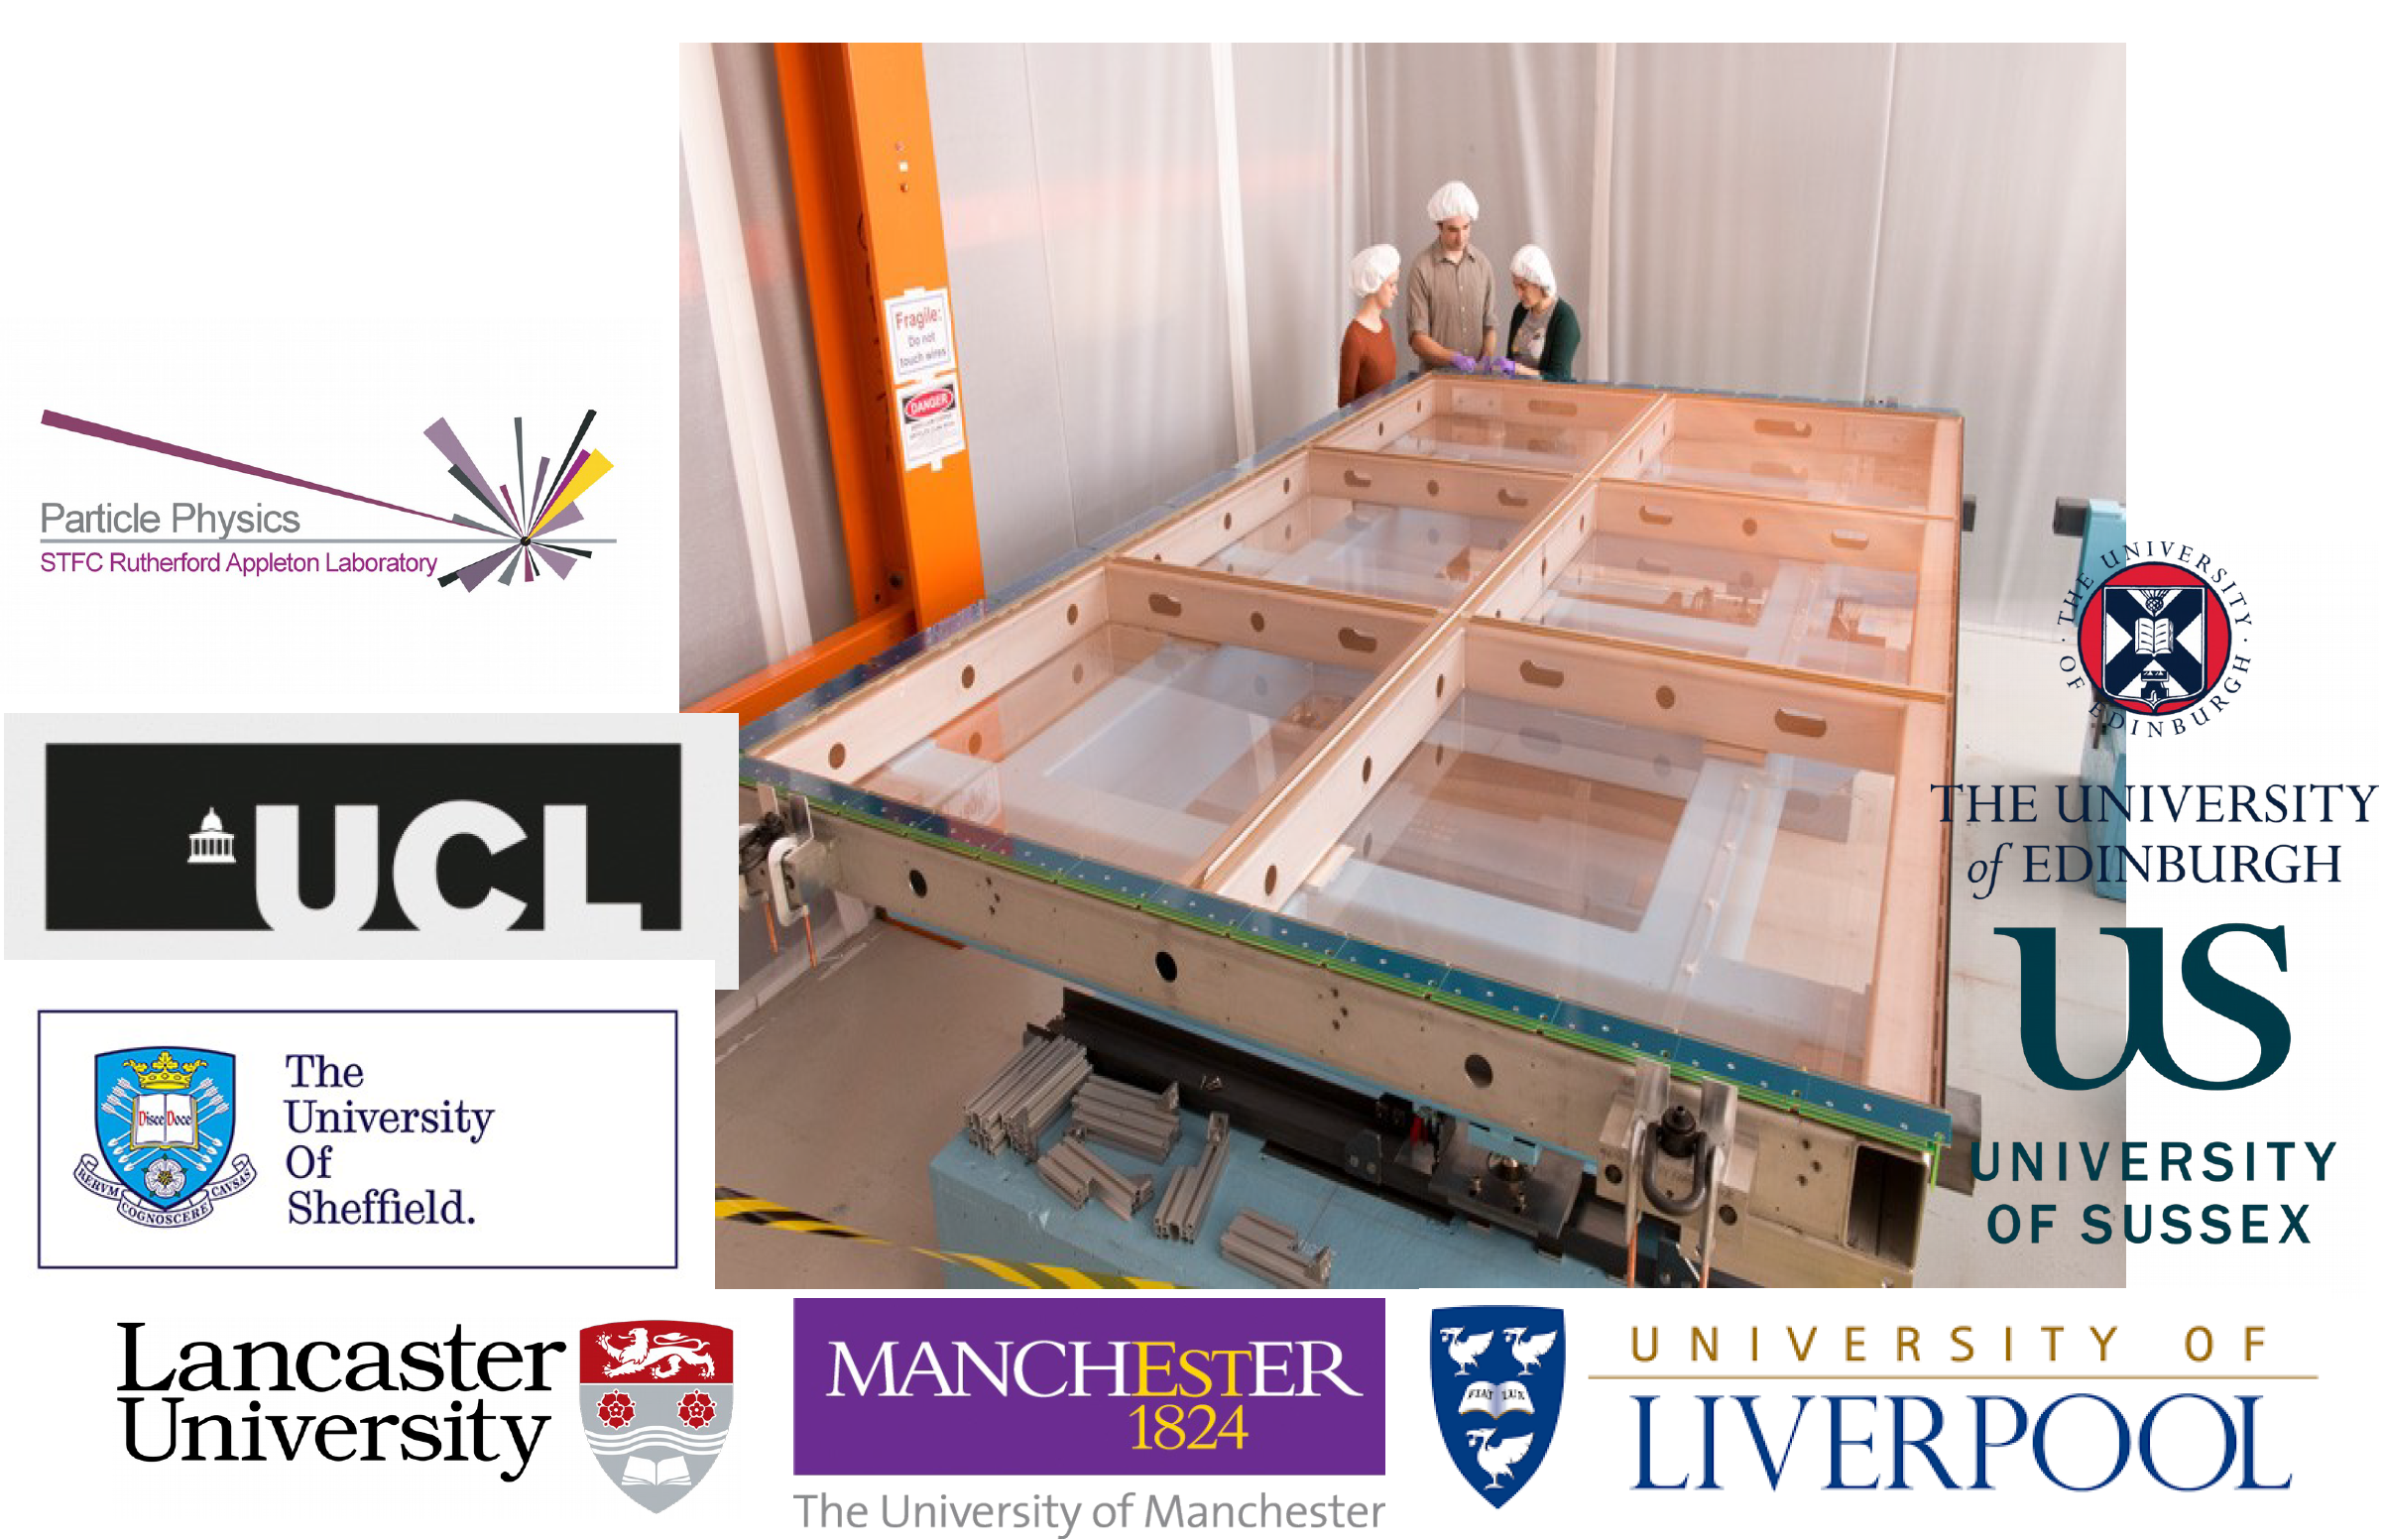
UK on SBND

Slide 21
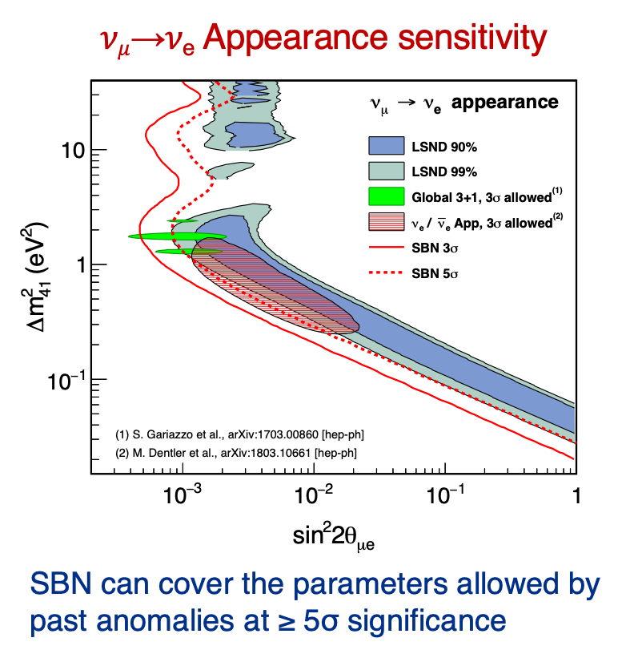
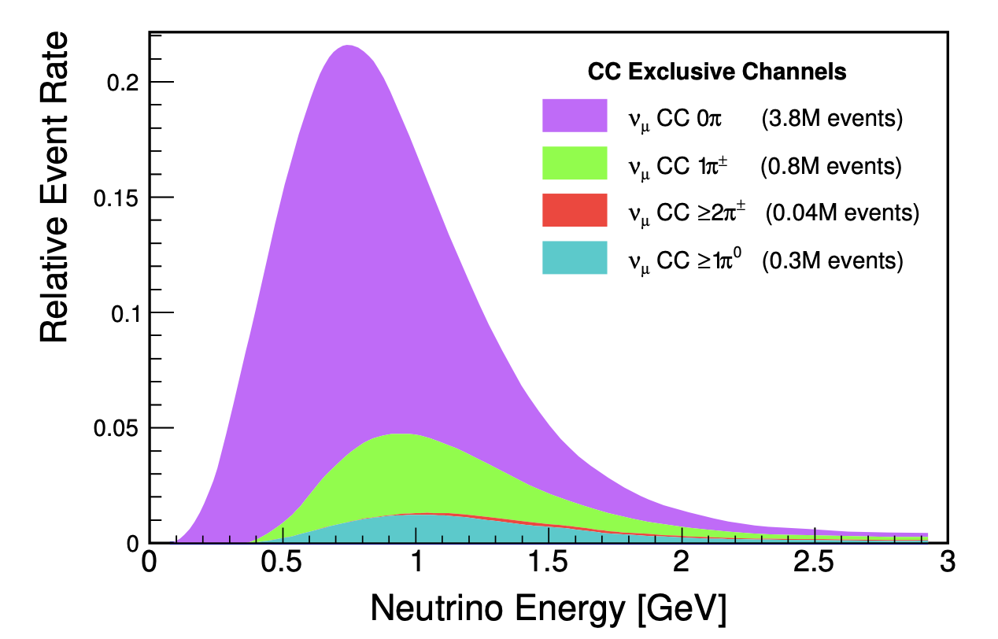
Strong UK physics leadership
Jarek Nowak
SBND: 7 million 𝜈_{𝜇} interactions (0.2-3 GeV) and
50,000 𝜈e interactions in 3 years
The broad program of neutrino-argon interaction measurements in SBND will have direct application for controlling systematic uncertainties in the future long-baseline program at DUNE.

Slide 22
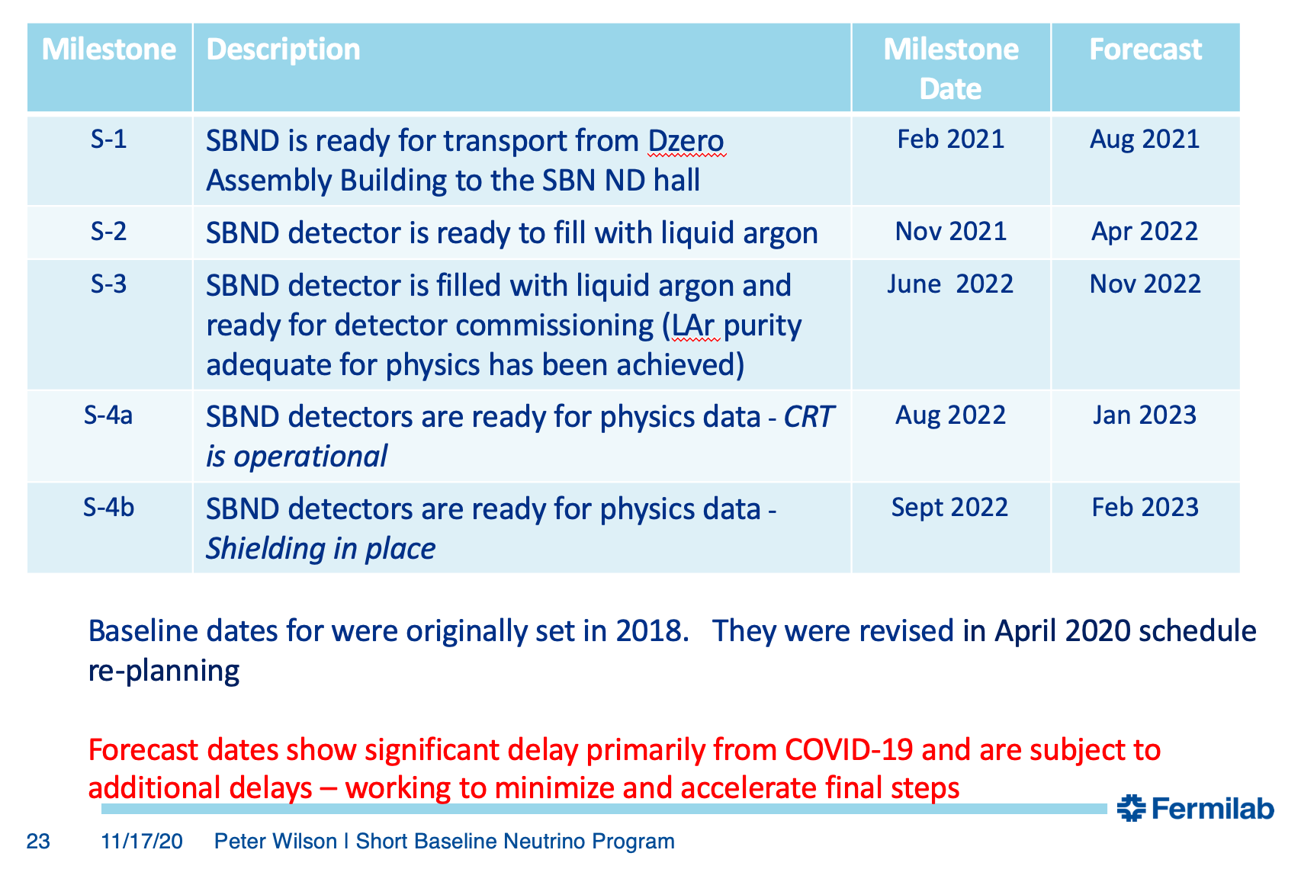
SBND Key Milestones

Slide 23
Jeff Hartnell
Best Fit
Normal hierarchy
Δm²₃₂ = (2.41±0.07)×10⁻³ eV²
sin²θ₂₃ = 0.57^{+0.04}_{-0.03}
δ = 0.82π
See no strong asymmetry in the rates of appearance of ν_{e} and ν̅_{e}
Consistent with hierarchy-octant-δ combinations which include some “cancellation” of matter effect and CPv.
Clear UK leadership, providing
→ Physics analysis coordinator
3-Flavour oscillation convenor
Institutional Board Chair
New UK group: QMUL, joins Sussex and UCL
STFC provided vital postdoc support in 2019 consolidated grant

Slide 24
Comparison with T2K
Tension with T2K’s preferred region
Quantifying consistency requires a joint fit of the data from the two experiments, which is already in the works
  UK NOvA and T2K groups heavily involved
  Provide a member of cross-experiment senior leadership team (from NOvA)
NOvA will run to 2025 or beyond
(>2.5x more data to come)

Slide 25
Summary
Vibrant and exciting accelerator-based neutrino physics programme located in North America with strong UK leadership.
UK groups participate in DUNE, MicroBooNE, SBND, and NOvA.
UK groups contribute to all stages of experiments – planning, design, R&D, construction, operation, data analysis.
Primary physics drivers are search for CP violation in lepton sector, astrophysical neutrinos (supernovae), sterile neutrino searches, BSM physics.

