Slide 1
PPAP Meeting - CMS
Claire Shepherd-Themistocleous (RAL)
on behalf of the CMSUK Collaboration

Slide 2
Outline
Outline
  Current status
  Physics recent UK highlights
  Upgrade programme and progress
  Computing – a word
  Future
  Summary

Slide 3
LHC Schedule

Slide 4
CMS LS2 activities

Slide 5
CMS LS2 activities
Detector will close end Sept 2021
Ready for RUN3 start Feb 2022

Slide 6
CMS Magnet Repairs
Needed to warm up magnet to replace broken pump
Procedure performed during lockdown
Started 20th April
Finished 24th May
Temperature stable

Slide 7
CMS papers

Slide 8
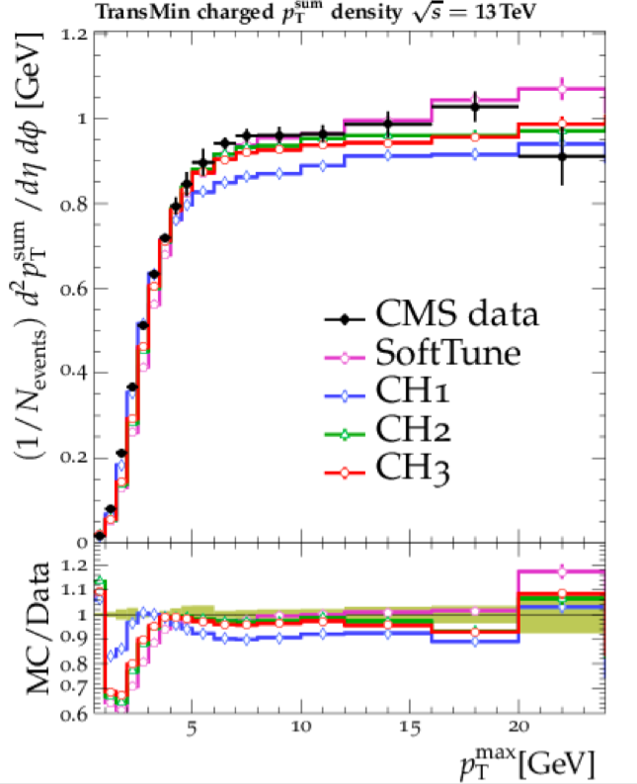
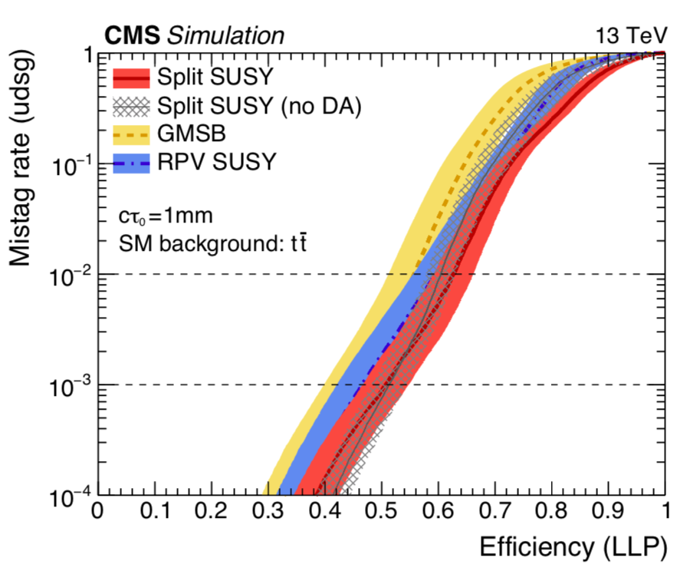
Recent UK Physics results
Phys. Rev. D 100, 072002 (2019)
ttbar Spin Correlations
SMEFT Wilson coeff. constraints
Herwig tune using CMS underlying events from 0.9,7,13 TeV data.
LLP tagger using DNN (CNN)

Slide 9
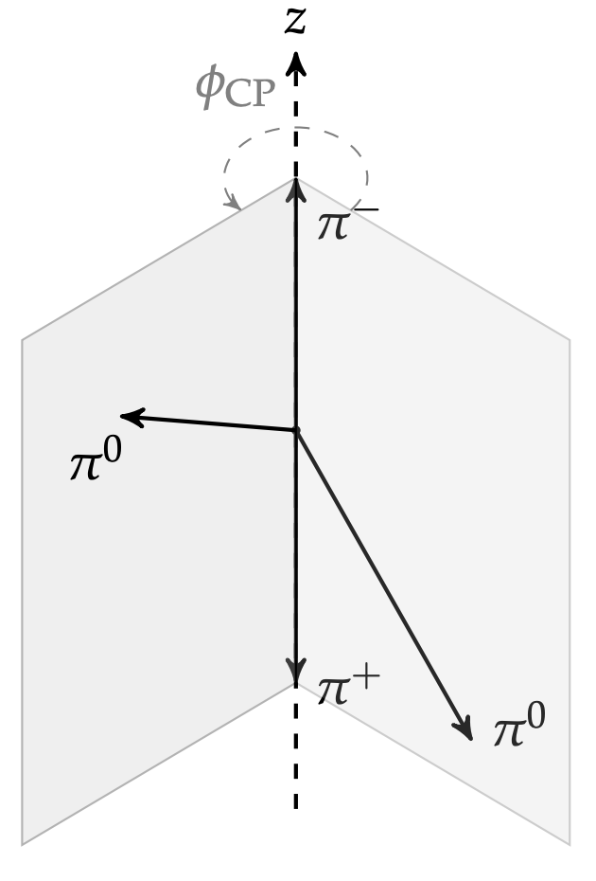
Recent UK Physics Results II
Lots of Higgs SM and BSM analyses!
Probing CP structure of Higgs to tau coupling
Angle between tau decay planes sensitive to CP structure
H→ γγ
H to gg large statistics Allow exclusive modes e.g. rare modes tH and ttH (use DNN)

Slide 10
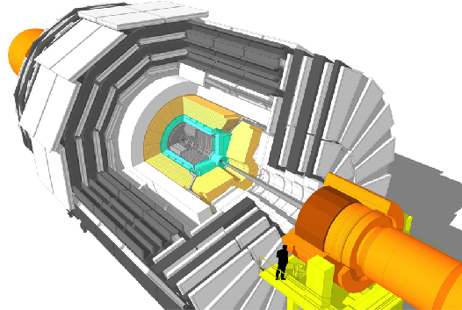
Upgrade of CMS for HL-LHC
L1-Trigger/HLT/DAQ
https://cds.cern.ch/record/2714892
https://cds.cern.ch/record/2283193
Tracks in L1-Trigger at 40 MHz
PFlow selection 750 kHz L1 output
HLT output 7.5 kHz
40 MHz data scouting
Barrel Calorimeters
https://cds.cern.ch/record/2283187
ECAL crystal granularity readout at 40 MHz with precise timing for e/γ at 30 GeV
ECAL and HCAL new Back-End boards
Muon systems
https://cds.cern.ch/record/2283189
DT & CSC new FE/BE readout
RPC back-end electronics
New GEM/RPC 1.6 < η < 2.4
Extended coverage to η ≃ 3
Calorimeter Endcap
https://cds.cern.ch/record/2293646
3D showers and precise timing
Si, Scint+SiPM in Pb/W-SS
Beam Radiation Instr. and Luminosity
http://cds.cern.ch/record/002706512
Bunch-by-bunch luminosity measurement: 1% offline, 2% online
Tracker https://cds.cern.ch/record/2272264
Si-Strip and Pixels increased granularity
Design for tracking in L1-Trigger
Extended coverage to η ≃ 3.8
MIP Timing Detector
https://cds.cern.ch/record/2667167
Precision timing with:
  Barrel layer: Crystals + SiPMs
  Endcap layer: Low Gain Avalanche Diodes

Slide 11
Upgrade of CMS for HL-LHC
L1-Trigger/HLT/DAQ
https://cds.cern.ch/record/2714892
https://cds.cern.ch/record/2283193
Tracks in L1-Trigger at 40 MHz
PFlow selection 750 kHz L1 output
HLT output 7.5 kHz
40 MHz data scouting
Barrel Calorimeters
https://cds.cern.ch/record/2283187
ECAL crystal granularity readout at 40 MHz with precise timing for e/γ at 30 GeV
ECAL and HCAL new Back-End boards
Muon systems
https://cds.cern.ch/record/2283189
DT & CSC new FE/BE readout
RPC back-end electronics
New GEM/RPC 1.6 < η < 2.4
Extended coverage to η ≃ 3
Calorimeter Endcap
https://cds.cern.ch/record/2293646
3D showers and precise timing
Si, Scint+SiPM in Pb/W-SS
Beam Radiation Instr. and Luminosity
http://cds.cern.ch/record/002706512
Bunch-by-bunch luminosity measurement: 1% offline, 2% online
Tracker https://cds.cern.ch/record/2272264
Si-Strip and Pixels increased granularity
Design for tracking in L1-Trigger
Extended coverage to η ≃ 3.8
MIP Timing Detector
https://cds.cern.ch/record/2667167
Precision timing with:
  Barrel layer: Crystals + SiPMs
  Endcap layer: Low Gain Avalanche Diodes

Slide 12
Common electronics
ATCA board with up to 2 FPGAs (pluggable)
288 optical fibres @ 25Gb/s ( ~ 7Tb/s)
Comes with infrastructure firmware & software
  Board management
  Control & feedback to system (trigger, timing, throttle)
  I/O links and buffering
  Path to DAQ
  Board monitoring (e.g. optics, power regulators)
Now producing version 1.2 of board. Boards in use at CERN and in variety of labs.
Framework firmware and software well advanced.
http://cern.ch/serenity

Slide 13
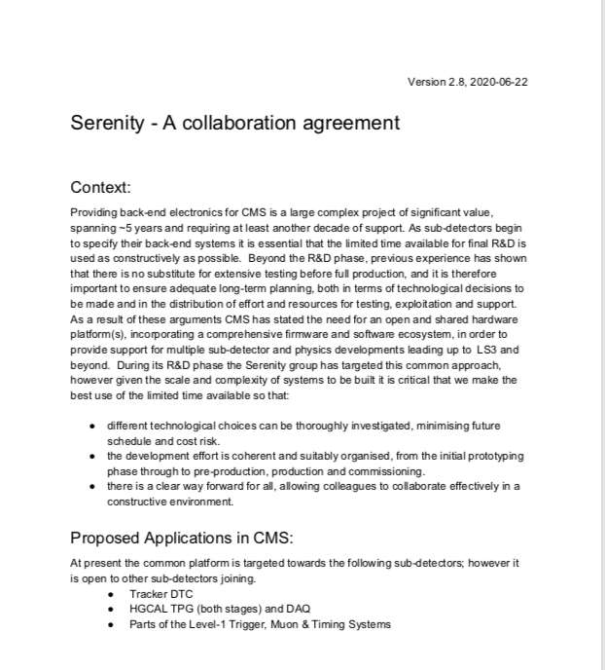
Common electronics
Flexible board many users:
  UK projects (Tracker, HGC, L1 trigger)
  non-UK ( muons, timing det)
Set up Serenity Consortium within CMS:
UK, Germany, France, Italy, India, ++?
7 Groups

Slide 14
Tracker
Si tracker to be completely replaced.
UK developed idea of “pt” modules enabling use of tracks at L1.
UK developed frontend ASIC (CBC)
UK led development of all FPGA track reconstruction

Slide 15
Outer module ASIC (CBC)
CBC is the readout ASIC for the 2S tracker modules
Major Milestone Procurement Readiness Reivew (PRR) passed March 2020
A good example of a successful ASIC project.
Wafer test stand at IC complete and ready for testing once bulk purchasing begins

Slide 16
Tracker – Off detector processing
DTC (Data, Trigger, Control)
  Stub sorting and routing to Track Finding boards
TF Finds and fits tracks
TMTT Algorithm latency < 2.5us
Serenity and Apollo boards at TIF at CERN
Hardware simulation comparison
Algorithm implementation and comparison
VU9P 360MHz

Slide 17
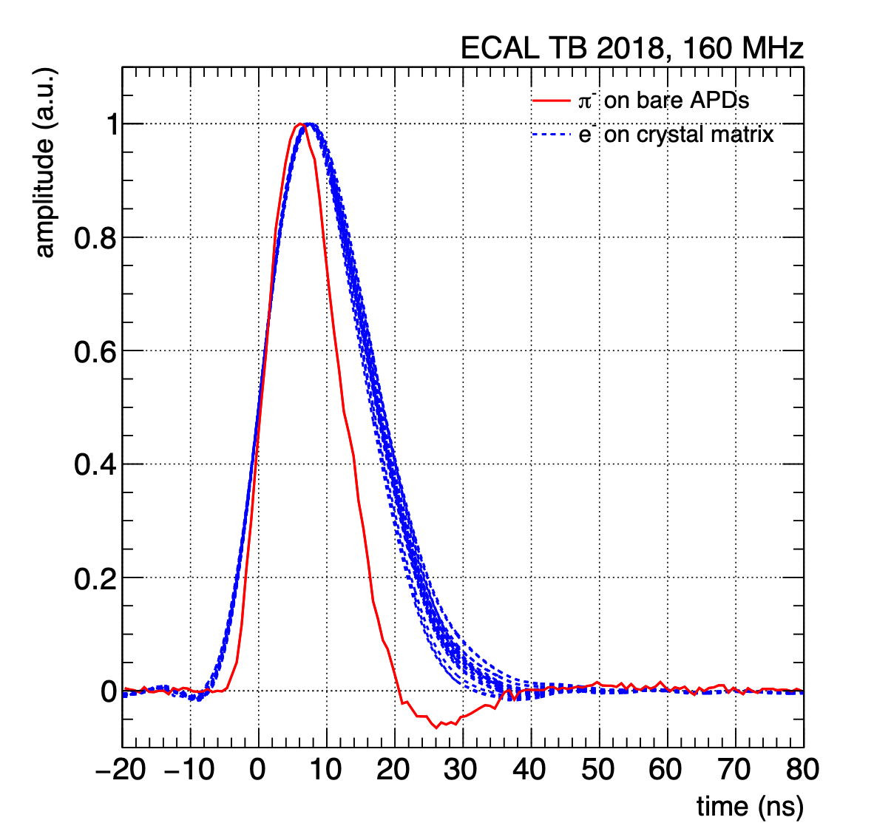
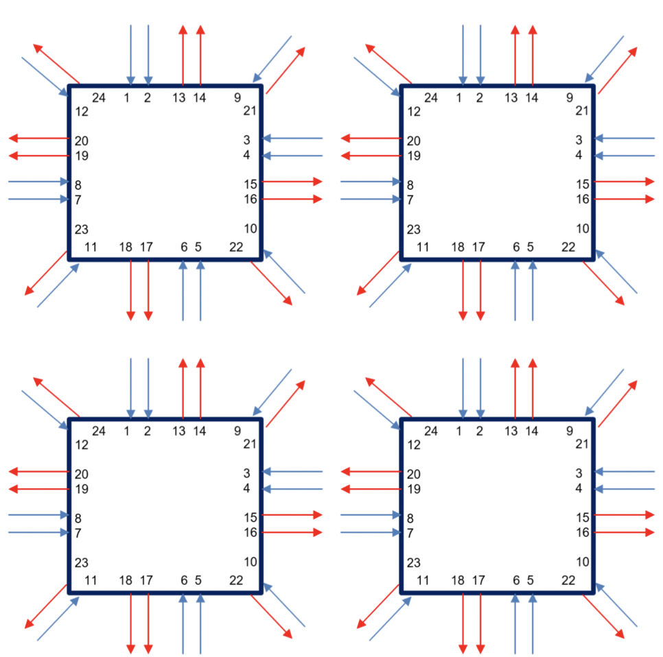
ECAL Barrel
Keep crystals and APDs
Replace all on and off detector readout
Trigger firmware/software (UK)
Optical Fibre router (UK)
Design exploits UK expertise from Phase 1 upgrade
Solve spike problem & include clustering in off-det FPGAs
using prototype Phase-2 on-detector electronics in test beam
FPGA1
FPGA2
FPGA3
FPGA4
electrons (blue)
Optical links
Transmit
Receive
Link sharing between FPGAs
pion-induced spikes (red)
Measured pulse shapes in test beam
pion-induced spikes (red) and electrons (blue)
Measured pulse shapes in test beam
pion-induced spikes (red) and electrons (blue)
Measured pulse shapes in test beam
pion-induced spikes (red) and electrons (blue)
Measured pulse shapes in test beam
pion-induced spikes (red) and electrons (blue)

Slide 18
HGC
Trigger primitive development and electronics, and simulation (UK)
Firmware development and detector performance simulation underway
Communication tests
with Serenity Board

Slide 19
L1 Trigger
Approved June 2020
Standalone muon, calorimeter, track triggers
Correlator enables Particle Flow reconstruction.

Slide 20
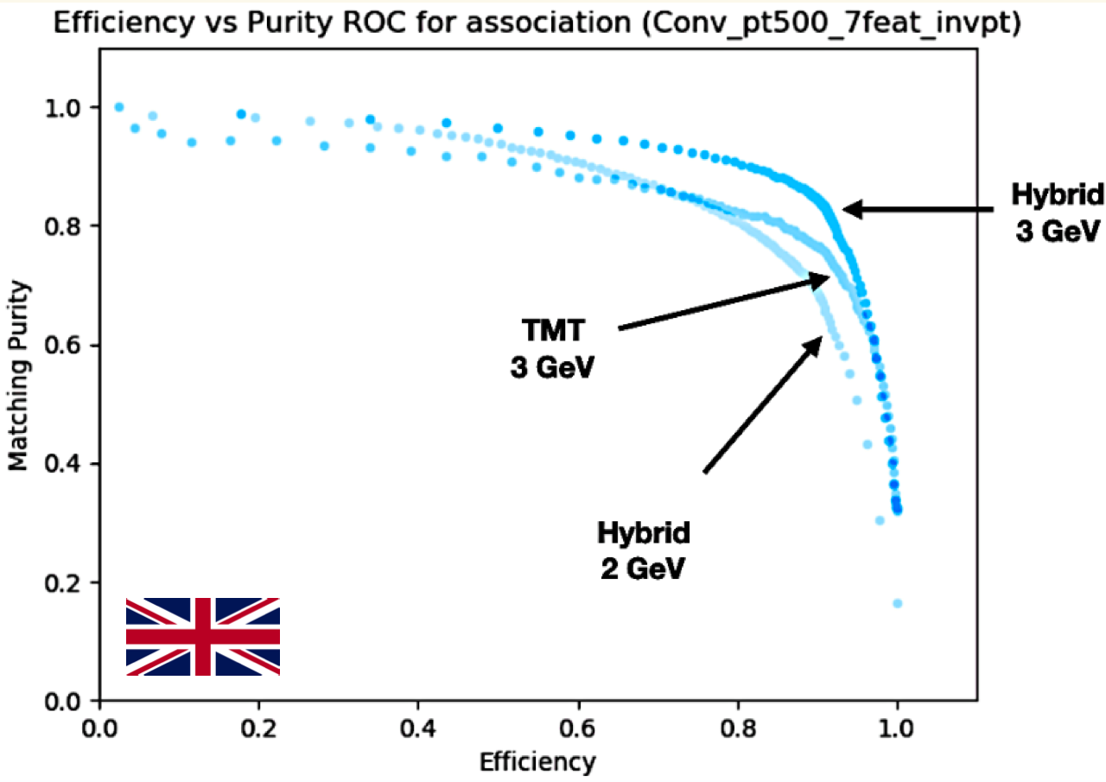
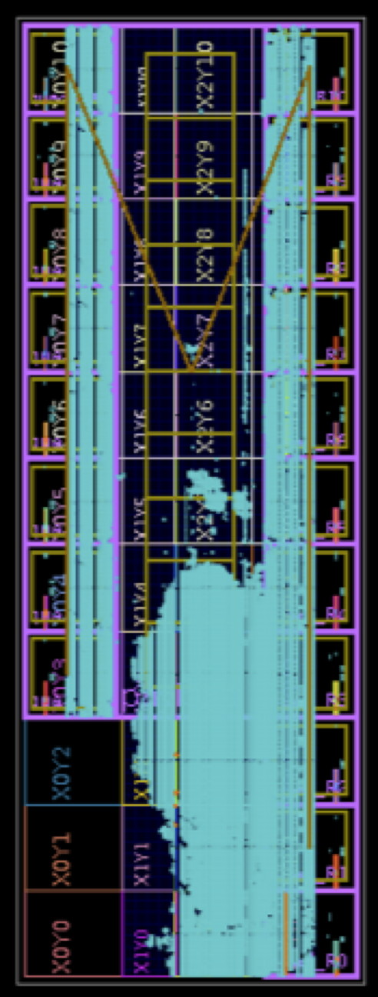
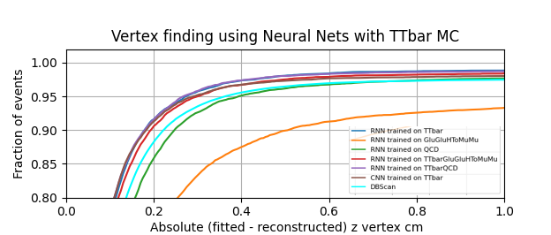
L1 Trigger – Algorithms
Jet finding
Implementation in FPGAs and on Serenity cards
Track vertex association
Vertex Reconstruction
Electron isolation

Slide 21
CMS and Coronavirus
L2 activities on CMS progressing well. Covid impact order of 3 months delay.
  Resident community vital for work done since March.
Impact on upgrades being evaluated. Estimate 3-5 months.
Small number of cases for people working at CMS pit.

Slide 22
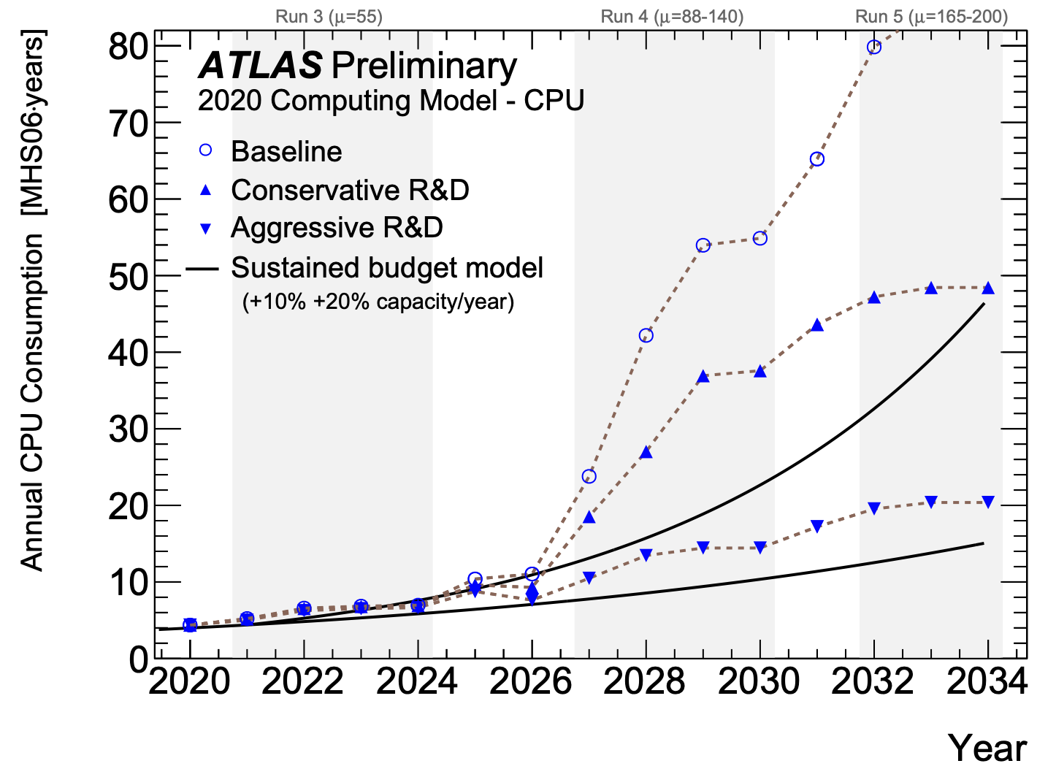
Computing Challenge
UK new initiative. (Swift-HEP, Excalibur)
HL-LHC computing demands can’t be met by current CPU based systems.
CMS participation
  Data management (IC, Brunel)
  FPGA acceleration. (RAL,IC)
  Data accessibility and analysis speed. (Bristol)

Slide 23
GPUs in CMS HLT
CMS already piloting the use of GPUs in the HLT for Run 3
Next major TDR for HLT
UK leads through Trigger Coordinator

Slide 24
Future
Major next run period Run 3.
Upgrade to start of run 4
  Procurement of hardware
  System development and realization
  Integration and commissioning
Major undertaking: operation, exploitation and upgrades.
  Operation and exploitation ability considerably reduced by successive reductions in funded effort. European strategy top priority exploitation of full physics potential of LHC & HL-LHC
…and then to Run 4
  Will be a new detector. Commissioning will extend into running & operation and exploitation will require that effort levels remain similar to current totals.

Slide 25
Summary
Physics analysis increasingly benefiting from large stats enabling high precession and differential measurements. Increasingly entering the high precision era
Upgrade work progressing well. UK and CMS globally broadly on schedule.
Intense work over next few years. Tackling operations, exploitation and upgrades simultaneously a major challenge.
CMS and LHC has a very long term programme. The completion and exploitation of the upgrades is a headline goal in the European Strategy update.
Computing capability a major challenge and CMSUK engaging strongly with UK initiative

Slide 26
Backup slides

Slide 28
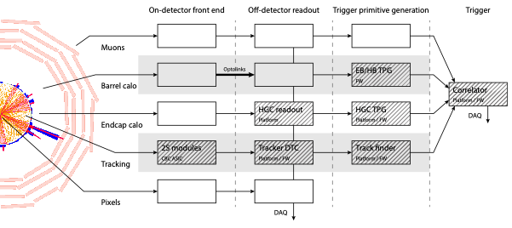
CMS UK Upgrade Activities

Slide 29
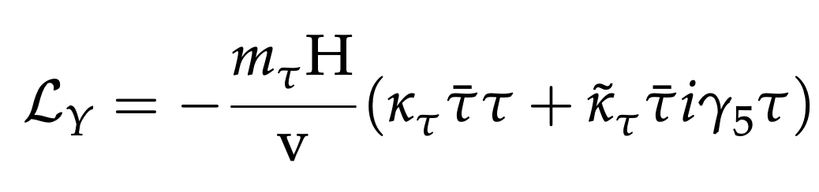
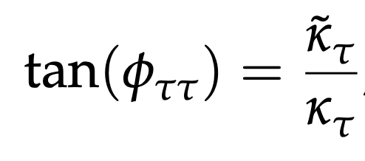
CP properties of fermion couplings with H→ττ
Probe CP nature of tau Yukawa by measuring
mixing between CP-even to CP-odd coupling
SM
CMS-PAS-HIG-20-006
Sensitivity to mixing angle from angular distribution of hadronic τ decay products.

Slide 30
CMS Management
Higgs Convenor
  Nick Wardle
L1 Trigger DPG
  Aaron Bundock
Computing - Data workflow
  Katy Ellis
ECAL trigger coord
  David Petyt
Generators
  Gurpreet Singh

Slide 31
Upgrade of CMS for HL-LHC
Thomas Reis
(reconstruction software)
Sudan Paramesvaran (Tech Coord)
Tom Williams
(online software)
Barrel Calorimeters
https://cds.cern.ch/record/2283187
ECAL crystal granularity readout at 40 MHz with precise timing for e/γ at 30 GeV
ECAL and HCAL new Back-End boards
L1-Trigger/HLT/DAQ
https://cds.cern.ch/record/2714892
https://cds.cern.ch/record/2283193
Tracks in L1-Trigger at 40 MHz
PFlow selection 750 kHz L1 output
HLT output 7.5 kHz
40 MHz data scouting
Muon systems
https://cds.cern.ch/record/2283189
DT & CSC new FE/BE readout
RPC back-end electronics
New GEM/RPC 1.6 < η < 2.4
Extended coverage to η ≃ 3
Paul Dauncey
(TDAQ)
Chris Seez (DPG)
Calorimeter Endcap
https://cds.cern.ch/record/2293646
3D showers and precise timing
Si, Scint+SiPM in Pb/W-SS
Beam Radiation Instr. and Luminosity
http://cds.cern.ch/record/002706512
Bunch-by-bunch luminosity measurement: 1% offline, 2% online
Mark Pessaresi (Data Processing)
Ian Tomalin (Online Tracking)
Sarah Storey
(DAQ)
Tracker https://cds.cern.ch/record/2272264
Si-Strip and Pixels increased granularity
Design for tracking in L1-Trigger
Extended coverage to η ≃ 3.8
MIP Timing Detector
https://cds.cern.ch/record/2667167
Precision timing with:
  Barrel layer: Crystals + SiPMs
  Endcap layer: Low Gain Avalanche Diodes

Slide 32
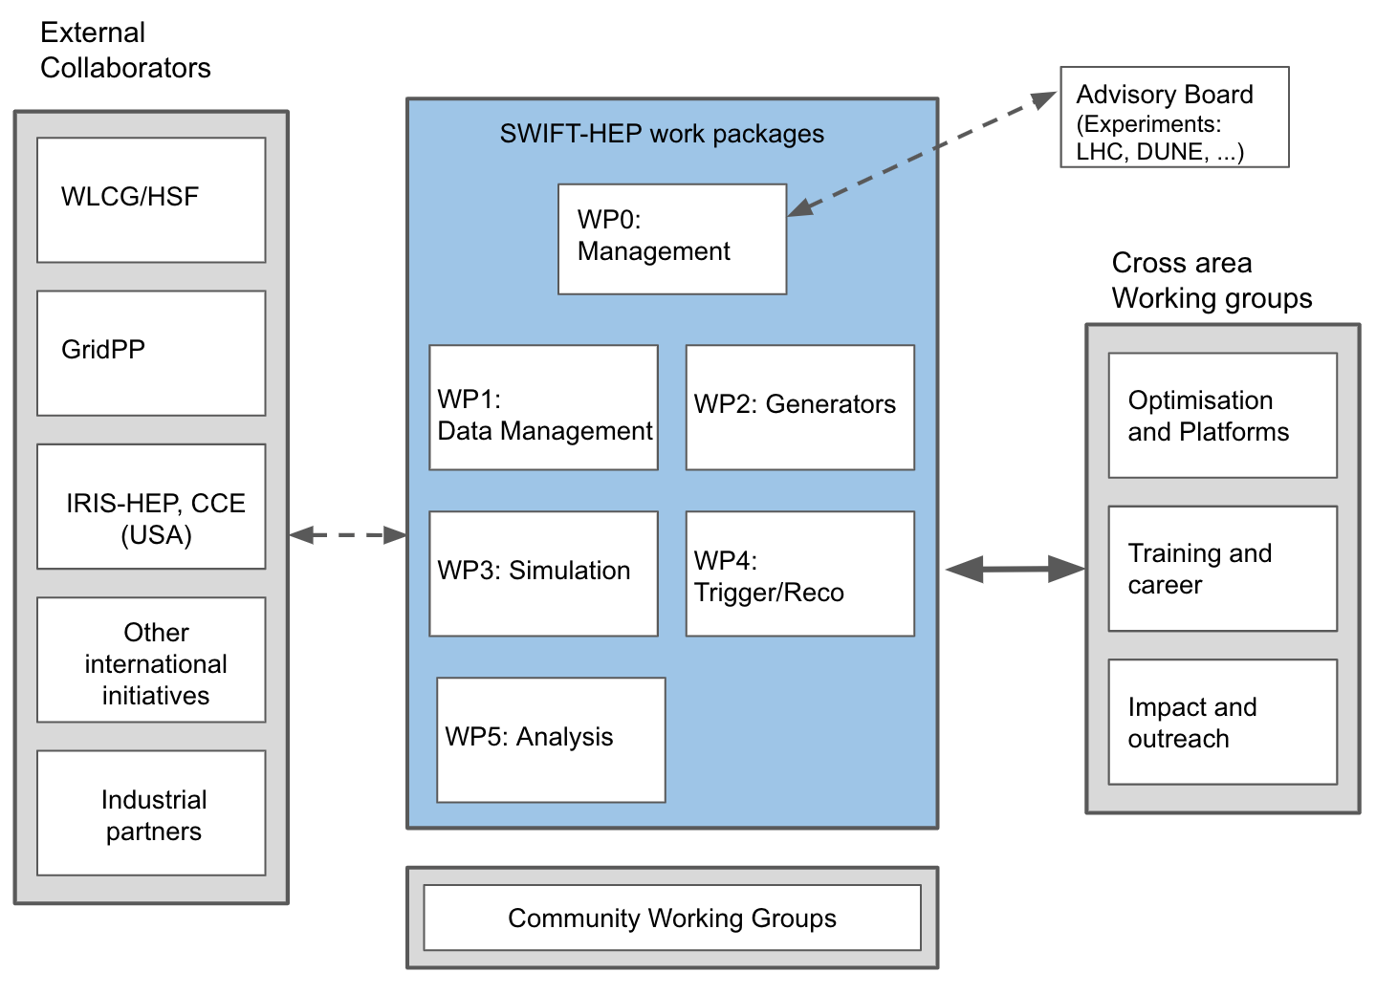
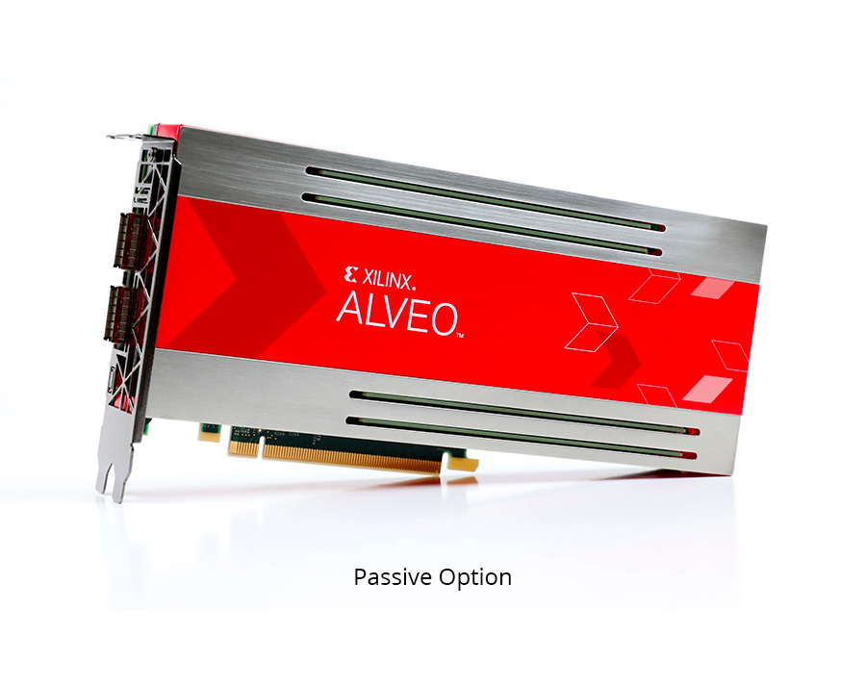
Swift-HEP
CMS participation
  WP1: (IC, Brunel) GridPP
  WP4: (RAL) FPGA acceleration.
  WP5: (Bristol) Data accessibility and analysis speed.
A lot of interest in UK. Good prospects for area and grant funding to grow. Currently 3 years
Excalibur UKRI funded similar programme. Current pilot project

Slide 33
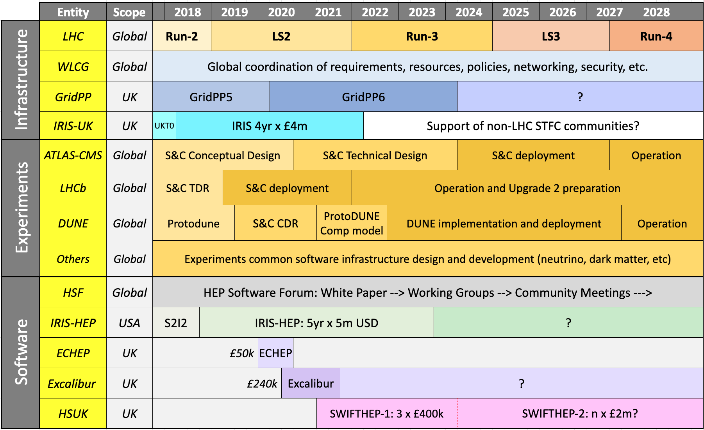
Swift-HEP: International picture

Slide 34
APx

