Slide 1
Lecture 3: Superconductivity
Louise Cowie
ASTeC
Slides adapted from Prof G Burt

Slide 2
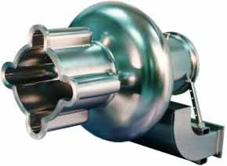
SCRF Cavities
The power required to keep a cavity on filled to a set voltage is the power extracted by the beam plus the ohmic heating in the walls.
In order to increase the efficiency of coupling power to the beam we need to minimise the ohmic heating in the cavity walls.
The ohmic heating can be reduced by 5-6 orders of magnitude with the use of a superconducting cavity.

Slide 3
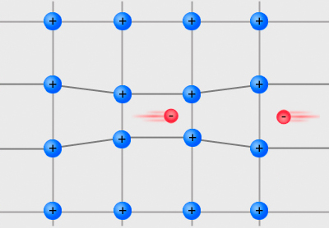
DC Superconductivity
Electrons are fermions and obey the Pauli exclusion principle.
In some materials, below a certain temperature, the motion of electrons distort the lattice.
This distortion can allow a small net attraction between two electrons.
The electrons then condense into pairs, known as Cooper pairs.
Cooper pairs are bosons and can all occupy the same state.
Hence the Cooper pairs can flow without being scattered and the material is perfectly conducting.
Notes:
Energy gap above boson state that inhibits collisions.

Slide 4
Miessner Effect
Perfect Conductor
Preserves field
Superconductor
Expels field
H > 0
T > Tc
H > 0
T < Tc
H = 0
T < Tc
H > 0
T > Tc
H > 0
T < Tc
H = 0
T < Tc

Slide 5


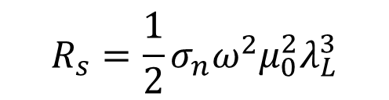
RF Superconductivity
When a DC electric field is applied to a superconductor all the current is carried by the cooper pairs, which flow without resistance to shield the “normal” electrons in the material.
If an RF field is applied the same thing occurs except when the field switches direction, although the pairs have no friction, they do have inertia.
The inertia means that the fields are not screened perfectly and the penetrating field can interact with the normal electrons causing a small resistance.
$$Zsurf=Rs +iXs$$
$$R_{s}=\frac{1}{2}σ_{n}ω^{2}μ_{0}^{2}λ_{L}^{3}$$
$$X_{s}=ωμ_{0}λ_{L}$$
Where $λ_{L}$ characterises the magnetic field penetration depth

Slide 6
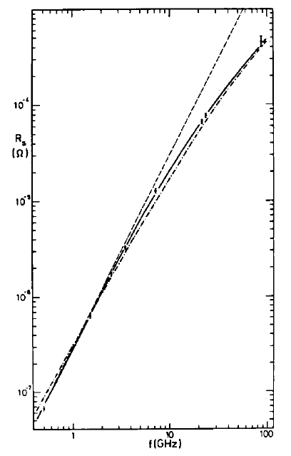
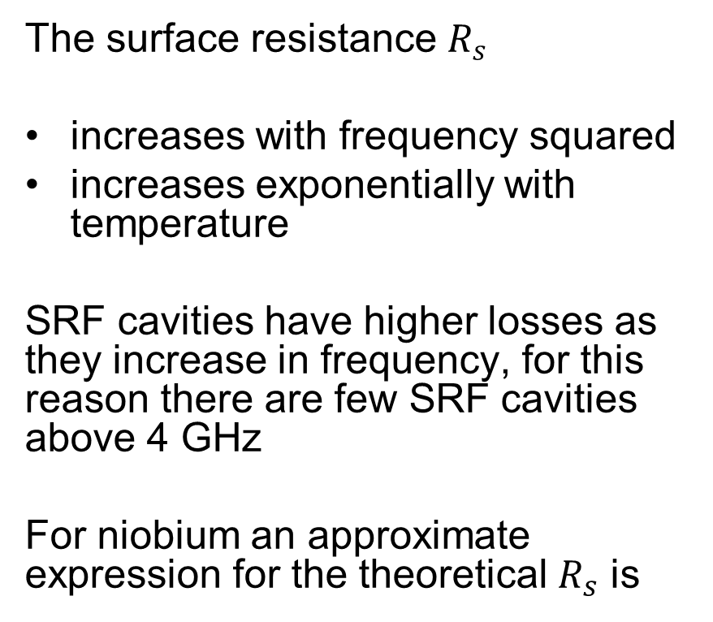
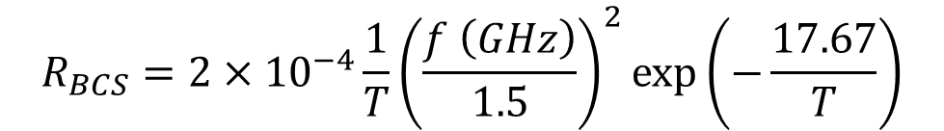
RF superconductivity
The surface resistance $R_{s}$
increases with frequency squared
increases exponentially with temperature
SRF cavities have higher losses as they increase in frequency, for this reason there are few SRF cavities above 4 GHz
For niobium an approximate expression for the theoretical $R_{s}$ is
$$R_{BCS}=2×{10}^{−4}\frac{1}{T}{\left(\frac{f \left(GHz\right)}{1.5}\right)}^{2}\text{exp}\left(−\frac{17.67}{T}\right)$$

Slide 7
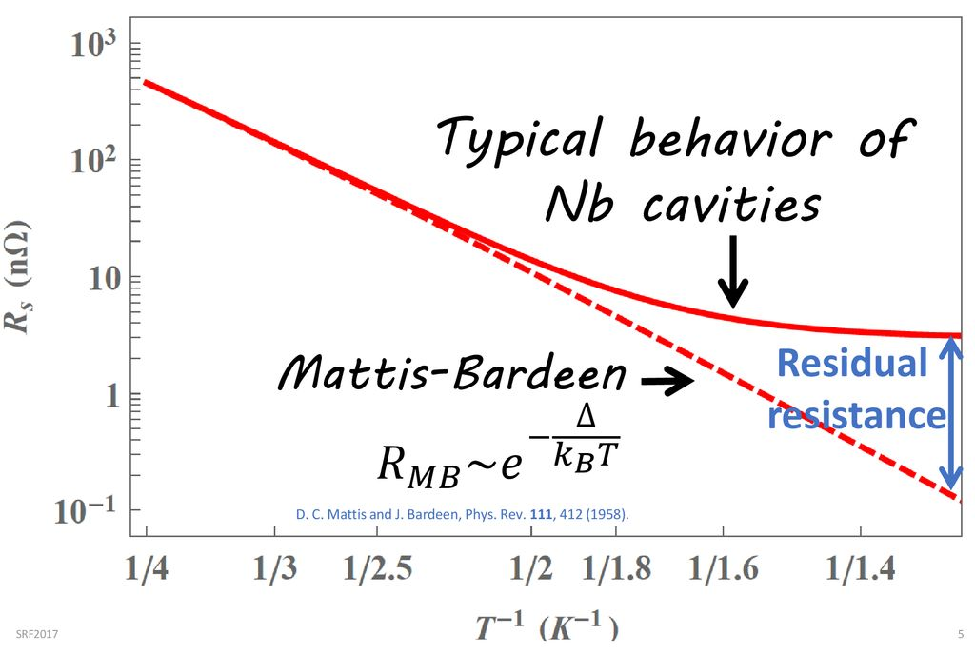
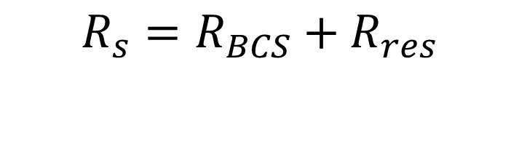
Residual Resistance
$$R_{s}=R_{BCS}+R_{res}$$
Measured resistance
R_{res} is normally between 1-10 nanoOhms
Theoretical BCS resistance
There is often a minimum resistance due to the effects of normal conducting impurities in the niobium.
One of the main effects is flux pinning where magnetic fields are frozen into normal conducting impurities inside the superconductor. This can be avoided by shielding the cavity from magnetic fields during cooldown.

Slide 8
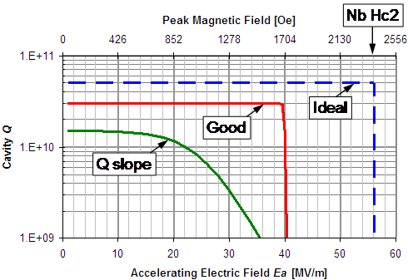
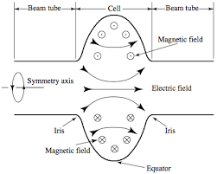
RF Critical B field
Nb H_{sh}
H_{c2}
Normal conducting state
H_{sh}
Vortex state
Meissner
state (metastable)
H_{c1}
Meissner state
T_{c}
When a magnetic field is applied to a superconductor, supercurrents flow at the surface and shield the material
This increases the free energy of the superconducting state. When the free energy of the superconducting state equals the normal conducting state the flux enters the material in vortices.
For RF fields the flux continues to be excluded in a metastable state until the field reaches the critical superheating field (240 mT for Nb)

Slide 9
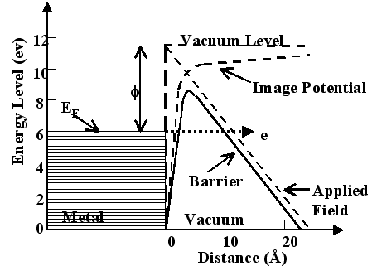
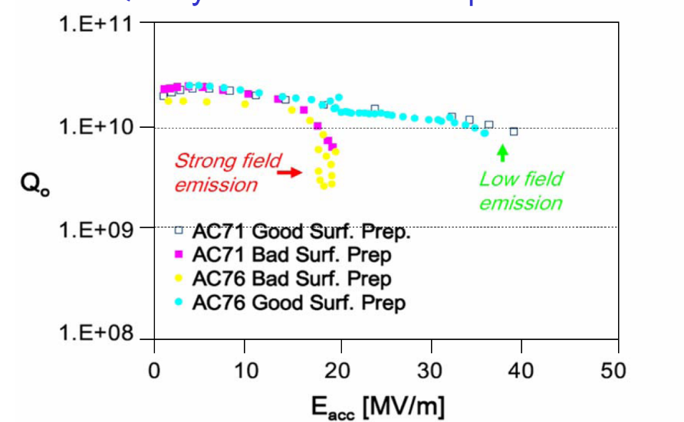

Field Emission
Electrons are emitted from surface imperfections or contaminants in high E field
Electrons can be accelerated by the RF fields and deposit their energy on the cavity walls, heating them.
If heat is above T_{c} thermal quench occurs
Limits operation from most cavities between 20-35 MV/m (depending on cleaning processes and luck).
doi:10.18429/JACoW-IBIC2017-TH1AB1

Slide 10
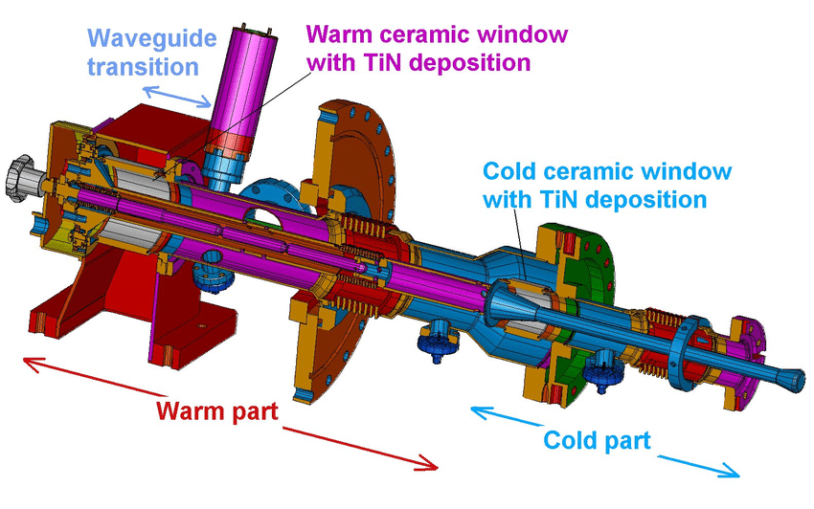
SRF Couplers
Also a limited power in SRF couplers.
WG limited to 500 kW due to multipactor (electron cloud).
Coax is limited to a similar amount by limited cooling of inner coax.
TTF III coupler

Slide 11
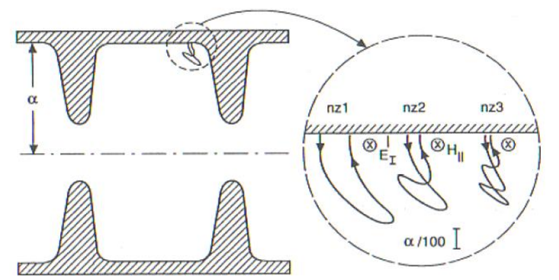
Multipactor
Seed electrons in the cavity are energised by the RF field in the cavity & collide with the wall
If their energy is in a specific range, secondary electrons are emitted
If statistically more than one electron is emitted per collision, and the secondary electron trajectories are synchronised with the RF field, there is an exponential increase in the number of electrons.
Electrons can absorb additional RF power and keep the cavity from increasing its voltage

Slide 12
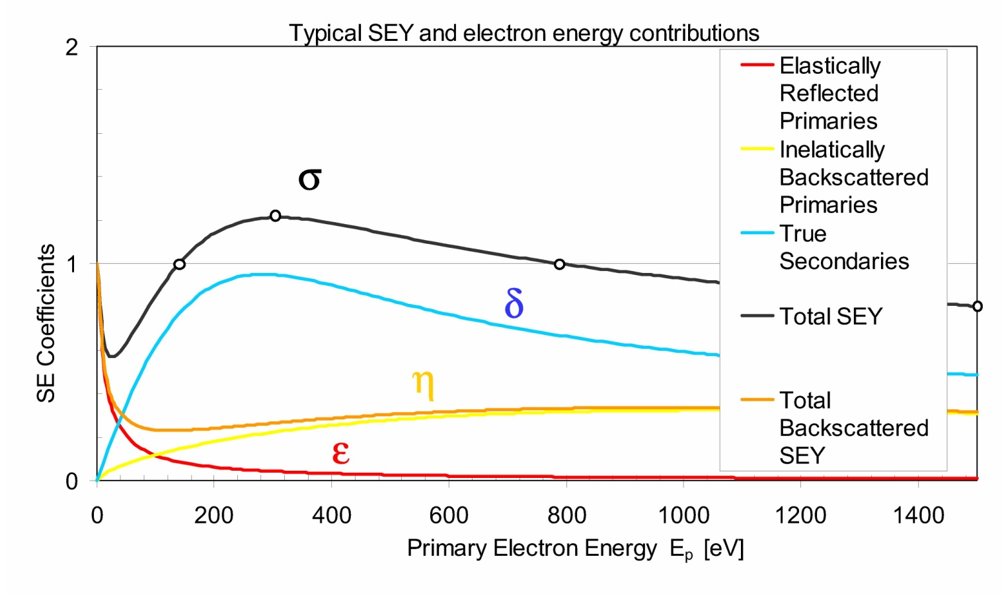
Secondary Electron Yield
Secondary Emission Yield
For multipactor to occur each electron striking the surface must generate more than one secondary on average.
The ratio of primary to secondary electrons is given by the secondary emission yield (SEY).
SEY is strongly dependant on impact energy and only gives an SEY>1 for a finite range of low energies

Slide 13
Parallel Plate Multipactor
One of the most common type of multipactor is two-point multipactor that occurs between two metallic plates.
The RF fields accelerate the particle across the gap.
The RF fields reverse every half period so the electron motion is resonant if it takes (n+1/2) periods to traverse the gap
a.c. electric field
across gap or in
waveguide
Notes:
A discharge is the passage of a conduction current (i.e. not a displacement current) through a medium that does not normally have any charge carriers.

Slide 14
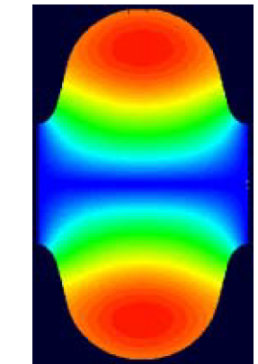
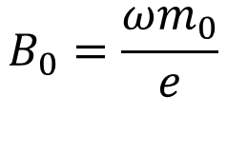
Multipactor in Cavities
Two point multipactor can also occur in pillbox and elliptical cavities.
The electron trajectories are bent by the RF magnetic field to form semi-circles.
In pillbox cavities trajectories are resonant if the cyclotron conditions are met
  Multipactor will occur if the electric field accelerates the electrons to energies between ~50-500 eV depending on the material.
In elliptical cavities the resonant condition varies with radius as smaller arcs are required. The electron energies are low and the multipactor is weak.
Electron trajectory
$$B_{0}=\frac{ωm_{0}}{e}$$
Notes:
One impact per RF period

Slide 15
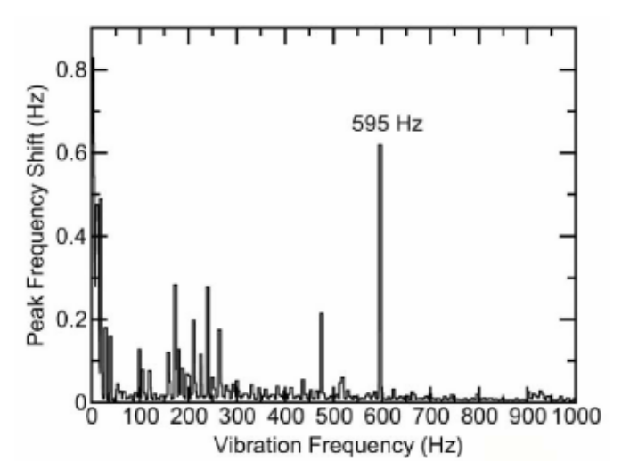
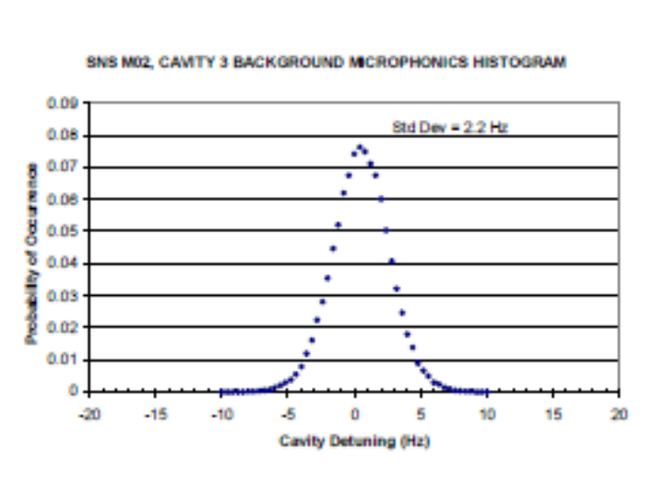
Microphonics
Changes in frequency caused by connections to the outside world:
Vibrations
Pressure Fluctuations
This means the cavity is not always on resonance.
Additionally the constantly varying frequency will cause phase errors.
To avoid problems we need to artificially broaden the cavity bandwidth by using a lower Q_{e} of at least 10⁶
The cavity is overcoupled and requires more RF power to reach the same gradient

Slide 16
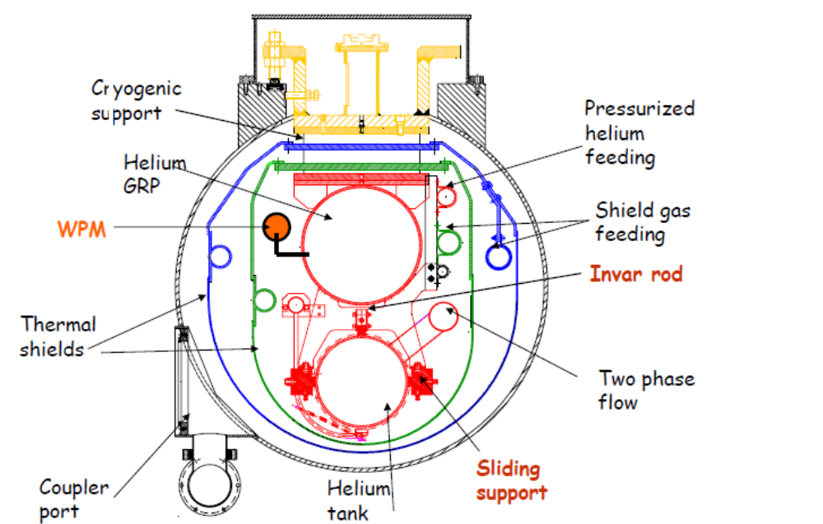
Cryomodules
The cryovessel is often one of the more complicated items required. It requires:
Inlet and return pipes for He and N.
It must support the cavity.
Have low static heat loss.
Incorporate all couplers.

Slide 17
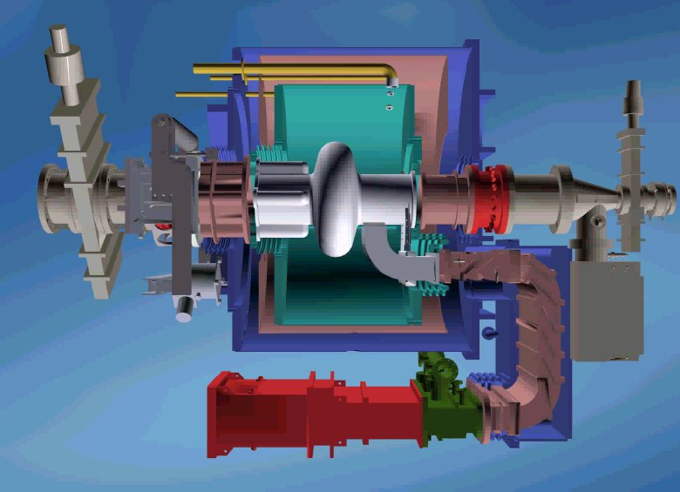
Filling factor
The cryomodule in an SRF system also takes up significant space.
The filling factor is the ratio of the cavity length to cryomodule length.
It varies from a factor of 5 for single cells to 1.5 for a 9 cell cavity (typically its 2 extra cells on each side).

Slide 18
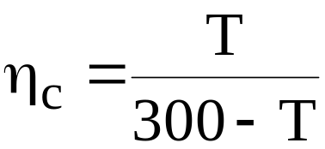
Cryogenic systems
All refrigerators have a technical efficiency, η_{T} of 20%-30%
The Carnot efficiency is given by
The dynamic heat load, P_{c}, is the rf power dissipated in the cavity walls.
A static heat load, P_{s}, adds an additional heating (~5-10 W)
Liquid helium transfer lines require 0.1-1W per metre, so total loss is length L (More efficient lines can be used)
It is standard to fill to an overcapacity, O (~50%)
Total Power for N cryostats= O N (P_{c} +P_{s} +L) / (η_{T} η_{c} )

Slide 19
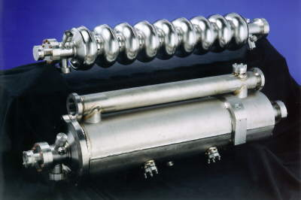
RF Cavities for Linacs and Circular Accelerators
Circular Accelerators | Linac (High energy)
High HOM damping CW operation → high power couplers required | High gradient cavities Multicell Pulsed operation (often)
CESR cavity
TESLA cavity

Slide 20
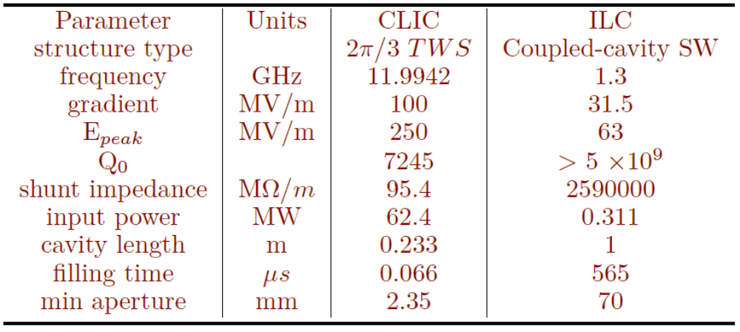
SCRF vs NCRF
SCRF
More efficient (even when including cryogenic losses)
Higher CW gradient
Long pulse or CW only
Complex system needing cryostats and cryogenics
Only frequencies below 4 GHz.
NCRF
Less efficient.
Higher pulsed gradient
Simpler systems, water cooled
More reliable
Lower capital costs
Smaller apertures mean higher wakefields

Slide 21
Frequency Scaling
 | Superconducting | Normal Conducting
R_{surf} | f² | f^{0.5}
Q_{o} | f⁻² | f^{-0.5}
R_{shunt} | f⁻² | f^{-0.5}
R/Q | f⁰ | f⁰

Slide 22
References
RF superconductivity for accelerators, Padamsee, Knobloch, Hays
Superconducting cavities, W. Weingarten https://cds.cern.ch/record/308015/files/p167.pdf
AC/RF Superconductivity, G. Ciovati
https://cds.cern.ch/record/1973680/files/CERN-2014-005-p57.pdf
Superconductivity, P. Schmüser
https://www.desy.de/~pschmues/Superconductivity.pdf

