Slide 1

Design aspects and operational characteristics of the NHMFL 32 T superconducting magnet
H.W. Weijers

Slide 2
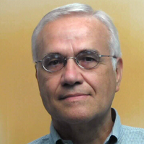




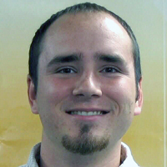
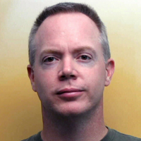
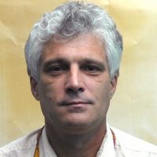
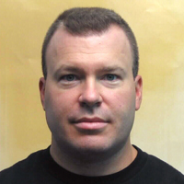



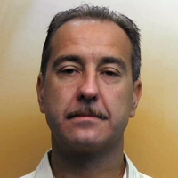

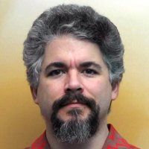
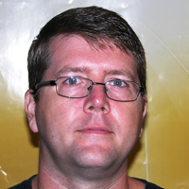


Credits
+90
And external reviewers P. Joshi (BNL), M. Steurer& F. Bogden (CAPS/FSU), H. Boenig,
administration and management at the NHMFL, collaborators, vendors, and many more

Slide 3
Outline
Introduction
  Brief comparison with selected other projects
  32T Concept
Project aspects
Prototype phase
Conductor specification
Quench simulation
Actual performance versus specification and simulations
Summary

Slide 4
32 T and selected other all-superconductor projects for perspective
Project | Group | Type | Δ B [T] HTS / LTS | HTS | J_{ave} [A/mm²] | HTS coil ID/OD/height [mm] | Operational | Comment
32 T | NHMFL | User magnet | 17 / 15 | REBCO | 200 | 40 / 140 / 178 | 2018 32 T | Insulated
 |  |  |  | REBCO | 170 | 164 / 232 / 320
25 T Cryofree | Tohoku | User magnet | 10.6 / 14 | (REBCO) Bi-2223 | 112 | 96 / 278 / 389 | 2016 24 T | Insulated
28 T NMR | Bruker | User magnet | ?? | REBCO ? | ?? | ?? | ?? | 26 T NMR in 2018?
28 T Demo | RIKEN | Demonstration | 11.5 / 17.1 | REBCO | 157 | 40 / 68 / 210 | - | Previous record 27.6 T Insulated
 |  |  |  | Bi-2223 | 78 | 81 / 125 / 384
Muon collider solenoid | Brook-haven | Demonstration | 15+ / 0 | REBCO | 539 | 25/91/64 | - | No insulation
26 T NI | SuNAM / MIT | Demonstration | 26.4 / 0 | REBCO | 343 (mid) (200-343) | 35 / 172 / 327 | Muon detection Under repair | No insulation (26 T quenches)
25 T (2017 version) | IEE / CAS | Demonstration | 10.7 / 15 | REBCO | 267 middle (~100-306) | 36 / 103 / 182 | - | No insulation
30.5 T NMR | MIT | User magnet | 18.8 / 11.7 | REBCO | 547 | 91 /118 / 324 | Under test now NMR in 2020? | No insulation
 |  |  |  | REBCO |  | 151 / 168 / 392
 |  |  |  | REBCO |  | 196 / 210 / 466
8 tesla is the largest single increase in the history of superconducting user magnets, 16.5 to 24 tesla took 40 years

Slide 5
Introduction – 32 T Concept
2009: The starting points for the 32 T magnet
(2009)
User magnet for 20 years of materials research
  Target above 30 T, bore of at least 32 mm desirable
  Ramp to field in one hour
200 A/mm² in the HTS windings
  Generic target for reasonably compact 30T class magnets
  This was aggressive and unprecedented at the time for a user magnet
Active quench protection
15 T LTS outer magnet, separately and concurrently developed by industry
  A challenging 250 mm bore, 7 MJ magnet in its own right
Not aggressive in
  HTS conductor specification
  Design fraction of critical current
  Design fraction of critical strain
  Field uniformity (500 ppm in 1 cm DSV
  Copper current density
  Cryogenic concept
Move past thermal fluctuations and really break open the quantum realm of temperatures near absolute zero and high magnetic field

Slide 6
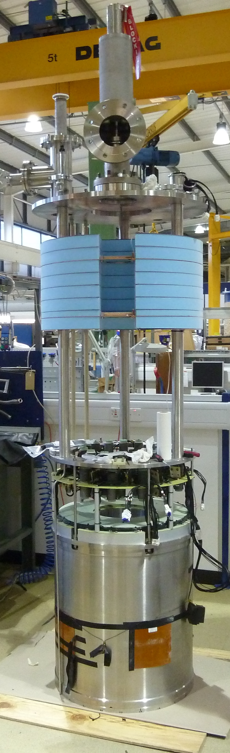
The 15 T LTS Outer magnet
(2009)
Specifications
  15 T, 250 mm bore, 4.2 K
  One hour to full field
  Radial field component < 1.5 T over HTS coil volume
  Must be tolerant of HTS insert coil quench
    Note: HTS quench behavior unknown at the time of order
  LTS quench must not destroy HTS coil
Required collaborative effort
  Especially on quench management
Outcome
  5-coil NbTi + Nb₃Sn magnet
  Passive + active quench protection
  268 A operating current for 15.0 T
  Rated at 15.3 T stand-alone
  294 H self inductance
  7.0 MJ stored energy
Completed Outsert at Oxford Instruments (late 2014)

Slide 7
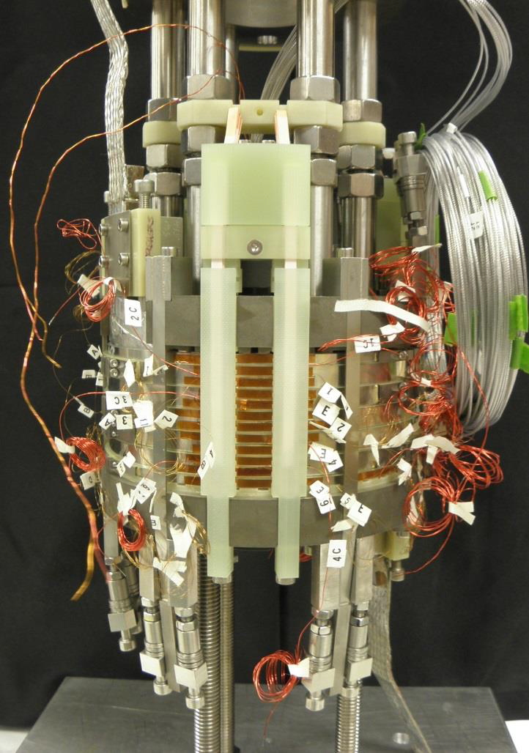
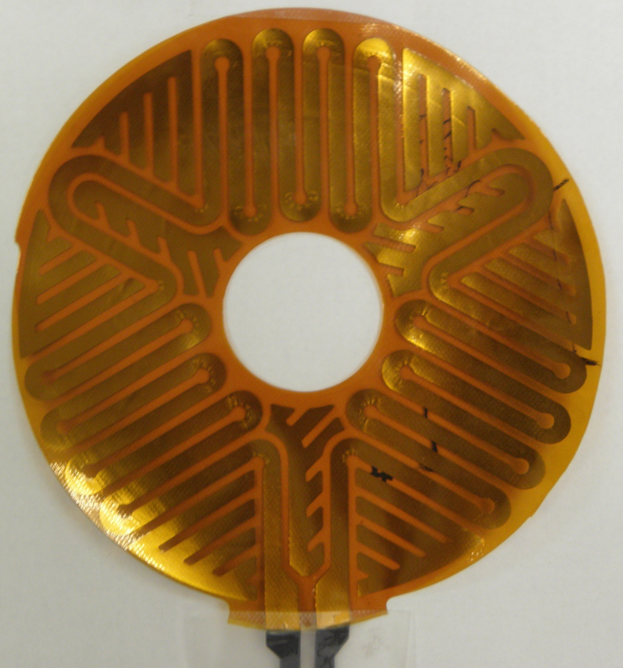
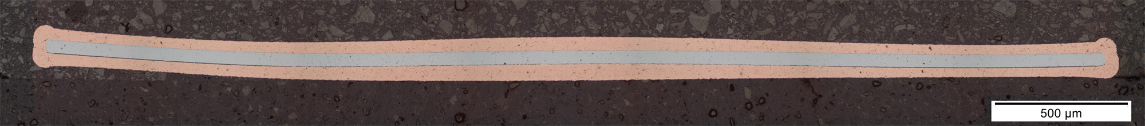
Prototype phase
(2013)
Key topics to resolve:
Construction
  Winding, joints, terminals, cross-overs, reinforcement
Stagnant “Helium bubble”
  At - B_{z}·dB_{z}/dz > 2100 T²/m: downward magnetic force on helium gas (bubbles) exceeds buoyancy: poor helium cooling in small % of windings
  Maximize axial conduction in windings and radial conduction in flanges
Quench detection
  Conventional approach with balanced voltage taps & 100 mV threshold OK
Quench protection
  Active quench heaters
  Develop & benchmark numerical simulation tools with “HTS physics”
l
l

Slide 8
REBCO conductor specification
(2009)
Comprehensive specifications negotiated (a first, took 2 years) for 12 km conductor that
  Meet 32 T project needs
  Are routinely achieved in production runs: “catch the outliers”
Insufficient I_{c} correlation (at the time) between 77 K, SF and 4.2 K in-field
  Specify I_{c} at 4.2 K and most demanding field and angle in coil
  Verify parameters in all conductors in collaborative NHMFL/SP QA program
Parameter | Unit | Value
I_{c} at 4.2 K, 17 T, 18° angle | A | ≥256
n-value at 4.2 K, 17 T, 18° angle | - | >25
Thickness (average over all pieces) | mm | ≤0.170
Width | mm | 4.10±0.05
Cu stabilizer cross-sectional area | mm² | 0.42±0.01
RRR stabilizer | - | >50
Hastelloy C267 (half hard) cross-sectional area | mm² | 0.20±0.01
Joint resistivity (77 K) | nΩ-cm² | ≤160
Piece length Coil 1 / Coil 2 | m | 60 / 110
I_{op} = 180 A, later 174 A
“mid-slit” only
(≤ 50 nΩ per joint)

Slide 9
Conductor as delivered
(2009)
Short sample I_{c} varies within piece length
Average I_{c} generally increased with time
This conductor is “TOO GOOD”
HTS Operating margin is large (at least 20-40 K):
Exceedingly stable
Takes 160,000 J to protect 100 kg HTS coil
Takes 300 J to protect 1400 kg LTS coils
Mostly M3, early deliveries
Mostly M4 (2014-early 2015)
☹
specification
☺
Data on 175 lengths, ordered in sequence of increasing average I_{c}
Energy needed to heat the 32 T HTS windings

Slide 10
Margins versus quench protection
(2009)
Magnet designs should have
specified range and distribution of temperature margin
Conductor specification should have
conductor grading with minimums and maximums on I_{c}

Slide 11
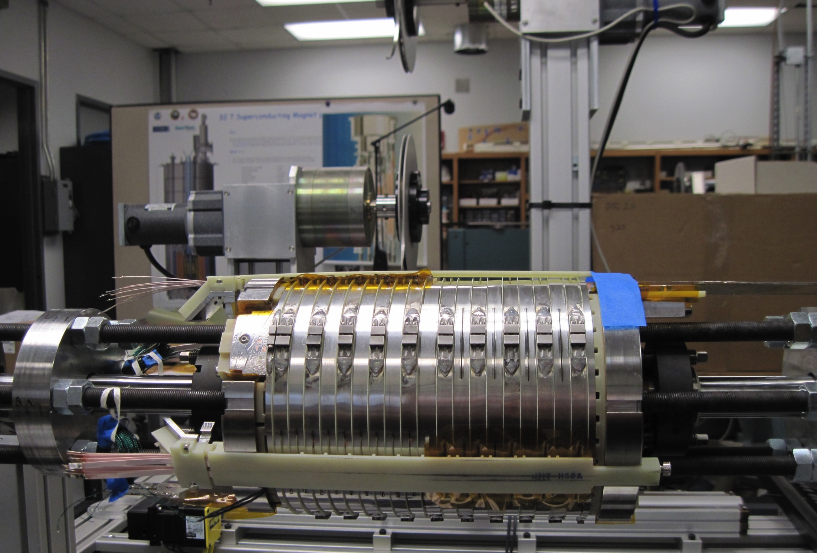
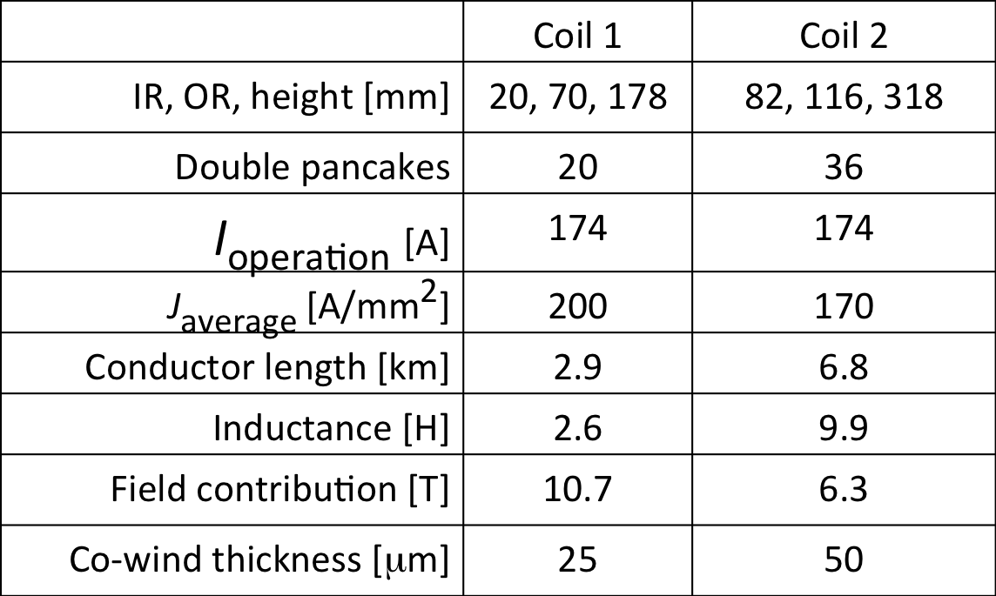
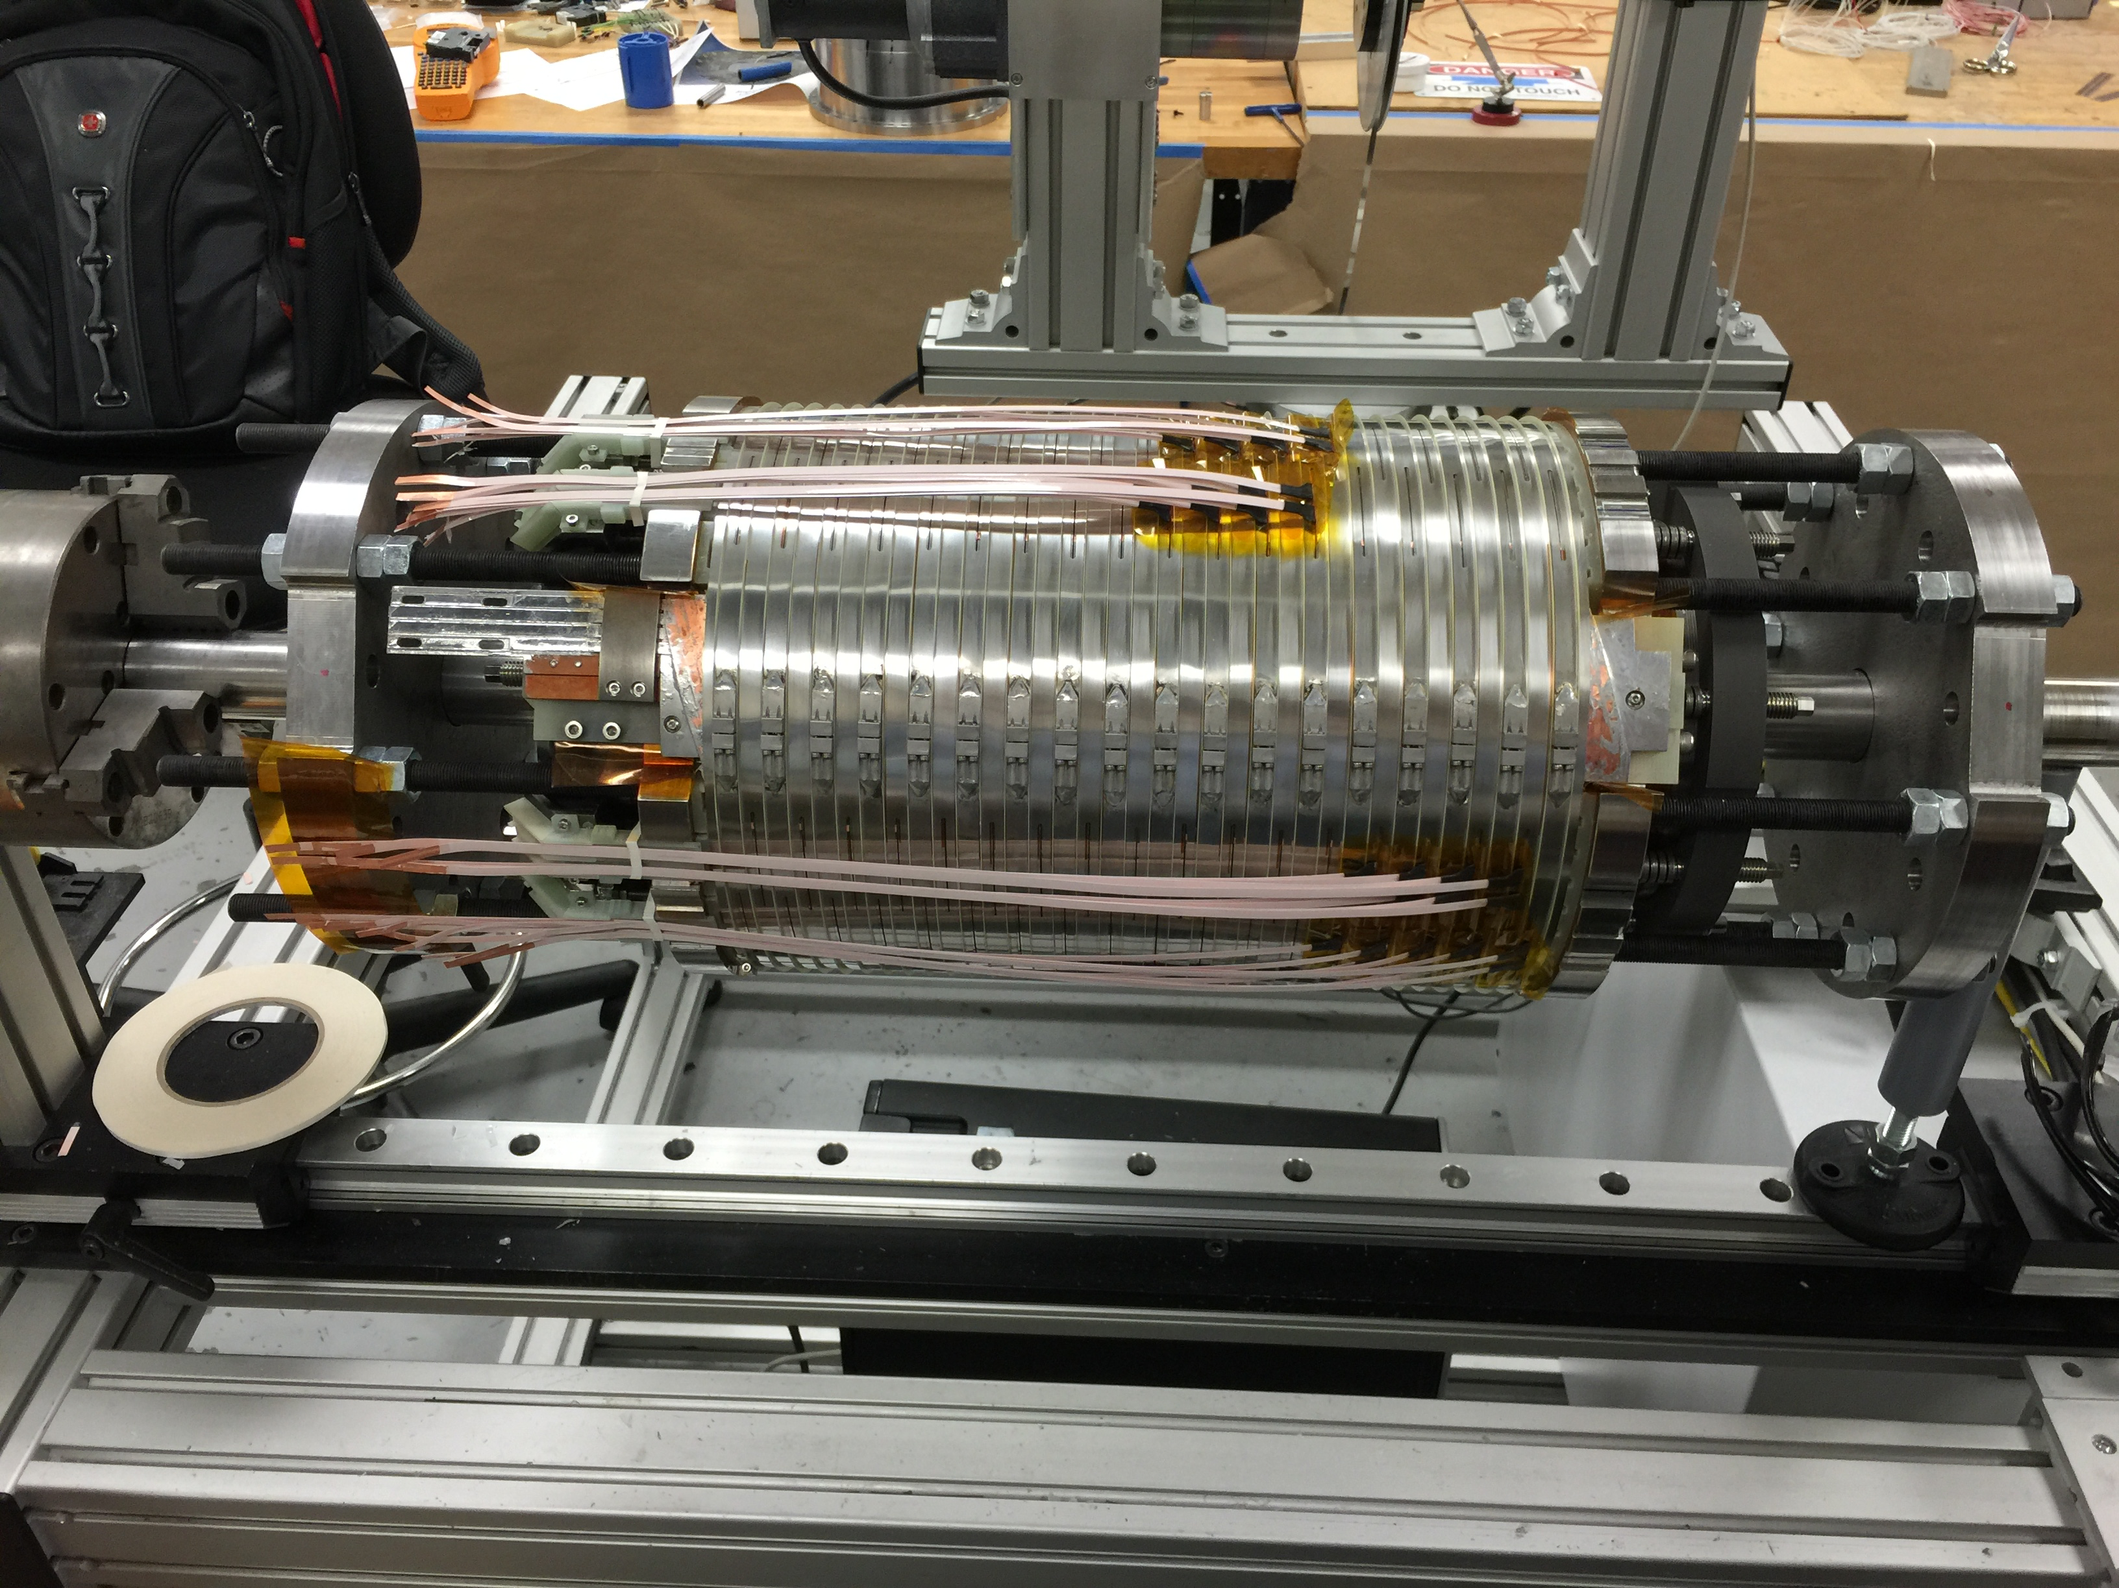
The 17 T HTS inner magnet
(2009)
Coil 1
3
2
Coil 2
1
Insulated co-wind reinforcement, wax impregnated windings
Right: Coil 1 and 2 on the winder during coil assembly
  Quench heater leads
  Quench heater lead covers
  Band clamps
Assembly from double pancake modules to complete coils and all electrical tests takes 2-3 months per coil

Slide 12
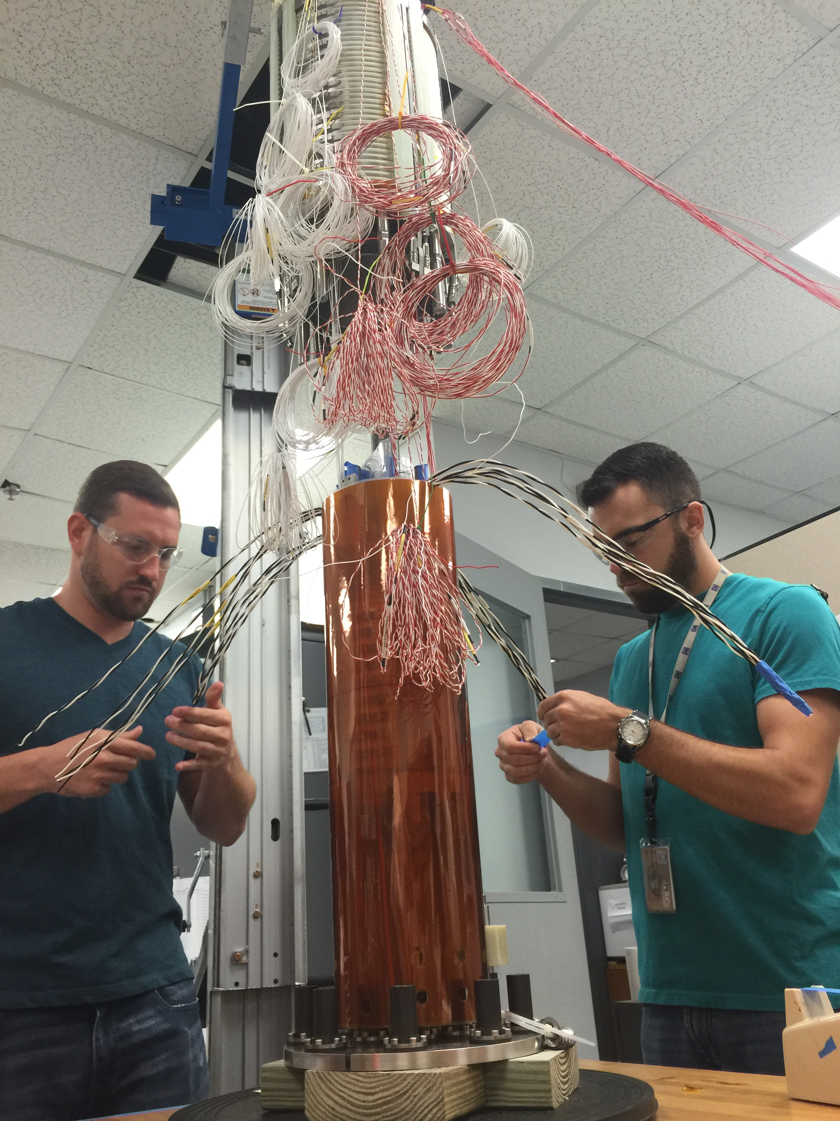
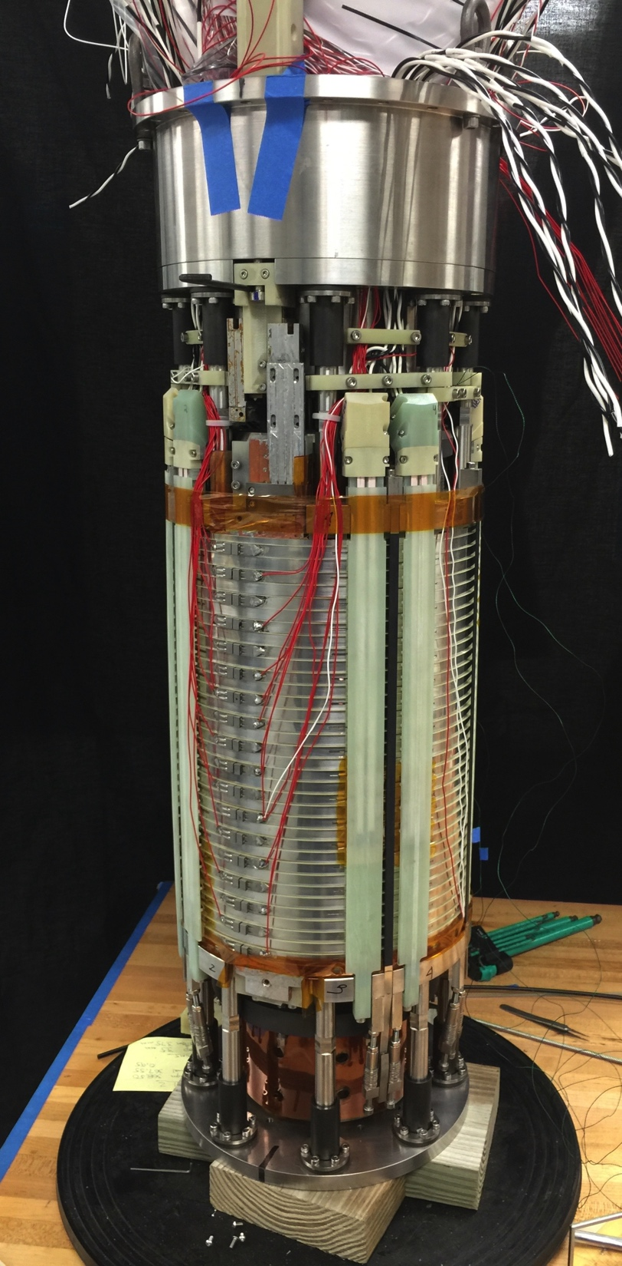
Combining Coil 1 and Coil 2
(2009)
<< Preparing to lower Coil 2 over Coil 1
The completed HTS coil assembly >>
Coil 2, April 25
~ 5000 parts, ~100 DAQ wires

Slide 13
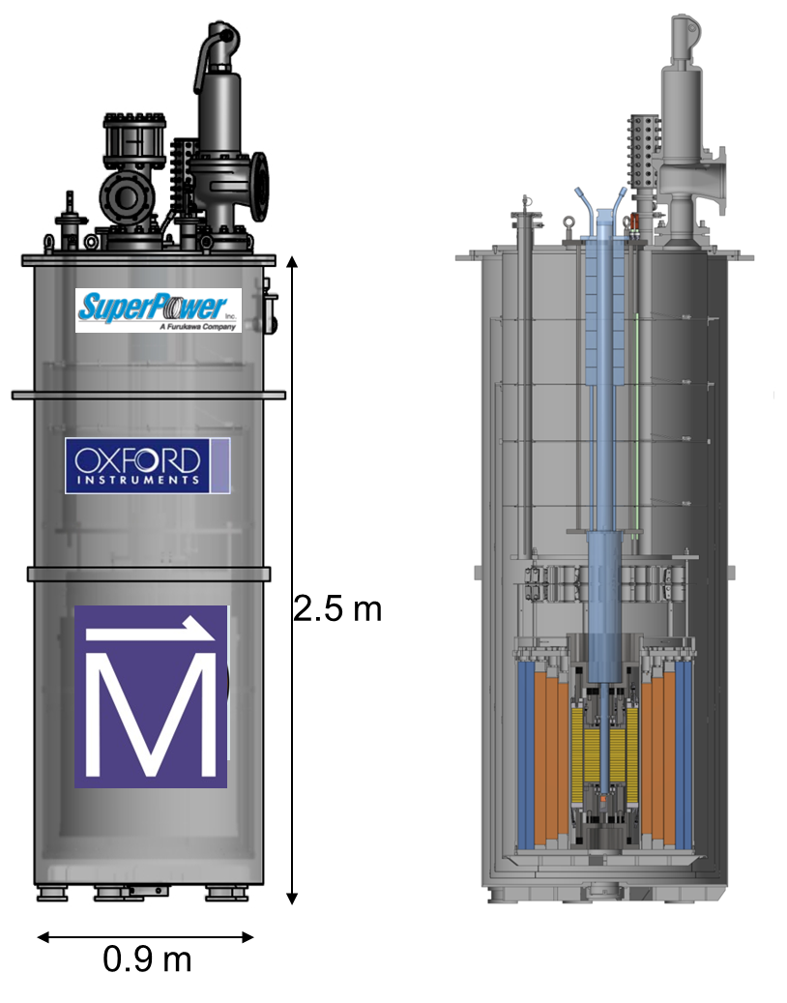
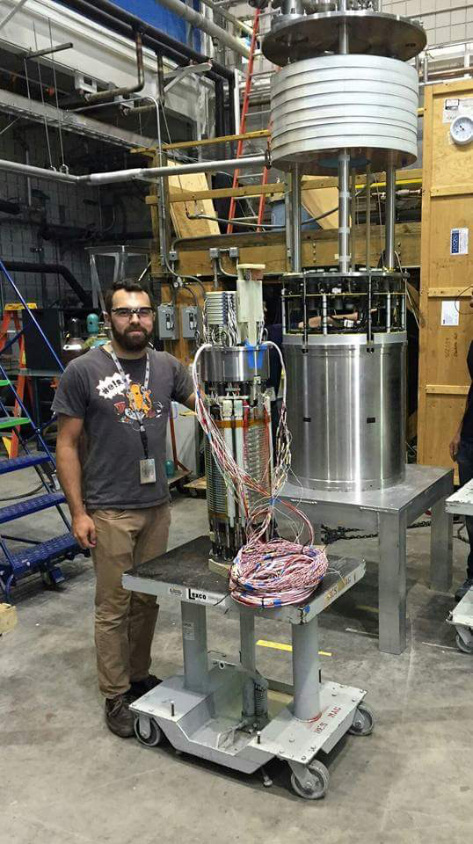
The 32 T magnet
(2009)
Key parameters:
Center field 32 T
Clear bore 34 mm
Ramp time 1 hour
Uniformity 1 cm DSV (spec) <5×10⁻⁴
Operating temperature 4.2 K
Stored energy 8.3 MJ
Expected cycles/20 years 50,000
System weight 2.6 ton
15 T / 250 mm bore LTS magnet
17 T / 34 mm bore REBCO coils
Separately powered, simultaneously ramped
REBCO: 2 double pancake coils
Nb₃Sn coils
NbTi coils
Dil. fridge or VTI
Just before the union of HTS and LTS coils

Slide 14
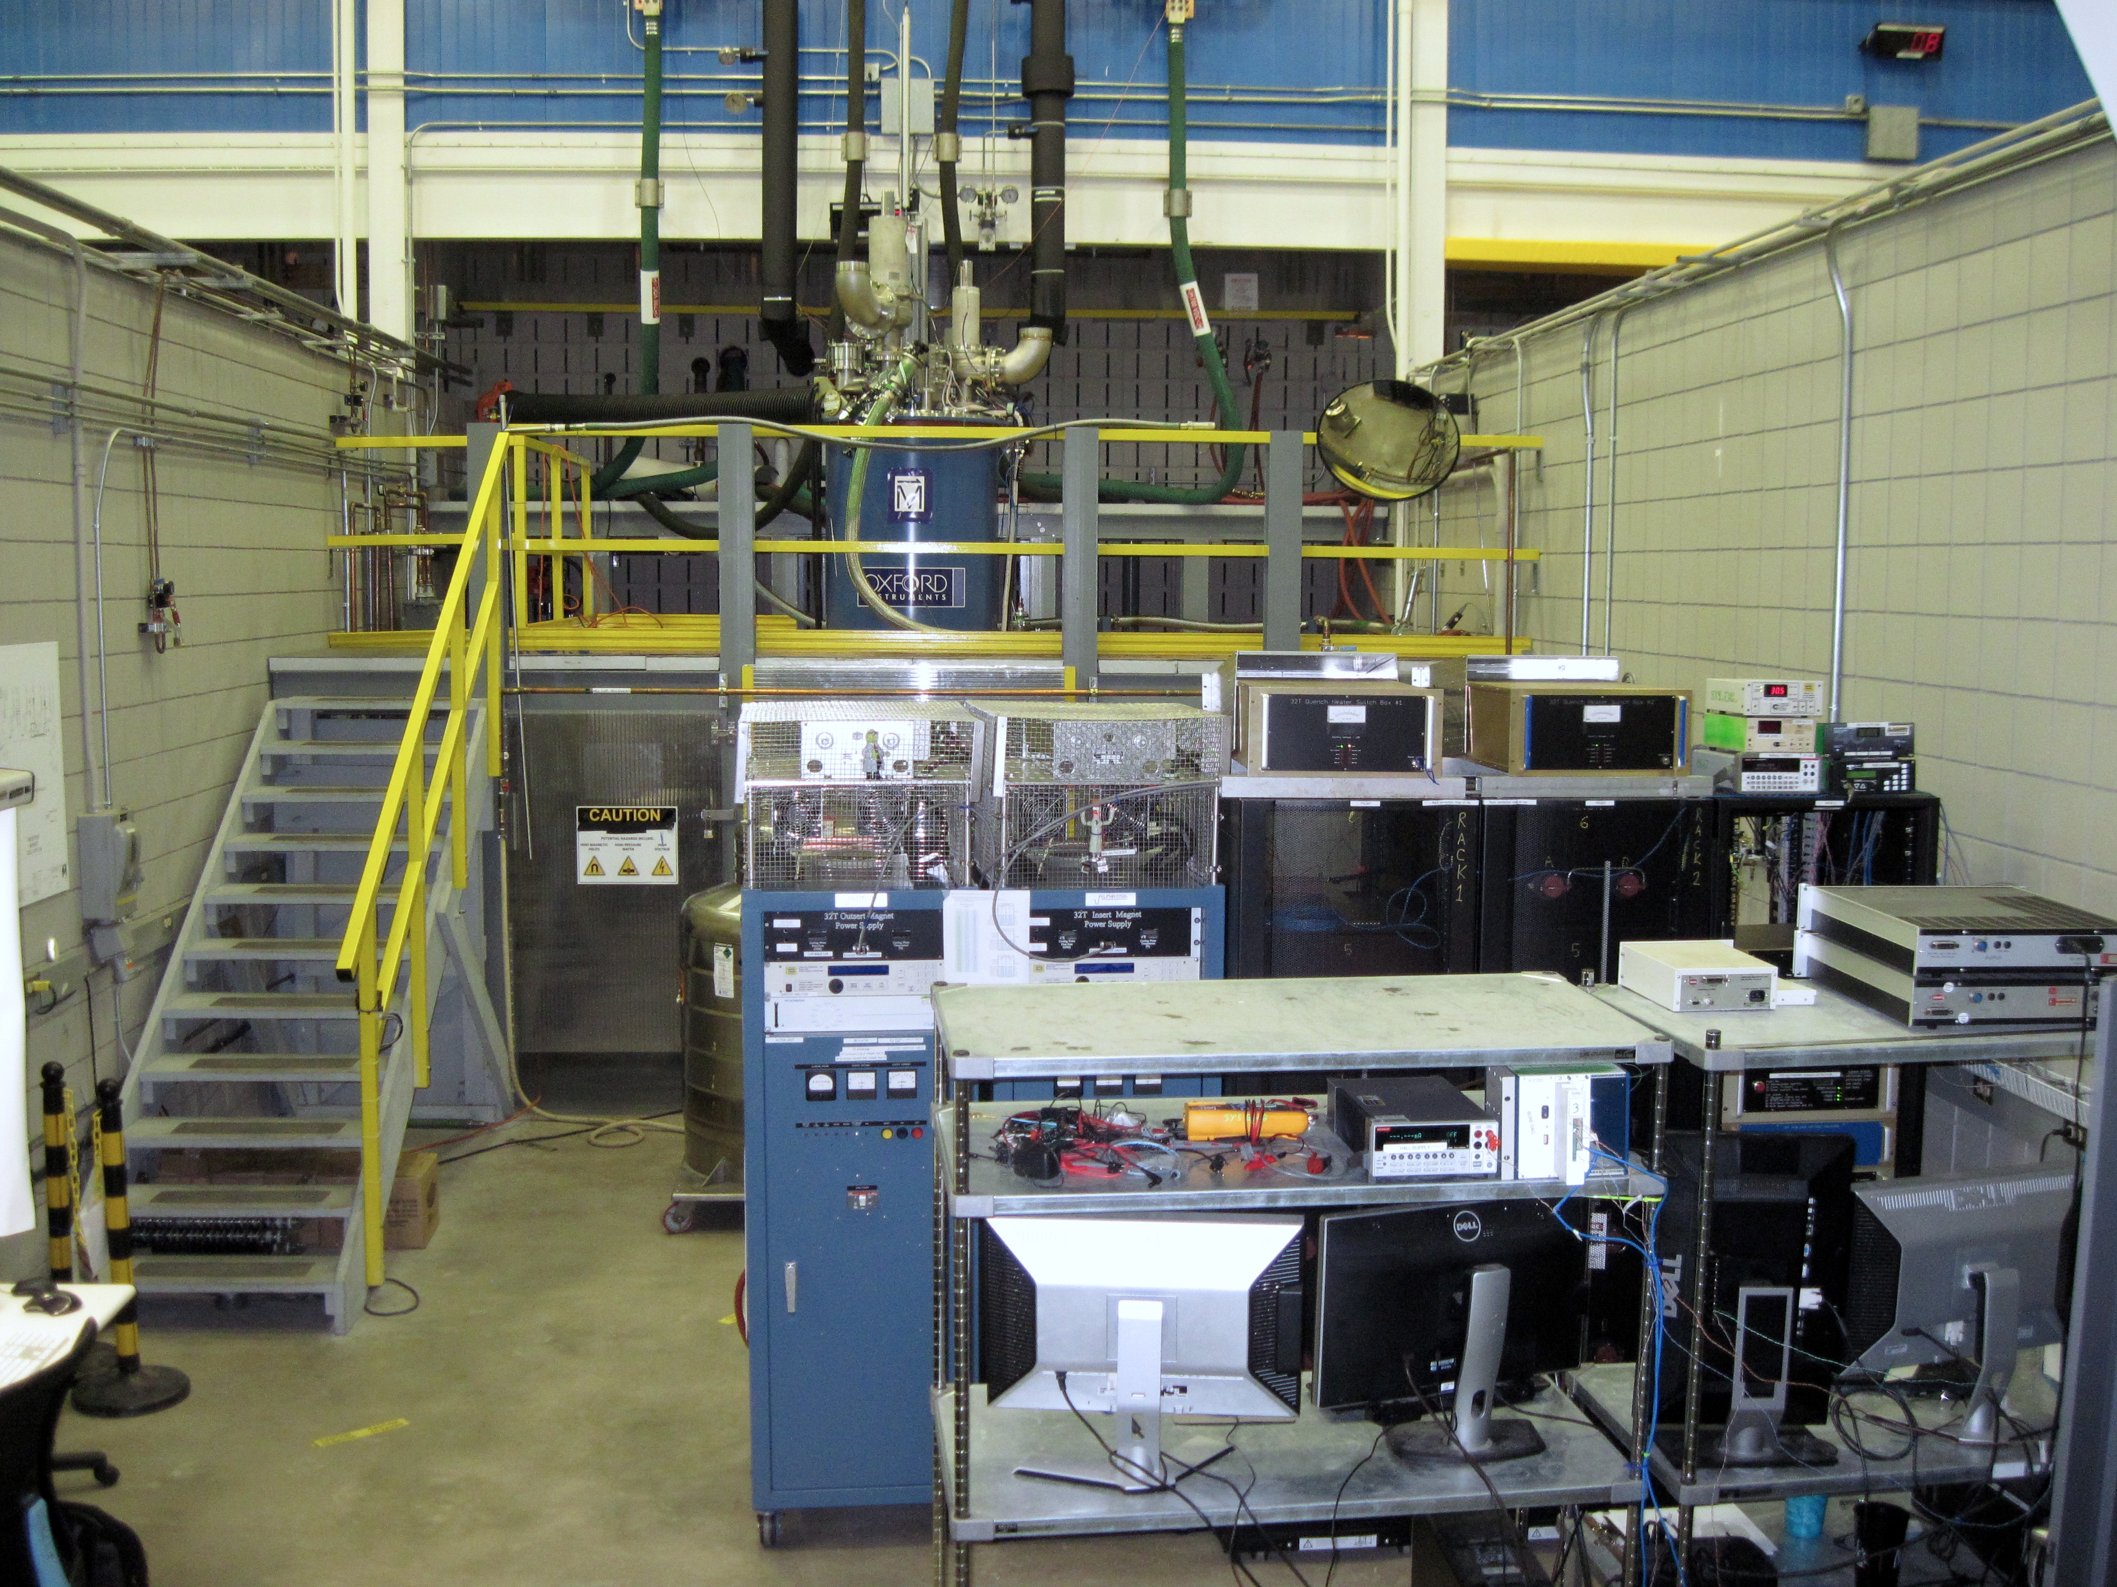
The 32 T system under test
(2009)
Top of cryostat
Data Acquisition

Slide 15
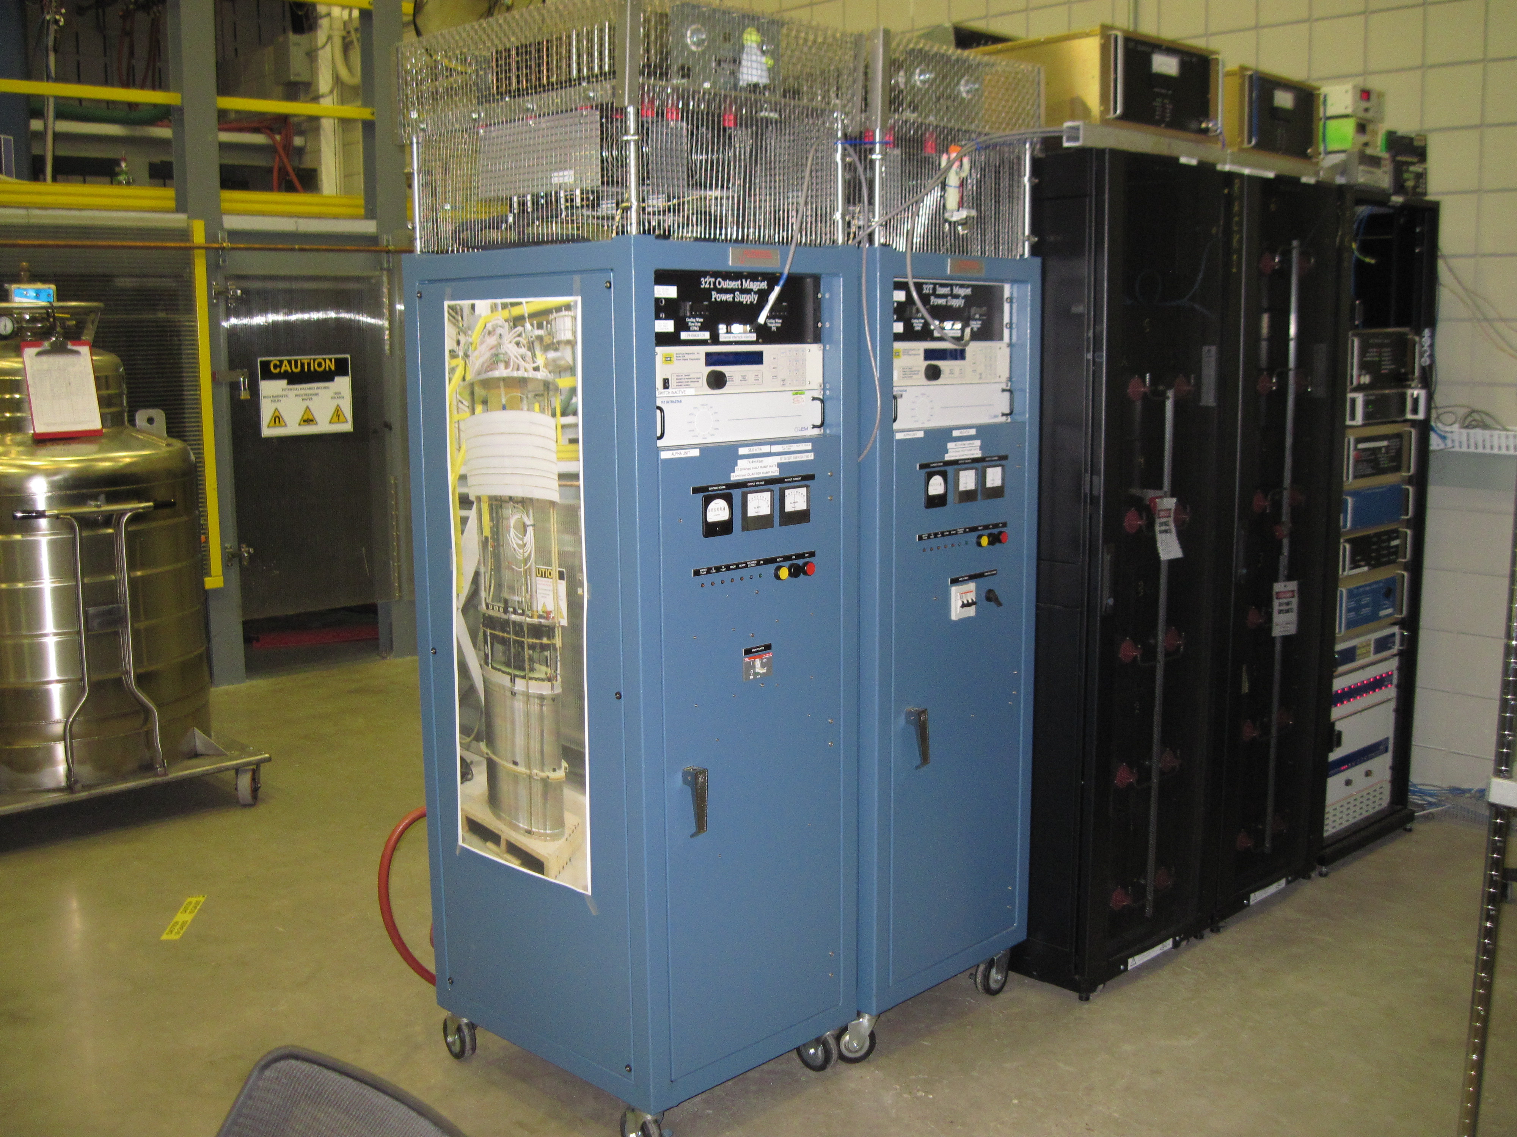
The 32 T system under test
(2009)
Switch Box 1 & 2
Crowbar resistor
Interlock
HTS Quench management
LTS Quench management
LTS magnet PS
HTS magnet PS
Battery bank

Slide 16
Actual performance
(2009)
Configuration | Number of runs
HTS coils alone to 9 T (~1/2 B_{HTS}) | Dozens
LTS coil alone, HTS open circuit | Once
Combined runs up to half-field | Several
Combined runs at and above 28 T (≥ ¾ energy, 7/8 of peak field) | 21

Slide 17
Quench history of assembled 32 T
(2009)
 | HTS-only operation, or LTS < 1 T | HTS + LTS series operation
Spontaneous HTS quenches | None | None
Spontaneous LTS quenches | None | None
False positive in quench detection | 9 trips*, all below 9 T central field | 2 trips*, -18.5 T, -11 T
Deliberately induced quenches | None | 16 T: half field, quarter energy 22.5 T: half energy 28 T: 7/8 field, ¾ energy
*: Had to reduce quench detection sensitivity at lower fields to address this

Slide 18
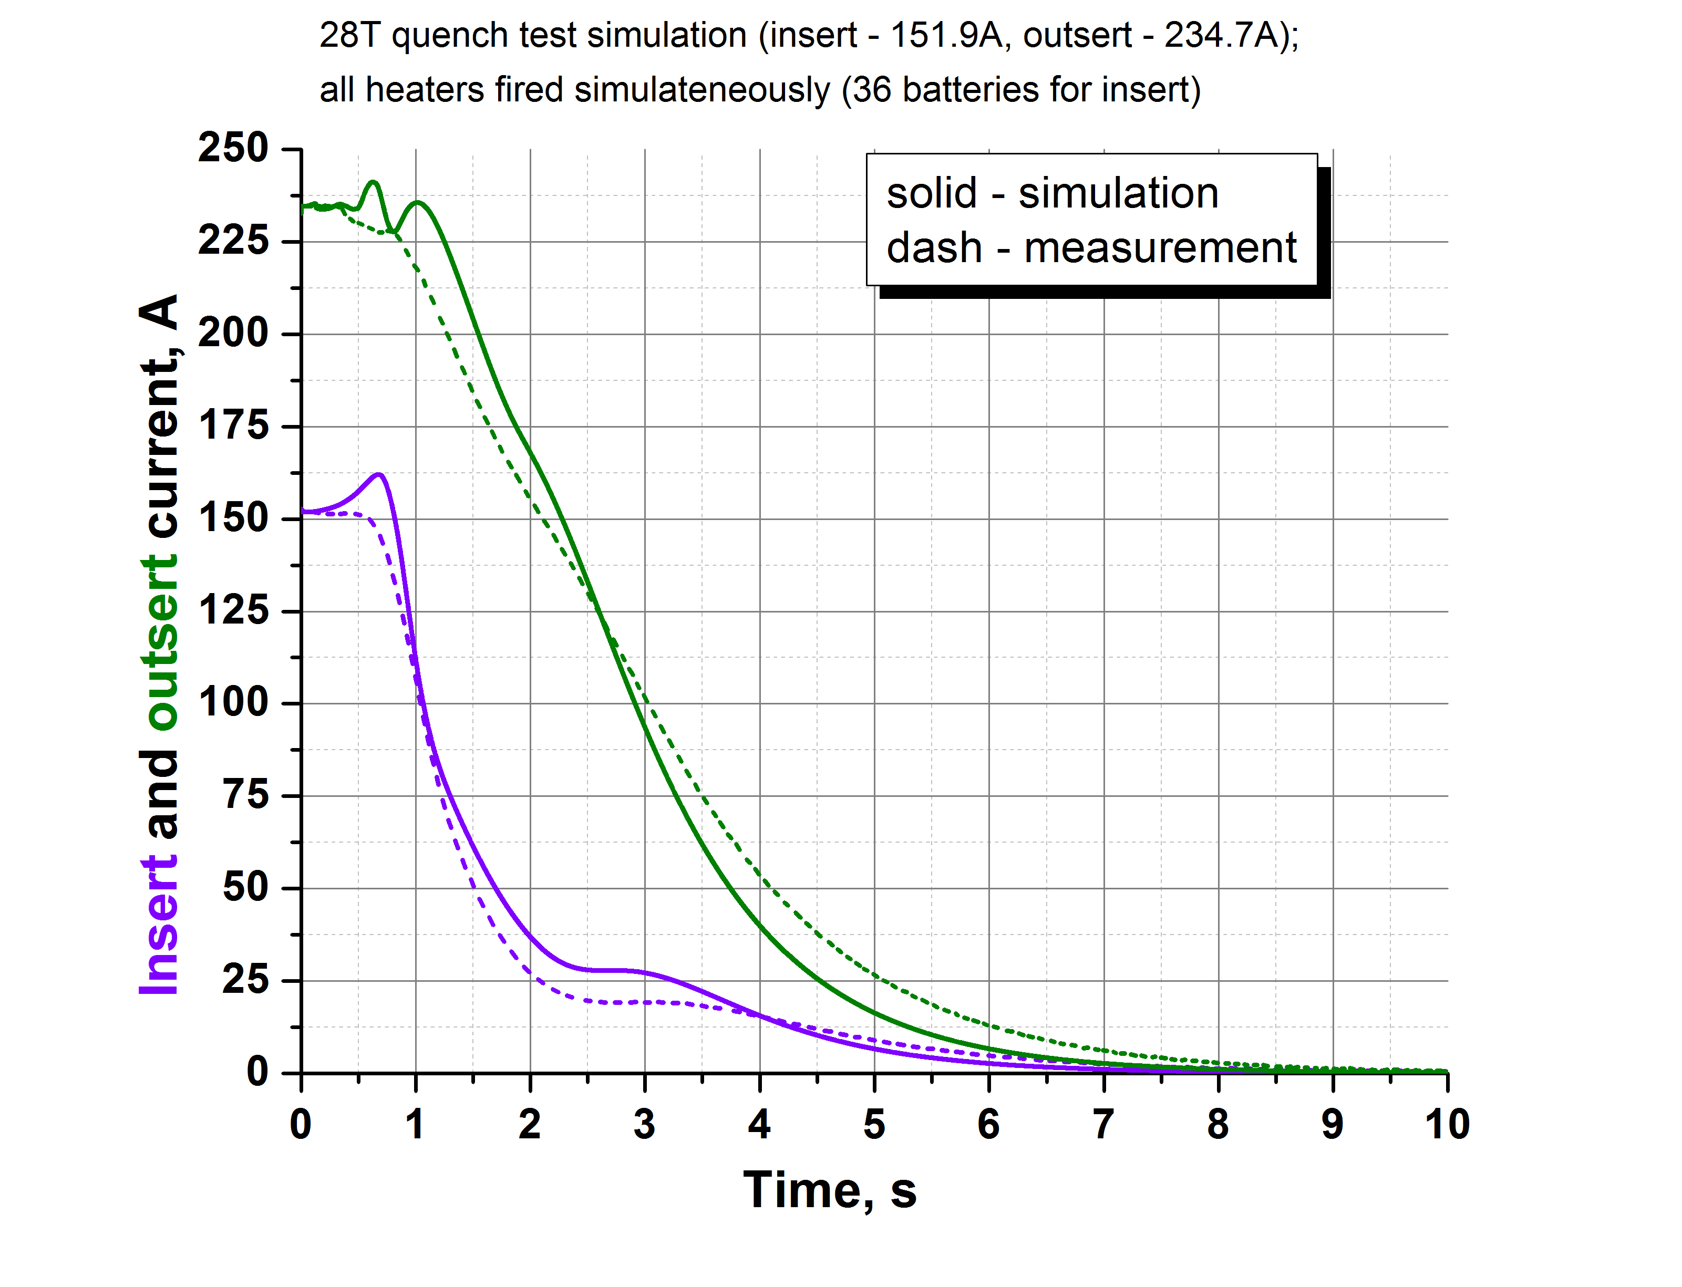
28 T quench data and simulation
(2009)
This is unique data:
High-value high-field HTS coils
The HTS coils survived
Actual behavior slightly more favorable than simulation:

Slide 19
Actual performance versus specifications
(2009)
Key specifications:
Center field 32 T
Clear bore 34 mm
Ramp time 1 hour
Uniformity 1 cm DSV 500 ppm
Operating temperature 4.2 K
Project started with 32 mm bore specification
Delivering 34.0 mm clear bore
4.25 K in bath-cooled areas
≤ 4.4 K in “helium bubble” zone

Slide 20
Actual performance versus specifications
(2009)
Key specifications:
Center field 32 T
Clear bore 34 mm
Ramp time 1 hour
Uniformity 1 cm DSV 5×10⁻⁴
Operating temperature 4.2 K
Peak field (32.1 T) later confirmed
with ⁶³Cu NMR measurement
Dec 8, 2017

Slide 21
Actual performance versus specifications
Flux Jumps
Only happen at low field (B_{CF}< 10 T)
Central field disturbance is small
Power supply response is not
Used 32 liters helium for this run
~ 6 liter/hour versus 11.3 liter/hour max in heat load budget
➔130 liter/day with 24/7 operation
Low-field flux jump related clusters of events:
LTS power supply response
32 T
HTS Coil 1
HTS Coil 2
HTS power supply (over-)reaction to
single flux jump event
PS limit
0 T
0 T
0 T
HTS power supply output
Event
- 32 T
1 Hz data over 5.5 hours
500 Hz data over 20 seconds

Slide 22
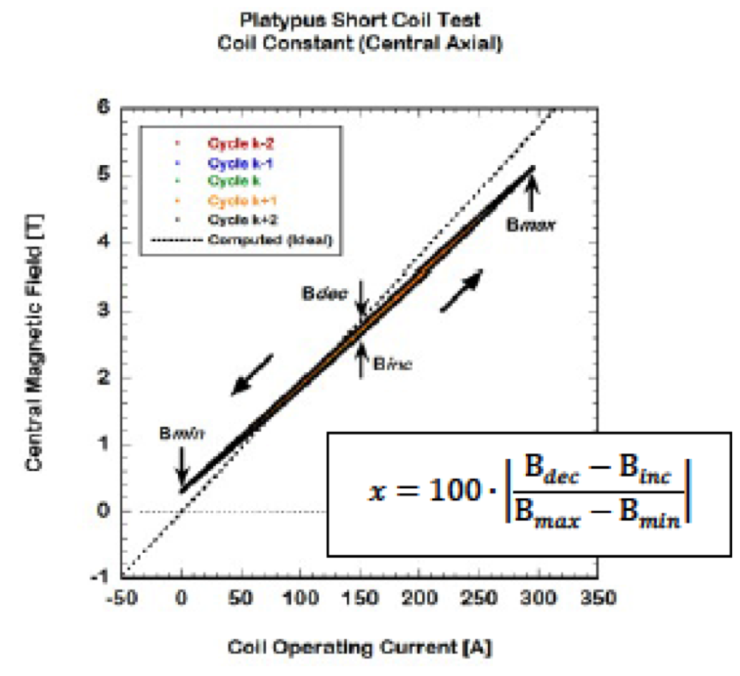
Observed behavior: Hysteresis
(2009)
Platypus Short Coil Test
B_{max}
Projected
Observed
B_{dec}
-1 0 1 2 3 4 5 6
Central magnetic field [T]
B_{inc}
B_{min}
-50 0 50 100 150 200 250 300 350
Coil operating current [A]
Extrapolating from other coils: expect 8.5% hysteresis in 0➔32➔0 tesla sweep expected (DKH)
Observed: 0.4 tesla, 0.7% hysteresis
In 0➔32➔0➔-32➔0 tesla

Slide 23
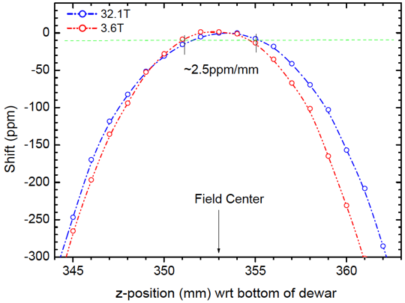
Observed behavior: Hysteresis and uniformity
(2009)
Key specifications:
Center field 32 T
Clear bore 34 mm
Ramp time 1 hour
Uniformity 1 cm DSV <500 ppm
Operating temperature 4.2 K
  There is hysteresis in the generated magnetic field
  Repeatable
  Not a simple ellipsoid
  Uniformity is ~ 125 ppm in 1 cm DSV ~independent of B
  Well within spec of 500 PPM
125 ppm in 1 cm DSV

Slide 24
Observed behavior: drift
(2009)
  Central magnetic field drifts
  10 ppm/minute in direction of ramp immediately after reaching a set point at full ramp rate
  0.5 ppm/minute after 2.5 hours (level of power supply drift)
  <0.5 ppm/minute immediately after reaching a set point at full ramp rate after slight overshoot
<2.5 hour wait results in
power-supply level drift
Slight overshoot immediately results in
power-supply level drift
10 ppm
10 ppm

Slide 25
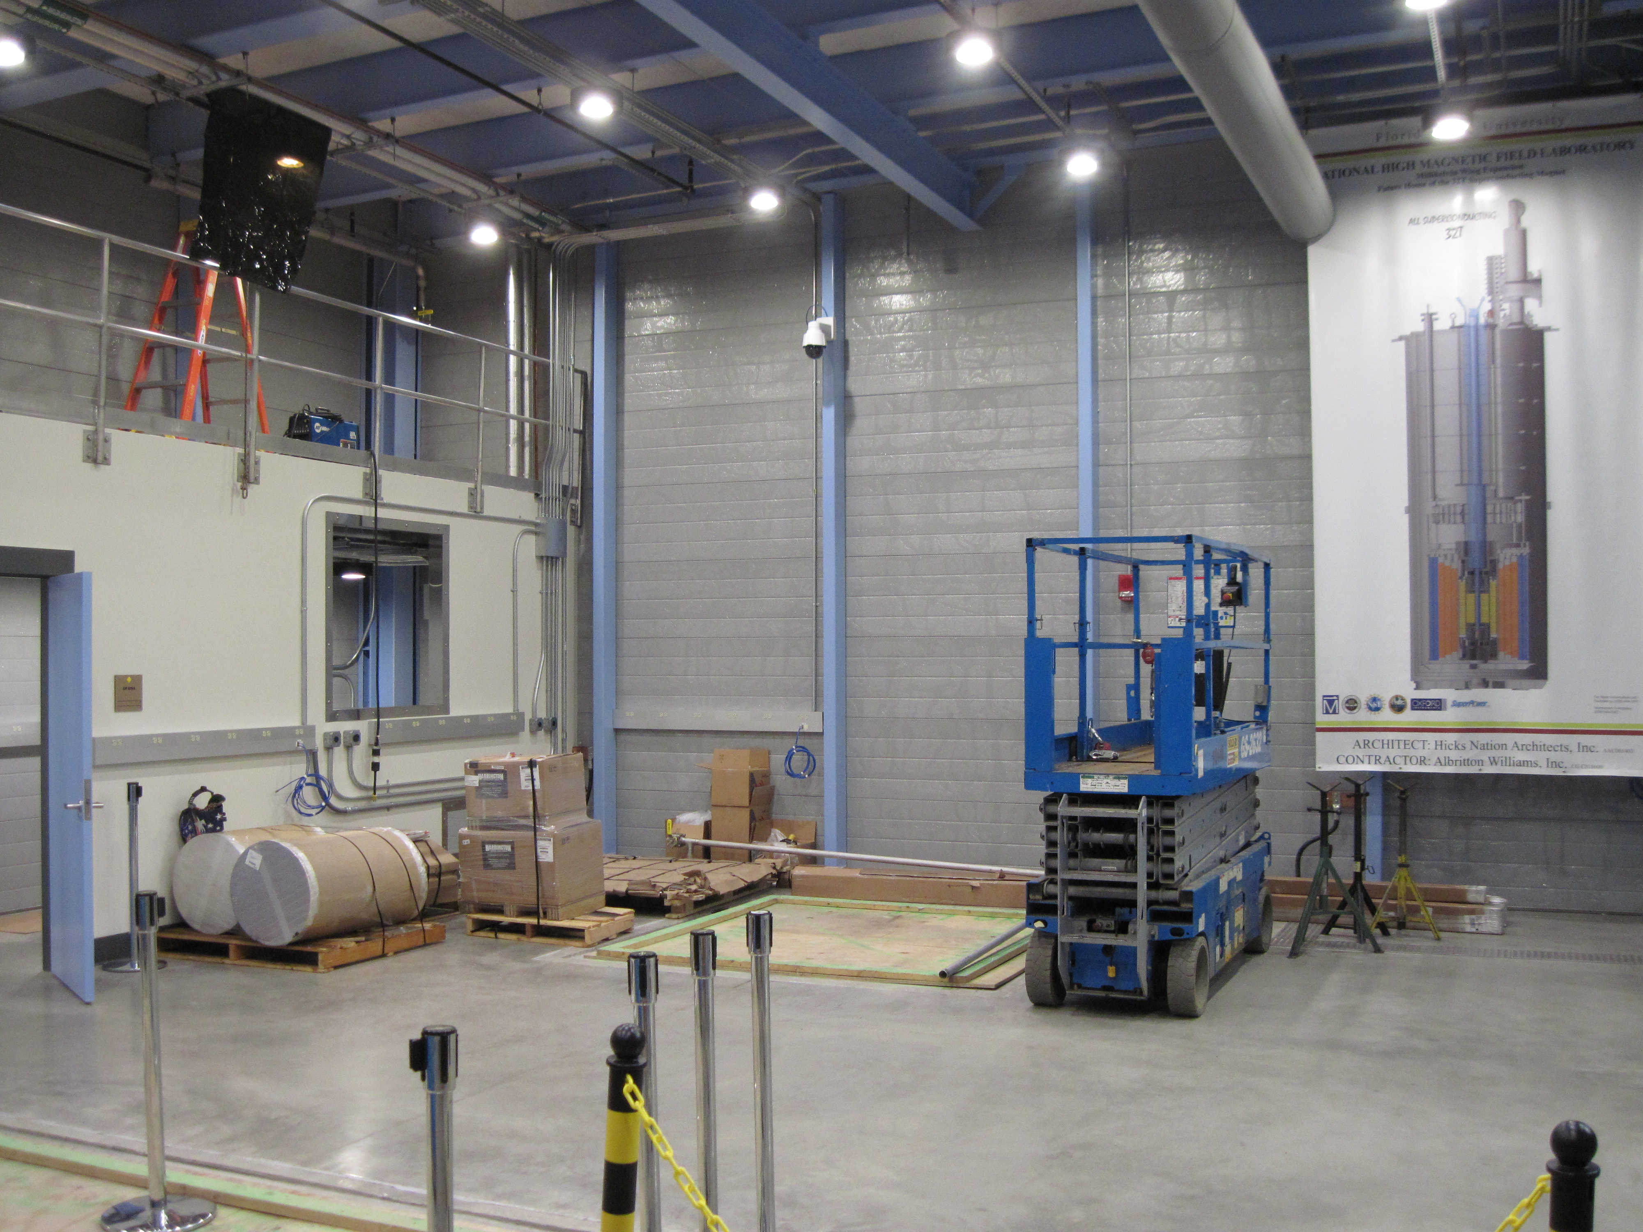
The future home of the 32 T magnet
(2009)
Pit

Slide 26
Summary
(2009)
32 T magnet tested: reached field repeatedly and met all specifications
0 to ±32 T in 1 hour, 34 mm cold bore, days between refill, 125 ppm / 1 cm DSV
In transition to be the first HTS-LTS superconducting user magnet > 30 T
HTS breakthrough: previous reference: 24 T for CMP, 23.5 T for NMR
32 T magnet combines sizeable LTS and HTS coils
Insulated HTS coated conductor, up to 200 A/mm² in modular windings
Required technology development and collaboration with vendors
High-power quench heaters for quench protection
Key design comments
  Quench management demonstrated effective from 10-28 T after false or manual triggers
    Quench Simulations quite sensitive to input parameters, required test quenches
  Desirable to engineer I_{c} and temperature margins across coil via conductor grading
    Even 160 kJ is ineffective in HTS coils below ~ 10 T central field with margins > 50 K
Key performance observations
No spontaneous quenches
Straightforward to operate
Helium use lower than budgeted
Magnetic field quality better than expected
Thank you
Questions?

Slide 27
Electrical schematic
(2009)

Slide 28
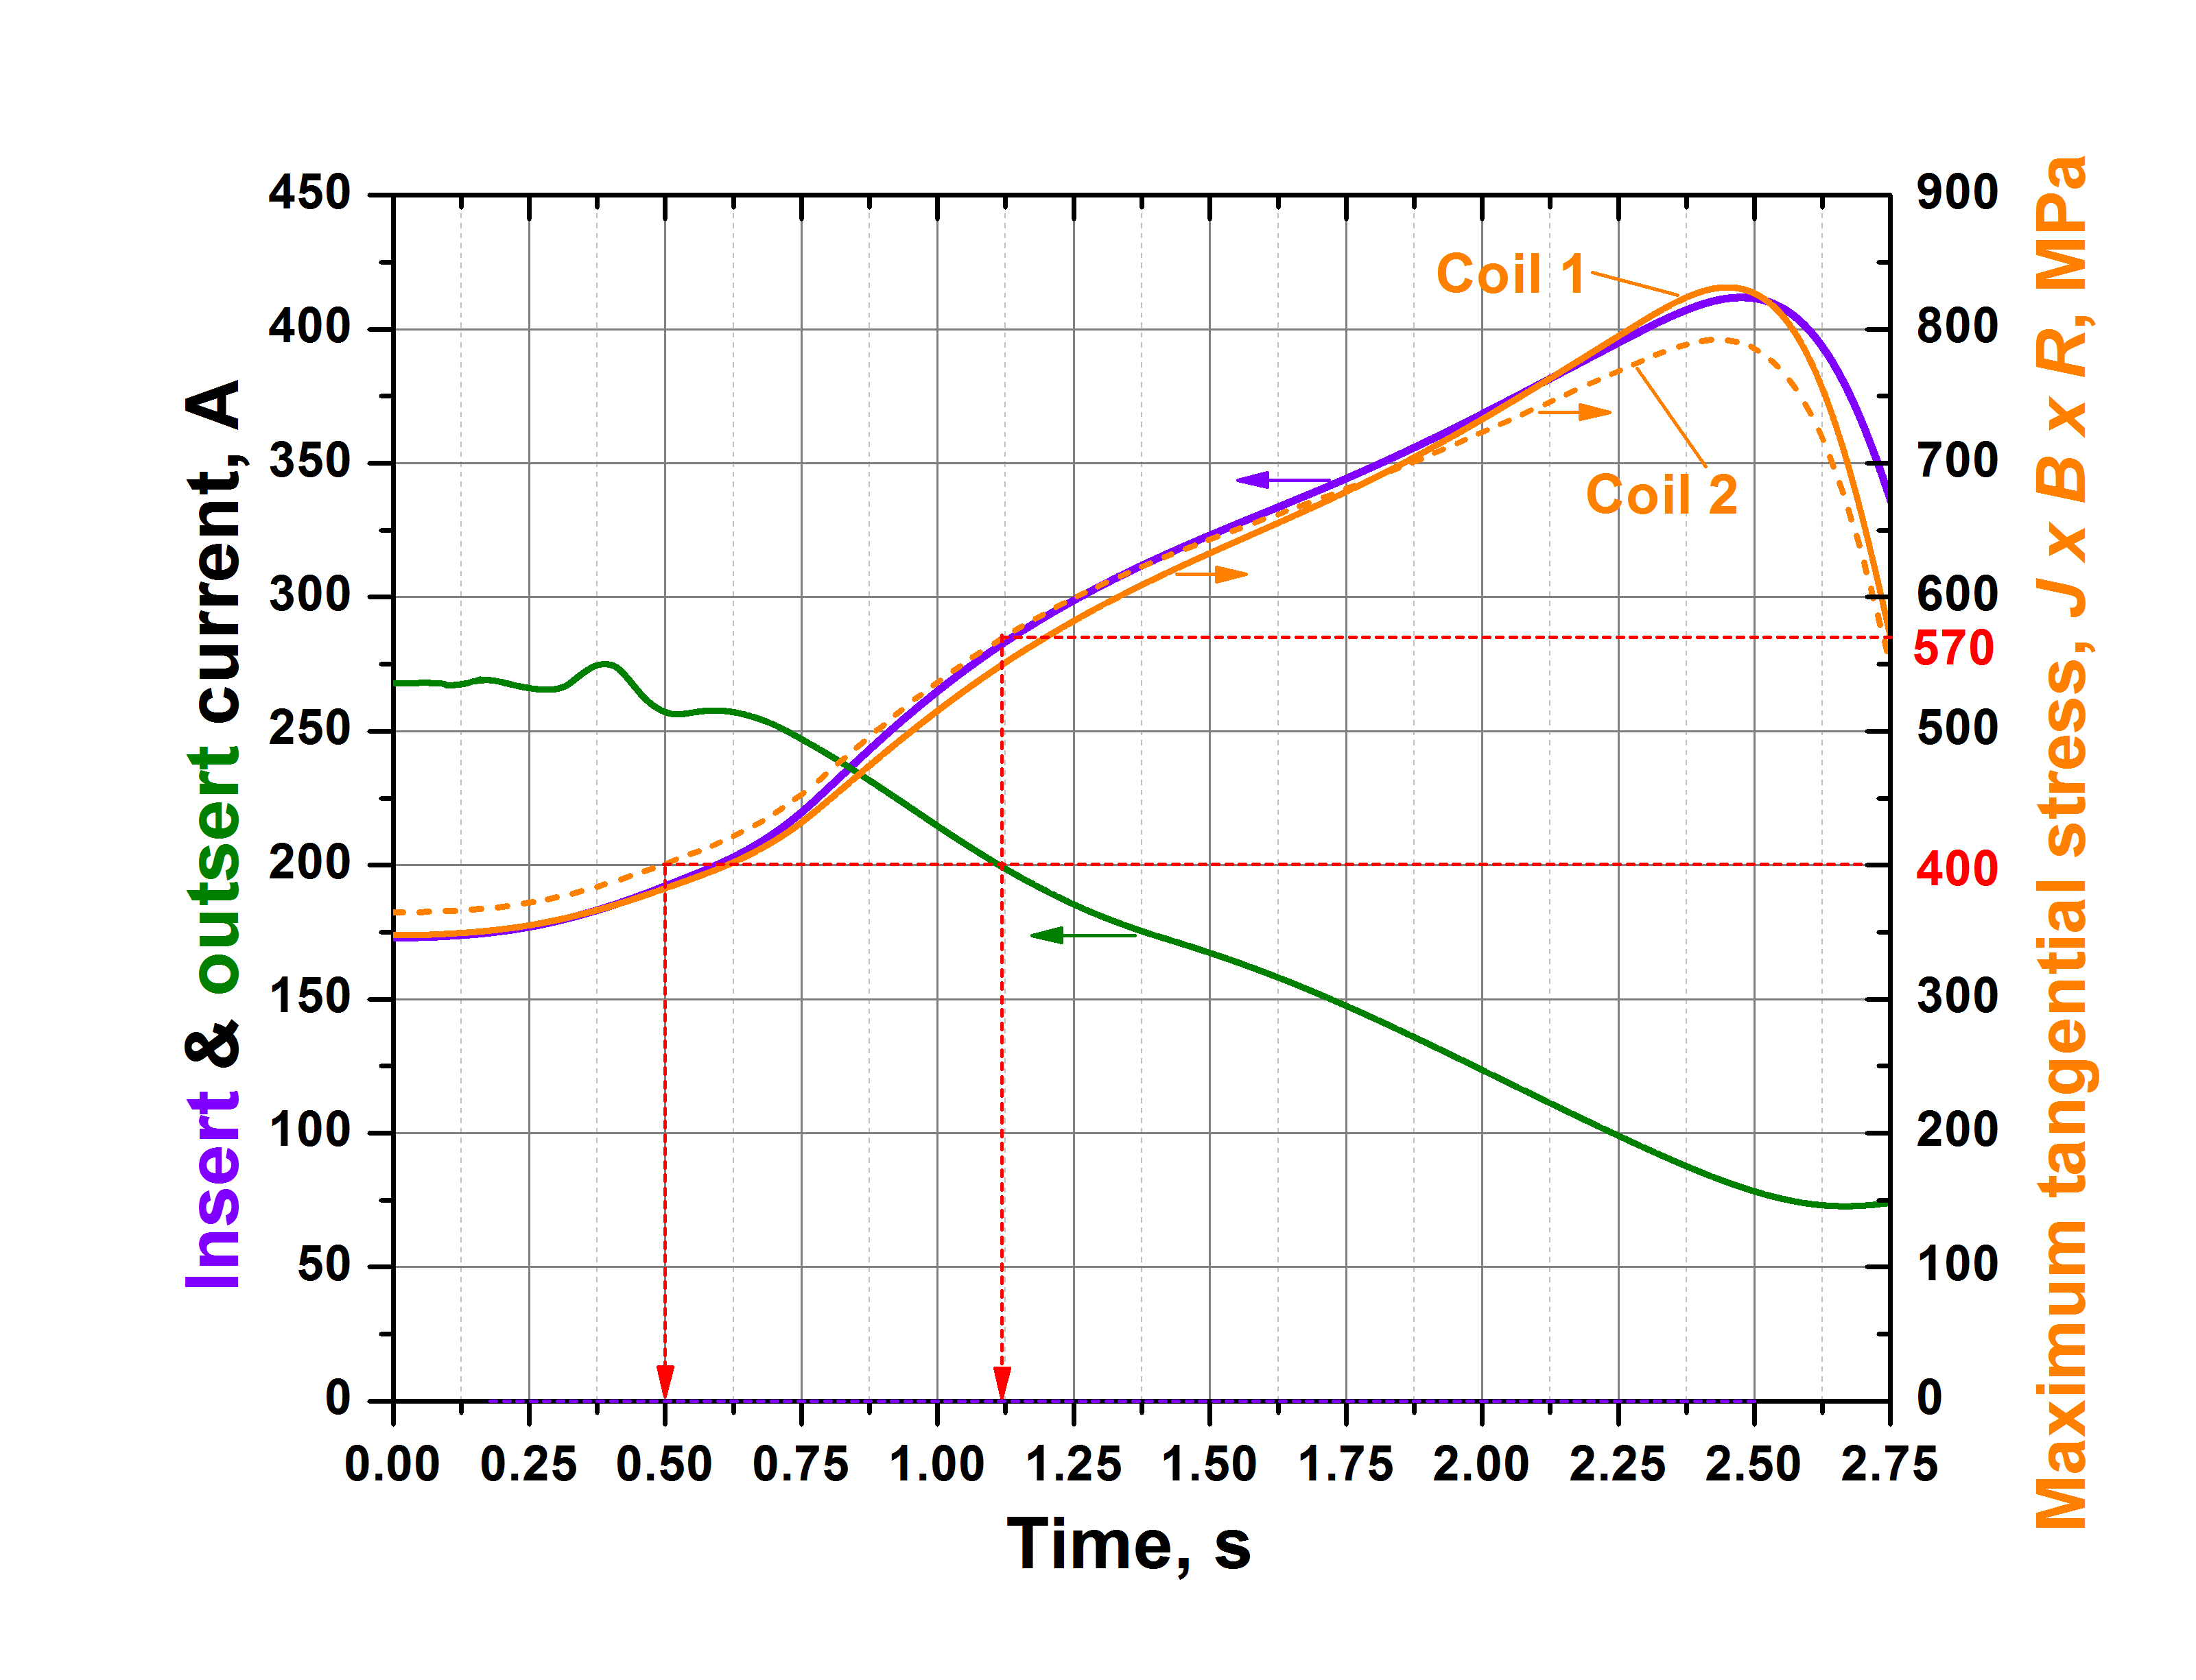
Full field quench protection simulation, HTS+ LTS
(2013)
(2013)
stress
Critical stress
Design stress limit
No HTS protection: HTS coils exceed critical stress-strain in 1.12 sec

Slide 29
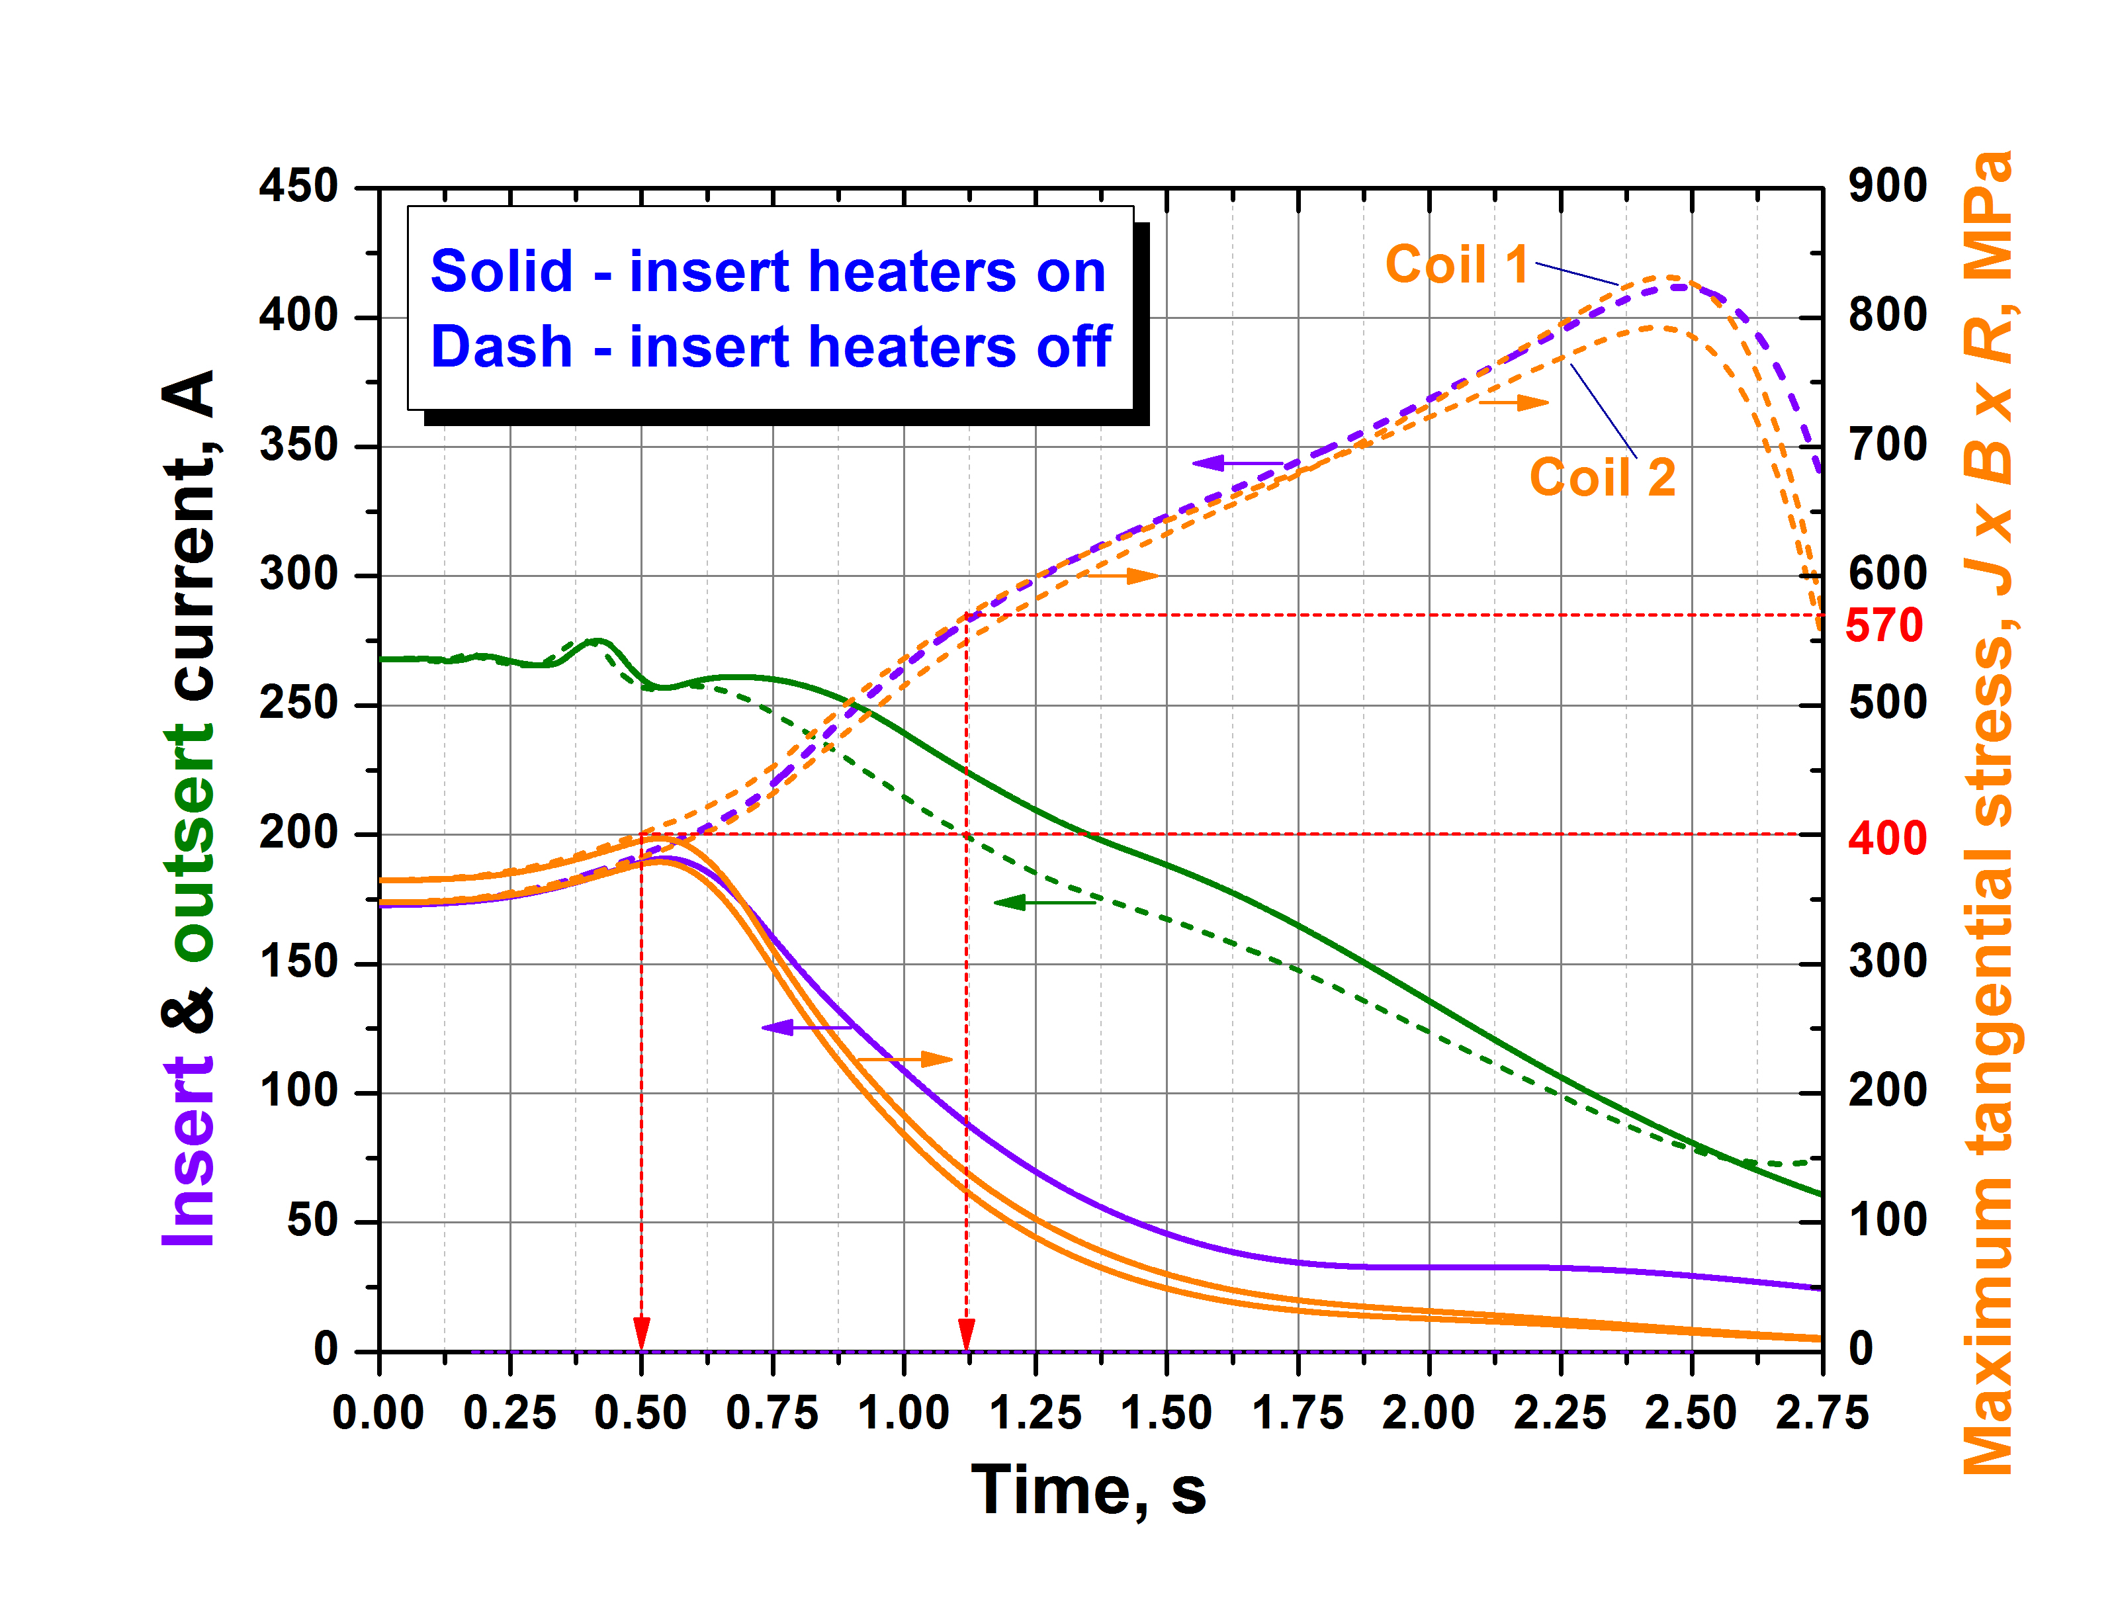
Full field quench protection simulation, HTS+ LTS
(2013)
(2013)
stress
Critical stress
Design stress limit
No HTS protection: HTS coils exceed critical strain in 1.12 sec
Key: time to reach current sharing temperature in REBCO insert
  Determined by heater power and temperature / I_{c} margin

Slide 30
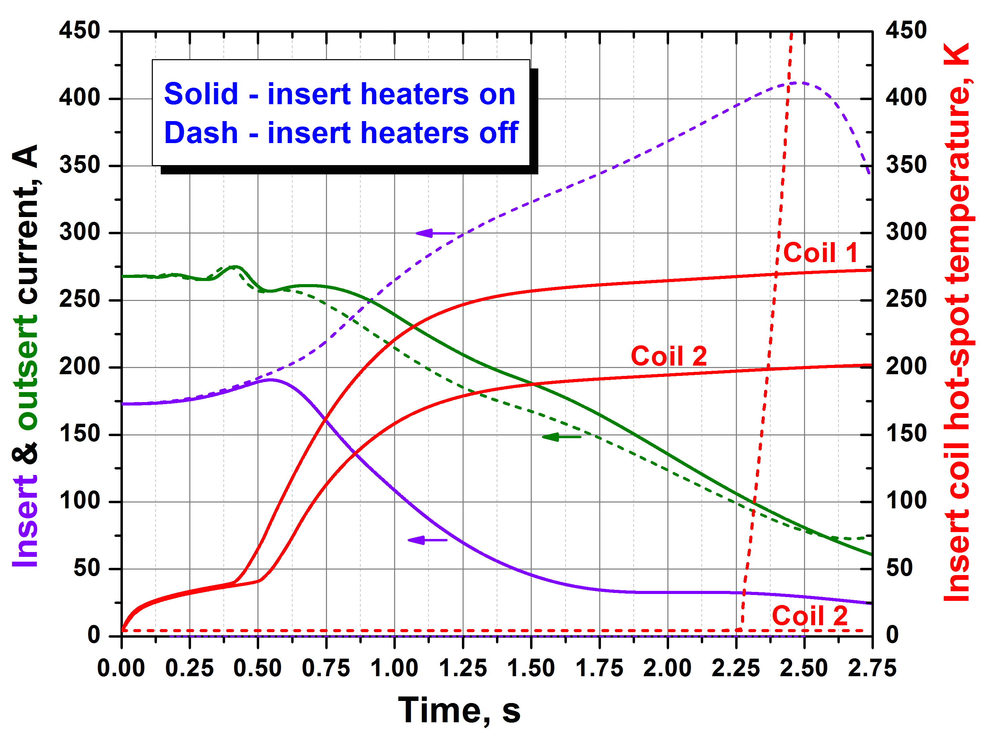
Full field quench protection simulation, HTS+ LTS
(2013)
(2013)
Temperature
No Protection
Protected
With HTS protection: T hot-spot is modest, but not ≤ 200 K (per simulation)
Without protection, if strain could be ignored: Coil 2 ~ 4 K, Coil 1 burn-out in 2.5 sec

