Slide 1
DC current injection into HTS coils using a superconducting dynamo
C.W. Bumby, R.A. Badcock, Z. Jiang, A.E Pantoja, K. Hamilton
Special acknowledgements to :
Christian Hoffmann, Rowan Walsh, Rob Slade, Donald Pooke, Sinhoi Phang, Ratu Mataira

Slide 2
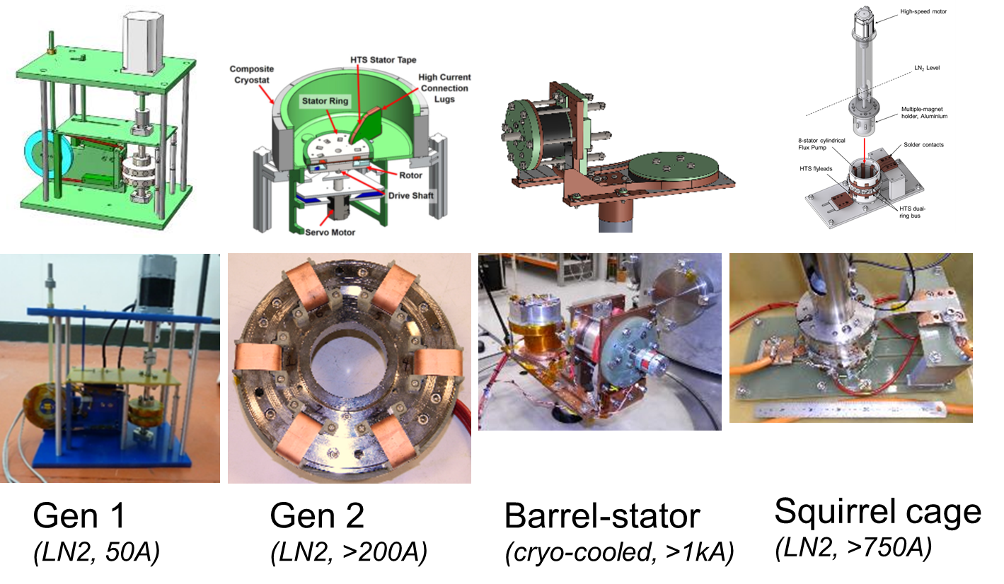
Outline
Motivation and background
Gen 1 device - unravelling the physics
Gen 2 – an external rotor
Barrel-stator - a kA class cryo-cooled dynamo

Slide 3
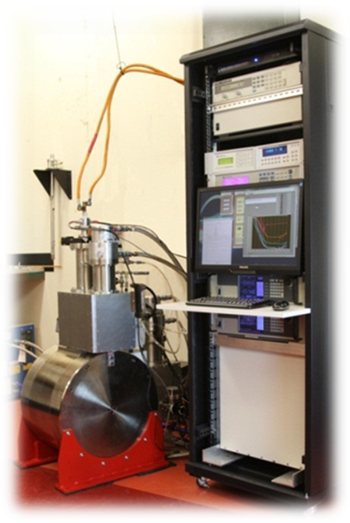
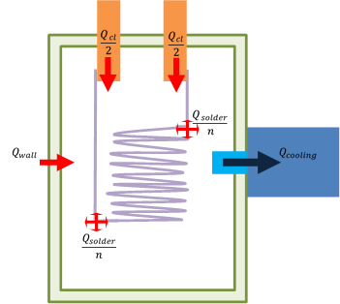
Current supply to an HTS magnet
All HTS magnet coils require an external DC current supply
  Bulky, inefficient electronic unit(s)
  Thick, heavy copper current leads required to inject current from room temperature to cryogenic coil
Conduction-cooled current leads:
  Impose heat load on cryostat, due to heat conduction & ohmic resistance
  Limit maximum coil current due to resistance of copper and RT circuit (300 A results in ~1kW dissipated in a 10 mΩ copper cabling)
Dynamo
  Preferred engineering solution:
  Eliminate normal-conducting current leads and penetrations of cryostat wall
  Eliminate bulky room temperature electronic current supply
  Enable injection of very high current injection (>1kA)
  These can all be achieved using an HTS dynamo!

Slide 4
Dynamo-type superconducting flux pumps
First demonstrated in type-I LTS using Pb foil in LHe (1962)
Up to 50 A DC current pumped into coil
Multiple other subsequent demonstrations in LTS at 4.2 K.

Slide 5
The HTS dynamo
In 2011, Hoffmann et al demonstrated an HTS dynamo employing YBCO coated conductor
Operated in LN2
Currents up to 50 A
But H_{c2} of YBCO >> 1T
  →No normal spot formed!

Slide 6
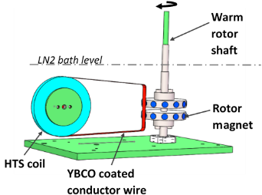
Gen 1: A simple experimental device
Rotates permanent (Nd-Fe-B) magnets past a ReBCO coated conductor wire
Rotor magnets mounted in homopolar radial-flux orientation
Flux penetrates YBCO film and induces a DC current to flow in series connected superconducting coil
  Stator wire: 12 mm Superpower (self-field I_{c} = 280A),
  Coil: AMSC 120 turn double pancake (I_{c}= 55A, L=2.5 mH)
Device outputs DC voltage in both closed-circuit and open-circuit configuration.
Output polarity determined simply by rotor direction & magnet polarity
Jiang et al., Appl. Phys. Lett. (2014)

Slide 7
DC Behaviour: a DC voltage source with internal resistance
Can treat DC behaviour as an ideal voltage source
  Open-circuit voltage, V_{oc}
  Short circuit current, I_{sc}
  Internal resistance = dV/dI = V_{oc}/I_{sc}
But stator is superconducting - so what causes internal resistance?
  - AC loss due to time varying B-field (‘Dynamic resistance’)
Coil I_{c}
Jiang et al. Appl. Phys. Lett. 105 (11), 112601 (2014)
Jiang et al. Supercond. Sci Technol. 28 (11), 115008 (2015)

Slide 8
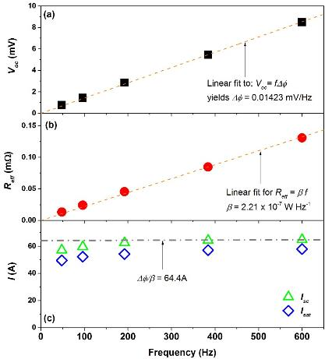
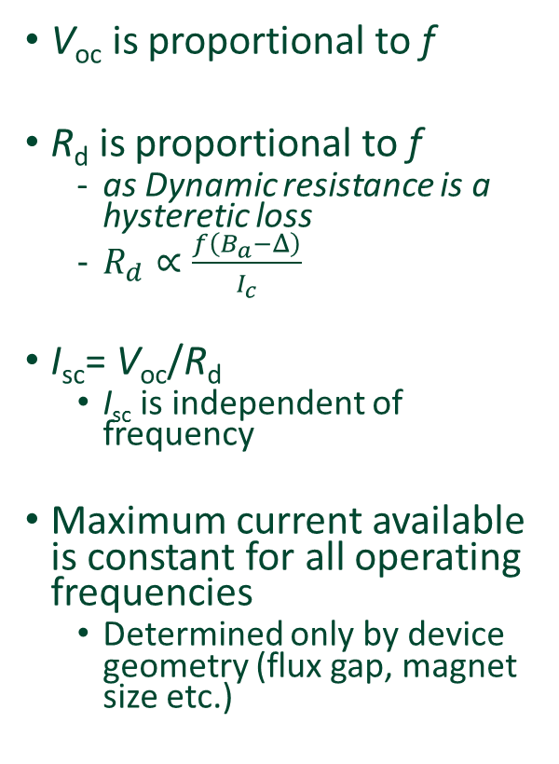
Frequency behaviour of simple dynamo
V_{oc} is proportional to f
R_{d} is proportional to f
  as Dynamic resistance is a hysteretic loss
  $R_{d}∝\frac{f\left(B_{a}−Δ\right)}{I_{c}}$
I_{sc}= V_{oc}/R_{d}
  I_{sc} is independent of frequency
Maximum current available is constant for all operating frequencies
  Determined only by device geometry (flux gap, magnet size etc.)
I_{sc} is constant

Slide 9
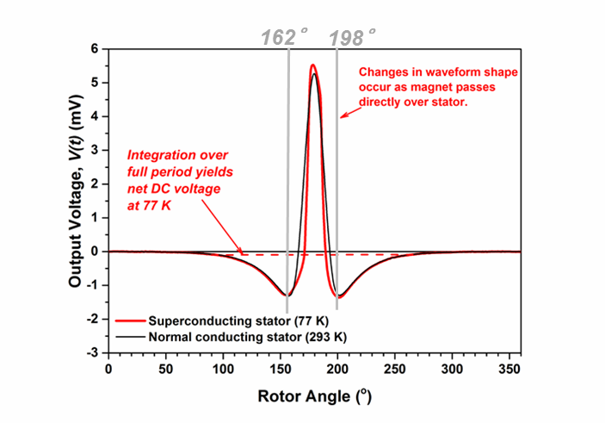
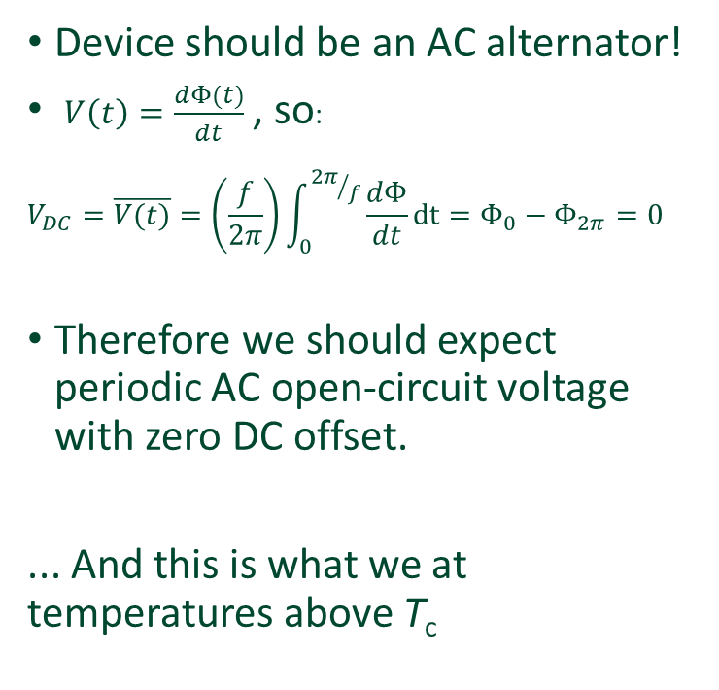
But hang on….. Why does this work at all?
Device should be an AC alternator!
$V\left(t\right)=\frac{dΦ(t)}{dt}$ , so:
$$V_{DC}=\overline{V(t)}=\left(\frac{f}{2π}\right)\int_{0}^{{2π}/f}{\frac{dΦ}{dt}}dt=Φ_{0}−Φ_{2π}=0$$
Therefore we should expect periodic AC open-circuit voltage with zero DC offset.
... And this is what we at temperatures above T_{c}
But below T_{c} the output waveform changes…

Slide 10
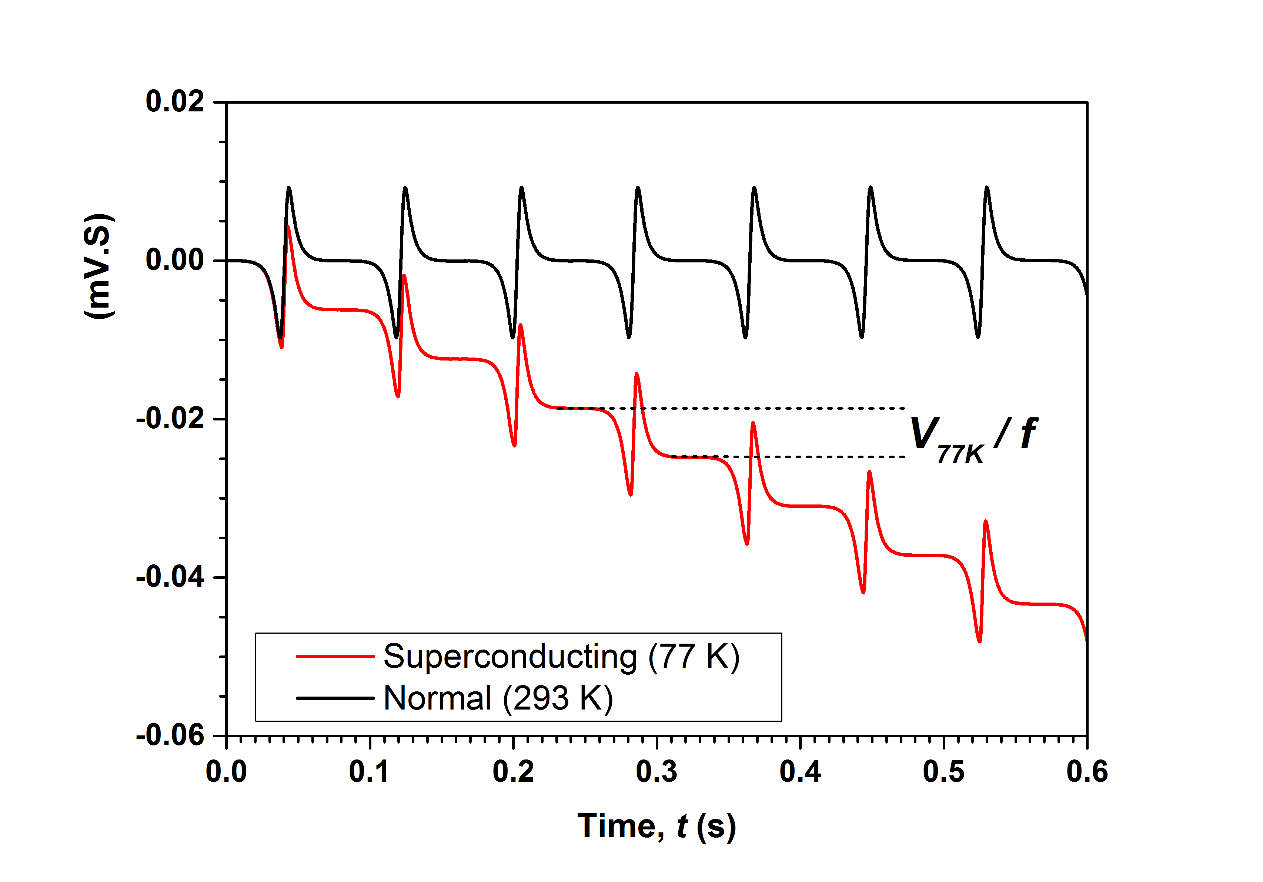
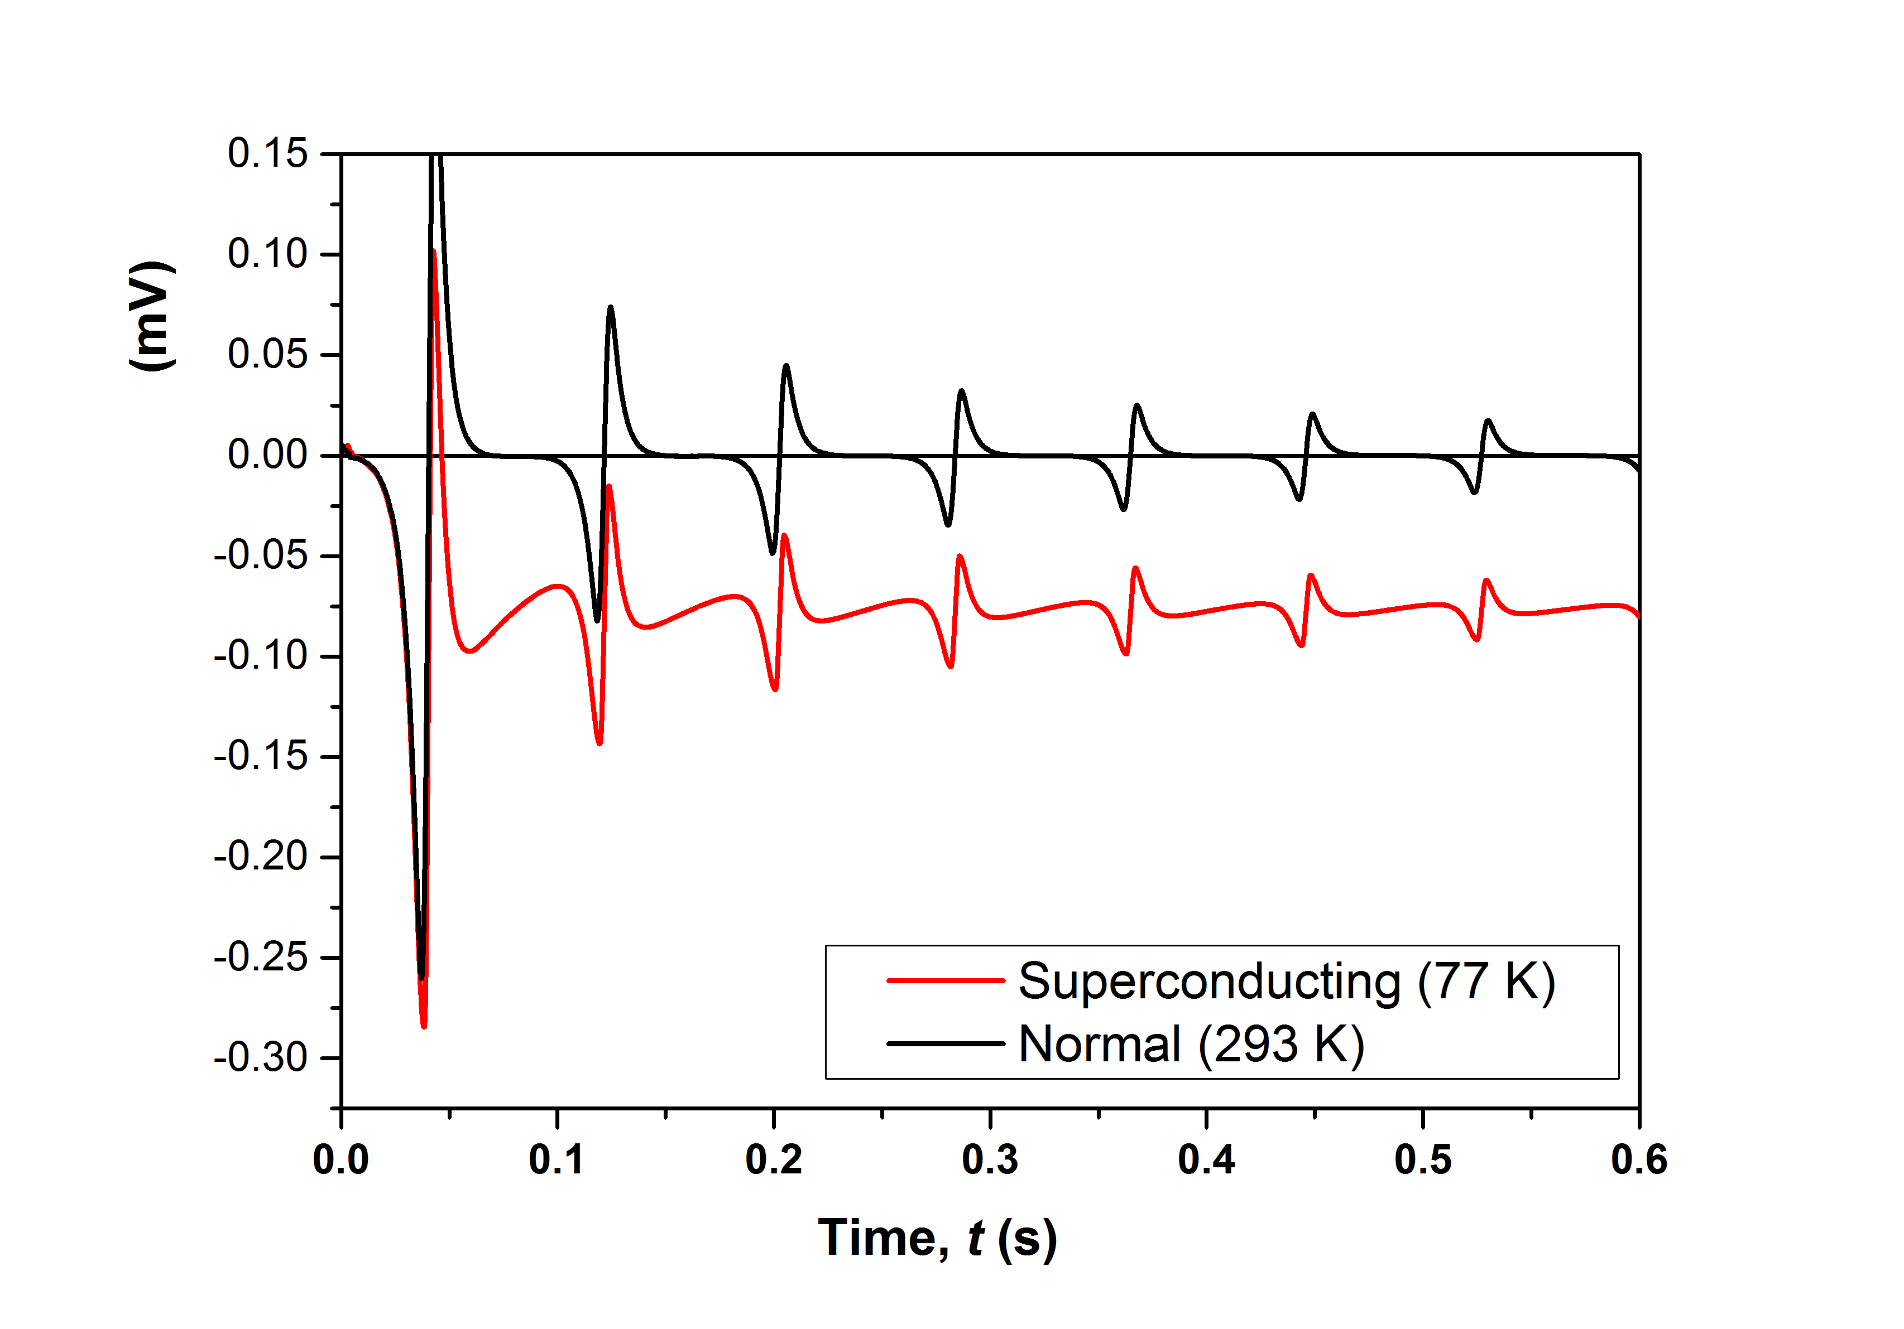
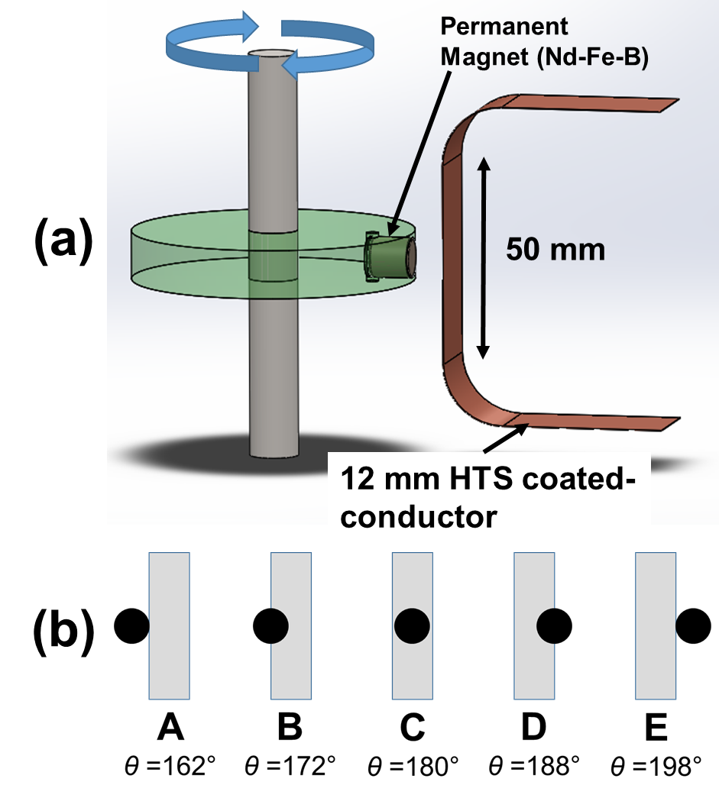
Magnet crossing effect
Series-connected inductance (coil) integrates waveform
This time-averages AC waveform to DC values.
Partial rectification occurs!
Effect observed only during period that magnet is directly above stator wire

Slide 11
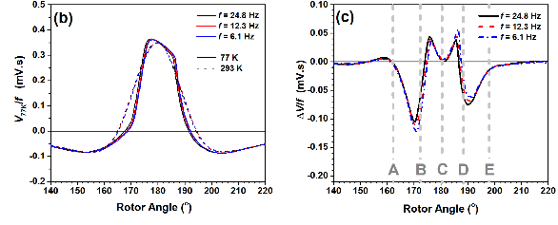

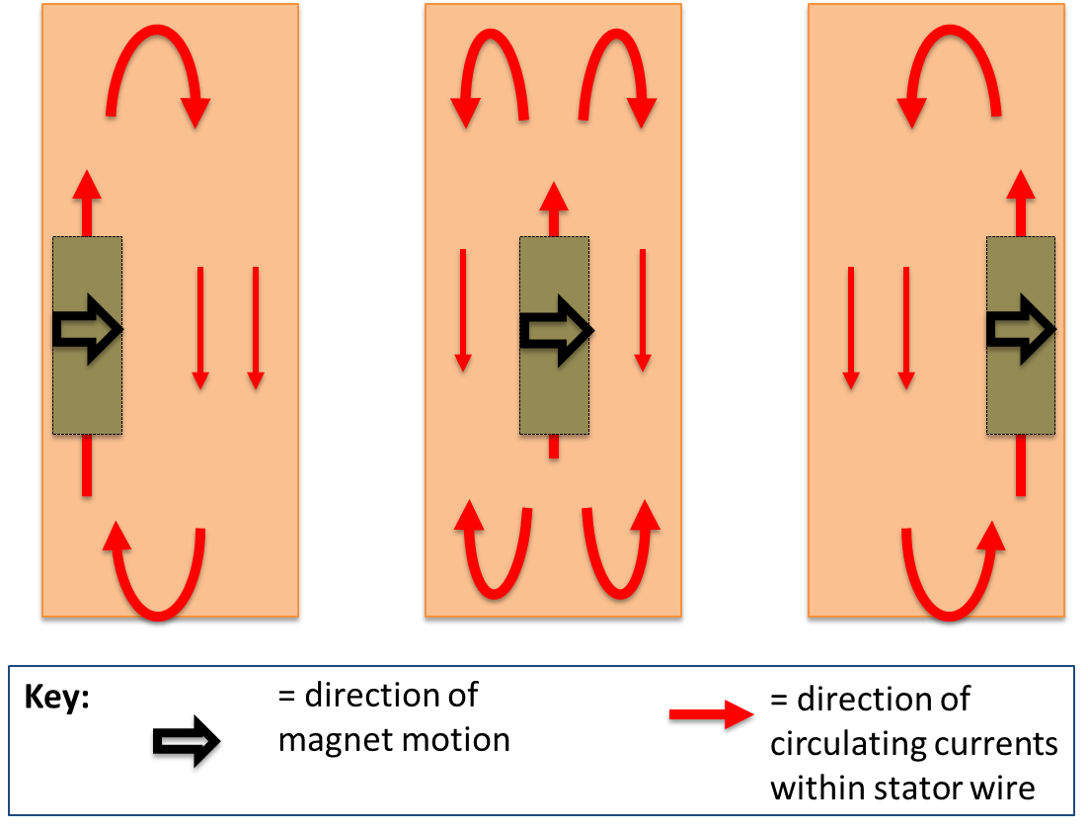
Origin of DC voltage?
Action happens as magnet crosses coated conductor wire
Normalised waveforms are a function of rotor angle only (independent of f).
Rotor magnet imposes inhomogeneous local field across stator
  Circulating currents flow back around high field region

Slide 12
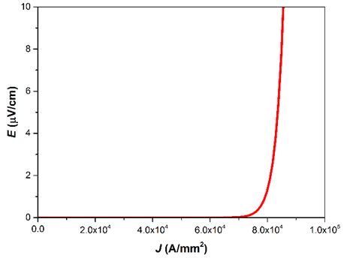
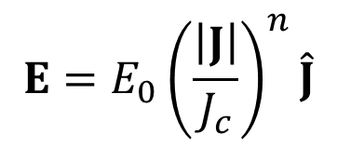
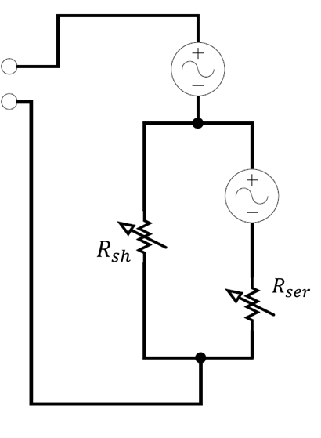

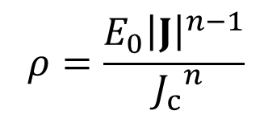
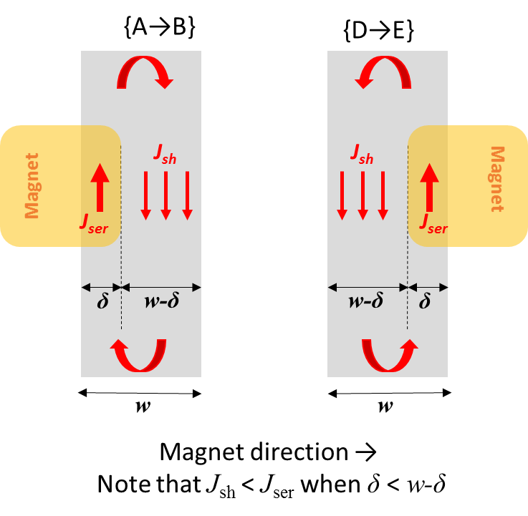

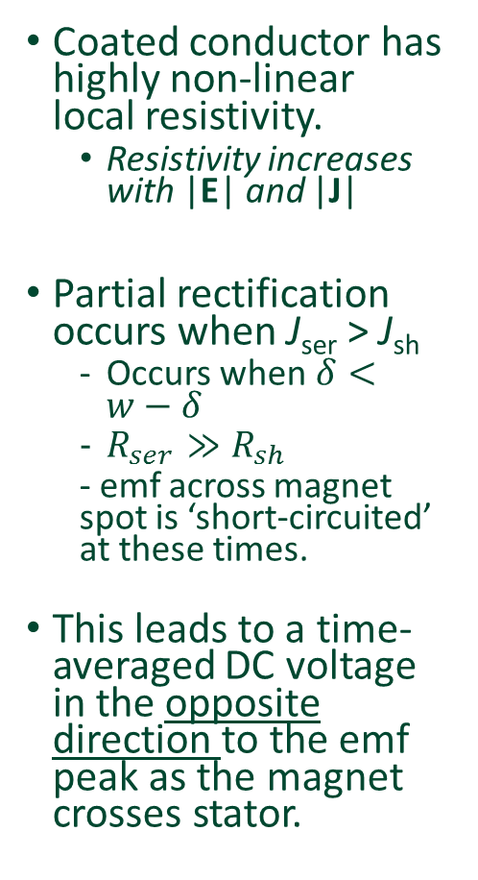
Origin of DC voltage – non-linear resistivity
Coated conductor has highly non-linear local resistivity.
  Resistivity increases with |E| and |J|
Partial rectification occurs when J_{ser} > J_{sh}
  Occurs when$δ<w−δ$
  $R_{ser}≫R_{sh}$
  - emf across magnet spot is ‘short-circuited’ at these times.
This leads to a time-averaged DC voltage in the opposite direction to the emf peak as the magnet crosses stator.
Bumby et al. Appl. Phys. Lett. 108 122601 (2016)
Charge continuity requires:
$$I_{t}=δJ_{ser}+\left(w−δ\right)J_{sh}$$

Slide 13
Lets engineer……
Complex physics
  Inherent phenomena of non-linear flux-flow regime
  Very hard to model – (finite-element approaches do not readily converge).
But ability to inject large currents into closed HTS circuit proven. Exciting possibilities…..
Empirical experiments required for device optimisation
Large set of design parameters to investigate

Slide 14
Design challenge 1:
  Rotating parts inside cryostat are dissipative and not desirable
  Can we move all the rotating parts outside the cryostat?

Slide 15
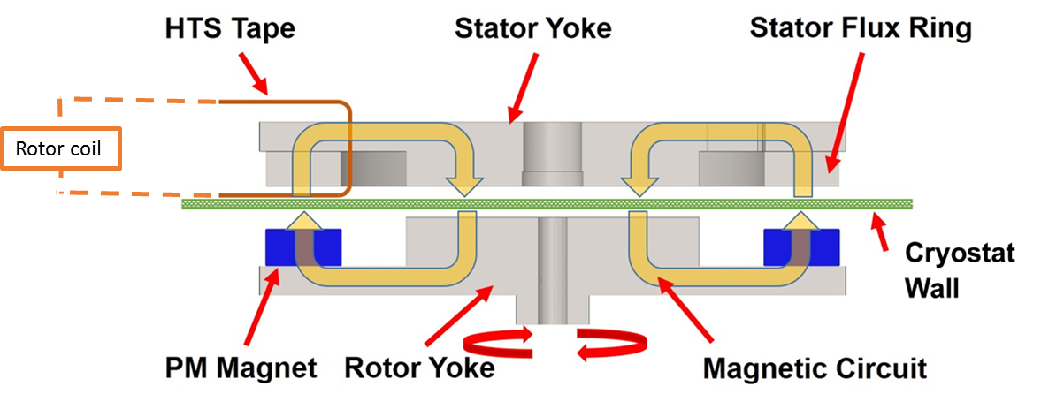
Pumping through the cryostat wall – Gen 2 design
Optimise dynamo design by placing rotor magnets outside cryostat.
But need to increase field strength to penetrate HTS sheet
Achieved using magnetic iron circuit to focus flux at stator
Enables flux gap to increase to >10 mm.
  Ample space for cryostat wall!
Bumby et al. SUST 29 (2), 024008 (2016)
Jiang et al. IEEE Trans. Appl. Supercond. 26(2) (2), 4900706 (2016)

Slide 16
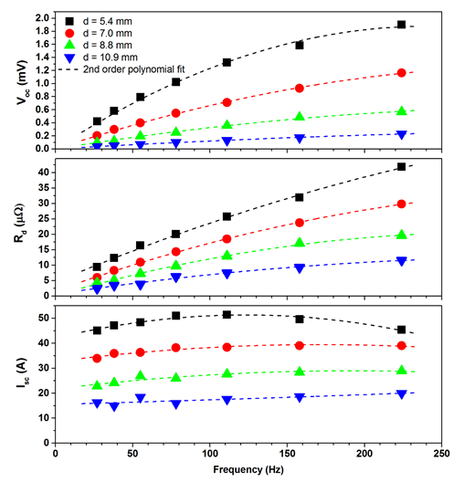
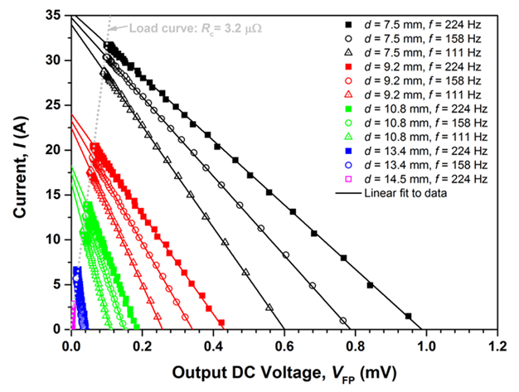
Output from Gen 2 ‘external FP exciter’
Similar DC I-V output to earlier devices…
Some evidence of eddy current non-linear frequency-dependence
  - Probably due to eddy currents flowing in large iron yoke at high-f, low-d
I_{sc}= V_{oc}/R_{d}
  - I_{sc} is only independent of frequency at low-f
Eddy current effects would be reduced by laminating cold iron yoke

Slide 17
Gen2: Effect of stator wire width
Increasing the width of the stator wire affects dynamo output
  Alters ‘space’ and period in which circulating currents flow
Tested wire stator widths up to 46 mm using ½” wide rotor magnet
I_{sc} > 300 A can be achieved with 46 mm wire
But output from wide wires drops at higher frequencies.
  Local heating?
Bumby et al. IEEE Trans. Appl. Supercond. 26(8), 4805208 (2016)

Slide 18
Design challenge 2:
  High currents are desirable as they allow access to larger fields.
  How far can we increase the output current?

Slide 19
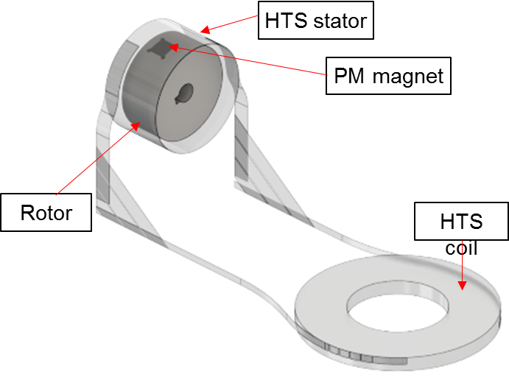
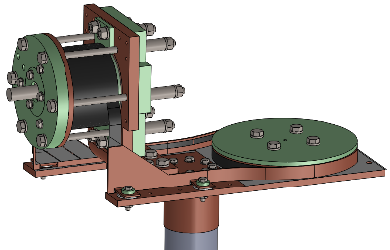
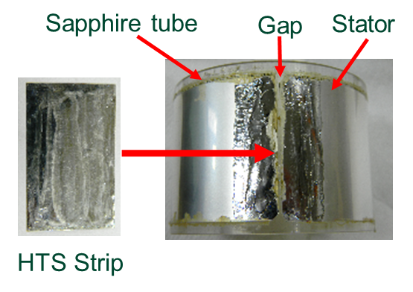
Barrel pump – a kA class dynamo
Maximise stator width by using a ‘continuous’ cylindrical stator
  No ‘edges’
Cryo-cool to increase wire J_{c}
Notes:
I’ll show the working principles of Simple HTS dynamo with single stator wire

Slide 20
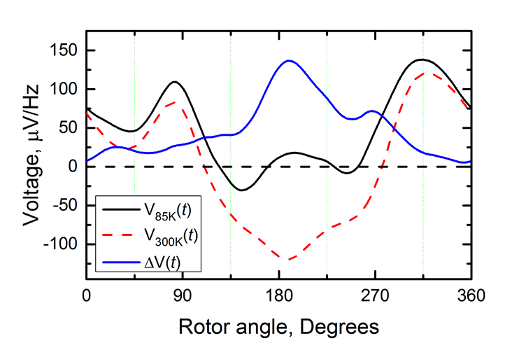
Open circuit voltage
Device generates an open-circuit voltage (reassuring!)
  Waveform is ‘partially rectified”
V_{oc} is a function of both rotor speed and temperature
Shielding currents reduce flux penetrating stator barrel at low T
  →V_{oc} is reduced at low T
180°is magnet at top of rotation
Notes:
Tc = 88.5 K, 46 mm stator, measured

Slide 21
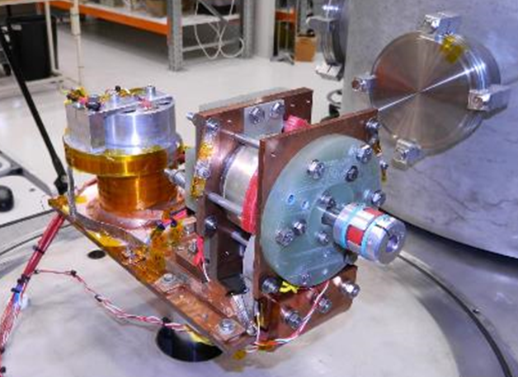
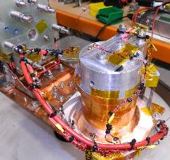
Required a very high current test coil……
Earlier double pancake coil has I_{c}~ 90 A.
  Too low for this device!
Fabricated a new single-layer solenoid
  Wound from 3 *10 mm Fujikura CC wires ‘wound in hand’
  I_{c} ≈ 1400 A @ 77K
  L= 2.8 µH
Conduction cooling via central Al core
Notes:
We replaced the DPC with a new solenoid coil.
This is the photo of the new coil.
The coil is 3 – ply 6-turn single layer solenoid coil wound from 10 mm wide Fujikura wires.
The coil was cooled by conduction cooling via central Al core.
60 – 90 K for coil measured at AI core

Slide 22
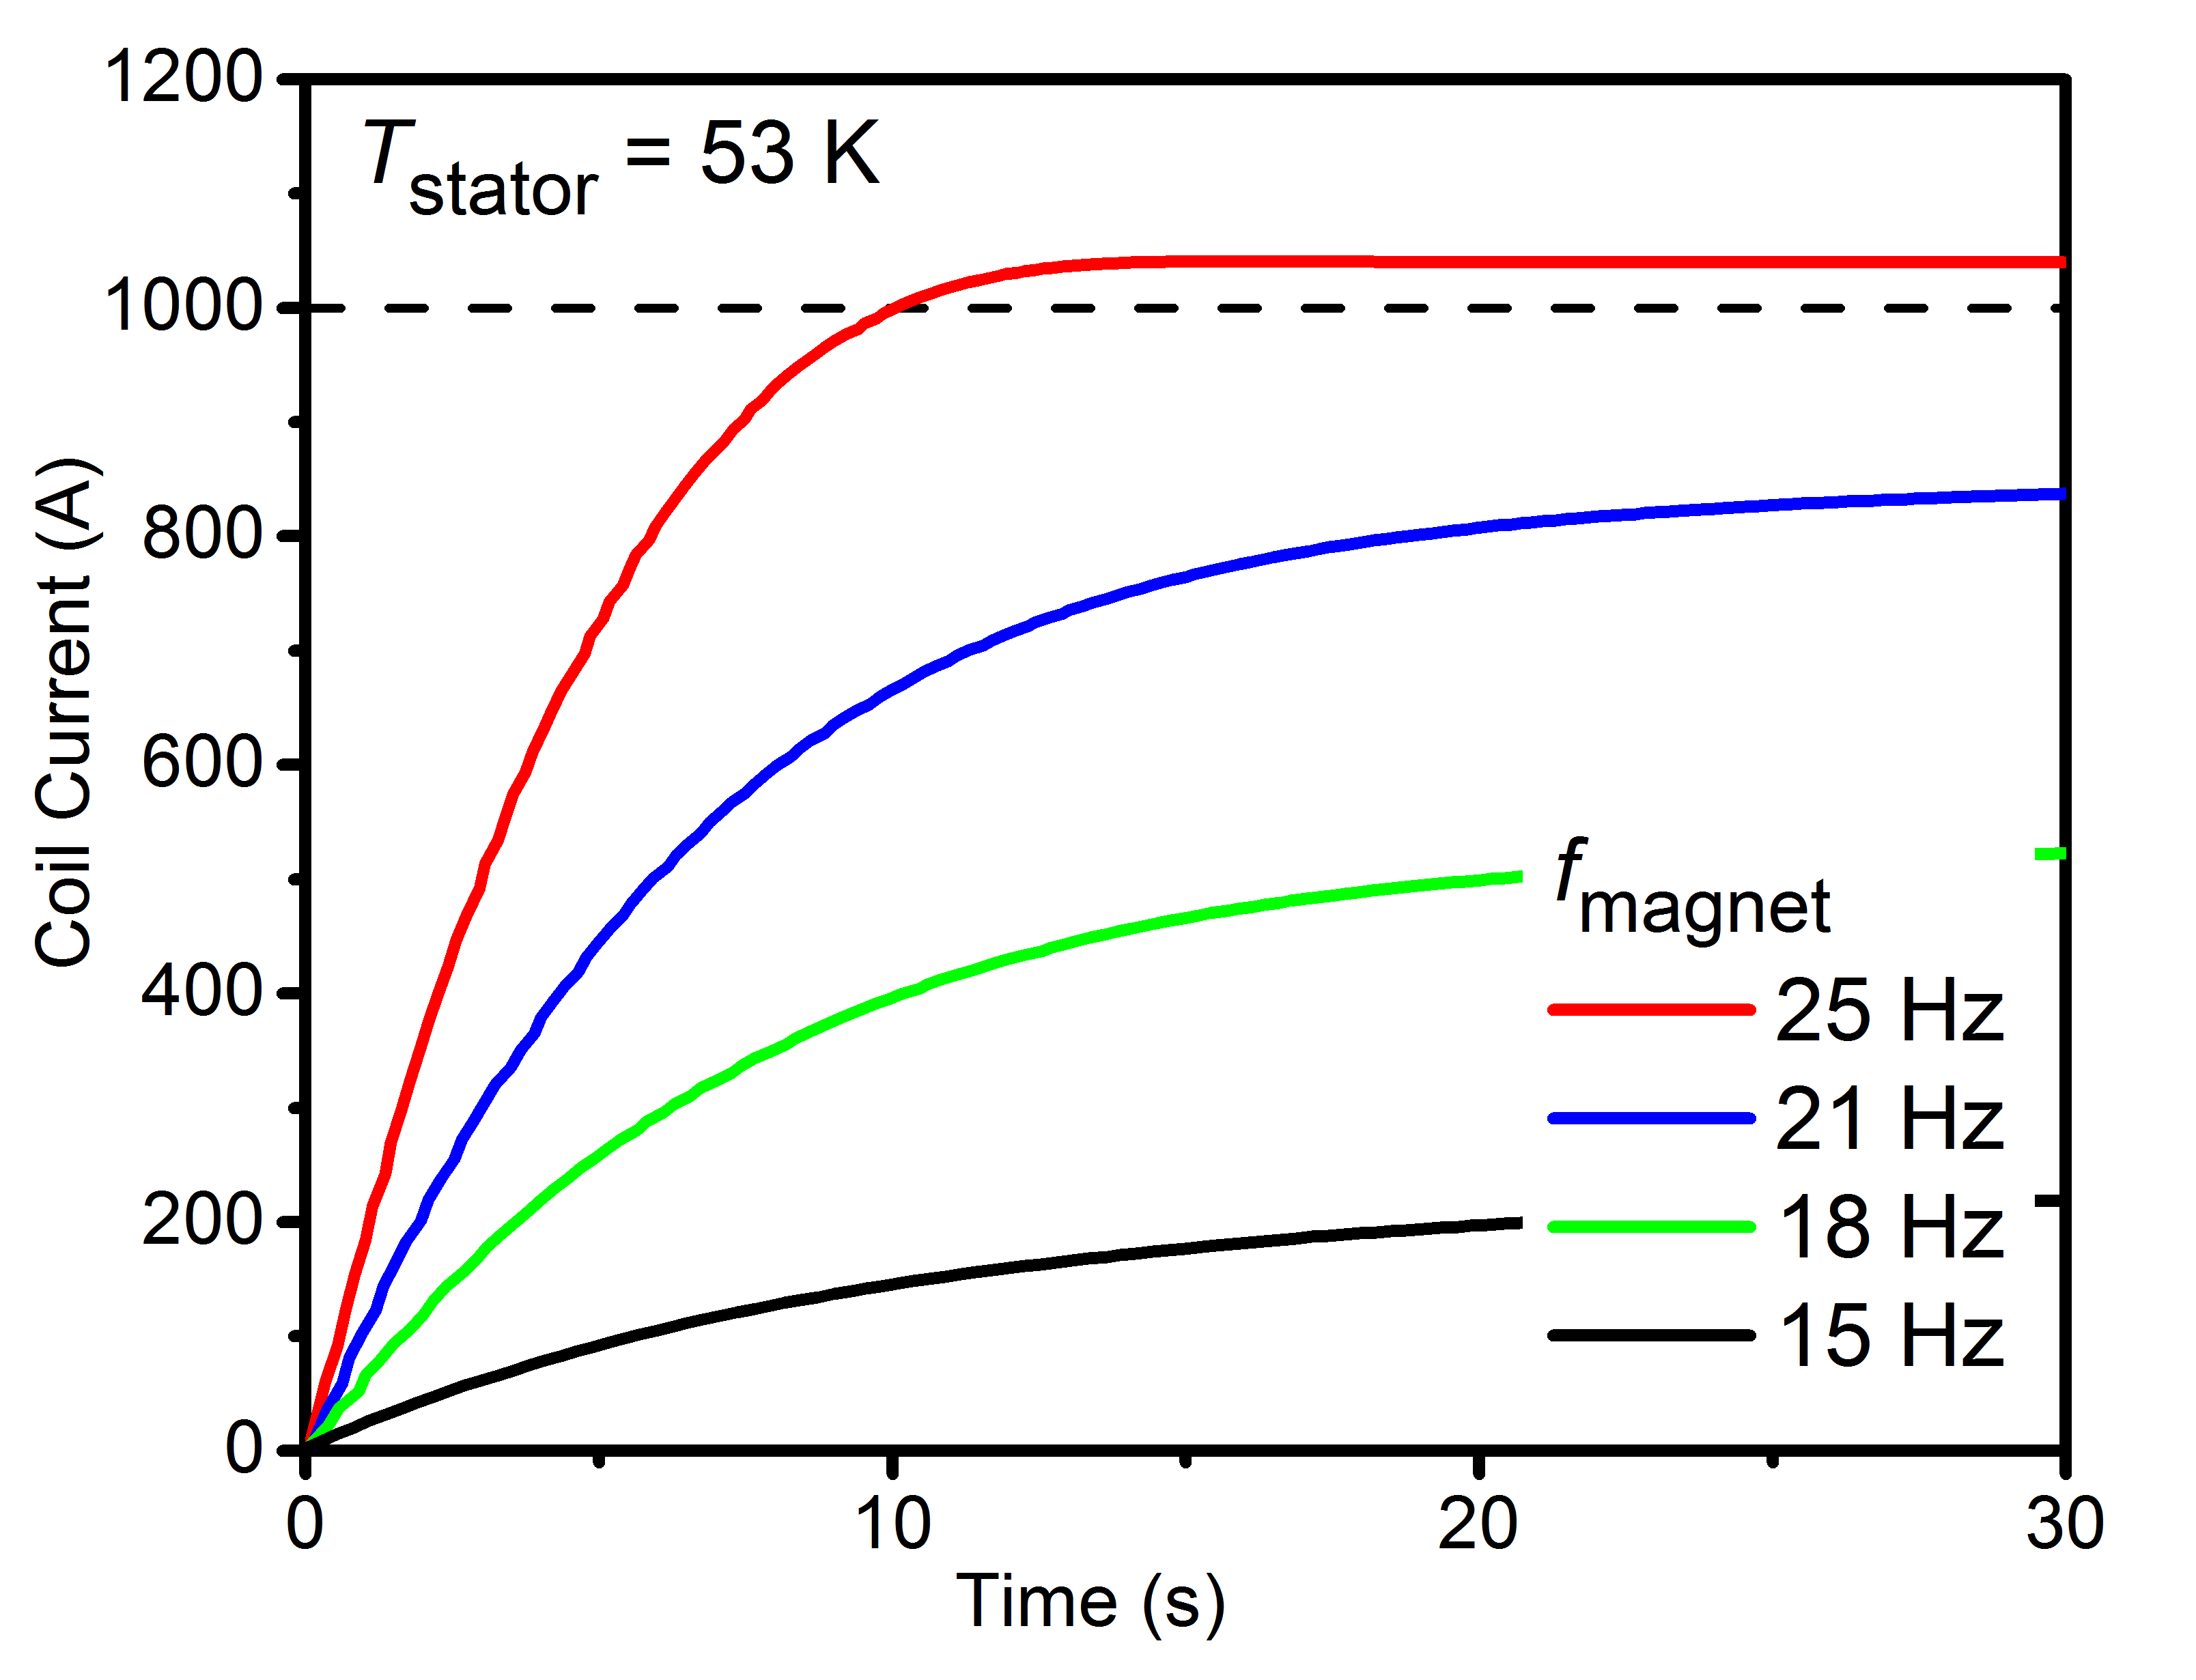
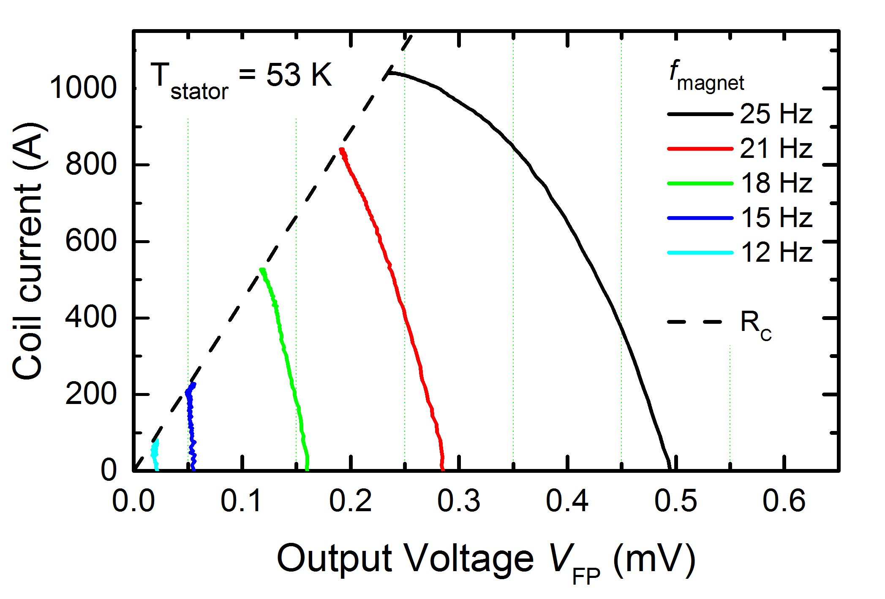
It works!
> 1000 A in 10 s
Highest output current ever reported for HTS flux pump!
τ↑= L/R ~ 7 s.
Notes:
This figure shows the pumped current vs time at various frequencies.
We have achieved more than 1000 A in around 12 s at 54 K.
Highest output current ever reported for HTS flux pump!
By the way in this case, L/R ~ 5 s
L/R ~ 10 s, is this true? Not 5 s?? I think I want to get rid of this.
What temperature is this?? Stator Temp at 54 K !!
What is coil Temp???
Not because larger L value at low current?

Slide 23
Summary & conclusions
HTS dynamos enable large DC currents to be pumped into a closed superconducting (HTS) circuit
  Can replace bulky power supplies and current leads
Physical origin of DC voltage is non-trivial
  Rectification caused by circulating eddy currents experiencing highly non-linear resistivity.
  Similar effect observed for continuous ‘barrel’ stator (which is topologically continuous....!)
A series of experimental prototypes has ben demonstrated and explored. Some empirical design rules to maximise current output:
  Minimise flux gap
  Stator width > twice magnet width
  Minimise joint resistance and ensure fly lead I_{c} > I_{sc}
External rotor design ensures all moving parts are outside of cryostat
  Reduces thermal operating budget and simplifies maintenance
  Currents up to 300A at 77K demonstrated so far
  Geometry is well suited to rotating HTS machines
Cryo-cooled barrel pump has achieved > 1 kA at 55K.
  Further optimisation ongoing

Slide 24
The End

Slide 25
Extra slides

Slide 26
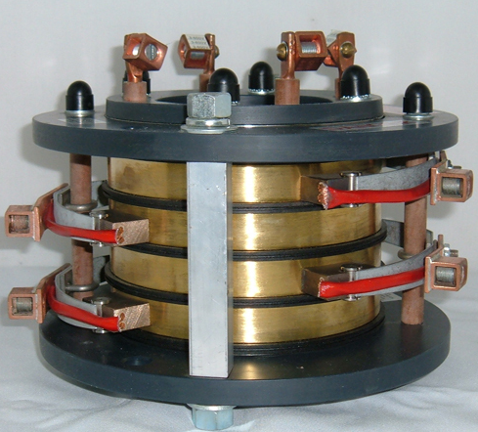
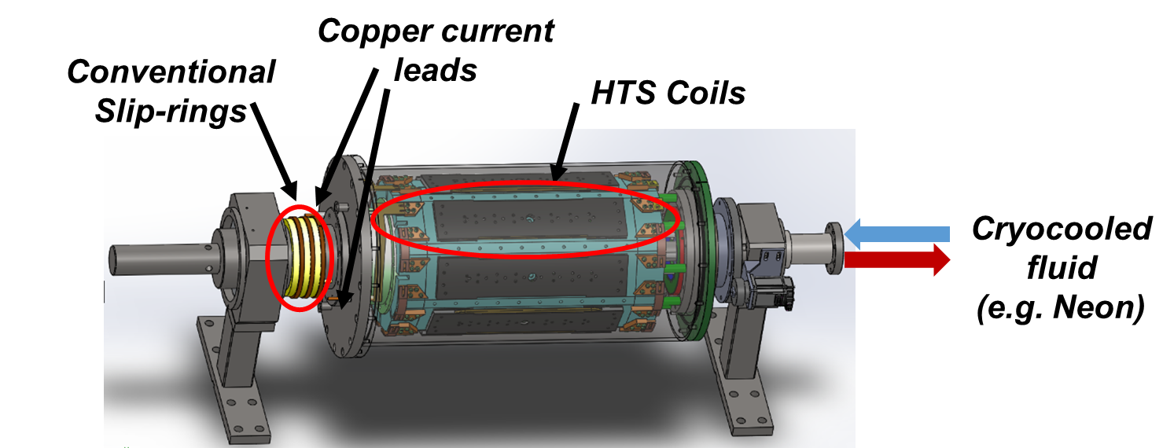
HTS wound rotors for synchronous machines
HTS rotor coils
  High field = high torque/power density
  Racetrack pancake windings readily manufactured
  Requires rotating cryostat – various proven approaches
BUT current must be injected into rotating coils
  Conventional slip-rings have high-wear rate
  Conduction cooled current leads – major source of thermal load
Sliding carbon contact, prone to wear and arcing
High-current rotating slip ring

Slide 27
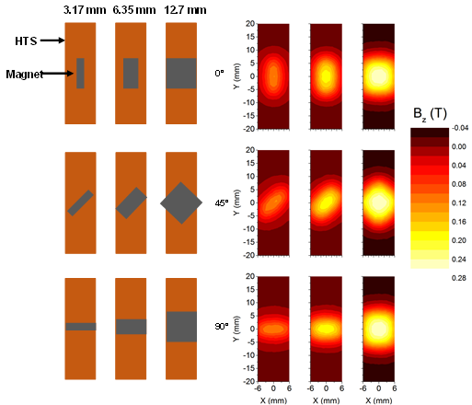
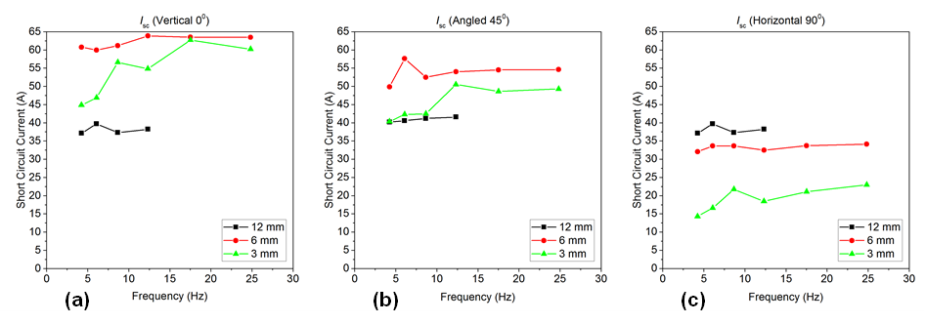
Other device parameters
Device geometry is described by multiple parameters
  - Flux gap, stator width, field amplitude and profile (at stator), etc.
We really need a good finite-element electromagnetic model to optimise device designs
    But - A-vector formulation does not converge for non-linear HTS materials!
    H-formulation might do it – but boundary conditions are a challenge for this problem. (work in progress)
For now – experimental determination of empirical design rules is the way forward….
Badcock et al., IEEE Trans. Appl. Supercond. (2016)

Slide 28
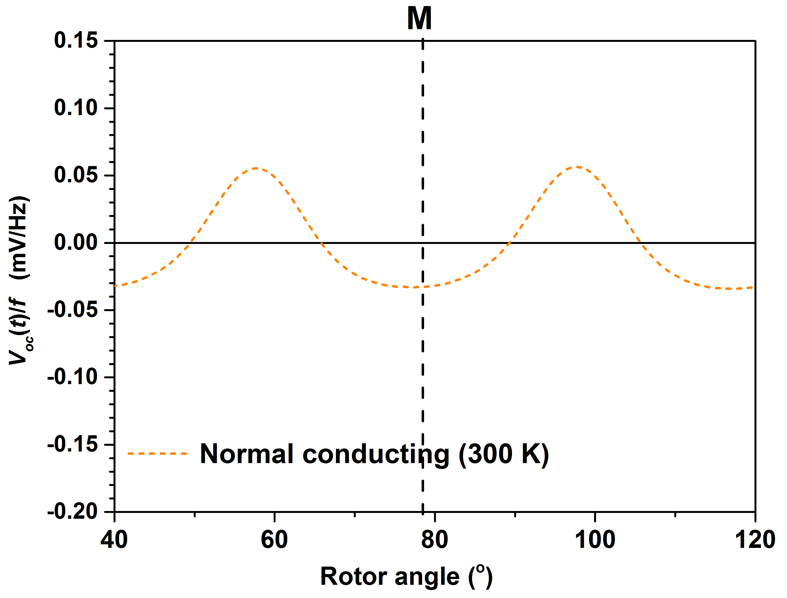
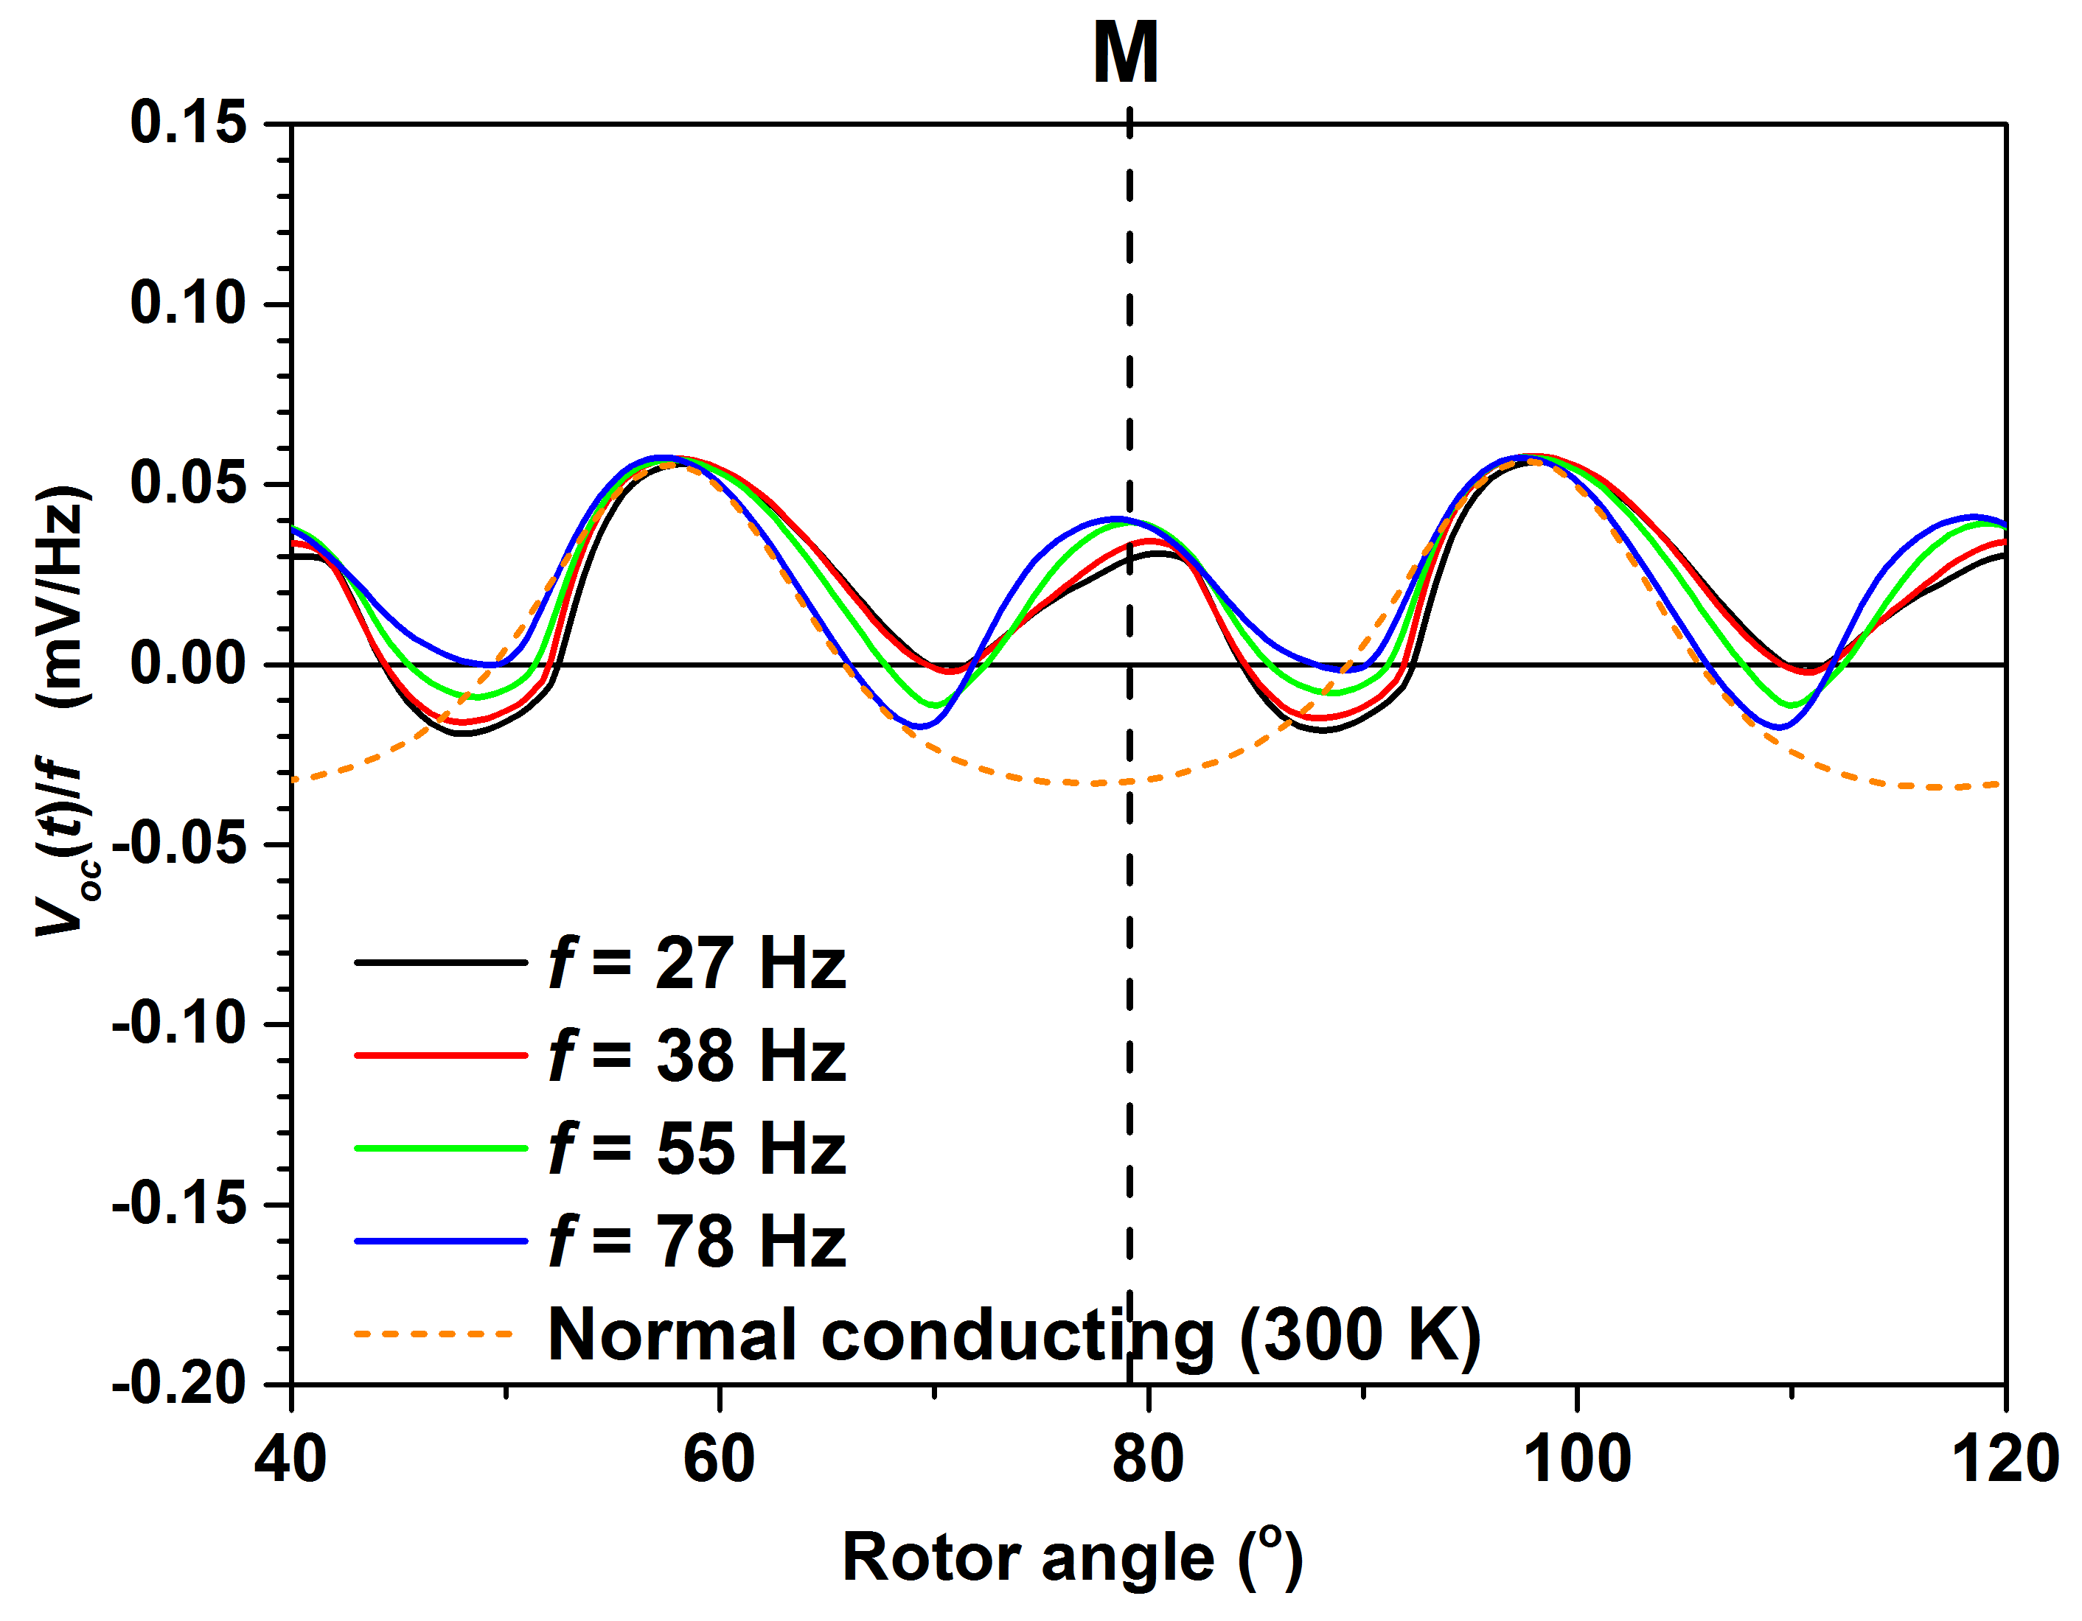
But hang on….. Why does this work at all?
Device should be an AC alternator!
$V\left(t\right)=\frac{dΦ(t)}{dt}$ , so:
$$V_{DC}=\overline{V(t)}=\left(\frac{f}{2π}\right)\int_{0}^{{2π}/f}{\frac{dΦ}{dt}}dt=Φ_{0}−Φ_{2π}=0$$
Therefore we should expect periodic AC open-circuit voltage with zero DC offset.
... And this is what we at temperatures above T_{c}
V_{DC} > 0!
V_{DC} = 0
But below T_{c} the output waveform changes…

Slide 29
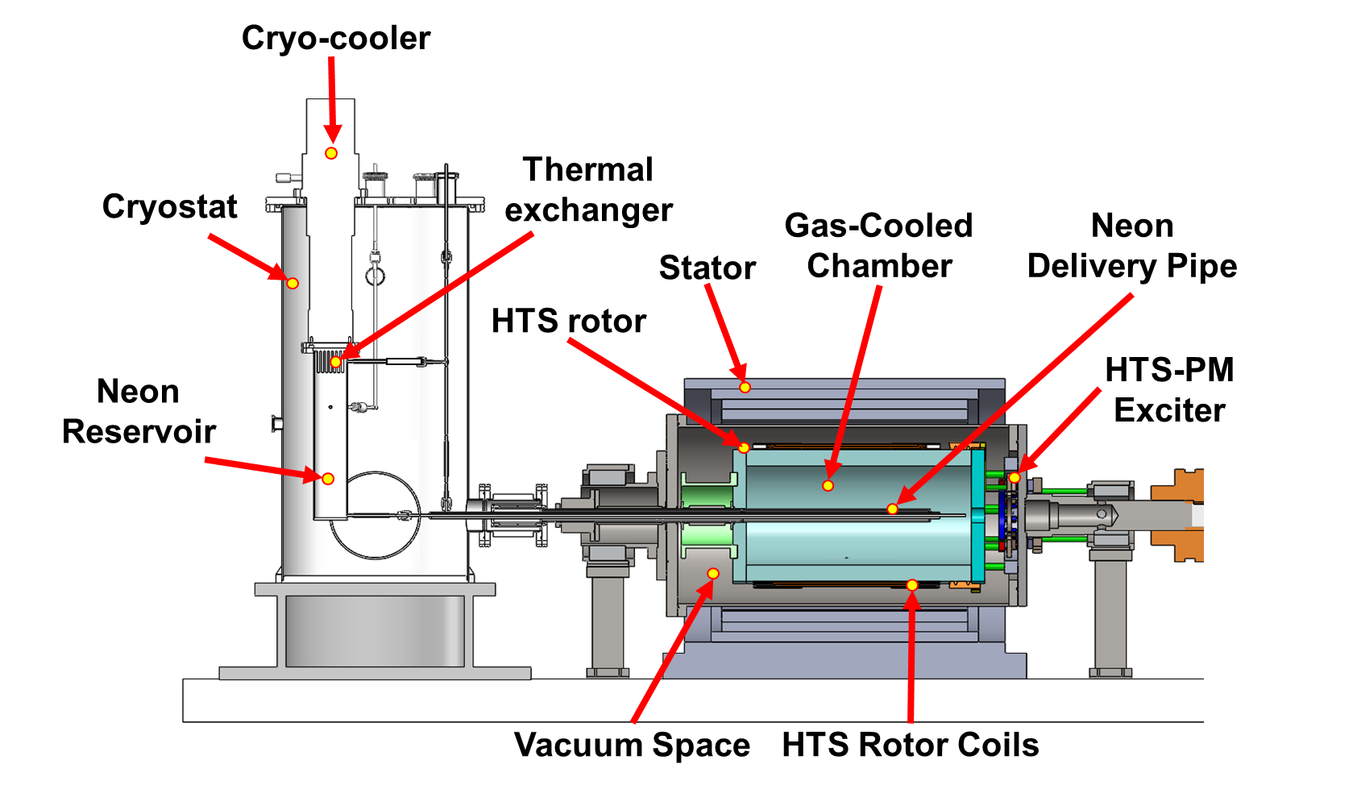
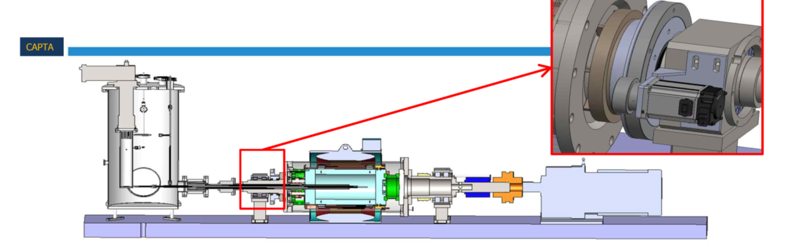
Implementing in an experimental HTS Generator
Test-bed machine built at Changwon National University
10 kW, 200 RPM HTS wound rotor generator
  Double pancake CC racetrack coils; 85 Amps / 1.5 T each
  Liquid Neon refrigerant (30 – 35 K)
  48-slot 3-phase copper-wound double layer armature
Can be excited using either HTS Brushless Exciter or conventional slip-rings
Dynamo flux-pump exciter supplied by Robinson Institute (VUW)
  Rotates co-axially with generator
Demonstration 10 kW HTS generator
(Changwon National University, S. Korea)

Slide 30
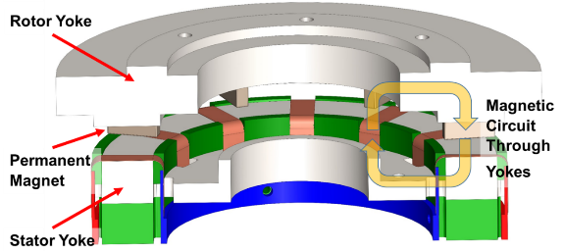
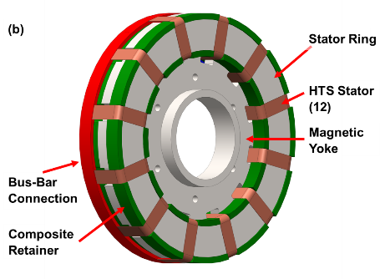
Initial design of the generator exciter
5 mm G10 cryostat
  flux gap of ≥ 5.4 mm
12 exciter-stator HTS wires
  Can be connected in any series or parallel combination
2 parallel 12 mm stator wires at d = 5.4 mm deliver > 85 A capability
Series-connected wires increase the open-circuit voltage of the flux pump
  Reduces the ramp time
Selected 2 parallel HTS paths upon the exciter-stator, each containing 6 wires in series
  6S-2P
Bumby et al., SUST 29 024008 (2016)

Slide 31
Experimental performance of the exciter
Pre-installation ex-situ lab tests at 77 K
Flux gap matches generator installation requirements
Maximum output depends on resistance per coil.
All fabricated rotor coils are < 2.5 µΩ.
For I(max) = 90A
f, Hz | R_{c} (max), μΩ
9 | 0.30
18 | 0.61
35 | 1.4
70 | 2.6
Solid lines: average IV curve characteristics of stators for a fixed f.
Dotted line: target coil operating current, 90A
Dashed lines: IV characteristic of Rc for values that will allow the coil to reach 90A.

Slide 32
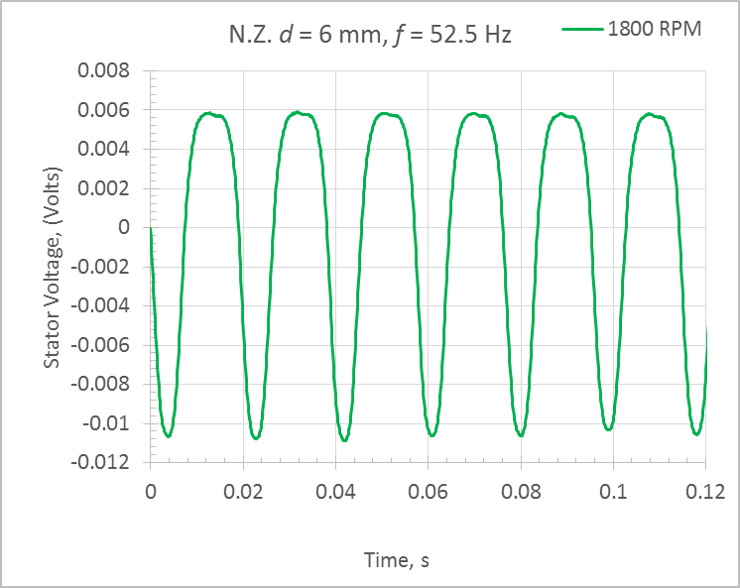
Current status: Warm tests at 300 K
FP brushless exciter installed in test generator
  Vacuum tight seal using SS316 end flange
300 K tests show close agreement with ex-situ experiments
Next step - cold tests…. Watch this space!
Left: Waveforms from flux pump in CWNU generator for 3 magnet frequencies. Right: Simulated waveforms from FP measured in N.Z at 52.5 hz..

Slide 33

Vacuum cryostat enables variable temperature operation
Temp. in stator : 30 K – 80 K
Temp. in HTS coil> 50 K
Series connected to 1G double pancake coil
  L = 1.97 mH,
  I_{c} = 95.0 A at 77 K
Copper Cooling Plate
HTS Coil
Cold Head
Notes:
This is the integrated system operating inside a vacuum cryostat which enables variable temperature operation.
This is the cold head, and this copper cooling plate, and this is HTS coil.
The HTS coil is 1G double pancake coil.
L = 1.97 mH,
I_{c} = 95.0 A at 77 K
Calibrated hall sensor was mounted at coil centre to the measure coil current.
An axial type AREPOC
T range in stator : 30 K – 80 K
T range in coil> 50 K : Copper cooling plate temperature 45- 50 K. So > 45 – 50 K
More details on the rig are needed:
Temperature was monitors using
T range in stator : 20 K – 90 K? Thesis
T range in coil> 45 – 50 K : Copper cooling plate temperature 45- 50 K. So > 45 – 50 K
Two 50 W heating components were installed on the clamping plates to bring the system to thermal equilibrium.
The T on the plates were monitored using the Lakeshore Cryogenic silicon diode temperature sensors (DT-670 series).
Temperature sensors were attached on the top and bottom Copper clamping plates near the stator, and copper cooling plate near the coil. Is this different in Olly’s case???
Cryocooler? Cryomech AL63
Cooling power: 15 W at 30 K; 50 W at 80 K

Slide 34
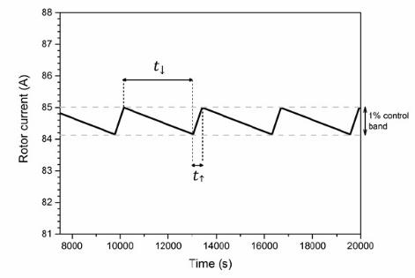
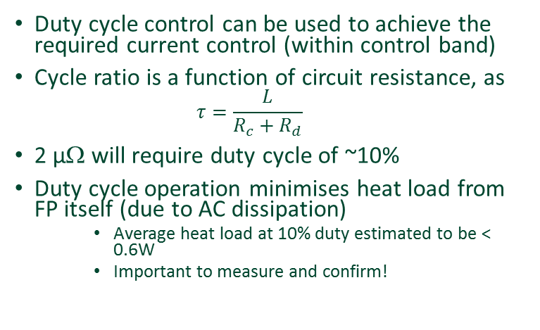
Controlling the output current
Duty cycle control can be used to achieve the required current control (within control band)
Cycle ratio is a function of circuit resistance, as
  $$τ=\frac{L}{R_{c}+R_{d}}$$
2 µΩ will require duty cycle of ~10%
Duty cycle operation minimises heat load from FP itself (due to AC dissipation)
    Average heat load at 10% duty estimated to be < 0.6W
    Important to measure and confirm!
Bumby et al., SUST 29 024008 (2016)

