Slide 2

Study of HTS superconducting coatings for beam impedance mitigation in the Future Circular Collider
Sergio Calatroni – CERN
On behalf of the collaborations:
CNR-SPIN (Genoa – Italy), TU-Wien (Austria)
and
ALBA, ICMAB-CSIC, IFAE, UPC (Barcelona – Spain)

Slide 3
Outline
The FCC at CERN
Why a beam screen, and why HTS
Beam impedance and HTS
Strategies:
  ReBCO tapes
  Tl-based coatings
Recent results and challenges
Conclusion and outlook

Slide 4
Circular Colliders Timeline
1980
1985
1990
1995
2000
2005
2010
2015
2020
2025
2030
2035
Constr.
Physics
LEP
Design
Proto
Construction
Physics
LHC
Design
Construction
Physics
HL-LHC
now is the time to plan for 2040!
Design
Proto
Construction
Physics
FCC
Conceptual Design Report (CDR) by end 2018
(review of European Strategy for Particle Physics)

Slide 5


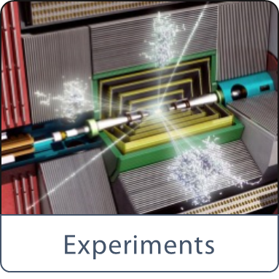
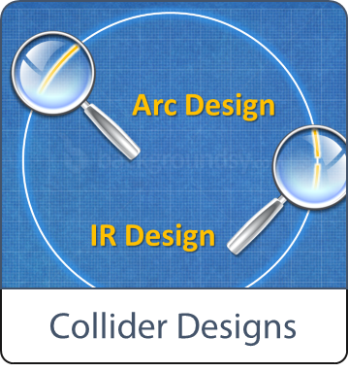
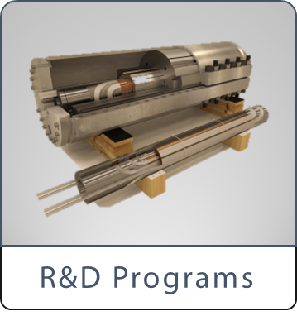


The Future Circular Collider(s)
International FCC collaboration (CERN as host lab) to study:
pp-collider (FCC-hh) → main emphasis, defining infrastructure requirements
~100 km tunnel infrastructure in Geneva area, site specific
e⁺e⁻ collider (FCC-ee), as potential first step
HE-LHC with FCC-hh technology
p-e (FCC-he) option, IP integration, e⁻ from ERL
HE-LHC
~16 T ⇒ 100 TeV pp in 100 km

Slide 6
The Future Circular Collider Study

Slide 7
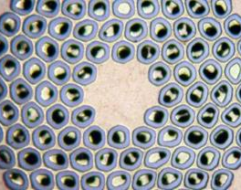
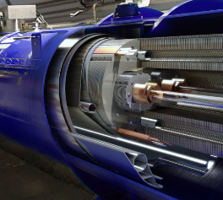
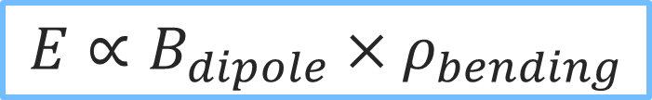

The FCC-hh: pushing the energy frontier
The raison d’être of a hadron collider is the energy reach
Compared to the LHC → E_{cms} 100 TeV pp (~6 increase)
factor ~3 in radius → 100 km
factor ~2 in field → ~16 T dipoles, Nb₃Sn at 1.9 K
Synchrotron radiation → $∝\frac{E^{2}B^{2}}{m^{4}}$
Nb₃Sn
$$E∝B_{dipole}{×ρ}_{bending}$$
Conductor R&D
16 T
Magnet Design

Slide 8
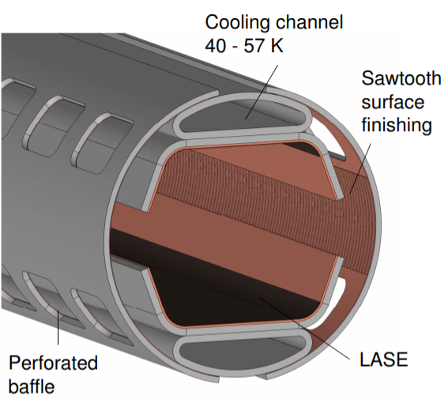
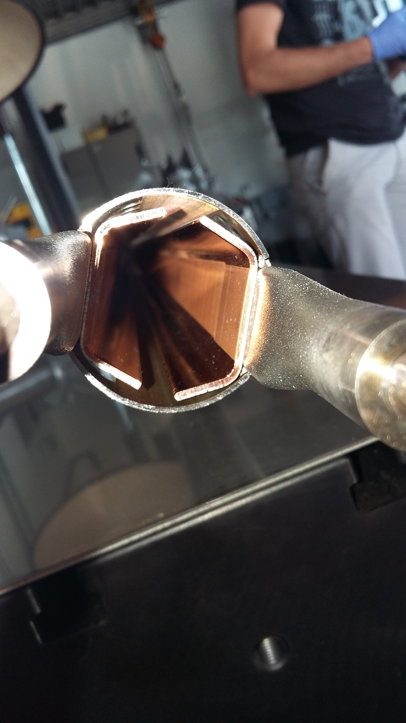
Need for a beam screen in a p-p collider
High synchrotron radiation load (SR) of protons @ 50 TeV:
~30 W/m/beam (@16 T)
5 MW total in arcs (LHC < 0.2 W/m)
Image currents
Electron cloud
(as for the LHC)
The synchrotron radiation cannot be dumped at 1.9 K
Taking into account vacuum requirements, overall cryogenic efficiency and power consumption of the accelerator, the synchrotron radiation has to be absorbed at 50 K
Courtesy: C. Garion

Slide 9
Optimisation of cryo-power, vacuum and impedance
3000
From:
Ph. Lebrun
L. Tavian
V. Baglin
T_{cold mass} = 1.9 K, ~30 W/m
2500
T_{cold mass} = 4.5 K, ~30 W/m
2000
300 MW
1500
Total power to refrigerator [W/m per beam]
200 MW
1000
100 MW
500
0
0
50
100
150
200
Multi-bunch instability growth time: 25 turns 9 turns (ΔQ=0.5)
Beam-screen temperature T_{bs} [K]

Slide 10
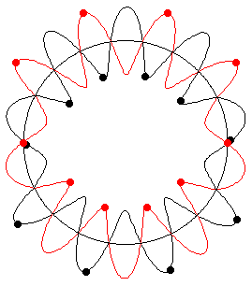
Beam instabilities in particle accelerators (in 1 slide)
F. Sacherer in: Proceedings of the First Course of the International School of Particle Accelerators, CERN 77-13, p. 198
gives rise to a (complex!)
(betatron oscillations)
“Transverse impedance”

Slide 11
Surface impedance: the key
Property of the beam
From beam to surface
Property of the surface
I_{b}: bunch current
M: number of bunches
E: beam energy
L: bunch length
R: accelerator radius
C: speed of light
b: vacuum chamber radius
f: wakefields frequency
ρ: electrical resistivity
What can be better than copper at 50 K?
HTS are the key

Slide 12
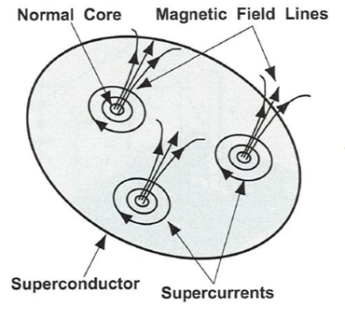
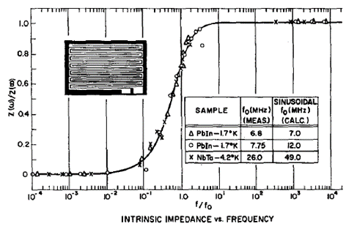
Fluxon motion in RF
The rigid fluxon lattice behaves as an harmonic damped oscillator
The “depinning frequency”
d
Flux flow regime
No flux flow
Gittleman and Rosenblum: Phys Rev. Lett. 16, 734 (1966), Journal of Applied Physics 39, 2617 (1968)
Calatroni and Vaglio, IEEE Trans. Appl. Supercond. 27 (2017) 3500506

Slide 13
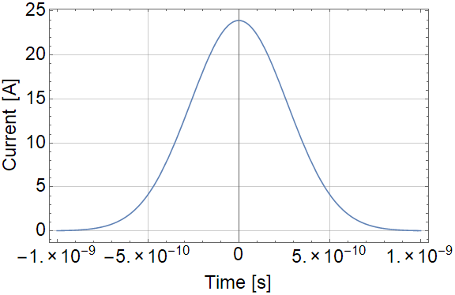
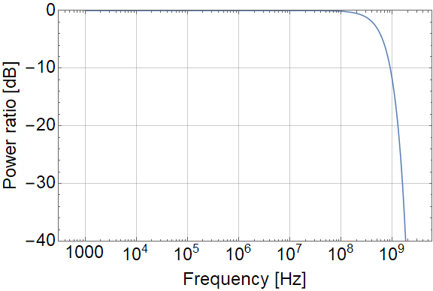
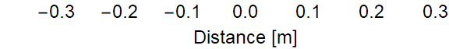
Current density and frequency spectrum
Bunches of 10¹¹ protons, 8 cm long
Beam instantaneous image current
Frequency spectrum
Bunch charge distribution
For a beam screen of about 30 mm diameter, and a film thickness / skin depth of 1 µm: J ~ 25 kA/cm²

Slide 14
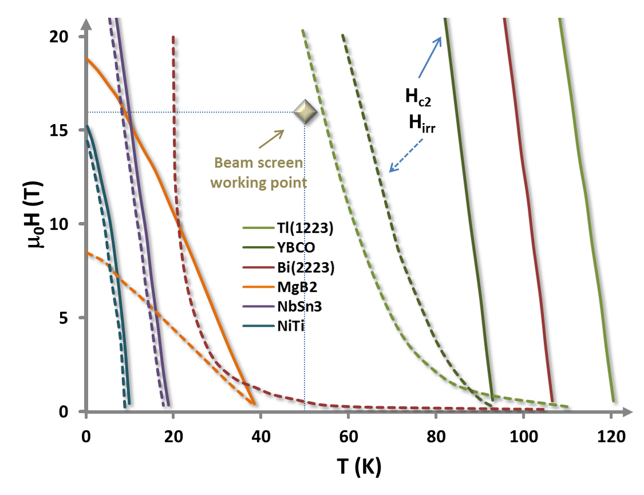
Choice of HTS
Nature 414, 368-377 (15 November 2001)
High-Tc superconducting materials for electric power applications
David Larbalestier, Alex Gurevich, D. Matthew Feldmann & Anatoly Polyanskii
Superconductor Science and Technology, Volume 11, Number 8
Synthesis and properties of fluorine-doped Tl(1223): bulk materials and Ag-sheathed tapes
E Bellingeri, R E Gladyshevskii, F Marti, M Dhallé and R Flükiger
Requirements:
HTS operate at 50 K and 16 T
Hc₂ , H_{irr} >> 16T
J_{c} > 25 kA/cm² (2.5x10⁸ A/m²)
R_{s} better than for copper
Courtesy: E. Bellingeri

Slide 15
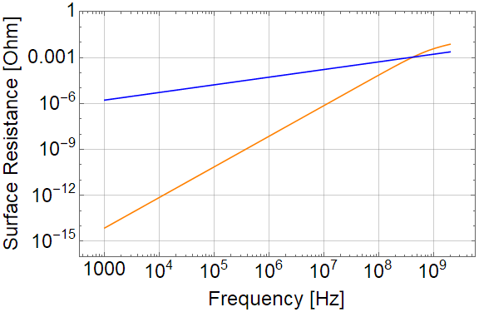
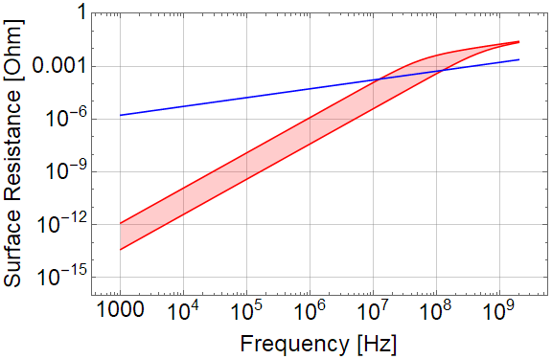
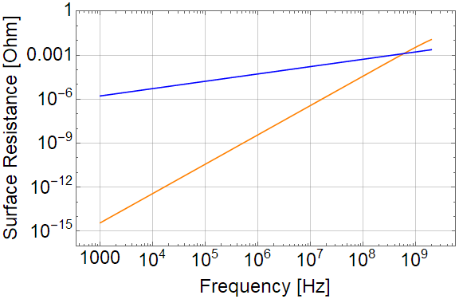
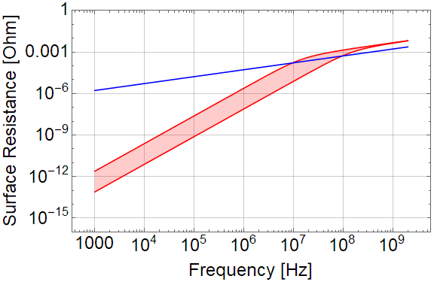
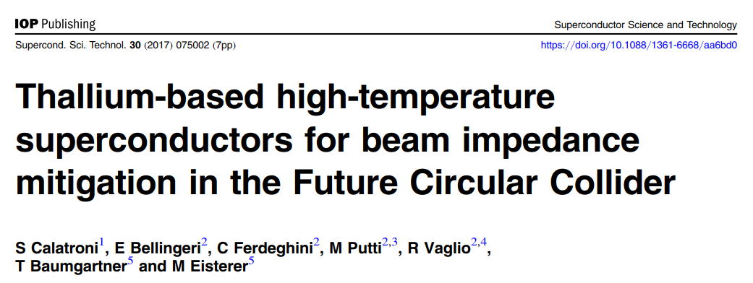
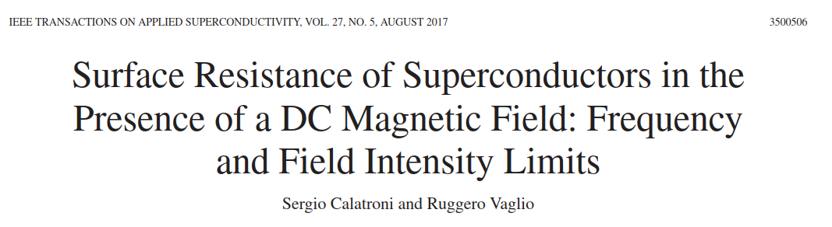
Predicted surface resistance of HTS in 16 T field
YBCO at 50 K compared to Cu
Tl-1223 at 50 K compared to Cu
B_{c2}=45T, ρ=50µΩcm, J_{c}=3x10⁹ Am⁻²,ν₀=3GHz
B_{c2}=70T,ρ=40µΩcm,J_{c}=10⁸÷10⁹Am⁻² ,ν₀<1GHz
At 1.06 T
(injection)

Slide 16

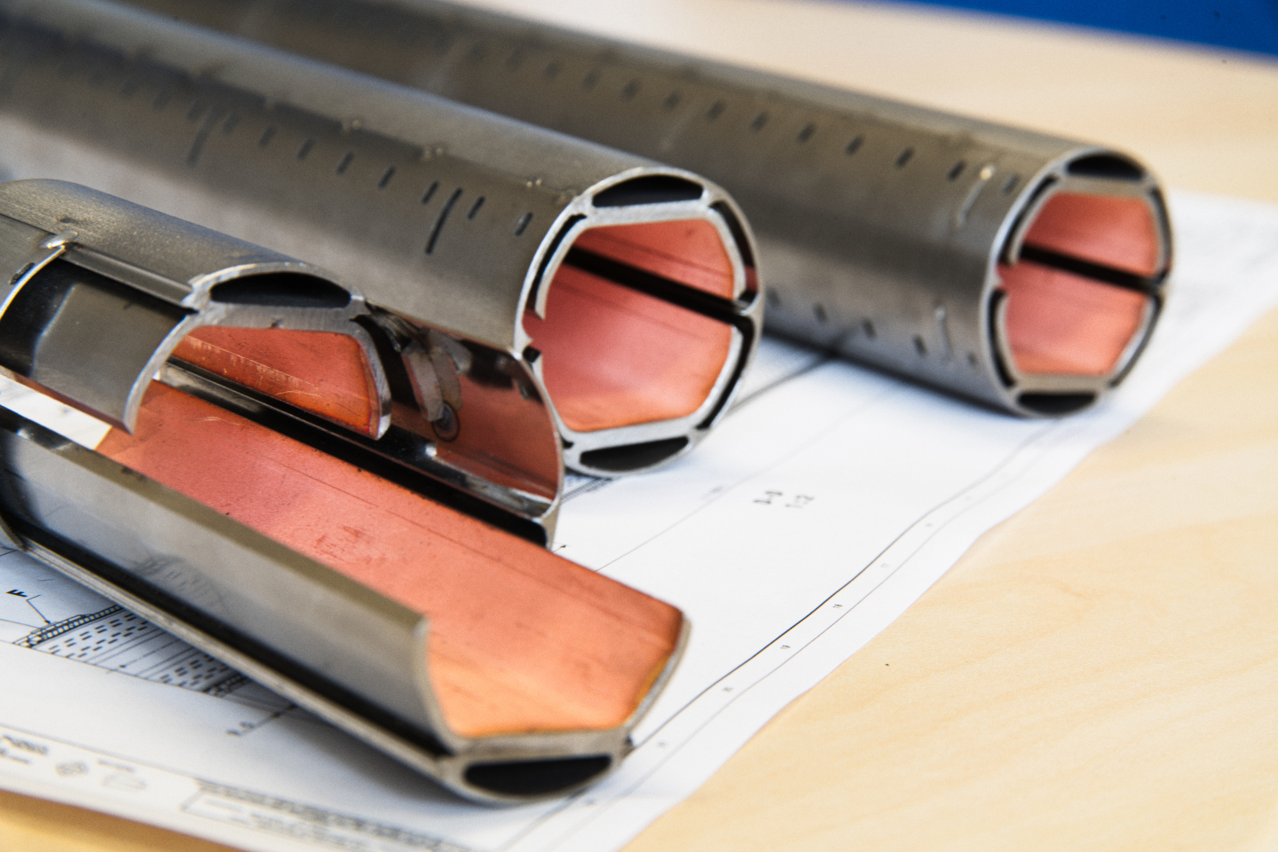







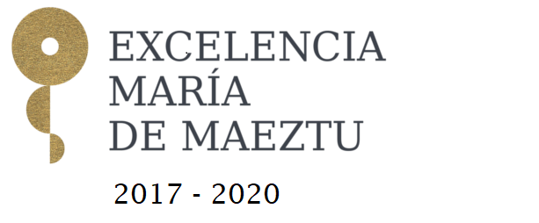

How to make it in practice ?
Manufacture the screen using ReBCO tapes
Coat the inside of the screen
with Tl-1223 films

Slide 17
ReBCO tapes: ALBA, ICMAB-CSIC, IFAE, UPC
Coated Conductors are a revolution
in materials science and engineering
A flexible metallic substrate coated with a multilayer of epitaxial multifunctional oxide layers, including a HTS RE(Y, Nd, Sm, Gd, Dy)Ba₂Cu₃O_{7-δ} film…
Capable of carrying 25 times higher current (DC) than the peak induced currents in the FCC.
… scalable technology for growing km-length REBCO CC and is commercially available
(12 mm width)

Slide 18
Collaboration program
Qualification and selection of tapes (Jc, Hc, Tc, magnetization and transport measurements) – (ICMAB)
Validation of RF performance up to 9T and higher (UPC)
Development and assessment of soldering technique preserving the properties (IFAE)
Resistance to synchrotron radiation, and transport + RF properties in-situ (ALBA)
Vacuum compatibility, SEY, outgassing… (CERN)
Goal is to have a demonstrator by end of 2019

Slide 19
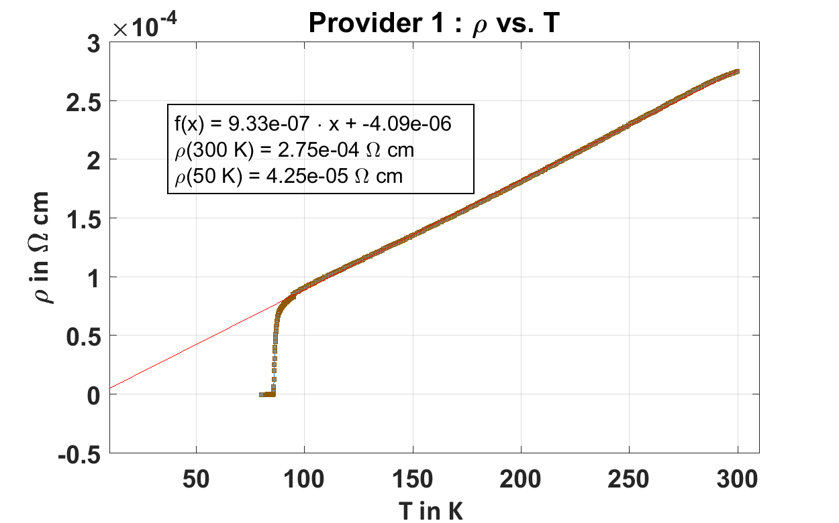
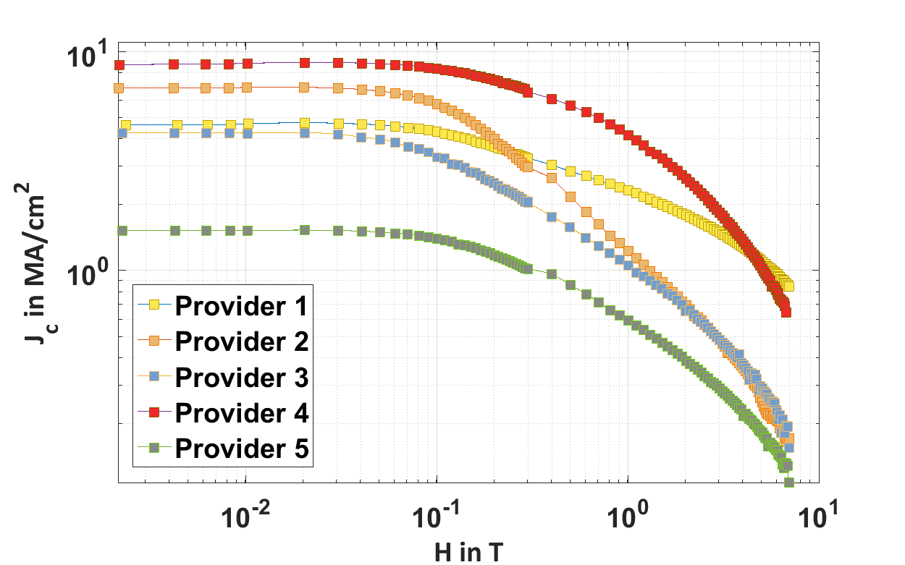


Transport measurements (ICMAB)
Normal resistivity $ρ_{n}(50K)$
Critical current density $J_{C}(50K, 7T)$*
*measured with SQUID
Qualification and selection of tapes, evaluation of depinning frequency and estimate RF performance

Slide 20
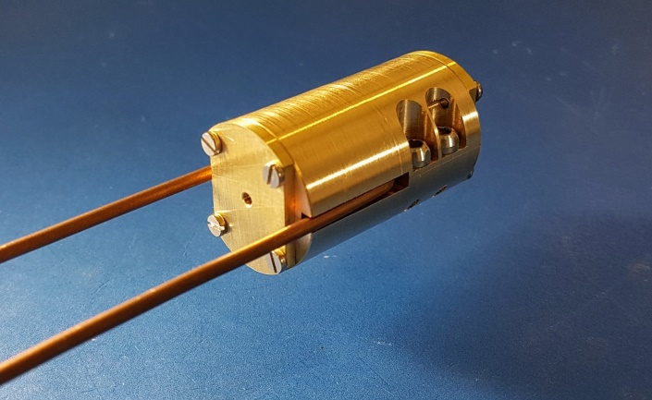
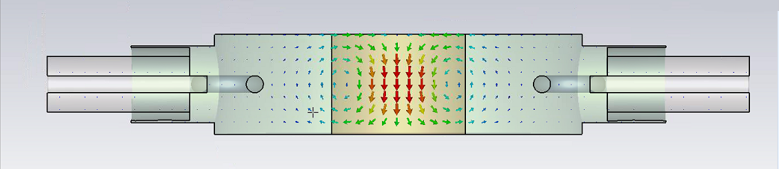
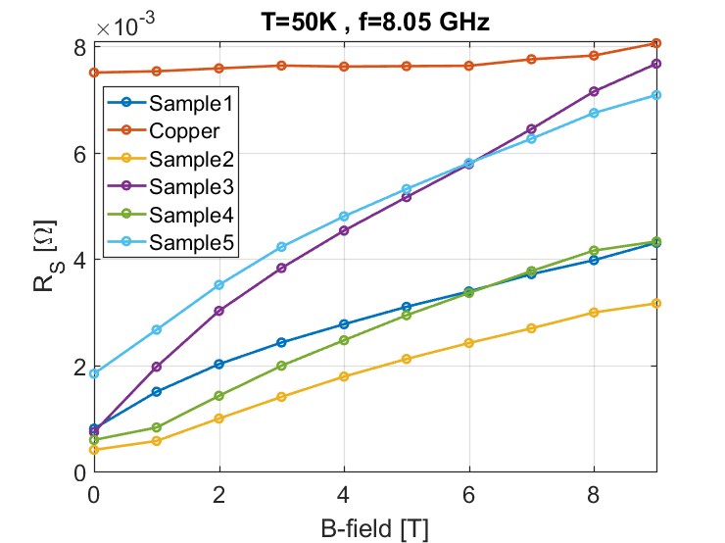
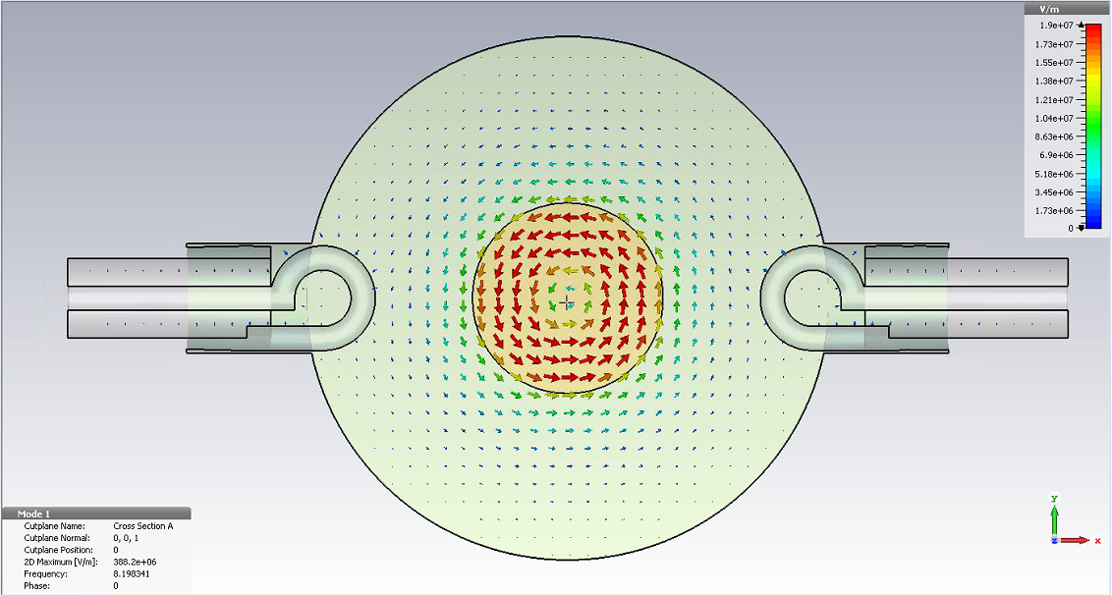
Validation of RF performance (UPC - ICMAB)
Copper
CC providers 1 - 5
In house developed 8.05 GHz cavity resonator compatible with 25mm bore 9 T magnet at ICMAB
“Non-optimized” REBCO CCs outperform Cu at 50K and up to 9T
R_{S} is microstructure dependent

Slide 21
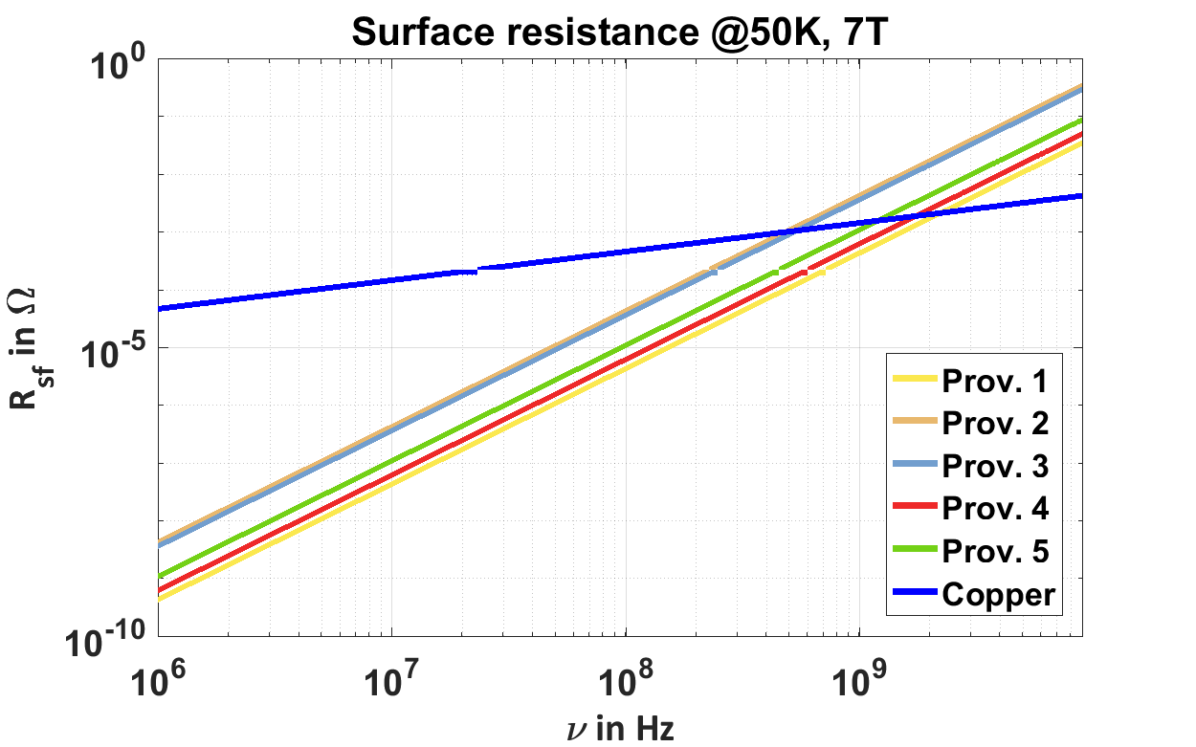

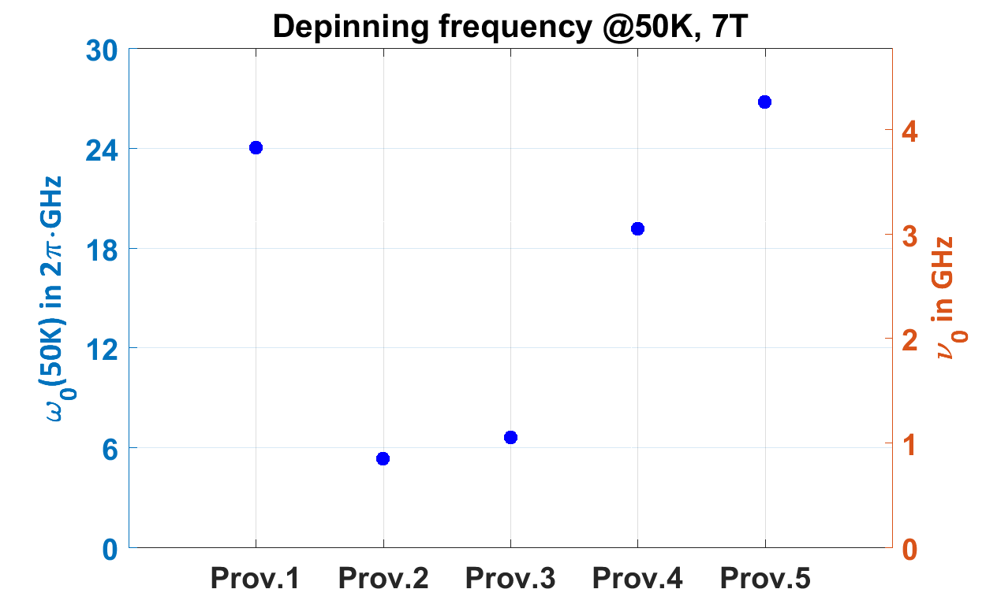
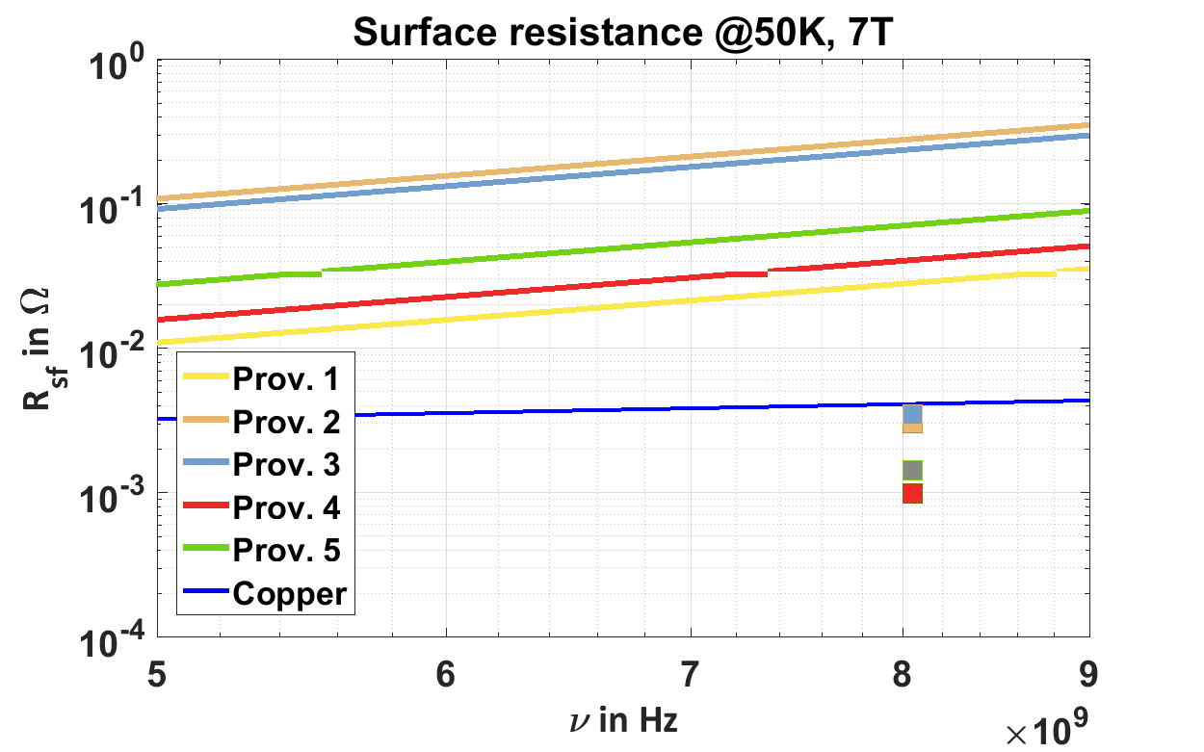
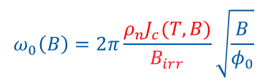
Prediction vs. experiment
$$ω_{0}\left(B\right)=2π\frac{ρ_{n}J_{c}(T,B)}{B_{irr}}\sqrt{\frac{B}{φ_{0}}}$$
ω₀ scales with experimental R_{s}
The rigid-fluxon model overestimates REBCO’s R_{s}
By tuning microstructure → optimize ρ_{n}, J_{c} and B_{irr} to maximize ω₀ and minimize R_{s}(H,T)
Experimental data

Slide 22
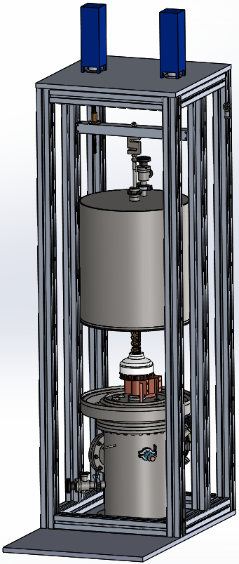
Development of soldering technology (IFAE)
Solder/glue
HTS tapes
CC
Solders based on Sn / Pb / Cu / Bi & In
will be tested at temperatures < 220ºC
beam
A cryogenic system to assess 2D /3D stress maps based on optical image correlation with in situ monitoring of the I_{c} is under its final steps of construction

Slide 23
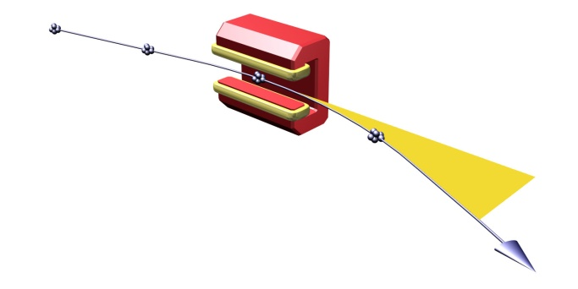
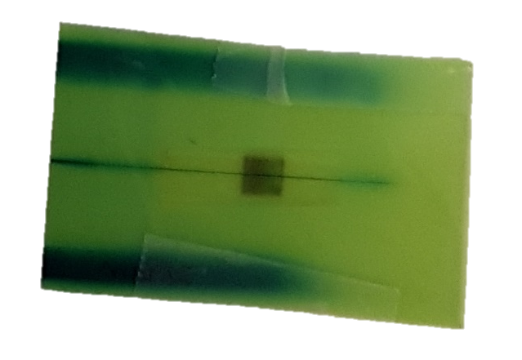
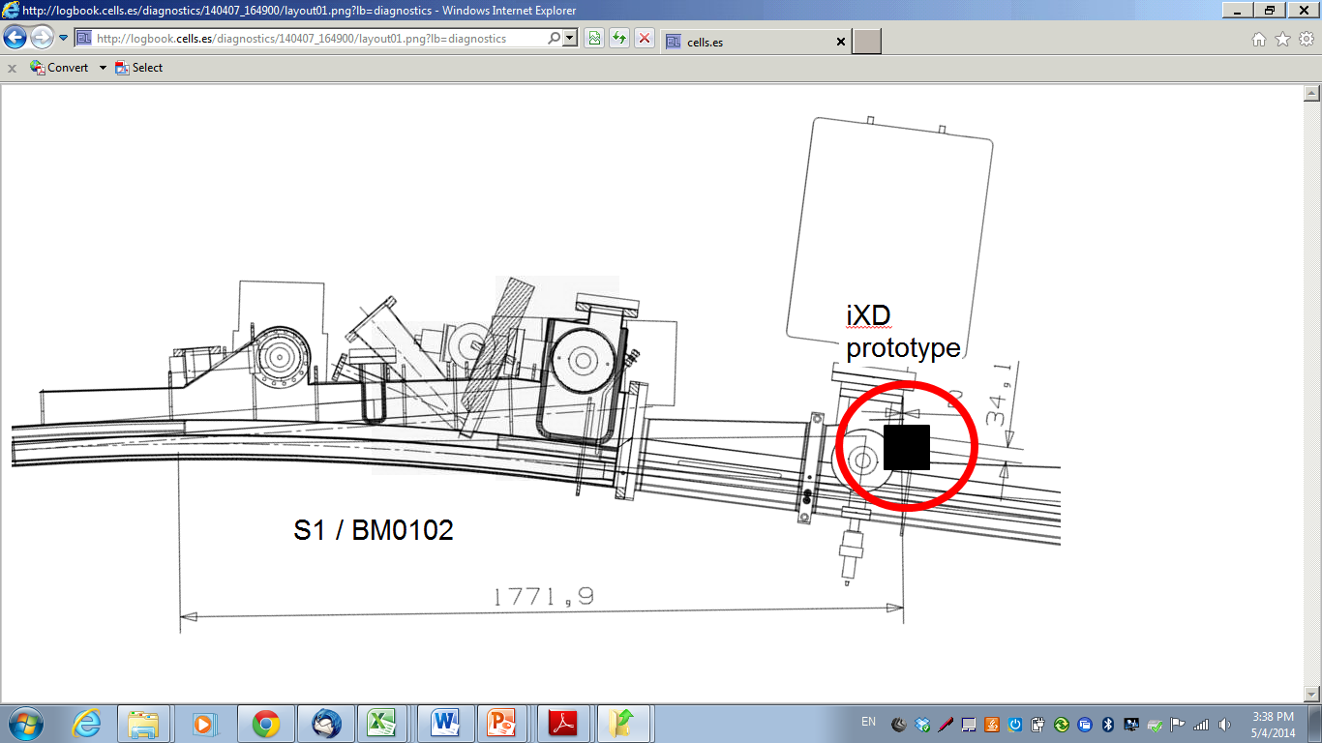



Synchrotron irradiation
Beam screen coatings have to sustain high synchrotron radiation loads
HTS tapes were irradiated with high energetic electron synchrotron radiation (E_{c} 130 keV) for four weeks in ALBA synchrotron
$$P_{beam}∝\frac{B^{2}E^{2}N}{\text{ρ}}$$
$$P_{beam}^{LHC}\sim 0,2 W/m$$
$$P_{beam}^{FCC}\sim 28 W/m$$
Absorber (35 mm)
X-rays
DIPOLE
sample
e-beam
Irradiated 5x5 mm² CC sample
Courtesy of U.Iriso and M. Pont
Artur Romanov

Slide 24
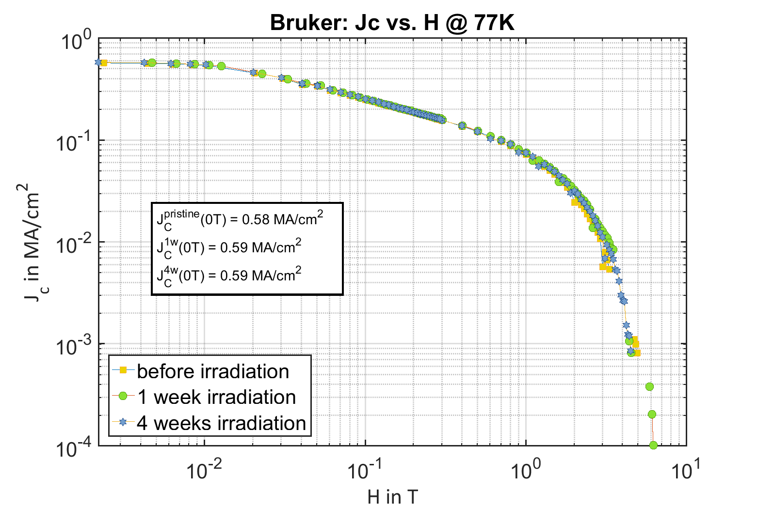
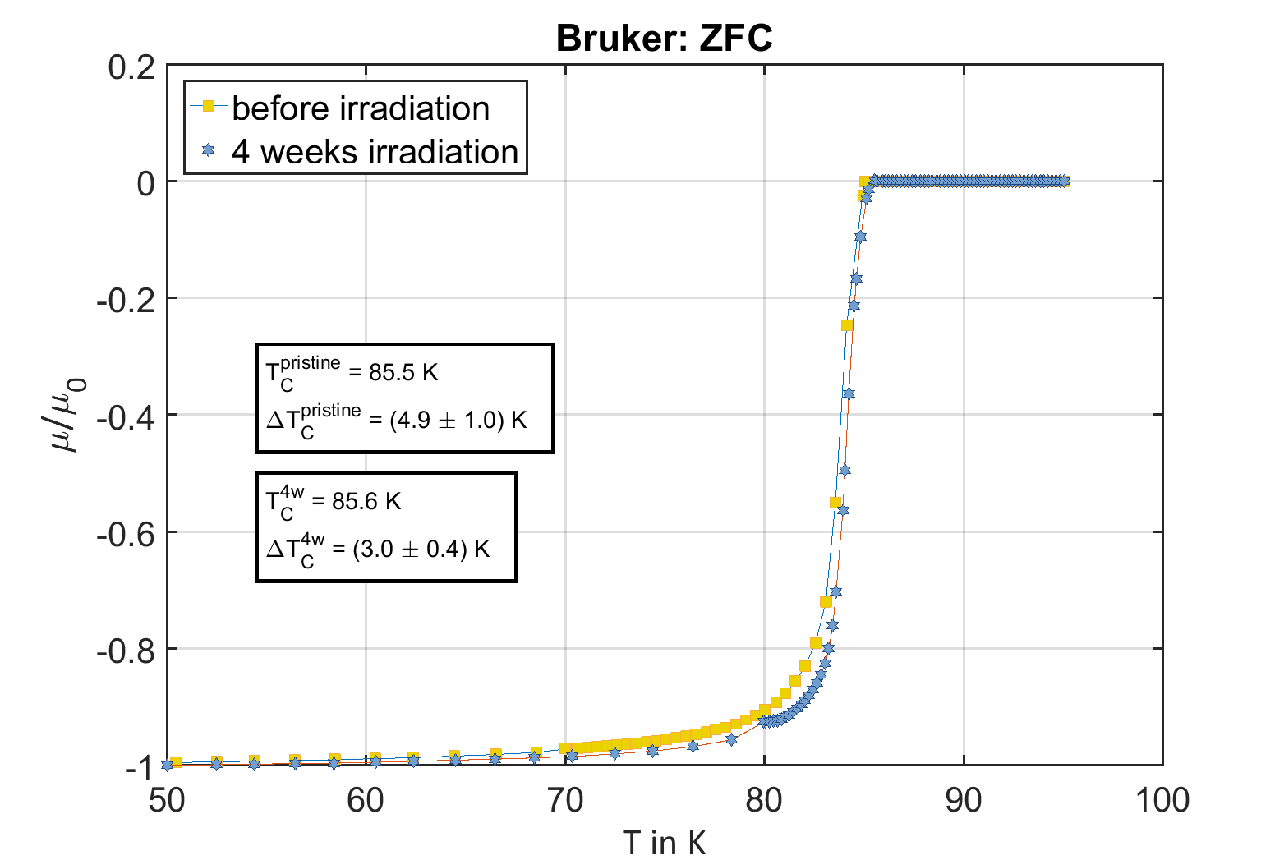
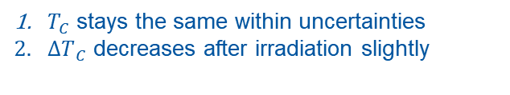
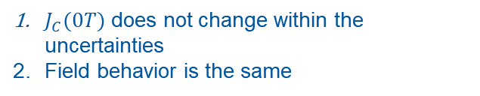
Synchrotron irradiation: first results
SC properties of samples before and after irradiation are compared by means of inductive measurements
$J_{C}(0T)$ does not change within the uncertainties
Field behavior is the same
$T_{C}$ stays the same within uncertainties
$ΔT_{ C}$ decreases after irradiation slightly

Slide 25
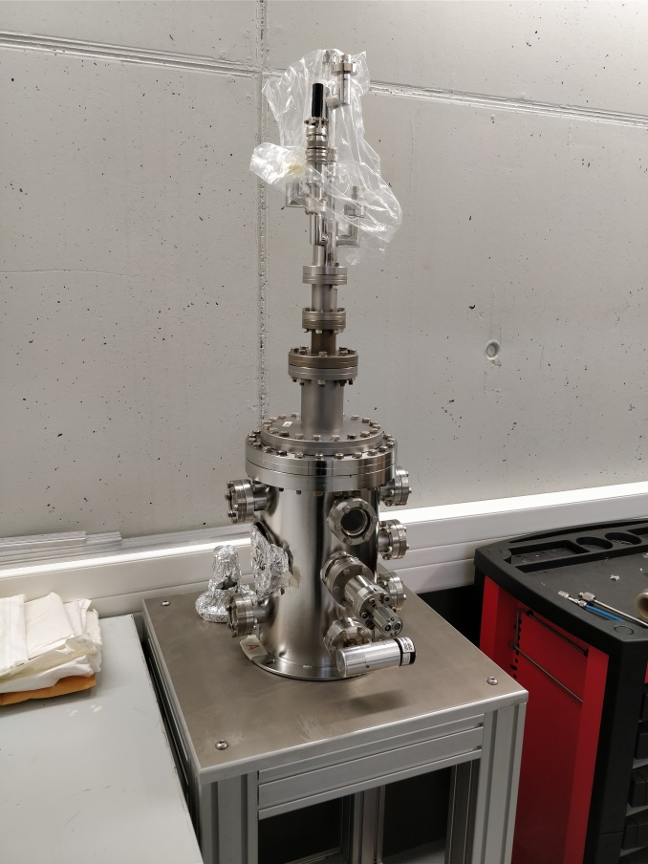
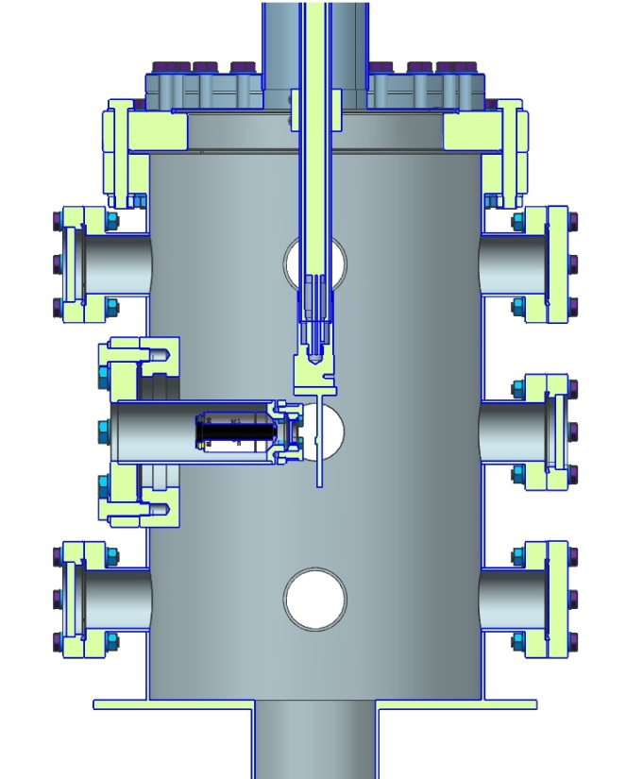
Cryogenic irradiation tests (ALBA)
Bending magnet @ ALBA
Temperature range 2-500K
DC resistivity online
RF test with synchrotron radiation as final goal

Slide 26
Tl-1223 tapes: CNR-SPIN, TU-Wien
 | YBCO | Tl-1223
PROs | Very good properties Indiustrially available in tapes | Very high Tc High Jc Very high Bc2 Tolerant for out stoichiometry Substrate-tolerant (Ag coating) Weak link effects my be cured by overdoping
CONs | Very expensive and complex preparation Lower Tc | Tl is toxic Weak link effects may not be overcome easily
May open up the 100-120 K operating window
Power consumption from 100 MW down to 50 MW

Slide 27
Collaboration program
Construction of a safe laboratory
Definition and selection of precursors for Tl-1223 coating (CNR-SPIN)
Optimization of coating procedure through:
Assessment of transport properties (TU-Wien Atominstitut)
And correlation with microstructural properties (TU-Wien USTEM)
(and repeat)
Produce high-quality coatings by electroplating (few cm²) on untextured substrate (Ag)
Goal is to have a reliable process defined by mid of 2019

Slide 28
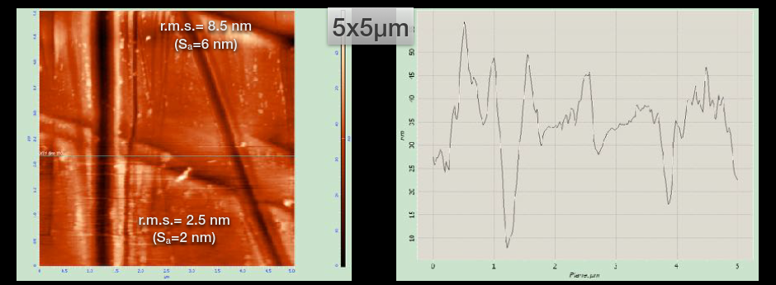
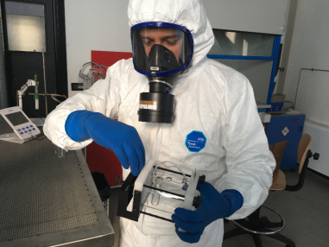
Sample preparation (CNR-SPIN)
Step 1: preparation of the substrate
  Laminated Ag ribbon
  Polishing
  Heat treatments
Step 2: preparation of the precursors
  TlNO₃ + Bi(NO₃)3 ·5H₂O +
  Sr(NO₃)₂ + Ba(NO₃)₂, +
  CaNO₃·H₂O + Cu(NO₃)₂ ·xH₂O
  In dimethyl sulfoxide (DMSO)

Slide 29
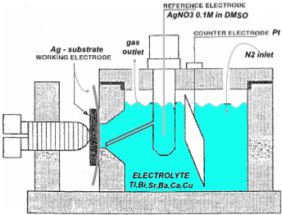
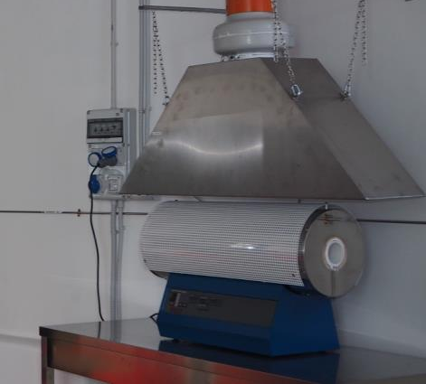
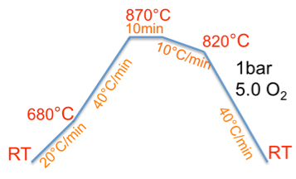
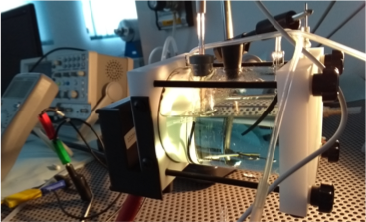

Sample preparation (CNR-SPIN)
Step 3 :Electroplating
Step 4: Heat treatment
(Thallium (oxide) is volatile above 700-715°C)
Flat cell

Slide 30


SQUID measurements (Atominstitut)
Thin film, sample 4x4 mm, Tc and hysteresis loop

Slide 31


Scanning Hall Probe Microscopy (Atominstitut)
zoom into different areas for high resolution scans

Slide 32

SEM – EDX elemental mapping (USTEM)

Slide 33



SEM, TEM (USTEM)
TEM image shows clear evidence of stacking of diﬀerent grains
The superconducting phases of diﬀerent grains can be determined through line scans
TEM investigation shows coexistence of Tl-1223 and Tl-1212 phase

Slide 34


Tl-1223: Iteration (All)
Focus on Tl-1223 (bulk) to optimize preparation and heat treatments

Slide 35

Tl-1223: Iteration (All)
Use single crystal TiSrO₃ to optimize thin film preparation and growth

Slide 36
Other requirements
Magnetic field quality
UHV compatibility
Low SEY (e-cloud suppression)
Lifecycle environmental radiation protection
Radiation hardness of HTS (p⁺, n, photons, …)
…

Slide 37


Striated configuration to minimize trapped fields
  Screening currents during magnetic field ramping will produce unacceptable field quality effects
  A striated geometry will drastically reduce trapped magnetic fields in the superconductor, recovering acceptable levels of field quality during ramping
Flux shaking in RF will also take care of suppressing the effect
J. van Nugteren, S. Bermudez, S. Calatroni, G. Kirby, G. de Rijk

Slide 38

Accelerator compatibility: SEY
No degradation of superconducting properties due to amorphous carbon sputter coating

Slide 39





a-C coating: RF compatibility
Uncoated
Copper
a-C coating
Ti + a-C coating
In untreated form not suitable for use in the FCC-hh
Coating of a-C decreases SEY under the desired limit
Ti as adhesion and protection layer
NO significant change in surface resistance
Uncoated
Copper
a-C coating
Ti + a-C coating
$$H=0T$$
Increase of $R_{Sf}$ not detrimental
About 85 % of the sample is coated

Slide 40
Summary and outlook
Impedance reduction for the FCC-hh: an application which can be done only with HTS
First approach: ReBCO Coated-Conductors
  State-of-the-art tapes, ensure they guarantee the requested performance for FCC (and tailor them if needed), develop soldering technology for beam screen fabrication, maintaining the properties: extensive RF, DC testing
Second approach: Tl-1223 thin films
  Opens-up 100-120 K window, 100 MW ↓ 50 MW consumption ! Complex
  5-components electroplating and annealing. Once established, should be scalable to large dimensions
We will manufacture a short-sample demonstrator (50 cm length) once the technology is ready.
  At CERN we are preparing a RF impedance test system dedicated to beam screens, at cryo-temperature and high magnetic field

Slide 41
Acknowledgements
CNR-SPIN: Carlo Ferdeghini, Emilio Bellingeri, Alessandro Leveratto, Marina Putti, Aisha Saba, Ruggero Vaglio
TU-Wien: Michael Eisterer, Thomas Baumgartner, Sigrid Holleis, Johannes Bernardi, Michael Stoeger-Pollach, Alice Moros
ALBA: Francis Peréz, Montse Pons, Patrick Krkotic
ICMAB-CSIC: Teresa Puig, Artur Romanov, Joffre Gutierrez, Xavier Granados, Xavier Obradors
IFAE: Ilya Korolkov, Pedro Gonzalez Melis
UPC: Joan O’Callaghan
CERN: Mauro Taborelli, Pedro Costa Pinto, Pierre Demolon, Danilo Zanin, Elisa Garcia-Tabares Valdivieso, Jeroen van Nugteren, Susana Bermudez, Markus Widorski

Slide 43

Comparison: Y-123, Bi-2223, Tl-1223
Susanne Tönies, Harald W. Weber, Gerhard Gritzner, Oliver Heiml, and Mario H. Eder,
IEEE TRANSACTIONS ON APPLIED SUPERCONDUCTIVITY, VOL. 13, NO. 2, JUNE 2003

Slide 44
Comparison: Tl-1223 and Tl-2212
Sundaresan et al. , IEEE TRANS. APPL. SUPERCOND. 13 (2003) 2913

Slide 45
Tl_{x}Ba₂Ca_{y}Cu_{y+1}O_{z}
Site | Tl_{x} | Ba₂ | Ca_{y} | Cu_{y+1} | O_{z}
Stoichiometry | X=1 o 2 | 2 | Y=0,1,2 | Y+1=1,2,3 | Z=5…10
Substitution | Pb,Bi,Cu,Hg | Sr | Tl | NONE | F

Slide 46

Surface impedance: effect of magnetic flux
considering the additional electric field related to the fluxons motion :

Slide 47

Conductivity: two-fluids
For perfect metals:
For superconductors:
Frequency independent

