Slide 1
Subcooling of
Liquid Hydrogen with a
Cryogenic Refrigerator
ICEC 27 - Oxford 2018
Oxford • 05 September. 2018 •
J.M. BERNHARDT, P. DE MAEYER
Gas & Cryogenics • ALaT Sassenage

Slide 2
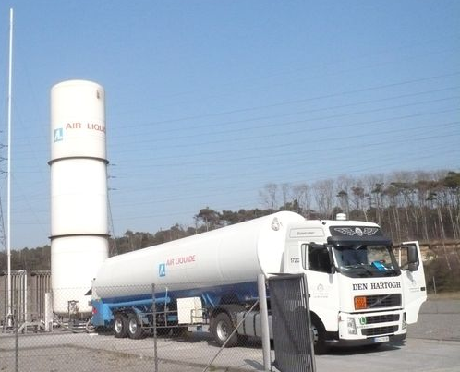
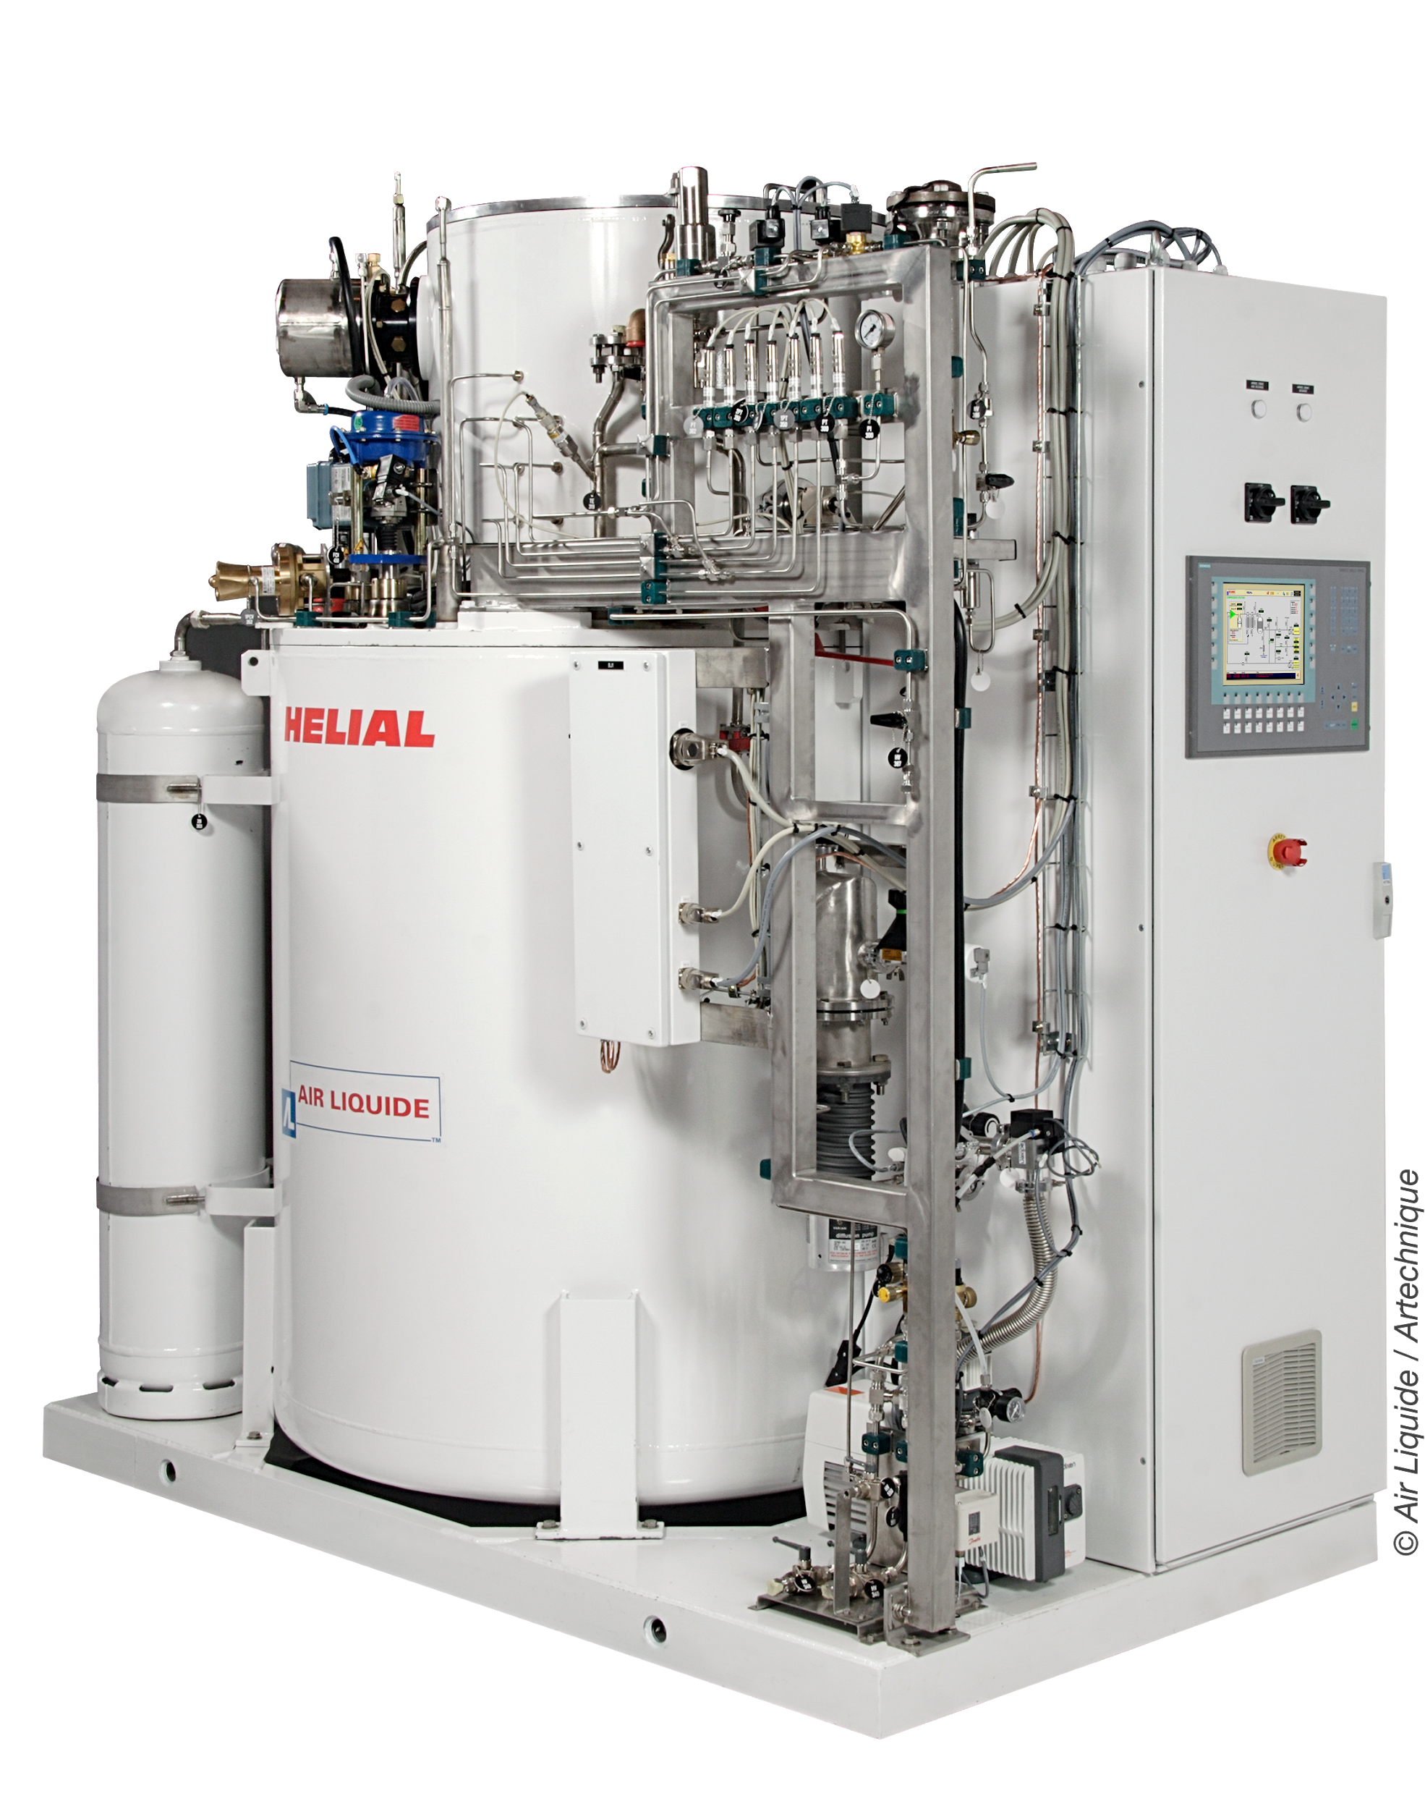
Subcooling of Liquid Hydrogen with a Cryogenic Refrigerator
Outline of the presentation
Air Liquide Advanced Technologies (AL-aT)
The customer requirement of subcooled LH2
The Sabre Test Facility TF1
Cryogenic Requirement
AL-aT Cryogenic System
CFD Simulation Results
Conclusion

Slide 3
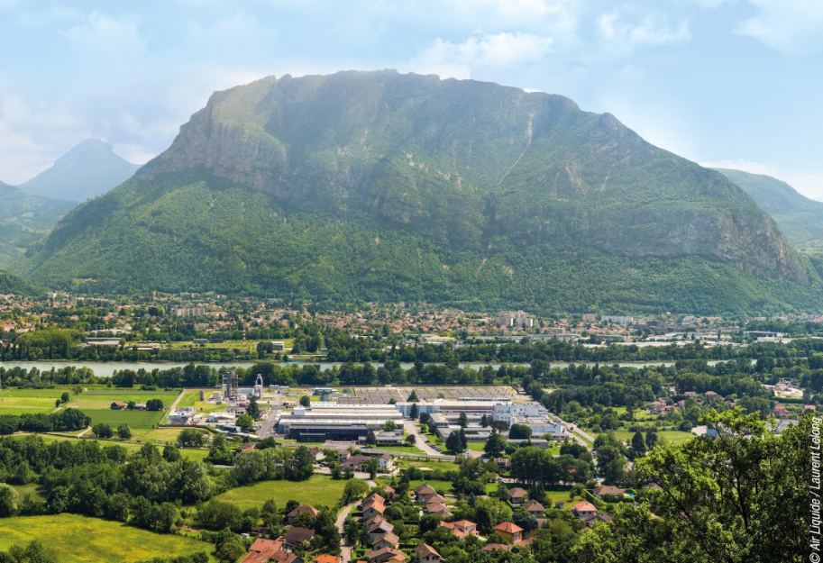
Air Liquide Advanced Technologies
Founded 1962, at present 700 people on Site
Located in Sassenage, near Grenoble in the French Alps
Advanced technologies in the Cryogenics field:
Design, Testing and Manufacturing Facilities

Slide 4
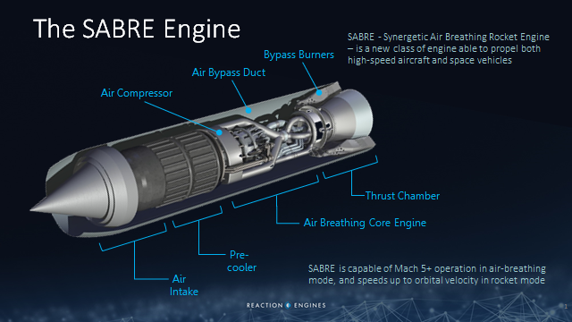
Subcooling of Liquid Hydrogen with a Cryogenic Refrigerator
The Customer Requirement
Reaction Engines Ltd (REL) of Culham, Oxfordshire, are developing the SABRE air-breathing rocket engine, which is fueled by Liquid Hydrogen.

Slide 5
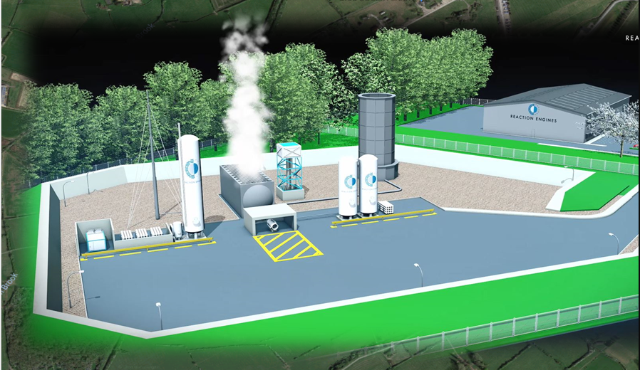
Subcooling of Liquid Hydrogen with a Cryogenic Refrigerator
The Customer Requirement
Reaction Engines Ltd (REL) of Culham, Oxfordshire, are developing the SABRE air-breathing rocket engine, which is fueled by Liquid Hydrogen.
SABRE Test Facility (SABRE TF1):
under construction in Westcott, Aylesbury, UK
to Supply SABRE with
5 kg/s of Liquid hydrogen (LH2) at 20 K (At 18 K at a later stage)
6 kg /s of Gaseous Hydrogen (at 75 barg)

Slide 6
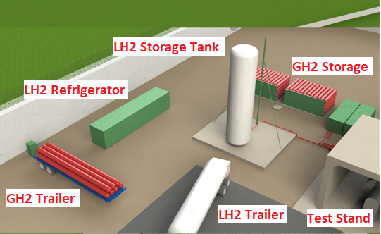
Subcooling of Liquid Hydrogen with a Cryogenic Refrigerator
The Customer Requirement
SABRE Test Facility (SABRE TF1):
to Supply SABRE with
5 kg/s of Liquid hydrogen (LH2) at 20 K (At 18 K at a later stage)
6 kg /s of Gaseous Hydrogen (at 75 barg)
LH2 Storage Tank Requirement:
Supply Two 210 second Test-Runs at 48 h interval (~ 1000 kg per run):
LH2 at 20.5 K, 7 barg
LH2 at 18.0 K, 7 barg
LH2 Temperature Control +/- 0.5 K

Slide 7
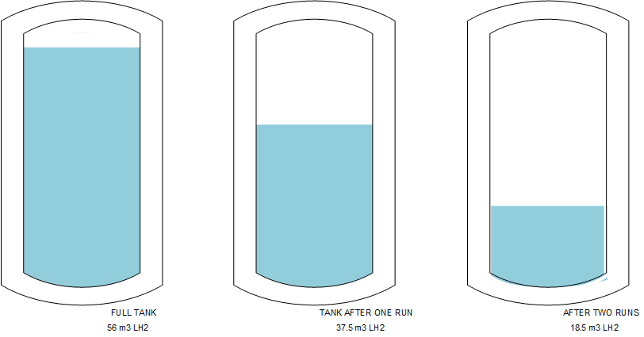
Subcooling of Liquid Hydrogen with a Cryogenic Refrigerator
Cryogenic Requirement
Supply Two 210 second Test-Runs at 48 h interval (~ 1000 kg per run):
LH2 at 20.5 K, 7 barg
LH2 at 18.0 K, 7 barg
LH2 Temperature Control +/- 0.5 K
Air Liquide’s Solution
LH2 consumption per run (18 m3):
14 m3 to fuel SABRE
4 m3 to cool down system
Storage Tank Volume: 56 m3 of LH2, i.e. two test -runs + margin
Tank Dimensions:
62 m3 Water Volume
17 m High, 3.2 m Outer diameter

Slide 8
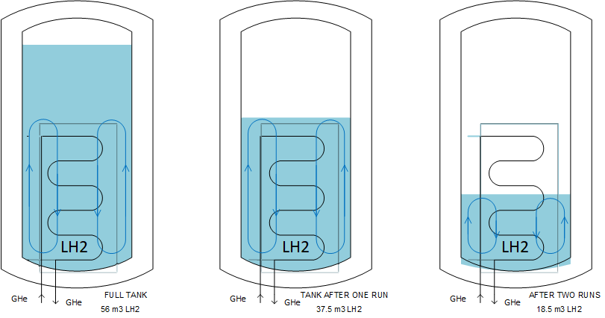
Subcooling of Liquid Hydrogen with a Cryogenic Refrigerator
Cryogenic Requirement
Supply Two 210 second Test-Runs at 48 h interval (~ 1000 kg per run):
LH2 at 20.5 K, 7 barg
LH2 at 18.0 K, 7 barg
LH2 Temperature Control +/- 0.5 K
Air Liquide’s Solution
Heat-Exchanger Coil immersed in LH2, entering tank at the bottom
Cold Helium Gas Fed to Top Coil Spiral Circulating Downwards
LH2 Cool Down stage at 1.05 bara, to avoid sub-atmospheric conditions
Cold Helium Gas Supplied by standard Air Liquide HELIAL Cryogenic Refrigerator
1.05 bara
1.05 bara
1.05 bara

Slide 9
Subcooling of Liquid Hydrogen with a Cryogenic Refrigerator
Cryogenic Requirement
Supply Two 210 second Test-Runs at 48 h interval (~ 1000 kg per run):
LH2 at 20.5 K, 7 barg
LH2 at 18.0 K, 7 barg
LH2 Temperature Control +/- 0.5 K
Air Liquide’s Solution
During the Test -Run, Room-Temperature GH2 is fed to the LH2 tank vapour dome in order to:
Pressurise LH2 Tank up to 7 barg
Drive out LH2 at 5 kg/s
GH2 stored in High-Pressure Cylinders
GH2
GH2
GH2

Slide 10
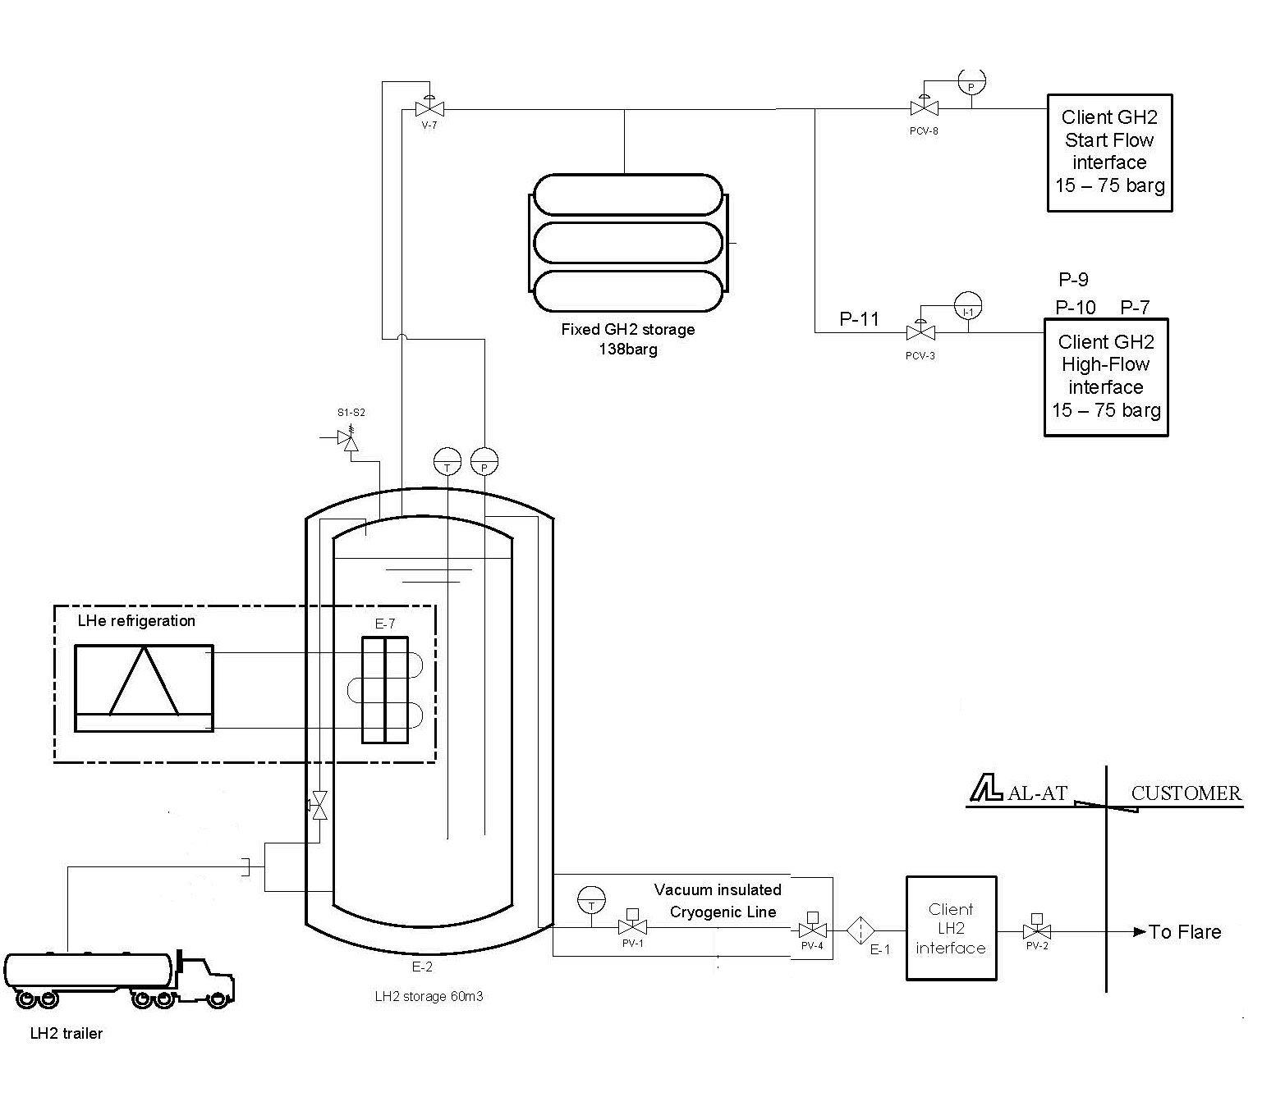
Subcooling of Liquid Hydrogen with a Cryogenic Refrigerator
Air Liquide’s Solution Description
HELIAL Cryogenic Refrigerator, including:
Helium Cycle Compressor and Oil Removal System (ORS)
HELIAL Cold Box
Cryogenic Feed Lines to Heat-Exchanger Coil
62 m3 Water Volume LH2 Storage Tank, including:
Filling Panel
Safety Panel
Cryogenic Feed Line To SABRE Test-Stand with Purge and Cooldown Systems
900 kg of High-Pressure GH2 Storage

Slide 11
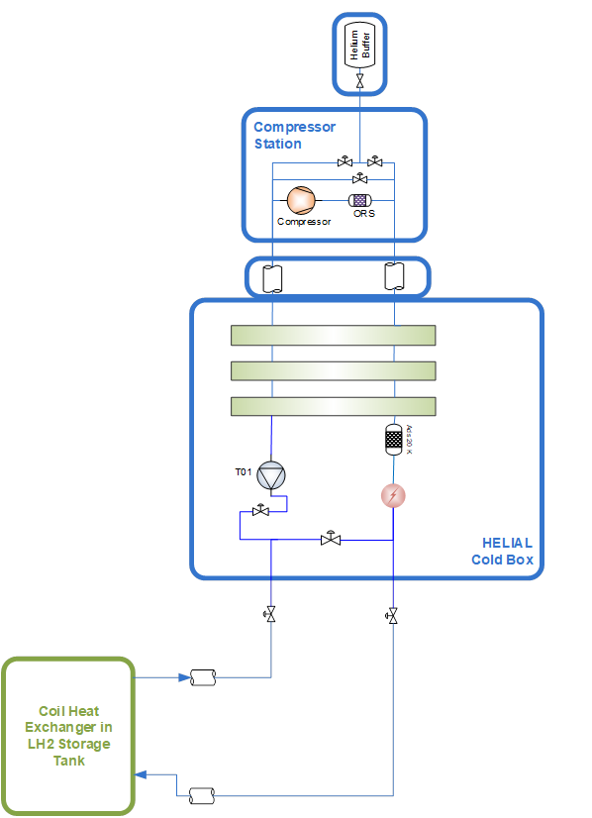
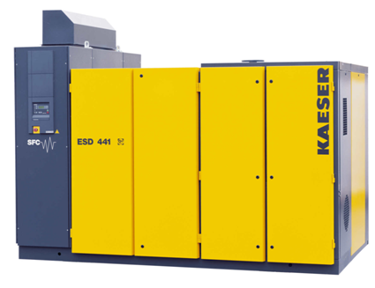
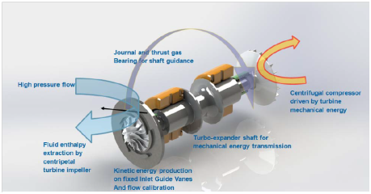
Subcooling of Liquid Hydrogen with a Cryogenic Refrigerator
Air Liquide’s Solution Description
HELIAL Cryogenic Refrigerator Main Characteristics
One static gas bearing expander
Cooling Power (with ΔT = 5 K):
1200 W at 20 K
700 W at 18 K
Power Consumption 160 kW

Slide 12
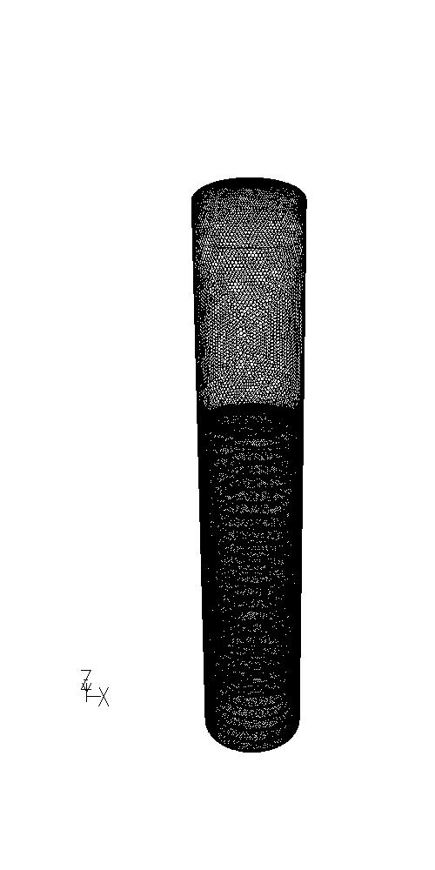
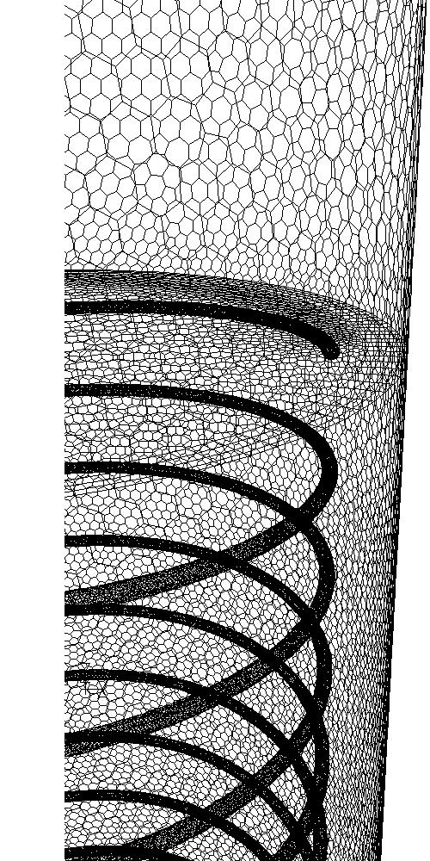
Subcooling of Liquid Hydrogen with a Cryogenic Refrigerator
CFD Simulation Results
Calculation Hypotheses:
Coil Fed by line along its centre (two calculation options : with or without heat transfer)
3D stationary simulations
Liquid Phase: Conduction and Natural Convection
Gaseous Phase: isothermal (No Convection)
Gas-Liquid Interface Heat Flow 480 W to model GH2 Condensation Heat (No Mass Transfer) .
Extracted Heat: 600 W Imposed by Heat-Exchanger Coil Surface Temperature
Initial Uniform Liquid Phase Temperature: 18K
Heat Inleaks 105 W Uniformly Distributed (Equivalent 0.5 % BOR)

Slide 13
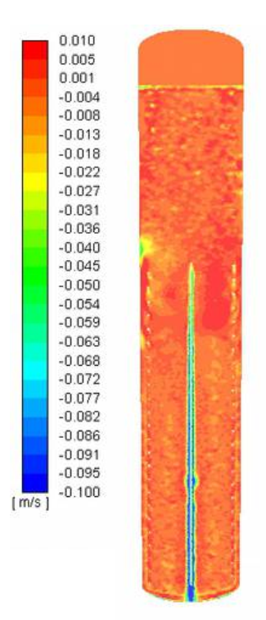
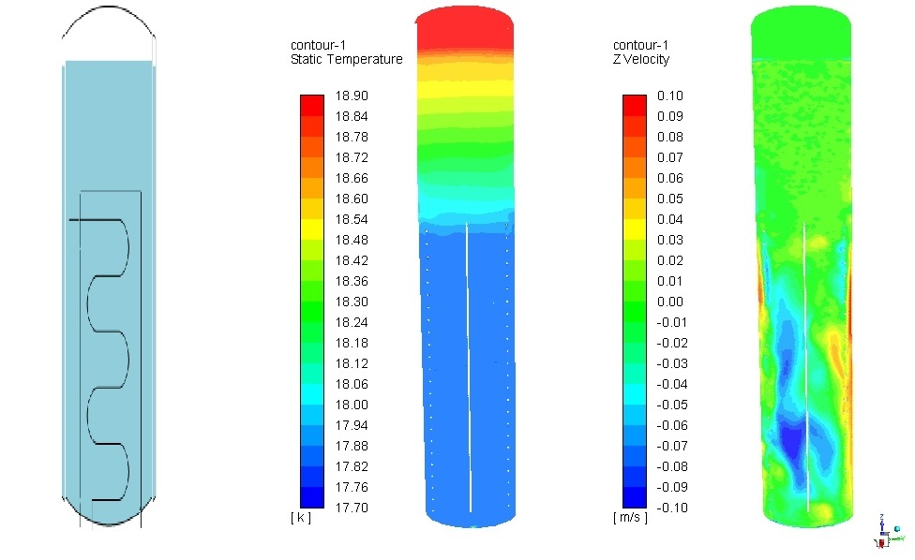
Subcooling of Liquid Hydrogen with a Cryogenic Refrigerator
CFD Simulation Results – Full Tank – with cooling on central tube
Liquid above Coil :
Stratified Temperature Profile
Temperature Variation < 0.7 K
No Vertical Movement in Liquid
Refrigerated LH2 volume:
Stratified Temperature Profile
Temperature Variation < 0.5 K
Higher Convection Flow Vz < 0.2 m/s
Falling along central tube and first tubes of coil
Rising along the walls and on vessel section

Slide 14
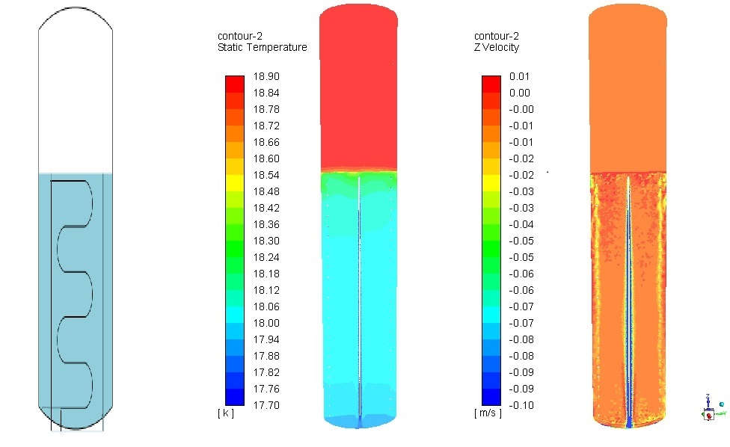
Subcooling of Liquid Hydrogen with a Cryogenic Refrigerator
CFD Simulation Results - Tank 2/3 Full (After one Test Run) – with cooling on central tube
Liquid above Coil :
NA
Refrigerated LH2 volume:
Stratified Temperature Profile
Temperature Variation < 0.4 K
Higher Convection Flow Vz < 0.2 m/s
Falling along central tube and first tubes of coil
Rising along the walls and on vessel section

Slide 15
Subcooling of Liquid Hydrogen with a Cryogenic Refrigerator
CFD Simulation Results – Full Tank – no cooling on central tube
Liquid above Coil :
Stratified Temperature Profile
Temperature Variation < 1.0 K
No Vertical Movement in Liquid
Refrigerated LH2 volume:
Uniform Temperature 17.9 K
Low-Intensity Convection Flow Vz < 0.1 m/s
Rising along the walls
Falling along first tubes of coil and other structures inside the tank

Slide 16
Subcooling of Liquid Hydrogen with a Cryogenic Refrigerator
CFD Simulation Results : Conclusions
Simple model to represent sub-cooled liquid in a LH2 tank
Liquid above Coil : Stratified ΔT = 0.7 K to 1 K
Refrigerated LH2 volume : From less than 0.1 K to 0.5 K gradient on total inventory
On the useful volume for one test run, the temperature gradient is less than 0.2 K
Within the worst condition on flow circulation (downstream on the central tube), the temperature gradient on sub-cooled LH2 is still acceptable for the SABRE project.

Slide 17
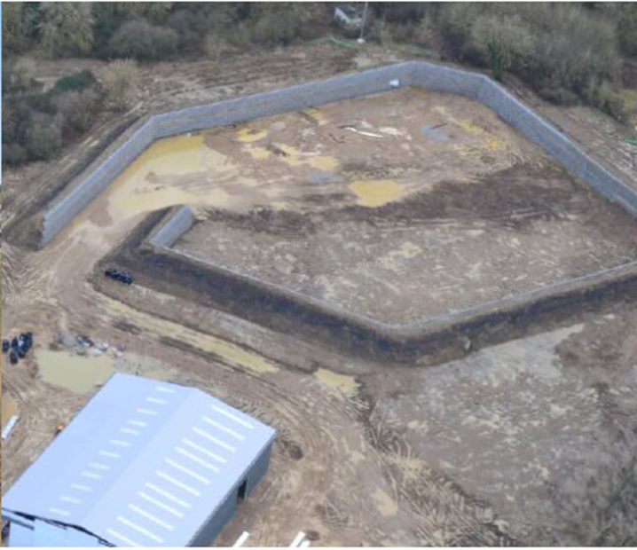
Subcooling of Liquid Hydrogen with a Cryogenic Refrigerator
Project Schedule
June 2017: REL Request for Proposal
March 2018: Contract Awarded to ALaT
May 2018: Project Kick- Off
September 2018: Preliminary Design Review
November 2018: Final Design Review
July 2019: Equipment Delivery
September 2019: Installation & Commissioning
November 2019: Site Acceptance Tests
January 2020: Start of SABRE Test Operations
SABRE TF1 Test Facility Currently Under Construction

Slide 18
Thank for your attention Questions ?

