Slide 1



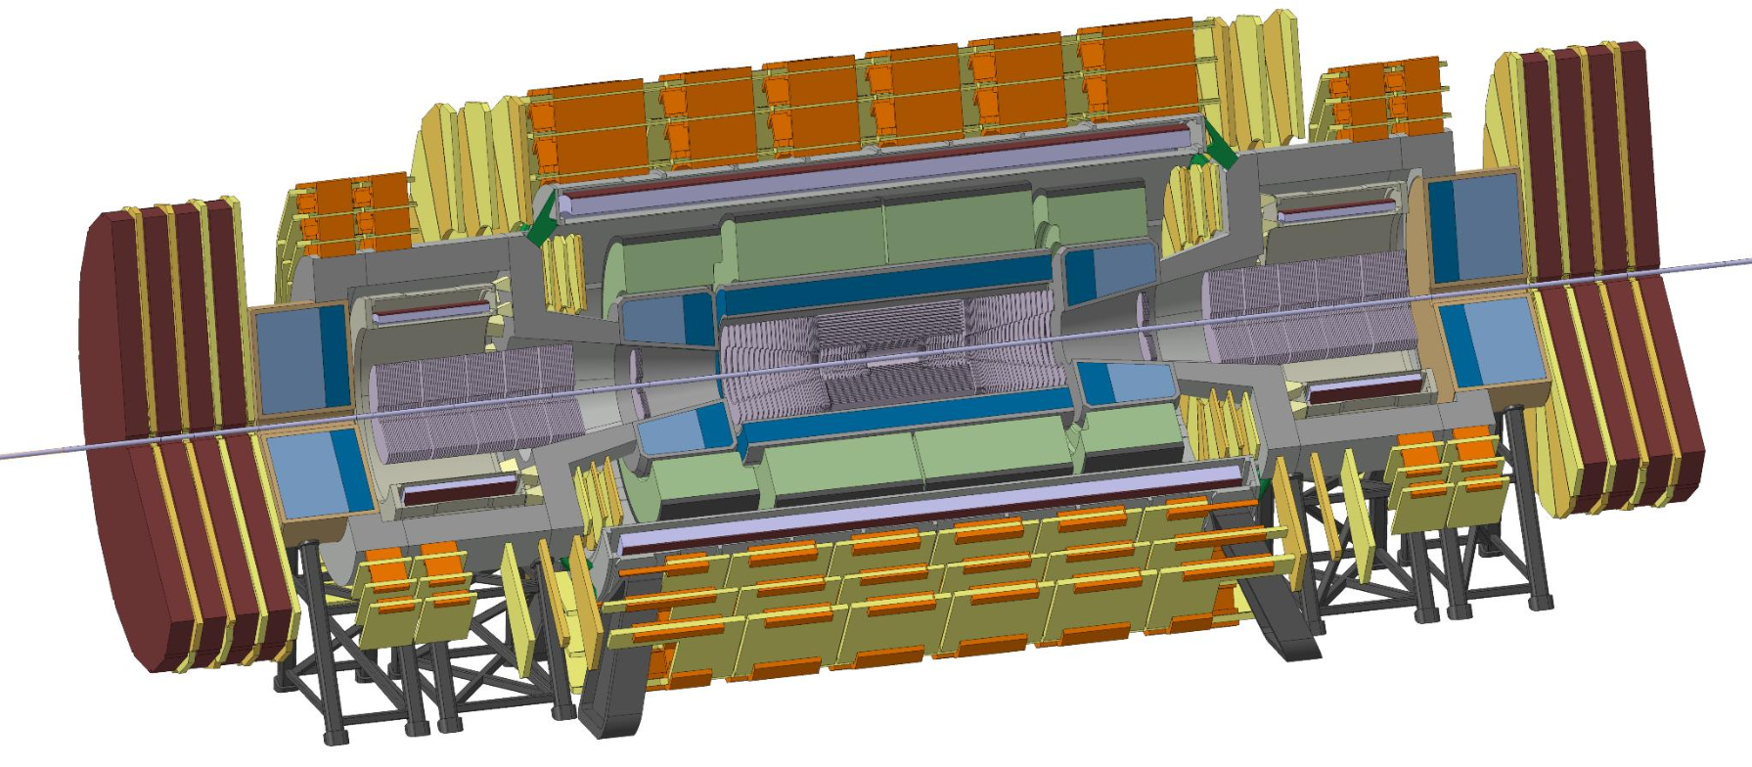
Detector Magnets for the Future Circular Collider
- Evolution towards the Baseline -
Content
From today’s LHC to next FCC
Physics requests and designs
New Baseline Detector Magnet
Ultra-thin & transparent Solenoid
Summary and outlook
Herman ten Kate
for the FCC Detector Magnets Working Group
A. Dudarev, M. Mentink, E. Bielert, B. Cure, A. Gaddi, V. Klyukhin, H. Gerwig, C. Berriaud, U. Wagner, H. Silva

Slide 2


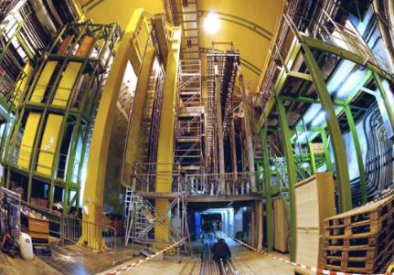
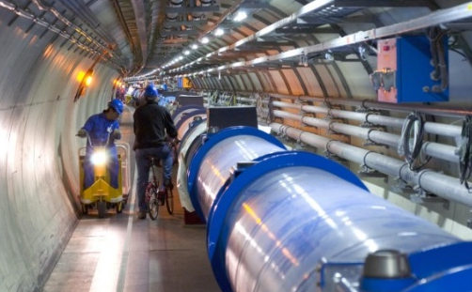
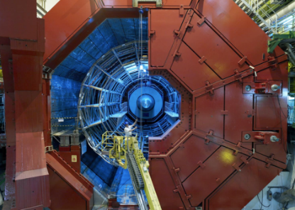

Enter a New Era in Fundamental Science
Large Hadron Collider
Start-up of the Large Hadron Collider (LHC), one of the largest and truly global scientific projects ever, is the most exciting turning point in particle physics.
Exploring the energy frontier at 14 TeV, but what is next, option FCC?
CMS
LHCb
LHC tunnel 27 km circumference
ALICE
Germany and CERN | May 2009
ATLAS
Notes:
2

Slide 3
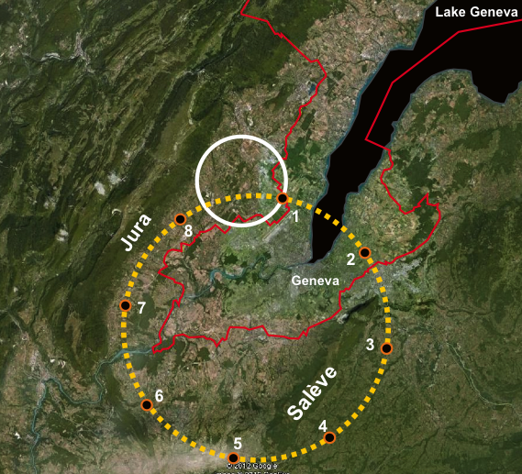
1. FCC: providing proton - proton collisions at 100 TeV
Collision Energy = 0.6 x B x R
B: 1.9 x from NbTi to Nb₃Sn
B: 2.4 x from NbTi to HTS
R: 4 x more magnets
≈ 15 T ⇒ 100 TeV in 107 km
≈ 16 T ⇒ 100 TeV in 100 km
≈ 20 T ⇒ 100 TeV in 80 km
LHC
New ≈100 km tunnel in Geneva area
100 TeV p-p determines the size
Options for staging, first an ee⁺ collider (TLEP), eventually an ep collider (VLHeC)
100 TeV p-p FCC
An extremely challenging project.
But the options shall be explored……….
………since there are no alternatives (yet)
Detectors in 300-400 m deep caverns!

Slide 4

Future Circular Collider Study
a CERN-hosted study since Feb 2014, reporting in 2019
LHC
PS
SPS
FCC
http://cern.ch/fcc
Work supported by the European Commission under the HORIZON 2020 project EuroCirCol, grant agreement 654305

Slide 5
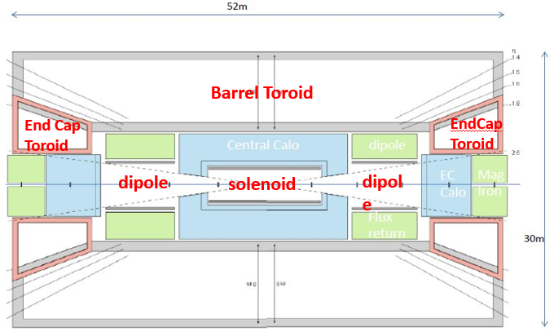
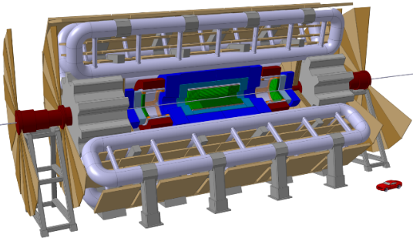
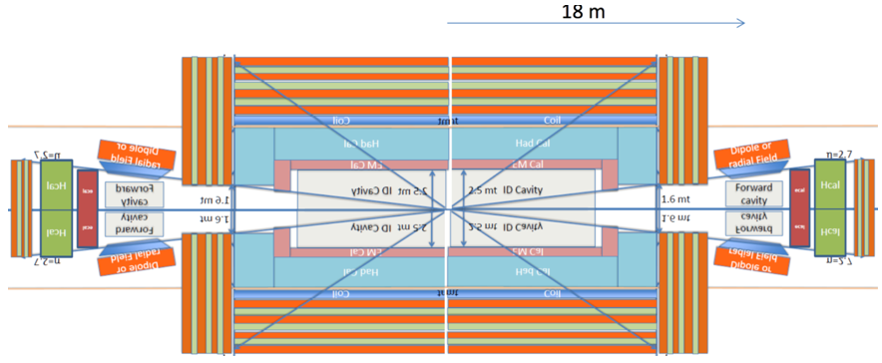
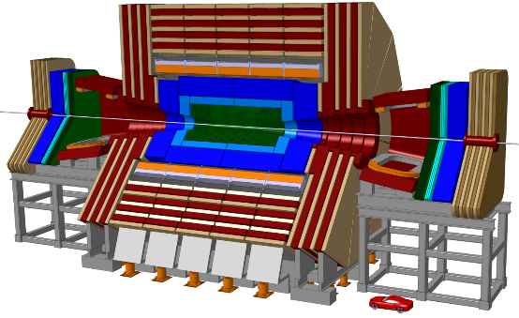
2. 2014-2015: Seeking physics demands, probing designs
FCC 100 TeV = 7x the 14 TeV of LHC, consequences?
Initial thoughts for 2 detectors:
Define CMS+ and ATLAS+ designs, but for 100 TeV
And add magnets in forward directions for 10 Tm (dipoles, solenoids)
For same tracking resolution, same σ, BL² has to go up by factor 7, in combination with thicker calorimeter, this leads to a 6T/12m bore solenoid
Similar arguments for a toroid leads to a gigantic 30m dia, 50m long system
All not affordable, too expensive (≈1 B€ magnets)!
Cure:
Standalone muon tracker not needed --> drop toroid design, define 1 detector
Assume higher tracker resolution, expected well possible (factor ≈3) --> less BL²
Limit calorimeter depth, not 12 but 11λ --> less radial thickness
Accept no magnetic shielding (cavern at -300 m) --> no iron, no shielding coil
Result:
Must lead to a baseline for Conceptual Design Review in 2019
1st ATLAS+ sketch
1st CMS+ sketch

Slide 6
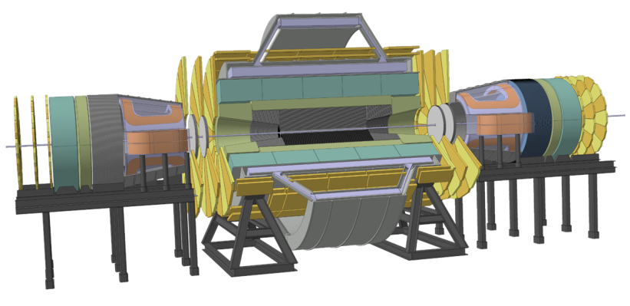
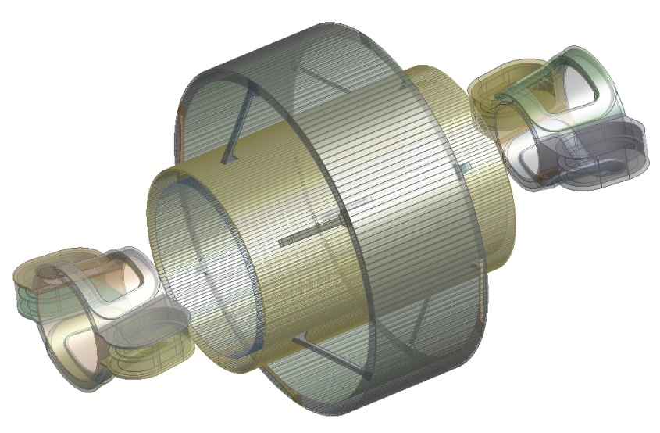
2016: 6T/12 m bore Twin Solenoid with Forward Dipoles
1st Physics-compliant design:
  Inner main solenoid generates 6 T in a 12 m free bore
  Outer solenoid returns flux --> Reduced stray field and increased bending power for muons
  Forward dipoles comprise main lateral dipole coils --> Net force and torque on each cold mass is zero
Result:
  Bending power for particle products for practically all angles
  Stored energy: 65 GJ (huge)!
  Complex combination of record-size solenoids and dipole magnets
  --> implies relatively high cost and technical risk

Slide 7
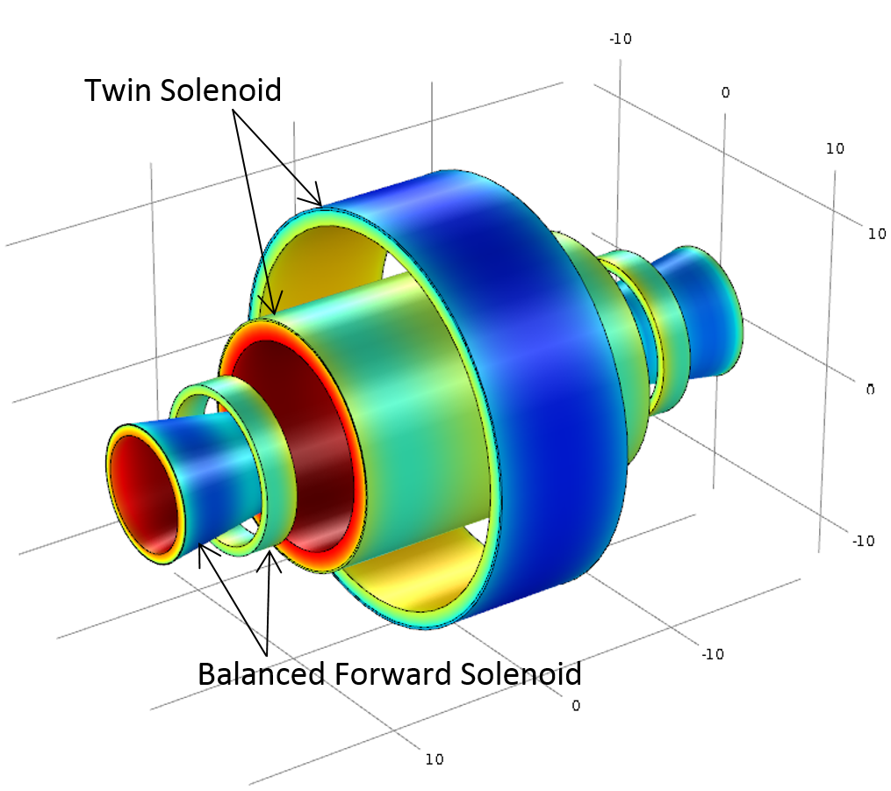
6T/12m bore Twin Solenoid with Balanced Forward Solenoids
Next step: get rid of the dipole magnets reducing risk and highly non-uniform field in transition area
Concept:
Very similar to Twin Solenoid + Forward dipoles
Combination of larger inner forward solenoid and smaller outer forward solenoid results in force and torque neutrality on every coil
Result:
Stored energy: 68 GJ
Bending power comparable to forward dipole in pseudorapidities up to 4
Radially symmetric detector magnet --> Easier particle tracking
Less complex forward magnet system implies reduced cost and reduced technical risk
Twin Solenoid + Balanced Forward Solenoid:
Net force and torque on each coil is zero

Slide 8
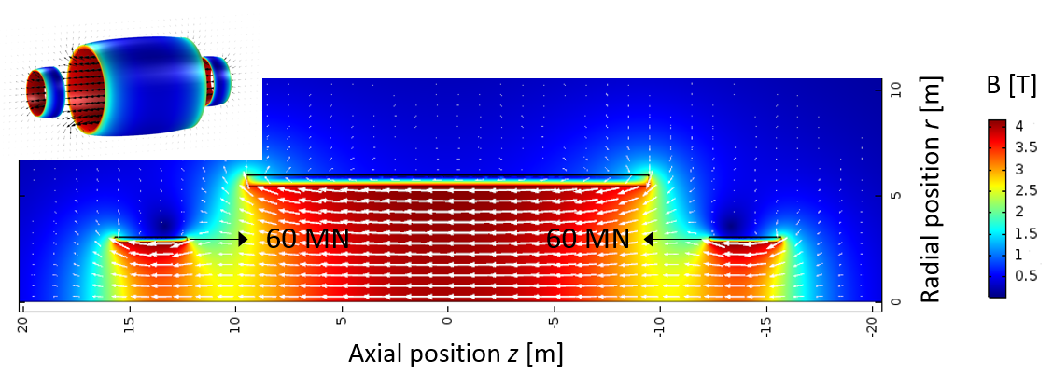
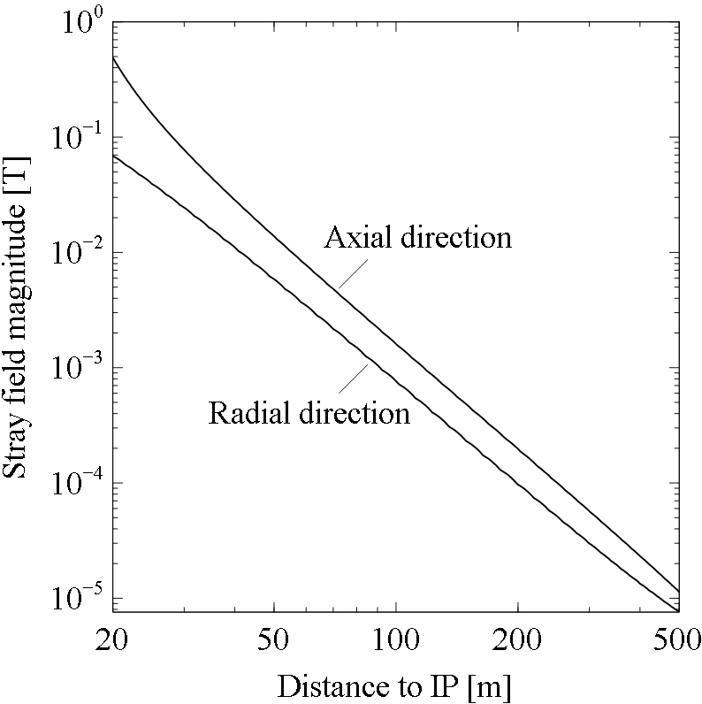
3. 2017, new Baseline: 4T/10m Solenoid & Forward Solenoids
Concept:
4 T in 10 m free bore, 18 m long main solenoid and 2 ‘forward’ solenoids
Removal of outer forward solenoids, magnetic shielding not required
60 MN net force on forward solenoids handled by axial tie rods
Result:
Stored energy: 13.8 GJ
Lowest degree of complexity from a cold-mass perspective
But: with significant stray field

Slide 9
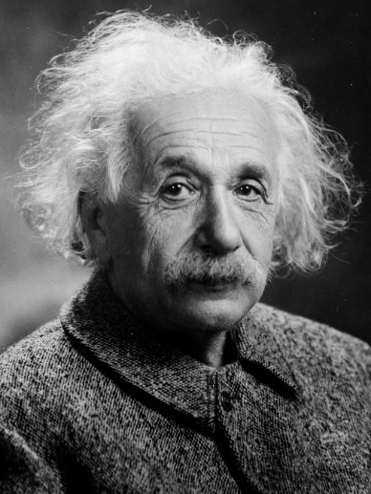
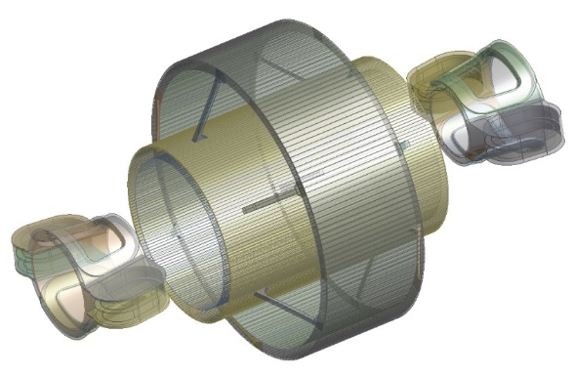

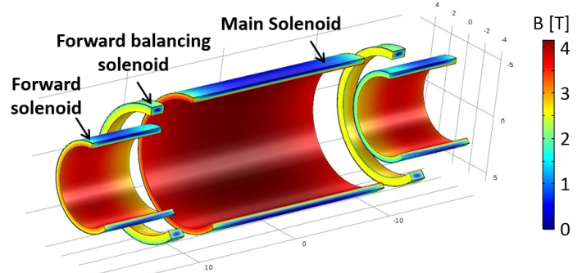
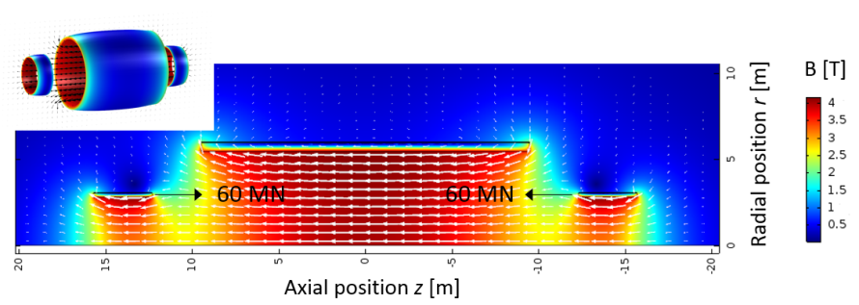
Design evolution of the FCC detector magnet baseline
Twin Solenoid +
Balanced Forward Dipoles
Everything should be made as simple as possible,
but not simpler
(Quote attributed to Einstein)
Twin Solenoid + Balanced
Forward Solenoids
Design evolution towards:
Lower stored energy, smaller, lighter designs
Less complexity, size reduction, fewer coils
More cost-effective!
Solenoid + Balanced
Forward Solenoids
Solenoid + Forward Solenoids

Slide 10
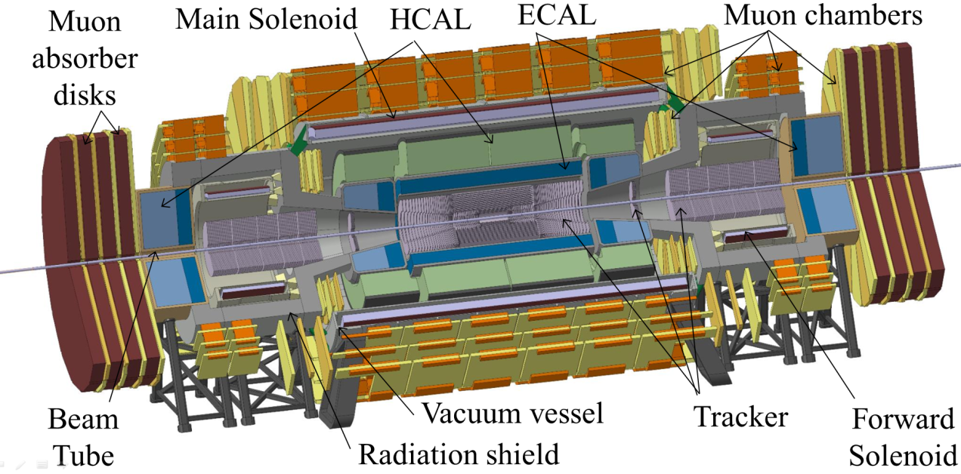
2017: New FCC proton-proton Detector Baseline
Main solenoid:
Trackers and calorimeters inside bore, supported by the bore tube
Muon chambers (for tagging) positioned outside of main and forward solenoids
Forward solenoid:
Tracker inside solenoid
Forward calorimeters after forward solenoids
Enclosed by radiation shield
(to shield muon chambers from neutrons emanating from forward calorimeters)

Slide 11
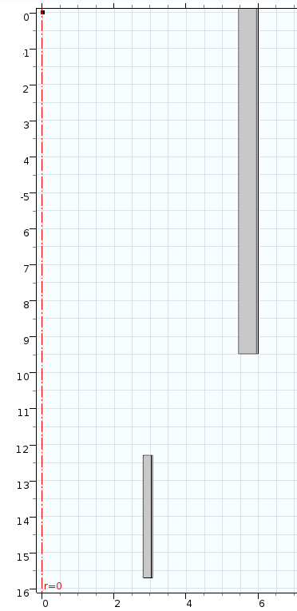
Details of 4T/10m Main Solenoid + 4T/5m Forward Solenoids
r = 6.00, z = 9.5
Composition [vol.%] | Main Solenoid | Forward Solenoid
Aluminum | 95.4 | 92.3
Copper | 0.8 | 1.6
Niobium | 0.4 | 0.8
Titanium | 0.4 | 0.8
G10 | 3.1 | 4.5
r = 5.45, z = 9.5
r = 3.07, z = 15.7
Radial position r [m]
r = 2.80, z = 12.3
Axial position z [m]
Mass per m³ cold mass [kg/m³] | Main Solenoid | Forward Solenoid
Aluminum | 2590 | 2508
Copper | 75 | 140
Niobium | 33 | 62
Titanium | 17 | 32
G10 | 56 | 81
Total | 2771 | 2823
Cold mass dimensions (cryostat not show)
Cold mass is radially symmetric and symmetric over z = 0
The main solenoid cold mass is 1070 tons, and each of the forward solenoids cold masses weighs 48 tons
Total stored energy = 13.8 GJ
Cold Mass Energy density = 12 kJ/kg

Slide 12
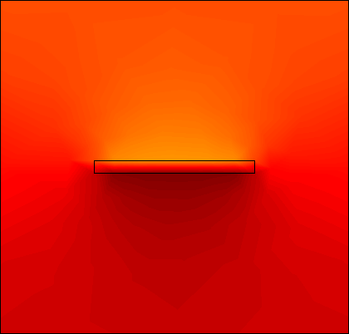
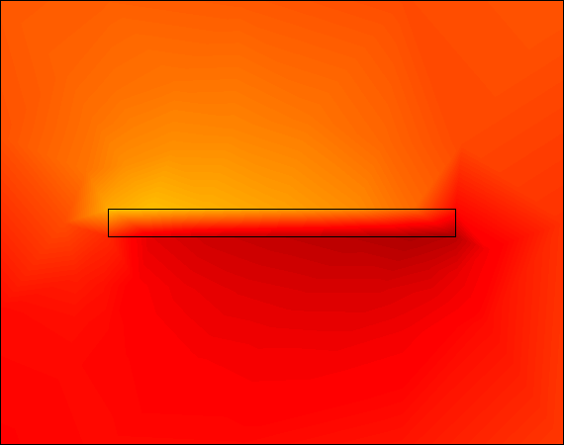
“Super” - Conductor in baseline design(indicative)
Main solenoid conductor
Forward solenoid conductor
 | Main Solenoid | Forward Solenoid
Current [kA] | 30 | 30
Self-inductance [H] | 28 | 0.9
Layers x turns | 8 x 290 | 6 x 70
Total conductor length [km] | 83 | 2 x 7.7
Bending strain [%] | 0.57 | 0.68
Al-0.1Ni
62.5 mm
38.3 mm
NbTi/Cu:
40 x Ø 1.5 mm
B
48.6 mm
65.3 mm
Aluminum-stabilized Rutherford conductors for 30 kA nominal
Peak magnetic field on conductor 4.5 T
Current sharing temperature 6.5 K
2.0 K temperature margin when operating at T_{op} = 4.5 K
Nickel-doped Aluminum (≥0.1 wt.%): combines good electrical properties (RRR=600) with mechanical properties (146 MPa conductor yield strength [1])
Peak stress on conductor is 100 MPa
1 mm insulation between turns, 2 mm to ground
[1] Yamamoto et al., IEEE Trans. Appl. Sup. 9, p. 852 (1999)

Slide 13
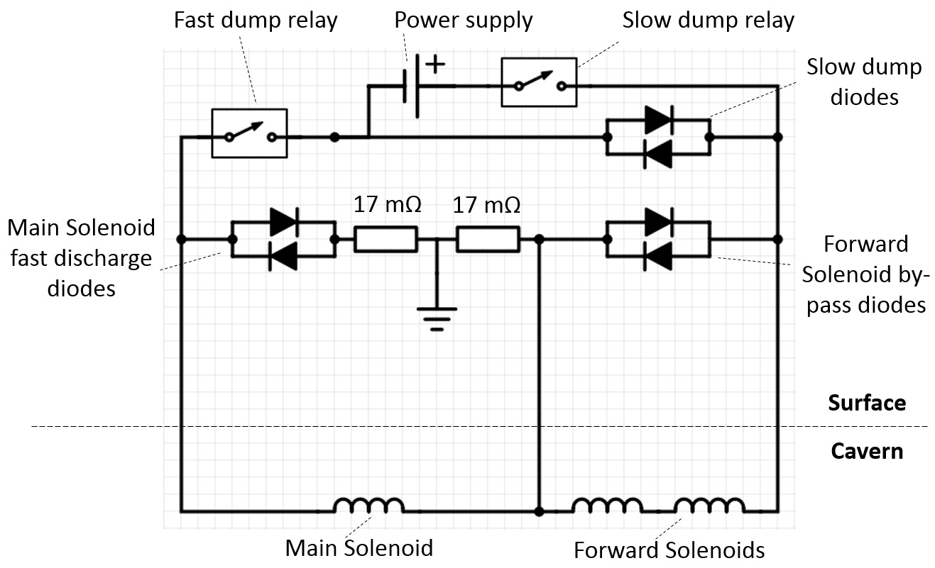
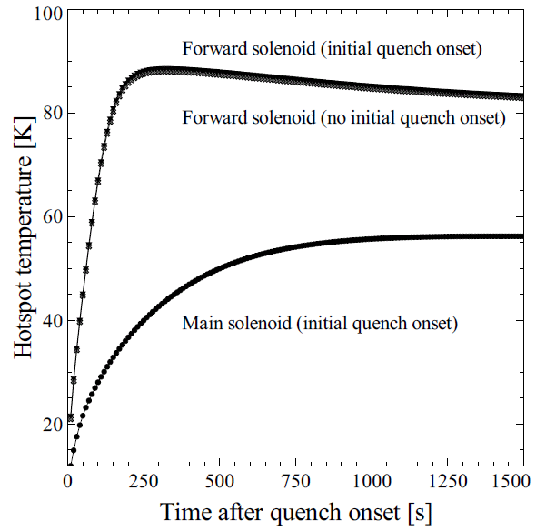
Electrical scheme and Quench protection
Electrical scheme
All Solenoids powered in series
Main solenoid decoupled from forward solenoids during quench (bypass diodes parallel to forward solenoids)
Requires three current leads
Quench protection
Conductor RRR = 400
Main Solenoid: Extraction (Quench-back) + Quench heaters
Forward Solenoid: Quench heaters
Nominal Quench: 56 K in main solenoid, 89 K in forward solenoid, 73% extraction
Worst case fault (no working heaters): 142 K in main solenoid, 133 K in forward solenoids, still safe

Slide 14
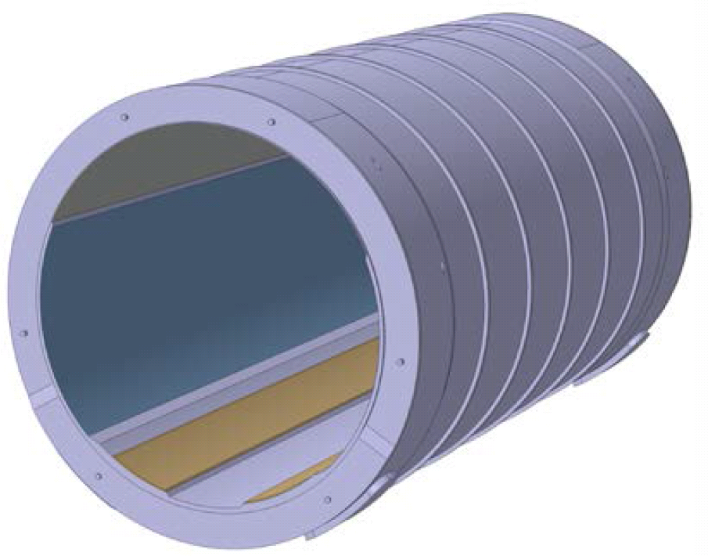
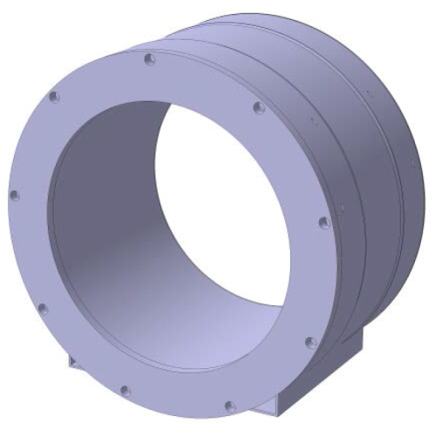
Cryostat and heat loads
Heat loads:
Radiation: 360 W on cold mass, 6.8 kW on thermal shields
Tie rods (Ti6Al4V rods, thermalized at 50 K): 20 W on cold mass, 1.4 kW on 50 K thermalization points
Acceptable heat load in tie rods, despite 60 MN net force on forward solenoids
Materials and mass:
Main solenoid cryostat: SS 304L (high strength, minimal space), 875 t
Forward solenoid cryostat: Al 5083-O (for minimal mass), 32 t
Total solenoid weights: Main 2 kt, forward 80 t (each)
Mechanical aspects:
Bore tube of main cryostat supports 5.6 kt (Calorimeters & tracker)
Bore tube of forward cryostat supports 15 t (Forward tracker)
Cryostats are sufficiently strong to withstand: 60 MN net Lorentz force; weights of the calorimeters & trackers; gravity; seismic load of 0.15g, buckling load with multiplier 5
Main solenoid vacuum vessel
Forward solenoid vacuum vessel

Slide 15
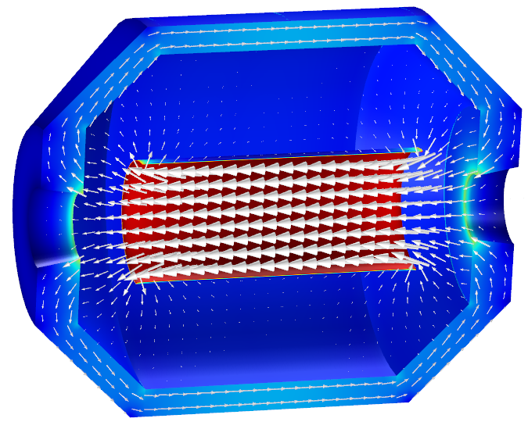
4. Challenging alternative - the Ultra-thin & “transparent” Solenoid
Motivation:
In baseline design, useful magnetic field is on the tracker + muon chambers, but most stored magnetic energy goes toward calorimeters, thus enormous “waste” of magnetic field
Solution: (concept of the 2 T ATLAS Solenoid):
Generate magnetic field on tracker & muon chambers only ---> 16x lower stored energy
Use iron yoke (6 kt) for returning flux
Provides magnetic flux for muon tagging
And perfect magnetic shielding
And Lorentz Force decoupling with forward detector magnets
But: particles go through solenoid before reaching calorimeters
Thin solenoid required for minimal interference
High-strength conductor needed
R&D currently in progress (2 PhDs) for maximum transparency of conductor, cold mass and cryostats, for FCC-hh and FCC-ee as well!
Muon chambers inside iron yoke
HCAL +ECAL
Tracker
Property | 4 m bore, ECAL out
Field in center [T] | 4
Stored energy [GJ] | 0.87
Iron mass [kt] | 6
Muon FI at η = 0 [Tm] | 1.2

Slide 16
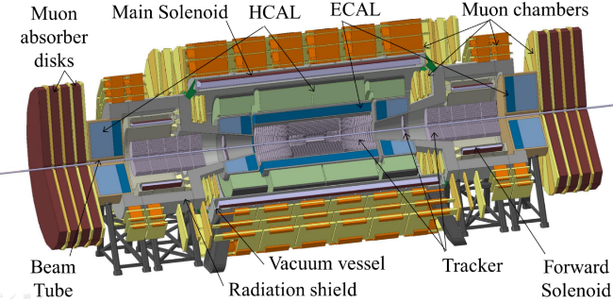
5. Conclusion & Outlook
After 3 years of iterations on physics requirements a final baseline design for the FCC-hh Detector Magnet System was accepted by the detector physics community
Evolution towards: fewer coils, all solenoids, less complexity, less risk, less weight, more space-efficient designs and lower cost (now in-line with an overall detector cost of ≈1 B€)
Baseline for the Conceptual Design Report in 2019:
  Main solenoid providing 4 T in a 10 m free bore, 20 m long
  Forward solenoids providing 4 T in a 5 m bore, 4 m long for high pseudo-rapidity particles
  Designs made for cold mass, vacuum vessel, cryogenics, electrical circuits, quench protection, et cetera. No show-stoppers identified!
An R&D program for engineering critical parts of the system is being prepared for the next step

