Slide 1
Review of failure rate input parameters
to risk analysis of cryogenic complex systems
Agnieszka Piotrowska
Wroclaw University of Science and Technology
POLAND

Slide 2
Outlines
Introduction
Risk analysis procedure
Risk assessment
Failure rates of the cryogenic systems
Conclusions

Slide 3
Risk Analysis of cryogenic system
Identification of all risks for personnel, equipment and environment caused by any failure mode of the cryogenic system
Classification of all failure modes (to determine worst case scenario)

Slide 4
Steps of Risk Analysis
Analysis of the system construction – node identification
(node: complete module of the system which can be analyzed separately)

Slide 5
Steps of Risk Analysis
Analysis of the system construction – node identification
(node: complete module of the system which can be analyzed separately)

Slide 6
Steps of Risk Analysis
Analysis of the system construction – node identification
(node: complete module of the system which can be analyzed separately)
List of the system critical components of the nodes

Slide 7
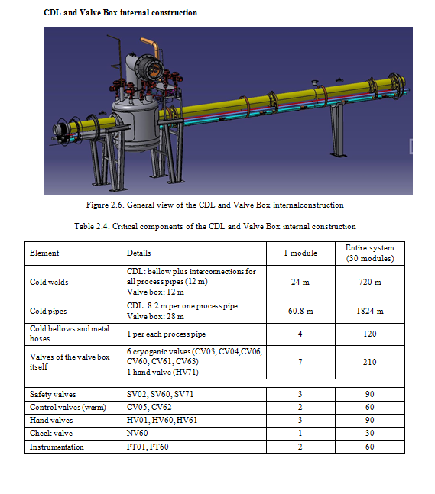
Steps of Risk Analysis
Analysis of the system construction – node identification
(node: complete module of the system which can be analyzed separately)
List of the system critical components of the nodes

Slide 8
Steps of Risk Analysis
Analysis of the system construction – node identification
(node: complete module of the system which can be analyzed separately)
List of the system critical components of the nodes
Identification of the possible failure modes

Slide 9
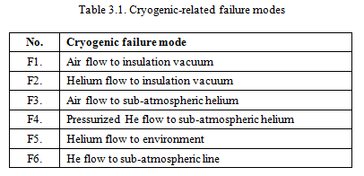
Steps of Risk Analysis
Analysis of the system construction – node identification
(node: complete module of the system which can be analyzed separately) identification
List of the system critical components of the nodes
Identification of the possible failure modes

Slide 10
Steps of Risk Analysis
Analysis of the system construction – node identification
(node: complete module of the system which can be analyzed separately)
List of the system critical components of the nodes
Identification of the possible failure modes
Identification of the potential causes of every failure mode

Slide 11
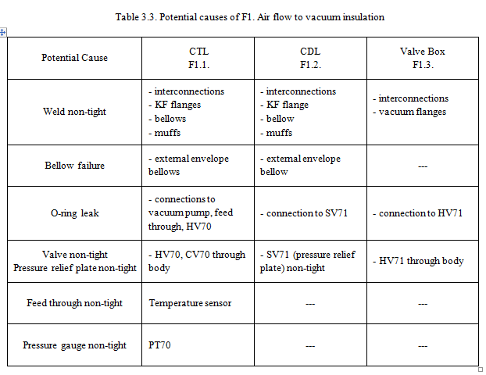
Steps of Risk Analysis
Analysis of the system construction – node identification
(node: complete module of the system which can be analyzed separately) identification
List of the system critical components of the nodes
Identification of the possible failure modes
Identification of the potential causes of every failure mode

Slide 12
Steps of Risk Analysis
Analysis of the system construction – node identification
(node: complete module of the system which can be analyzed separately)
List of the system critical components of the nodes
Identification of the possible failure modes
Identification of the potential causes of every failure mode
Identification of the consequences of every failure mode

Slide 13
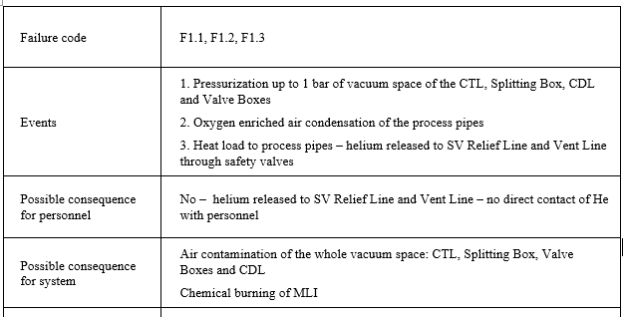
Steps of Risk Analysis
Analysis of the system construction – node identification
(node: complete module of the system which can be analyzed separately)
List of the system critical components of the nodes
Identification of the possible failure modes
Identification of the potential causes of every failure mode
Identification of the consequences of every failure mode

Slide 14
Steps of Risk Analysis
Analysis of the system construction – node identification
(node: complete module of the system which can be analyzed separately)
List of the system critical components of the nodes
Identification of the possible failure modes
Identification of the potential causes of every failure mode
Identification of the consequences of every failure mode
Risk assessment – classification of the recognized failure modes

Slide 15
What is risk?
Definition: RISK is defined as the probability of an event that causes a loss and the potential magnitude of that loss.
Risk = (failure probability) x (failure consequence)

Slide 16
Risk Assessment
Criticality rate of the failure
failure occurence rate
(based on probability data – failure rates)
severity rate to the personnel
(based on oxygen deficiency hazard)
severity rate to the system
(based on estimated time to restart system)

Slide 17
Risk Assessment
Criticality rate of the failure
failure occurence rate
(based on probability data – failure rates)
severity rate to the personnel
(based on oxygen deficiency hazard)
severity rate to the system
(based on estimated time to restart system)

Slide 18
Probability data - failure rates
Failure rate: number of failures over time
Sources of data:
Manufacturer’s data (can be too optimistic)
Statistical calculations (Chi-square distribution)
Operation data (databases)

Slide 19
Probability data - failure rates
Failure rate: numer of failures over time
Sources of data:
Manufacturer’s data (can be too optimistic)
Statistical calculations (Chi-square distribution)
Operation data (databases)

Slide 20
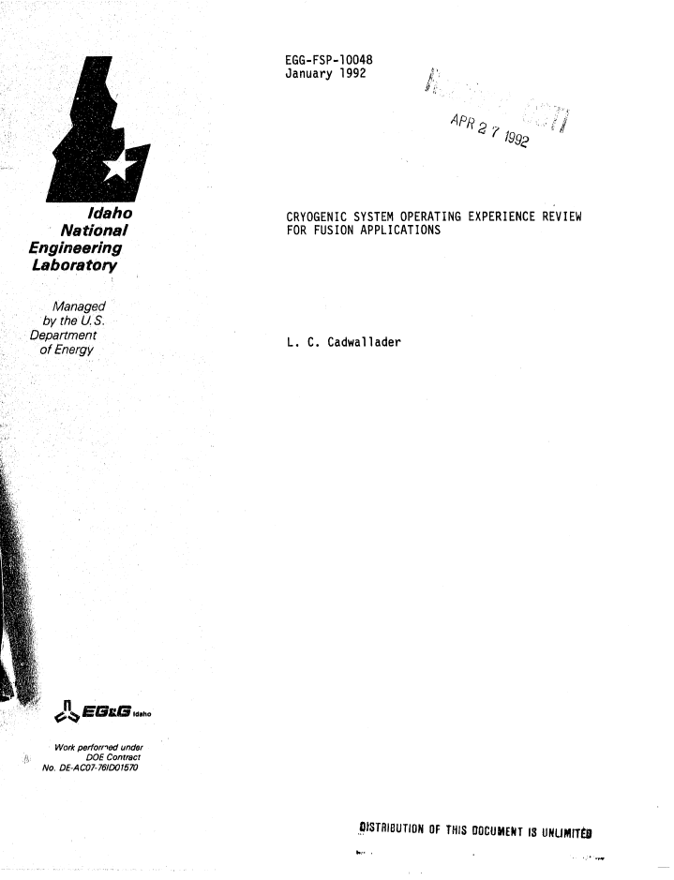
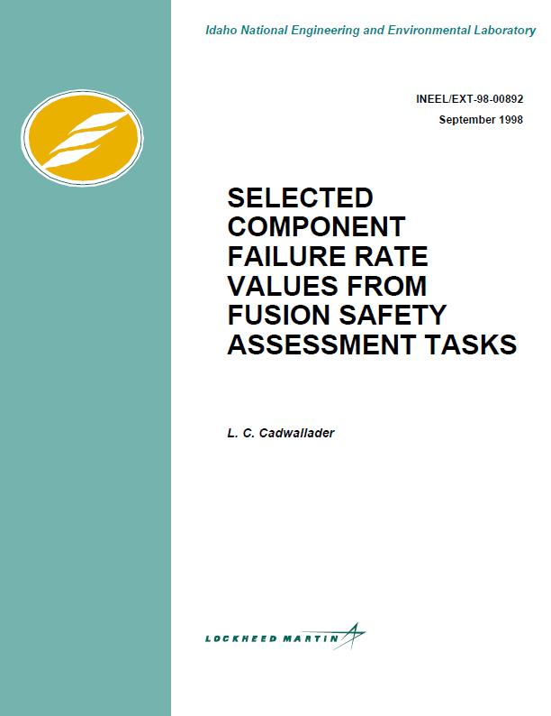
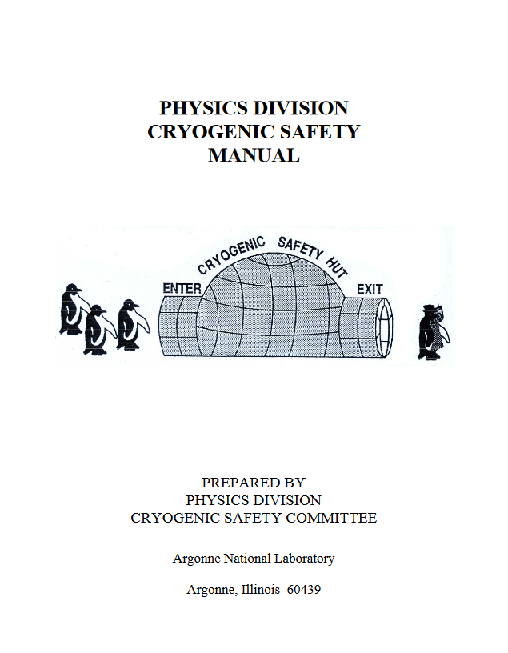
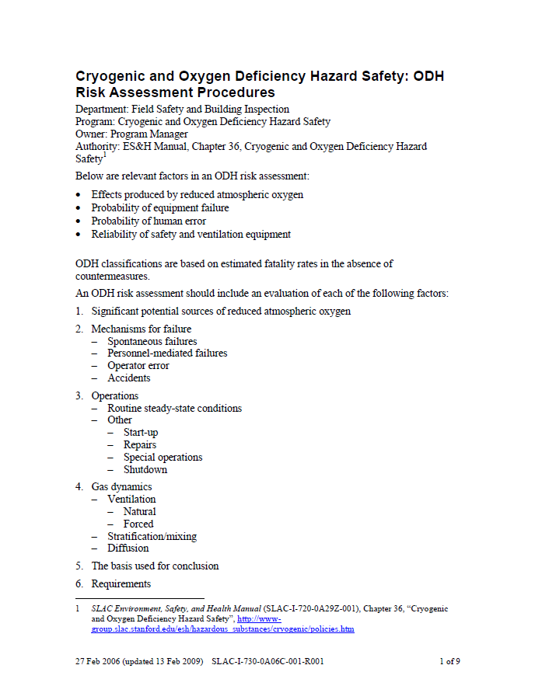
Failure rates of the cryogenic components
L.C. Cadwallader
Cryogenic System Operating Experience Review for Fusion Applications
Published in 1992
L.C. Cadwallader
Selected Component Failure Rate Values from Fusion Safety Assessment Tasks
Published in 1998
Physics Division
Cryogenic Safety Manual
Argonne National Laboratory
Published in 2001
Cryogenic and ODH Safety:
ODH Risk Assessment Procedures
SLAC
Published in 2009

Slide 21
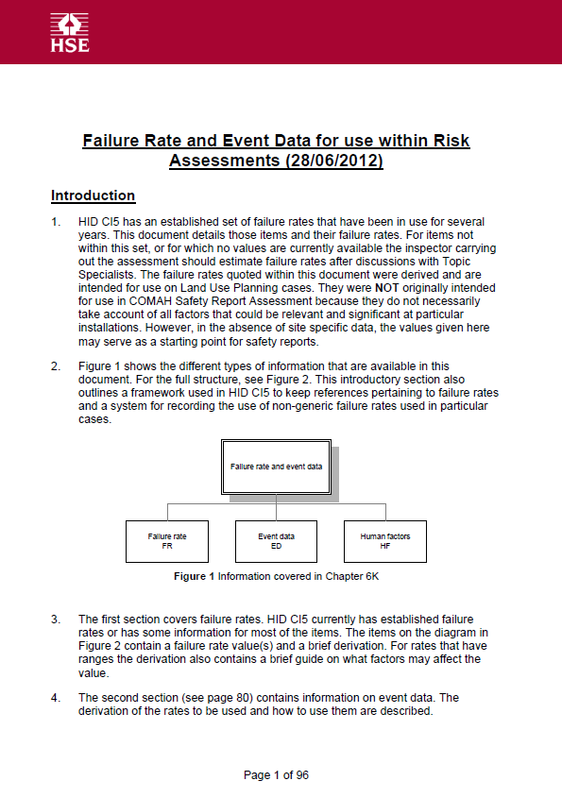
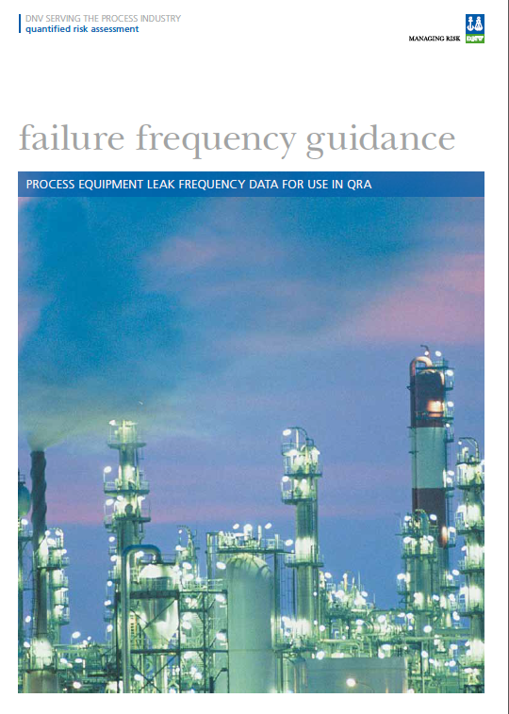
Other sources of failure rates
Failure Rate and Event Data for use within Risk Assessment
Health and Safety Executive
Published in 2012
Failure Frequency Guidance
Process Equipment Leak Frequency Data for Use in QRA
DNV
Published in 2012

Slide 22
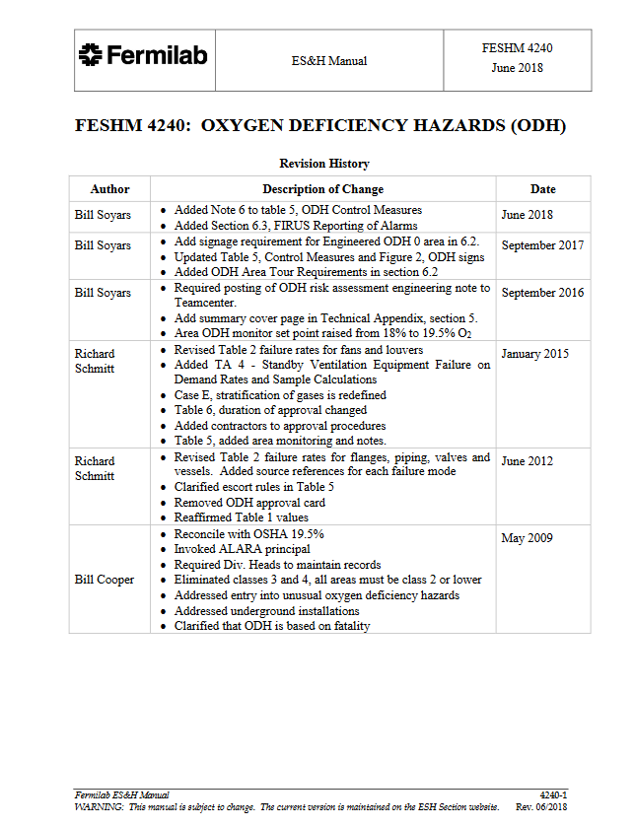
Failure rates of the cryogenic components
FESHM 4240:
Oxygen Deficiency Hazards
Fermilab
Published in 2018

Slide 23
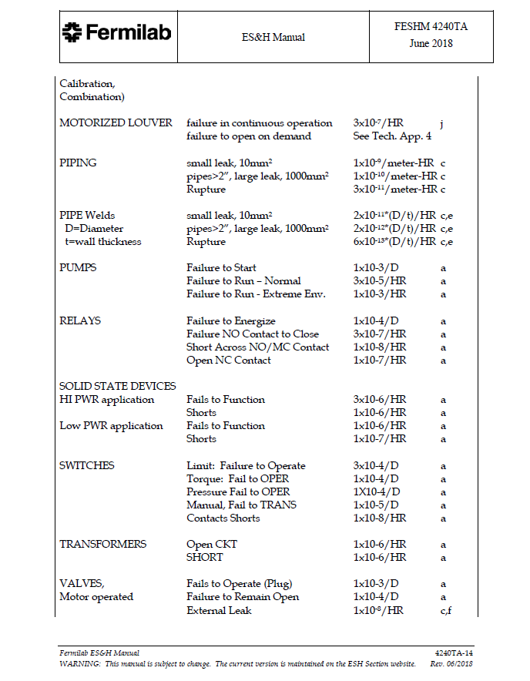
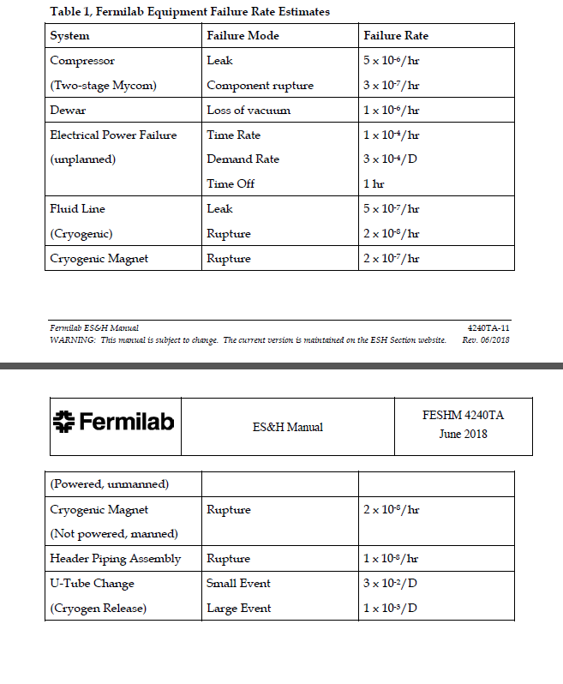
Failure rates of the cryogenic components

Slide 24
Probability assessment of the exemplary system
 |  | Cadwallader 1992 |  | Fermilab 2018
 |  | FR, 1/year |  | FR, 1/year
Process pipe | 260 m | 4.4·10⁻⁵ | 1.1·10⁻² | 8.8·10⁻⁷ | 2.3·10⁻⁴
Weld | 80 m | 5.3·10⁻⁶ | 4.2·10⁻⁴ | 1.8·10⁻⁷ | 1.4·10⁻⁵
Pneumatic valve (leak) | 30 | 5.3·10⁻³ | 1.6·10⁻¹ | 4.4·10⁻⁶ | 1.3·10⁻⁴
Relief valve (fail to open) | 24 | 1·10⁻² | 2.1·10⁻¹ | 1·10⁻⁵ | 2.4·10⁻⁴
Orifice | 24 | 8.8·10⁻⁵ | 2.4·10⁻³ | 8.8·10⁻⁵ | 2.1·10⁻³
Bellow | 80 | 3·10⁻⁵ | 2.4·10⁻³ | 3·10⁻⁵ | 2.4·10⁻³
 |  |  | 4.2·10⁻¹ |  | 5.1·10⁻³
Failure expected every 2 years 4 months
Failure expected every 195 years

Slide 25
Conclusions
Latest update on input data for risk analysis: June 2018 by Fermilab
Significant changes to failure rate values introduced
Still limited data from European Centers

