Slide 1
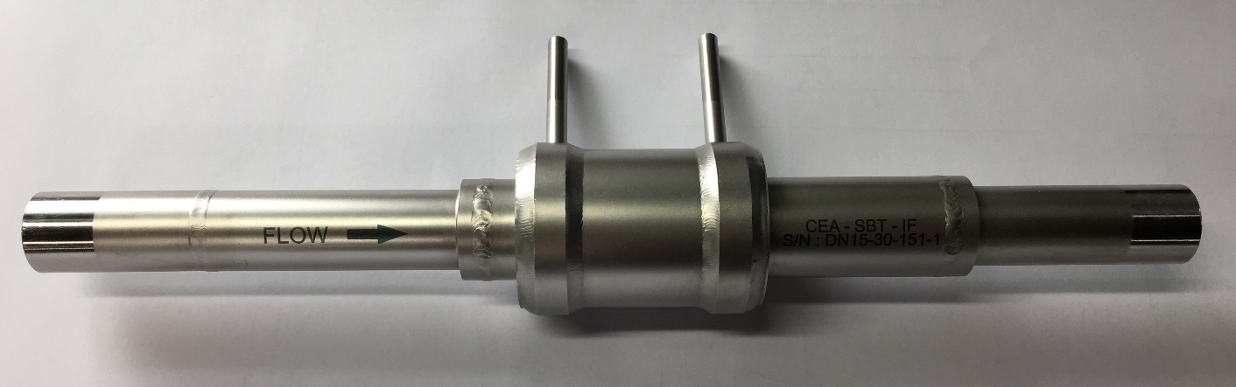
Characterization of the Venturi flowmeters for the control of ITER magnets
presented by S. Varin
S Varin¹, J–M Poncet¹, J André¹, E Ercolani¹, N Luchier¹, C Mariette¹, N Clayton², J-Y Journeaux²
¹ Univ. Grenoble Alpes, CEA, INAC-SBT, 38000 Grenoble, France
² ITER Organization, Route de Vinon-sur-Verdon, 13115 Saint Paul-lez-Durance, France

Slide 2

Introduction
Context
June 2014: Supply contract between CEA-SBT and the Magnet Division of the ITER Organization
CEA/SBT was in charge of the design, manufacturing & delivery of 277 flowmeters
June 2018: Final delivery
Flowmeters will be used to operate the superconducting magnet system of the ITER tokamak

Slide 3
Introduction
Design, manufacturing & delivery of 277 flowmeters
Reynolds number not included in the standard NF EN ISO 5167-4 (2×10⁵ < Re < 1×10⁶)
➔Experimental characterisation
➔ Manufacturing strategy
Size | Mass flowrate | Temperature | Pressure | Reynolds number | Number
DN8 | 0.1 to 1 g/s | Near 300 K | 3.8 to 4 bar | 6×10² to 6×10³ | 18
DN10 | 1 to 7 g/s | Near 300 K | 3 to 4 bar | 3×10³ to 3×10⁴ | 42
DN15.20 | 2 to 20 g/s | 4.2 to 6 K | 4 to 10 bar | 4×10⁴ to 5×10⁵ | 89
DN15.30 | 3 to 30 g/s | 4.2 to 6 K | 4 to 10 bar | 6×10⁴ to 8×10⁵ | 28
DN20 | 13 to 130 g/s | 4.2 to 6 K | 4 to 10 bar | 2×10⁵ to 3×10⁶ | 40
DN25 | 40 to 400 g/s | 4.2 to 6 K | 4 to 10 bar | 4×10⁵ to 6×10⁶ | 60
Operation of the current leads at room temperature
Control of the supercritical helium flow in the magnets

Slide 4
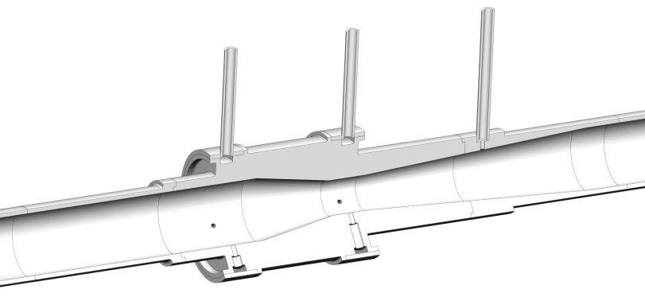
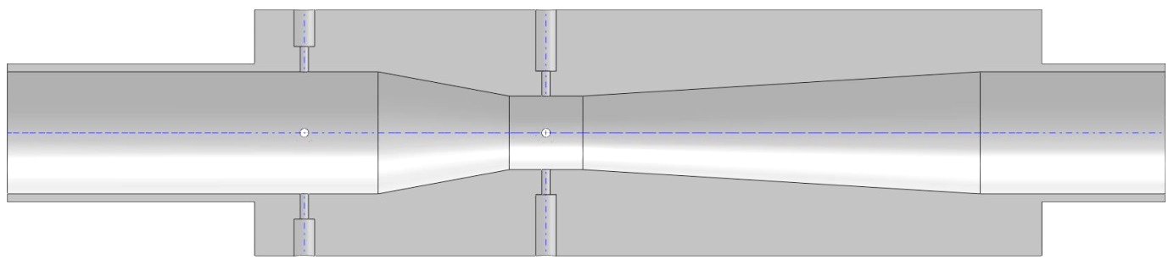
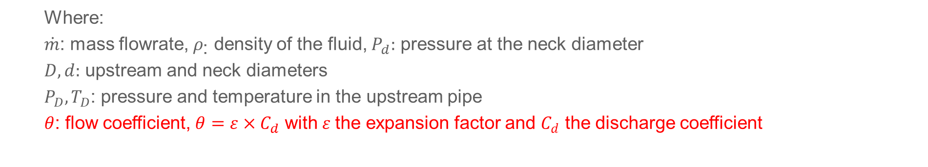
Sizing and manufacturing strategy
Sizing
Designed following the standard NF EN ISO 5167-4
d
D
21°
d
7°
Flow
$$\dot{m}=θ×\frac{π}{2\sqrt{2}}×{\left(d^{−4}−D^{−4}\right)}^{−0.5}×\sqrt{ρ\left(P_{D},T_{D}\right)×\left(P_{D}−P_{d}\right)}$$
  Where:
  $\dot{m}$: mass flowrate, $ρ_{\text{:}}$ density of the fluid, $P_{d}:$ pressure at the neck diameter
  $D,d:$ upstream and neck diameters
  $P_{D},T_{D}$: pressure and temperature in the upstream pipe
  $θ$: flow coefficient, $θ=ε×C_{d}$ with $ε$the expansion factor and $C_{d}$ the discharge coefficient

Slide 5
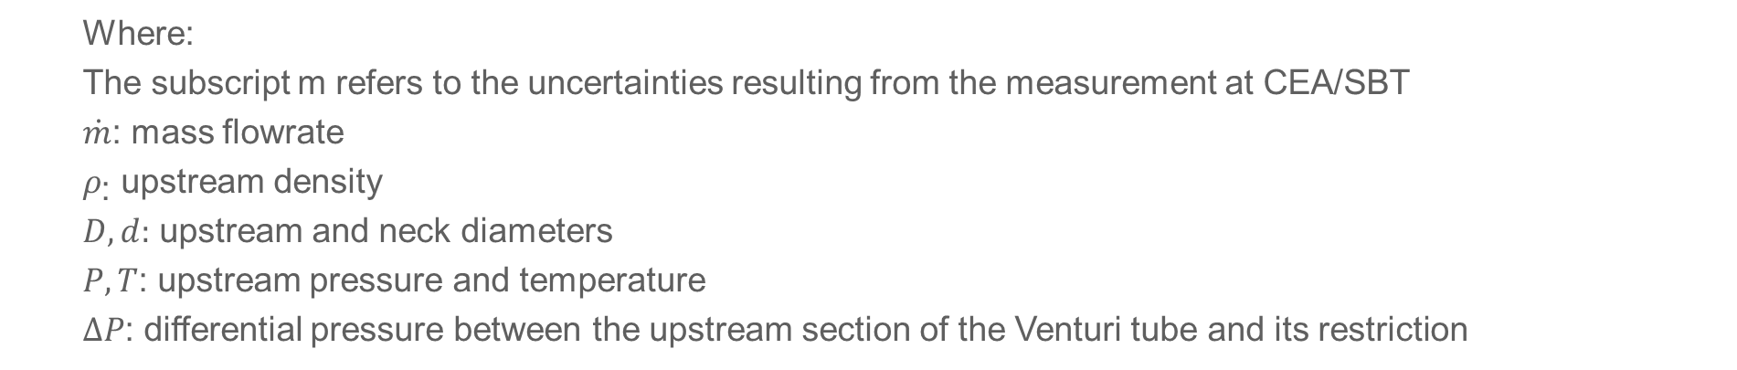
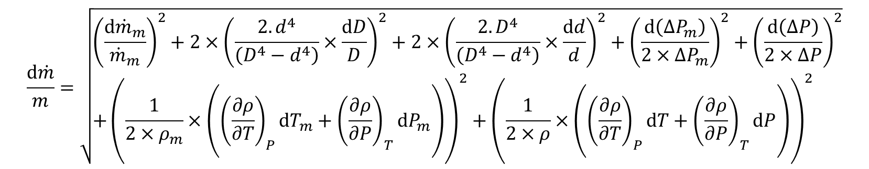
Sizing and manufacturing strategy
Measurement accuracy
$$\frac{d\dot{m}}{m}=\sqrt{\begin{aligned}&{\left(\frac{d{\dot{m}}_{m}}{{\dot{m}}_{m}}\right)}^{2}+2×{\left(\frac{2.d^{4}}{\left(D^{4}−d^{4}\right)}×\frac{dD}{D}\right)}^{2}+2×{\left(\frac{2.D^{4}}{\left(D^{4}−d^{4}\right)}×\frac{dd}{d}\right)}^{2}+{\left(\frac{d\left({∆P}_{m}\right)}{2×{∆P}_{m}}\right)}^{2}+{\left(\frac{d\left(∆P\right)}{2×∆P}\right)}^{2} \\ &+{\left(\frac{1}{2×ρ_{m}}×\left({\left(\frac{∂ρ}{∂T}\right)}_{P}dT_{m}+{\left(\frac{∂ρ}{∂P}\right)}_{T}dP_{m}\right)\right)}^{2}+{\left(\frac{1}{2×ρ}×\left({\left(\frac{∂ρ}{∂T}\right)}_{P}dT+{\left(\frac{∂ρ}{∂P}\right)}_{T}dP\right)\right)}^{2}\end{aligned}}$$
  Where:
  The subscript m refers to the uncertainties resulting from the measurement at CEA/SBT
  $\dot{m}$: mass flowrate
  $ρ_{\text{:}}$ upstream density
  $D,d:$ upstream and neck diameters
  $P,T$: upstream pressure and temperature
  $∆P$: differential pressure between the upstream section of the Venturi tube and its restriction

Slide 6
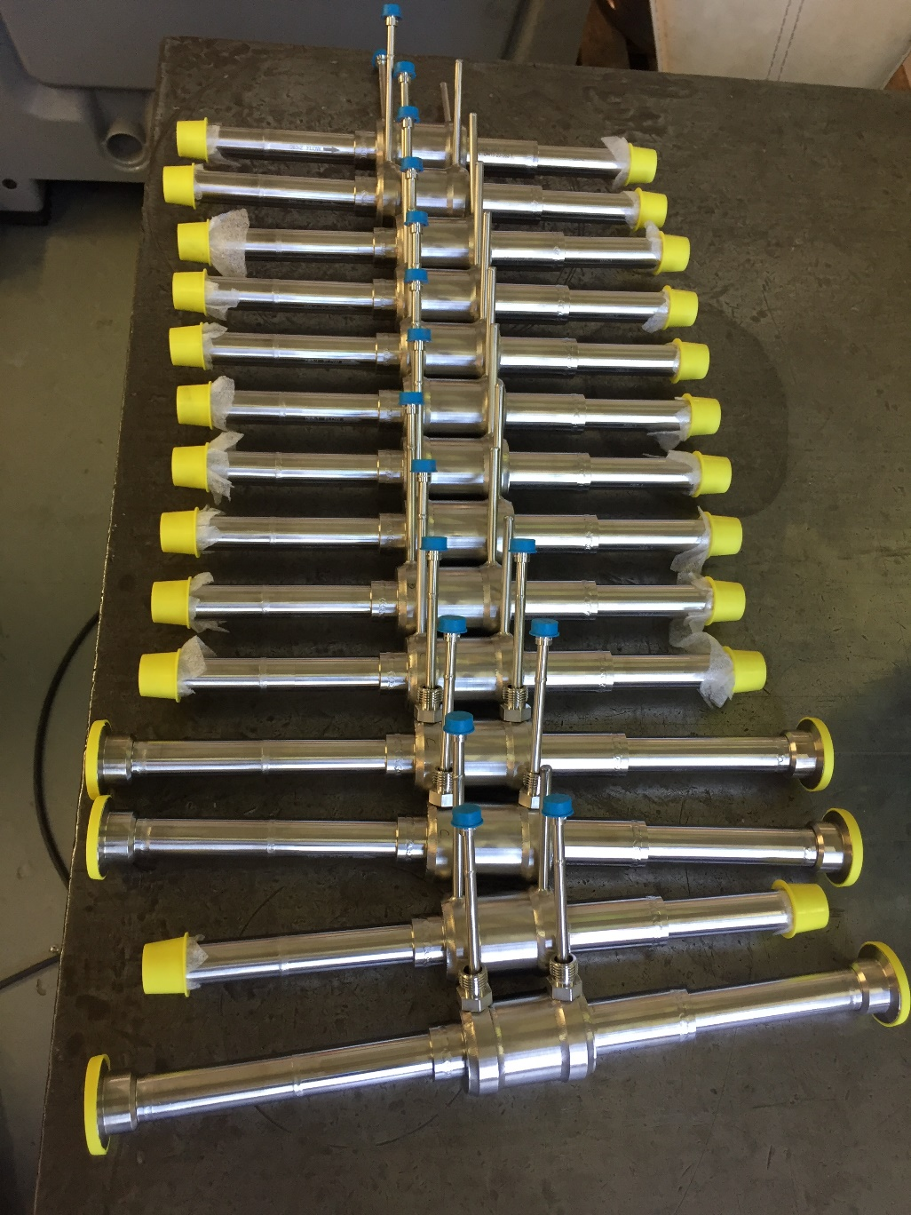
Sizing and manufacturing strategy
Manufacturing strategy
277 flowmeters ➔ avoid an individual characterization
Tight dimensional tolerances
Reproducible behaviour
Sampling measurement

Slide 7
Sizing and manufacturing strategy

Slide 8
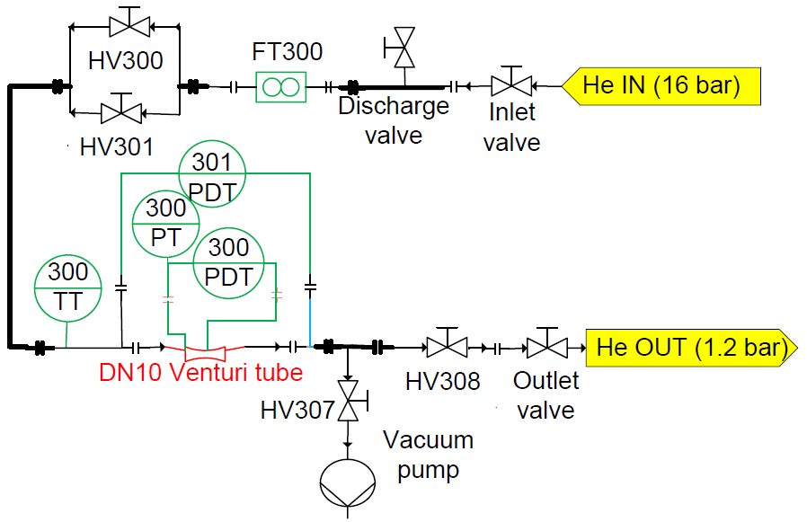
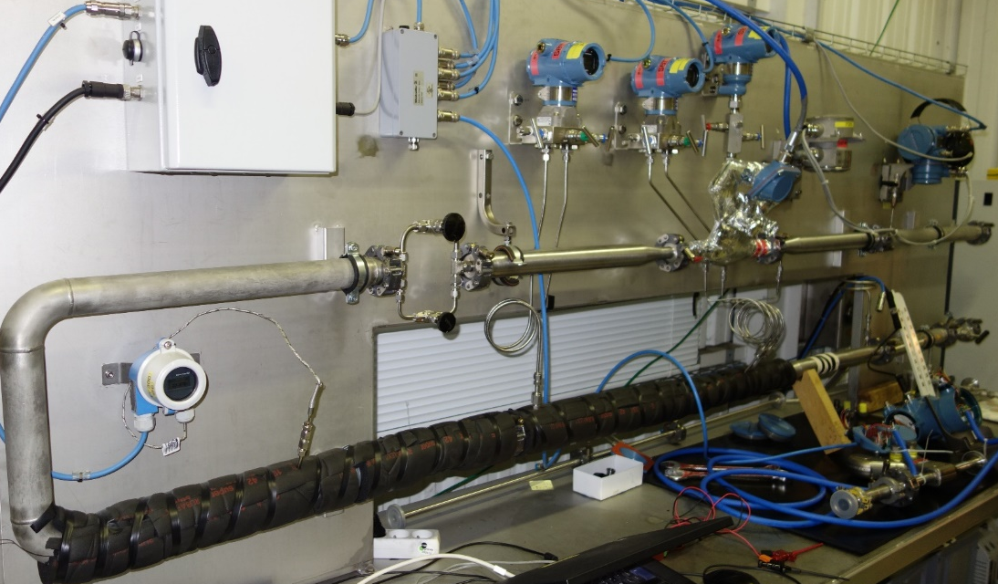
Method for the characterization of flowmeters
Warm bench
Determination of the flow coefficient by comparison with a Coriolis flowmeter

Slide 9
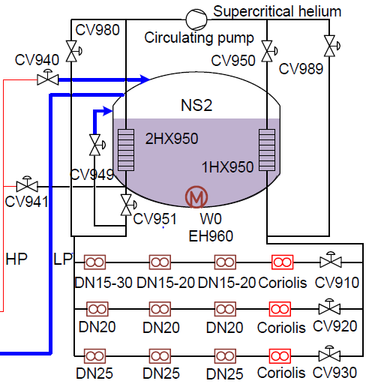
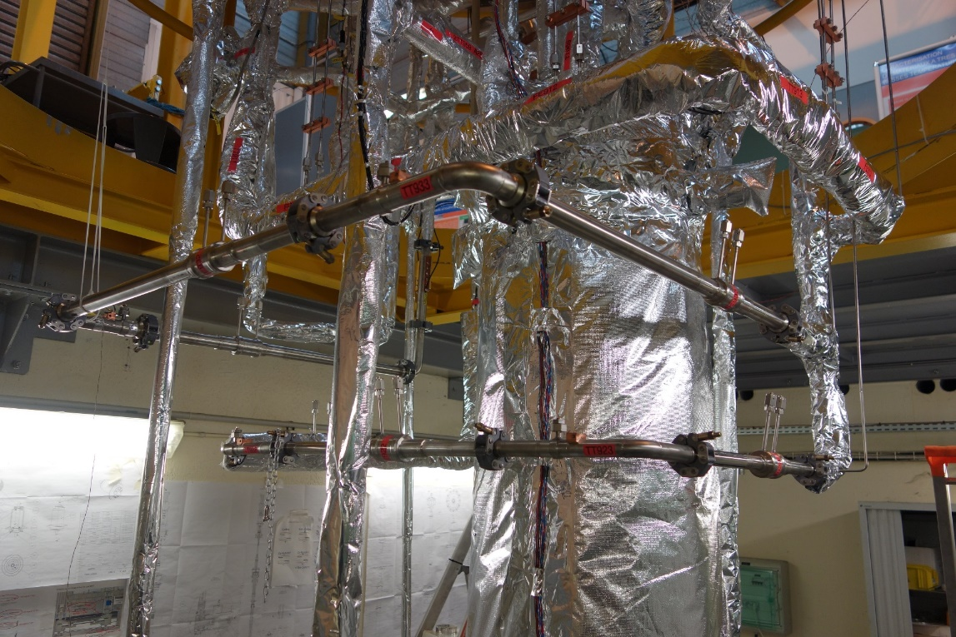
Method for the characterization of flowmeters
Cold bench
Loop cooled by a helium refrigerator producing 800 W @4.5 K
Test of 9 Venturi tubes
Determination of the flow coefficient by comparison with a Coriolis flowmeter

Slide 10
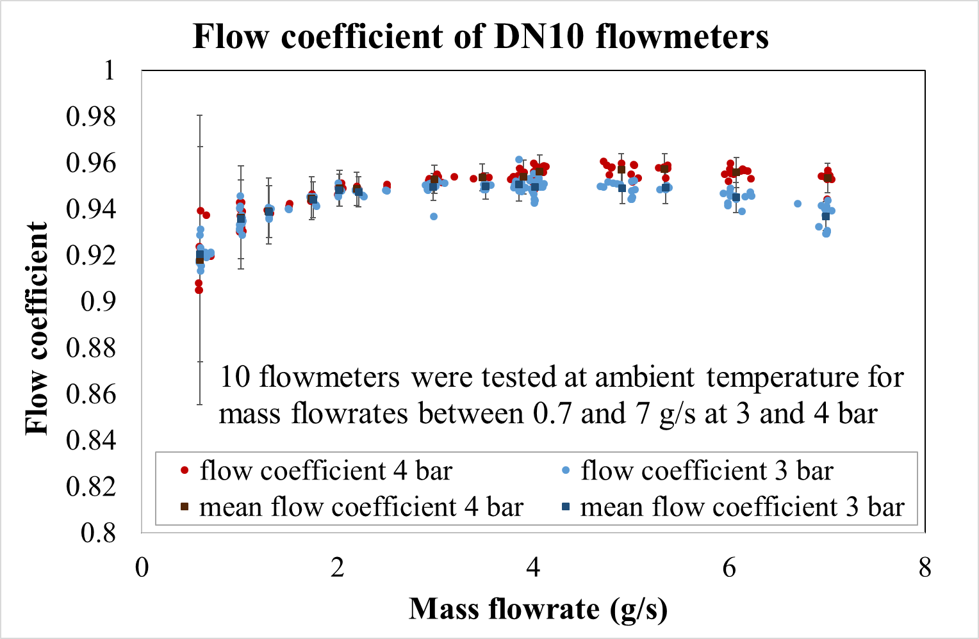
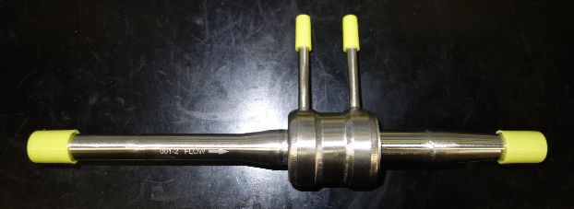
Results
Warm flow test
Test of 7 DN8 and 10 DN10 flowmeters
Influence of the pressure and differential pressure (mass flowrate) on the flow coefficient
Difference between flow coefficients of a given type of flowmeters < 2% at full-range

Slide 11
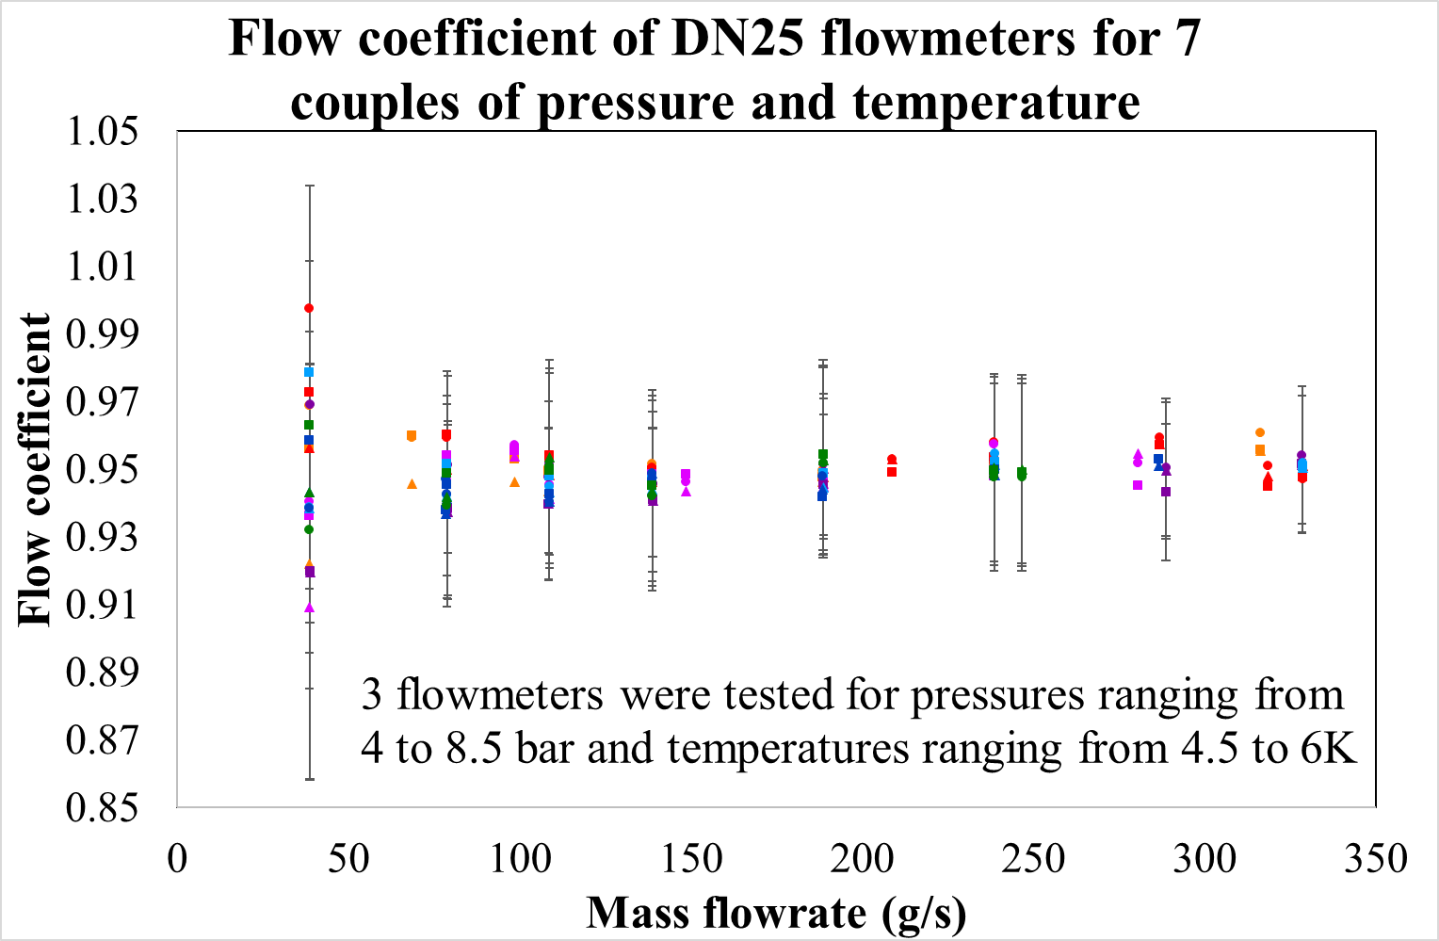
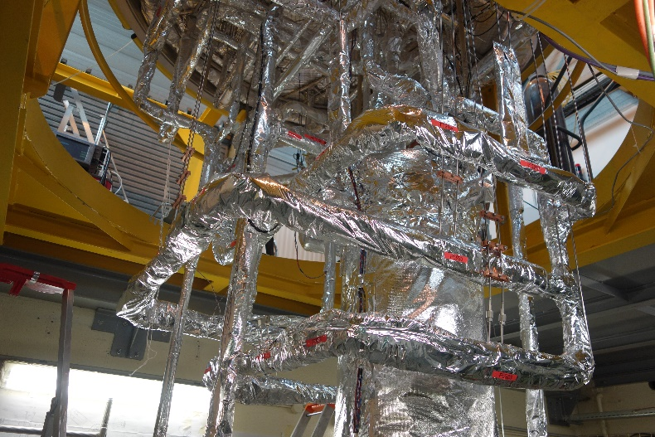
Results
Cold flow test
Test of 9 flowmeters
No influence of the pressure, temperature and mass flowrate
Difference between flow coefficients of a given type of flowmeters < 3% at full-range

Slide 12
Validation of the manufacturing strategy
Achievement of the objectives
Determine the flow coefficient
Constant values for cold flowmeters
Flow coefficient fits as a function of the differential pressure for warm flowmeters
Validate the manufacturing strategy
Reproducible behaviour (difference between flowmeters of a given type <3% at full-range)

Slide 13
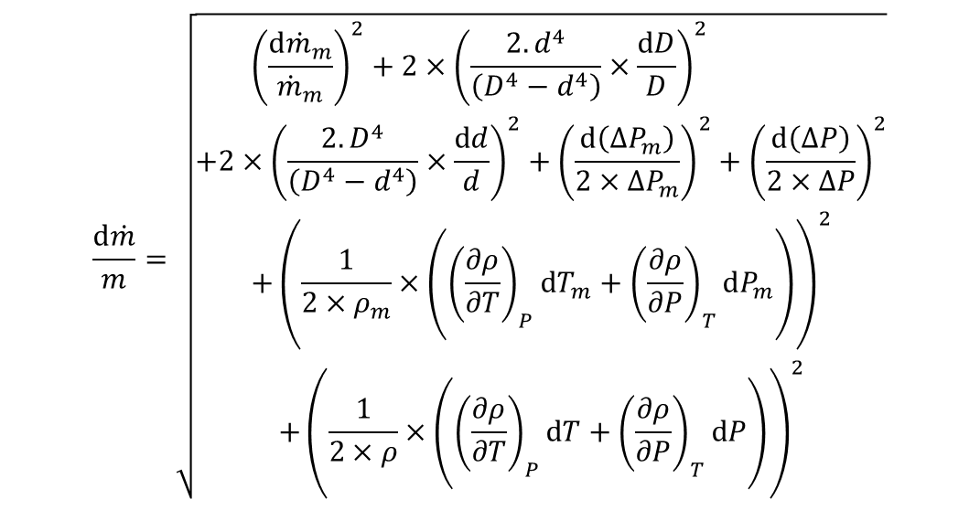
Validation of the manufacturing strategy
Probable error on the measurement of the mass flowrate
Influence of the mass flowrate on the measurement accuracy
$$\frac{d\dot{m}}{m}=\sqrt{\begin{aligned}&{\left(\frac{d{\dot{m}}_{m}}{{\dot{m}}_{m}}\right)}^{2}+2×{\left(\frac{2.d^{4}}{\left(D^{4}−d^{4}\right)}×\frac{dD}{D}\right)}^{2} \\ +2×{\left(\frac{2.D^{4}}{\left(D^{4}−d^{4}\right)}×\frac{dd}{d}\right)}^{2}+{\left(\frac{d\left({∆P}_{m}\right)}{2×{∆P}_{m}}\right)}^{2}+{\left(\frac{d\left(∆P\right)}{2×∆P}\right)}^{2} \\ &+{\left(\frac{1}{2×ρ_{m}}×\left({\left(\frac{∂ρ}{∂T}\right)}_{P}dT_{m}+{\left(\frac{∂ρ}{∂P}\right)}_{T}dP_{m}\right)\right)}^{2} \\ +{\left(\frac{1}{2×ρ}×\left({\left(\frac{∂ρ}{∂T}\right)}_{P}dT+{\left(\frac{∂ρ}{∂P}\right)}_{T}dP\right)\right)}^{2}\end{aligned}}$$
5.2
2

Slide 14
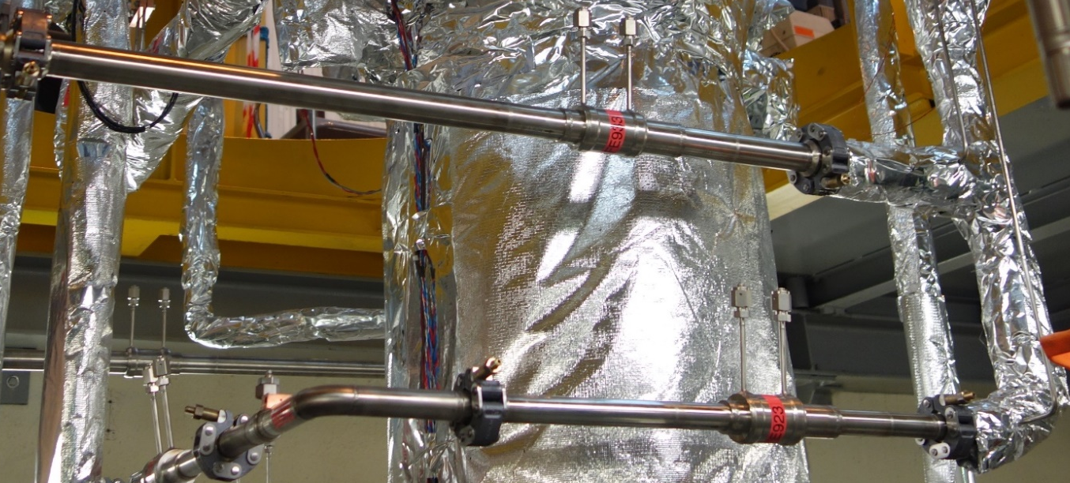
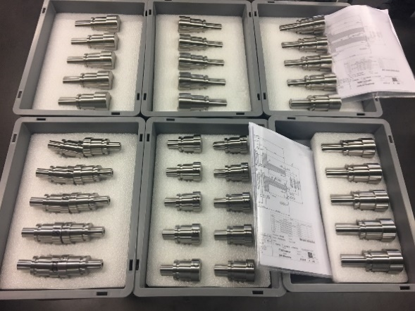
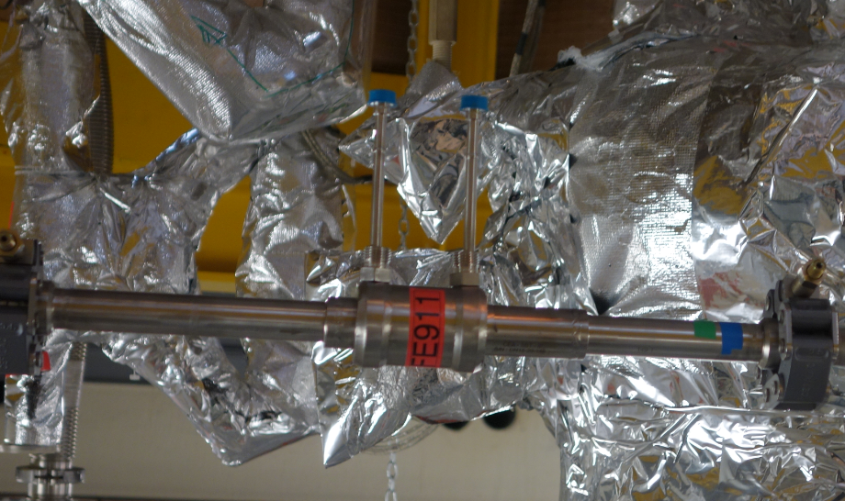
Conclusion
Conclusion
Test of 17 warm flowmeters & 9 cold flowmeters
Determination of the flow coefficient
Constant for cold flowmeters
Flow coefficient fits as a function of the differential pressure for warm flowmeters
Reproducible behaviour
➔ Validation of the manufacturing strategy
Good accuracy
➔ 2% at full-range
(except in the neighbourhood of the critical point)
The technical specifications were met for all flowmeters

