Slide 2
Implementation of Preventive Diagnostics Measures for the CERN Cryogenic System
Roberta Cirillo, Philippe Gayet, Benjamin Bradu

Slide 3
Outline
Motivation
Introduction
Methodology
Case 1: Turbine filter clogging
Case 2: Turbine wheel erosion
Challenge
Conclusions

Slide 4
Motivation
Reducing the recovery time after a failure of the cryogenic system is a major concern
Not spotted malfunction → downtime → lost availability of the accelerator

Slide 5
Introduction
The operation of the cryogenic system at CERN is fully automated.
Operators in the control room are there to
monitor
optimise the controls settings
initiate procedures when necessary
take action when a failure occurs

Slide 6
Introduction
Since the beginning of the LHC project, the control system has been made to include trending facilities and alarm system.
Results are excellent for the detection of threshold crossing and rapid perturbations.
However, due to the huge amount of information, slow perturbations can remain hidden.
Notes:
Having to deal with such a big amount of information SLOW PERTURBATION can stay hidden
Difficult to detect especially when their signatures is at the limit of detectability
MORE DETAILS ABOUT TRENDING FACILITIES AND ALARM SYSTEM
TRENDING FACILITIES →
ALARM SYSTEM → threshold traspassing ??

Slide 7
Methodology
To ease the detection process, it is better to look at a variable that highlights the signature of the faulty process
It triggers the attention faster and allows to take early mitigation measures.
These type of variables are residues.
Notes:
Residues are computed as the difference between the process data and a correspondent dynamic model output.

Slide 8
Methodology
Residue = process – model
If it is not null, it means that the behaviour of the installation is deviating from the expected one.
A portion of the cryogenic system is compared to the corresponding model.
The smaller the system, the simpler the model, the more direct the comparison.
Notes:
Process data (i.e. reality) and model output (i.e. ideal behaviour).

Slide 9
Methodology
The focus of this study is on turbines.
Residues:
The speed of the turbine (ST)
The turbine outlet temperature (T_out)
The turbine inlet pressure (P_in)
The mass-flow rate through the turbine ($\dot{m}$)
Notes:
Turbines since they are on of the most delicate components in the distribution system
The speed of the turbine is a sensitive indicator because even a relative small variation of 50 Hz
can determine the transition over a zone of criticality, affecting the performance of the rotating machine.
The outlet temperature, being measured after the decompression is a sensitive indicator since even 0.1 K of variation can translate into a big enthalpic variation,
suggesting a variation in the efficiency of the turbine.
Both inlet pressure and mass-flow rate are the first indicators of a clogging problems:
pressure that rises, or mass-flow rate that varies despite no variation in the valve opening, for instance.
ONE RESIDUE FOR EACH PORT

Slide 10
Methodology
The portion of the cryogenic system will include:
The turbine
The upstream control valve: CV210
Sensors for: mass-flow rate (FT), pressure (PT), speed (ST) and temperature (TT)
INPUT
OUTPUT
Notes:
Process data will be fed to the model in order to reproduce the same operating conditions. A few parameters though, will be left to the model to calculate in order to compute the residues.
OUTPUT are computed by the model and compared with process data (data exist anyway)
The models needed for such a study, have been realised with EcosimPro and the associated cryogenic library CRYOLIB®. The choice of these tools relies on the fact the EcosimPro® and CRYOLIB® have been validated several times and proven able to model big cryogenics systems (LHC cryogenic plant [2], JT-60SA cryogenic system [3], ITER…). Moreover, CRYOLIB® has been developed at CERN itself hence, it is somehow a natural choice when it comes to choose an environment where developing a numerical study.
The helium circuit is open, no control has been simulated. The data have been collected each hour over about two months’ time window. Knowing the time when the failure occurred, data have been gathered before and after.

Slide 11
Turbine filter clogging
Recurring phenomenon of filter clogging
If this phenomenon could be associated with a deviation on a specific residue, it will make it easier to see when some out-of-normal behaviour is taking place.
Notes:
Turbine which is part of the CMS experiment cryogenic system.
Recurring phenomenon of filter clogging which requires periodical corrective measures to be put in place.

Slide 12
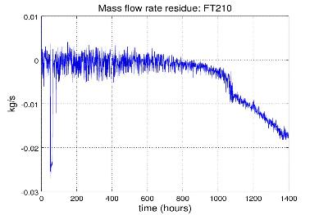
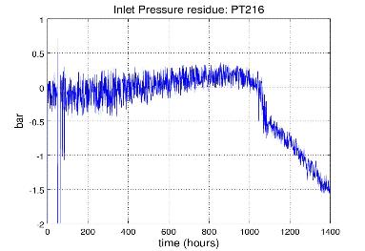
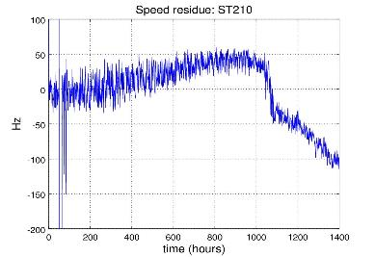
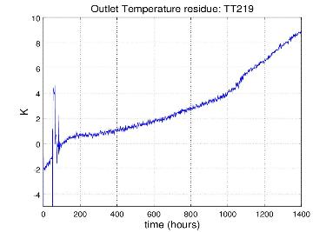
Turbine filter clogging – RESIDUES (process-model)
Mass flow rate Residue
Inlet Pressure Residue
Speed Residue
Outlet Temperature Residue
Notes:
Time window 15 july- 15 september 2017
Mass flow goes down, temperature goes up

Slide 13
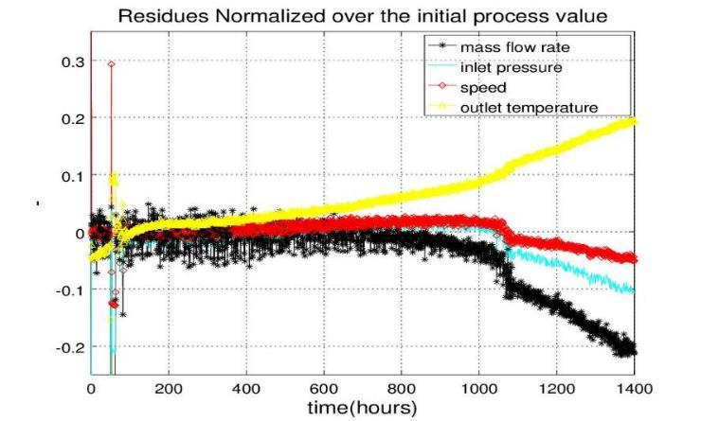
Turbine filter clogging
Residues NORMALIZED over the initial process value
+20% T_out
-20% $\dot{m}$
Notes:
It is clear already that residues are not null and this proves that there is a fault, now the question is which residue shows the sharpest deviation.
Finding an answer will tell which residue is the most relevant to watch every time a similar fault, like filter clogging, is suspected. In order to do so, all the residues have to be normalized and re-plotted
The normalization of the residues can be made either over the initial value (i.e. process data at time=0)
or over the maximum value among process data.
Both approaches have a drawback though.
The initial value can be poorly representative if the variable oscillates a lot from the beginning;
the maximum value can be flawed if there are important oscillations or maybe spikes.

Slide 14
Turbine wheel erosion
Problem of reduced velocity.
It has not been possible to push the turbine as fast as wanted for a few years.
After replacing the turbine, an erosion of the wheel was reported, explaining the lower speed.
It is an example of exceptionally slow perturbation.
Notes:
The model is the same as represented before
This case is a good test bench for the presented methodology because of the exceptionally long time window, one year, over which the abnormal behaviour has been recorded.

Slide 15
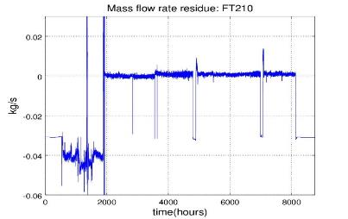
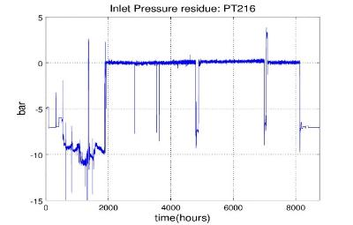
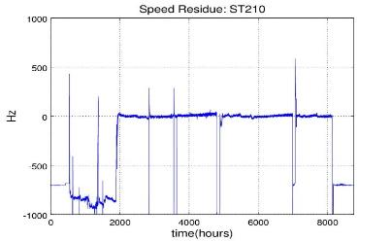
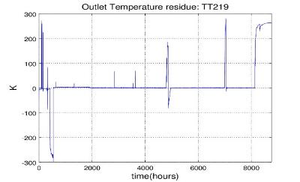
Turbine wheel erosion – RESIDUES (process - model)
Mass flow rate Residue
Inlet Pressure Residue
Speed Residue
Outlet Temperature Residue
Notes:
Residues over one year period (2010) are shown. Deviations in this case are much slower and hard to spot but they are indeed there and their rising stops any time there has been an intervention on the turbine.
They can be explained with a piling up of pollutants in the turbine filter which gets purified once the installation is stopped and warmed up for regular maintenance.
After the yearly shut down starting mid-December, about three months are needed to cool-down the whole accelerator, this explains the enormous fluctuations concerning all the residues both at the beginning and at the very end of the time window.

Slide 16
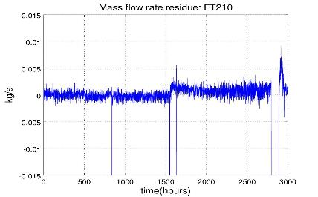
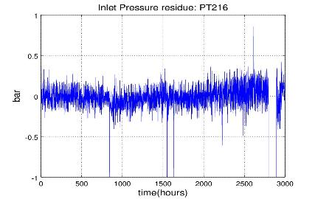
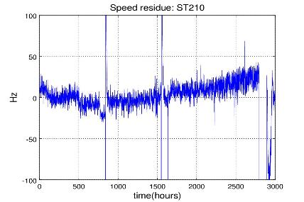
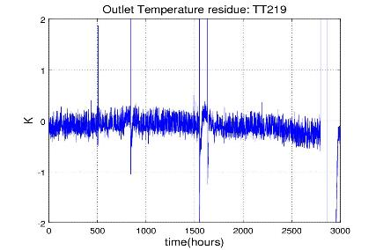
Turbine wheel erosion – RESIDUES (process - model)
Mass flow rate Residue
Inlet Pressure Residue
Speed Residue
Outlet Temperature Residue
Notes:
To better show the deviations and the normalizations of the residues, data of fig.4 have been reduced to a four months window: April-July.
I m showing data from 2010
The turbine has been changed in 2015…
Because it was not working properly…THESE RESIDUES indicated that something wrong was going on in 2010 already…
Mass-flow went up, temperature went down BUT THE SPREAD OVER THE SPEED IS WIDER hence it odes not mean that we are cooling more…
because we are not looking at variables

Slide 17
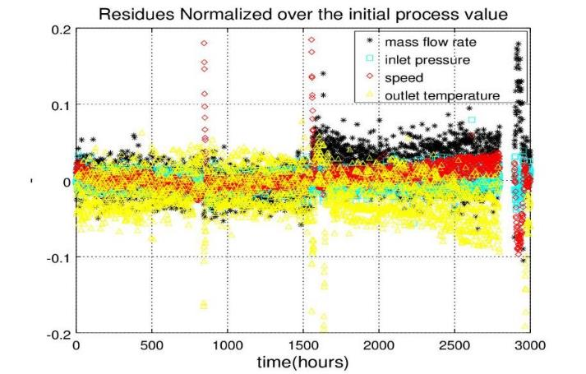
Turbine wheel erosion
Residues NORMALIZED over the initial process value
-10% T_out
Notes:
The normalization of the residues can be made either over the initial value (i.e. process data at time=0)
or over the maximum value among process data. Both approaches have a drawback though.
The initial value can be poorly representative if the variable oscillates a lot from the beginning;
the maximum value can be flawed if there are important oscillations or maybe spikes.
THE TURBINE HAS BEEN CHANGED IN 2015 !!
RESIDUES SHOWED DEVIATIONS IN 2010 ALREADY !!

Slide 18
Challenge
Difficulties can arise in the analysis, since the signature might not be totally damage-specific.
A possible solution is to look at more residues finding the one that gives an unequivocal piece of information.
More residues to plot require more process data to collect and in some case this is not possible.
Notes:
The methodology in itself is very straight forward: either there is a fault or there is not.
Signature INTENDED as ensemble of deviations of some chosen residues
Some sensors could not be put in place, or were not working properly

Slide 19
Conclusions
This type of monitoring is for sure worth to be put in place.
Can be performed either online or offline.
Even if the deviation found in a particular residue is not unequivocal, it is still a precious indicator that a faulty process is developing and will rise the attention level.
Notes:
This type of monitoring is for sure worth to be performed, as illustrated by the presented examples.

Slide 20
Conclusions
A residue is
null if everything works properly,
not null if some faulty process is going on.
It is easier to spot a null or not-null variation instead of a change in temperature, or speed, or pressure which might be mistaken for a normal fluctuation.
Can be applied to turbines, compressors, valves…
Notes:
It is easier to spot a null or not-null variation instead of a change in temperature, or speed, or pressure which might be mistaken for a normal fluctuation.

Slide 21
Thanks for your attention

Slide 23
Offset
Very often there can be an offset between process data and model output, this does not indicate a faulty behaviour.
An offset can have many explanations, for example the fact that the turbine and its filter are considered as one single object and the pressure is measured before the filter only.
It does not change the analysis which can be driven from the deviations, if present.
Notes:
The turbine and its filter, which is located just before, are considered as one single object. Their volume is considered as a whole and the pressure is measured before the filter only. But this, does not change the analysis which can be driven from the deviations, if present.
OR it can simply be AN OFFSET ON THE SENSOR
GENERAL QUESTIONS
* How did CERN manage «preventive diagnostics» so far? Is this a new thing?
YES INDEED, it is a completely new approach
* How do youplan to integrate this «residue info» in t^he existing structure of monitoring tools?
NOT EASY . In same cases, like the «filter clogging» kind of problem it can be done ONLINE (quite steep slope, not too slow perturbation: 2 months, but effects are visible even before)
In cases like the «wheel erosion» kind problem, maybe it is better to perform the check OFFLINE given the very slow developement of the faulty process
Doing some statistics can help in cleaning the signals → for the future.
(AVG, MEAN, STD Deviation, White noise spectrum)

Slide 24
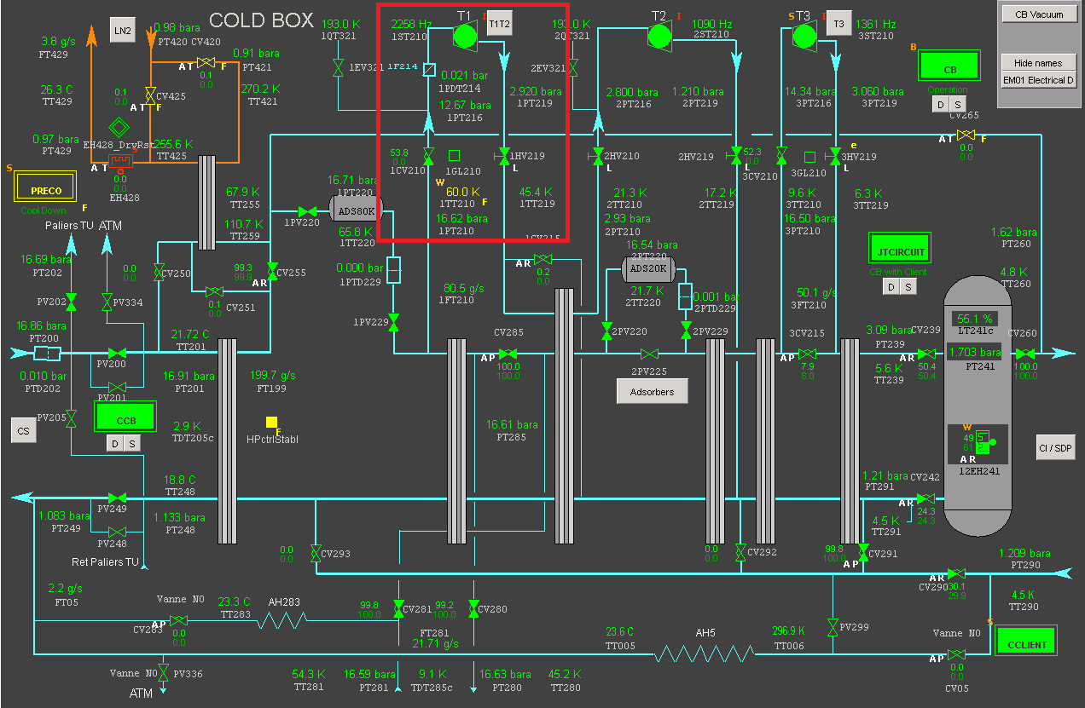
Location

