Slide 1


Radiobiology research using laser-driven ions: Experimental workflow and infrastructure requirements
Professor Jason Parsons
Department of Cancer and Genomic Sciences
School of Physics and Astronomy
j.parsons.3@bham.ac.uk

Slide 2
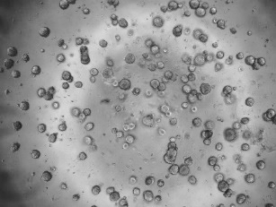
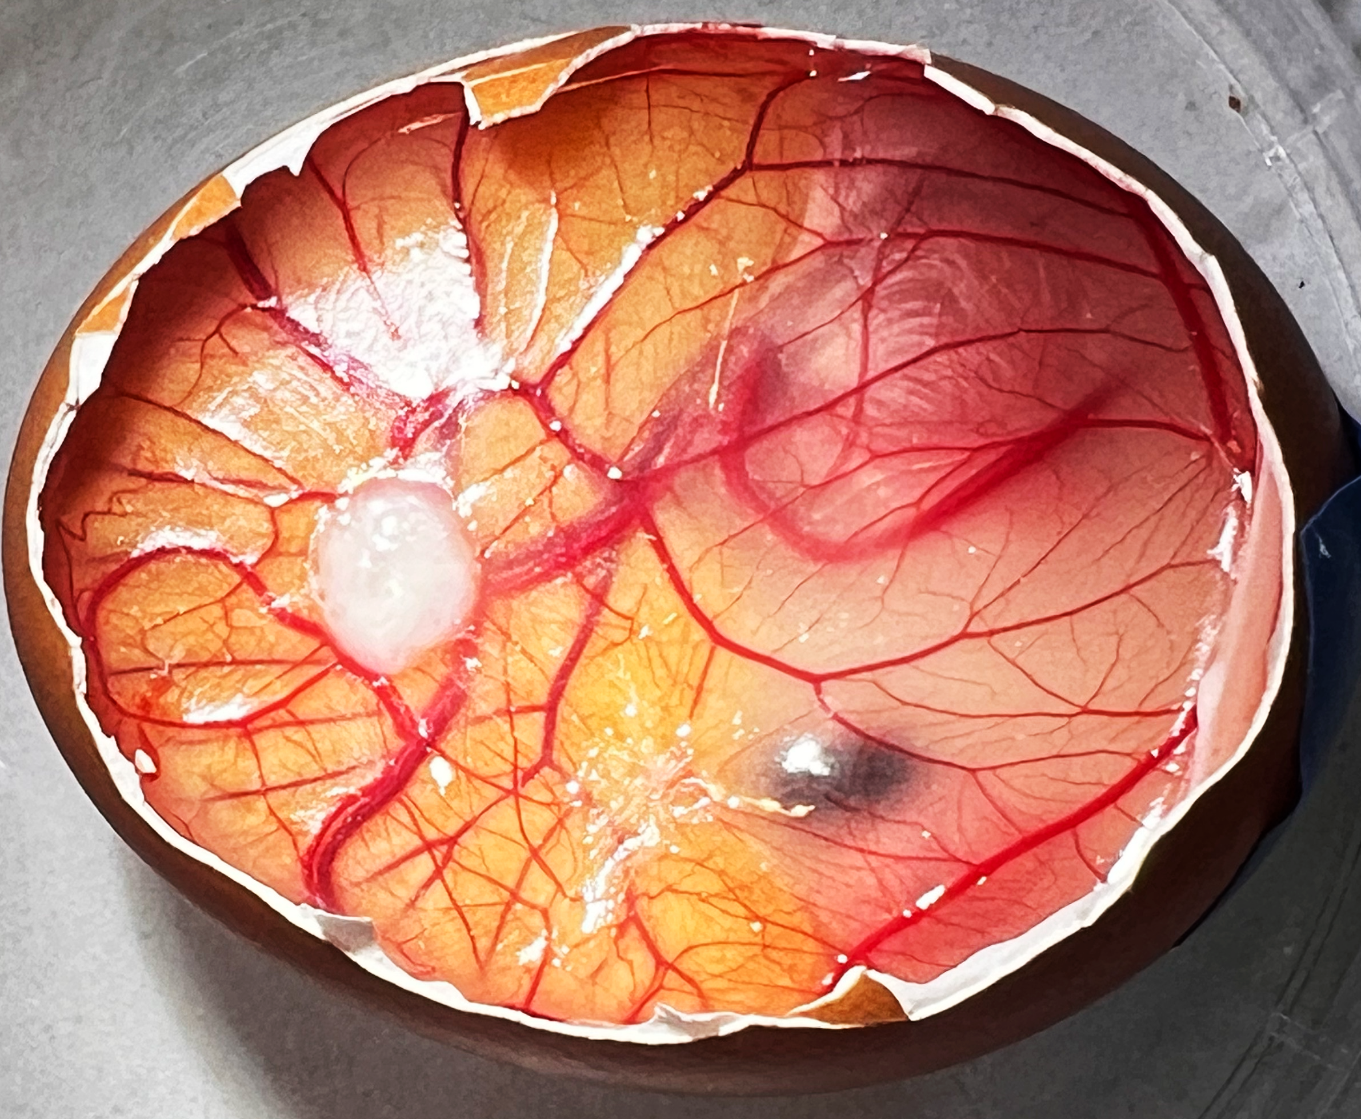
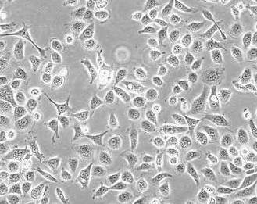
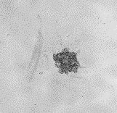
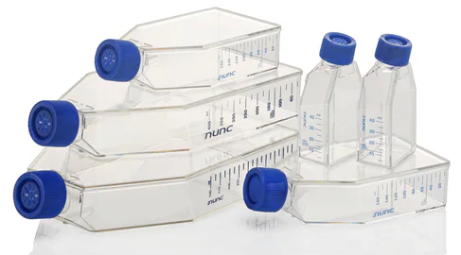
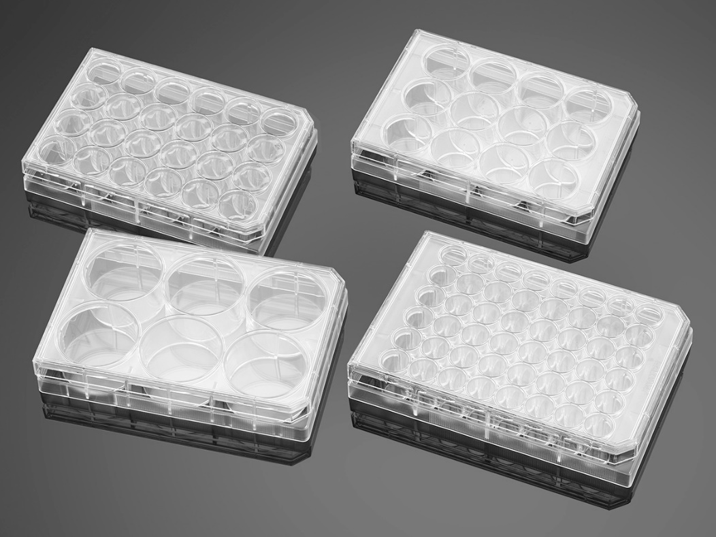
Typical cell models and growth formats
Tumours grown in chick embryo model
2D monolayer cells
3D spheroids
Patient-derived organoids
1000 µm
Each cell is ~20 µm in size
Each spheroid is ~50-500 µm in size
Each organoid is ~10-1000 µm in size
Tumour is ~2-3 mm in size
  Multi-well plates (127 mm x 85.5)
 | 6-well | 12-well | 24-well | 48-well | 96-well
Diameter (mm) | 35.43 | 22.73 | 16.26 | 11.56 | 6.86/ 6.35
Area (cm²) | 9.5 | 3.83 | 1.93 | 0.95 | 0.32
Thickness (mm) | 1.27 | 1.27 | 1.27 | 1.27 | 1.27
Elevation (mm) | 2.54 | 2.16 | 2.54 | 2.87 | 3.55
25 or 75 cm² surface area

Slide 3
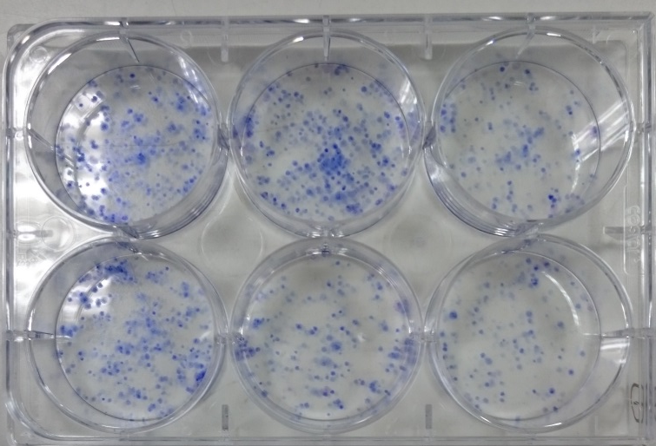
Clonogenic assays for analysis of cell sensitivity
Cells as a monolayer
Trypsinise cells and plate as single colonies
Irradiate, count and seed into individual colonies
Irradiate colonies
Allow colonies to grow for 7-14 days
Clonogenic assays is a measurement of the ability of single cells to grow and divide into colonies.
This is the gold standard technique for radiobiology.
Fix, stain and count colonies

Slide 4
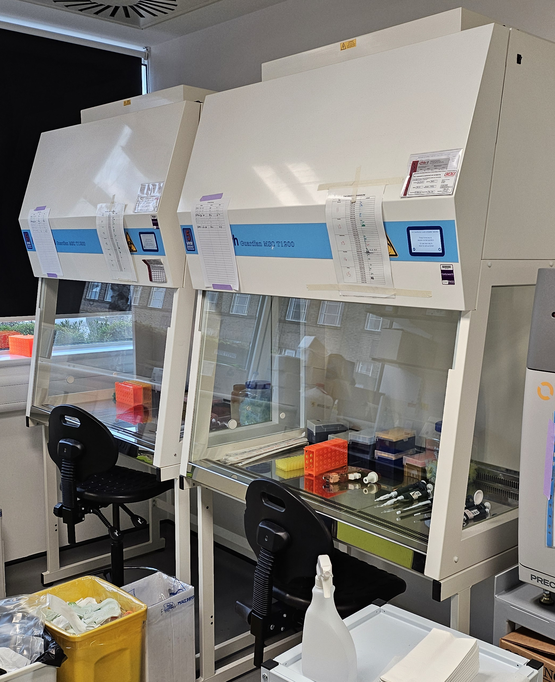
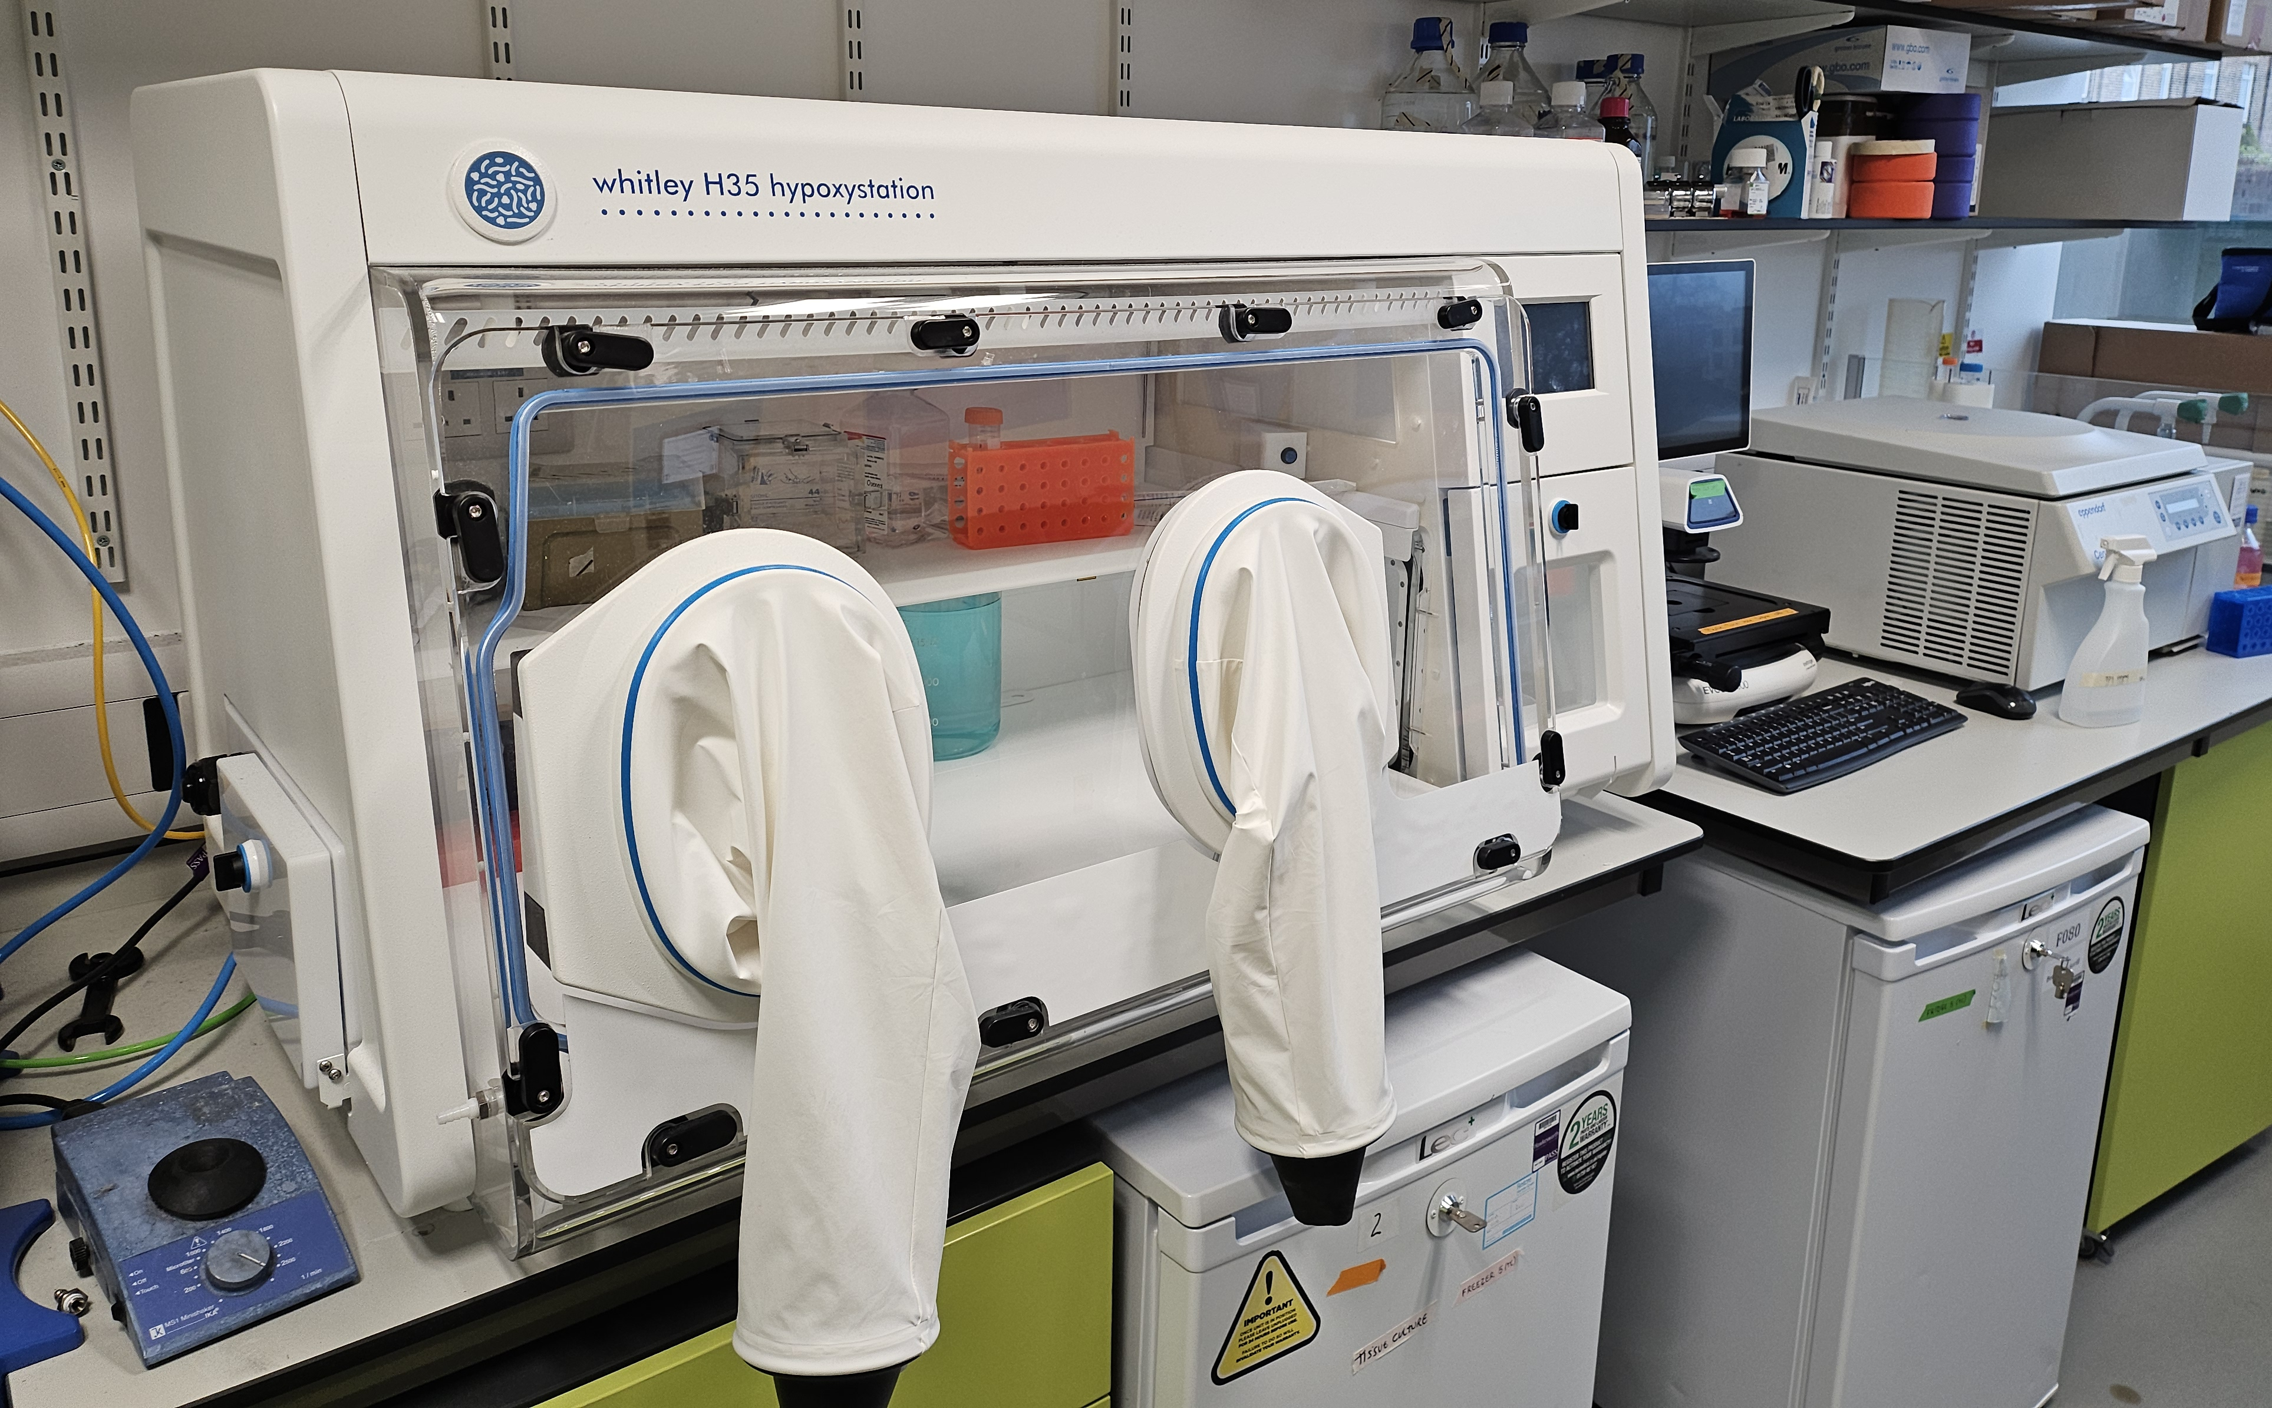
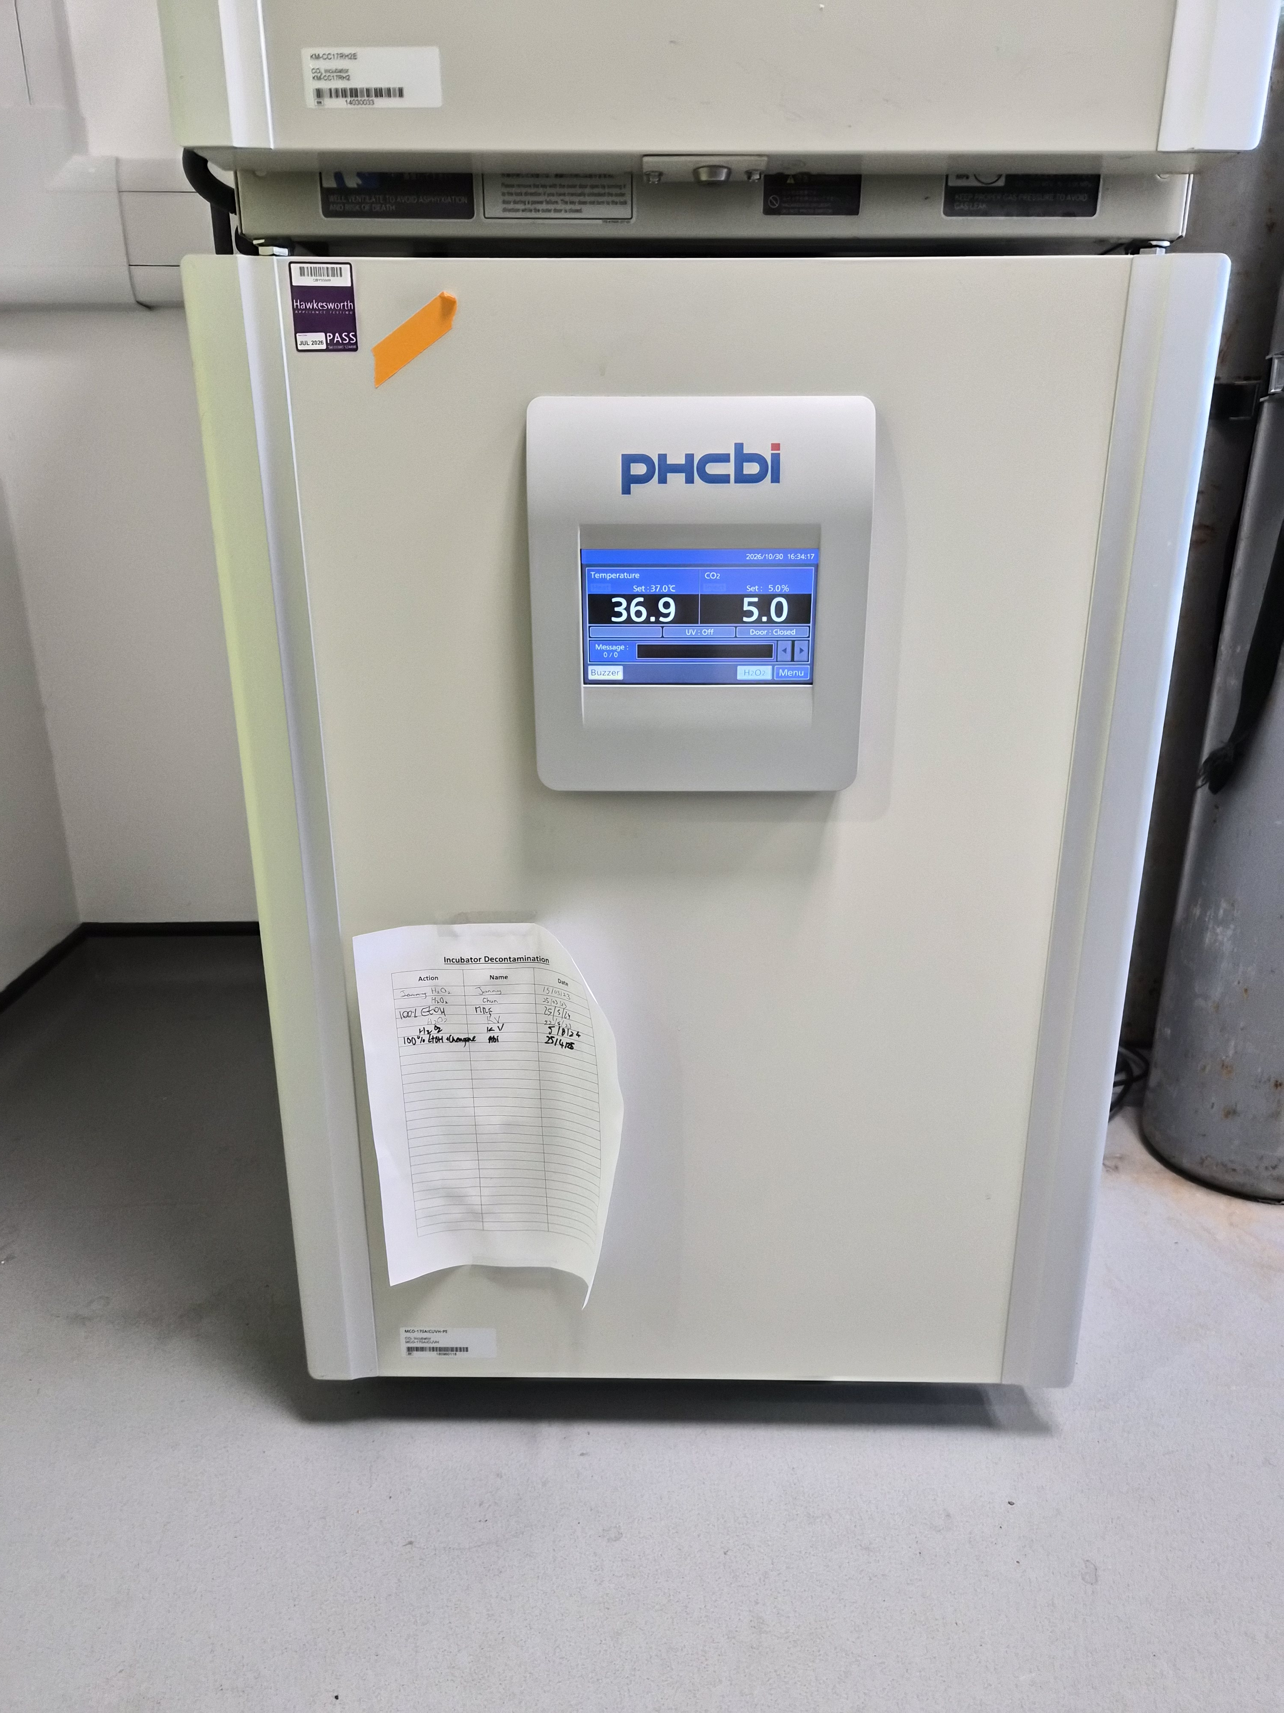
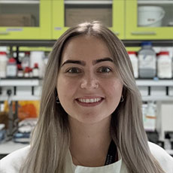
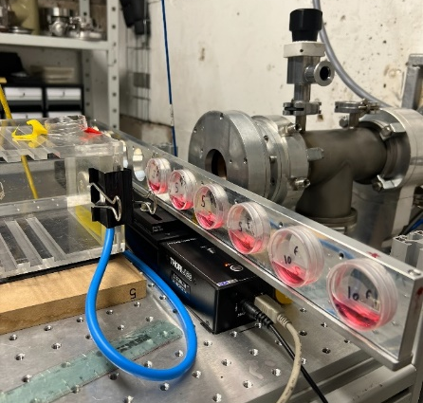
Typical clonogenic assay protocol
Equipment
Class II safety cabinet
Hypoxia workstation
(different oxygen tensions)
CO₂ incubator
A radiobiologist or two!
Schedule
A week in advance – cells need to be growing well and are healthy.
Day 1 - Seed cells into the appropriate dishes/plates and leave to settle for 24-48 hours.
Day 3 – Prepare cells for irradiation (e.g. seal dishes/plates from air; assemble into holding platform).
– After irradiation, cells would be harvested, counted and plated (~1 h).
– Allow colonies to grow for 7-14 days.
Day 10-17 – Colonies are stained and can be counted (offsite).
Notes
A single experiment (one cell line, 4 radiation doses, triplicate samples) may involve ~50 irradiations.

Slide 5
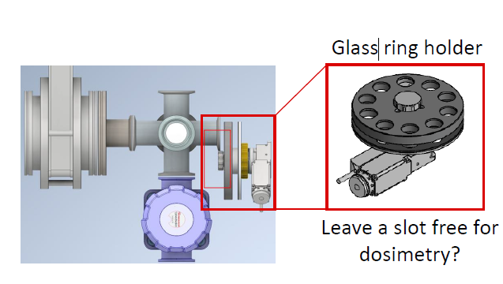
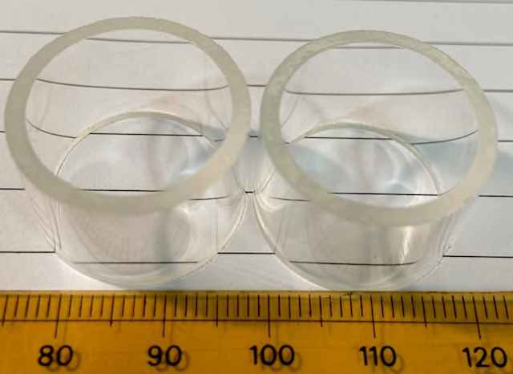
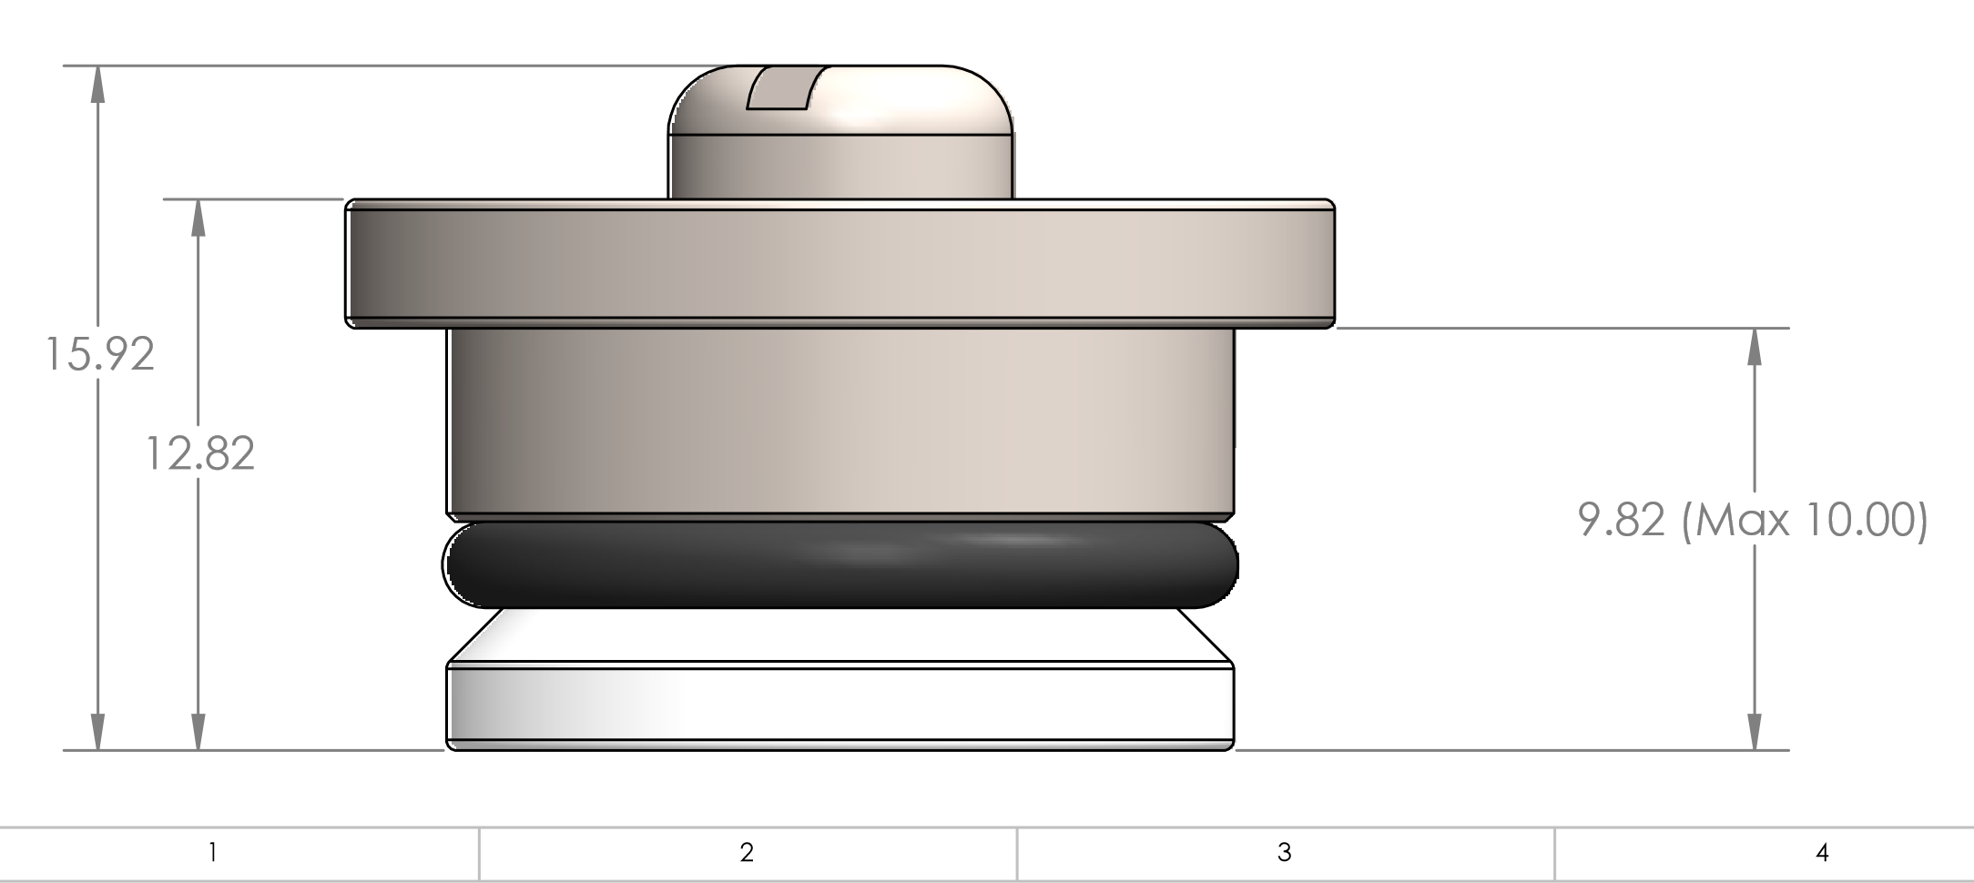
Radiobiology setup at SCAPA
Internal diameter – 18.5 mm
Outer diameter – 22.5 mm
Survival curves as a function of dose

Slide 6
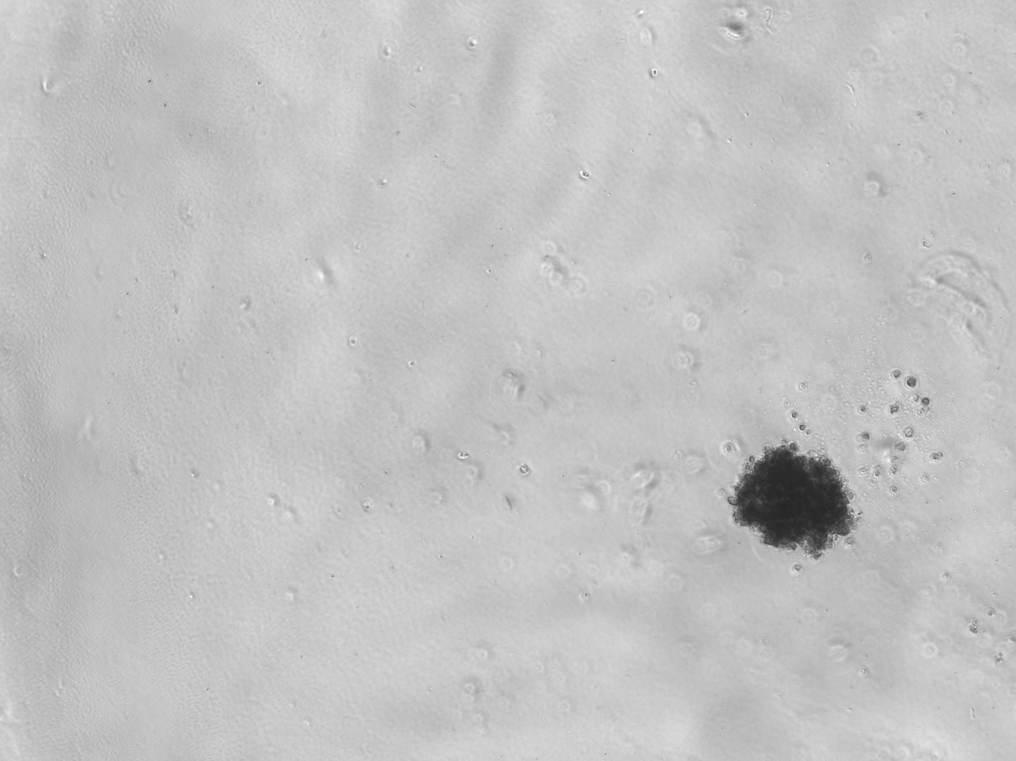
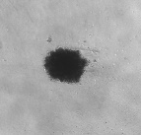
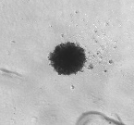
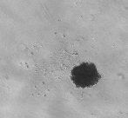
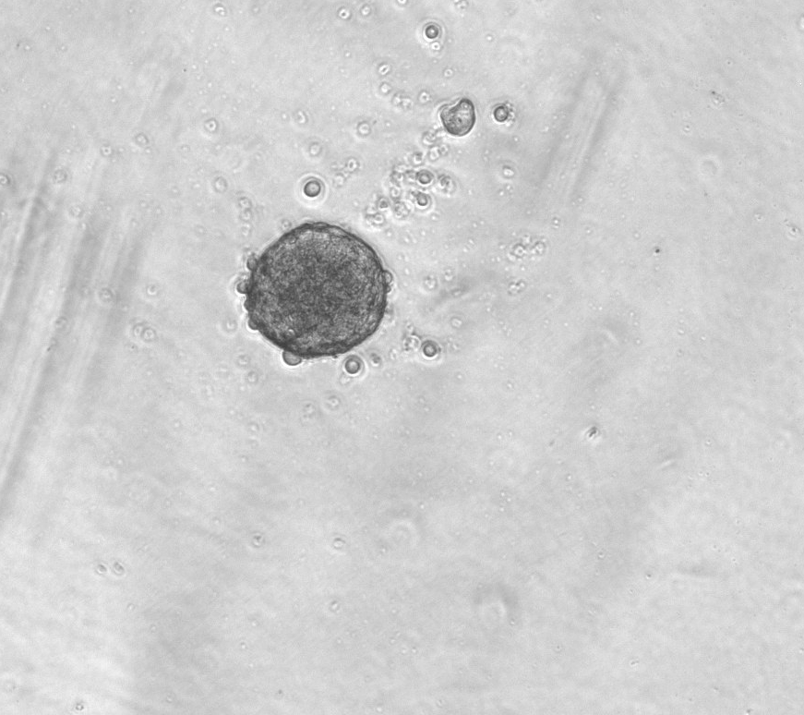
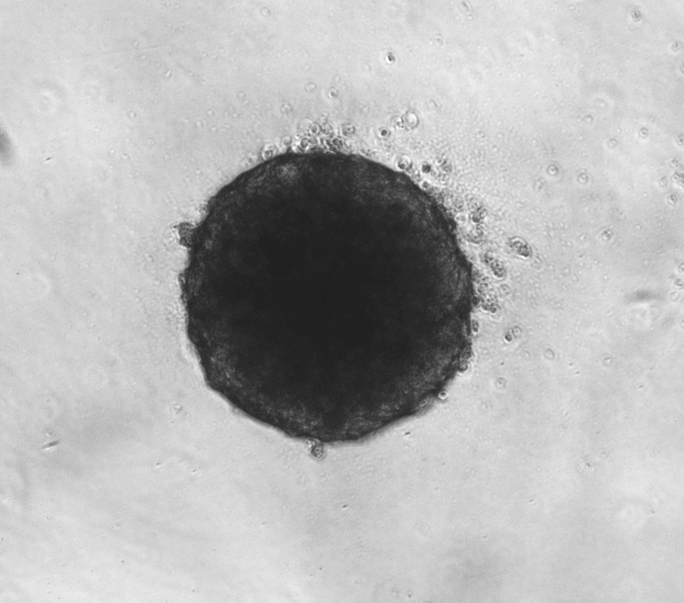
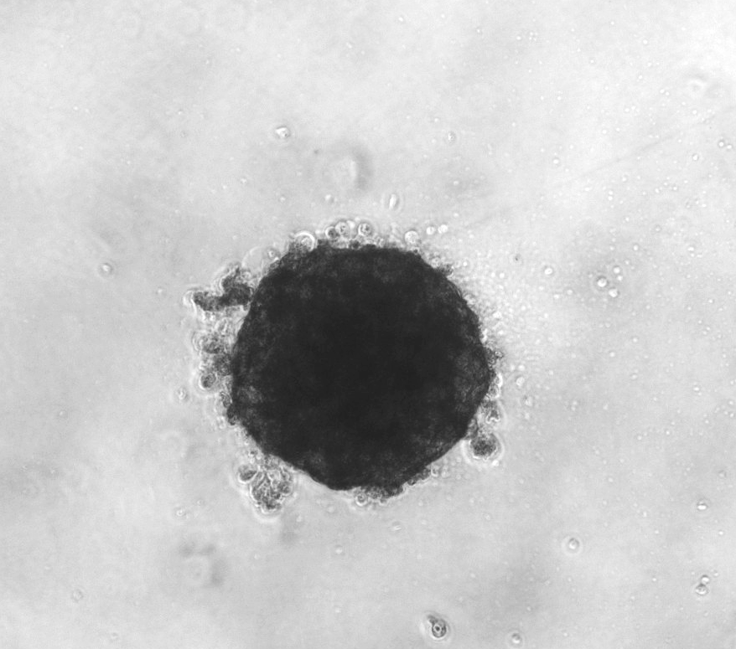
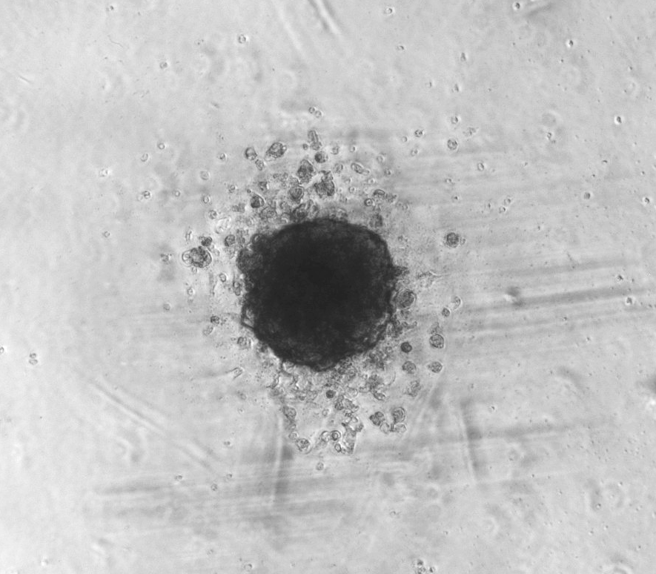
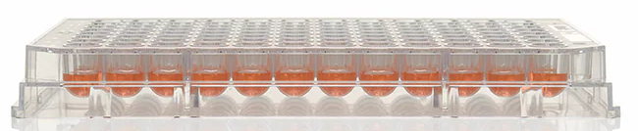
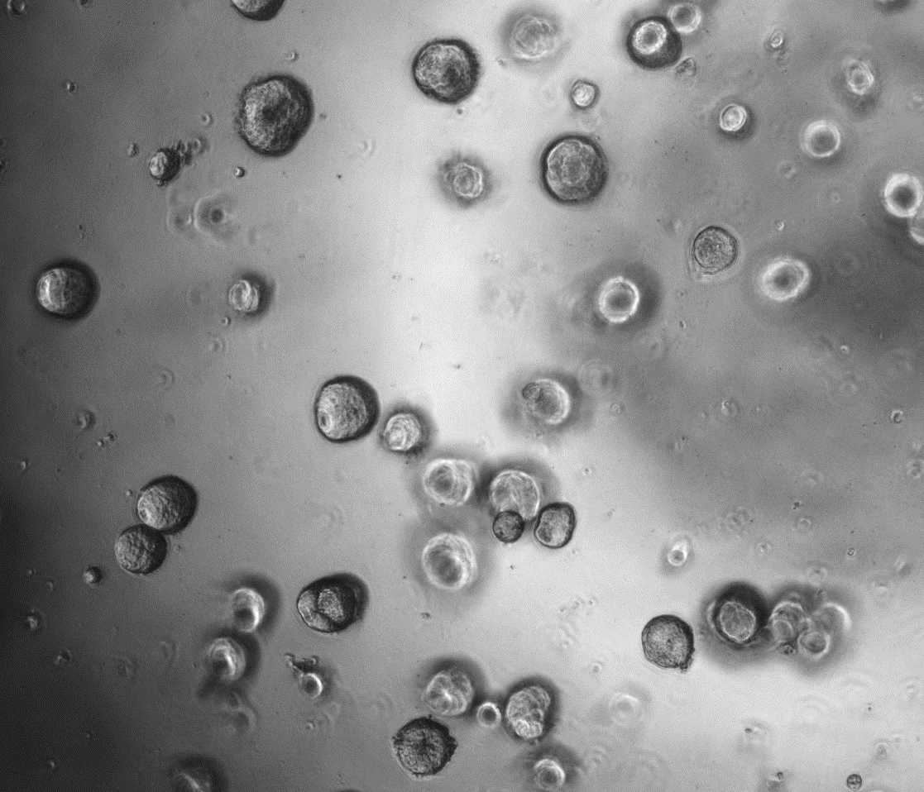
Spheroid growth data
  Day 3
  Day 10
  No-IR
  No-IR
  1 Gy
  2 Gy
  UMSCC74A
1000 µm
  UMSCC6
Notes
Spheroids are advantageous as they recapitulate 3D tumour structure.
However, spheroids grow in 96 well plates (generally round bottom, plastic is ~1.5 mm thick but tapered).
Spheroids are also free floating in the media (challenging for energy/LET targeting).
Similar protocol for patient-derived organoids, although these usually fixed in a matrix to the bottom of the plate (easier for energy/LET).
800 µm

Slide 7
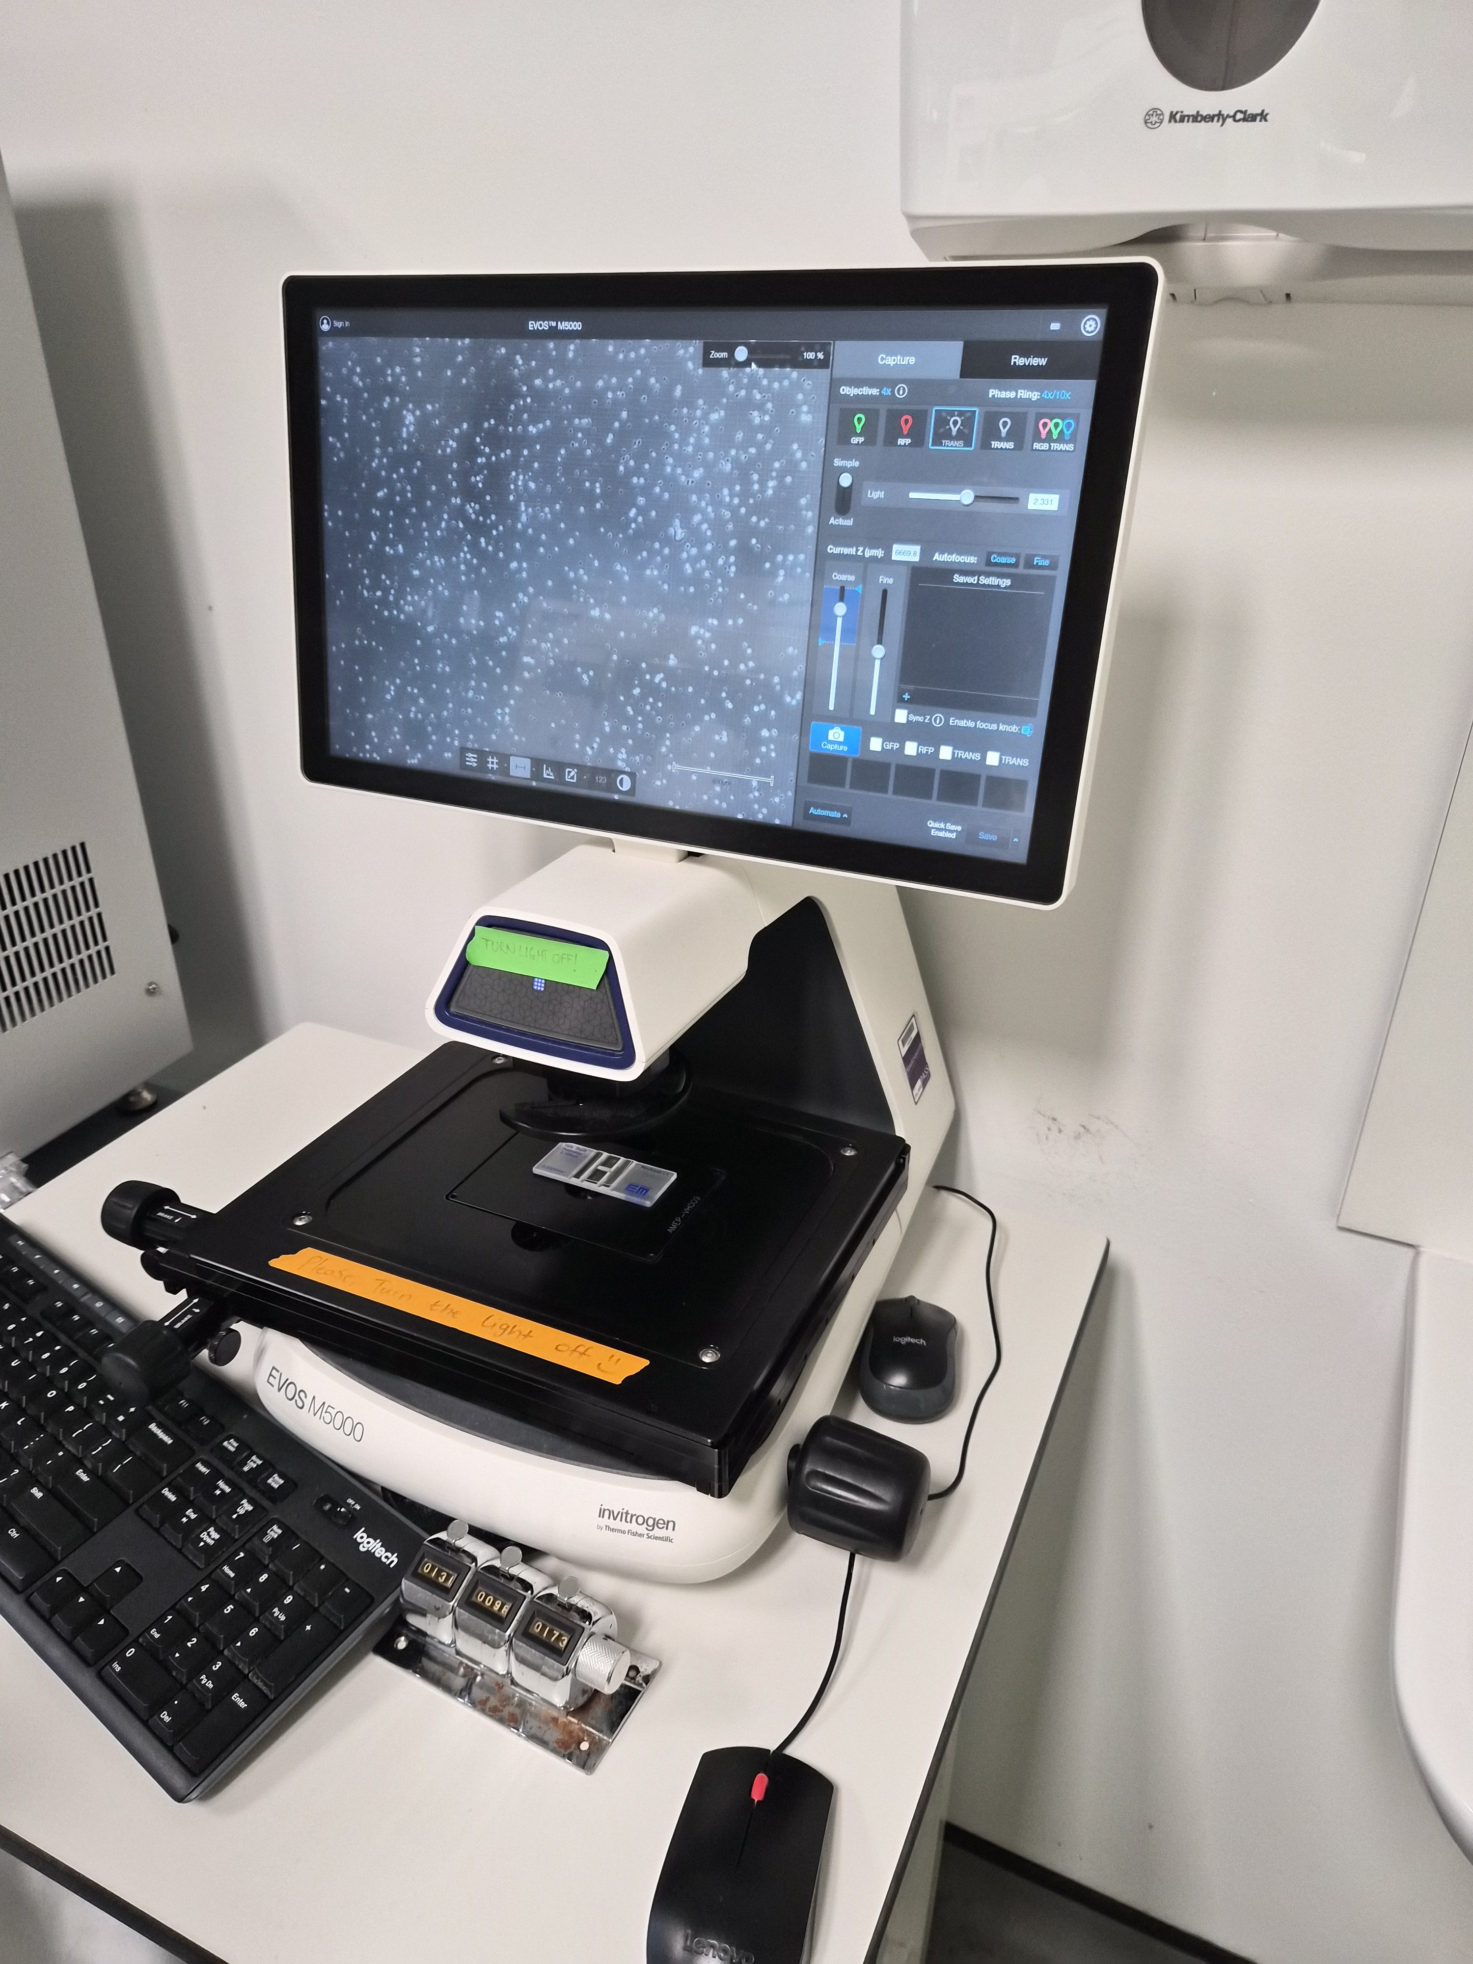
Typical spheroid growth assay protocol
Equipment
Class II safety cabinet
CO₂ incubator
Imaging microscope
A radiobiologist or two!
Schedule
A week in advance – cells need to be growing well and are healthy.
Day 1 - Seed cells into 96 well plates and leave to settle for 48 hours for spheroids to form.
Day 3 – Prepare cells for irradiation (e.g. seal dishes/plates from air; assemble into holding platform)
– Allow spheroids to grow for 14-21 days.
Days 3-24 – Capture images of spheroids every 2-3 days (could be done offsite).
Notes
A single experiment (one cell line, 4 radiation doses, triplicate samples) may involve ~50 irradiations.

Slide 8
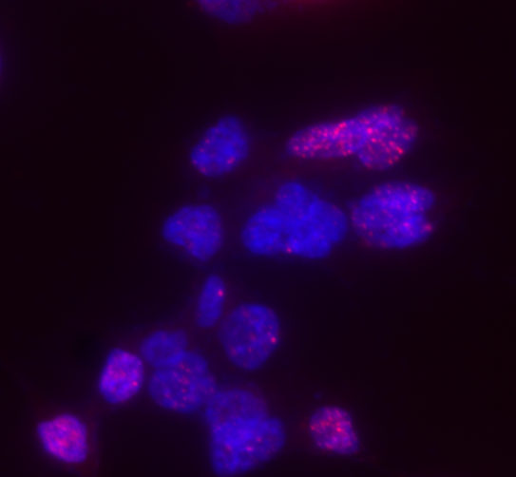
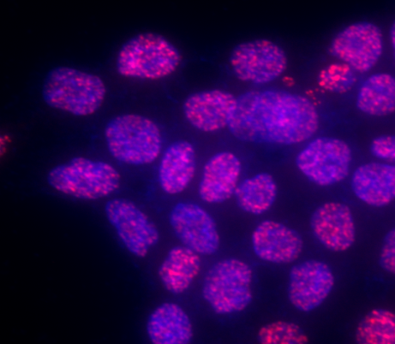
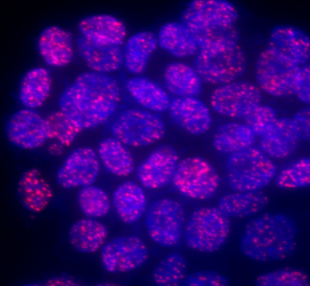
Analysis of DNA damage: γH2AX foci as a surrogate DNA double strand break (DSB) marker
Control
1
4
Hours post-IR (4 Gy)
UMSCC74A head and neck cancer cells
Each γH2AX foci corresponds to the site of a DSB.
Can also use other markers of DNA damage (53BP1, RAD51, OGG1) giving information on DNA repair pathway dependence.

Slide 9
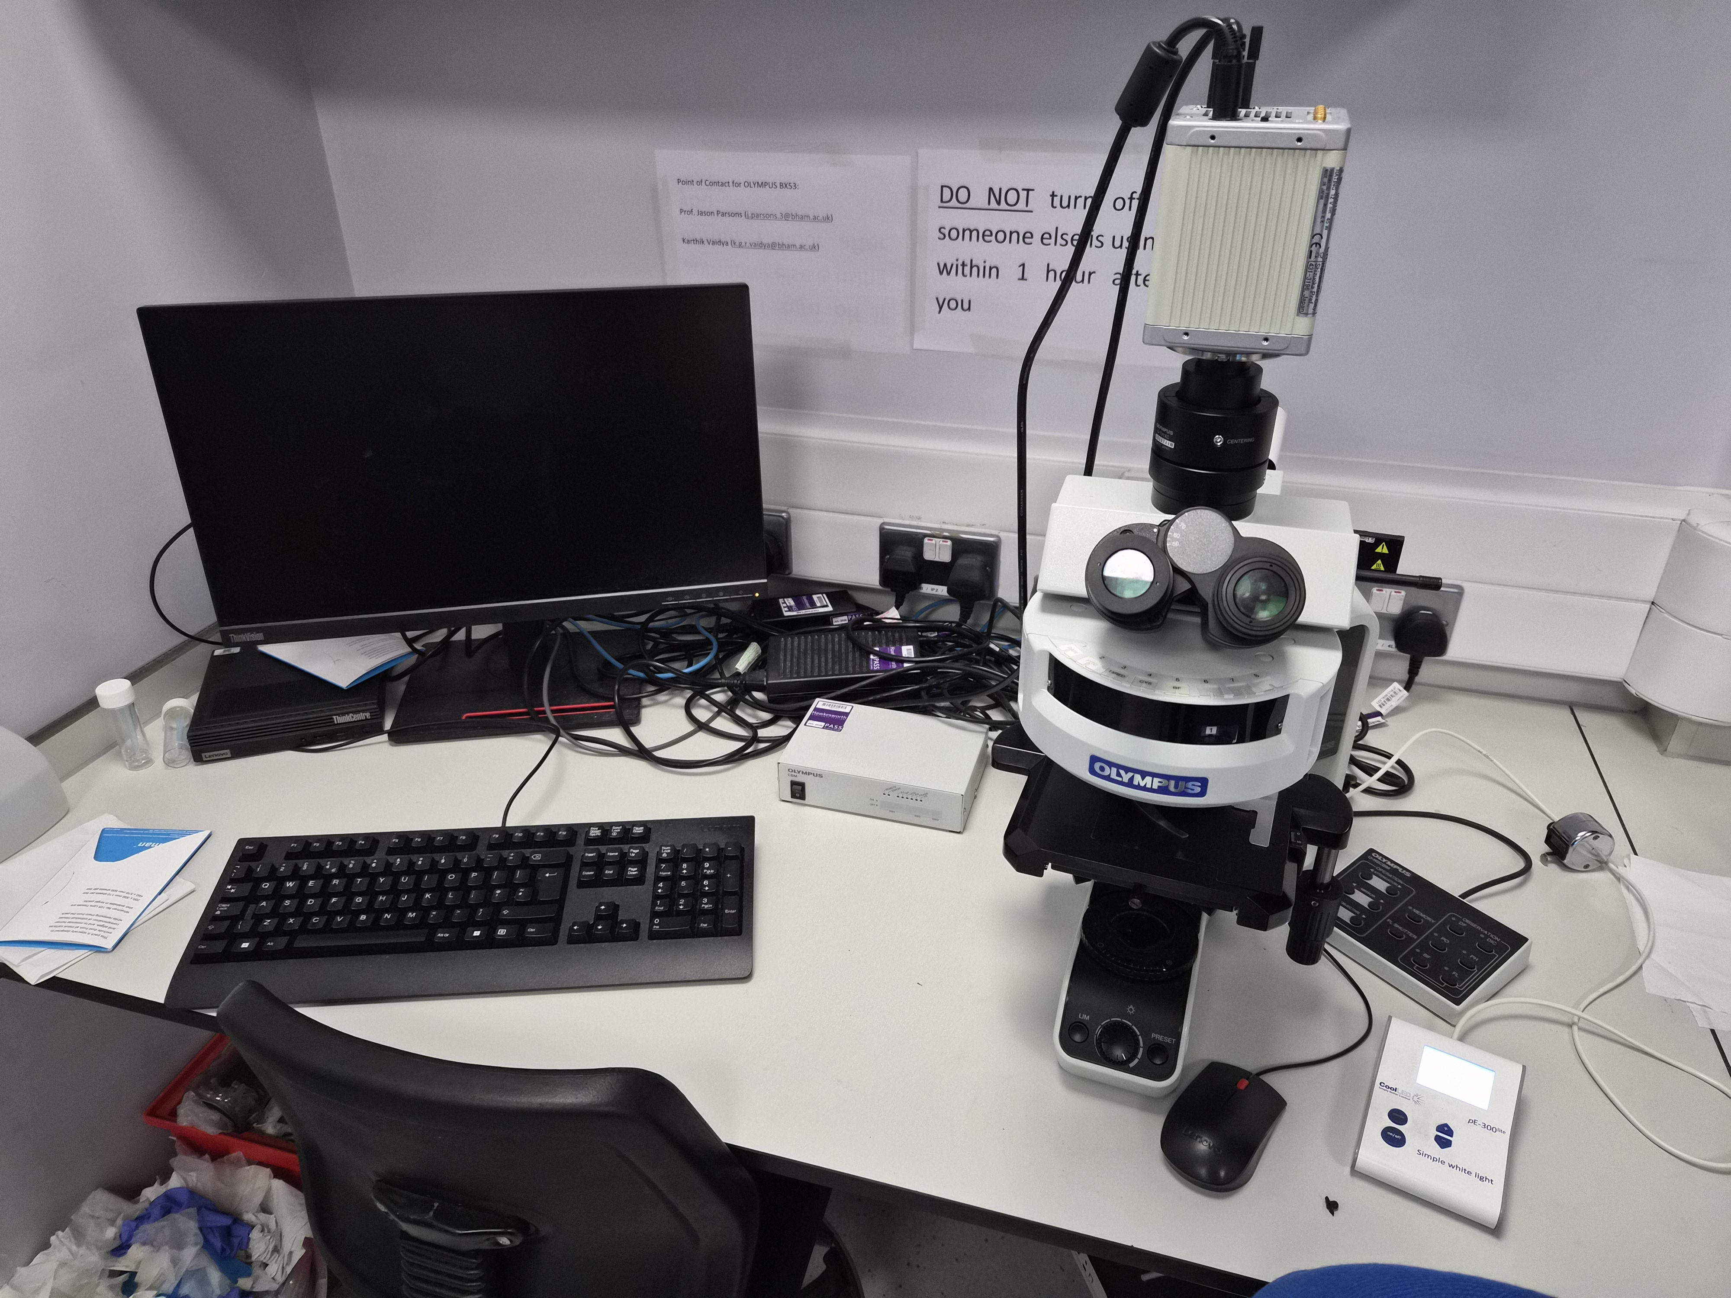
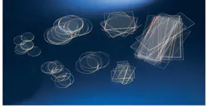
Typical immunofluorescent staining protocol
Equipment
Class II safety cabinet
CO₂ incubator
Fluorescent microscope
A radiobiologist or two!
Schedule
A week in advance – cells need to be growing well and are healthy.
Day 1 - Seed cells onto 0.1 mm glass coverslips placed within plates/dishes and leave to settle for 24-48 hours.
Day 3 – Prepare cells for irradiation (e.g. seal dishes/plates from air; assemble into holding platform).
– Allow cells to repair for 1-48 hours, fix at these different times (e.g. formalin).
Days 5 – process using antibodies (usually takes 2 days).
– Alternatively, cells can be moved offsite and processed.
Notes
Coverslips can be replaced and cells irradiated as normal, although another piece of equipment (Cytospin) is needed to mount cells on microscope slides.
A single experiment (one cell line, single radiation doses, 4 time points, triplicate samples) may involve ~50 irradiations.

Slide 10
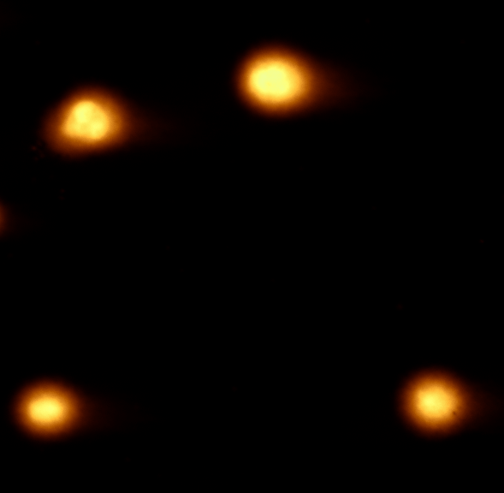
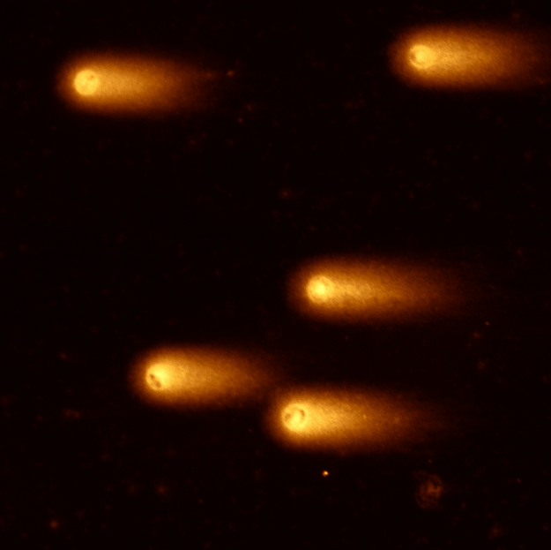
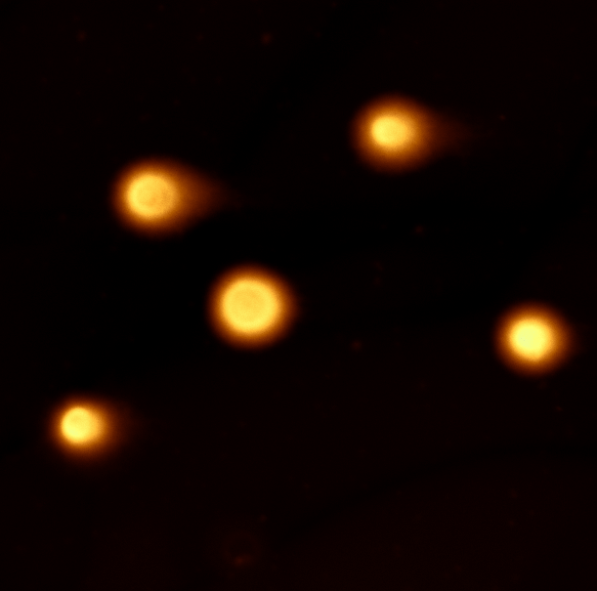
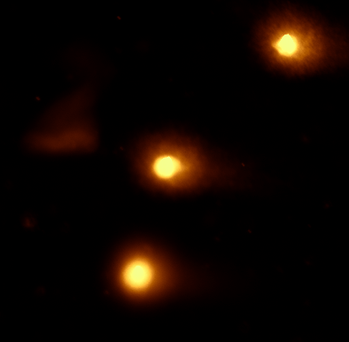
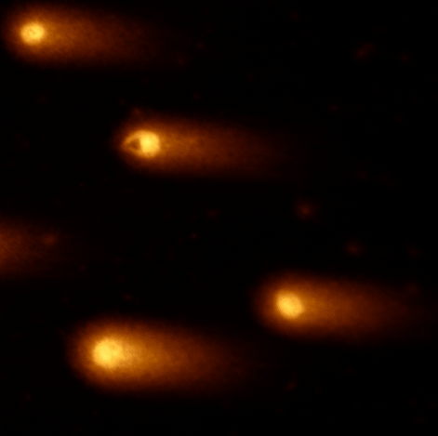
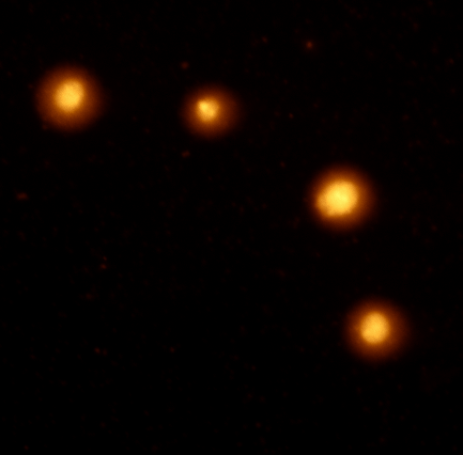
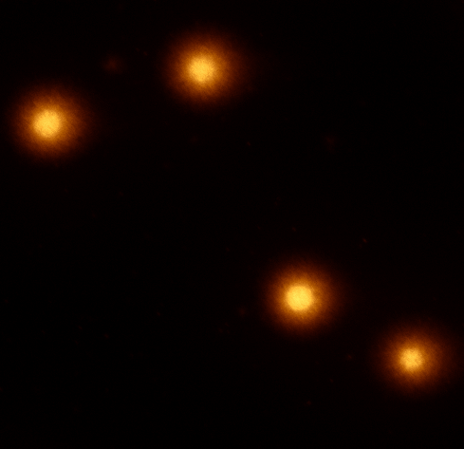
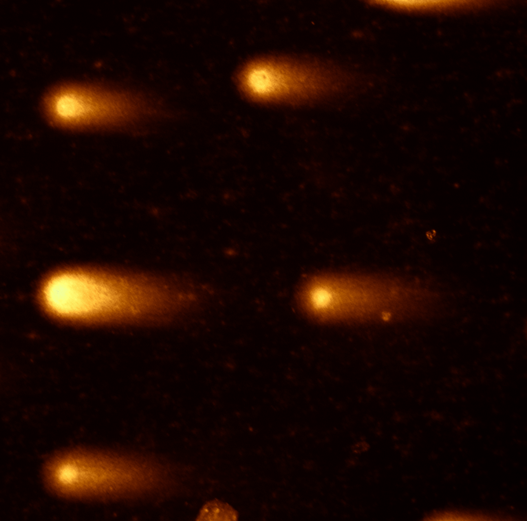
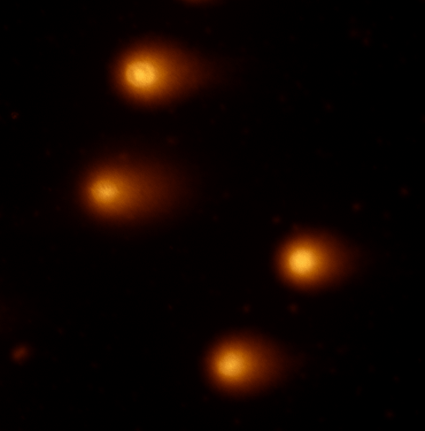
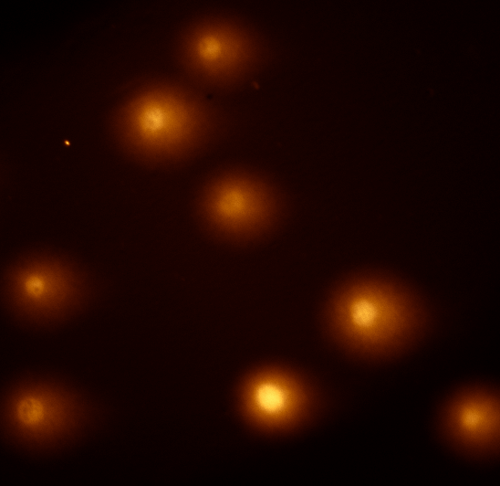
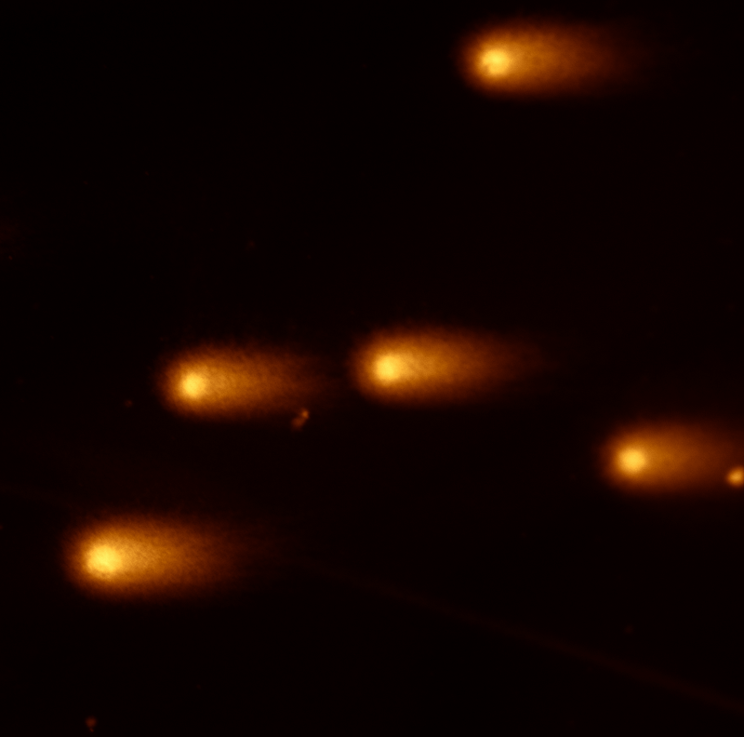
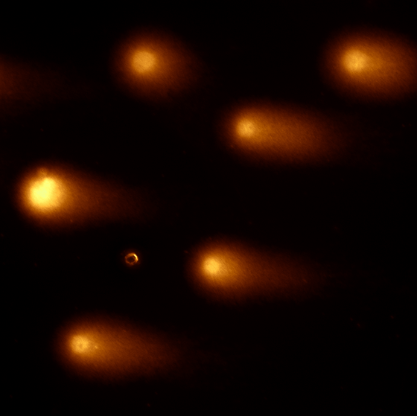
Comet assay used to measure the efficiency of DNA repair in individual cells
4 Gy x-rays
Control
0 min
240 min
*
*
UMSCC6
**
***
*
UMSCC74A
UMSCC47
HPV-negative (UMSCC6, UMSCC74A)
HPV-positive (UMSCC47, UPCI-SCC090)
UPCI-SCC090
Nickson et al (2017) Oncotarget

Slide 11
The Comet Assay
Measures DNA strand breaks and/or alkali-labile sites within single cells
Cells in culture
DNA damage treatment
1 % agarose added to cells
Cells embedded in agarose
Lysis of cells
-
+
Microscope slide
Current
Electrophoresis
Analysis using fluorescent microscope and Komet software
DNA stained with SYBR Gold
Nickson and Parsons (2014) Front Genet

Slide 12
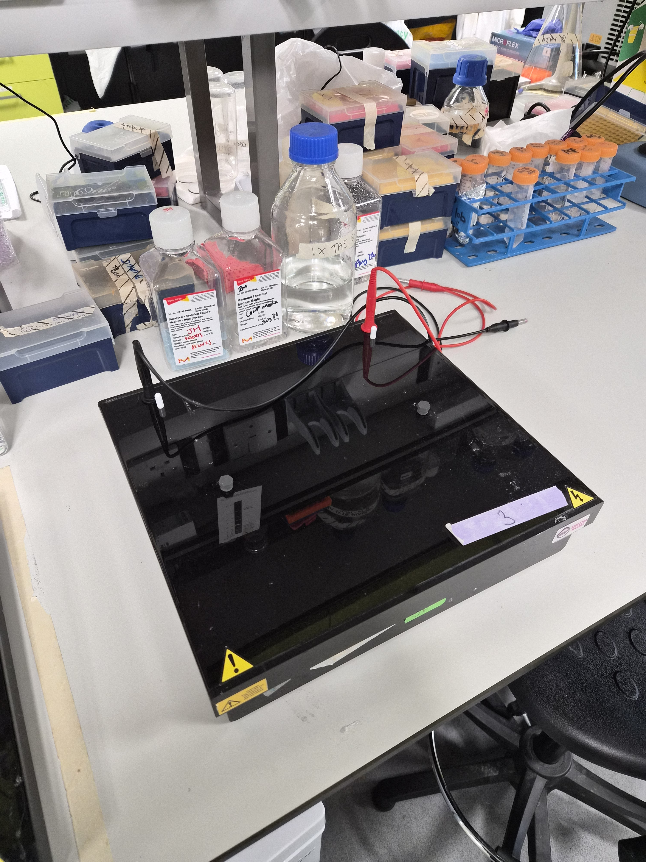
Typical comet assay protocol
Equipment
Class II safety cabinet
CO₂ incubator
Comet assay equipment
A radiobiologist or two!
Schedule
A week in advance – cells need to be growing well and are healthy.
Day 1 - Seed cells into the appropriate dishes/plates and leave to settle for 24-48 hours.
Day 3 – Prepare cells for irradiation (e.g. seal dishes/plates from air; assemble into holding platform).
– Collect cells at different time points for 1-24 hours.
Days 4 – Process cells onto slides, lyse cells and electrophorese DNA (usually takes 1.5 days).
After these steps, the analysis/processing can be done offsite.
Notes
A single experiment (one cell line, 4 radiation doses, triplicate samples) may involve ~50 irradiations.

Slide 13
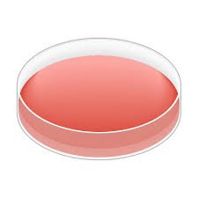
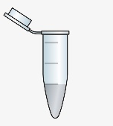
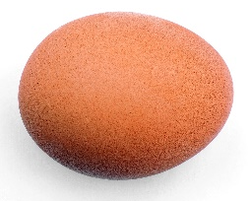
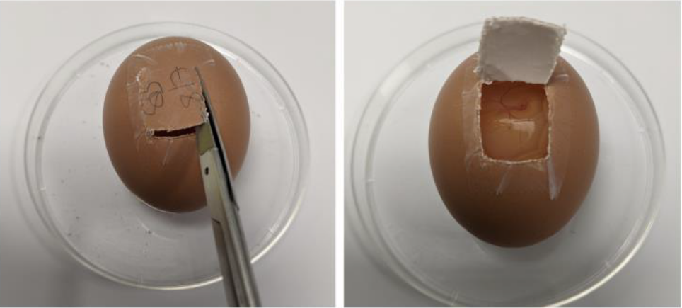
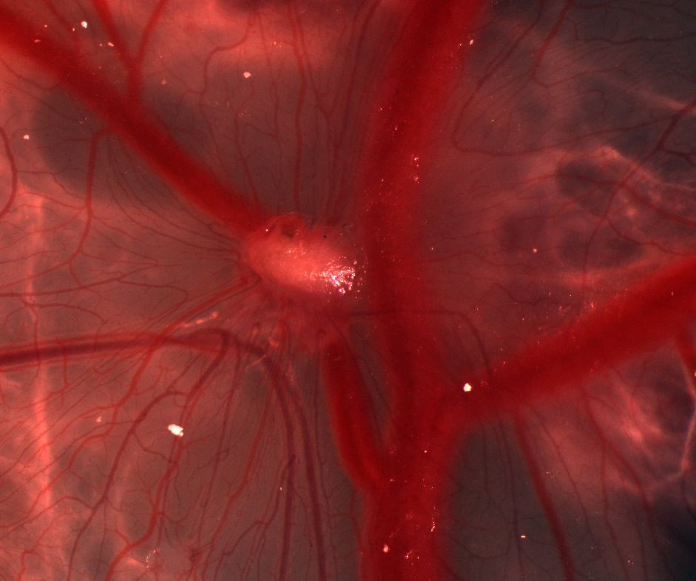
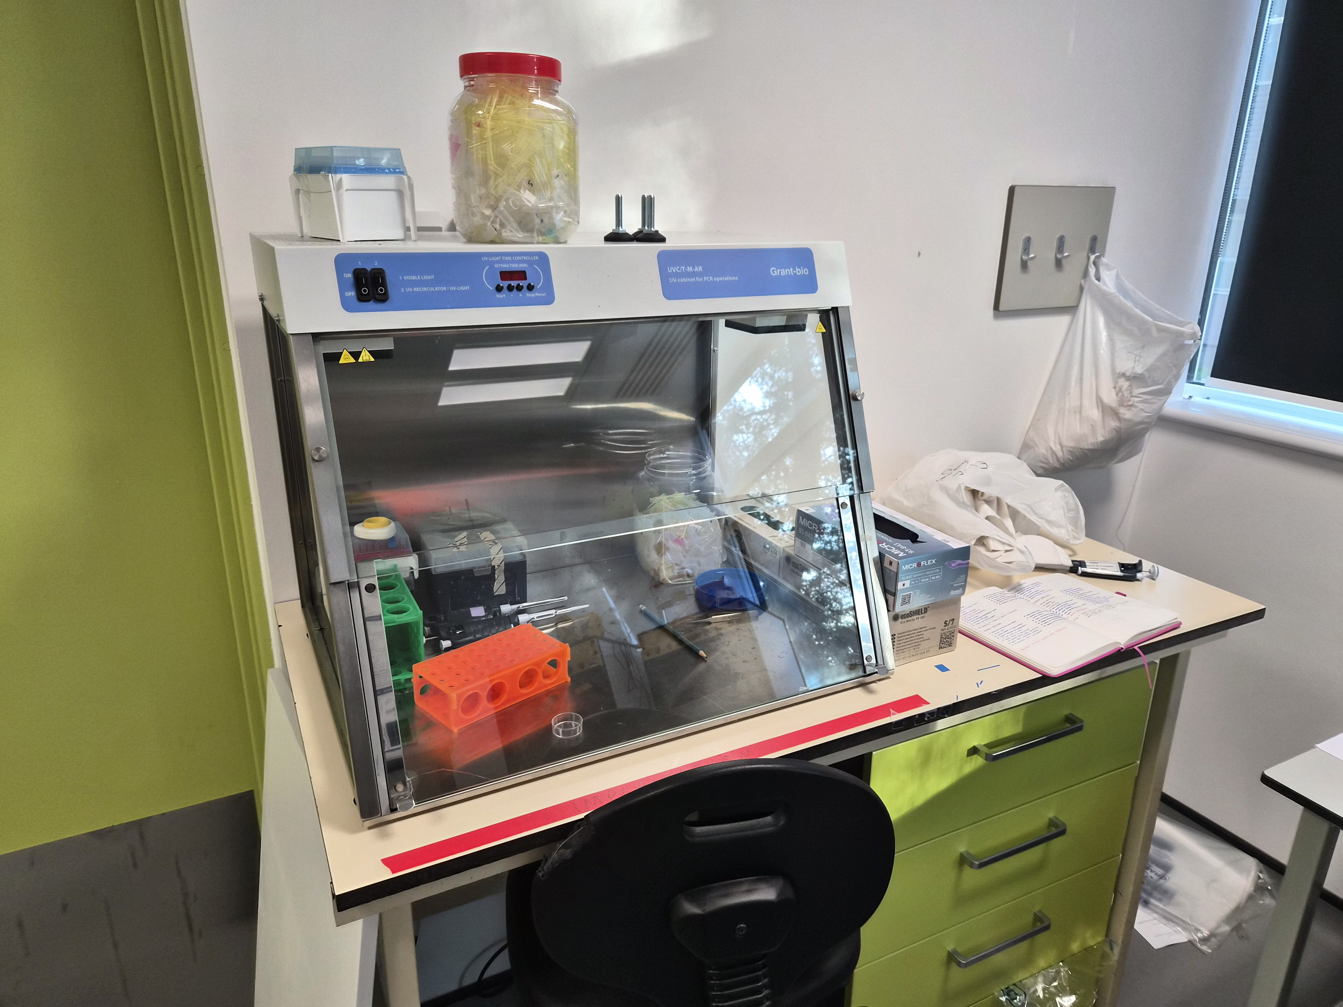

The chick embryo tumour model
Day 0
Day 3
Day 7
Day 10
Day 11
Day 14
Window
Implant cells
Drug
Irradiate
Dissect
Notes
Very good preclinical tumour model (3Rs).
Needs specialist laboratory, equipment and technical expertise.
Chick embryos are very sensitive to the environment (~30 % embryos survival from start to finish).
Very labour intensive (needing ~2-3 million tumour cells per implant).

Slide 14
Take home messages
Key equipment needed (class II safety cabinet, CO₂ incubators, pipettes, pipette fillers, plastic consumables etc).
Key infrastructure needed (CO₂ for incubators, CO₂/N₂/compressed air for hypoxia workstations, bench area, sink).
Waste disposal (generating biological waste that needs specialist route).
Some techniques are time intensive, needing dedicated space in class II safety cabinet (ideally need multiple), and/or bench space.

