Slide 1






Beamline Diagnostics for LhARA and PoPLaR
Presenter: Calvin Dyson
2nd November 2026
CLF/LhARA Workshop
Notes:
Calvin Dyson and work completed with

Slide 2
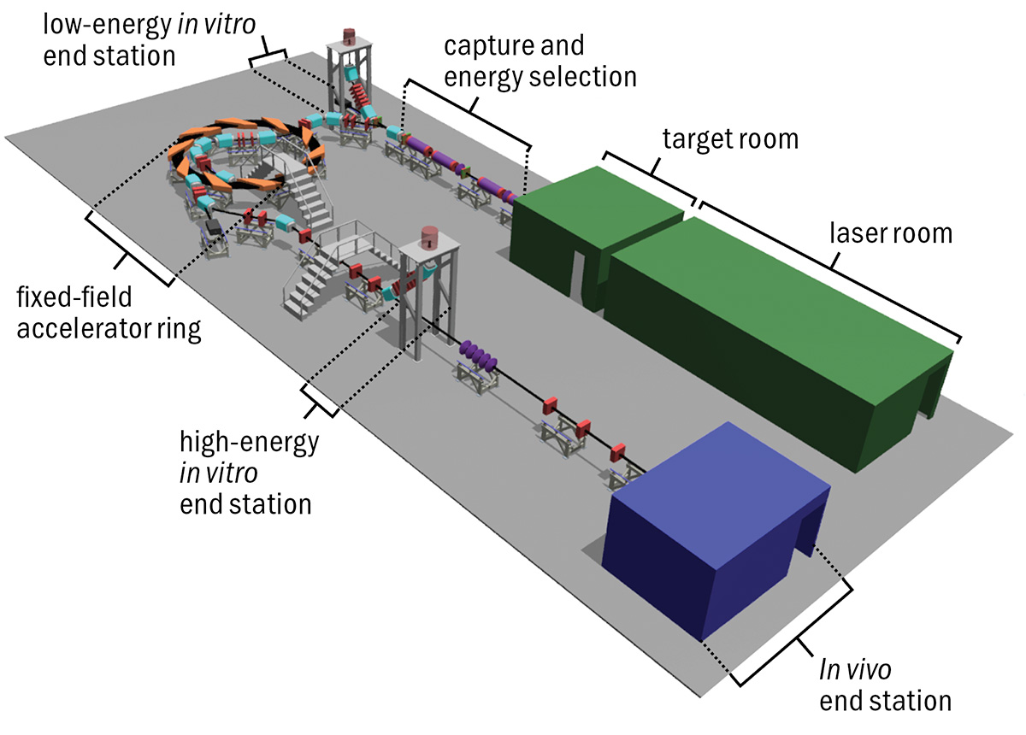
LhARA
Beamline Monitoring
Key Parameters are:
Beam Size
Beam Position
Beam Current
Bunch Length
Requirements:
Shot-to-shot real-time measurements
    10Hz Repetition Rate
Multi-species and multi-energy flexibility
Non-destructive on-line operation
Bunch Length:
    Stage 1: <1 ns -> 10-40 ns
    Stage 2: 10s of ns

Slide 3
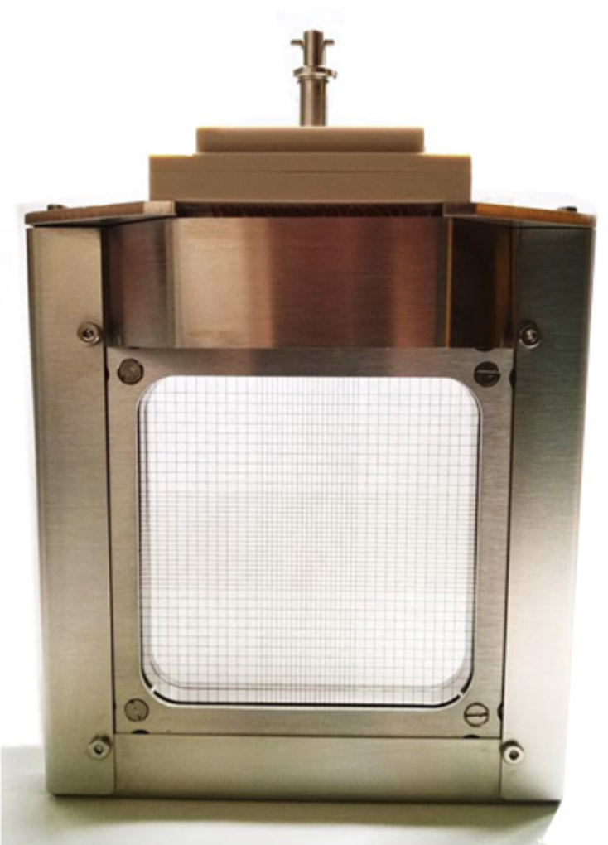
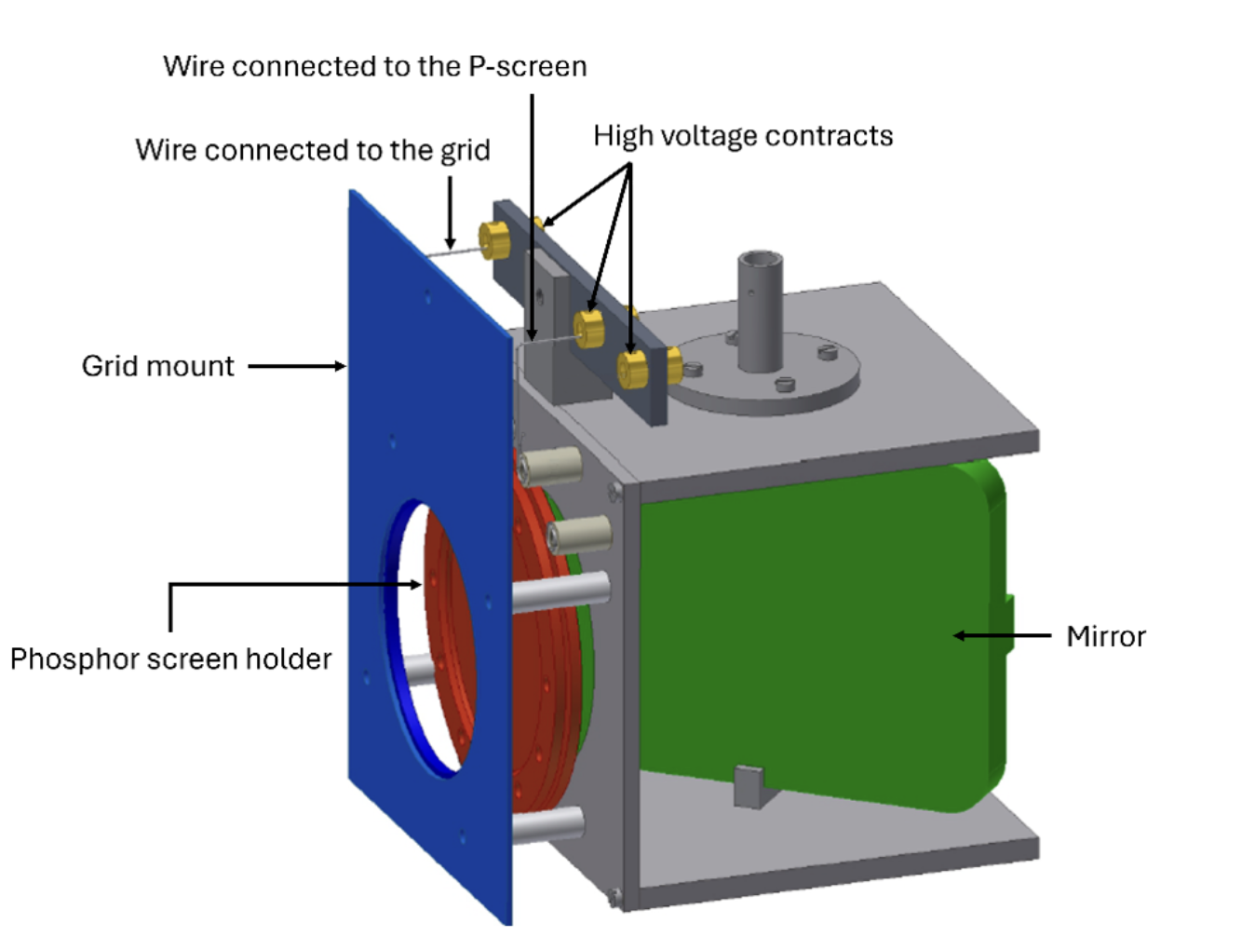
LhARA
Beamline Monitoring
Beam Size and Position
Scintillating Screens
Secondary electron emission (SEM) grids
Beam Current
Wall-Current Monitors (WCMs)
Beam Loss Monitors
Positioned at places of high-loss (collimators etc)
Plastic scintillator
Bunch Length
In Stage 1: <1ns -> 10-40ns
    WCMs cannot resolve the bunch length
    Specialised bunch shape monitors have been shown to work at sub-ns resolution
Stage 2: 10s of ns
    WCMs can resolve the bunch length
Example SEM taken from ntg.
Phosphor screen used in Gabor lens experiments
Notes:
Ions knock electrons off the surface layer of wires
Leave a net positive charge, which is read out as current or charge
Grid gives position/profile while a single foil would give intensity
Wire or gas target releases electrons, and an RF deflector turns arrival time into position. Both are on RF linacs, so they need adapting for LhARA.
Lots of these require beam pipe

Slide 4
LhARA
End Station Dosimetry
Key Parameters are:
Dose per Shot
Dose Uniformity
Requirements:
Dosimetry of 5% accuracy and repeatability
Very high instantaneous dose rate (10⁸-10⁹ Gy/s)
Notes:
Lots of these require beam pipe

Slide 5
LhARA
End Station Dosimetry
Dosimeter | Suitable for FLASH | Suitable for Low Energy End Station | Suitable for High Energy End Station | Real Time?
Ionisation Chamber | Currently unsuitable | Entrance windows too thick? | Suitable in-beam | Yes
Solid-State Detectors | Currently unsuitable | Replace the cells | Suitable in-beam | Yes
RCF | Suitable | Suitable in-beam although energy attenuation must be understood and LET dependence | Suitable in-beam | No
Alanine | Suitable | Protons stop within pellets | Suitable in-beam | No
TLDs | Suitable | Suitable as replacement for cells - LET dependence | Suitable in-beam | No
OSLDs | Suitable | Suitable as replacement for cells - LET dependence | Suitable in-beam | No
RPLs | Suitable | Suitable as replacement for cells | Suitable in-beam | No
Scintillators | Suitable | Suitable in-beam - Birks’ law quenching | Suitable in-beam | Yes
Calorimeters | Suitable | Currently too thick | Suitable in-beam | No
Air Fluorescence | Suitable | Suitable | Suitable in-beam | Yes
Ion-Acoustic | Suitable | Potentially suitable | Suitable in-beam | Yes
Notes:
IC: Electron-ion pairs created in a gas gap and collected by an external electric field. Boag’s 300Gy/s. Underestimates
SSD: radiation creates electron-hole pairs in diamond, collected under bias. Overrespond
Alanine: Free radical. Read out using eletron paramagnetic resonance spectroscopy
TLDs: Signal fading, chemiluminescence background. Strict batch controls
OSLDs: Cumulative background. Simpler than TLDs.
RadioPhotoLuminescence: UV Laser. Multiple readouts
Cal: Minor temp increase. Takes seconds to minutes. Independent of dose rate

Slide 6
LhARA
FFA
Challenge: The transverse beam aperture is much larger than in a conventional synchrotron of comparable size
Diagnostics
Beam scrapers and intercepting wires can measure the horizontal position
    LhARA will require high-gain and high-bandwidth amplifiers due to its low bunch charge
Faraday cups used for total current calibration
Non-intercepting electrostatic/button beam-position monitors span the wide aperture to measure beam position current and betatron tune
Notes:
Scrapers
A movable metal blade is pushed through the beam and a detector says how much is lost
Beam edge, extent and position, and the profile
Fully destructive
Wires
A thin metal wire is swept across the beam
Secondary electrons or collected charge
Less beam loss
Low signal so need high-gain
BPMs
Beam induces wall charges on opposing pickups
Voltage differene gives position while total gives beam charge
Passing charged bunches induce wall charges on opposing pickup plates or button electrodes; differential voltage gives position, while sum voltage gives beam charge

Slide 7
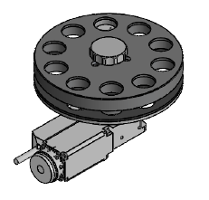
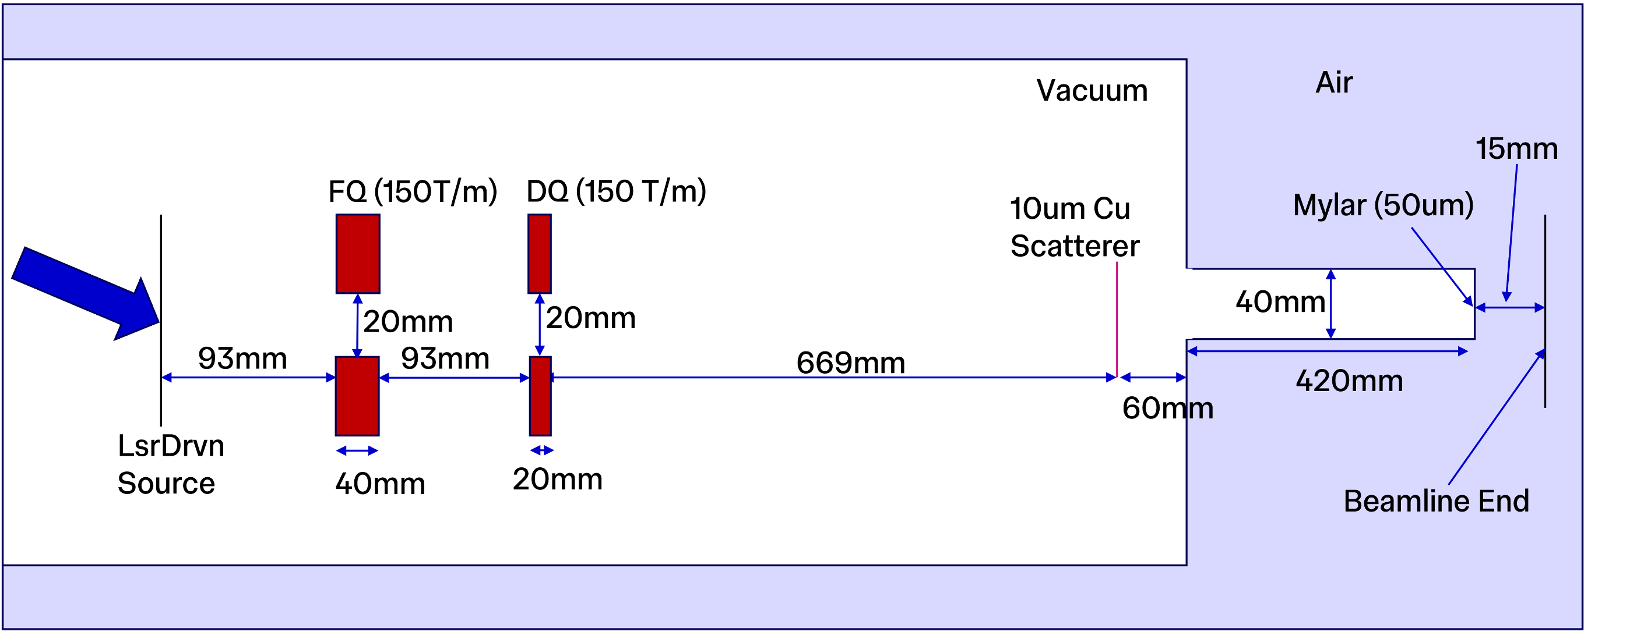
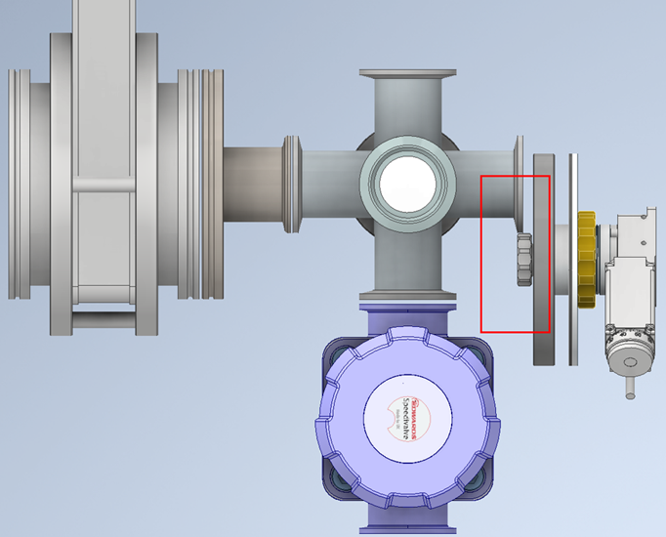
PoPLaR
Beamline
Testing location for new diagnostics
Need to know shot-to-shot variation and spatial variation
Requirements:
    Must be real-time (5-20s between shots)
    Not destructive
    Handle low energy (8MeV)
Carousel

Slide 8
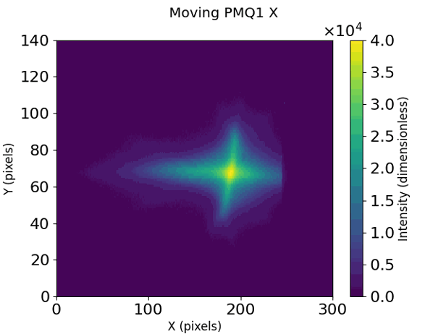
Current Diagnostics
Radiochromic Film (RCF)
Colour change proportional to dose
High spatial resolution 2D(/3D) dose distributions
Tissue equivalent, energy independent, dose rate independent
Under-responds at high LET
Must wait 24 hours after irradiation before scanning
Scanning introduces errors
Currently only dose diagnostic at PoPLaR
Lanex
Used as a fast real time beam profiler
Completely destructive
    A few mm thick
Notes:
PoPLaR

Slide 9
Short-Term

Slide 10
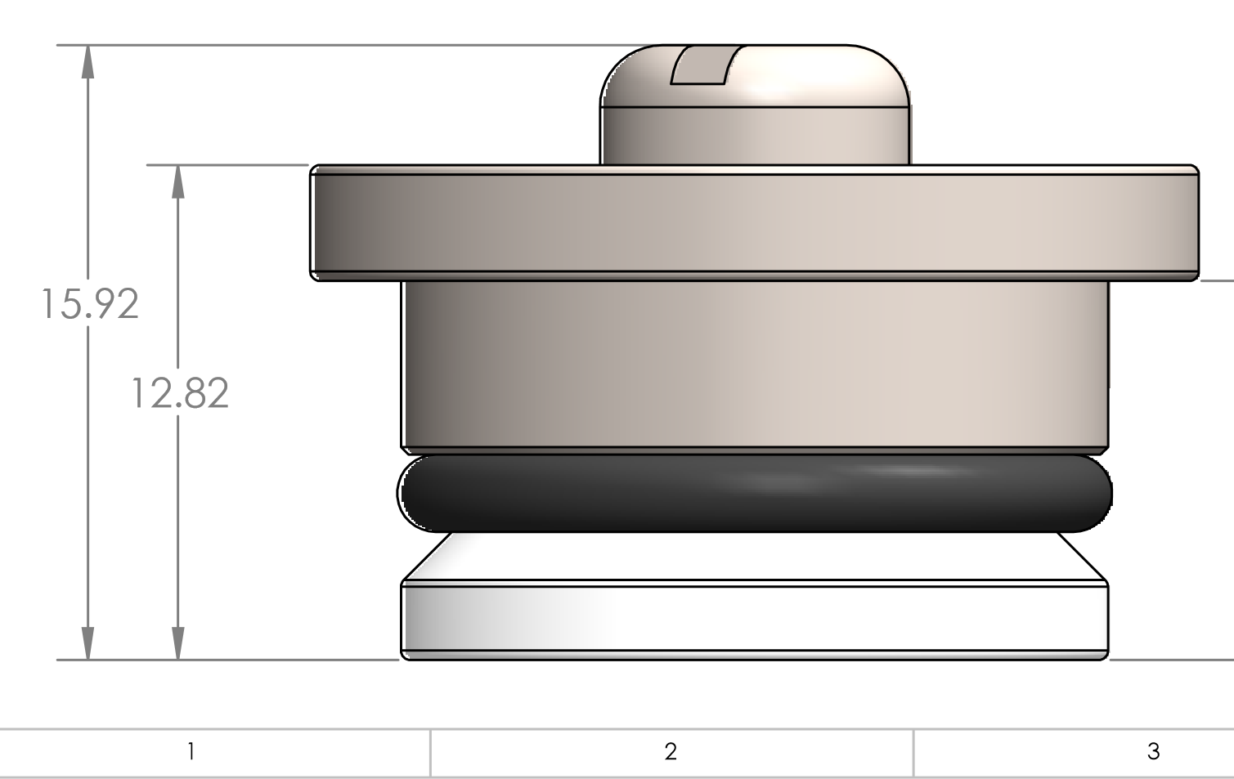
Adapting RCF
Delaminated RCF (EBT3)
    Increases LET by an acceptable amount
    Dose received on RCF is ~90% dose seen on cells
    Main issue is supplier no longer making delaminated EBT3
Switching to Transwells instead of Cell Dishes
Replace thick-lidded cell dishes with no-lidded transwells and 10μm rear film
Can place RCF or another diagnostic behind the transwells (thin scintillators?)
Cell Dish:
Polymer Layer
Cells
RCF
Beam
Active Layer
Beam
Mylar Cover
Transwell:
Beam
Notes:
If the diagnostics come with the cells then it’s pretty modular
LULI facility
Katia Parodi
Last year

Slide 11
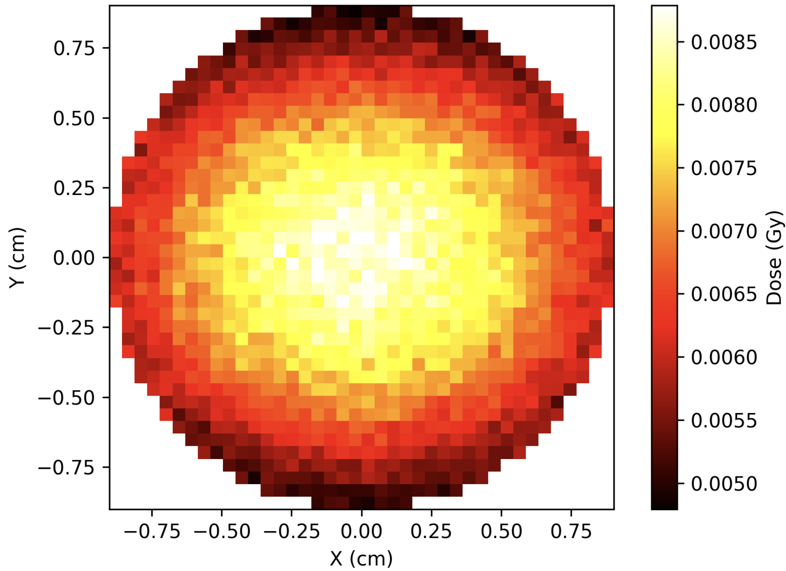
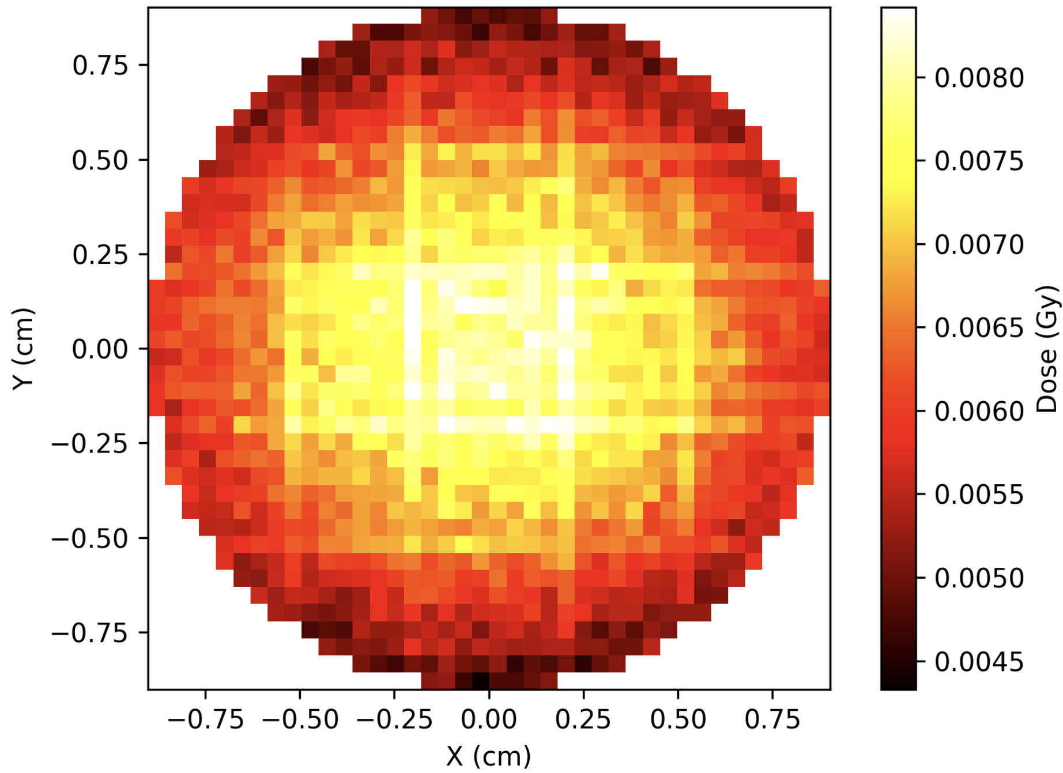
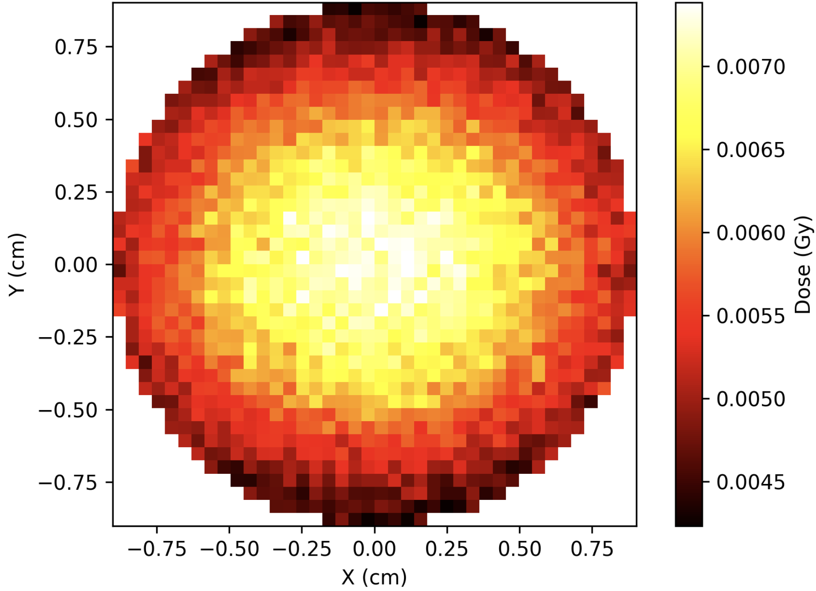
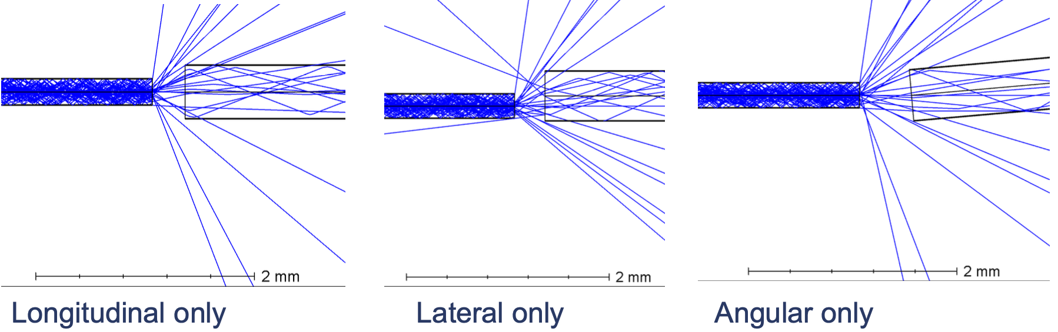
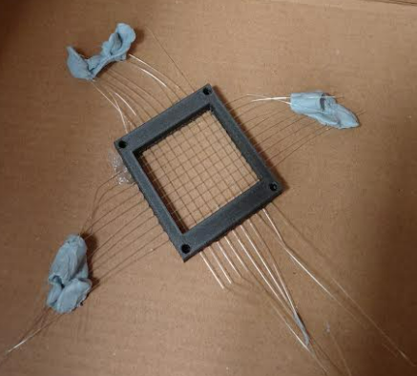
Scintillating Fibres
PoPLaR
D1
D2
D3
Sparse Scintillating Fibre Array
    250μm diameter
    BCF-20
Concerns
Impact on the beam
    Fine if before the scatterer
Light collection
    Image with camera outside of the vacuum chamber
    Transport with optical fibres
Air
No Arrays
SciFi at D3 and Air
SciFi at D1, D2 and D3
Notes:
Concerns about transport fibres scintillating as well?

Slide 12
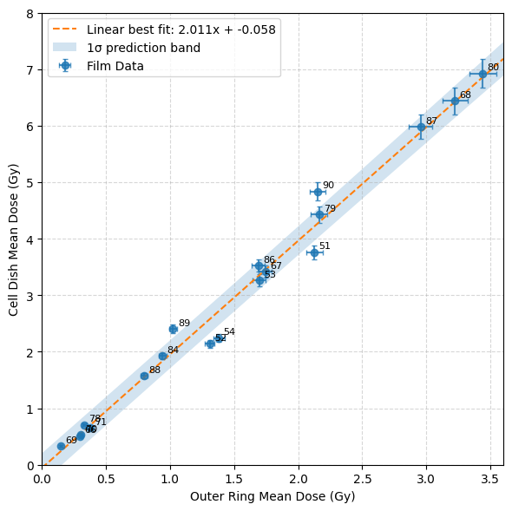
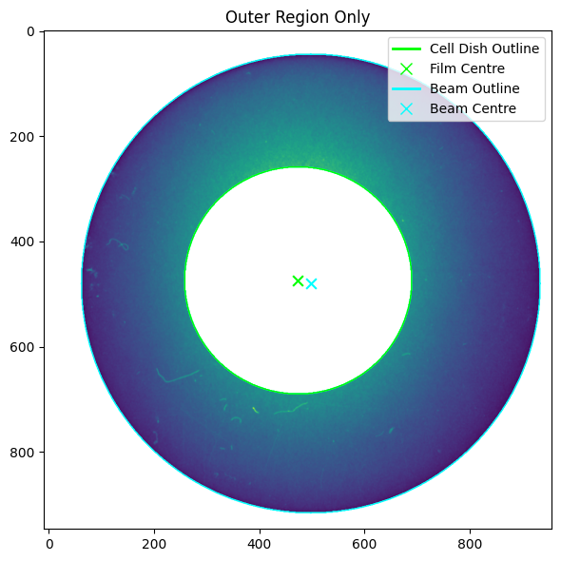
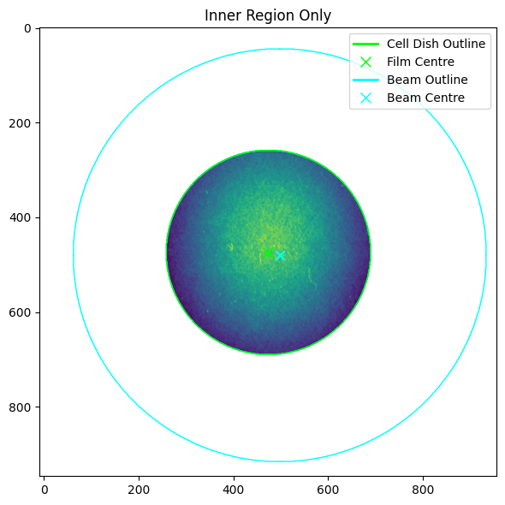
Monitors around the Cell Dish
PoPLaR
Placed around the Cell Dish
Options:
    RCF
    Scintillating Fibre
    Scintillating Screen
Tests on previous RCF show an inherent uncertainty on the fit of 0.23Gy

Slide 13
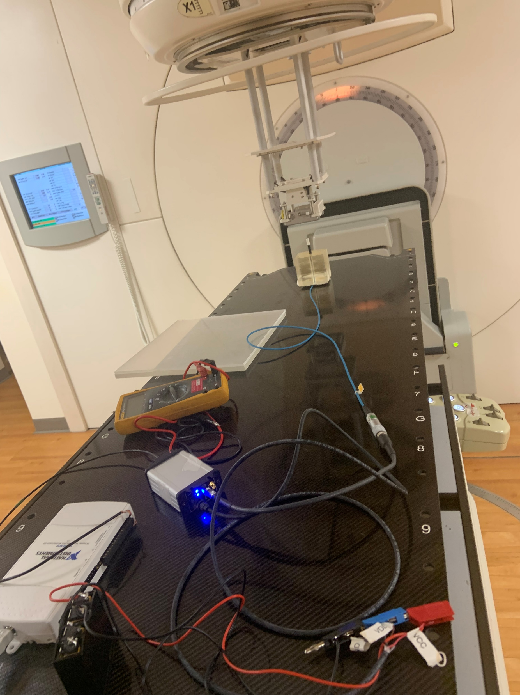
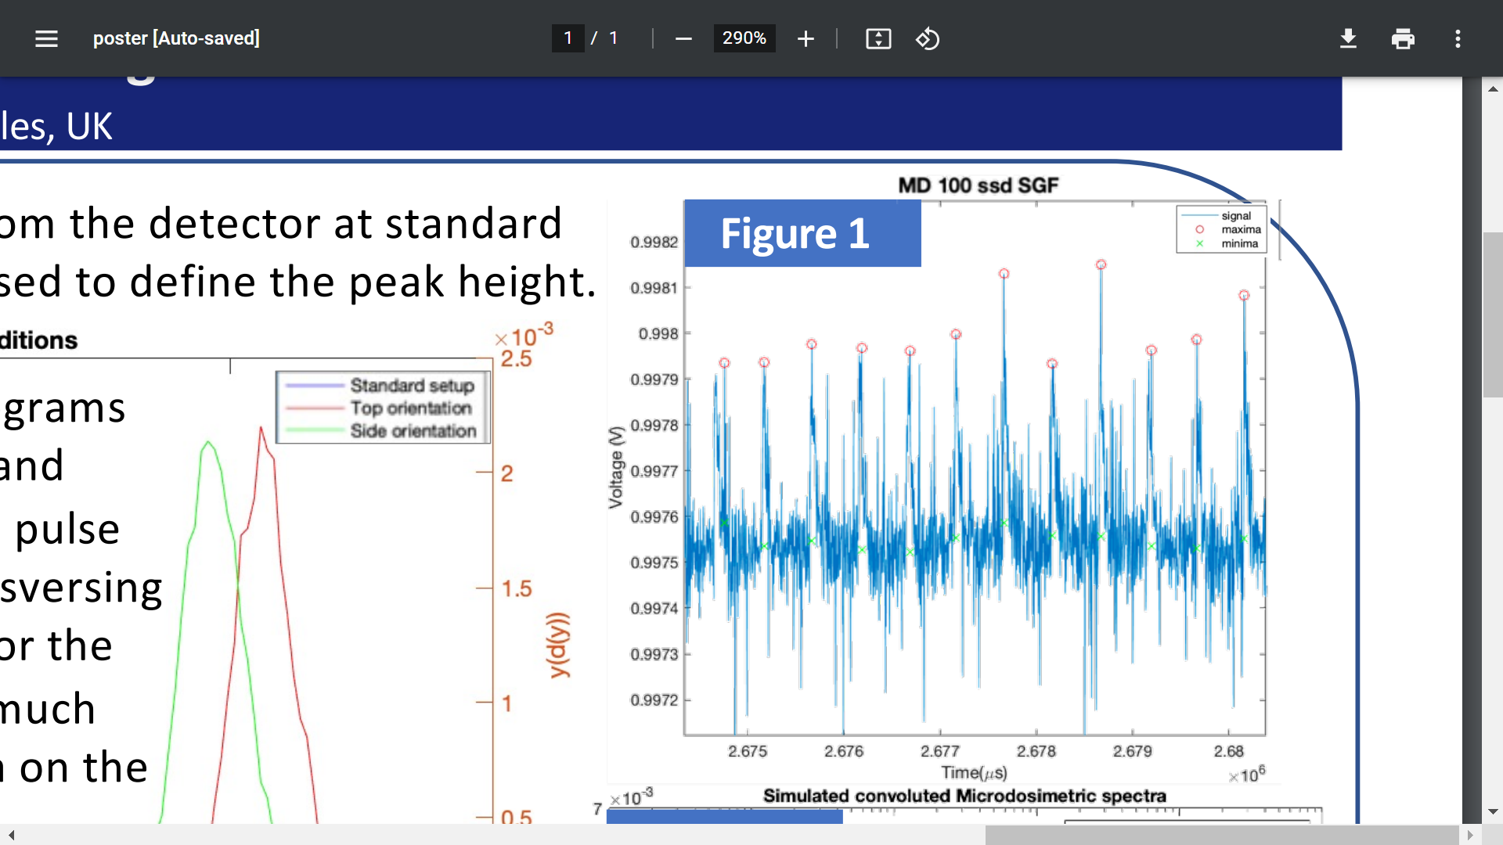
Solid-State Detectors
Use at PoPLaR
AC pulses detected with the PTW microDiamond Pulses: 0.25 mGy (100s Gy/s instantaneous) [MSc of Ruhani Khanna]
Credit: R. Hugtenburg
microDiamond Detector
Radiation creates electron-hole pairs in diamond, collected under bias
    Small active volume, fast response
    Rate independent up to 1000Gy/s
    Over responds by 7% at 16kGy/s
Read out with in-house electronics
Detects single pulses at 0.25mGy/pulse on a LINAC
Pulse stretch electronically for sampling
At PoPLaR would measure the electrons not the protons
    Protons would not get through the housing
Requires a good understanding of electron distribution

Slide 14
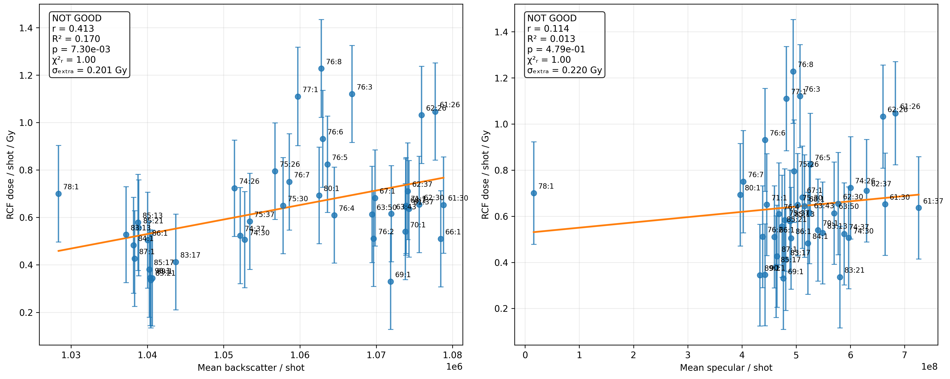
PoPLaR
Near-Term Diagnostics
Laser Diagnostics
Backscatter and Specular light are collected on every shot
Compared these values to the delivered dose to the RCF
Where several shots were on one RCF, the laser signal and dose were each averaged.
Neither diagnostic provides useful prediction of dose

Slide 15
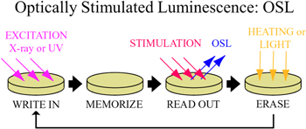
Optically Stimulated Luminescence Dosimeters (OSLD)
PoPLaR
LET Detectors
Impurities introduced create additional energy levels which trap electrons
The electrons can then be released through external stimulation
Offline measurements
Mark Hill is currently testing at Oxford
Not a real-time response
Also measures dose
Most likely in place of cells
Adapted from Nanto and Okada, “Optically stimulated luminescence dosimeters: principles, phosphors and applications,” Japanese Journal of Applied Physics, 62, 010505 (2023). https://doi.org/10.35848/1347-4065/ac9106.
Notes:
Preliminary data indicate reasonably good agreement with modelling across the Bragg peak and can obtain 2D LET distributions
Requires appropriate calibration

Slide 16
PoPLaR
Short-Term Diagnostics Summary
SciFi Arrays
SciFi around Cell Dish
RCF behind Cell Dish
microDiamond Detector

Slide 17
Long-Term

Slide 18
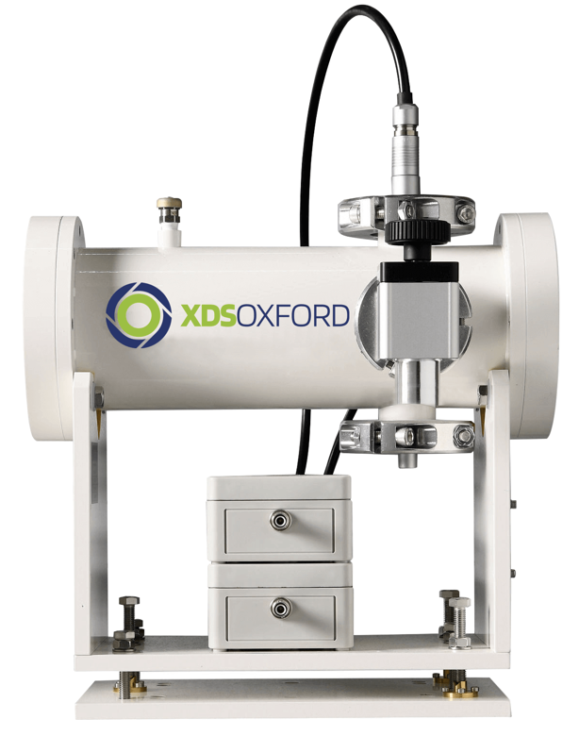
Ionisation Chambers
Thin-Window Ionisation Chambers
Electron-ion pairs created in a gas gap and collected by an external electric field
Due to the high dose per pulse, recombination causes large dose under-estimations
Boag’s model corrects recombination up to ~300Gy/s
Deviations up to 15% remain at ~1kGy/s
DOSION is a modified IC that reduces recombination to below 1% for instantaneous dose rates of 1kGy/s
LhARA’s expected instantaneous dose rates are 10⁸-10⁹Gy/s
IC Spec Ionisation Chamber from XDS Oxford
Potential commercial option
25 μm Kapton entrance and exit windows
6 × 36 mm aperture is too small for the beam
Severe recombination expected

Slide 19
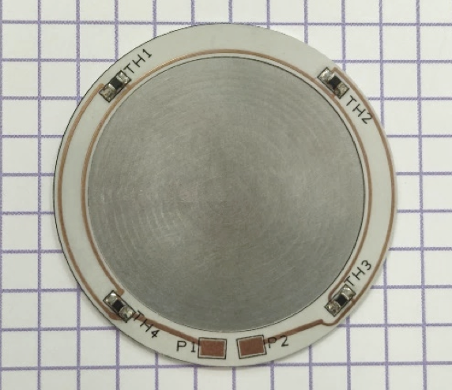
Calorimeters
Transmission Calorimeter
Work done by Sam Flynn at NPL
Dose from the temperature rise
The beam passes through it
Designed for FLASH radiotherapy; final prototype built and testing completed in 2025
Lowest tested dose was 2 Gy, with potential to reach 0.3 Gy
PoPLaR will require a thinner, customised design for the lower energy
Could provide a stable, well-understood reference measurement of dose
Calorimeter cores take ~3 seconds to peak
    In testing 120 seconds were left between irradiations to let the heat dissipate
    Cumulative measurement
Photograph of the hybrid dosimeter calorimeter core. Reproduced from S. Flynn et al., JINST 21, P06001 (2026), Fig. 1, CC BY 4.0, doi:10.1088/1748-0221/21/06/P06001
Notes:
£10,000
Linear response at tests of 1.8 MGy/s instantaneous dose rate using 6MeV electrons

Slide 20
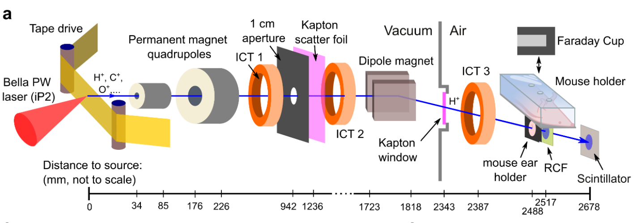
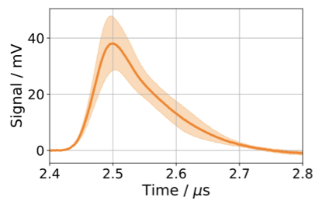
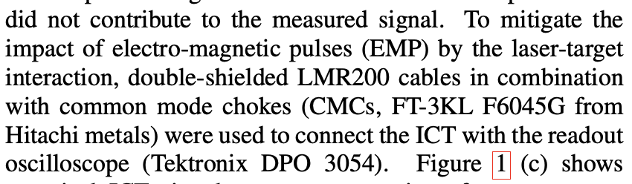
Integrated Current Transformers
A coil around the beam picks up the current of the passing charge. Integrating the signal gives the charge per shot
In-beam and non-destructive
Real-time charge per shot
Depending on rise time unlikely to show bunch shape
Can still use the integrated charge
No species discrimination
Potential issue with EMP
Used at BELLA and correlated with dose to handle the shot-to-shot variation
Obst-Huebl, Lieselotte, et al. "Radiation damage to normal mammalian tissue in vivo with laser-driven protons at ultra-high instantaneous dose rate." arXiv preprint arXiv:2602.20460 (2026).
Geulig, Laura D., et al. "Online charge measurement for petawatt laser-driven ion acceleration." Review of Scientific Instruments 93.10 (2022).
Notes:
Signal trace measured with the ICT
and the oscilloscope readout representative of the ion beam charge
measurements during cell sample irradiations. The solid line shows
an average over 10 shots and the shaded area indicates the standard
deviation.
EMP:
Double-Shielded Cabling
Common Mode Chokes (CMCs) along the cables
Electron & Radiation Deflection
Conductive Metallic Shielding around the coils
Temporarily store induced current in an internal coaxial capacitor before discharging it smoothly across a load

Slide 21
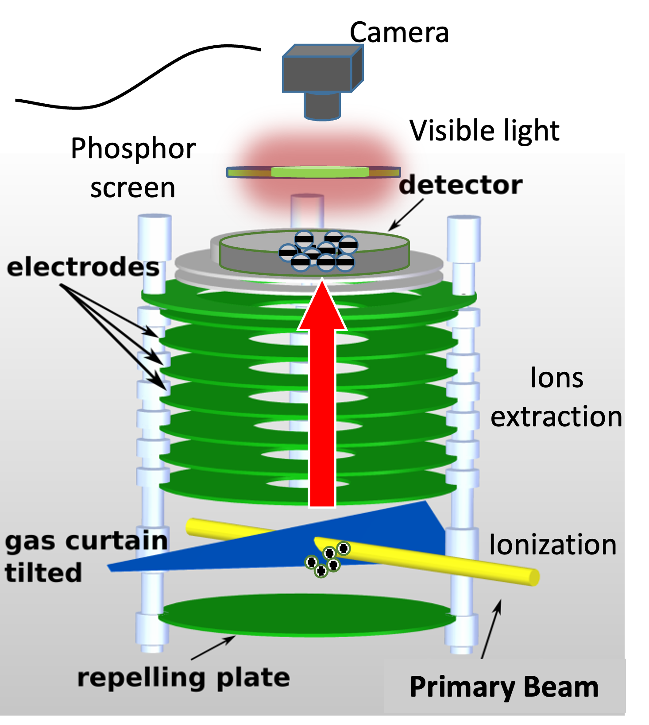
Air Fluorescence
Supersonic Gas Jet Ionisation Profile Monitor
A gas jet (typically Nitrogen) creates an extremely thin, flat supersonic gas curtain at 45° across the beam
The beam ionizes a fraction of the gas and an electric field guides them to a micro-channel plate detector
Non-destructive, ultra-fast readout and dose-rate independent
Measures 2D beam profile, position and current
Potentially can measure absolute beam energy but requires gas-ion interaction cross-sections, which are currently sparse in the literature for LhARA’s energy regime

Slide 22
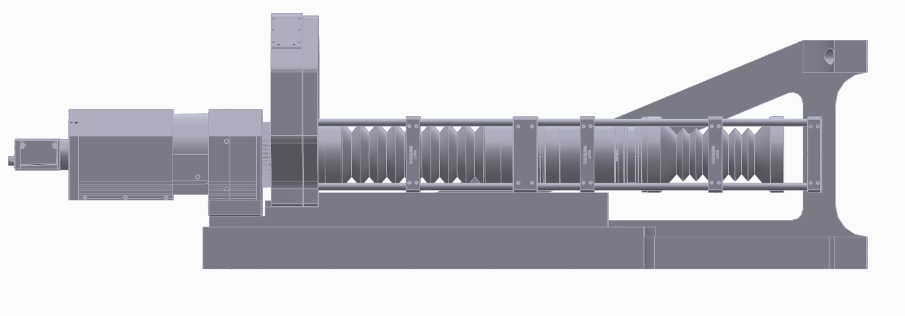
Air Fluorescence
Optical Air Fluoresence Monitor
Same principle as the gas curtain monitor but uses fluorescence in air
Largest signal comes from N₂
The count rate indicates the beam current
Current experiments use 10mm of air but this can be reduced down to a few mm
Previous work on N₂ fluorescence suggests the main issue is the sunlight background, however for a pulsed beam the signal may be high enough to avoid this
Apochromatic Triplet F= 600
Image Intensifier
Camera
Beam
25:7 imaging optics
Band pass Filter wheel
Aperture
Depth of field

Slide 23
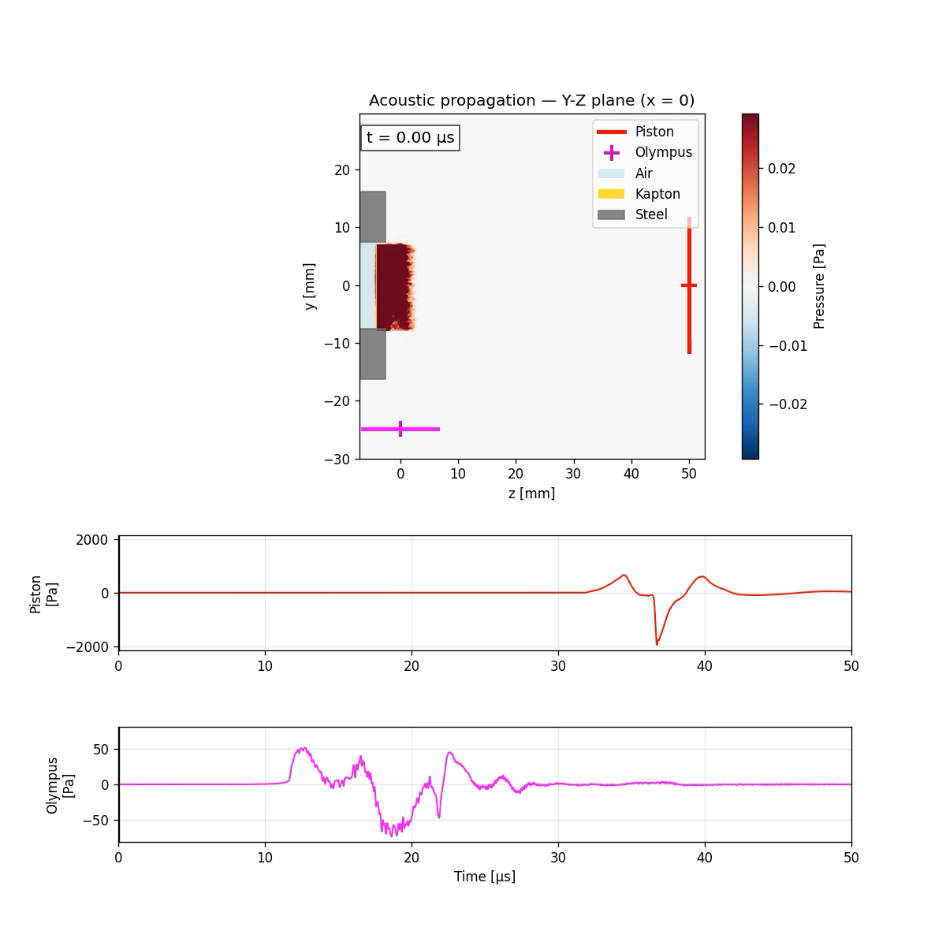
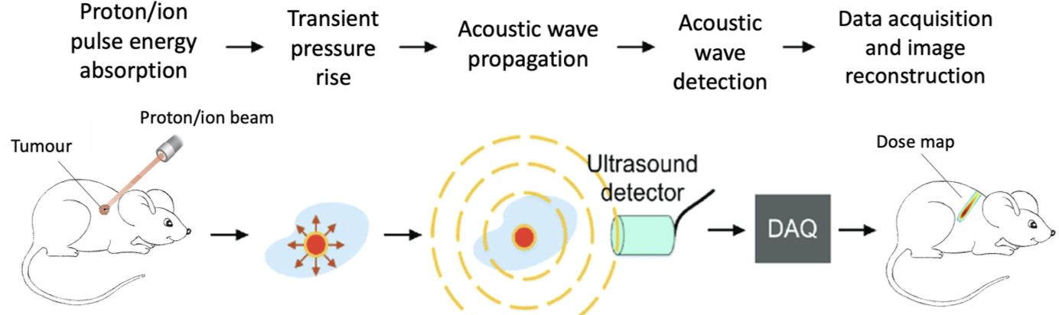
Ion-Acoustic
When the bunch length is smaller than the stress relaxation time of the liquid this generates ultrasonic acoustic waves detectable by ultrasound detectors
Real-time 3D spatial dose distribution measurement
Avoids saturation
Fast readout
Low signal amplitudes at low dose per shot require high-gain pre-amplifiers
Requires significant research and improved spatial acoustic detectors for full 3D reconstruction
    Tests comparing acoustic and scintillating outputs at LMU
    being analysed currently
Schematic diagram of the ion-acoustic wave generation and detection. Taken from M. Maxouti, PhD Thesis, Imperial College London (2025)

Slide 24
Conclusions
  LhARA
    Needs high rep-rate, non-destructive, FLASH-dose rate dosimetry (10⁸-10⁹ Gy/s, 5% accuracy)
    Actively researching several including gas jet, air fluorescence and ion-acoustic detectors
  PoPLaR
    Testbed to investigate new diagnostics
    RCF is currently our main diagnostic and it is offline
    Near-term tests: scintillating fibre arrays and fibre around the cell dish, RCF behind transwells, the microDiamond (measuring the electrons), and OSL films for LET.
    Longer term: ICT for charge per shot (proven at BELLA), a transmission calorimeter as a stable dose reference, and the gas jet, air fluorescence and ion-acoustic monitors for in-beam profile and dose.
Notes:
The pattern is the same across all of these: something fast for every shot, something absolute for the calibration. PoPLaR is where we find out which pair works at these energies and doses.

Slide 25
Thank you
LhARA/CLF Workshop
02/11/2026

