Slide 1


Ion Beam Transport for EPAC: A Comparison of Quadrupole and Solenoid-Based Beamline Concepts
Lauren McCollum

Slide 2
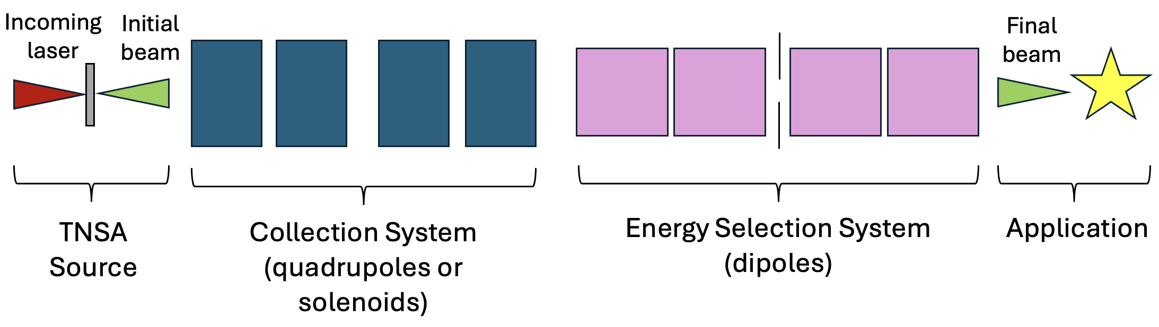
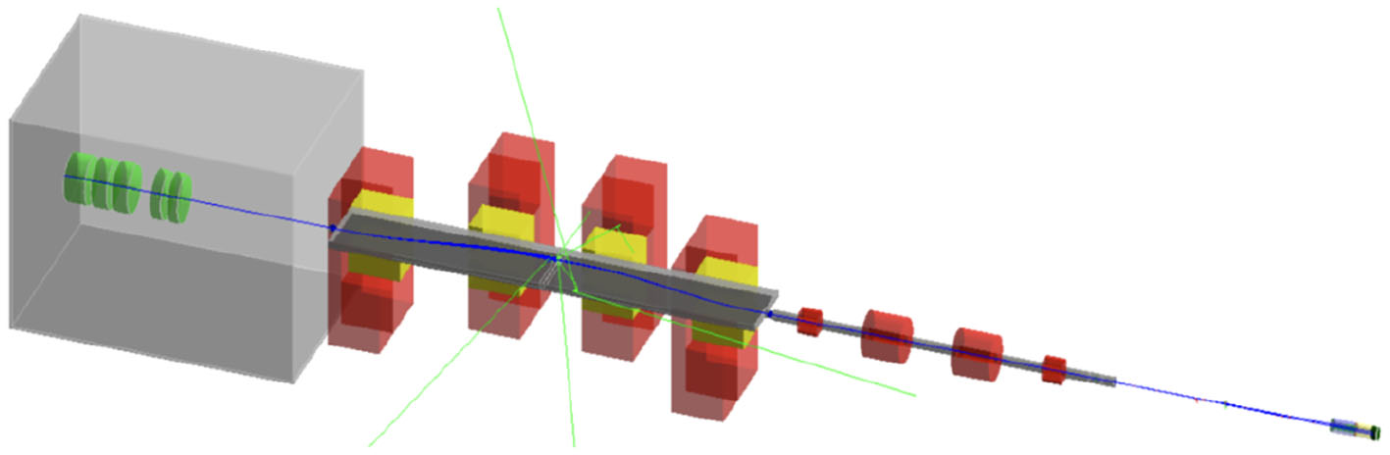
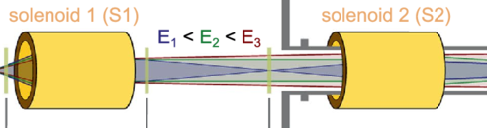
Motivation
Laser-driven ion acceleration experiments show proton energies up to 150 MeV with high flux per shot
These proton beams exhibit large angular divergence and broad energy spread
(quadrupoles or solenoids)
(dipoles)
ELIMED beamline at ELI Beamlines
Solenoid beamline at the Draco Petawatt facility
Which magnet is better for a collection system in order to increase transmission into the energy selection system and achieve better output flux?
ELIMED beamline: Cirrone GAP et al (2020) ELIMED-ELIMAIA: The First Open User Irradiation Beamline for Laser-Plasma-Accelerated Ion Beams. Front. Phys.
Draco beamline: Brack, Florian-Emanuel et al (2020) Spectral and spatial shaping of laser-driven proton beams using a pulsed high-field magnet beamline. Scientific Reports.

Slide 3
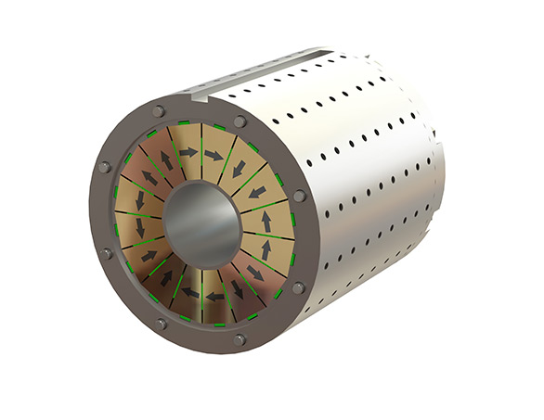
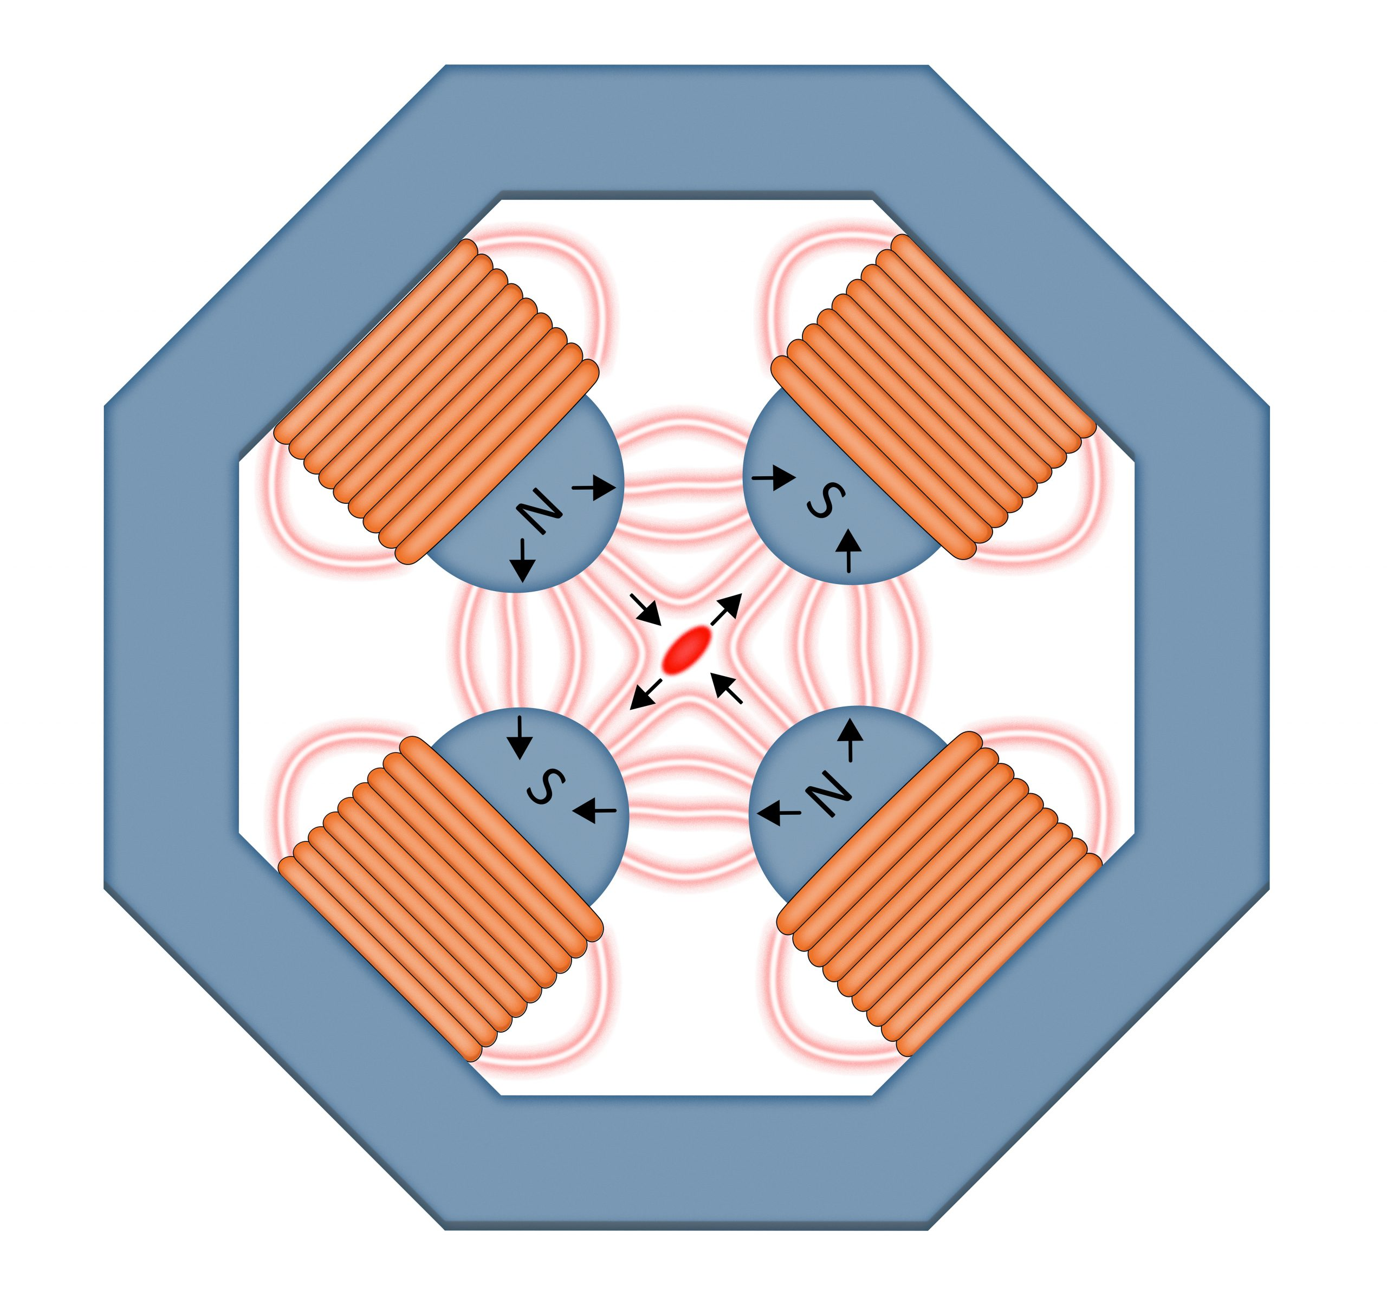
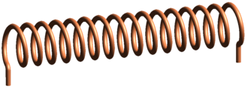
What do these magnets actually look like?
Permanent Magnetic Quadrupoles (PMQs)
Electromagnetic Quadrupoles (EMQs)
Solenoids
Helical coil of wire through which an electrical current flows
Variable magnetic field
Permanent magnetic material in a Halbach array
Fixed magnetic field
Current carrying coils wound around iron poles
Variable magnetic field
PMQ: antec-group.com/en/magnets/permanent
EMQ: Pinson Jerald (2020) The power of attraction: magnets in particle accelerators, news.fnal.gov
Solenoid: Wikipedia contributors. (2026) Solenoid. Wikipedia, The Free Encyclopedia.

Slide 4
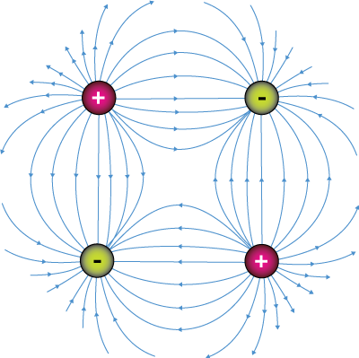
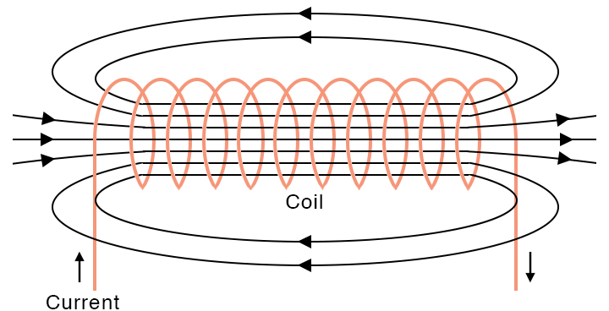
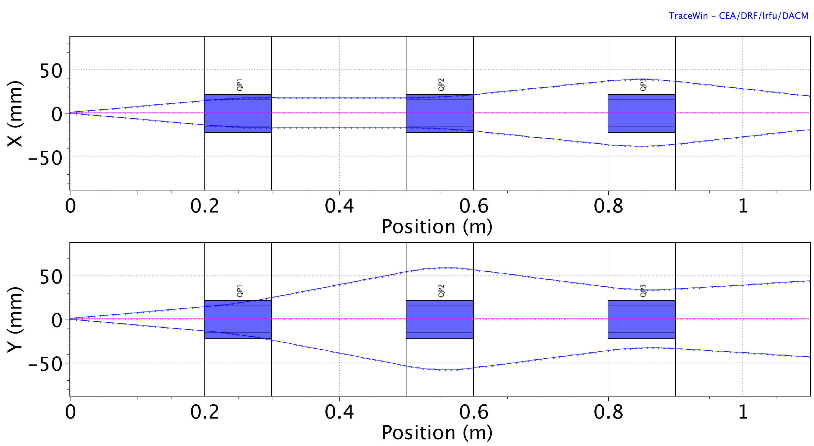
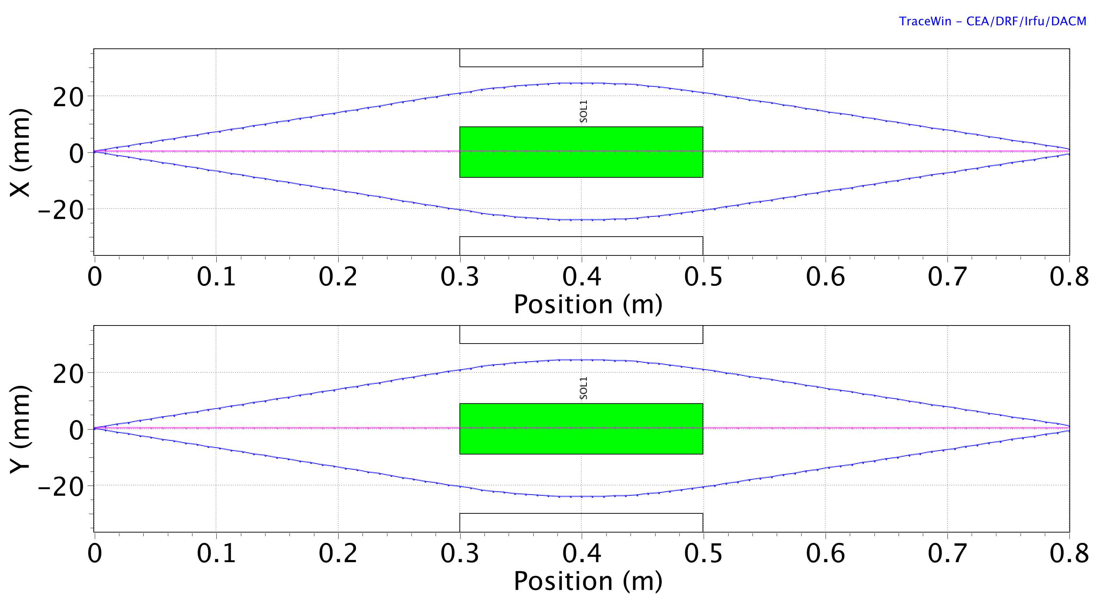

Proton Focusing using Quadrupoles vs Solenoids
$$F=q ( E+v × B )$$
Quadrupole field: xaktly.com/ElectricField
Solenoid field: www.sciencefacts.net/solenoid-magnetic-field

Slide 5
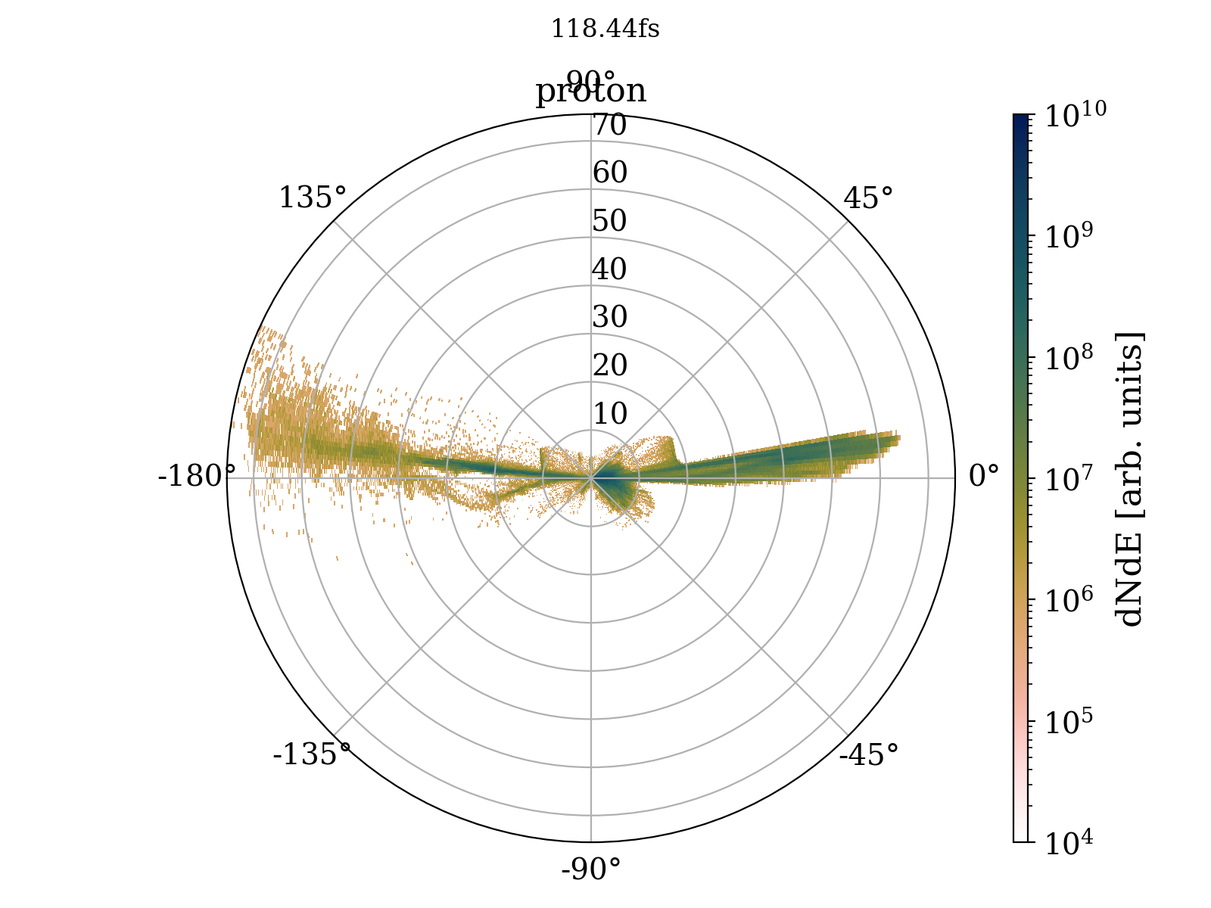
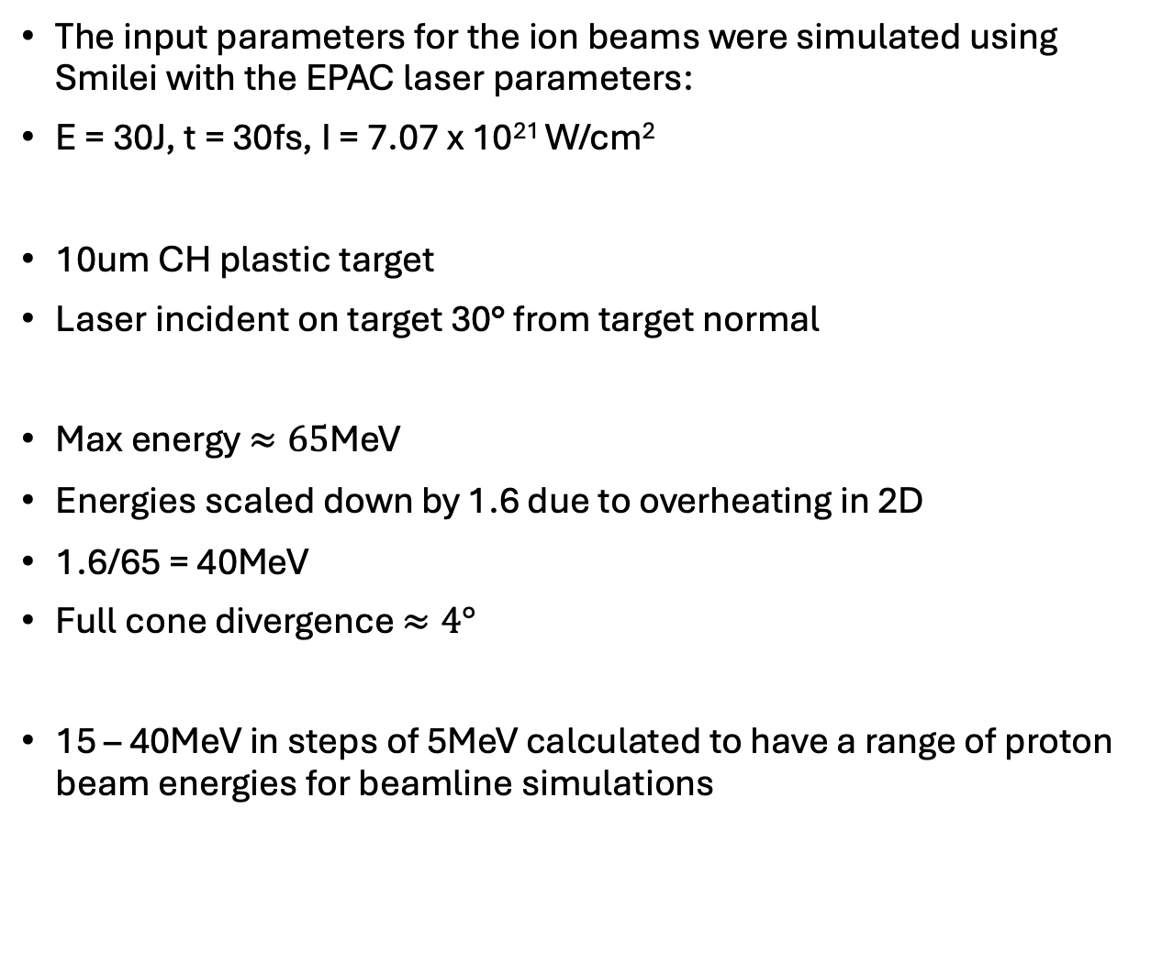
PIC Simulations - Smilei
The input parameters for the ion beams were simulated using Smilei with the EPAC laser parameters:
E = 30J, t = 30fs, I = 7.07 x 10²¹ W/cm²
10um CH plastic target
Laser incident on target 30° from target normal
Max energy $≈65$MeV
Energies scaled down by 1.6 due to overheating in 2D
1.6/65 = 40MeV
Full cone divergence $≈4°$
15 – 40MeV in steps of 5MeV calculated to have a range of proton beam energies for beamline simulations
Scaling factor: Lillian A. et al (2025) Intensity and dimensionality-dependent dynamics of laser-proton acceleration in 1d, 2d, and 3d particle-in-cell simulations. Physics of Plasmas

Slide 6
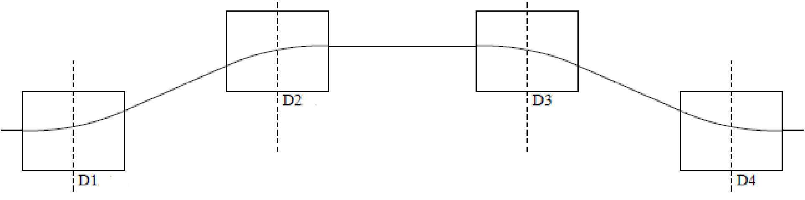
TraceWin Simulations – Designing 3 beamlines
In order to simulate the effect of magnetic quadrupoles and solenoids on a particle beam, the particle tracing software TraceWin was used
The energy selection system (ESS) in all simulations is a collimating aperture followed by a chicane of 4 dipole magnets
Chicane: Castro P (2003) Beam trajectory calculations in bunch compressors of FFT2, DESY Technical Note

Slide 7
TraceWin Simulations – Designing 3 beamlines
For simplicity in simulation, the ESS is represented by 3 apertures in order to calculate the transmission of the proton beam through the system
Optimal injection into ESS: beam waist in x and collimated beam in y at the selection aperture
Chicane: Castro P (2003) Beam trajectory calculations in bunch compressors of FFT2, DESY Technical Note

Slide 8
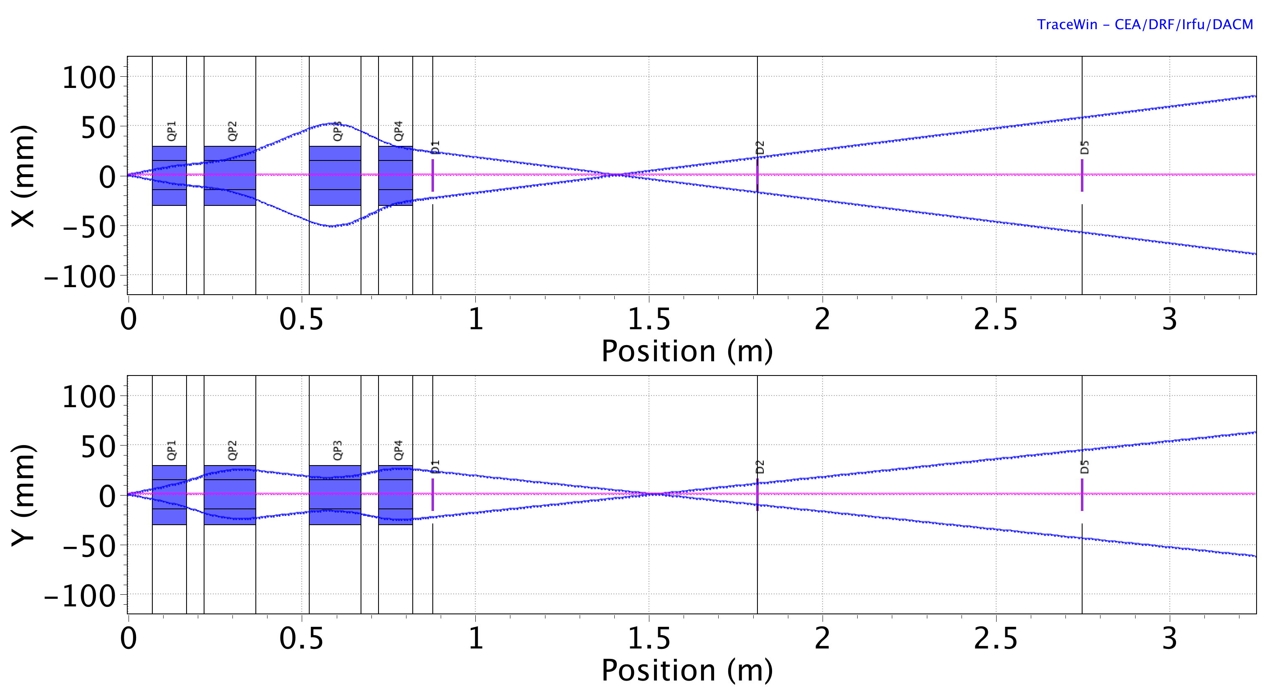
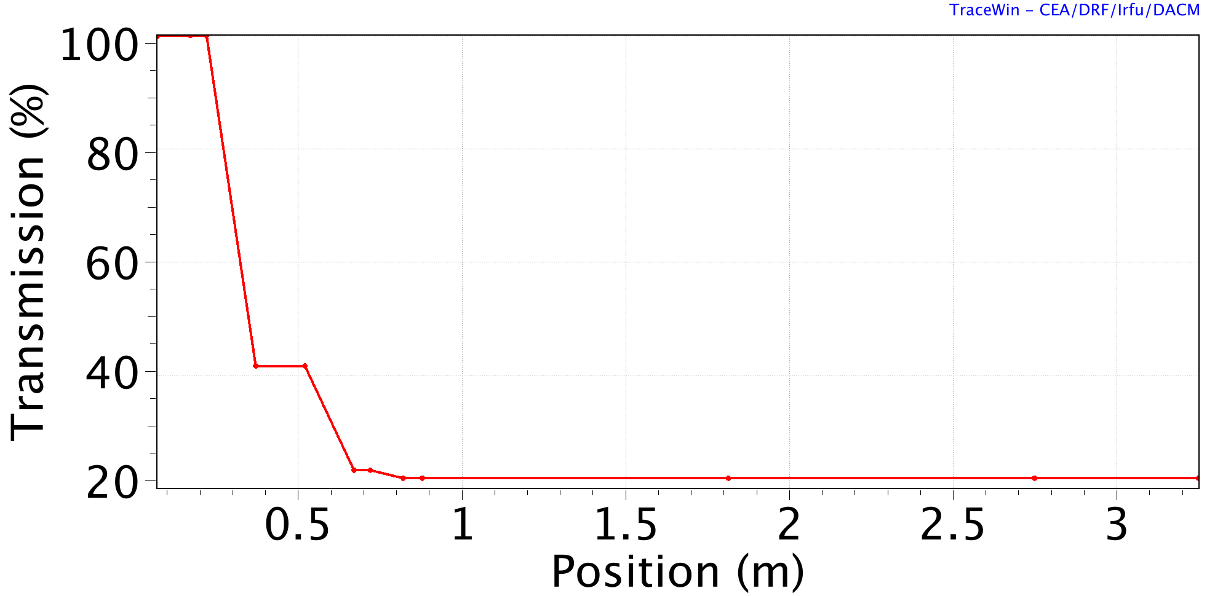
TraceWin Simulations – Designing 3 beamlines
4 PMQs
Quadrupole | Length [mm] | MagneticField Gradient [T/m]
PMQ1 | 100 | +39
PMQ2 | 150 | -39
PMQ3 | 150 | +39
PMQ4 | 100 | -39

Slide 9
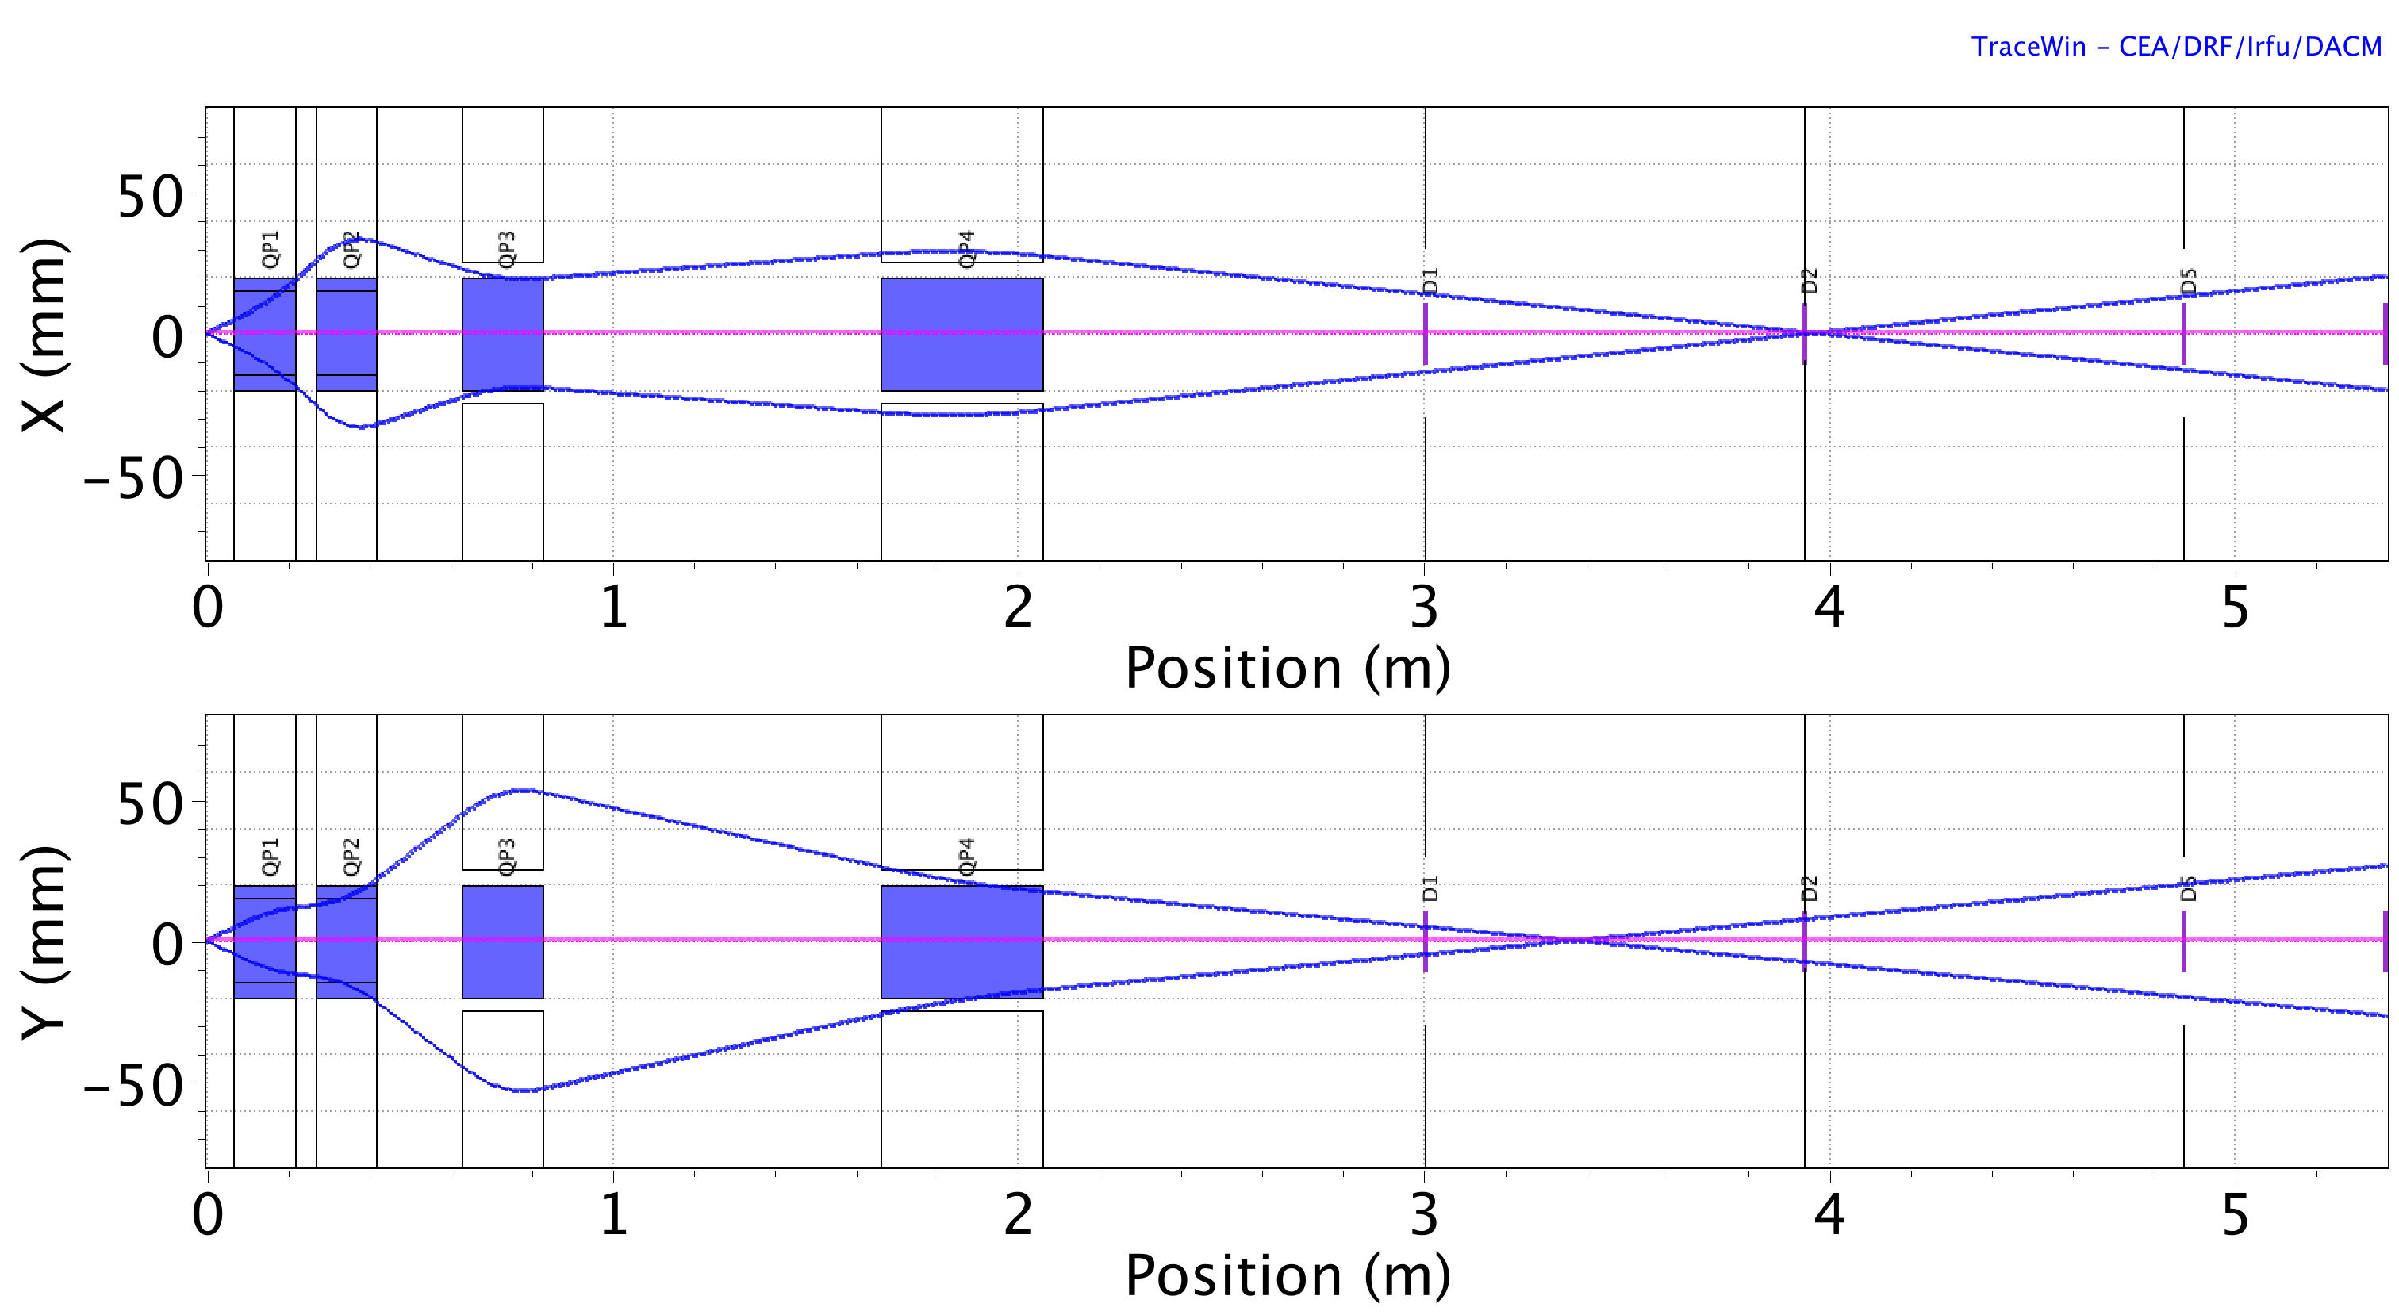
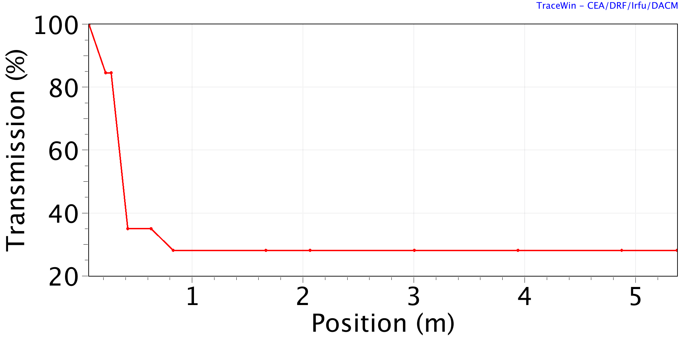
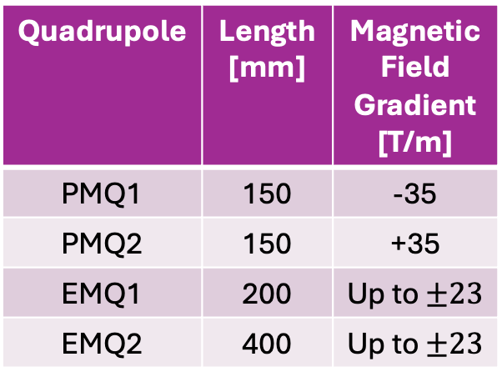
TraceWin Simulations – Designing 3 beamlines
2 PMQs + 2 EMQs
4 PMQs
Quadrupole | Length [mm] | MagneticField Gradient [T/m]
PMQ1 | 150 | -35
PMQ2 | 150 | +35
EMQ1 | 200 | Up to $±23$
EMQ2 | 400 | Up to $±23$

Slide 10
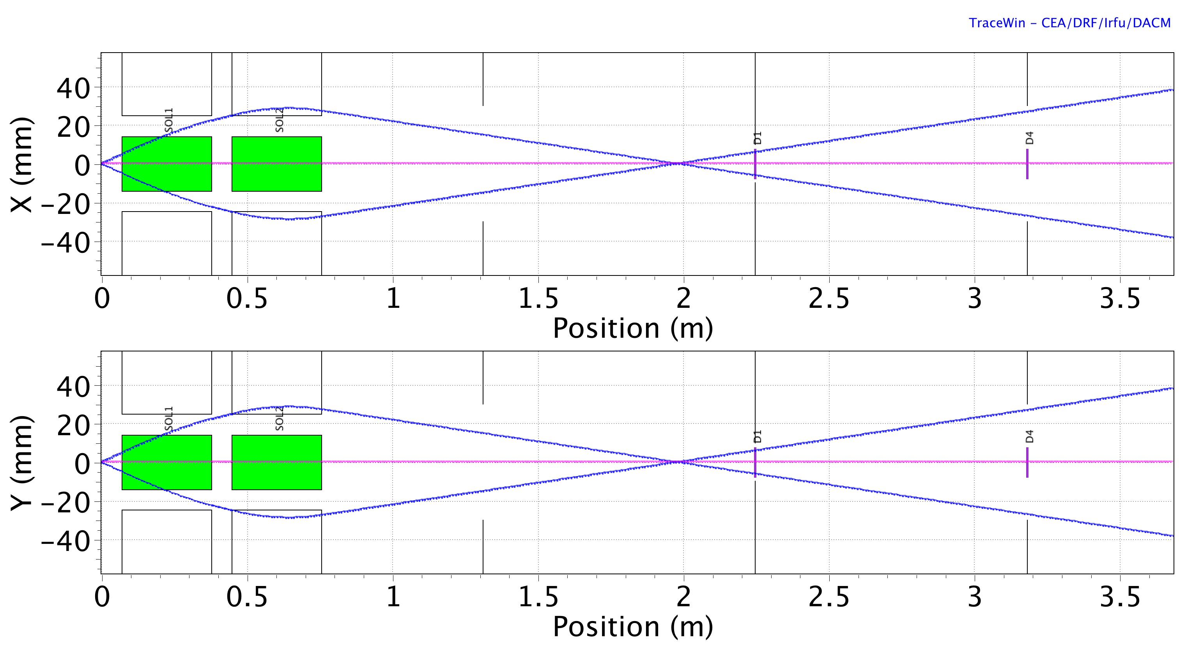
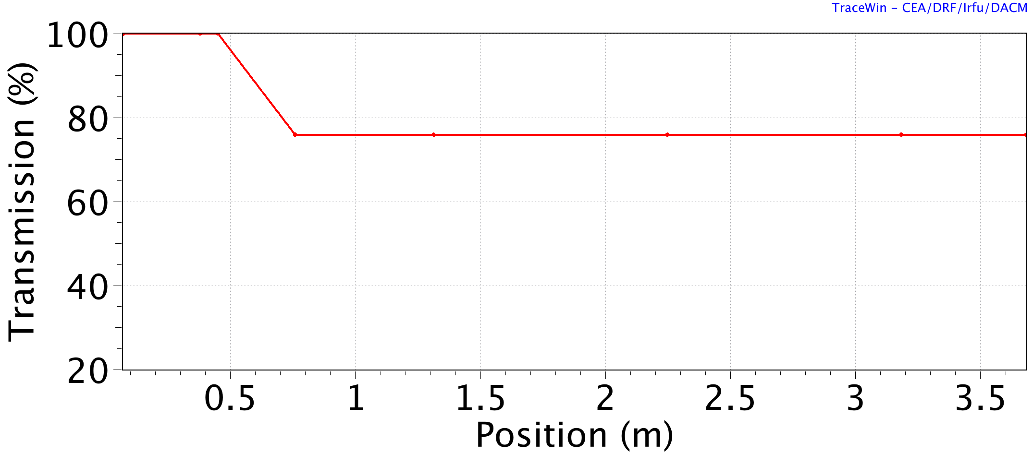
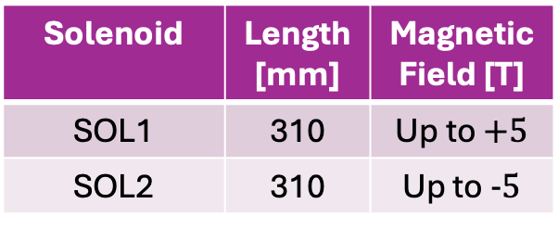
TraceWin Simulations – Designing 3 beamlines
2 Solenoids
4 PMQs
2 PMQs + 2 EMQs
Solenoid | Length [mm] | MagneticField [T]
SOL1 | 310 | Up to $+5$
SOL2 | 310 | Up to $−5$

Slide 11
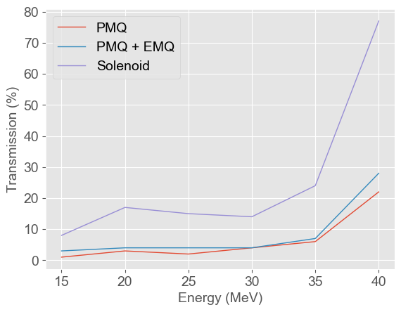
Transmission Comparisons
Transmission through the solenoid beamline is much better than either quadrupole beamline
The solenoids have variable magnetic fields depending on the current flowing through its coils and a symmetric field
Second best transmission is seen from the PMQ + EMQ beamline
EMQs have a larger bore than the PMQs and a variable magnetic field
4 PMQs
2 PMQs + 2 EMQs
2 Solenoids

Slide 12
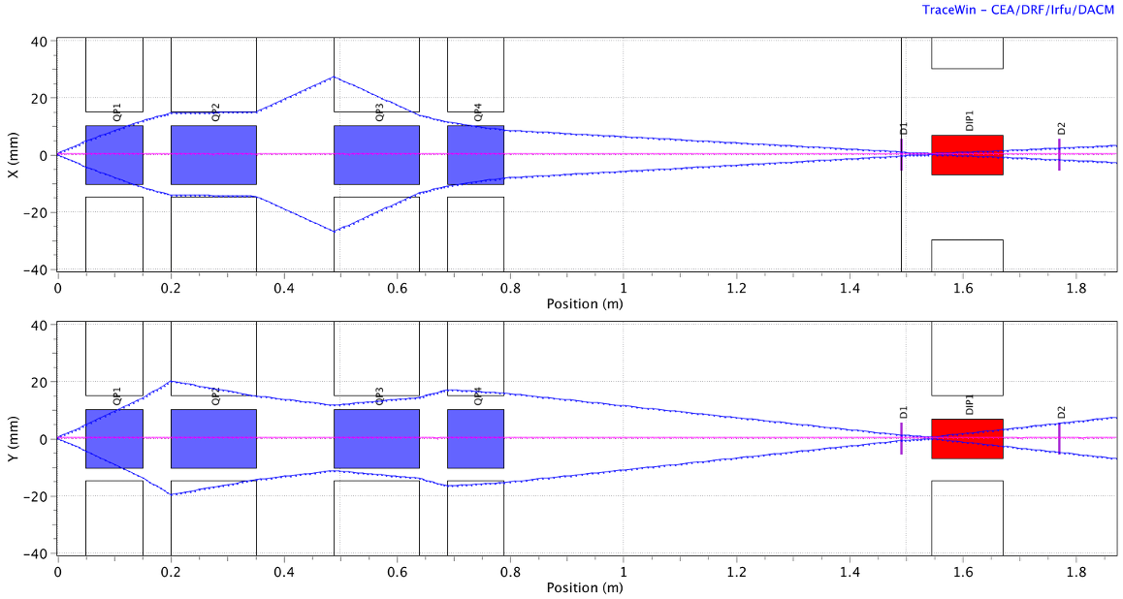
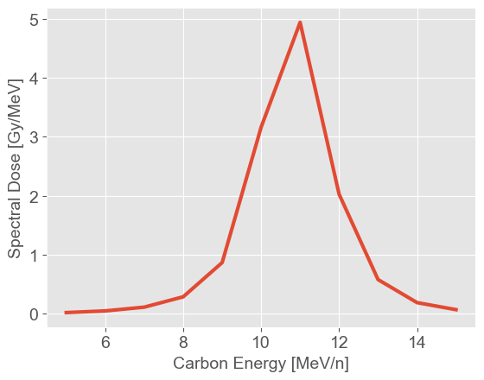
High Repetition Rate Operation at EPAC + Carbon Focusing
1Hz tape drive high repetition rate operation
PMQs are compatible with high rep rate without the additional cost
Beamline can enable biology study at 1Hz
Dipole placed behind PMQs to separate protons from carbon ions
Cells placed 100mm from end of dipole
Optimised for spot size of 5x5mm on cells
Carbon simulations with PMQ only beamline for carbon energies 5 – 15 MeV/n in steps of 1MeV
Integrating under spectral dose curve; total dose of 11.3Gy irradiating cells

Slide 13
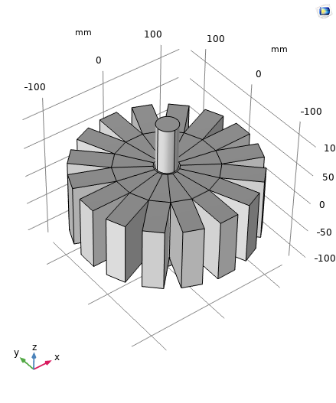
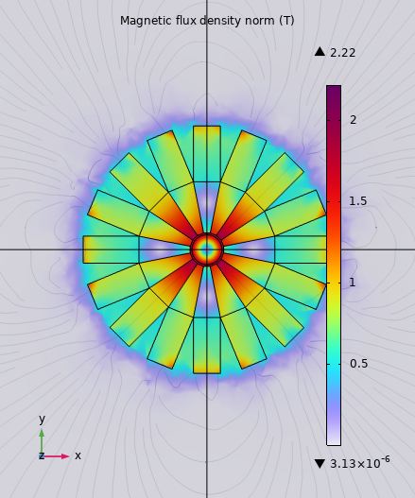
Conclusions + Additional Work
Three collection system configurations were explored using TraceWin simulations: a PMQ beamline, a combined PMQ + EMQ beamline, and a solenoid beamline
The results demonstrated that the solenoid beamline provides the highest transmission, primarily due to their symmetric focusing
In contrast, both quadrupole beamlines exhibited significant particle losses due to the defocusing plane increasing the beam size beyond the bore size of the quadrupole
The inclusion of EMQs in the PMQ + EMQ beamline improves transmission due to the ability to alter the magnetic field depending on proton energy but does not fully mitigate the limitations of the quadrupole
Additional work on error studies show the quadrupole-based beamlines experience large emittance growth and losses while the solenoid beamline maintains relatively stable beam transport, even when subjected to large errors
Additional work on modelling the magnets in COMSOL and importing their field maps into TraceWin for more accurate simulations

