Slide 1
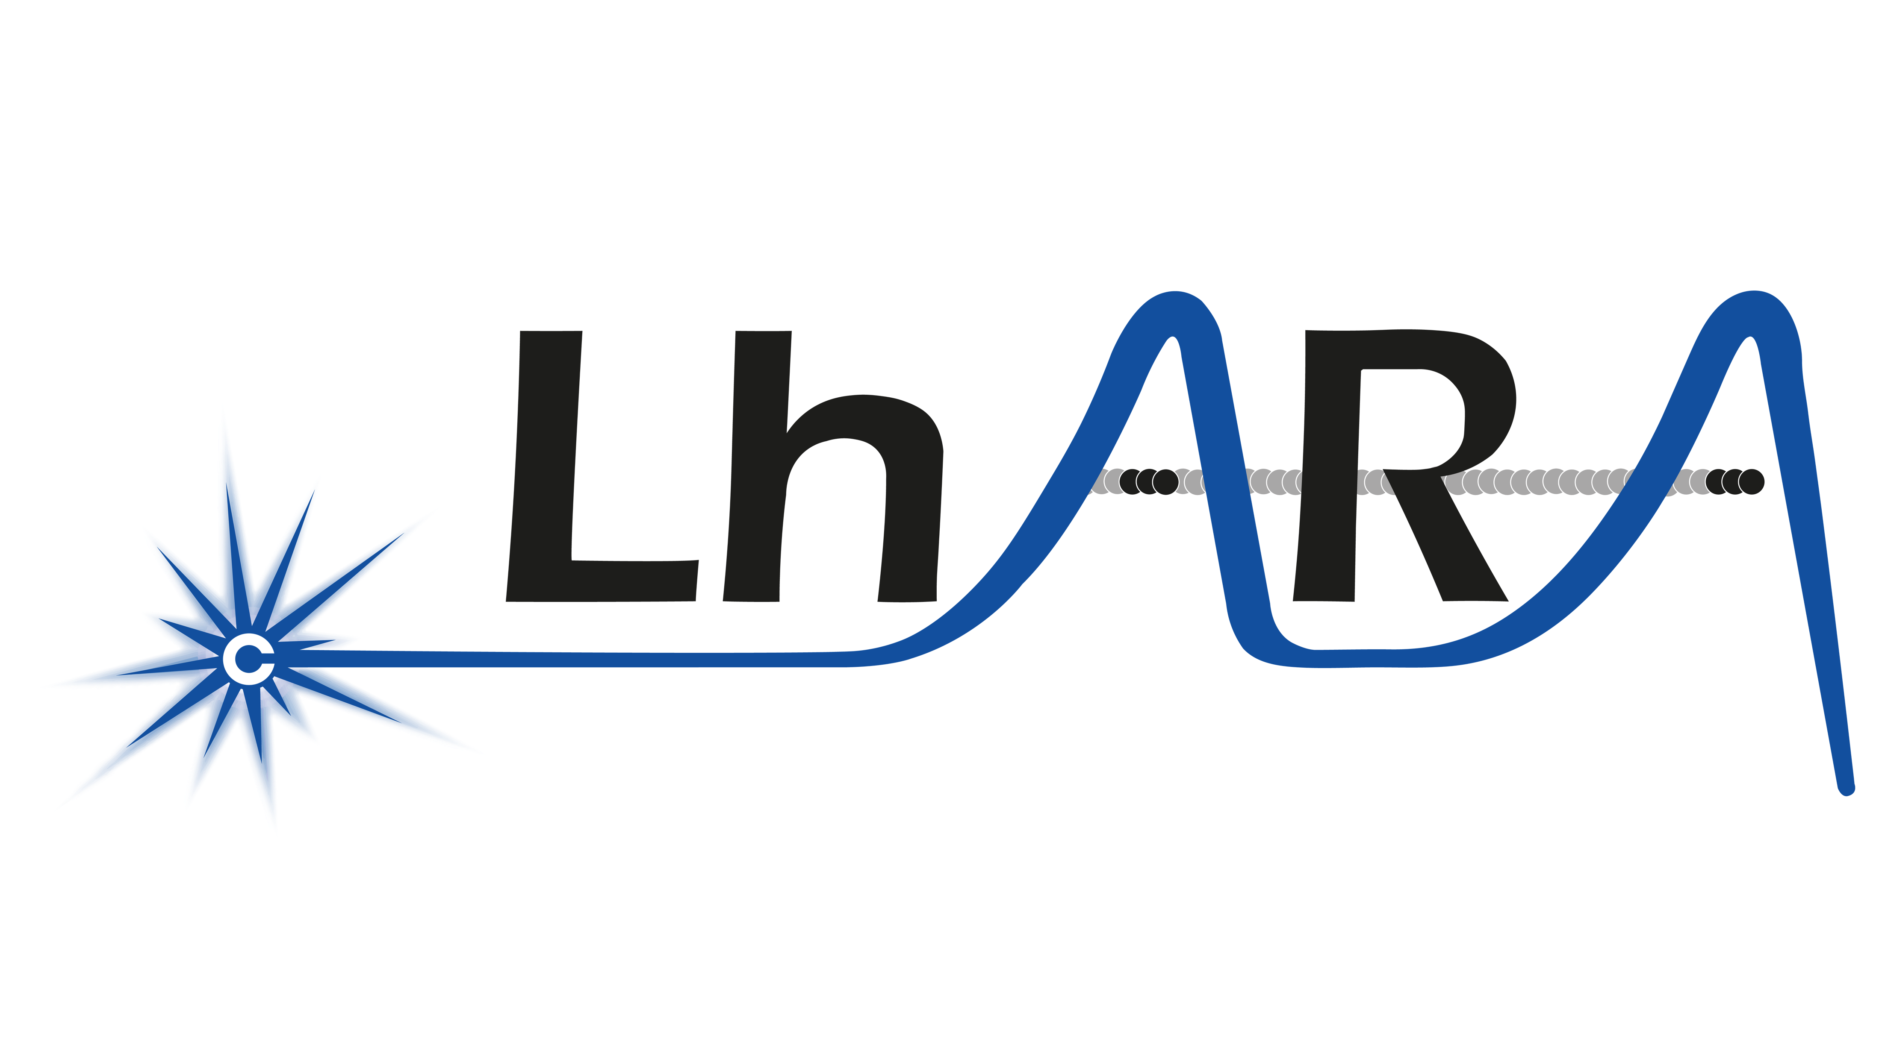
Update on cylindrical focusing
K.Long for P.Ruksasakchai
2 November 2026

Slide 2



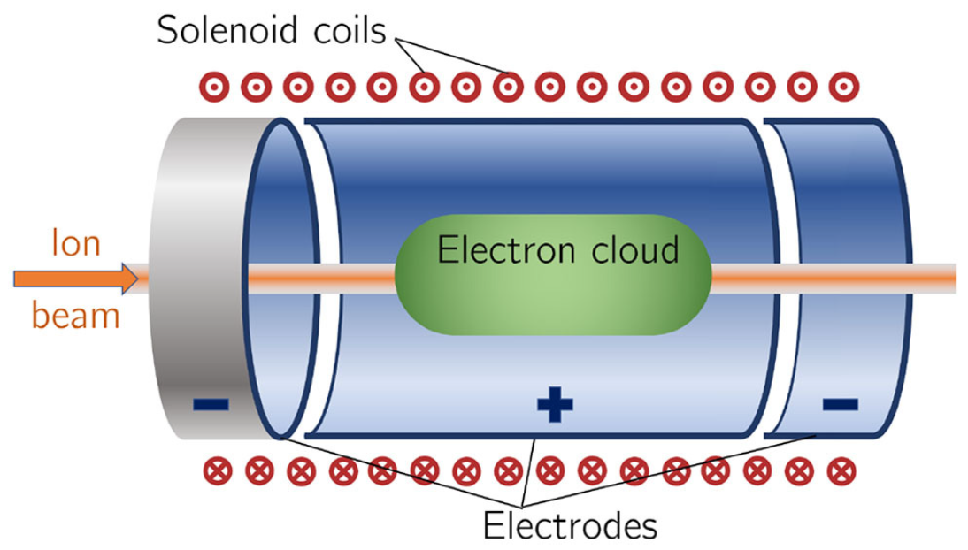
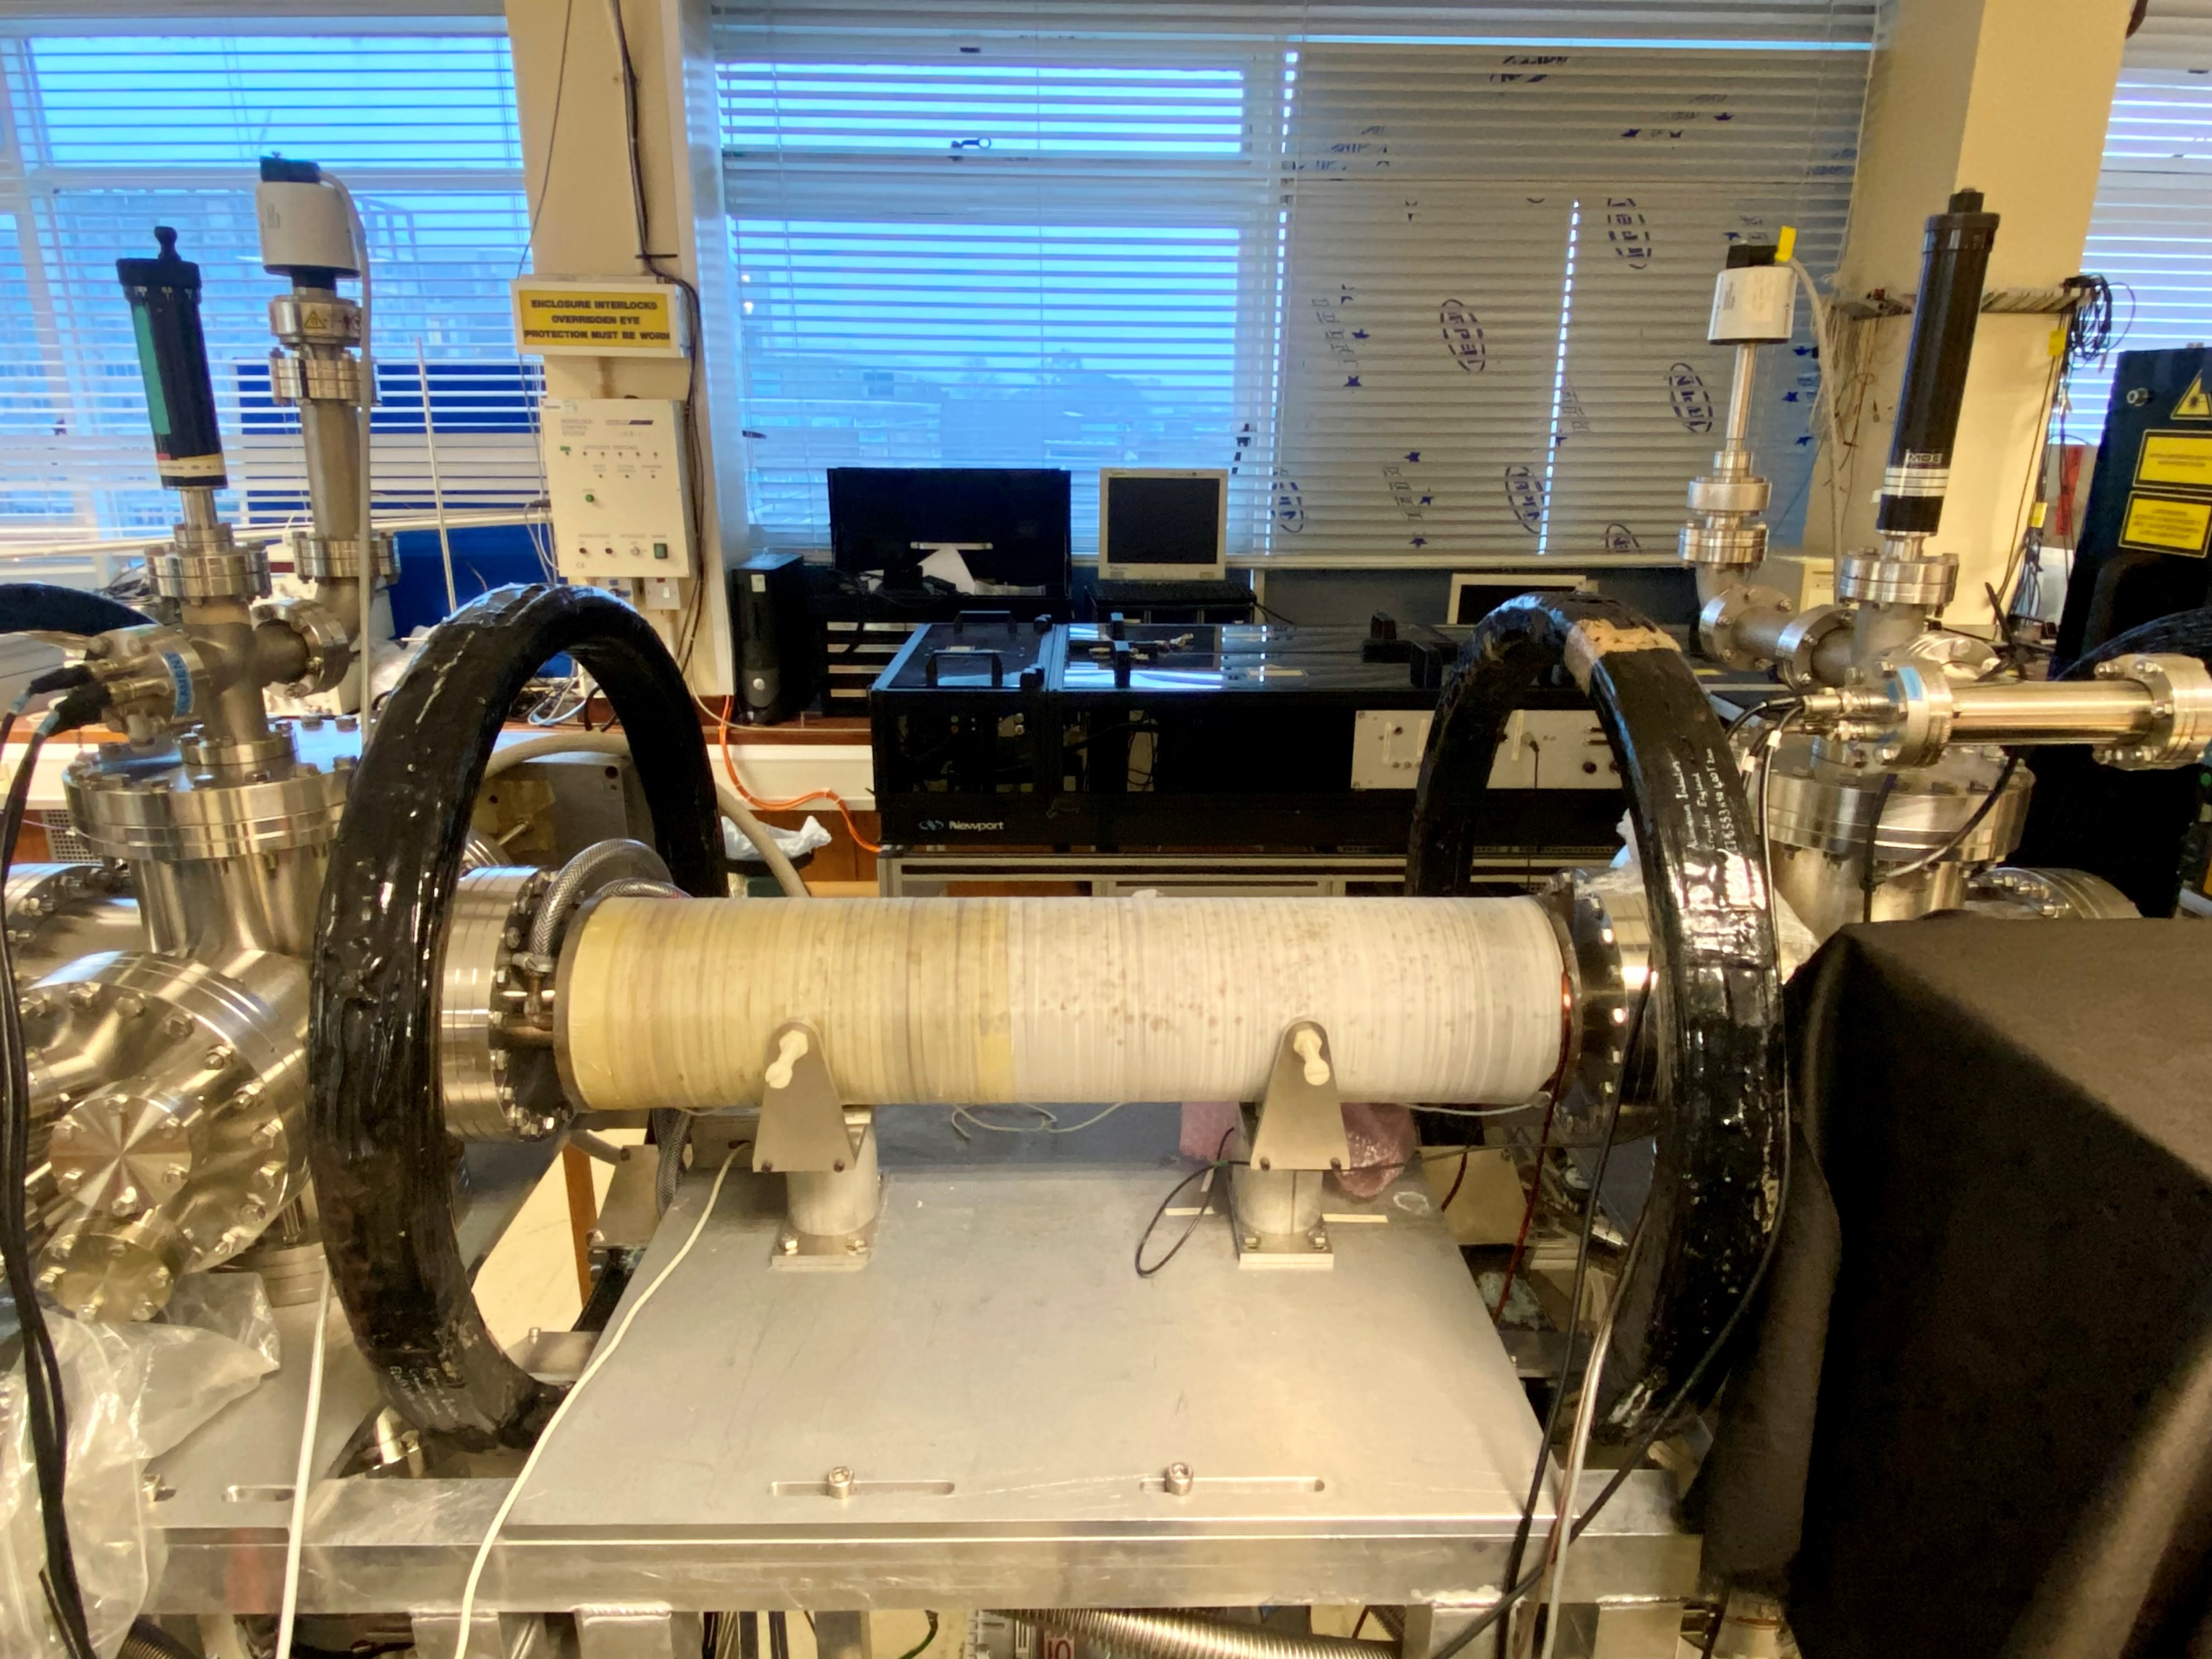
Gabor lens development
for Proton Capture and Focusing
Aymar, G., Becker, T., Boogert, S., Borghesi, M., Bingham, R., Brenner, C., ... & Xiao, R. (2020). LhARA: the laser-hybrid accelerator for radiobiological applications. Frontiers in Physics, 8, 567738.
LhARA / CLF workshop (2nd November 2026)

Slide 3
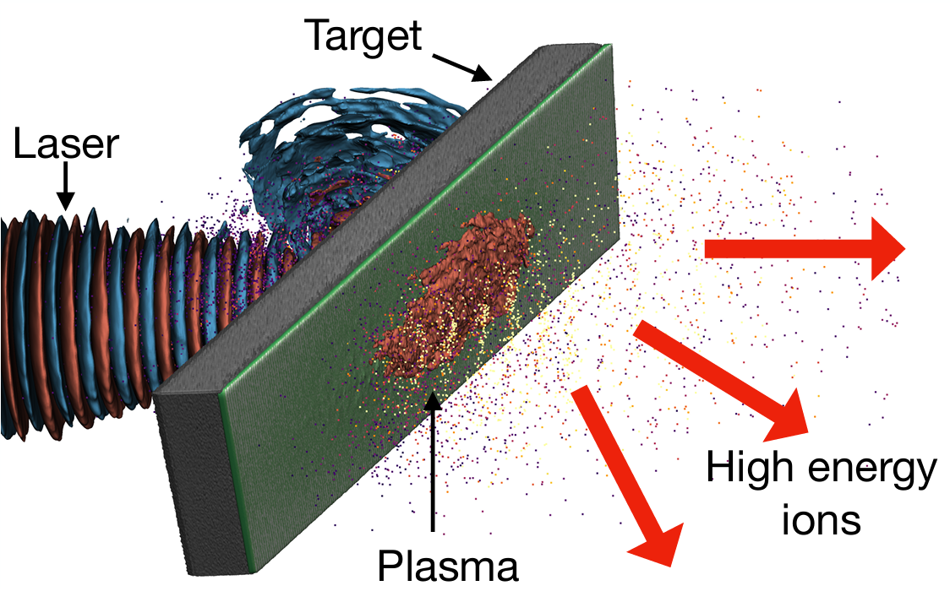
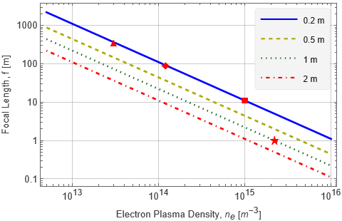
Gabor lens
The electron plasma acts as a continuous focusing medium
High energy
ion beam
Electron plasma
→ electric field
→ focusing effect
$$\overset{⃑}{E}$$
Ahmed, H., Alderton, M., Amos, R. A., Ariyanto, D. O., Baker, C. J., Bamber, J., ... & van der Werf, D. P. (2026). ITRF/LhARA conceptual design report (No. STFC-TR-2026-007). STFC.
Focal length of Gabor lens (the thin-lens approximation):
$\frac{1}{f}=\frac{e^{2}n_{e}l}{4ε_{0}U}$
where $e$ is electric charge of the electron
$n_{e}$ is the plasma density
$l$ is the length of the plasma
$ε_{0}$ is the permittivity of free space
$U$ is the kinetic energy of the positively charge particle.
T. S. Dascalu
Density = ~2×10¹⁵ m⁻³
Radius = ~4 cm
Length = 1 m
LhARA
*Passing a 10 MeV positively charged particle beam through the lens

Slide 4
How are the electrons confined?
Penning-Malmberg Trapping
Axial: electrostatic confinement
Radial: magnetic confinement
Aymar, G., Becker, T., Boogert, S., Borghesi, M., Bingham, R., Brenner, C., ... & Xiao, R. (2020). LhARA: the laser-hybrid accelerator for radiobiological applications. Frontiers in Physics, 8, 567738.
LhARA / CLF workshop (2nd November 2026)

Slide 5
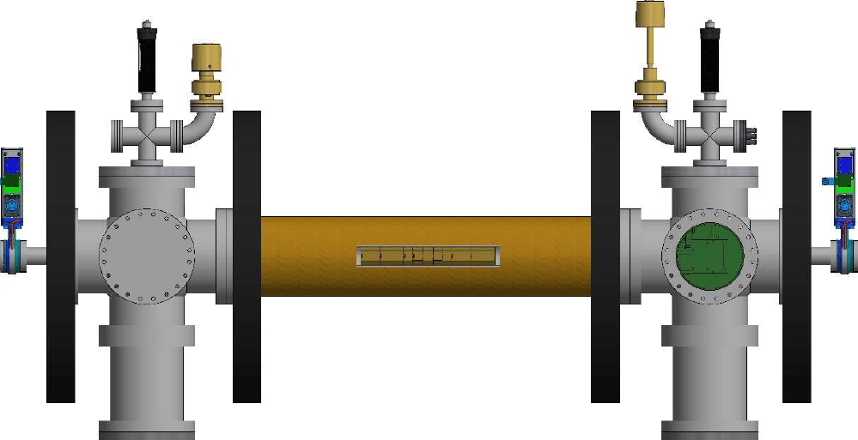
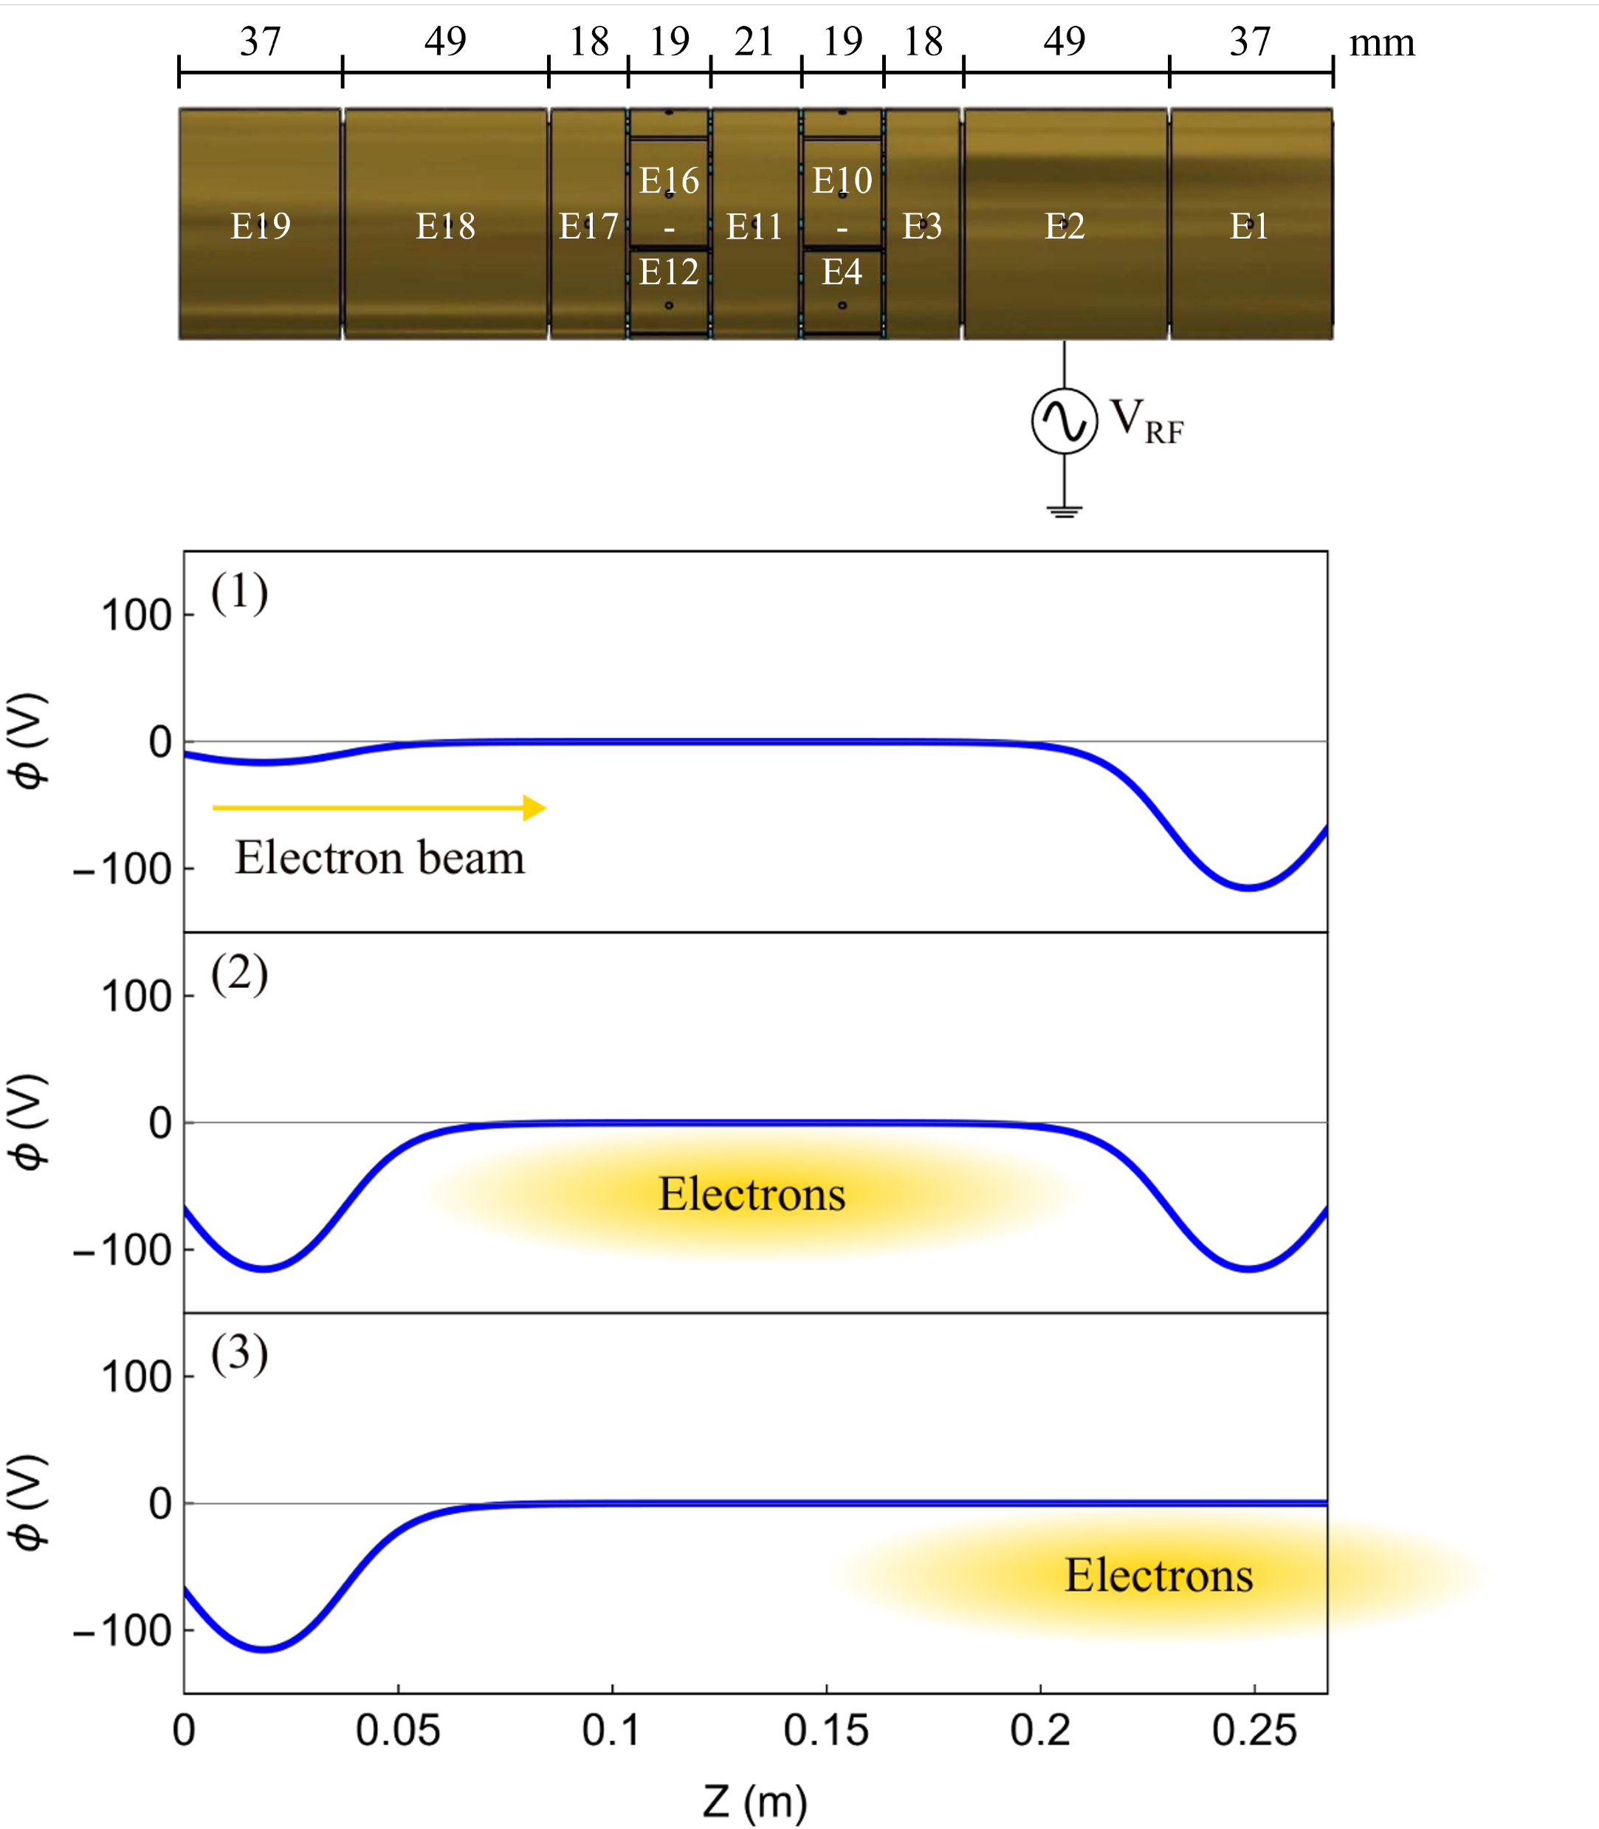
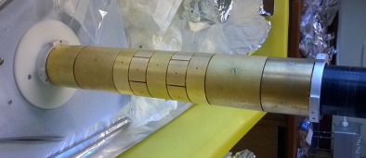
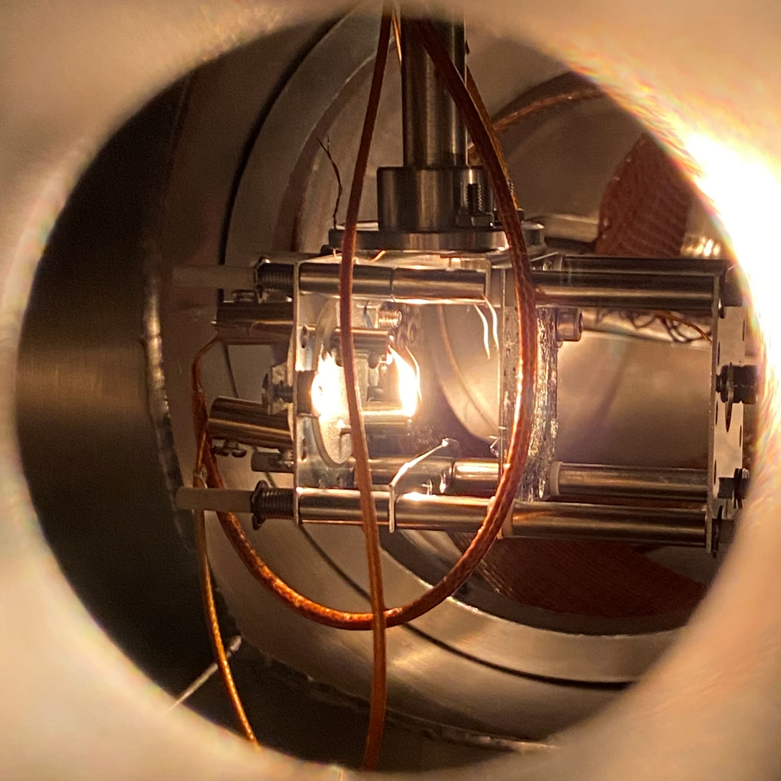
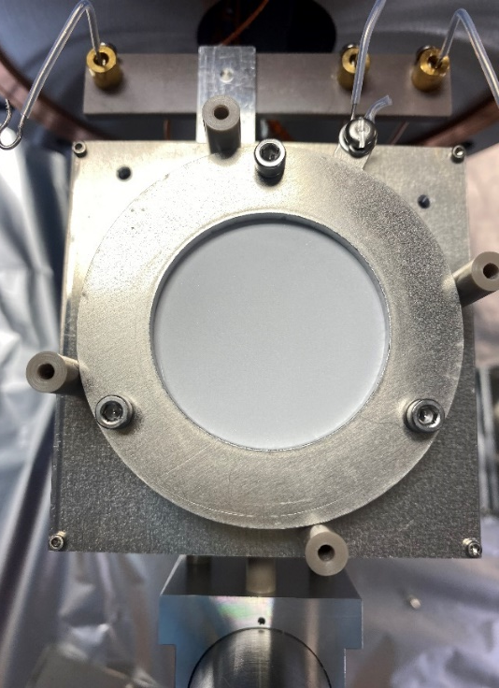
Experimental setup
Solenoid (B ≈ 400G)
$n_{B}=\frac{ε_{0}B^{2}}{2m}=7.8×{10}^{15}$ m⁻³
Load
Hold
Electron source
Phosphor screen
(diameter = 40 mm)
9-electrode stack
(length = 280 mm,
diameter = 41 mm)
Eject
LhARA / CLF workshop (2nd November 2026)

Slide 6
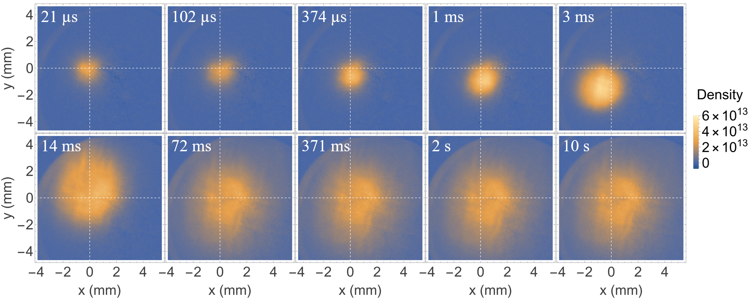
Produce a dense e⁻ plasma
RF-driven ionisation
Seed electrons
(with CO₂)
RF excitation
Dense plasma
Load = 3us-10s
[m⁻³]
Hold
3 ms
40 ms
Eject
LhARA / CLF workshop (2nd November 2026)

Slide 7
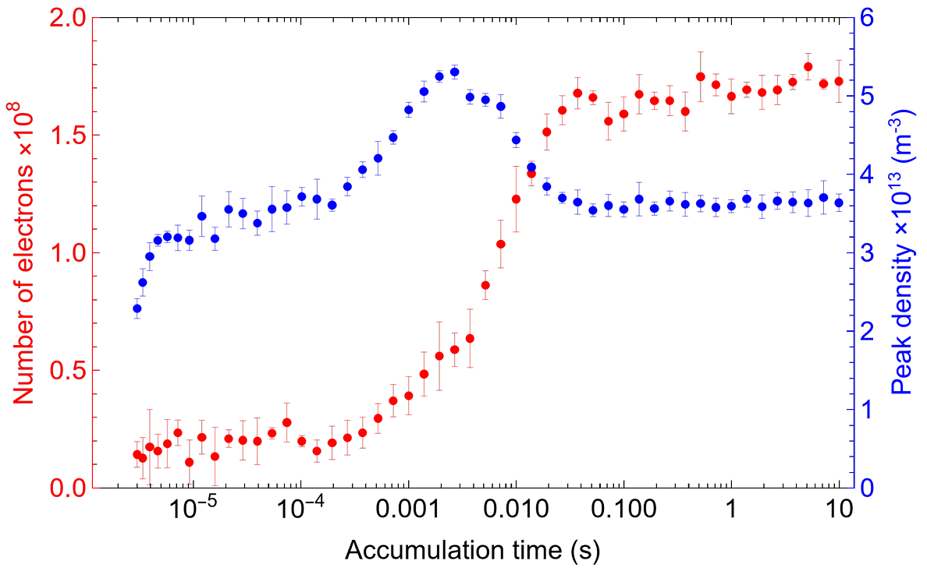
Produce a dense e⁻ plasma
RF-driven ionisation
Seed electrons
(with CO₂)
RF excitation
Dense plasma
[m⁻³]
3 ms
40 ms
LhARA / CLF workshop (2nd November 2026)

Slide 8
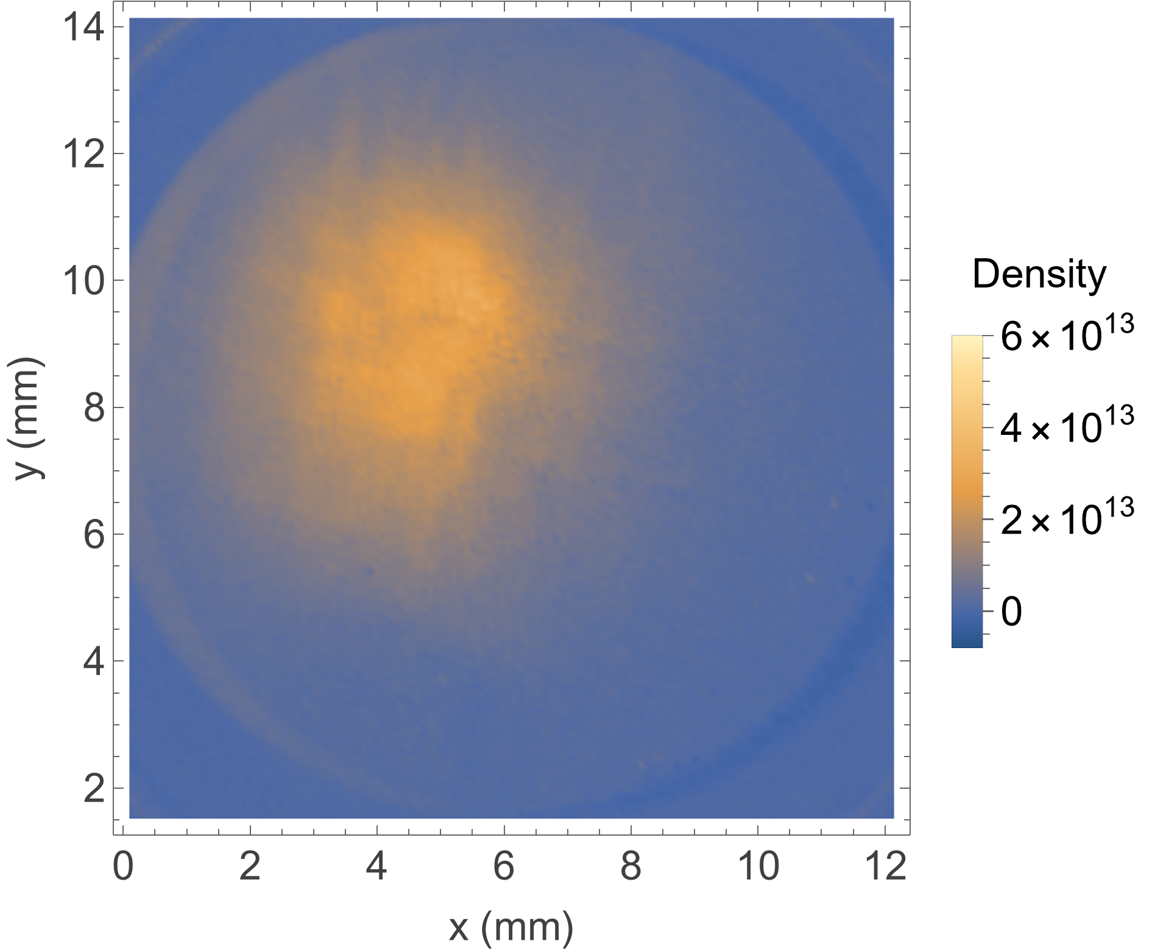
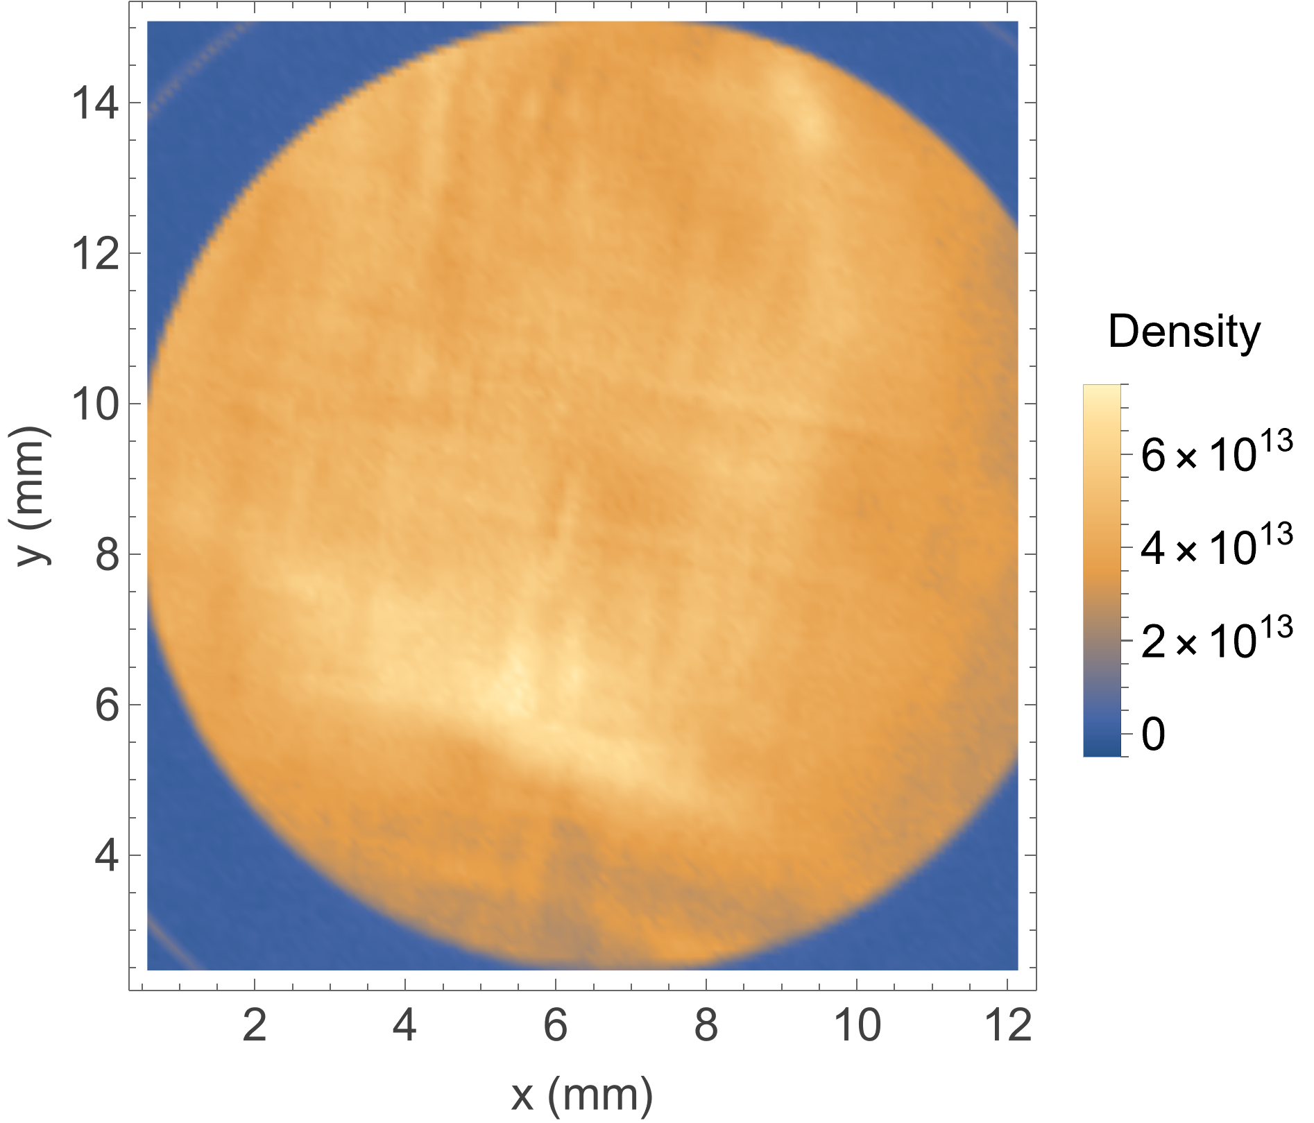
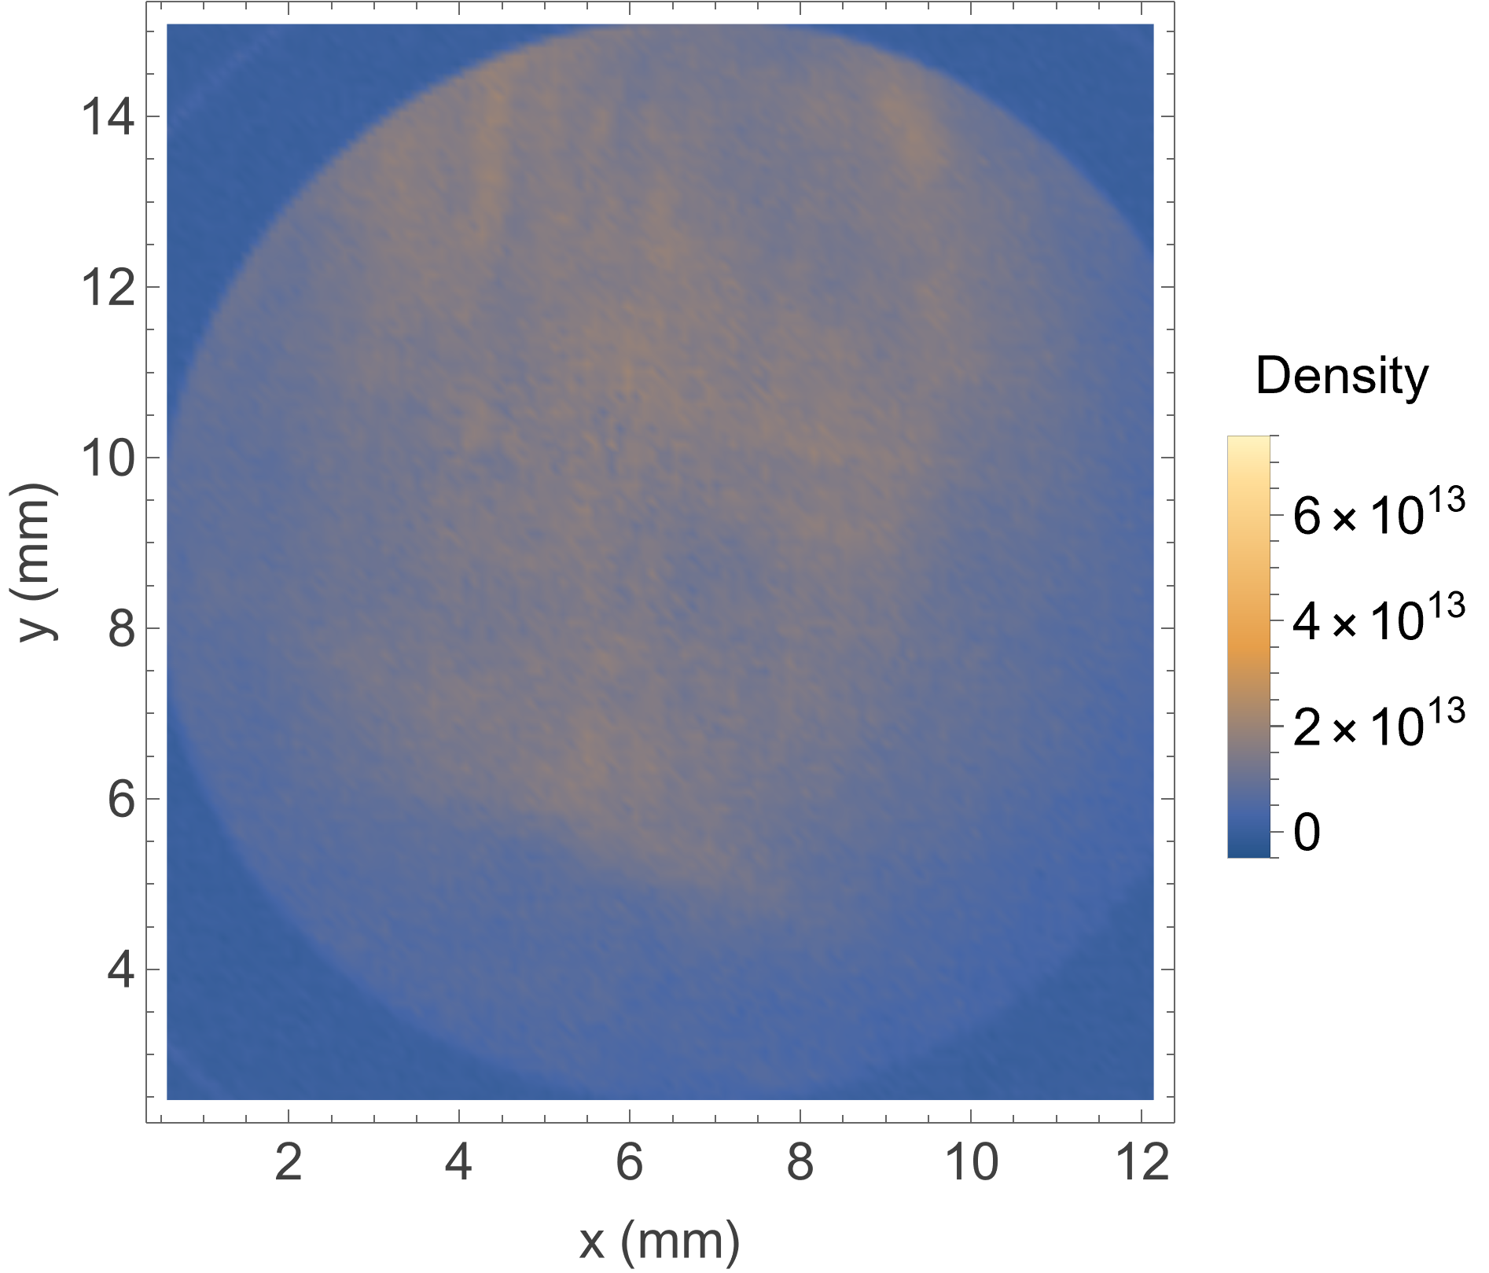
Produce a dense e⁻ plasma
RF-driven ionisation
Seed electrons
(with CO₂)
RF excitation
Dense plasma
11MHz, 5.7V_{pp}
Load = 1s
Seed plasma
RF duration = 1s
RF duration = 10s
Hold + RF = 1s
[m⁻³]
[m⁻³]
[m⁻³]
Eject
3.6×10¹³ m⁻³
7.7×10¹³ m⁻³
LhARA / CLF workshop (2nd November 2026)

Slide 9
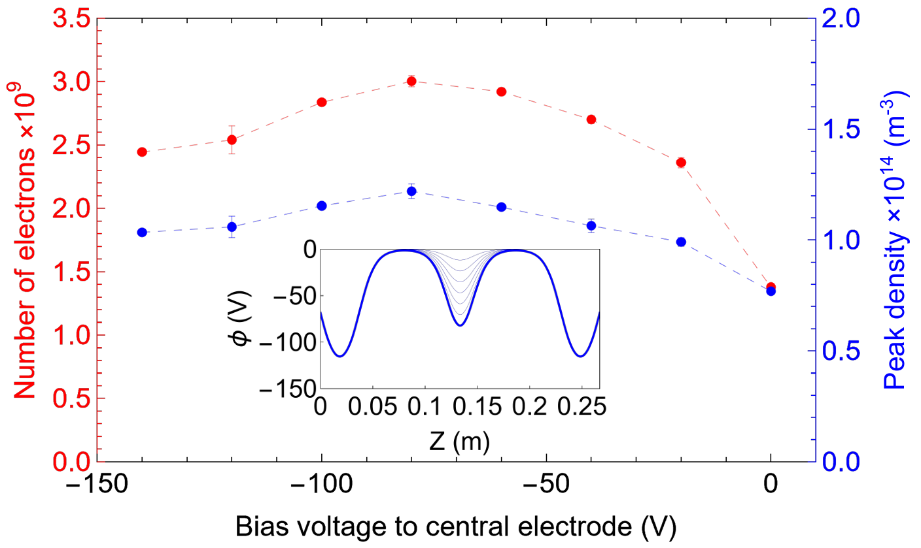
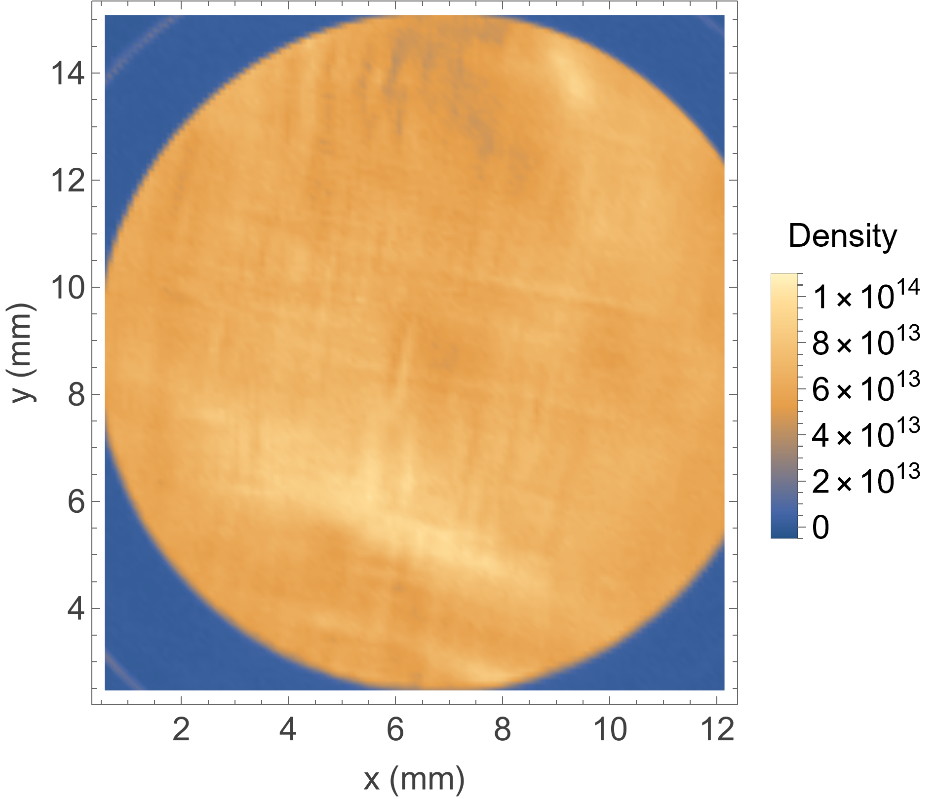
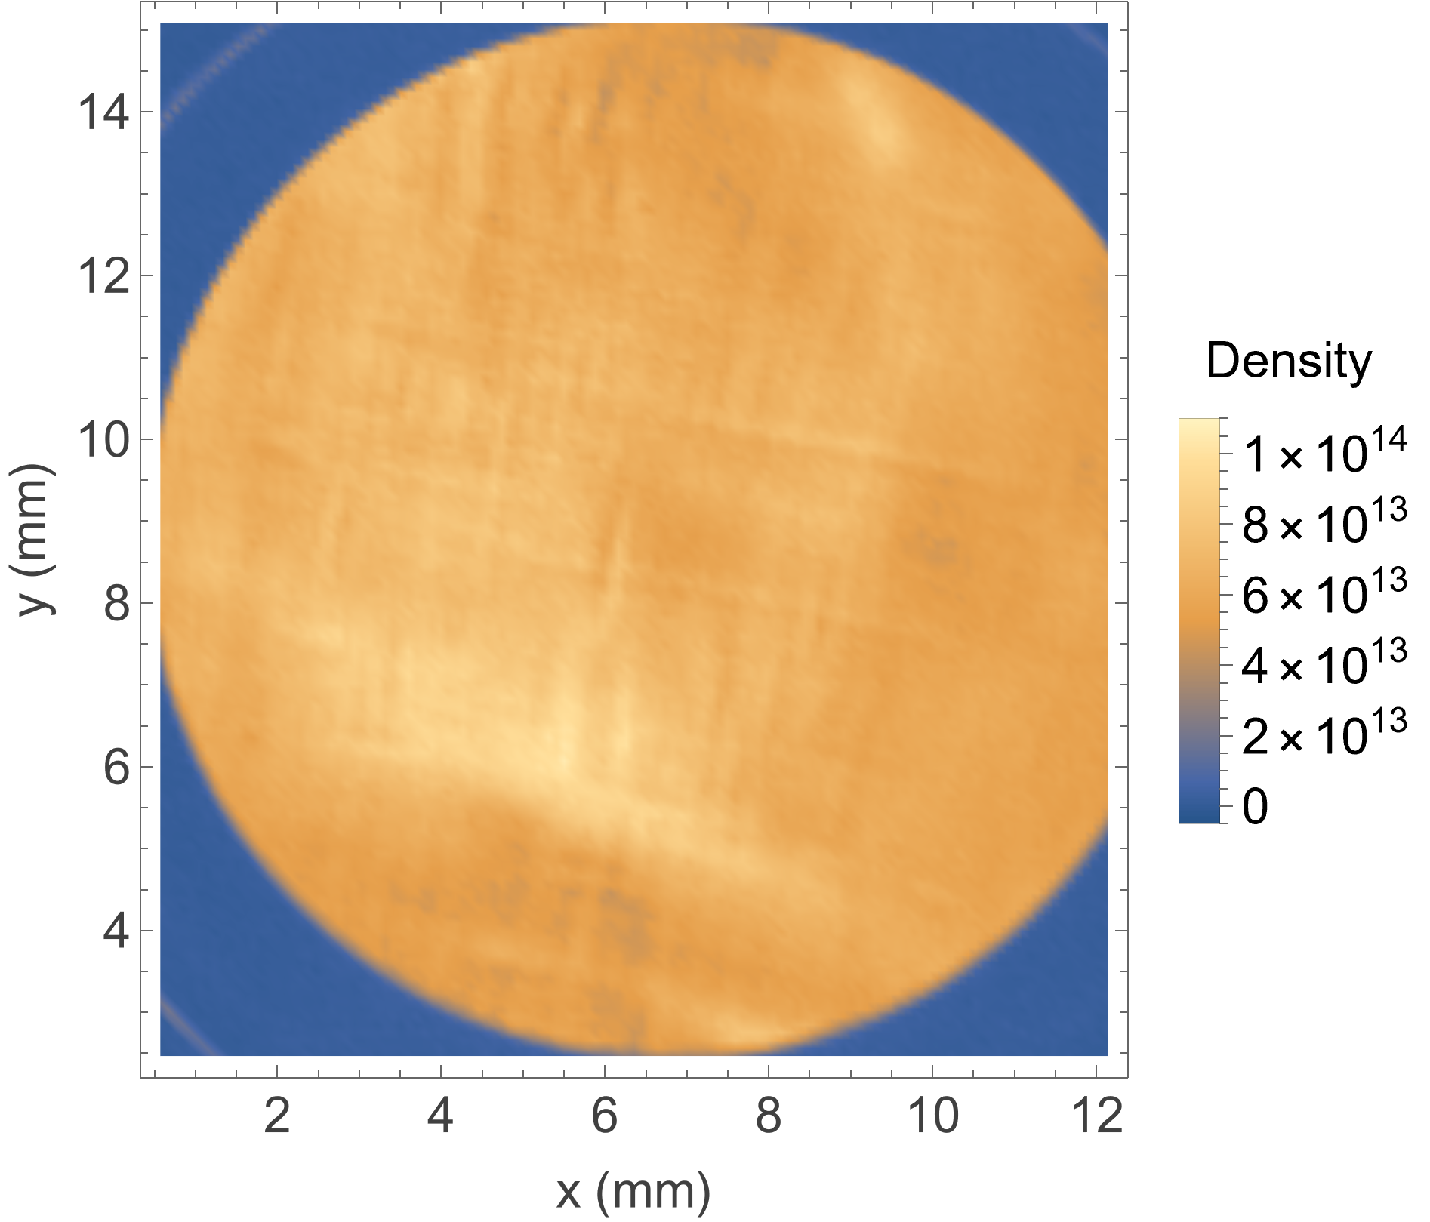
Improve plasma confinement
Central negative bias ('dimple') improves confinement
Baseline potential
Central negative bias/dimple
Reduce loss and higher N_{e}
Electrons
Electrons
RF duration = 1s
10s
RF duration = 1s
10s
Optimised confinement
→ electron population = 3×10⁹
→ plasma density = 1.2×10¹⁴ m⁻³
7.7×10¹³ m⁻³
1×10¹⁴ m⁻³
LhARA / CLF workshop (2nd November 2026)

Slide 10
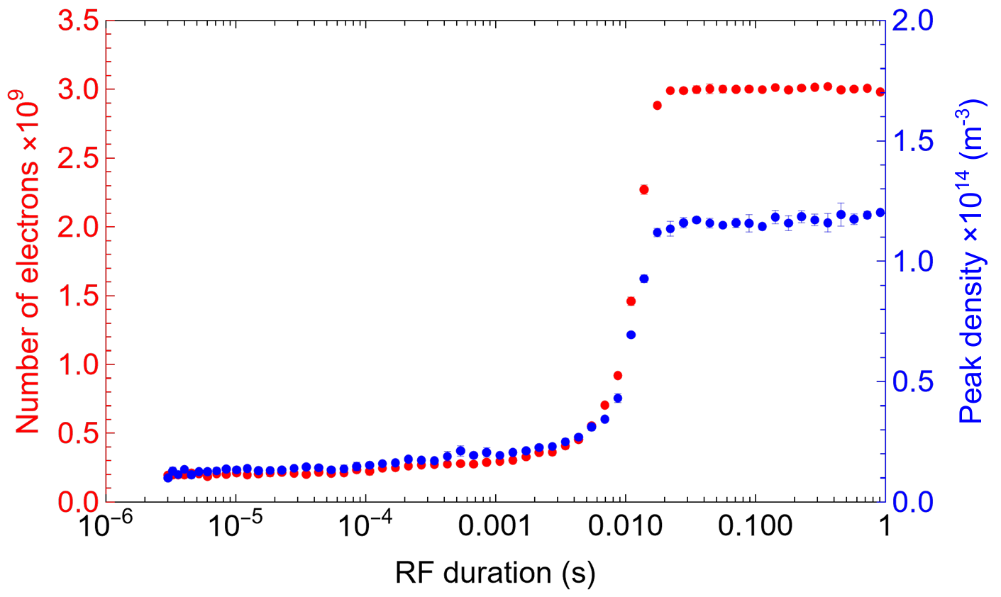
Timescale for generating dense plasma
17 ms
Avalanche-type ionization: RF-heated electrons trigger successive ionization events in background CO₂, drives exponential plasma growth.
Growth continues until an equilibrium state has established.
LhARA / CLF workshop (2nd November 2026)

Slide 11
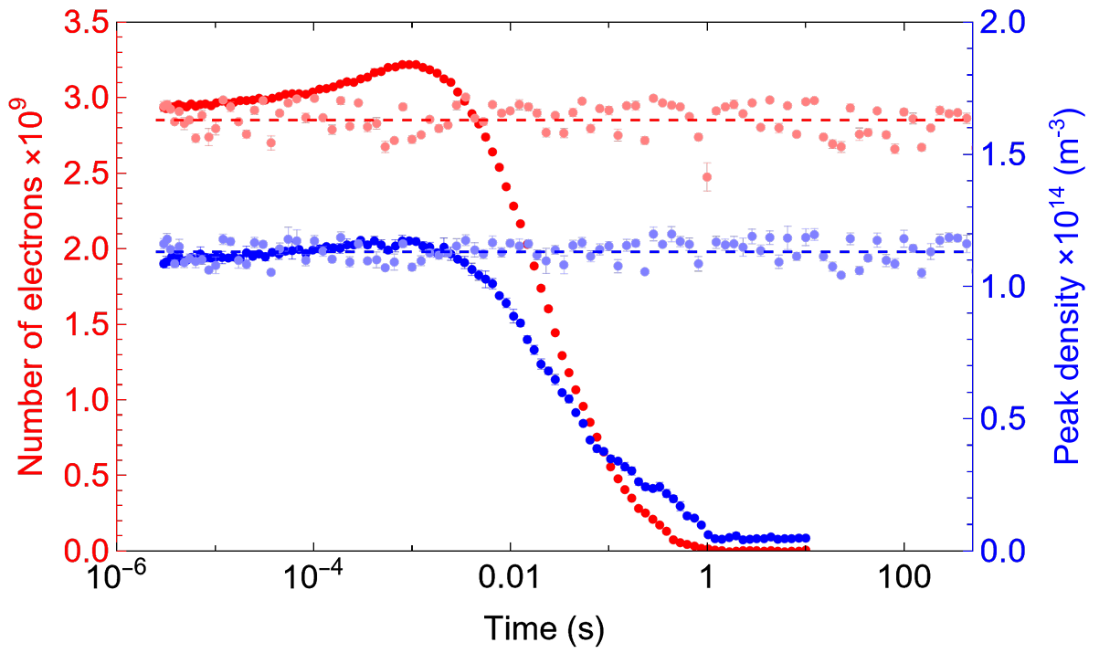
Plasma stability
High density is useful only if the plasma can be maintained
Characteristic timescale for dense plasma formation
Long-term stability
Continuous RF
RF off
17 ms
1 ms
Avalanche-type ionization: RF-heated electrons trigger successive ionization events in background CO₂, drives exponential plasma growth.
Growth continues until an equilibrium state has established.
Stable confinement demonstrated for >100 s
LhARA / CLF workshop (2nd November 2026)

Slide 12
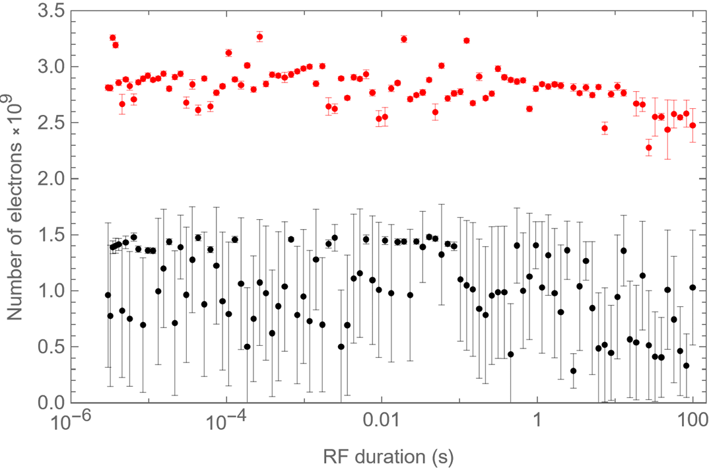
Plasma reproducibility
High density is useful only if the plasma can be maintained and reproducible.
Reproducibility and robustness (100 runs/ data points)
with the −80 V dimple
Stable plasma containing ~2.8×10⁹ electrons.
Small standard deviation across all RF durations.
Indicates robust and reproducible plasma confinement.
without dimple
Only ~1×10⁹ electrons trapped.
Significantly larger shot-to-shot fluctuations.
Frequent plasma collapse and poorer stability.
The dimple both increases the trapped electron population and significantly improves plasma stability and reproducibility over long operating times.
LhARA / CLF workshop (2nd November 2026)

Slide 13
Towards the density required for a Gabor lens
Connecting measured plasma properties to focusing strength
High energy
ion beam
Measured
$n$≈1.2×10¹⁴ m⁻³
$l$ ≈ 0.2 m,
$U$ = 10 MeV
Focal length
$f$ ≈ 100 m
$$\overset{⃑}{E}$$
T. S. Dascalu
140V trap
Focal length of Gabor lens (the thin-lens approximation):
$\frac{1}{f}=\frac{e^{2}n_{e}l}{4ε_{0}U}$
where $e$ is electric charge of the electron
$n_{e}$ is the plasma density
$l$ is the length of the plasma
$ε_{0}$ is the permittivity of free space
$U$ is the kinetic energy of the positively charge particle.
400V trap
LhARA
*Passing a 10 MeV positively charged particle beam through the lens

Slide 14
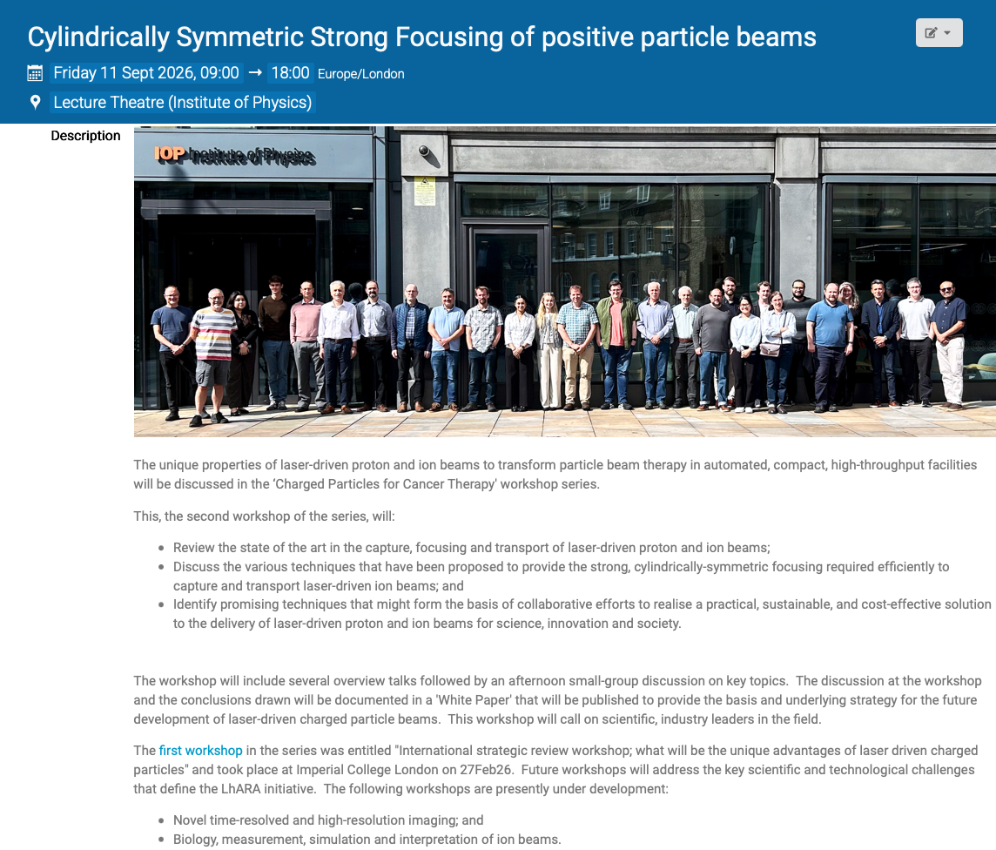
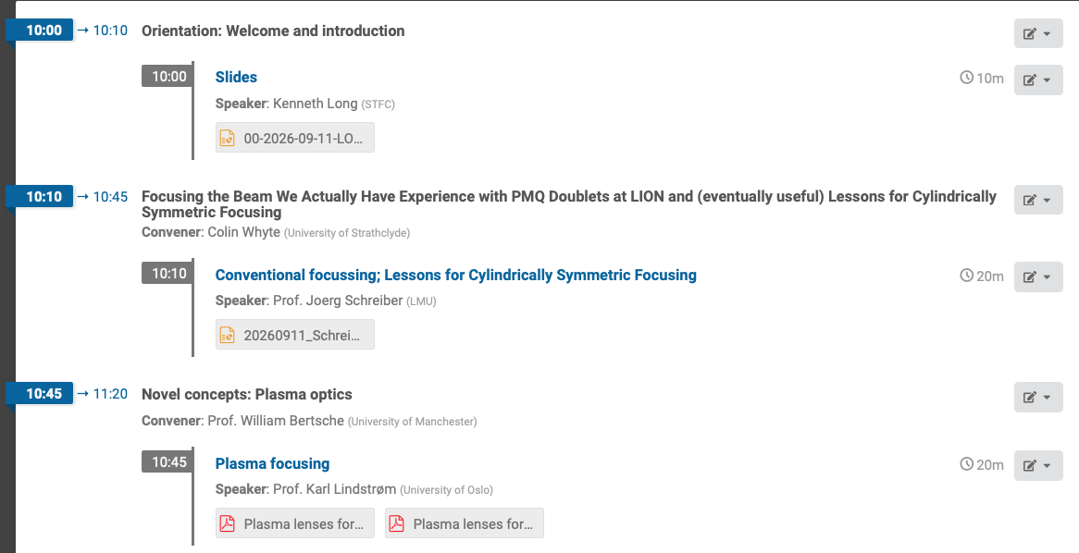
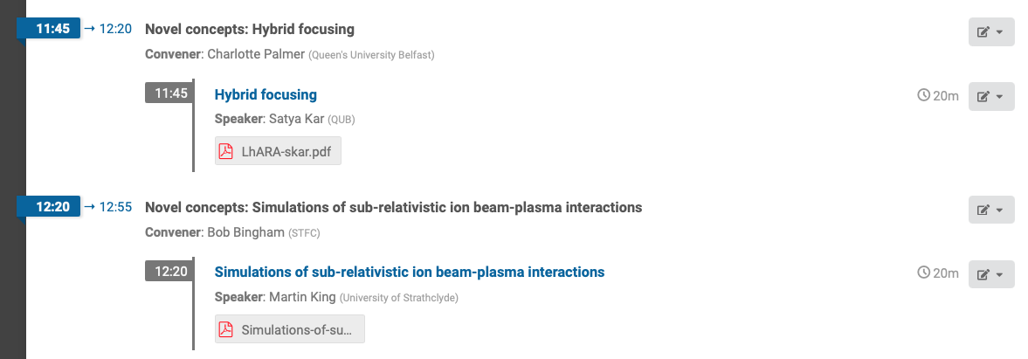
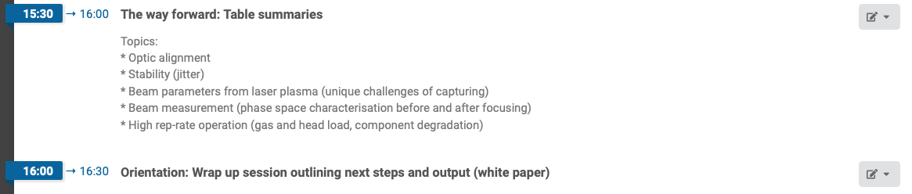
https://indico.stfc.ac.uk/event/1956/

Slide 15
Conclusions and outlook
Developed a robust method for generating and stabilizing high-density electron plasmas in a Penning–Malmberg trap.
RF-driven avalanche ionization forms a high-density plasma in ~17 ms.
A −80 V central dimple enhances confinement, enabling steady-state operation with
  Peak density: 1.2×10¹⁴ m⁻³
  Stable for >100 s under continuous RF excitation
The demonstrated technique provides a promising route toward Gabor lenses for charged-particle beam focusing.
Next steps…
Demonstrate the plasma lens with positively charged particle beams
Further investigate the stabilising effect of the dimple to understand the mechanism responsible for maintaining plasma stability.
LhARA / CLF workshop (2nd November 2026)

Slide 16



Thank you
Plasma lens group:
P. Ruksasakchai
W. Bertsche
M. Charlton
S. Eriksson
C. A. Isaac
D. P. van der Werf
J. Morgan-Sparks
LhARA collaboration:
LhARA / CLF workshop (2nd November 2026)

Slide 18
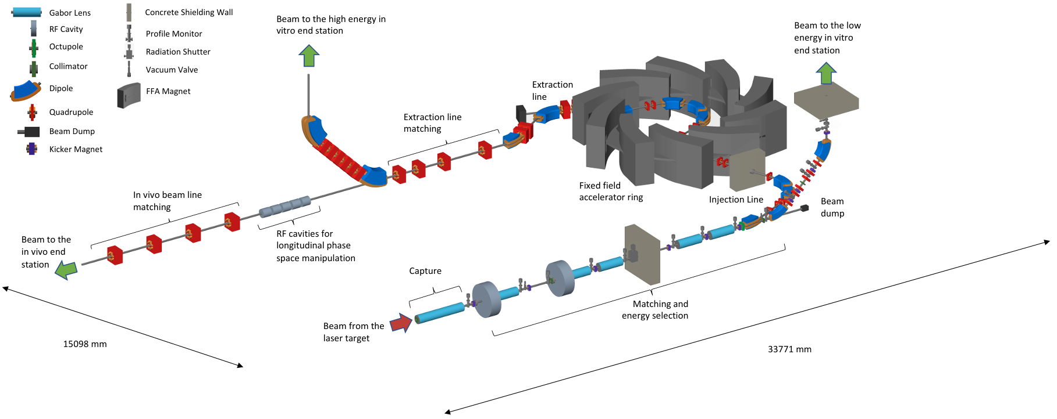
LhARA
Laser-hybrid Accelerator for Radiobiology Applications
Develop a flexible and compact particle-beam facility for radiobiology and future radiotherapy research
Provide proton and light-ion beams with flexible energy, intensity and time structure
Laser-driven particle source
Gabor lens
Beam transport / FFA
Irradiation
The Gabor lens is a key
beam-capture technology.
Ahmed, H., Alderton, M., Amos, R. A., Ariyanto, D. O., Baker, C. J., Bamber, J., ... & van der Werf, D. P. (2026). ITRF/LhARA conceptual design report (No. STFC-TR-2026-007). STFC.
LhARA / CLF workshop (2nd November 2026)

