Slide 1

The LhARA initiative
motivation and status
Ken Long
1 November 2026

Slide 2
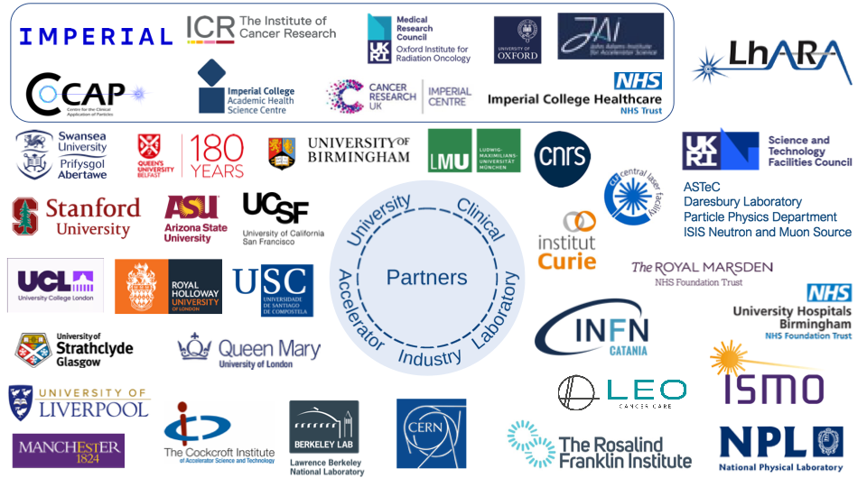
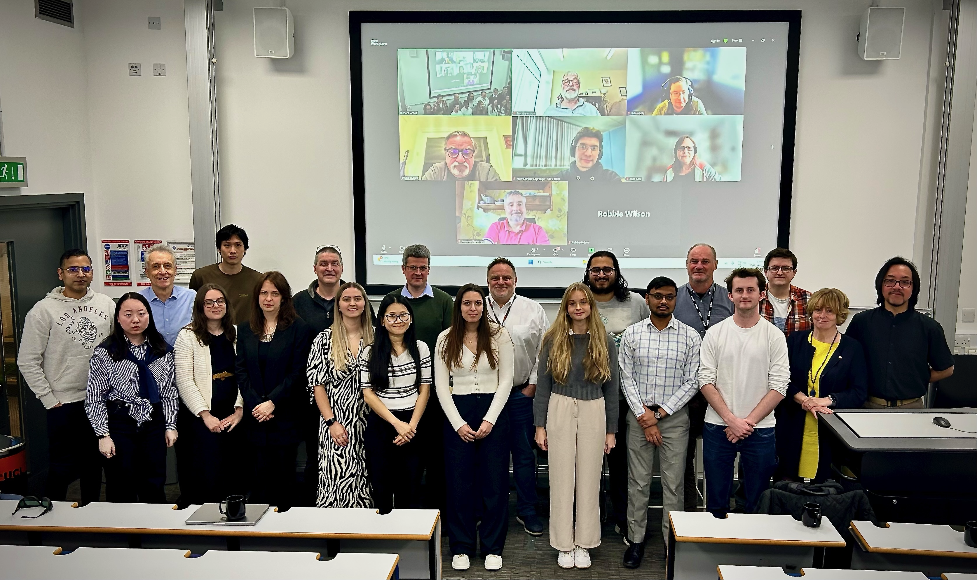
Acknowledgements

Slide 3
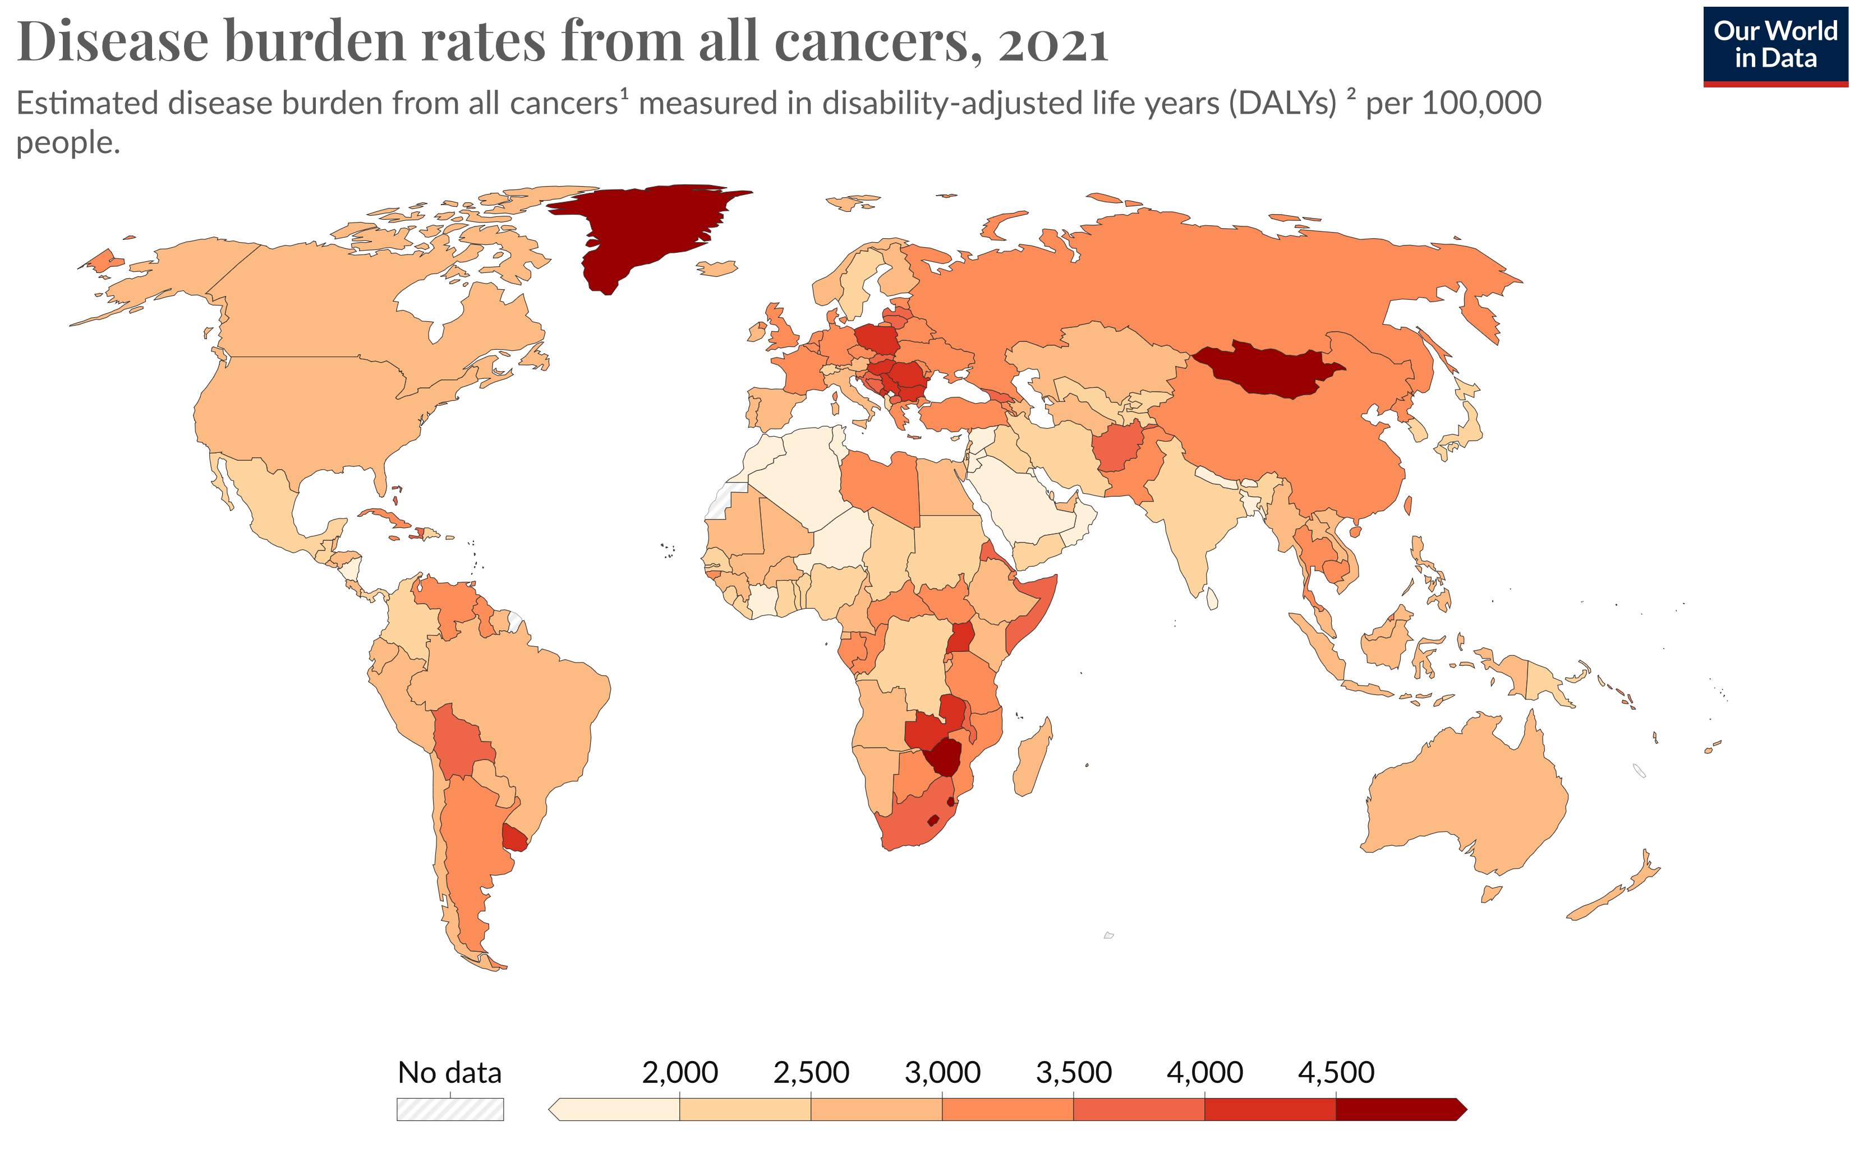
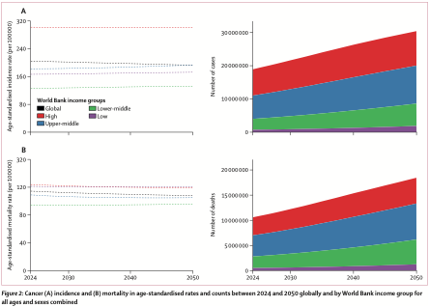
Cancer:
Second most common cause of death
Significant growth in cases anticipated
Large growing unmet need:
Scale-up in provision essential
New techniques required to meet need

Slide 4

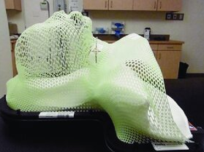
The challenge
Radiotherapy:
Indicated in 50% of treatment
Instrumental in 40% of cures
Opportunity:
Harness novel techniques for clinical benefit

Slide 5
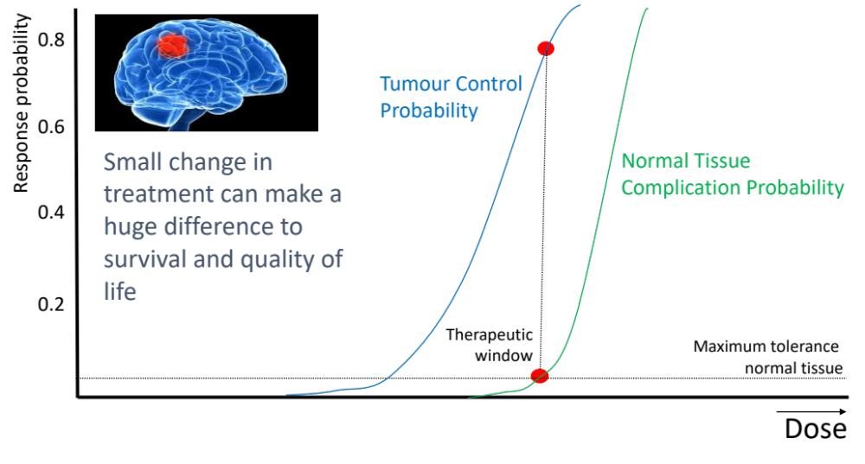
The benefit of particles
Maximise therapeutic benefit by:
  Maximising damage to tumour
  Minimising damage to healthy tissue
X-ray therapy:
  Modality used in most radiotherapy
  Dose falls exponentially with depth
  Proximity of sensitive organs limits dose to tumour

Slide 6
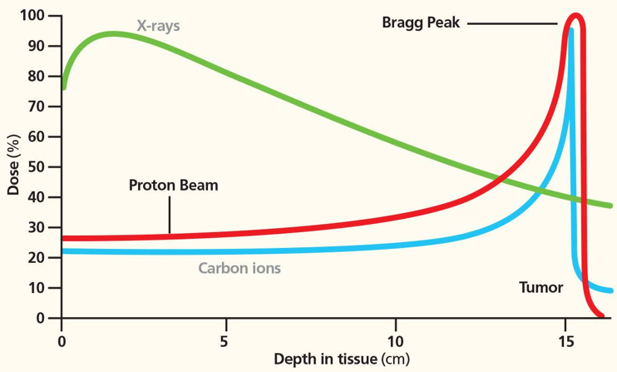
Particle-beam therapy
Proton and ion-beam therapy:
  Bulk of dose deposited in Bragg peak
  Significant normal-tissue sparing (entry)
  Almost no dose beyond the Bragg peak

Slide 7
The need for a step-change in capability
Growing recognition of benefits of PBT worldwide:
  >70 PBT centres in operation; 40 under construction
‘Incremental’ development of technique
  Existing suppliers; new initiatives
Exciting indications of benefits of novel beams …

Slide 8

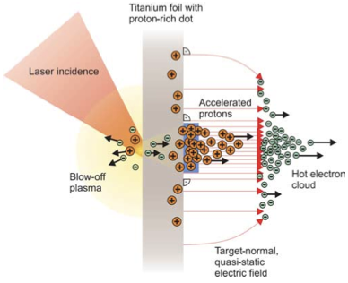
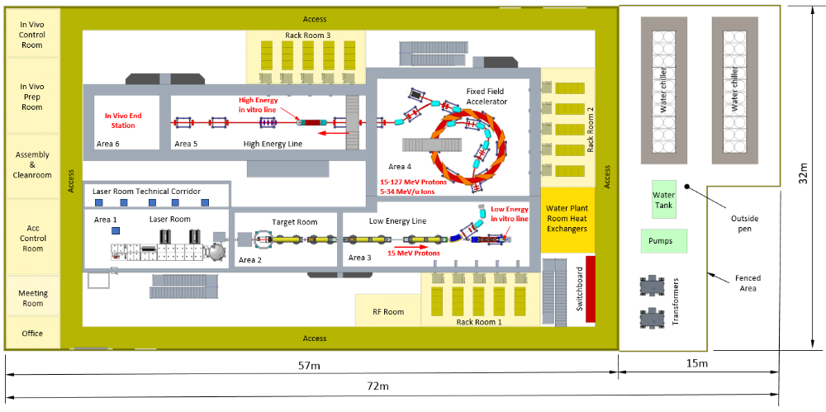
The LhARA initiative:
Deliver a systematic and definitive radiation biology programme
Prove the feasibility of laser-driven hybrid acceleration
  Spin into curiosity-driven science
Lay the foundations for the transformation of ion beam therapy
  automated, patient-specific proton and ion beam therapy

Slide 9

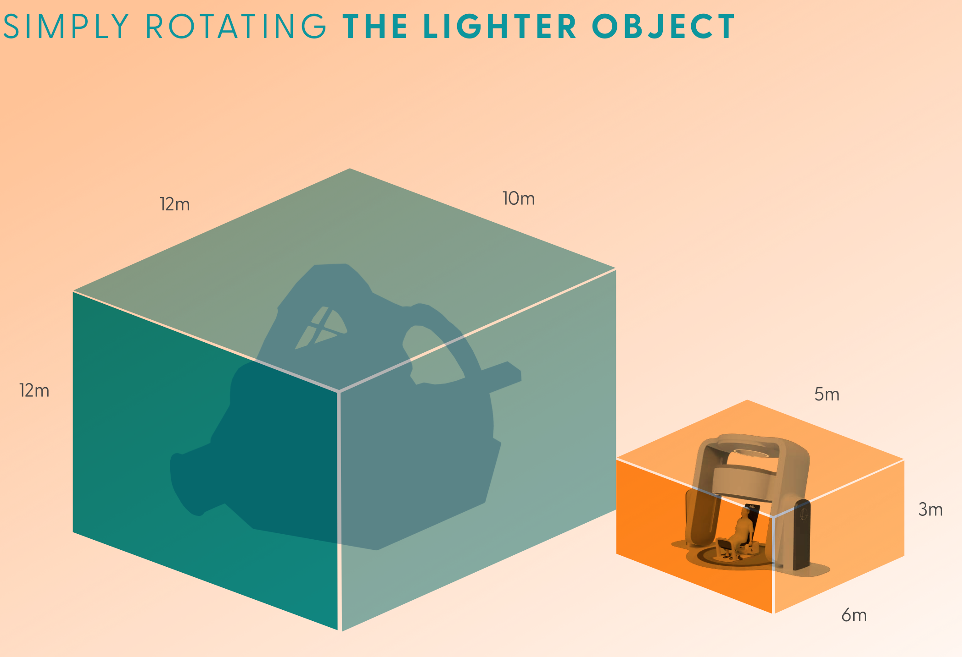
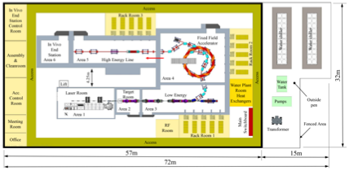
Three pillars
Systematic radiobiology
programme
PoPLaR @ SCAPA, ELIMED,
cyclotron, synchrotron, linac,
proton, ions, electrons, X-rays
Science: radiobiology
Project: LhARA
Impact: co-creation

Slide 10
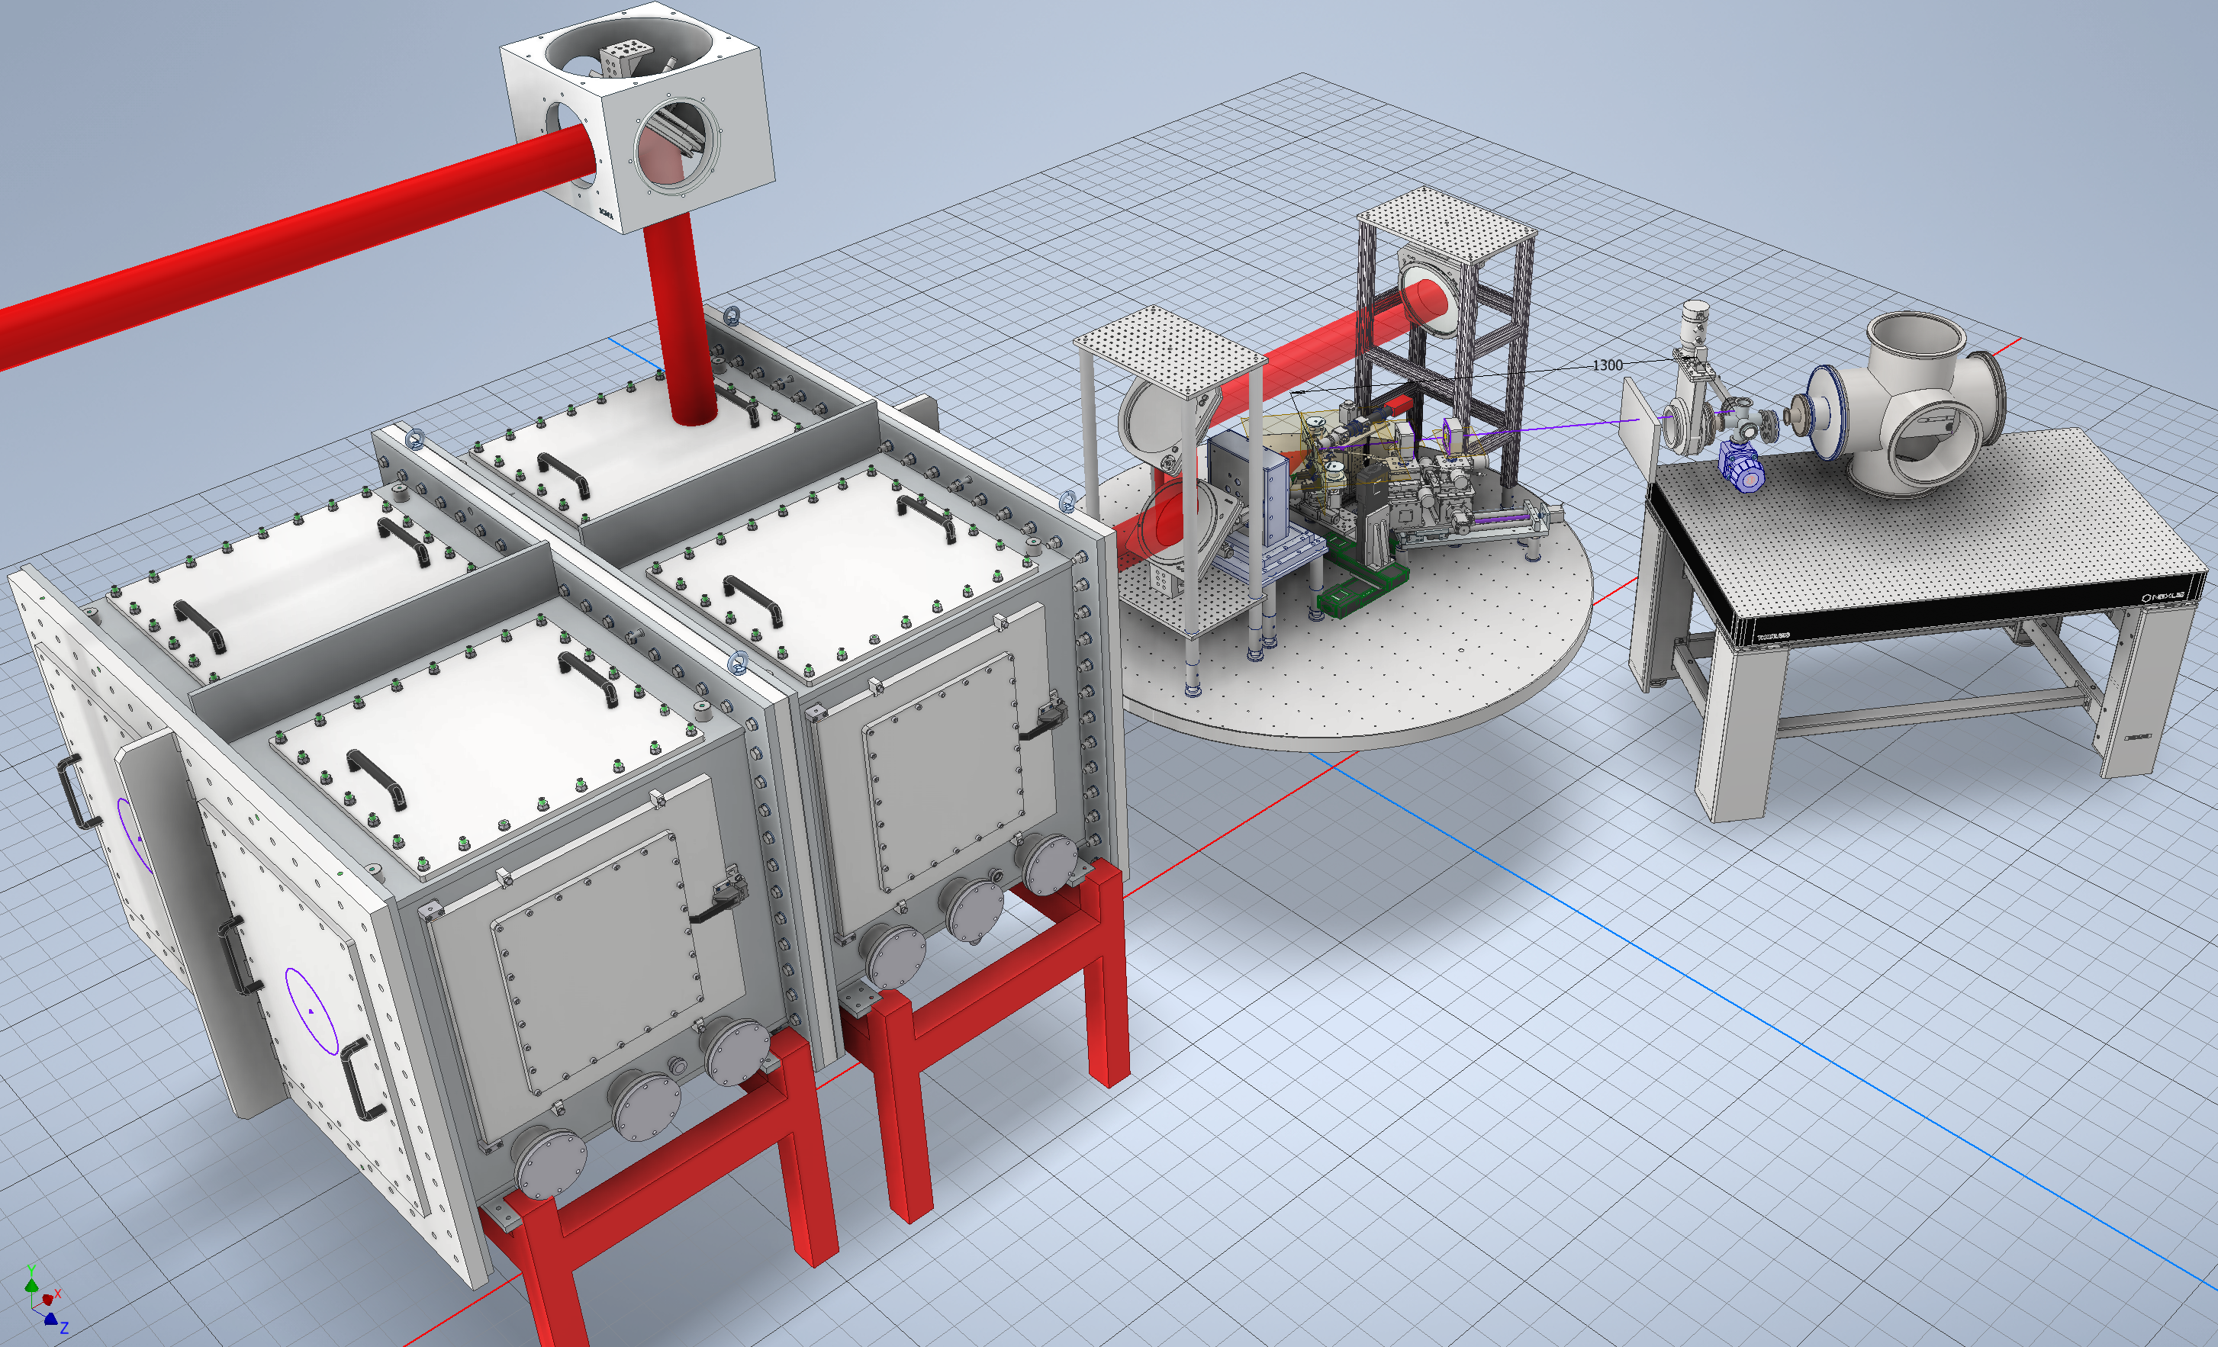
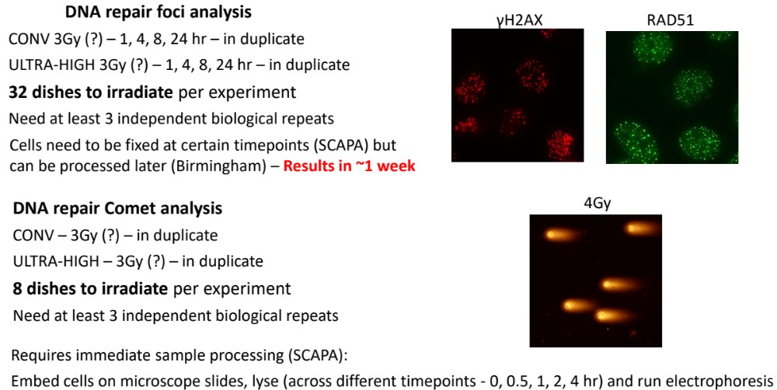
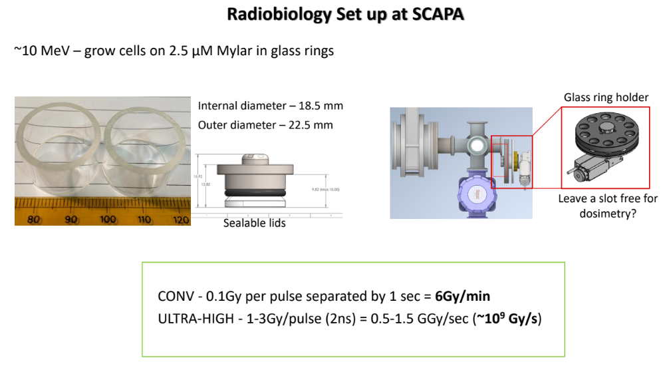
Proof of Principle LhARA Radiobiology, PoPLaR, Experiment
Cell Irradiation End Station
SCAPA AT
THE UNIVERSITY OF STRATHCLYDE
Permanent Magnet Quadrupole (PMQ) System
10
Notes:
This is a CAD model of said experiment.
We plan to install a capture beamline to guide the proton source to a cell irradiation station
This will involve a permanent magnet quadrapole system as seen on left, and a cell irradiation end station which will sit at target normal in the TP line.
Very exciting application experiment for Bunker B

Slide 11
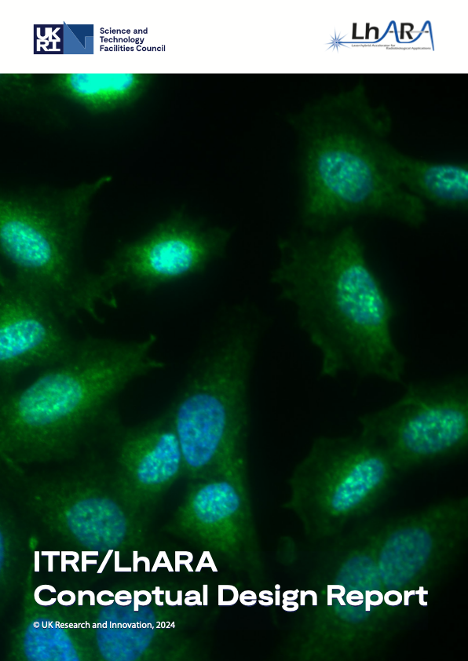
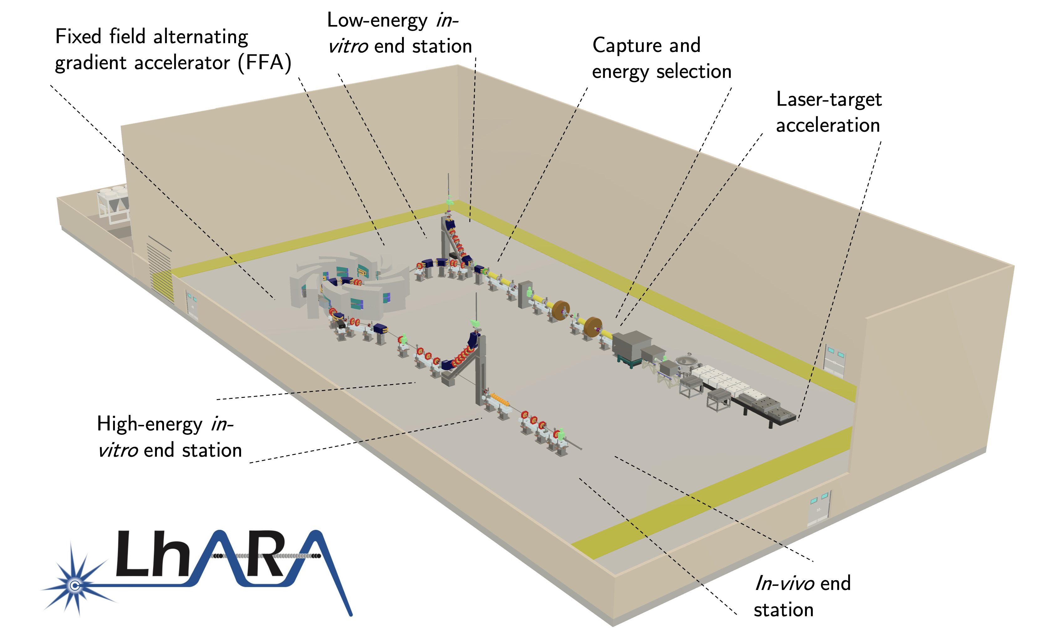
DOI: 10.5286/stfctr.2026007

Slide 12
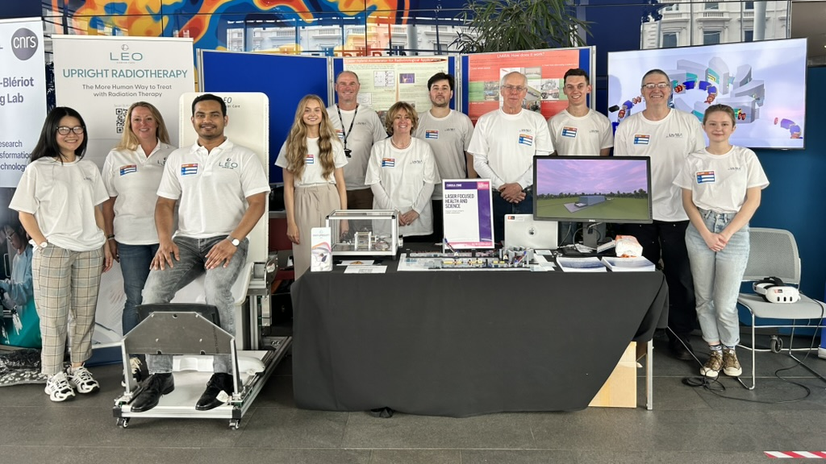


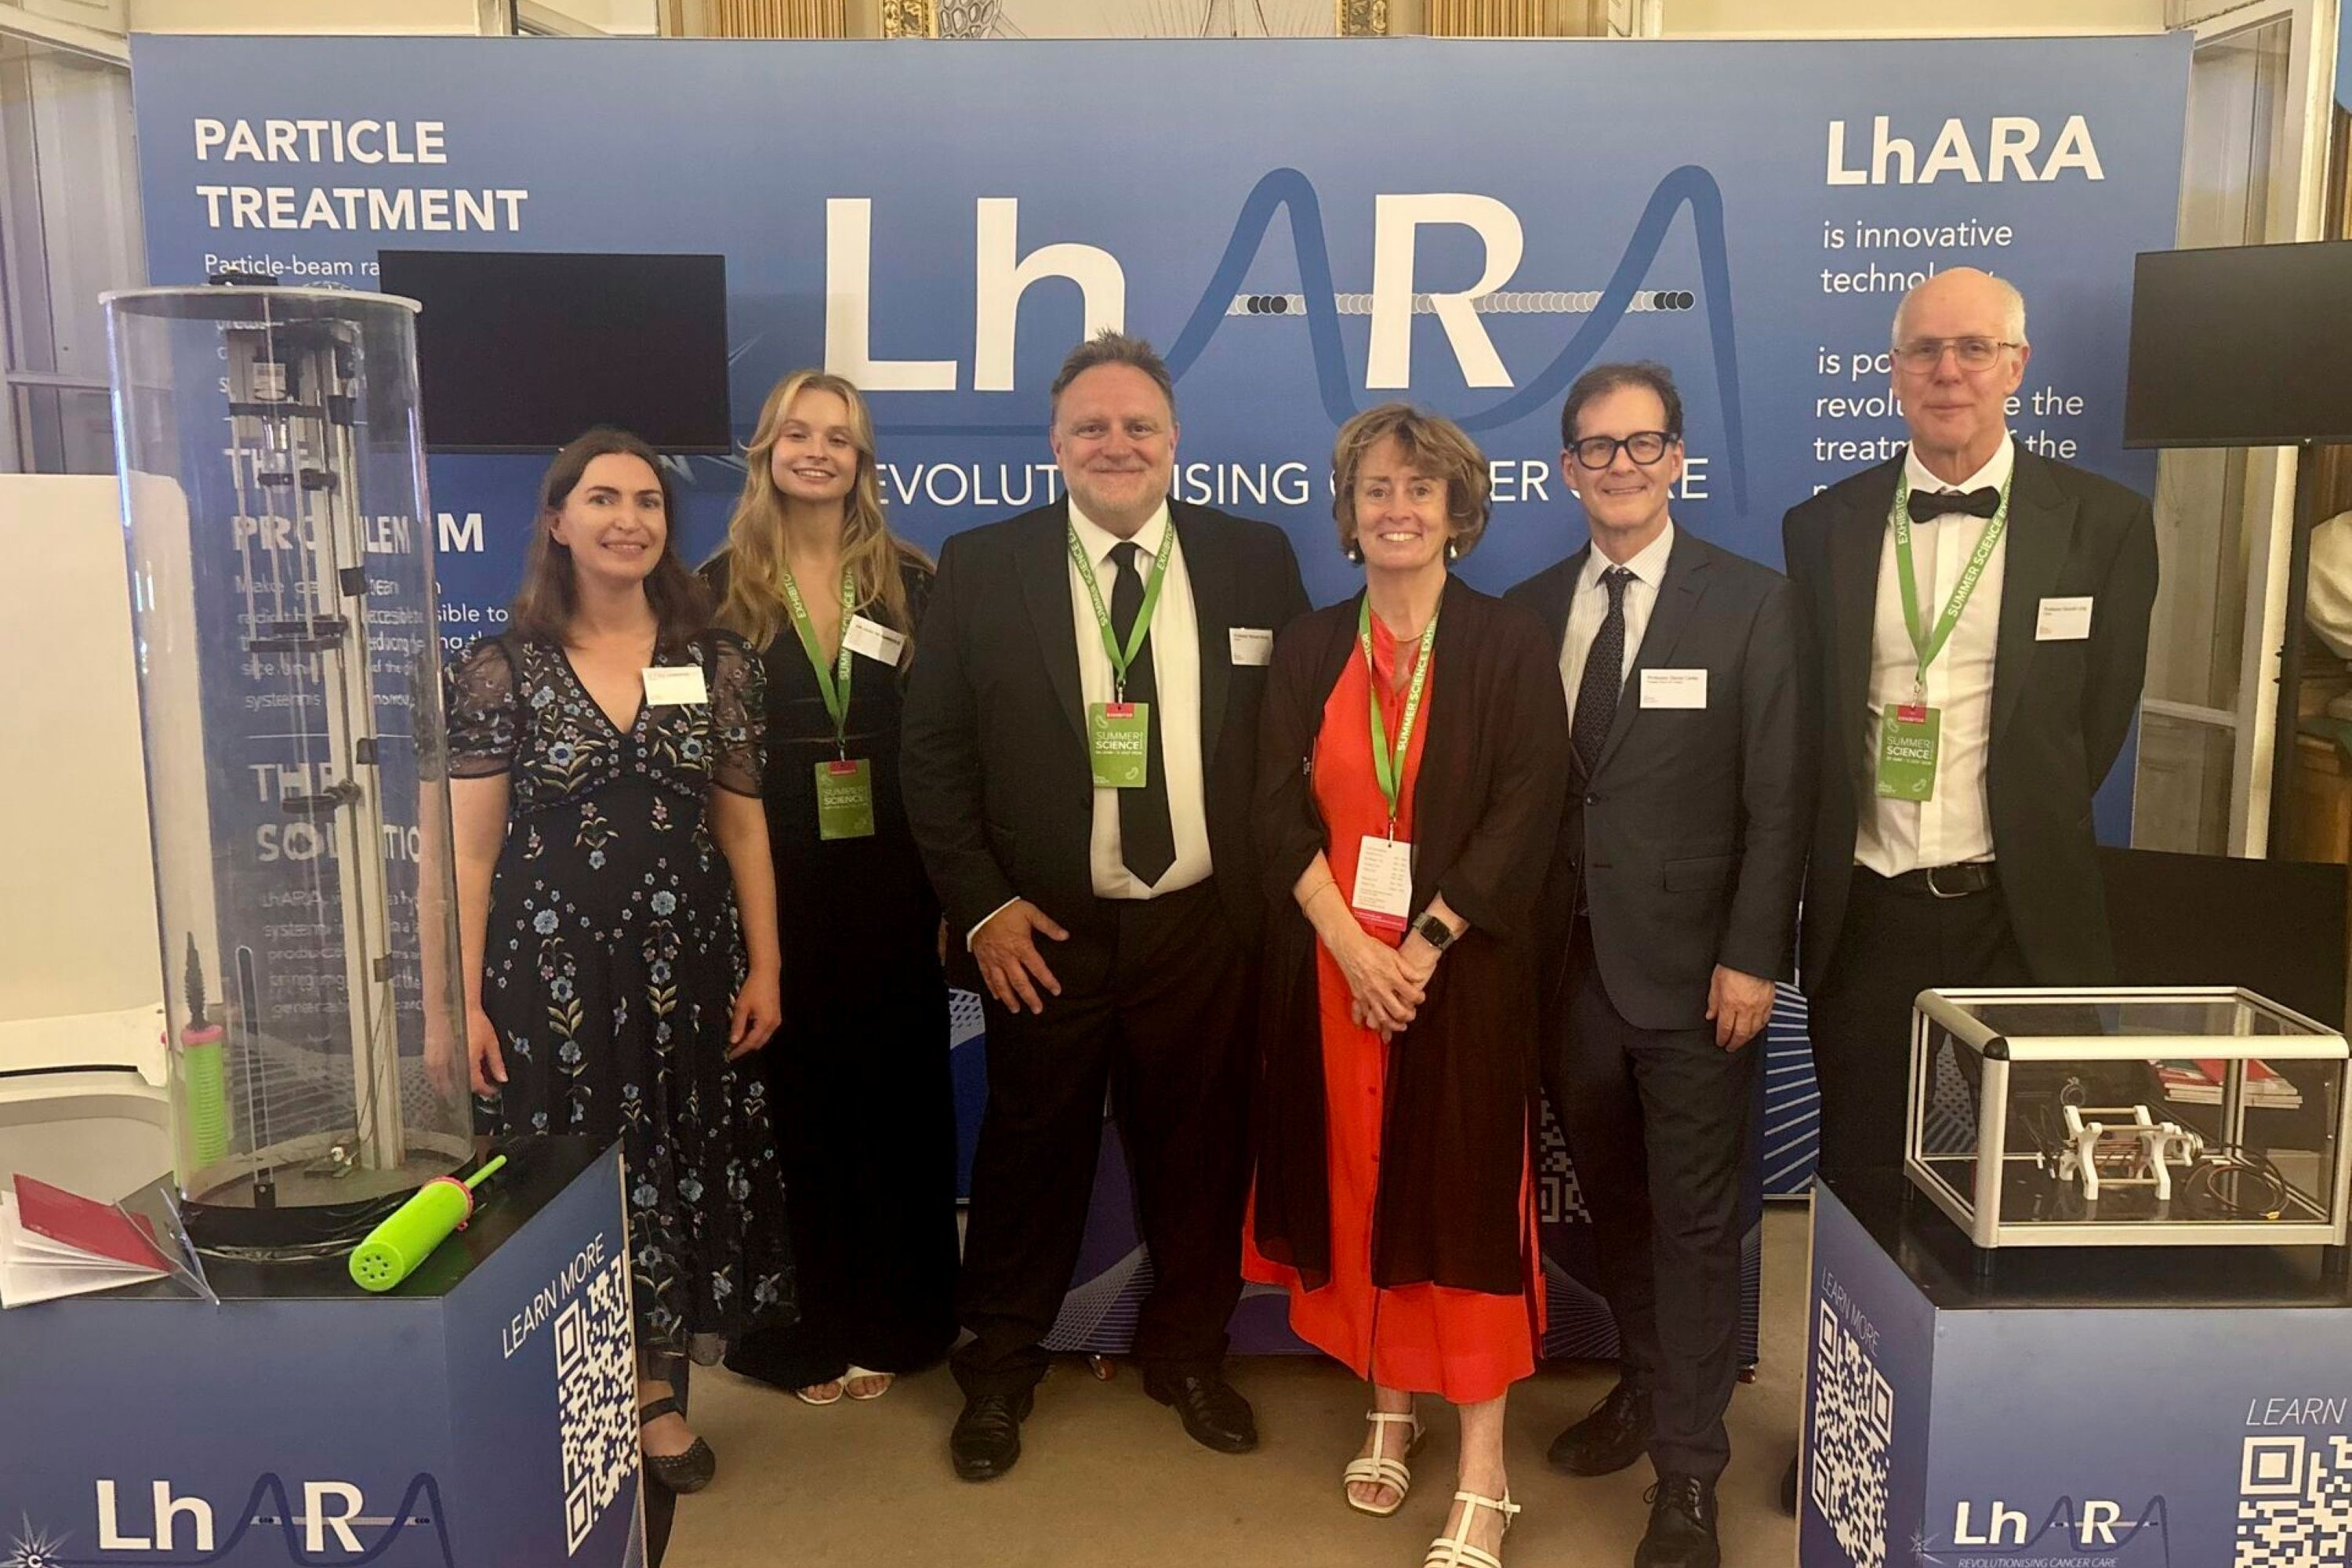
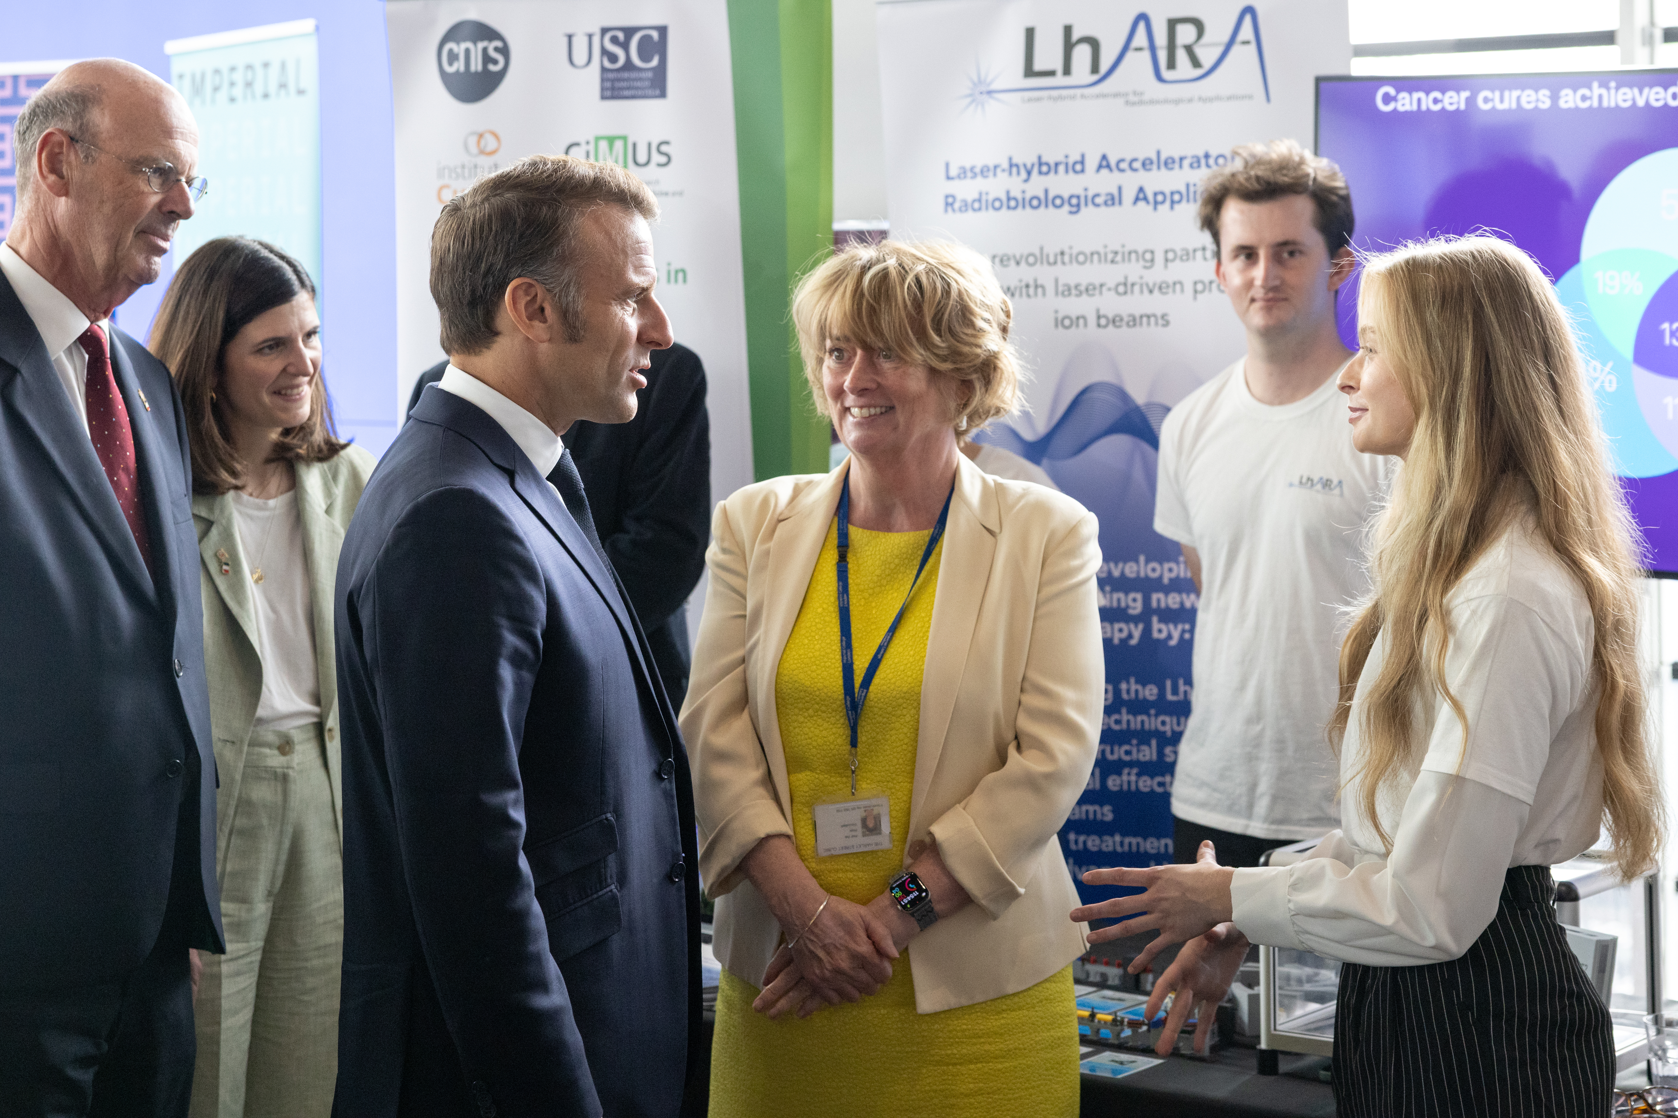
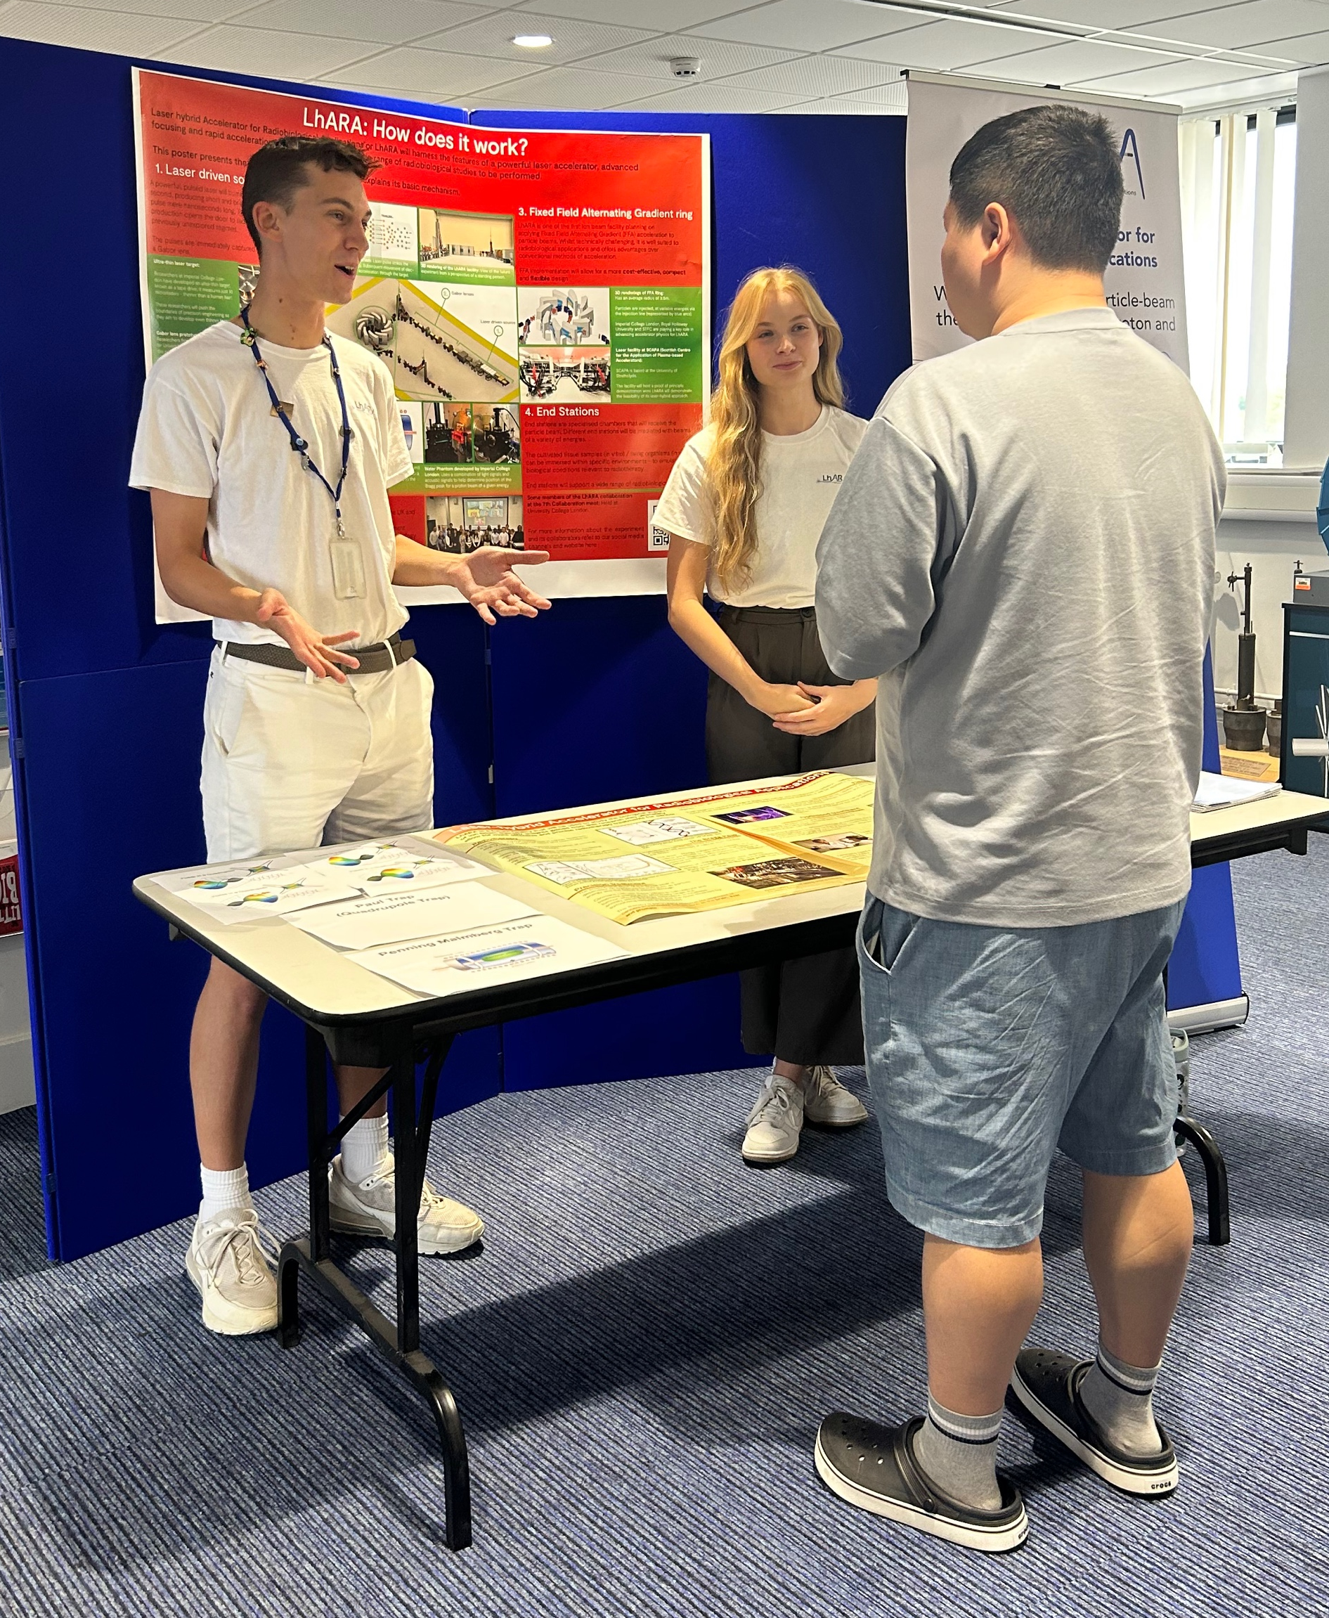
8/9Jun25
Co-creation
30Jun—05Jul 2026
Aug25
Jul25
Co-creation

Slide 13
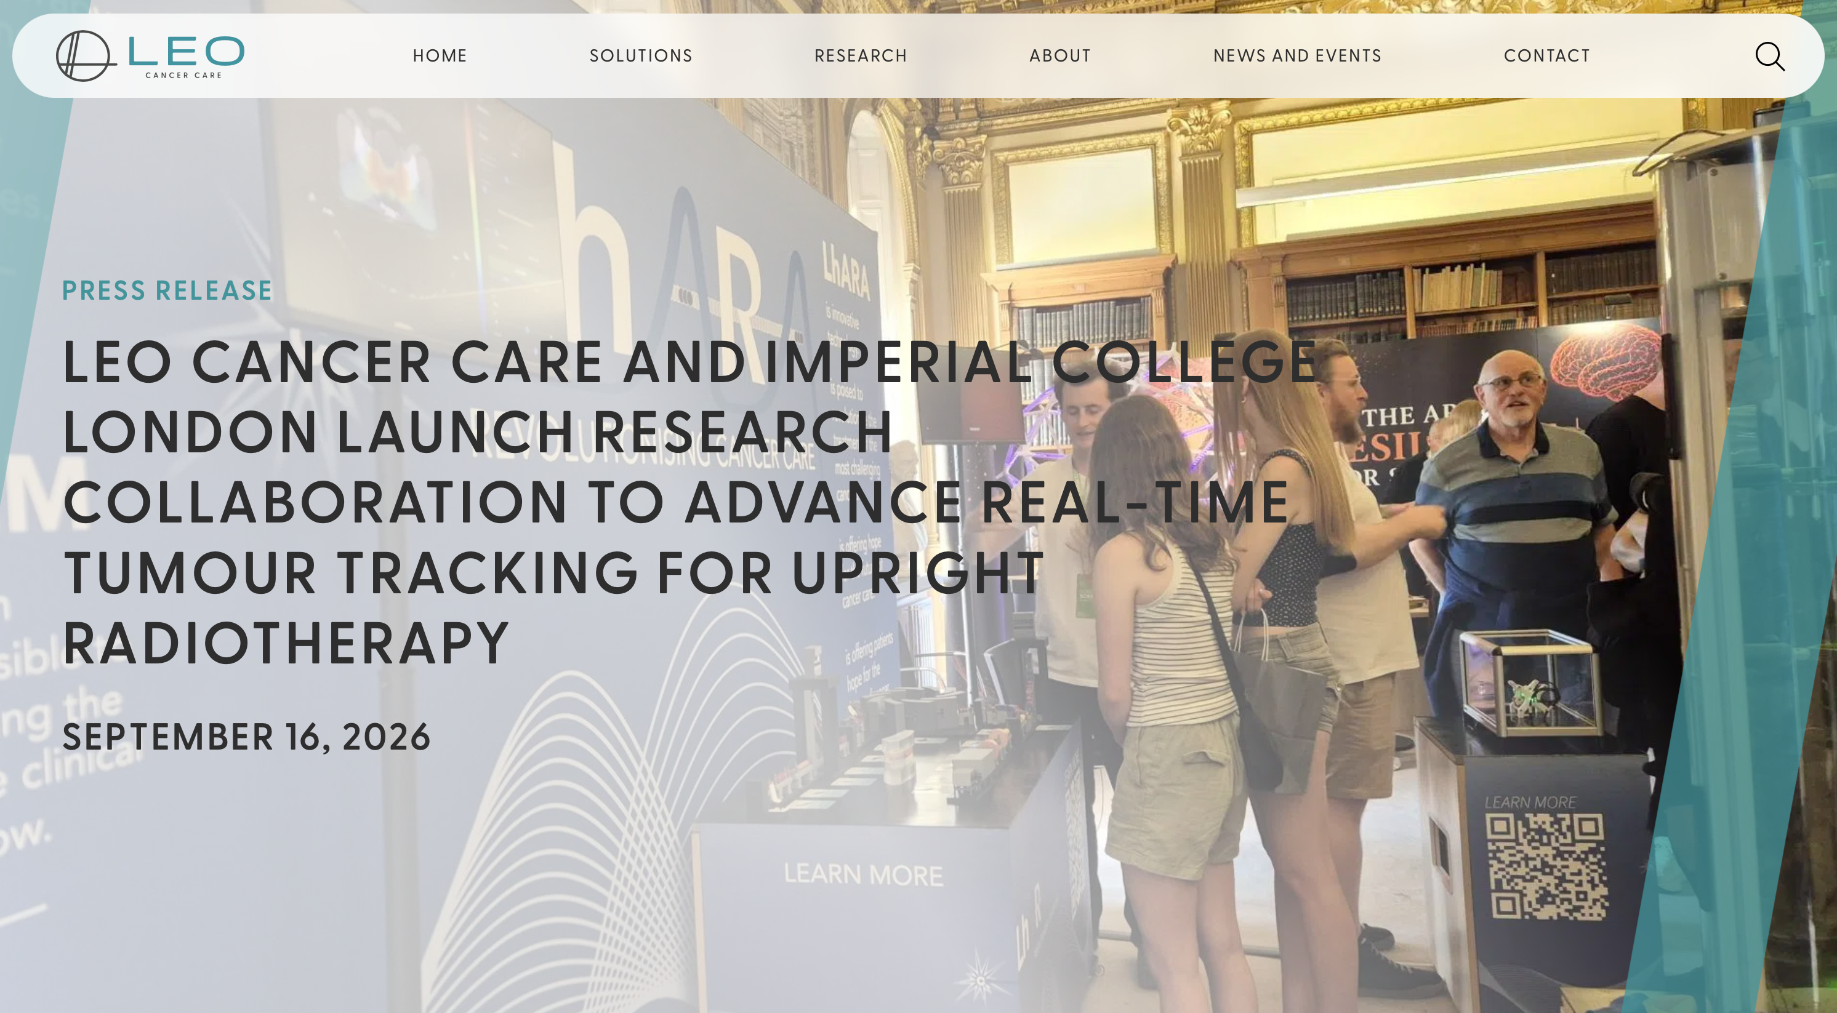

Slide 14
The LhARA initiative
Preparation
Proposals:
Establish R&D
R&D:
Stage 1
Project:
Stage 2
Project:
Stage 3
Ambition:
EU: MCSA
UKRI: TBD
IS-8+ Bucket 2
...
Business case
Radiobiology
Laser/accel.
Science,
Industrial
partnership
End station
Interpretation
Staged build & operation of laser-hybrid source serving low-energy in-vitro end station
Staged build & operation of boosted beam serving high-energy in-vitro and in-vivo end stations
LhARA facility: radiobiology
Co-creation of laser-hybrid system for the clinic
2026/27
2028 …
2030 …
2035 …
2040 ..

Slide 15
Opportunity, through the LhARA initiative:
Deliver a systematic and definitive radiation biology programme
Prove the feasibility of laser-driven hybrid acceleration
  Spin into curiosity-driven science
Lay the foundations for the transformation of ion beam therapy
  automated, patient-specific proton and ion beam therapy

