Slide 1
Nuclear data
DATA
measure
evaluate
use
repeat
From measured quantities to reliable predictions
Mamad Eslami
University of York
18 September 2026
Notes:
You cannot do clean nuclear science without nuclear data. Apparently, you cannot do the dirty kind without it either. Whatever the application, we need to know which nuclei we are dealing with, how they decay, how they react—and, crucially, how uncertain those answers are.
nuclear data sit between a physical interaction and the quantitative prediction we eventually trust. the talk covers the whole data ecosystem, then uses copper radionuclides as one compact case study.

Slide 2
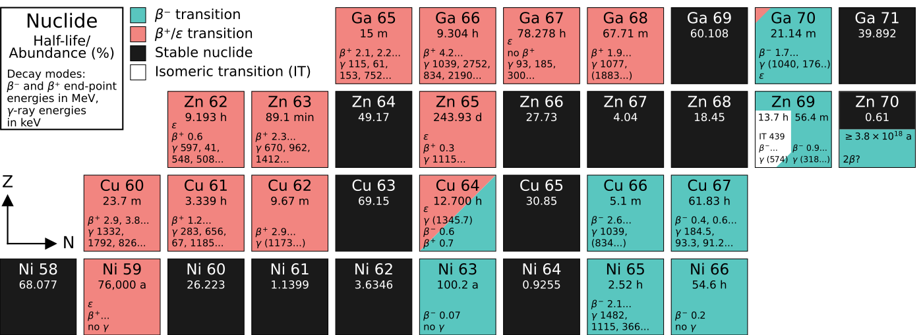
What nuclear data include
A complete description of a nucleus and what it can do
Cross sections are one part - not the whole system
Identity and bulk properties
Nuclear structure
masses · separation energies · Q values · natural abundances
levels · spins and parities · lifetimes · transition probabilities
Decay
Reactions and emissions
half-lives · branches · radiation energies and intensities · delayed particles
cross sections · resonances · distributions · yields · covariances
ONE CELL
THEN ADD
mass
half-life
decay modes
radiation energies
reaction data
uncertainty
covariance
provenance
M. Eslami · Nuclear data
02
Notes:
Nuclear data cover static properties, structure, decay and reactions. applications often couple several categories. A cross section measurement can depend on masses, decay constants, emission probabilities, standards and detector response data.
Sources / further reading:
- IAEA Nuclear Structure and Decay Data: https://nds.iaea.org/pages/structure-data
- IAEA Nuclear Reaction Data: https://nds.iaea.org/pages/reaction-data
- Nuclide chart visual: Cu-64/Cu-67 poster artwork

Slide 3
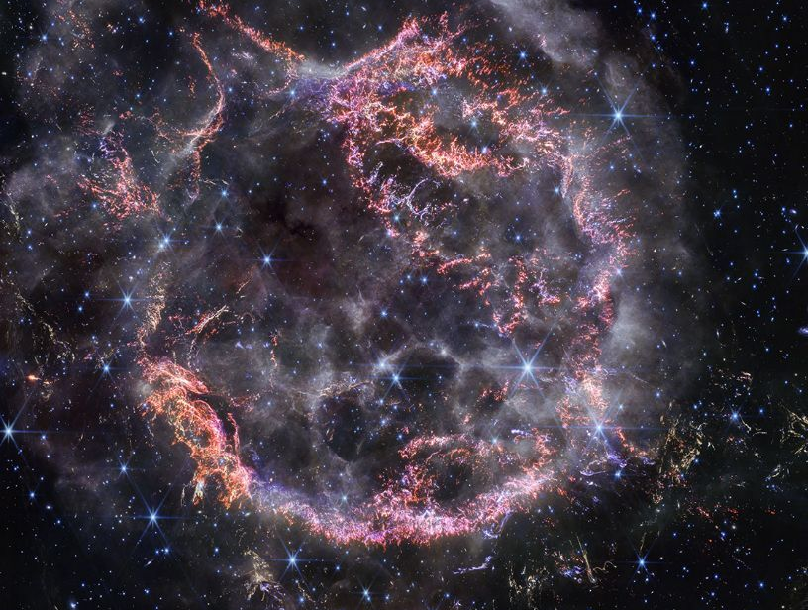
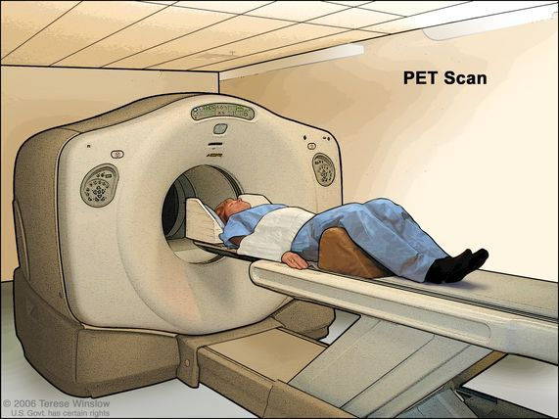
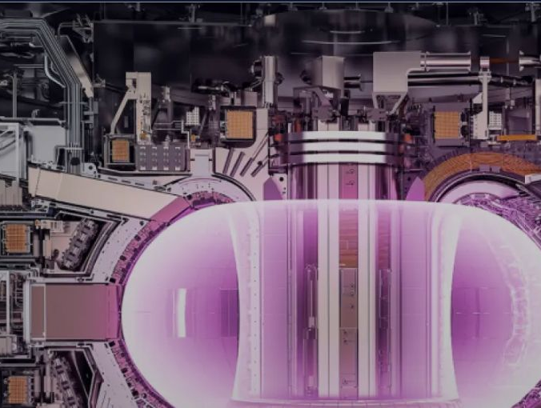
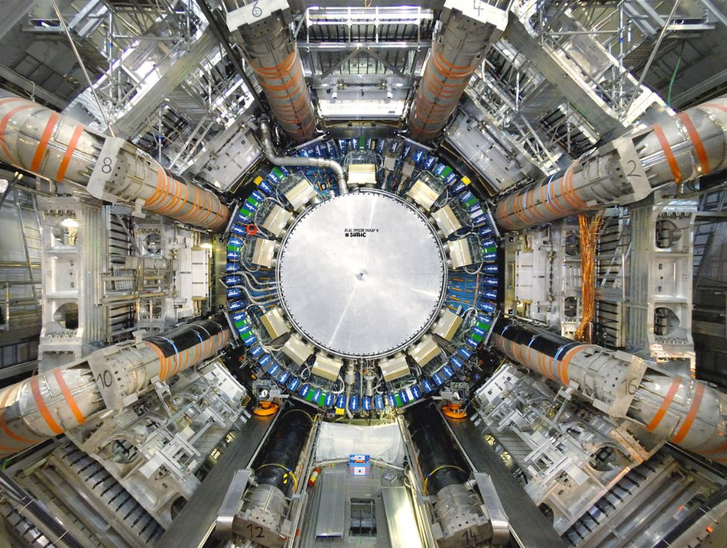
Applications that depend on nuclear data
Fundamental physics
Particle and rare event physics
structure, reactions, tests of models
activation, backgrounds, detector response
Astrophysics
Fusion and materials
ASTROPHYSICS
MEDICINE
reaction rates and nucleosynthesis
NUCLEAR DATA
damage, transmutation and inventories
Energy
Safeguards and security
criticality, burnup, decay heat, shielding
FUSION
PARTICLE PHYSICS
signatures, assay and forensics
Medicine
Space, industry and environment
isotope production, imaging and dose
dose, electronics, analysis and dating
M. Eslami · Nuclear data
03
Notes:
Move quickly around the slide. For particle physicists, emphasise activation, cosmogenic and beam-induced backgrounds, material inventories and detector response. For nuclear physicists, connect the same datasets to structure, reaction mechanisms and astrophysics. The central point is that one maintained data infrastructure serves many communities.
Sources / further reading:
- IAEA Nuclear Data for Applications: https://nds.iaea.org/pages/applications-data
- Bernstein et al., Our Future Nuclear Data Needs, Annu. Rev. Nucl. Part. Sci. 69 (2019), DOI: 10.1146/annurev-nucl-101918-023708
- Astrophysics image: NASA Webb / Cassiopeia A, https://science.nasa.gov/missions/webb/nasas-webb-stuns-with-new-high-definition-look-at-exploded-star/
- Medicine image: NCI PET scan illustration, https://www.cancer.gov/publications/dictionaries/cancer-terms/def/pet-scan
- Fusion image: ITER, What is a tokamak?, https://www.iter.org/machine/what-tokamak
- Particle-physics image: CERN ATLAS, https://home.cern/science/experiments/atlas/

Slide 4
From microscopic quantities to observables
Create
Evolve
Transport
Observe and decide
flux or population
reaction probabilities
fission yields
half-lives
branching ratios
decay chains
spectra and angles
scattering
energy deposition
counts · dose · activity
background · k-effective
material inventory
R = Nₜ ∫ Φ(E) σ(E) dE
dNᵢ/dt = production + feeding − removal − decay
Every final number combines several nuclear datasets, experimental inputs and correlations.
M. Eslami · Nuclear data
04
Notes:
Walk from left to right. A reaction rate uses flux and reaction data. Time evolution adds half-lives, branches and daughter feeding. Transport introduces differential data and energy deposition. Observation adds detector or dosimetry response. This makes clear why a precise cross section alone cannot guarantee a reliable result.

Slide 5
The nuclear data ecosystem
Different resources answer different questions
Role | What it contains | Examples
Literature and indexing | Published work organised by nuclide, reaction and subject | NSR · CINDA · INIS
Experimental records | Measured values, methods, uncertainties and metadata | EXFOR · XUNDL
Evaluated structure and decay | Recommended masses, levels, half-lives and decay radiations | ENSDF · AME/NUBASE · DDEP
Evaluated reactions | Self-consistent reaction files, spectra and covariances | ENDF/B · JEFF · JENDL · CENDL · BROND · TENDL
Models and parameters | Inputs for reaction calculations and interpolation | RIPL
Application and processed data | Collections or formats prepared for a task or transport code | FENDL · IRDFF · IBANDL · MIRD · medical portals · ACE · Geant4
EXFOR: experimental reaction records. ENDF/B, JEFF, JENDL and peers: evaluated reaction files.
M. Eslami · Nuclear data
05
Notes:
Make the distinction explicit. EXFOR is an experimental reaction-data database, not an evaluated library. ENSDF evaluates structure and decay. ENDF/B, JEFF, JENDL and related projects evaluate reaction data. RIPL supports modelling. Application-specific libraries and processed formats sit closer to the end user. The boundaries sometimes overlap, but the roles remain distinct.
Sources / further reading:
- IAEA Nuclear Data Section: https://nds.iaea.org/
- IAEA Nuclear Reaction Data resource list: https://nds.iaea.org/pages/reaction-data
- NNDC database descriptions: https://www.nndc.bnl.gov/databases/

Slide 6
The nuclear data feedback loop
Application need
Measure and model
Compile
Evaluate
quantity, domain and target accuracy
new evidence and physical description
standardise metadata and preserve provenance
reconcile evidence and quantify covariance
No stage is the end of the chain
New evidence and application feedback restart the loop
Feedback
Use and decide
Implement
Process and validate
gaps, discrepancies and new priorities
prediction, design or interpretation
transport, inventory and analysis codes
formats, benchmarks and consistency checks
M. Eslami · Nuclear data
06
Notes:
This is the organising slide for the talk. Nuclear data form a feedback loop rather than a one-way publication pipeline. Applications define accuracy needs. Experiments and theory supply evidence. Compilation preserves it. Evaluation creates a recommended representation. Processing and validation make it usable. Applications then reveal remaining deficiencies and start the next cycle.
Sources / further reading:
- NEA High Priority Request List: https://www.oecd-nea.org/jcms/c_12806/the-nea-high-priority-request-list-hprl-for-nuclear-data
- IAEA international nuclear-data networks: https://nds.iaea.org/

Slide 7
What evaluation contributes
Evidence is usually incomplete, inconsistent and unevenly precise
Experiments
Usable output
normalisation, resolution, systematic errors and correlations
EVALUATION
recommended values
self-consistent channels
covariances
traceable provenance
standard formats
Theory and constraints
assess
reconcile
model gaps
document choices
reaction models, conservation laws, systematics and standards
Validation evidence
integral benchmarks, application tests and consistency checks
Averaging points rarely produces a good evaluation.
M. Eslami · Nuclear data
07
Notes:
Explain that evaluation requires judgement and documentation. The evaluator examines experimental methods and correlations, enforces physical consistency, uses theory where measurements are absent, and tests the result against integral evidence. The product must remain traceable so users can understand why one value was adopted over another.
Sources / further reading:
- NNDC description of evaluated databases: https://www.nndc.bnl.gov/databases/
- Bay Area Nuclear Data Program, Evaluation: https://nucleardata.berkeley.edu/

Slide 8
Why evaluations need revision
1
2
3
4
5
New data
Revised standards
Improved models
Benchmark feedback
New applications
measurements extend coverage or expose disagreement
change flux, detector or decay normalisation
change interpolation and unmeasured regions
reveals missing physics or compensating errors
demand different energies, observables or accuracy
New evaluated release
updated values · covariance · documentation · validation record
Each release reflects the evidence and application needs available at that time.
M. Eslami · Nuclear data
08
Notes:
Answer the likely question: why evaluate again? Evaluations age because their inputs and intended uses change. A revised gamma intensity can renormalise an activation result. A new benchmark can expose a problem that differential data did not reveal. Updated files must then propagate through databases, portals, processing systems and simulation codes.

Slide 9
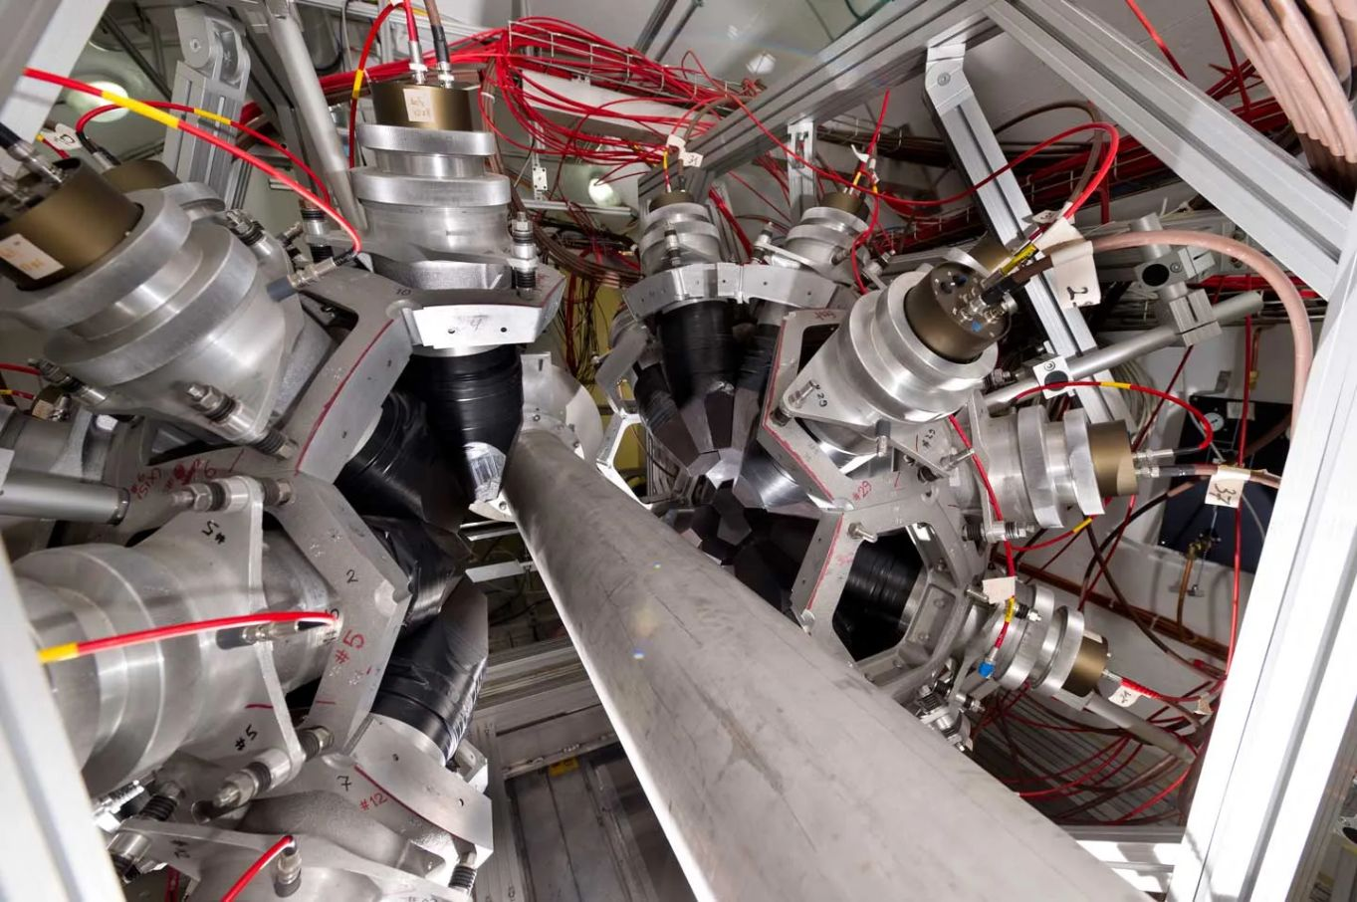
Why new measurements remain essential
Models connect measured regions. Experiments anchor the connection.
01
Coverage gaps
important nuclides, energy ranges and reaction channels still lack data
02
Accuracy limits
existing uncertainties dominate a dose, yield, background or safety margin
03
Missing observables
spectra, angles, isomeric ratios, fission yields and delayed emissions remain incomplete
04
Legacy limitations
older work may lack raw data, metadata, systematic correlations or modern standards
n_TOF experimental area · CERN
Changing use cases
fusion, advanced reactors, isotope production and rare event searches probe new domains
A new measurement is more than a new point
05
observables · metadata · systematics · covariance
A mature database can still contain decisive gaps for a new application.
M. Eslami · Nuclear data
09
Notes:
Stress that the existence of a database does not imply complete or sufficiently precise coverage. New measurements should be targeted by sensitivity and consequence, not by filling the chart uniformly. Differential observables and covariance information can matter as much as a total cross section.
Sources / further reading:
- NEA High Priority Request List: https://www.oecd-nea.org/jcms/c_12806/the-nea-high-priority-request-list-hprl-for-nuclear-data
- IAEA research projects and standards: https://nds.iaea.org/
- Measurement image: CERN n_TOF, https://home.cern/science/experiments/n_tof/

Slide 10
Current challenges in nuclear data
Scientific challenges
Infrastructure challenges
coverage across nuclides, particles, energies and observables
limited evaluator time and a specialised workforce
disagreement, shared normalisations and hidden correlations
traceable metadata, raw data preservation and reproducibility
model bias when extrapolating beyond measured regions
synchronised releases across databases, portals and codes
complete covariance and coupled decay or reaction networks
validation benchmarks and fast feedback from users
Continuity of expertise and update pathways is now a major bottleneck.
M. Eslami · Nuclear data
10
Notes:
Separate scientific problems from infrastructure problems. The field needs better measurements and theory, but it also needs evaluators, traceable metadata, maintained formats, reproducible processing and mechanisms that propagate revisions. The last point is easy to overlook because users usually encounter nuclear data only through a simulation package or portal.
Sources / further reading:
- Bernstein et al., Our Future Nuclear Data Needs, Annu. Rev. Nucl. Part. Sci. 69 (2019)
- IAEA Nuclear Data Section and international networks: https://nds.iaea.org/
- Bay Area Nuclear Data Program: https://nucleardata.berkeley.edu/

Slide 11
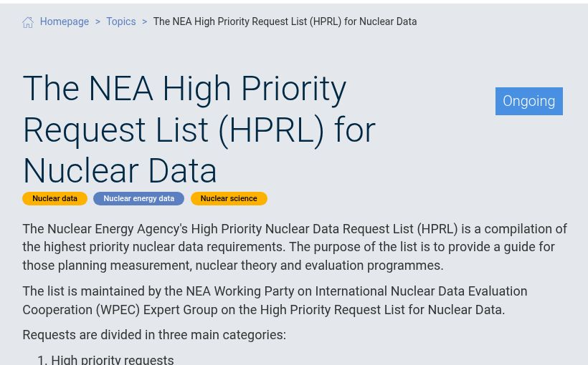
Application driven priorities
The useful question is where improved data change a decision
1
Define the output
dose · k-effective · yield · inventory · background
2
Propagate uncertainty
identify the nuclides, reactions and decay quantities that dominate
3
Set a target accuracy
specify energy range, observable and acceptable uncertainty
NEA High Priority Request List
4
Coordinate the response
measurement · theory · evaluation · benchmark
FORMAL PRIORITISATION
turn an application need into a coordinated measurement and evaluation response
Also: IAEA coordinated research projects · application specific issue lists
M. Eslami · Nuclear data
11
Notes:
Show how scarce measurement and evaluation effort should be prioritised. Start from an output that matters, use sensitivity and uncertainty analysis, define a target accuracy in a specific domain, then coordinate measurement, modelling, evaluation and validation. The NEA HPRL is a formal example of this application-driven approach.
Sources / further reading:
- NEA High Priority Request List: https://www.oecd-nea.org/jcms/c_12806/the-nea-high-priority-request-list-hprl-for-nuclear-data
- IAEA Nuclear Data Section research projects: https://nds.iaea.org/
- Priority-list visual: NEA HPRL webpage, https://www.oecd-nea.org/jcms/c_12806/

Slide 12
Case study · Cu-64 and Cu-67
One element, complementary decay modes - and a compact test of the full data chain
⁶⁴Cu
PET imaging
⁶⁷Cu
β⁻ therapy
↔
t½ = 12.70 h · β⁺ / EC decay
⁶⁴Ni(p,n)⁶⁴Cu benchmark route
t½ = 61.83 h · β⁻ decay
⁷⁰Zn(p,α)⁶⁷Cu and ^{nat}Zn(p,x)⁶⁷Cu
same chemistry
What the experiment had to determine
Production
Separation
Interpretation
excitation functions across a wide energy
⁶⁷Cu from ⁶⁷Ga in shared γ lines
natural target data into isotope channels
Time-resolved γ-ray spectrometry ultimately enabled seven excitation functions.
M. Eslami · Nuclear data
12
Notes:
Open the five-minute case study with the clinical logic: Cu-64 is used mainly for PET imaging and Cu-67 for beta therapy, while their shared copper chemistry supports a matched theranostic pair. Then pivot immediately to the nuclear-data question: production requires reaction data, activity extraction requires decay data, and the stacked-foil experiment requires monitor and stopping-power data. The study measured proton-induced production from 4 to 28 MeV and ultimately produced seven excitation functions.
Sources / further reading:
- M. Eslami, PhD thesis, Chapter 5, Proton-induced production of Cu-67 and Cu-64
- M. Eslami et al., Proton-induced cross sections for medical radioisotopes Cu-64 and Cu-67, abstract and Nuclear Data Conference poster

Slide 13
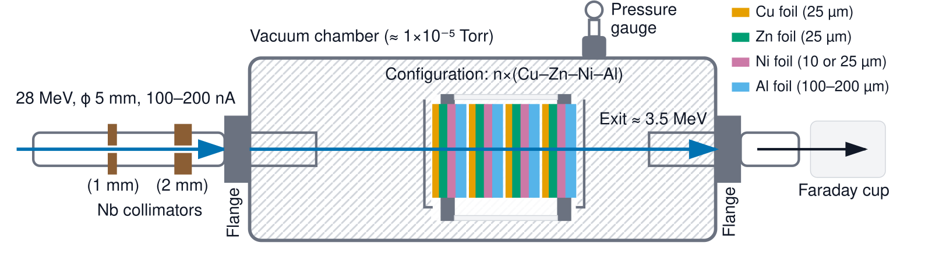
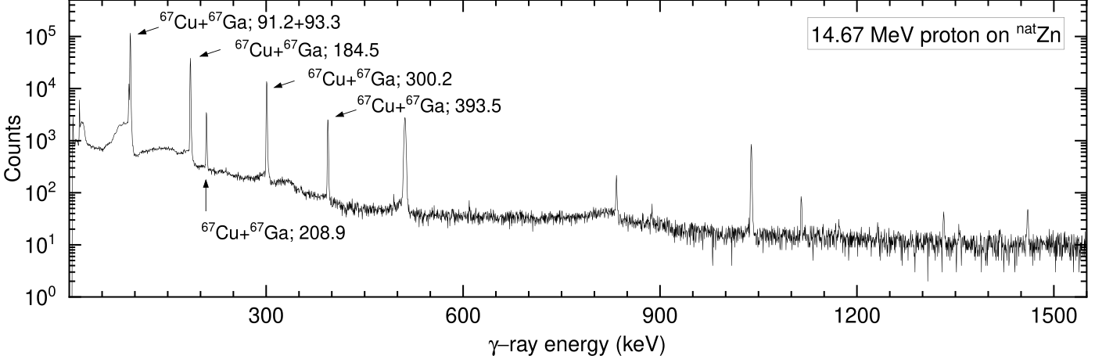
One irradiation, several layers of inference
Stacked foils map energy in one irradiation
Shared γ lines require time information
1 · Beam + target
2 · Repeated HPGe
3 · Joint deconvolution
Cu/Ni monitor reactions, foil areal density and energy degradation set E and fluence.
Typically 8–10 spectra per Zn foil, extending to about two weeks after EOB.
Shared lines and different half-lives separate ⁶⁷Cu (61.83 h) from ⁶⁷Ga (78.28 h).
Counts become cross sections only after reaction and decay data are combined.
M. Eslami · Nuclear data
13
Notes:
Walk through the inference chain. The repeated Cu-Zn-Ni-Al stack degraded a 28 MeV beam to about 3.5 MeV, so one irradiation sampled many energies. Cu and Ni monitor reactions constrained fluence; stopping calculations and straggling set the horizontal uncertainties. The harder problem was spectral: Cu-67 and Ga-67 populate the same states in Zn-67 and share lines such as 184.57 keV. Eight to ten spectra over roughly two weeks provided the time dependence needed for a separation.
Sources / further reading:
- M. Eslami, PhD thesis, Chapter 5, Sections 5.2.4–5.2.5 and Figures 5.1, 5.8
- M. Eslami et al., Nuclear Data Conference poster

Slide 14
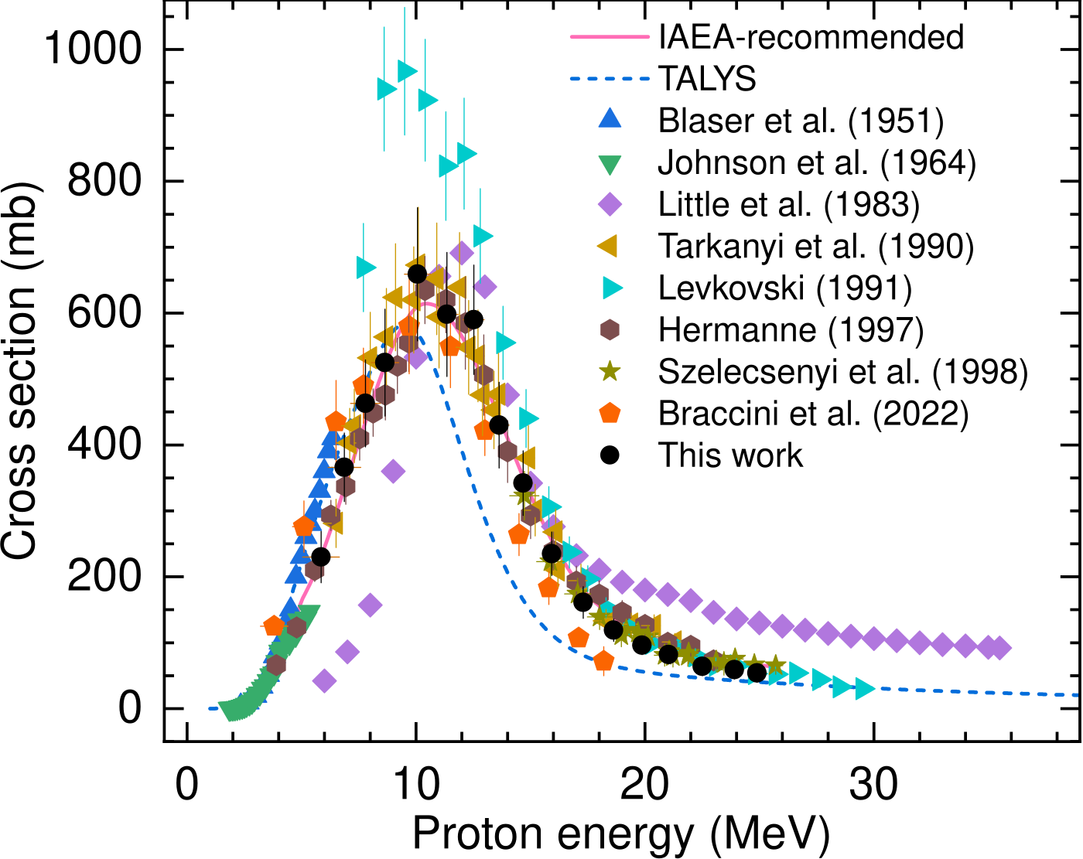
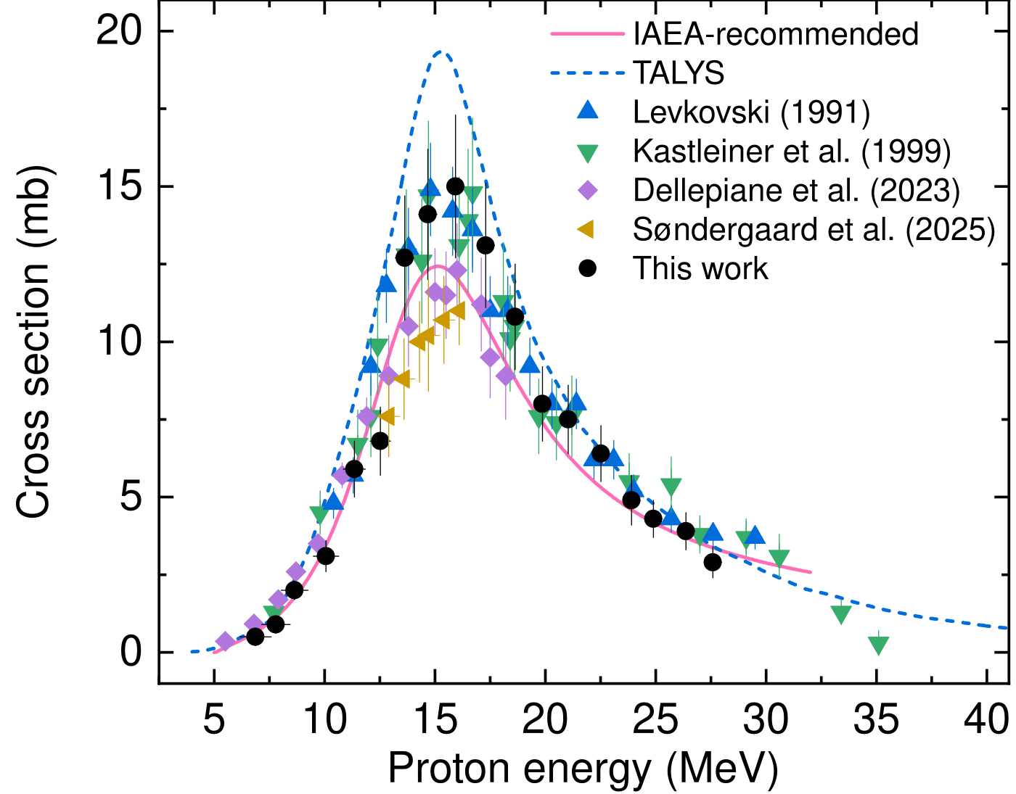
Two excitation functions (different lessons)
⁶⁴Ni(p,n)⁶⁴Cu · benchmark route
⁷⁰Zn(p,α)⁶⁷Cu · extraction challenge
3.8–18.3 MeV · within the established spread
Practical production window ≈ 6–14 MeV
Peak ≈15 mb at 15 MeV · window ≈11–22 MeV
Model gets the shape but overpredicts the peak
M. Eslami · Nuclear data
14
Notes:
Give one message per panel. For Ni-64(p,n)Cu-64, the points from 3.8 to 18.3 MeV sit within the established experimental spread and support the activity-to-cross-section procedure; the thesis identifies about 6–14 MeV as a practical production window. For Zn-70(p,alpha)Cu-67, the extracted excitation function peaks around 15 MeV at approximately 15 mb. The measurements bracket the IAEA recommendation with recent datasets, while default TALYS reproduces the broad shape but overestimates the peak. Stress that this curve required both isotope separation in time and reaction-channel separation.
Sources / further reading:
- M. Eslami, PhD thesis, Chapter 5, Figures 5.11–5.12 and Sections 5.4.1–5.4.2
- Plot assets from M. Eslami et al., Nuclear Data Conference poster

Slide 15
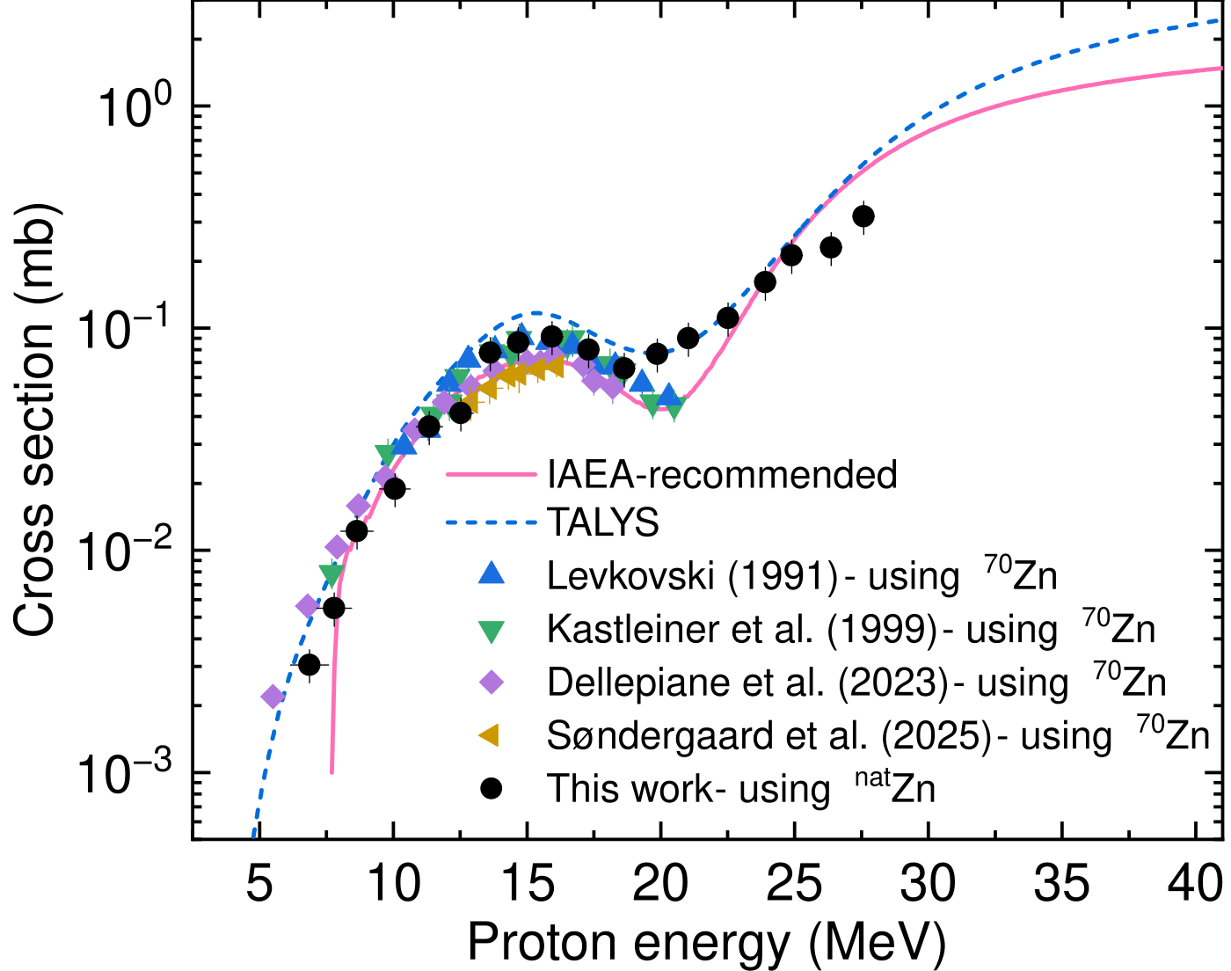
Cu-67: not one peak, not one channel
1 · Spectral mixture
Composite ⁿᵃᵗZn(p,x)⁶⁷Cu excitation function
⁶⁷Cu and ⁶⁷Ga share several γ-ray energies. Cooling time dependence supplies the missing information.
2 · Reaction mixture
ⁿᵃᵗZn(p,x)⁶⁷Cu combines ⁷⁰Zn(p,α) at lower energy with ⁶⁸Zn(p,2p) above ≈20 MeV.
3 · Evaluation lesson
Evaluated curves guide decomposition and comparison; new measurements expose where model normalisation needs work.
New data to 28 MeV capture the high-energy rise and feed the next evaluation cycle.
M. Eslami · Nuclear data
15
Notes:
Use this slide to reconnect the case study to the feedback loop. Natural zinc is not a single reaction: the low-energy part is dominated by Zn-70(p,alpha), while Zn-68(p,2p) becomes important above roughly 20 MeV. The measured natural-zinc excitation function agrees broadly with the IAEA recommendation and adds information above 21 MeV, including the high-energy rise. TALYS overestimates the cross section across the measured range. The broader lesson is that evaluated information was necessary to interpret the measurement, while the new measurement now becomes evidence for future model tuning and evaluation.
Sources / further reading:
- M. Eslami, PhD thesis, Chapter 5, Sections 5.4.3–5.4.4 and Figure 5.13
- M. Eslami et al., Nuclear Data Conference poster and abstract

Slide 16
Messages
01
Nuclear data cover properties, structure, decay, reactions, emissions and their uncertainties.
02
Their value comes from a maintained chain of measurement, compilation, evaluation, validation and use.
03
New data and repeated evaluation remain necessary because evidence, standards and applications change.
A reliable prediction requires traceable data.
Questions
Notes:
Close by returning to the opening claim. Nuclear data are infrastructure. Reliable predictions require both good numbers and a traceable path from evidence to implementation. Invite questions from both communities.
40Ar cosmogenic activation
The $214$Pb β spectrum in xenon
A γ ray almost exactly at the ${}^{76}$Ge $0νββ$energy
Neutron inelastic scattering on lead produces a 2041-keV γ ray, extremely close to the ${}^{76}$Ge $Q_{ββ}$value near 2039 keV. A 3062-keV transition can also create a double-escape feature near the same region. That makes partial Pb$\left(n , n^{′}γ\right)$ cross sections much more important
A complete, material-relevant $\left(α , n\right)$dataset for PTFE and detector ceramics

