Slide 1

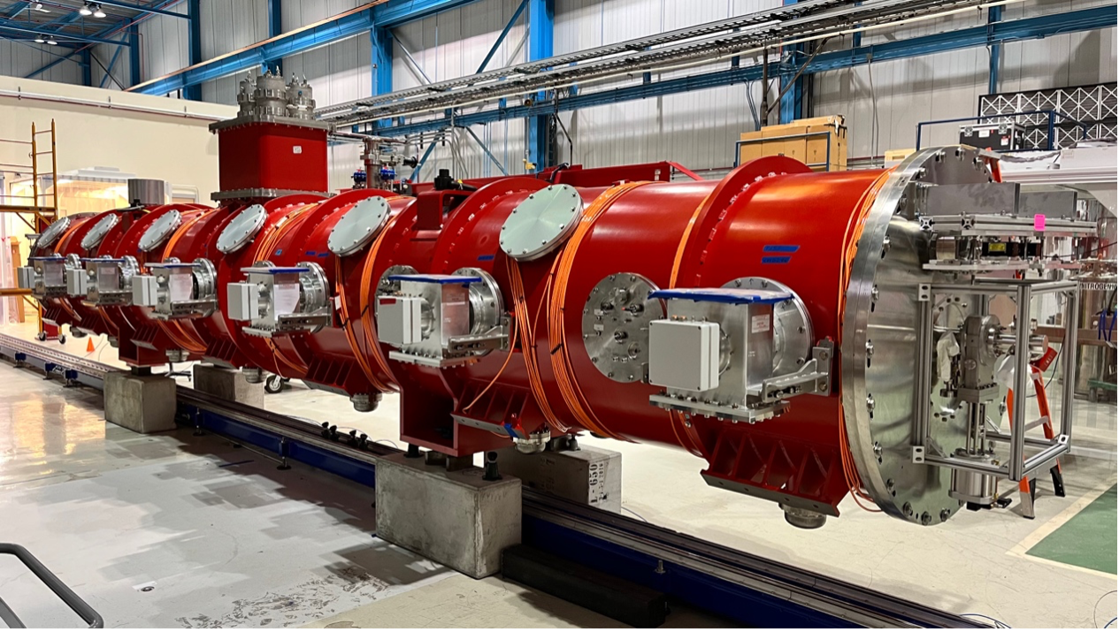
PIP-II Cavity and Cryomodule Integration
Alan Wheelhouse – Principal Investigator
On behalf of the PIP-II Team
Notes:
When choosing your slide there are two master themes to choose from, one with a logo in the bottom left and one without.

Slide 2

Outline
      Project Overview
      Infrastructure Development & Validation
      Cavity Production & Testing
      Cryomodule Integration
      Delivery Progress
      Summary
Notes:
To replace with a photo of your own: Right click on centre of image select ‘Change picture’ click ‘from file…’ and choose your image.

Slide 3

Project Overview
Notes:
To replace with a photo of your own: Right click on centre of image select ‘Change picture’ click ‘from file…’ and choose your image.

Slide 4
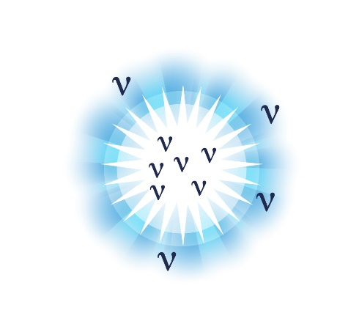



LBNF/DUNE/PIP-II … Global Partnership!
Neutrinos are the least understood particle in the universe.
Opportunities for game changing physics discoveries
Origin of Matter
Neutron Star and Black Hole formation
Unification of Forces
Three multi-billion dollar US-DoE projects being performed internationally with partners from more than 30 countries around the world and with 175 institutions:
  LBNF has 25% contributions from international partners;
  DUNE has 75% contributions from international partners;
  Proton Improvement Plan PIP-II has 80% contributions from international partners.
Unique global science opportunity:
  CP violation in lepton sector and opportunities to observe formation of a neutron star … even a black hole!
PIP-II is the heart which provides multi-MW proton beams, to generate the most intense neutrinos in the world!

Slide 5
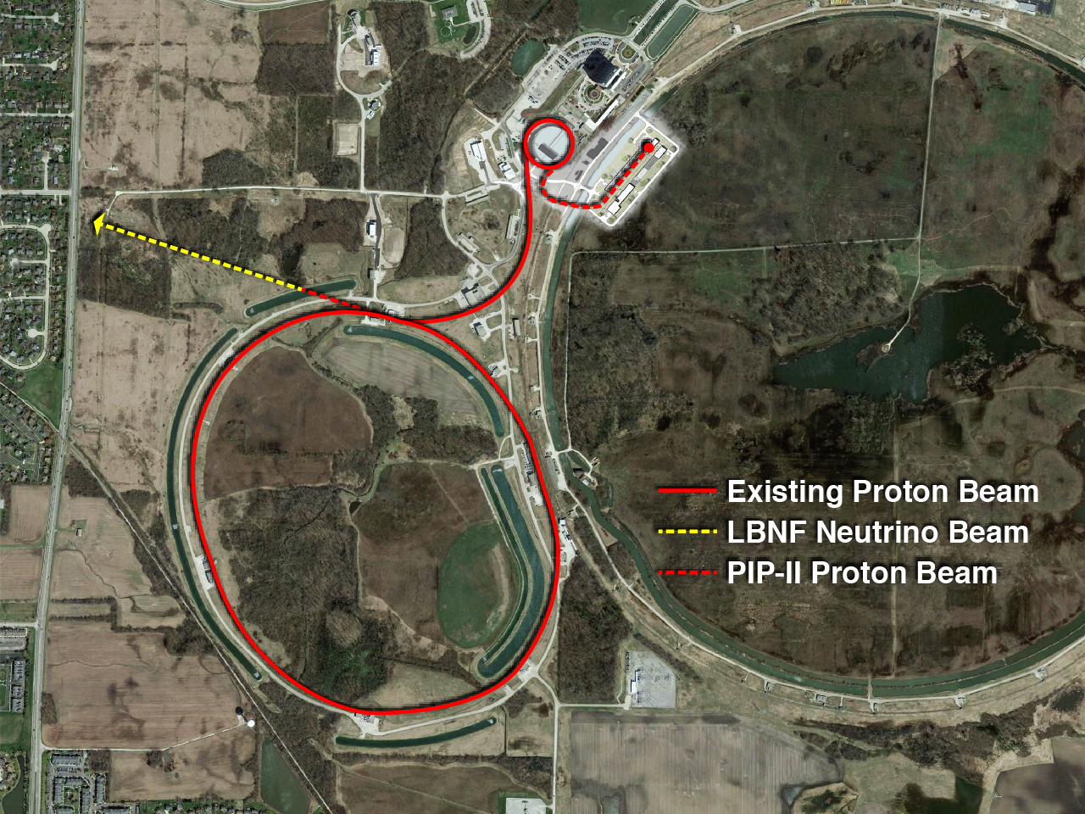
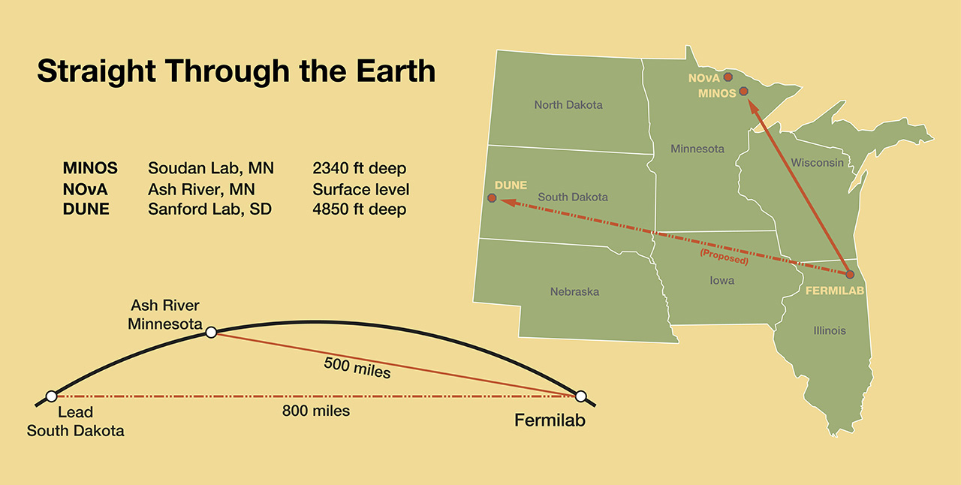
LBNF/DUNE and PIP-II @ FNAL, USA
PIP-II
South
Dakota
  Deliver 1.2 MW proton beam over the energy range 60 – 120 GeV..
  Establish a platform for future upgrades to multi-MW capability.

Slide 6
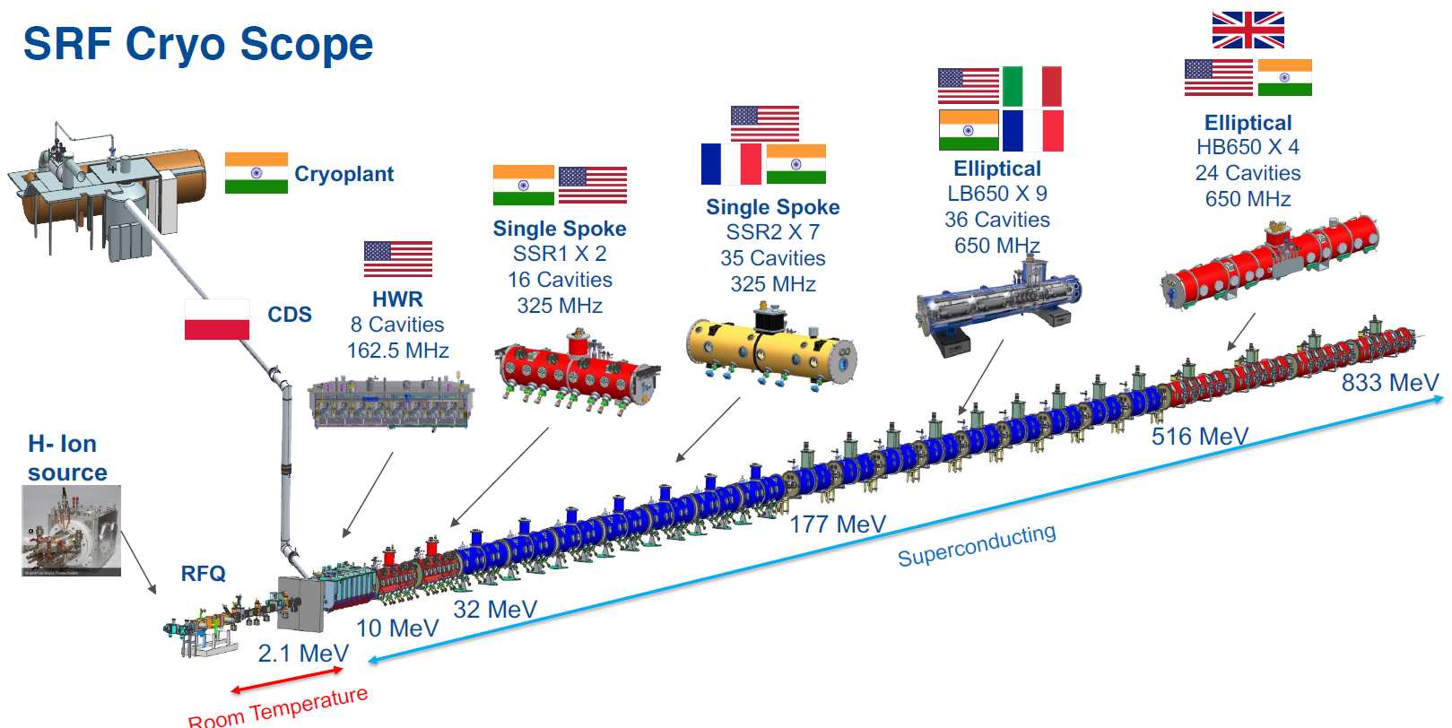
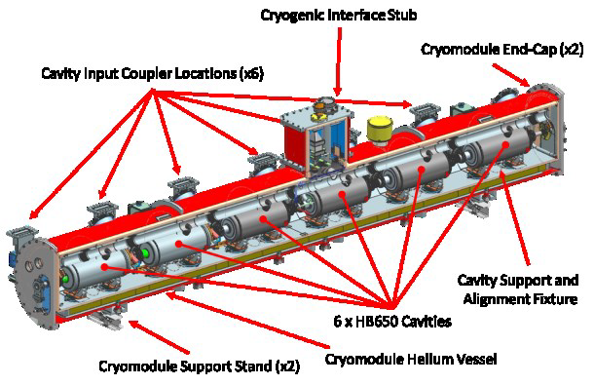
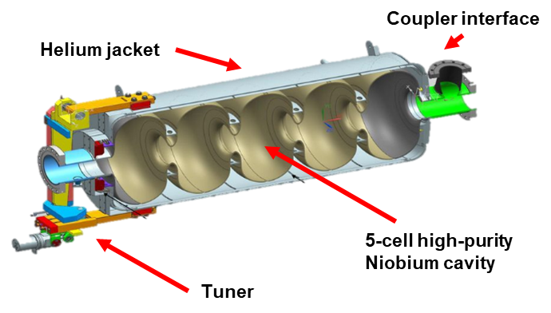
Proton Improvement Project (PIP-II)
UK Delivery Scope
3 x HB650 Cryomodules
6 x HB650 Cavities
Per Cryomodule
Cavity | PIP-II
Frequency (MHz) | 650
Cavity Beta | 0.92
Gradient (MV/m) | 18.8
Quality Factor Qo (CM) | >3.3 x 10¹⁰ (N2 Doped)
Number of Cells | 5
Cavity Dynamic Load (W) | <22
Cavity Length (m) | 1.42
Number of Cavities | 18 (+2)
FNAL to provide 1st prototype cryomodule (pCM) components – which STFC will refurbish as CM0

Slide 7
Infrastructure Development & Validation
Notes:
To replace with a photo of your own: Right click on centre of image select ‘Change picture’ click ‘from file…’ and choose your image.

Slide 8
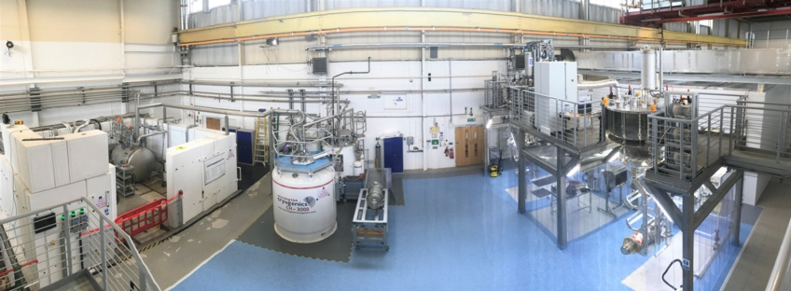
Infrastructure Upgrade Requirements
Cavities
Manipulation
  PIP-II cavities are larger & heavier than ESS cavities (650 MHz cf 704 MHz) – Modification of clamping fixtures and supports
Cryogenic Testing
  Fast cool-down required due to N doping (x10 needed)
  New cryogenic testing insert to accept HB650 cavity (single cavity cf. 3-cavity for ESS)
Cavity Processing
  Modify HPR system to accept HB650 cavity.
RF Testing
  New 650 MHz RF control system for cavity testing
Cryomodules (New for PIP-II)
Cavity String Integration
  ISO3/4 Cleanroom upgrade to assemble cavity string (14 m x 5 m).
  Cleanroom assembly tooling and fixtures.
Manipulation
  Rail system for cavity string integration into the outer vessel.
Outer Vessel Assembly
  Support fixtures to load cavity string, assemble thermal and magnetic shields, cryogenics, instrumentation and outer vessel.
  Acceptance testing of assembled HB650 cryomodules.
Cleanroom
Test Bunker
Liquefier
Cavity Insert

Slide 9
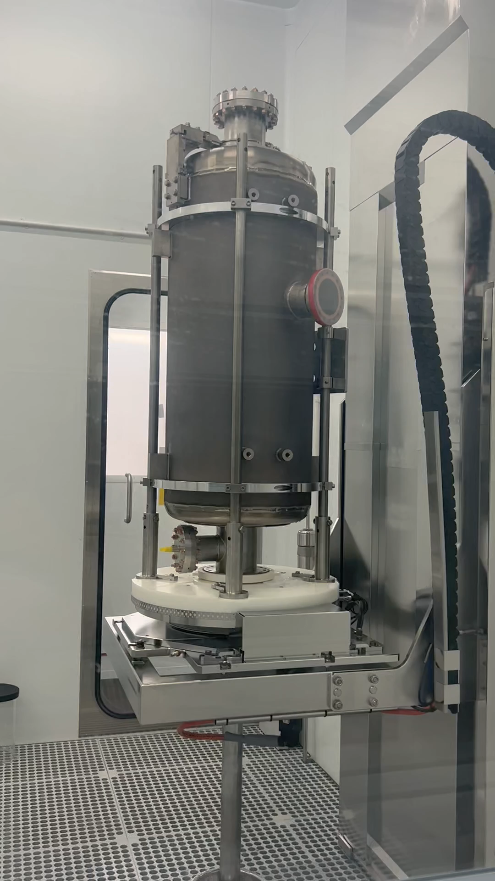
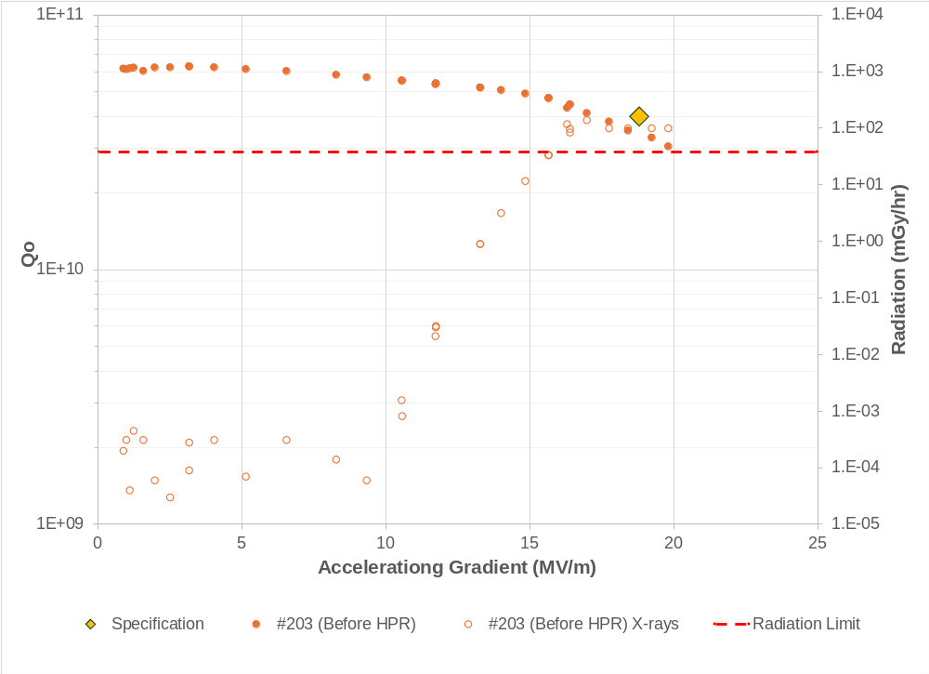
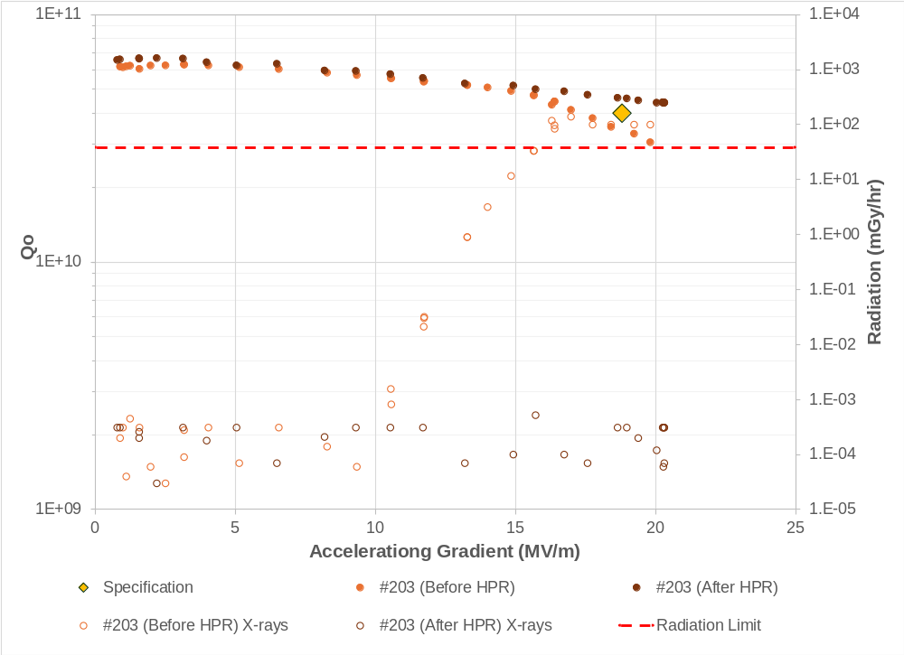
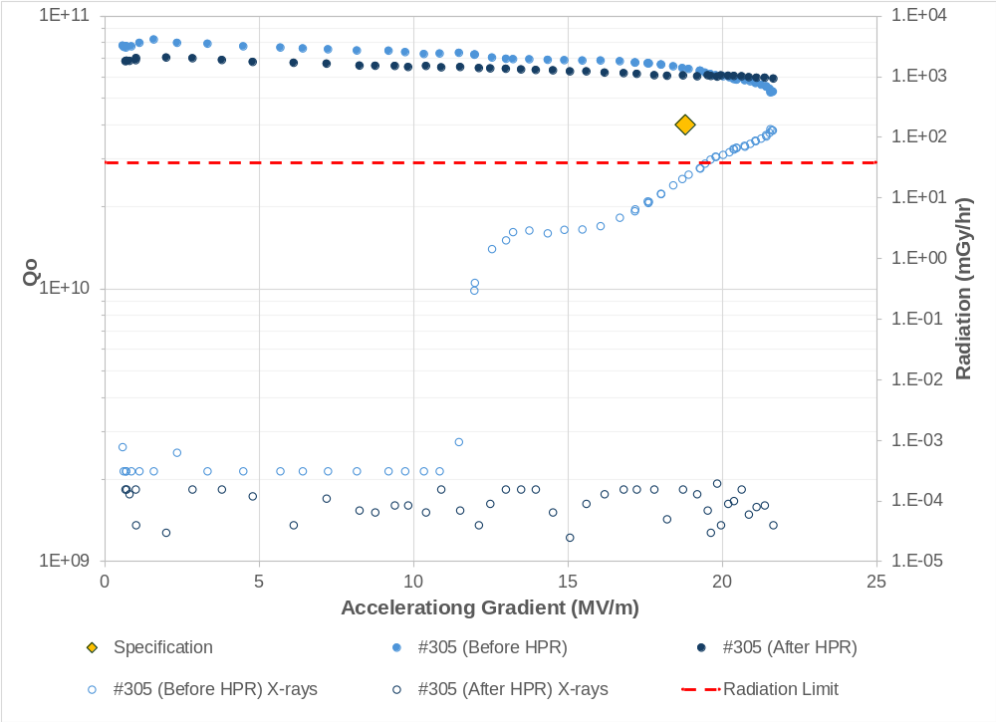
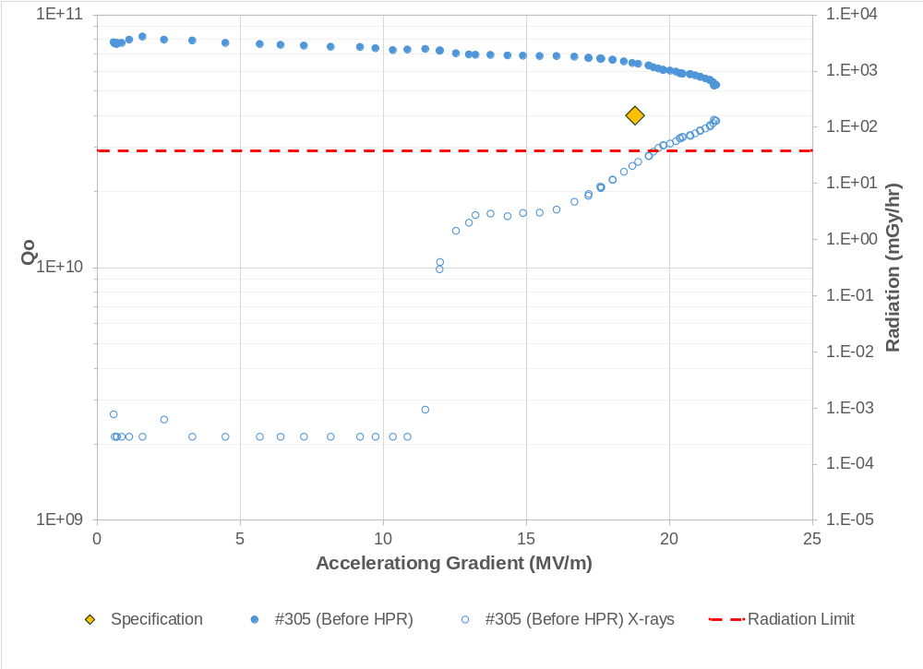
High Pressure Rinse System
More than 40% of ESS HB cavities needed to be re-processed due field emission
HPR system upgraded for PIP-II– New nozzle design
Trials on PIP-II cavities showed successful re-processing
All cavities HPR’d @ DL prior to testing (both FNAL and Zanon)
100% success rate to date in meeting the specification
Enabled recovery of several problematic FNAL cavities
#203
#305
Spec
Spec
Before HPR
After HPR
Before HPR
After HPR

Slide 10
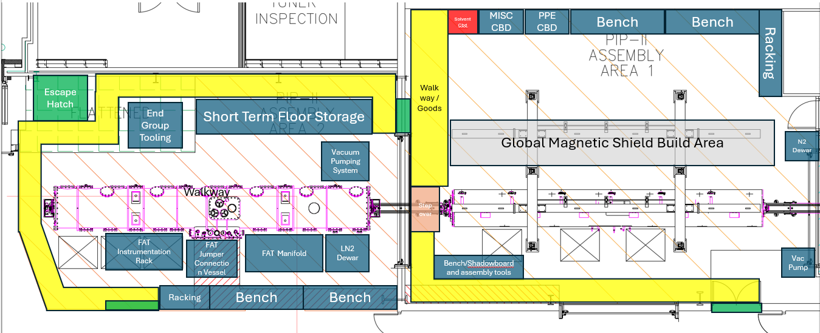
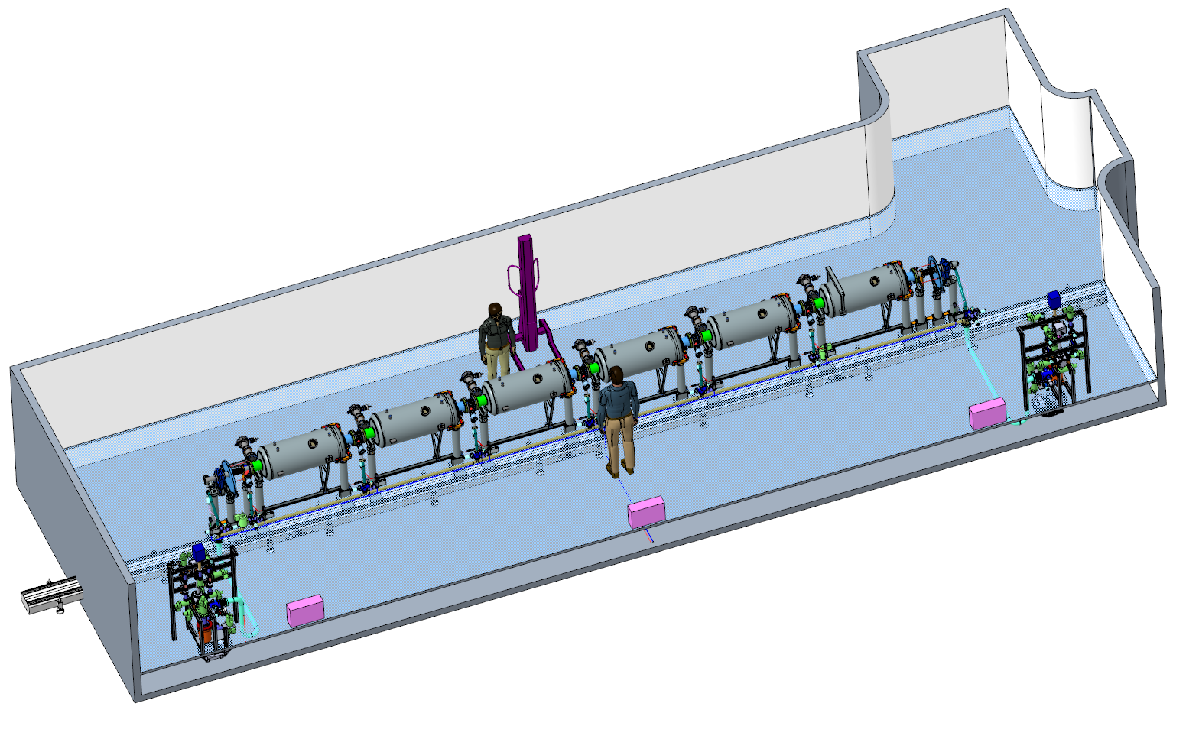
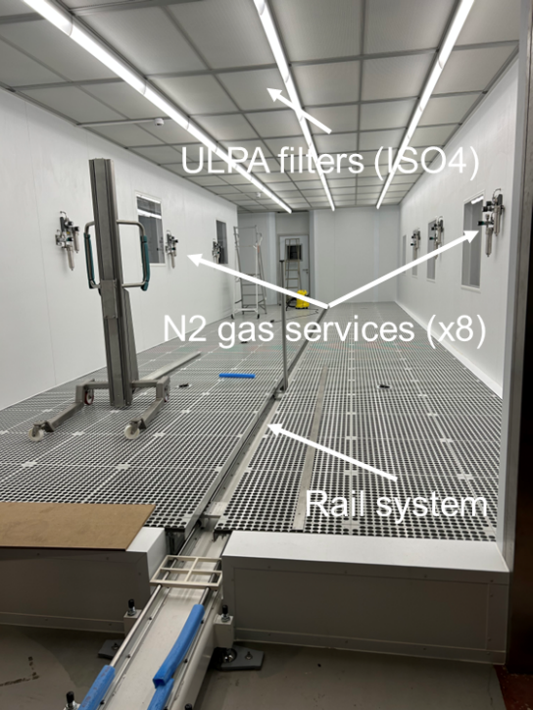
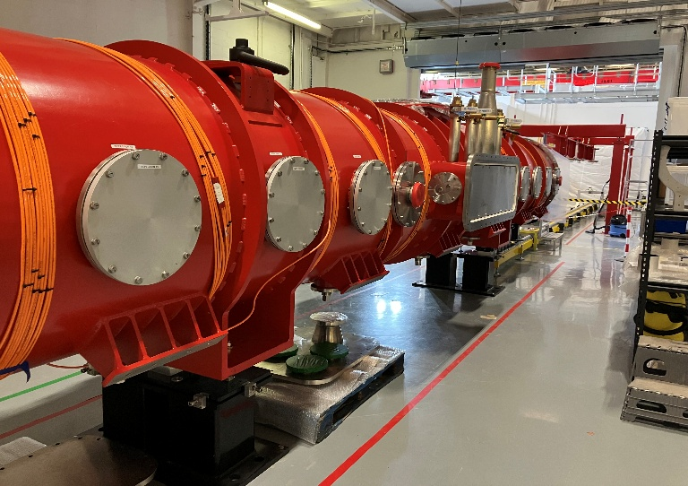
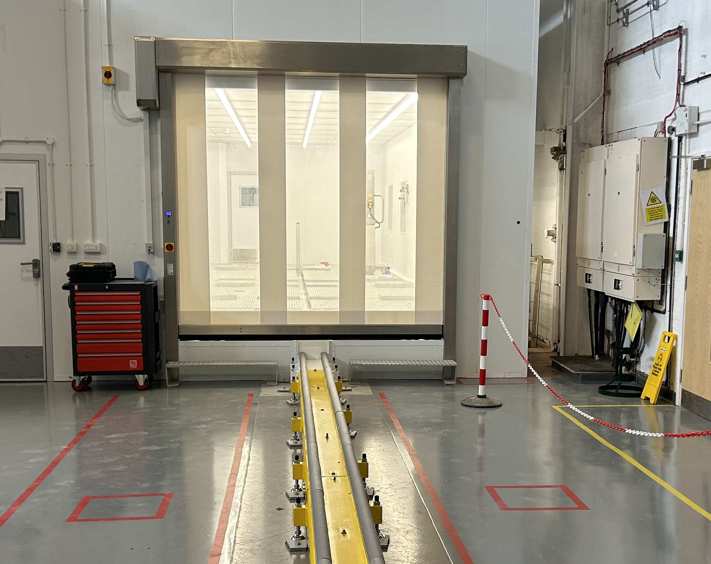
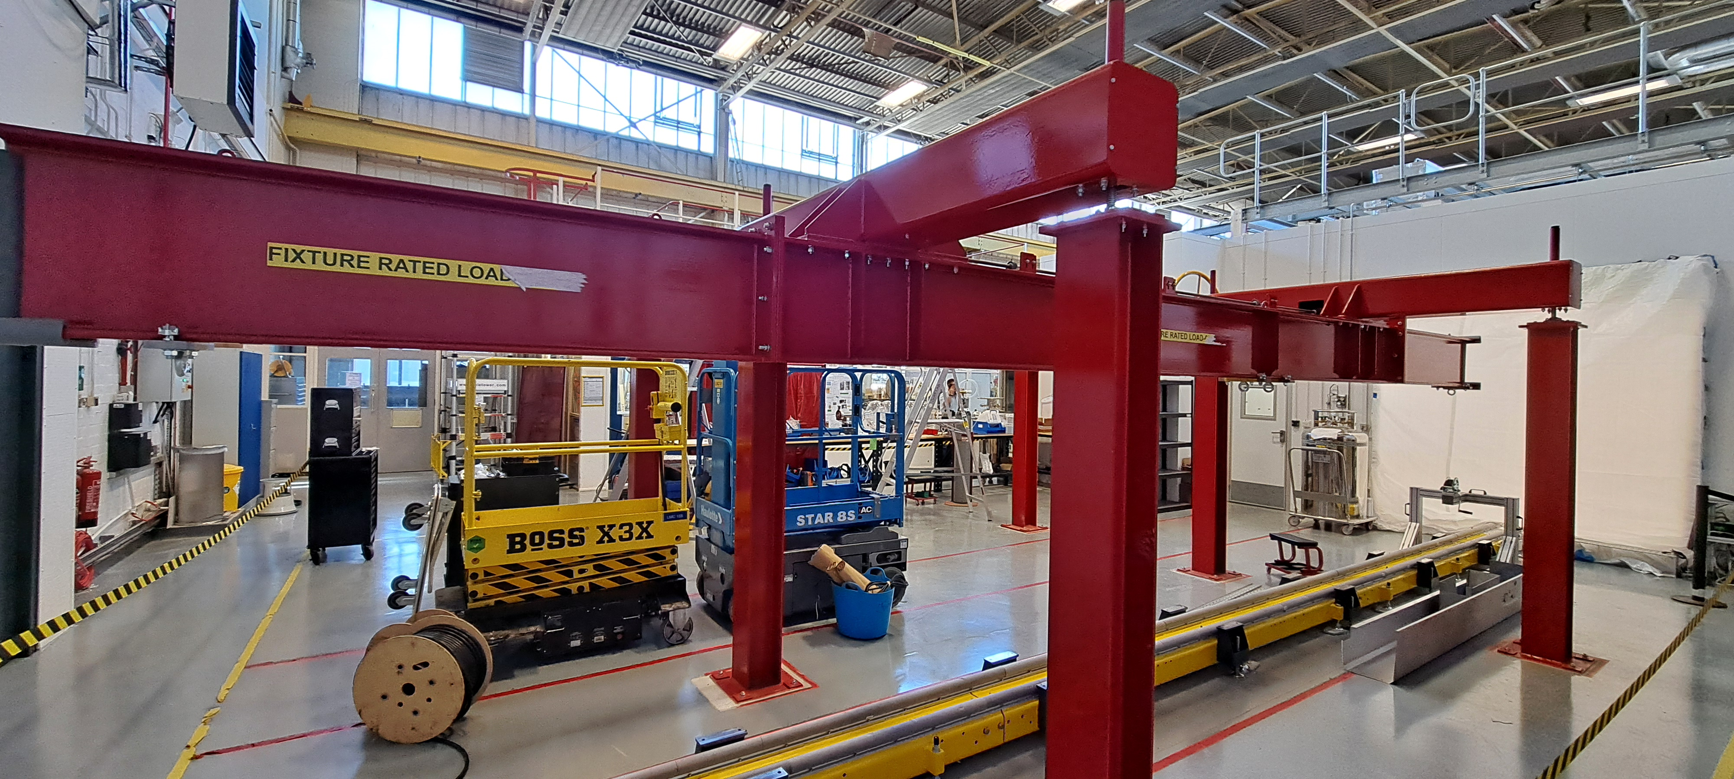
PIP-II Cryomodule Infrastructure
Electron Hall
SuRFLab
Workstation 1: Cavity String Integration
ISO4 Cleanroom
14 m x 5 m
CM0 vessel arrived 22ndAug
Workstation 3: CM Vessel
Workstation 2: Cold-Mass

Slide 11
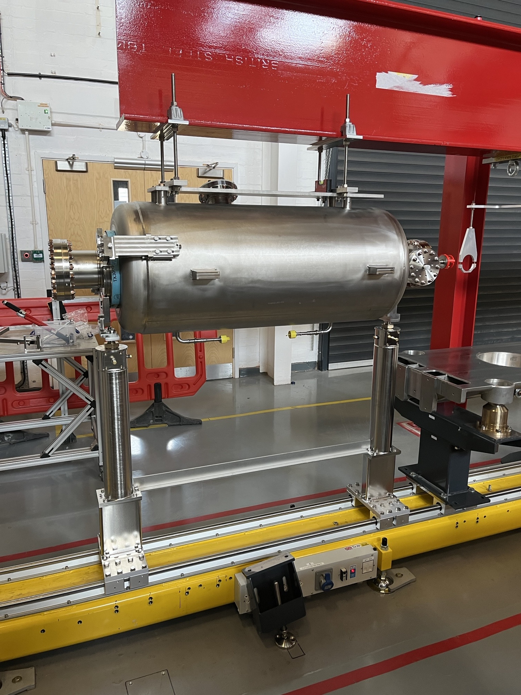
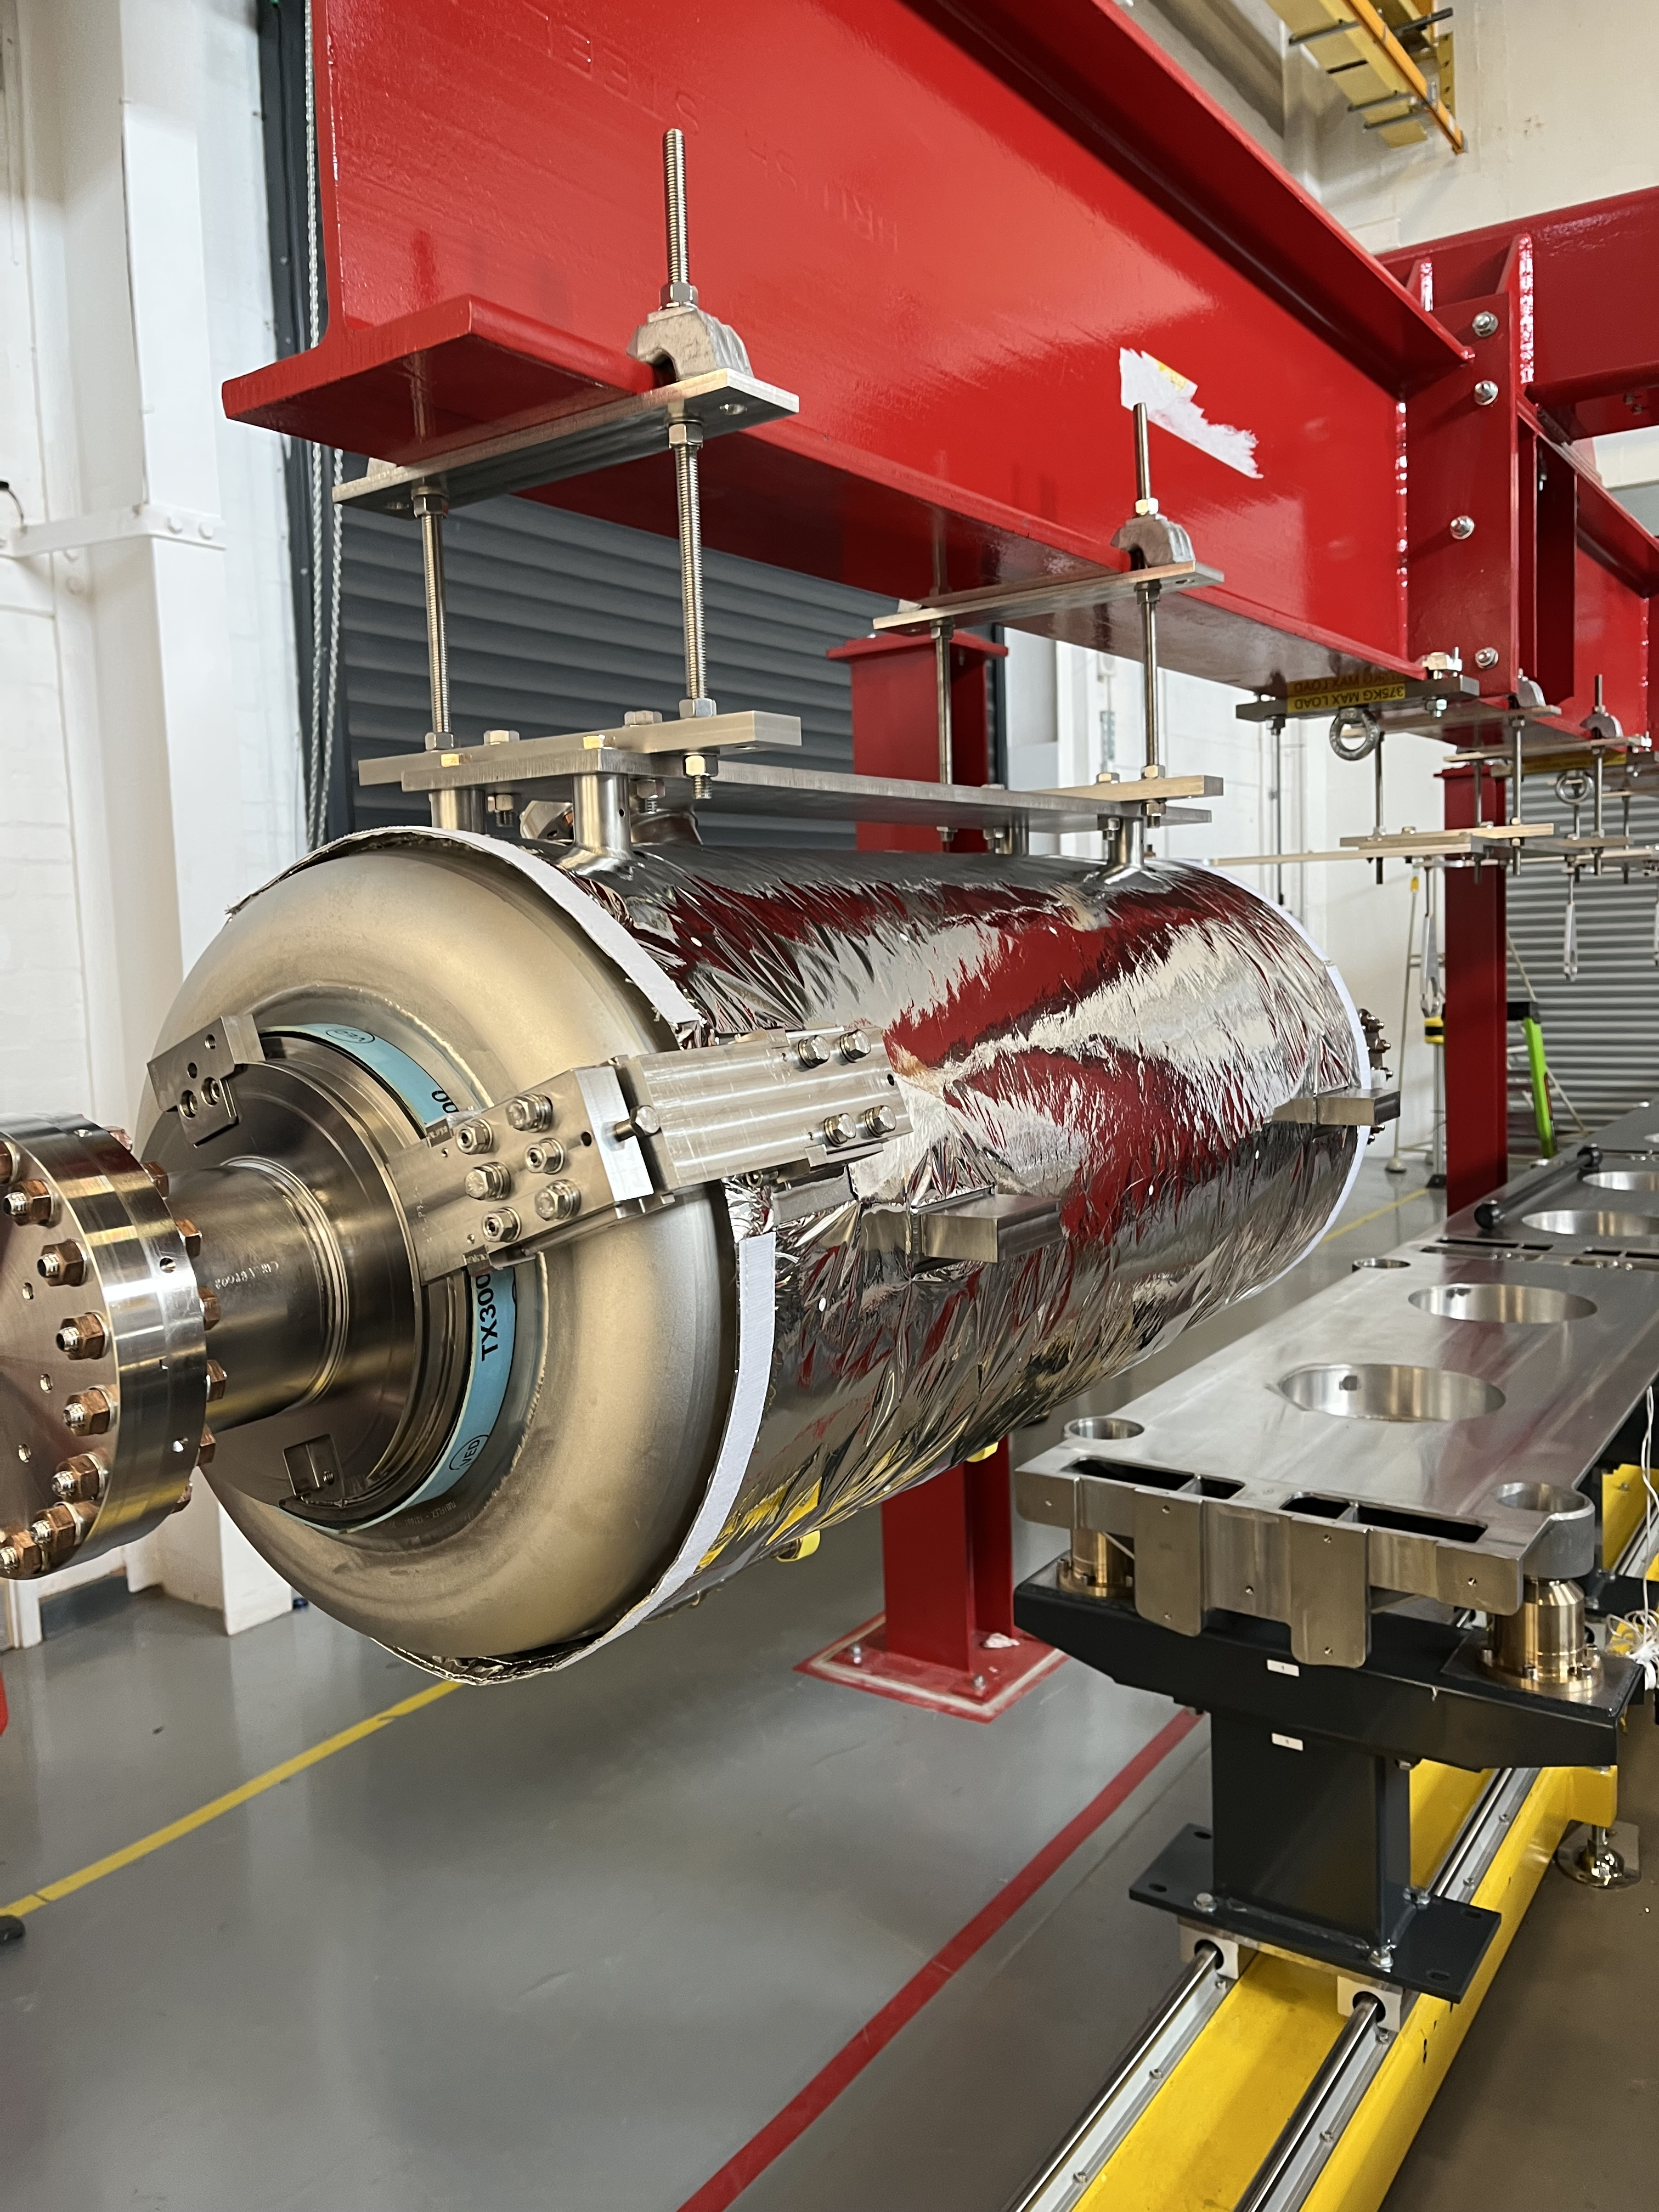
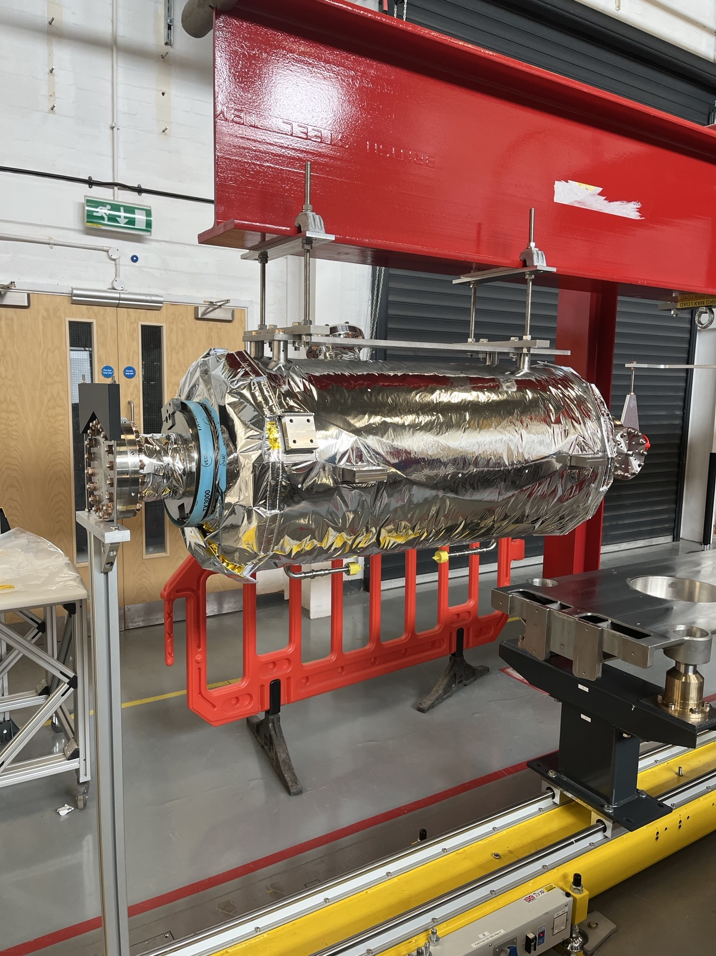
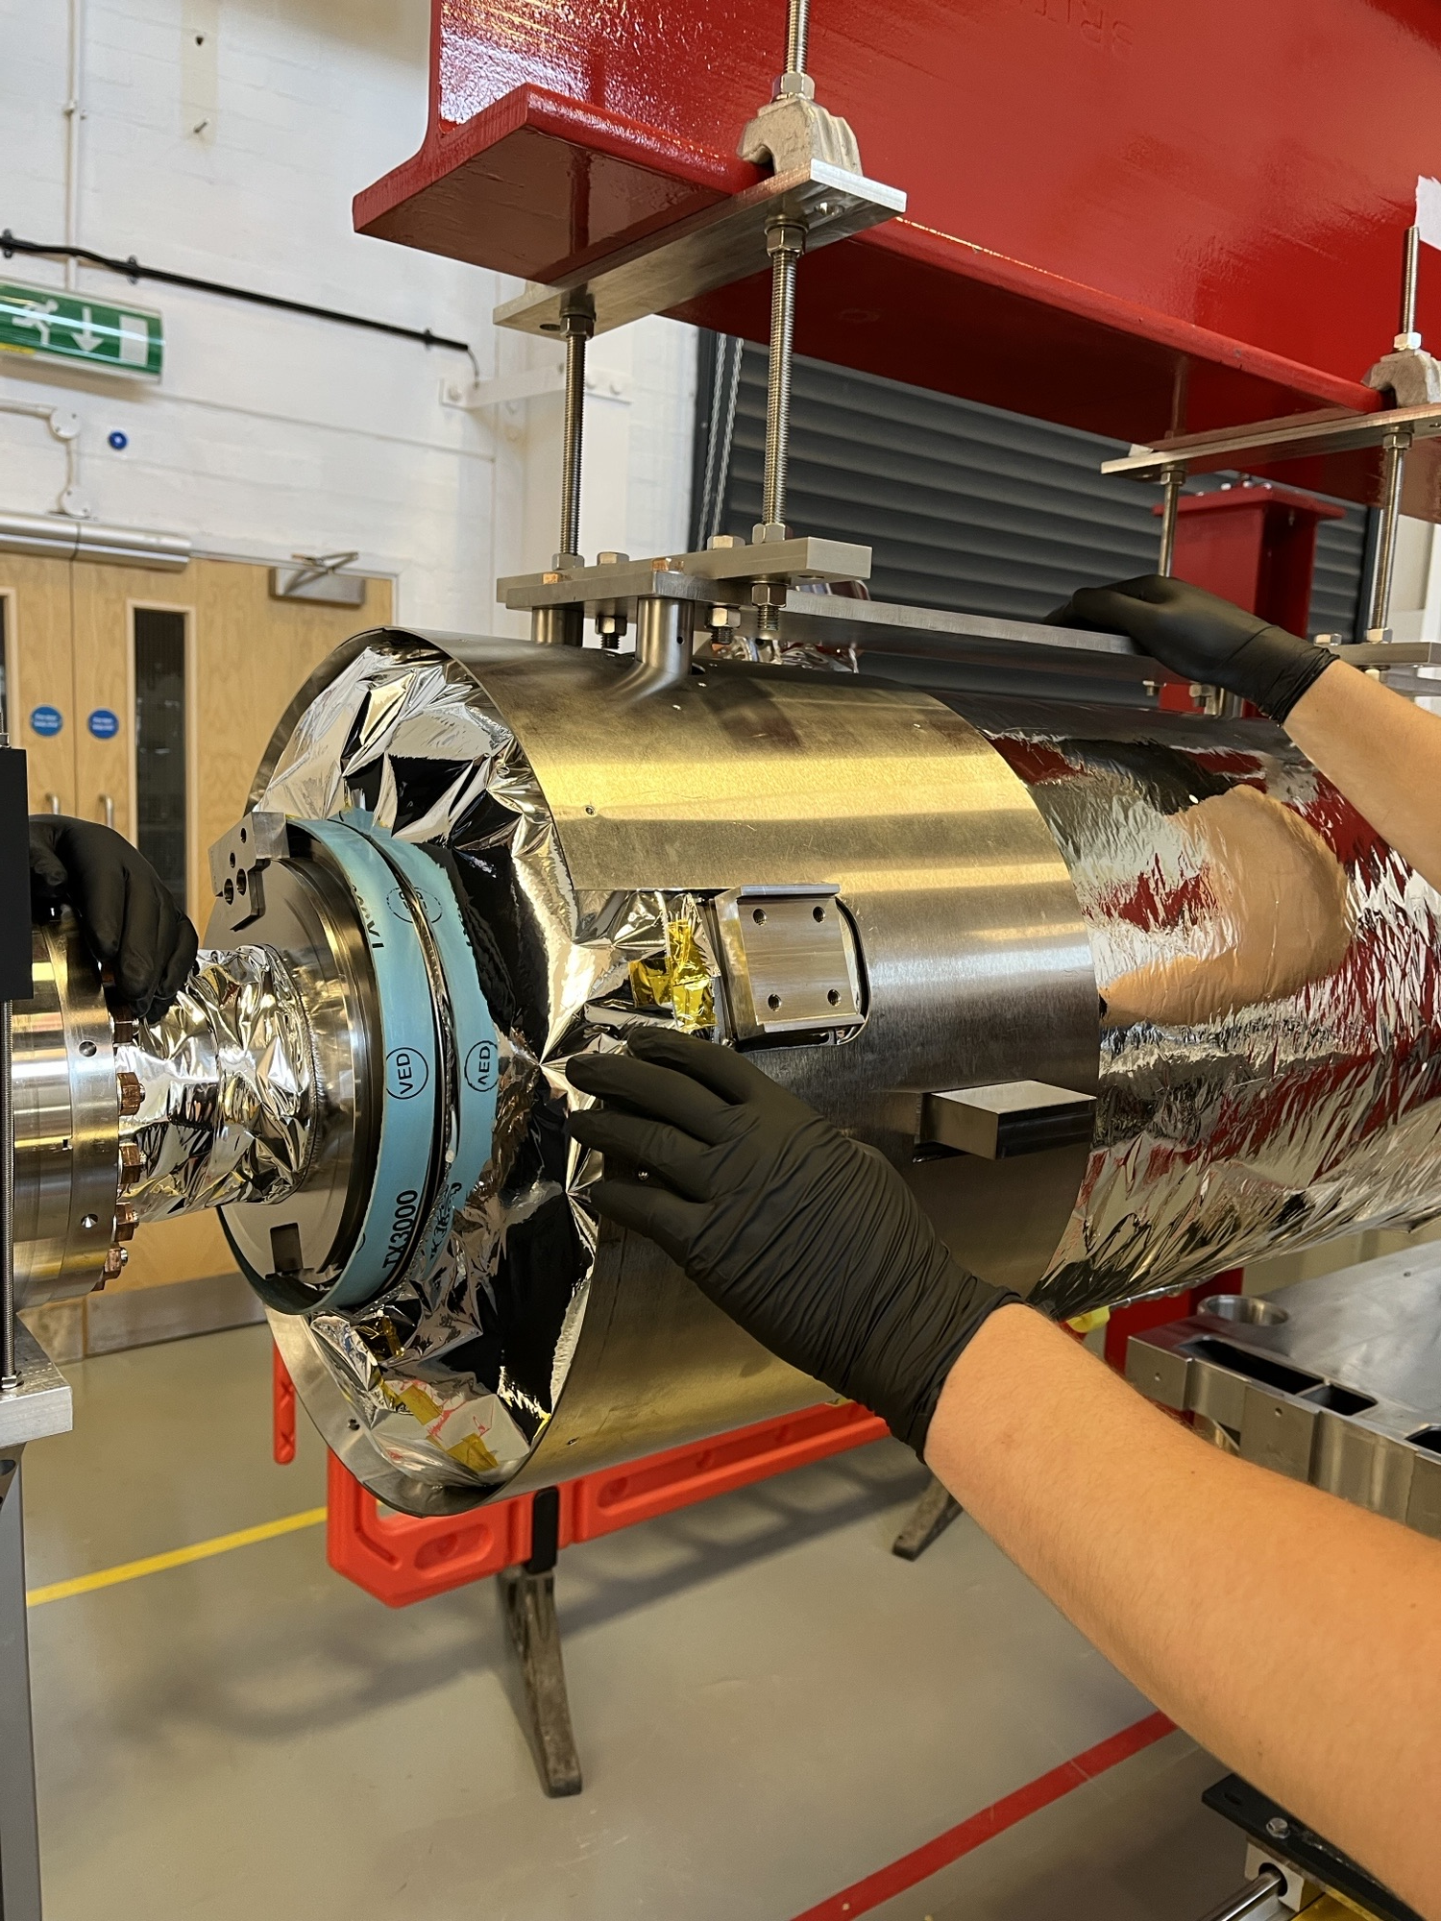
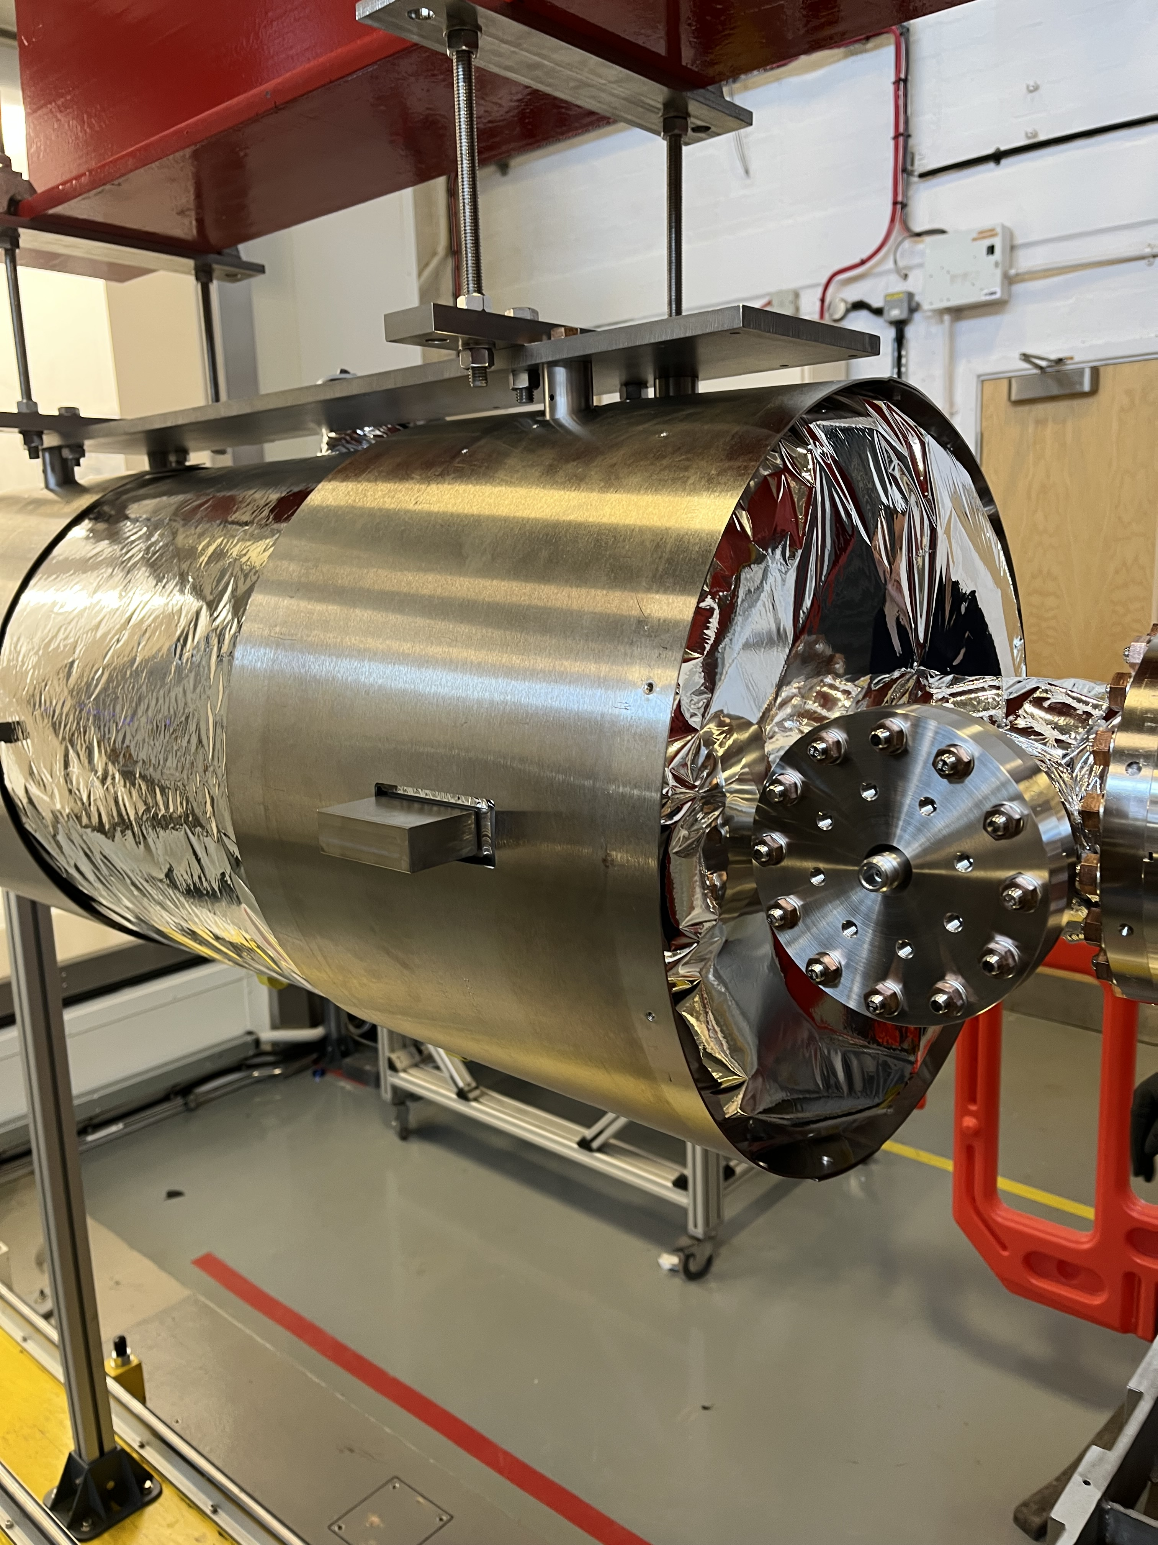
PIP-II Cryomodule Infrastructure Verification
CM0 build preparations and trials
  Cleanroom rail system checks performed with a cavity - Frequency verified
  Multi-Layer Insulation (MLI) blanket fitted
  Cavity installed onto the lifting tooling
  Safety brackets removed and frequency checks repeated
  Magnetic shielding installation performed

Slide 12
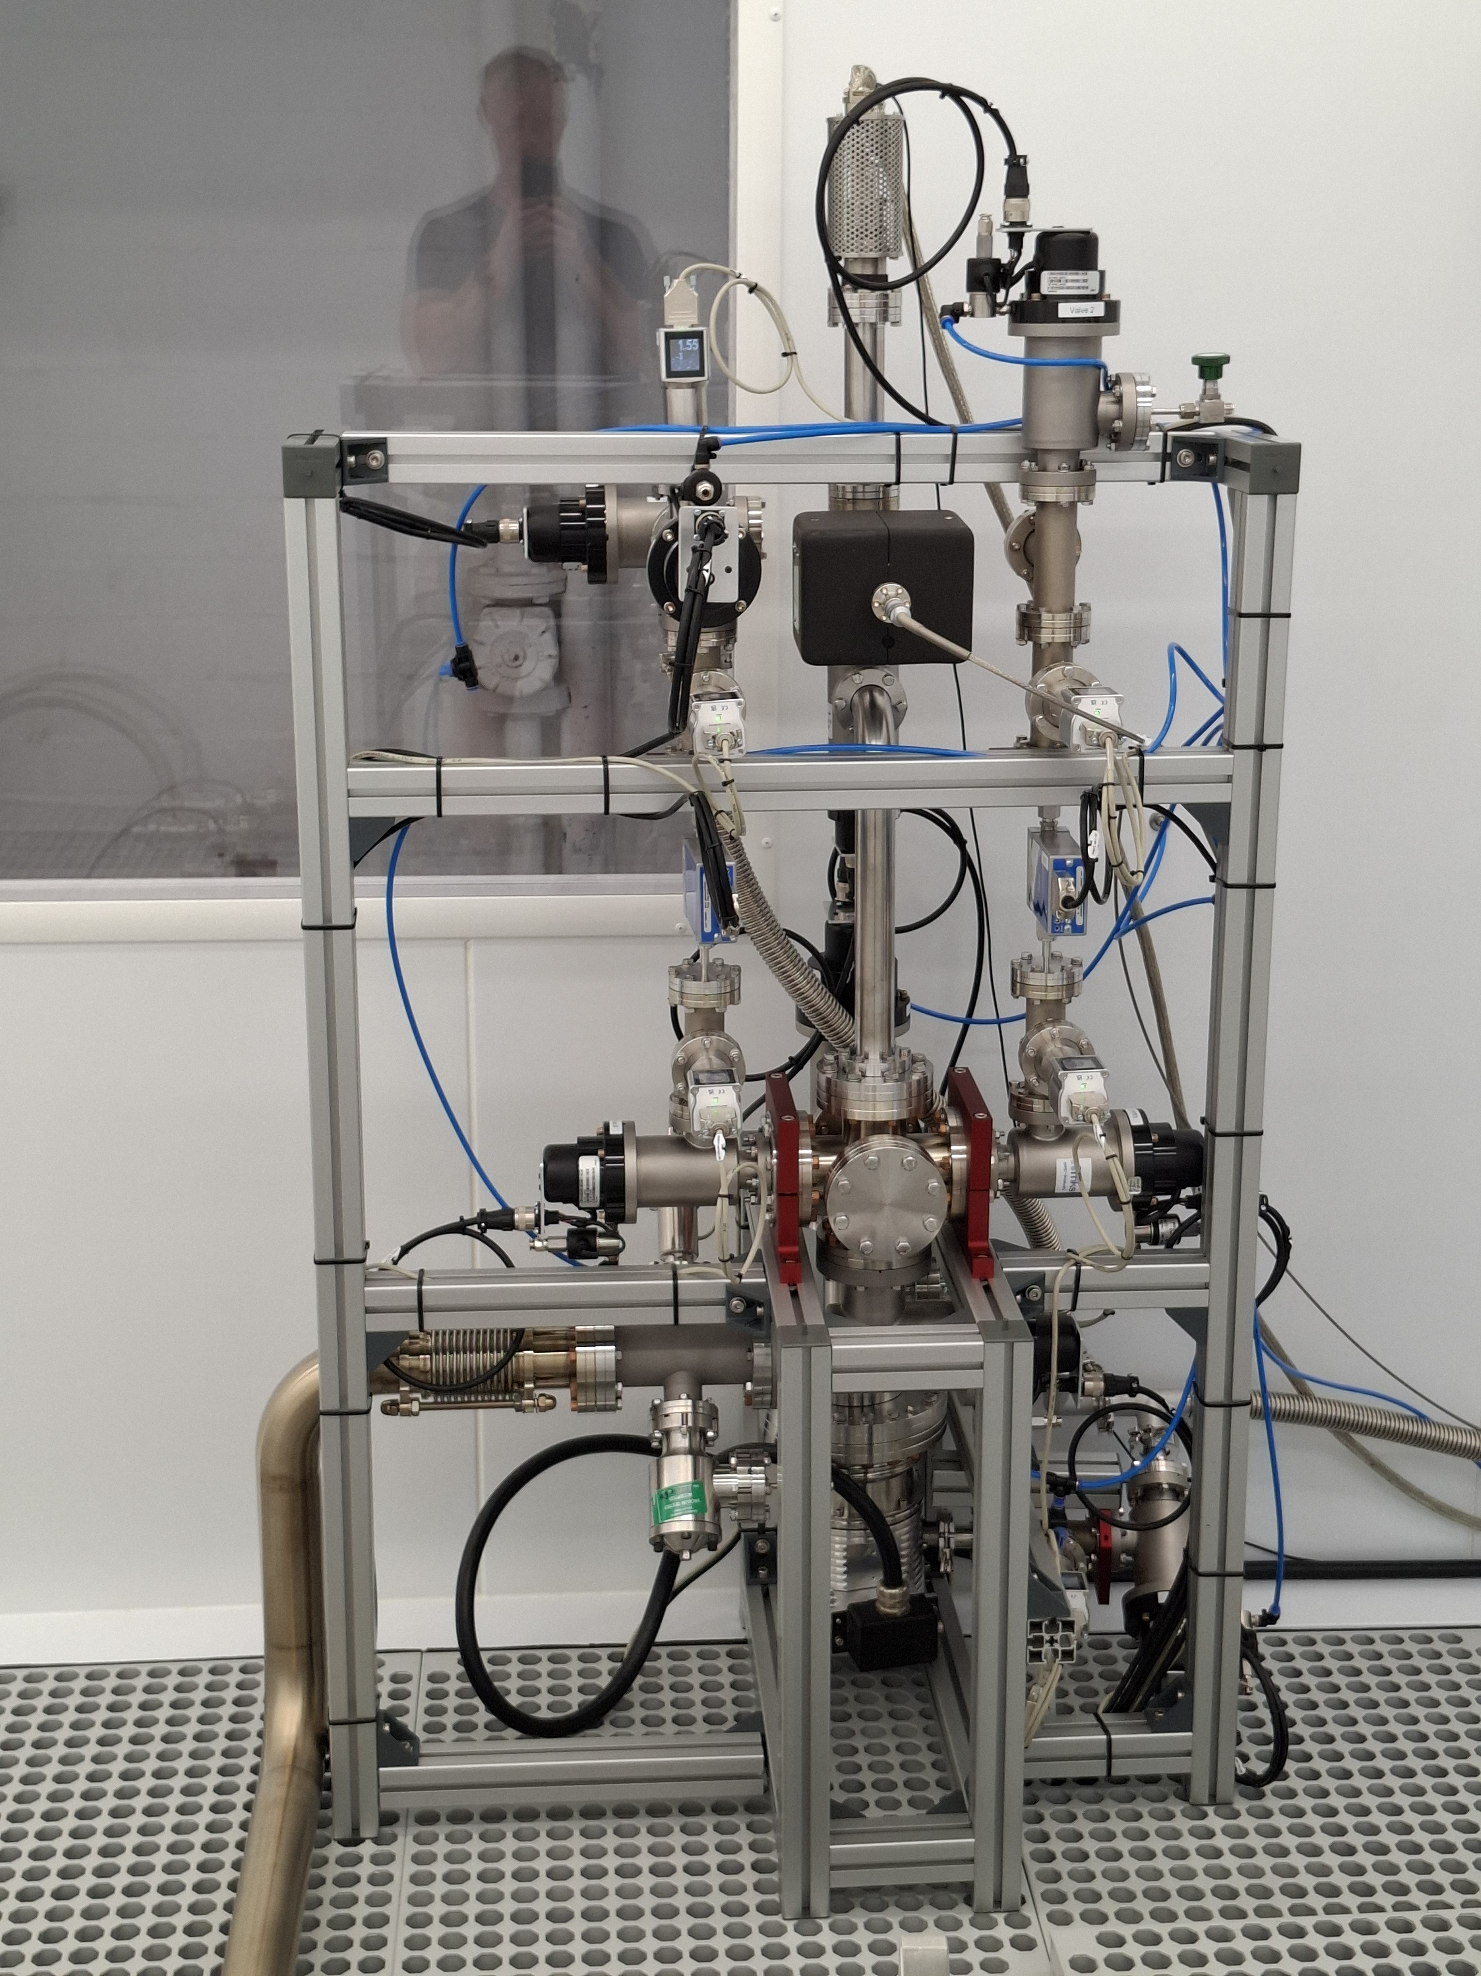
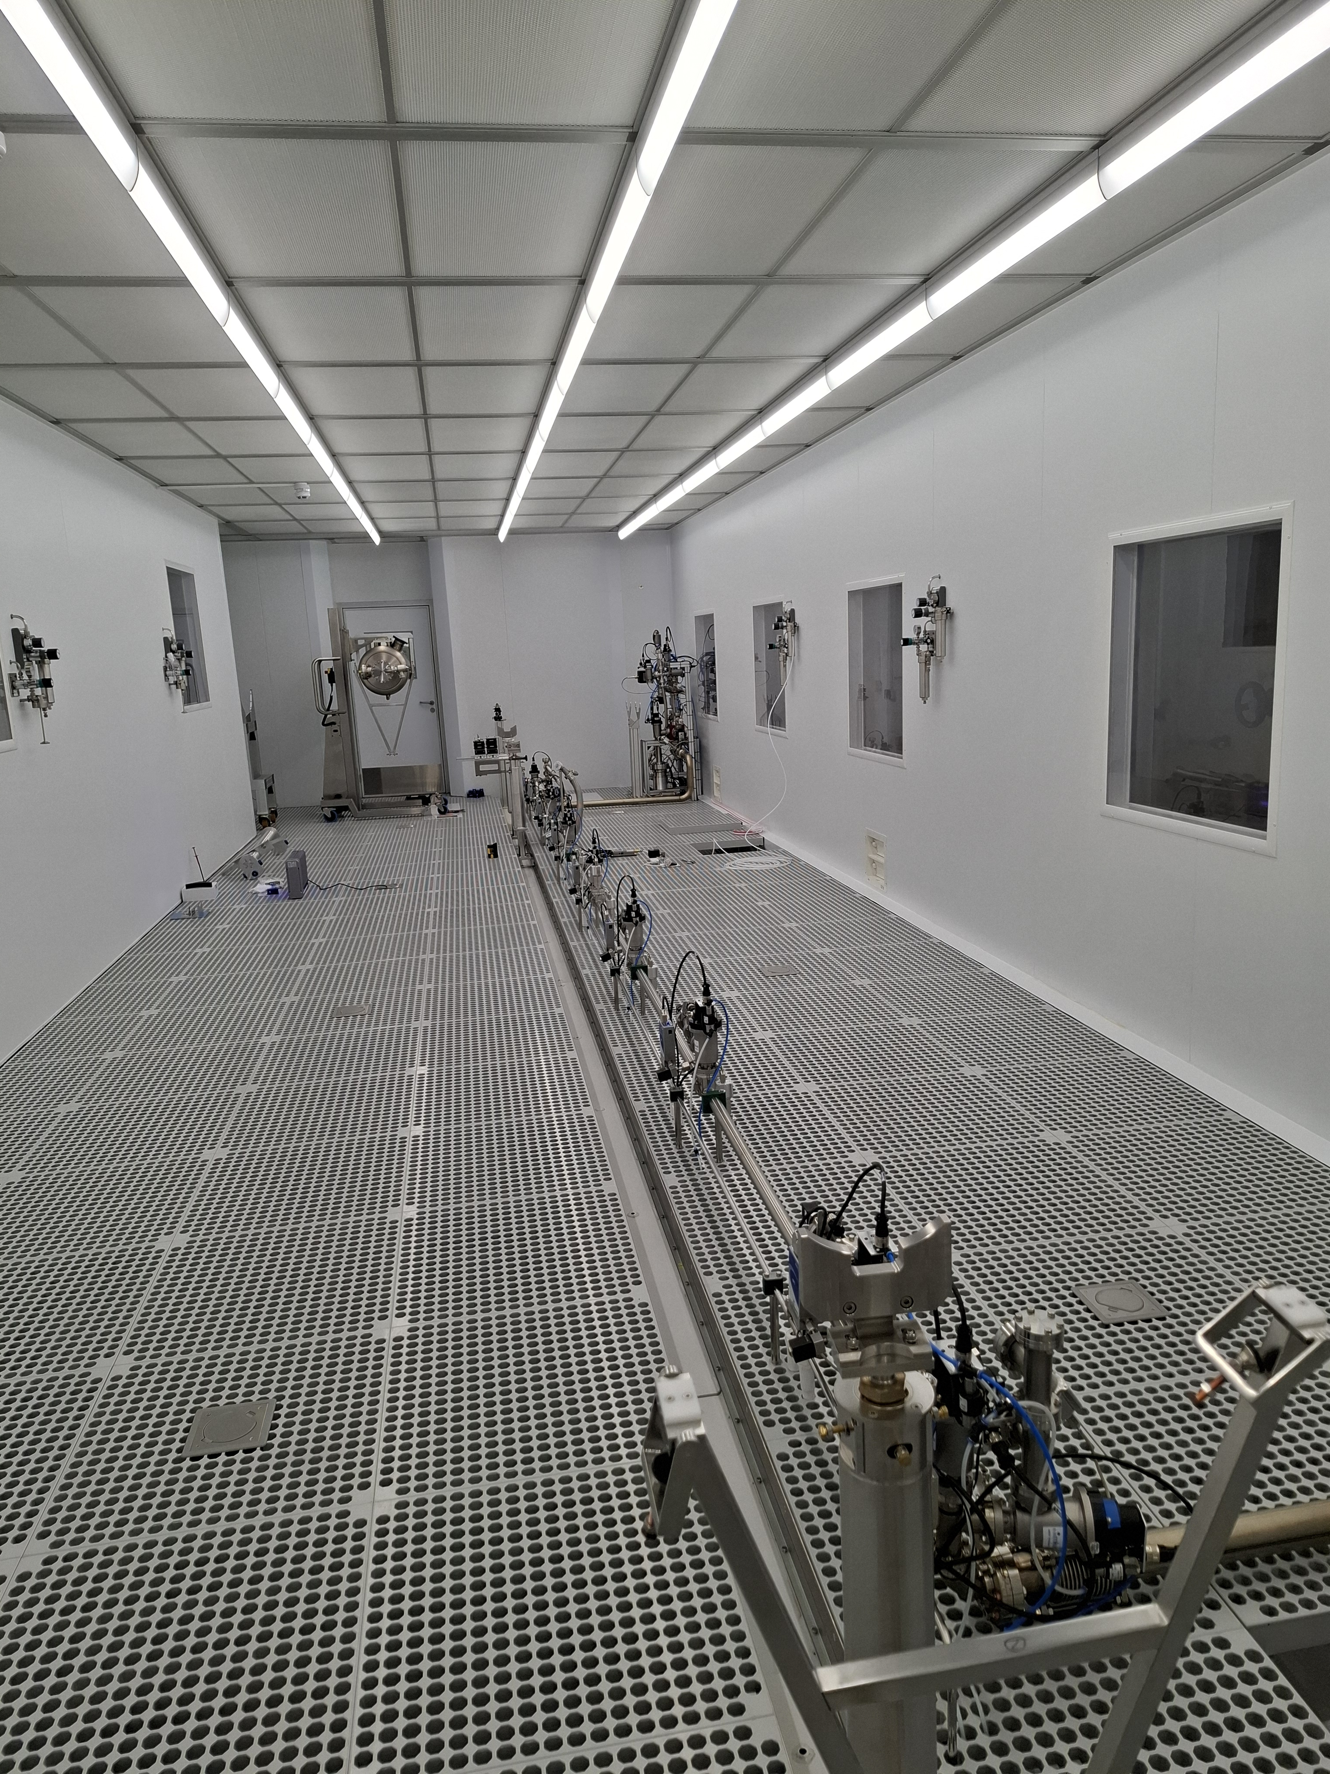
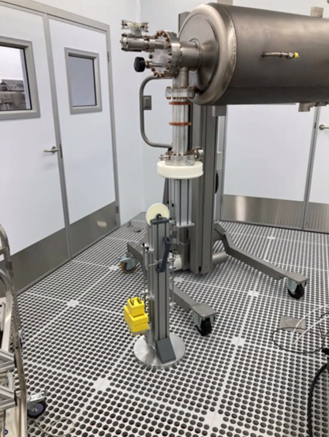
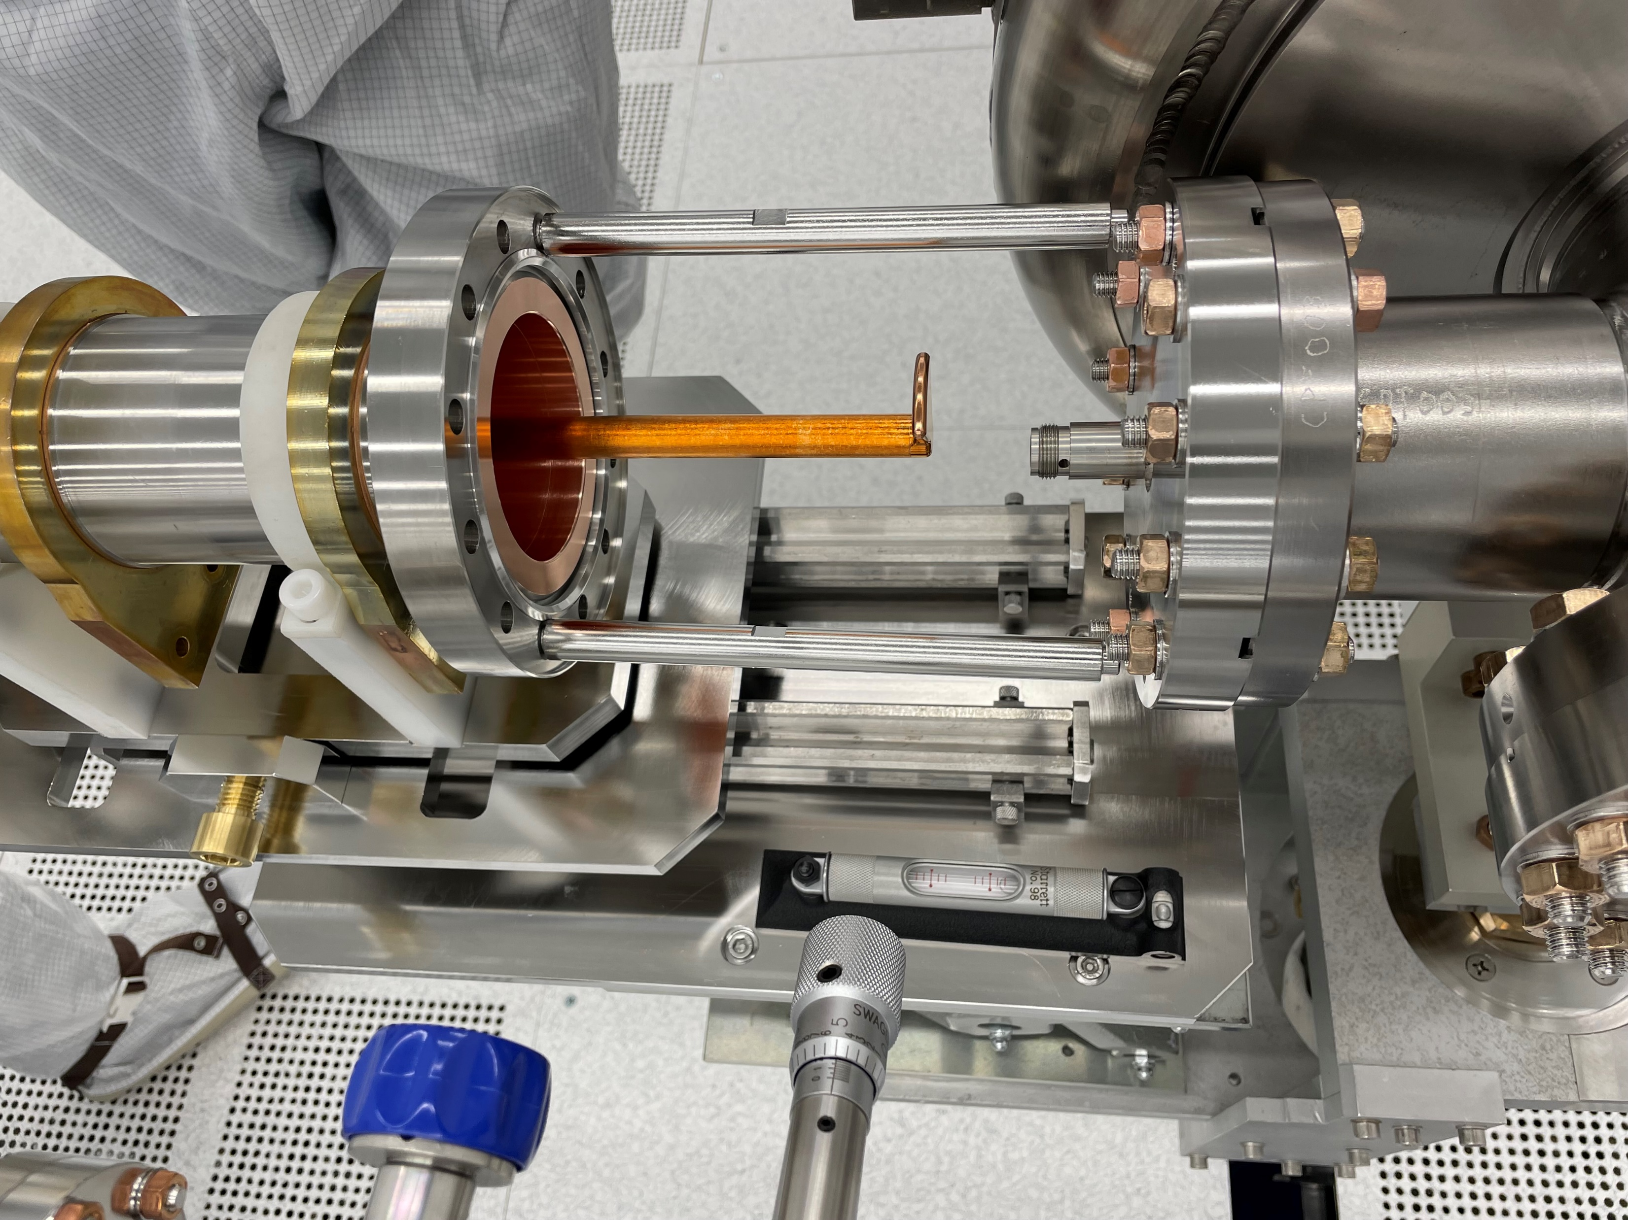
String Integration and Verification
Slow Pump Slow Vent System
Cleanroom
Coupler is heavy (>10 Kg), cumbersome with long fragile antenna
  Installation procedures have been fully developed
Slow Pump Slow Vent (SPSV) commissioned for pump and purge
  Vacuum systems consist of 2 SPSV pumping systems (flow rates from 0 to 10,000 sccm) control the migration of particulates
  9 individual Nitrogen purge lines with flow rates up to 50 LPM providing enhanced flexibility
  Fully automated with options to vary pump and gas flow rates
Coupler installation trials performed on several cavities
Successful tests at FNAL have validated the tooling and cavity-coupler assembly process
Cavity-coupler-bellows assembly verification prior to string integration is currently on-going
Coupler assembled in SuRFLab

Slide 13
Cavity Production & Testing
Notes:
To replace with a photo of your own: Right click on centre of image select ‘Change picture’ click ‘from file…’ and choose your image.

Slide 14


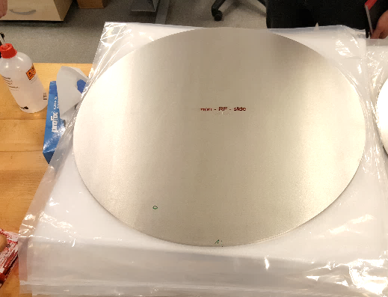
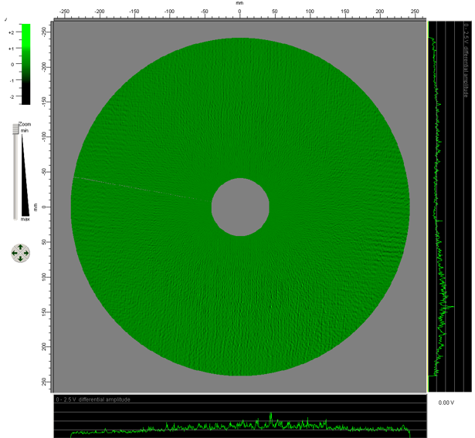
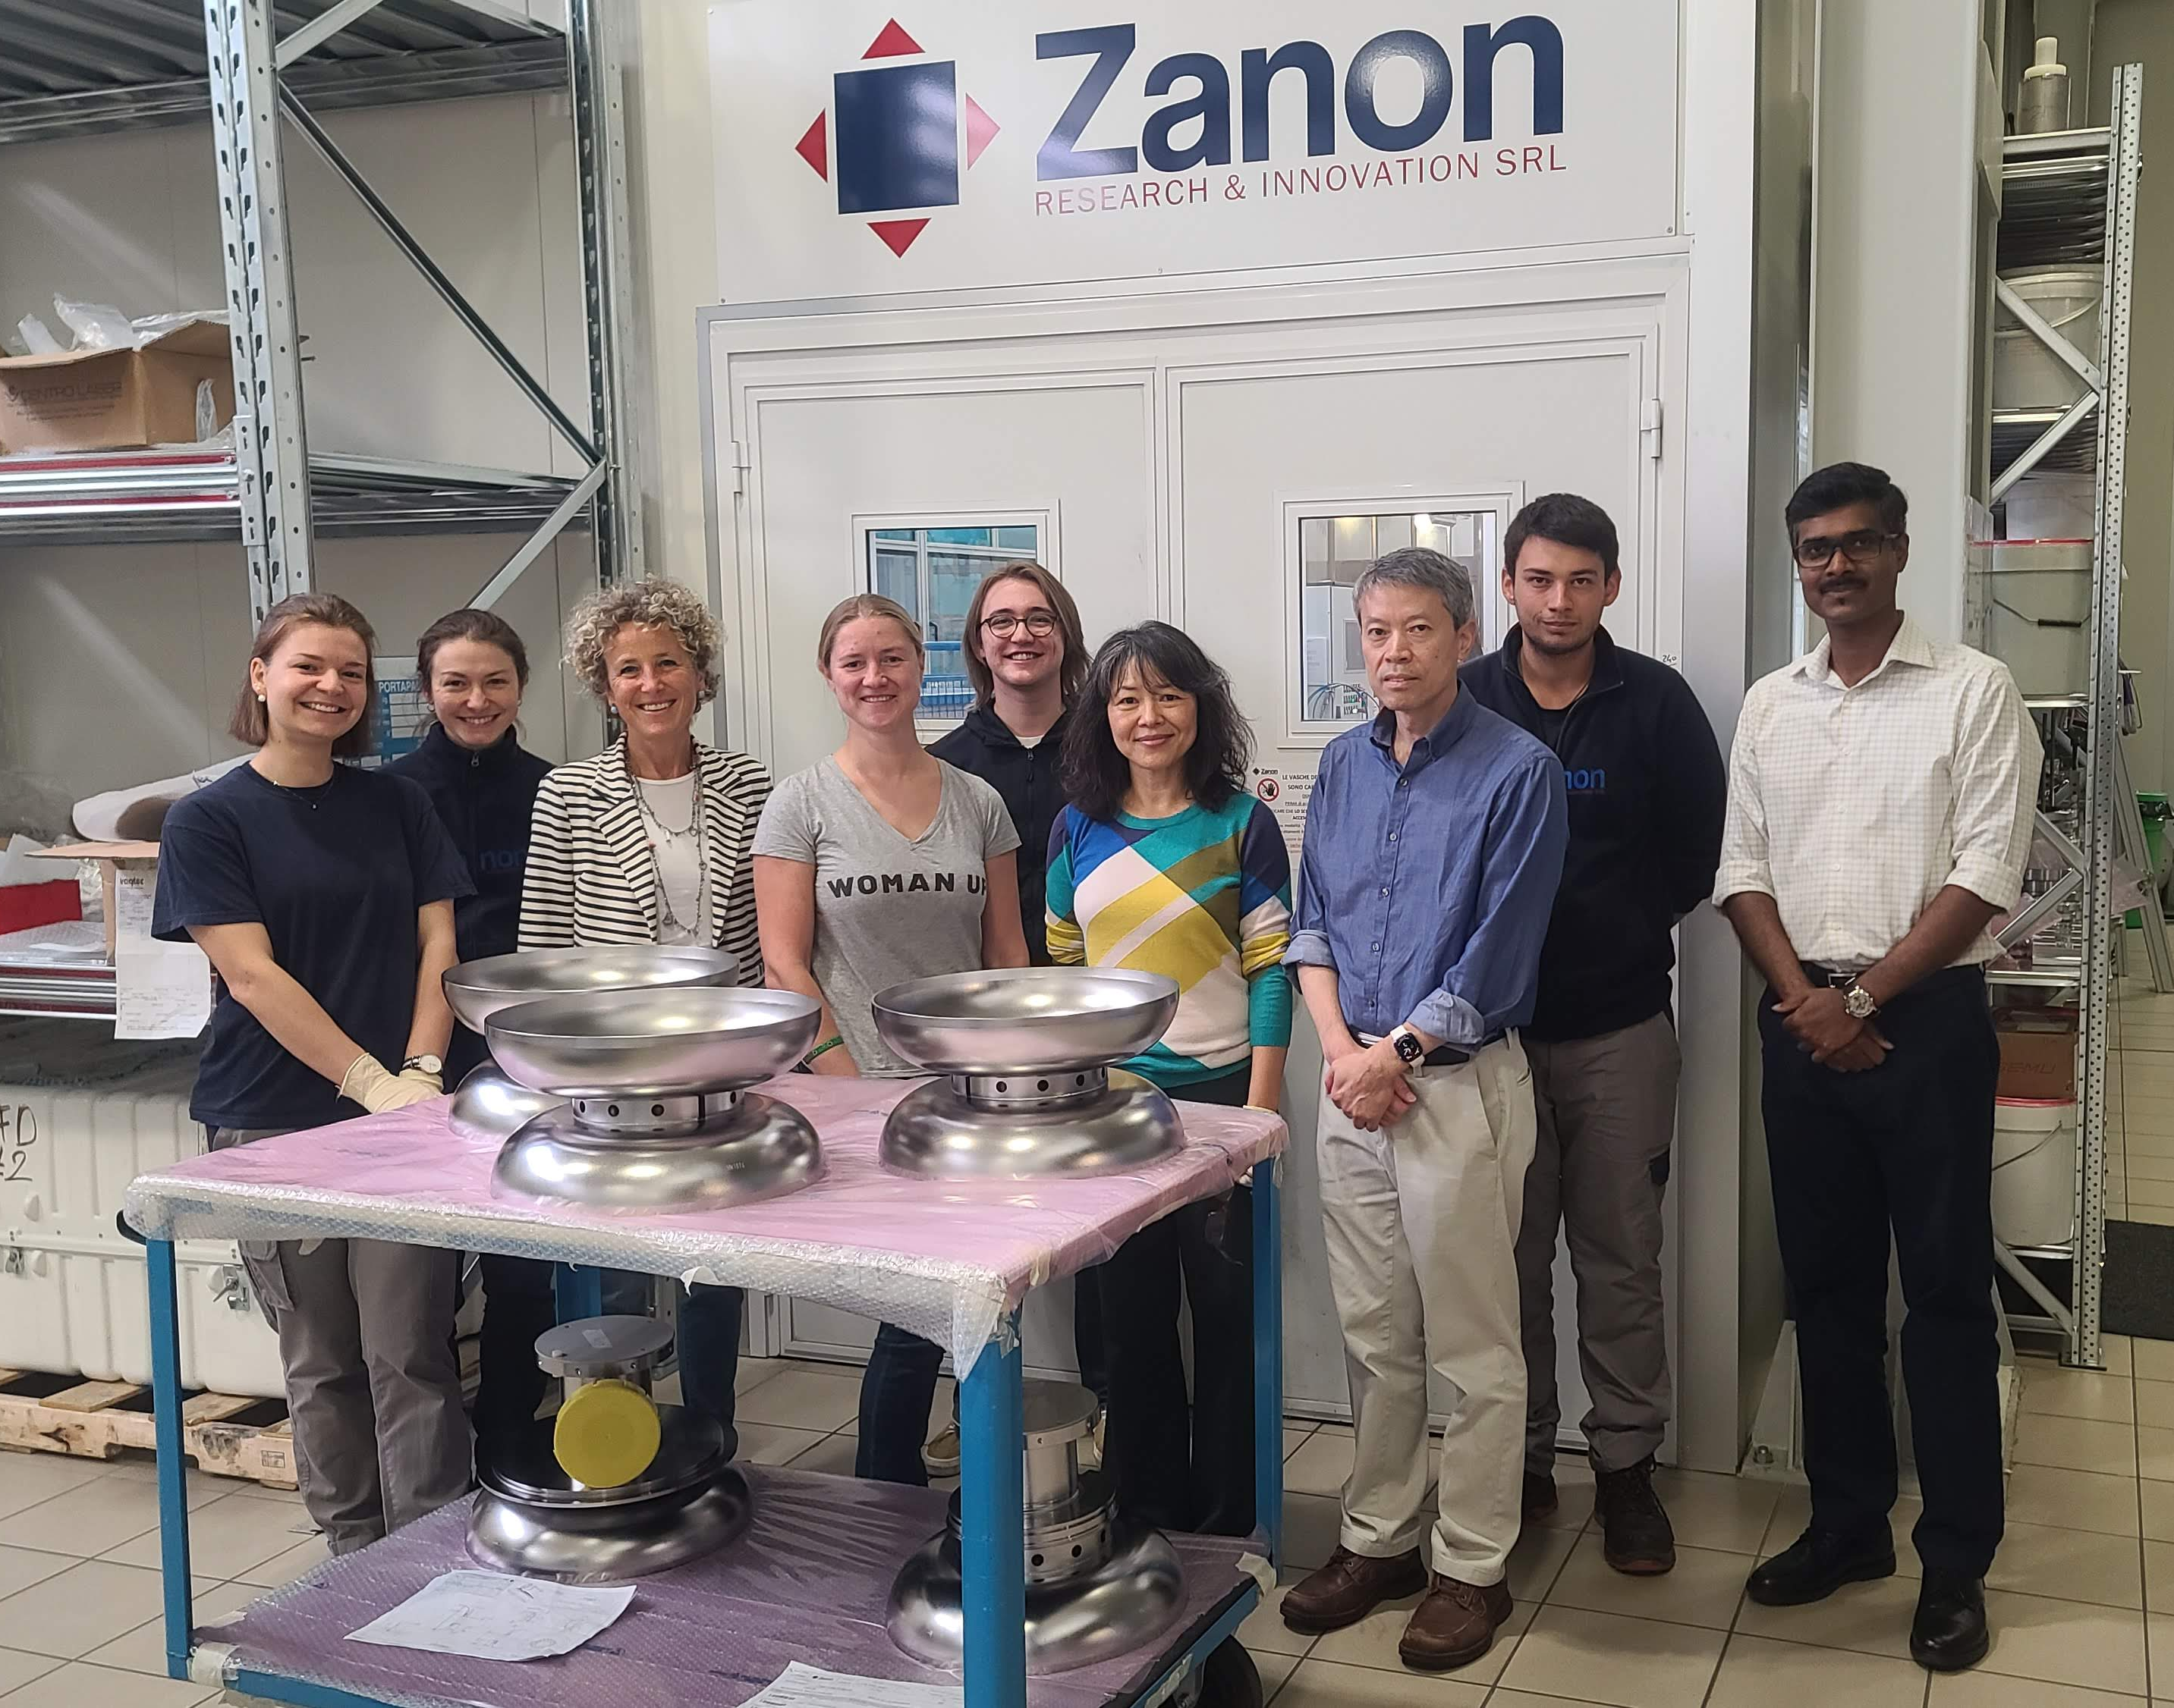
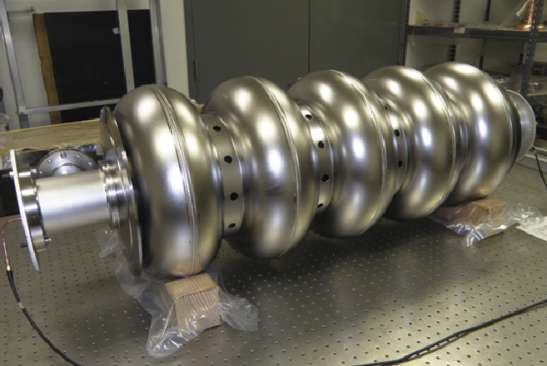
Cavity Manufacturing
Niobium
Niobium procured from OTIC Ningxia, China
Eddy current verification performed by DESY, Germany
Cavities
Requirement 18 cavities + 2 spares
Cavity fabrication being performed by Zanon, Italy
Target 18.8 MV/m with Q_{o} of 3.3 x 10¹⁰ inside the cryomodule
  VT performance Q_{o} of 4 x 10¹⁰
Cavities to be heat-treated in vacuum furnace at 900°C and Nitrogen-doped.
2- Pre-series cavities built to qualify processes – tested bare at FNAL and jacketed at DL
17 delivered and 10 tested to date

Slide 15
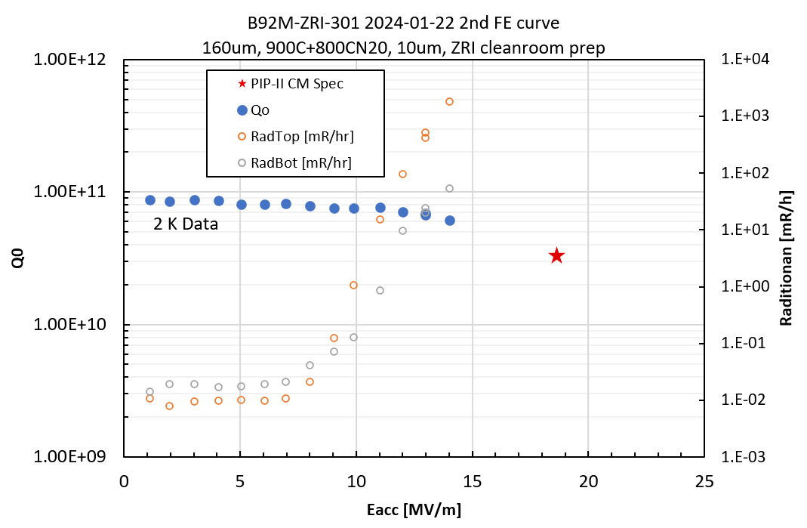
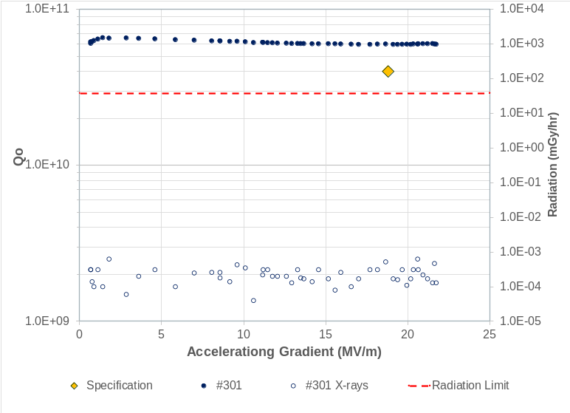
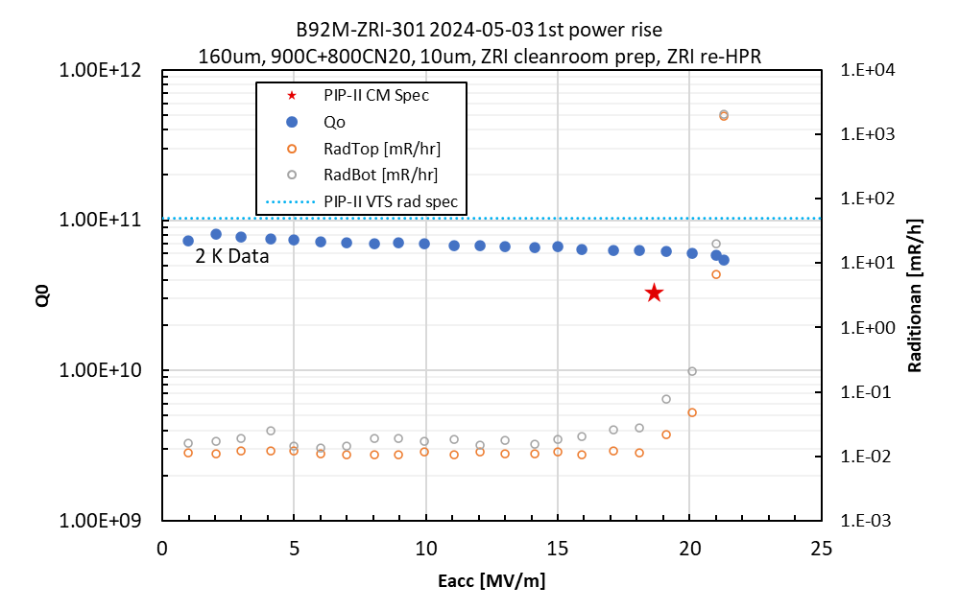
First Pre-Series Cavity Test (#301)
Third test: Jacketed
(STFC)
First test: Unjacketed (FNAL)
22/1/24
29/10/24
Cavity #301 considerably exceeds PIP-II performance specification:
  Qo - 6x10¹⁰
  Gradient reached FNAL administrative limit of 21.6 MV/m, without field emission!
Demonstrates that Zanon processing capabilities for the HB650 cavities.
Required strong management required from STFC to achieve.
Second test: Unjacketed
(FNAL)
After Re-HPR
8/5/24
A World Record for this type of cavity!

Slide 16
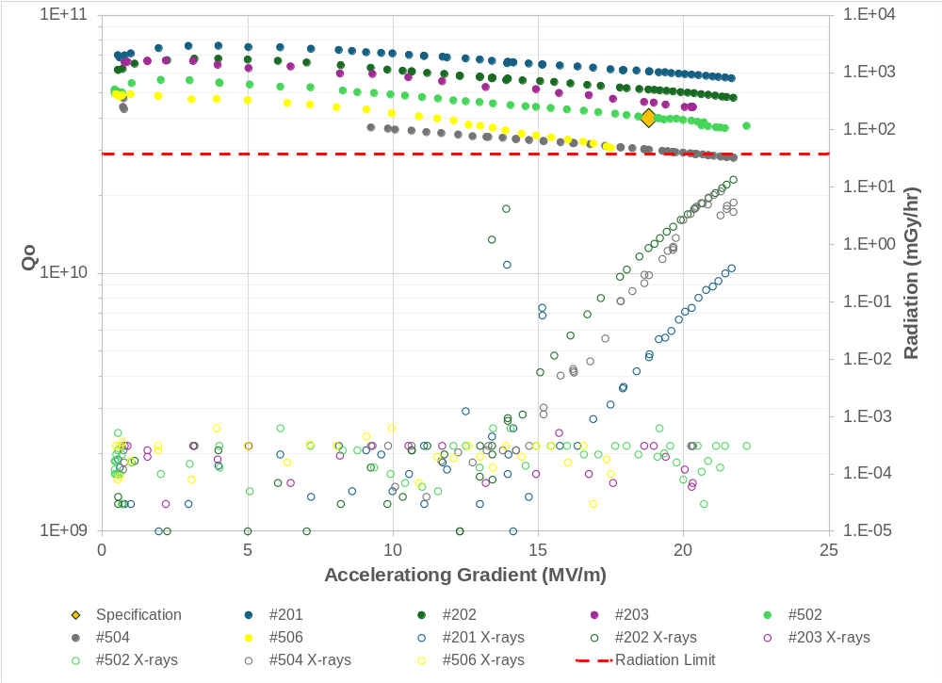
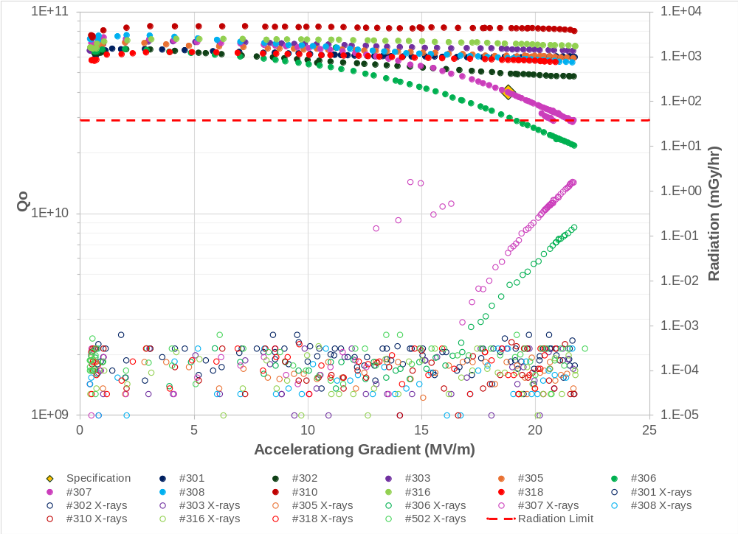
Cavity Tests
FNAL Prototype Cavities
Zanon Production Cavities
Spec
Spec
A total of 16 HB650 cavities tested to date (6 FNAL and 10 Zanon).
15 meet gradient
13 meet Q₀
All 16 accepted by FNAL for crymodule integration
Sufficient cavities for CM0 and CM1

Slide 17
Cryomodule Integration
Notes:
To replace with a photo of your own: Right click on centre of image select ‘Change picture’ click ‘from file…’ and choose your image.

Slide 18
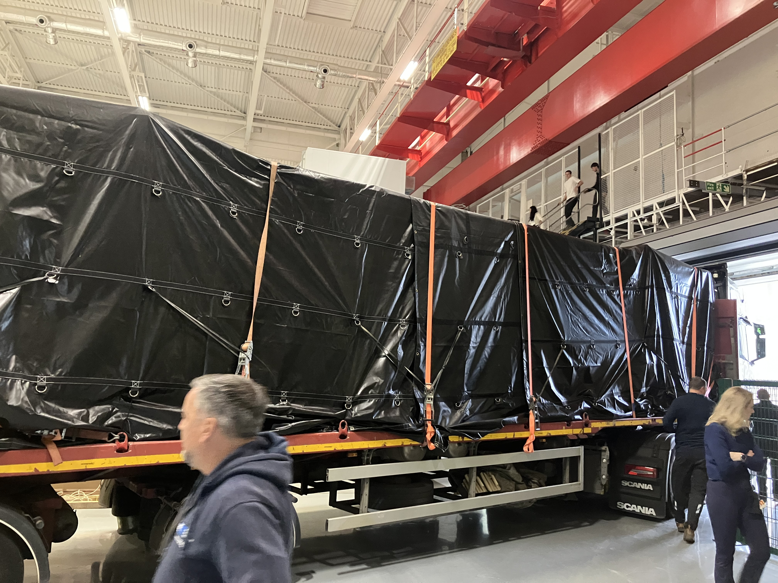
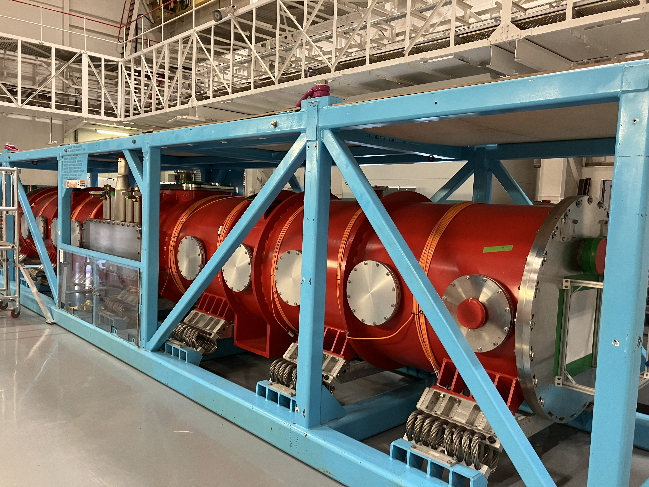
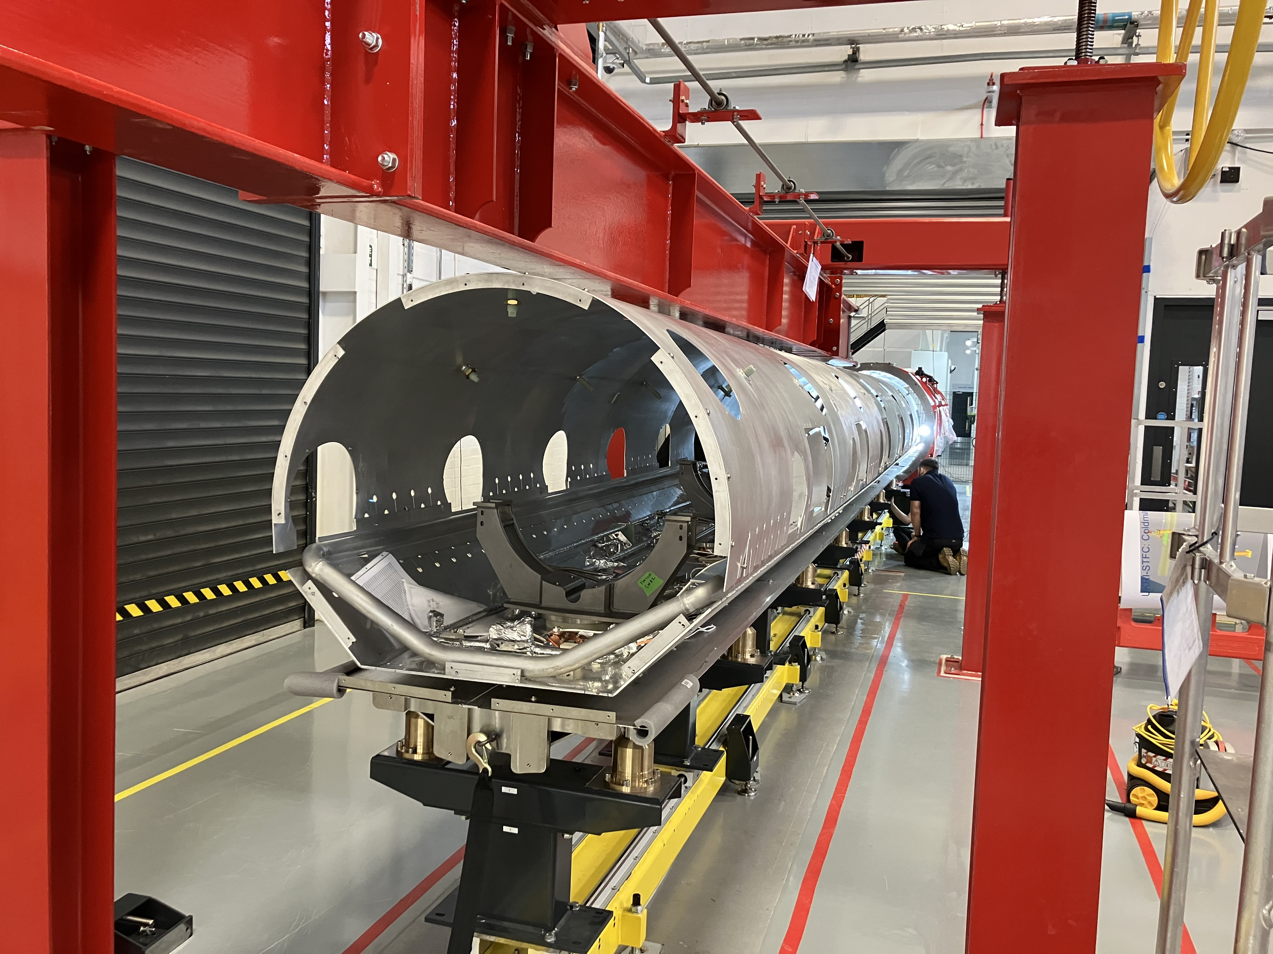
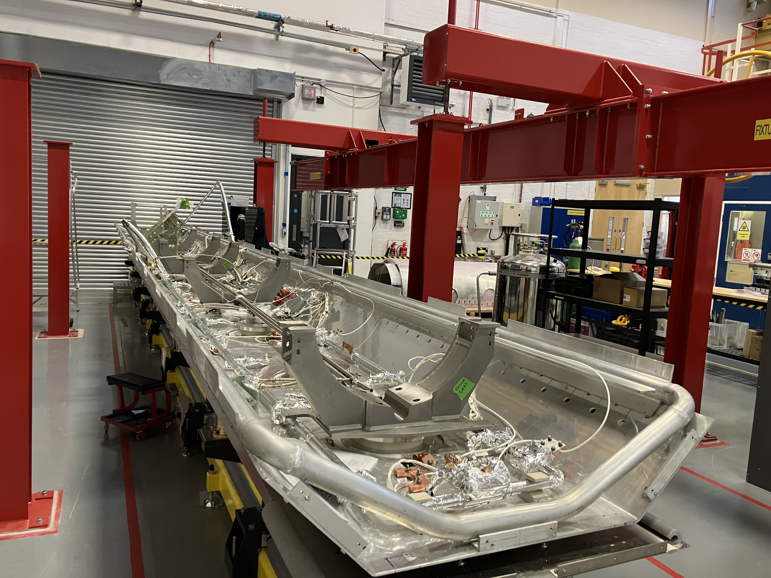
CM0 – Arrival, Offloaded & Disassembly
312
ZRI-304

Slide 19
CM0 Parts Verification
Strongback and OVC integration alignment checks:
First stage component verification checks conducted.
QMS staged CM assembly procedures developed and ready to validate.
WS1
WS2
WS3
OVC
in WS3
STRONGBACK
in WS2
Integrated Alignment Rail

Slide 20
Major Procurements
Item | PRR Status | MRR Status | Schedule Risk | Delivery CM1 | Delivery CM2
Cavity tuners | Dec 22 | Feb 23 |  | Complete | Complete
Cavity Support Insert for vertical tests | STFC only | N/A |  | Complete
Cryomodule instrumentation | Dec 23 | May 24 |  | Complete | Complete
Cryomodule assembly rail | STFC only | N/A |  | Complete
Cavity couplers | Jul 23 | Apr 24 |  | Complete | Complete
Cavity manufacture | Apr 22 | Jan 23 | Low/Med | Complete | Mar-27
Cryomodule vacuum vessel, strongback and supports | Mar 24 | Jan 26 | Med/High | Nov 26 | Apr 27
Cryomodule thermal and magnetic shields | Mar 24 | Nov/Oct 25 | Low/Med | Complete | Jun 27
Cryomodule cryogenic pipework | Sep 25 | Feb-26 | High | Complete | Jun 27
All major procurements launched

Slide 21
Quality System

Slide 22
Major Procurements (CM1,2 and 3-Parts)
DATE (France)
Soditech (France)
Allectra (UK)
Automated laser cutting machine for MLI blankets
Delivered MLI blankets
Instrumentation Flanges
Cryogenic Piping
22
Magnetic Shield Corp (US)
22
Magnetic Shield Assembly
Magnetic Shield Assembly
Magnetic Shield Assembly

Slide 23
Thermal Shield FAT @ INOX (India)
Thermal Shield undergoing Thermal Cycling
Completed successfully - March & August 26 (Lot 1 & 2)

Slide 24
Cryo-piping FAT @ WUXI (China)
MLI Checks
Leak Tests
Pressure Tests
Completed successfully - September 2026 (All 3 Lots).

Slide 25
Assembly of CM0
Successful validation of Tuner Installation and Operation
Cavity Posts Ready
Thermal Shield & Vacuum Vessel Ready
Strongback Ready
CM0 Assembly Phase-1a has begun

Slide 26
Delivery Plan
Notes:
To replace with a photo of your own: Right click on centre of image select ‘Change picture’ click ‘from file…’ and choose your image.

Slide 27
Cryomodule Delivery Plan
CM0
~9-mo duration
CM1
~10-mo duration
CM2
~8-mo duration
CM3
Parts delivery
Second assembly area utilised to enable parallel build of CMs.
Support for CM0 build to be provided by FNAL

Slide 28
Summary
Notes:
To replace with a photo of your own: Right click on centre of image select ‘Change picture’ click ‘from file…’ and choose your image.

Slide 29
Summary
SRF Assembly and Test Infrastructure:
  SuRFLab and Electron Hall assembly area upgrades all complete.
  Increased assembly facility capability
Cavity Manufacture and Testing:
  Manufacturing processes successfully translated to industry  Achieving performance significantly above the required specification
  17 out of 20 cavities delivered
  16 compliant cavities  Sufficient cavities for the first 2 CMs
Cryomodule Integration:
  All major procurements launched  Final component delivery Feb 2027
  Final cavity-coupler validation completed July 26
  String assembly validation on-going
  First phase of CM0 rebuild has commenced. Completion date Aug 2027
  Final cryomodule delivery CM2 delivery Apr 2028
Need to add statements to the effect of:
Production ready delivery demonstrated for 650MHz, very high-performance cavities!
CM integration expected in mid 2027 – full production demonstrated.
This is to showcase the fact that we are then ready to step in to support CERN for FCC at 600/650MHz immediately should they require a partner ready to help

Slide 30
Acknowledgements:
WP0 Ed Cavanagh
Alan Wheelhouse
Peter McIntosh
WP1 Mark Pendleton
Geraint Jones
WP3 Anna Shabalina
Paul Smith
WP4 Shrikant Pattalwar
Rhys Foster
Thank You
&
Questions
Notes:
To edit the background image, select ‘Format’ from the PowerPoint menu and ‘Slide Background’ from the drop-down menu. Within the new list of options that appears on the right of the screen, select the ‘File’ button under ‘Insert picture from’ and select your image from your file browser.

