Slide 1



Mini Workshop: High-Rep Ions at NSF ZEUS
Veronica Contreras
Advanced Accelerator Concepts - 2026

Slide 2
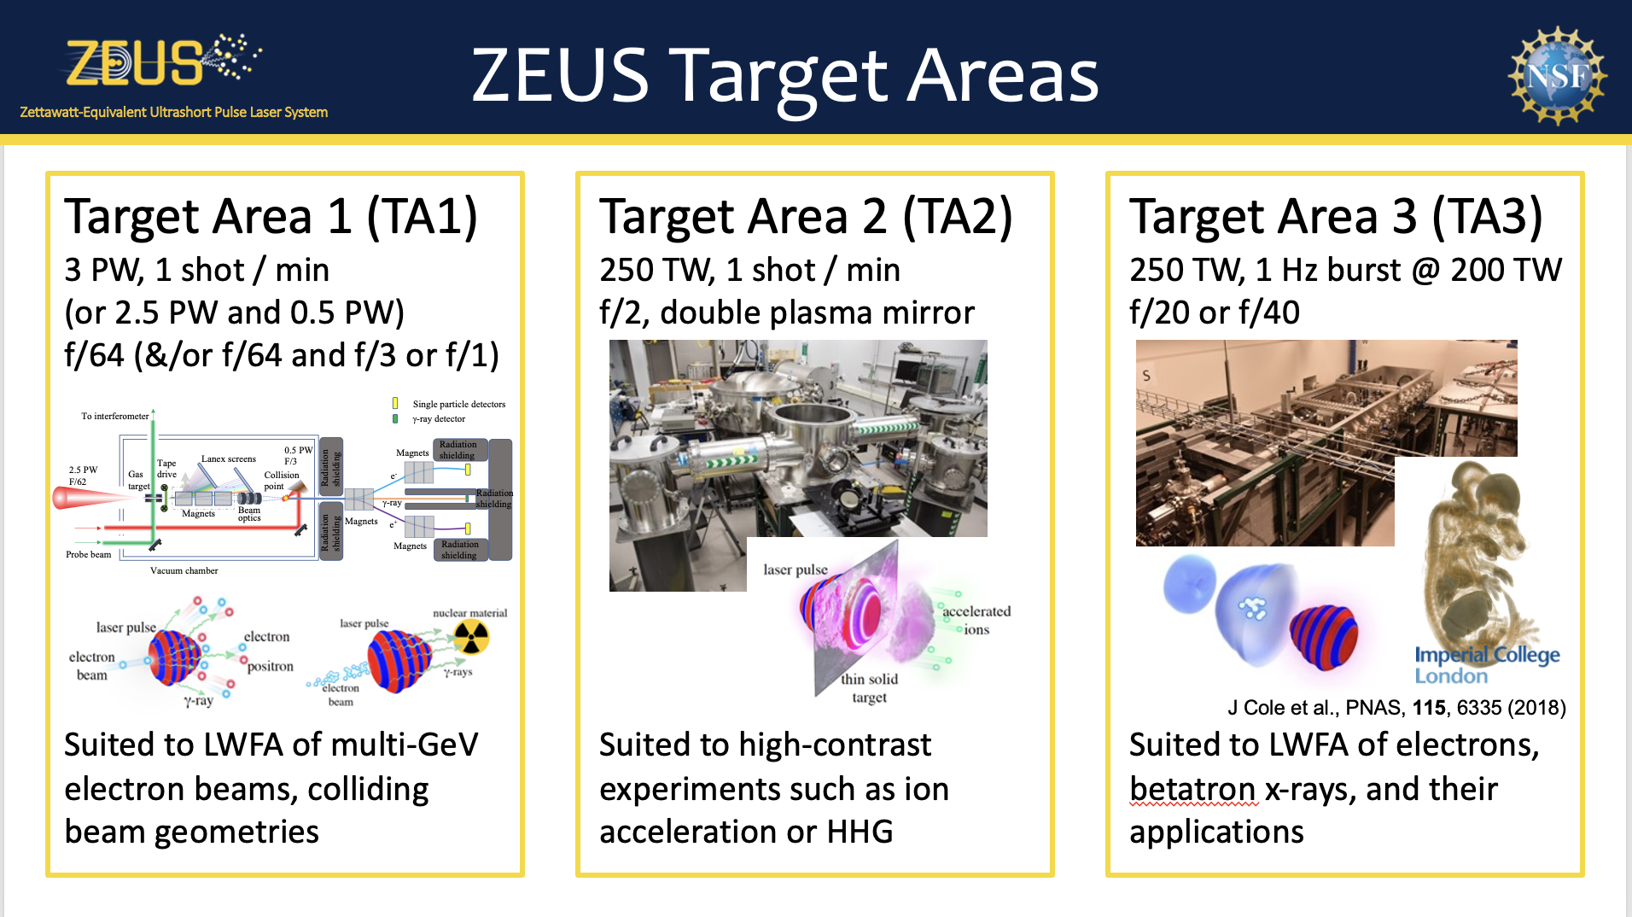

Slide 3
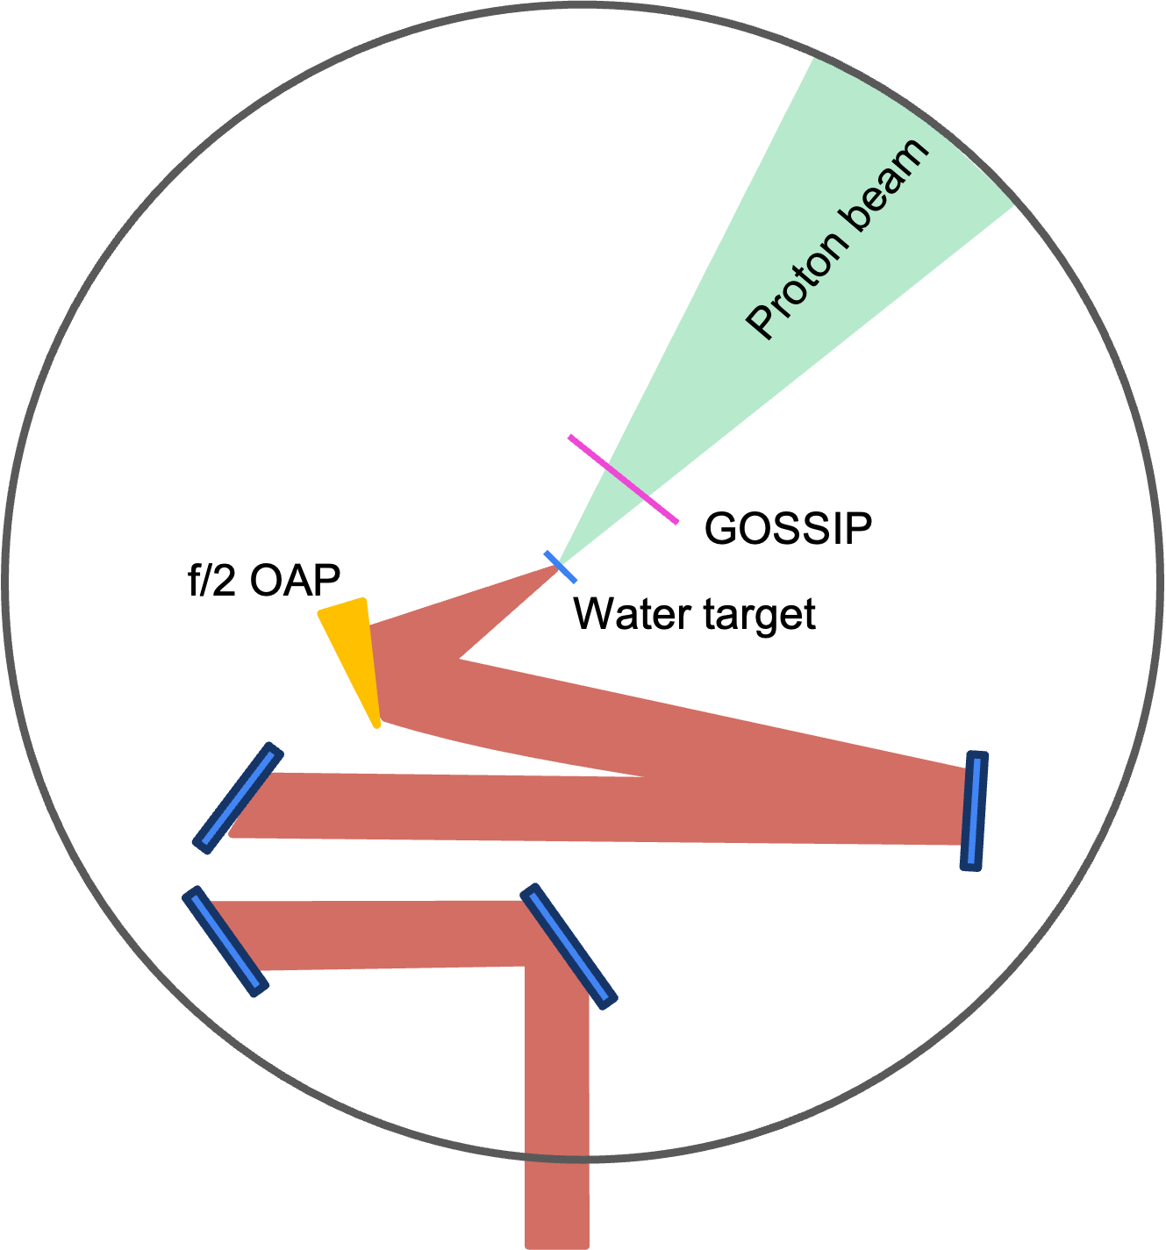
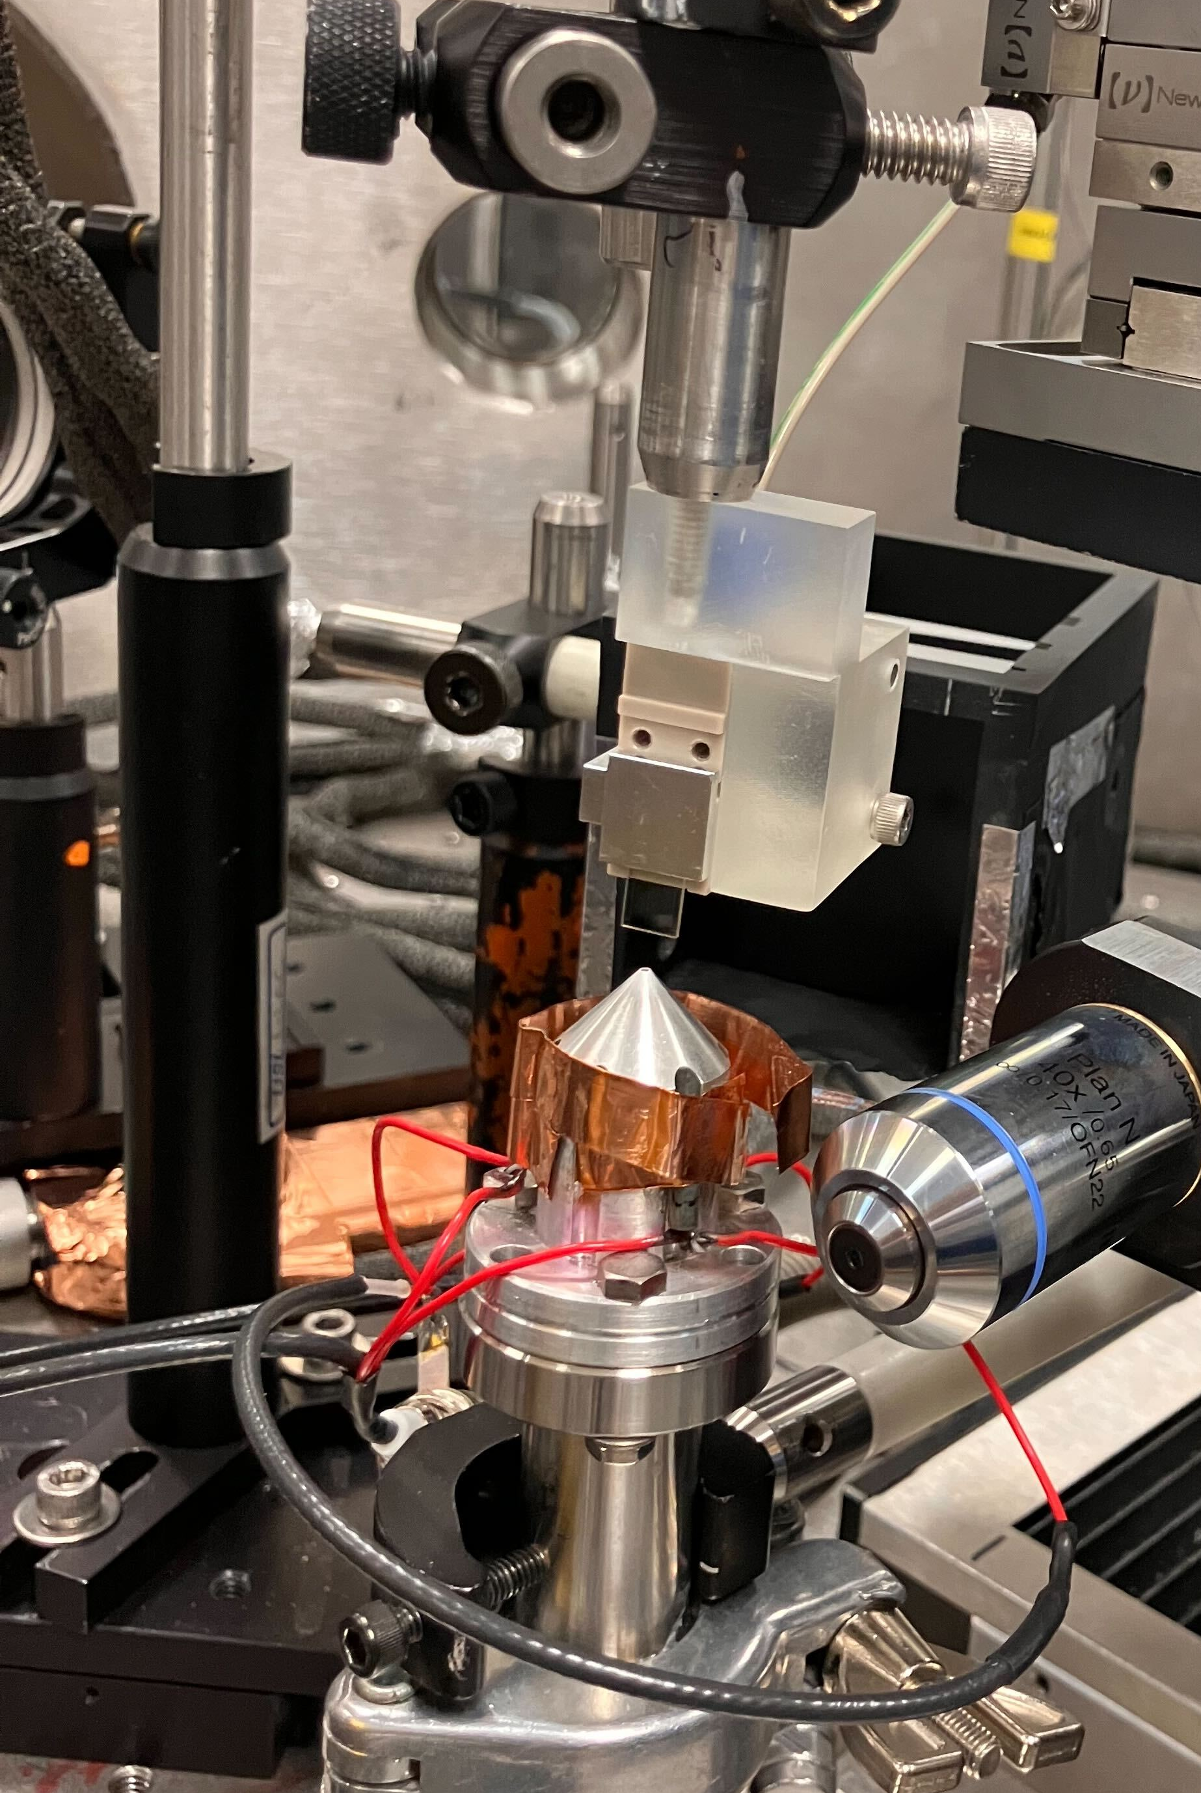
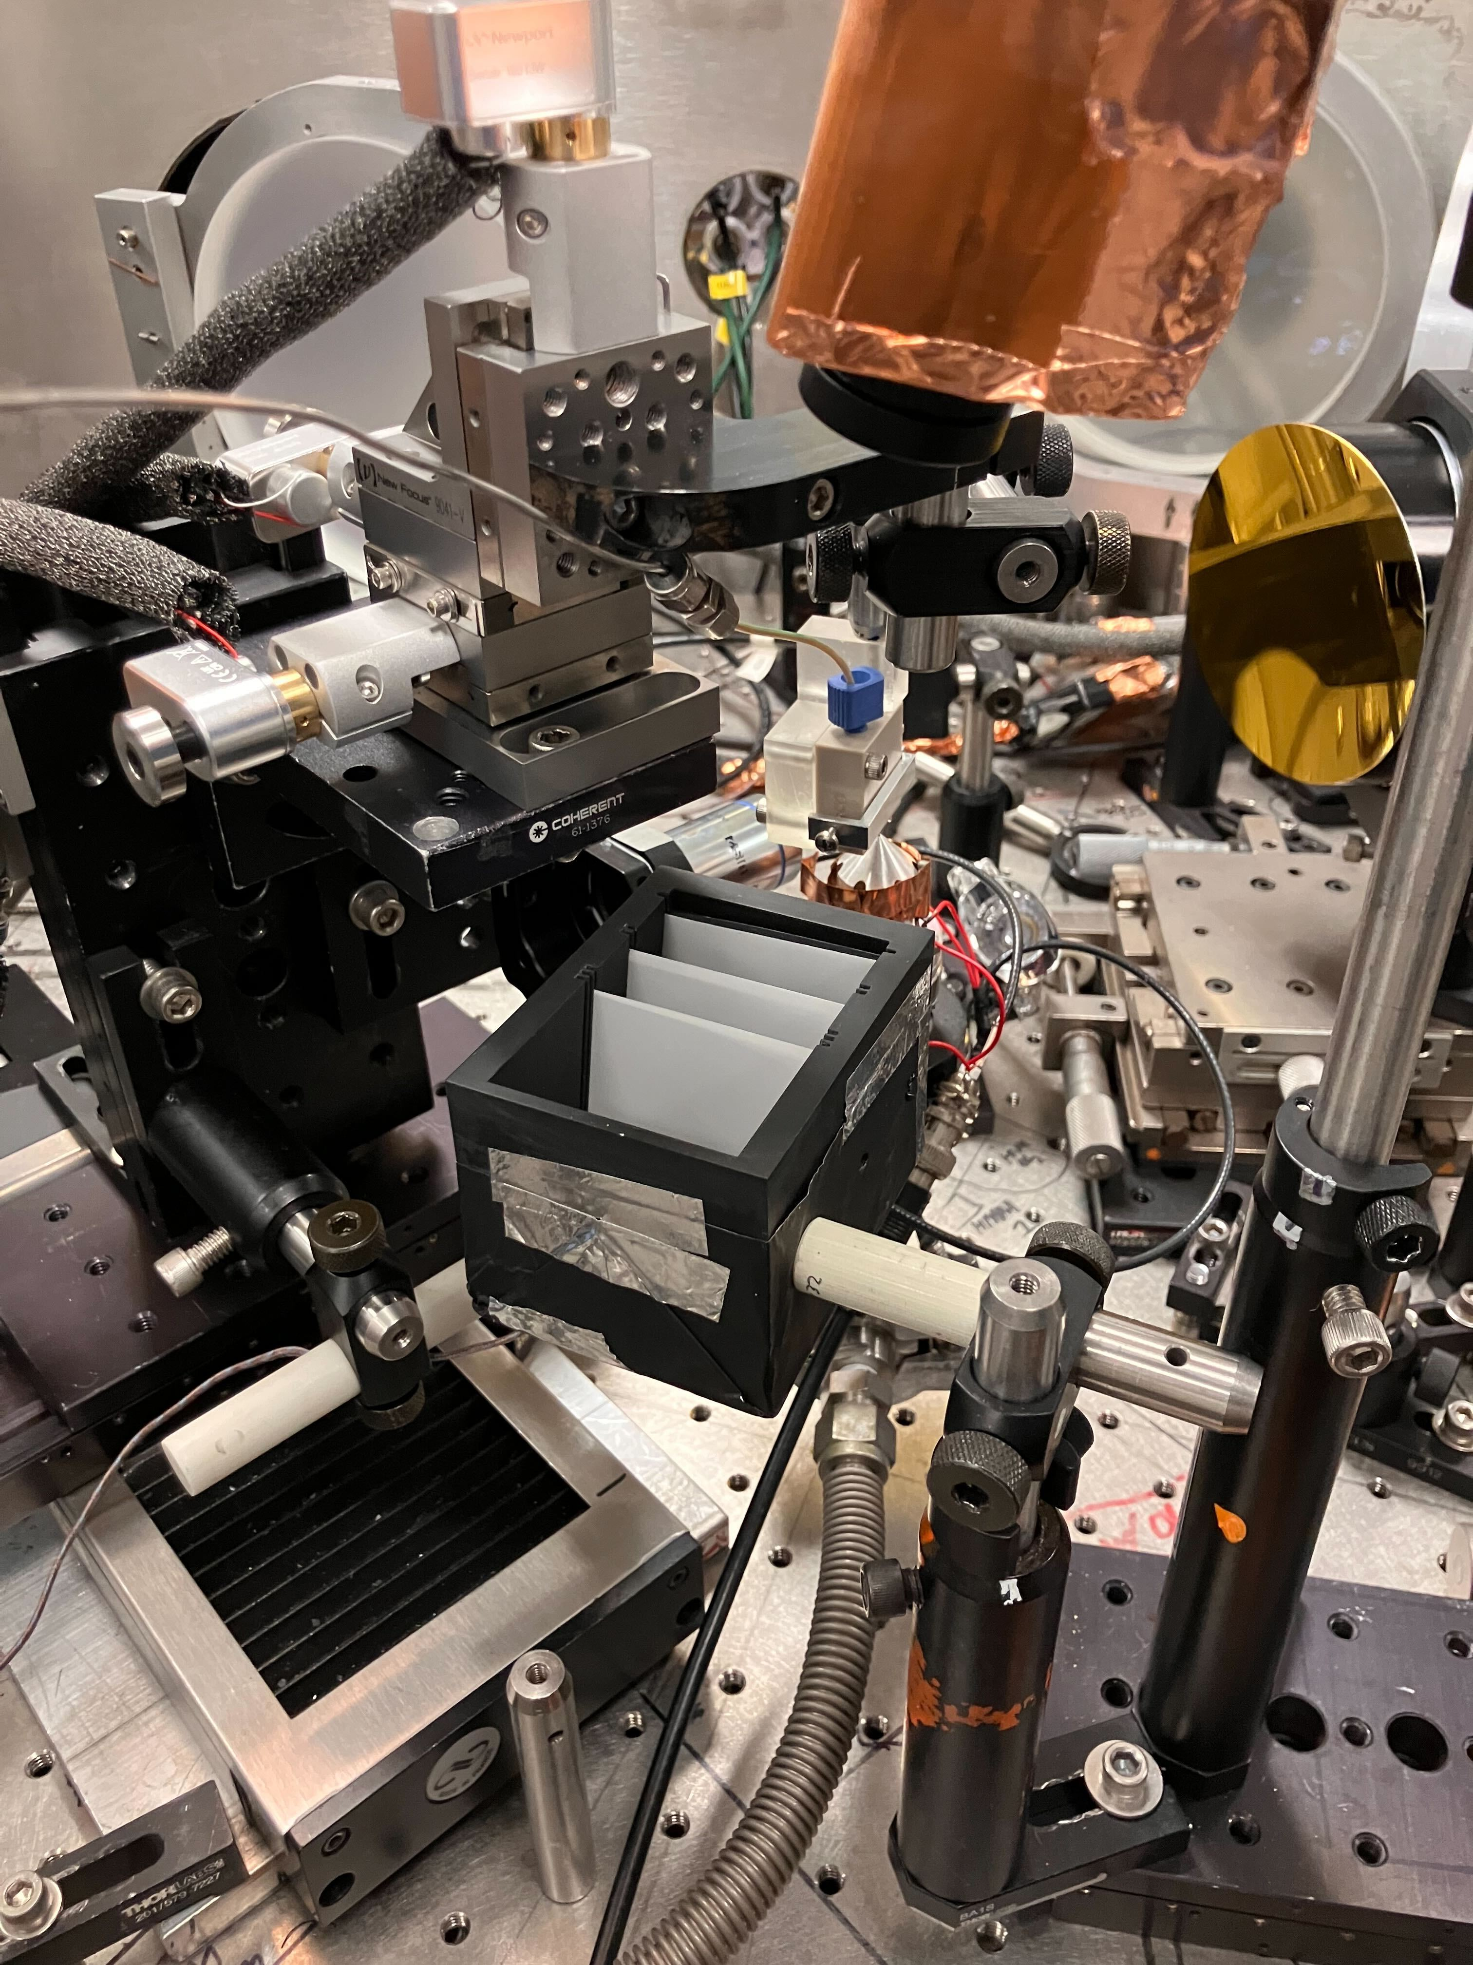
ZEUS TA2: Liquid Target Experiment Setup
Experiment Aims
Test GOSSIP as a HRR beam profiling diagnostic using micronit glass chip nozzle
Characterize the proton beam
  pointing,
  spatial quality,
  divergence,
  and energy spread.
Front of Target
Back of Target
Camera
Water Target
GOSSIP
Protons
Water target calibration image with optical probe
Notes:
Quality – spatial variations.

Slide 4
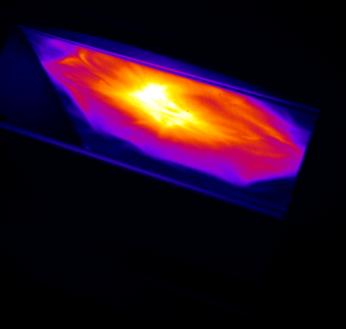
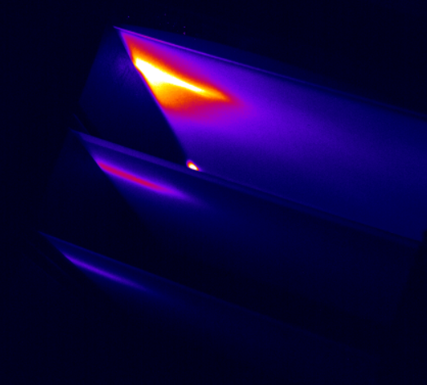
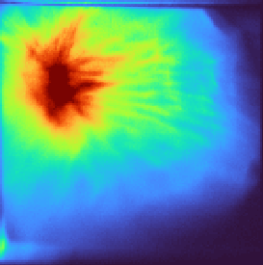
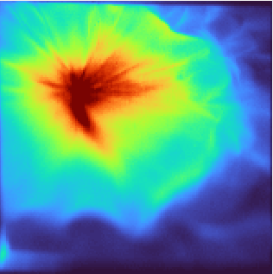
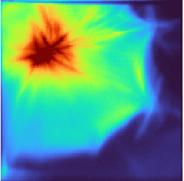
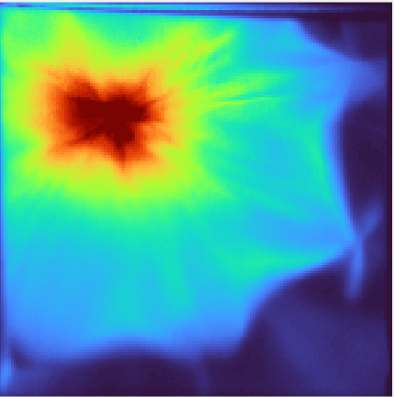
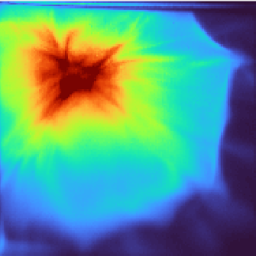
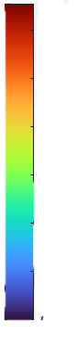
ZEUS TA2: Liquid Target Experiment Results
Raw data shows pointing variance
Scintillator Stack
1.5 MeV
Layer 1: 1.5 MeV
5.6 MeV
Proton Source
4.9 cm
8.1 MeV
8 cm
1 2 3
1.5 MeV Proton Beams – 1 Hz Burst @ 1J on target
Shot 1
Shot 2
Shot 3
Shot 4
Shot 5
x 10⁴
6
5
4
3
2
1
30° divergence, FWHM
0
Red feature in beam is ~1cm in diameter,
corresponding to ~14° divergence (full angle)

Slide 5
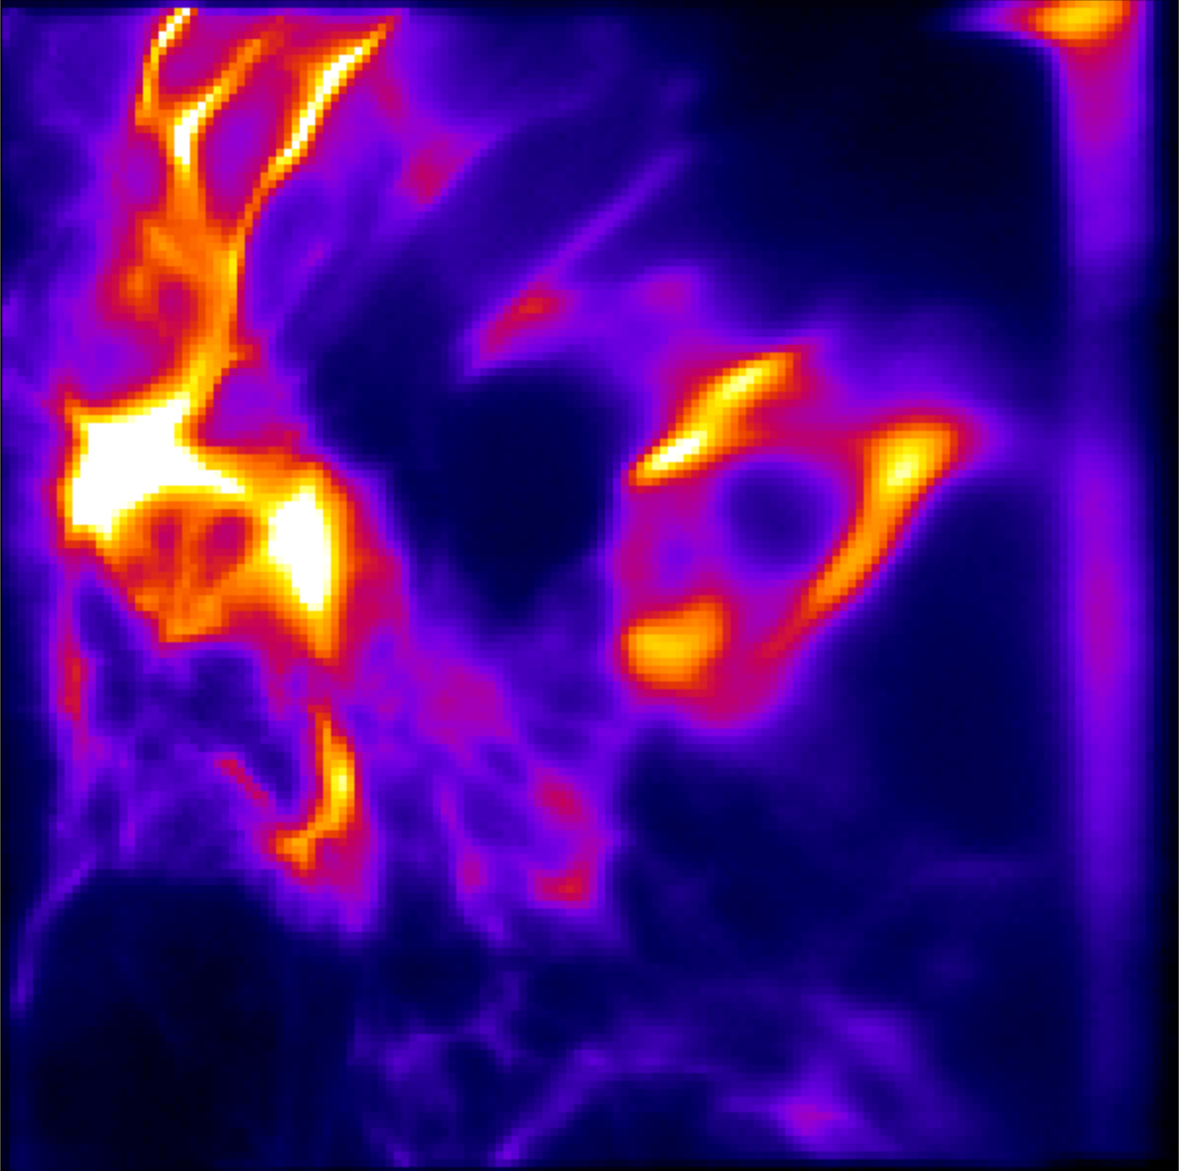
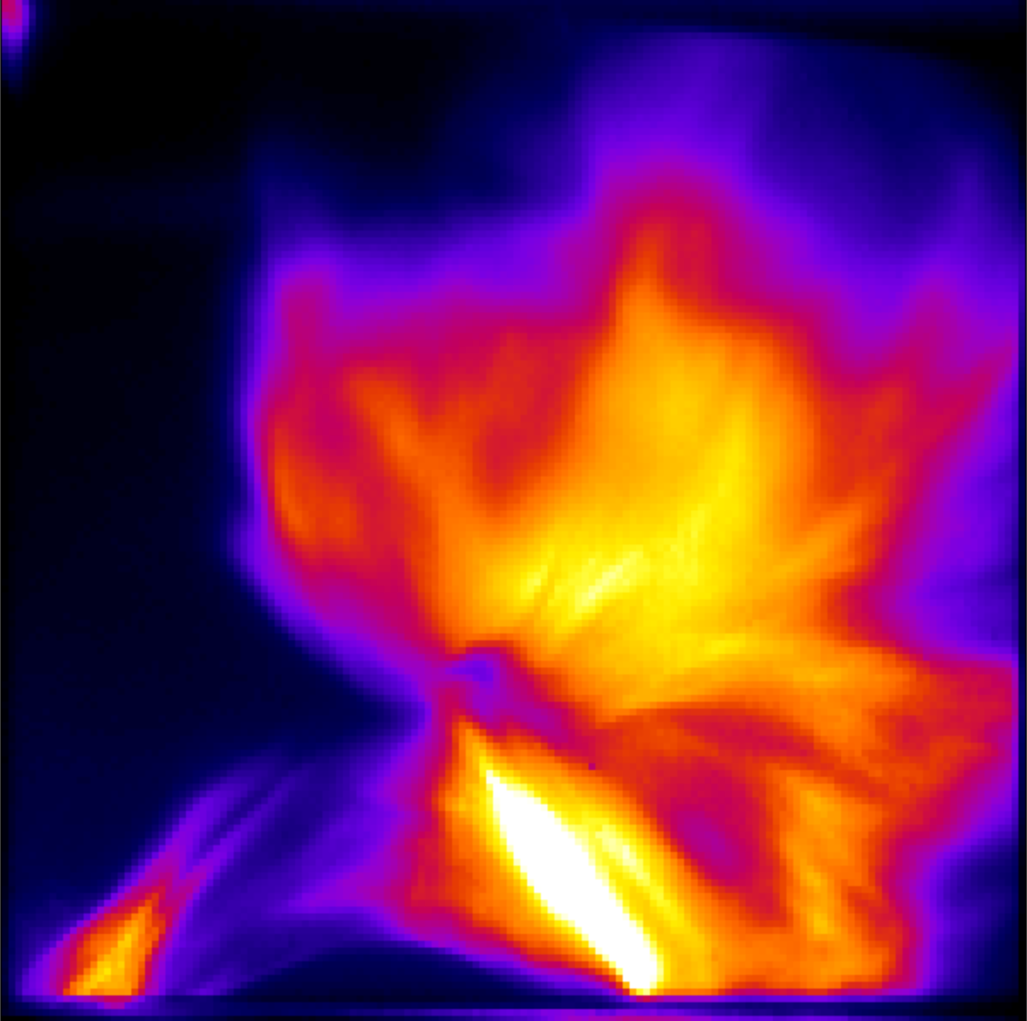
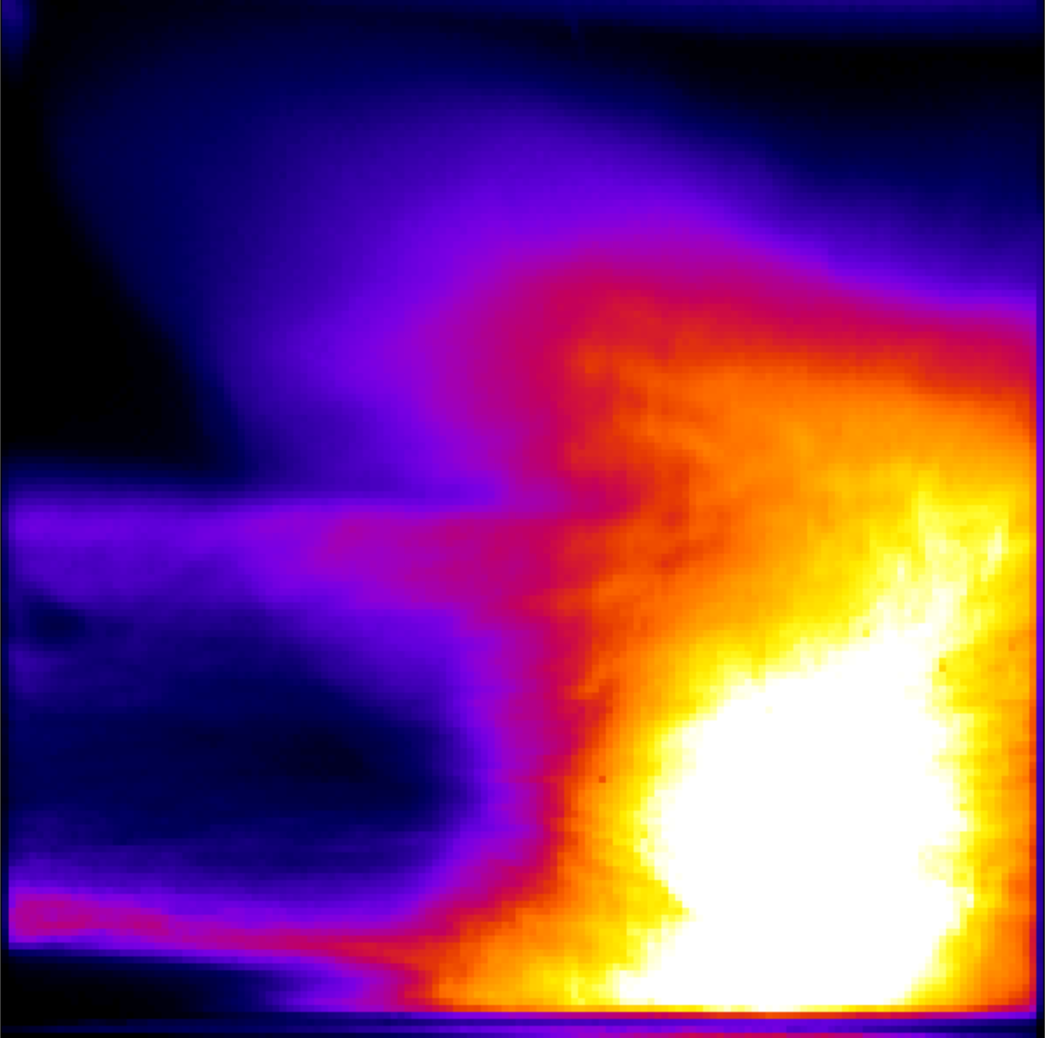
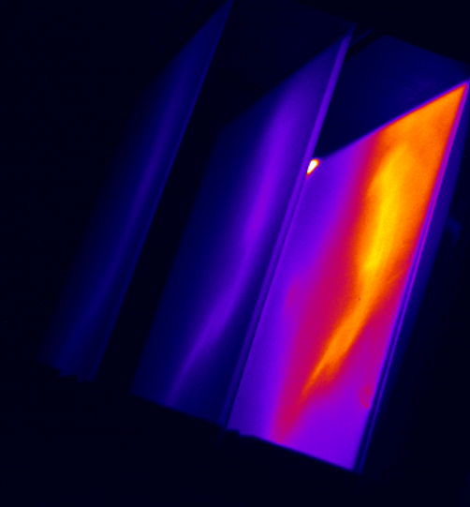
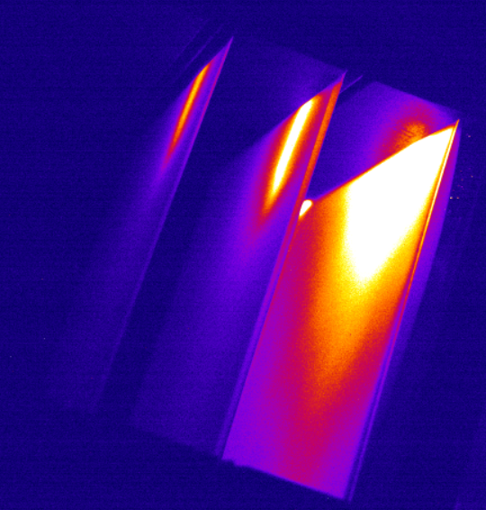
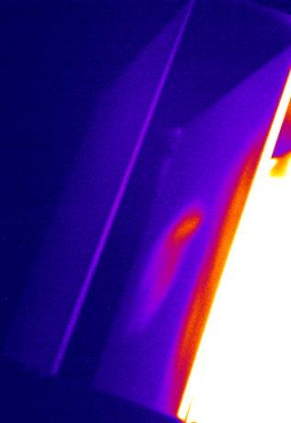
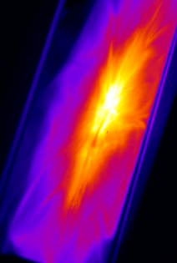
ZEUS TA2: Other Results
1.5 MeV Proton Beams – 1 Hz Burst
“Weird” results are perhaps more likely a result of the laser conditions rather than the liquid
  Pre-pulse
  Burst mode laser degradation
1 J
3 J
3 J
Multi-energy (raw) data
(L to R) 8.1 MeV, 5.6 MeV, 1.5 MeV
We observe pointing fluctuations in our proton beam
Much more narrow beams at higher energies

Slide 6
Questions? vacontre@umich.edu

Slide 7

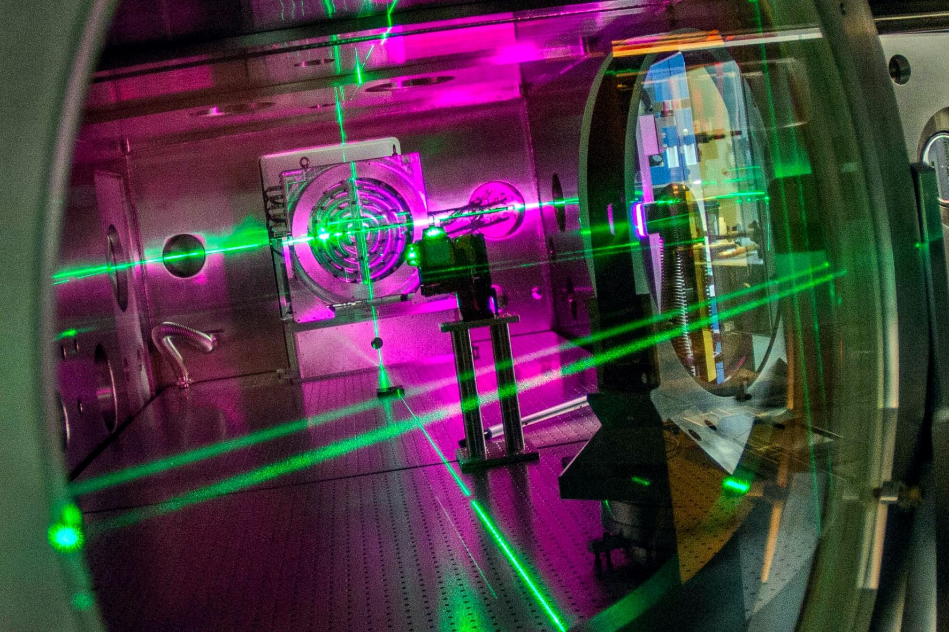
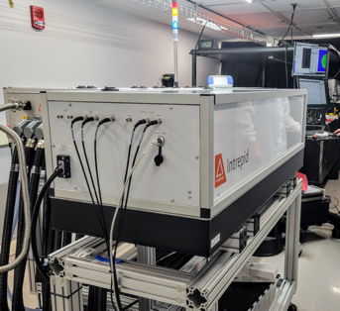

The NSF laser:
A high-field user facility
ZEUS Facility
A “shock-driver” laser will be available in two target areas
Amplitude Intrepid:
Nd:glass system, $λ=1054$ nm (or 527 nm)
1 shot per minute rep rate
  110 J (75 J) at 10 ns duration
  46 J (35 J) at 1.5 ns duration
3 Petawatt power laser user facility
Experiments on:
Testing extreme field physics
Unique particle & photon sources
Applications of sources across STEM
The ZEUS facility construction and operation is supported by the National Science Foundation under award 1935950 and 2126181, as well as by the AFOSR grant number FA9550-21-1-0264 and the University of Michigan.

