Slide 1


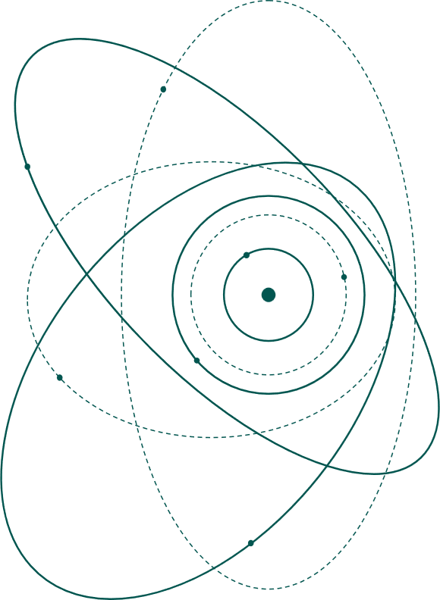

Focusing what we actually have
Experience with PMQ Doublets at LION and (eventually useful) lessons for cylindrically symmetric focusing
LMU Munich, Medical Physics
Prof. Dr. Jörg Schreiber

Slide 2
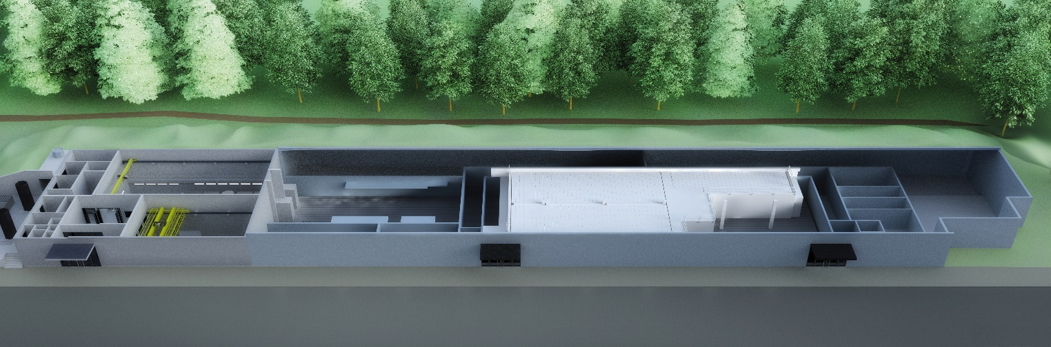
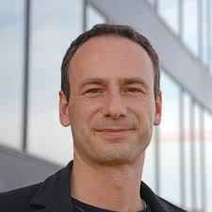
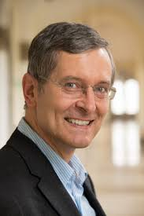
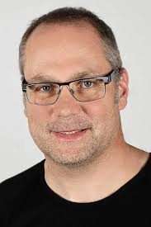
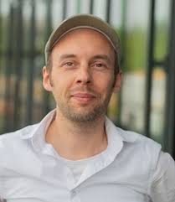
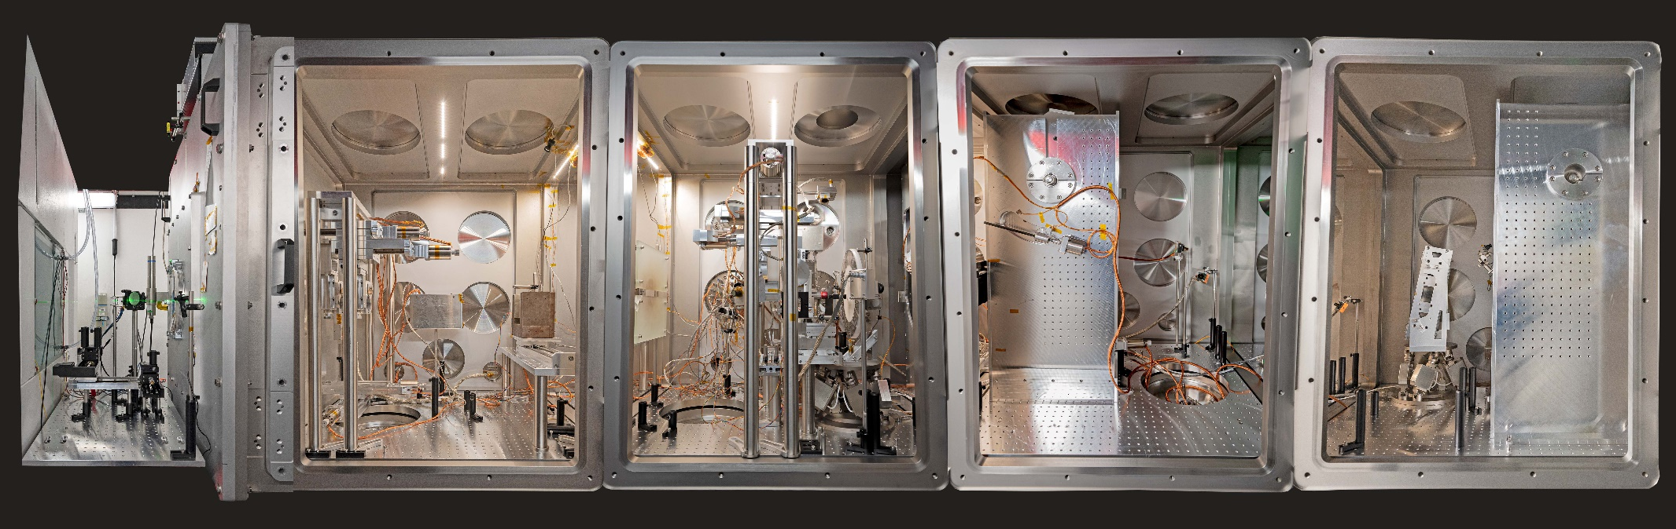
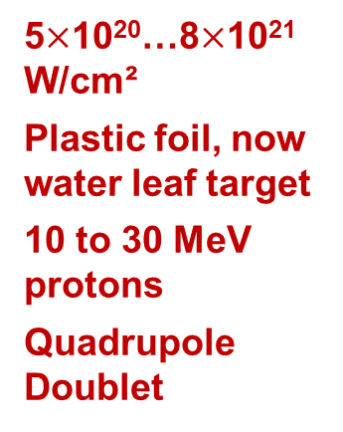
Laser-ION acceleration at CALA
Broadband IR-spectroscopy, F. Krausz et al.
ATLAS3000
Protons, ions, …
Heavy
ions
Nonlinear Vacuum
Electrons+xrays
High rep Electrons+Xrays
5$×$10²⁰…8$×$10²¹ W/cm²
Plastic foil, now water leaf target
10 to 30 MeV protons
Quadrupole Doublet
5…60 J, 30 fs
←∅5µm ∅28cm

Slide 3



The promise: ultralow-emittance proton beams (Cowan+ 2004)
A micron-scale source and an almost laminar expansion suggested extraordinary focusability.
• micron-scale virtual source
• very small normalized transverse emittance
• high particle number in a short bunch
• a result for a specific target and regime
The hidden leap
A remarkable result became an assumed generic source property.
Cowan et al., Phys. Rev. Lett. 92, 204801 (2004)
Notes:
Do not say Cowan was wrong. Emphasize that the result was correct for its source and regime; the mistake was treating ultralow emittance as universal.
[Sources]
https://doi.org/10.1103/PhysRevLett.92.204801

Slide 4
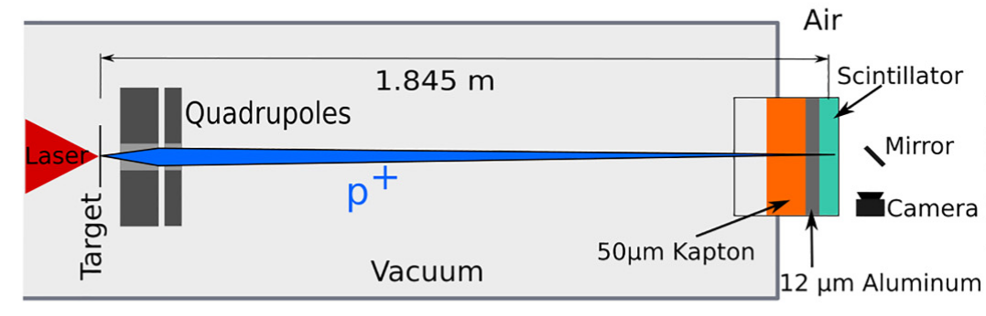
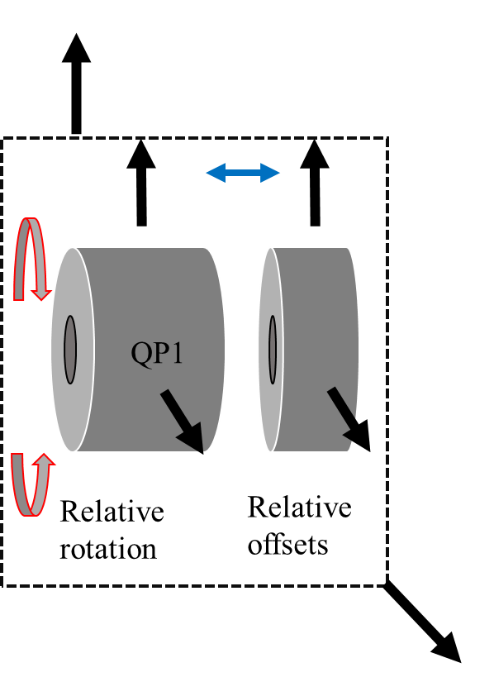
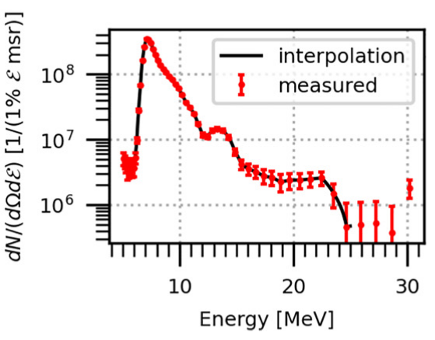
Deliberately simple baseline
PMQ doublet
Two Halbach quadrupoles
≈330 T/m gradient
Fixed fields, movable positions
No discharge · no trigger · no power supply
Design intent
3D-Hallprobe
measurements revealed ~99% L2
Focus a selected proton energy onto the application plane while keeping the system compact, vacuum-compatible and reproducible.
Hartmann et al., Proc. SPIE 2021 · Rösch et al., PRE 109, 025201 (2024)
Notes:
Use your own CAD or beamline photograph. Present simplicity as a scientific advantage: fewer components made discrepancies between model and measurement easier to expose.
[Sources]
https://arxiv.org/abs/2111.08461
https://doi.org/10.1103/PhysRevE.109.025201

Slide 5
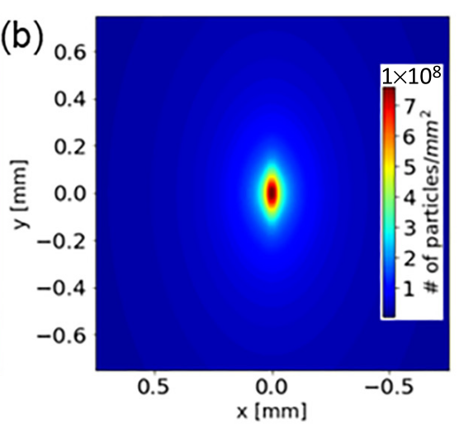
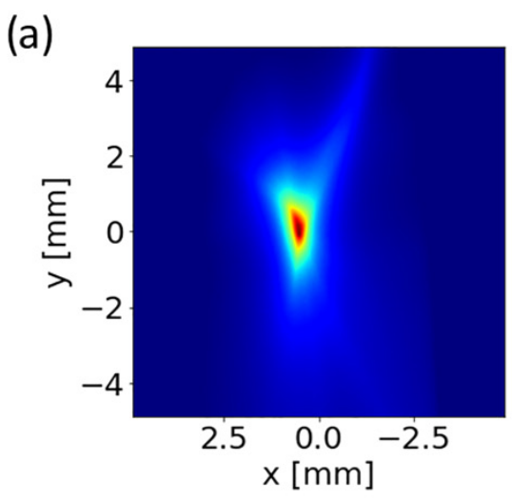
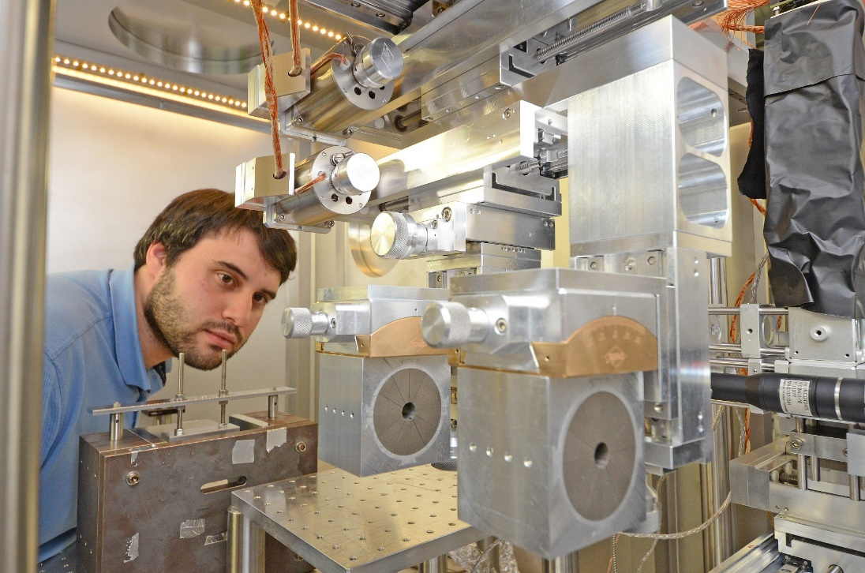
A 60 µm prediction became a 500–600 µm focus
PREDICTED FOCUS
→
MEASURED FOCUS
Insert simulation / ideal spot
Insert scintillator / detector image
≈60 µm
≈500–600 µm
prediction
measurement
LION result; published analysis: Rösch et al., Phys. Rev. E 109, 025201 (2024)
Notes:
This is the reveal. State: still an excellent focus, but almost an order of magnitude larger than expected. Replace both placeholders with matched visual scales if possible.

Slide 6
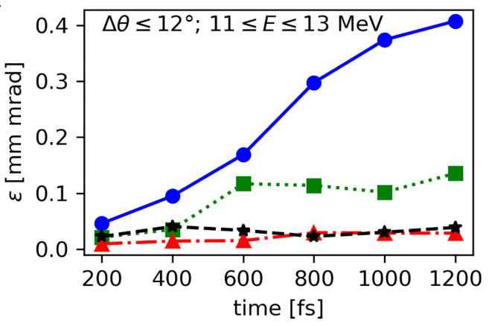
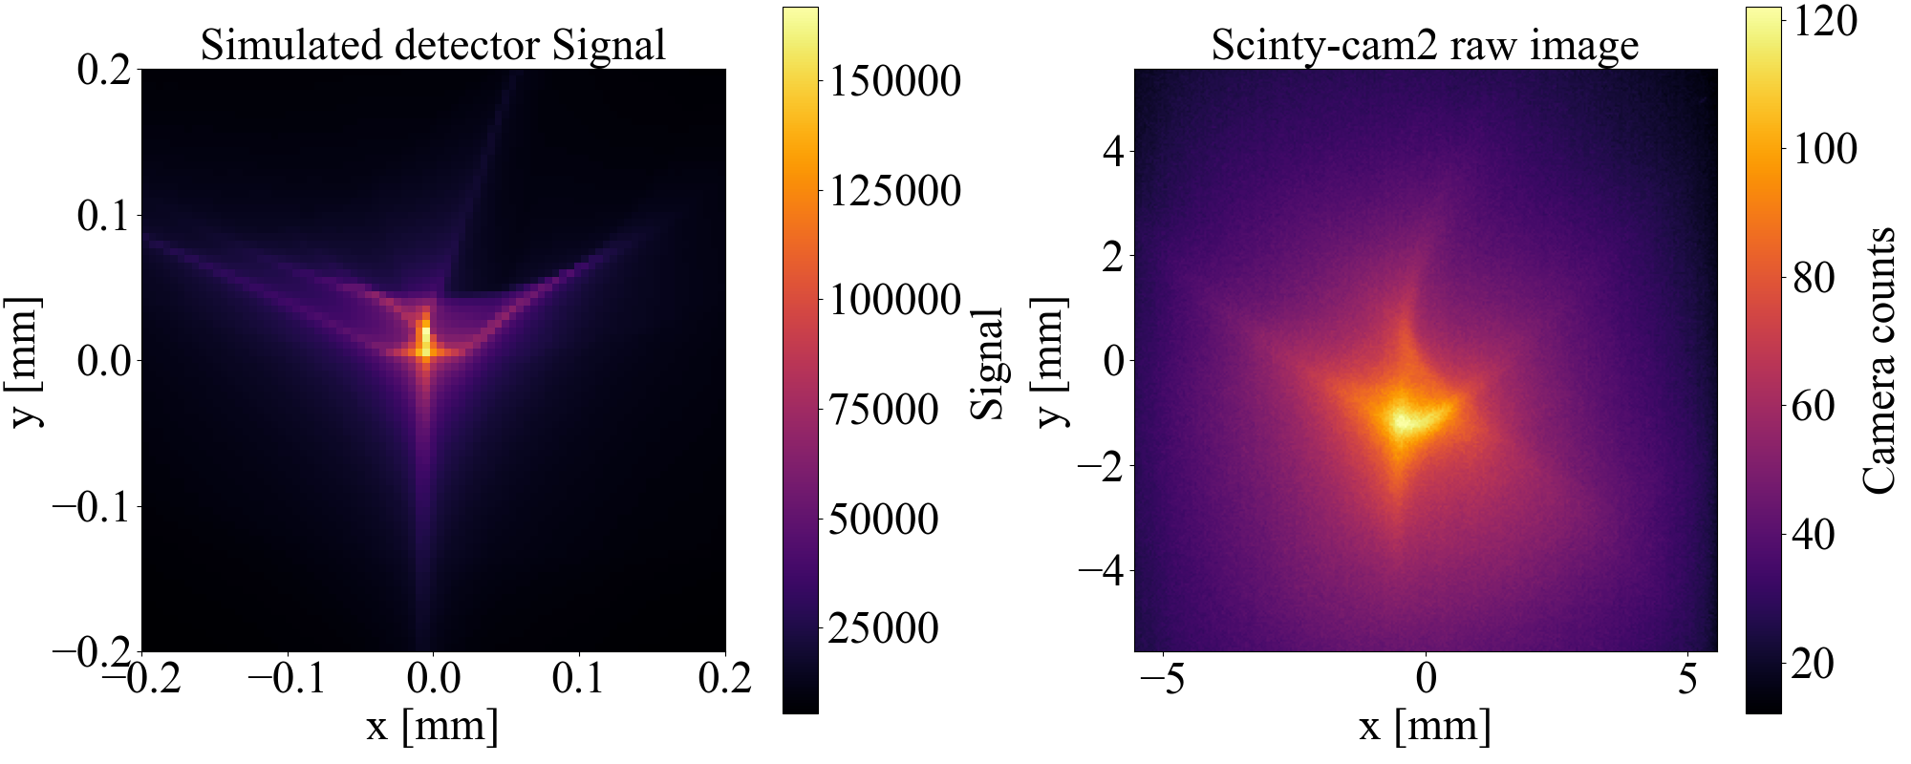
Two idealisations failed together
Beyond the RMS source
Beyond the nominal gradient
PIC hints at emittance growth due to collisions
(no Point-like/
Gaussian/
Elliptical PS)
Insulator vs.
Metal foil
Targets
…
Fringe fields and higher multipoles indicate distinct features
Higher moments of the distribution
Higher-order field components
X. Chen et al., unpublished
Rösch et al., Phys. Rev. E 109, 025201 (2024)
Notes:
Keep the two meanings of 'higher order' distinct: statistical moments of the beam distribution versus higher-order multipole content and nonlinear fringe fields of the magnets.

Slide 7
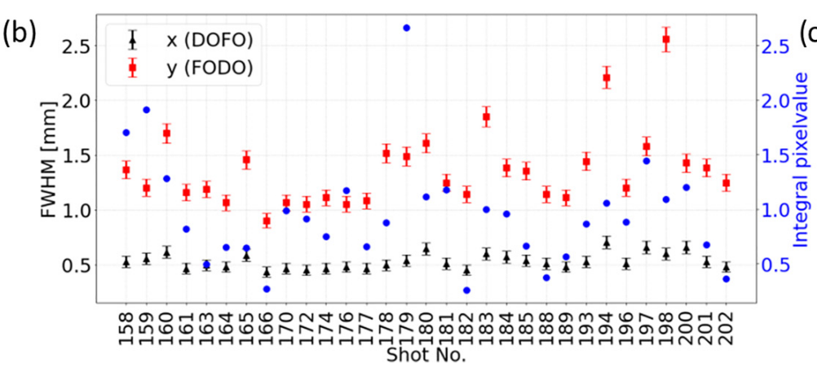
Shot-to-Shot variability of proton focus
Rösch et al., Phys. Rev. E 109, 025201 (2024)

Slide 8
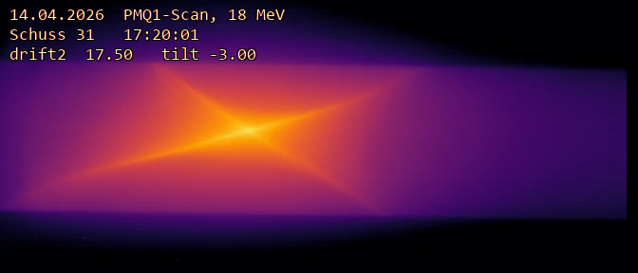
A rep-rated source is not necessarily an easy beam to focus
Water-leaf targets solve a different part of the problem
• 1 Hz operation, >1000 shots per day
• proton energies up to 30 MeV
• high repetition and debris-free target renewal
• transverse phase-space quality remains a separate question
Insert representative angular / spatial profiles
WATER-LEAF BEAM PROFILES
Target type may matter—but causality remains to be tested.
Live-adjustment of “roll” angle between quads
Notes:
Be explicit: the published 500–600 µm discrepancy was obtained with sub-micrometre plastic foils, not the later water-leaf system. Present current water-target profile observations as a hypothesis-generating comparison, not a demonstrated causal explanation.
[Sources]
https://doi.org/10.1103/PhysRevResearch.7.023190

Slide 9
The focus is good, our understanding isn‘t.
The discrepancies become a diagnostic of what we do not yet know about the source (and the magnets).
Notes:
Pause here. This is the conceptual turn from a success story to a tutorial about phase space and real fields.

Slide 10
The bunch lives in six dimensions, we only measure projections
x, pₓ
y, pᵧ
t, ΔE
horizontal trace space
vertical trace space
longitudinal phase space
Often measured
Rarely measured
dN/dE/dΩ in selected directions (3D sparse, online)
Energy-resolved beam profiles (3D complete, single shot)
Slice emittance / divergence
Longitudinal emittance / bunch duration
integrated charge or dose
Pragmatic transport starts with the least-wrong distribution consistent with all diagnostics.
See energy-resolved trace-space diagnostics: Salgado-López et al., PR Research 7, 033277 (2025)
Notes:
Use practical coordinates x, x', y, y', t, E in speech, then mention canonical coordinates if useful. Emphasize energy-angle, energy-source-size and time-energy correlations.
Once we have that “least wrong distribution”, we can plan irradiation

Slide 11
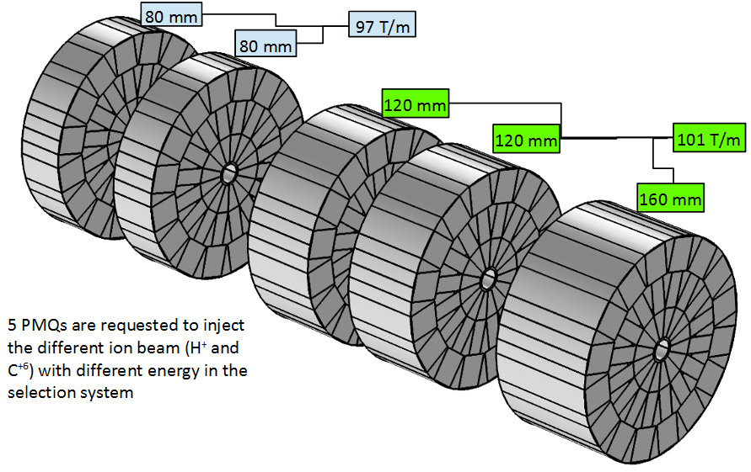


Transport matches acceptance to useful phase space (ideally)
Source
Capture
Selection
Application
→
→
→
Least wrong 6D distribution
(Least wrong) fields + aperture
energy + species
dose, spot, time
We rarely transport the whole bunch.
Application co-defines transport, e.g.
Energy/ion selection/capture (ELI)
“Conventional”:
← (Permanent)
Magnets (Quads, Sext, …), curtesy Schillaci
(Pulsed) Solenoids, curtesy Kroll →
homogeneous dose distribution (HZDR)
single-shot FLASH irradiation
Metzkes-Ng et al., Sci. Rep. 13 (2023)
multi-shot precise dose delivery
Kroll et al., Nat. Phys. 18 (2022)
Notes:
Use this to define the performance metric before comparing lenses. A minimum spot is not automatically the most useful delivered beam.

Slide 12
Ion/Proton collection experiments
(Permanent-)Magnet (Quads) (CALA, ELI, CLAPA)
Cork & Zajec, UCRL-2182 (1953) — first ion/proton quadrupole focusing
Schollmeier et al., PRL 101, 055004 (2008) — first strong focusing of laser-driven protons with PMQs
Nishiuchi et al., APL 94, 061107 (2009) — repetition-rate PMQ focusing
Nishiuchi et al., PRSTAB 13, 071304 (2010) — integrated proton beamline / PMQ triplet
Zhu et al., PRAB 22, 061302 (2019) — controlled transport & energy selection
Yan et al., PRAB 27, 052801 (2024) — high-acceptance PMQ pre-focusing
Pulsed solenoids (GSI, HZDR)
Busch, Ann. Phys. 386, 974 (1926) — origin of magnetic-lens focusing
Harres et al., Phys. Plasmas 17, 023107 (2010) — first solenoid collimation of laser protons
Burris-Mog et al., PRSTAB 14, 121301 (2011) — capture & transport with pulsed solenoid
Busold et al., PRSTAB 16, 101302 (2013) — LIGHT: high-intensity proton transport
Brack et al., Sci. Rep. 10, 9118 (2020) — dual-solenoid spectral & spatial shaping
Kroll et al., Nat. Phys. 18, 316 (2022) — solenoid beamline for in-vivo irradiation
Active plasma lens (Berkeley, Frankfurt/GSI)
Panofsky & Baker, RSI 21, 445 (1950) — original concept & proton demonstration
Bin et al., Sci. Rep. 12, 1484 (2022) — laser-driven proton transport
Yan et al., PRAB 27, 052802 (2024) — high-acceptance / variable-radius APL
Yan et al., PRAB 28, 032801 (2025) — focusing + bending
Dehmer et al., NIM A 1091, 171741 (2026) — APL development for LIGHT proton beamline
Gabor lens (LhARA)
Gabor, Nature 160, 89 (1947) — original electron-space-charge lens concept
Booth & Lefevre, NIM 151, 143 (1978) — experimental ion-beam focusing
Pozimski & Aslaninejad, Laser Part. Beams 31, 723 (2013) — Gabor lenses for laser-driven ions
Aymar et al., Front. Phys. 8, 567738 (2020) — LhARA: Gabor-lens capture concept
Nonnenmacher et al., Appl. Sci. 11, 4357 (2021) / Dascalu et al., IPAC (2021) — proton-beam tests of LhARA prototype
Passive / self-generated plasma focusing
Willingale et al., PRL 96, 245002 (2006) — self-organized ion collimation in plasma
Ni et al., Phys. Plasmas 20, 083111 (2013) — passive self-collimation in foil stack
Kim et al., PRL 115, 054801 (2015) — beam–plasma magnetic self-focusing
Streeter et al., Nat. Commun. 16, 1004 (2025) — proton self-guiding / collimation in vapour plasma
Helical coil / travelling-field structures
Kar et al., Nat. Commun. 7, 10792 (2016) — guided post-acceleration, collimation & energy selection
Ahmed et al., Sci. Rep. 7, 10891 (2017) — <1° collimated, narrow-band proton beamlet
Bardon et al., PPCF 62, 125019 (2020) — chromatic focusing, post-acceleration & bunching
Ahmed et al., Sci. Rep. 11, 699 (2021) — high-energy guided re-acceleration
Other / source-integrated focusing
Wilks et al., Phys. Plasmas 8, 542 (2001) — curved-target TNSA ion-lens concept
Patel et al., PRL 91, 125004 (2003) — hemispherical target focusing / isochoric heating
Toncian et al., Science 312, 410 (2006) — laser-triggered electrostatic microlens
Kar et al., PRL 100, 105004 (2008) — self-charged target / dynamic electrostatic collimation
Bin et al., Phys. Plasmas 20, 073113 (2013) — intrinsically low-divergence ultrathin-foil proton source
Relatively simple,
low efficiency
Very high fields,
Rotation/emittance
Better than Quad,
similar potential as solenoid,
Scattering!
* Lensing often (always?) demonstrated with laser-driven electrons first, e.g. APL Tilborg 2015, PPL Kuschel 2016, PRL Lindstrøm 2018, …

Slide 13
Laser-driven proton focusing: strength vs. collection
Representative systems • common reference: 15 MeV protons • compare optical strength and actual capture separately
Approach / representative case
Field
D
L
f_{eq}@15 MeV
D / f_{eq}
Demonstrated / design acceptance
PMQ
Schollmeier 2008
B ≈ 1.25 T
5 mm
17 mm
6.6 cm
76 mrad
±15 mrad geom.
0.1% through doublet
https://doi.org/10.1103/PhysRevLett.101.055004
Pulsed solenoid
Dresden
≈8 T†
19.5 T max
40 mm
150 mm
13 cm†
300 mrad†
https://doi.org/10.1038/s41598-020-65775-7
±14° (≈250 mrad) geom.
≤50% transport
Gabor lens
LhARA GL1
E ≈ 1.7 MV/m
73 mm
857 mm
0.75 m
100 mrad
https://doi.org/10.3389/fphy.2020.567738
±50 mrad design
Active plasma lens
BELLA / Berkeley
B ≤ 0.30 T†
(600 T/m max)
1 mm
33 mm
≥2.8 cm†
≤35 mrad†
±11 mrad model
~0.2% transport
https://www.nature.com/articles/s41598-022-05181-3
Active plasma lens
LIGHT design
B ≈ 0.49 T†
40 mm
200 mm
11.5 cm†
350 mrad†
±125 mrad @ 8 MeV
(design)
https://ieeexplore.ieee.org/document/10481410
Passive plasma
Streeter 2025
Bθ ~ 1 T
(PIC scale)
no hard
aperture
~10 mm–cm
—
—
≤20 mrad output
no entrance-aperture loss
https://www.nature.com/articles/s41467-025-56248-4
Helical coil
Kar 2016
travelling EM
pulse
0.7 mm ID
8.7 mm
—
—
https://www.nature.com/articles/ncomms10792
7% collection
<0.5° output
Source-integrated
Patel 2003
TNSA sheath
Ø 320 µm
—
fgeo ~160 µm*
~2 rad*
intrinsic focusing
no downstream aperture
https://doi.org/10.1103/PhysRevLett.91.125004
† 15 MeV hard-edge / momentum-scaled estimate from published device parameters * geometric/source-integrated quantity; not a paraxial lens metric
Notes:
Speaker notes — definitions and interpretation
Common reference
• Proton kinetic energy: 15 MeV, Bρ ≈ 0.562 T·m.
• f_eq is an equivalent integrated linear focusing strength, 1/f_eq ≡ ∫K(s) ds. It is not necessarily the literal image focal distance of a thick lens.
• D/f_eq is shown next to demonstrated/design acceptance on purpose: D/f_eq tells how much angular kick the optic can in principle provide, while actual collection is also limited by the entrance geometry, approximately θ_geom ≈ D/(2d), with d the source–lens distance.
Row-by-row
• PMQ — Schollmeier et al. 2008: first PMQ had g ≈ 500 T/m, ~5 mm aperture and ~17 mm magnetic length. For 15 MeV protons, 1/f ≈ gL/(Bρ) gives f_eq ≈ 6.6 cm and D/f_eq ≈ 76 mrad in the focusing plane. A single quadrupole focuses one plane and defocuses the other; the reported two-PMQ experiment transmitted only ~0.1% because of the small apertures and second-plane losses.
• Pulsed solenoid — Dresden: the installed device reaches 19.5 T, with ~40 mm clear entrance and ~15 cm effective length. The ~8 T number is a hard-edge estimate for 15 MeV protons chosen to illustrate a representative collimating strength; it is not a quoted operating point. D/f_eq ≈ 0.30 rad. The real capture advantage is the 40 mm aperture only ~8 cm from target, corresponding to ~14° geometrical half-angle; the dual-solenoid beamline demonstrated up to ~50% transmission for selected spectral shaping conditions.
• Gabor lens — LhARA GL1: published capture-lens geometry uses D = 73 mm and L = 0.857 m with 50 mrad design capture. Using the LhARA electron density / equivalent-solenoid design gives an edge electric field of ~1.7 MV/m, f_eq ~0.75 m and D/f_eq ~98 mrad at 15 MeV. Main caveat: stable, sufficiently homogeneous electron-cloud operation.
• Active plasma lens — BELLA / Berkeley: Bin et al. 2022 used a 1-mm-diameter, 33-mm-long argon APL placed 13 mm behind the TNSA source. The published maximum gradient is 600 T/m, corresponding to B ≈ 0.30 T at the channel wall. At 15 MeV this maximum gives f_eq ≈ 2.8 cm and D/f_eq ≈ 35 mrad. The beam model limited the source divergence to ±11 mrad by the APL acceptance; measured transport efficiency for >1.5 MeV protons was ~0.2%. These 15 MeV optical-strength values use the published maximum gradient, not the 90 A operating point used for the radiobiology delivery.
• Active plasma lens — LIGHT design: large-aperture proton APL, ~20 cm long and cm-scale bore. The B ≈ 0.49 T, f_eq ≈ 11.5 cm and D/f_eq ≈ 0.35 rad values are momentum-scaled 15 MeV estimates from the published/design current and geometry, not yet a 15 MeV experimental result. The design literature reports ~125 mrad half-angle acceptance around 8 MeV, comparable to the existing LIGHT solenoid.
• Passive plasma — Streeter et al. 2025: no conventional entrance aperture or unique static f_eq. The beam propagates through low-density water vapour and develops self-generated azimuthal magnetic fields (PIC scale ~tesla) that reduce the measured divergence to ≤20 mrad. The essential collection advantage is the absence of a hard entrance aperture.
• Helical coil — Kar et al. 2016: synchronous travelling electromagnetic fields provide focusing, energy selection and post-acceleration; a unique linear f_eq is therefore not meaningful. The proof-of-principle device had ~0.7 mm inner diameter and ~8.7 mm length, with ~7% collection and <0.5° output divergence for the selected ~9 MeV component.
• Source-integrated — Patel et al. 2003: hemispherical ~320 µm Al target produces convergent TNSA emission and ~50 µm heating spot near its geometric center. The displayed f_geo ~160 µm and D/f_geo ~2 are purely geometric source quantities and must not be compared numerically to paraxial magnetic/plasma lenses. The conceptual advantage is that no downstream capture aperture is needed.
[- https://doi.org/10.1103/PhysRevLett.101.055004
- https://doi.org/10.1038/s41598-020-65775-7
- https://doi.org/10.3389/fphy.2020.567738
- https://ieeexplore.ieee.org/document/10481410
- https://www.nature.com/articles/s41467-025-56248-4
- https://www.nature.com/articles/ncomms10792
- https://doi.org/10.1103/PhysRevLett.91.125004
Sources]
[/Sources]

Slide 14
Maximum angular acceptance of ion-focusing lenses
Fully illuminated / aperture-limited comparison — optimize collection only
Assumption: source divergence ≫ lens acceptance → aperture always fully illuminated. Goal: maximize θacc; irrespective of focal length
Method
Local focusing K
Maximum angular acceptance
Key scaling / remark
Solenoid
(qB / 2p)²
qBa / 2p
∝ a · B/p
Active plasma lens
qBedge / (p a)
√(qBedge a / p)
∝ √(a · Bedge/p)
Gabor lens
q e ne / (2 ε₀ p v)
a √[q e ne / (2 ε₀ p v)]
∝ a · √(ne / pv)
Quadrupole doublet
qBedge / (p a)
η_{Q} √(qBedge a / p)
ηQ < 1 from unavoidable defocusing
Symmetric F–D, g → 0: η_{Q} ≈ 0.135*
Main result: APL and quadrupoles have the same local K at fixed Bedge and a, but the doublet pays an acceptance penalty η_{Q} because one plane must defocus.
* idealized hard-edge model, equal-length symmetric doublet, zero gap, both planes captured at exit

Slide 15
Pre-emptive conclusions: source divergence changes the ranking
The useful figure of merit depends on whether the source overfills or underfills the lens acceptance.
Large source divergence
source shaping / passive focusing / foil-coil / target concepts
Low source divergence
1 | Large-divergence regime
2 | Low-divergence regime
Goal: maximize angular acceptance / collection
Goal: compact focusing + low chromaticity
• APL and quadrupoles have the same local focusing strength at equal B_edge and aperture a.
• Once θ_beam ≪ θ_acc, collection no longer differentiates the concepts.
• The quad doublet pays the DOFO penalty: one plane must defocus before it can be recovered → acceptance lower by a factor of a few.
• For a nearly parallel beam, the characteristic focusing length is
L₉₀ = π / (2√K) ∝ 1/√K
• At equal B_edge and aperture, an ideal APL is ≈2× more compact than an optimized quad doublet.
APL edge field required to match a solenoid
B_APL = B_sol² · a / (4 Bρ)
15 MeV p: Bρ = 0.562 Tm; a = 4 cm; B_sol = 8 T → B_APL = 1.14 T
Chromaticity of focusing phase rate κ = √K
Solenoid, Gabor: κ ∝ p⁻¹
APL, quad: κ ∝ p⁻¹ᐟ²
Take-away
For collection, the APL can compete with multi-tesla solenoids at surprisingly modest edge fields.
Low divergence shifts the advantage from collection to compactness — and makes the weaker chromaticity of APL / quads particularly attractive.
Core message: high divergence → compare θ_acc,max | low divergence → compare L₉₀ and chromaticity

Slide 16
Passive and laser-generated lenses make the beam–plasma system part of the optic
Passive / beam-driven
Laser-generated / target-attached
The bunch creates or modifies the plasma response.
Potentially no external discharge pulse—but performance depends on charge density, plasma state and collective dynamics.
Transient sheath, return-current or coil fields are driven by an auxiliary interaction.
Very strong and compact—but timing, target renewal and reproducibility become part of the lens.
These concepts blur the boundary between source, lens and transport medium.
Notes:
This is the bridge to the dedicated plasma-optics and hybrid-focusing talks. Keep examples brief so the next speakers retain room for the detailed physics.

Slide 17
The real comparison is system-level
01
6D acceptance
02
energy bandwidth
03
field linearity
04
emittance preservation
05
source-jitter sensitivity
06
alignment
07
target proximity
08
debris tolerance
09
tunability
10
repetition rate
11
thermal load
12
operating complexity
The best optic is the one that repeatedly delivers the useful particles—not the largest field gradient.
Notes:
Connect this list to the afternoon breakout topics: alignment, jitter, beam parameters, phase-space measurement, high repetition rate, gas/heat load and degradation.

Slide 18
A small emittance does not guarantee a small focus
source distribution
+
real lens fields
+
acceptance
→
delivered beam
Cylindrical symmetry removes one limitation. It does not remove the need to know the beam or the lens.
Notes:
Close by returning to LION: the doublet was valuable precisely because its simplicity exposed the inadequacy of the source and lens models. Transition: the next question is not only how strong plasma focusing can be, but how well its real field matches the real beam.

Slide 19

https://www.alpa.physik.uni-muenchen.de/

Slide 20
Selected references
Laser-ion phase space and conventional transport
Plasma focusing and diagnostics
Cowan et al., PRL 92, 204801 (2004)
Kemp et al., PRE 75, 056401 (2007)
Schollmeier et al., PRL 101, 055004 (2008)
Burris-Mog et al., PRSTAB 14, 121301 (2011)
Hartmann et al., Proc. SPIE / arXiv:2111.08461 (2021)
Metternich et al., PRAB 25, 111301 (2022)
Rösch et al., PRE 109, 025201 (2024)
He et al., PR Research 7, 023190 (2025)
Gabor, Nature 160, 89 (1947)
Panofsky & Baker, RSI 21, 445 (1950)
van Tilborg et al., PRL 115, 184802 (2015)
Lindstrøm et al., PRL 121, 194801 (2018)
Yang et al., PRAB 24, 031301 (2021)
Yan et al., PRAB 27, 052802 (2024)
Yan et al., PRAB 28, 032801 (2025)
Salgado-López et al., PR Research 7, 033277 (2025)

