Slide 1
Welcome!
Ken Long
11 September 2026

Slide 2
Thanks …
To all for being here or online …
To presenters for their contributions … and …
To the organising committee:
Bob Bingham, Calvin Dyson, Ken Long, Aled Isaac, Charlotte Palmer, Colin Whyte, Dan Symes, David Carroll, Gudrid Moortgat-Pick, Hamad Ahmed, James Green, Marco Borghesi, Nicolas Bourgeois, Paul McKenna, Poram Ruksasakchai, Rajeev Pattathil, Richard D'Arcy, Simon Hooker, Stefan Eriksson, Stuart Mangles

Slide 3
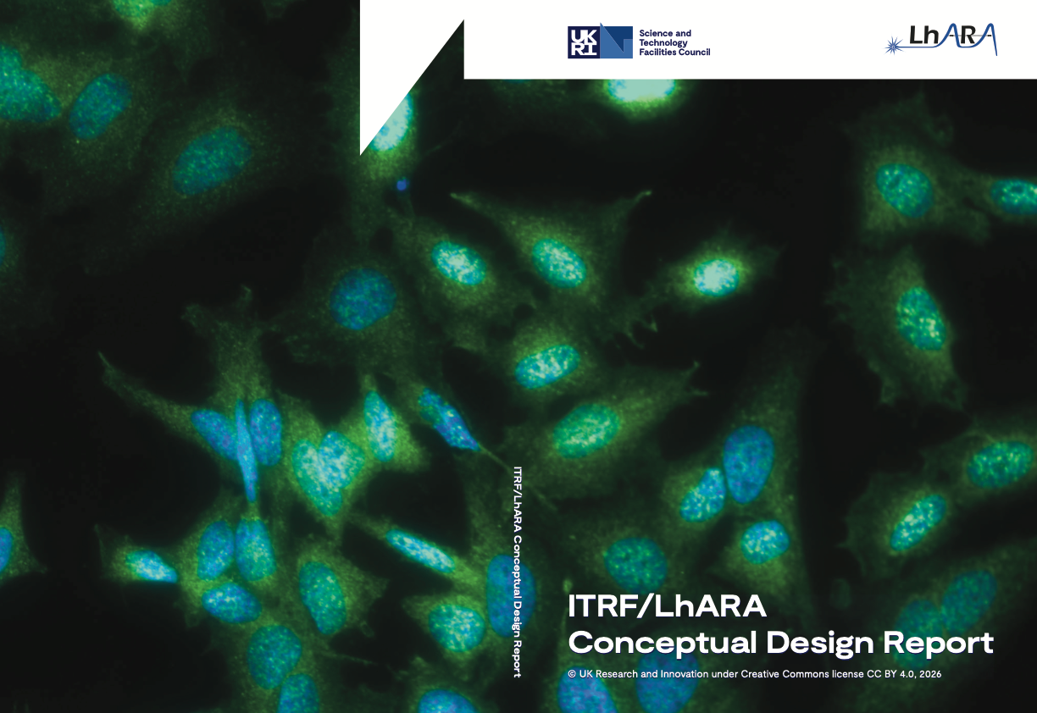
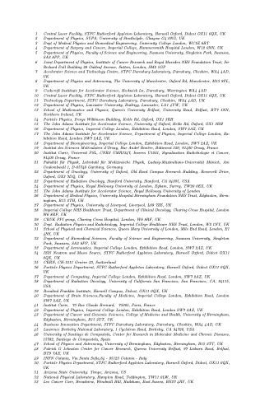

http://purl.org/net/epubs/work/64272701

Slide 4

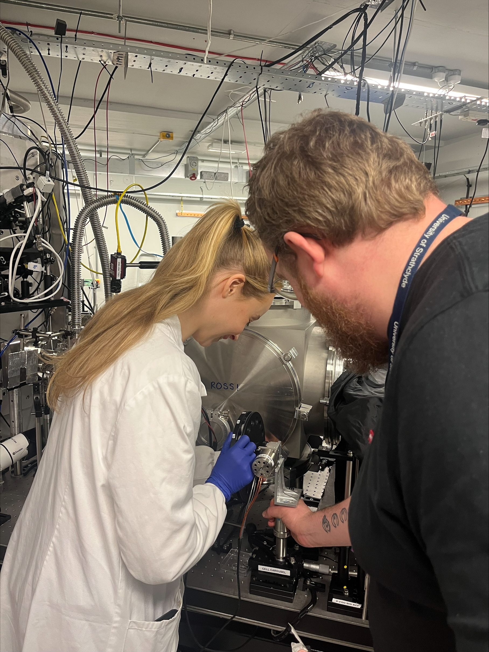
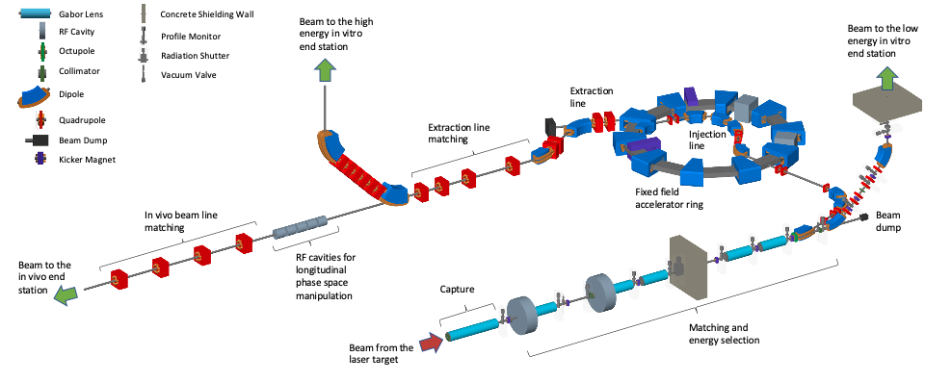
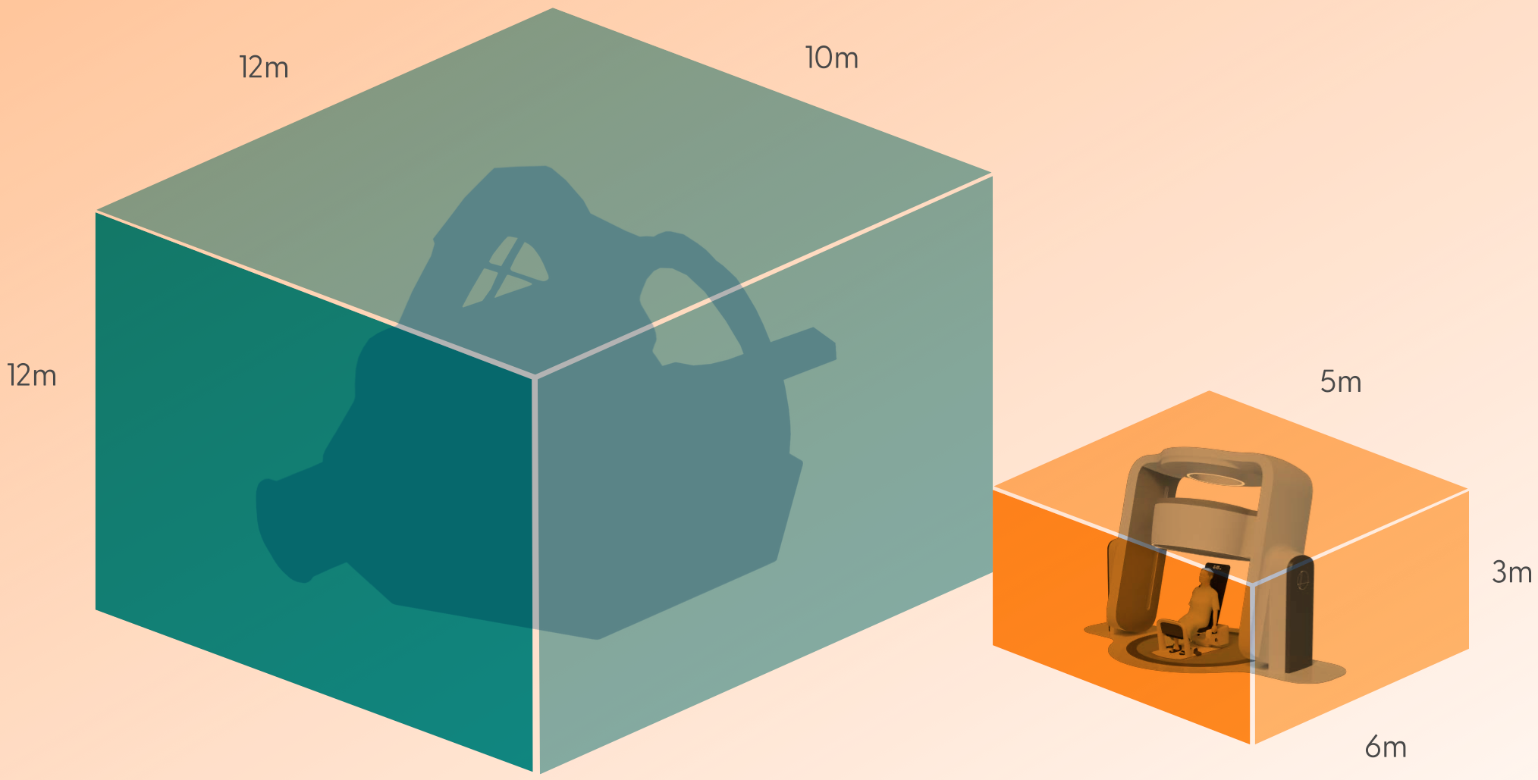
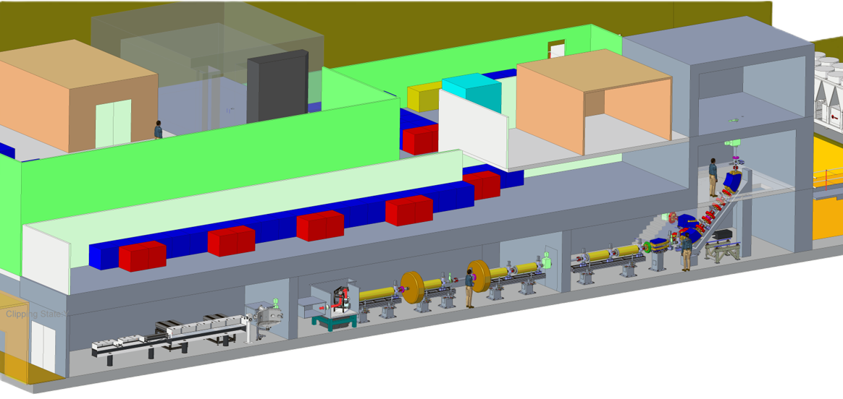
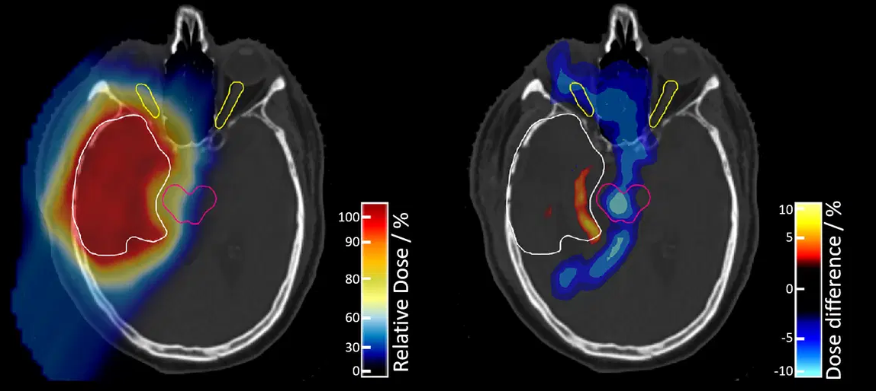
The LhARA initiative
RADIOBIOLOGY
LhARA
Co-creation

Slide 5
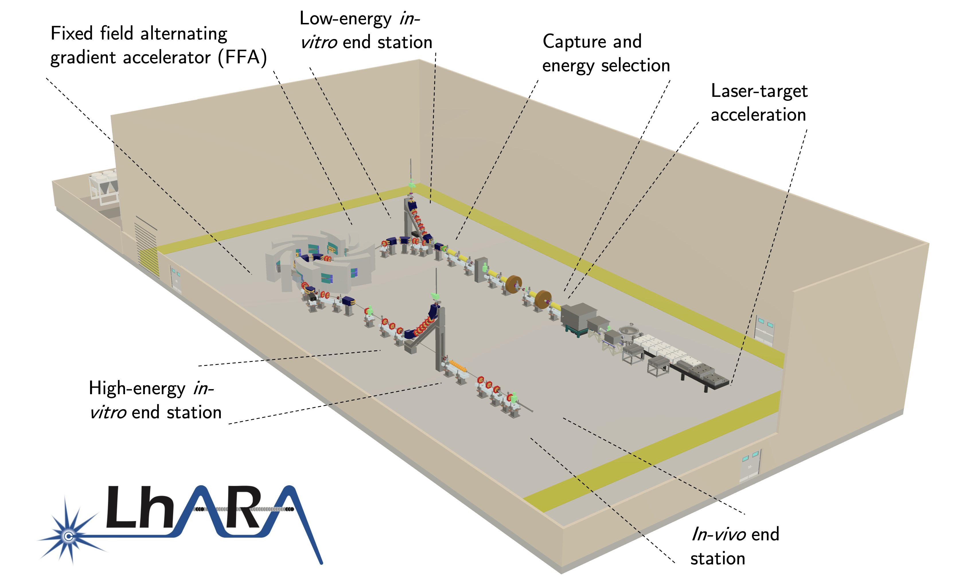
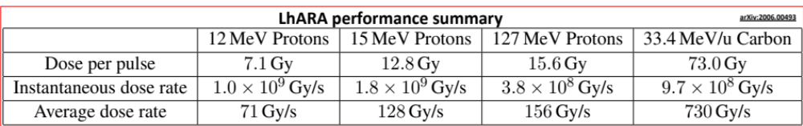
Specifications
A novel, hybrid, approach:
Laser-driven, high-flux proton/ion source
  Overcome instantaneous dose-rate limitation
    Capture at >10 MeV
  Delivers protons or ions in very short pulses
    Bunches as short as 10—40 ns
  Triggerable; arbitrary pulse structure
Novel “electron-plasma-lens” capture & focusing
  Strong focusing (short focal length) without the use of high-field solenoid
Fast, flexible, fixed-field post acceleration
  Variable energy
    Protons: 15—127 MeV
    Ions: 5—34 MeV/u
DOI: 10.5286/stfctr.2026007

Slide 6
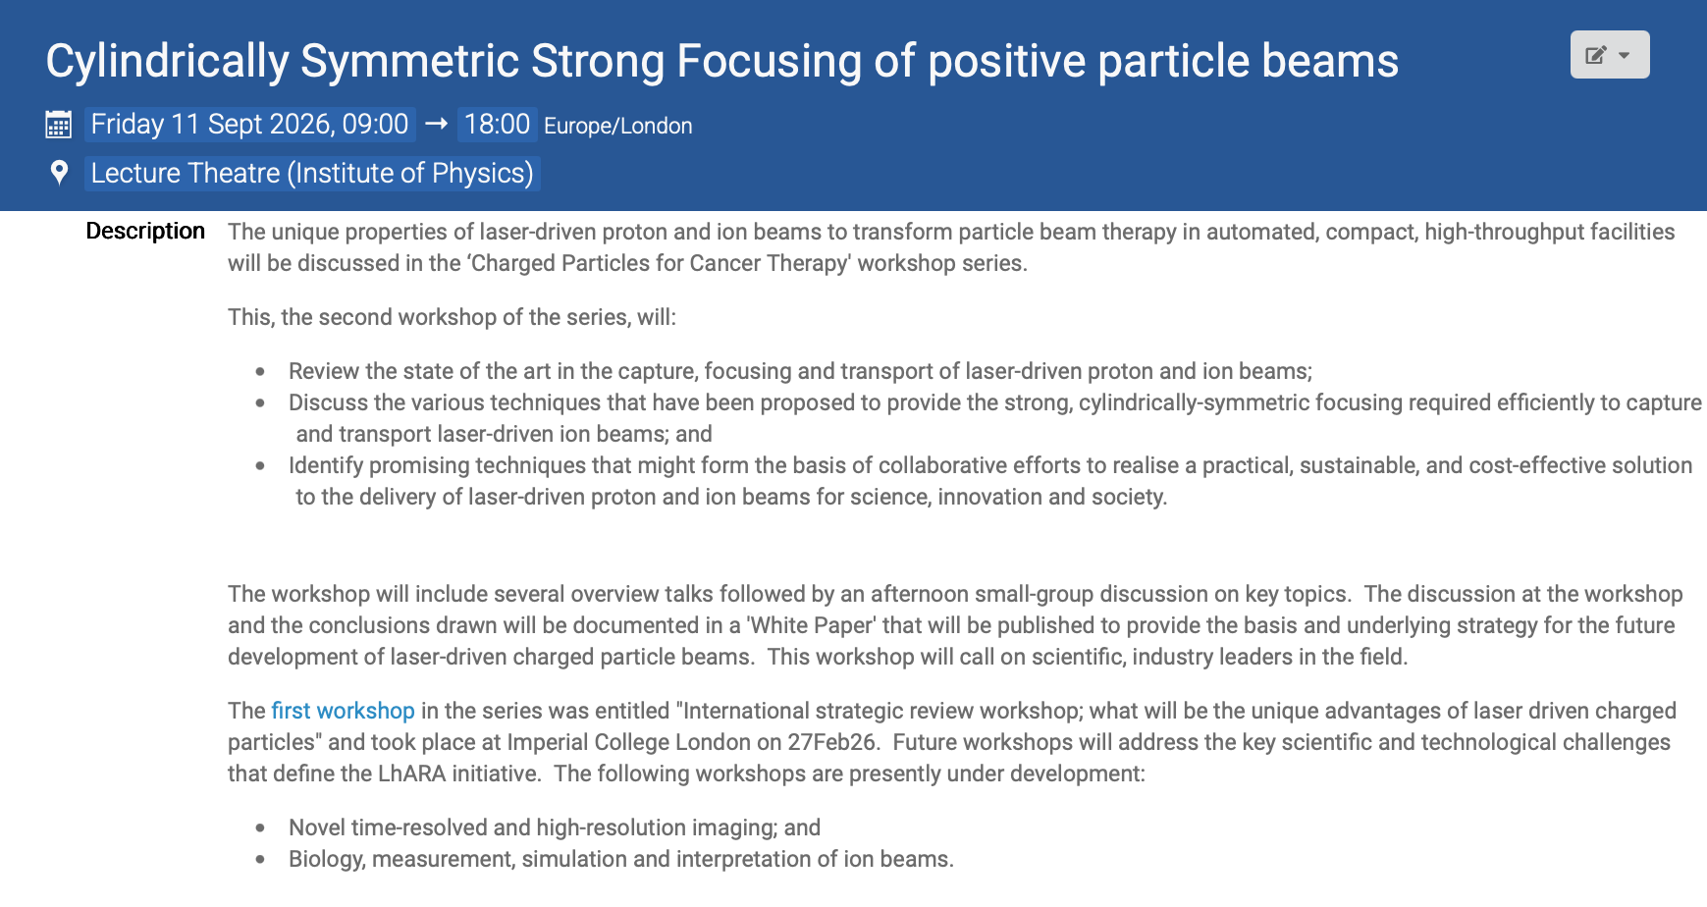

Slide 7
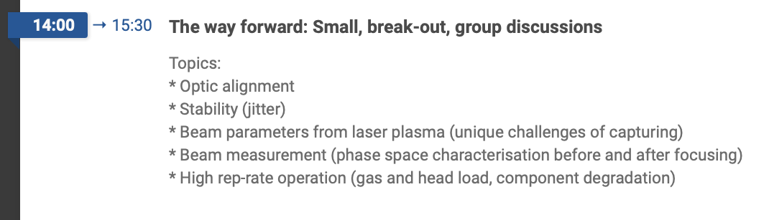
Format and desired outcome(s) …
Discussion during presentations
and discussion session the feature
of the workshop
Contribute to one or more
discussion topics
Still time to choose which group(s)
to join
Discussion and exchange of ideas …

Slide 8
Format and desired outcome(s) …
Discussion and exchange of ideas …
Declared goal:
creation of forward looking, strategic, white paper:
roadmap for the collaborative R&D programme towards a transformational plasma lens
Corollary:
key R&D topics to take make progress towards this goal
collaborations to drive proposals to secure necessary resources

Slide 9
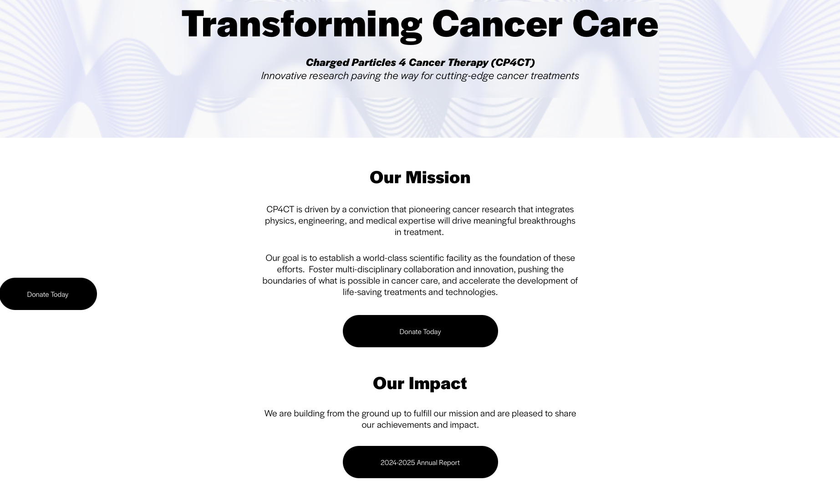
https://www.cp4ct.org

