Slide 1

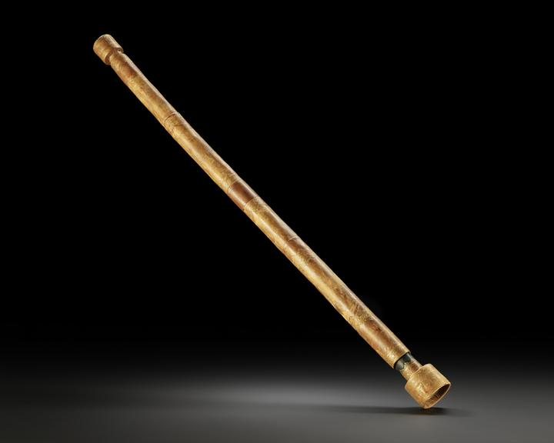
Quantum Technologies for Fundamental Physics
“New directions in science are launched by new tools much more often than by new concepts.”
— Freeman Dyson
Opening new experimental windows on the Universe
Silke Weinfurtner representing QTFP community

Slide 2
Why quantum technologies for fundamental physics?
Big questions
Tiny signals
Quantum tools
New physics reach
dark matter, neutrino mass, gravity, the early Universe
precision, low noise, long baselines, quantum-limited readout
sensors, clocks, interferometers, simulators, amplifiers
measure what was previously inaccessible

Slide 3
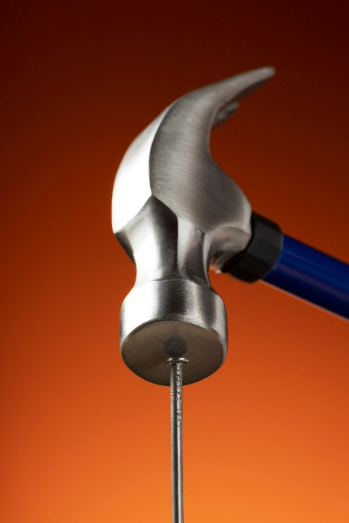


What is QTFP?
QTFP: a national effort at the interface of quantum technologies and fundamental physics
£40M
7
17
>200
Strategic Priorities Fund investment
large consortia funded in Wave 1
smaller projects funded in 2022
researchers in the QTFP community
What becomes possible when quantum sensors,
clocks, interferometers and simulators are developed specifically for fundamental physics…

Slide 4


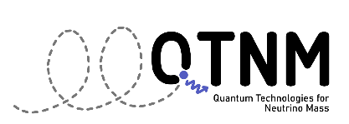




The seven large consortia
AION — quantum atom interferometers for dark matter and gravitational waves
QSHS — quantum sensors for hidden-sector and axion dark matter
QTNM — quantum technologies for neutrino mass
QI — quantum-enhanced interferometry for dark matter and quantum gravity
QSNET — quantum clock networks for fundamental physics
QSimFP — quantum simulators for black holes and the early Universe
QUEST-DMC — superfluid quantum technologies for dark matter and cosmology.
Notes:
The individual themes are diverse but coherent and span much of the international quantum technology for fundamental physics landscape.
AION — Atom Interferometer Observatory and Network
Developing atom interferometers to search for dark matter and detect gravitational waves, while laying the foundations for future large-scale quantum observatories.
QSHS — Quantum Sensors for the Hidden Sector
Using quantum sensors and ultra-low-noise microwave technologies to search for axions and other hidden-sector particles that may make up dark matter.
QTNM — Quantum Technologies for Neutrino Mass
Developing quantum-enabled technologies to determine the absolute neutrino mass, one of the major unresolved questions in particle physics.
QI — Quantum Enhanced Interferometry for New Physics
Applying squeezed light, single-photon detection and precision interferometry to search for dark matter and test fundamental aspects of gravity.
QSNET — Networked Quantum Sensors for Fundamental Physics
Building networks of ultra-precise quantum clocks to probe fundamental physics and search for variations in nature's fundamental constants.
QSimFP — Quantum Simulators for Fundamental Physics
Using analogue quantum simulators to investigate black holes, curved spacetime, quantum field theory and processes in the early Universe.
QUEST-DMC — Quantum-Enhanced Superfluid Technologies for Dark Matter and Cosmology
Combining superfluid quantum systems with advanced sensors to investigate dark matter and cosmological phase transitions in the early Universe.

Slide 5



The seven large consortia tackling PPAP questions
PPAP question | QTFP consortium
What is dark matter? | AION, QSHS, QUEST-DMC, QI
What is the neutrino mass? | QTNM
How does gravity behave at the quantum level? | QI, QSimFP
What happened in the early Universe? | QSimFP, QUEST-DMC
Are fundamental constants truly constant? | QSNET
Are there hidden sectors beyond the Standard Model? | QSHS
Can new observatories reveal new physics? | AION, QSNET, QI

Slide 6
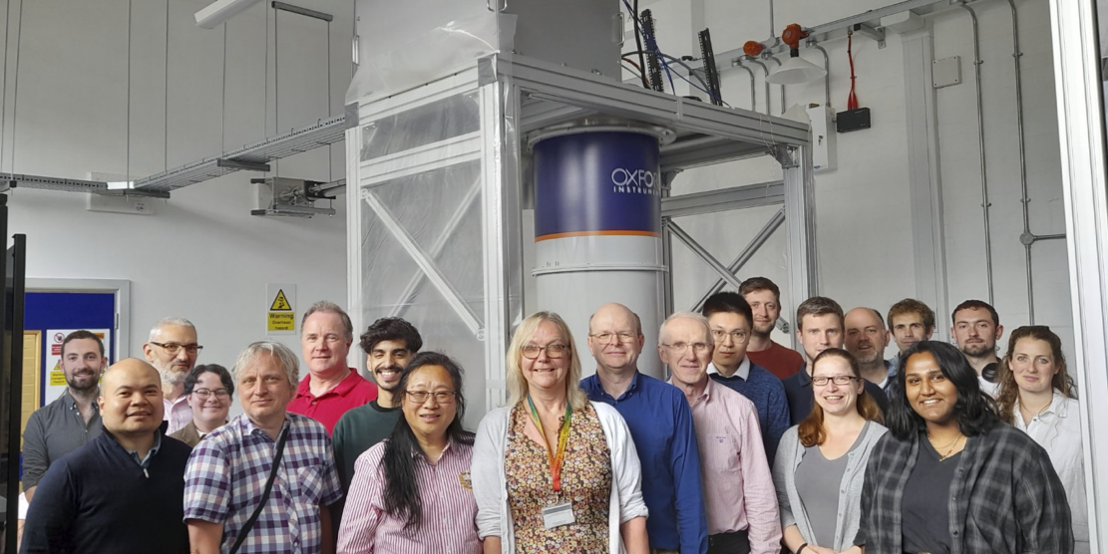
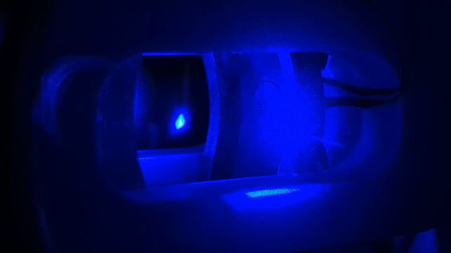
Science highlights I: quantum sensors for particle physics
AION
QSHS
QTNM
QSNET
Built the world's first prototype differential clock atom interferometer for fundamental physics, opening a path towards future atom-interferometer observatories for gravitational waves and dark matter
Nature 654, 622–628 (2026)
Established a UK axion dark matter search and built a strong partnership with ADMX, using quantum-limited microwave technologies to search for hidden-sector dark matter
Developing quantum-enabled technologies that could finally determine the absolute neutrino mass, one of the outstanding questions in particle physics.
Realized the most accurate clock in Europe and is using networks of ultra-precise clocks to search for dark matter and variations in fundamental constants.
CONSORTIUM HIGHLIGHTS

Slide 7
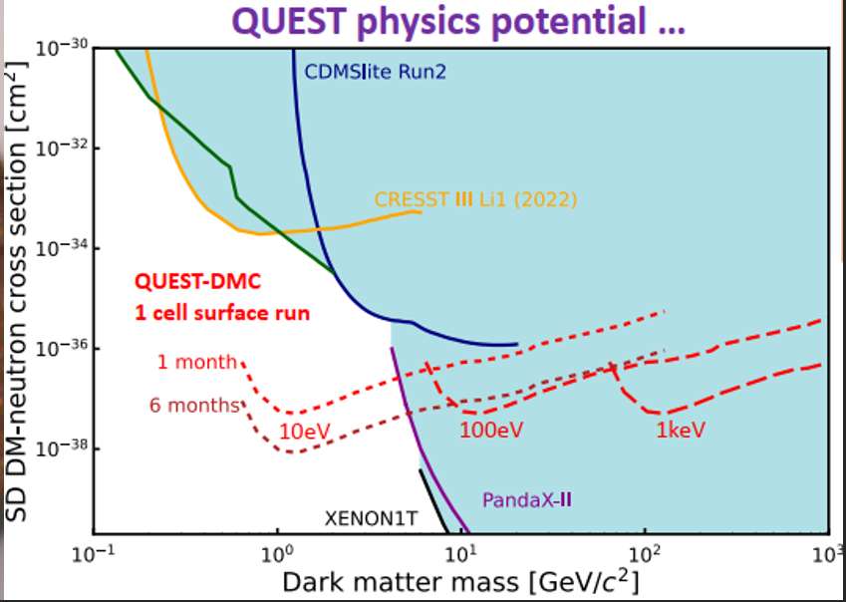
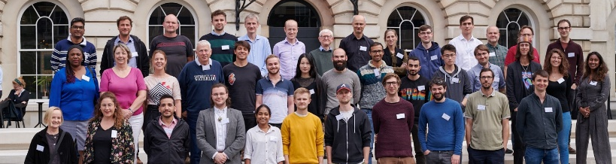
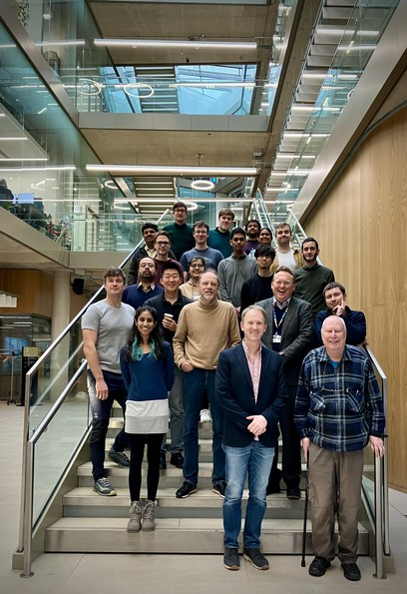
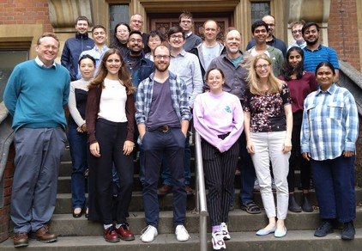
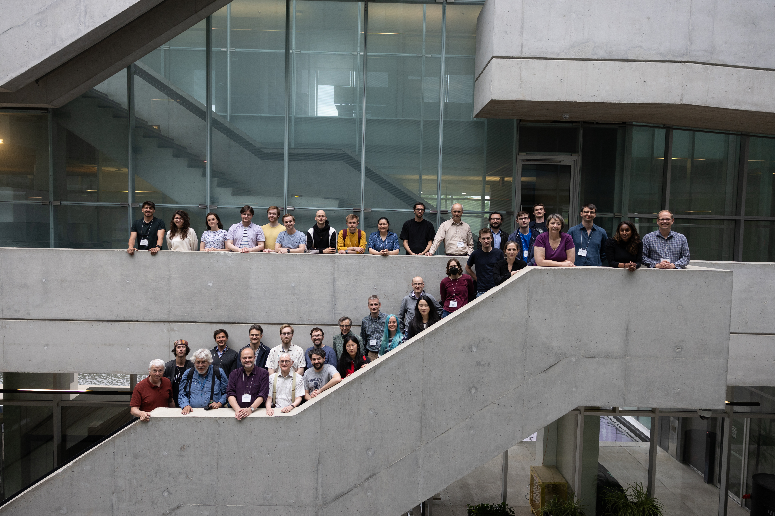
Science highlights II: quantum simulation and quantum-enhanced experiments
QSimFP
QI
QUEST-DMC
Demonstrated how quantum simulators can probe black holes, relativistic quantum fields and early-Universe physics that are otherwise inaccessible experimentally.
Nature volume 628, 6–70 (2024)
First limits on axion dark matter using a novel interferometric haloscope and world-leading table-top interferometers searching for dark matter and quantum gravity.
Nature 600, 424–428 (2021)
Delivered an operational helium-3 dark matter detector below 200 μK while also addressing the long-standing helium-3 nucleation mystery linked to cosmological phase transitions.
CONSORTIUM HIGHLIGHTS

Slide 8
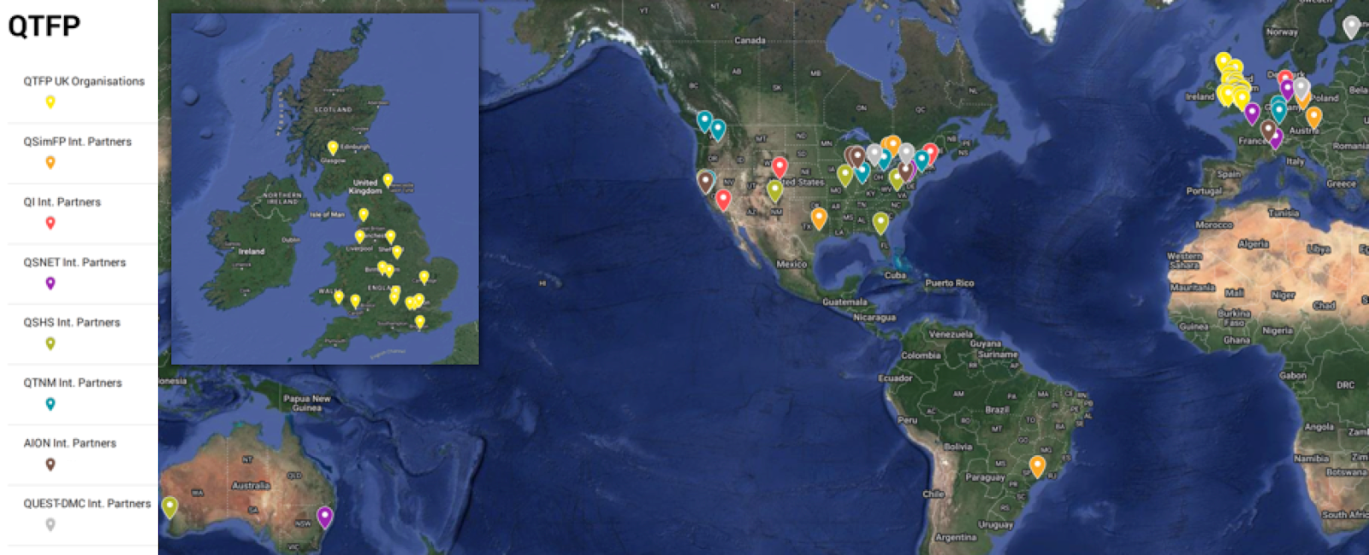
International reach: QTFP as a global connector
Flagship international partnerships
AION ⟷ MAGIS
QSHS ⟷ ADMX
QTNM ⟷ Project 8
QUEST-DMC ⟷ HERALD
Reach
76 international partnerships
26 active international links
9 countries
4 UK–US consortium agreements
Major facilities
CERN
Fermilab
SLAC
DESY

Slide 9
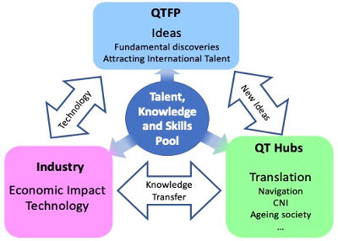
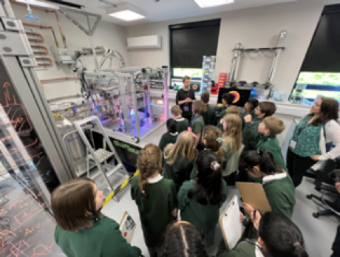

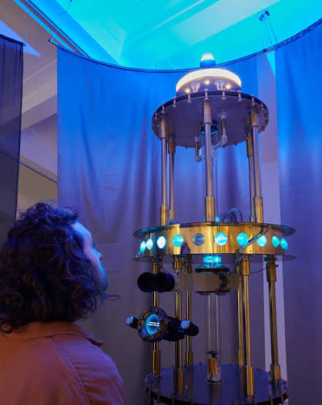
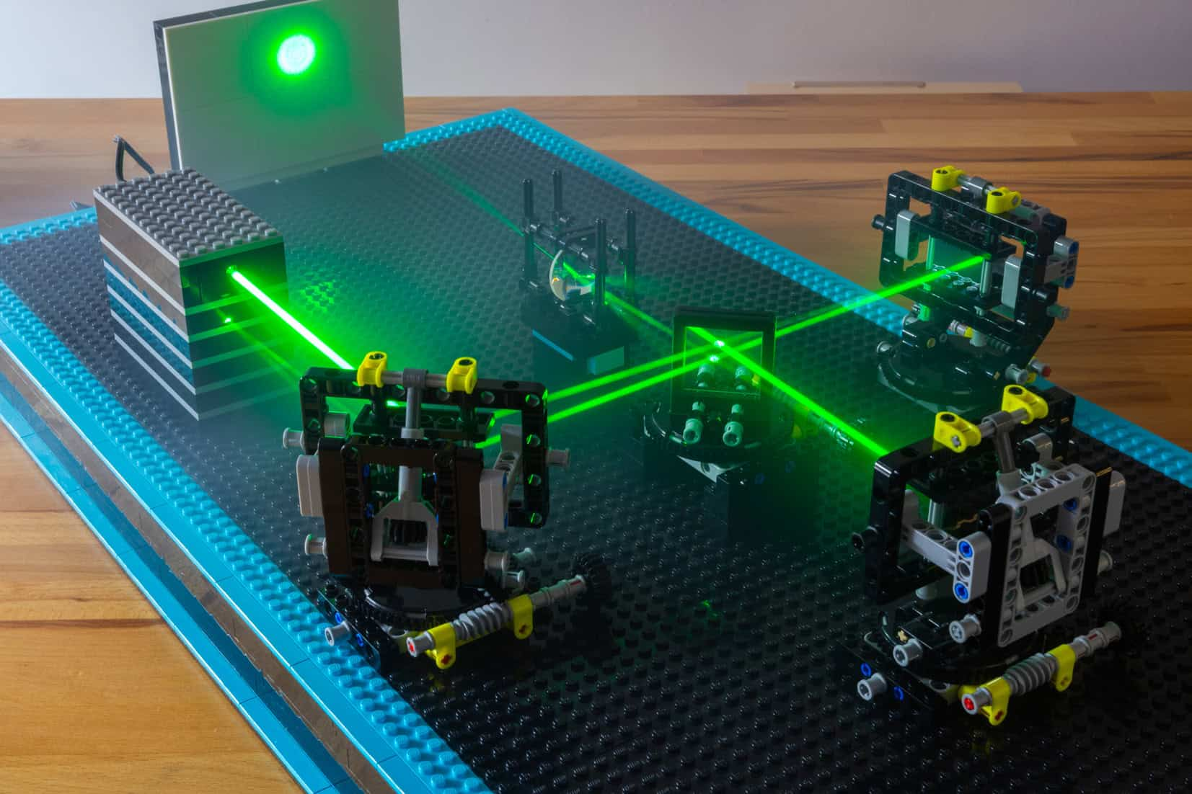
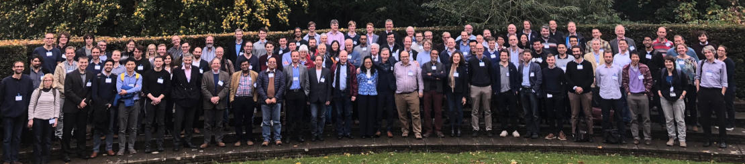
What has QTFP achieved?
QTFP Phase I (2021-2025) Science Review 2024
• High standard and transformational
• Industry connection ➔ quantum economy
• Clear evidence for world-leading results
• Cross-disciplinary Community building has been exemplary
• Did particularly well in attracting and training ECR
• Highly successful Engagement Program
Legacy of QTFP is the formation of a new world-leading interdisciplinary community

