Slide 1

ESPP a view from ECFA-UK
D. Bortoletto
*community feedback via RECFA delegates and National Contacts

Slide 2
ECFA UK
Restricted ECFA: one member per country, appointed for at most two three-year periods, who acts as the communication channel to each participating country, its physics community and national institutes and authorities.
  D. Bortoletto
Plenary ECFA: ECFA appoints members for a total maximum period of six years after nomination by their country. While the members should be able to represent the views of the high-energy physics community of their country, they are members of Plenary ECFA as individuals. Plenary ECFA normally holds two meetings per year. Meetings are public unless otherwise decided.
  Daniela Bortoletto, Joel Goldstein, Haroon Rafique, Aidan Robson, Michael Spannowsky, Williams, Matthew Wing + labs directors (Sinead Farrington, Peter McIntosh)
ECFA ECR Panel: Estifa’a Zaid, Harriet Watson, Aidan Wiederhold, Alison Elliot (RAL), Ben Hounsel (Daresbury)

Slide 3
ECFA and ESPP
Latest PECFA meeting in Amsterdam focused on the FCC and ESPP (https://indico.cern.ch/event/1567686/timetable/?view=standard)
Afternoon session on Thursday devoted to FCC reports:
  FCC status by Frank Zimmerman
  FCC PED: From the Strategy Update to the project approval (and beyond) by Patrick Janot
Morning session on Friday devoted to a review of the ESPP
  Presentation of ESPP highlights by K. Jakobs
  Status of CERN and plans in the post-ESPP era by M. Thomson
  Accelerator R&D roadmap in the post-ESPP era by M. Seidel
ECFA meetings used as a checkpoint for reviewing the DRD collaborations in light of the ESPP update.
  This PECFA meeting:
    ECFA Detector Panel Report by Giuliana Rizzo
    4 DRDs (1, 3, 4 and 6), as directly linked to FCC-ee and with three of them providing updates to the DRDC in November
  November PECFA meeting at CERN (19–20 November) — 4 others (DRDs 2, 5, 7 and 8)
Notes:
The PECFA meeting naturally divided into three themes: first, the FCC programme; second, the implementation of the Strategy update; and third, what this means for the detector R&D collaborations. I'll follow the same structure.

Slide 4

The path is set…
Council gives CERN a mandate to prepare FCC-ee for a 2028 decision
Council resolution on European Strategy invites the CERN management:
(20) to use the Strategy update as input for its Medium-Term Plan and the ongoing studies towards the FCC-ee as the possible next flagship project at CERN;
(21) to initiate discussions with the relevant authorities and entities in the Member and Associate Member States, as well as non-Member States and the European Union, with a view to obtaining pledges of additional cash and/or in-kind contributions to the cost of constructing and operating the FCC-ee, and, on this basis, to develop a financially feasible funding plan for the possible FCC-ee project;
(22) to provide annual reports on the implementation of the Strategy update and the necessary information to support national decision-making processes; and
(23) to make every effort to ensure that the Council is in a position by 2028 to take a decision on the FCC-ee, taking into account elements such as the scientific, technical and financial feasibility of the project.
This clear mandate from CERN Council is a major step forward
Mark Thomson
Notes:
"The most important outcome is that CERN Council has now given management a clear mandate. The emphasis is no longer on whether FCC should be studied, but on preparing the information needed for a project decision around 2028."

Slide 5
Draft FCC Timeline – TBC
Planned FCC Phases:
2026-2028: Reference Design Phase (previously referred to as pre-TDR Phase)
2029-2033: Technical Design Phase
2033- : Project Implementation
Draft proposed “Council-level” Milestones
Mar 2026: discussion of Reference Design Phase scope and deliverables
Jun 2026: Council approval of the FCC-ee Reference Design Phase
Sep 2026: input from Council on requirements for project approval
Dec 2026: decision in Council on the main features of the funding model
Mar 2027: decision on FCC governance model – following a discussion at a Council Retreat
Jun 2028: final review of Reference Design Phase
after June 2028: ready for a decision on FCC-ee
24 months
Mark Thomson
Notes:
"This timeline shows that the next two years are devoted to the Reference Design Phase. The Council milestones are already mapped out, with governance and funding discussions beginning immediately."

Slide 6
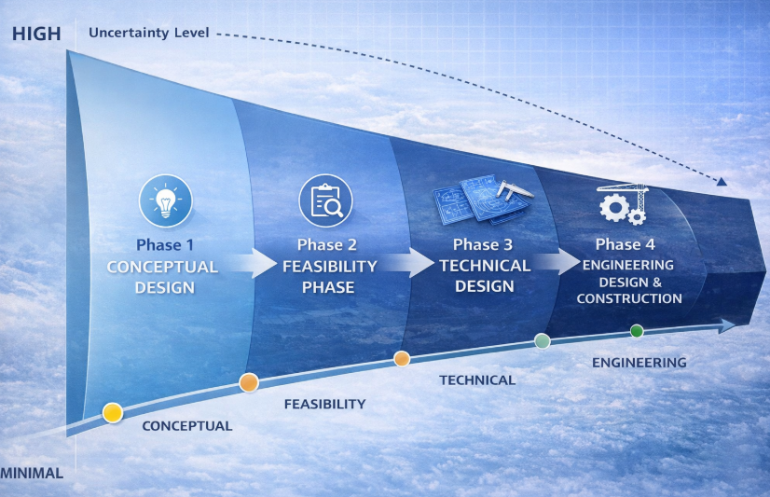
From Feasibility Study to Project Realisation
Following positive results of Feasibility Study and European Strategy process, FCC moves towards technical design
Expertise across CERN and from collaboration partners required to deliver integrated technical design, with cost estimate and schedule, bearing in mind project authorisation processes, societal acceptance, & procurement strategy
2026-2028 Reference Design Phase
2029-2032 Technical Design Phase
REFERENCE
Aiming for project decision by CERN Council after the Reference Design Phase
Frank Zimmerman
Notes:
"This illustrates the transition from feasibility to project realisation. The challenge now is producing an integrated technical design with credible cost, schedule and risk estimates."

Slide 7
Reference Design Phase (RDP) objectives
Increase maturity of technical design (incl. recommendations from feasibility study reviews)
Overall project integration and requirements on civil engineering sufficiently detailed to enable subsequent launch of civil engineering tender design in case of project approval
Overall project design sufficiently detailed to allow advancing with environmental impact assessment as core part of project authorisation processes in Host States
Reducing project risks via:
  Integrated planning across all domains and interface management
  Prototyping of critical systems
  Build up cost / performance contingency by design optimization
  Civil engineering refinement
  Close coordination with Host States on territorial implementation aspects
  Reinforcing collaboration as basis for global support for the project
Reference Design Phase aims to reduce technical and project risk
Frank Zimmerman
Notes:
The Reference Design Phase is essentially about reducing uncertainty.”
technical maturity, ntegration, risk reduction

Slide 8
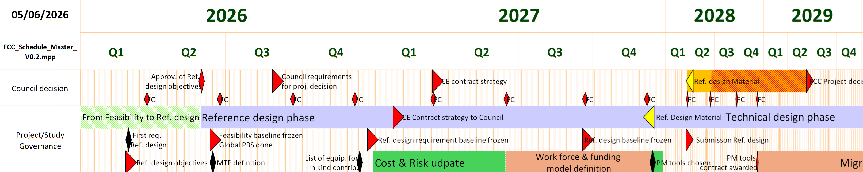
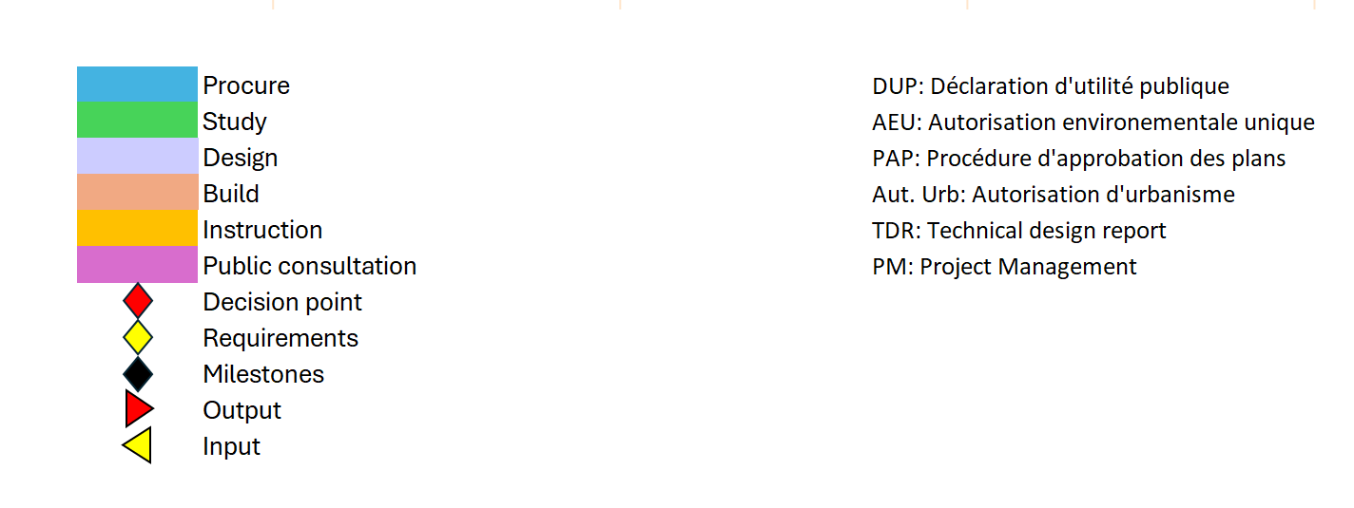
Deliverables and Schedule for RDP 2026-2028
Reference Design Documentation by Q1 2028 to enable CERN Council decision on project realisation:
Integrated technical baseline
Resource-loaded project master schedule
Updated cost estimate with uncertainty
Project-wide risk register
Procurement strategy (incl. in-kind contribution opportunities)
Frank Zimmerman
Notes:
"By early 2028 the collaboration aims to deliver a complete technical package: design baseline, project schedule, cost estimate, risk register and procurement strategy."

Slide 9

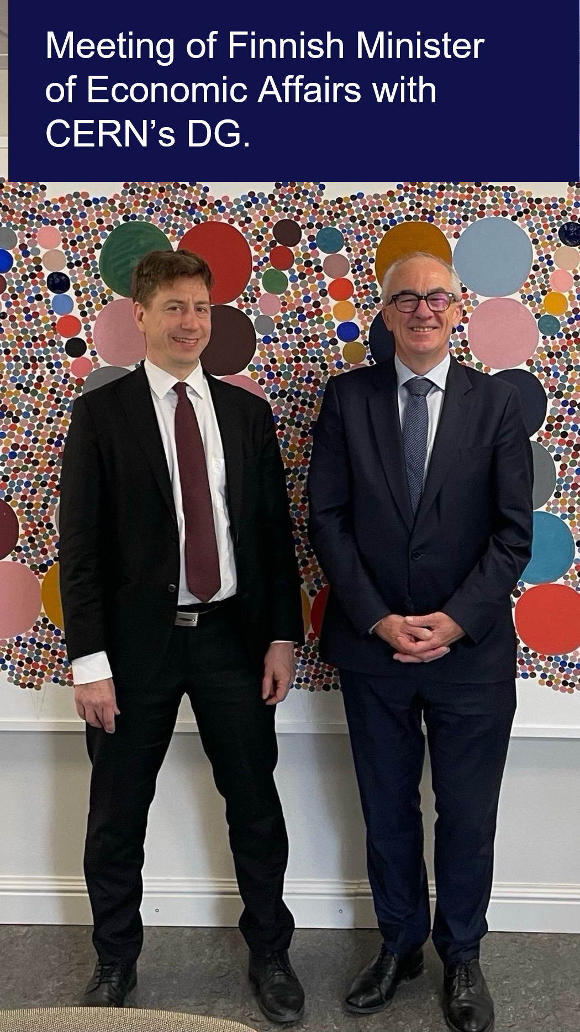
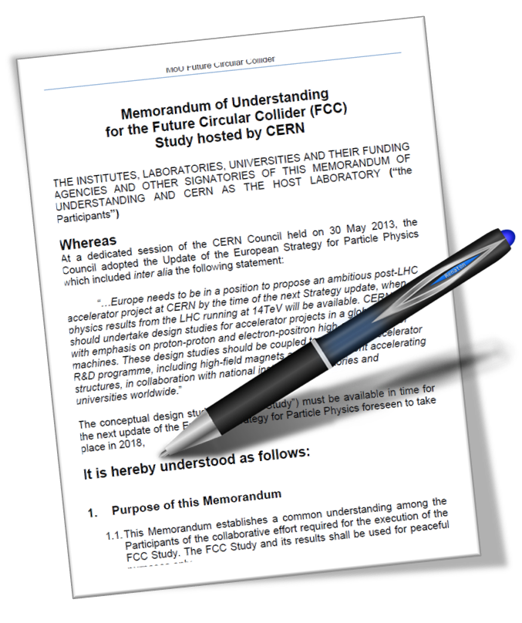
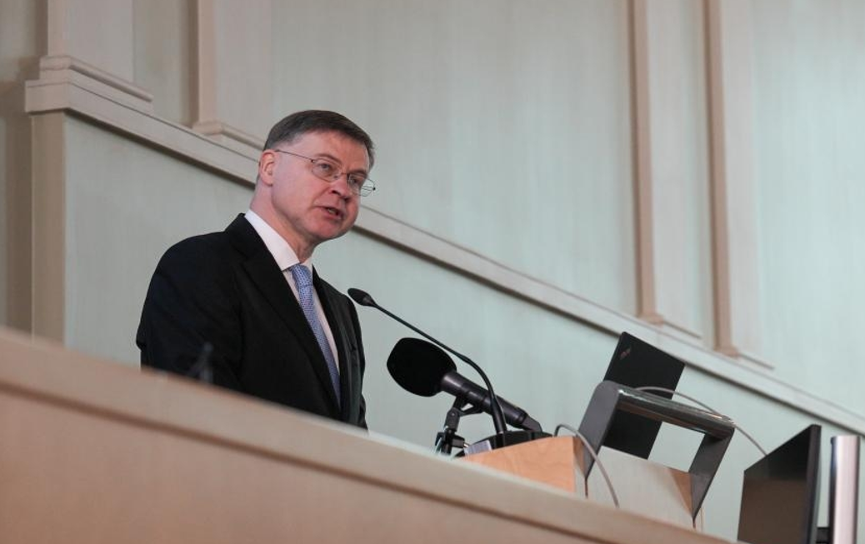
FCC collaboration framework
A consortium of partners based on a
Memorandum Of Understanding (MoU)
Working together on a
best effort basis
Incremental & open to
academia and industry
Individual projects defined in specific addenda
Last FCC collaboration meeting: FCC Week 2026 in Helsinki, Finland, with 66 public sessions, 265 oral presentations, 47 posters, 656 registered participants
Valdis Dombrovskis: European Commissioner for Economy & Productivity, Implementation & Simplification
Frank Zimmerman
Notes:
The collaboration is also expanding internationally. FCC Week showed strong community engagement, and the collaboration framework is designed to remain open to new partners from academia and industry."

Slide 10
PED Objectives during the RDP
The PED highest priorities therefore become quite concrete
  Consolidation of the interaction region layout, detector integration, and beam-induced
  Background mitigation
  Optimised procedures for √s calibration and for effective operation at √s = 125 GeV
  Finalising the common software/analysis framework and developing a common computing architecture
  Realistic implementation of algorithms to control the experimental systematic uncertainties for
  the most demanding measurements, and consolidation of the pertaining requirements on detectors, collider, and theory
  Engagement of the theory community to address theory challenges and nurture the young generation
  Continue developing the high-energy physics international community
TODAY
  Proposals for staging implementation and for an improved staged/descoped FCC-ee
  Prepare to answer call for (at least 4) documented EoI’s for FCC-ee detector concepts by Q1/Q2 2028
Patrick Janot
Notes:
For the Physics Experiment Detector programme, priorities become much more concrete: detector integration, beam backgrounds, software, computing, systematic uncertainties and preparation of detector concepts."

Slide 11
Detector concepts
Already six detector concepts under study – they are not experiment collaborations
  Two new concepts, ALFA and AGORA, have been presented during the FCC Week in Helsinki
  A healthy situation at this point of the studies – more concepts are welcome
Detector concepts now need to mature into credible EOIs
Aim to produce (>= 6, then) documented detector EoI’s by Q1/Q2 2028
Patrick Janot
Notes:
Six detector concepts are already under study. These are not yet collaborations but concept studies. The goal is to mature these into documented Expressions of Interest by 2028."

Slide 12
Potential role ECFA
We suggest that ECFA organises a series of Evian-like workshops
  Maybe on the model of the three successful Higgs/EW/top factory workshops
  Starting immediately after the approval (Q2 2028)
This series of workshops would be intended to
  Provide a forum to working groups and to already forming proto-collaborations
  Discuss in depth experimental ideas between the various groups
  Review the different propositions
  Check the compliance to physics requirements
  Verify the compatibility with collider constraints
  Discover advantages, disadvantages, and maybe also similarities
  Encourage mergers towards four robust experiment LoI’s
  Form four collaborations no later than end 2029 - beginning 2030
Altogether, the announcement of such a clear plan from ECFA to the community
  Would be a strong incitement to generate the missing resources
  Would encourage a structured community building in line with the FCC-ee timeline
Patrick Janot
Notes:
Patrick Janot suggested ECFA could play an active role after project approval by organising workshops to help the community converge from multiple detector concepts towards a smaller number of mature collaborations.

Slide 13
DRD Strategic alignment with updated ESPP
ECGA Detector Panel (Rizzo)
Notes:
The detector R&D collaborations are expected to align their future programmes with the updated Strategy. This will be part of their re-approval process."

Slide 14
Further post-ESPP update actions
ECGA Detector Panel (Rizzo)
Notes:
Beyond individual DRDs, there is now greater emphasis on coordination across the detector R&D programme and implementation of the strategic recommendatio

Slide 15
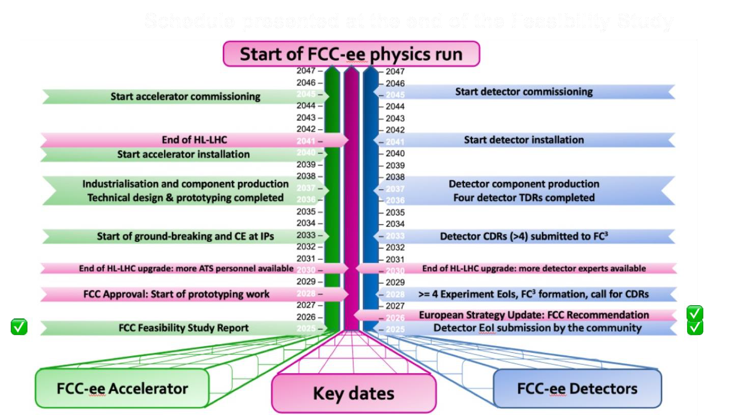
Conclusion
ESPP has provided a clear mandate
  FCC-ee enters the Reference Design Phase (2026–2028)
  Focus shifts from feasibility studies to project preparation
The next two years are critical
  Mature the technical design
  Develop realistic cost, schedule and governance
  Build international commitments
Detector community must respond
  DRDs should align R&D priorities with FCC-ee
  Detector concepts should evolve into strong Expressions of Interest by 2028
  Community organisation is becoming as important as technology
Role of ECFA
  Coordinate the European detector community
  Support convergence towards viable detector collaborations
  Provide checkpoints on progress towards FCC-ee
Notes:
Overall, the tone of the meeting was noticeably different from previous years. The Strategy update has established FCC-ee as the reference project, and attention has shifted towards implementation. Over the next two years the priorities are clear: mature the technical design, establish realistic project plans, align detector R&D with the strategy, and organise the detector community so that it is ready for the 2028 Council decision."

