Slide 1



PPD report
Sinéad Farrington
(Particle Physics Department, Rutherford Lab
& University of Edinburgh)
15th July 2026
Notes:
The abstract pattern can be removed or repositioned if required. Be careful to ‘Send to Back’ so that it does not obscure any important information.

Slide 2
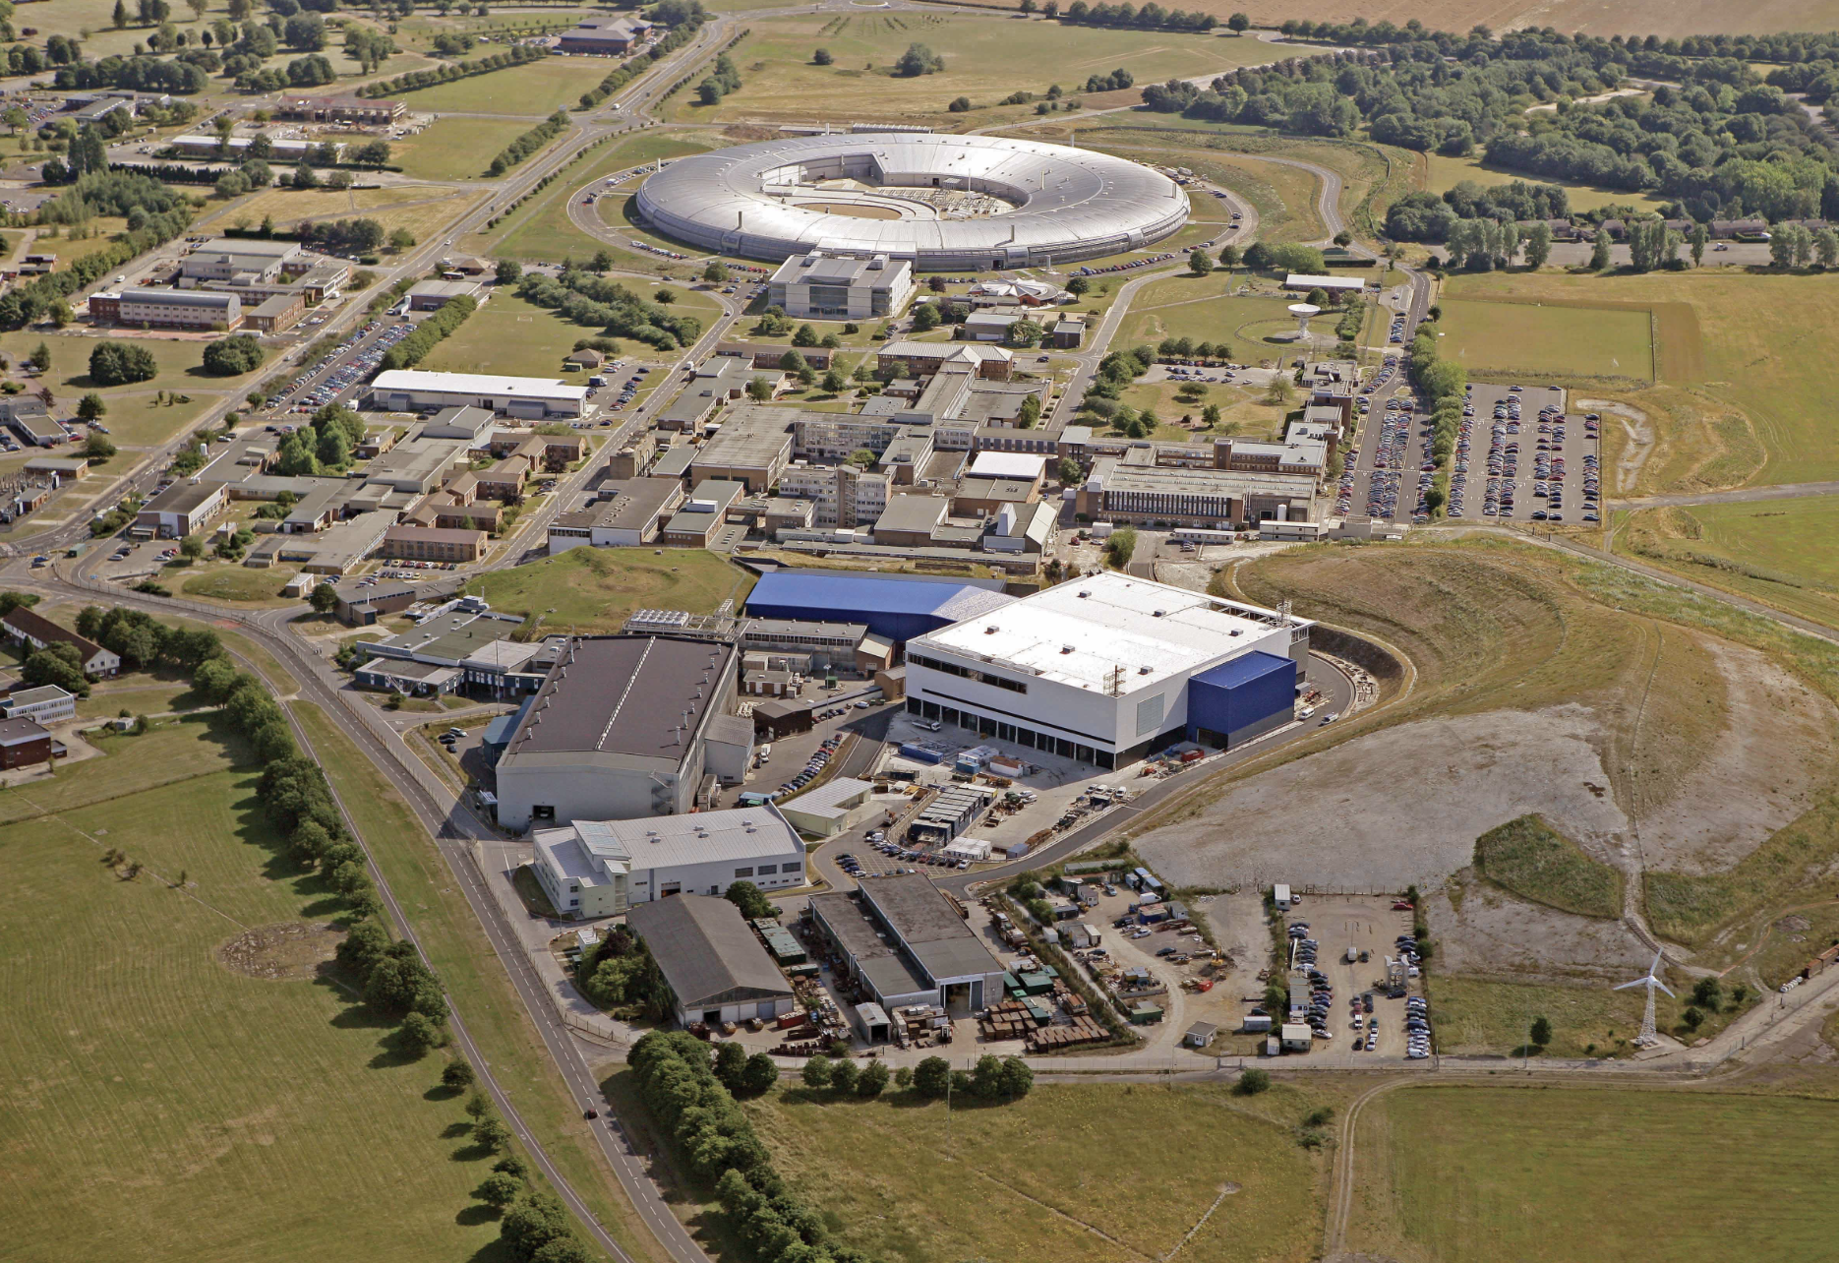
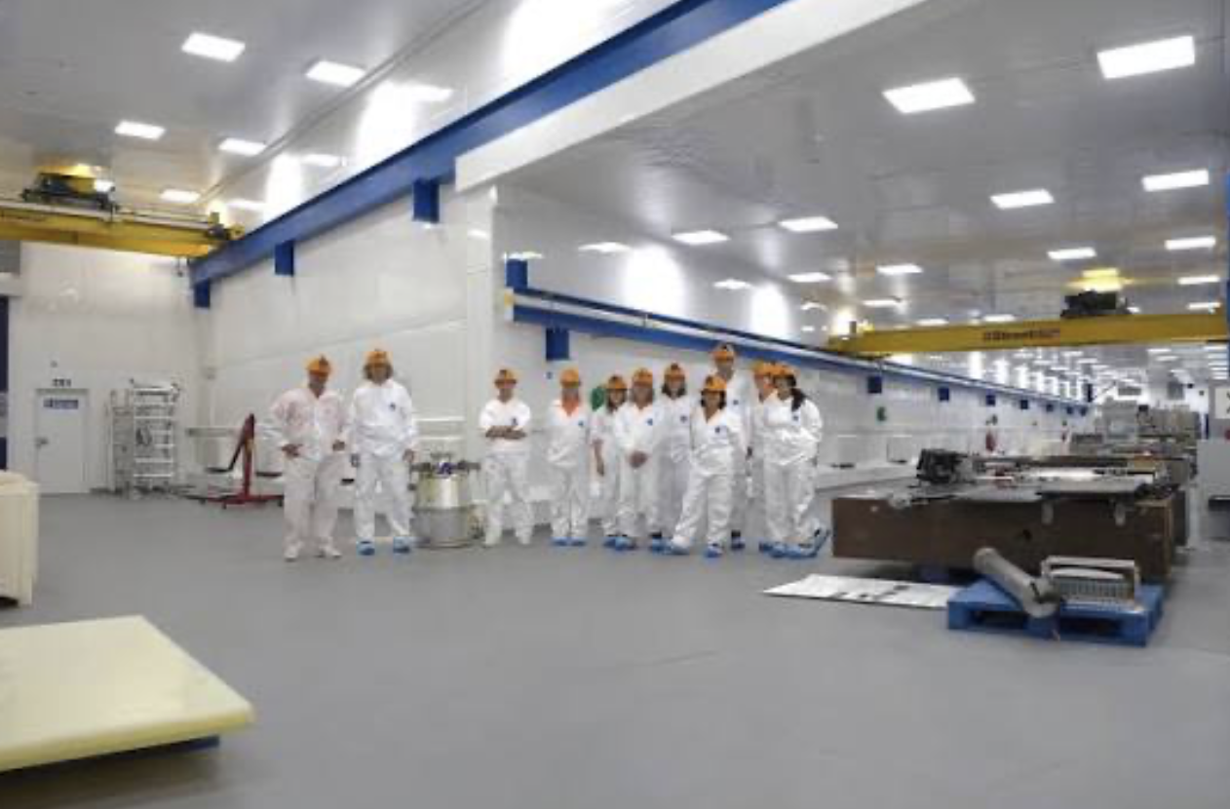
Particle Physics Department (PPD)
The UK’s national lab for particle physics
RAL + Boulby sites
Separate talk tomorrow on Boulby (Sean Paling) – so will focus on the RAL site PPD activities today (including CERN-based staff)

Slide 3
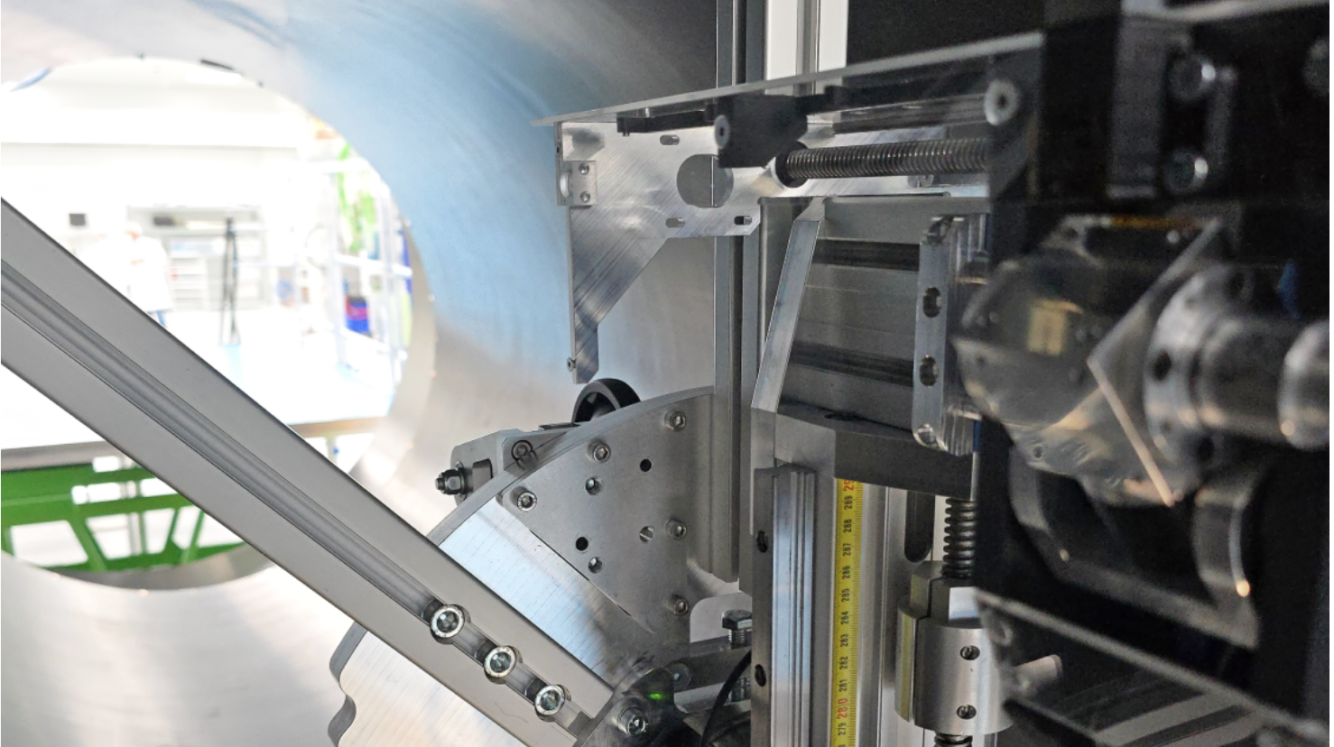
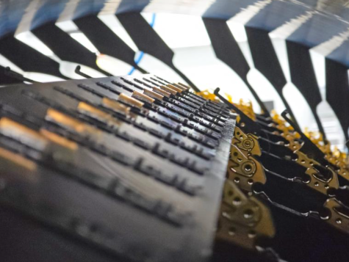
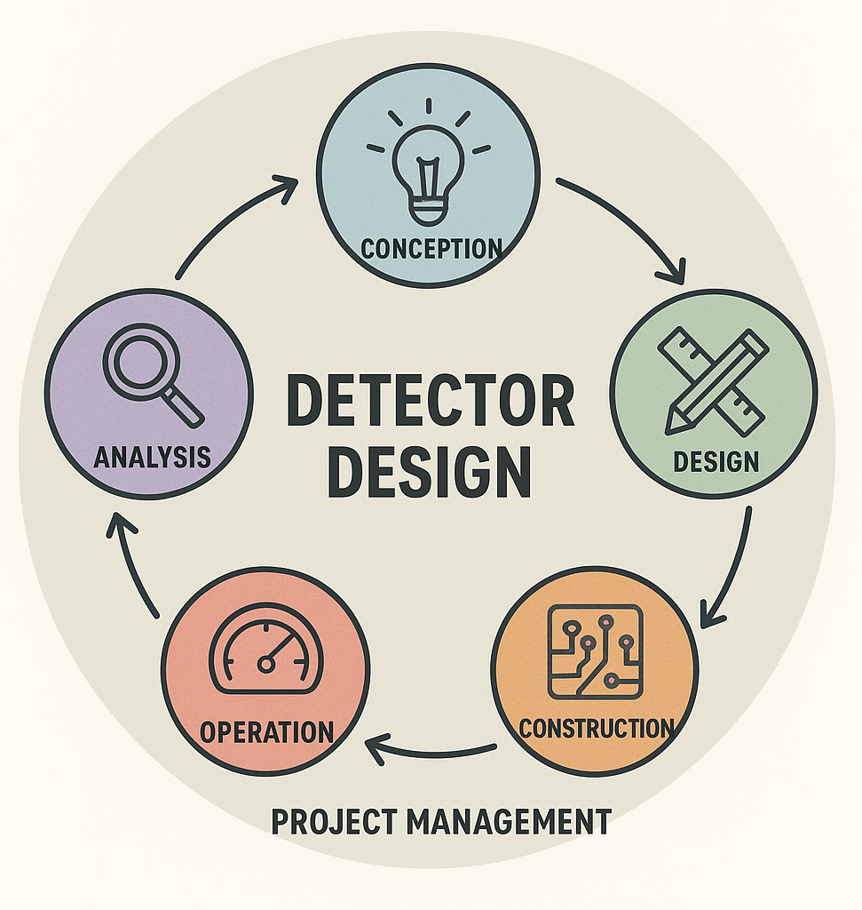
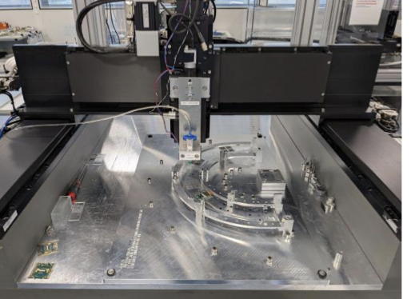
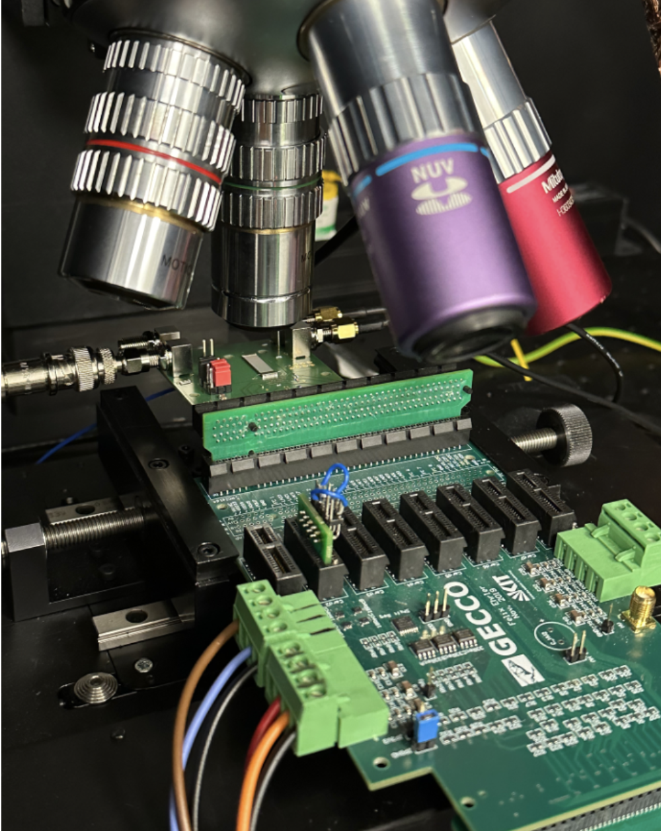
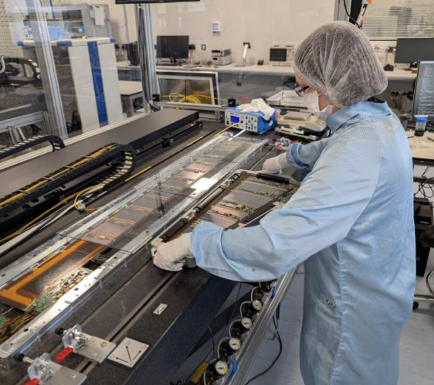
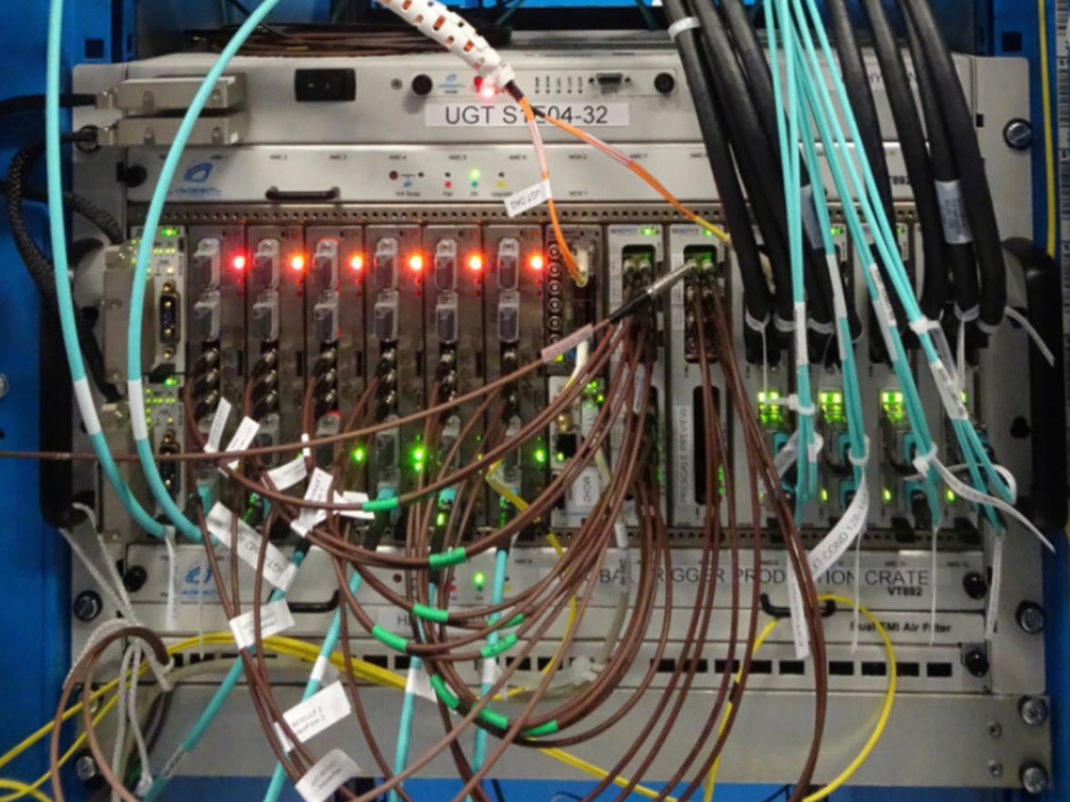
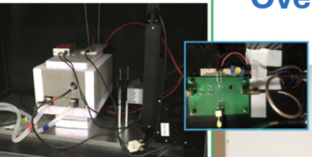
PPD
Current projects
LHC
ATLAS – ITk, HLT, L1 Trigger
CMS – L1 Trigger, ECAL, HLT
LHCb – RICH, Mighty Tracker
+UK universities

Slide 4
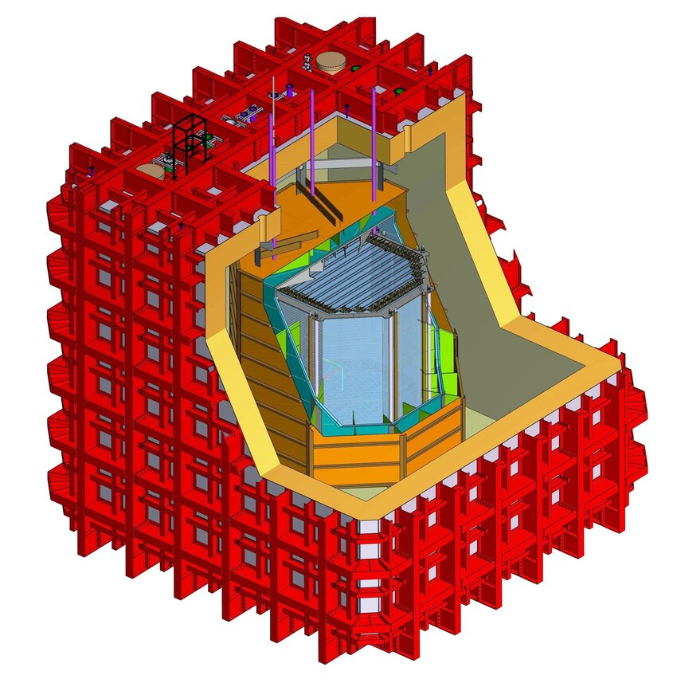
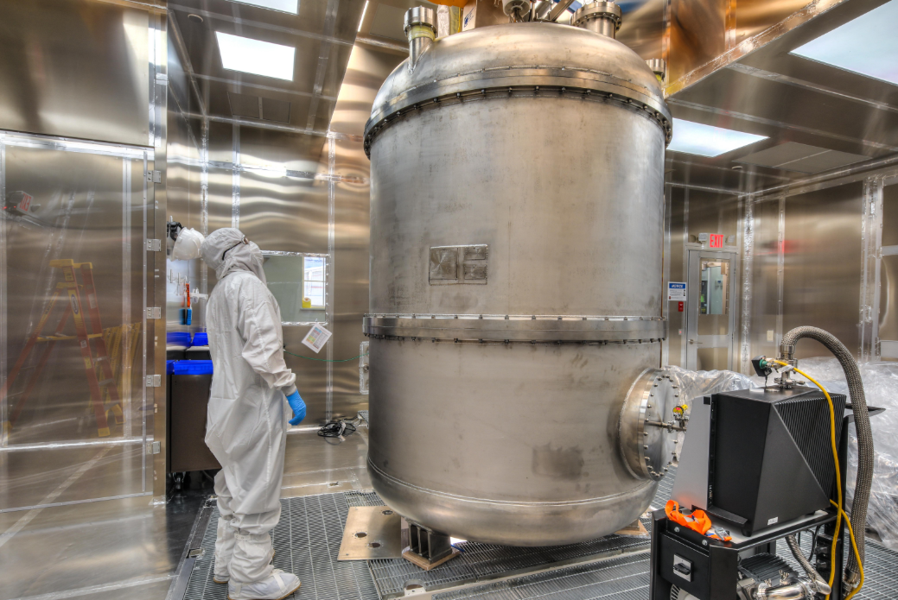
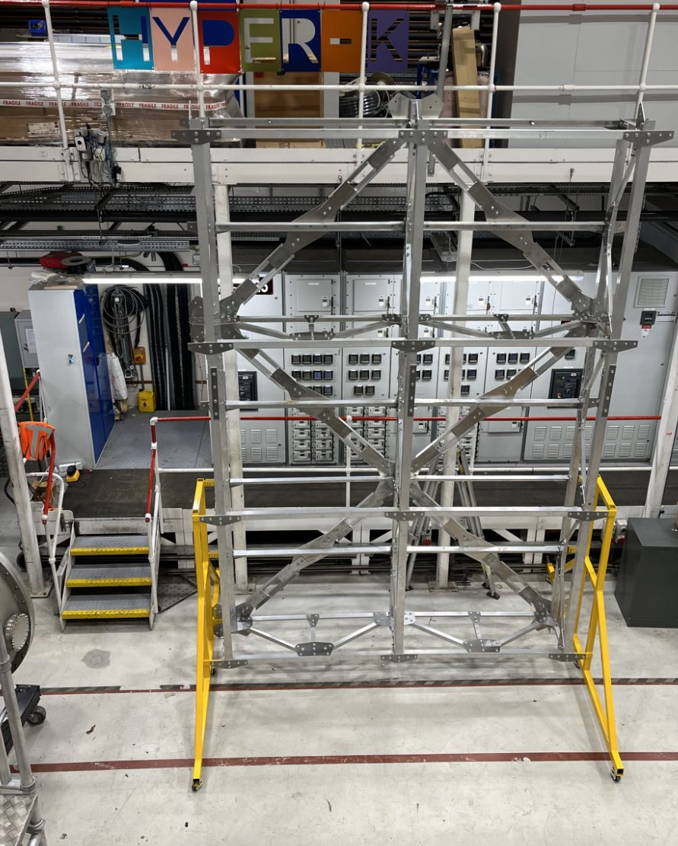
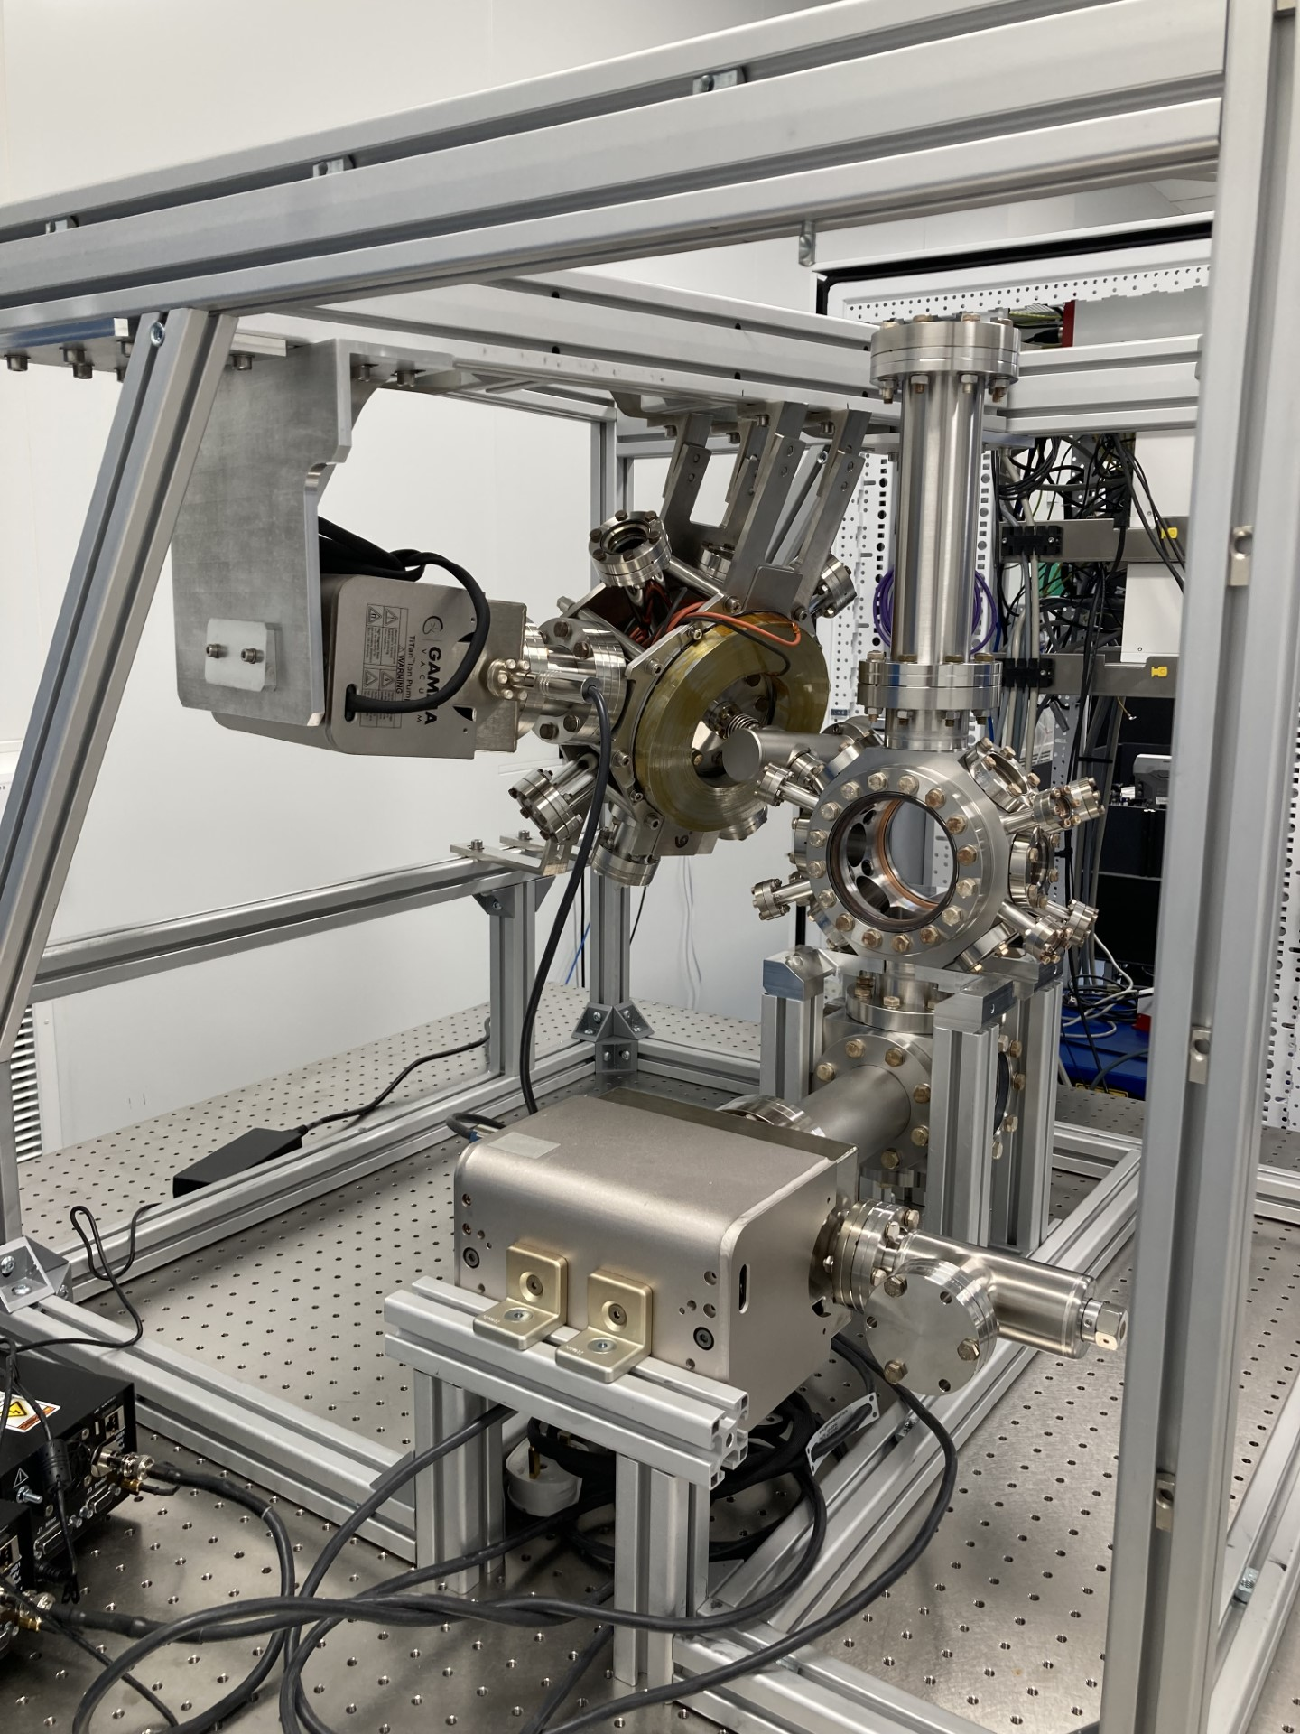
PPD
Current projects:
Neutrino physics
T2K, Hyper-K
DUNE
Dark matter/
Quantum
LZ, XLZD
DarkSide-20k
QUEST-DMC
AION (nature paper!)
MIGDAL
NQCC collaboration
DarkSide-20k SiPM

Slide 5

Computing & Engineering provision
Large-scale computing – with Scientific Computing Centre (SCD)
Worldwide LHC Computing Grid Tier-1 Centre - part of GridPP
Tier-2 facility – part of GridPP
Technology Department
Electronic + mechanical engineering
ASICs and sensors
Joined-up TRL pipeline for particle physics

Slide 6
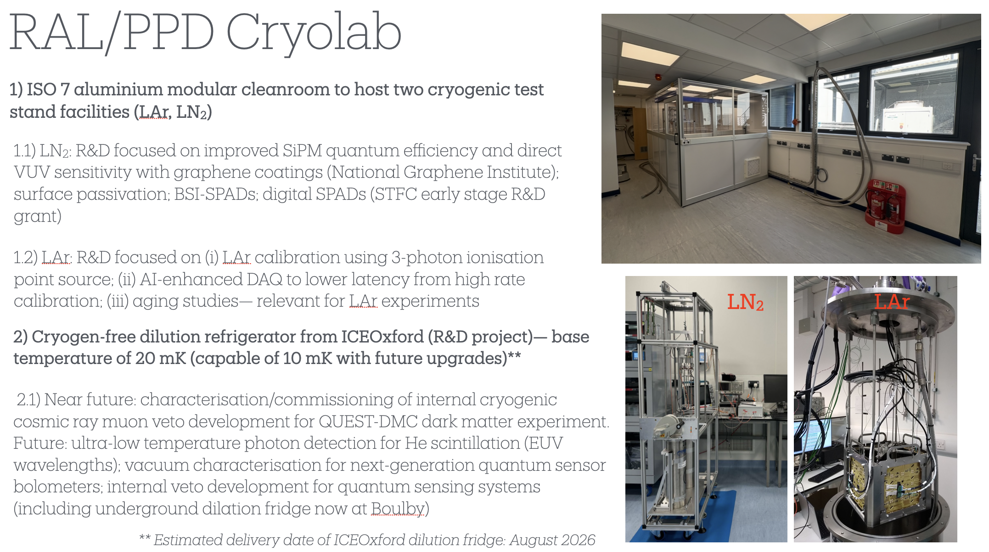

Slide 7

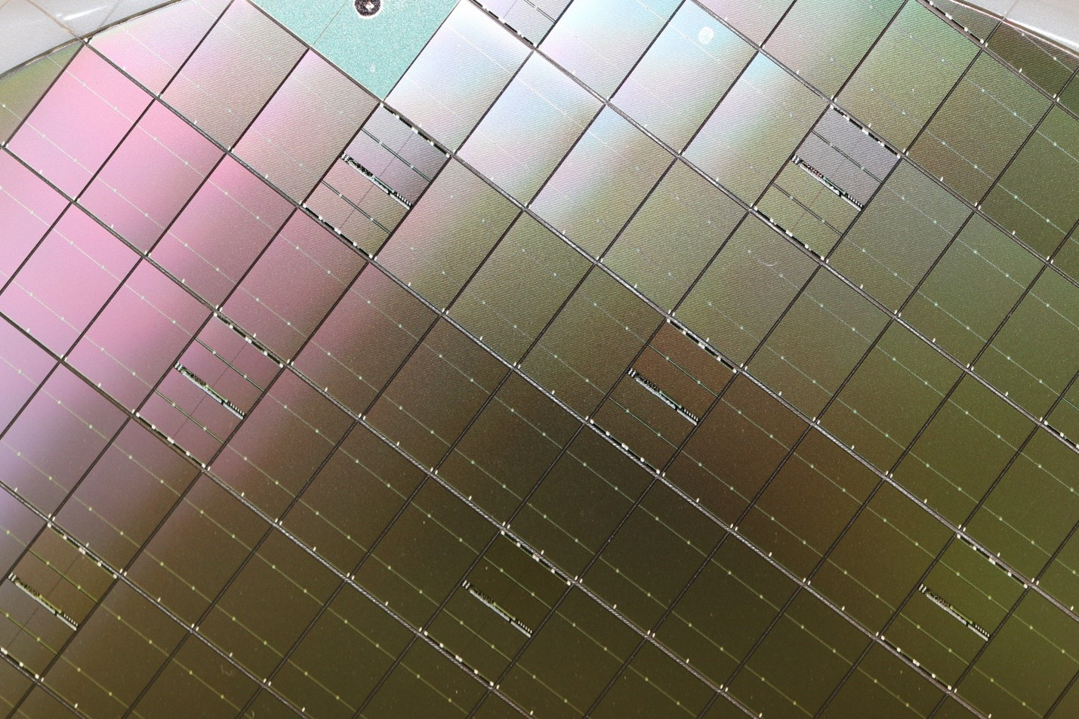
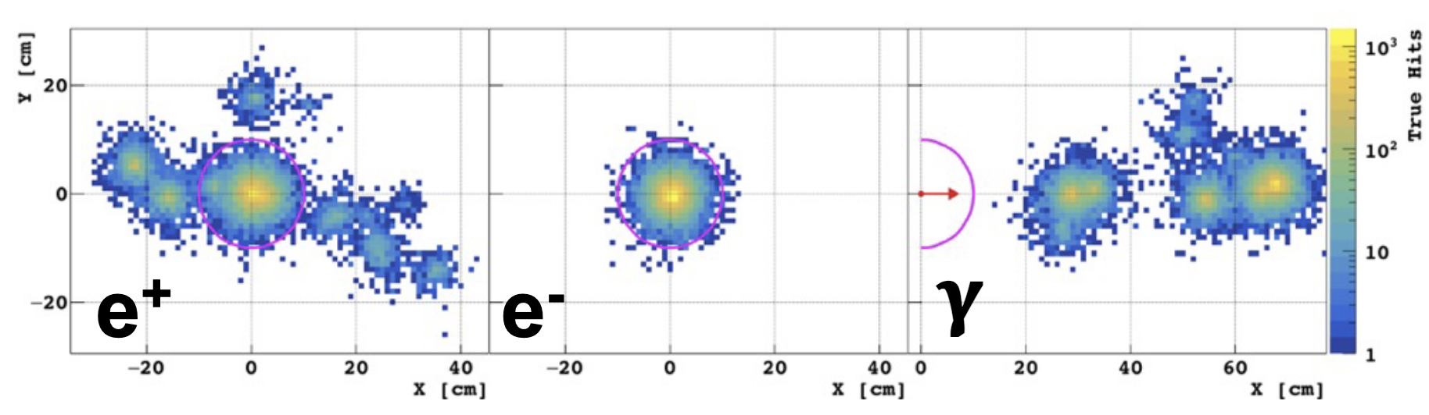
R&D
Detectors, computing, software, accelerator applications – small opportunistic resource
DRD engagement from PPD and TD (Technology department): semiconductors; TDAQ, liquid/gaseous etc
  Scarce resouce for R&D (after upgrade construction it can increase), with a focus on construction projects
  Highly skilled people (PPD/TD)
  Example: collaboration with TRIUMF on SiPM characterisation; with Sussex on LiquidO
GaN with a view to future use as detector material and readout, given our investigations into use for HV switches and finding them to be extremely rad-hard and temperature insensitive
  LGAD industrial production; 28nm frontend chips
2 MeV

Slide 8
Future Collider & other future experiments
Placed to understand link to Industrial Strategy (IS8) activities – engage with “growth mission”
  AI, quantum, semiconductor, clean energy groups within STFC – PPD members
    Represent national capabilities; have insisted on community representation
  Pursue multiple technologies
      With possible further narrowing of choices when it becomes clear which are best aligned with future UK experiment commitments and bucket 2/3 opportunities – think about co-fund
Vital now to define what we plan: UK roadmap for upgrades / M&O / future collider / future DM / quantum sensors etc given updated constraints
Ensure we maintain capability in the labs and in the universities for contributions commensurate with our European/world standing
  Planning of which workforce we need within the labs
  Avoid assuming underpinning technology capability will be available without planning

Slide 9
Lab to community
Have greatly valued visits to groups since I started in the role 2 years ago - wish to continue fine tradition of valuing and upholding community cohesion and co-operation, and looking for new ways to collaborate

Slide 10
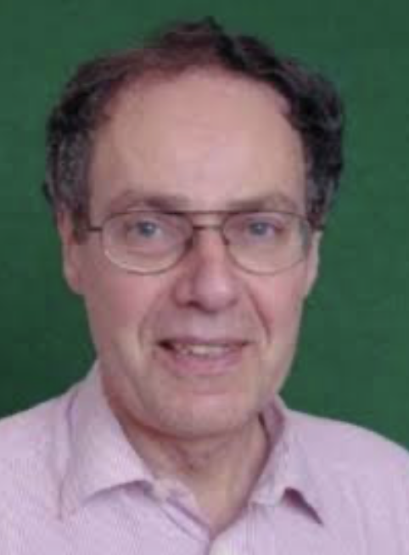
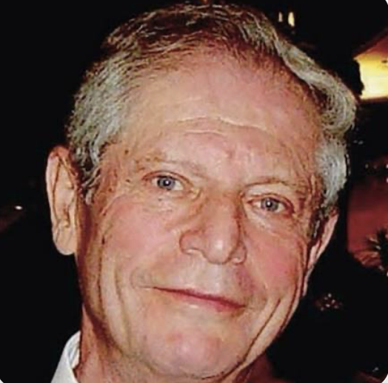
Have greatly valued visits to groups since I started in the role 2 years ago - wish to continue fine tradition of valuing and upholding community cohesion and co-operation and looking for new ways to collaborate
  Remembering fondly two former directors:
  George Kalmus and Norman McCubbin

Slide 11
Enabling functions
Have greatly valued visits to groups since I started in the role 2 years ago - wish to continue fine tradition of valuing community cohesion and co-operation and looking for new ways to collaborate
UKLO
  Insurance
Access agreements e.g. SURF and Fermilab
Project Office
Procurement, logistics
Travel budgets, project capital purchases
PPUAC, PI forum, UK HEP forum
… new functions: equipment list and outreach equipment list; skills pool; open way to propose visits
New website – with long overdue function of seeing who is who – to propose joint projects/students etc

Slide 12

Lab Directors Group (LDG) activities
European large lab directors group
  RAL (Sinead, PPD Director); Daresbury (Peter McIntosh, AsTeC director)
  Survey non-collider latent capabilities – equipment, people and propose experiments/grant proposals
    Underway now, with reps from most large labs, Maurits van der Grinten from RAL
  Get insights on how “bucket 2” is being done elsewhere
  Hosting LDG meeting (usually closed) at Coseners House in October
  A dominant activity of the LDG is the accelerator roadmap, to which many vital UK contributions come from AsTeC, CLF, ISIS, John Adams Institute and Cockroft Institute
Sinead and Jim Clarke (Peter’s predecessor) ex officio members of European Strategy Group and of P-ECFA
SF on DRD Committee as link between DRD/LDG
Jens Dopke on ECFA detector panel

Slide 13
Backdrop
Last week:
20% cut (~1.1M) to PPD* (excl. Boulby) baseline/core (+ project impacts unknown within 10% scenario)
  Hiring freeze for past two years, excellent new people through fellowship funding – new quantum sensing capabilities; exotics convenor at ATLAS…
  40% cut to Boulby operations budget
5.5M cut to technology and instrument development (not including projects)
10M cut to computing (not including projects)
8M cut to accelerators (not including projects)
Facilities 15%; Hartree and RAL space no core funding
*same as ATC

Slide 14
Backdrop
Substantial challenge to deliver current project commitments, and future underpinning capabilities from PPD and other departments
  PPD (including Boulby) mitigate as best as possible
    Keep working towards bucket 2/3 - and continue working to spell out ways we fill the pipeline with technology for transfer
    Build on new directions with National Quantum Computing Centre
    External funding
    Commercial (so far equipment usage)
  Maintain core function – national lab for particle physics
  The labs have strong skills and are part of a strong community

Slide 15
extras

Slide 16
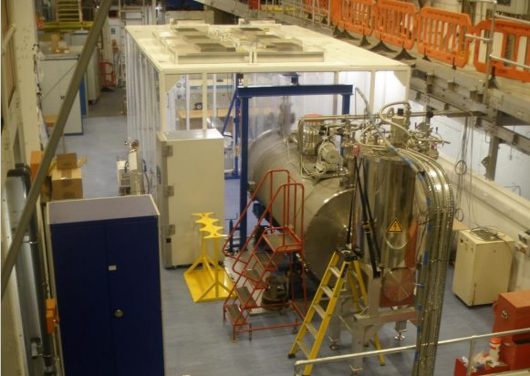
What we do
Facilities
Cold Radon Emanation Facility (CREF)
Boulby Underground Germanium Screening (BUGS)
Total owned lab space near 500m^2, including a small workshop, computing infrastructure, cleanroom, dark lab
Another ~450m^2 of cleanroom operated through TD, providing for all kinds of electronics assembly and testing
Dilution fridge being installed at Boulby
Equipment
Laser equipment for LGAD testing, currently measuring to less than 10ps jitter
X-ray irradiation facility for ASIC irradiation
Wafer probing facility
TCAD infrastructure (Compute with >128GB RAM) – complex 3D simulation capability
Climate chambers to large sizes (m^3)
Equipment to support all forms of electronics testing
…
Cold Radon Emanation Facility (CREF)

