Slide 1





Decision-making workflows in computational biology, using AI and classical statistical approaches
David McDonagh and Rob Nicholls
PPD Seminar 07/10/26

Slide 2
Contents
Brief Intro: Computational Biology & Imaging Theme in the STFC SCD
A Bayesian decision-theoretic framework for process optimisation – Rob Nicholls
- optimising individual software components
Diffraction processing workflows in macromolecular crystallography – David McDonagh
- optimising whole workflows
Disclaimer – these are work-in-progress

Slide 3
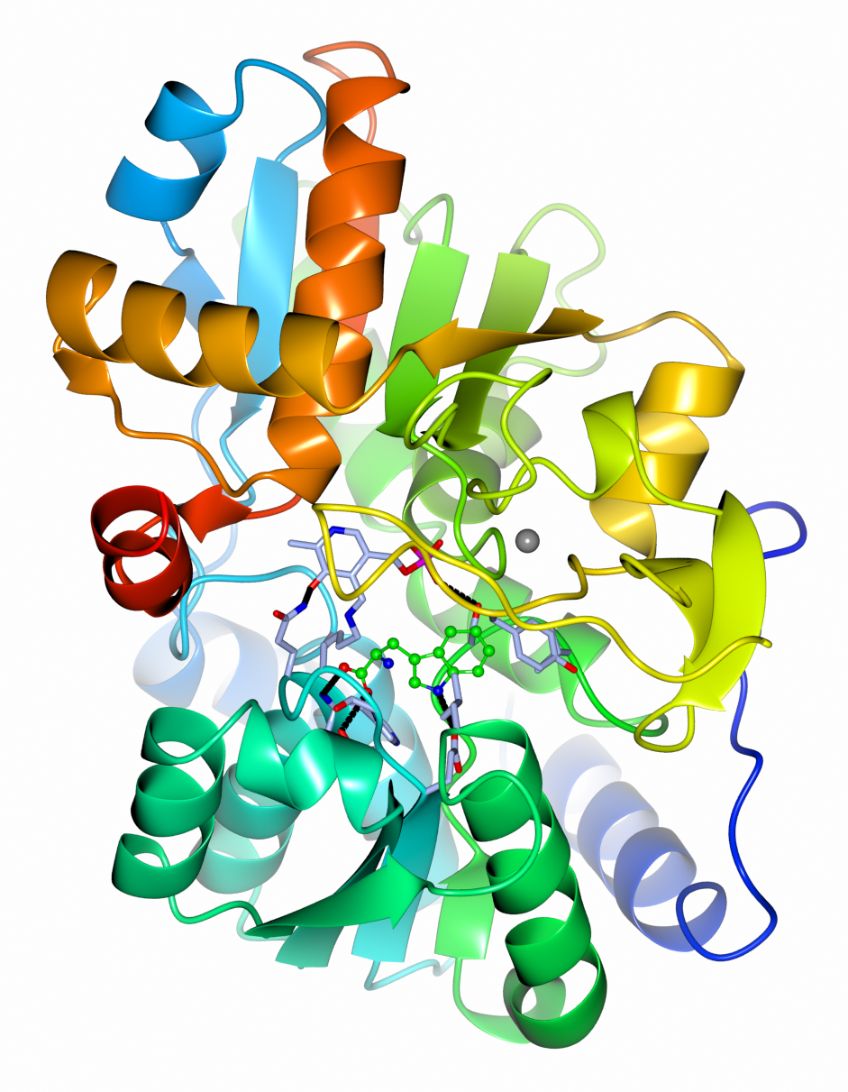
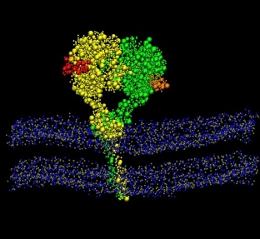
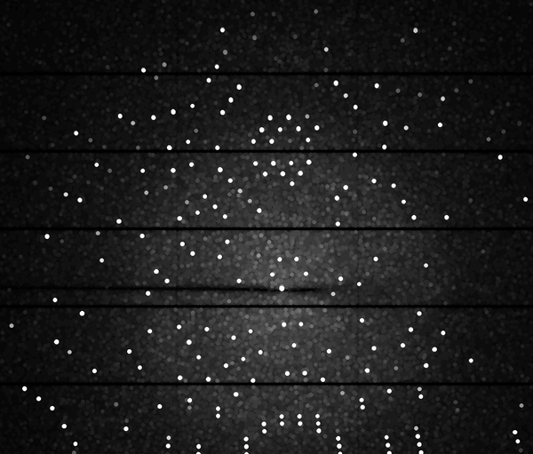



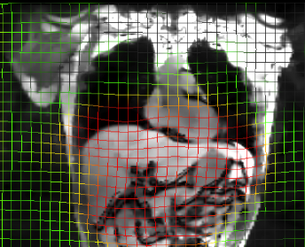

Computational Biology & Imaging Theme
Scientific Computing Department
Macromolecular Crystallography
Methods development
Software suite
Biomolecular simulation
Dynamics / in silico experiments
Molecular & Cellular Electron Microscopy
Methods development
Software suite
Computed Tomography & Imaging
CCPi – materials science
CCPSyneRBI – biomedical imaging

Slide 4
Use of Statistics (ML/AI) in Computational Science

Slide 5
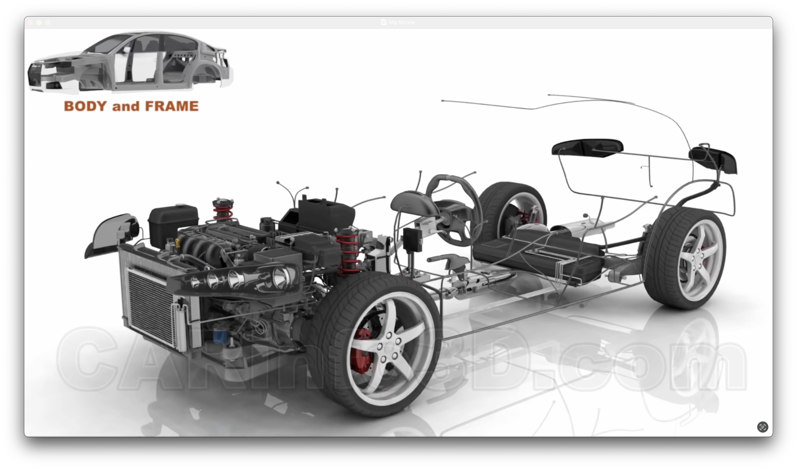
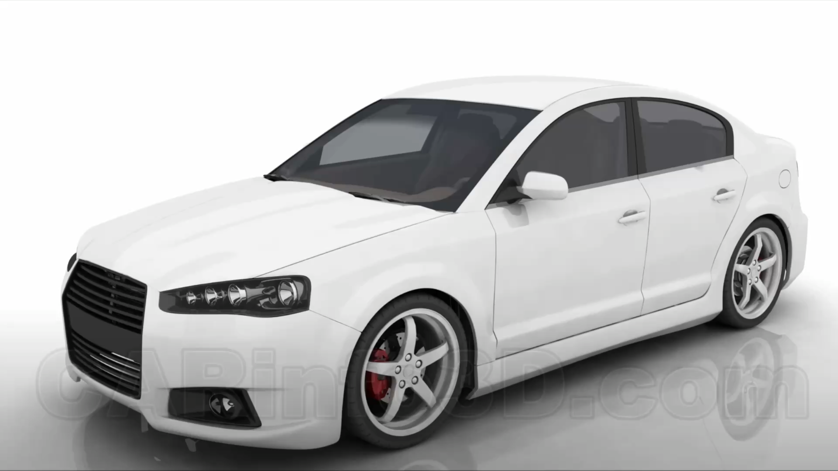




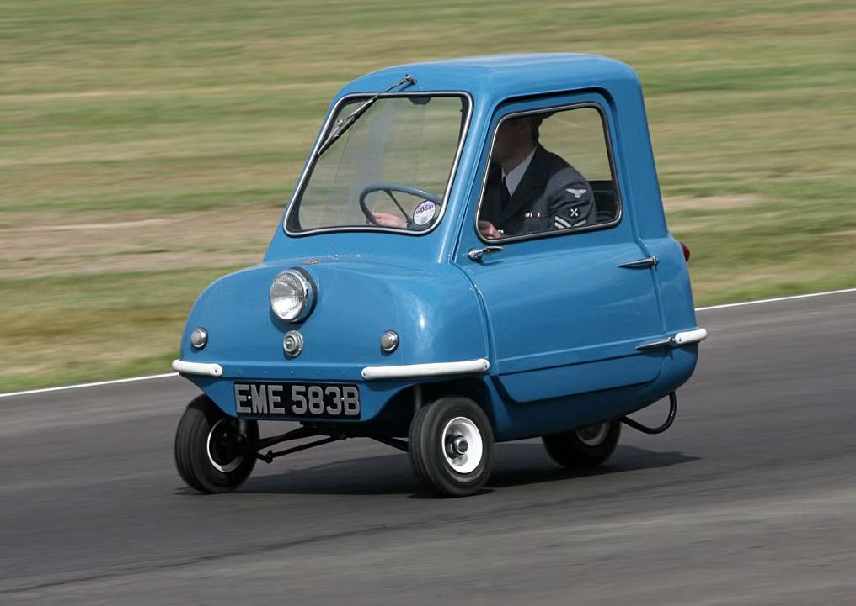
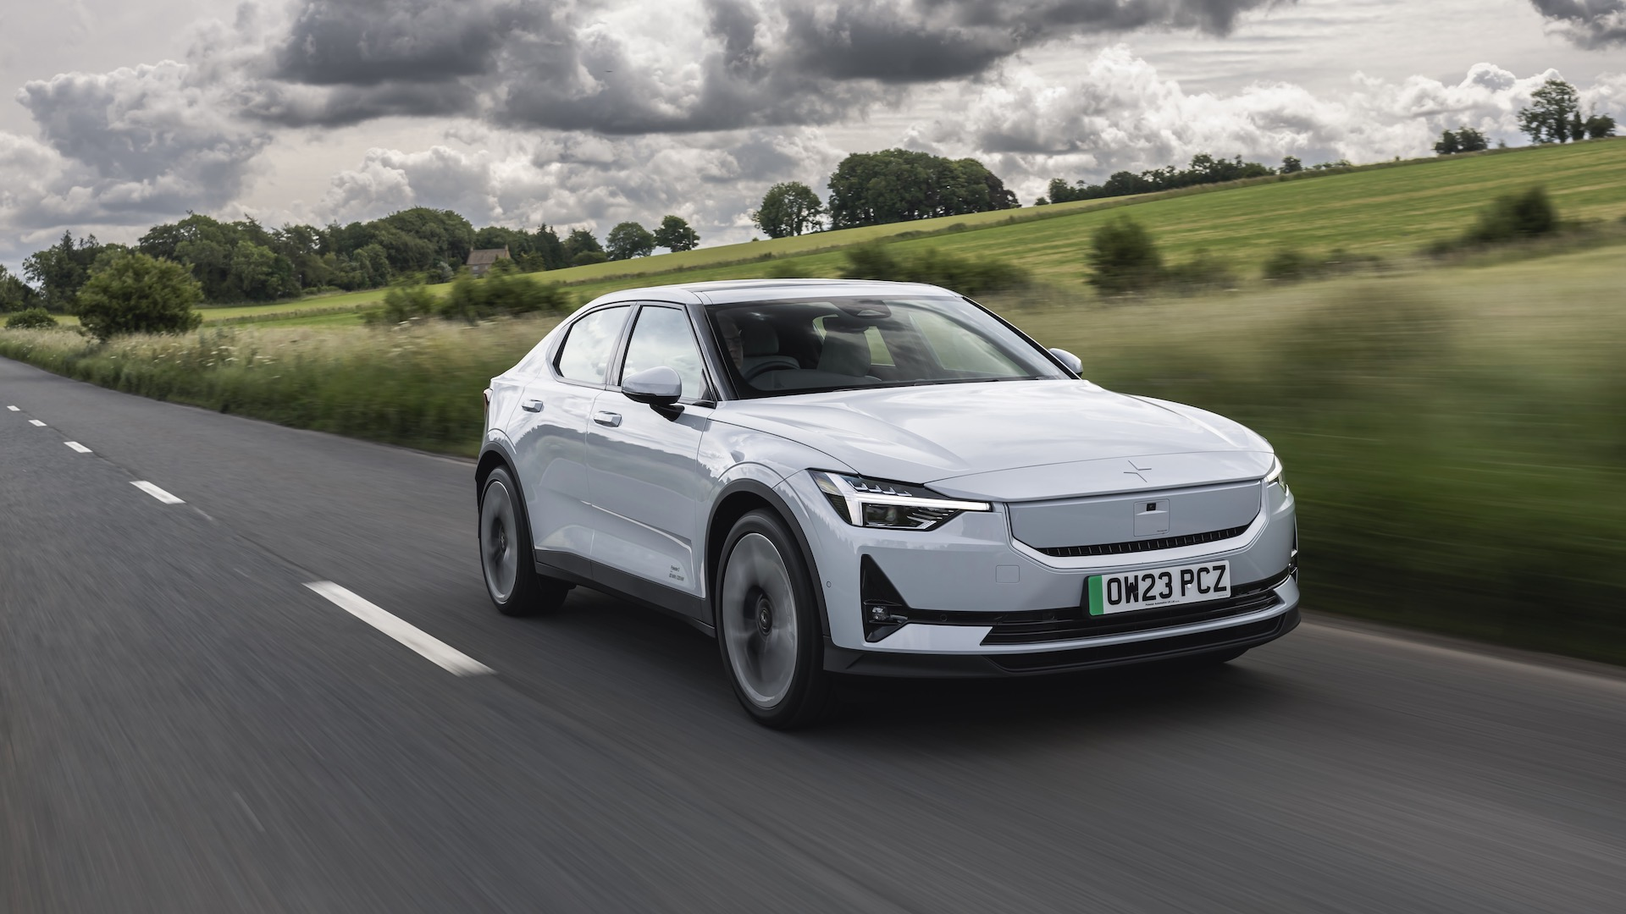
Use of Statistics (ML/AI) in Computational Science
Cars !!!
Three Areas That Involve Decision-Making
Customer – Operation
Automotive Engineer – Design & Production
Mechanical Engineer – Configuration & Tuning

Slide 6
Use of Statistics (ML/AI) in Computational Science
Three Areas That Involve Decision-Making
Overall Workflow – users or pipeline
Methods & Software Development
Customer – Operation
Automotive Engineer – Design & Production
Software Optimization
Mechanical Engineer – Configuration & Tuning

Slide 7
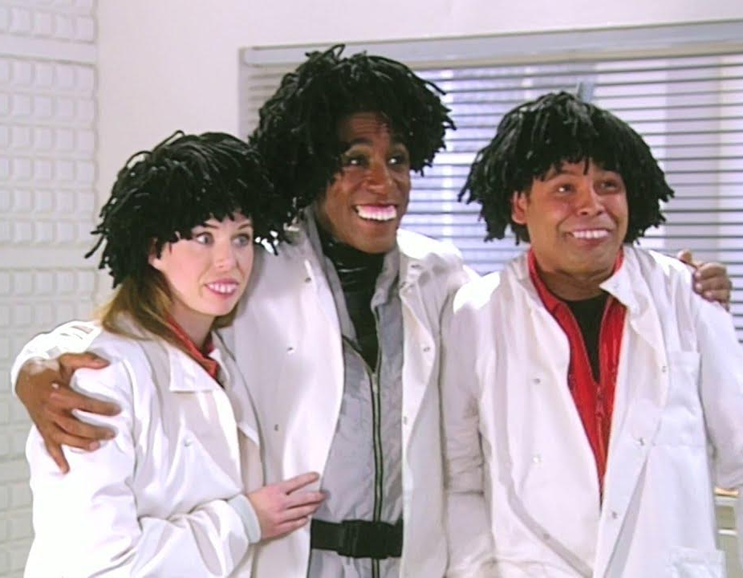
Use of Statistics (ML/AI) in Computational Science
Three Areas That Involve Decision-Making
Overall Workflow – users or pipeline
Methods & Software Development
AI-guided automated pipelines – see David later…
Explosion of ML-based approaches in recent years…
Customer – Operation
Automotive Engineer – Design & Production
Software Optimization
Mainly ad-hoc / heuristic?
Room for improvement?
We’re computer programmers
Mechanical Engineer – Configuration & Tuning

Slide 8
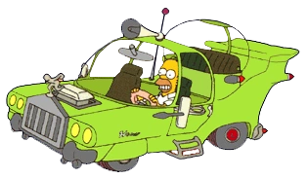
Use of Statistics (ML/AI) in Computational Science
Cars !!!
Should drivers be left to tune their own cars…?!
Software Optimization
Mainly ad-hoc / heuristic?
Room for improvement?
Mechanical Engineer – Configuration & Tuning
Issues with:
Quality Control
Consistency & Reproducibility
User Experience & Satisfaction
Drivers are neither engineers nor mechanics
Software users are neither programmers nor analysts

Slide 9
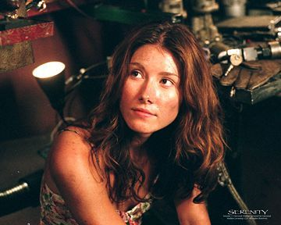
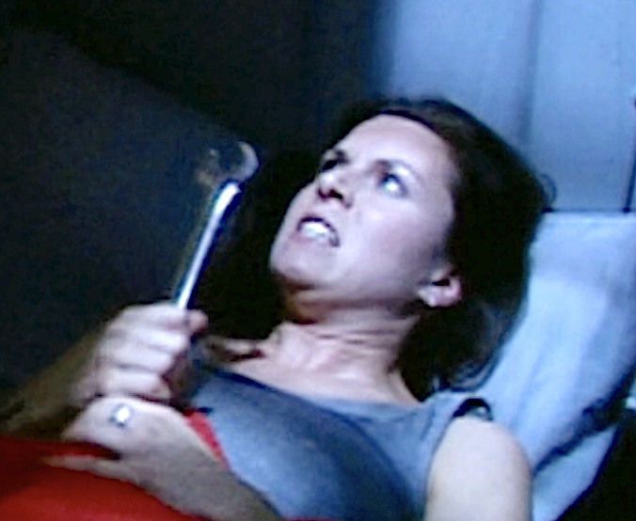
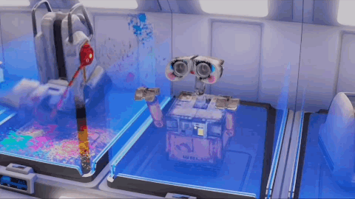


Use of Statistics (ML/AI) in Computational Science
Should we use AI…?!
Software Optimization
Mainly ad-hoc / heuristic?
Room for improvement?
Userbase
Suboptimal machines,
Limited by training data
Power Users
Frustrated
AI
Clueless
Oblivious

Slide 10
How to use Statistics in Computational Science???
“AI” is good at finding a plausible answer from a set/space of reasonable answers
AI can learn from historical user behaviour
Graphical interfaces – extremely complex
Optimal pathways through workflows
Agentic AI can read documentation, tutorials, historical records…
Historical decisions are heterogeneous and often suboptimal
We want to do a better job than today’s practice…
Solution: use purposefully designed experiments + principled statistical modelling
Robust
Efficient

Slide 11
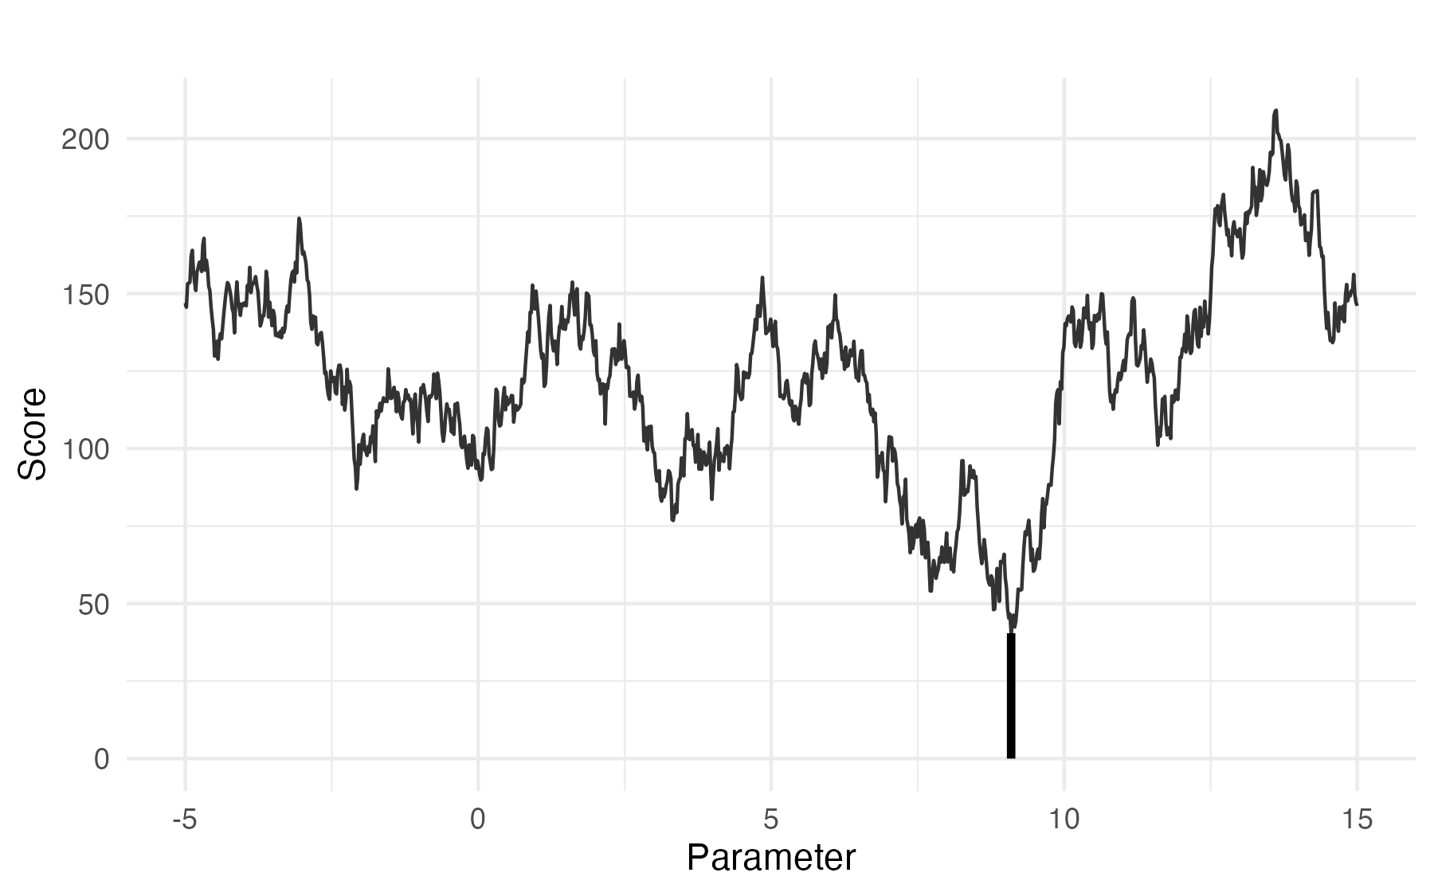
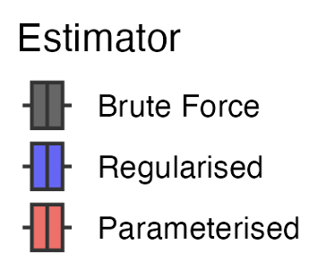
Statistical Robustness
Brute Force
Smoothed
Parameterised

Slide 12
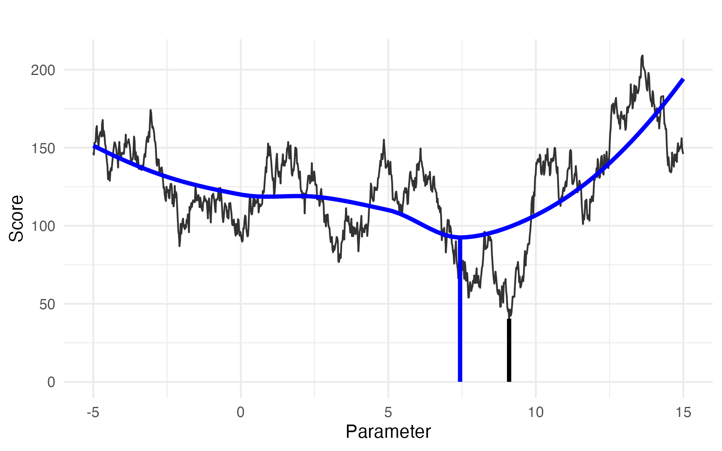
Statistical Robustness
Brute Force
Smoothed
Parameterised

Slide 13
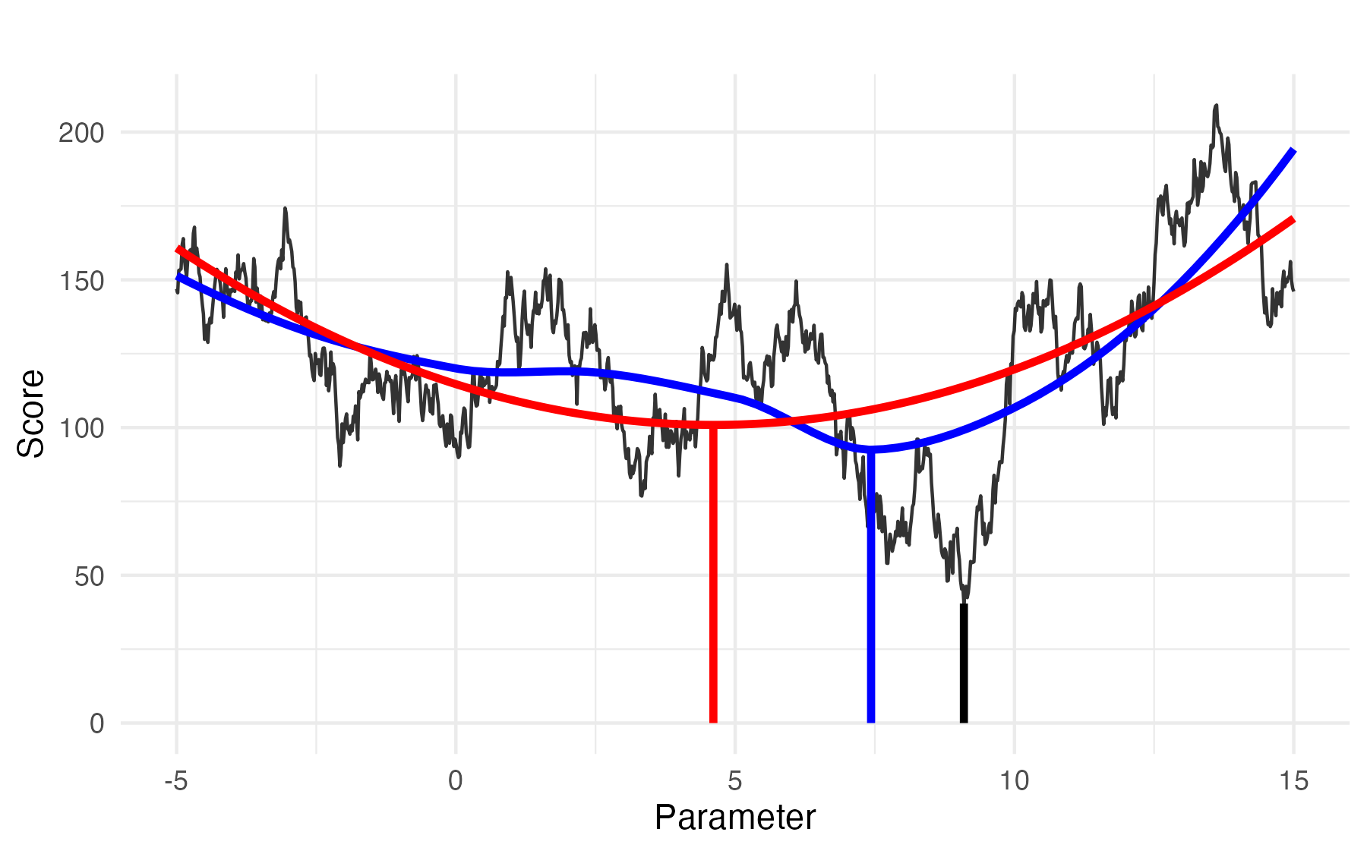
Statistical Robustness
Brute Force
Smoothed
Parameterised

Slide 14
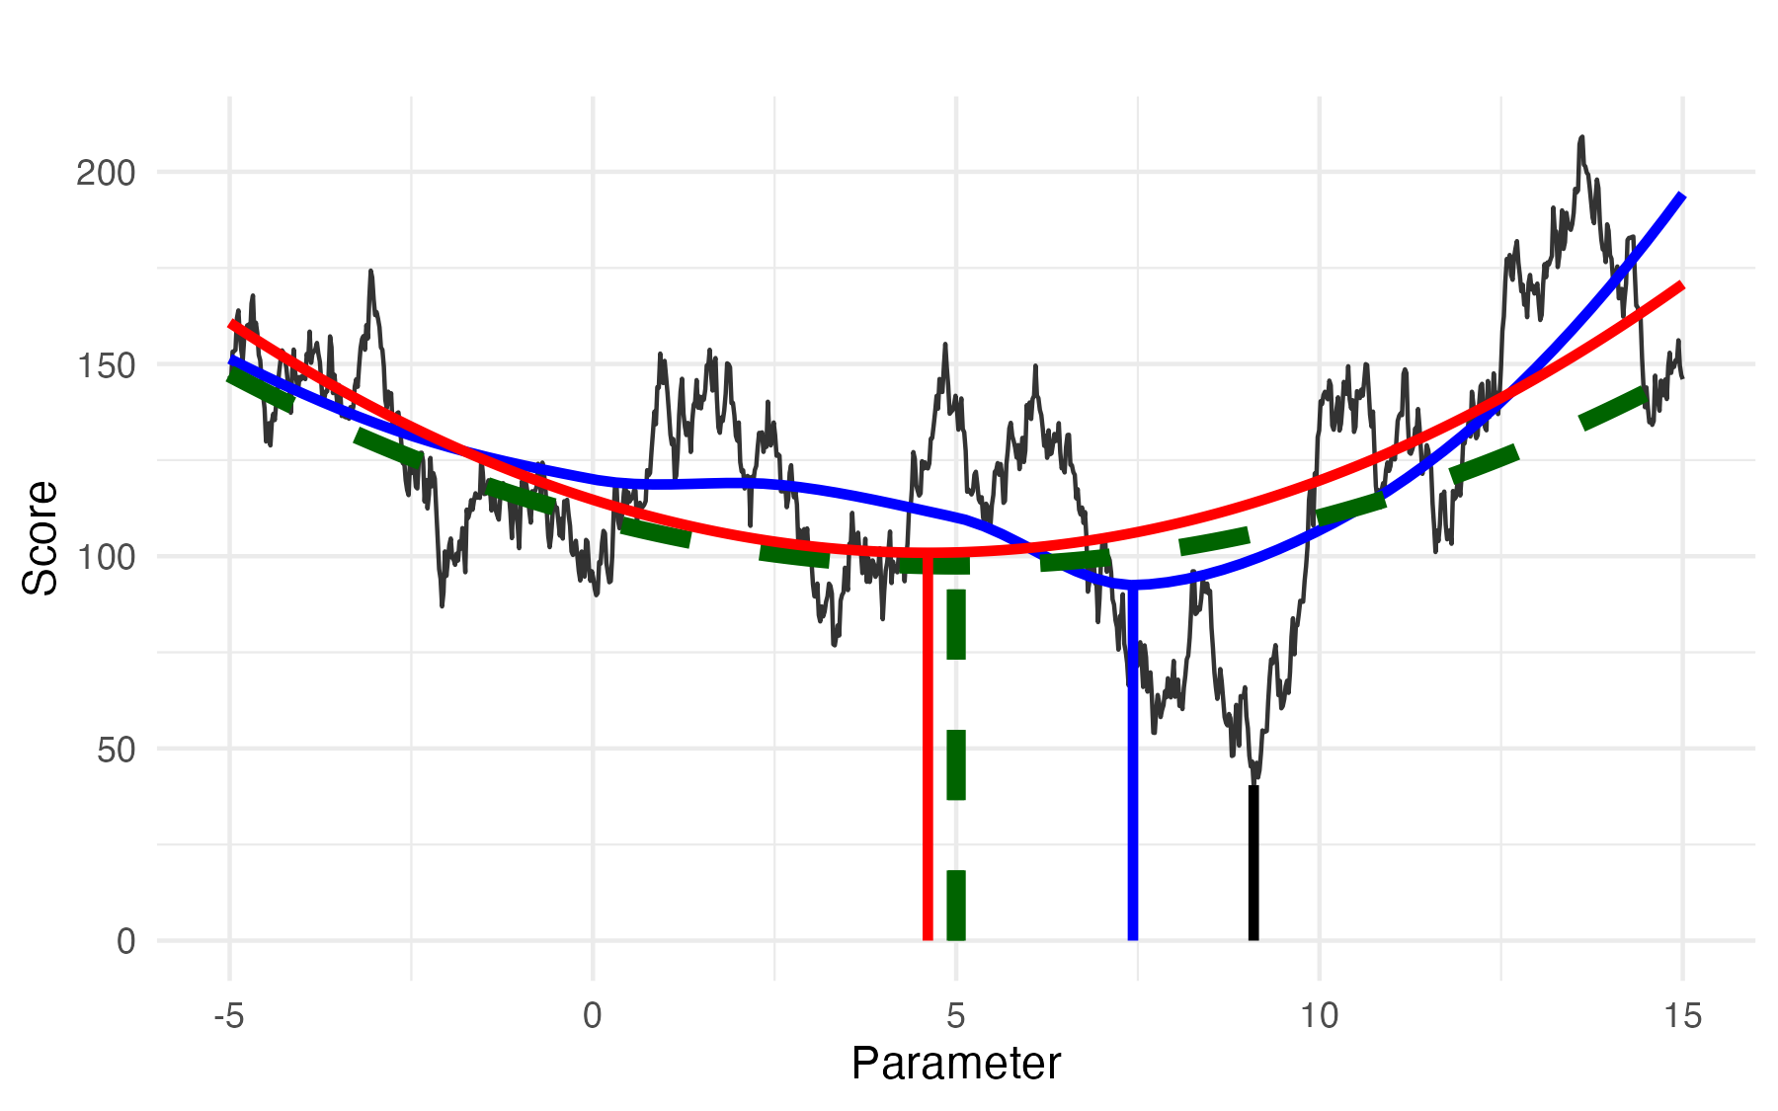
Statistical Robustness
How much does the answer change when the data change?
Brute Force
Smoothed
Parameterised

Slide 15
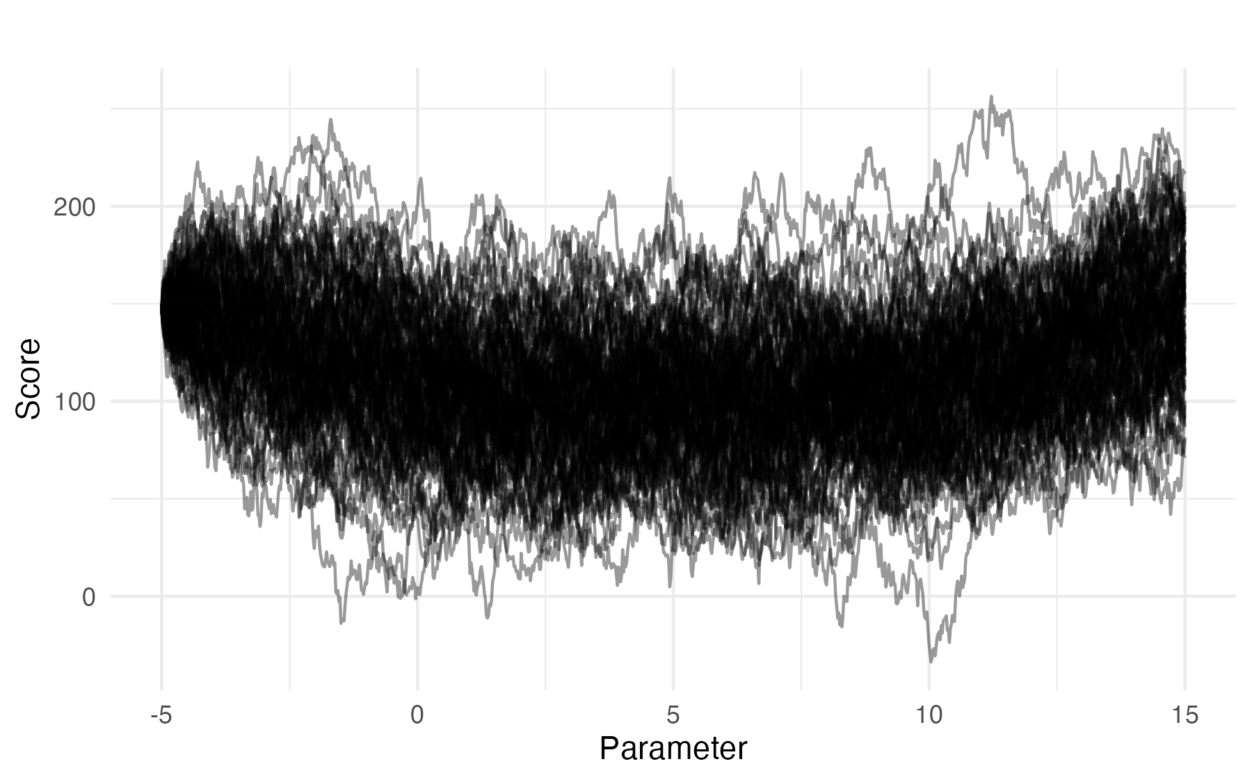
Statistical Efficiency

Slide 16
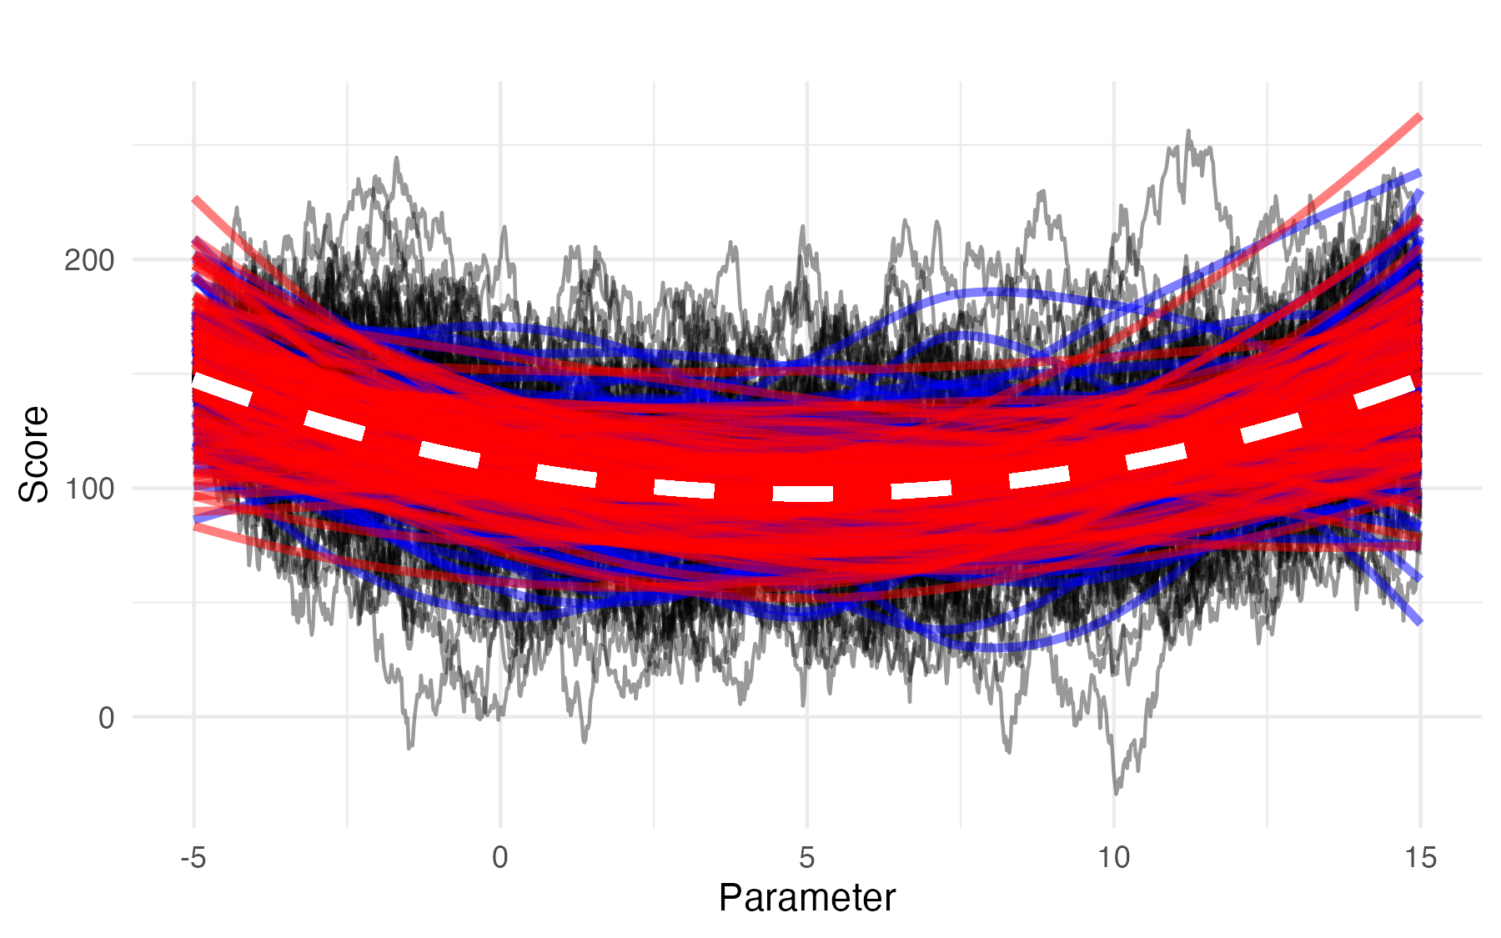
Statistical Efficiency

Slide 17
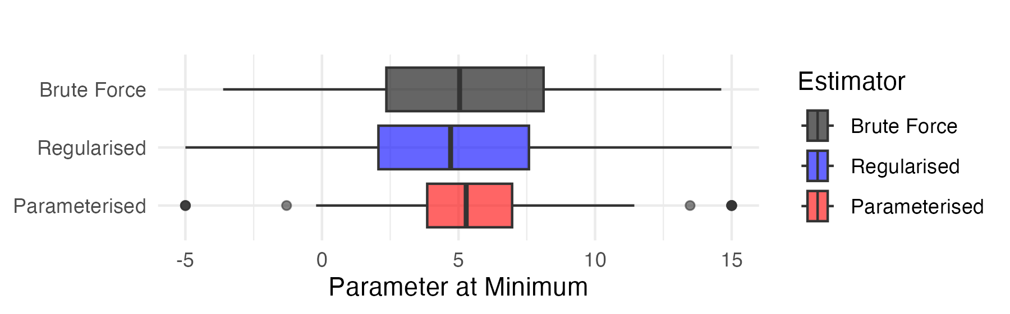
Statistical Efficiency
How precisely can I answer the question with the data I have?
Law of Large Numbers
to the rescue!
Brute Force
Smoothed
Parameterised
Brute Force
Smoothed
Parameterised

Slide 18
Takeaway Messages
Single-dataset brute-force search is a bad idea
  Not robust
Good regularisation can help
  More robust – less sensitive to noise
  Not necessarily efficient – still requires substantial data
Appropriate parameterisation can improve efficiency*
This is what structural biologists are doing today!
*unsuitable parameterisation just trades variance for bias…

Slide 19
Process Optimisation Framework – Objectives
We aim to improve:
Quality of Output – improved, robust, reproducible
Computational Efficiency – less compute waste, scalable, transferable
User Experience – faster, easier, automated
We are not aiming to modify:
Scientific methods
Internal algorithms
Computational acceleration
We’re making the most out of existing software implementations

Slide 20
Core Idea
Program parameters are treated as random variables; optimise conditional probabilities
E( parameters )
E( parameters | data )
P( parameters | data )
One-fits-all solution, e.g. program/interface defaults
Often heuristic; most common approach in CCP4
Tuned to properties of the data
Uncommon in CCP4; typically hard-coded heuristics
Uncertainty-aware – confidence in the decision is retained

Slide 21
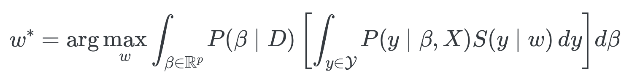
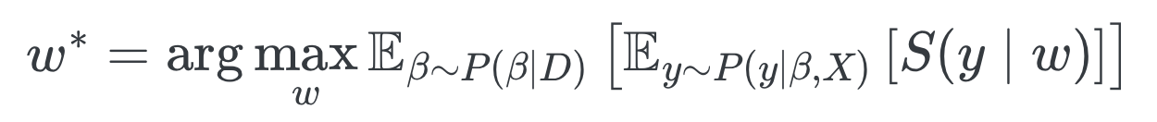
Bayesian Objective Aggregation
via Marginal Expected Utility Maximisation
Choose the weights w
That maximises the score S
Given expected coefficients β
Associated with the expected set of process hyperparameters y
Corresponding to a given dataset D

Slide 22
Bayesian Objective Aggregation
via Marginal Expected Utility Maximisation
Given dataset D
…what are the coefficients β
(associated with predictors X from dataset D)
execute process
…that tell us the process hyperparameters y
…that will result in the best score S
But we don’t know how to score the process output… figure it out (w : vector)

Slide 23
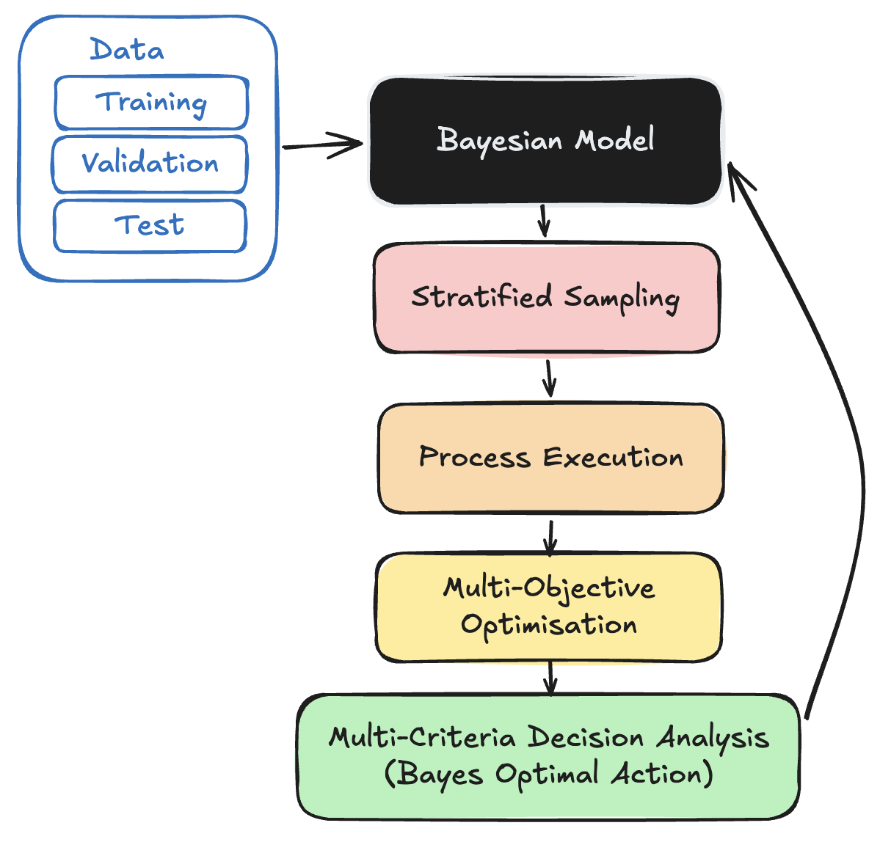

Bayesian Decision-Theoretic Framework
Response: Process hyperparameter values
Predictors: Data properties
Predict maximally informative jobs to execute
Run jobs to sample from hyperparameter space
Balance risk/reward; tune for generalisability
Estimate response for the next iteration

Slide 24
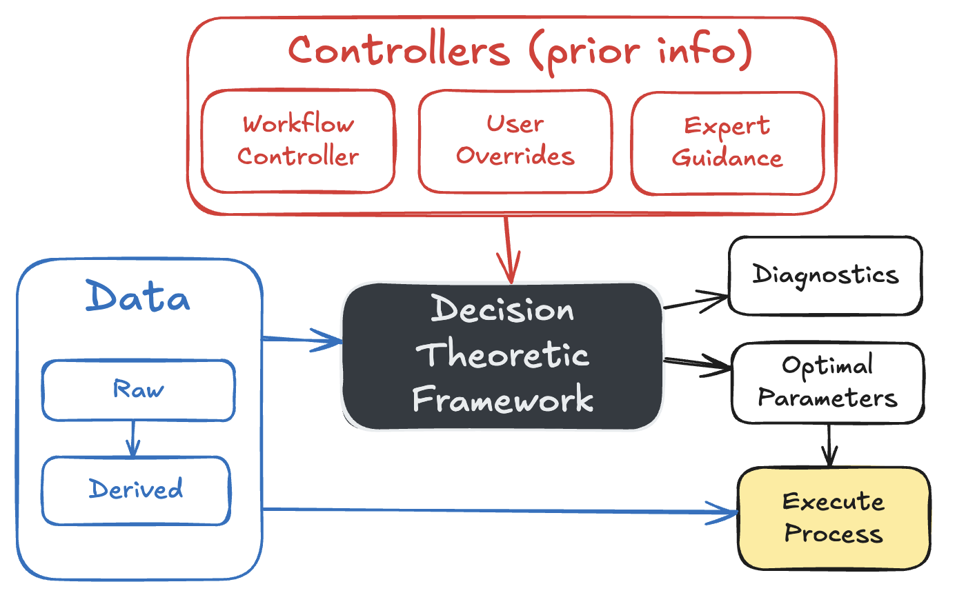
User Perspective
Uncertainties
Predicted outcomes
Runtime estimate

Slide 25
The Vision
The user should only have to run one job.
Improved robustness and efficiency.
Substantial reduction in computational wastage.
(in most cases)

Slide 26
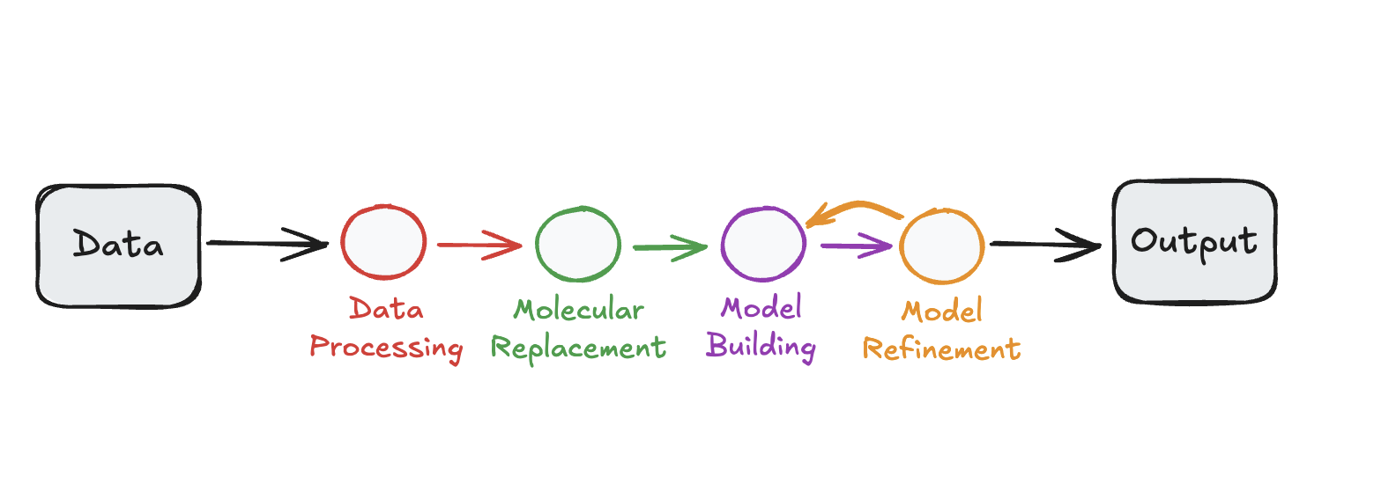
Synergy with Automated Workflows
Example – macromolecular crystallography workflow

Slide 27
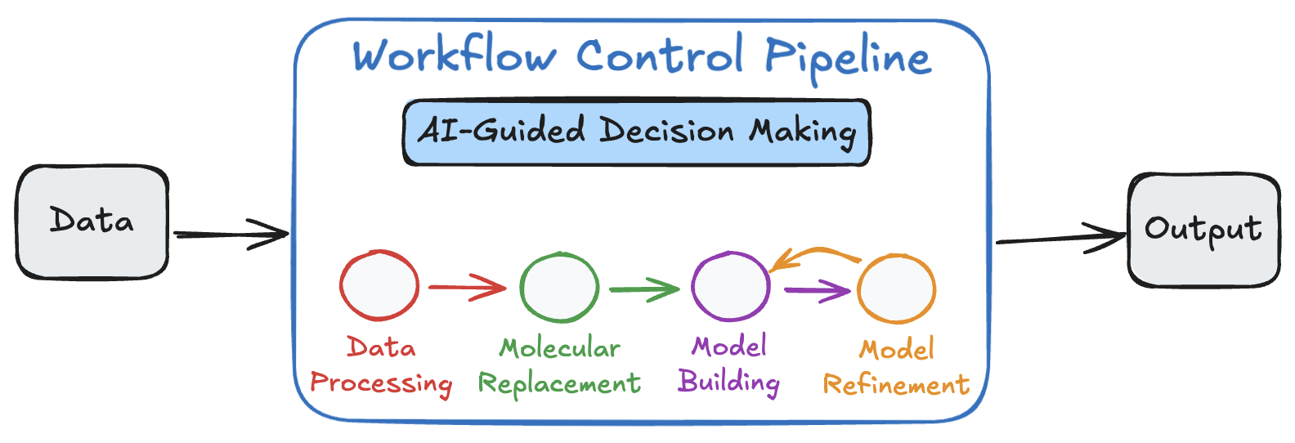
Synergy with Automated Workflows
Automated pipeline

Slide 28
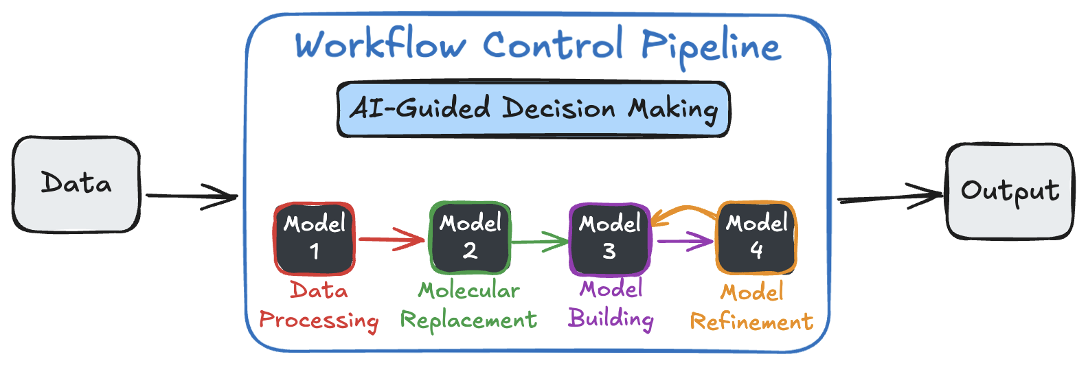
Synergy with Automated Workflows
This development aims to optimise individual nodes

Slide 29
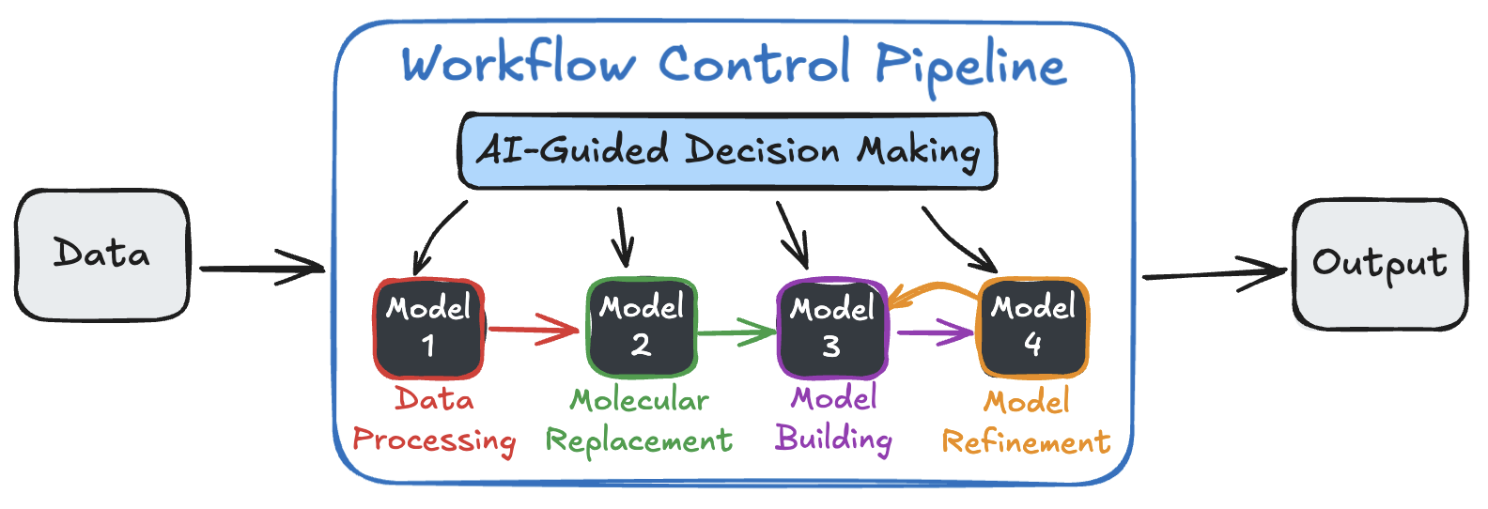
Synergy with Automated Workflows
Meta-control over individual nodes
Parameters can be (1) nudged or (2) overridden.

Slide 30
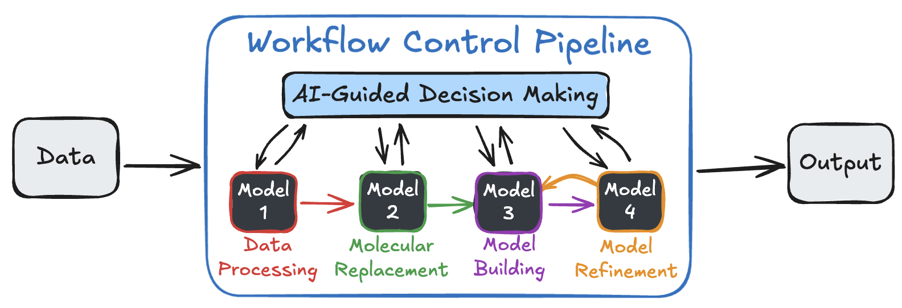
Synergy with Automated Workflows
Feeds information back – could improve an AI controller
Parameters can be (1) nudged or (2) overridden.
Feedback (posterior; posterior predictive; diagnostics) to inform workflow.

Slide 31

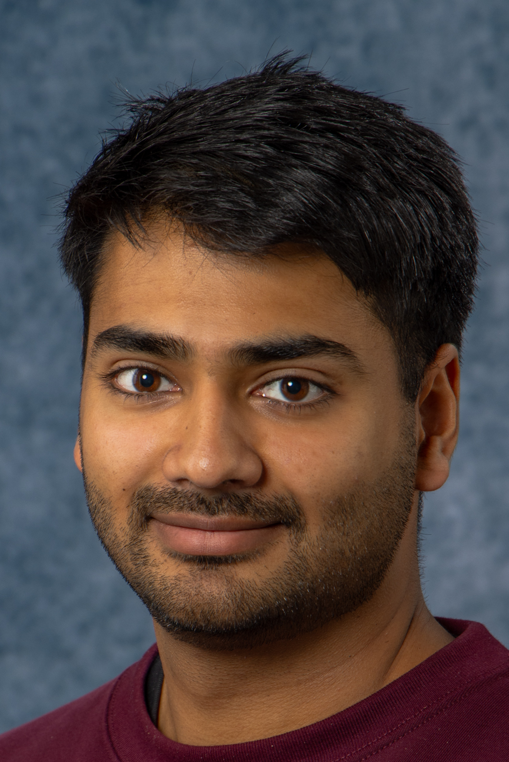

Current Funded Applications
Macromolecular structure refinement (Servalcat)
– Alex Konstantinov (generic framework)
Cryo-EM 3D Reconstruction (RELION)
– Milan Kumar
Crystallographic data processing (DIALS)
– Terence Lobo
Eugene Krissinel (CCP4)
Maria Fando (CCP4)
Tom Burnley (CCP-EM)
Colin Palmer (CCP-EM)
Jason van Rooyen (eBIC)
David McDonagh (CCP4)
David Waterman (CCP4)

Slide 32
ML/AI Workflows in Crystallography

Slide 33



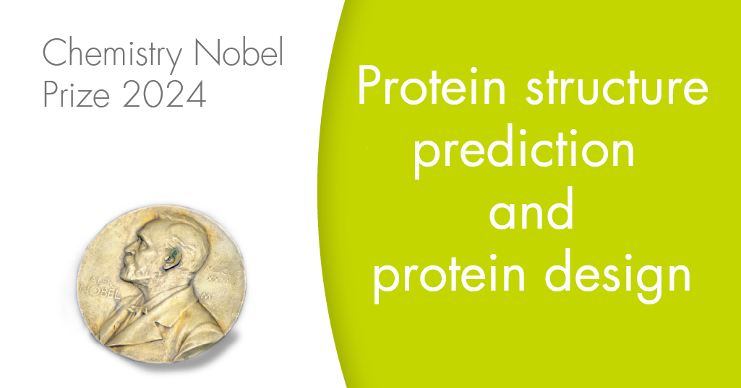
Context
Crystallography is the foundation for vast areas of science
  > 40 Nobel prizes
  UN International year of Crystallography in 2014
Macromolecular crystallography (MX) is the study of biological structures
  Backbone of > £108 billion UK Life Sciences sector
  Fundamental to new government drug discovery initiatives
MX is underpinned by vast amounts of data processing to move from raw data to the underlying molecular structure
DSIT £8 million investment, based at Diamond Light Source

Slide 34

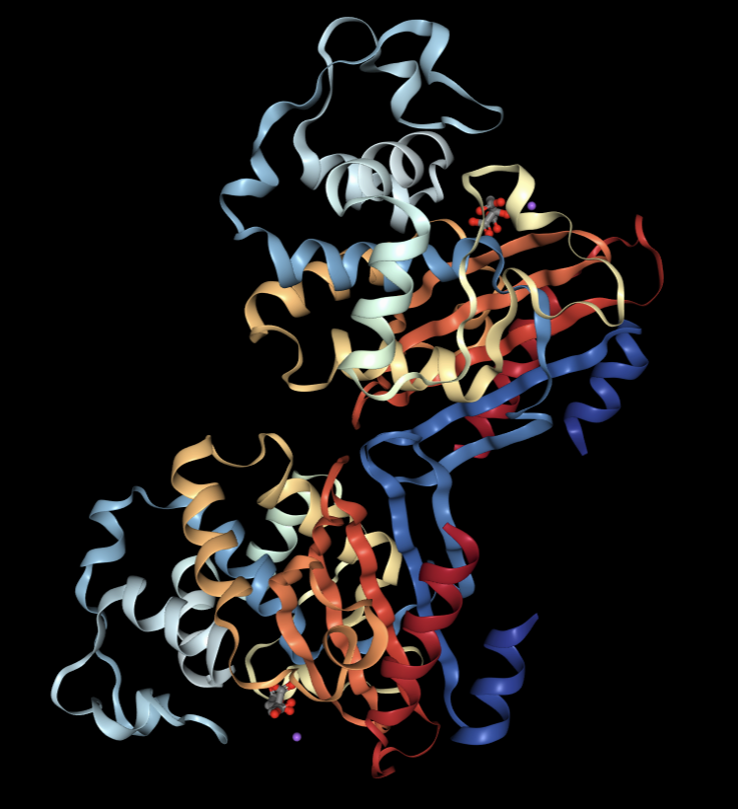
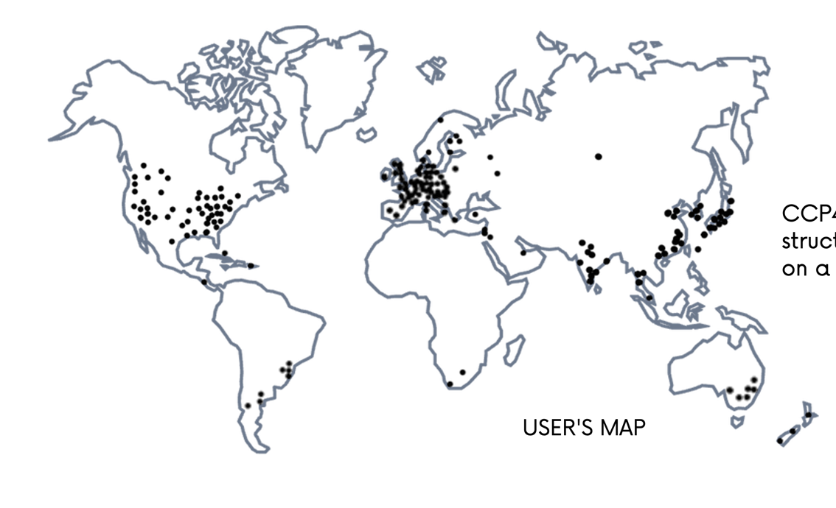
CCP4 is a software suite for macromolecular crystallography
  Used by >25,000 researchers globally
  >230 industrial licenses
  Commercial software licensing income of >£2.3 million
User Map

Slide 35
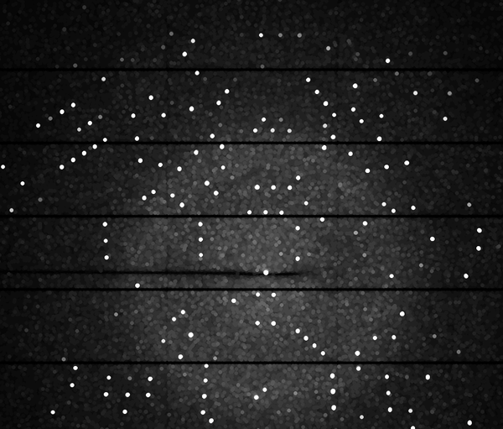
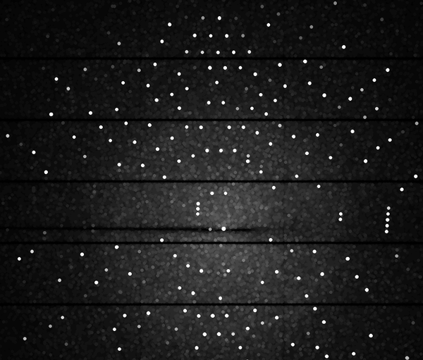
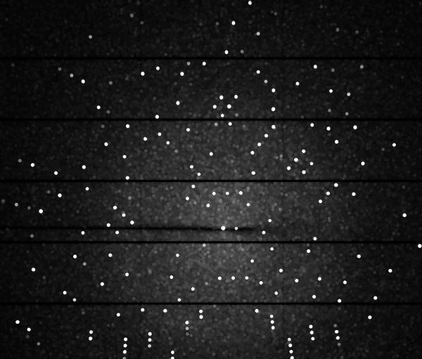
Macromolecular Diffraction

Slide 36
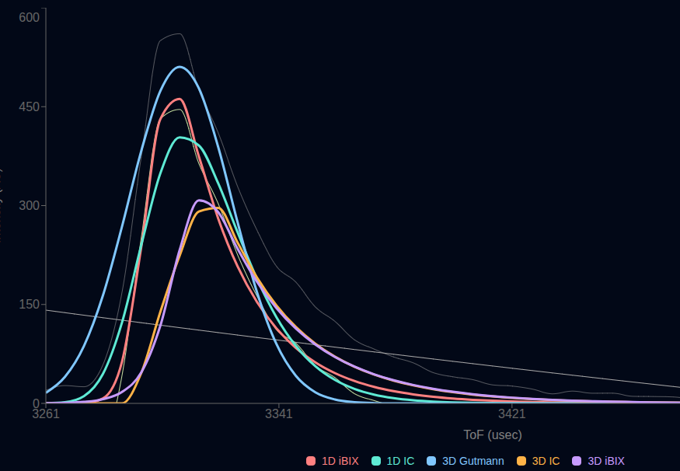
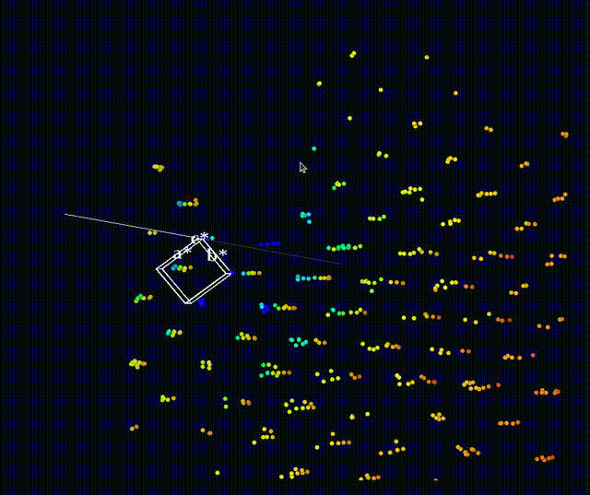
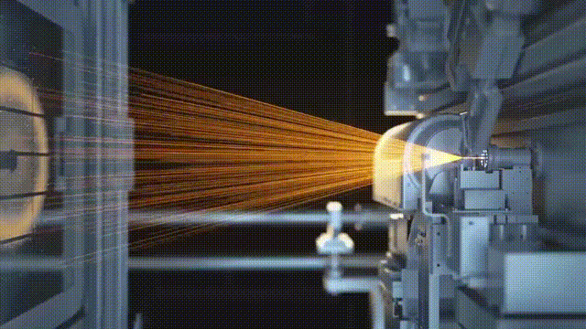

Diffraction Processing is Broken into Discrete Steps
Data Collection
Spot Finding
Indexing
Model Refinement
Integration
Scaling
Credit: Deutsches Elektronen-Synchrotron

Slide 37
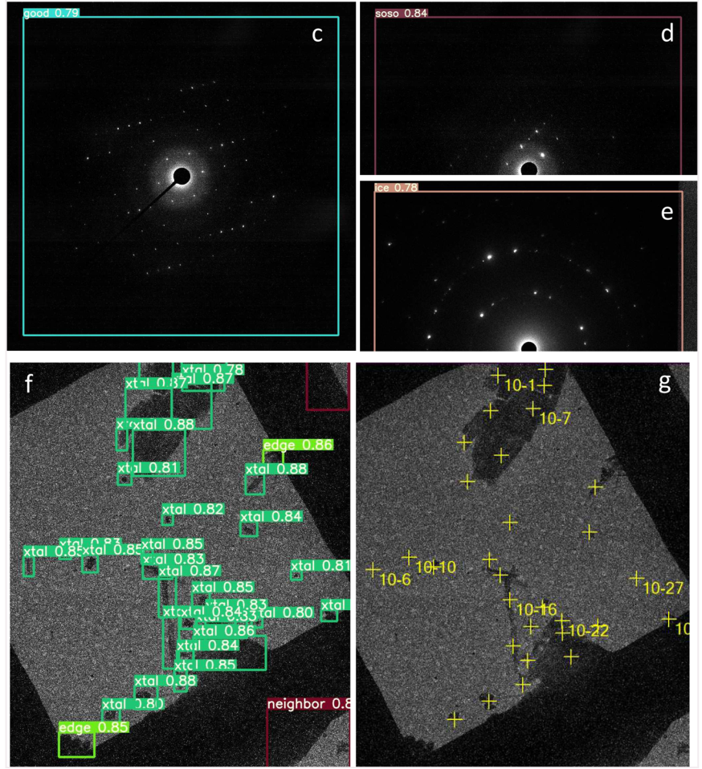
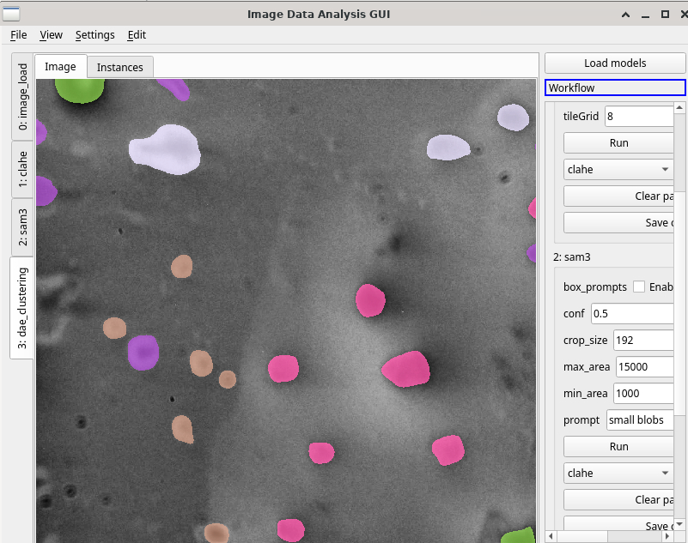
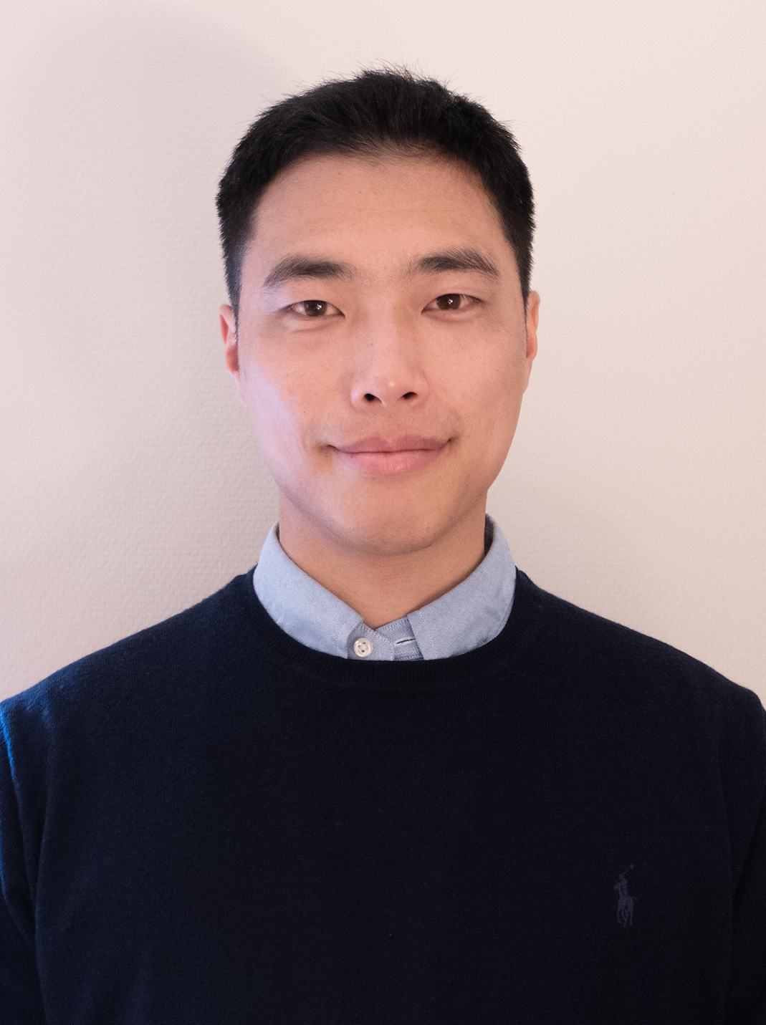
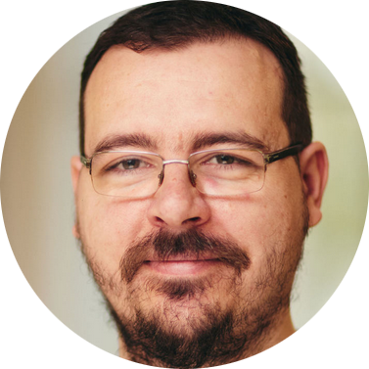
Steps can be Optimised Individually
Data Collection
Spot Finding
Indexing
Model Refinement
Integration
Scaling
Scientific Question & Data
Data Modality & Context Understanding
Scientific Analysis Agent
Validated Scientific Analysis Tools
Agentic Data Collection and Preprocessing
Tool & Parameter Refinement
Electron Diffraction Data Collection Accelerated via Machine Learning
Result Integration & Reporting
Jaehoon Cha
Marko Petrovic

Slide 38
We also want to Consider the Entire Workflow
Data Collection
Spot Finding
Indexing
Model Refinement
Integration
Scaling
Credit: Deutsches Elektronen-Synchrotron

Slide 39
Reframing Workflows
Historically...
Instrument Specific Software
Generic Software

Slide 40




Reframing Workflows
Historically...
Several different software packages with different strengths
Instrument Specific Software
Generic Software
XDS
Red

Slide 41
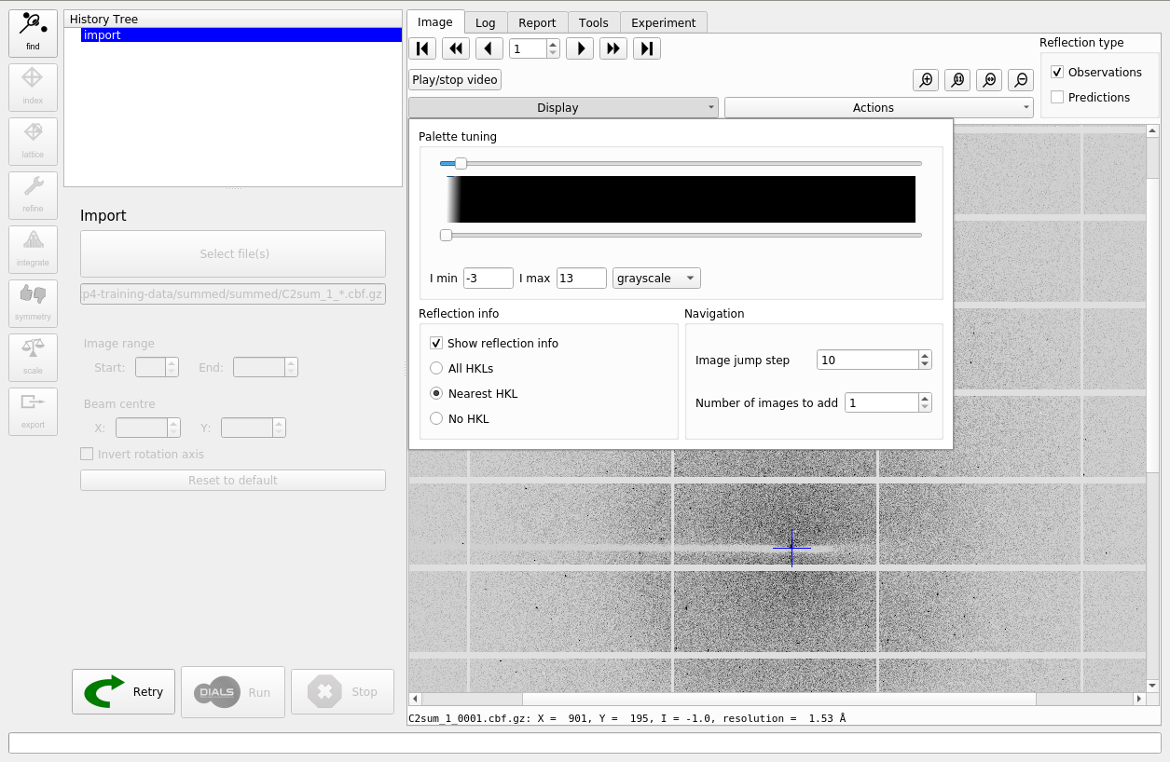
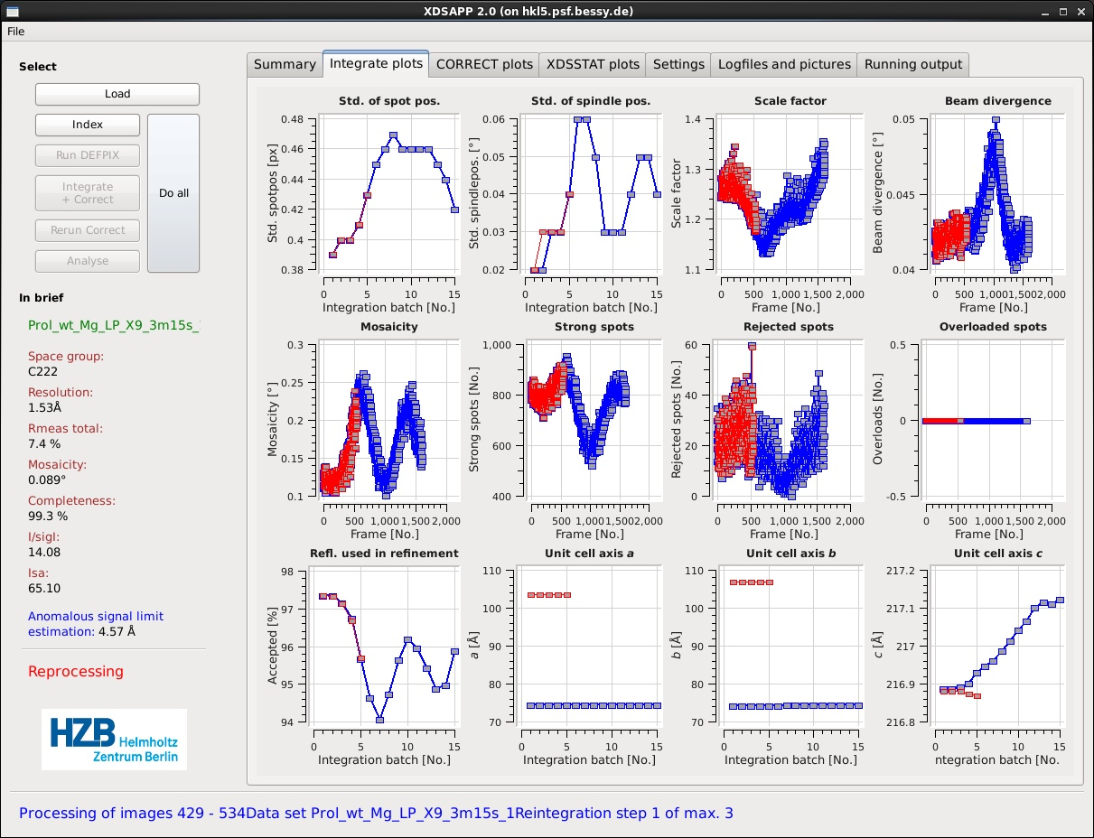
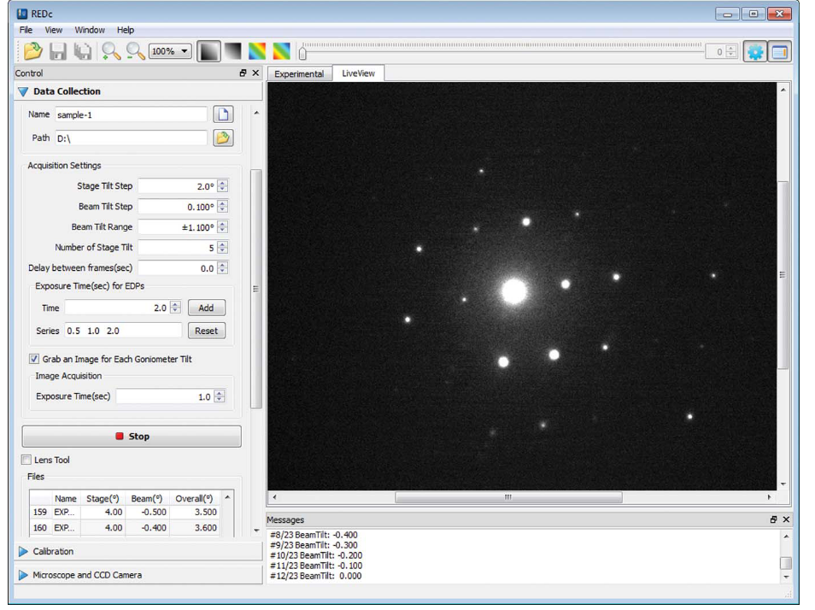
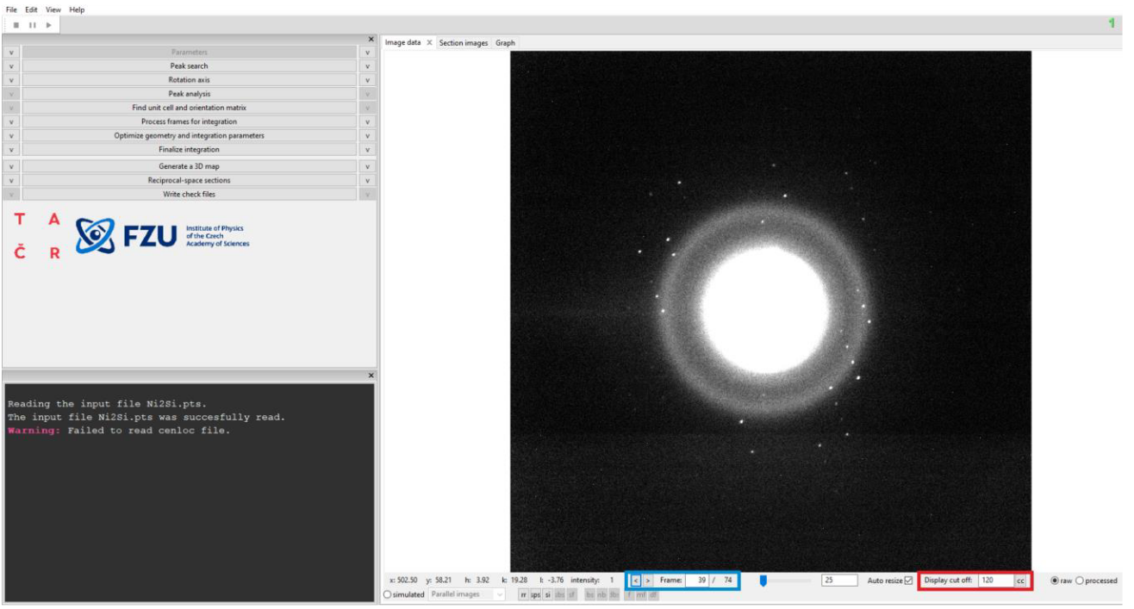
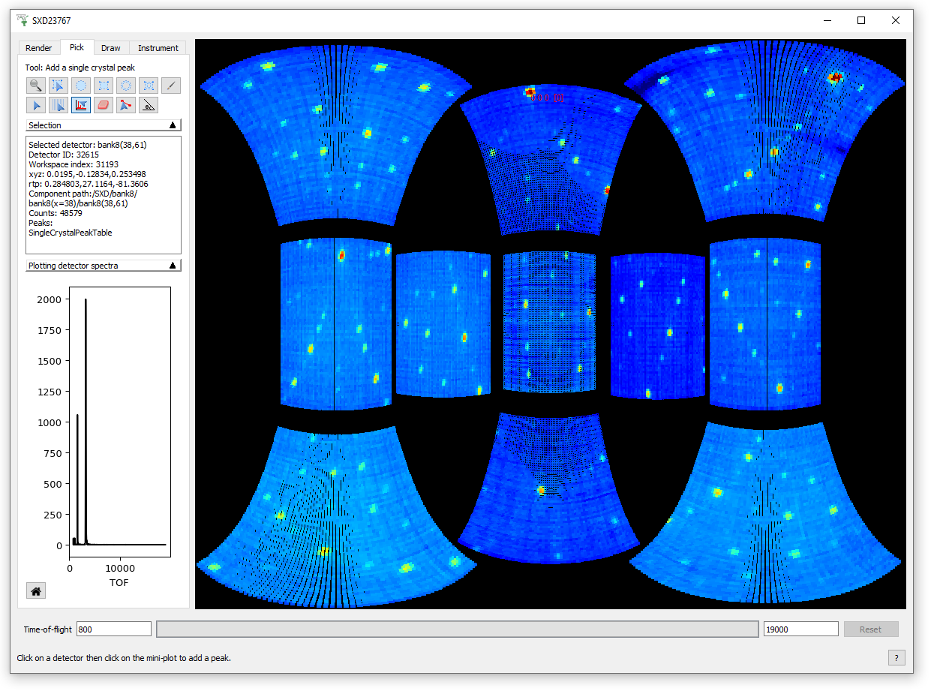
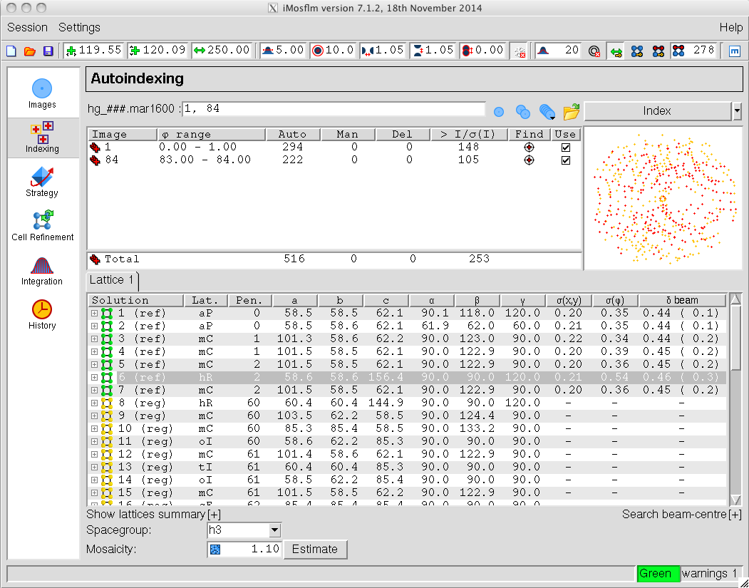
Reframing Workflows can be
Historically...
Friction for users
Instrument Specific Software
Generic Software
XDS
Red

Slide 42

Reframing Workflows
Browser interface that enables users to visualise workflows from different software packages

Slide 43

Reframing Workflows
Users can now move between software packages easily
Instrument Specific Software
Generic Software
XDS
Red

Slide 44

Reframing Workflows
Different workflows can be run and visualised from a common interface
Spot Finding
Indexing
Model Refinement
Integration
Scaling
Data Collection
Spot Finding
Indexing
Model Refinement
Integration
Scaling

Slide 45
Reframing Workflows
New workflows can be designed by combining software packages
Spot Finding
Indexing
Model Refinement
Integration
Scaling
Data Collection
Spot Finding
Indexing
Model Refinement
Integration
Scaling

Slide 46


Diffraction Processing is High Throughput
~10,000 datasets per day possible
Too much data to manually investigate
Too much data to store to train?
Processing is largely static
Software should be dynamically improving over time, in response to data
  Reduce compute cost
  Use information being lost
  Improve what quality of data can be processed
Diamond Light Source beamlines

Slide 47
Diffraction Processing Workflows Through an ML Lens
Reframing Diffraction processing for dynamic optimisation
  Optimising a fixed pipeline
Number of spots
/ number expected
Number processed, I/Sigma..
Metrics
Number of images
% indexed, RMSE
RMSE
CC ½
Completeness..
Data Collection
Spot Finding
Indexing
Model Refinement
Integration
Scaling
Actions
Data State
Has images
Has spots
Indexed
Refined
Integrated
Scaled

Slide 48

Diffraction Processing Workflows Through an ML Lens
Reframing Diffraction processing for dynamic optimisation
  Optimising a fixed pipeline: Bayesian approach
Number of spots
/ number expected
Number processed, I/Sigma..
Metrics
Number of images
% indexed, RMSE
RMSE
CC ½
Completeness..
Data Collection
Spot Finding
Indexing
Model Refinement
Integration
Scaling
Actions
Data State
Has images
Has spots
Indexed
Refined
Integrated
Scaled
Bayesian Optimisation of Algorithm Parameters in DIALS
Bayesian Model
Terence Lobo

Slide 49
Diffraction Workflows can be Redesigned
Reframing Diffraction processing for dynamic optimisation
  Optimising a fixed pipeline: Reinforcement Learning (RL) approach
Running in the background for online learning during normal data processing
Given the metrics so far and the sequence of states, how should I perform this action?
Sequential experiments, delayed/complex set of steps to a reward
Number of spots
/ number expected
Number processed, I/Sigma..
Metrics
Number of images
% indexed, RMSE
RMSE
CC ½
Completeness..
Data Collection
Spot Finding
Indexing
Model Refinement
Integration
Scaling
Actions
Data State
Has images
Has spots
Indexed
Refined
Integrated
Scaled
RL Model

Slide 50

Diffraction Workflows can be Redesigned
Reframing Diffraction processing for dynamic optimisation
  Optimising a fixed pipeline: Reinforcement Learning (RL) approach
Running in the background for online learning during normal data processing
Given the metrics so far and the sequence of states, how should I perform this action?
Sequential experiments, delayed/complex set of steps to a reward
Number of spots
/ number expected
Number processed, I/Sigma..
Metrics
Number of images
% indexed, RMSE
RMSE
CC ½
Completeness..
Data Collection
Spot Finding
Indexing
Model Refinement
Integration
Scaling
Actions
Data State
Has images
Has spots
Indexed
Refined
Integrated
Refined
Integrated
Scaled
Scaled
RL Model

Slide 51

Diffraction Workflows can be Redesigned
Reframing Diffraction processing for dynamic optimisation
  Optimising a fixed pipeline

Slide 52


Diffraction Workflows can be Redesigned
Reframing Diffraction processing for dynamic optimisation
  Optimising a fixed pipeline
Shared models between beamlines

Slide 53
Diffraction Workflows can be Redesigned
Reframing Diffraction processing for dynamic optimisation
  Optimising a fixed pipeline
  Optimising pipeline design: Given my data, what should my pipeline be?
Number of spots
/ number expected
Number processed, I/Sigma..
Metrics
Number of images
% indexed, RMSE
RMSE
CC ½
Completeness..
XDS
Data Collection
Spot Finding
Indexing
Model Refinement
ML Model
Scaling
Actions
Data State
Has images
Has spots
Indexed
Refined
Integrated
Scaled
RL Model

Slide 54

Diffraction Workflows can be Redesigned
Reframing Diffraction processing for dynamic optimisation
  Optimising a fixed pipeline
  Optimising pipeline design: Given my data, what should my pipeline be?
Number of spots
/ number expected
Number processed, I/Sigma..
Metrics
Number of images
% indexed, RMSE
RMSE
CC ½
Completeness..
XDS
Data Collection
Spot Finding
Indexing
Model Refinement
ML Model
Scaling
Actions
Data State
Has images
Has spots
Indexed
Refined
Integrated
Scaled
RL Model

Slide 55


Summary
Making better decisions in computational workflows
Individual processes
Learn how software should behave for the data in front of it.
Connected workflows
Learn what action should happen next.
The longer-term goal
Scientific software that learns from computation – rather than repeatedly starting from scratch.
Automate the expertise, not merely the existing behaviour.

