Slide 1
The use of FLUKA in the ISIS
Health Physics & Facility Safety
(HPFS) Group
Xavier Queralt
ISIS-RAL
2nd June 2026

Slide 2
ISIS HPFS Group (Instrumentation Division)

Slide 3
FLUKA Examples
ISIS Synchrotron Dipole Coil (Co-60 source)
Radioactive copper coils modelled as a composite
2. electron
  Separator: shielding analysis & interlock
  Pulse Slicer: shielding analysis
  Spin rotator: shielding analysis
  HV power connector: shielding analysis
3. e⁺ / µ⁺ / µ⁻
Beam Stop: shielding diagnose
4. neutron
Chopper neutron beam: neutron distribution and activation
5. proton / neutron
Dummy geometry: dose map and activation
5. proton / neutron
Dummy geometry: dose map and activation
6. JUAS 2026
FLUKA & flair brief introduction

Slide 4
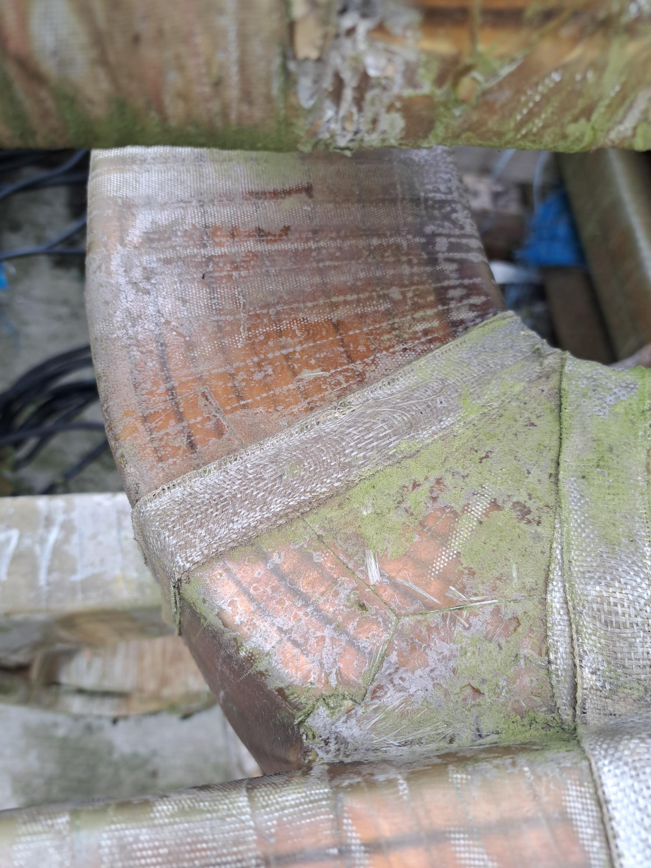
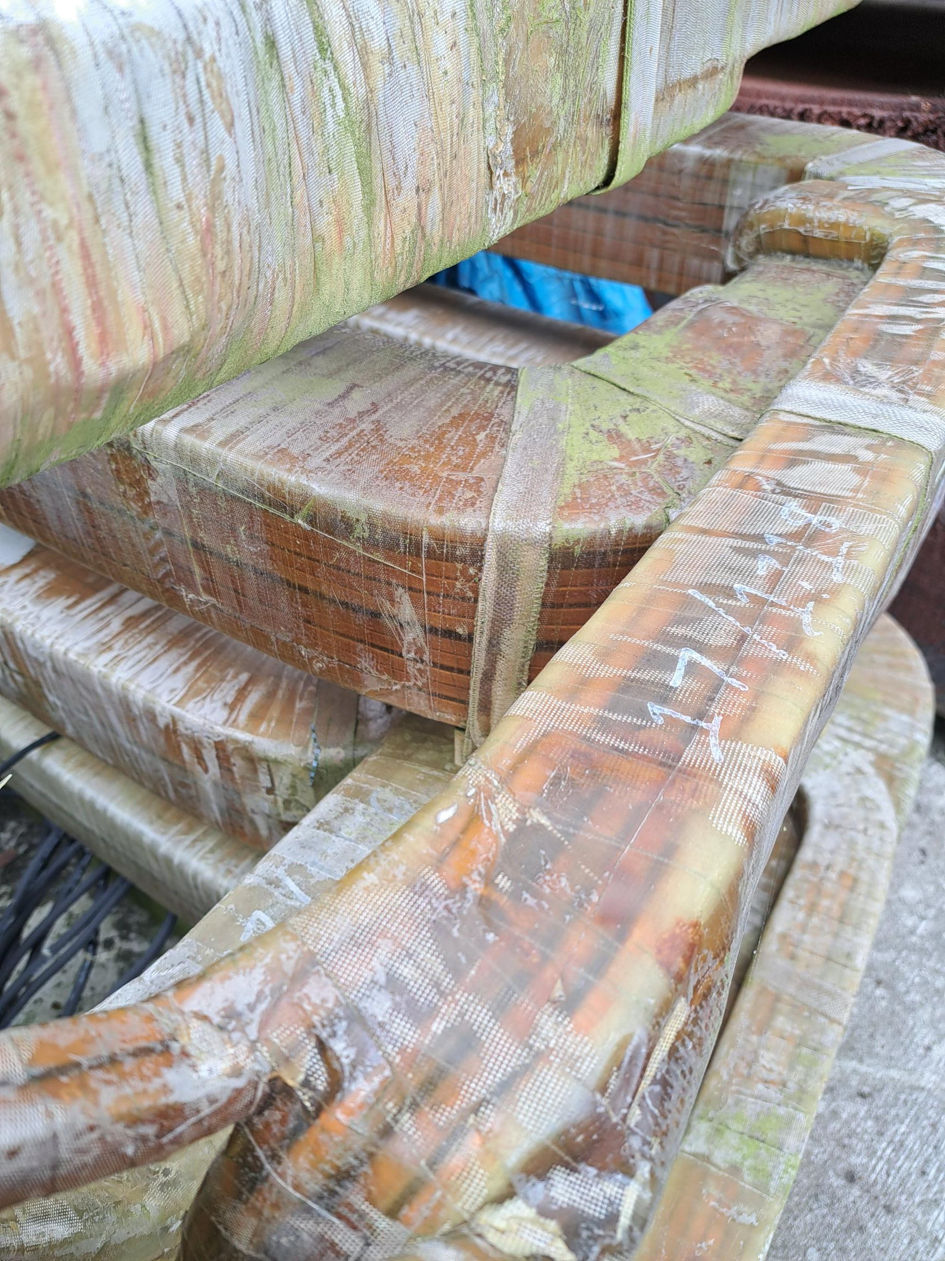
ISIS Synchrotron Dipole Coil (Co-60 source)
Radioactive copper coils modelled as a composite

Slide 5
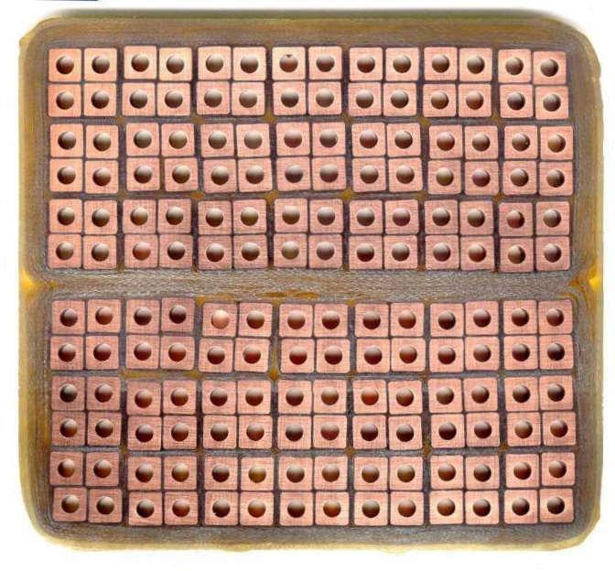
Dipole cross section structure: dimension & composition (3/3)
W* = 13.0 cm
1
2
3
4
5
6
7
6
5
4
H* = 11.5 cm
3
2
Y
1
X
*Measure with a tape

Slide 6
W = 13.3 cm
Resin
Approximation
Composite (Cu/Air/Resin)
H = 11.9 cm
Y
(Vertical)
X
W = 12.8 cm
(Horizontal)
T6 = 1.17 mm
T4 = 1.42 mm

Slide 7
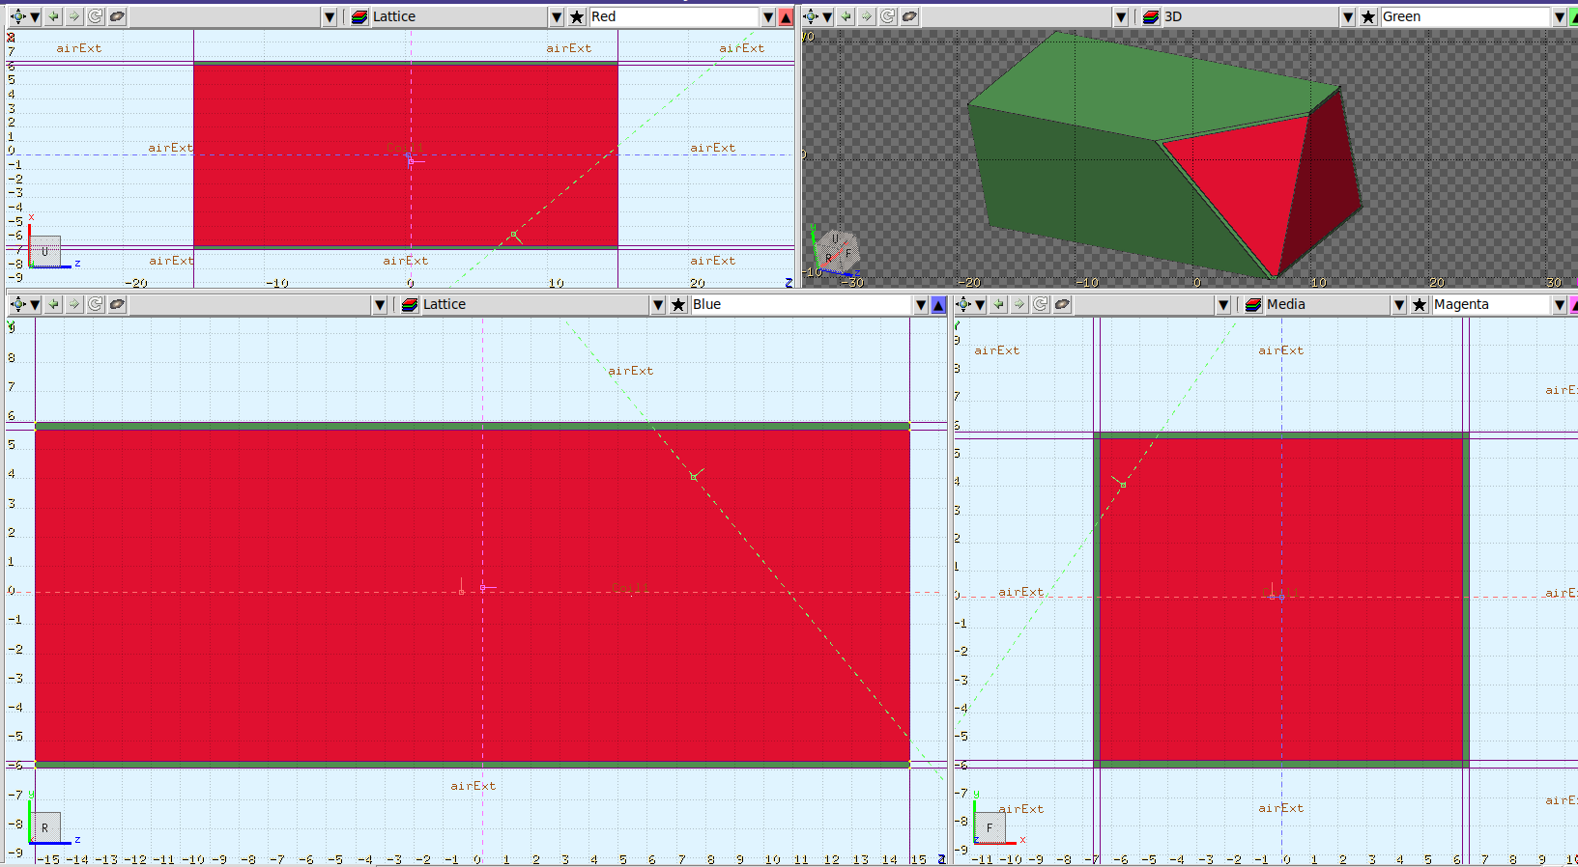
FLUKA Simulation Characteristics:
30 cm dipole coil length
Resin & Composite approximation (see slide #7)
Uniform Co-60 source distribution in the composite volume
10⁸ iterations

Slide 8
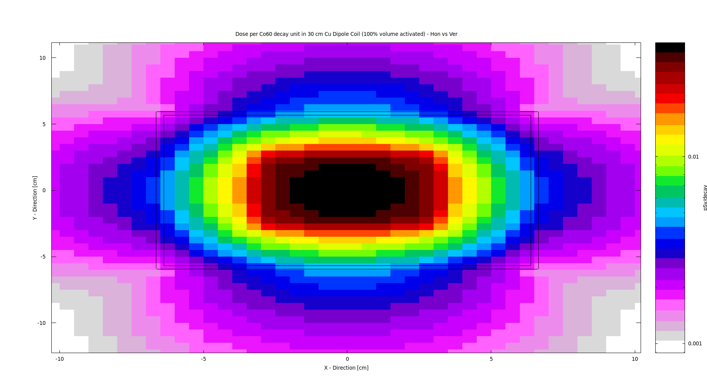
XY Map of Dose per Activity (DpA) close to the dipole surfece (pSv/Bq•s)
DpA
8
6
4
2

Slide 9
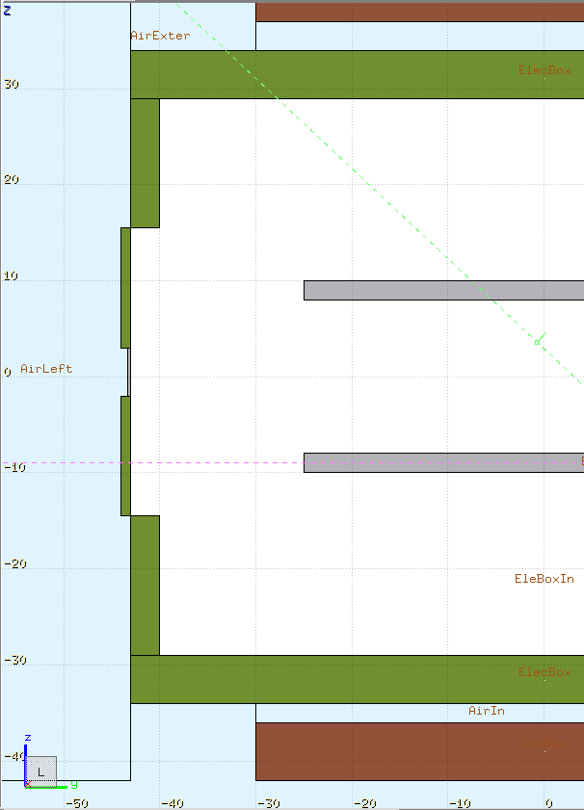
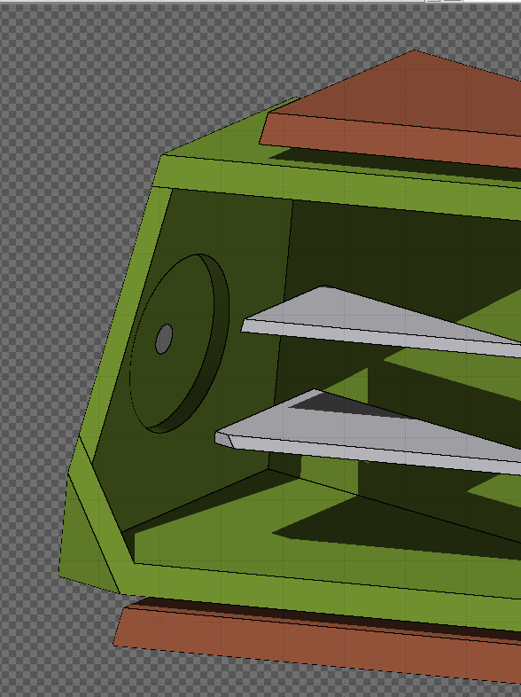
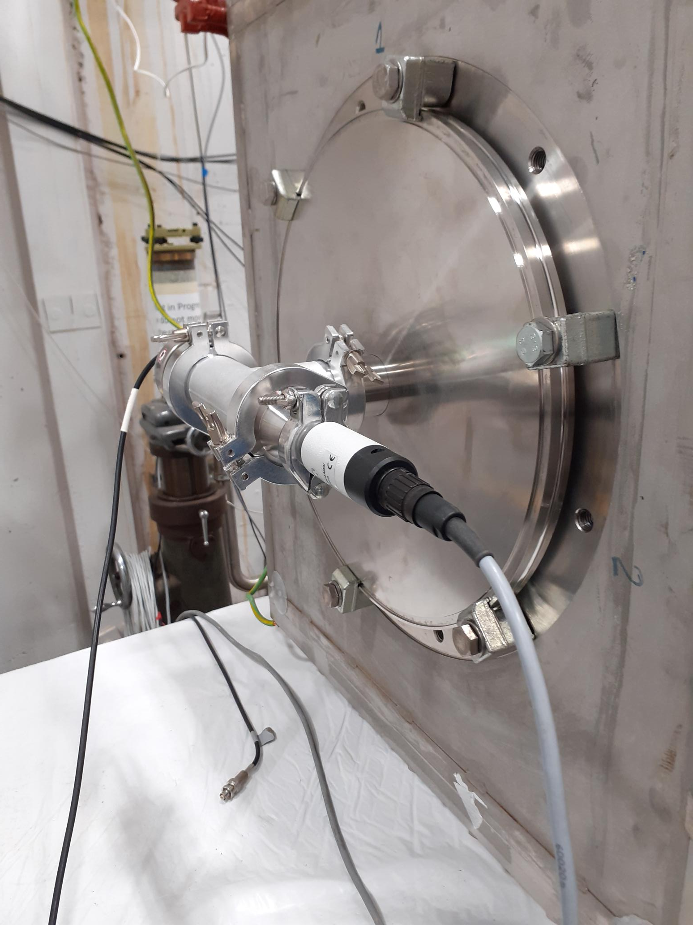
2a. Separator stainless steel wall thickness (100 kV)
1 cm
Roof
Iron
Stainless steel
Z
5 cm
Aluminium
0.3 cm
Y
Floor
3 cm

Slide 10
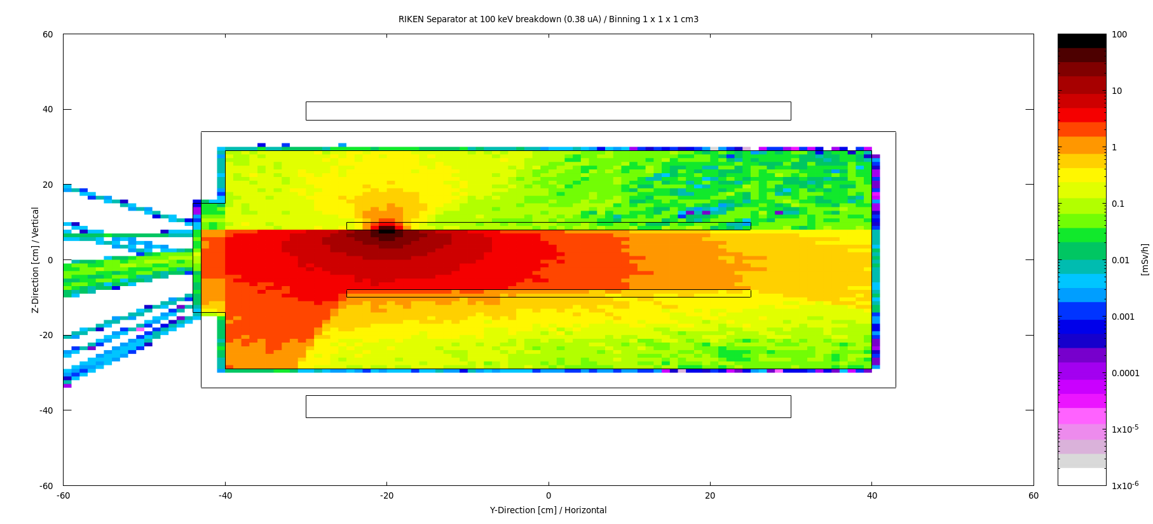
Dose rate mapping Y-Z Plane (assuming a steady 0.38 µA current, according to the maximum capacitor stored)
Off centred

Slide 11
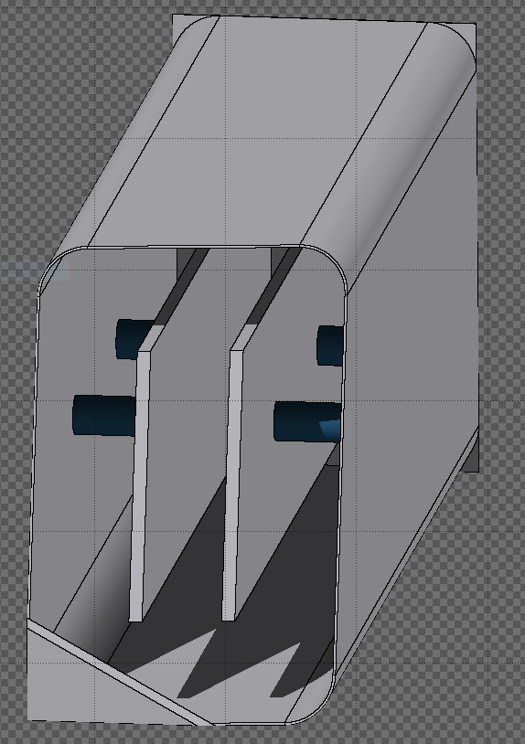
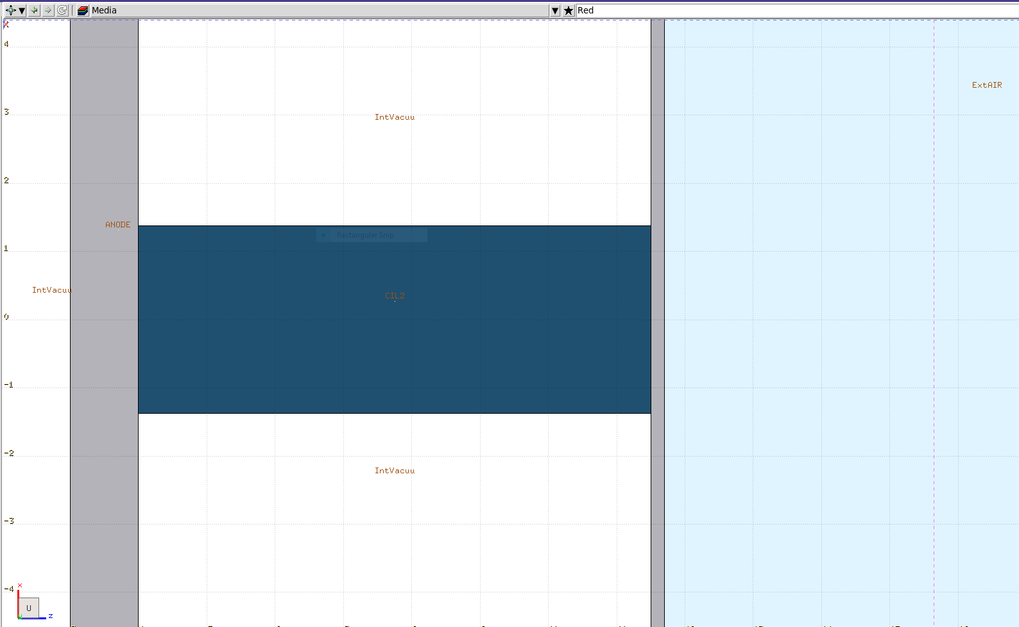
2b. Pulse Slicer: shielding analysis
70 kV applied voltage
Air
NEW!
Three OPTIONS:
Aluminium (6 mm & 20 mm thick)
SS316N (non-magnetic, 6 mm thick)
Al2O3 (insulator bars)
Aluminium (Anode & Cathode)
(1.0 cm thick)
Vacuum

Slide 12
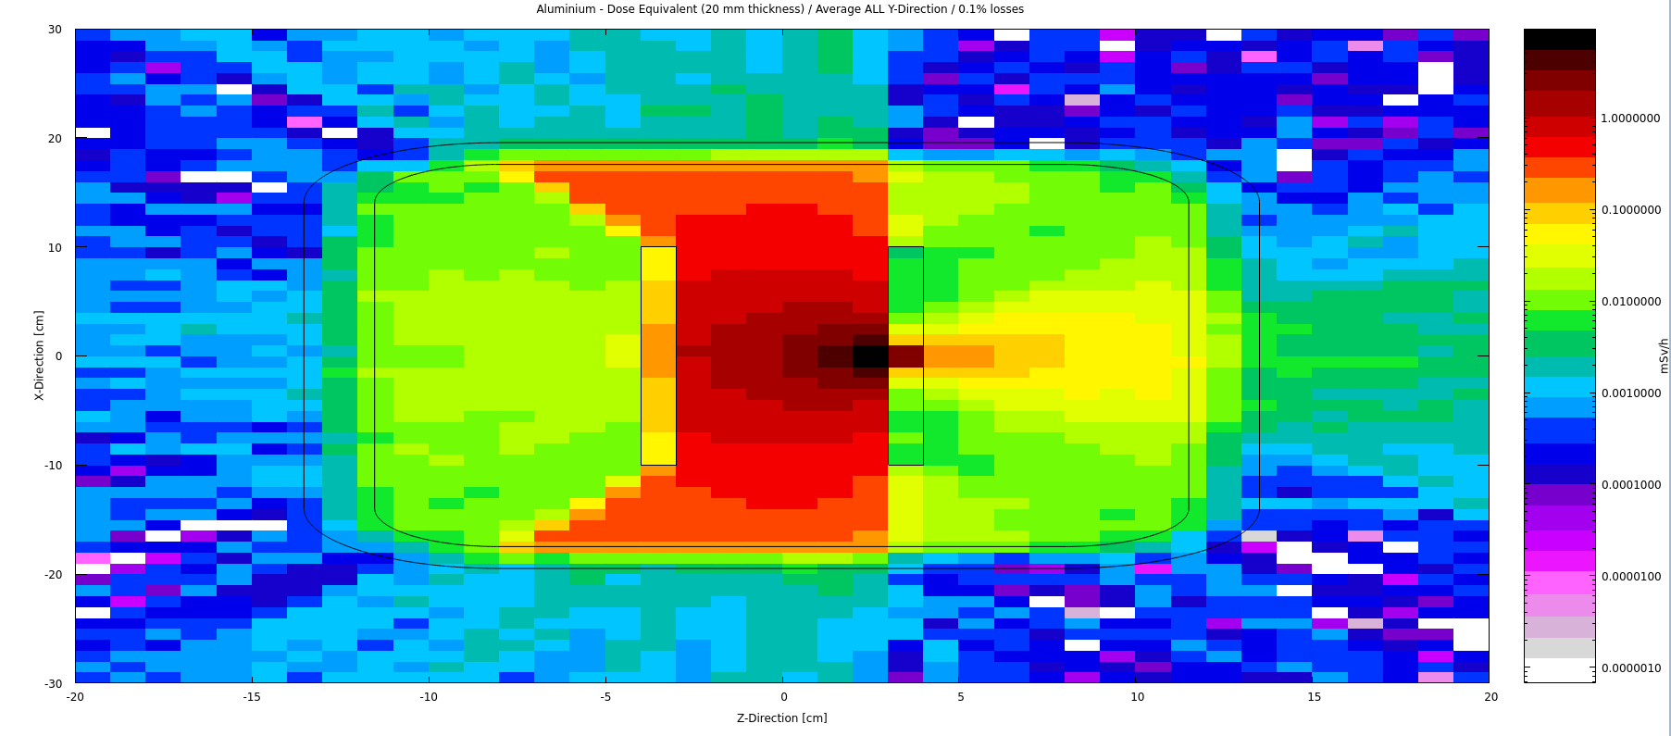
20 mm Aluminium Vacuum Vessel
2D Dose mapping (XZ plane projection, average Y-Direction values, 0.1% losses)
8 µSv/h

Slide 13
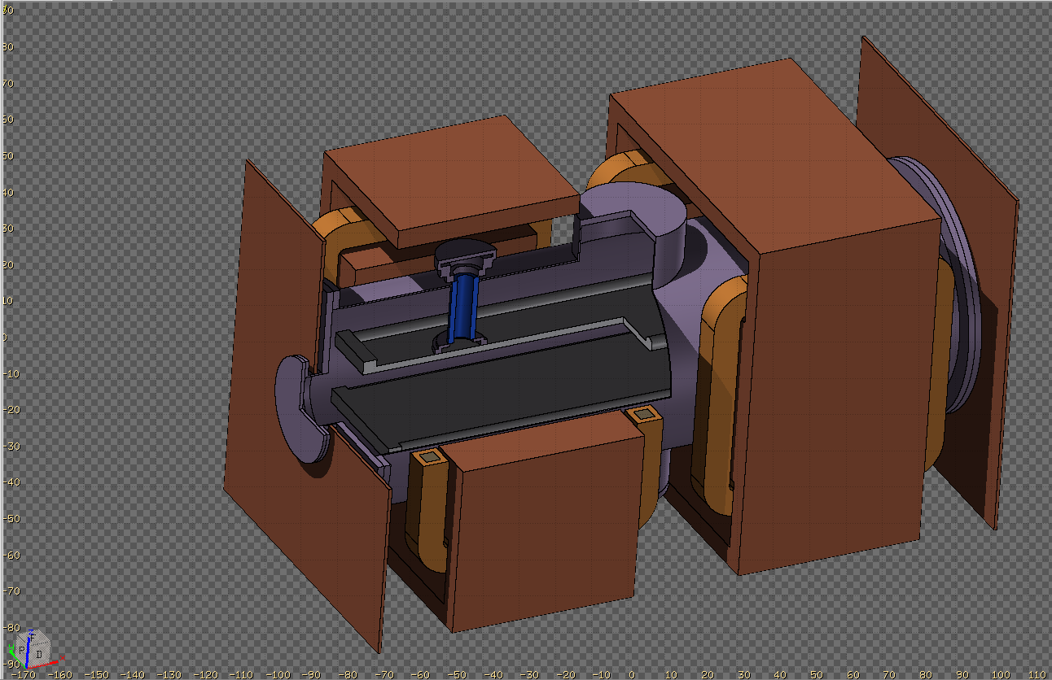
2c. Spin rotator: shielding analysis (430 kV)

Slide 14

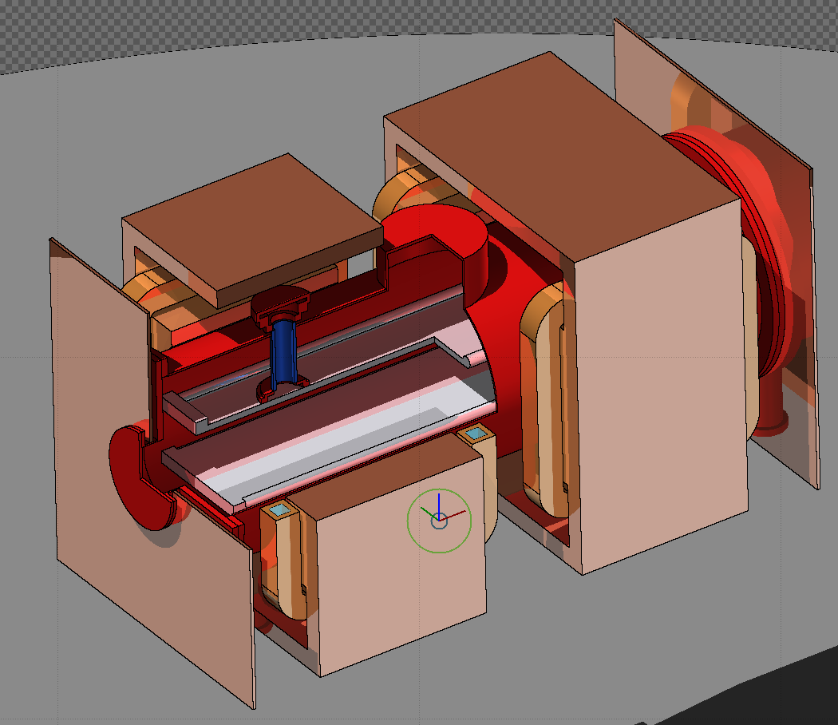







Calculate the source term (electron current-capacitor approach)
A = L x h
Where:
k: media permittivity
k = 1 (in vacuum)
ε₀ : vacuum permittivity
ε₀ = 8.854·10⁻¹² C²/(N·m²)
A: capacitor area
A = L x h = 1.6 x 0.35 m²
d: plates distance
d = 0.14 m
Spin Rotator = Parallel plane capacitor
L
$$C_{PS}$$
d
h
V_{Max} = 430 kV
(Between plates)
V_{Max} = 215 kV
(Plate - Vessel)
Maximum charge stored in the Spin Rotator capacitor:
$$Q\left(V_{Max}\right)=C_{PS}∙V_{Max} = \frac{ε_{0∙A}}{d}∙V_{Max}=\frac{8.842·{10}^{−12}∙\frac{C^{2}}{N·m2}∙\left(1.6 x 0.35\right)m^{2}}{0.14 m}∙(430;215)∙{10}^{3} {N∙m}/C$$
$$1.52·{10}^{−5} C$$
$$7.61·{10}^{−6} C$$
The electron current, assuming 15 discharges in an hour:
$$I_{Max}=63.5 nA$$
$$I_{Max}=$$
$I_{Max}=$ 31.7 nA

Slide 15
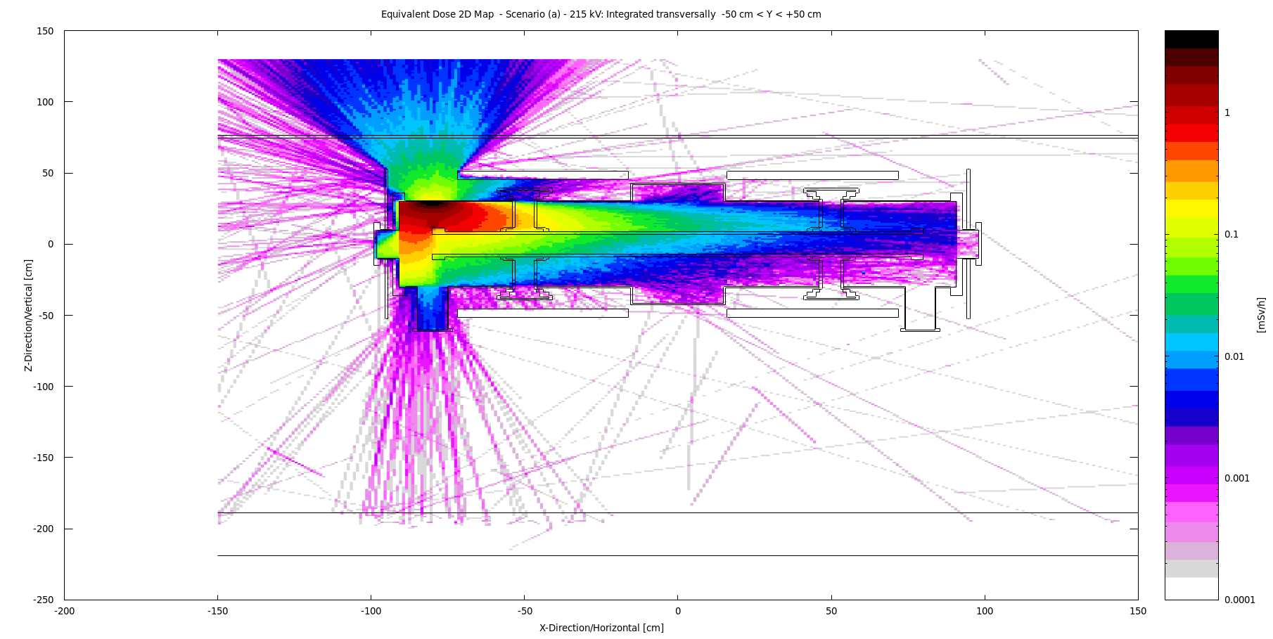

Slide 16
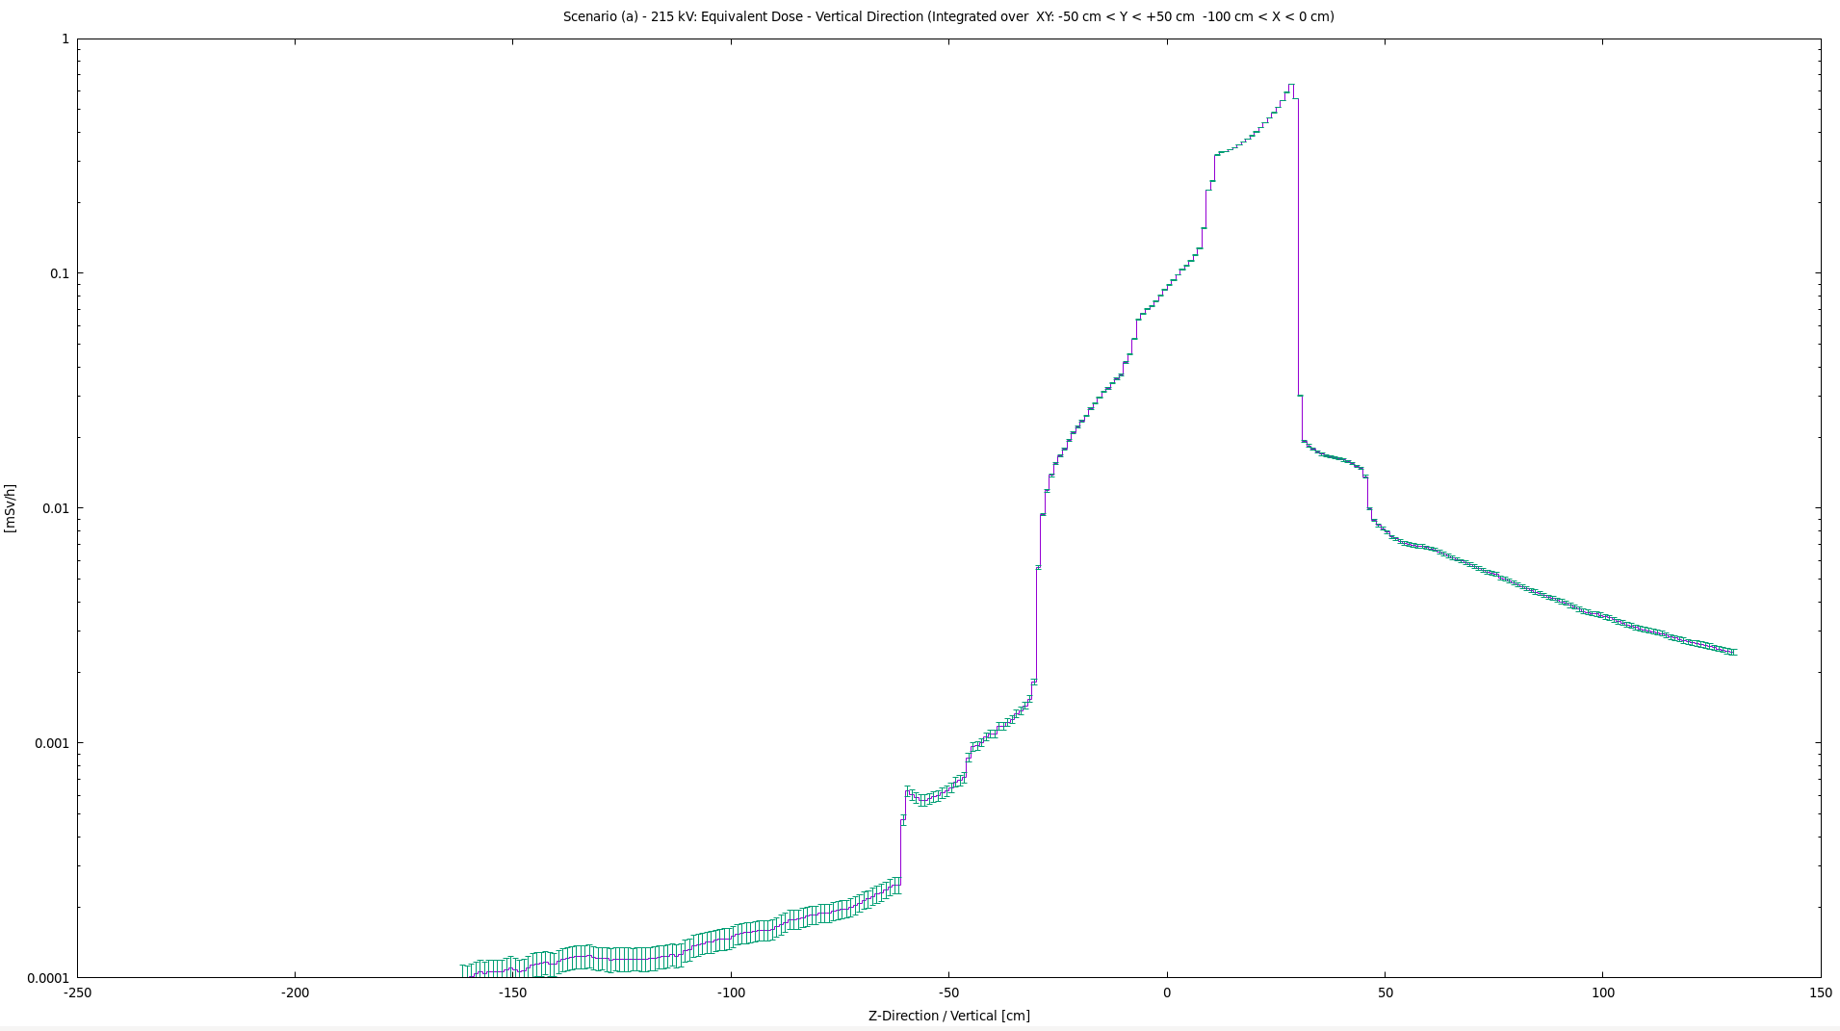
Ground Floor
Mezzanine Floor
5 µSv/h
SR Vessel
-189.0 cm
-30.6 cm
30.6 cm
76.5 cm

Slide 17
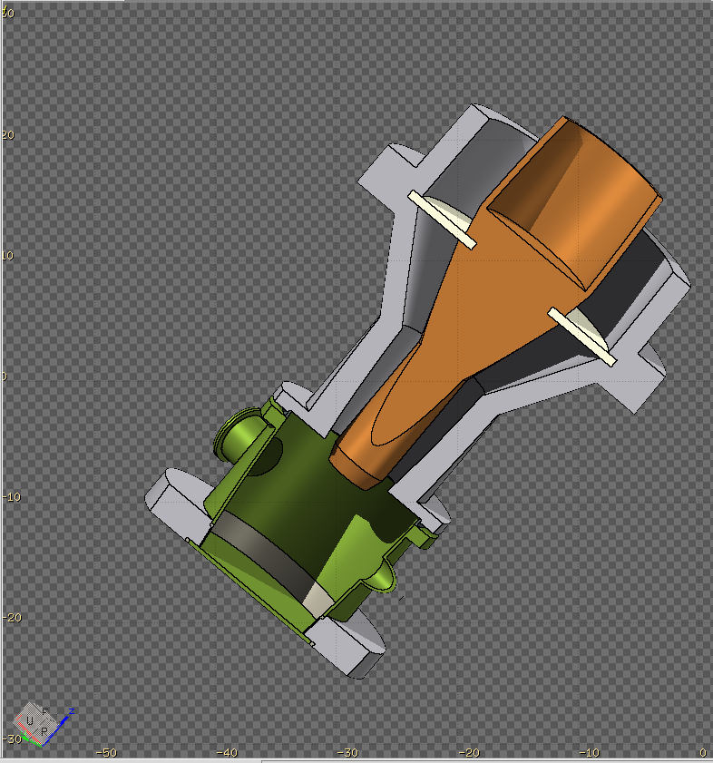
2d. HV power connector: shielding analysis

Slide 18
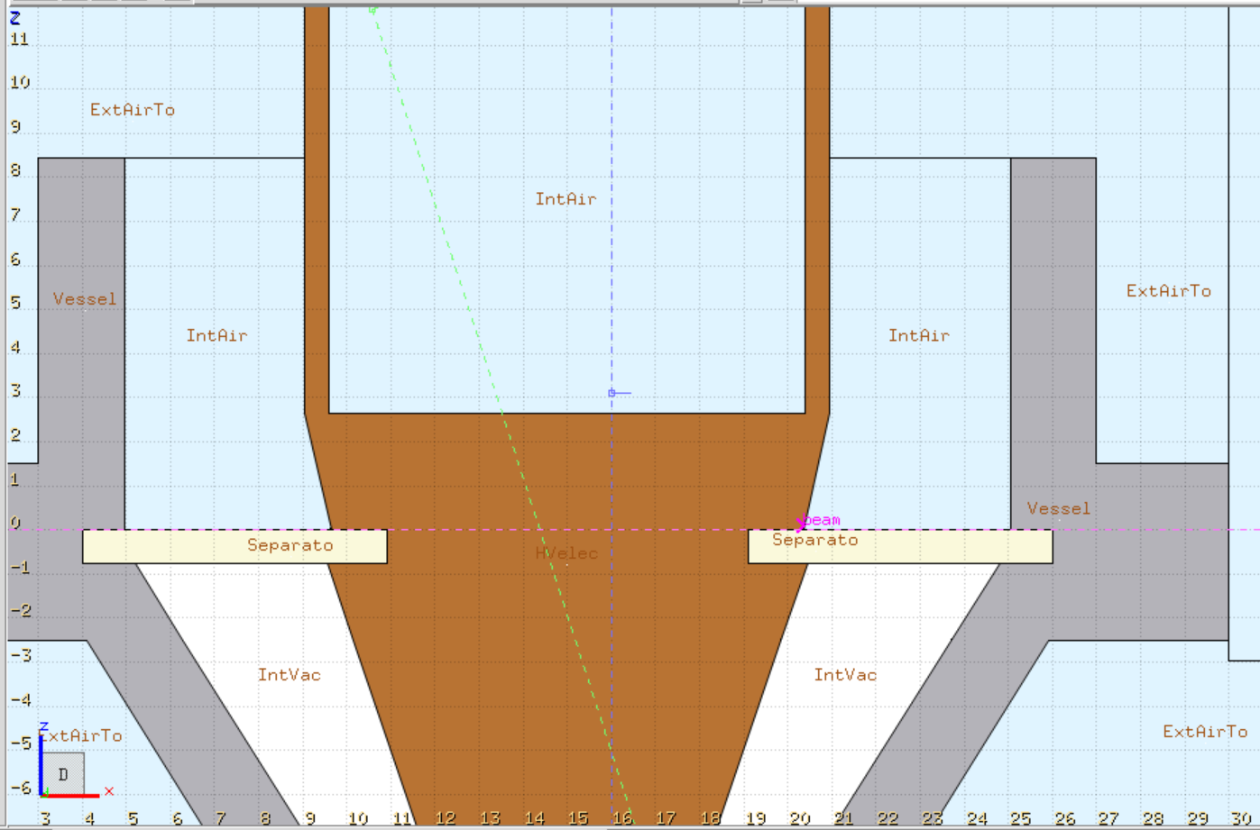
Beam Characteristics – e⁻ Discharge
Air discharge
Location
Voltage: 35 kV
Current: 380 µA
Frequency: 50 Hz
Simulation:
  10⁸ primary particles (e⁻)
  Binning size: 1 x 1 x 1 cm³
  Dose equivalent (1D & 2D)

Slide 19
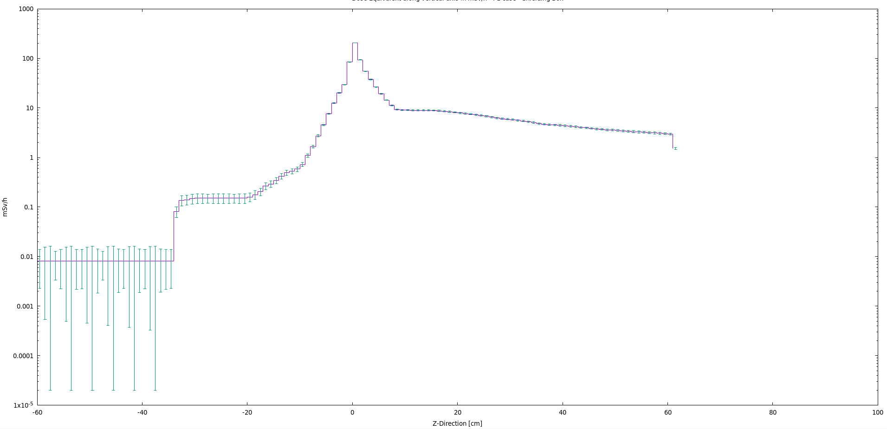
Stainless Steel: Dose Equivalent Vertically (All X,Y-Direction Integrated))
If a continuous 380 µA current discharge
If a continuous 7.4 µA current discharge

Slide 20
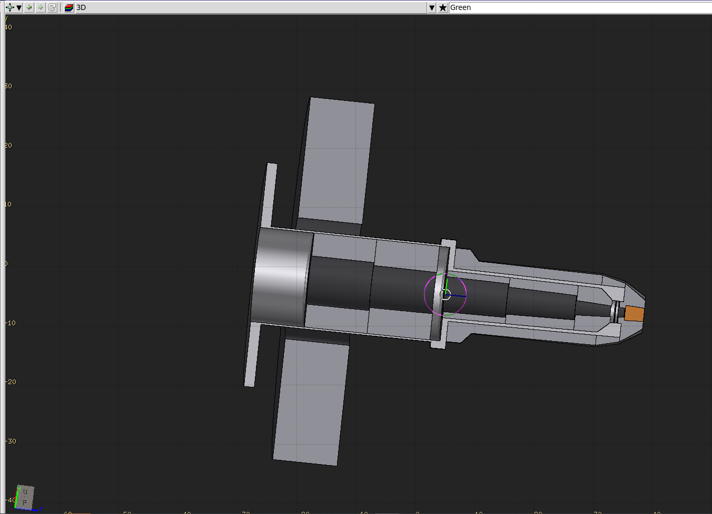
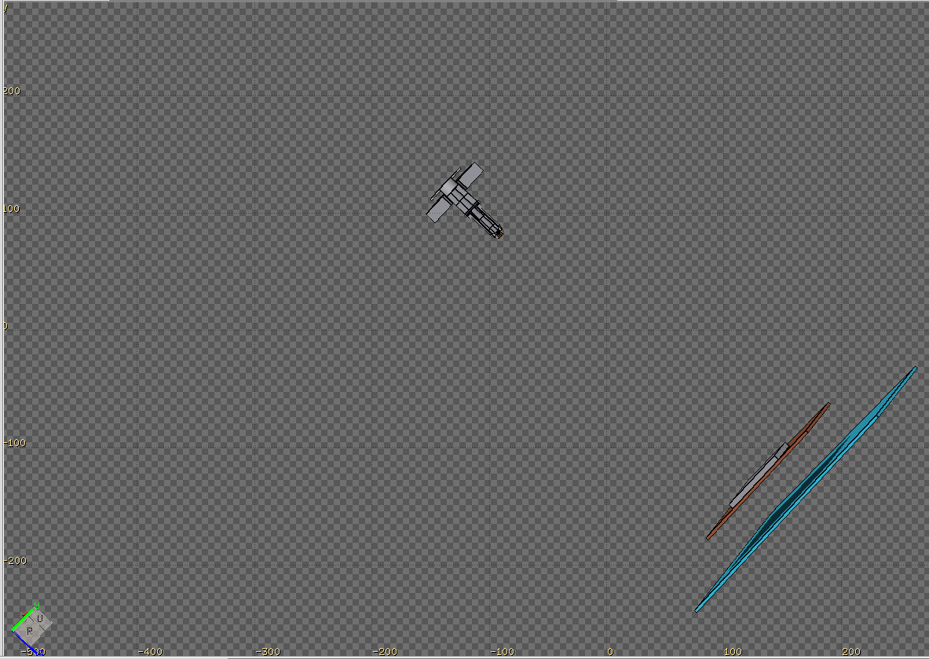
3. µ⁺ / µ⁻ Beam Stop: shielding diagnose (at 27 MeV/c)

Slide 21
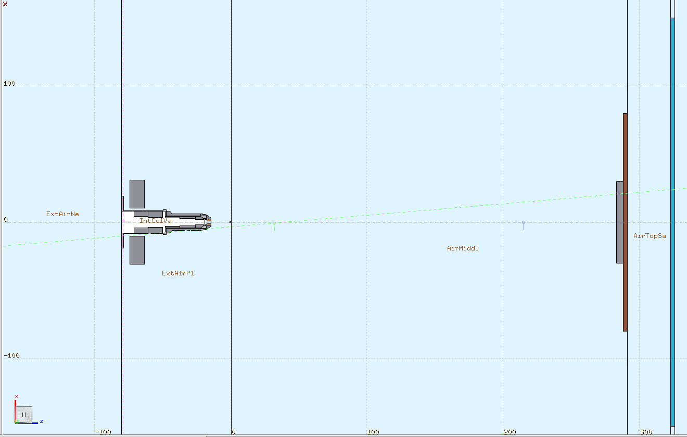

Slide 22
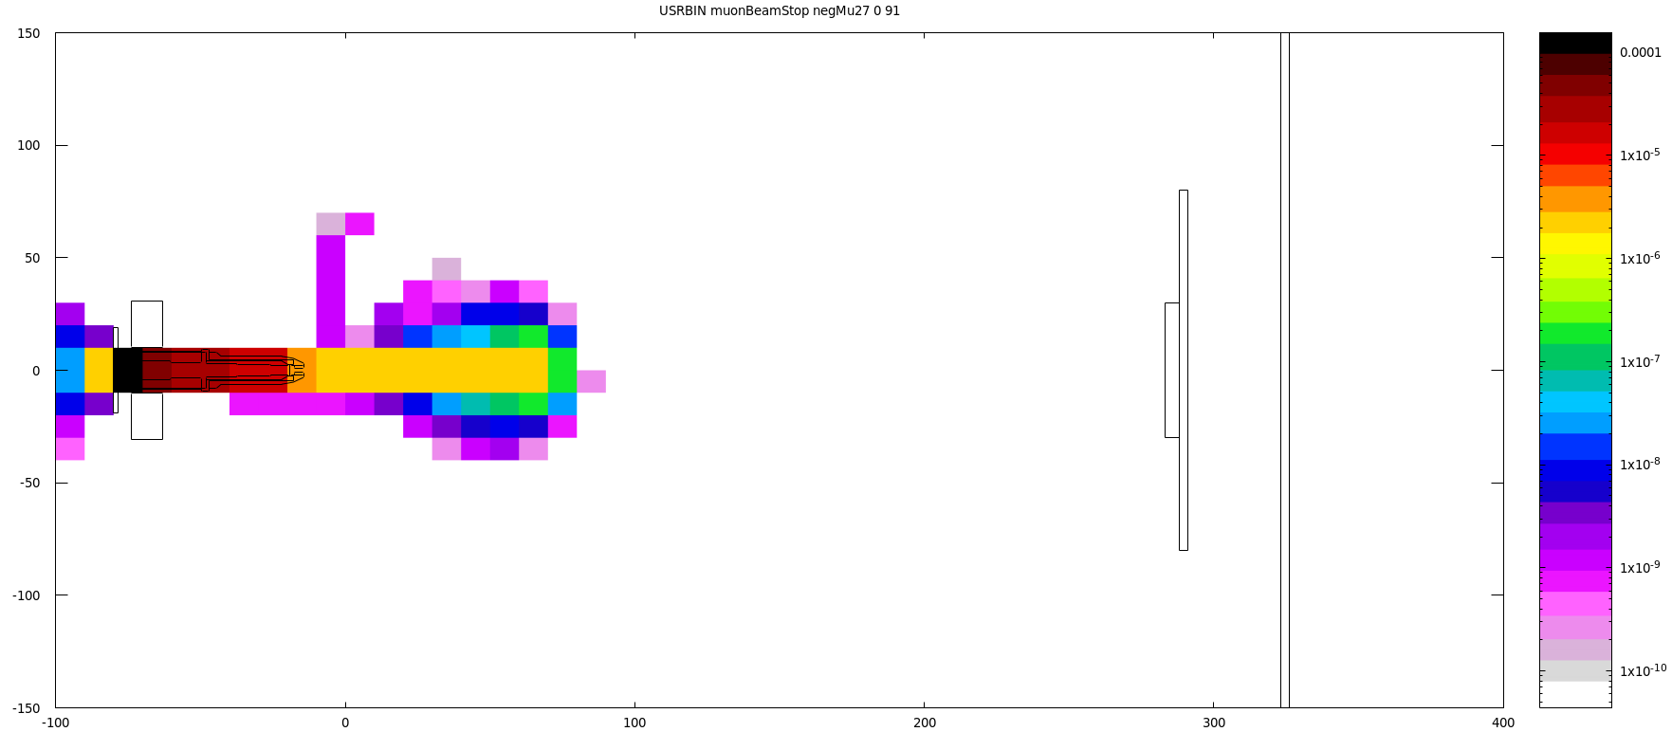
µ- at 27 MeV/c: Primary particles energy deposition

Slide 23
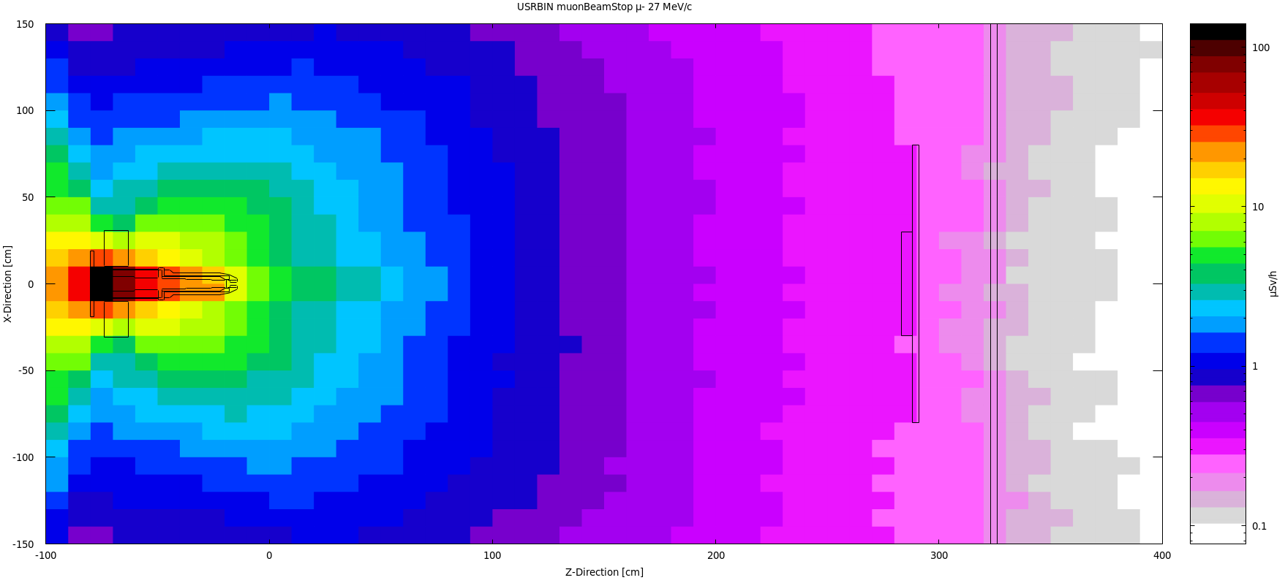
µ- at 27 MeV/c: Dose (µSv/h ; Factor conversion for 5000 µ-/pulse, 40 Hz)

Slide 24
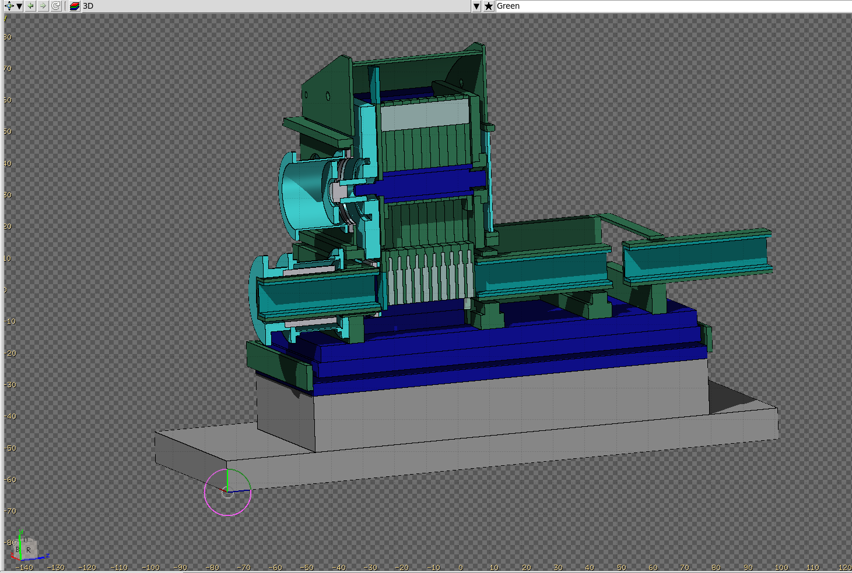
4. Neutron / Chopper neutron beam: neutron distribution and activation

Slide 25
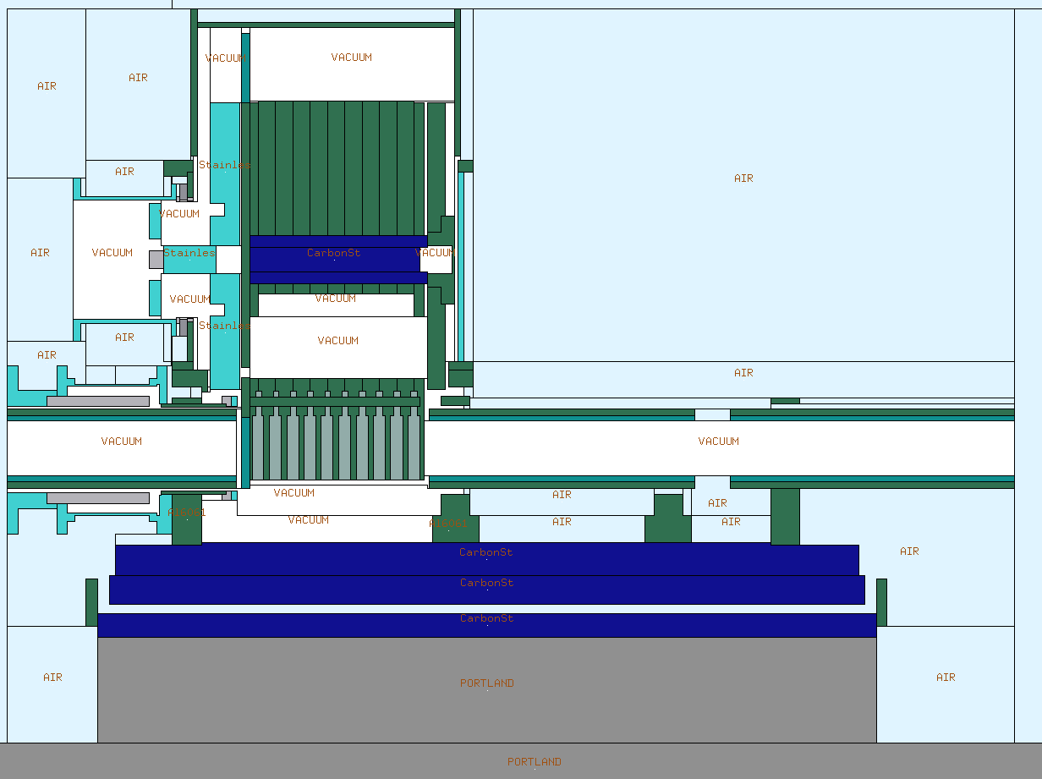
Next slide

Slide 26
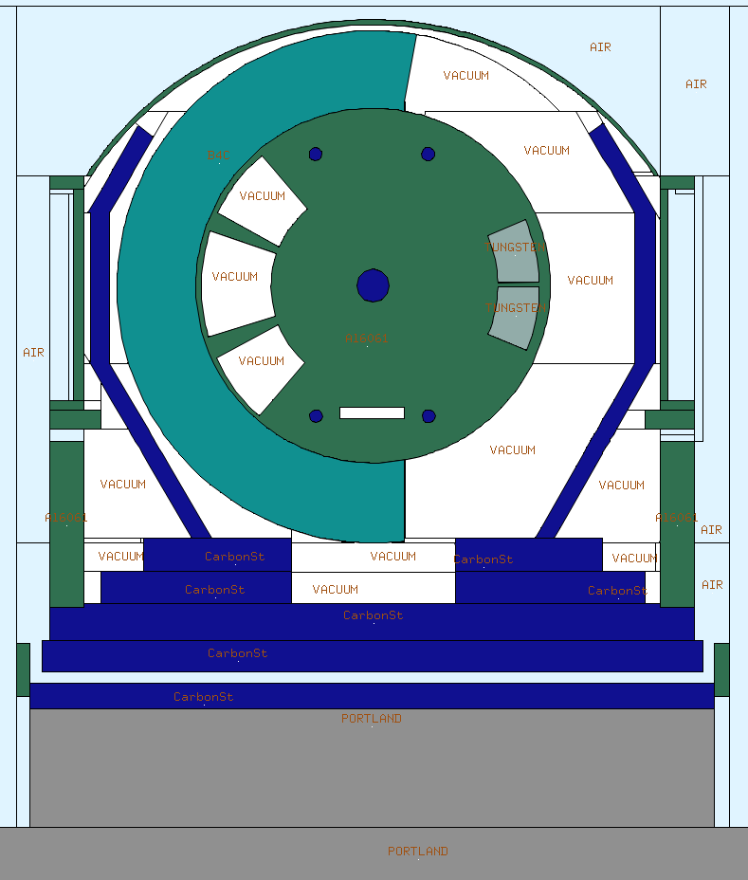

Slide 27
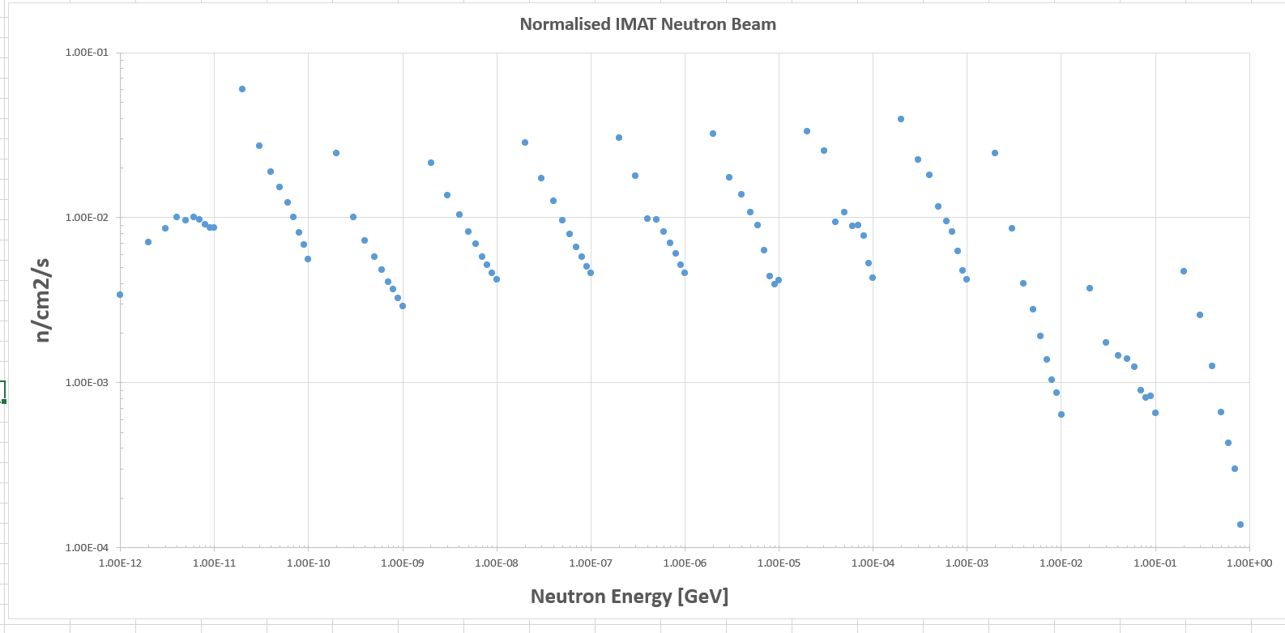
IMAN spectra (external file): NeutronHISTimat_0.dat

Slide 28
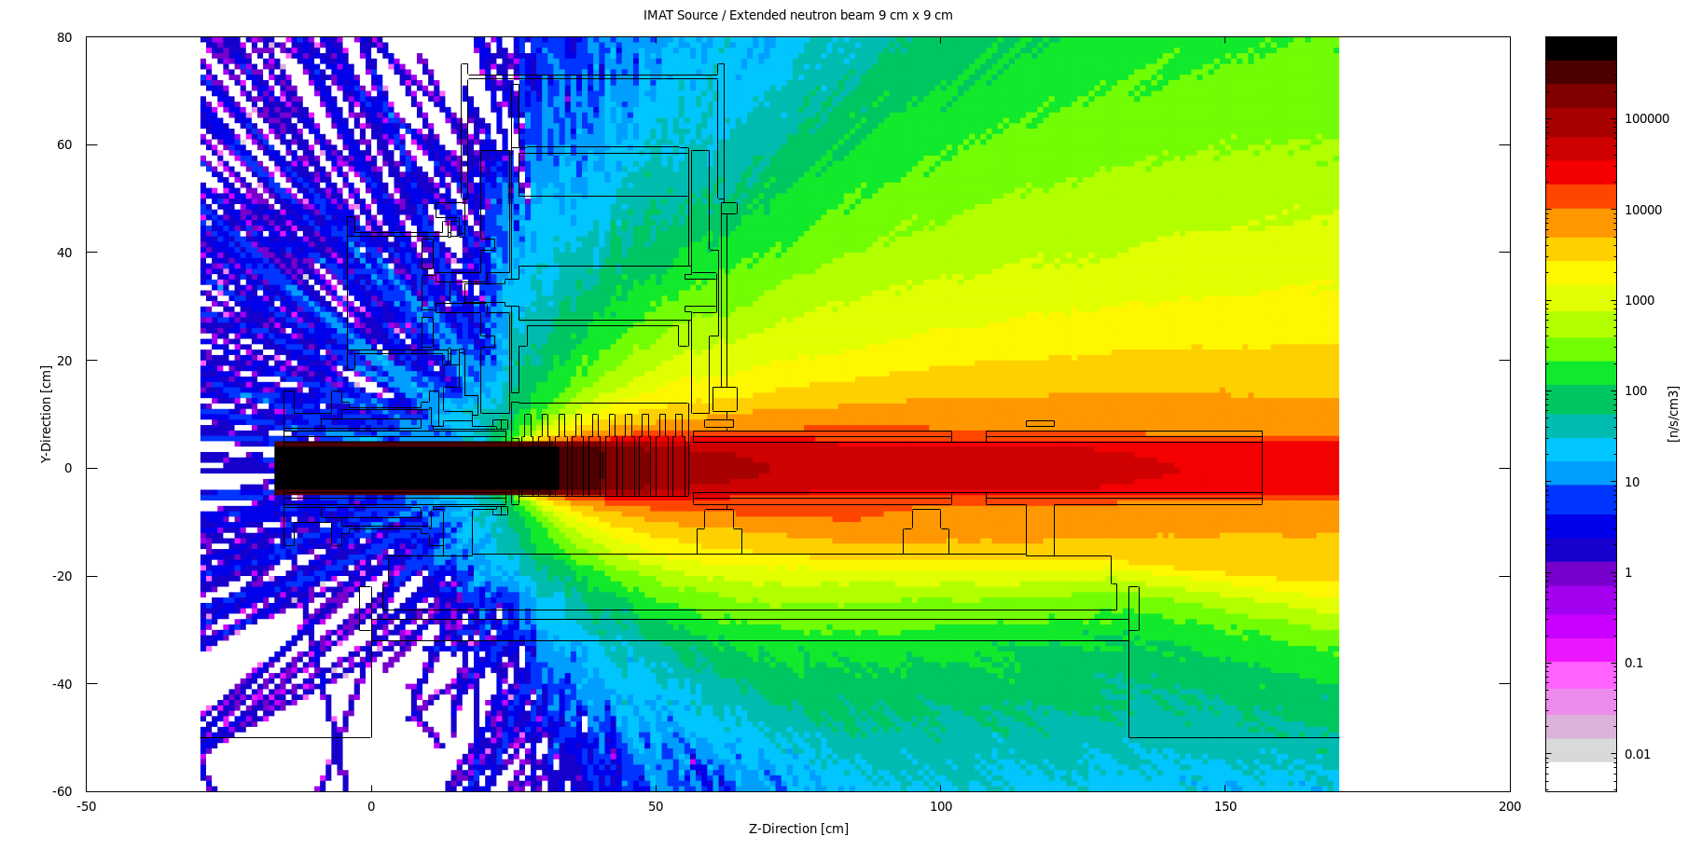

Slide 29
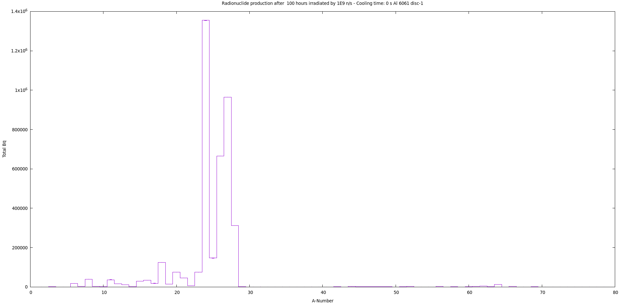

Slide 30
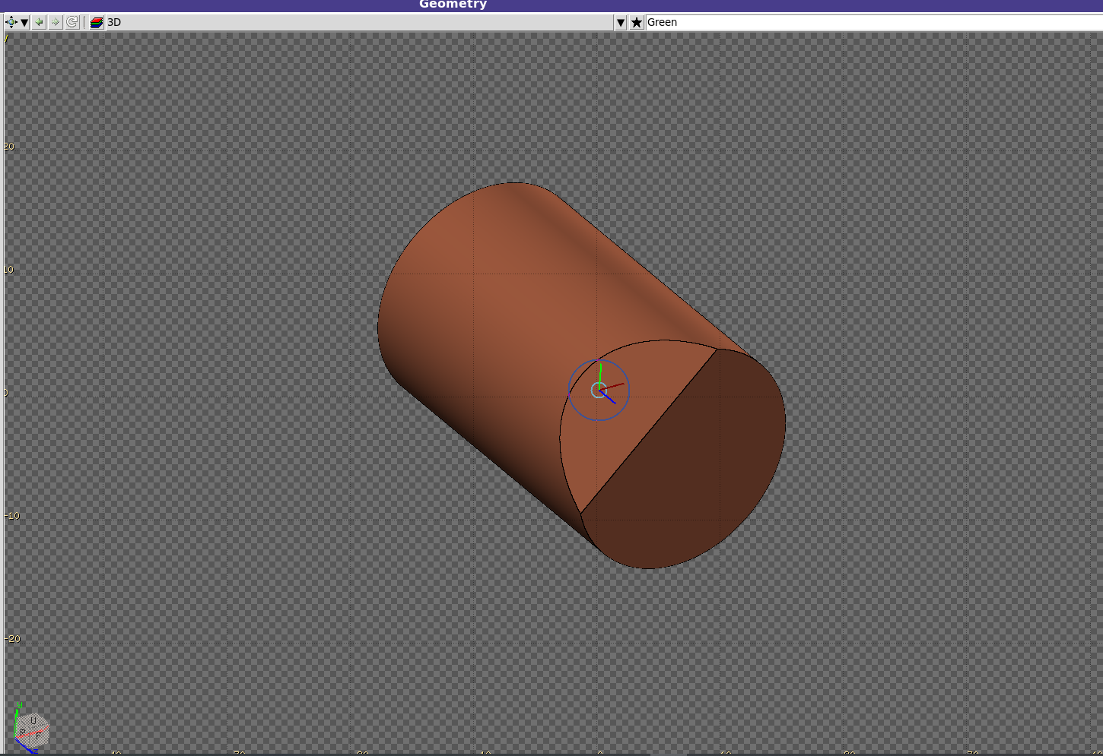
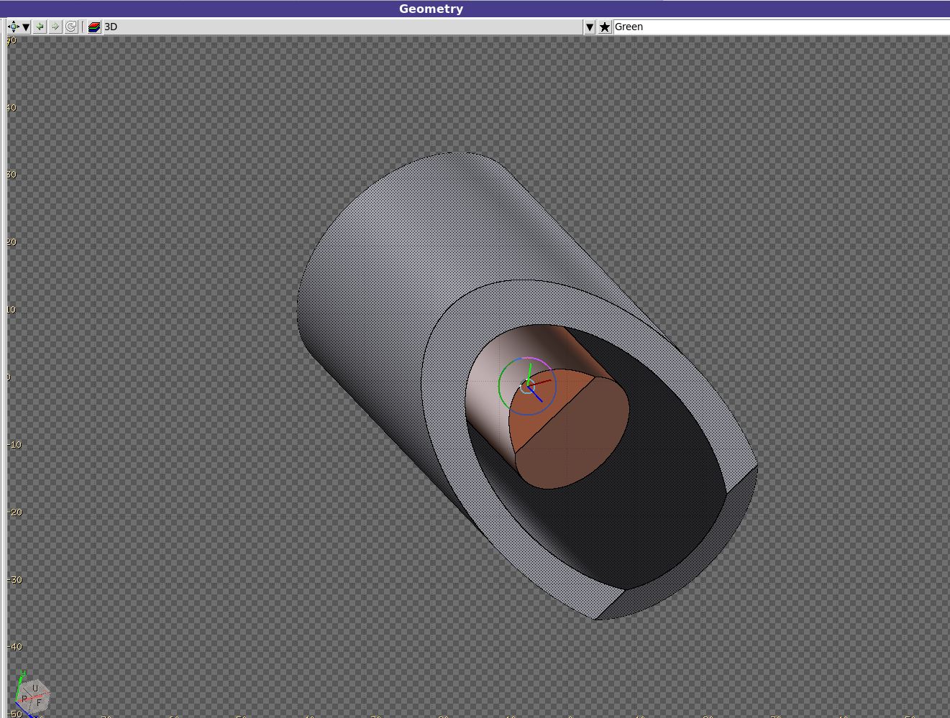
5. proton / neutron - Dummy target geometry: dose map and activation (ongoing)

Slide 31
5. proton / neutron: Dummy geometry: dose map and activation (ongoing)
Beam | Beam Energy [GeV] | Cylinder Length [cm] | Target Material | Cooling Time | Scoring
Proton | 0.8 | 30 | Fe | 0 sec | Dose map
Neutron | 0.08 | 10 | Al | 1 day | Nuclide list
 | Histogram | 5 | Cu | 1 week | Particle spectrum
 |  | 0.5 | Stainless Steel | 1 moth
 |  |  | Concrete | 3 moths
 |  |  |  | 1 year

Slide 32

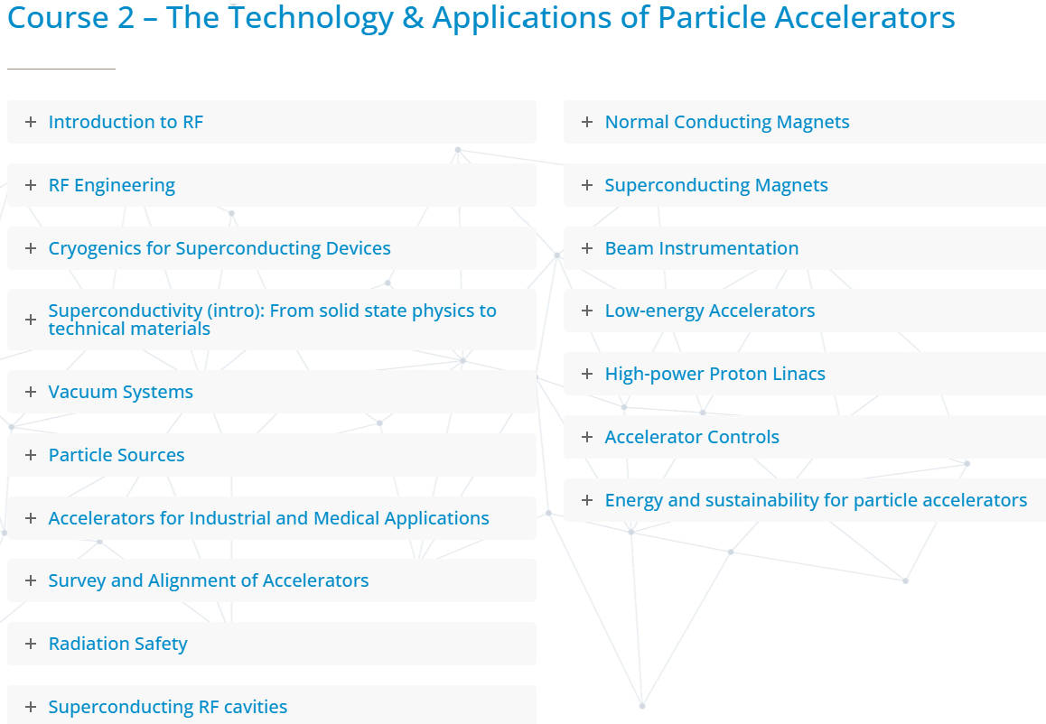
6. JUAS 2026 - FLUKA & flair brief introduction

Slide 33
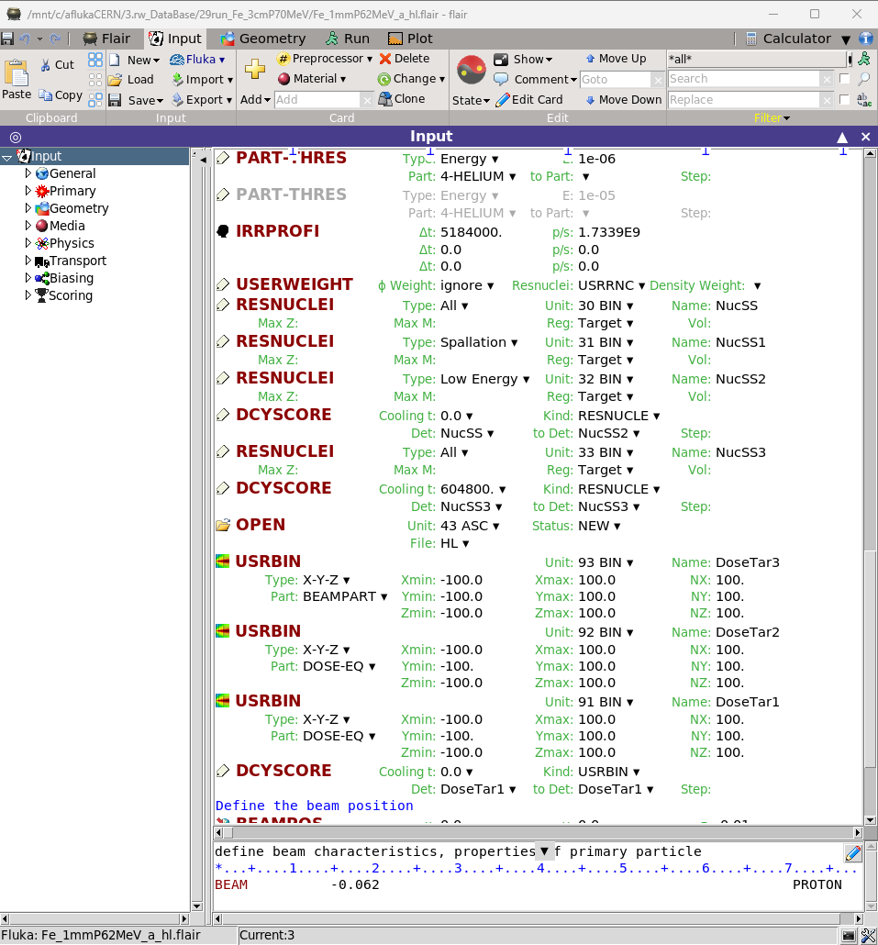
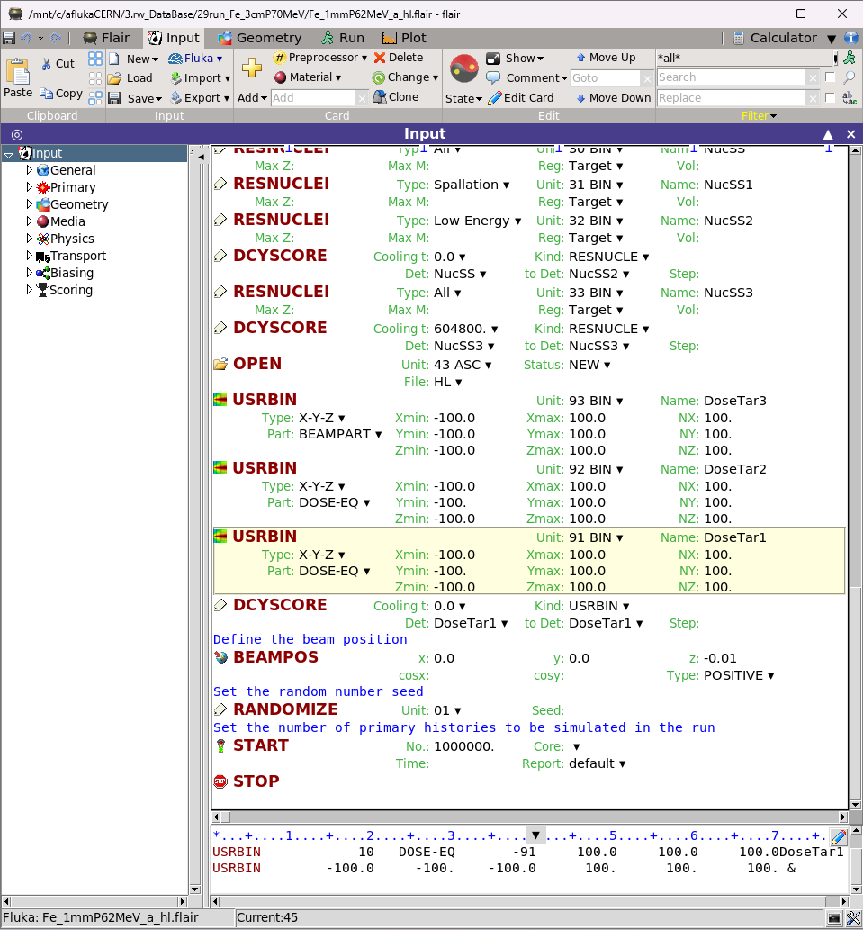
Basic input overview
FLUKA input file (flair)

Slide 34
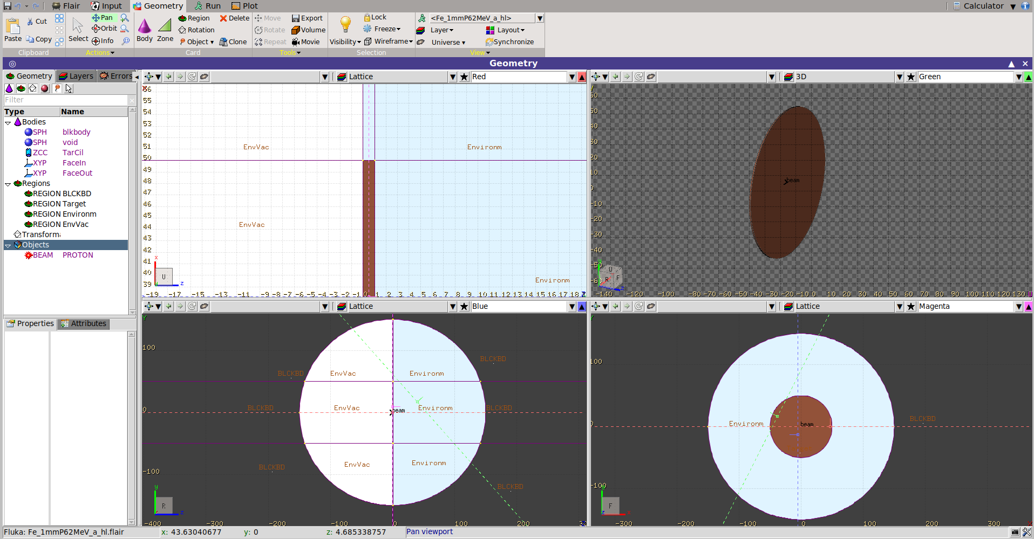
Basic input overview
Geometry (Geoviewer)

Slide 35
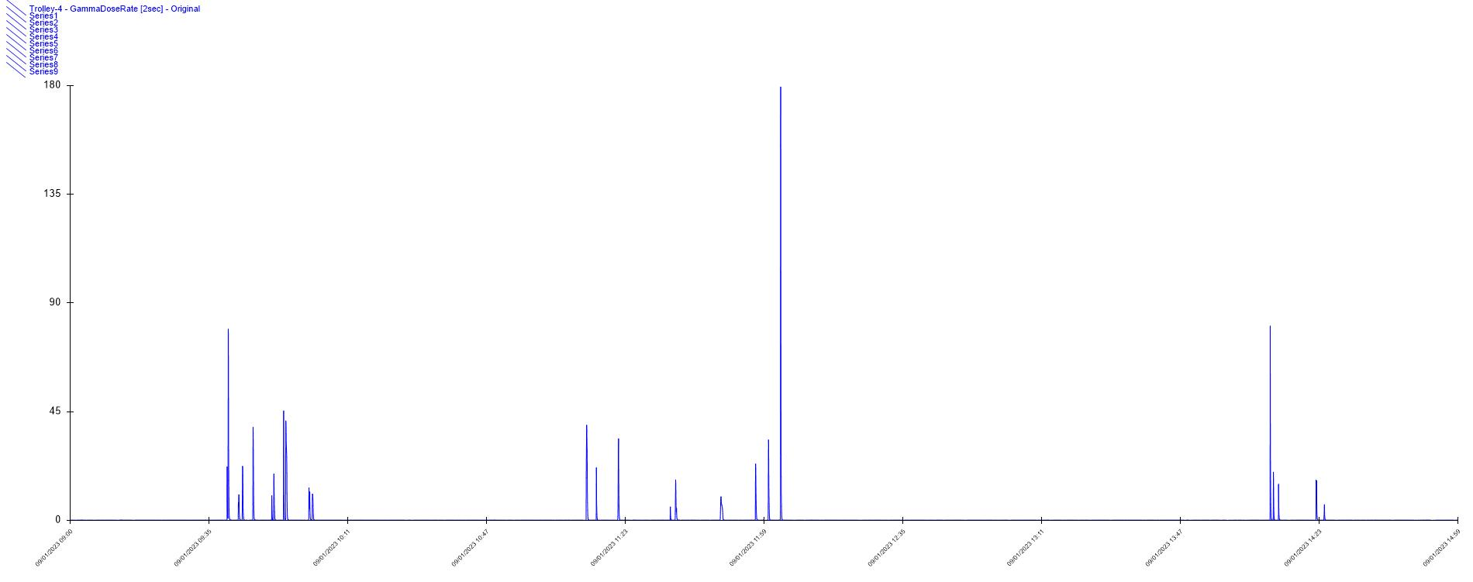
2a. Separator Measured Data: Gamma dose rate
Alarm Trip-off
µSv/h
79.2
33.9

Slide 36
Many thanks!!!
Any questions?

