Slide 1
Instrument Development & Fluka
Robert Dalgliesh
2nd June 2026

Slide 2
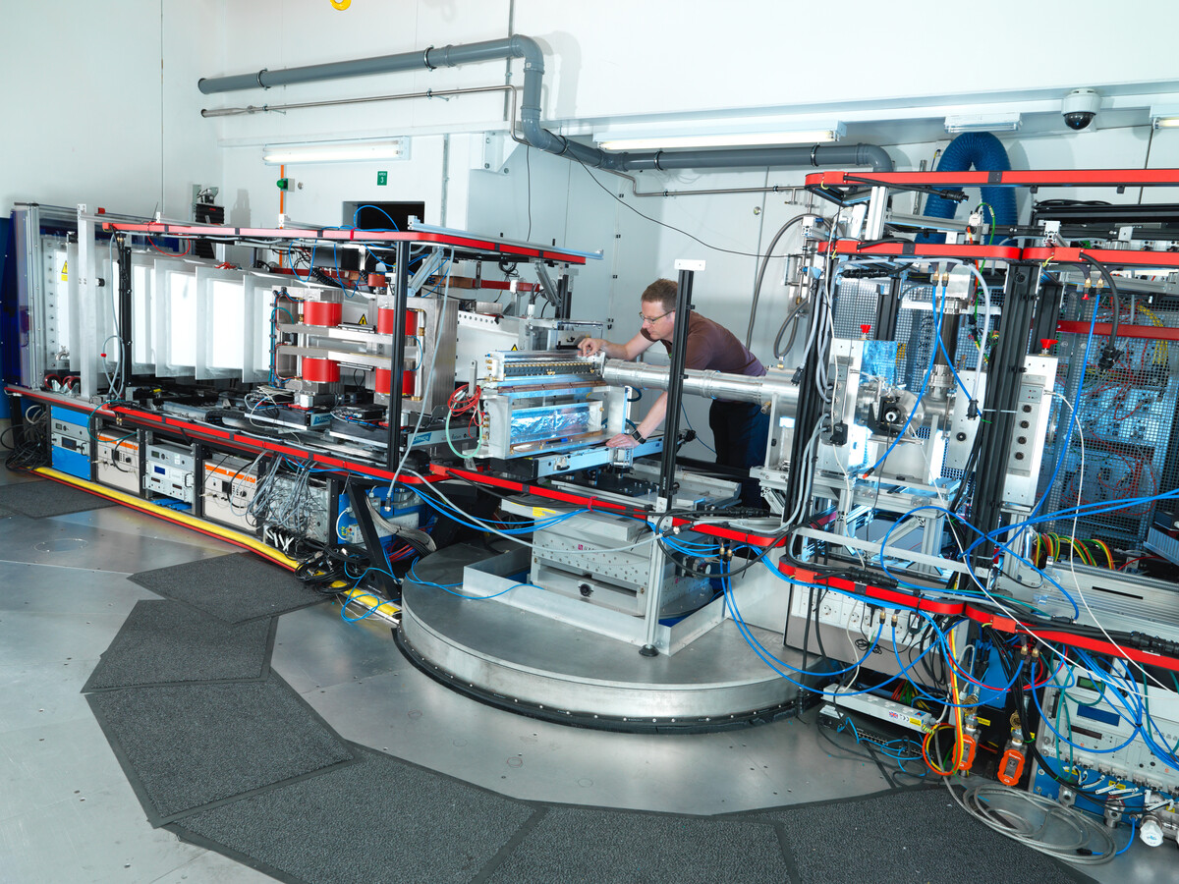
Instrument Development Requirements (Time-of-Flight)
TOF Instrument Design
  Lots of trade offs to consider
    Simultaneous wavelength band
    Wavelength resolution requirements
    Angular acceptance at the sample.
    Detector resolution requirements
    Flux on sample
    Potential backgrounds
    Source structure

Slide 3
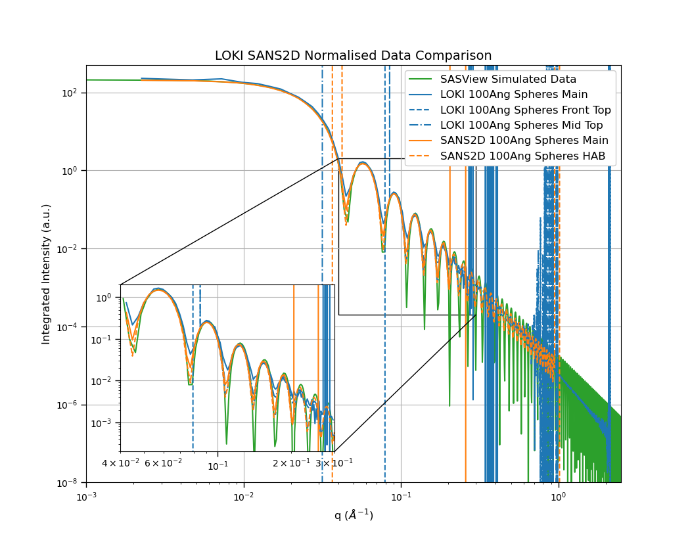
Instrument Development Requirements (Time-of-Flight)
Neutron Pulse Structure
  Accurate reconstruction of neutron T₀ from the point of emission.
  Flux at sample as a function of wavelength. (n/s/cm²)
  Wavelength Resolution
    Accurate prediction of pulse shapes as a function of wavelength
  Accurate simulation all wavelength/energies.
  Detector resolution requirements
    Combination of multiple considerations

Slide 4
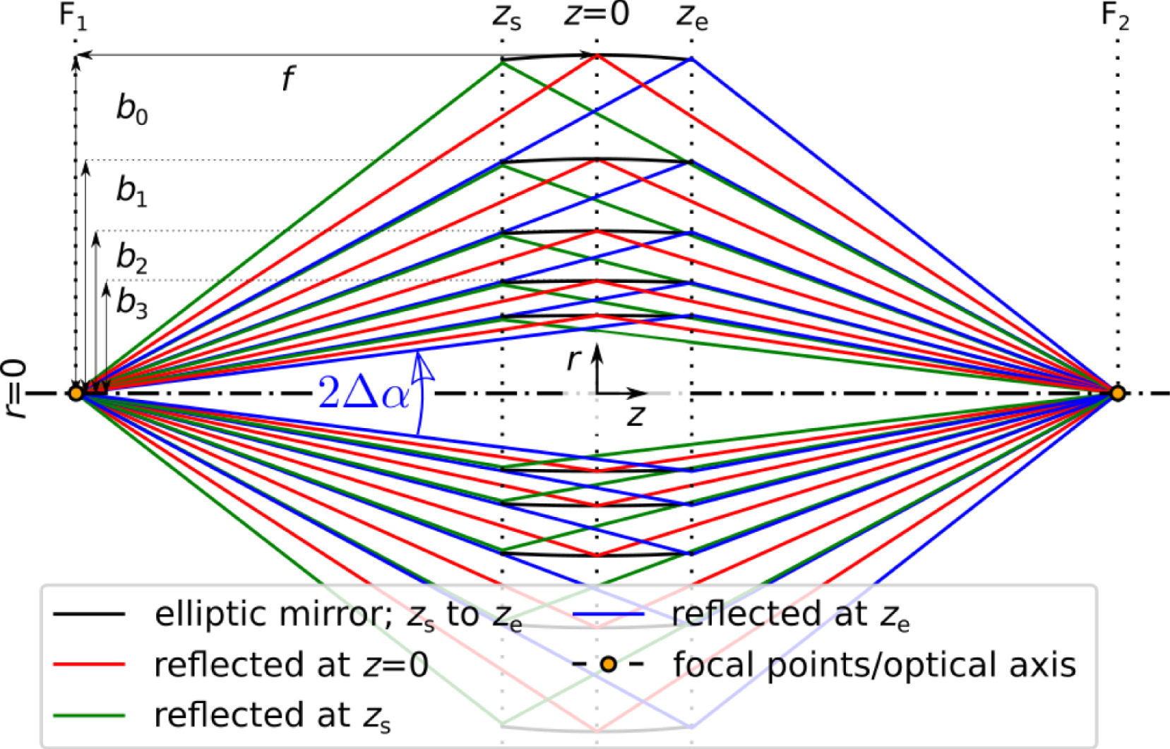
Instrument Development Requirements (Time-of-Flight)
Angular acceptance.
  Depends on the instrument design
  Upstream collimation limiting the accepted divergence can be very limiting (SANS <0.2deg)
    How can this be calculated efficiently
  Low dimension moderators
    What are the effects of misalignment?
    Needs a structured source file
Herb et al. 10.1016/j.nima.2022.167154

Slide 5
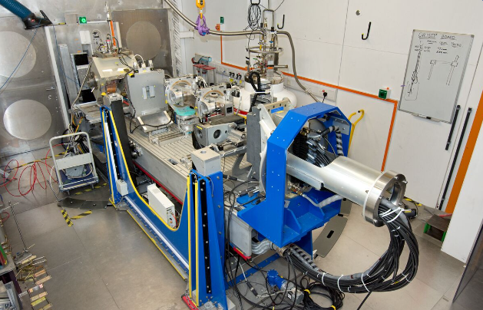
Instrument Development Requirements (Time-of-Flight)
Potential Backgrounds
  Fast Neutrons
  Activated components (moderators)
    Continuous fast neutron backgrounds on straight guide instruments
  Activated Gamma sources along the beamline
  Air scatter
  Optics and collimation misalignment
PolRef

