Slide 1



FLUKA use in the High Power Targets Group (HPTG)
Mike Fitton
June 2026
RAL High Power Targets Group
Notes:
The abstract pattern can be removed or repositioned if required. Be careful to ‘Send to Back’ so that it does not obscure any important information.

Slide 2
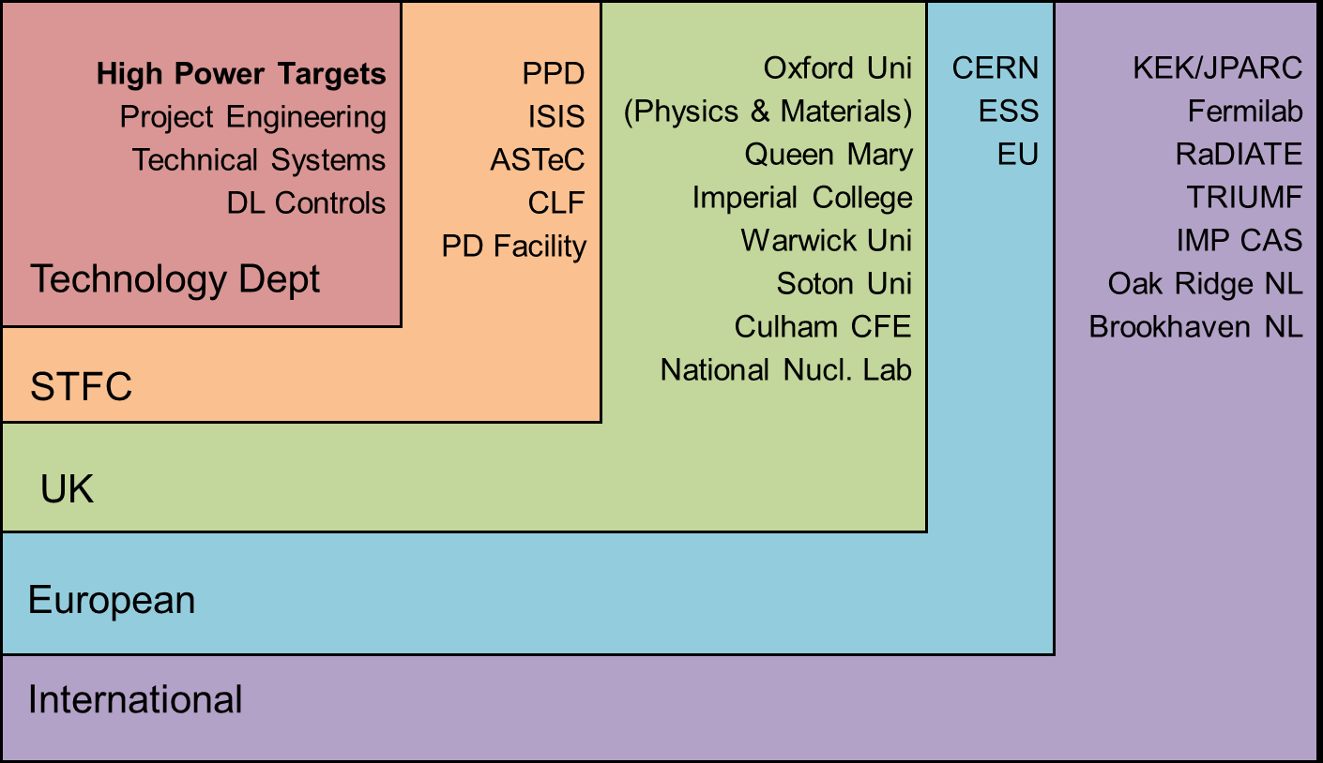
High Power Targets Group (Applied Science Division, Technology Department)
“We specialise in designing and building high power targets, a crucial enabling technology for the next generation of particle accelerators”
Our Mission: To be a ‘one-stop shop’ for accelerator target technology
​STFC Technology has built an international reputation in this field, and has accelerator target expertise ranging from concepts through to detailed design, prototyping, manufacture, commissioning,
maintenance & operation.
Responsible for many beam intercepting devices, such as:
Targets
Beam windows
Baffle/collimators
Beam dumps
High power beam instrumentation

Slide 3
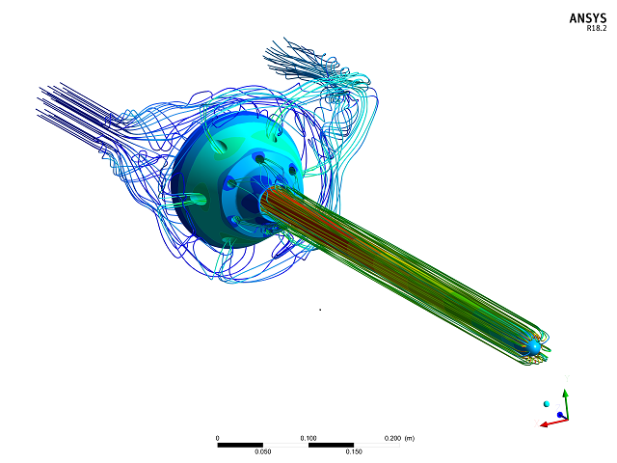
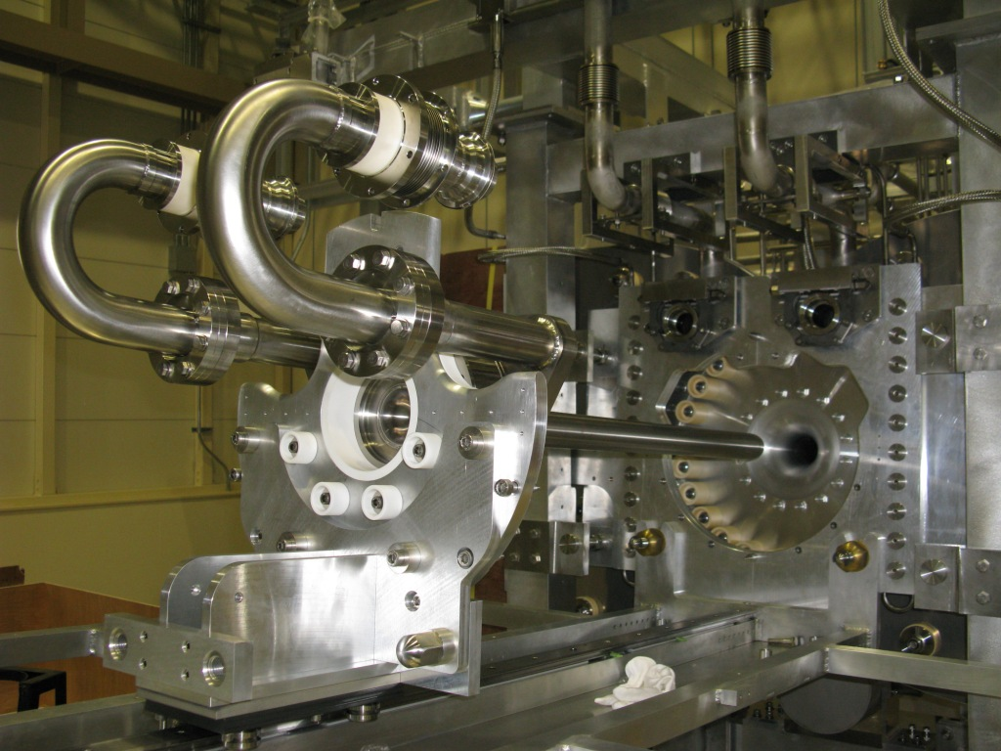
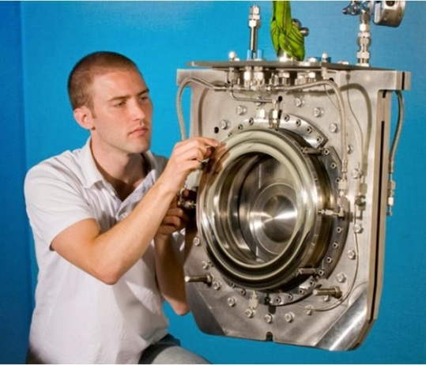
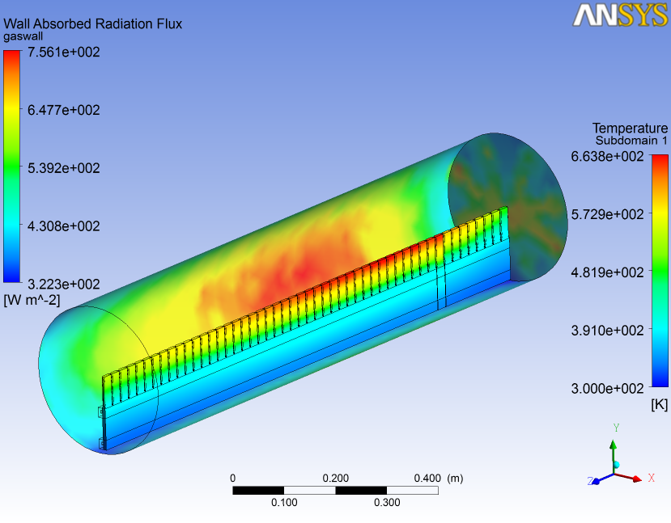
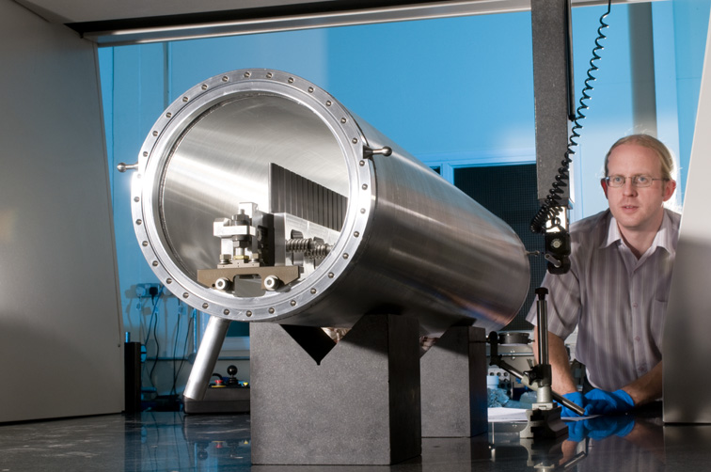
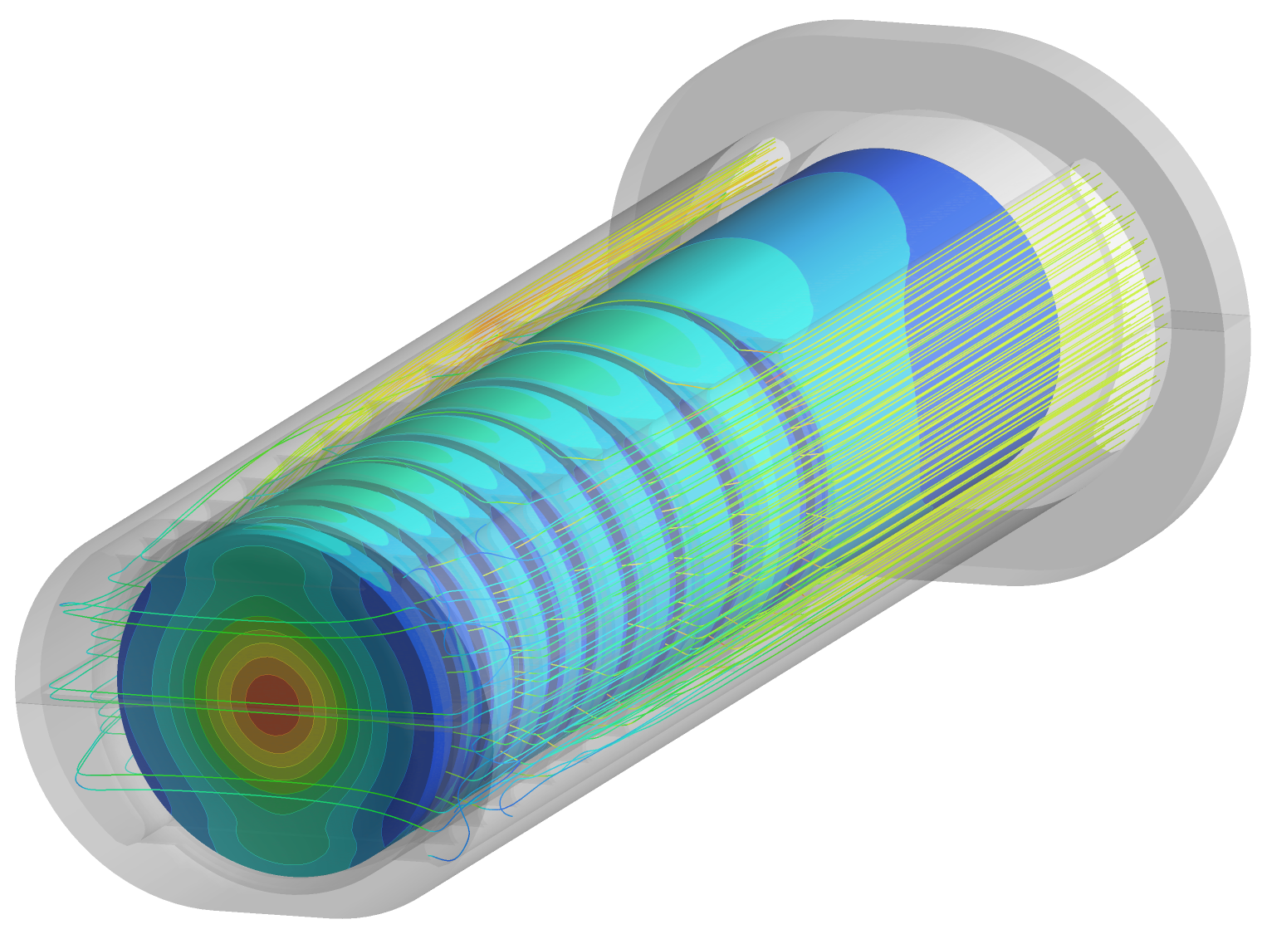
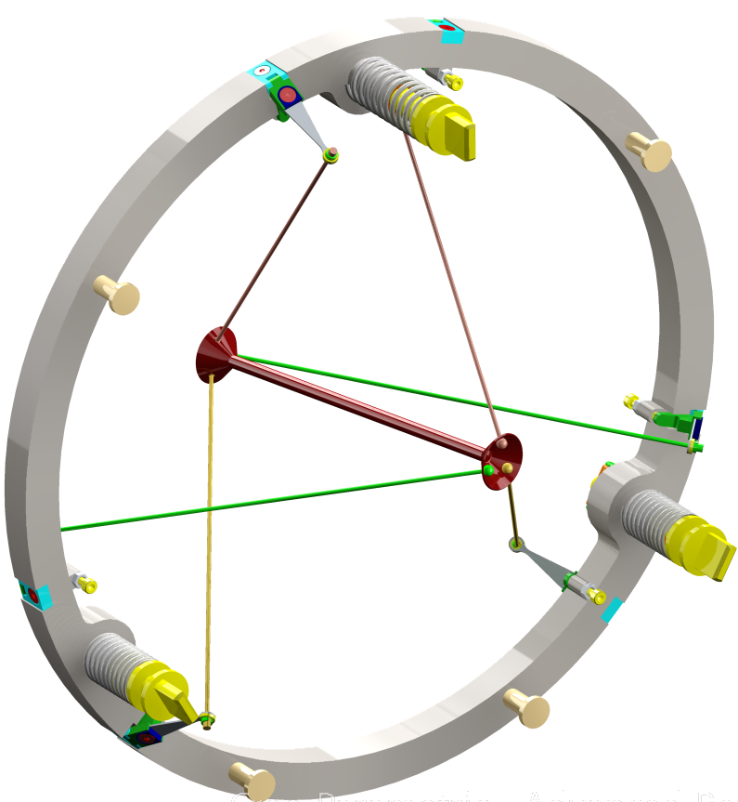
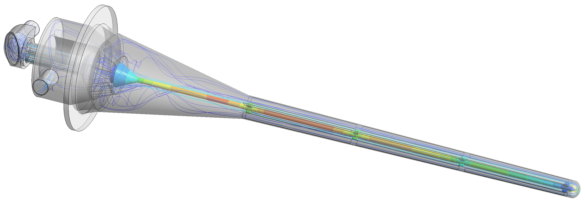
HPTG – Examples of current and recent projects
T2K PBW
T2K Target
Current power – 910kW
Design power – 1.3MW
T2K Target
NuMi – NOVA
ISIS TS1
NuMi – NOVA
Operational power – 1MW
Mu2e
LBNF target
Design power – 1.2MW

Slide 4
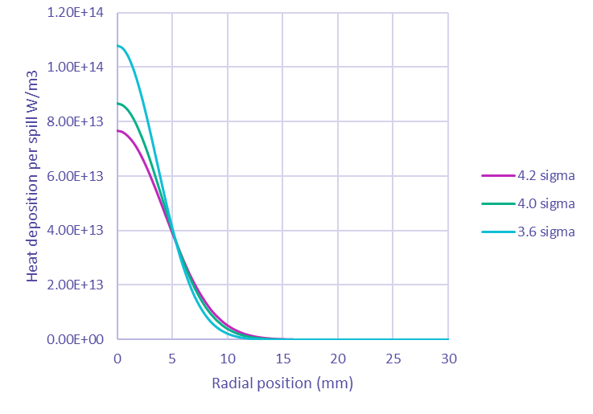
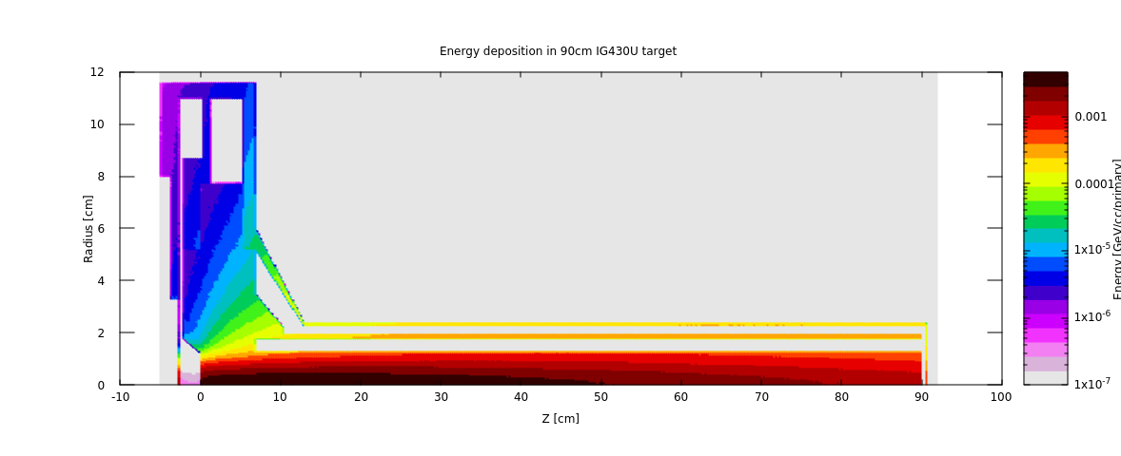
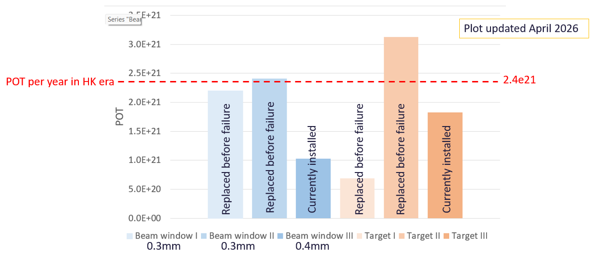
Energy deposition (Primary FLUKA use)
Energy deposition in T2K Target
Effects of beam sigma on beam window
Good experience with targets and windows.
Accumulated up to 3.1e21 POT without failure so far (~3.6DPA-NRT & 2600appm He in Ti-6Al-4V).

Slide 5
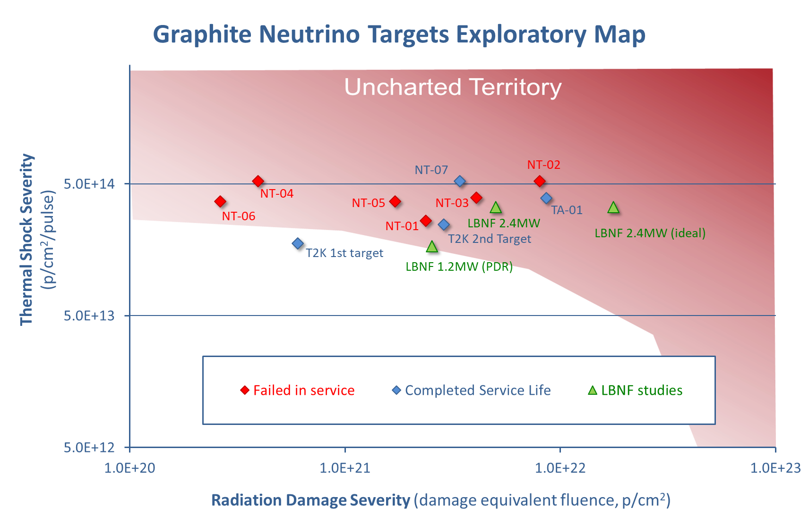
More recent developments and how our use of FLUKA has changed
In the past, concentrated on energy deposition & thermo-mechanical design.
As facilities become higher power & well optimised, we are spending more time on materials damage to push the limits of targets.
What is the best material for damage resistance?
How long will a target/window last?
What are the limits?
Potential material limits
    DPA
    H/He production
This leads to materials irradiation studies
What is best irradiation method (What primary particle?, what energy?, etc)
DPA + Gas production
Activation of samples
What isotopes produced?
Activation of coolant (liquid or gas)

Slide 6

Radiation Damage
Recently, more interest in ARC-DPA but some of the coefficients not well known or easily found for some materials
Usually we are comparing facilities/experiments, so a consistent measure is as important as the correct DPA.
A reference list of B_{arcdpa} & C_{arcdpa} coefficients would help consistency

